Slide 1
NTS Screenshots
DMDC

Slide 2
OMB CONTROL NUMBER: 0704-NCTS
OMB EXPIRATION DATE: XX/XX/XXXX
AGENCY DISCLOSURE NOTICE
The public reporting burden for this collection of information, 0704-NCTS, is estimated to average 5 minutes per response, including the time for reviewing instructions, searching existing data sources, gathering and maintaining the data needed, and completing and reviewing the collection of information. Send comments regarding the burden estimate or burden reduction suggestions to the Department of Defense, Washington Headquarters Services, at whs.mc-alex.esd.mbx.dd-dod-information-collections@mail.mil. Respondents should be aware that notwithstanding any other provision of law, no person shall be subject to any penalty for failing to comply with a collection of information if it does not display a currently valid OMB control number.

Slide 3
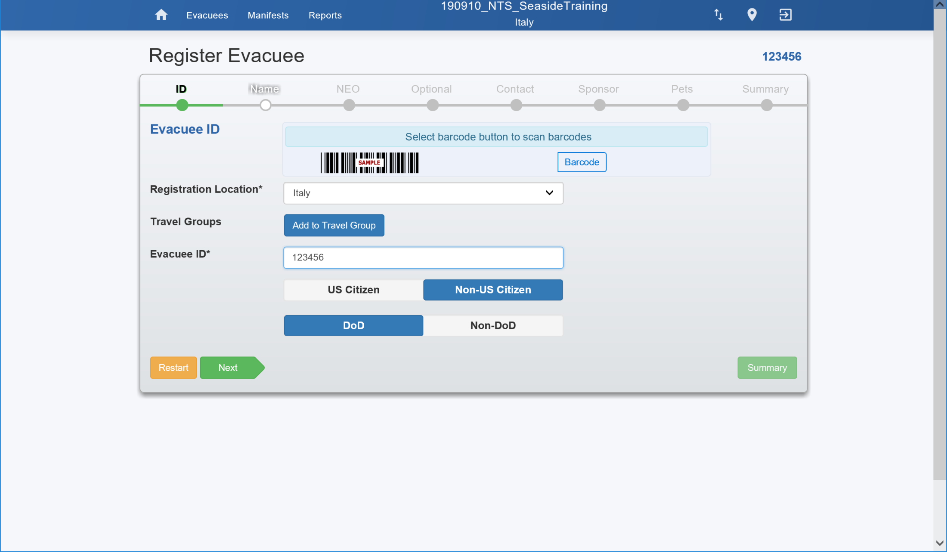
First page where a bracelet is scanned which is used through the evacuation to track the evacuee

Slide 4
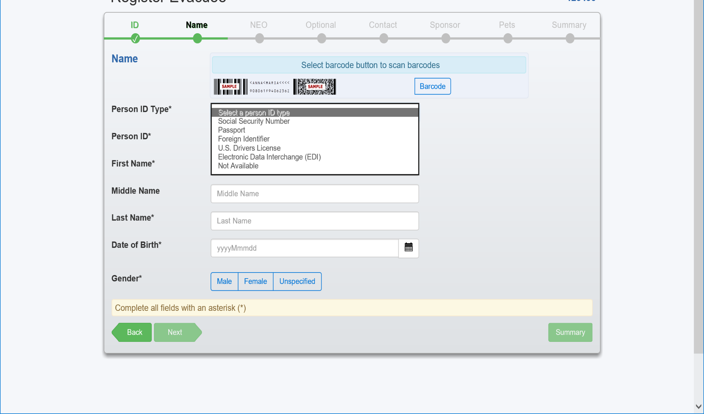
Page where evacuee ID is scanned – see list of IDs that can be scanned

Slide 5
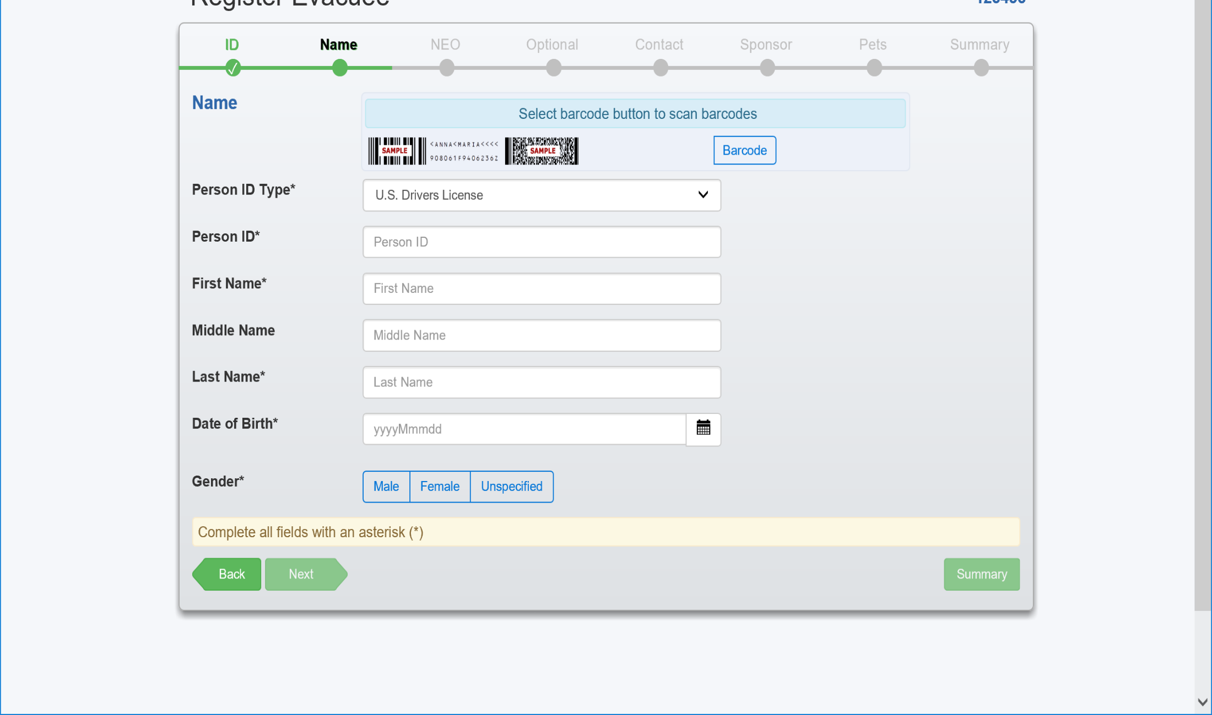
Information about evacuee which is collected

Slide 6
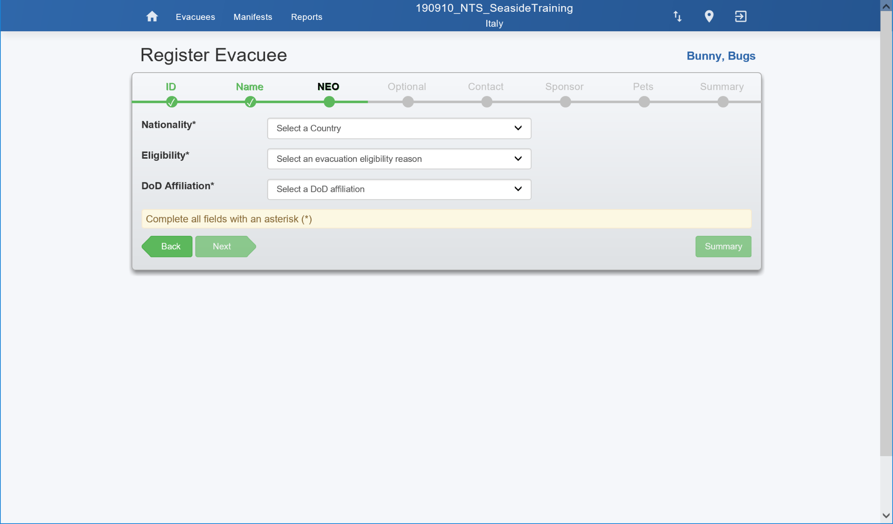
Additional information about the evacuee

Slide 7
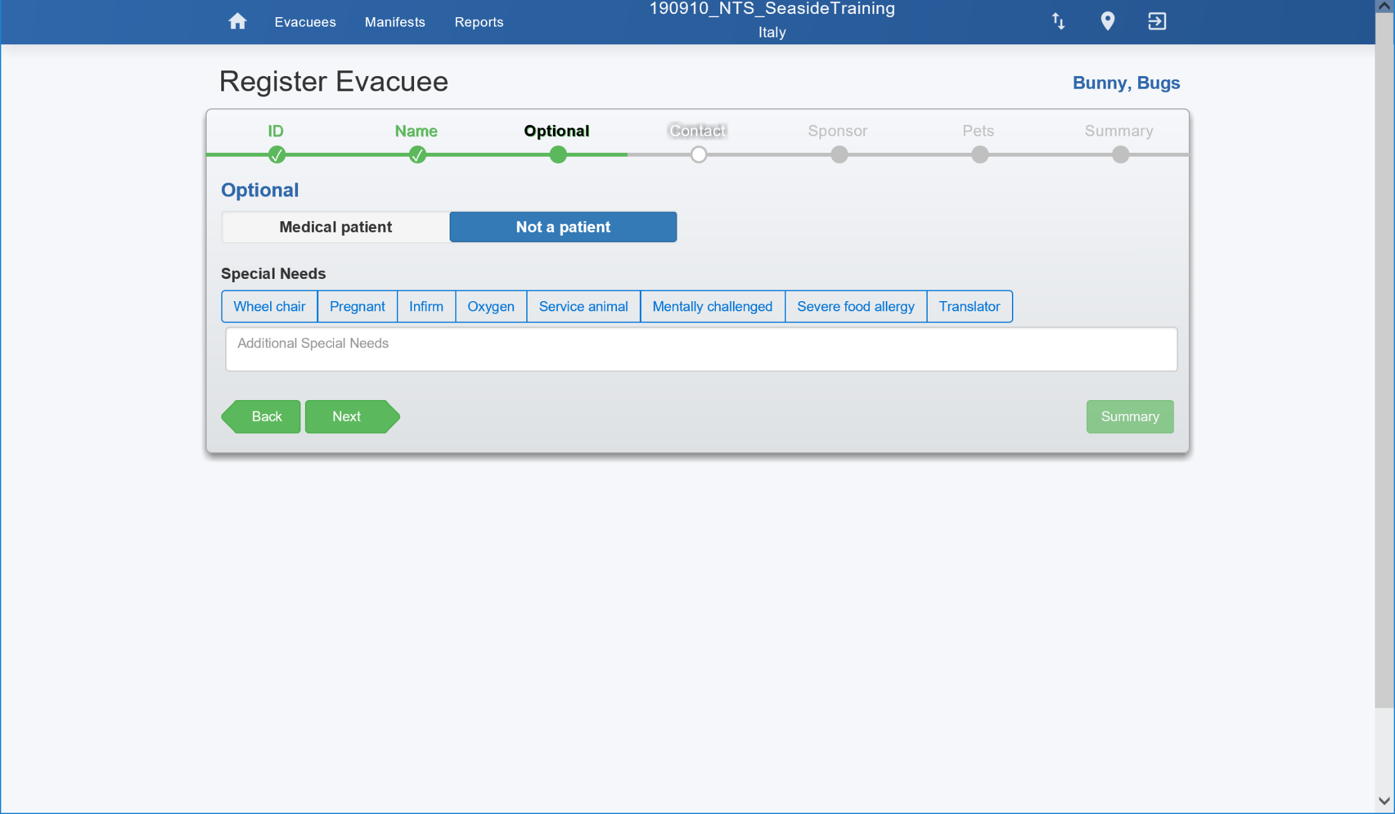
Option 1 Adult – Optional medical information to help receiving site be prepared

Slide 8
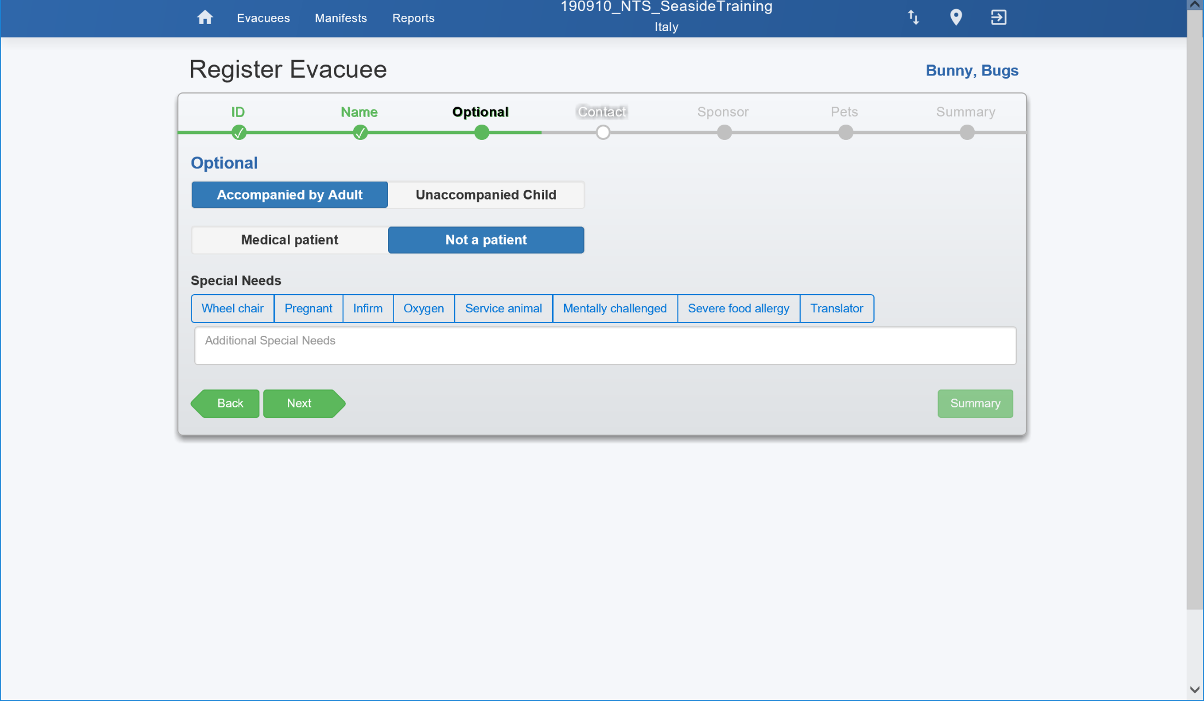
Option 2 Minor – Optional medical information to help receiving site be prepared & whether the minor is accompanied or not

Slide 9
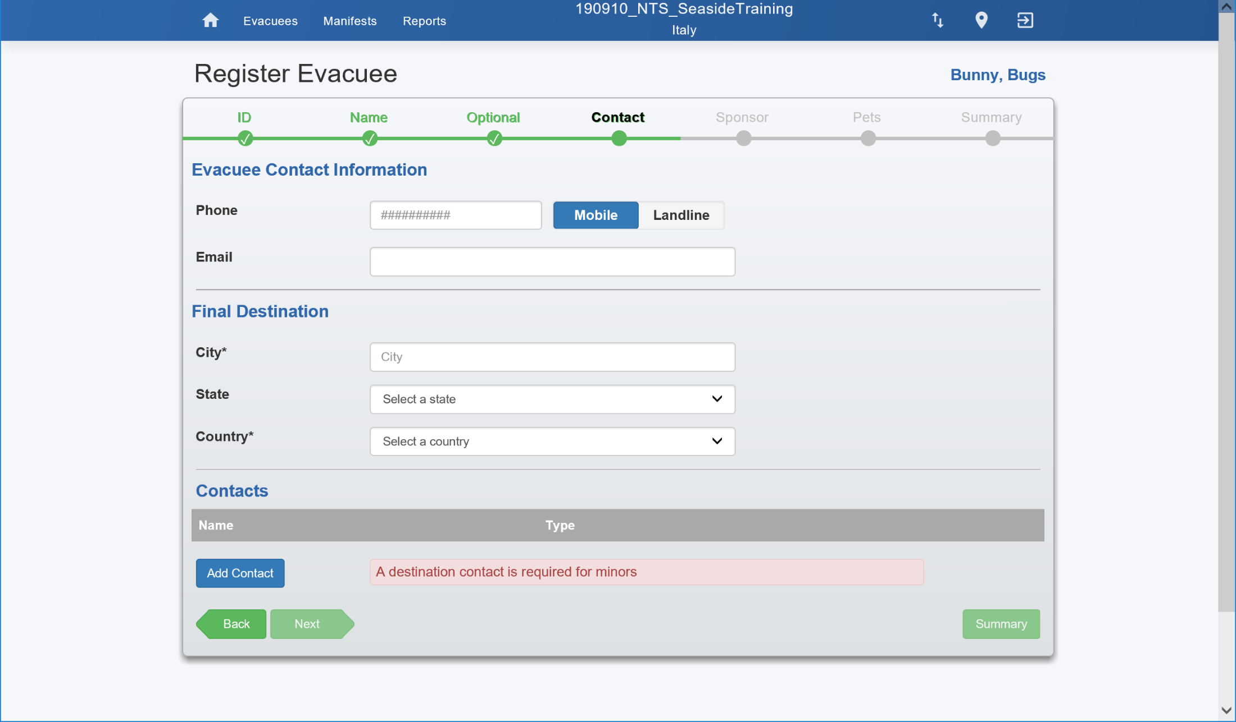
Mandatory is final destination, optional contact info for evacuee & if a minor then information for a travel & destination contact is required.

Slide 10
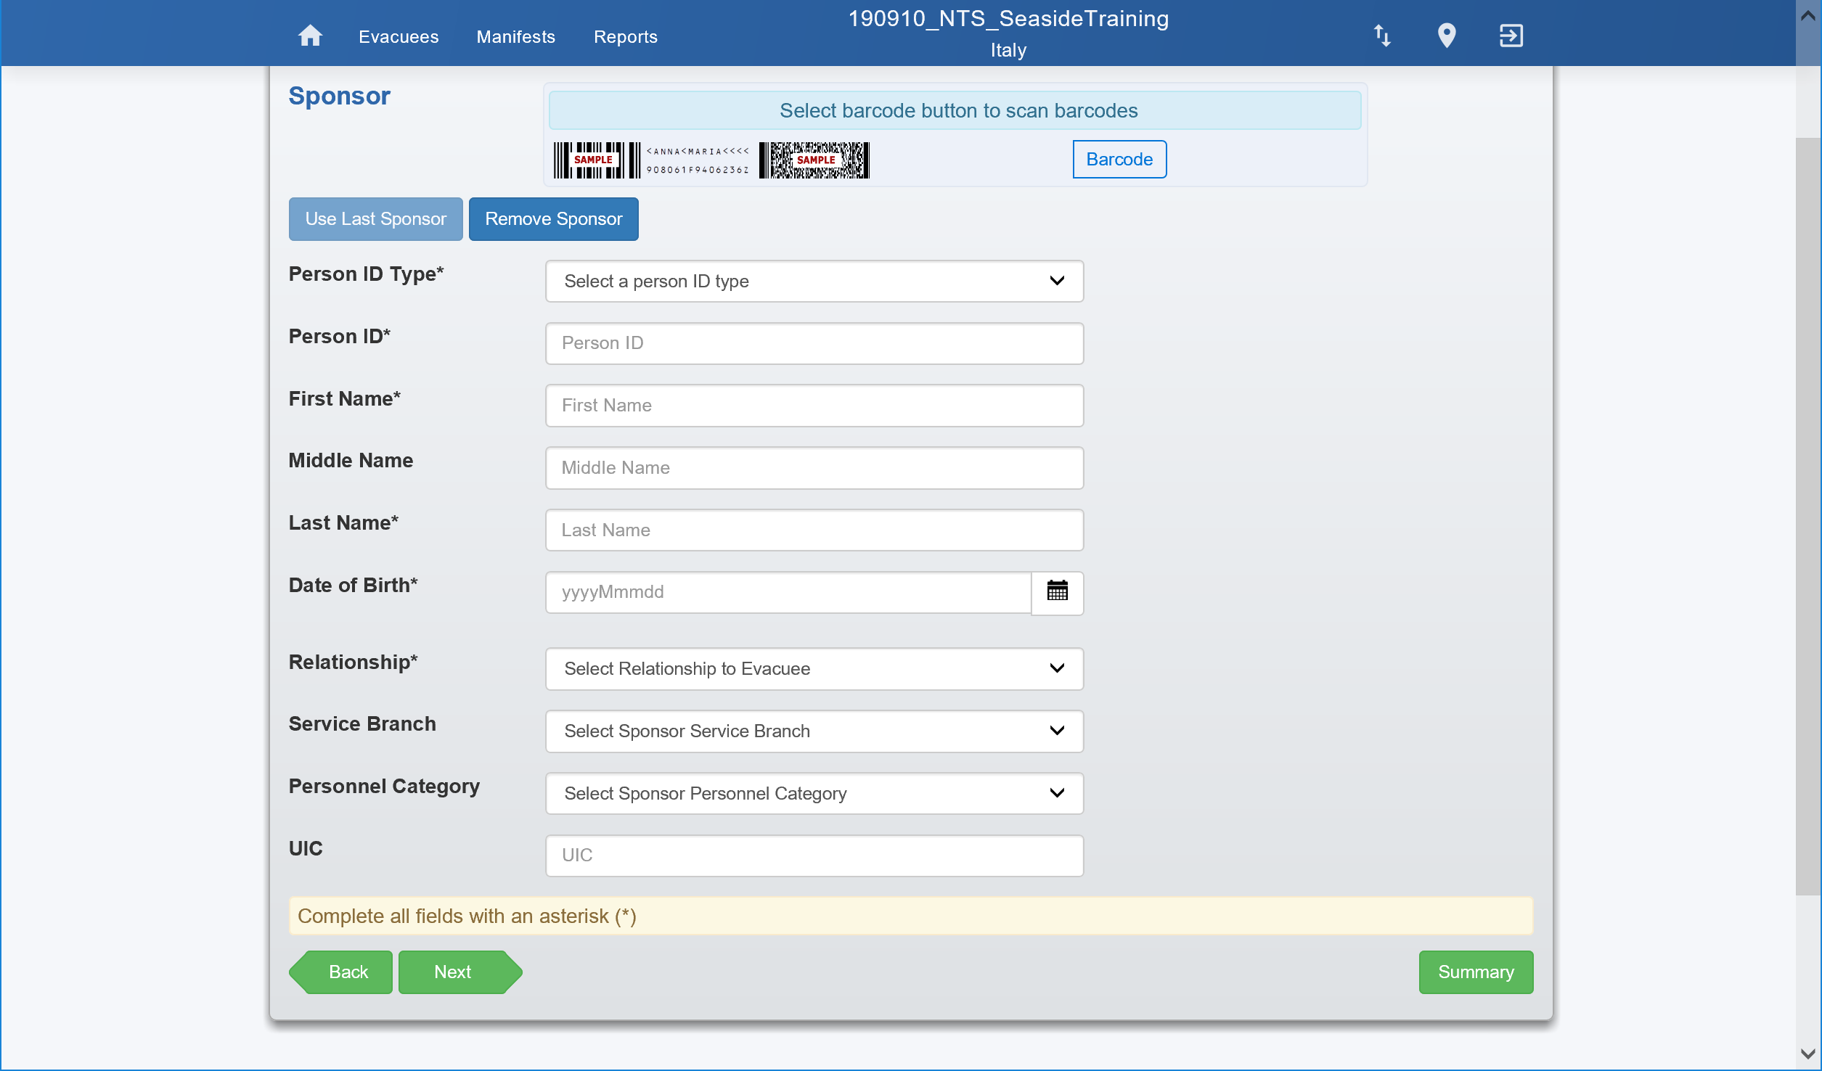
If the evacuee is a DoD Dependent, this information provides their DoD Sponsor info

Slide 11
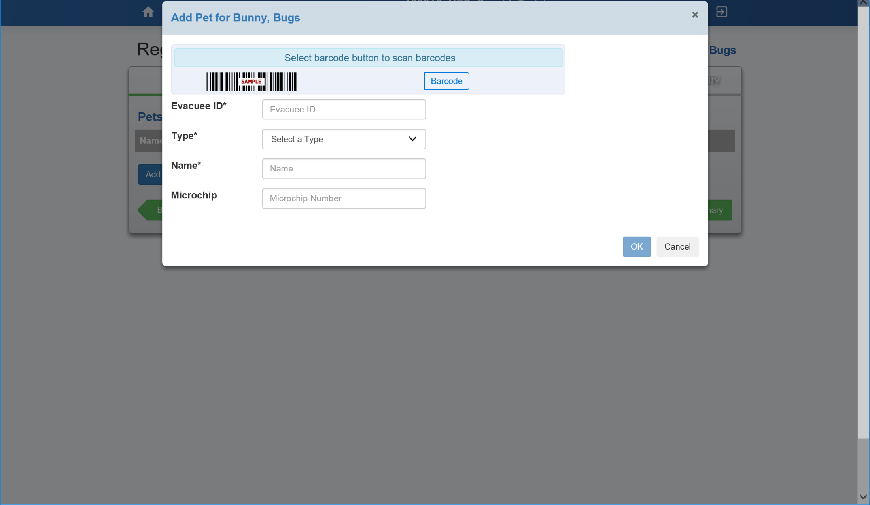
If the evacuee is traveling with a pet, can have multiple

Slide 12
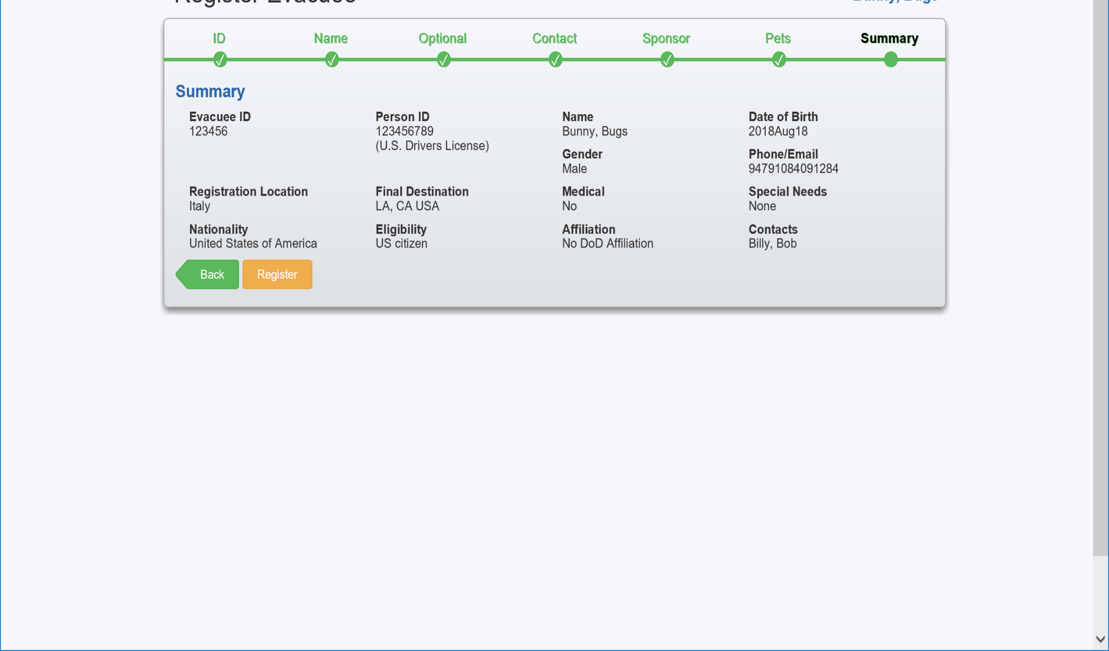
Summary of data to review prior to registering the evacuee

