Slide 1
1652-0034 LEO _ FAT
Screenshots of webpage

Slide 2
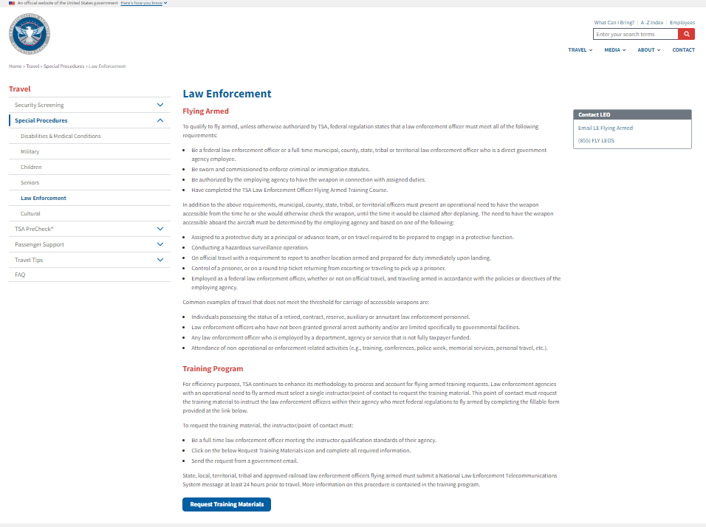

Slide 3
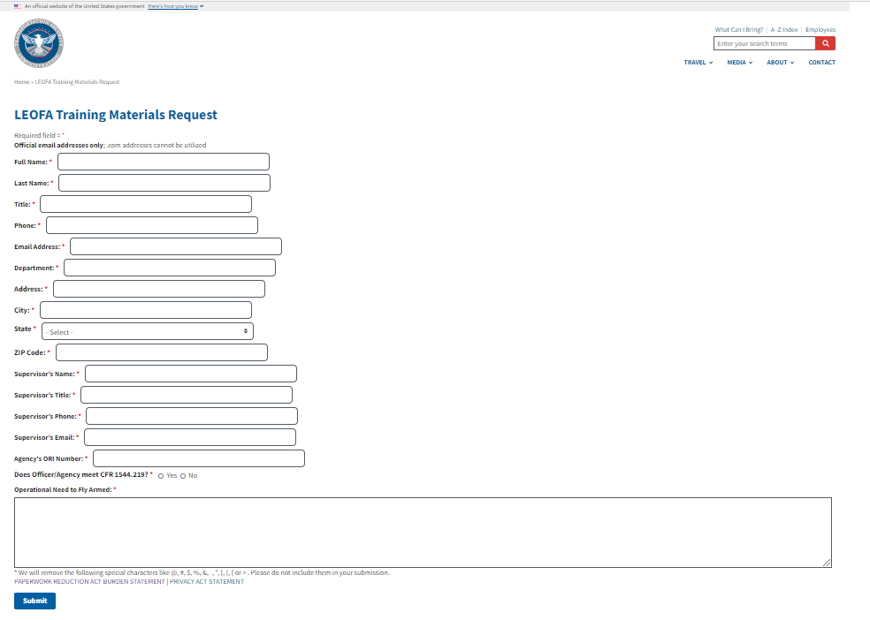

Slide 4
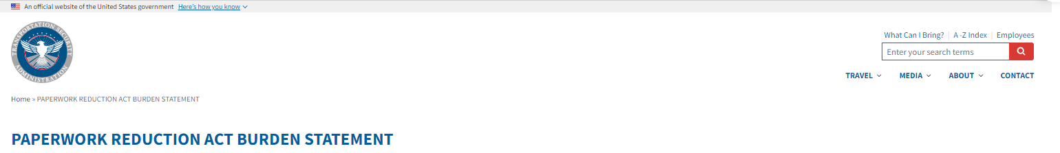
TSA is collecting this information from law enforcement agencies that have requested the LEO Flying Armed training course. The public burden for this collection of information is estimated to be approximately 5 minutes per response. This is a mandatory collection of information. Send comments regarding this burden estimate or any other aspect of this collection to: TSA-11, Attention: PRA 1652-0034 6595 Springfield Center Drive, Springfield, VA 20598-6011. An agency may not conduct or sponsor, and persons are not required to respond to, a collection of information unless it displays a currently valid OMB control number. The OMB control number assigned to this collection is 1652-0034, which expires 02/28/2022.

Slide 5
