Slide 1
Call Center RI Script
English
COVID Funeral Assistance

Slide 2
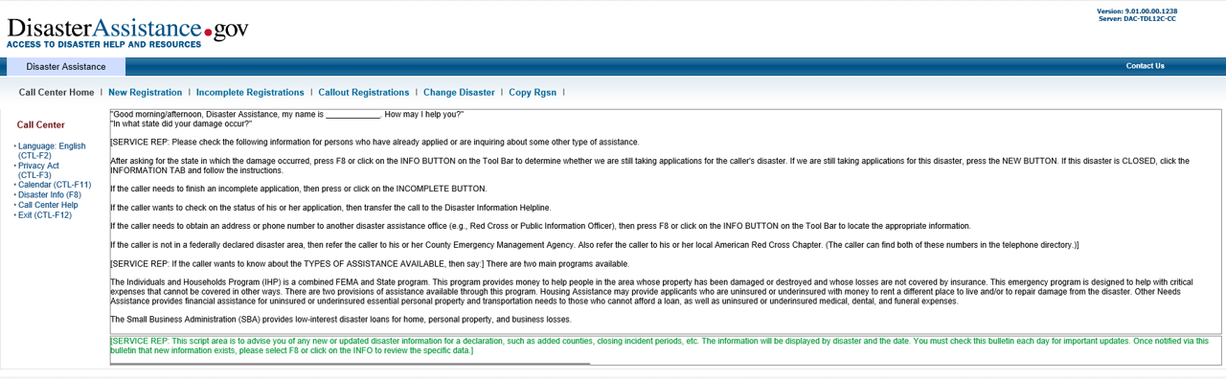
Current Greeting Screen

Slide 3
Modified Greeting Language Contractor Will Use
“Good Morning/Afternoon, FEMA COVID-19 Funeral Assistance, my name is _______. We’re deeply sorry for your loss. I will gladly help you through the process of applying for Funeral Assistance today.
COVID-19 Funeral Assistance may only be provided to the individual who paid for or is responsible for funeral expenses incurred prior to December 31, 2020. Are you the person responsible?”
If YES, SAY “Thank you. We can continue with the registration process.”
If NO, SAY “COVID-19 Funeral Assistance may be provided to only those who paid for or are responsible for funeral expenses incurred prior to December 31, 2020. If multiple applications are completed for the same deceased individual, it may delay the processing of assistance. Would you like to continue with this registration?”
If YES, SAY “Thank you. We can continue with the registration process.”
If NO, SAY “Thank you. Please feel free to have the individual responsible for the funeral expenses contact us when they are ready to start the registration process.”
“Currently assistance is not available for COVID-19 funeral expenses incurred after December 31, 2020. If your expenses were incurred after December 31, 2020 you will not be considered for assistance at this time, but may be considered if the assistance is extended in the future. Would you like to continue with this registration?”
If YES, SAY “Thank you. We can continue with the registration process.”
If NO, SAY “Thank you, Please monitor the news for information on any changes to COVID-19 Funeral Assistance and contact us in the future if the eligibility date for funeral expenses is extended.

Slide 4
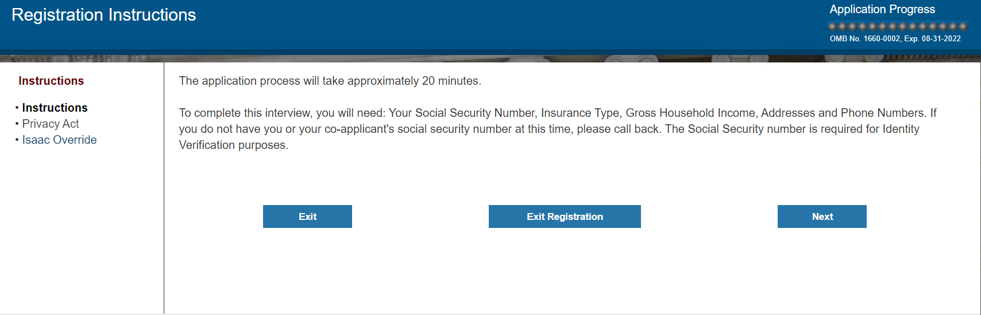

Clarifying Statement Addition: “Please note, the current wording in the system reflects FEMA’s standard disaster assistance registration process. We will provide clarification for each question regarding how it relates to COVID-19 Funeral Assistance.
There may also be pauses throughout the registration process while we enter your information into the system.”

Slide 5
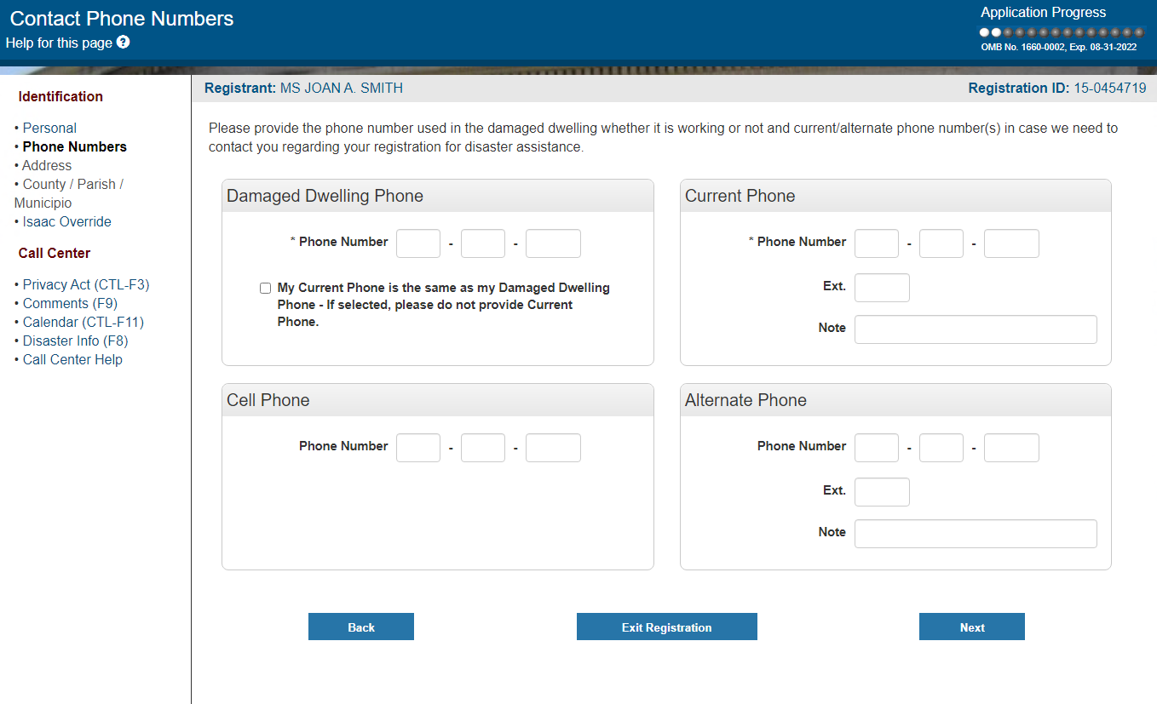
Clarifying Statement Addition: “To clarify, for funeral assistance we just need the current phone number where you can be reached.”

Slide 6
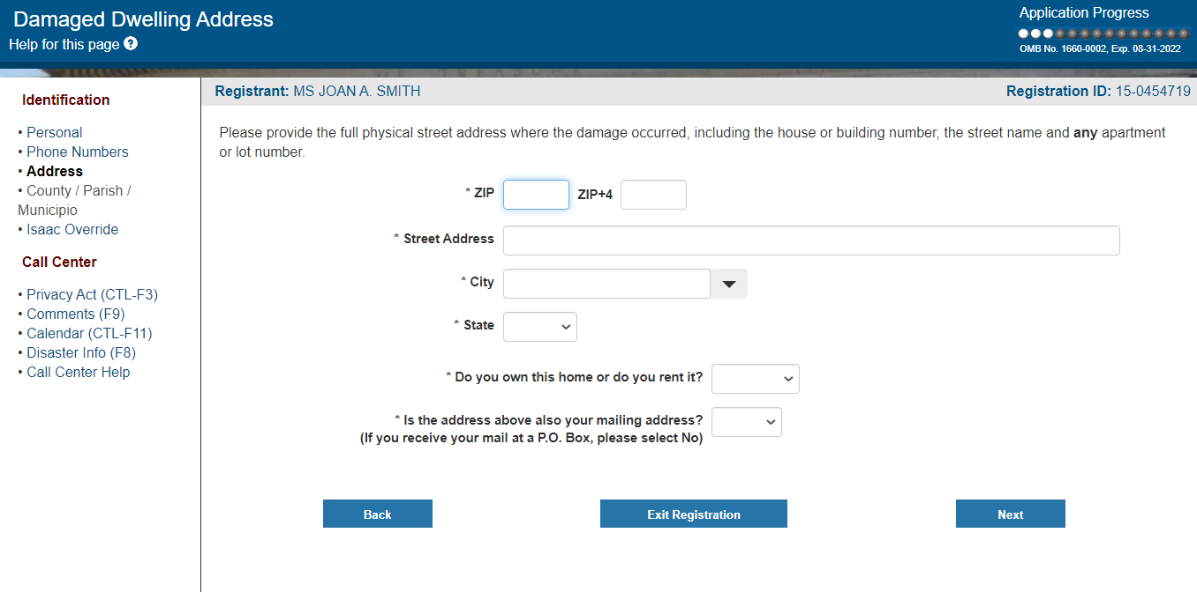
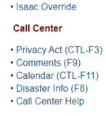
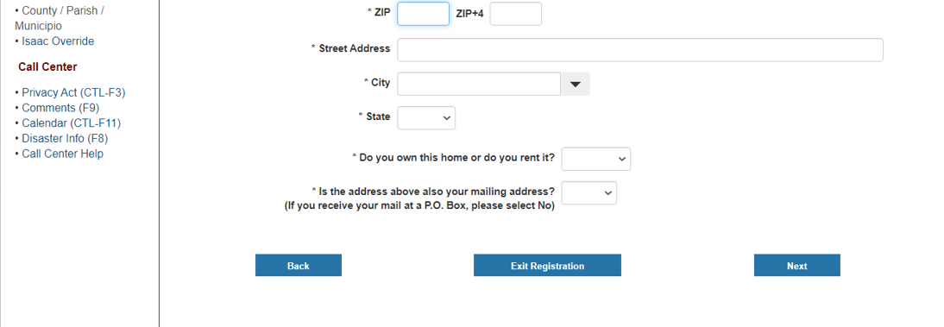
Clarifying Statement Addition: “To clarify, funeral assistance is provided based on the state or territory listed on the deceased individual’s death certificate. Since this registration is for funeral assistance, we need the street name or facility name, city, state, and zip code where the death occurred.”

Slide 7
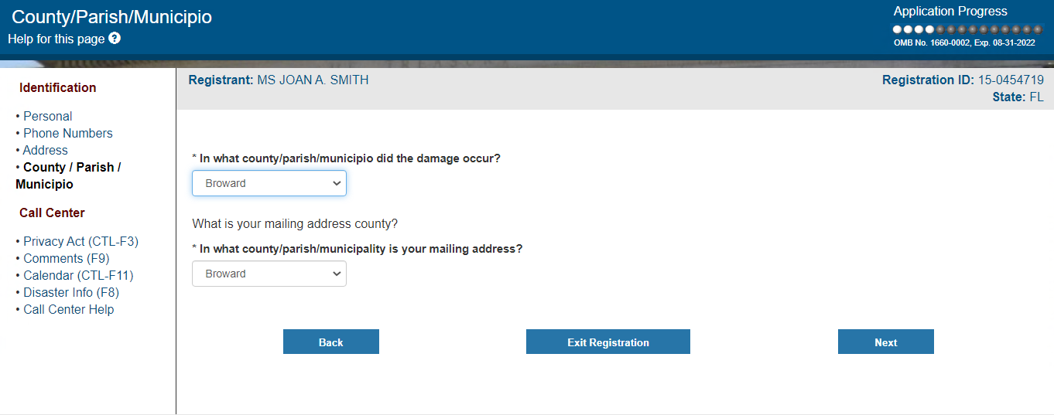
Clarifying Statement Addition: “To clarify, please provide the county, parish, or municipio listed on the death certificate.”

Slide 8
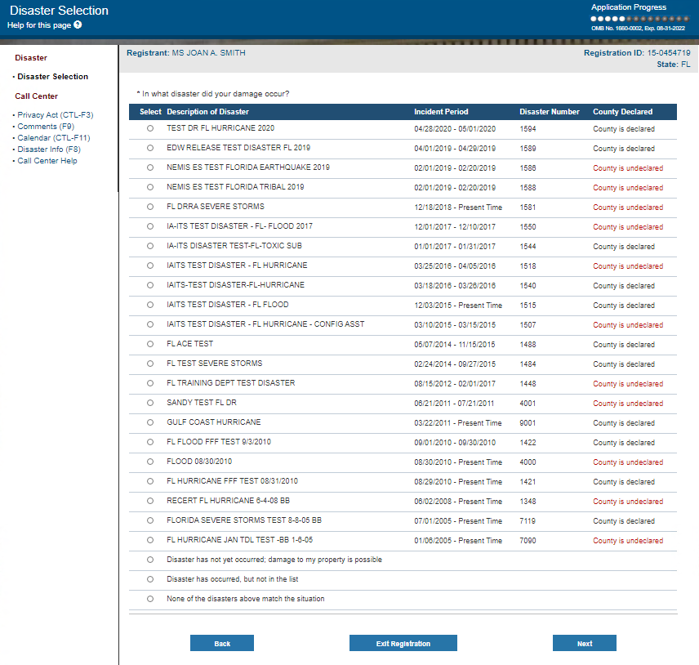
Clarifying Statement Addition: “To clarify, could you please once again confirm the state or territory listed on the death certificate?”
Current disasters
pre-populate based on the DDA state.
Only the COVID-19 Disaster for the
state will appear for the Call Center
staff member to select from.

Slide 9
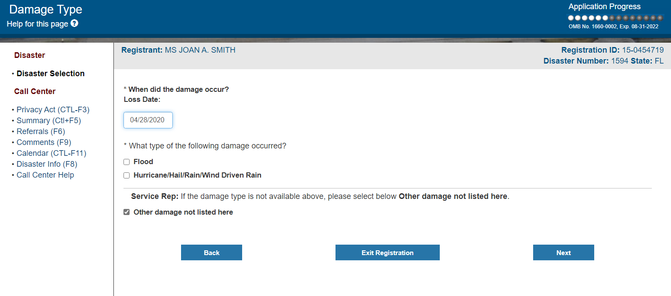
Clarifying Statement Addition: “To clarify, on what date did you incur funeral expenses?”

Slide 10
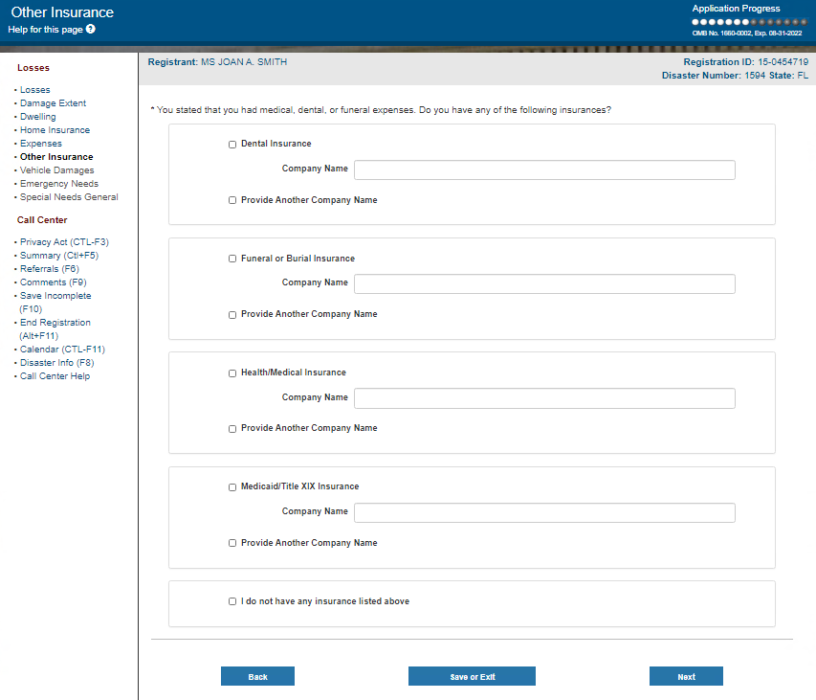


Clarifying Statement Addition: “To clarify this should also include any assistance you were provided from another source, such as from the state or any voluntary organizations.”

Slide 11
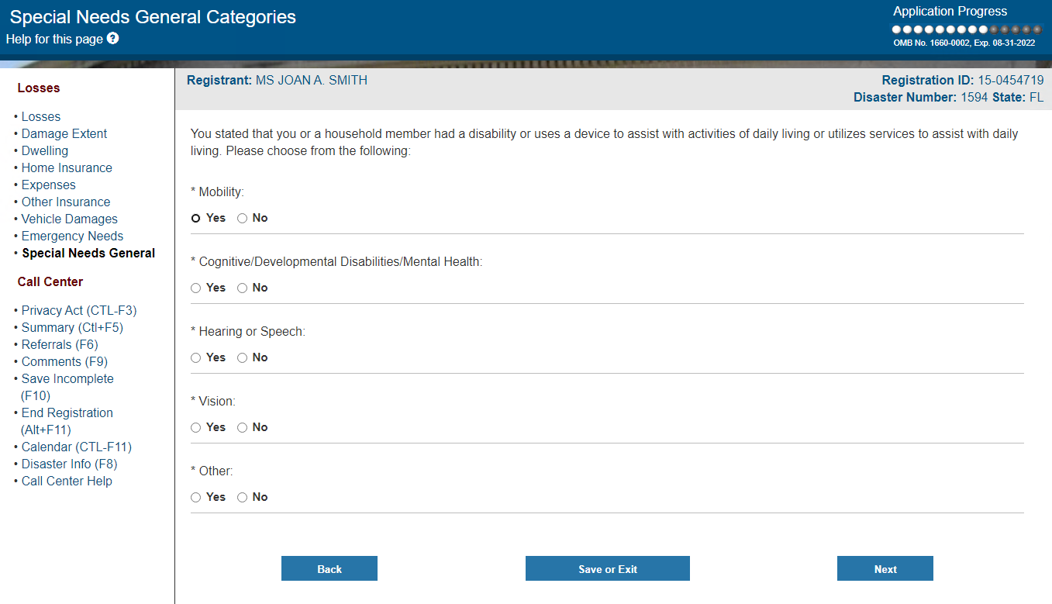
Clarifying Statement Addition: “To clarify, this question is in relation to your ability to communicate with FEMA regarding your COVID-19 funeral registration. With that in mind, please choose from the following”

Slide 12
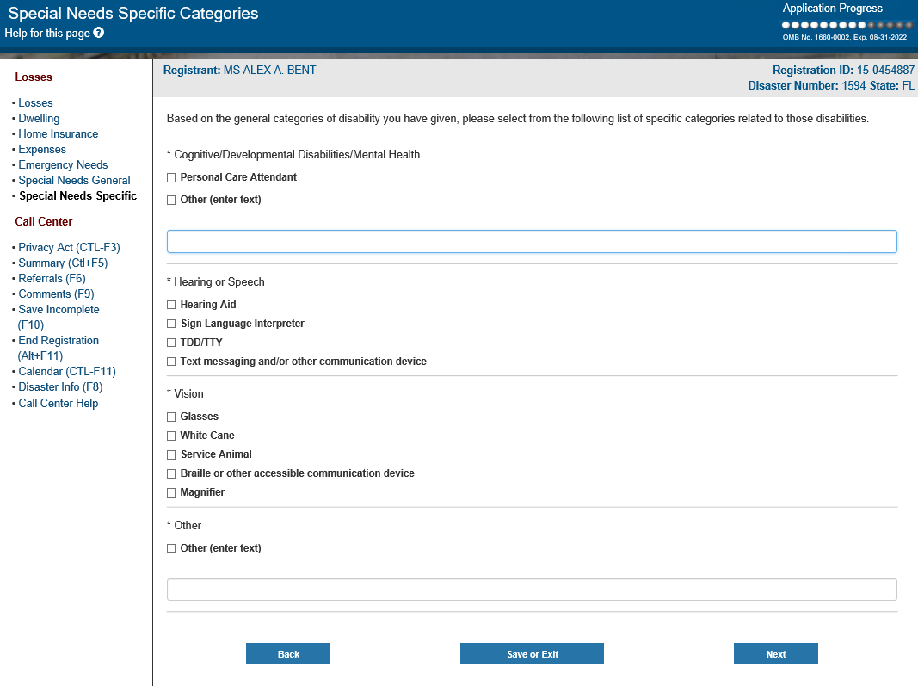
Clarifying Statement Addition: “To clarify, do you use or need to use any of the following items to communicate with FEMA regarding your COVID-19 funeral registration?”

Slide 13
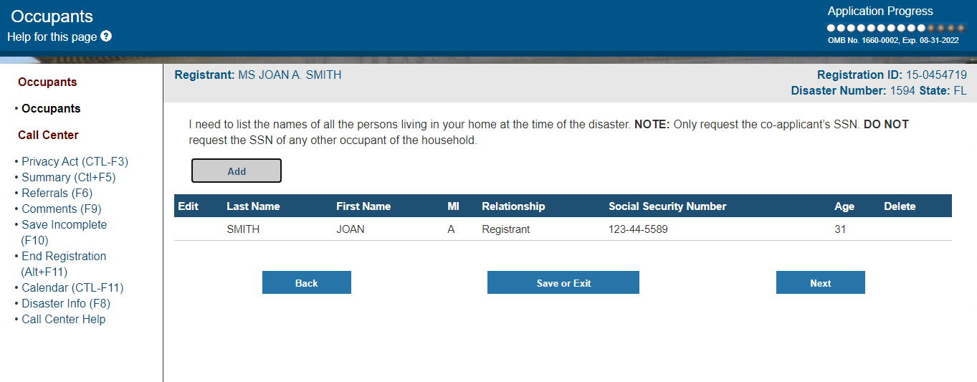
Clarifying Statement Addition: “To clarify, since this registration is for funeral assistance, I do not need the members of your household. We only need the name, SSN, and date of birth of each deceased individual.”

Slide 14
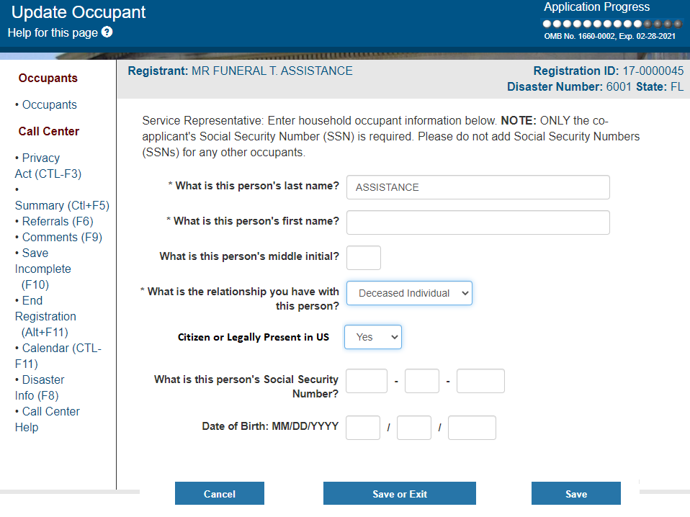

Slide 15
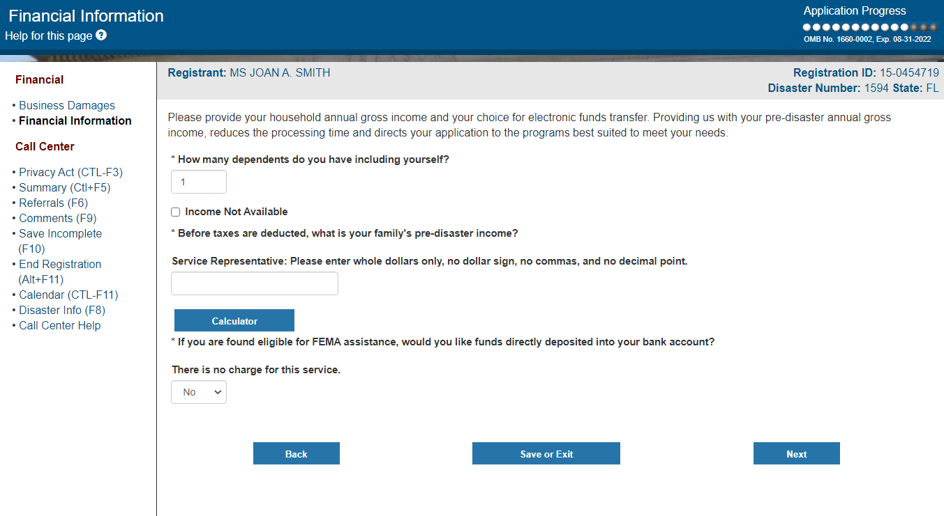
Clarifying Statement Addition: “To clarify, for funeral assistance we need your family’s current annual gross income.”

Slide 16
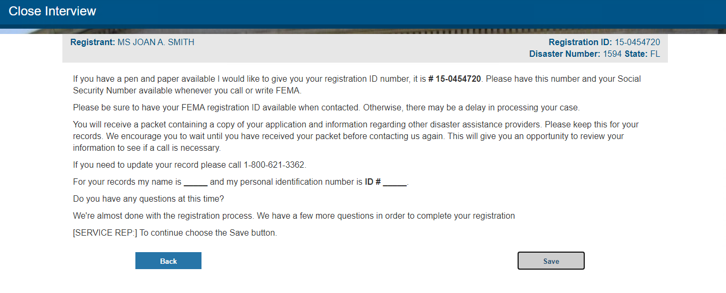
Current Close Interview Screen

Slide 17
Modified Close Interview Language Contractor Will Use
“Before FEMA can take further action on your application you will need to submit additional documentation. You will also receive a letter shortly that details the requested information. Providing the requested information as quickly as possible will help to ensure your application for assistance is processed efficiently.
You will need to send the following documents:
  A death certificate for the deceased indicating COVID-19 as the cause of death, AND
  Receipts, invoices or a funeral home contract indicating the cost of the funeral, the date the funeral expenses were incurred, confirmation the funeral was for the deceased individual(s), and the name of the person(s) who paid for the funeral.
  If the deceased had funeral or burial insurance, or any assistance for the funeral was provided by a state agency, voluntary agency, or other sources, you must provide documentation showing the amounts paid by these entities specifically for funeral costs.
For your records, my name is ______, your registration ID number is ___ and your disaster number is ___.
Please ensure you include your name, registration ID, and disaster number and send copies of these materials to:
FEMA
P.O. Box 100055
Hyattsville, MD 20782
OR
Fax number 800-827-8112, Attn: FEMA
If you have questions regarding the required documentation, you can visit the website on Funeral Assistance on FEMA.gov or call our COVID-19 Funeral Assistance Helpline at XXX-XXX-XXXX.
We’re almost done with the registration process. We have a few more questions in order to complete your registration.”

