Slide 1

Year 9 Extension Webinar
OMB Approval No.: 0584-0580
Approval Expires: XX/XX/20XX
Appendix O
Study extension webinar slides
[Insert Date]

Slide 2
Greetings from the Feeding My Baby Study Team!
Westat
Public Health Foundation Enterprises WIC Program
Nutrition Policy Institute of the University of California
USDA Food and Nutrition Service
Notes:
Greetings from the Feeding My Baby Study team. Our team includes…..
We are pleased you are joining us today for updates on the study and we very much appreciate your continued cooperation and support for this important and unique study.

Slide 3
Webinar Agenda
Study background, objectives, timeline
Role of State Agencies and sites during study extension period
Study report highlights
Questions from State Agencies and sites
Notes:
Our agenda today is going to cover 4 topics starting with a brief review of the study objectives and timeline. We’ll share highlights from study reports that have been produced to date. Then, we’ll talk about the future study activities to take place during the study extension period to the child’s ninth year and describe how we’ll be asking state agencies and WIC sites to assist.
We’ll end with time to answer your questions, and, over the next few weeks, we’ll also be having phone calls with each state agency and its sites in the study to talk about the assistance needed and address your questions.

Slide 4
Original Study Objectives
Update findings from the last study, the WIC infant feeding practices study, conducted in 1994-95
Identify nutrition education influences on infant and child feeding practices
Assess the impact of WIC on nutrition, health, and developmental outcomes
Examine changes in feeding practices and behaviors as infants transition to toddlers and preschoolers and early childhood
Identify factors that lead to continued, discontinued, or renewed participation in WIC through age 5 years
Notes:
The Feeding My Baby Study also known as the WIC Infant and Toddler Feeding Practices Study – 2 or WIC ITFPS-2 is designed to answer many questions regarding nutrition and feeding practices for infants and young children. Because it is a longitudinal study of children up to age 6, with a followup at age 9 which we will talk about today, we have the opportunity to gain a tremendous amount of information about these topics. Major study objectives include…..

Slide 5
Year 9 Extension Objectives
Two studies
Year 9 Followup Study
Lost-to-Followup Study
How does WIC participation influence the health and nutrition trajectories of school-aged children who previously received program benefits?
What are the characteristics of WIC ITFPS-2 participants who left the study during the first five years and how do they compare with those who stayed in the study?
Notes:
After the tremendous success of the Feeding My Baby Study to age six, we are excited that we have the opportunity to follow up with the cohort one more time. The Age 9 Extension of the study comprises two studies, the Age 9 Followup Study and the Lost-to-Followup Study
Literature previously published from this WIC ITFPS-2 cohort suggests that longer participation in WIC improves children’s diet quality. Children who participate for only one year, or only two years, or only three years, have lower diet question scores than children who participate consistently through the first five years of life. Research on this cohort has also found that participation with WIC during the study child’s fifth year increases the likelihood that the child’s diet meets the DGA recommendation for added sugar intake. Over the longer term, diet may influence weight status. The Age 9 Followup Study aims to determine whether and how past WIC participation may be associated with children’s later diet quality and weight trajectories.
For the Lost-ot-Followup Study, we want to understand whether those who left the study are different than those who stayed with the study. As many of you know, caregivers who enrolled in the study may continue participating in the study regardless of whether their child continues to participate in WIC; however, it is unknown if those who leave the study also discontinue WIC at the same rate as those who remain in the study. The Lost-to-Followup Study will examine the WIC participation patterns of participants who are lost to study follow-up during the first 5 years of the study (i.e., during the period of time when study children would be categorically eligible for WIC).

Slide 6
Study Recap
80 WIC service sites in 27 State agencies sampled
Recruited 4,367 mother/child dyads between July and November, 2013
Follow up telephone interviews from Prenatal to child age six (2013 – 2020)
      Dietary Recall
      Survey questions
Notes:
For the WIC ITFPS-2, 27 states and 80 WIC service sites were sampled. With help from all of you, back in 2013, we recruited 4,367 participants for the study. This met our recruitment goal. As you may recall, eligible study participants were caregivers that were pregnant or had a newborn, spoke English or Spanish, were at least 16-years-old, and were enrolling in WIC for the first time for their pregnancy or young child. They could have had older children who were participating in WIC.
Study children are followed up with periodic telephone interviews with the caregiver. The interviews consist of a detailed dietary recall and questions about WIC experience, maternal and child health and lifestyle, and child’s environment.
You are all important partners in this study and we thank you for your cooperation

Slide 7
Caregiver Participation
Has Been High
90 percent completed the prenatal interview
70 percent completed the interview when the child was 72-months-old
Average completion rate 77 percent over 18 interviews from prenatal through 72-months.
Notes:
Since 2013, we have conducted a total of 51,244 interviews with the prenatal women and with the parents/caregivers of the infants and children. We have finished all of the interviews for children through age six. Our responses rates have been high for such a long study. We appreciate the help from the WIC sites and agencies for your help in getting in touch with participants we lost touch with.

Slide 8
Measurements of
Infants/Children
WIC data requests to State Agencies for measurements at 6, 12, 24, 36 and 48 months
Started using Feeding My Baby measurement card at 36 months
Also accepted copies of recent health care provider reports with height and weight
Notes:
The study collects measurements for the study children at select time points to assess their growth. We are obtaining weight and height measurements through several sources. Most of the measurements up to 36 months came from WIC administrative data requests to state agencies. We really appreciate all the state agency staff for providing us with these critical data
We have also been obtaining measurements for children at age 3 years and older via a Feeding My Baby measurement card completed by WIC sites or children’s healthcare providers or from printouts from recent doctor visits. About 1/3 of these measurements came from cards completed by WIC, 1/3 from cards completed by the healthcare providers and 1/3 from copies of recent doctor visit printouts.
Thanks to all of the State agencies for providing the data from the WIC visits and for staff in the sites for doing the measurements and completing the measurement card when requested. The measurements are so important for the study, as they document how children are growing.

Slide 9
How will the findings be used?
The Year 9 Extension findings will be used to inform the nation about the important role WIC plays in early childhood nutrition even beyond the period of eligibility.
Along with the base study, the extension study findings may also be used to:
Inform nutrition education
Assess the role of WIC in children’s food and nutrient intakes
Identify factors associated with movement in and out of WIC
Notes:
The findings from the overall study will be useful for WIC program policy and planning, and they will provide insights regarding infant and child feeding practices that will be valuable for health and nutrition practices outside of WIC. Examples of how the findings may be useful include…..

Slide 10
Study Activities during Extension
Obtain State/local IRB approvals
Stay in contact with parents/caregivers
Conduct one additional interview at age 9
Obtain measurements at age 9
Obtain administrative data on study participants who left the study in the first five years.
Notes:
Now we want to turn our attention to the future….the study activities during the extension to age 9. The key activities include…..

Slide 11
Study Participation during Extension
4,032 active participants at the end of the 72-month interview
1,098 expected to complete the final age 9 interview.
Interview time period April, 2022 – August, 2023
Notes:
Here are our estimates of the number of children who will continue in the study and the percent of their parents who will participate in the interview at age 9.
We started with a little over 4,000 infants (4,032) and expect to have about 1,098 of them in the study at the end of nine years with a final age nine interview. This would be about 27% of their parents completing the last interview at age nine. Note that children remain in the study even if they are no longer participating in WIC.
Because the interview dates are based on the child’s birthday, we expect that the age 9 interview will take place over 15 months between April 2022 and August 2023.

Slide 12
Keeping Parents/Caregivers
Engaged
Extension letter, birthday cards, thank you notes, phone calls, text messages
Proposed incentives
  $70 gift card (plus $10 for use of cell phone) for age nine interview
  $70 gift card (plus $10 for transportation) for obtaining measurements at age nine.
Notes:
MAY WANT TO MENTION THE SECOND AM/PM INTERVIEW FOR SUBSET
One of our biggest challenges is to keep parents/caregivers engaged in the study—participating in the interviews and providing the measurements. We use several methods to keep in touch with them including….
We have found that the higher incentives offered as children get older up to age six are important for keeping them engaged in the study.
During the study extension to age nine, the amount the parent/caregiver will receive $60 for the interview and we provide an additional $10 if the parent uses their own cell phone.
For parents who obtain the measurements and send them in to us, we will give them $70 for the measurements at age 9 plus $10 to cover transportation costs.
We will also give the parents/caregivers small incentives of $10 for updating their contact information with us approximately once every 3 months.

Slide 13
Assistance from States and Sites – Age 9 Measurements
All parents/caregivers will be asked to take child to WIC site or healthcare provider for measurements
Measurement cards will be provided to all parents/caregivers to obtain measurements and return to Westat
Notes:
For the Age 9 Study extension, we will need your help with both the Age 9 Followup study and the Lost to Followup Study. For the Age 9 Follow up Study, we’ll need help from you to obtain the weight and height measurements for the children at age nine. The amount of assistance we’ll need is fairly small, but it will have a large impact on the study results. We believe measurements taken at WIC sites are one of the most accurate sources available.
We will ask all parents/caregivers of the children in the study at those times to…..

Slide 14
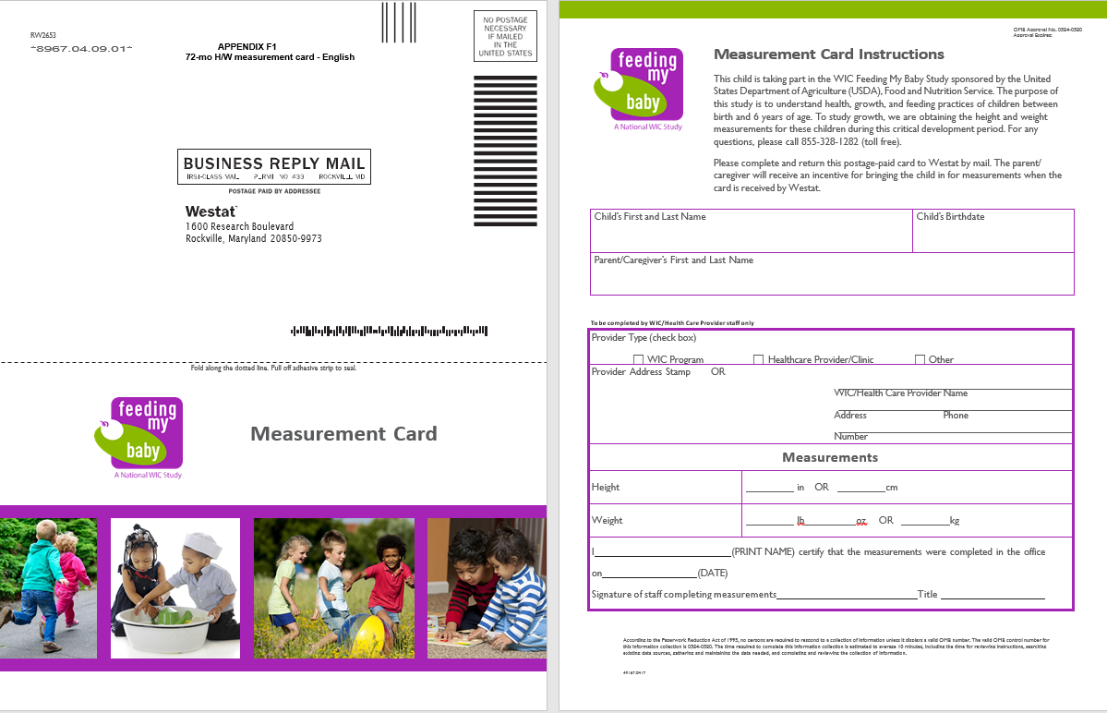
Measurement Card
Notes:
This is what the measurement card looks like. Many of you or the staff in your WIC sites have seen this card since we’ve been sending to parents of the children in the study who are no longer participating in WIC. We are asking them to take the child to a WIC site or healthcare provider for the measurements and to return the card to us. We will be using this card for the nine year old children and can make minor revisions based on experience using it to date.

Slide 15
Measurements at WIC Sites
All children in the study who choose to come to WIC for measurements
All parents/caregivers will be offered incentive to have measurement card completed and returned
  Identify convenient WIC site for parent/caregiver
Notes:
All parents/caregivers of children in the study will receive the measurement card near the time of the child’s ninth birthday. The number of children we anticipate having in the study at age 6 is 2,268.
All parents will be offered the incentive to return the completed measurement cards.
The parents will be asked to take the child to a WIC site or their healthcare provider for the measurements and to return the completed measurement card. For the parents who choose to go to WIC for the measurements, we will suggest the WIC site where they were enrolled in the study if they still live in the area where it is located. If the family or the site has relocated, we will assist them with identifying a site that is convenient for them. State Agencies and sites have been helping with identifying alternative sites when needed.

Slide 16
What if……?
Original study site has closed?
Family has relocated within study site area?
Family has relocated outside of study site area?
Notes:
While we hope that all of the original study sites are willing to continue to assist with measuring the children, we know that some of those sites have closed and more may close over the course of the next 2 years. We also know that families in the study have relocated—sometimes within the vicinity of the WIC site where they enrolled in the study and sometimes outside of the area.
This will be a topic for discussion when we have calls with the State Agencies and sites in the study starting next month. We are hopeful we can work with you to identify alternatives for the children to be measured when the original study site is no longer operational or the family is no longer living in the vicinity of the site.

Slide 17
Measurement Card Alternatives
Parent/caregiver sends in copy of record from healthcare provider within 4 months of child’s 9th birthday.
Notes:
Presenter:
If the measurement card is not returned…..

Slide 18
Assistance from WIC – Participant contact information
Help with locating parents/caregivers of children in the study if….
  They can’t be located through other means
Notes:
The other area where we need your help is with the participant contact information. If we cannot get in touch with parents/guardians using the contact information they provided, we will contact the site or, if preferred, the state agency where they were enrolled in the study.
We will ask for updated contact information if you have information that is more current that what we have. We have been making these requests of WIC sites or state agencies since the study began and appreciate the cooperation we’ve received.

Slide 19
Administrative Data from
State Agencies – Lost to Followup Study
Similar to the previous administrative data requests.
Westat will provide a list of participants who left the study in the first five years.
State agencies fill in the requested variables and return the list
$1,000 grant offered towards the extra effort.
Notes:
For the Lost to Followup Study, we will also request the State agencies for administrative data on the participants who left the study before the study child turned five.
This will be similar to the data requests for child height/weight measurements at ages 6, 12, 24, 36, and 48 months. We will provide you with an Excel spreadsheet with the participants’ information with blank columns for the requested variables. We ask that you review your records to fill in the variables and return the spreadsheet to Westat.
We are pleased to offer the agencies a grant of $1,000 as a token of our appreciation for this extra effort.

Slide 20
Typical Report Topics
Work, child care, and feeding beliefs
Feeding practices
Food intake
Energy and nutrient intake
Weight and growth
Correlates of WIC participation
Notes:
What have we learned from the study so far? Annual reports from data collected through the Prenatal period to five years from 2013 to 2020 have been released by FNS and available at their website. The reports typically cover….

Slide 21
Positive Prenatal Perceptions of Breastfeeding Generally Increased
Notes:
To examine changes over time, the findings from the early years of the WIC ITFPS-2 were compared with findings from the Infant Feeding Practices Study – I that was conducted in the mid-90s. This slide presents one example for findings around prenatal feeding intensions.
The findings make clear that, in general, women are now largely positive about the benefits of breastfeeding. Estimates range from a low of 50% of women agreeing that breastfeeding reduces the risk of a child becoming overweight to a high of 88% of women indicating that breastfeeding brings a mother closer to her baby. The biggest changes have occurred around agreeing that breastfeeding helps a mother lose weight and breastfed babies are healthier. These findings are really good news for mothers and babies in WIC because, as many of you know, prenatal feeding intentions influence postnatal feeding practices.

Slide 22
Negative Prenatal Perceptions of Breastfeeding Evidenced
Some Decline
Notes:
As a second example of comparing to the previous study. WIC ITFPS-2 also asked prenatal enrollees about seven perceived barriers to breastfeeding. Again, the findings show that compared with IFPS-I, fewer of our study participants perceive barriers. For example, in IFPS-I, 61% of participants agreed that breastfeeding in public is not something they want to do, whereas only 37% of the Feeding My Baby Study participants agreed with that statement. Again, this is good news for breastfeeding.

Slide 23
Breastfeeding Initiation Rates and Duration Increased
Notes:
The breastfeeding initiation rate among the study population of mothers is 83%. This is consistent withe National Immunization Survey (NIS) finding that that 81% of their 2012 cohort “ever breastfed.”
Comparing the current finding with that from the previous study, WIC IFPS-1, we find that there has been a 48% increase or 27 percentage-point increase in percentage of WIC mothers who initiate breastfeeding.
Over time, the breastfeeding rates fall from 83% mothers initiating to 61% of mothers breastfeeding at month 1. The rate continues to decline through month 7, when 26% of study mothers are still breastfeeding.
Comparing these findings from those with IFPS-1, the breastfeeding rate is higher each month than it was in the mid-1990s. From month 3 onwards rates are at least double those that they were.
Despite this tremendous progress, there is room for improvement. The Healthy People 2020 goal for breastfeeding is 61% of infants breastfeeding at 6 months.

Slide 24
Increasing percentages of study mothers are working or attending school
The percentage of study mothers working and/or going to school
Notes:
WIC mothers report returning to work or school steadily over the first five years of the child’s life
PRESS A SECOND TIME FOR THE ARROW TO APPEAR
At 3 months postpartum 39 percent are working or going to school
There’s a gradual rise in employment and school, and by 54 months, 61 percent of mothers report working or going to school.
Of note here is also that a small but present group of mothers report both working and going to school, a heavy burden for a woman with an infant or young child.
The percentage of WIC ITFPS-2 caregivers working matches closely the percentage of FDA IFPS-II mothers who are WIC recipients and employed at 3 months (36 percent), 6 months (40 percent) and 12 months (45 percent).

Slide 25
Mothers who work full-time are less likely to be breastfeeding than are mothers who are not employed at each time point
Breastfeeding rates by employment status groups (Months 3, 7, and 13)
Notes:
Breastfeeding an infant while working can be challenging, but at 3 months postpartum 34% of women working full-time chose this path. That number drops with time as do all the breastfeeding rates, until at 13 months 10% of women working full-time are still breastfeeding.
If you look at the same-colored circles, that’s the comparison I want to focus on for a moment. Circled numbers indicate statistically significant differences.
Rates of breastfeeding for women working full-time are consistently significantly lower than rates for women who are not employed.
It’s not shown here, but mothers employed full-time also have a significantly shorter median BF duration than mothers employed PT or not employed.

Slide 26
WIC is a Trusted Source for Infant Feeding Information
Notes:
The study also examined the sources of feeding information. Study mothers could indicate all sources that they have used for information on feeding their children.
The child’s doctors or another health professional was the leading source, with 66% percent of mothers citing this source.
My WIC office or clinic was the second most-frequently cited source: 59% of mothers indicated that they have turned to WIC for information on how to feed their children even ahead of family members.
The third leading source was a family member such as their mother or mother-in-law: 56% of the mothers indicate this source.
The internet and husband or boyfriend were cited about one-third of mothers. Books or magazines were cited by about a quarter. A friend was cited by slightly less than one quarter and a mom’s group or class was cited by slightly less than 10 percent of study mothers.

Slide 27
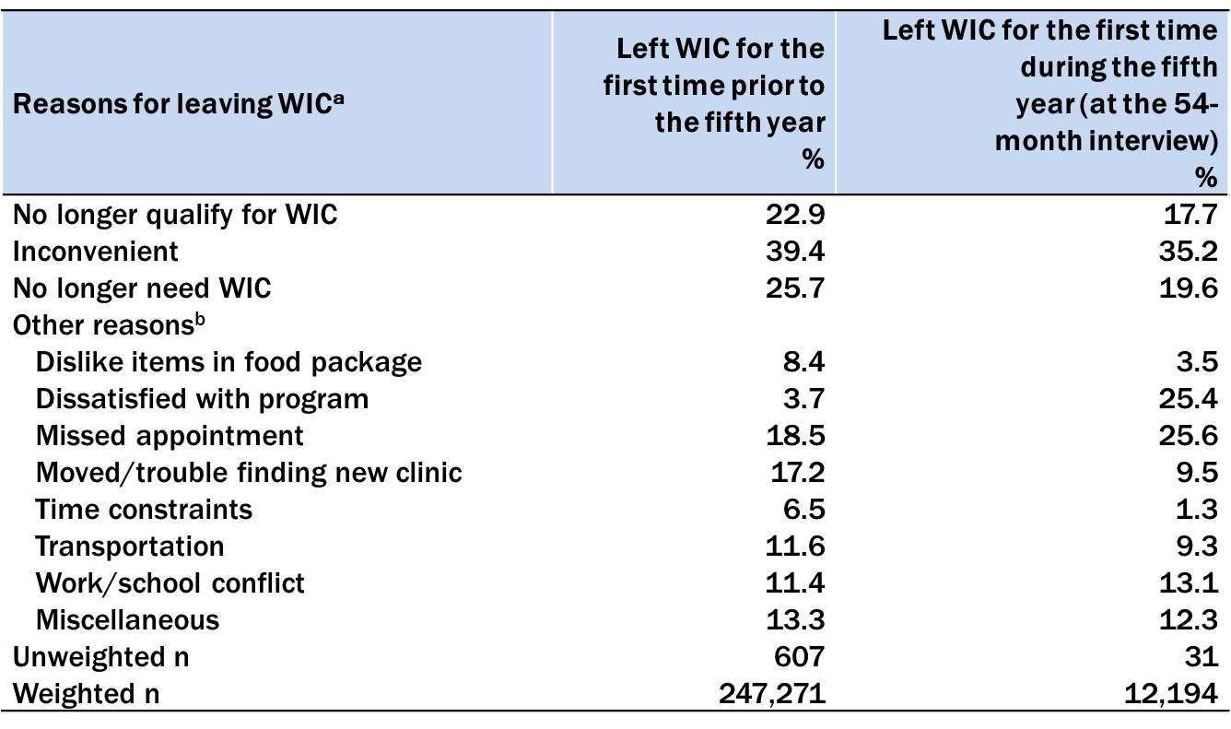
Reasons for Leaving WIC the First Time
Notes:
At every interview, the study participants are asked if they are participating in WIC, and the first time they indicate they are no longer participating, are asked the reason for leaving WIC. As the above table shows, a combined 48.6 percent left WIC for the first time before the study child turned five because they no longer qualify for WIC or felt they no longer needed WIC. The other biggest reason for leaving WIC is cited inconvenience.

Slide 28
Though Some Leave WIC, Many Return after a Short Break
Notes:
By the study child’s fourth year, about 20 percent of study participants indicate that at some point in the first four years, they took a temporary break from WIC. As the pie chart on the left of the slide shows, for the majority, the length of the break was 6 months or less.
The bar chart on the right show reasons that people returned. Respondents could mark all that apply, so the percentages do not sum to 100%. Re-enrolling after a move was the most frequently cited reasons for returning after a temporary break. Three-quarters of participants cited this reason. Missing a recertification appointment but intending to return was cited by more than half of those who return.

Slide 29
People Stay with WIC for Several Reasons
Notes:
During the study child’s fourth year, the study asked those who were participating with WIC, why they stayed. Again survey respondents could mark all reasons that apply. More than 90 percent indicated that there are several reasons: food, education, and that WIC staff listen to them. About two-thirds of WIC participants also stay because they get to talk with other parents about parenting and feeding.

Slide 30
Participation in Benefit Programs
Notes:
Participation in WIC decreased over time, from the 63% of study participants continuing with WIC at 30 months. However, it’s worth noting that at the time of the 54-month interview, 52% of the study participants were still participating in WIC. In addition, many study participants were also participating in other Federal benefit programs such as SNAP, school meals programs, and Medicaid. Participation in SNAP and Medicaid has remained fairly steady from the 30-month interview onwards, but participation in the school meals programs increased.

Slide 31
Energy intakes rises with age
Notes:
The Feeding My Baby Study also gathers dietary data on children by asking the mother during the interview to recall everything the child ate or drank the day before and the amounts. As expected, the energy intake by study children rises as they grow. At age five, the study found that for both boys and girls total energy intake as measured in kilocalories exceeds the recommendations.

Slide 32
Prevalence of Picky
Eating Rises
Notes:
As children grow, their pickiness also increases. The percentage of study mothers who indicate that their child is not a picky eater, shown on the purple line, falls from 68 percent to 35 percent between 18 and 54 months. Concurrently, the percentage of study mothers indicating that the child is a somewhat picky eater rises from 26 percent to 47 percent over the same interval. The percentage of study mothers indicating that the child is a very picky eater, shown on the red line, triples over this interval, rising from 6 percent at 18 months to 18 percent at 54 months.

Slide 33
Study Children’s Diet Quality as Good as a National Sample of US Children
Study child’s age
Notes:
The study uses the Healthy Eating Index 2015, a measure of diet quality developed by the USDA, to assess the quality of the diet of the study children. On a score ranging from 0 – 100, our study children consistently are achieving mean scores that are comparable to those observed in the children participating in a national study that includes all income groups.

Slide 34
Longer WIC Participation is
Positively Associated with Diet Quality
The asterisk (*) indicates that each mean differs significantly from the mean for the group who participated consistently with WIC through the 54-month interview.
Notes:
Another exciting finding from the study is that longer participation in WIC is associated with better diet quality as measured by the HEI-2015 scores. Whereas the mean HEI-2015 score for study children who participated in WIC in only the first year is 59.8 at age five, it goes up to 61.7 for children who participated consistently throughout the five years. The asterisks indicate that statistically, the difference between those who participate consistently and those who participate with WIC intermittently through child age 5, or leave after the child’s first year, or leave after the child’s third year is significant.

Slide 35
A Few Nutrients with Inadequacies
Notes:
Even though the study children’s overall diet quality is comparable to that of children in other national studies, there are inadequacies for a key nutrients. For some, like calcium, the percentage of study children with inadequate intakes goes up from 1% at age two to 13% at age five. The “blip” at 48-month is when the requirement for calcium rose. For Vitamin E, it goes down from 55% at age two to 33% at age five, probably due to the more varied diet the children consume as they grow.

Slide 36
Consumption of Desserts,
Sugar-sweetened Beverages, and Salty Snacks Rises Over Time
Notes:
At the same time that WIC children are eating healthy foods, they are also gradually increasing intake of dessert and candy, sugar-sweetened beverages, and salty snacks on a given day.
By 24 months, half of children are consuming a dessert or candy on a given day. It raises to 60% at age five.
Sugar-sweetened beverages are increasing as well, with 36% of children consuming one on a given day at 60 months. These are mostly fruit flavored drinks.
Salty snacks are rising too, including foods like chips, popcorn, and cheese puffs.

Slide 37
Sodium Intake is Excessive
2,648
2,411
2,200
Notes:
Excessive sodium intake is a concern. In 2019 the National Academies of Science, Engineering and Medicine set a new sodium target to reduce risk of hypertension and cardiovascular disease (referred to as chronic disease risk reduction or CDRR). For children ages 4 to 8 years, the new CDRR for sodium recommends reducing intakes above 1,500 mg/day. Measured against that recommendation, median sodium intake of the study children has been consistently excessive, reflecting the national trend. It shows there is much work still to be done to improve the children’s diet quality.

Slide 38
Percentage of Overweight and Obese Children Rising
Notes:
First let’s look at the distribution of low, healthy, and high weight longitudinally.
You can see that we have very few children falling into the “low” category. These may be children with special circumstances or medical conditions affecting growth.
PRESS AGAIN FOR ARROWS
Most children are falling in the healthy category, but you can see that the percentage of children in this category is declining with age.
In a contrasting pattern, the percentage of children in the high category is rising with age, and reaches 23 percent around the second birthday.
This pattern is similar to that seen in other studies of WIC children, although our 23 percent is a little higher than other estimates. Despite similarity to other findings, the trend is concerning.

Slide 39
Next Report (Age 6)
Work, child care, medical care, federal food benefit receipt
Healthy food purchasing, feeding beliefs, rules, and practices
Food intake
Energy and nutrient intake
Weight and growth
Correlates of past WIC participation
Notes:
The next report covers the sixth year with data from an interview conducted around the child’s sixth birthday, and the child’s height/weight measurements around age six. We are looking forward to the release of this report covering the period after the study child’s eligibility for WIC ends.

Slide 40

Thank you for your support!
Notes:
Presenter: All
Opportunity for all on team to make comments of thanks.

Slide 41
What are your questions?
The Food and Nutrition Service (FNS) is collecting this information to investigate (1) the dietary practices and the health and nutritional status of the WIC ITFPS-2 children during the ninth year of life; (2) if participants who left the study were systematically different than those who continued in the study and if these study participants left WIC at the same rate as their counterparts who remained in the study. This is a voluntary collection and FNS will use the information to s inform WIC service delivery. The collection does request personally identifiable information under the Privacy Act of 1974. Responses will be kept private to the extent provided by law and FNS regulations. According to the Paperwork Reduction Act of 1995, an agency may not conduct or sponsor, and a person is not required to respond to, a collection of information unless it displays a valid OMB control number. The valid OMB control number for this information collection is 0584-0580. The time required to complete this information collection is estimated to average 1.0 hours (60 minutes) per response, including the time for reviewing instructions, searching existing data sources, gathering and maintaining the data needed, and completing and reviewing the collection of information. Send comments regarding this burden estimate or any other aspect of this collection of information, including suggestions for reducing this burden, to: U.S. Department of Agriculture, Food and Nutrition Service, Office of Policy Support, 1320 Braddock Place, 5th Floor, Alexandria, VA 22314. ATTN: PRA (0584-0580). Do not return the completed form to this address.
Notes:
Now we’d like to hear your questions about the study or the activities during the extension to age nine.
As mentioned earlier, we’ll be setting up calls with each state and the sites in their state to have a chance to talk about the specifics and logistics for the assistance we’ll need through the end of the study.

