Slide 1
Capital Project Fund (CPF) Tribal CPF Application
System Screenshots
September 29, 2021

Slide 2
Overview: CPF Application
As a Tribal applicant for the CPF program, I will see the following functionality in order to apply for funding based on CPF allocation amounts. Consortiums and Tribes can also apply on behalf of one or multiple tribal applicants in the same application.

Slide 3
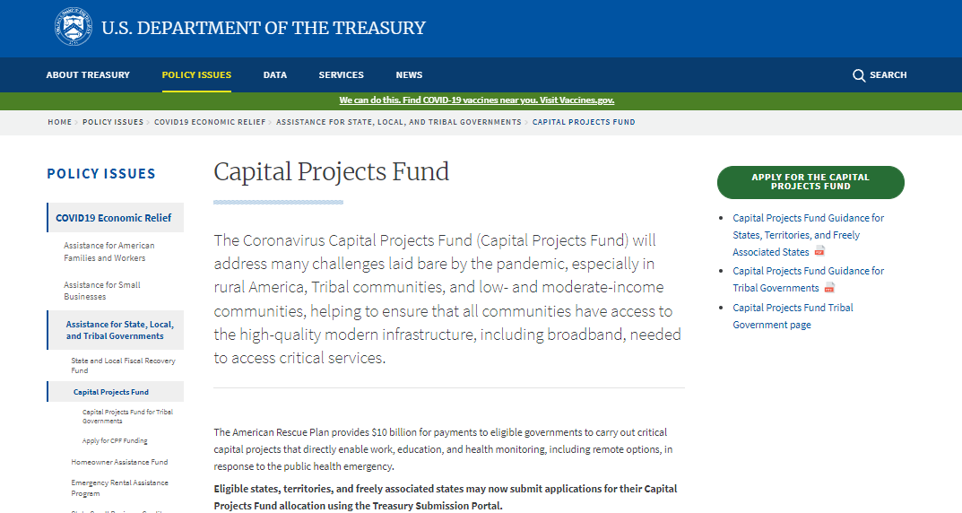
Treasury.gov Page

Slide 4
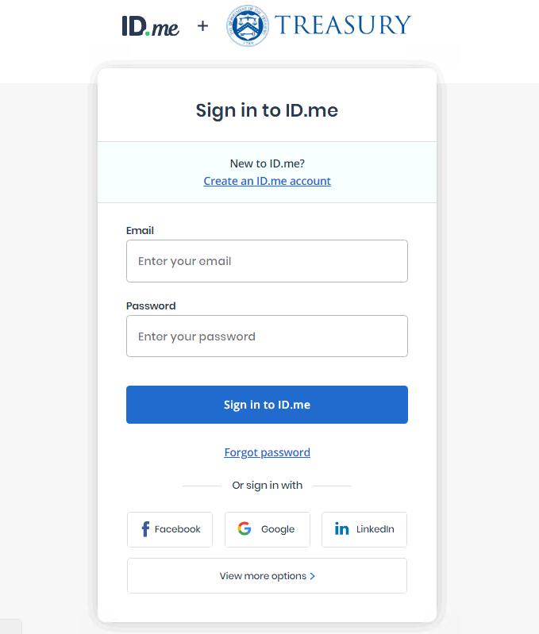
ID.me Login/Registration

Slide 5
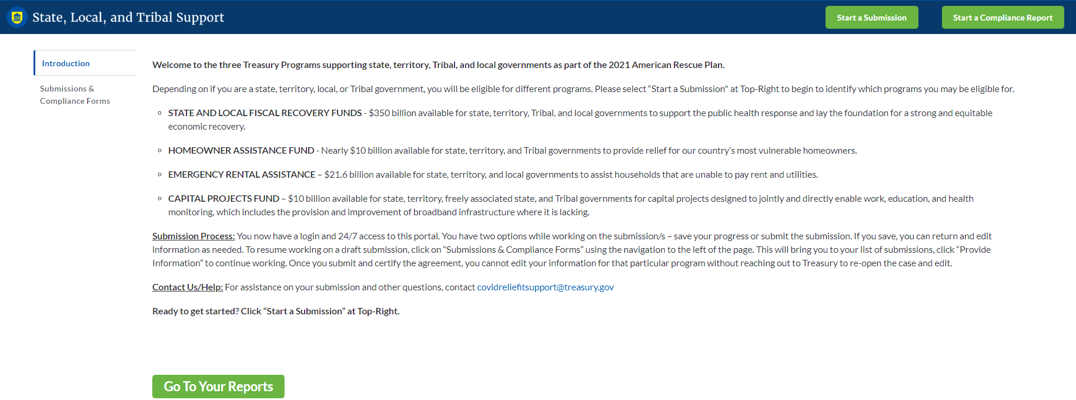
CPF Homepage
The page the applicant sees once logged in

Slide 6
Start Submission

Slide 7
Start Submission

Slide 8
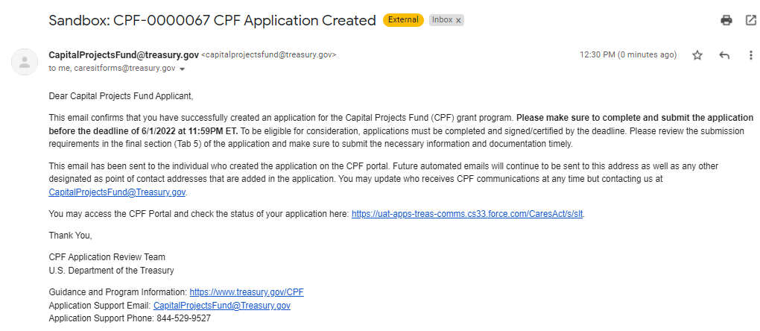
Start Submission Confirmation

Slide 9
Application in List

Slide 10
Application Form - Header

Slide 11
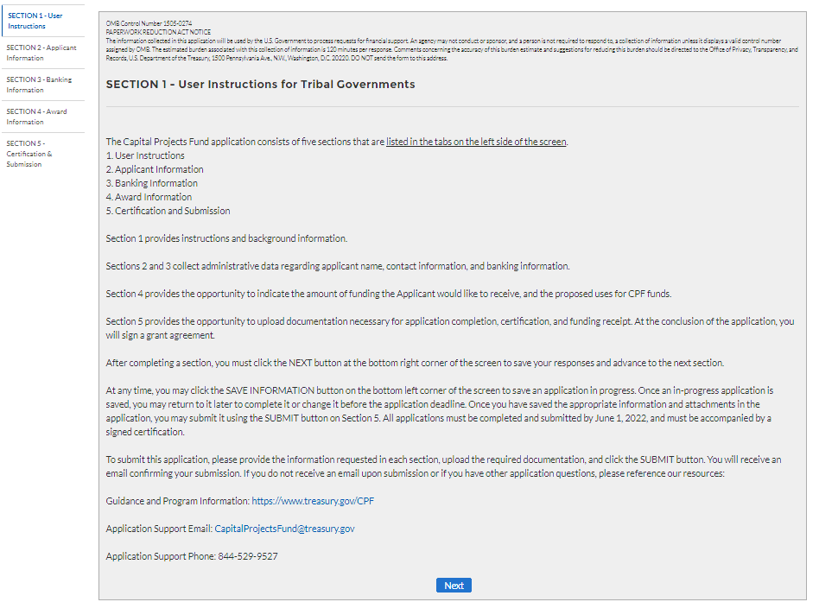
Tab 1

Slide 12
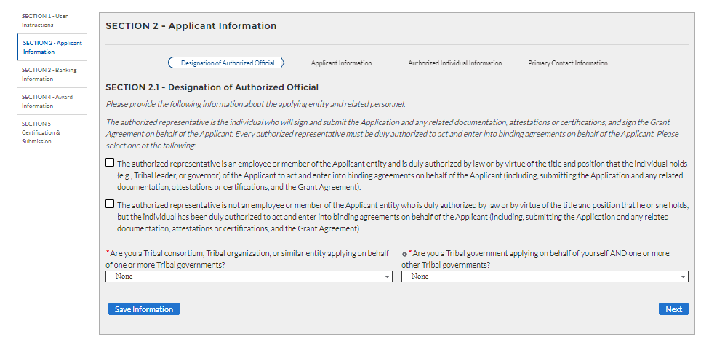
Tab 2.1
If Authorized individual is not delegated

Slide 13
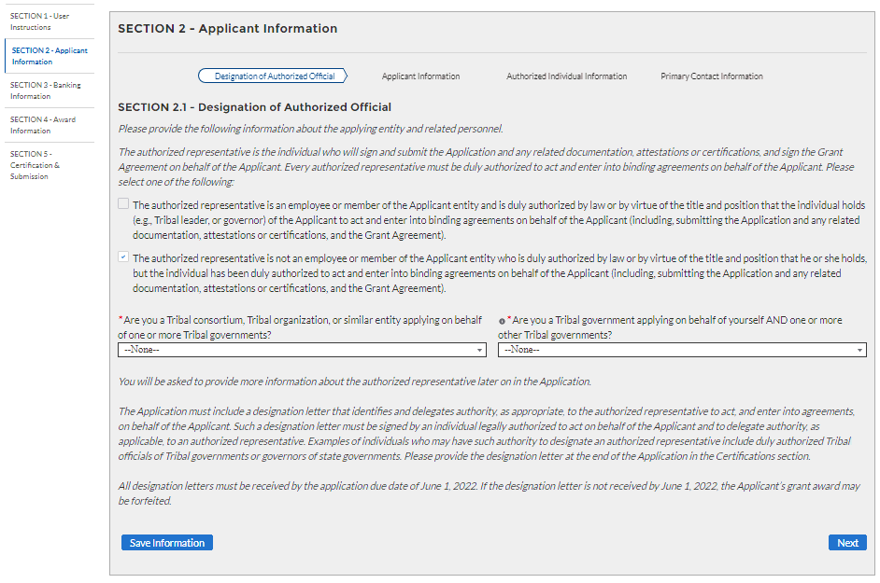
Tab 2.1
If Authorized individual is delegated, Consortium, or applying “On Behalf” (additional text visible)

Slide 14
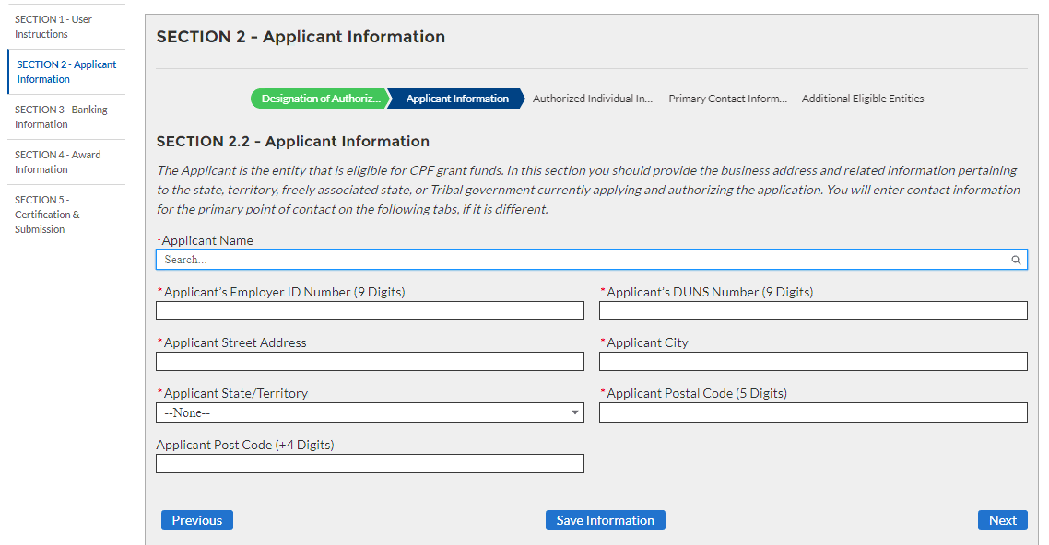
Tab 2.2
If applicant is NOT Consortium

Slide 15
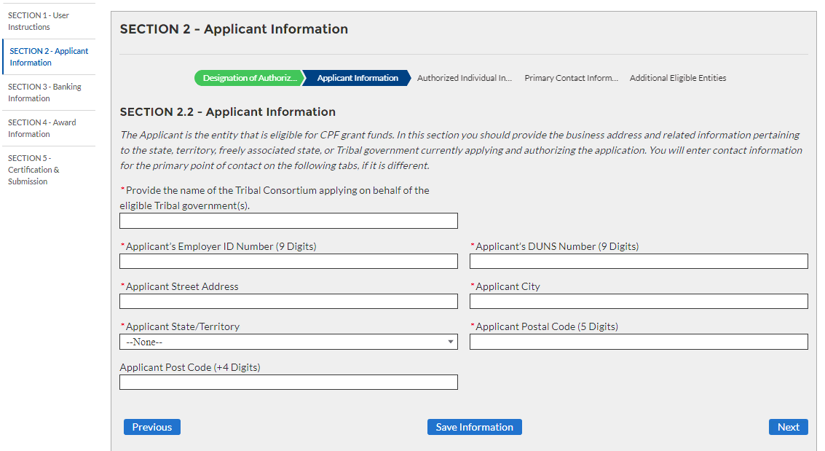
Tab 2.2
If applicant is Consortium

Slide 16
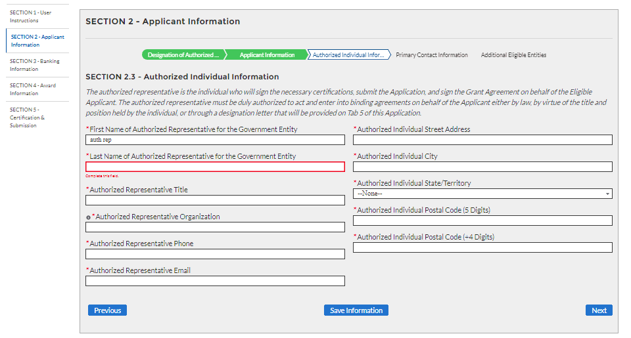
Tab 2.3

Slide 17
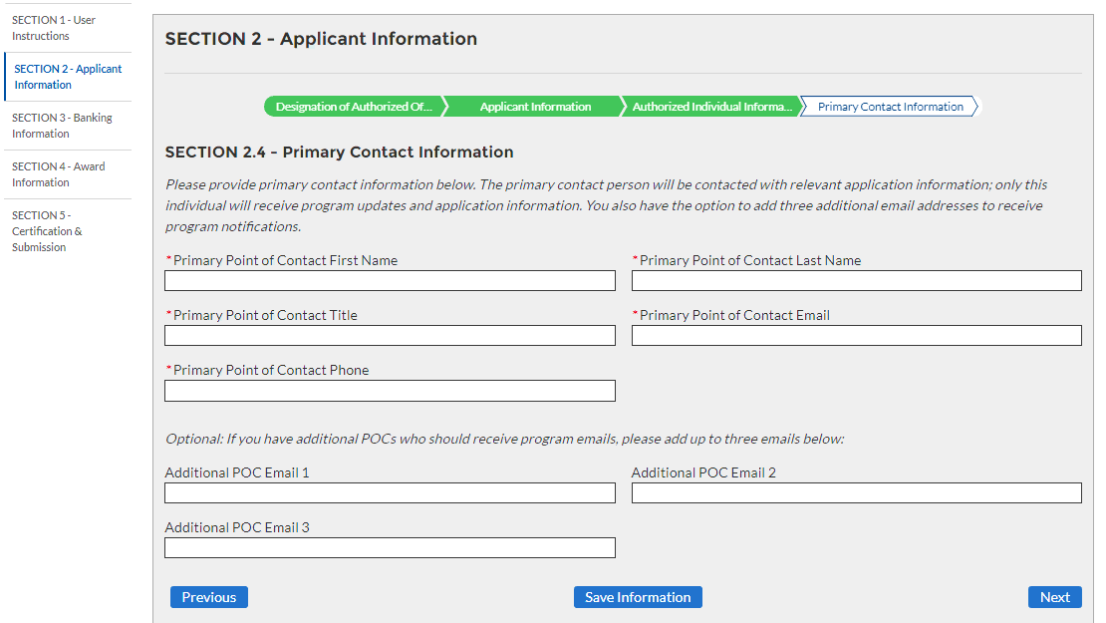
Tab 2.4

Slide 18
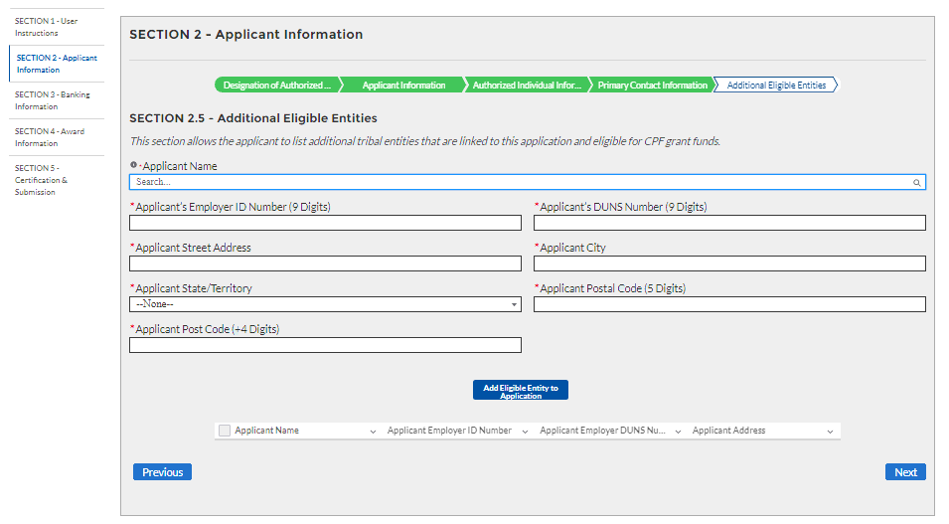
Tab 2.5
If applicant is Consortium or “On Behalf” (i.e., multiple entities)

Slide 19
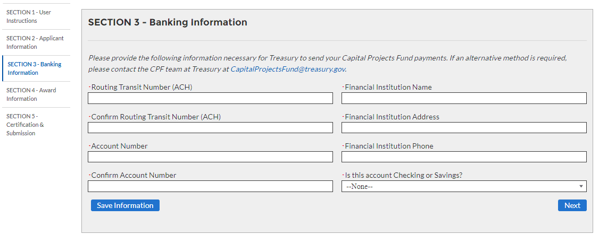
Tab 3

Slide 20
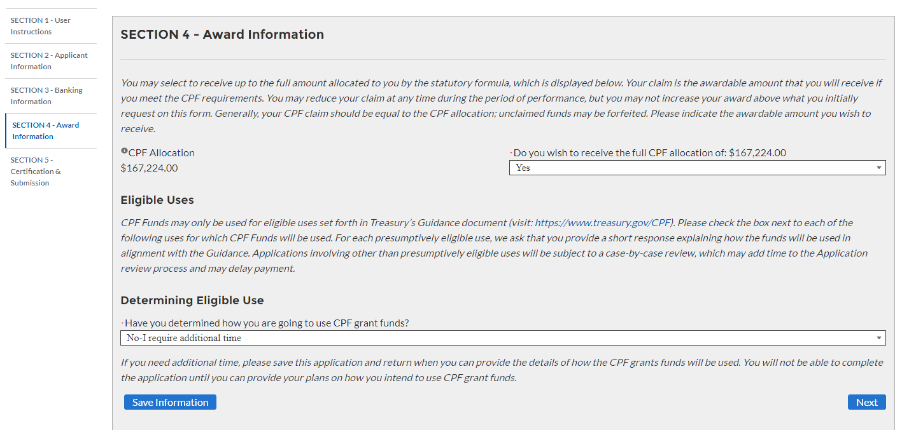
Tab 4
Receive Full Allocation = Yes AND Determined Funds Use = “No-I require additional time”

Slide 21
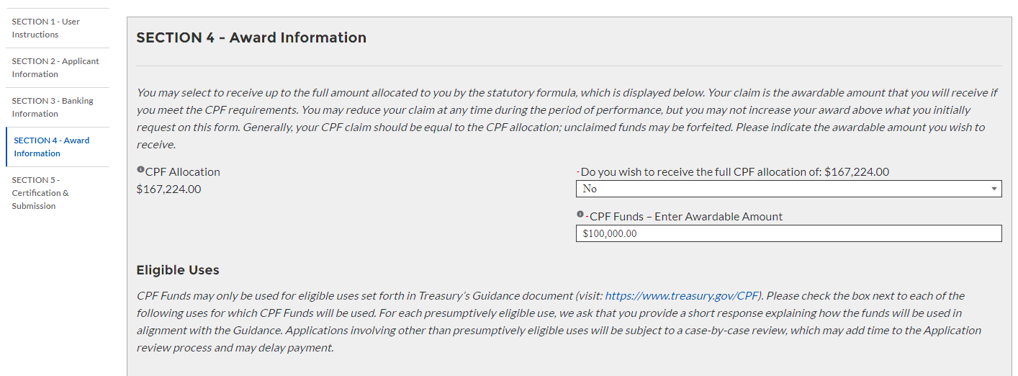
Tab 4
Receive Full Allocation = No

Slide 22
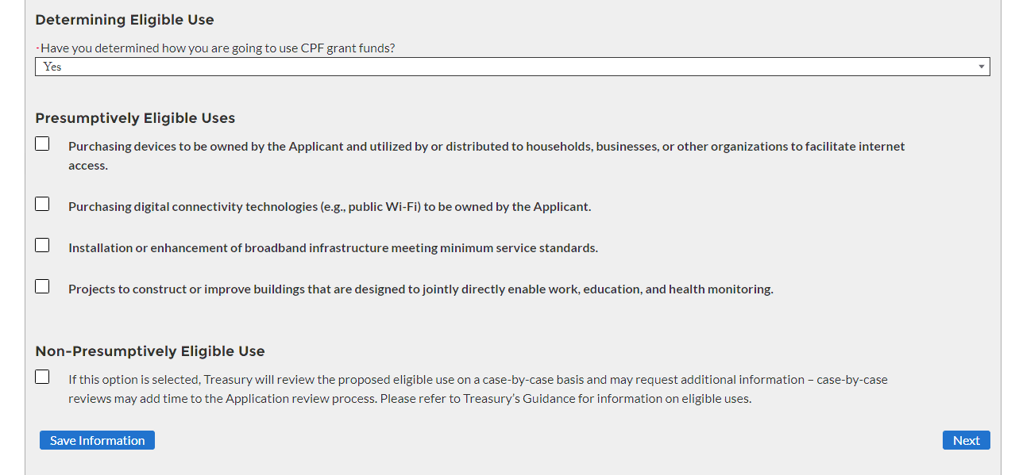
Tab 4
Cont. Funds Use Overview

Slide 23
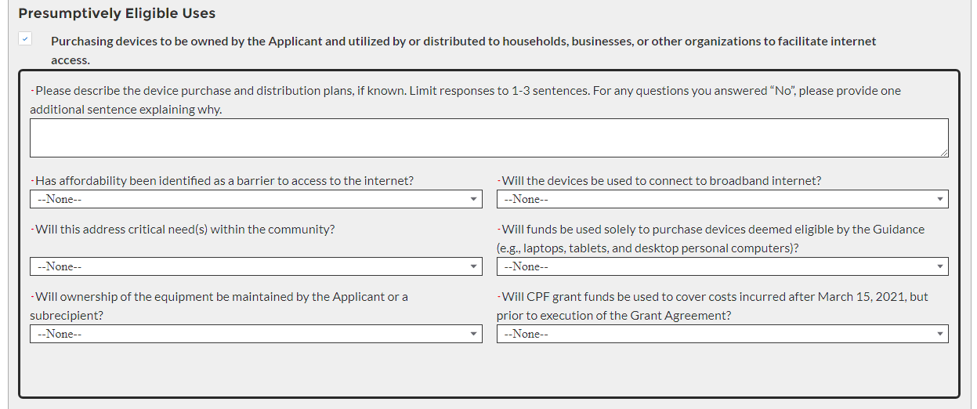
Tab 4
Cont. Purchasing devices section

Slide 24
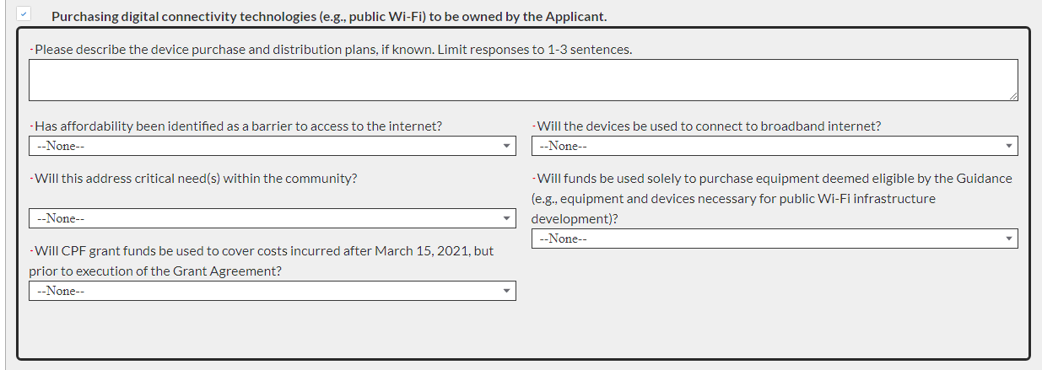
Tab 4
Cont. Purchasing digital connectivity

Slide 25
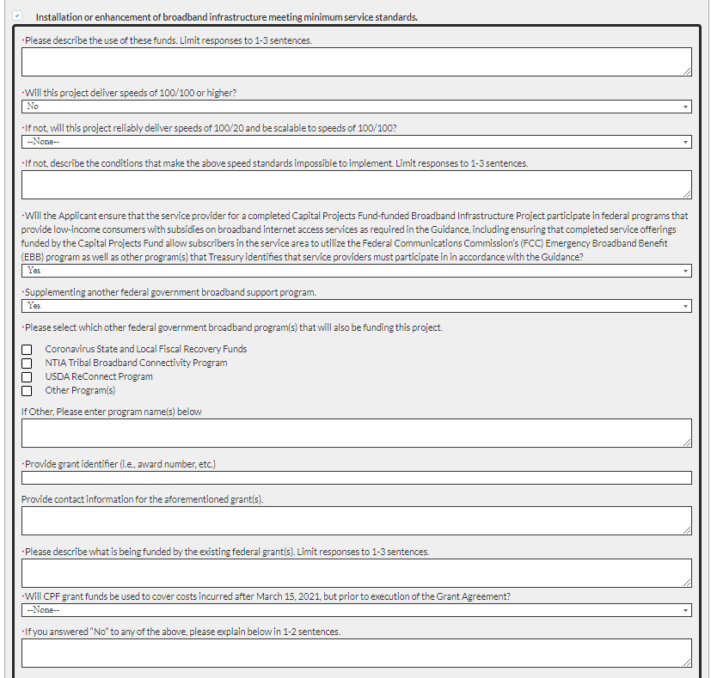
Tab 4
Cont. Installation or Enhancements of broadband

Slide 26
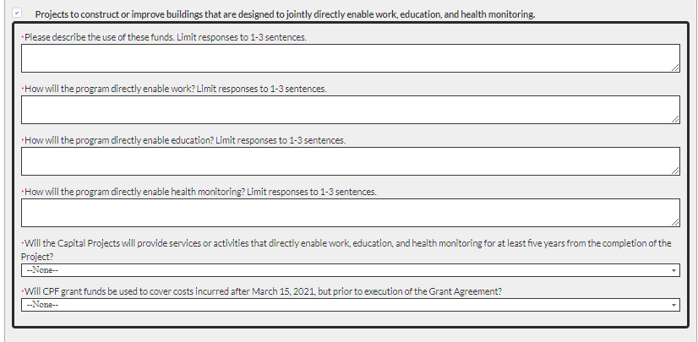
Tab 4
Cont. Projects to construct or improve buildings

Slide 27
Tab 4
Cont. Non-Presumptively Eligible Use

Slide 28
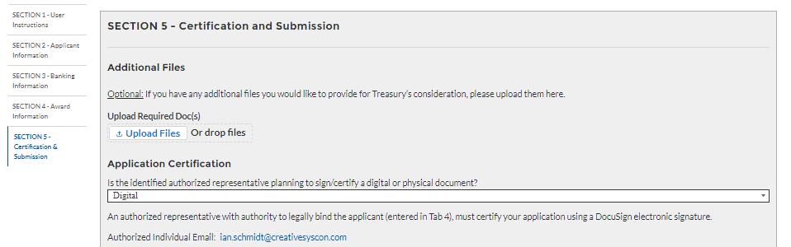
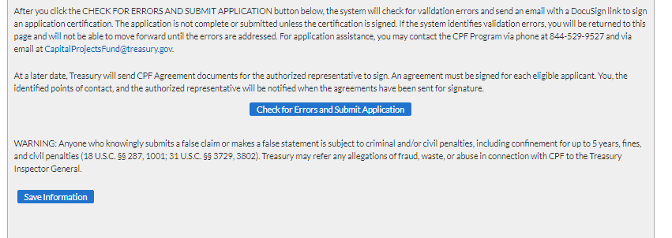
Tab 5
Designation Letter Needed = No
Certification Type = Digital
Applicant(s) = Single Entity

Slide 29
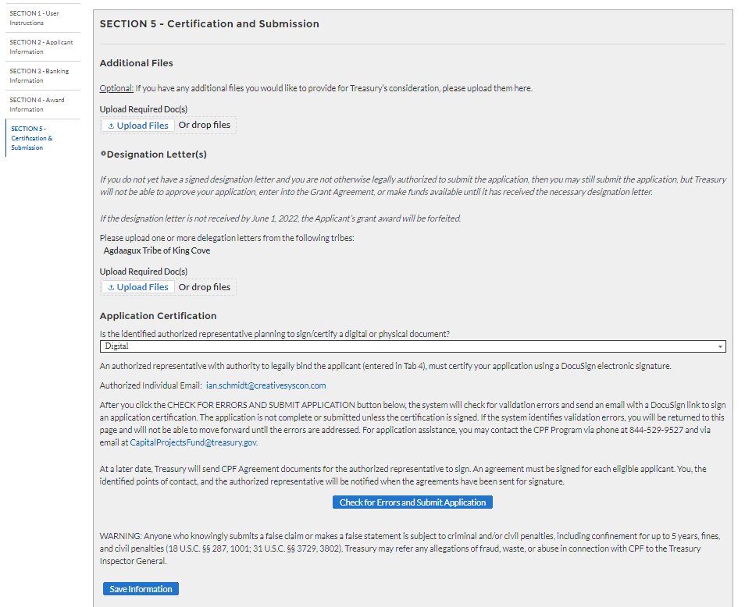
Tab 5
Designation Letter Needed = No
Certification Type = Digital
Applicant(s) = Multiple Entities

Slide 30
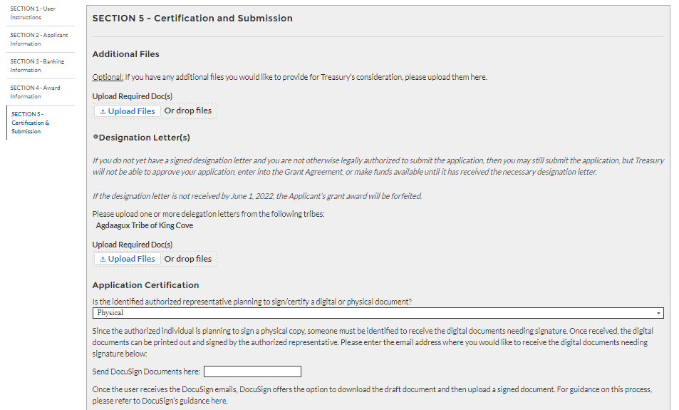
Tab 5
Designation Letter Needed = Yes
Certification Type = Physical
Applicant(s) = Single Entity

Slide 31
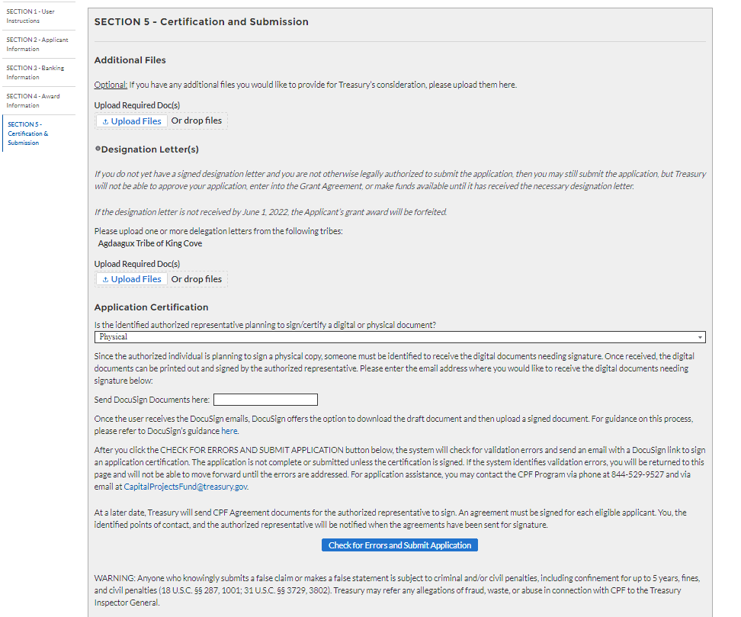
Tab 5
Designation Letter Needed = Yes
Certification Type = Physical
Applicant(s) = Multiple Entities

Slide 32
Tab 5

Slide 33
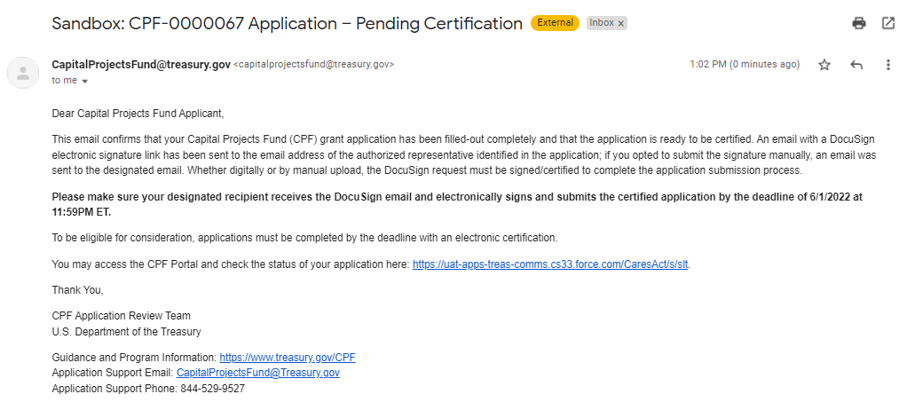
Signature Pending Email for POCs

Slide 34
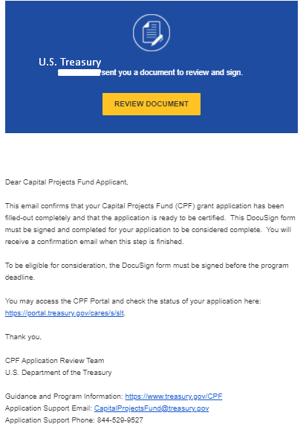
Signature Pending Email for Authorized Individual

Slide 35
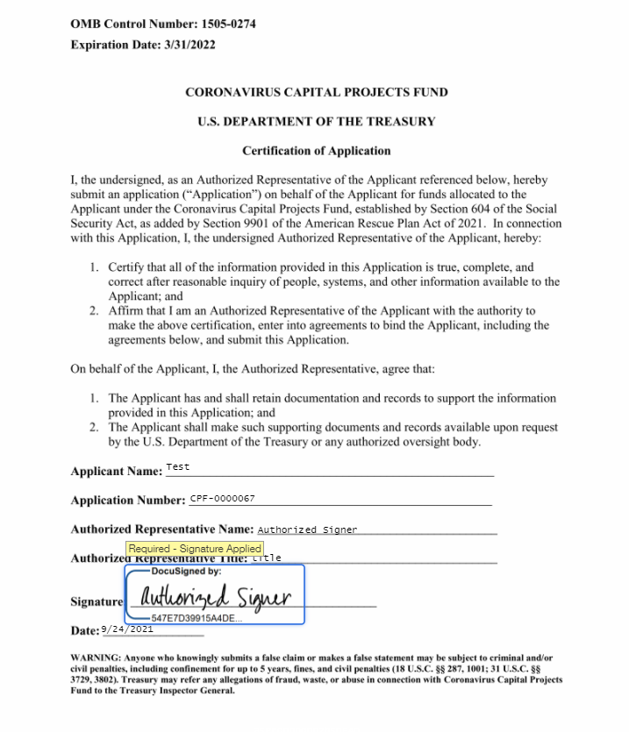
DocuSign Certification for Application

Slide 36
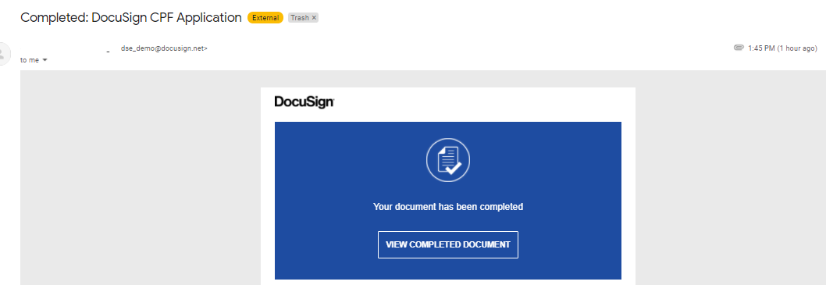
Signature Completed Email for Authorized Individual

Slide 37
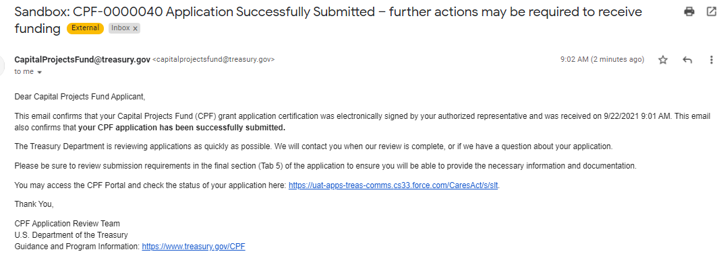
Signature Completed Email for POCs

