Slide 1
EXIS
Screenshots
Online Exercises & Survey

Slide 2
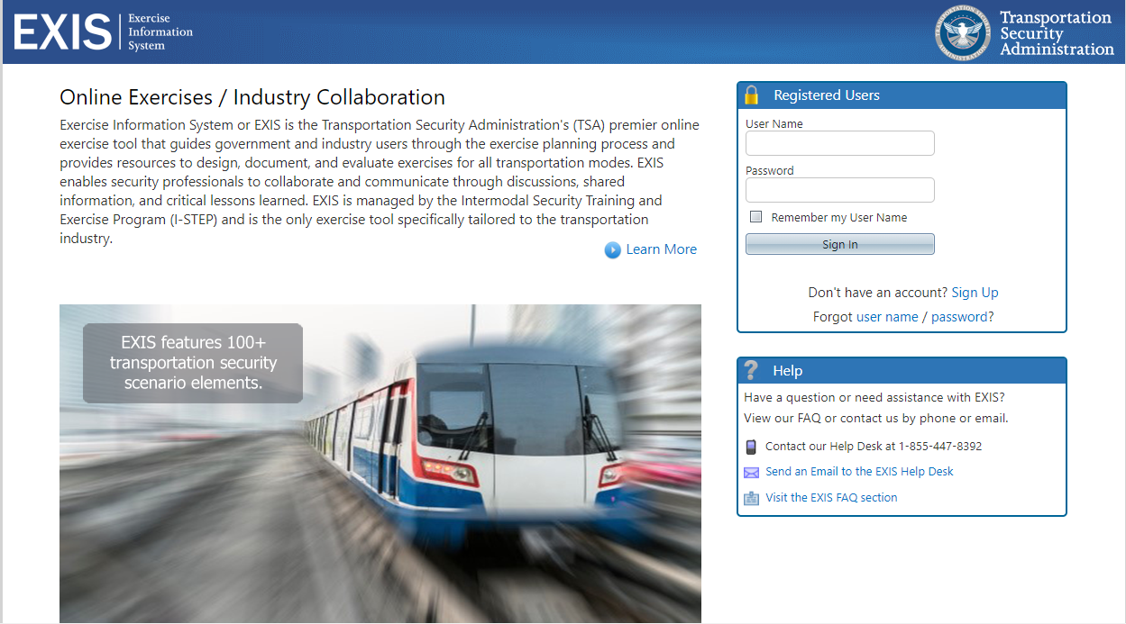

Slide 3
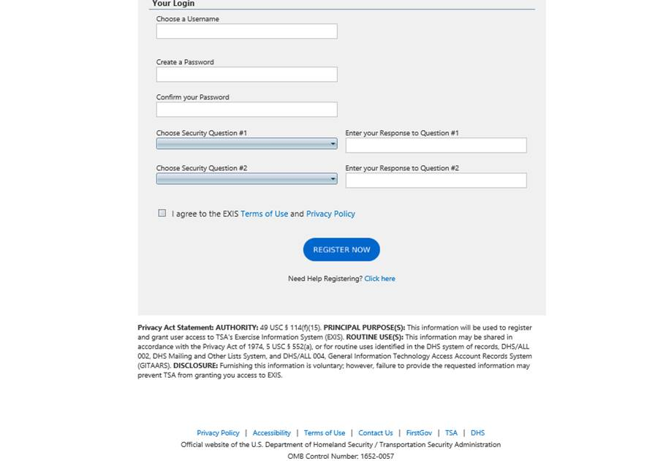
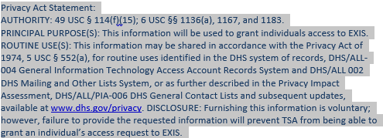

Slide 4
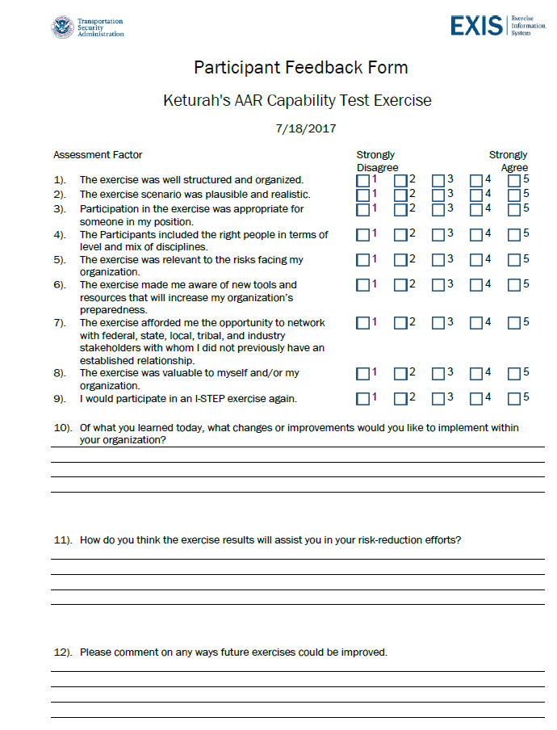
OMB Control No: 1652-0057
Exp.: 04/30/2018

Slide 5
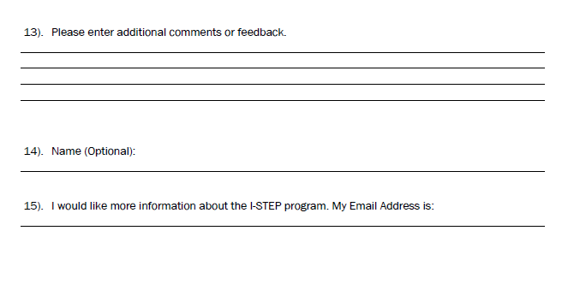
OMB Control No: 1652-0057
Exp.: 04/30/2018

Slide 6
Paperwork reduction act burden
This collection of information is voluntary pursuant to Implementing Recommendations of the 9/11 Commission Act of 2007. It is estimated that the time to design and conduct an exercise is approximately 3.5 hours and the time to complete the survey is 0.25 hours. An agency may not conduct or sponsor, and a person is not required to respond to a collection of information unless it displays a valid OMB control number. The OMB control number assigned to this collection is 1652-0057, which expires 04/30/2022. Send comments regarding this burden estimate or any other aspect of this collection of information including suggestions for reducing this burden to TSA PRA Officer, 6595 Springfield Center Drive, Springfield, VA 20598-6011. ATTN: PRA 1652-0057.

