Slide 1
CMSDT
Screenshots

Slide 2
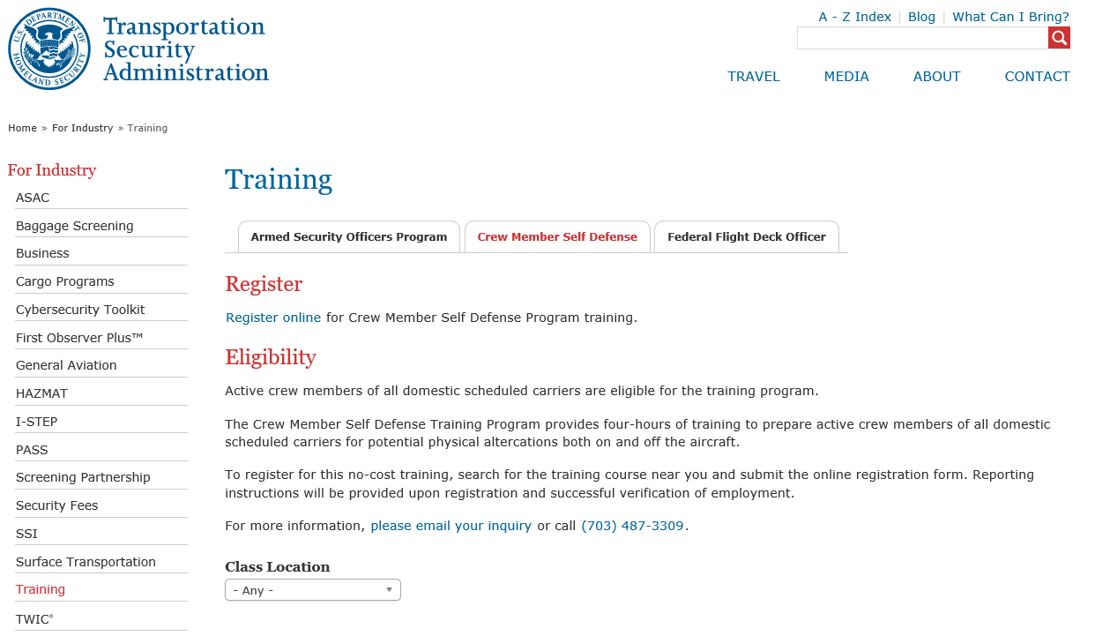
Feedback
If you have any feedback or comments on the course you feel may improve the CMSD program, please email your inquiry here.

Slide 3
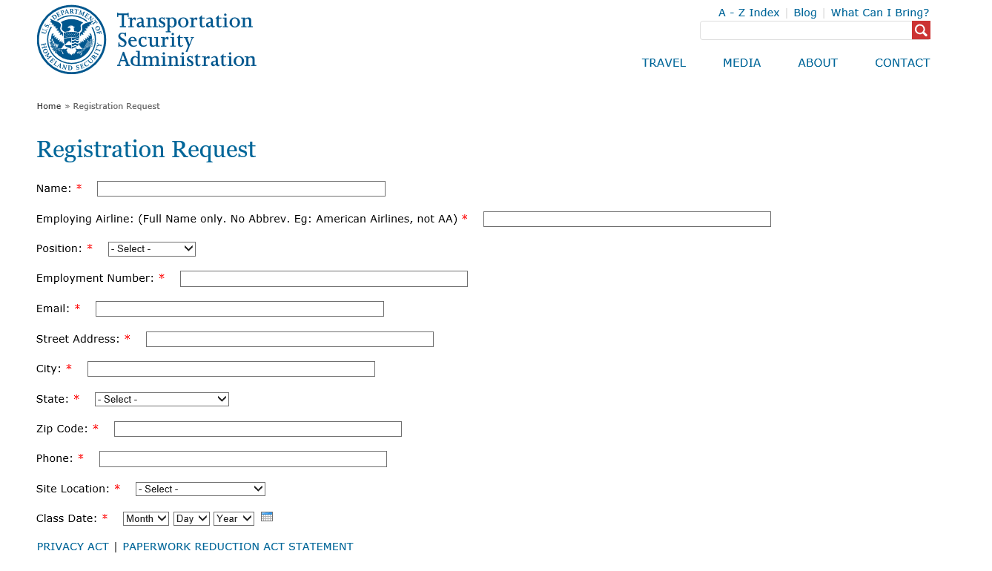

Slide 4
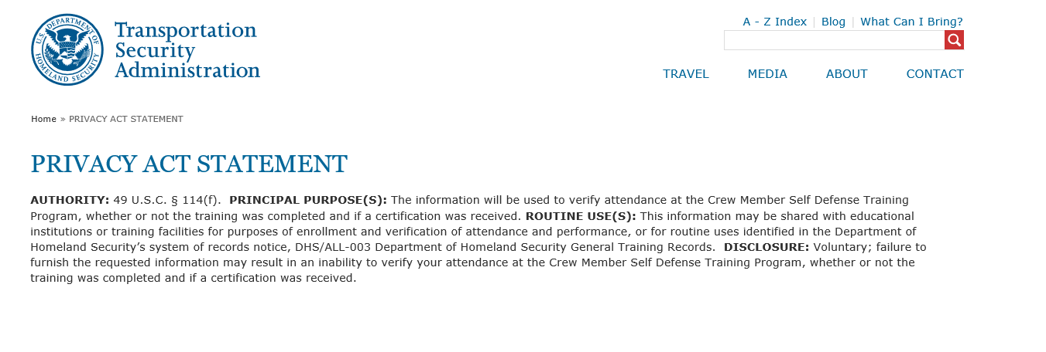

Slide 5
