Slide 1
CMSDT
Screenshots

Slide 2
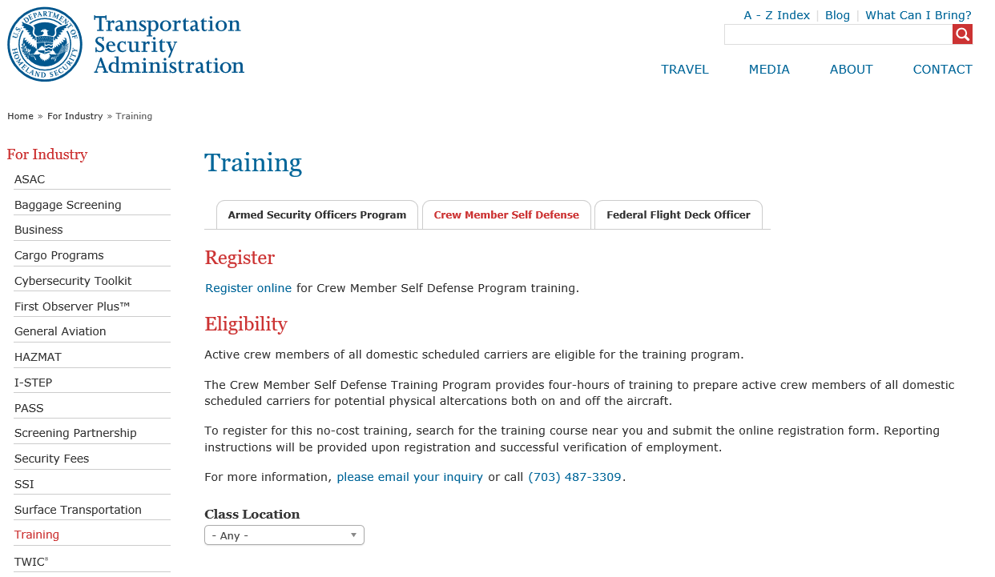
Feedback
If you have any feedback or comments on the course you feel may improve the CMSD program, please email your inquiry here.

Slide 3
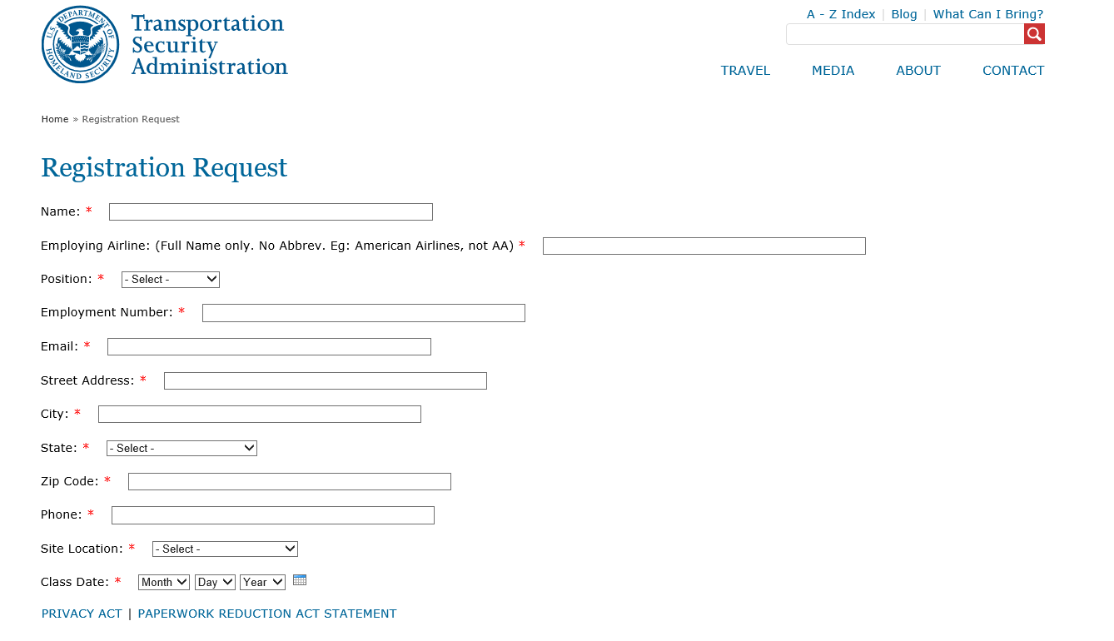

Slide 4
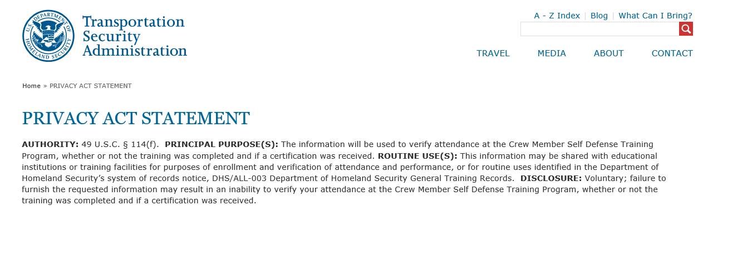

Slide 5
PAPERWORK REDUCTION ACT STATEMENT
Through this voluntary collection of information, TSA is gathering information about you to confirm your attendance at TSA’s crew member self-defense training course. The public burden for this collection of information is estimated to be five minutes. An agency may not conduct or sponsor, and a person is not required to respond to, a collection of information unless it displays a currently valid OMB control number. The OMB control number assigned to this collection is 1652-0028, which expires 4/30/2022. Send comments regarding this burden estimate or any other aspect of this collection of information including suggestions for reducing this burden to TSA PRA Officer, 6595 Springfield Center Drive, Springfield, VA 20598-6011. ATTN: PRA 1652-0028.

