Slide 1
TSA Pipeline Cybersecurity Self-Assessment
OMB Control Number 1652-0050
Exp. 11/31/2021

Slide 2
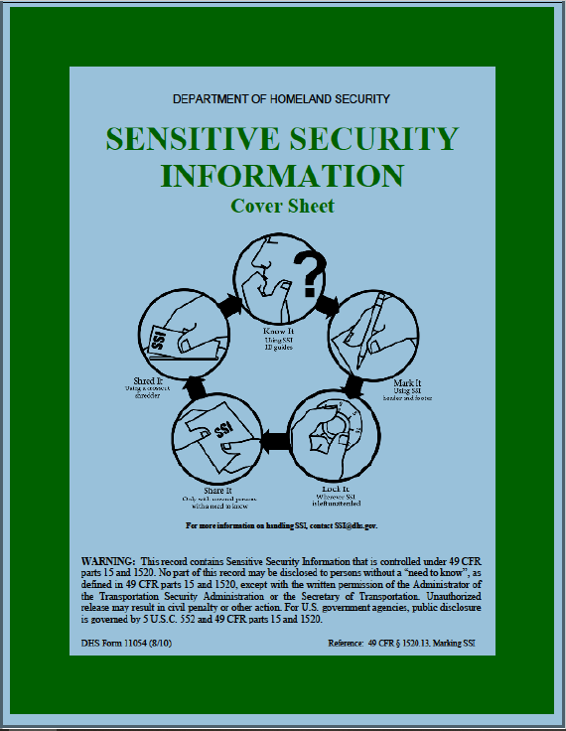
When completed, this document is SSI.

Slide 3
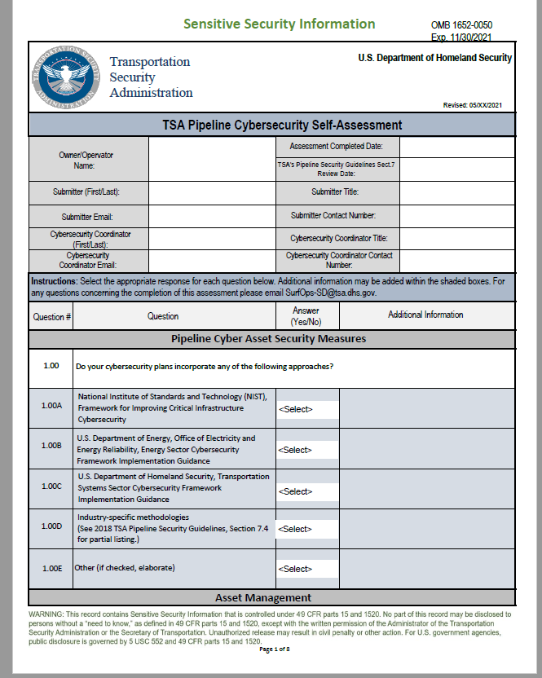

Slide 4
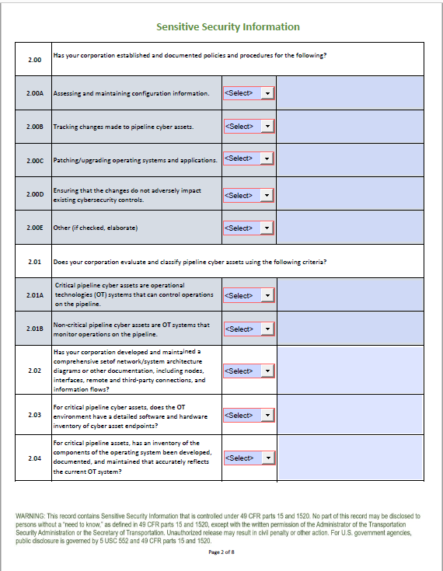

Slide 5
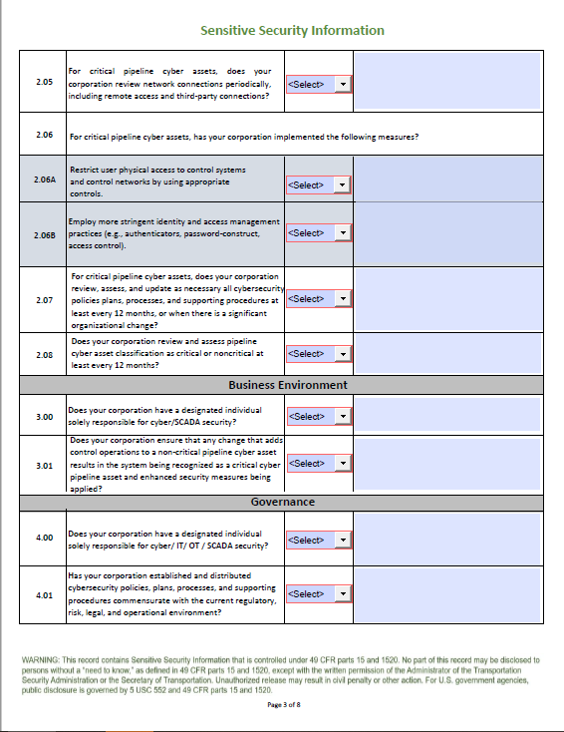

Slide 6
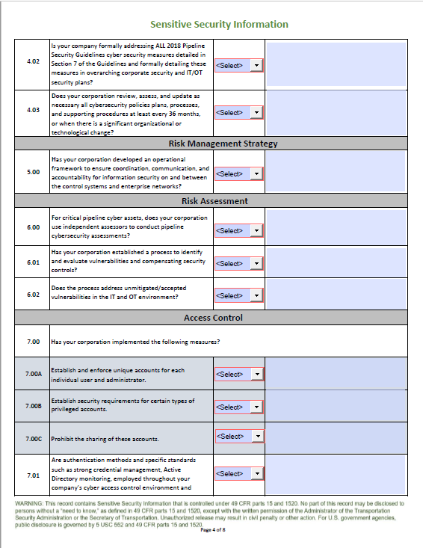

Slide 7
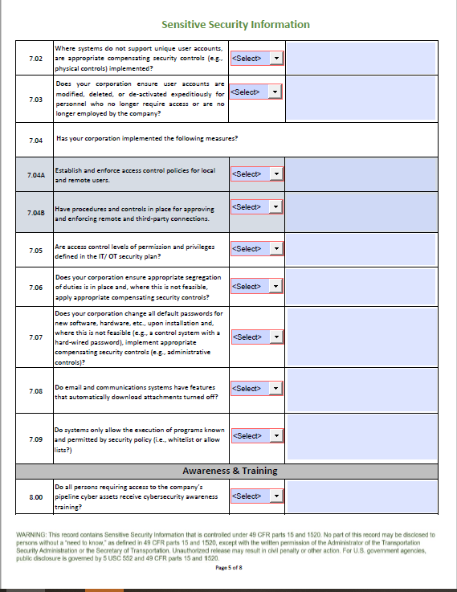

Slide 8
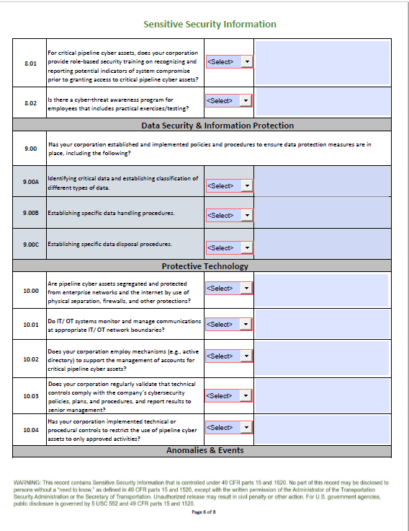

Slide 9
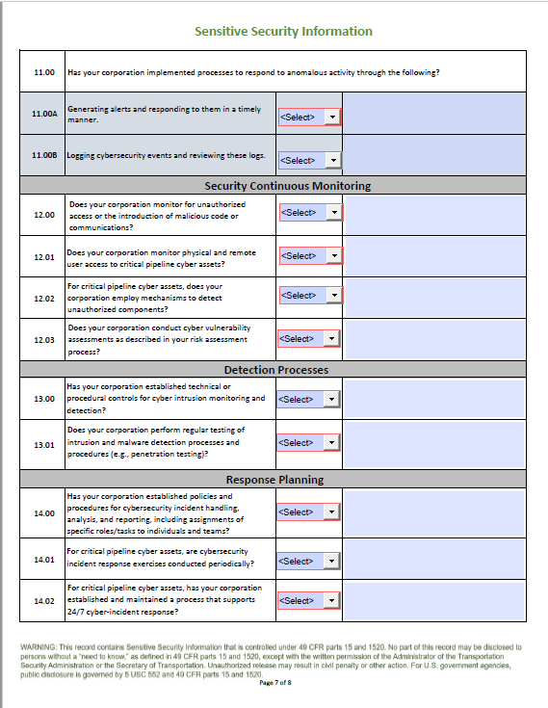

Slide 10
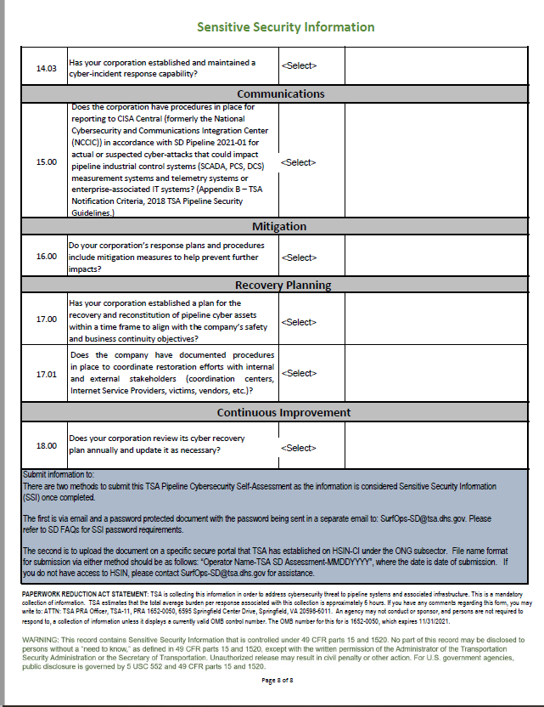

Slide 11
Paperwork Reduction Act Statement
PAPERWORK REDUCTION ACT STATEMENT: TSA is collecting this information in order to address cybersecurity threat to pipeline systems and associated infrastructure. This is a mandatory collection of information. TSA estimates that the total average burden per response associated with this collection is approximately 6 hours. If you have any comments regarding this form, you may write to: ATTN: TSA PRA Officer, TSA-11, PRA 1652-0050, 6595 Springfield Center Drive, Springfield, VA 20598-6011. An agency may not conduct or sponsor, and persons are not required to respond to, a collection of information unless it displays a currently valid OMB control number. The OMB number for this for is 1652-0050, which expires 11/31/2021.

