Slide 1
Testimonial Stimuli

Slide 2

Amanda

Slide 3
Felicia

Slide 4
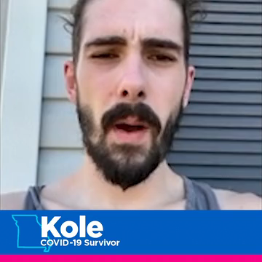
Kole

Slide 5
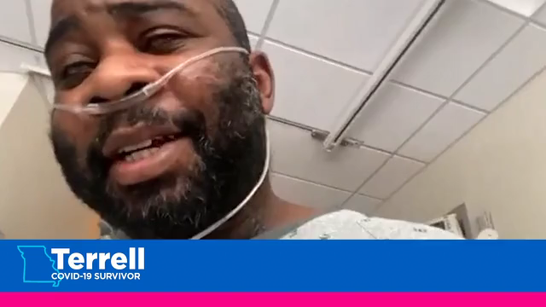
Terrell

Slide 6
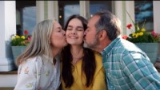
“Thanks” Ad

Slide 7
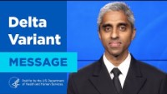
Surgeon General

