Slide 1
Business name: __________________________________
Please answer the questions as completely as possible. Review your records, if you have time. We will make estimates for missing items and non-responding firms, but your best recollection is likely better than our estimates. All individual responses are kept confidential.
Was your facility active in [YEAR]? □ Yes □ No
What products did you manufacture in [YEAR]?
Primary _____________________________________________
Secondary ___________________________________________
How much of your primary product did you produce in [YEAR]? (Please indicate unit of measure) ________________________ units ______________
What is your annual capacity? ________________________ units ______________
If you have any questions, or are willing to share additional sales information to assist us in estimating your industry’s economic contribution to the state economy, please contact [CONTACT NAME, PHONE AND EMAIL].
How much timber/raw material did you receive in [YEAR]?
(Please indicate unit of measure)
________________________ units ______________
Ownership of raw material received, [YEAR] (√ all that apply):
□USFS □BLM □State □Industry □Private □Tribal
Percent from each ownership:
_______ _______ ______ ________ _______ ______
------------------------------------------------ Fold here -----------------------------------------------
Origin of raw material received, [YEAR] (√ all that apply): □ Your county □ Adjacent counties □ Out of state
Percent from each origin:
__________ __________ ___________
Other: ________________________ Percent _________
How would you like to be contacted?
□ Phone ______________ □ Mail
□ Email: ____________________
Contact person’s name: ___________________________
Total residue volume: _______________ units _________ □Chips/Slabs/Ends □Sawdust □Shavings □Bark
Percent of total:
_____________ _________ _________ _________
Disposition of residuals (circle appropriate):
Sold/used Sold/used Sold/used Sold/used
Unused Unused Unused Unused
Address or contact correction:
__________________________
__________________________
__________________________
__________________________
__________________________
How many days did you operate in [YEAR]? ____________
How many employees: Production_______ Admin _______
Thank you for your time.

Slide 2
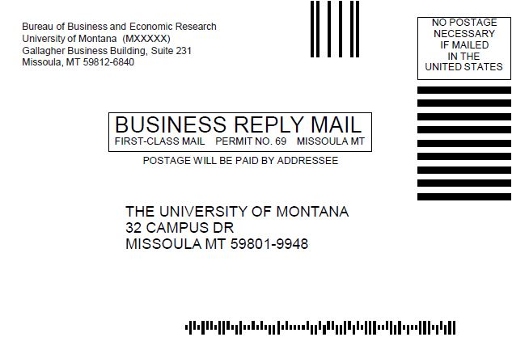
Thank you for your participation!

