Slide 1
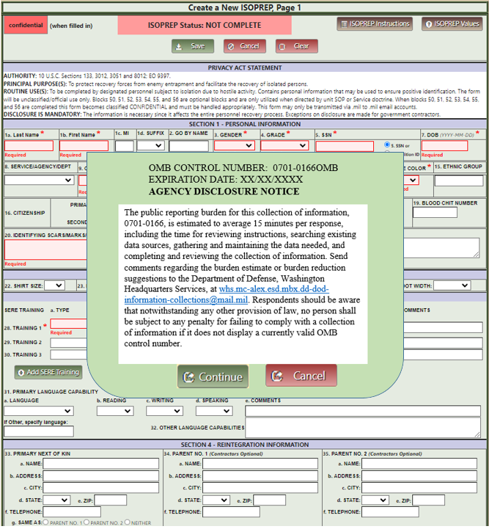
OMB Message that user must select continue or the ISOPREP cannot be accessed for creation or any viewing/updating.

Slide 2
CONFIDENTIAL (when blocks 50 - 56 filled in)
Top of Page 1
Read the AGENCY DISCLOSURE NOTICE, at top of Page 3.
PRIVACY ACT STATEMENT
AUTHORITY: 10 U.S.C. Sections 133, 3012 and 8012; E.O. 13478. PRINCIPAL PURPOSE(S): To protect recovery forces from enemy entrapment and facilitate the recovery of isolated persons. ROUTINE USE(S): To be completed by designated personnel subject to isolation due to hostile activity. Contains personal information that may be used to ensure positive identification. The ISOPREP will be Controlled Unclassified Information (CUI) when single or combinations of blocks are completed as described in the instructions. Blocks 50-56 are optional blocks and are only utilized when directed by unit Standard Operating Procedures or Service doctrine. When blocks 1.a-1.b, or block 5, or block 6 are complete and any one of blocks 50 – 56 are also complete the form becomes CONFIDENTIAL, releasable to the author regardless of clearance level and must be handled appropriately. The ISOPREP may only be transmitted encrypted via .mil/.gov to .mil/.gov email accounts. DISCLOSURE IS MANDATORY. The information is necessary since it affects the entire personnel recovery process. Exceptions on disclosure are made for government contractors.

Slide 3
Top of Page 3
AGENCY DICLOSURE NOTICE
OMB CONTROL NUMBER: 0701-0166
EXPIRATION DATE: XX/XX/XXXX
AGENCY DISCLOSURE NOTICE
The public reporting burden for this collection of information, 0701-0166, is estimated to average 15 minutes per response, including the time for reviewing instructions, searching existing data sources, gathering and maintaining the data needed, and completing and reviewing the collection of information. Send comments regarding the burden estimate or burden reduction suggestions to the Department of Defense, Washington Headquarters Services, at whs.mc-alex.esd.mbx.dd-dod-information-collections@mail.mil. Respondents should be aware that notwithstanding any other provision of law, no person shall be subject to any penalty for failing to comply with a collection of information if it does not display a currently valid OMB control number.

