Slide 1
PSB-CY Child Information (Case) Updated with drop-down screen information IMPORTANT: ALL DATA SHOWN IN THIS PRESENTATION IS FOR DEMONSTRATION PURPOSES. NO REAL DATA (PII) FROM ANY PERSON HAS BEEN USED.
17 September 2021
ALL DATA SHOWN IN THIS PRESENTATION IS FOR DEMONSTRATION PURPOSES. NO REAL DATA (PII) FROM ANY PERSON HAS BEEN USED.

Slide 2
View Case
Child’s Name

Slide 3
Edit Case
Child’s Name

Slide 4
Edit/Update Case
Child’s Name

Slide 5
Edit/Update Case
Child’s Name

Slide 6
Edit/Update Case
Child’s Name

Slide 7
Edit/Update Case
Child’s Name

Slide 8
Edit/Update Case

Slide 9
Edit/Update Case

Slide 10
Edit/Update Case

Slide 11
View Case – Information Tab

Slide 12
View Case – Information Tab

Slide 13
View Case – Information Tab

Slide 14
View Case – Information Tab

Slide 15
View Case – Information Tab

Slide 16
View Case – Information Tab

Slide 17
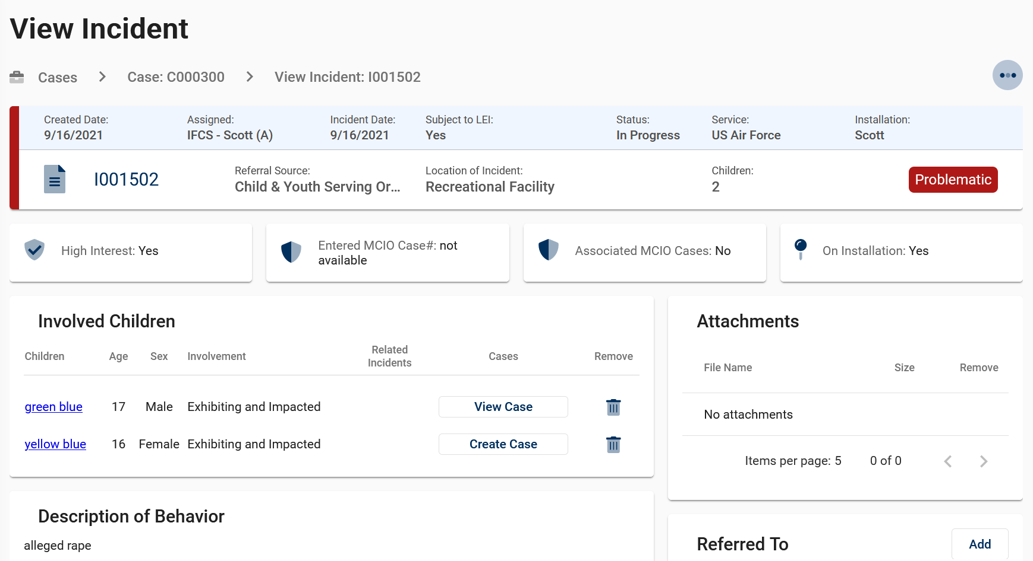
View Case – Information Tab
Clicking on the Related Incident ID number (live link) opens that Incident.

Slide 18
View Case – Information Tab

Slide 19
View Case – Information Tab

Slide 20
View Case – Information Tab

Slide 21
View Case – Information Tab

Slide 22
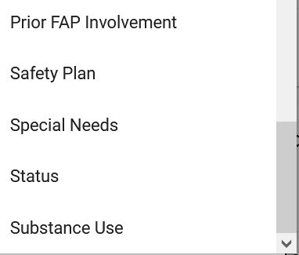
View Case – Information Tab

Slide 23
View Case – Information Tab

Slide 24
View Case – Information Tab

Slide 25
View Case – Information Tab

Slide 26
View Case – Information Tab

Slide 27
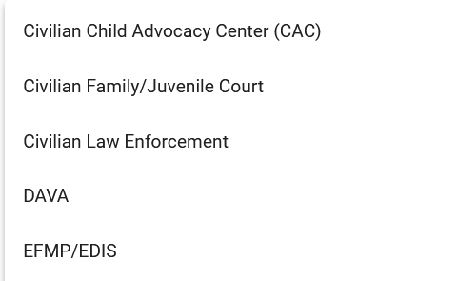
View Case – Information Tab

Slide 28
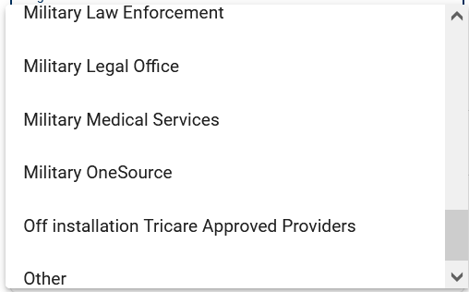
View Case – Information Tab

Slide 29
View Case – Information Tab

Slide 30
View Case – Information Tab

Slide 31
View Case – Information Tab

Slide 32
View Case – MDT (Multi-Disciplinary Team)Tab

Slide 33
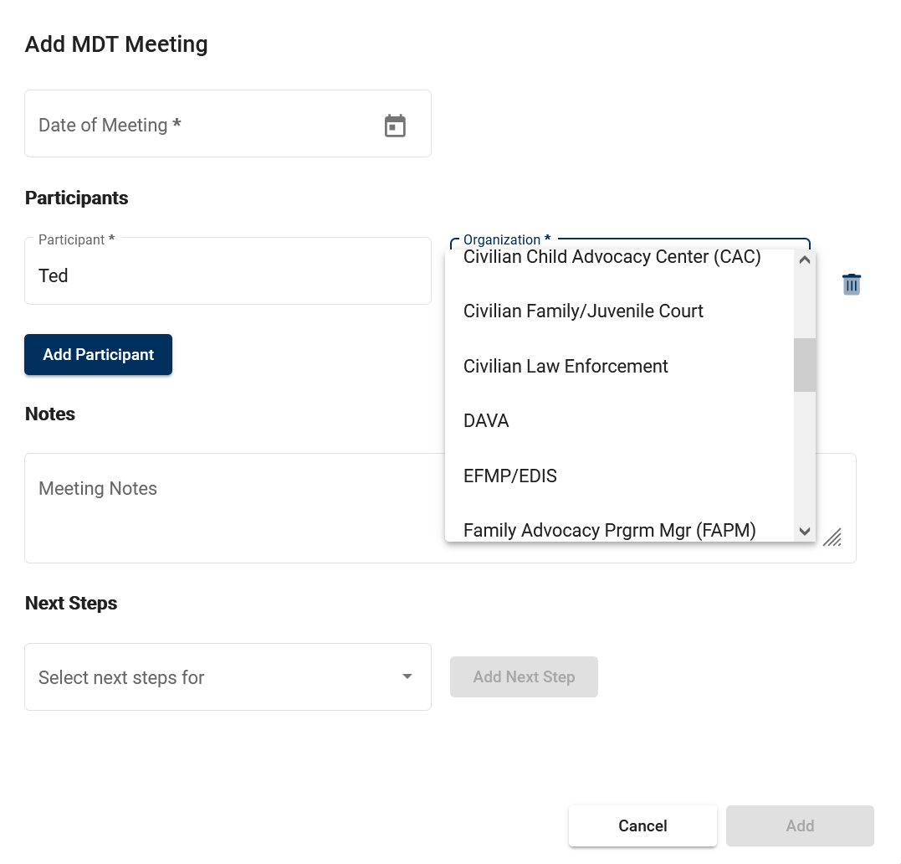
View Case – MDT (Multi-Disciplinary Team)Tab

Slide 34
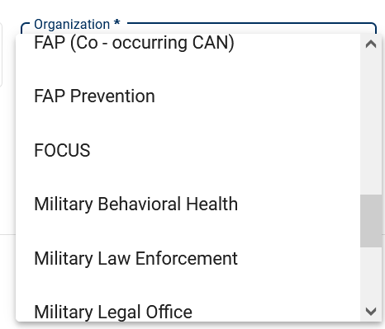
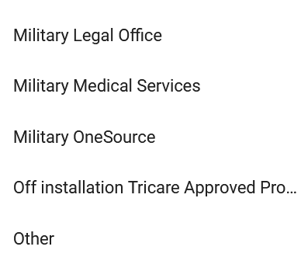
View Case – MDT (Multi-Disciplinary Team)Tab

Slide 35
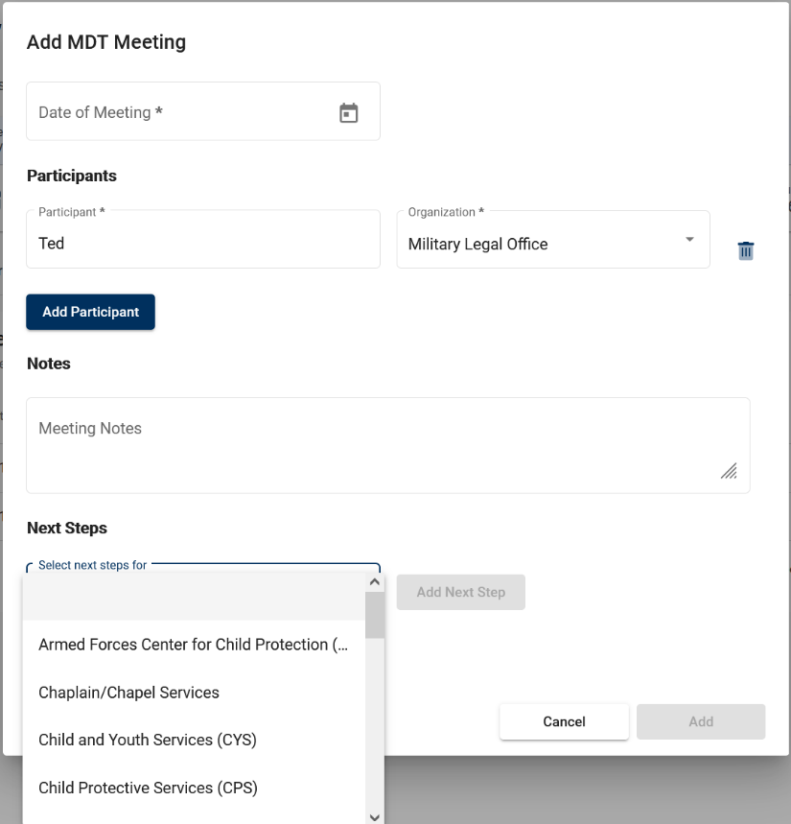
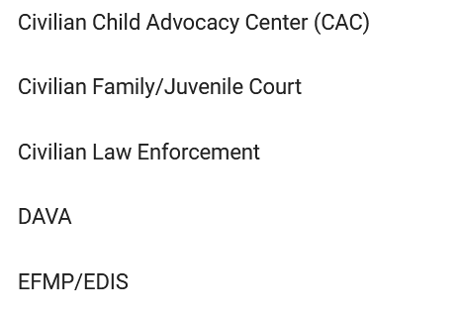
View Case – MDT (Multi-Disciplinary Team)Tab

Slide 36
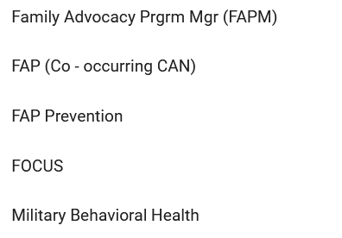
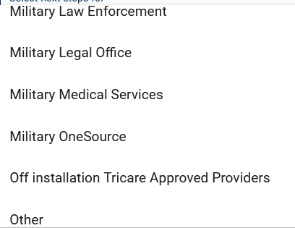
View Case – MDT (Multi-Disciplinary Team)Tab

Slide 37
View Case – MDT (Multi-Disciplinary Team)Tab

Slide 38
View Case – MDT (Multi-Disciplinary Team)Tab

Slide 39
View Case – Review Tab

Slide 40
View Case – Review Tab

Slide 41
View Case – Review Tab

Slide 42
View Case – Review Tab

Slide 43
View Case – Transfer Tab

Slide 44
View Case – Transfer Tab

Slide 45
View Case – Transfer Tab

Slide 46
View Case – Transfer Tab

Slide 47
View Case – Transfer Tab

Slide 48
View Case – Timeline Tab

