Slide 1
Federal COVID Response - Audience Feedback to Inform Ongoing Messaging and Strategies for “Combat COVID” #0925-0769
Supplementary Documents: Consumer Message Recall Stimuli

Slide 2
Consumer –Video Ad Stimulus

Slide 3
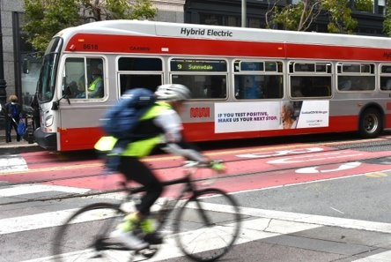
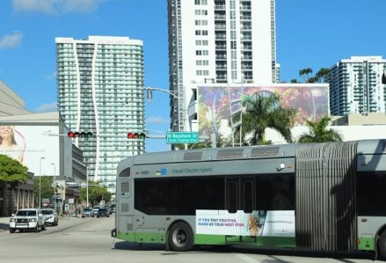
Consumer – Bus Ad Stimuli

Slide 4
Consumer – Web Ad Stimulus

Slide 5
Consumer – Streaming Radio Ad Stimulus

