Slide 1
Federal COVID Response - Audience Feedback to Inform Ongoing Messaging and Strategies for “Combat COVID” #0925-0769
Supplementary Documents: Healthcare Provider Message Recall Stimuli

Slide 2

Healthcare Providers – Video Ad Stimulus

Slide 3
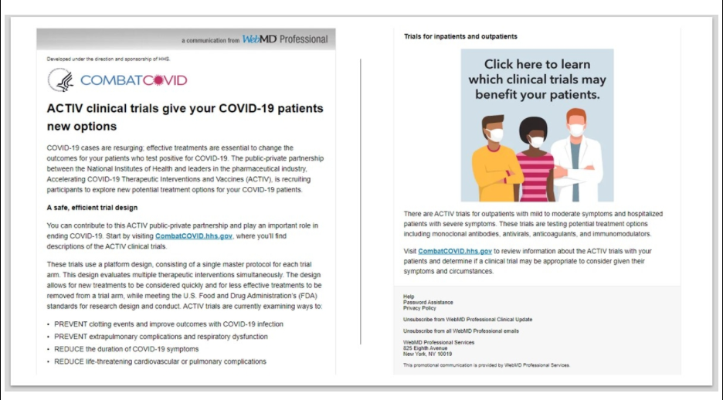
Healthcare Providers – Email Newsletter Stimulus

Slide 4

Healthcare Providers – Web Ad Stimulus

