Slide 1
Capital Project Fund (CPF) States and Territories CPF Application
System Screenshots
September 23, 2021

Slide 2
Overview: CPF Application
As a State or Territory applicant for the CPF program, I will see the following functionality in order to apply for funding based on CPF allocation amounts.

Slide 3
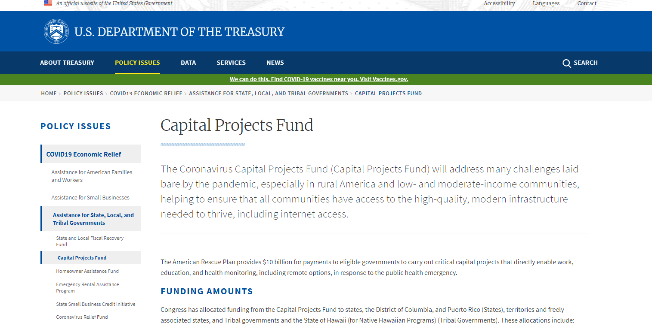
Treasury.gov Page

Slide 4
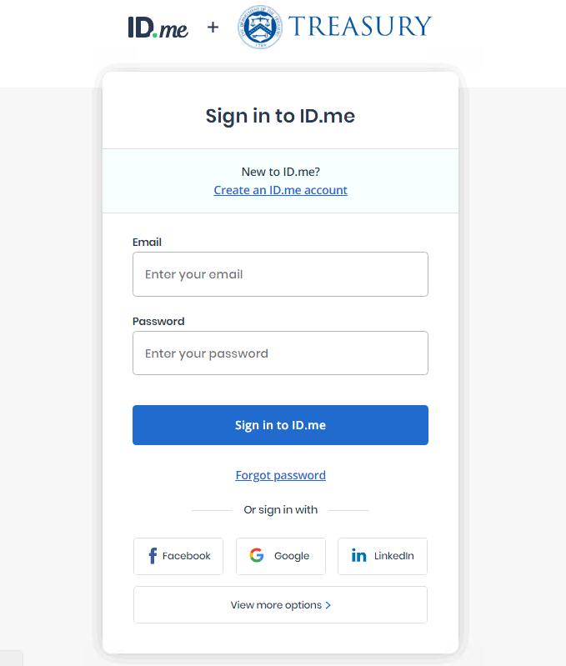
ID.me Login/Registration

Slide 5
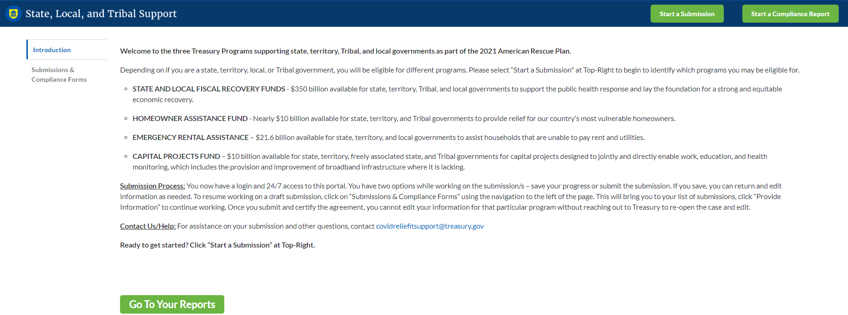
CPF Homepage
The page the applicant sees once logged in

Slide 6
Start Submission

Slide 7
Start Submission

Slide 8
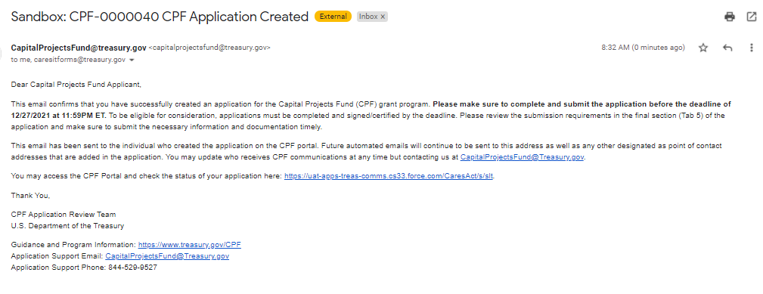
Start Submission Confirmation

Slide 9
Application in List

Slide 10
Application Form - Header

Slide 11
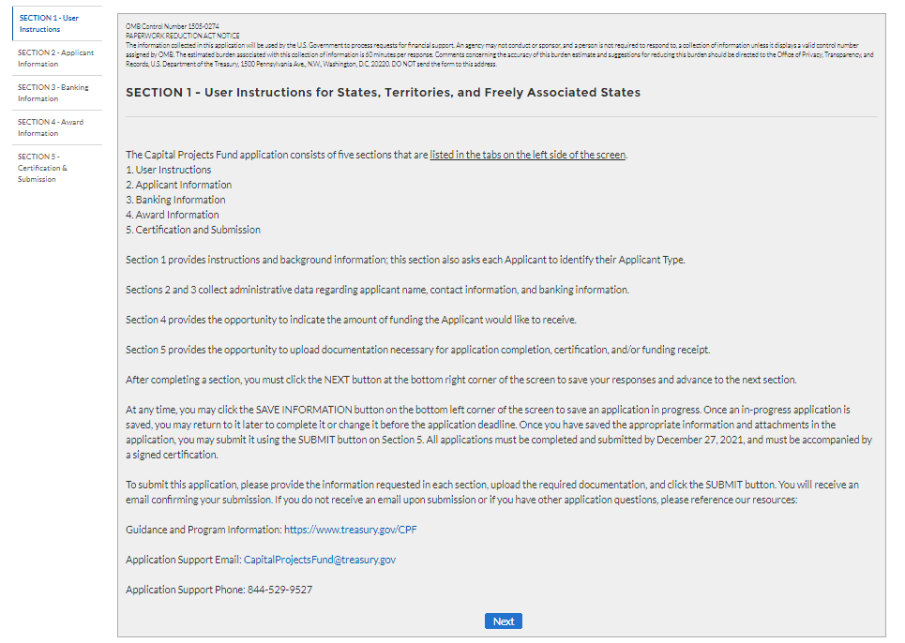
Tab 1

Slide 12
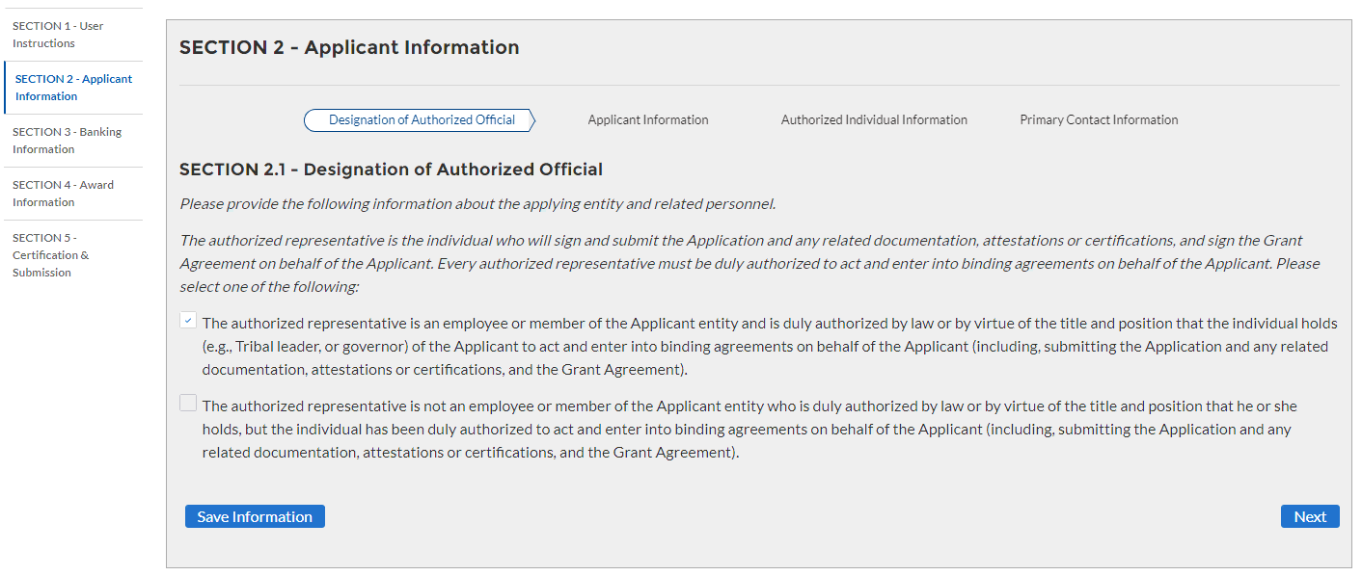
Tab 2.1
If Authorized individual is not delegated

Slide 13
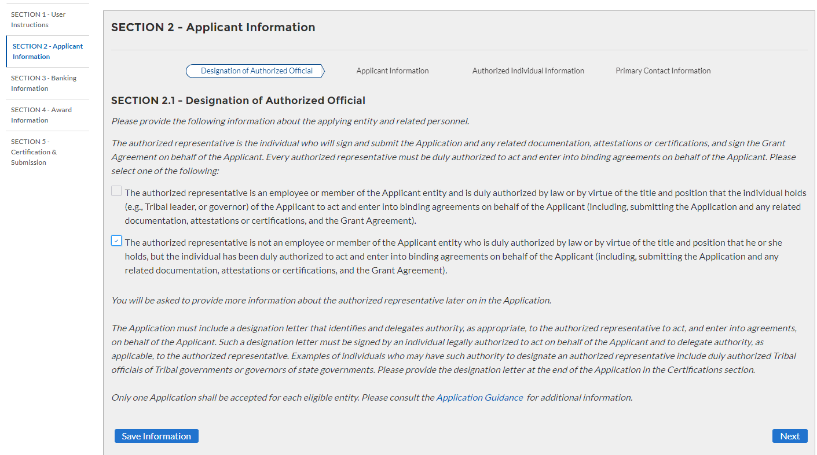
Tab 2.1
If Authorized individual is delegated (additional text visible)

Slide 14
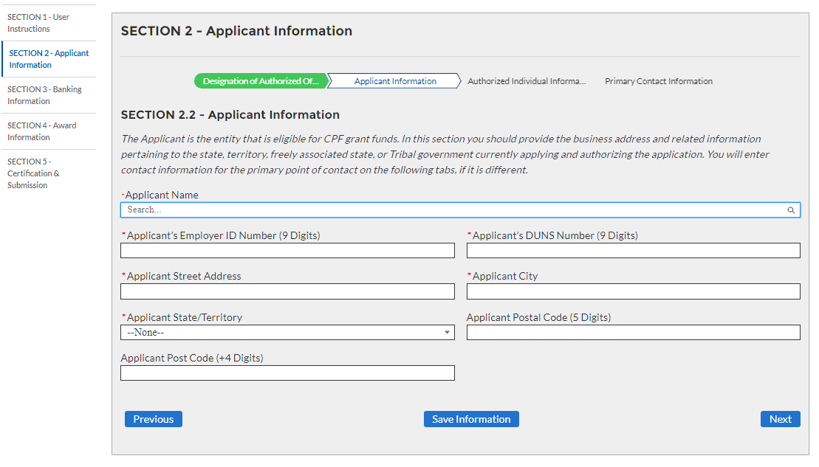
Tab 2.2

Slide 15
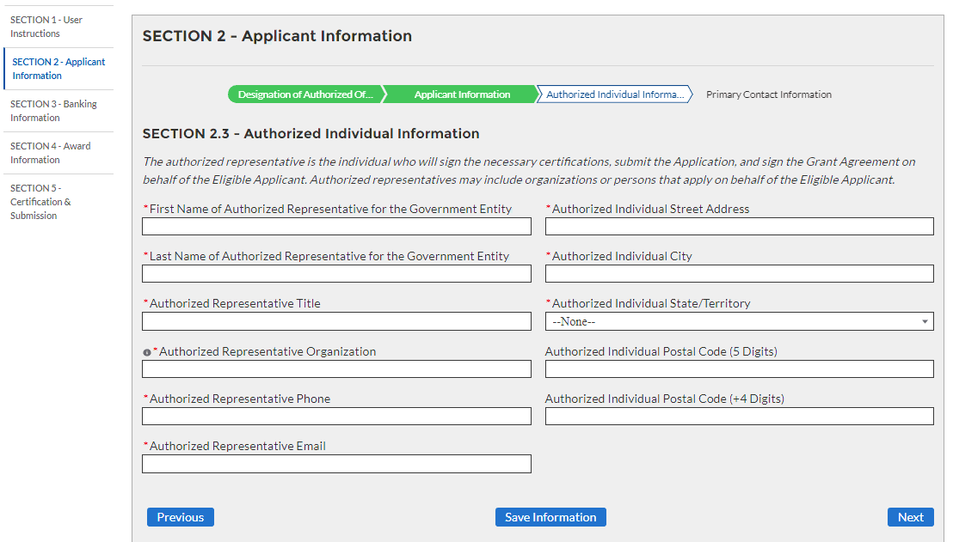
Tab 2.3

Slide 16
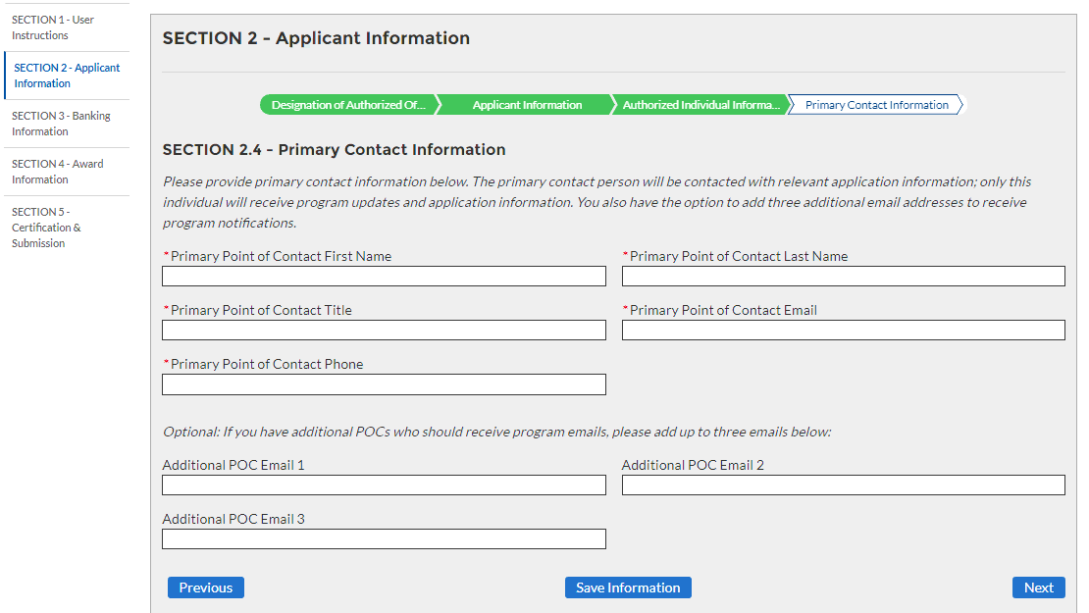
Tab 2.4

Slide 17
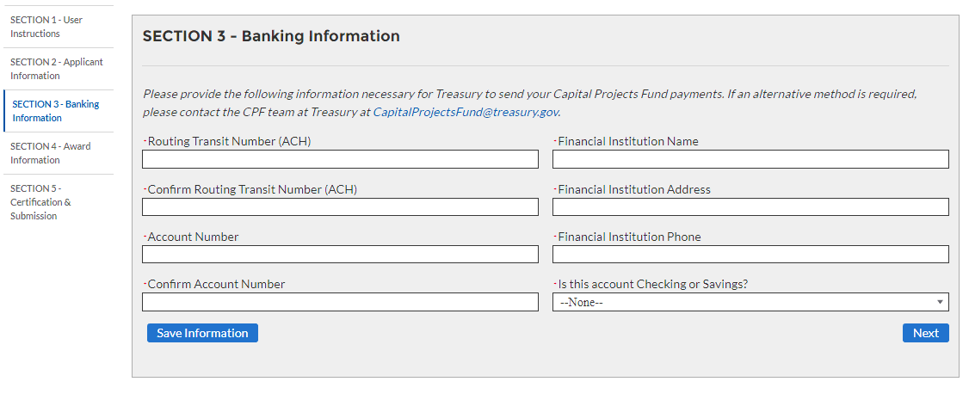
Tab 3

Slide 18
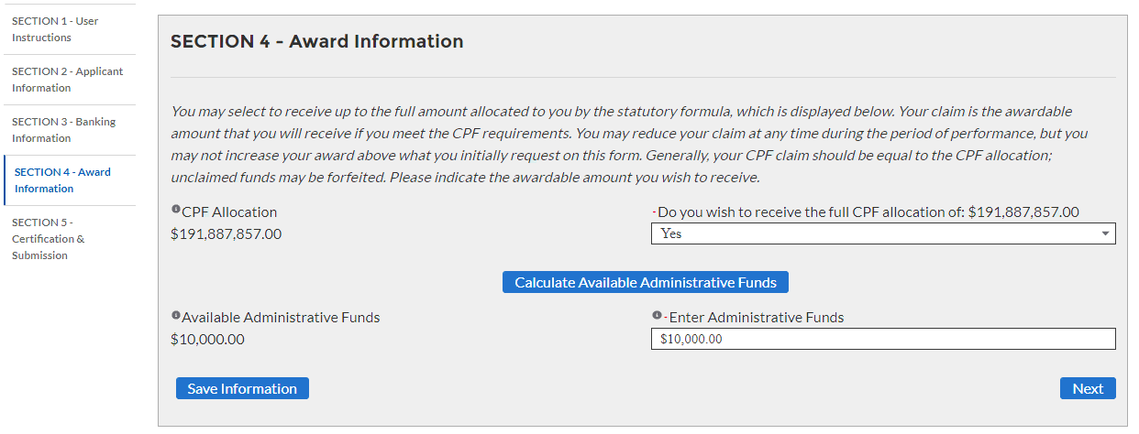
Tab 4
Receive Full Allocation = Yes

Slide 19
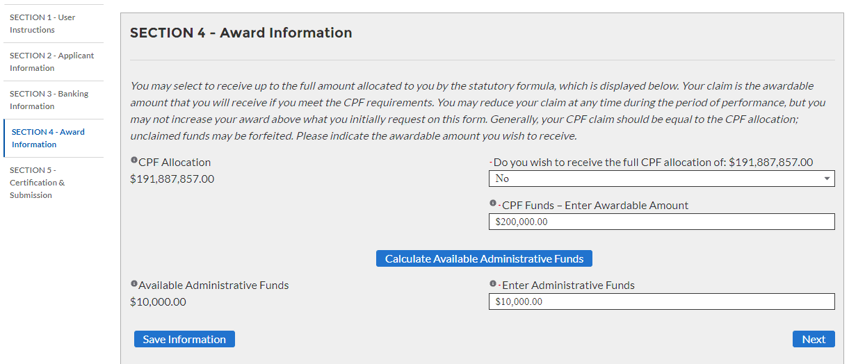
Tab 4
Receive Full Allocation = No

Slide 20
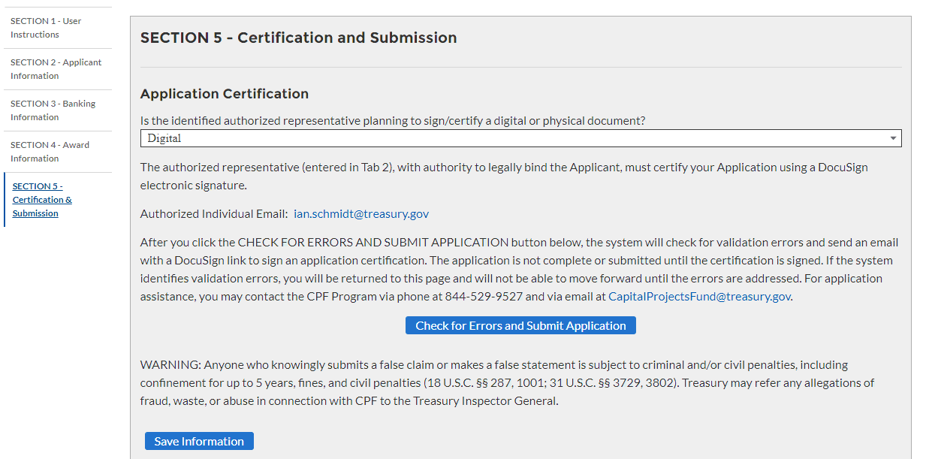
Tab 5
Designation Letter Needed = No
Certification Type = Digital

Slide 21
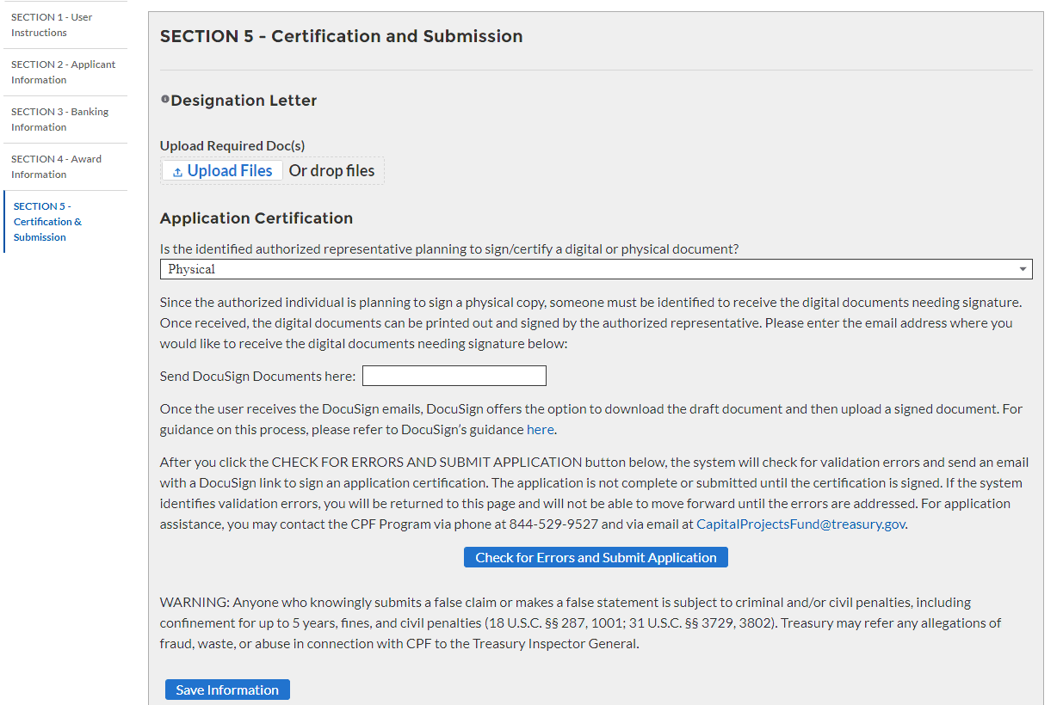
Tab 5
Designation Letter Needed = Yes
Certification Type = Physical

Slide 22
Tab 5

Slide 23
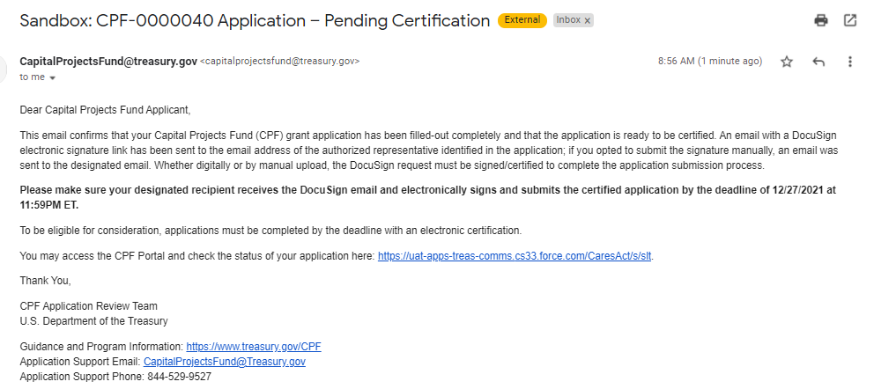
Signature Pending Email for POCs

Slide 24
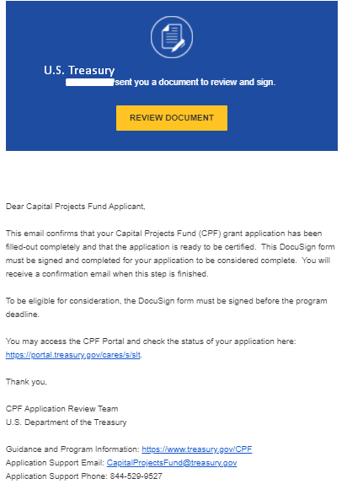
Signature Pending Email for Authorized Individual

Slide 25
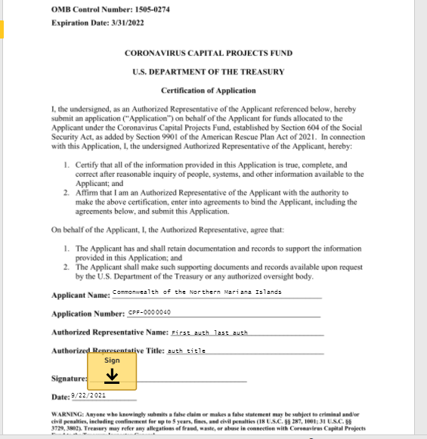
DocuSign Certification for Application

Slide 26
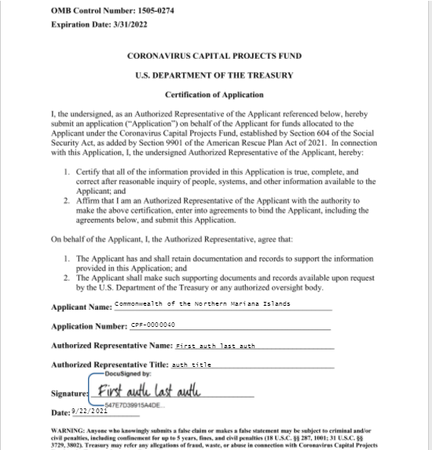
DocuSign Certification for Application

Slide 27
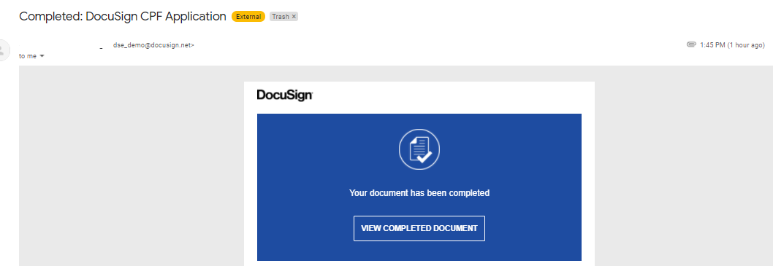
Signature Completed Email for Authorized Individual

Slide 28
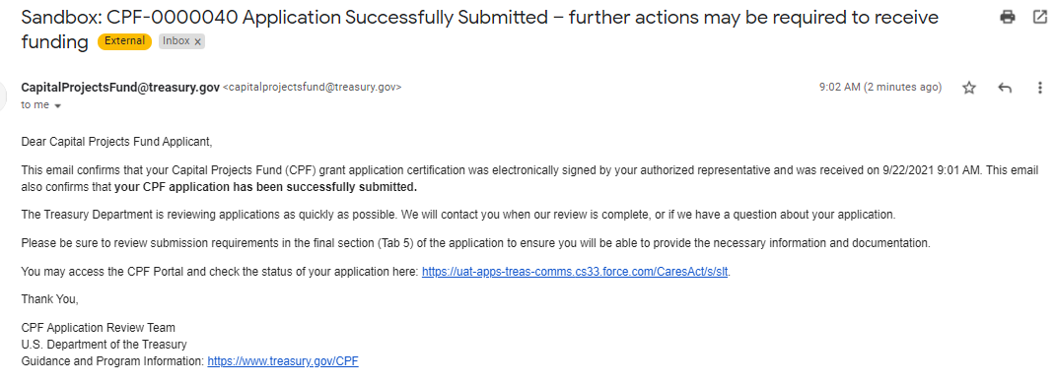
Signature Completed Email for POCs

