Slide 1
Overview

Slide 2
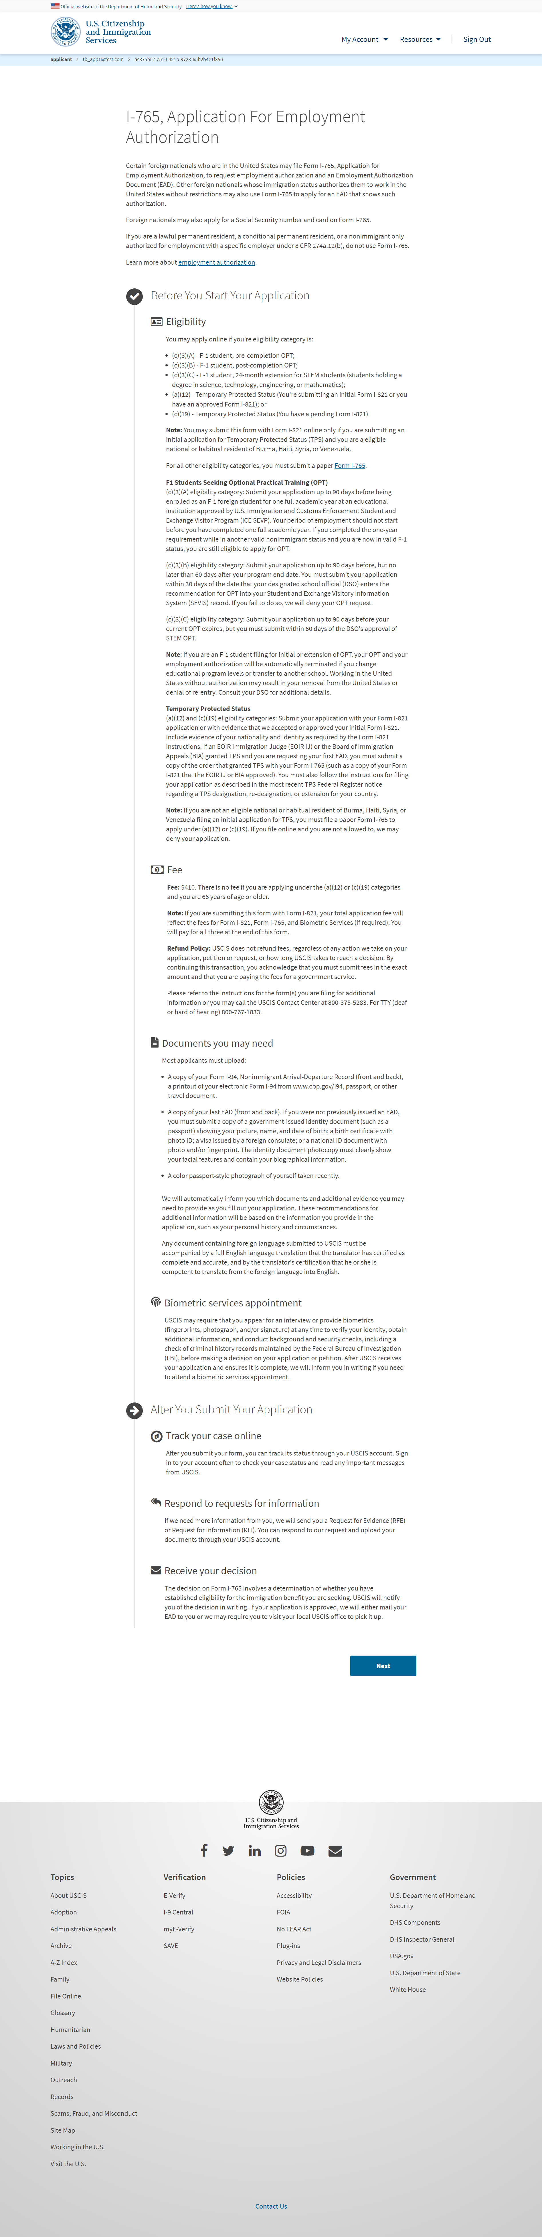
I-765: Application Overview
(You are submitting an initial Form I-821 or you
Note: You may submit Form I-765 online as an (a) (12) or (c) (19) applicant only if you are:
A national of Burma, Haiti, Syria or Venezuela, or a person without who last habitually resided in one of these four countries;
Filing an initial application for TPS; and
Applying for an initial request to accept employment or renewing permission to accept employment
All other applicants must submit a paper Form I-765.
(c)(3)(A) eligibility category: Submit Form I-765 up to 90 days before being enrolled as an F-1 foreign student for one full academic year at an educational institution approved by U.S. Immigration and Customs Enforcement (ICE) and Student and Exchange Visitor Program (SEVP). Your period of employment will not start before you have completed one full academic year. If you completed the one-year requirement while in another valid nonimmigrant status and you are now in valid F-1 status, you are still eligible to apply for OPT.
(c)(3)(B) eligibility category: Submit Form I-765 up to 90 days before, but no later than 60 days after your program end date. You must submit your application within 30 days of the date that your designated school official (DSO) enters the recommendation for OPT into your Student and Exchange Visitor Information System (SEVIS) record. If you fail to do so, we will deny your OPT request.
(c)(3)(C) eligibility category: Submit Form I-765 application up to 90 days before your current OPT expires, but you must submit within 60 days of the DSO's approval of STEM OPT.
Note: If you are an F-1 student filing for initial or extension of OPT, your OPT and your employment authorization will be automatically terminated if you change educational program levels or transfer to another school. Working in the United States without authorization may result in your removal from the United States or denial of re-entry. Consult your DSO for additional details.
Temporary Protected Status
(a)(12) and (c)(19) eligibility categories: Submit your application with your Form I-821 application or with evidence that we accepted or approved your initial Form I-821. Include evidence of your nationality and identity as required by the Form I-821 Instructions. If an EOIR Immigration Judge (EOIR IJ) or the Board of Immigration Appeals (BIA) granted TPS and you are requesting your first EAD, you must submit a copy of the order that granted TPS with your Form I-765 (such as a copy of your Form I-821 that the EOIR IJ or BIA approved). You must also follow the instructions for filing your application as described in the most recent TPS Federal Register notice regarding a TPS designation, re-designation, or extension for your country.
Note: You may submit this form with Form I-821 online if you are applying under the (a)(12) eligibility category and applying for an initial request to accept employment.
Fee: $410. If you are requesting an EAD as an initial TPS applicant, you must pay the Form I-765 filing fee, unless you are younger than 14 or older than 65.
Note: If you are submitting this form with Form I-821, your total application fee will reflect the fees for Form I-821, Form I-765, and Biometric Services (if required). You will pay for all three at the end of this form.
Refund policy:
USCIS does not refund fees, regardless of any action we take on your application, petition or request, or how long USCIS takes to reach a decision. By continuing this transaction, you acknowledge that you must submit fees in the exact amount and that you are paying the fees for a government service.
Please refer to the instructions for the form(s) you are filing for additional information, or you may call the USCIS Contact Center at 800-375-5283. For TTY (deaf or hard of hearing) 800-767-1833.
USCIS may require that you appear for an interview or provide biometrics (fingerprints, photograph, and/or signature) at any time to verify your identity, obtain additional information, and conduct background and security checks, including a check of criminal history records maintained by the Federal Bureau of Investigation (FBI), before making a decision on your application or petition. After USCIS receives your application and ensures it is complete, we will inform you in writing if you need to attend a biometric services appointment. If an
appointment is necessary, the notice will provide you the location of your local or designated USCIS Application Support Center (ASC) and the date and time of your appointment.
The decision on Form I-765 involves a determination of whether you have established eligibility for the immigration benefit you are seeking. USCIS will notify you of the decision in writing. If your application is approved, we will either mail your EAD to you or we may require you to visit your local USCIS office to pick it up. If USCIS cannot approve your application, you will receive a written notice explaining the basis of your denial.

Slide 3
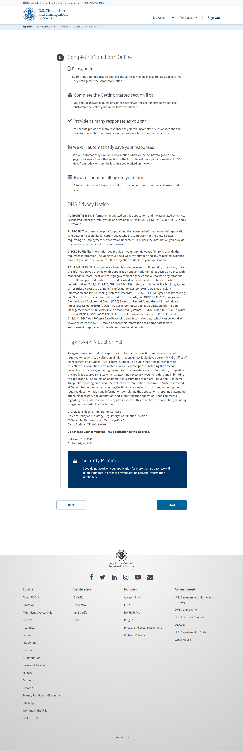
I-765: Start Application
AUTHORITIES: The information requested on this application, and the associated evidence, is collected under the Immigration and Nationality Act, 8 U.S.C. section 1324a, 8 CFR 274a.12, and 8 CFR 274a.13.

Slide 4
Getting Started

Slide 5
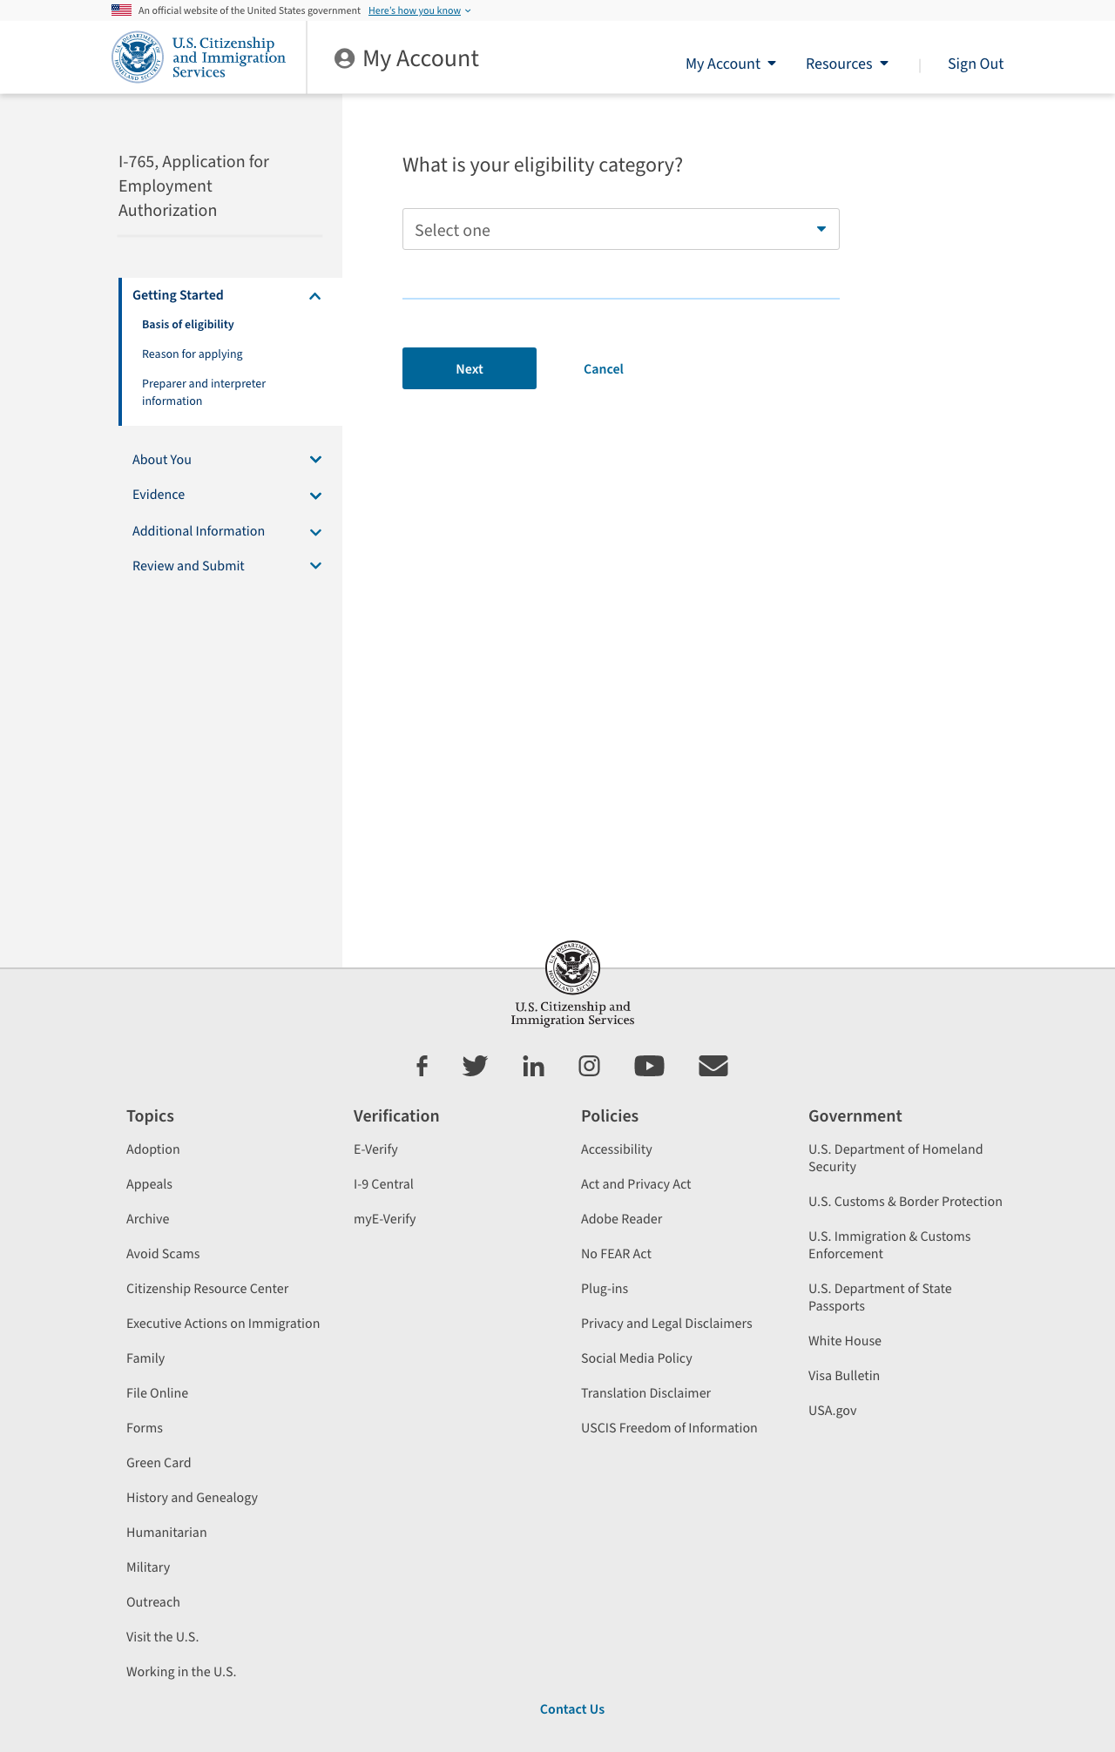

Slide 6
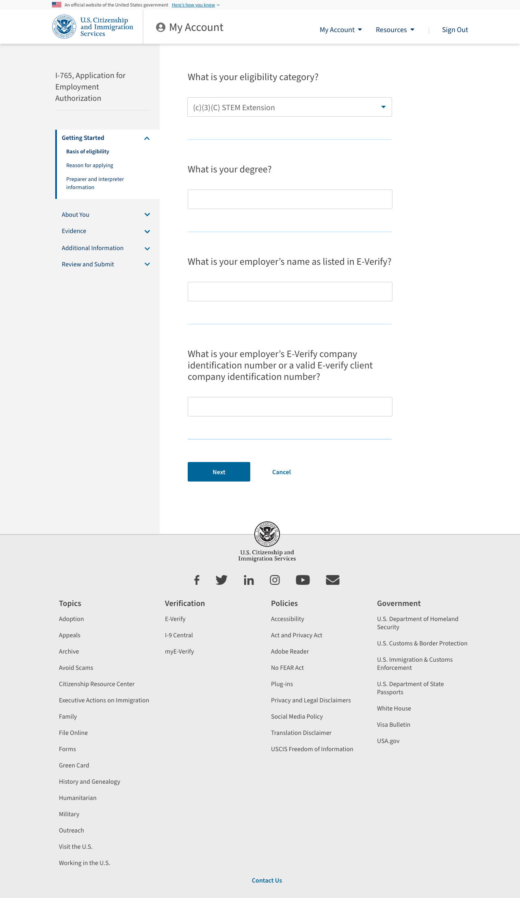
I-765: Getting Started – Reason for applying – If a STEM/OPT eligibility category was selected

Slide 7
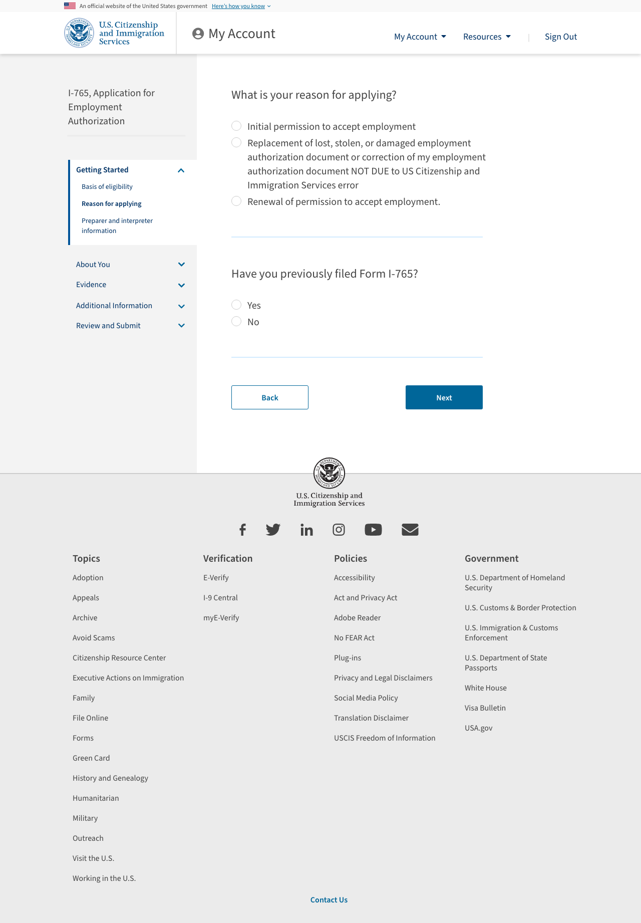
I-765: Getting Started – Reason for applying – If a STEM/OPT eligibility category was selected

Slide 8
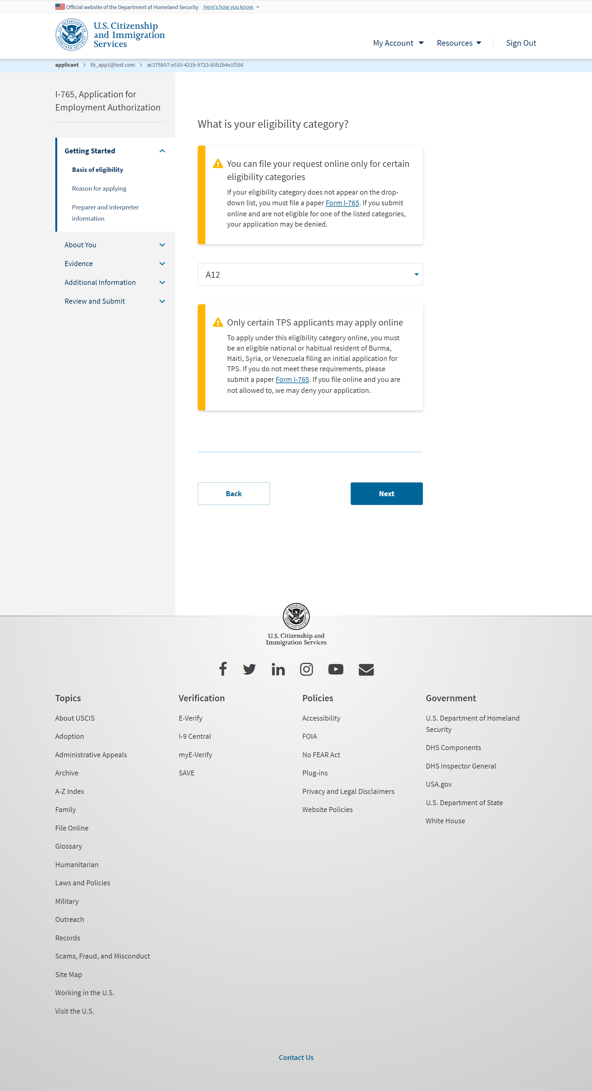
I-765: Getting Started – Basis for Eligibility – If a TPS eligibility category is selected

Slide 9
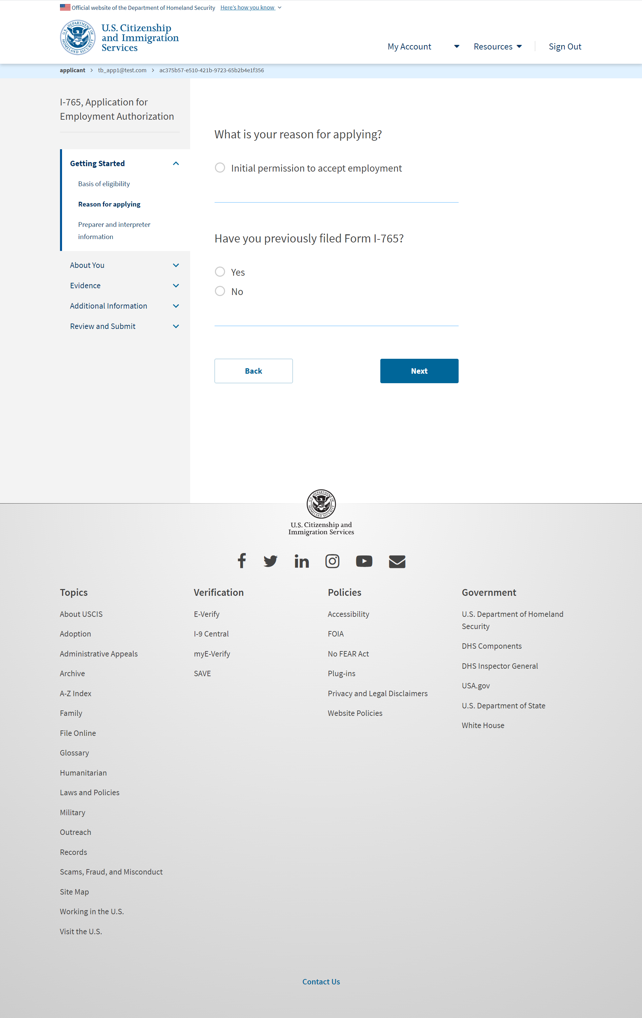
I-765: Getting Started – Reason for applying – If a TPS eligibility category was selected

Slide 10
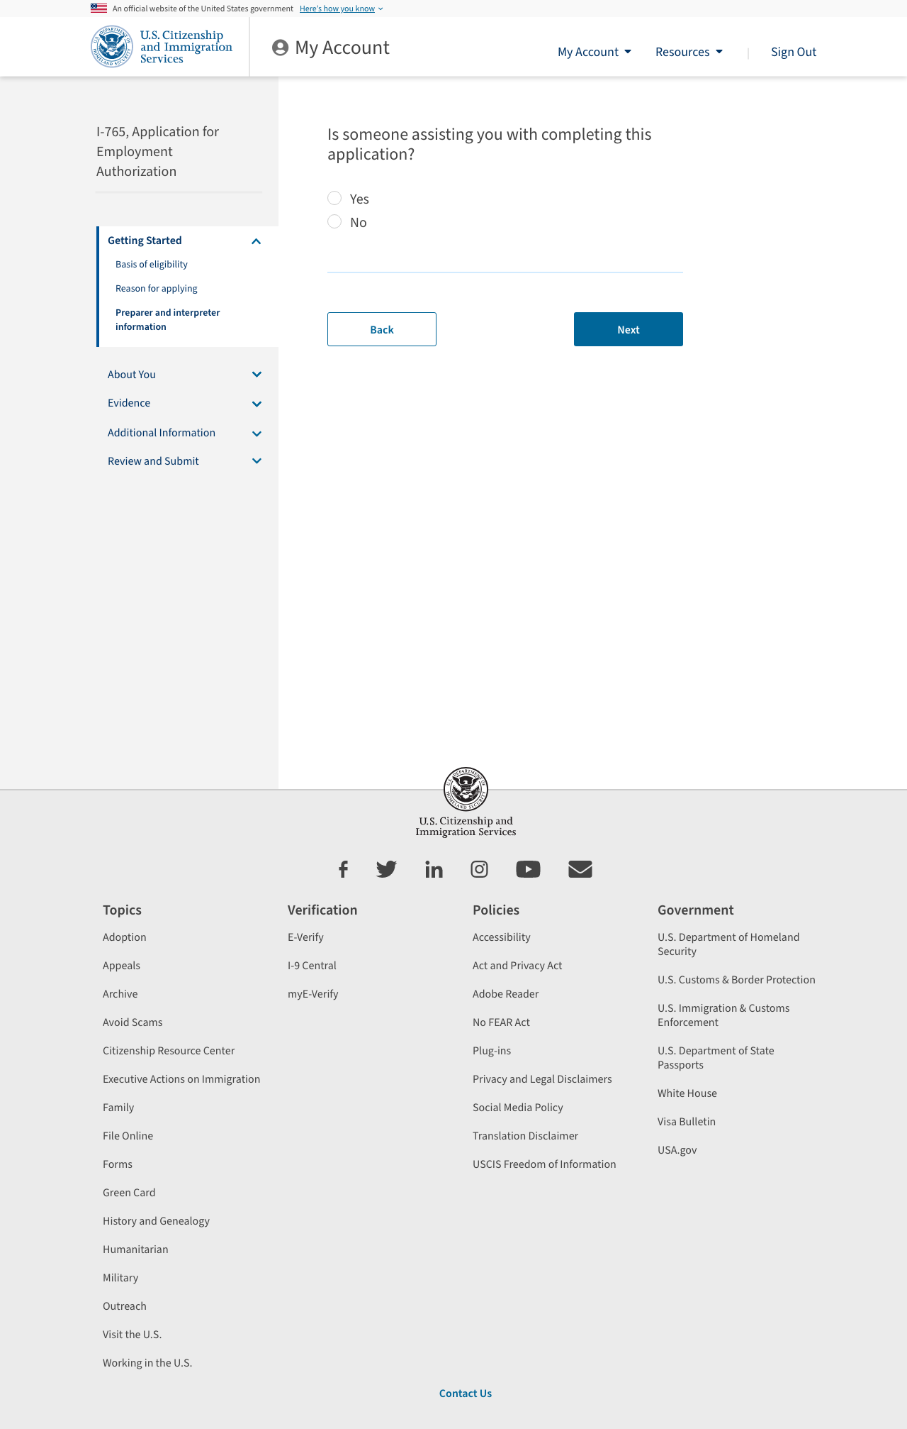

Slide 11
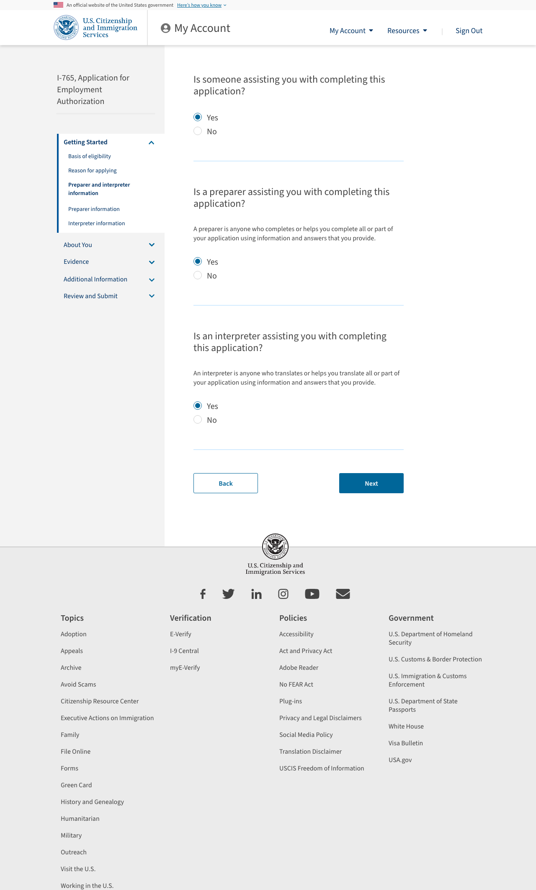

Slide 12
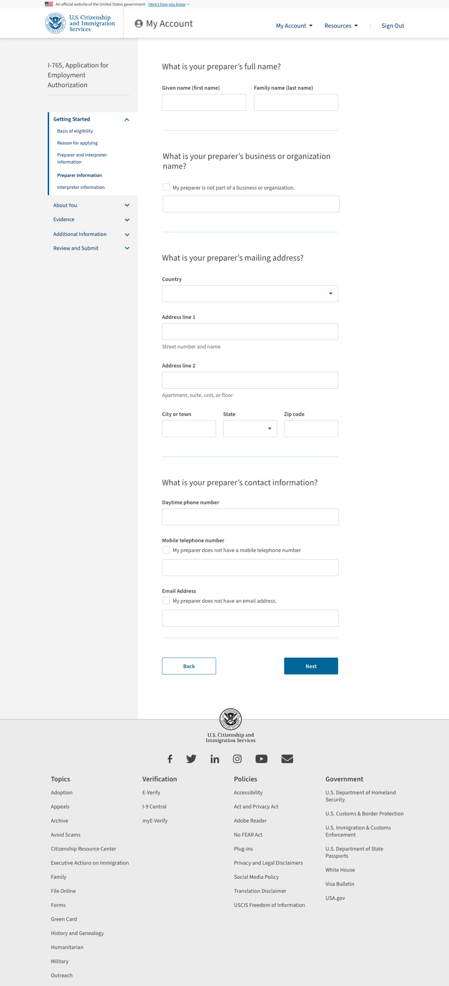

Slide 13
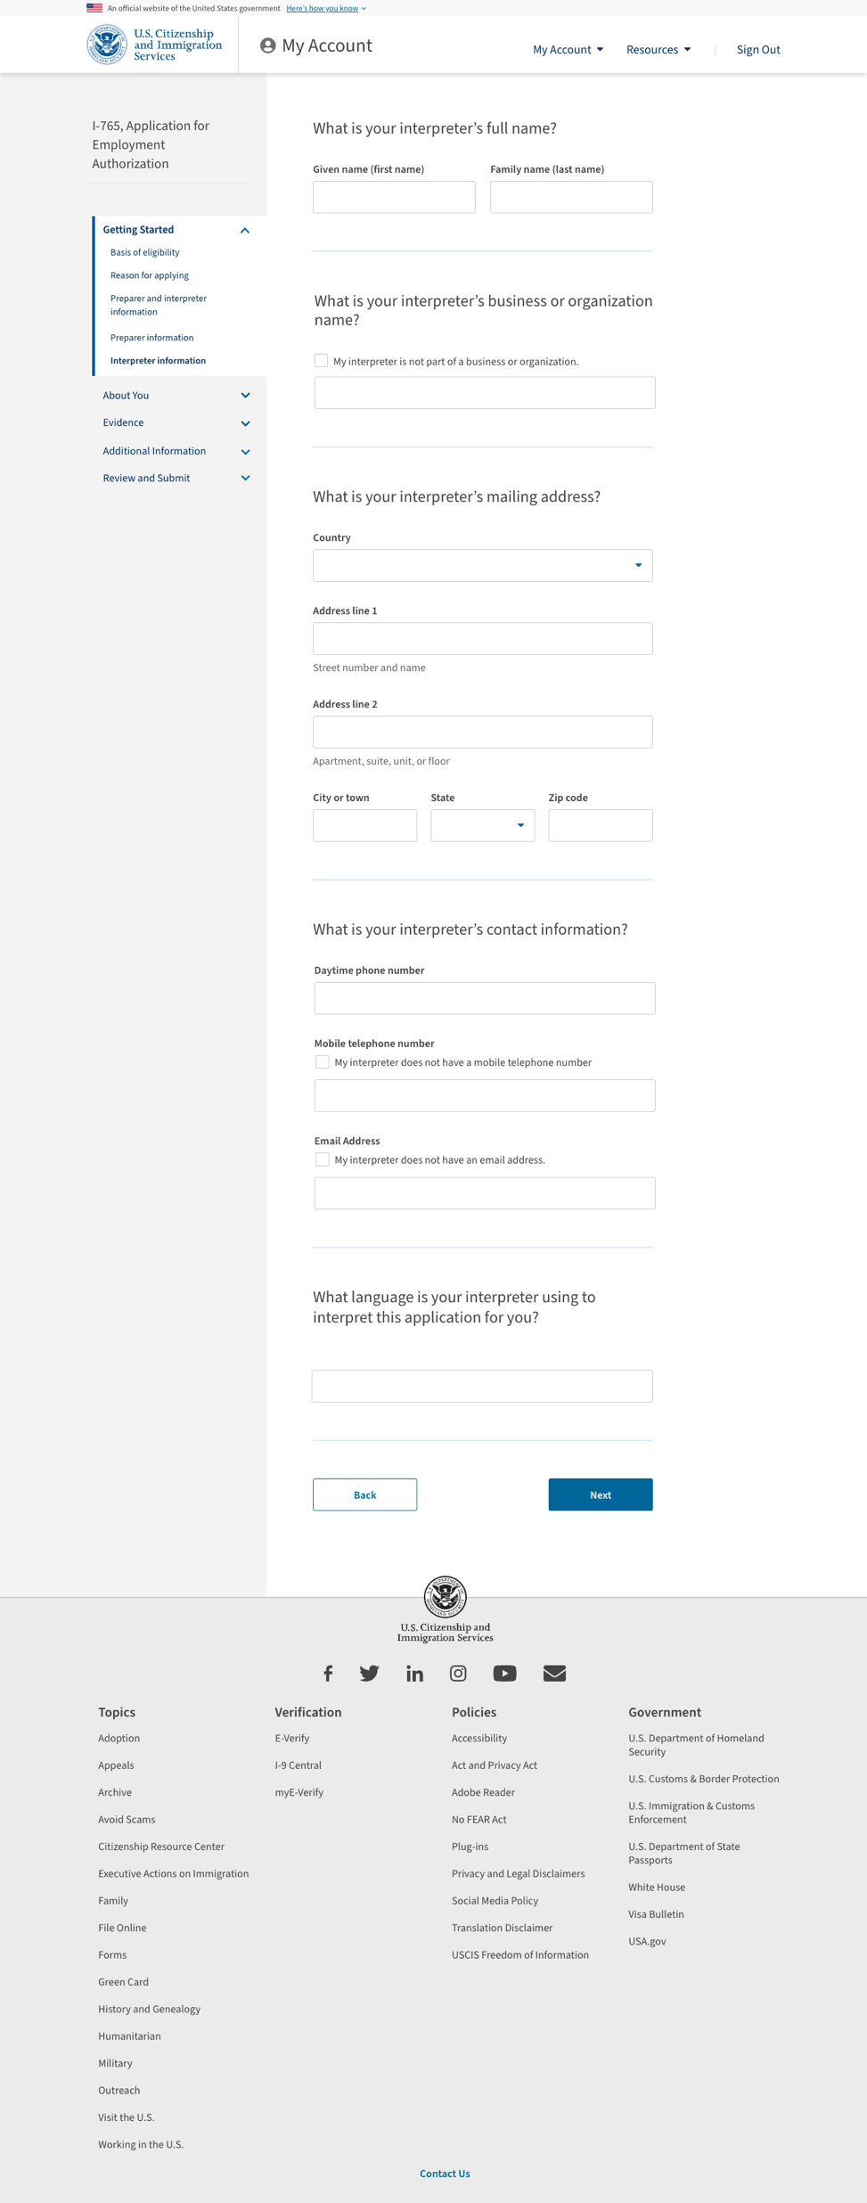

Slide 14
About You

Slide 15
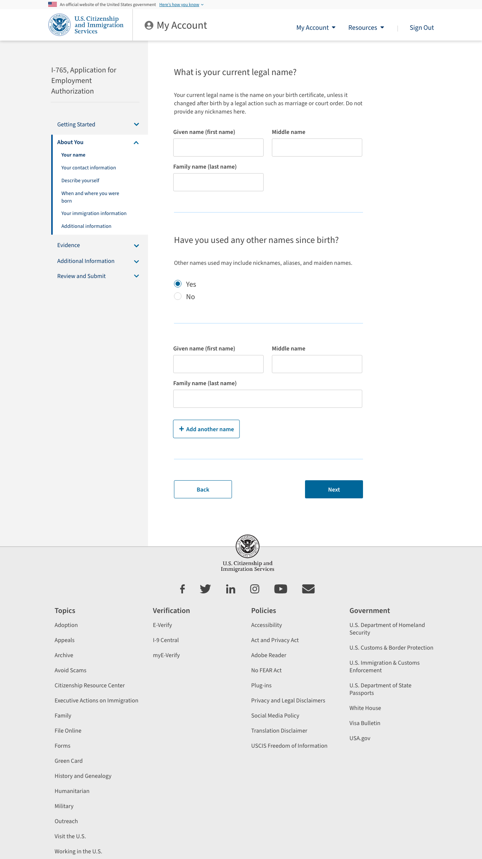

Slide 16
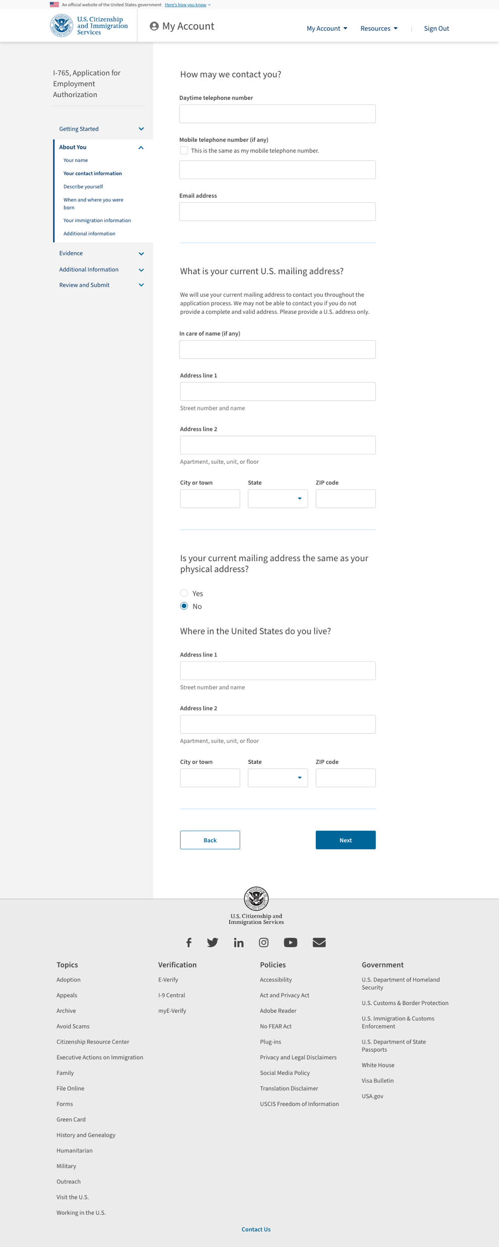

Slide 17
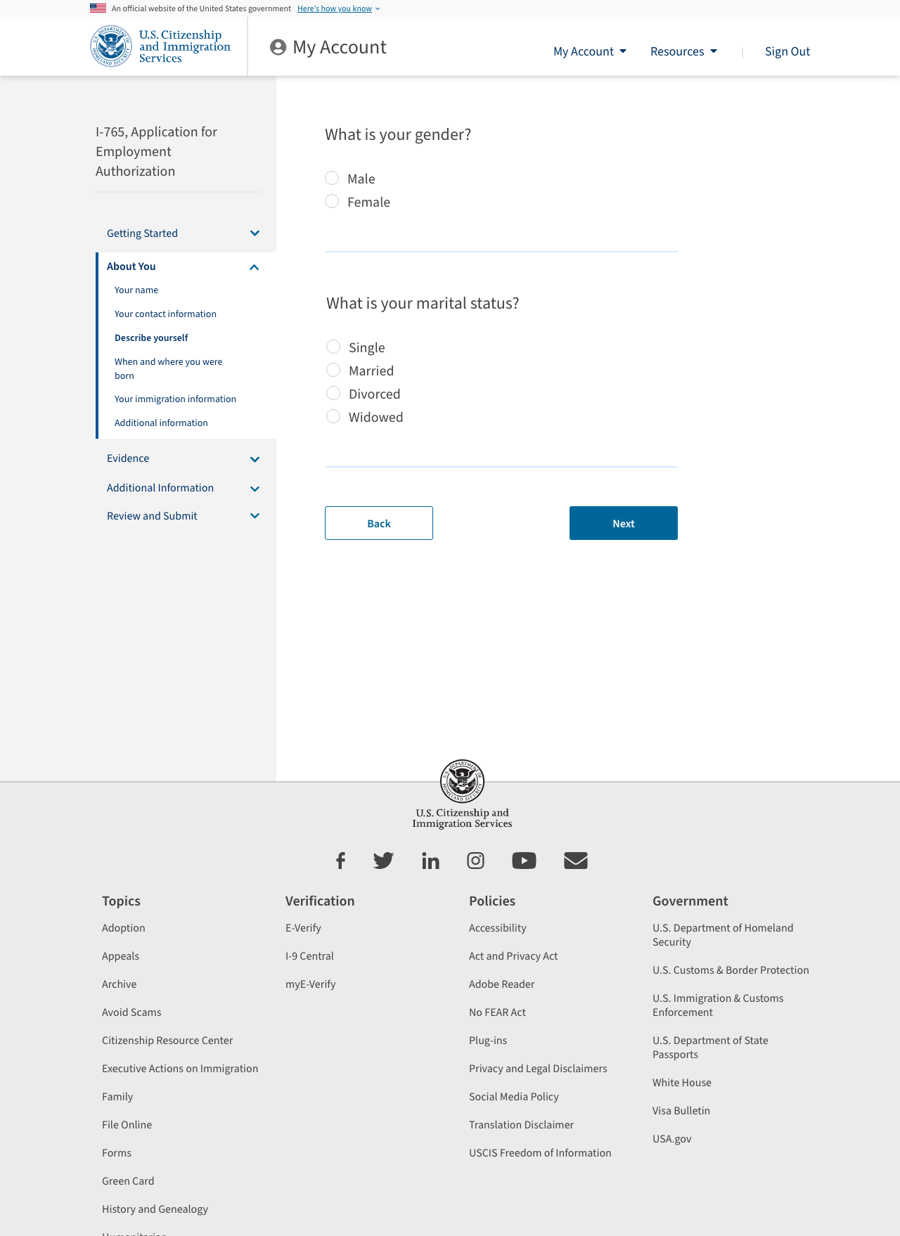

Slide 18
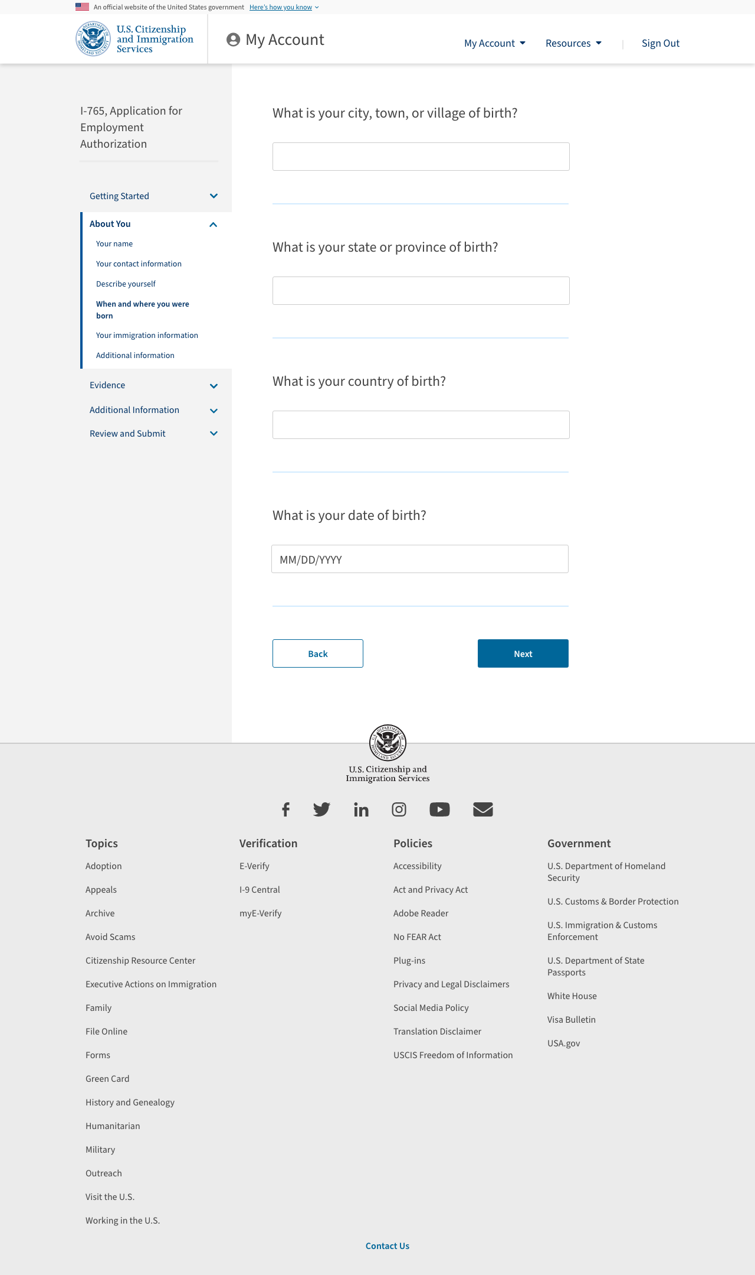

Slide 19
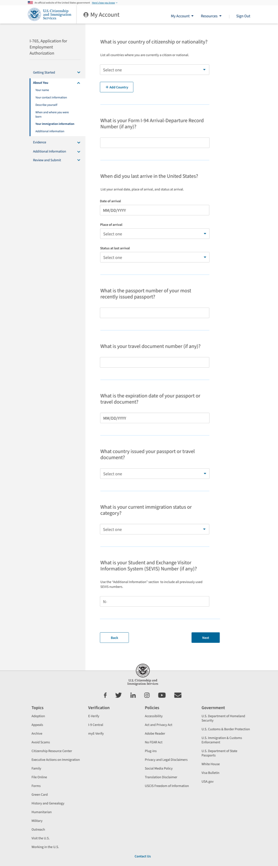

Slide 20
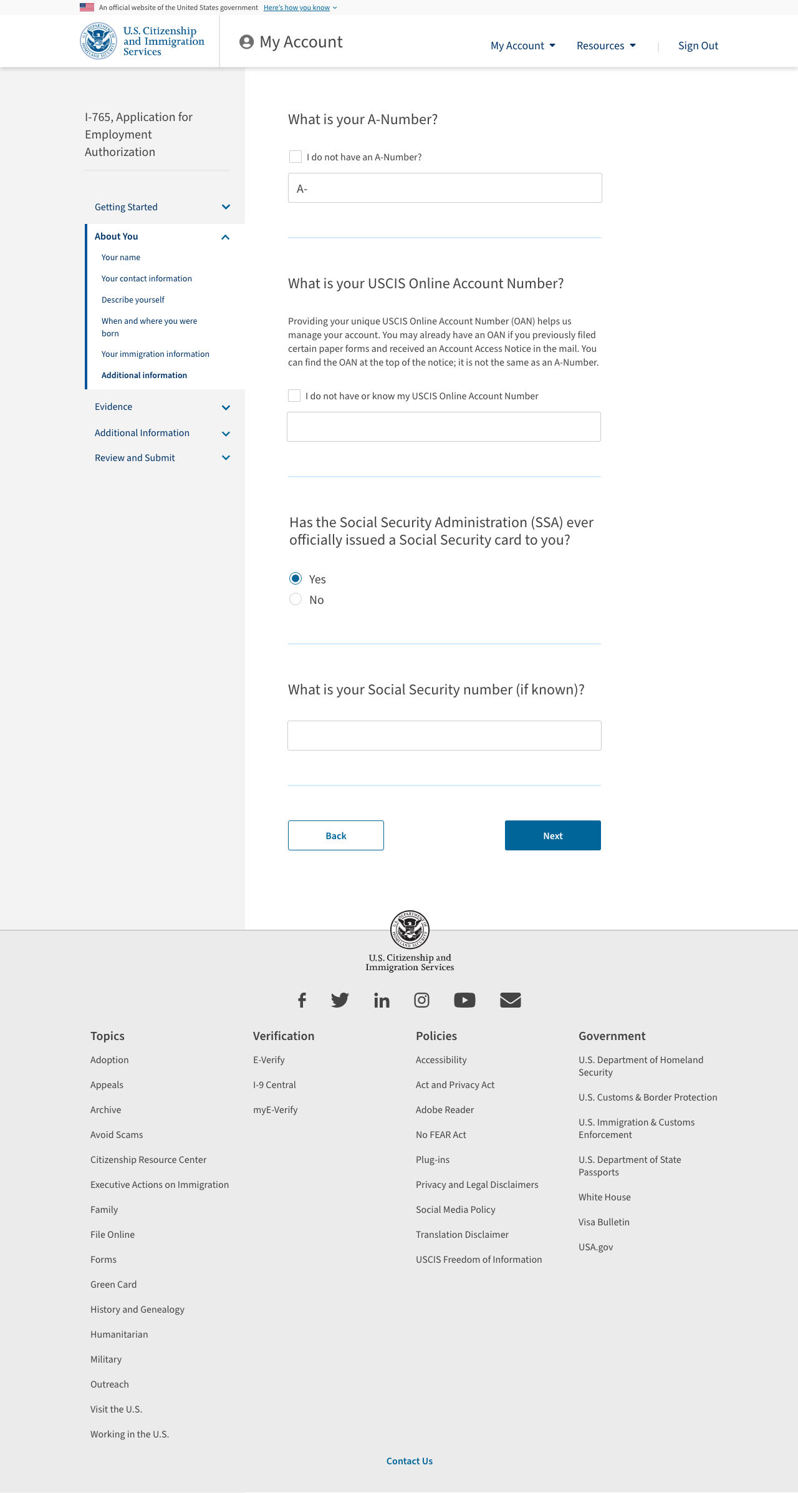


Slide 21
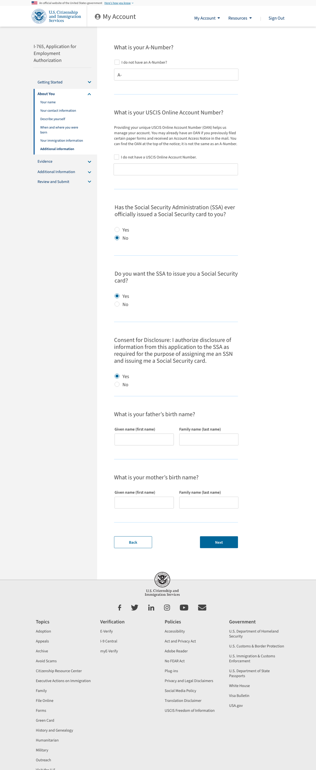

Slide 22
Evidence

Slide 23
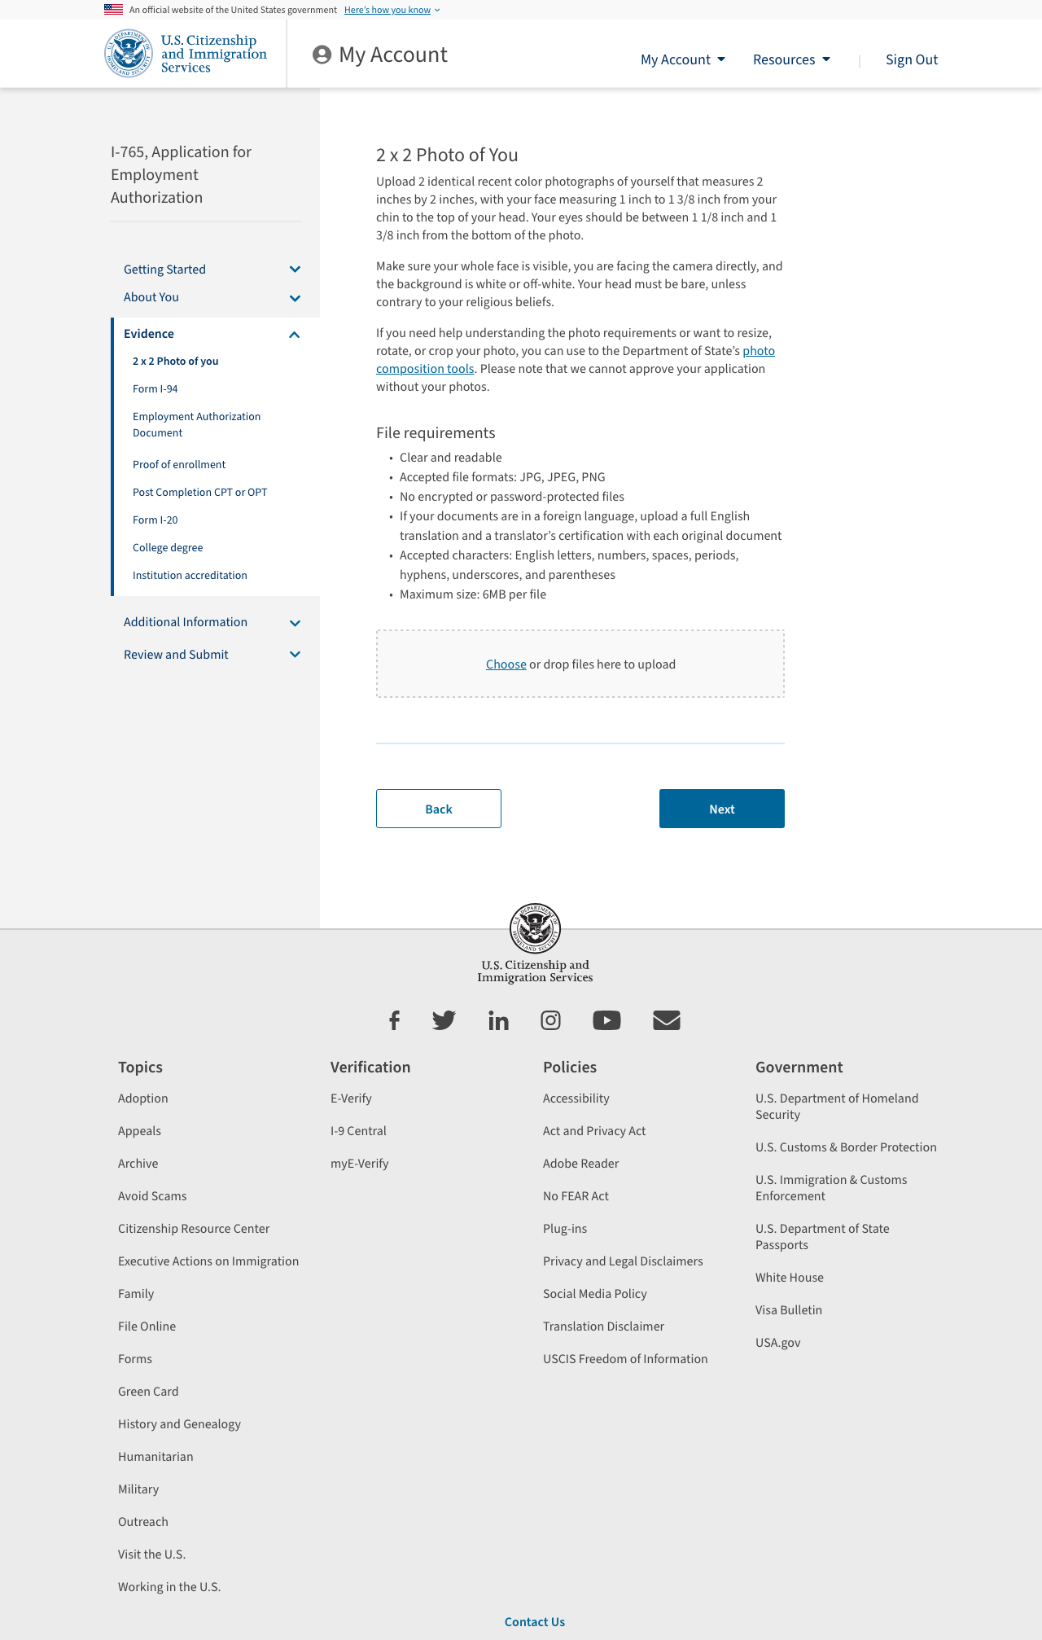

Slide 24
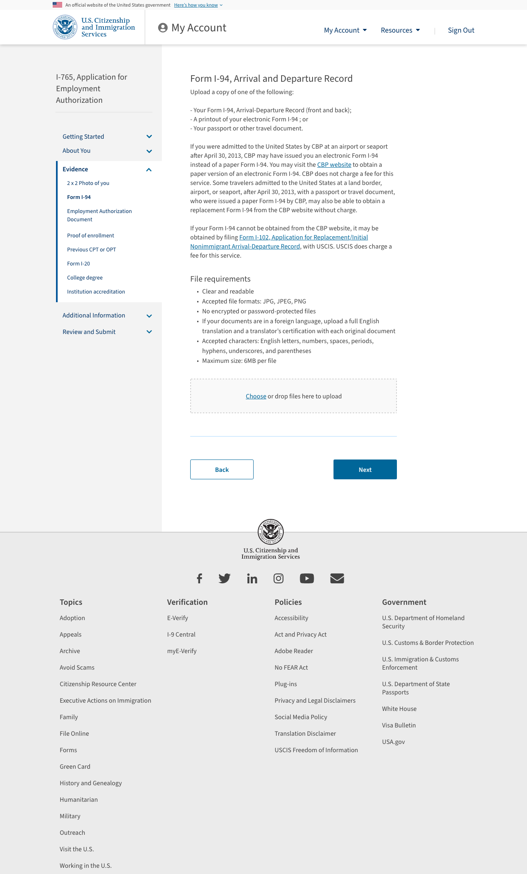

Slide 25
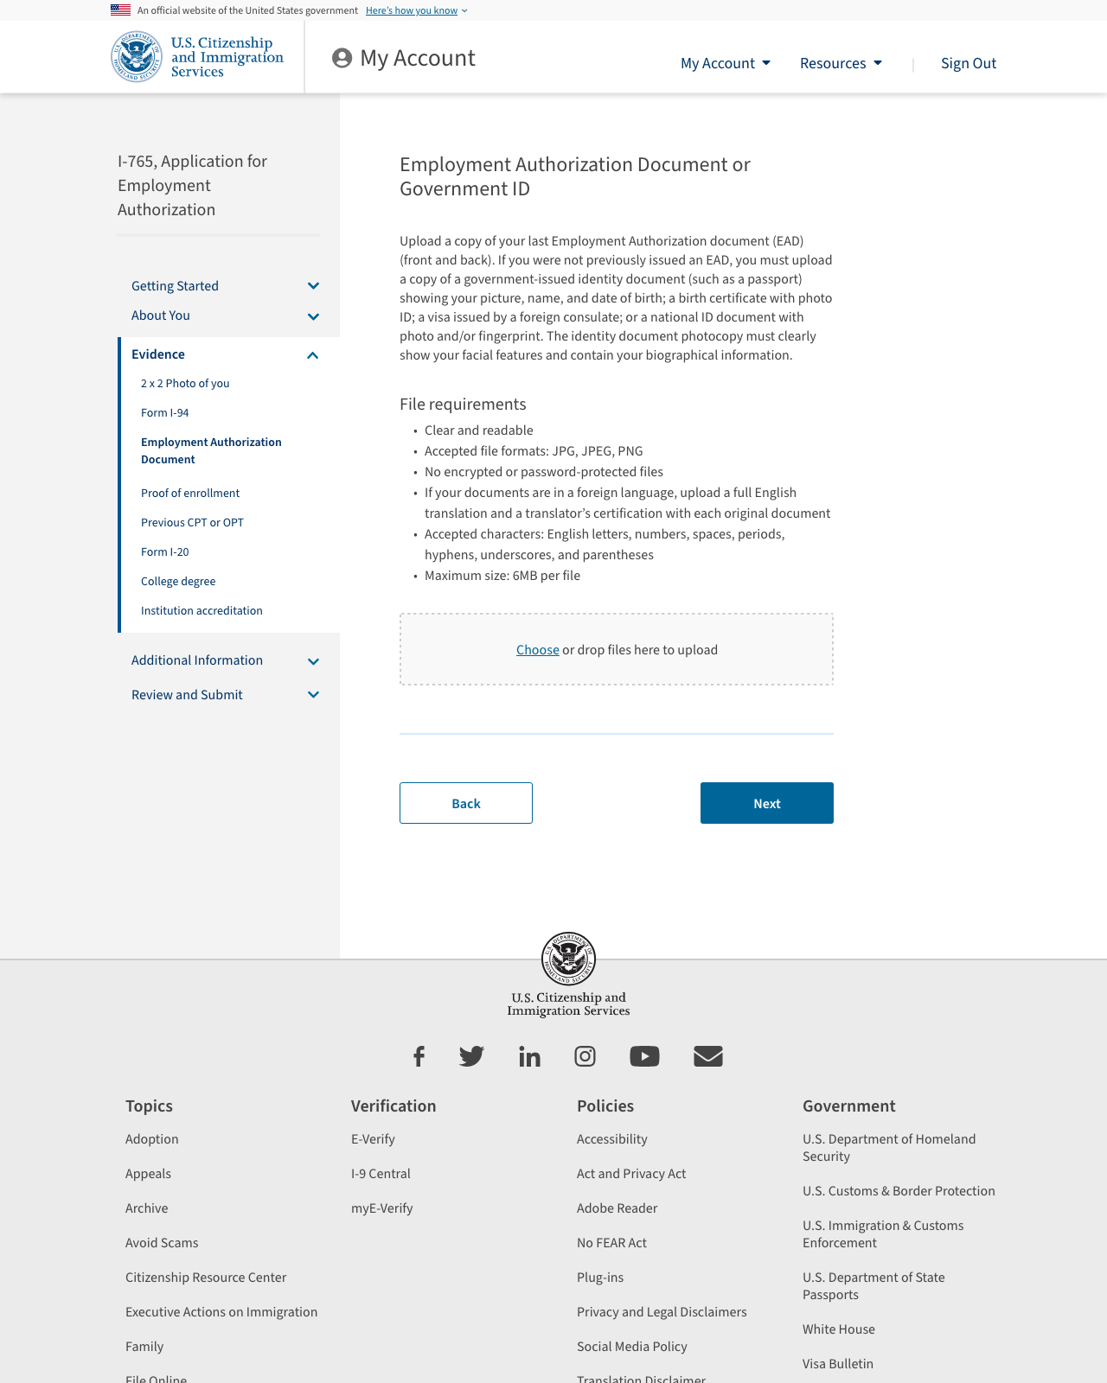

Slide 26
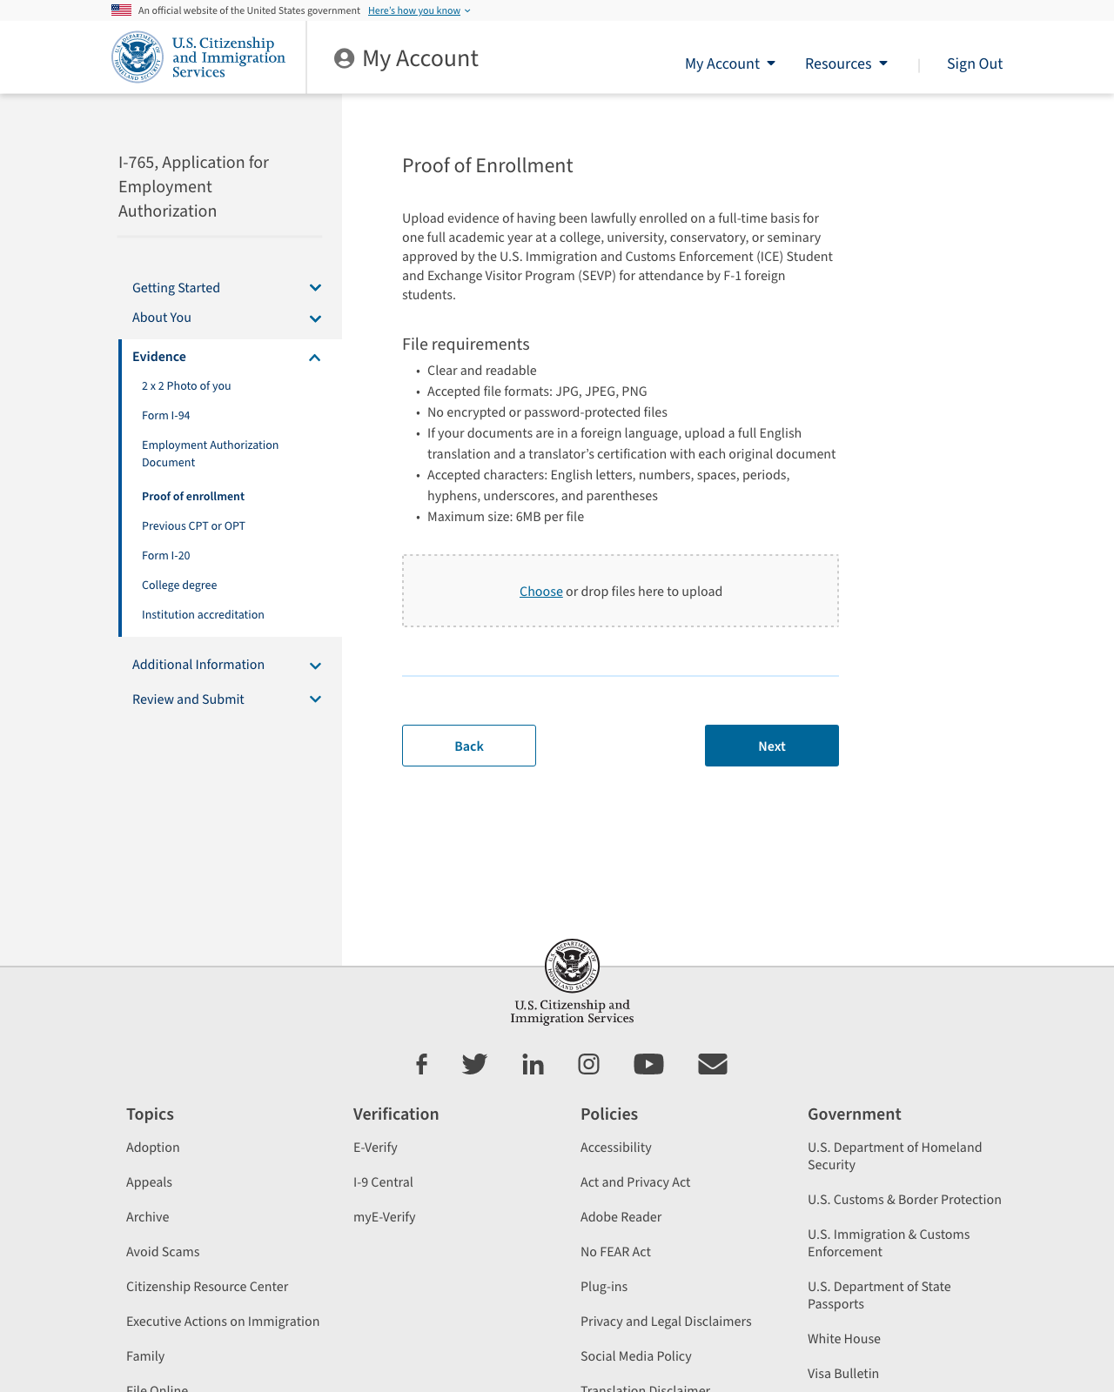
Please note: this evidence is conditional for eligibility category is (c)(3)(A)

Slide 27
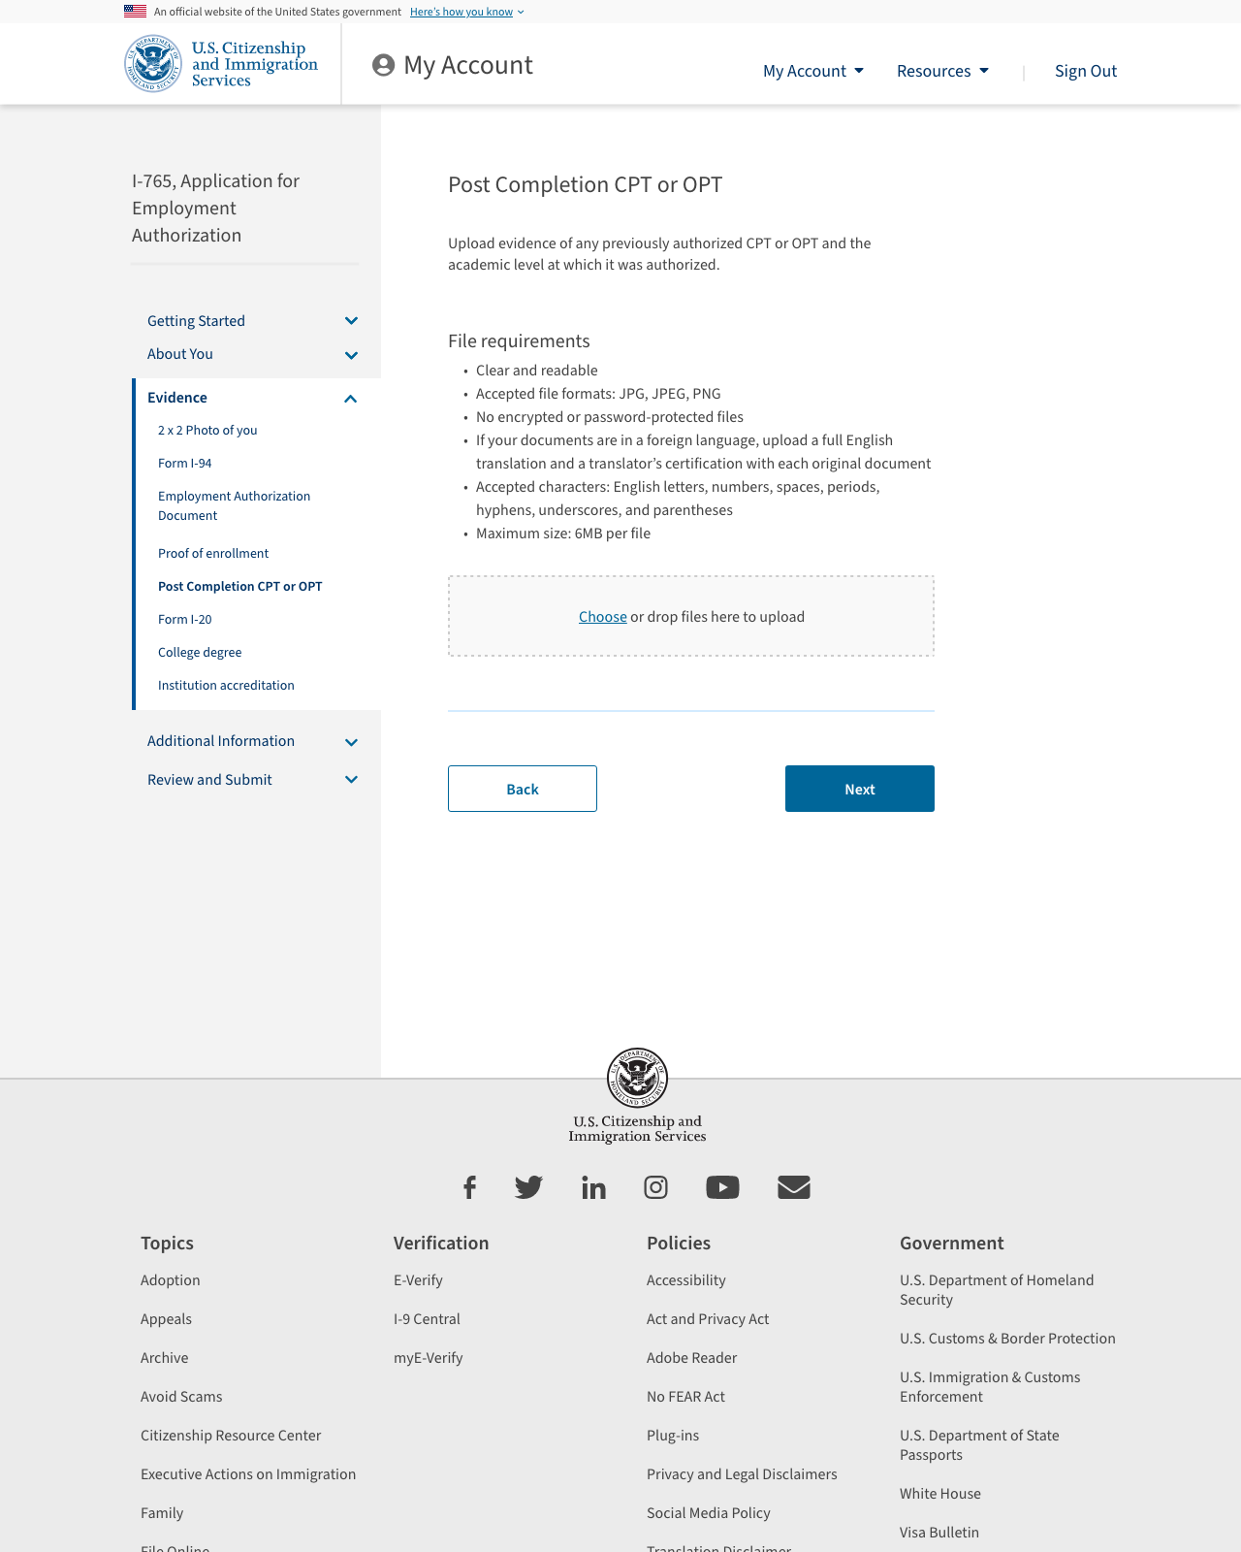
Please note: this evidence is conditional for eligibility category is (c)(3)(A) or (c)(3)(B)

Slide 28
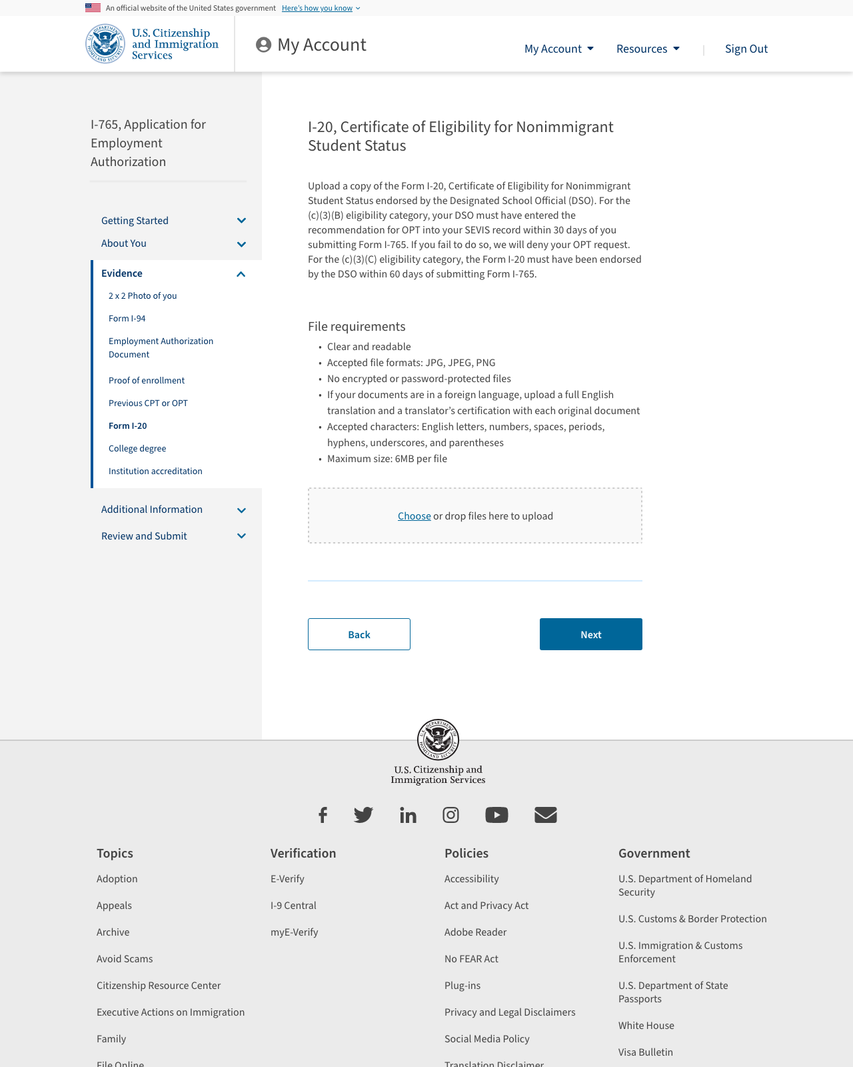

Slide 29
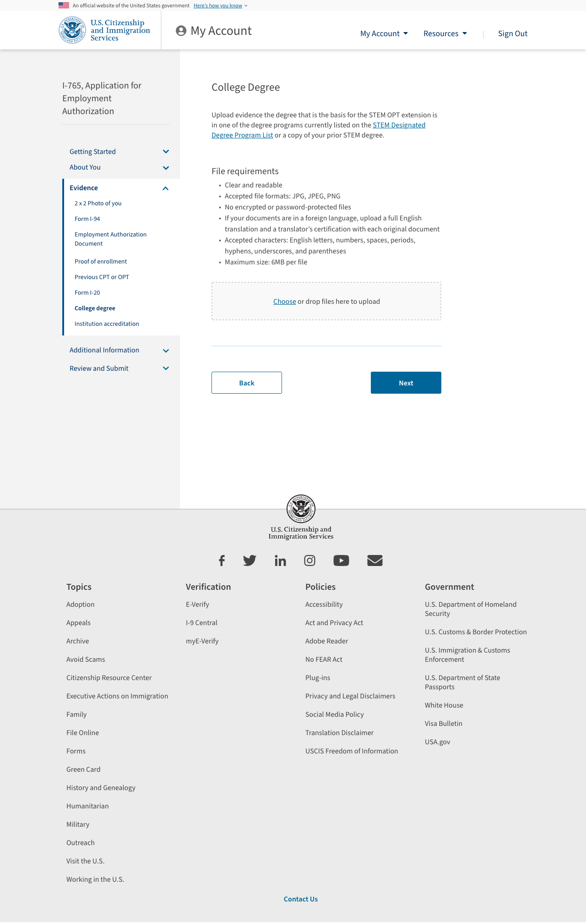
Please note: this evidence is conditional for eligibility category is (c)(3)(C)

Slide 30
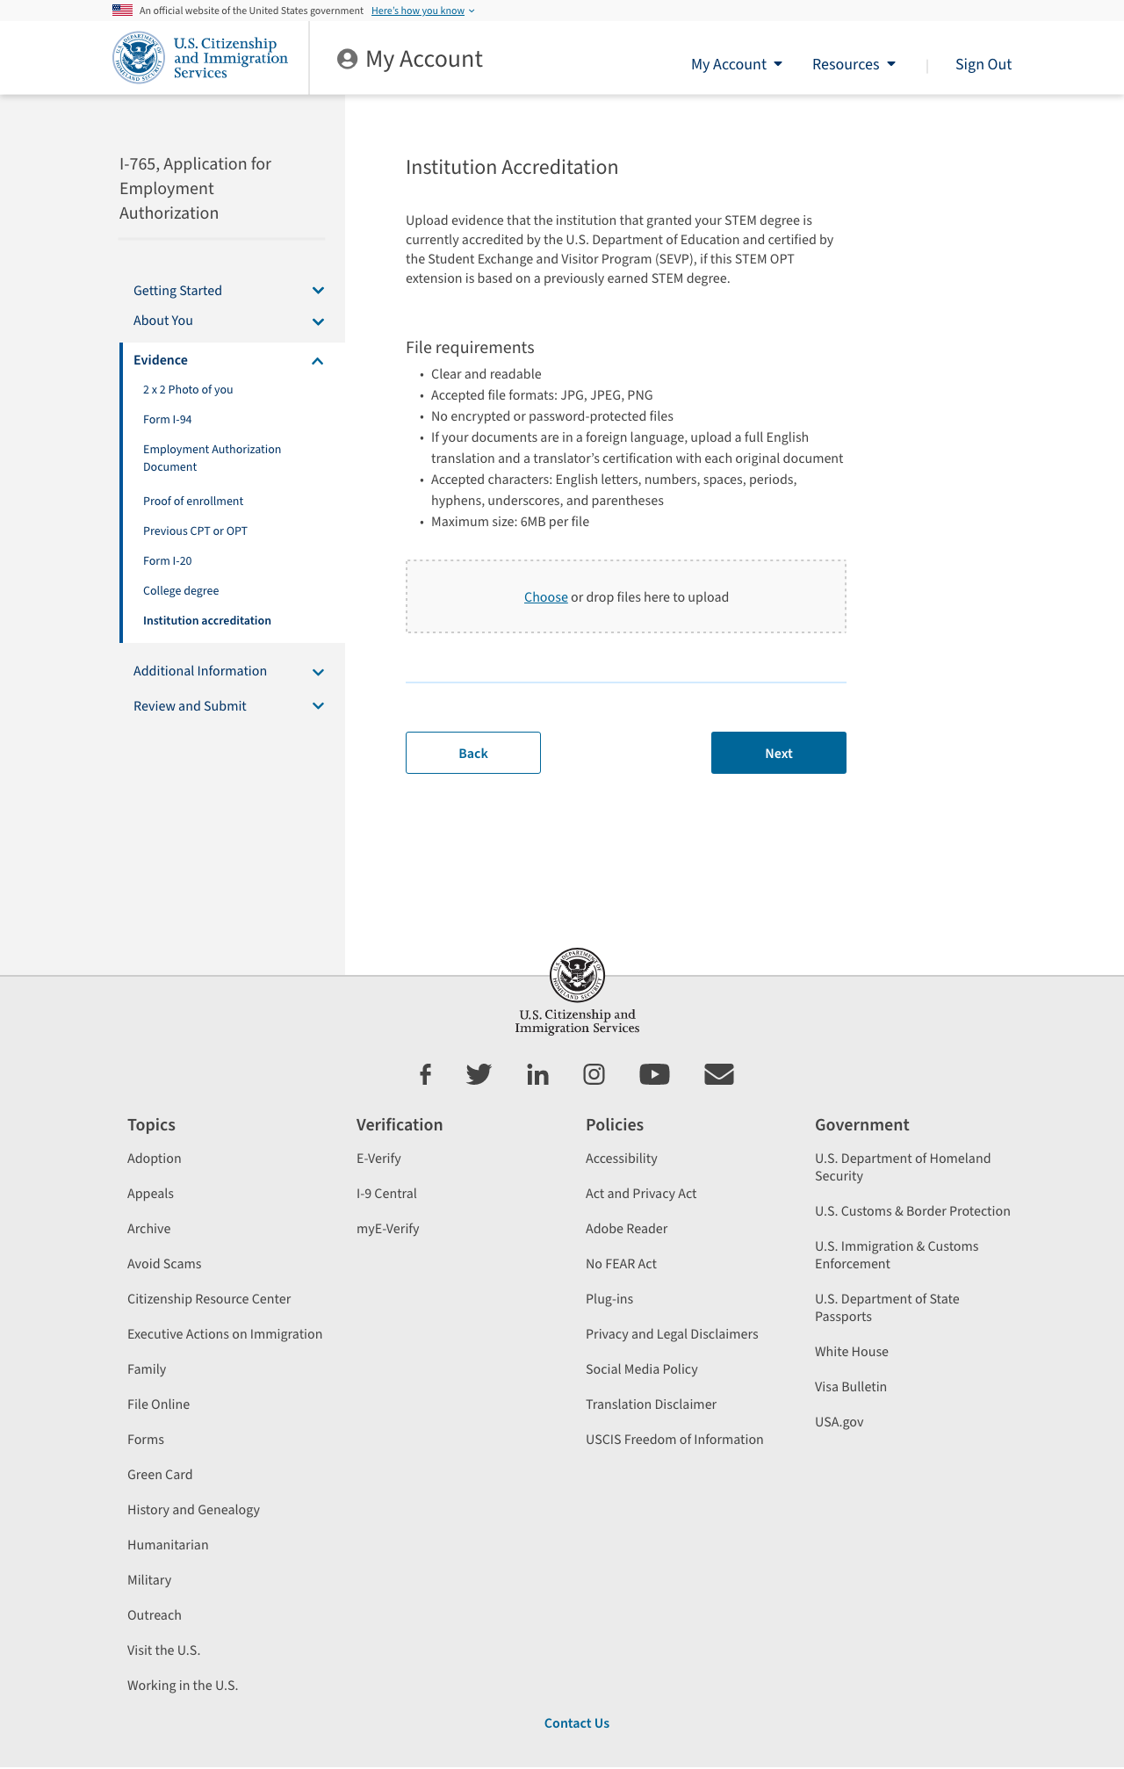
Please note: this evidence is conditional for eligibility category is (c)(3)(C)

Slide 31
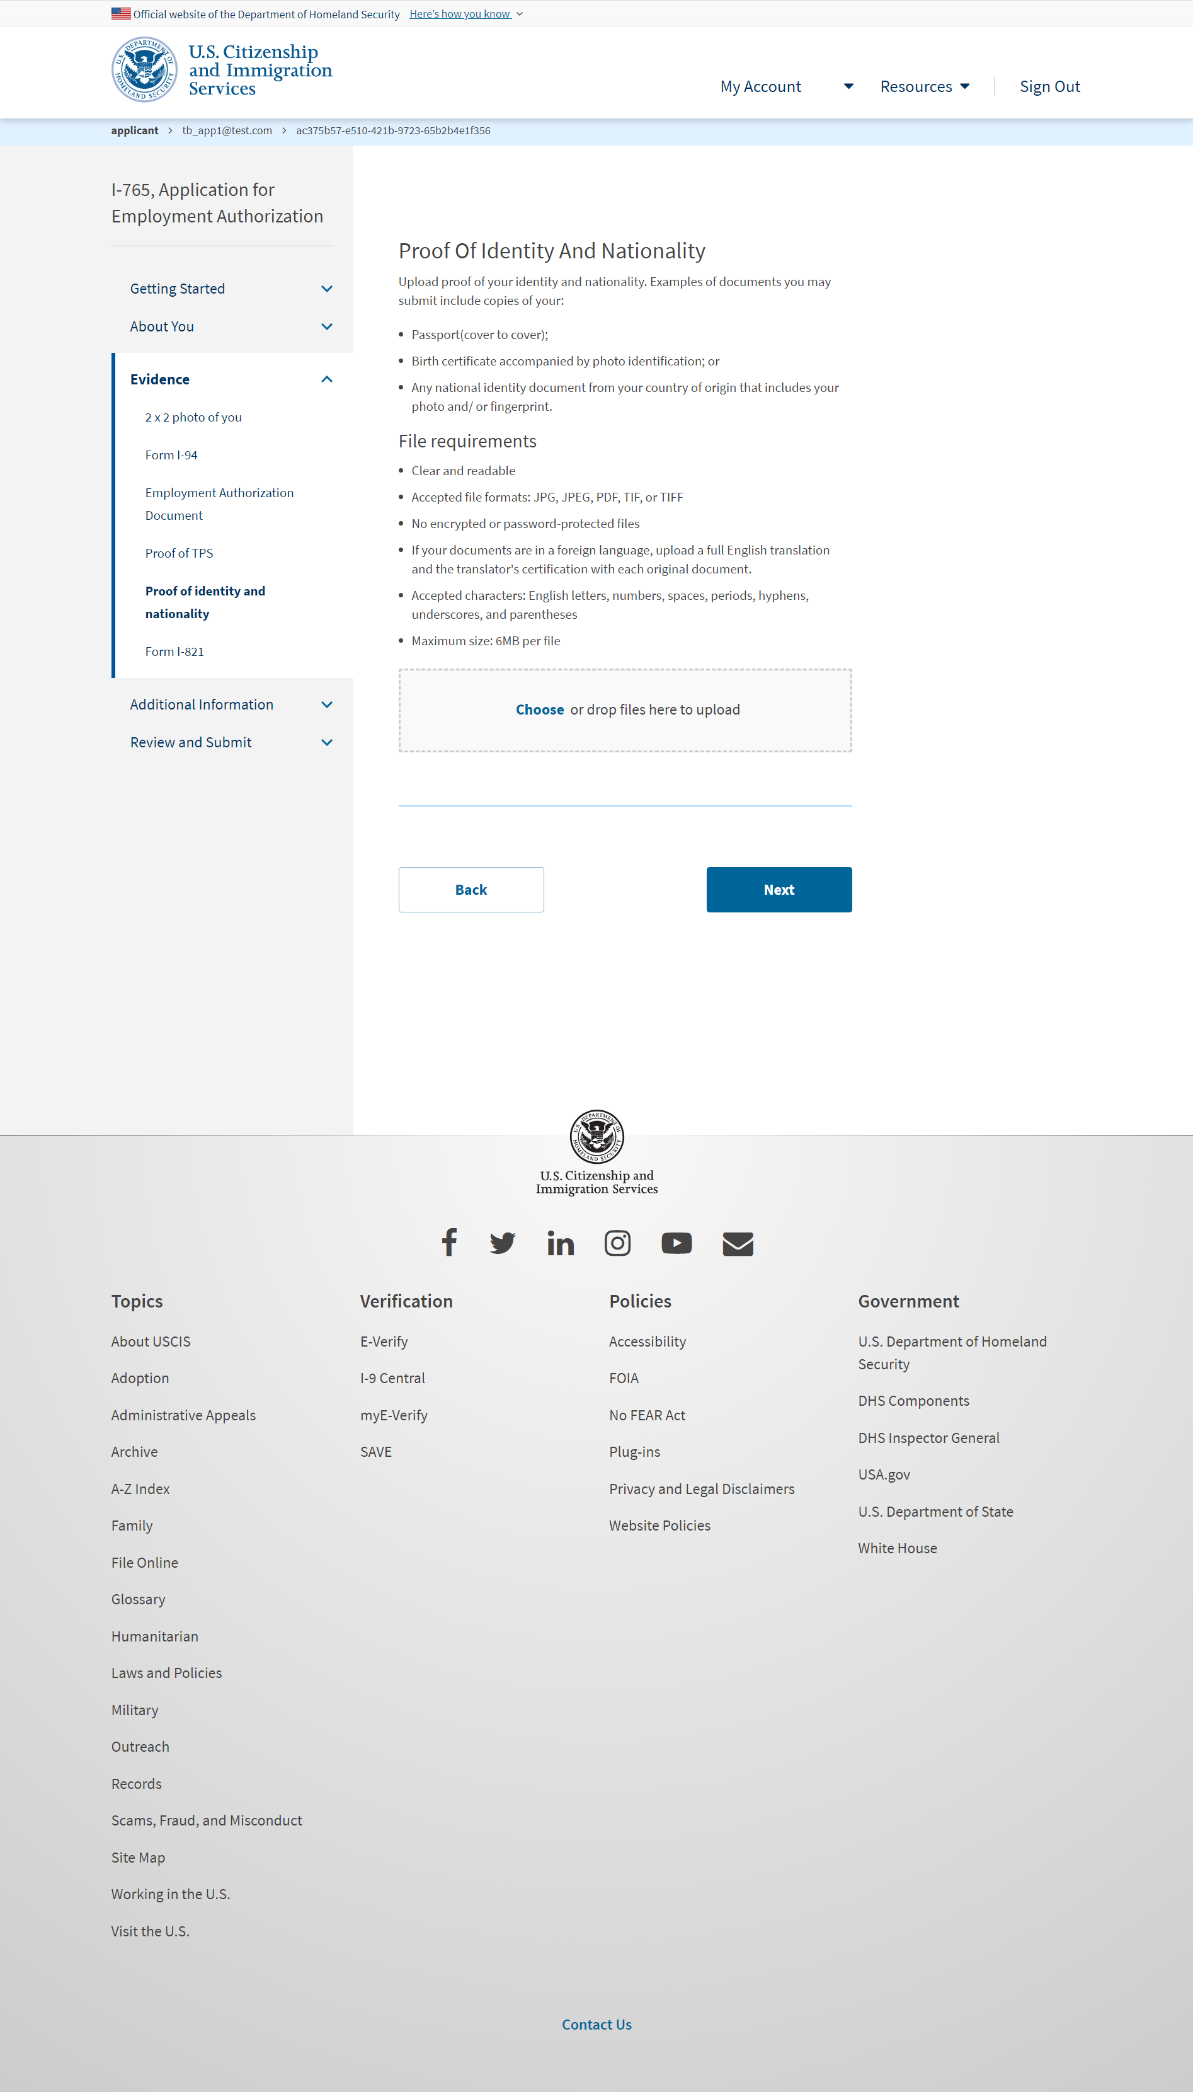
I-765: Evidence – Proof of identity and nationality – this evidence is required if a TPS eligibility category was selected

Slide 32
Additional Information

Slide 33
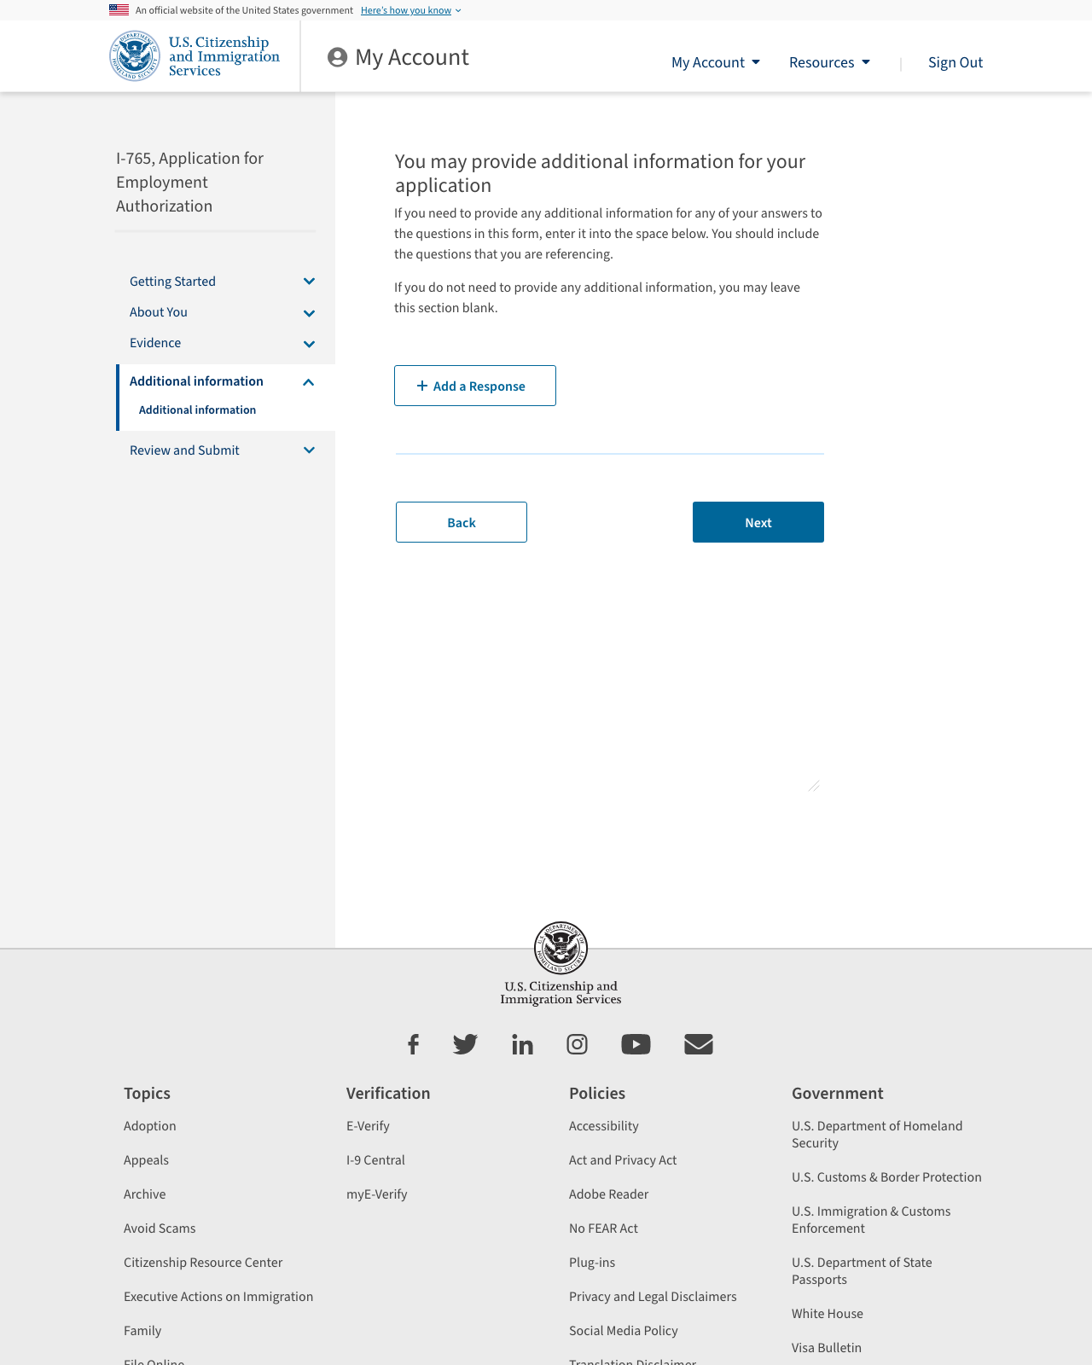

Slide 34
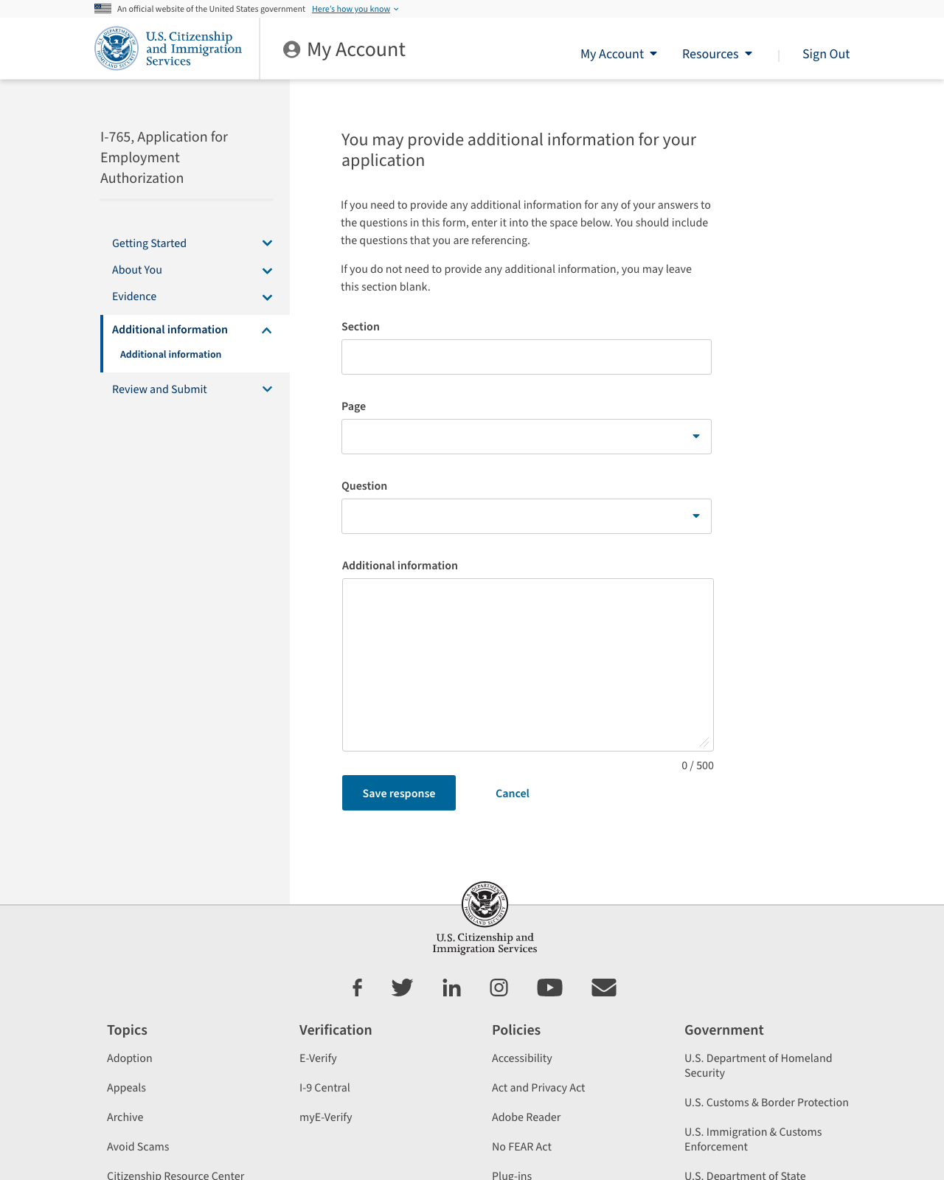

Slide 35
Review and submit

Slide 36
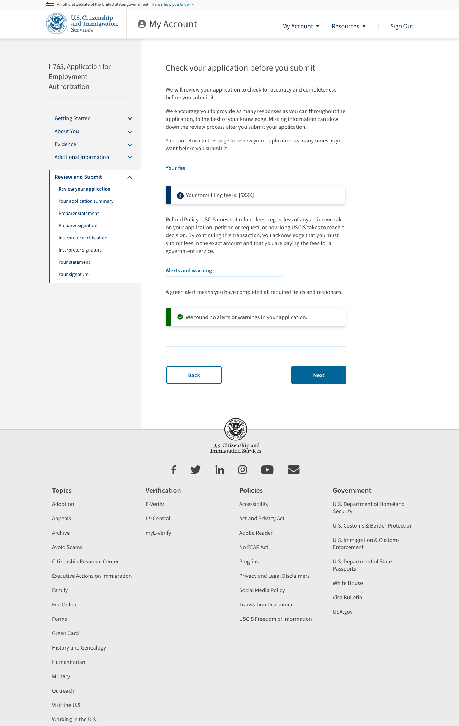

Slide 37
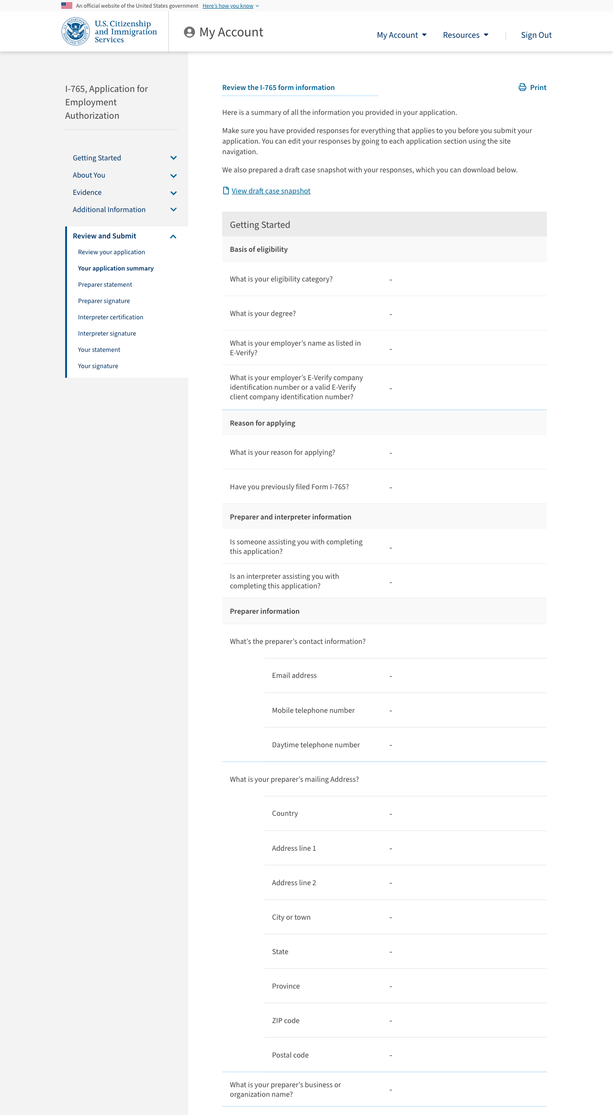

Slide 38
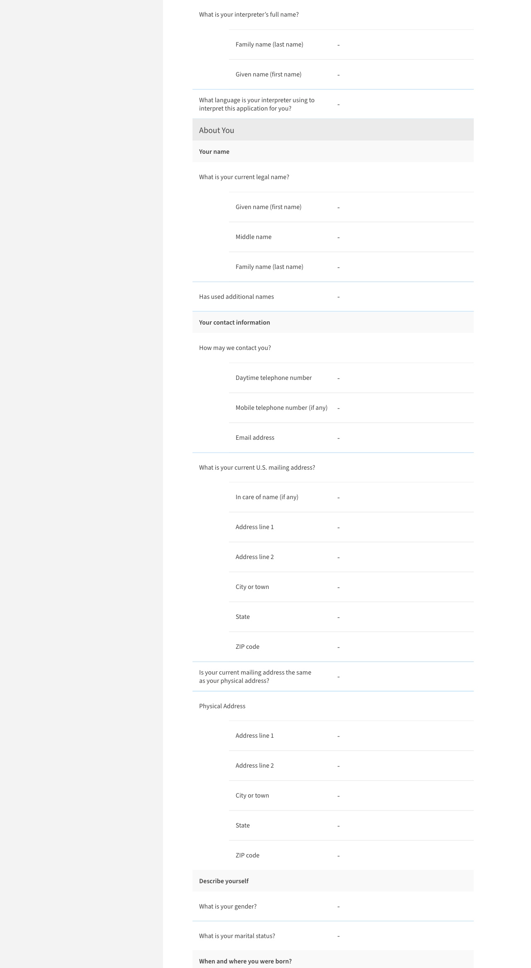

Slide 39
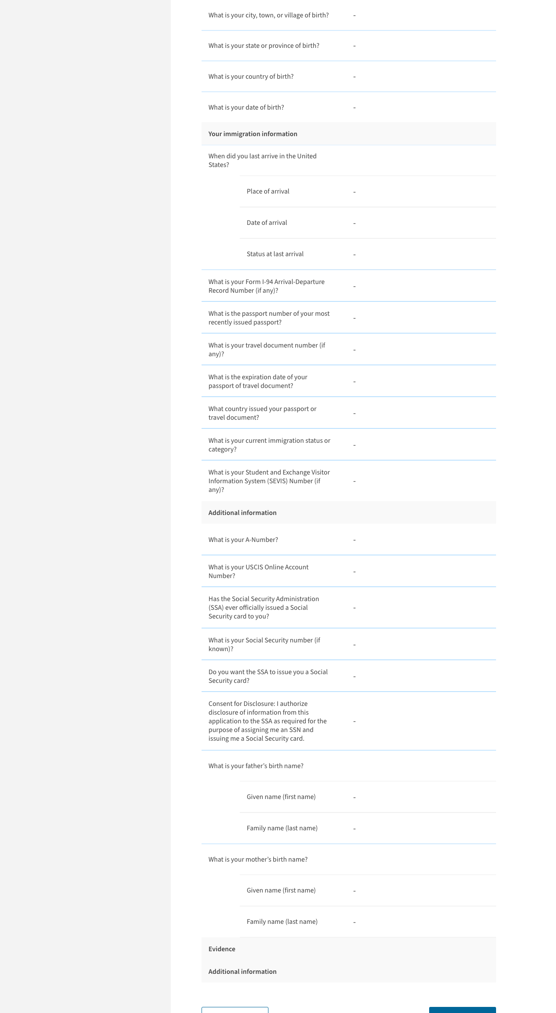

Slide 40
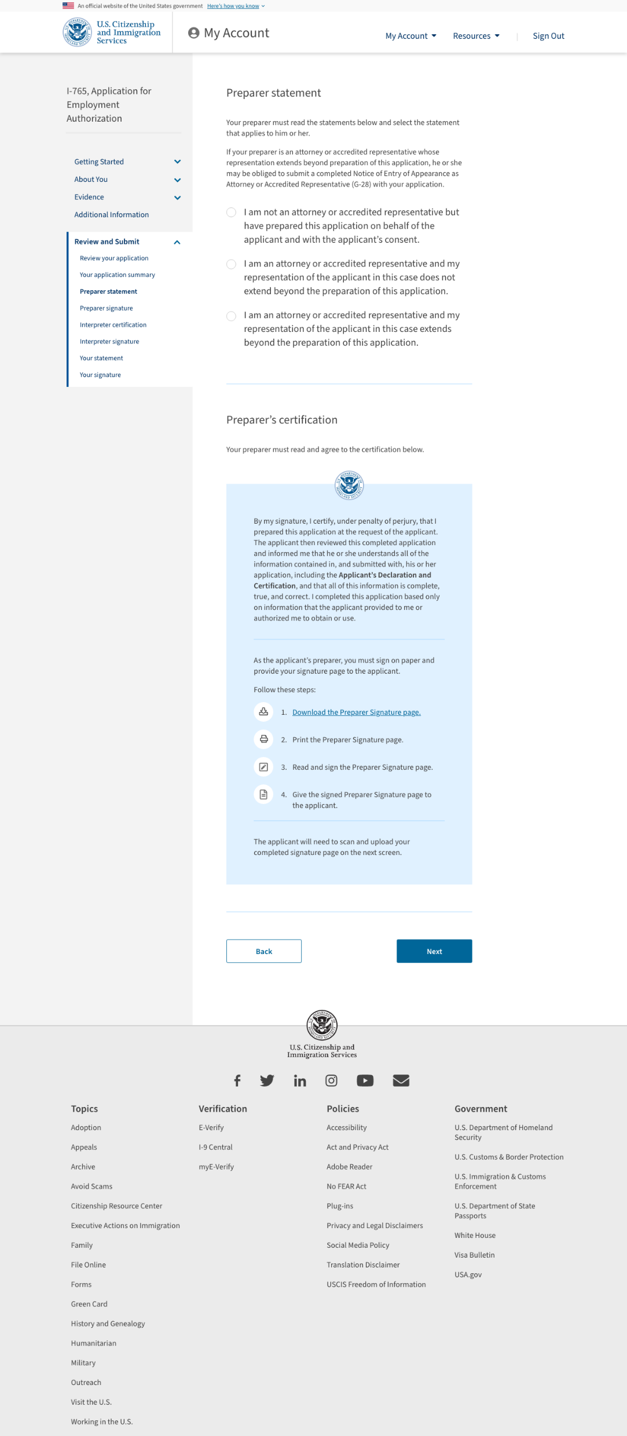

Slide 41
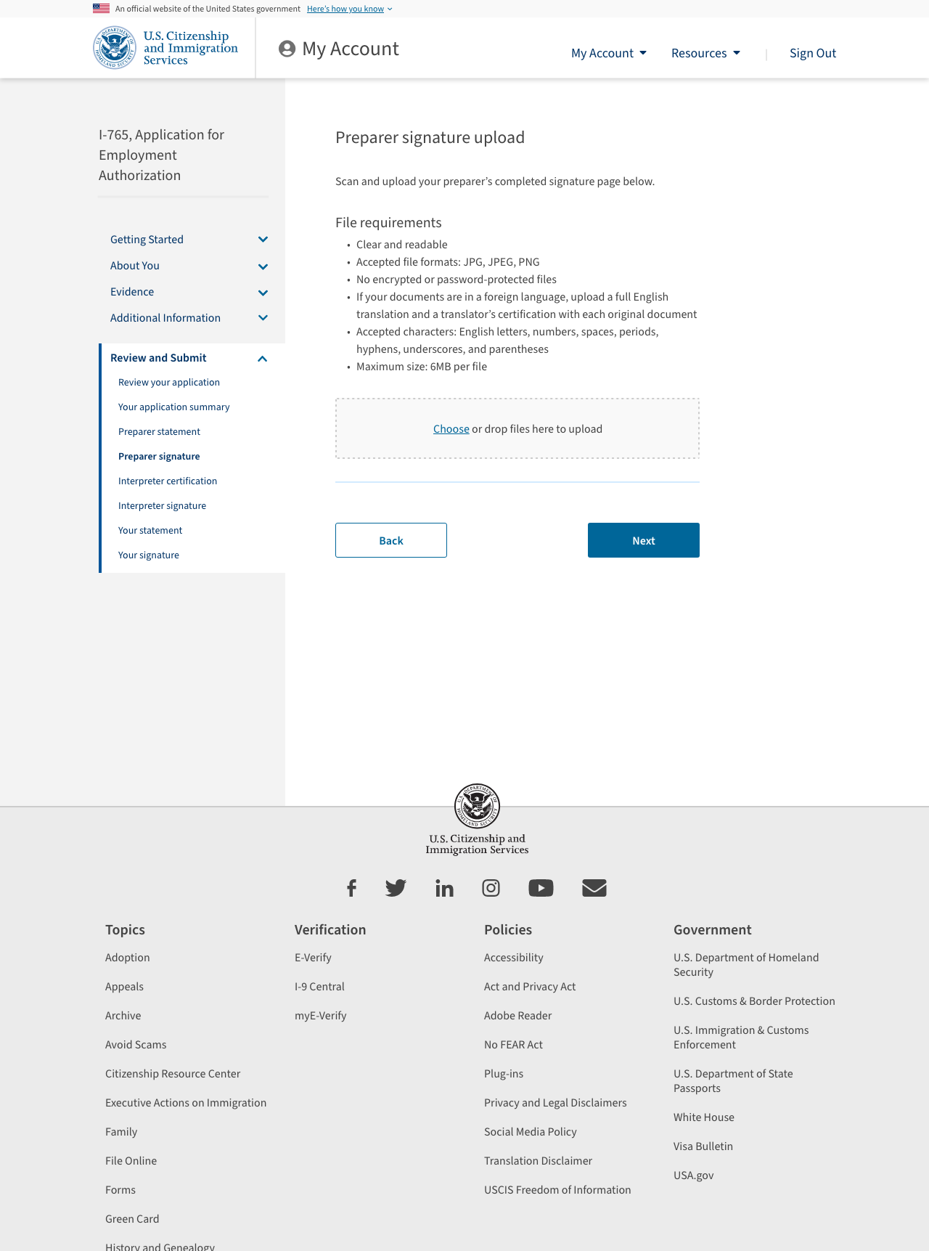

Slide 42
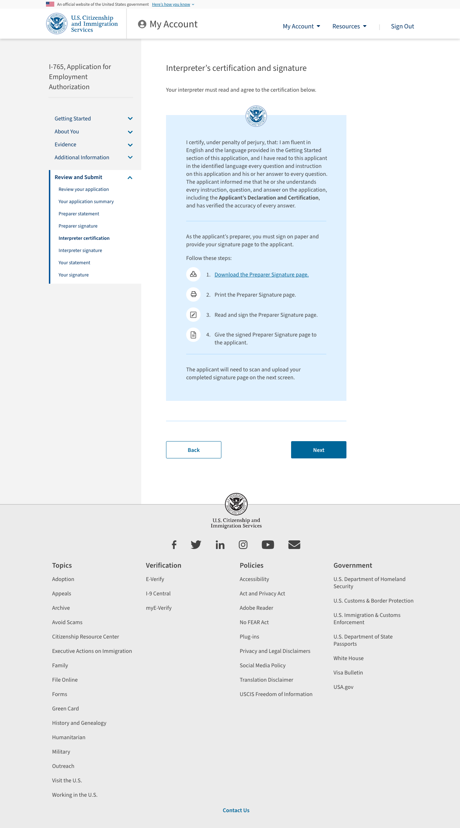

Slide 43
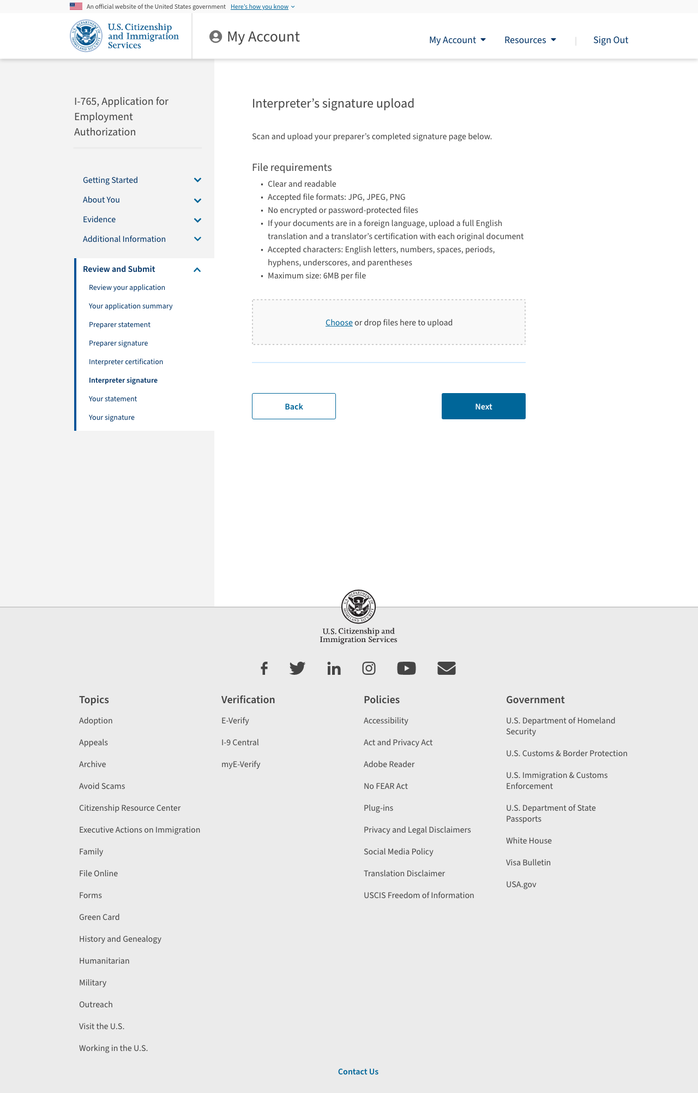

Slide 44
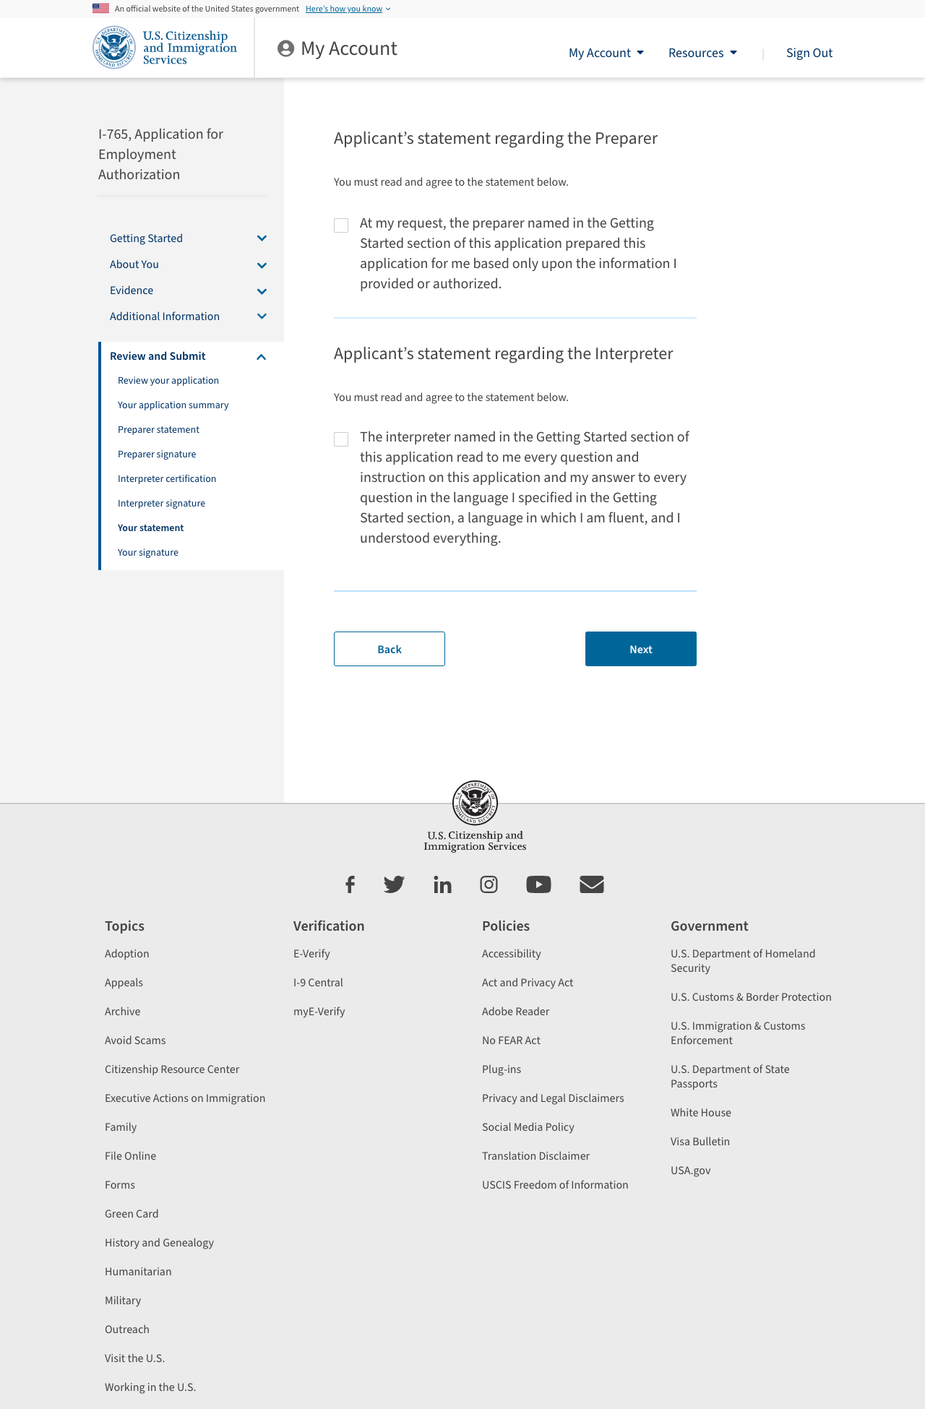

Slide 45
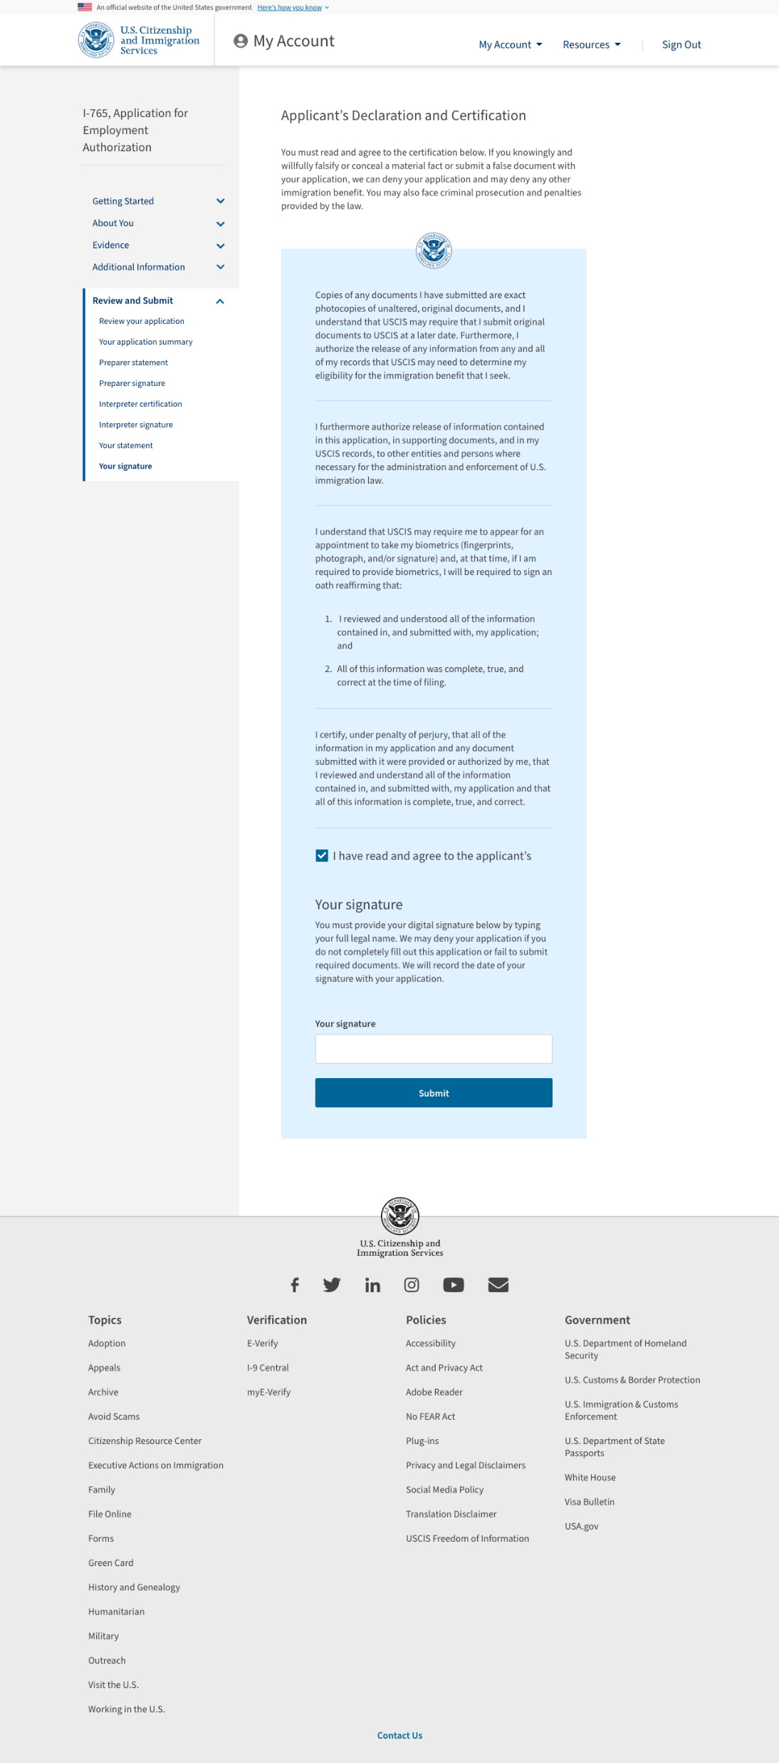

Slide 46
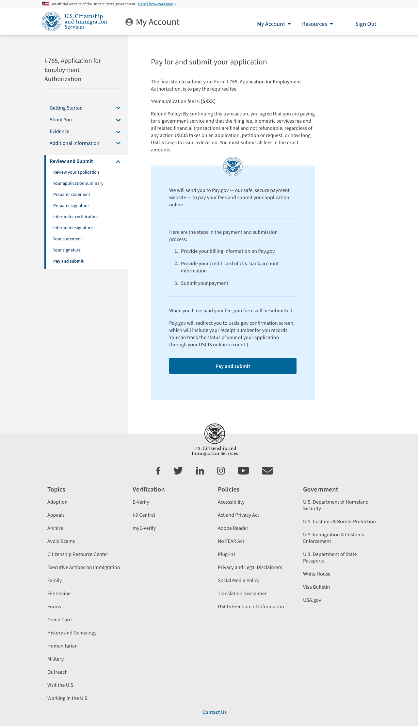

Slide 47
Payment happens on pay.gov

Slide 48
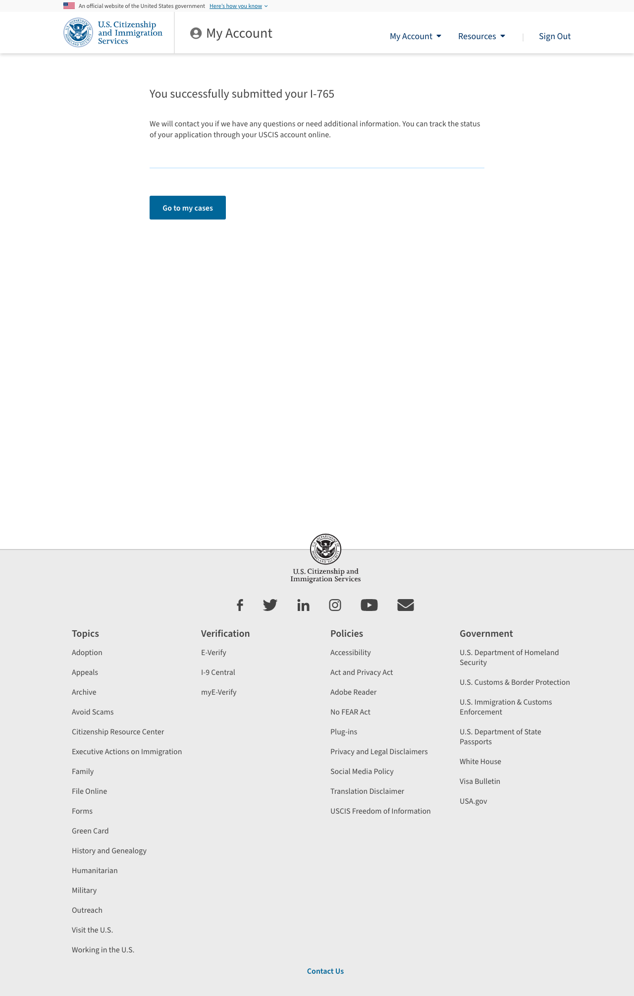

Slide 49
Alerts

Slide 50
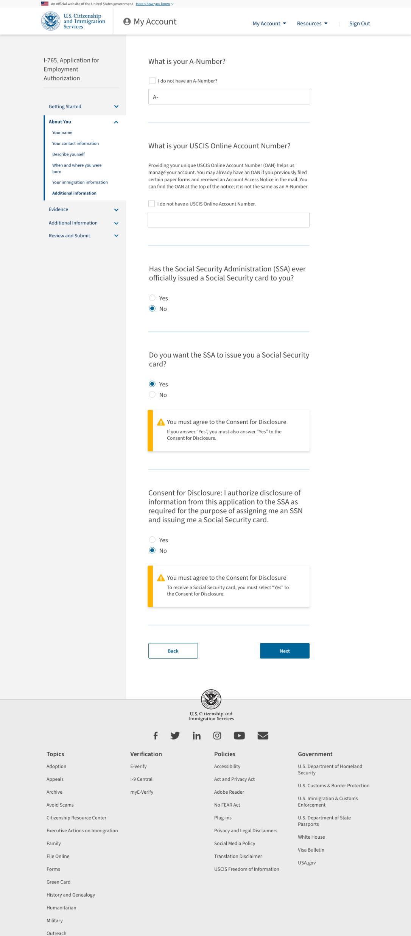

Slide 51
