Slide 1
ESTA Mobile App
I-Solutions Division
Passenger Systems Program Directorate (PSPD)
Office of Information Technology (OIT) US Customs Border Protection (US CBP)

Slide 2
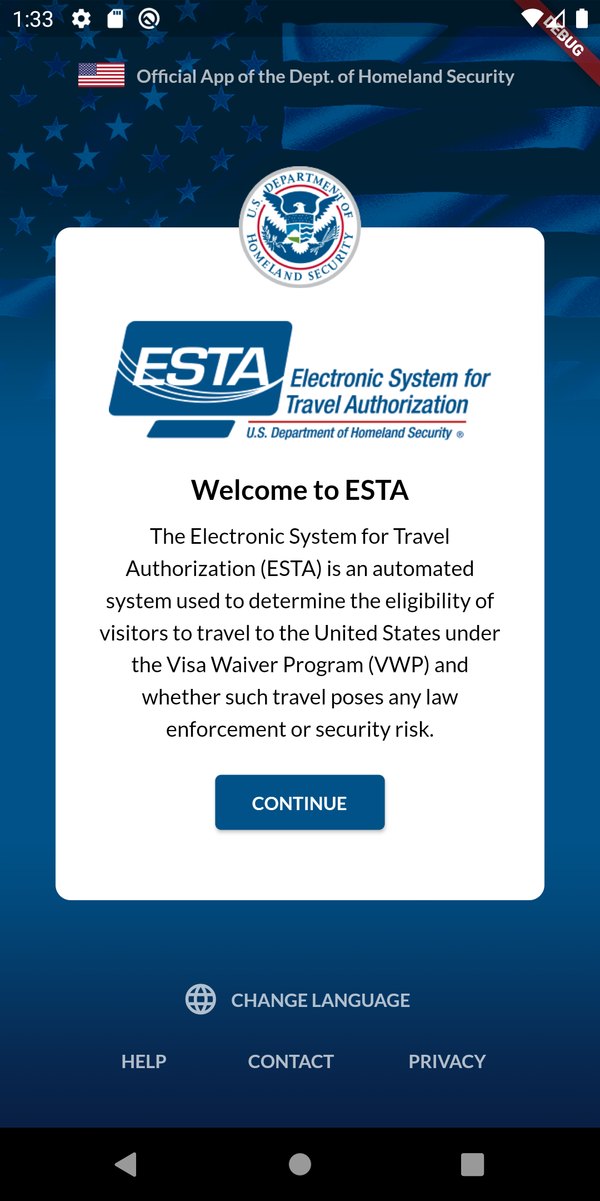
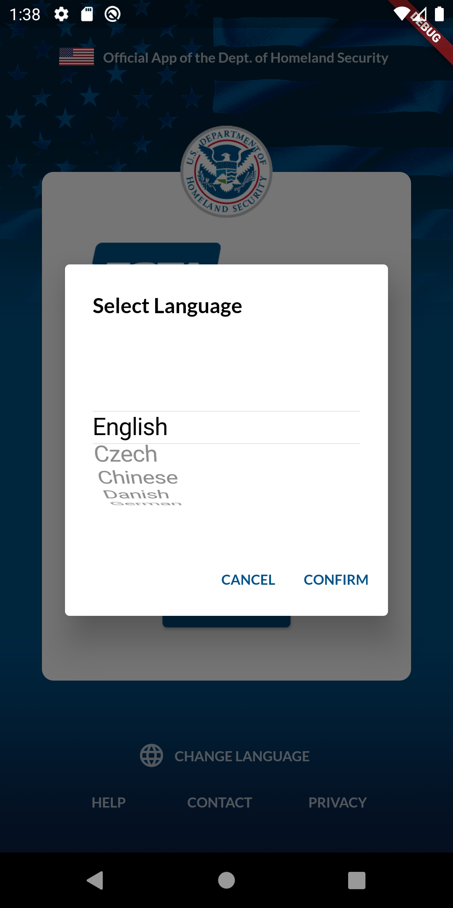
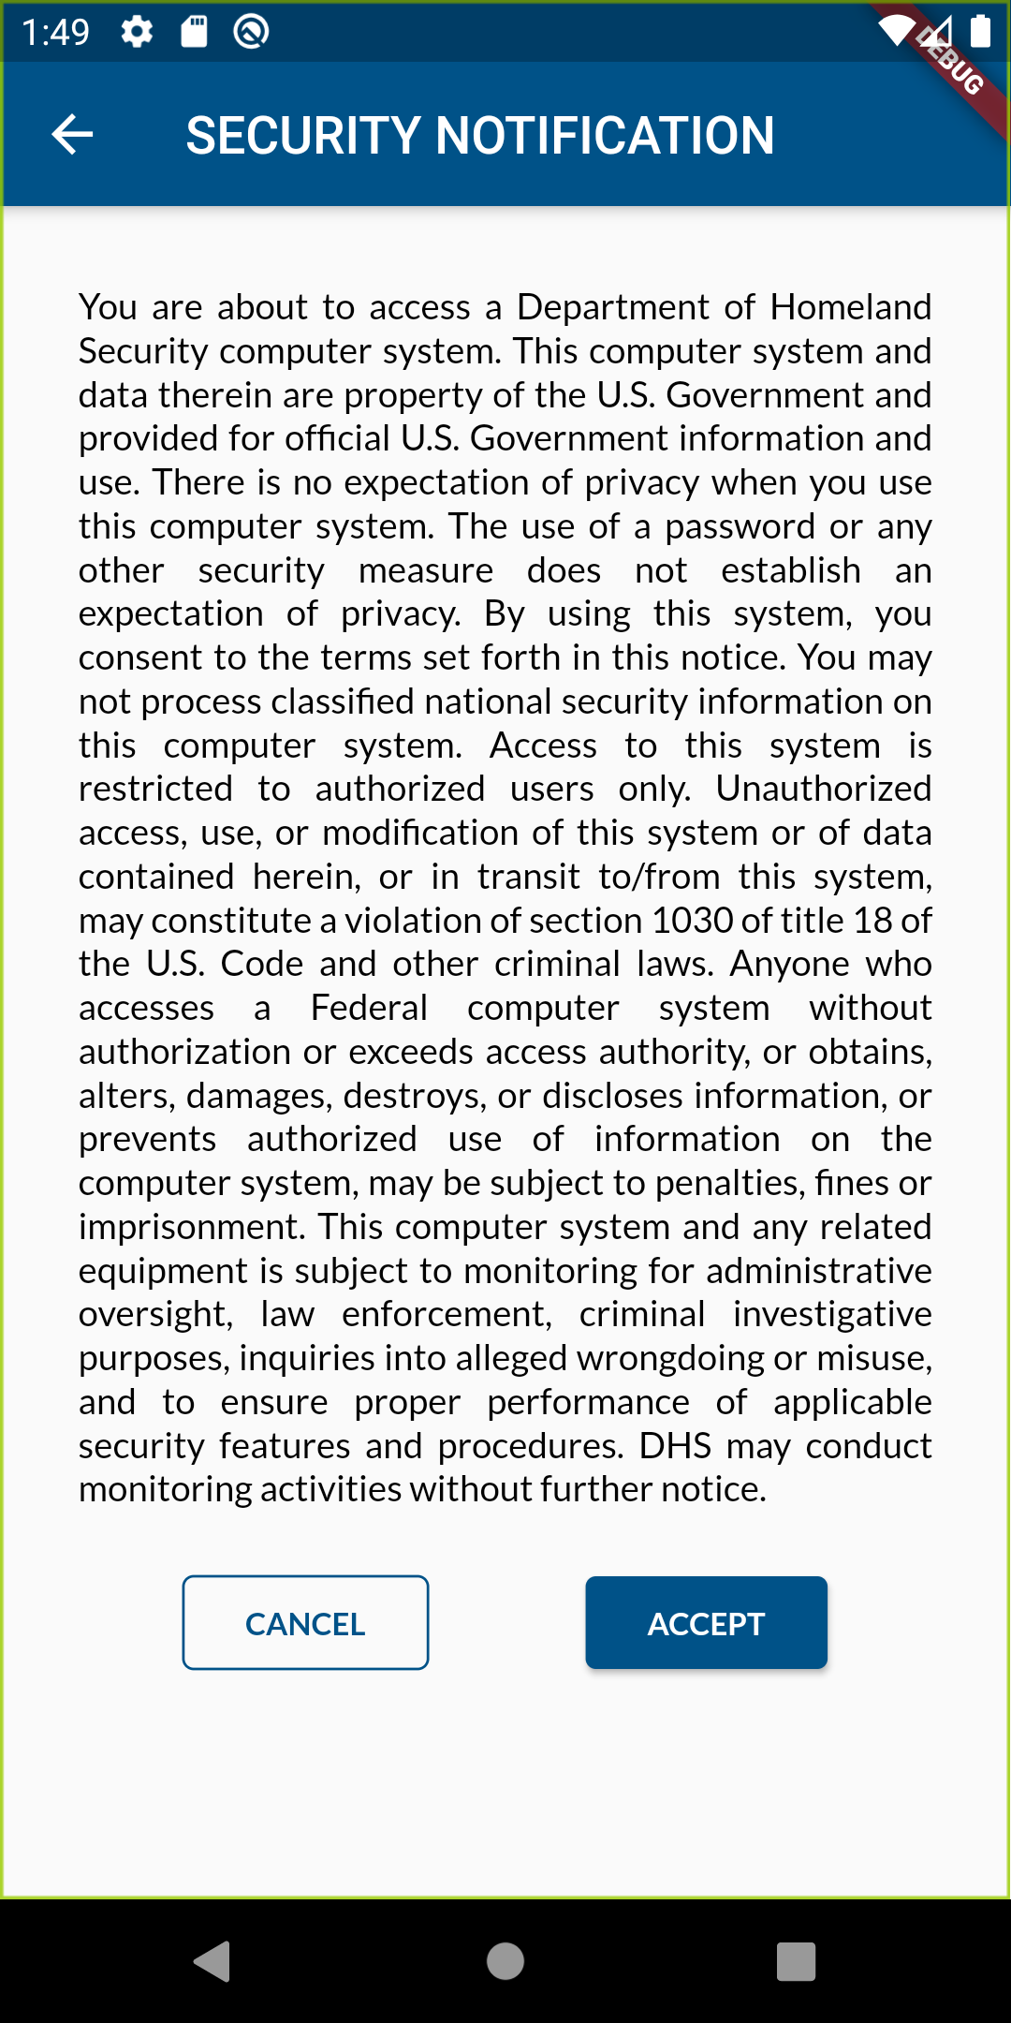
ESTA Mobile App – Welcome Page
1
2
2
1
CBP | OIT

Slide 3
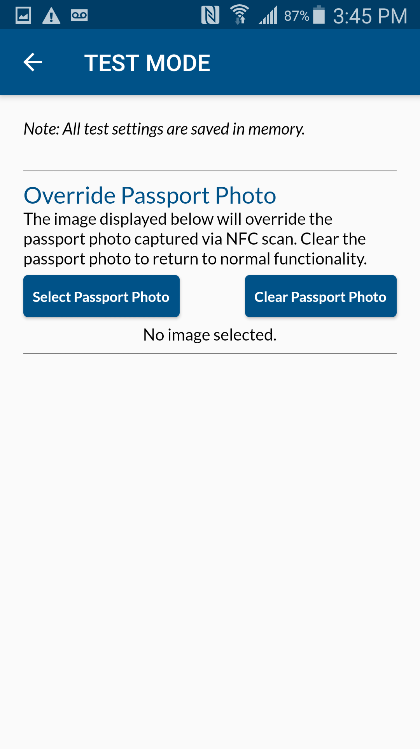
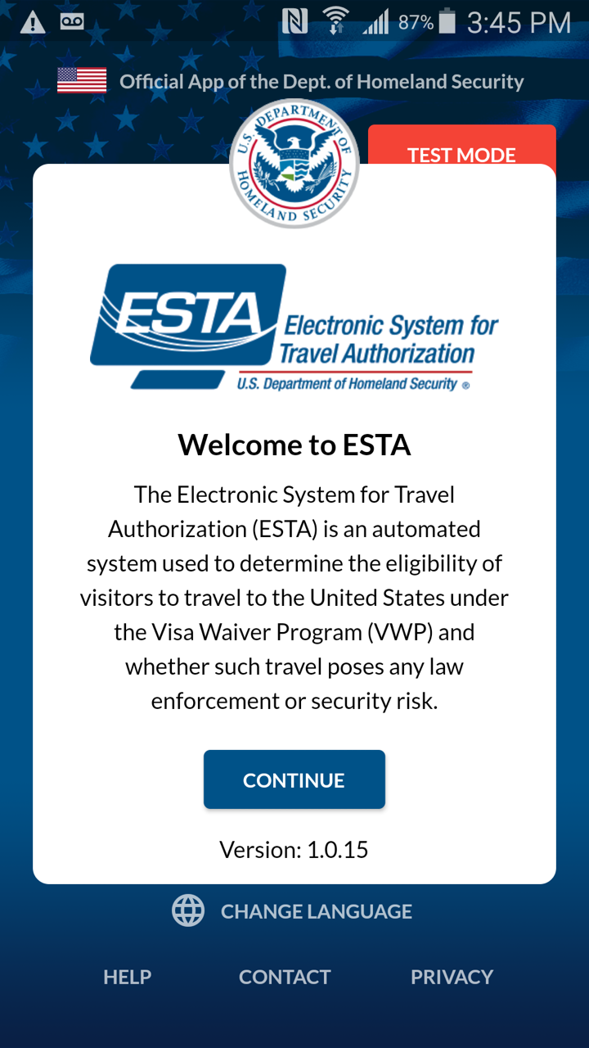
ESTA Mobile App – TEST MODE (Only for Testing Purpose)
4
2
Purpose: To test the Photo Matching service that compares the ‘Passport Photo’ from the NFC Scan and the Live Photo taken on the App.
The selfie photo selected from the TEST MODE will be used as a ‘Passport Photo’ to be compared to the Live Photo taken on the App.
Steps:
Save a selfie of yourself on your mobile device
Click TEST MODE from the Welcome screen
Click ‘Select Passport Photo’ and select your selfie
Click ← to return to the Welcome screen
Click CONTINUE from the Welcome screen
Start a new application on the next screen
3
5
CBP | OIT

Slide 4
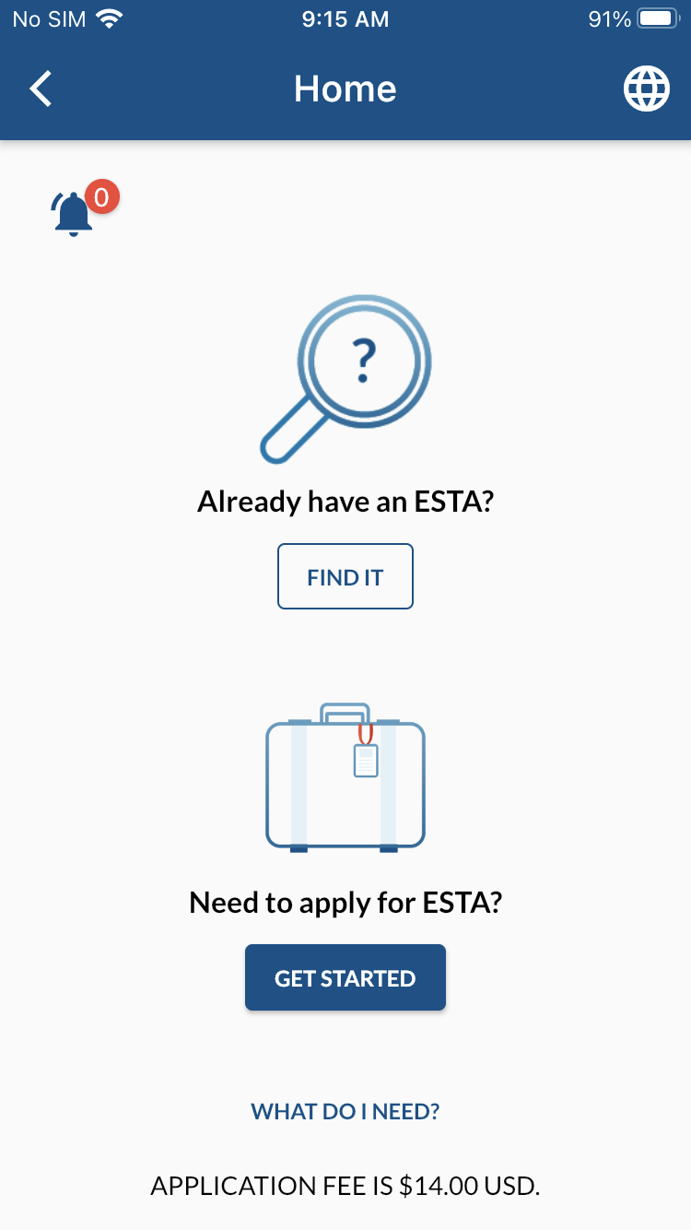
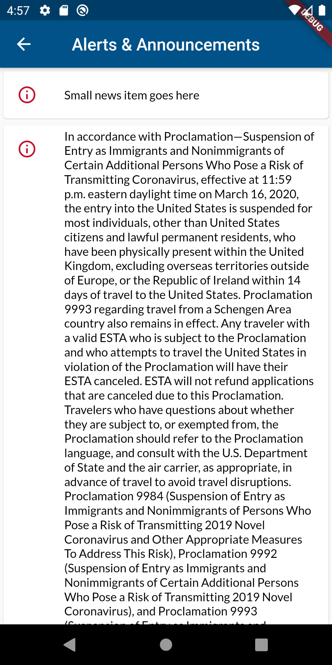
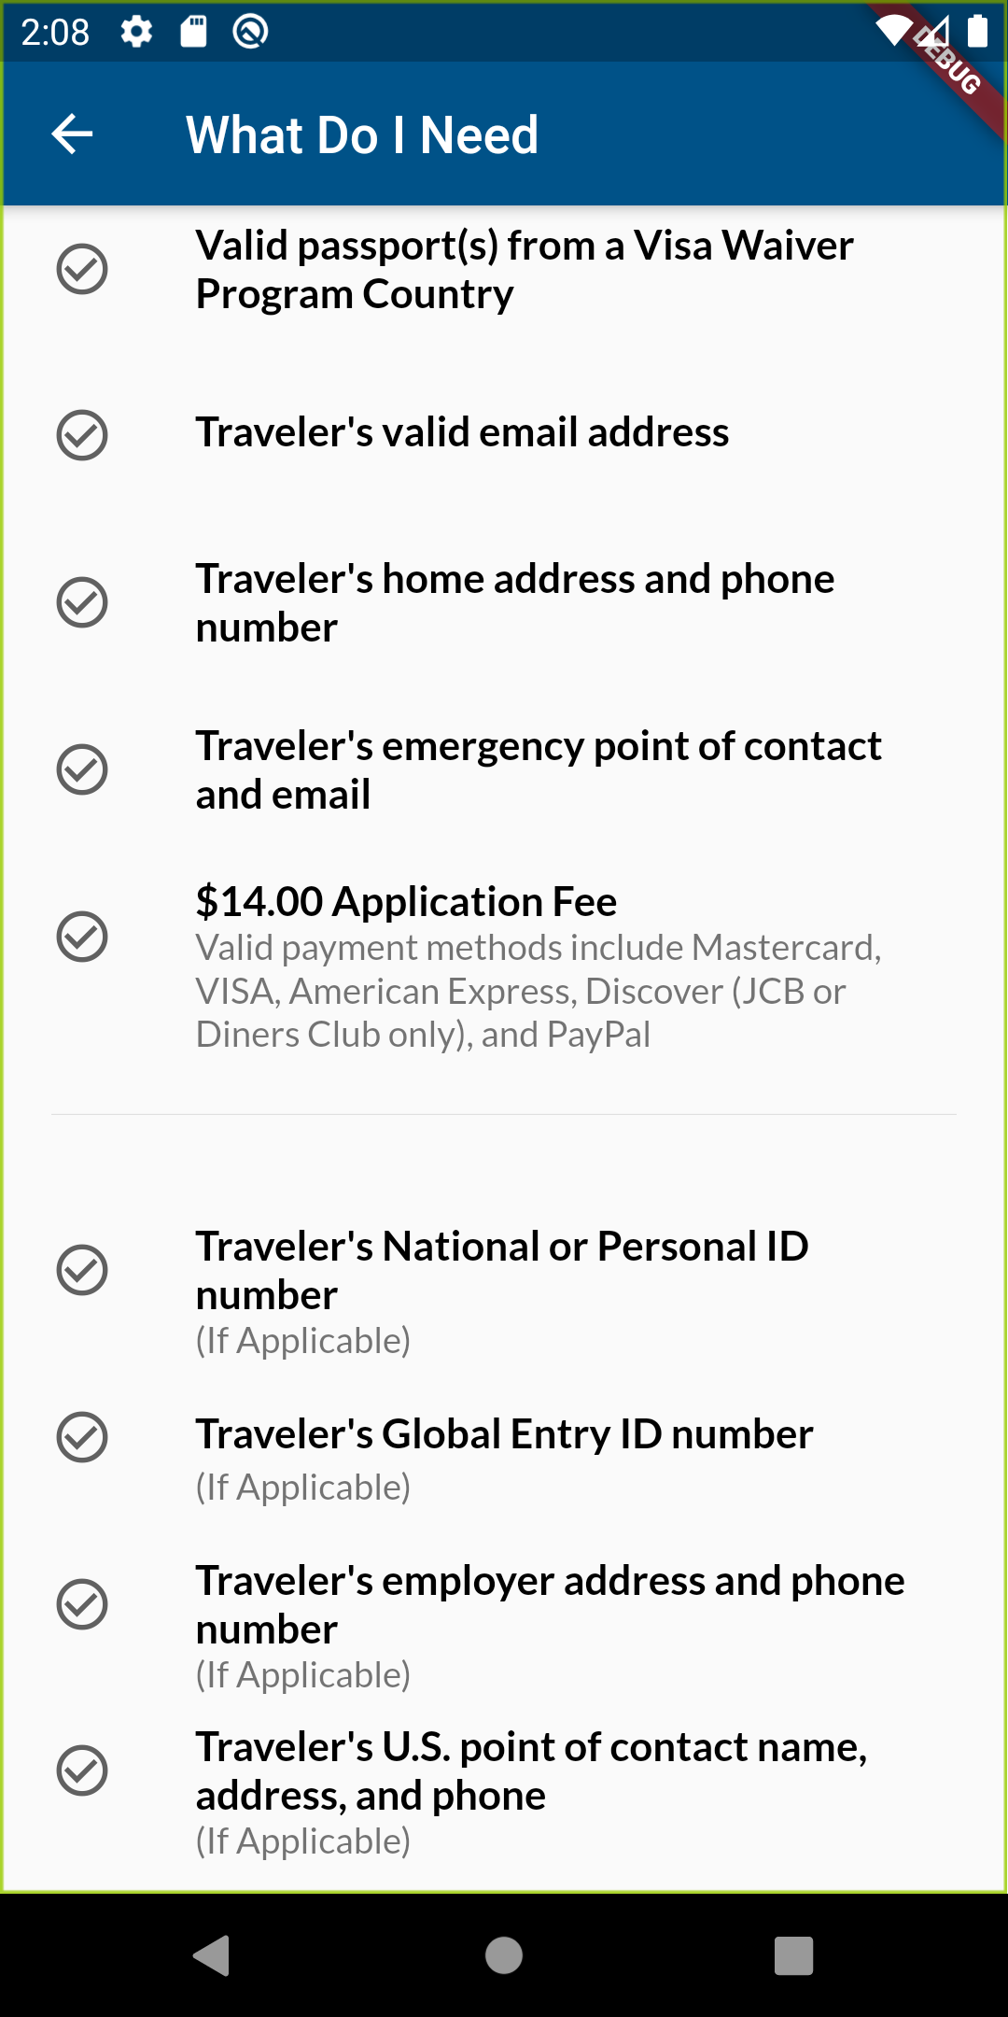
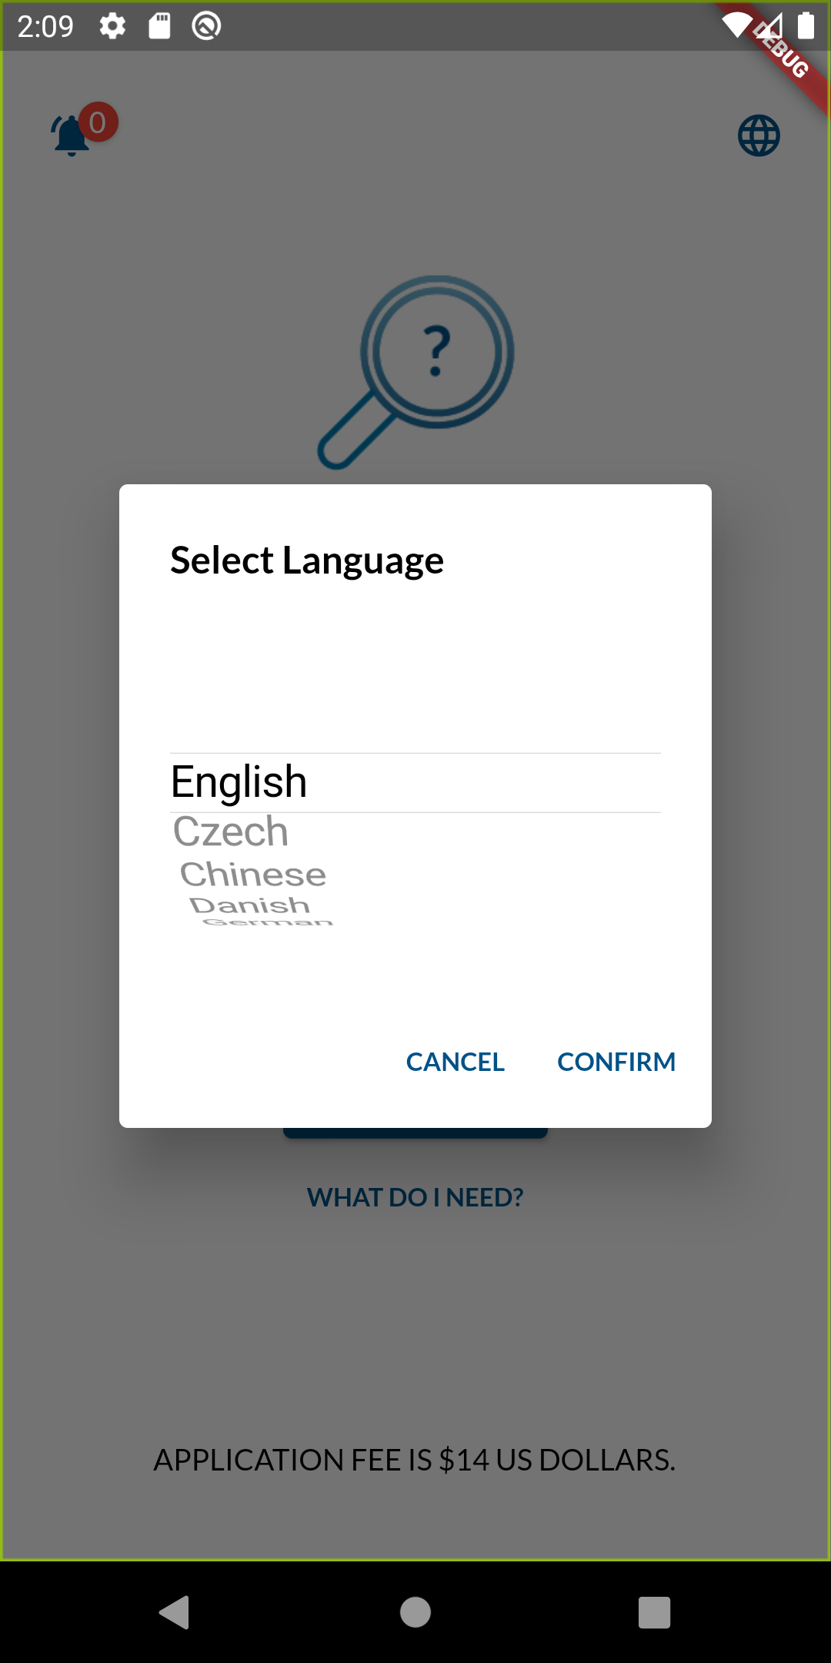
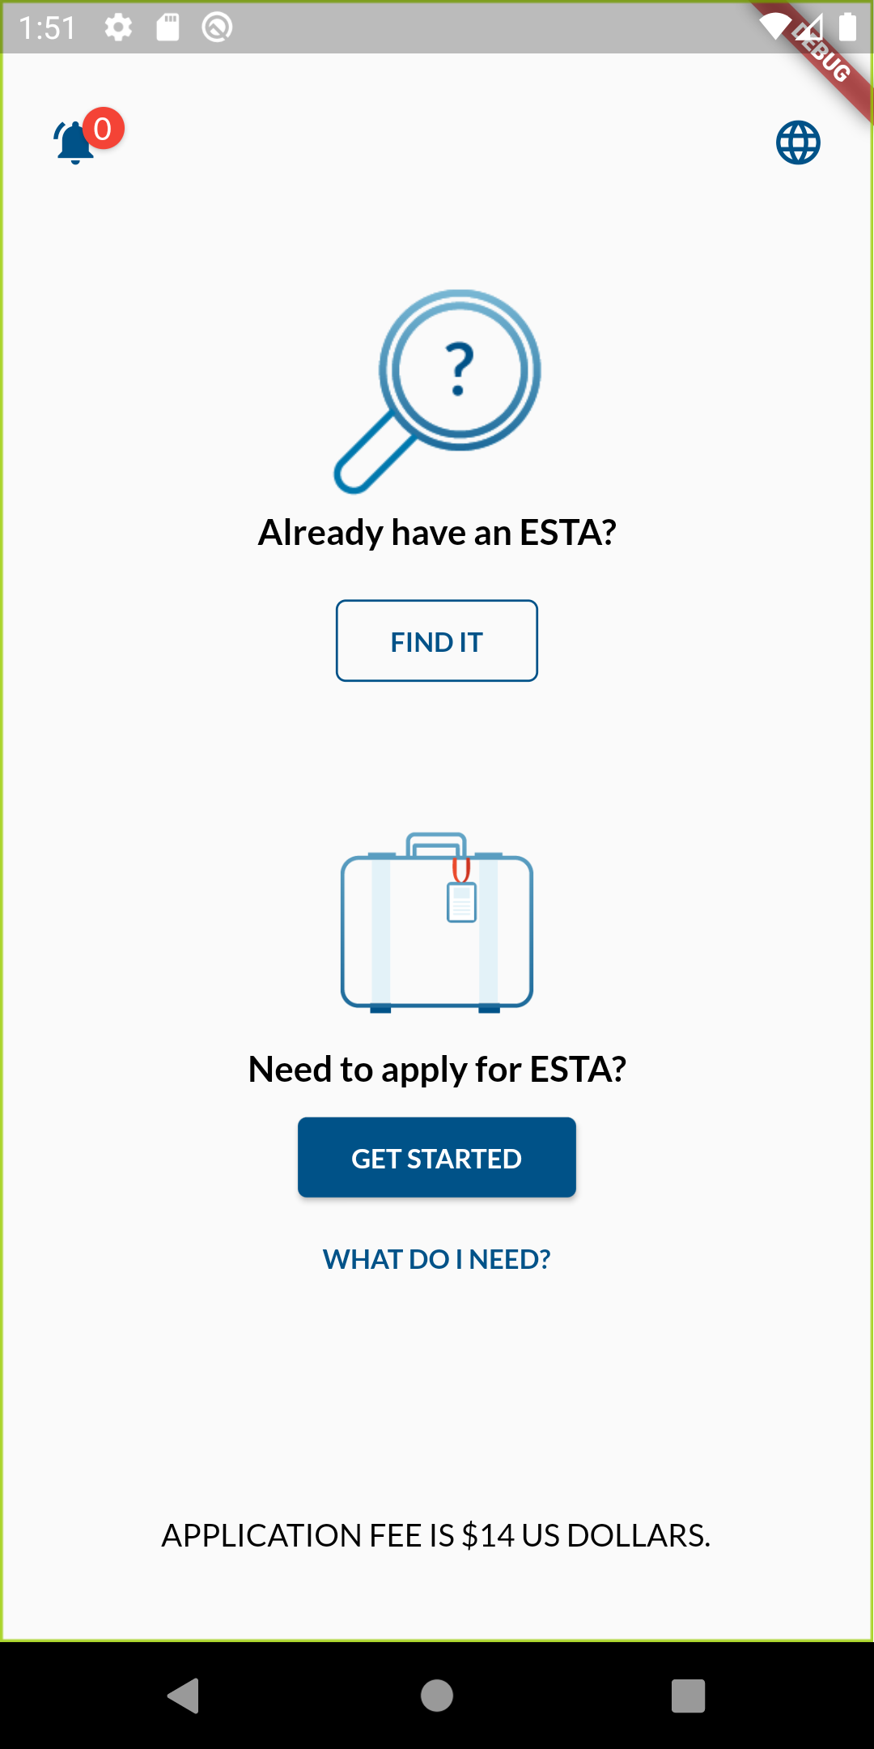
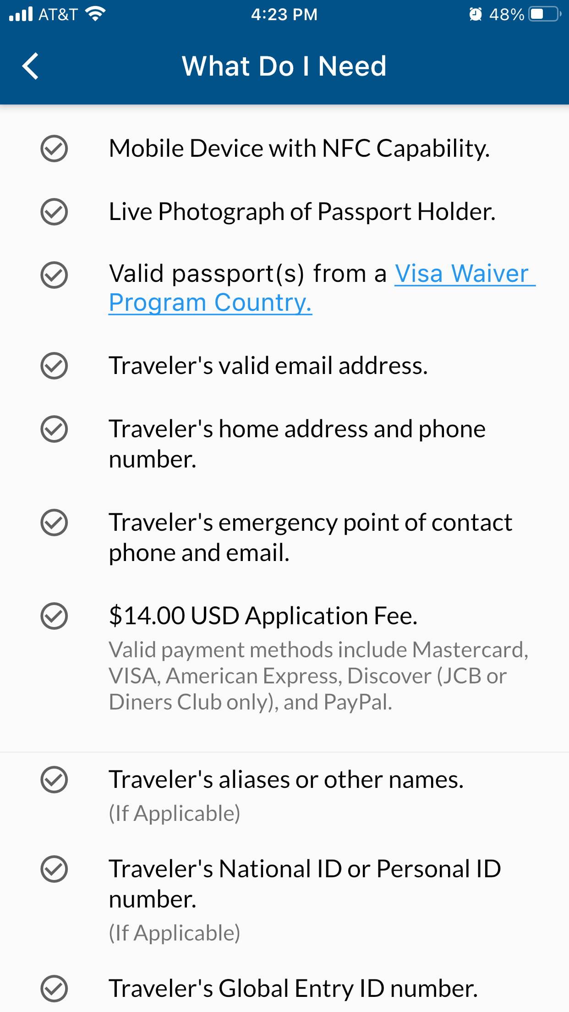
ESTA Mobile App – Home Page
1
2
3
3
1
2
CBP | OIT

Slide 5
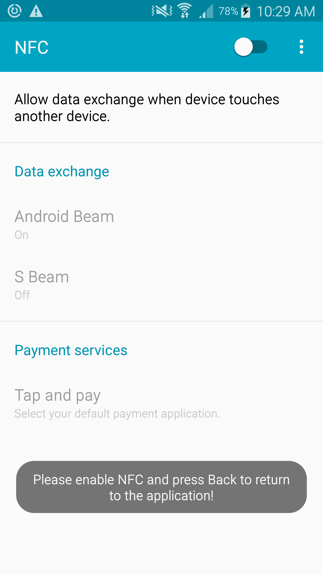
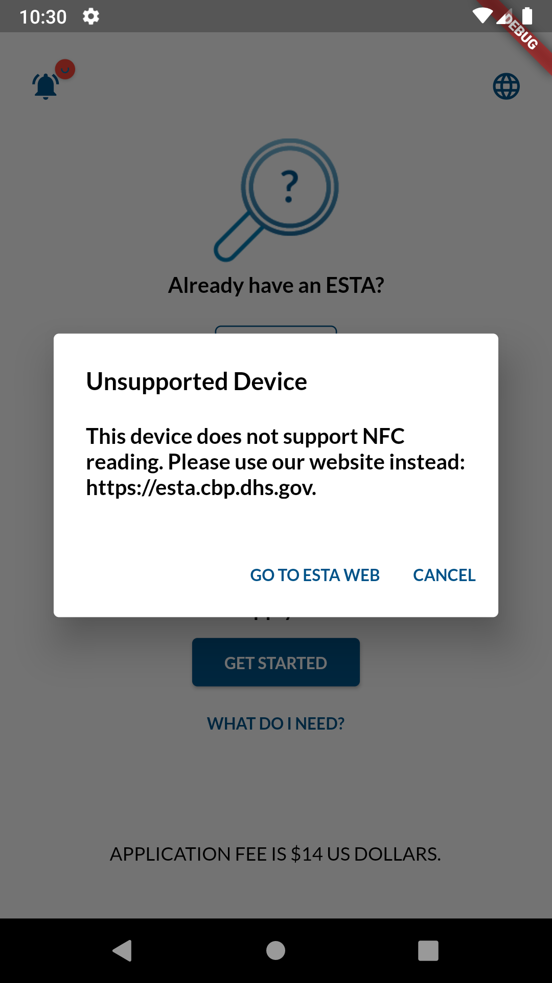
Home Page → GET STARTED (When NFC is turned off/Not Supported)
Near Field Communication (NFC), allows users to scan the passport eChip to extract passenger data located either in the front/ back of the passport.
A Mobile Device with a Near Field Communication (NFC) capability is required to scan the Passport E-Chip when applying for a new application using the ESTA Mobile App.
The ESTA Mobile App checks if the mobile device has the NFC capability and allows the user to turn on the NFC setting or display a message ‘Unsupported Device’ if the mobile device does not have the NFC capability.
CBP | OIT

Slide 6
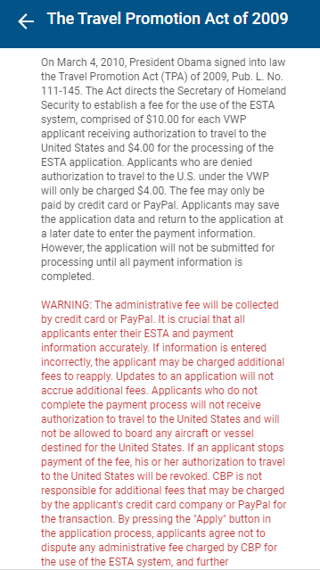
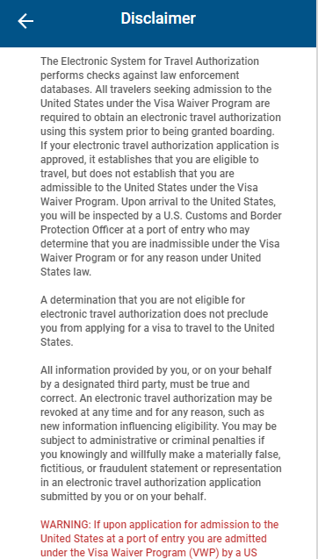
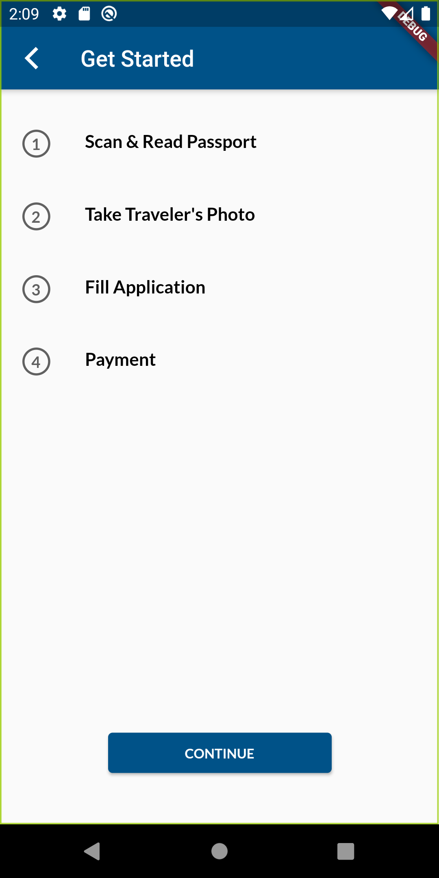
Home Page → GET STARTED
The “GET STARTED” option enables the user to fill out a new application.
CBP | OIT

Slide 7
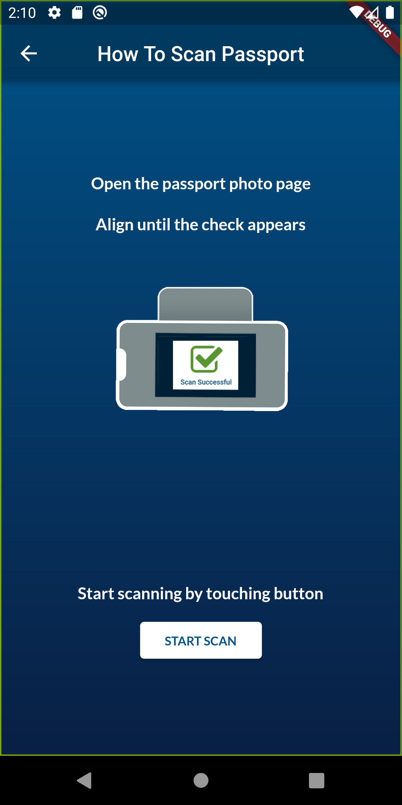
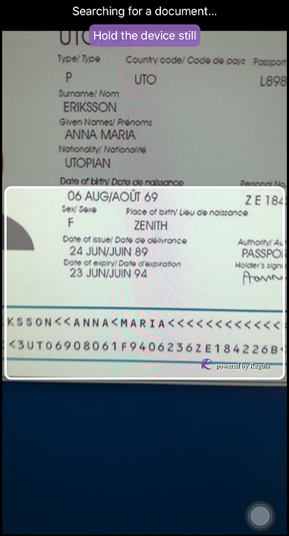
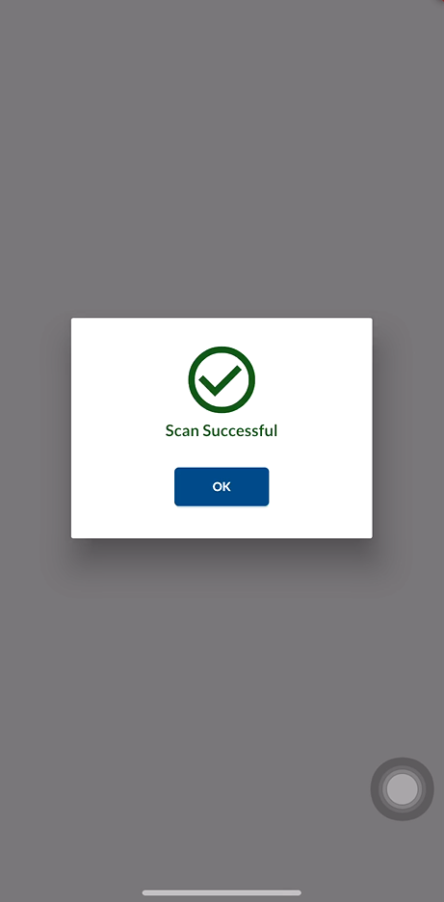
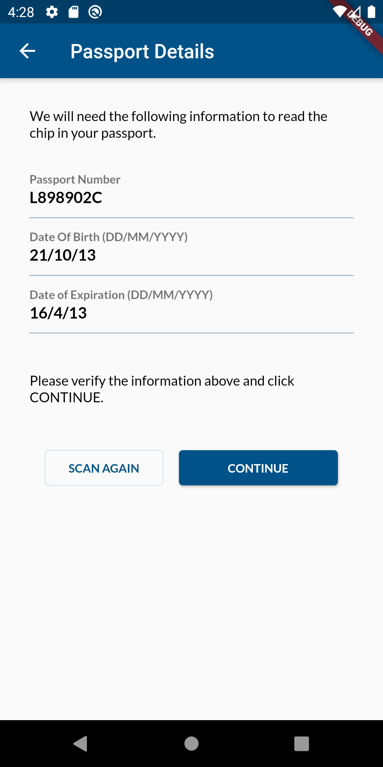
Passport Scan (MRZ)
Machine Readable Zone(MRZ), allows users to scan the identification page of the passport to read “Passport Details” -> Auto populate “Passport Details” page. This information is also needed to open the eChip.
CBP | OIT

Slide 8
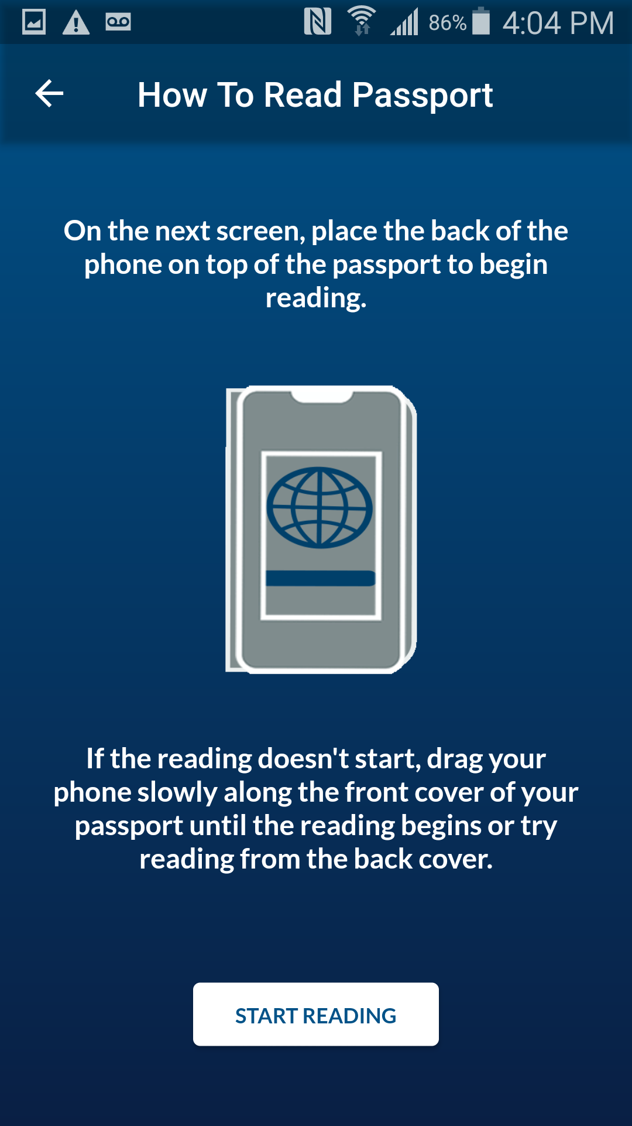
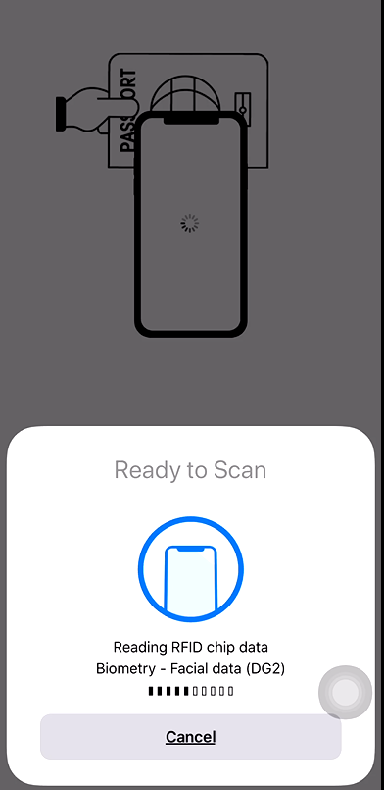
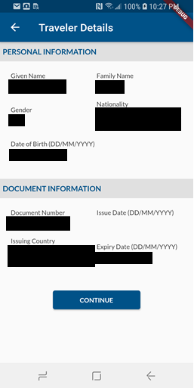
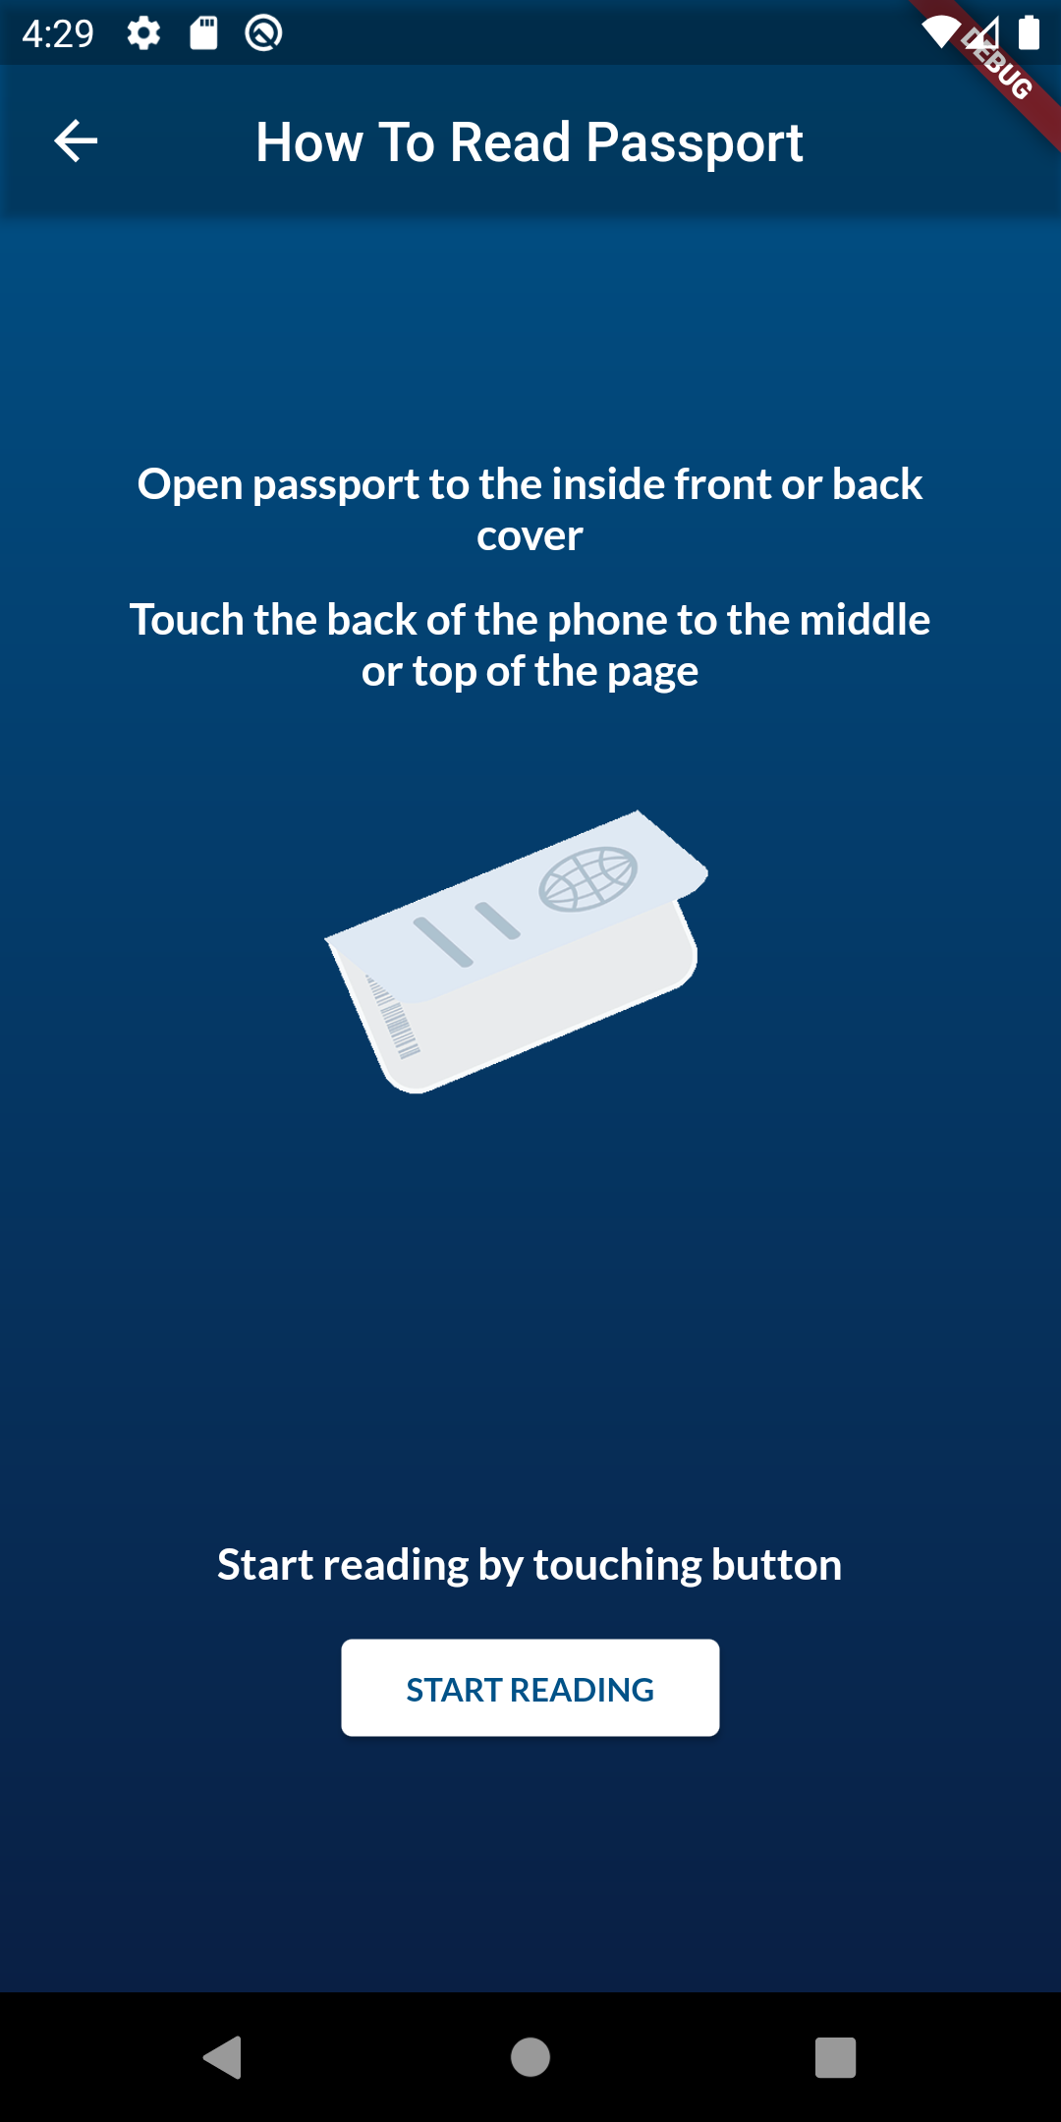
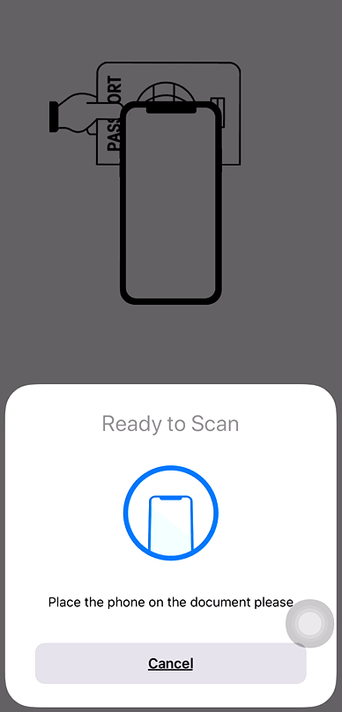
E-Passport Chip Read (NFC Scan)
E-Chip, contains data to enable the NFC Scan.
CBP | OIT

Slide 9
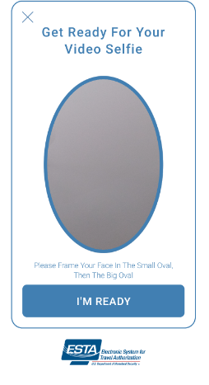
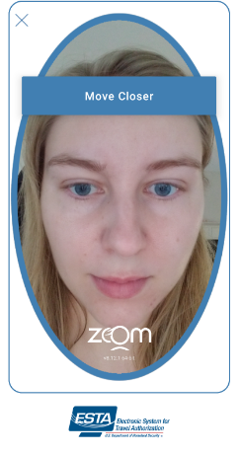
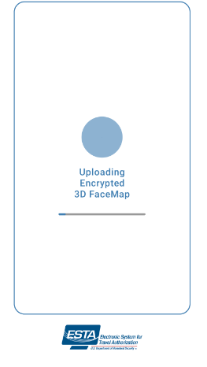
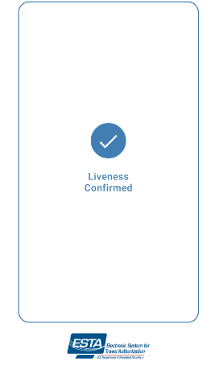
Live Photo Capture & Liveness Test (FaceTec)
CBP | OIT

Slide 10
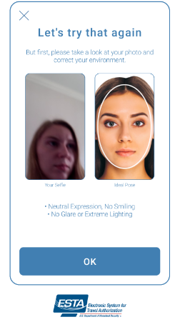
Live Photo Capture & Liveness Test
Liveness Photo Capture & Test, is an AI computer system’s ability to determine that it is interfacing with a physically present human being and not an inanimate spoof artifact.
*Only displayed when photos do not match
In the background, ESTA Mobile App performs a Photo Matching process to determine if the passport photo retrieved from the Passport NFC Scan matches the person who took the Live Photo, if the Liveness is confirmed.
The ‘Third Party Acknowledgement’ screen is only displayed if the Photo Matching service determines the Passport Photo and the Live Photo do not match.
Photo Mismatch
I certify submitting the application on behalf of the applicant
RETAKE PHOTO
CONTINUE
CANCEL
CBP | OIT

Slide 11
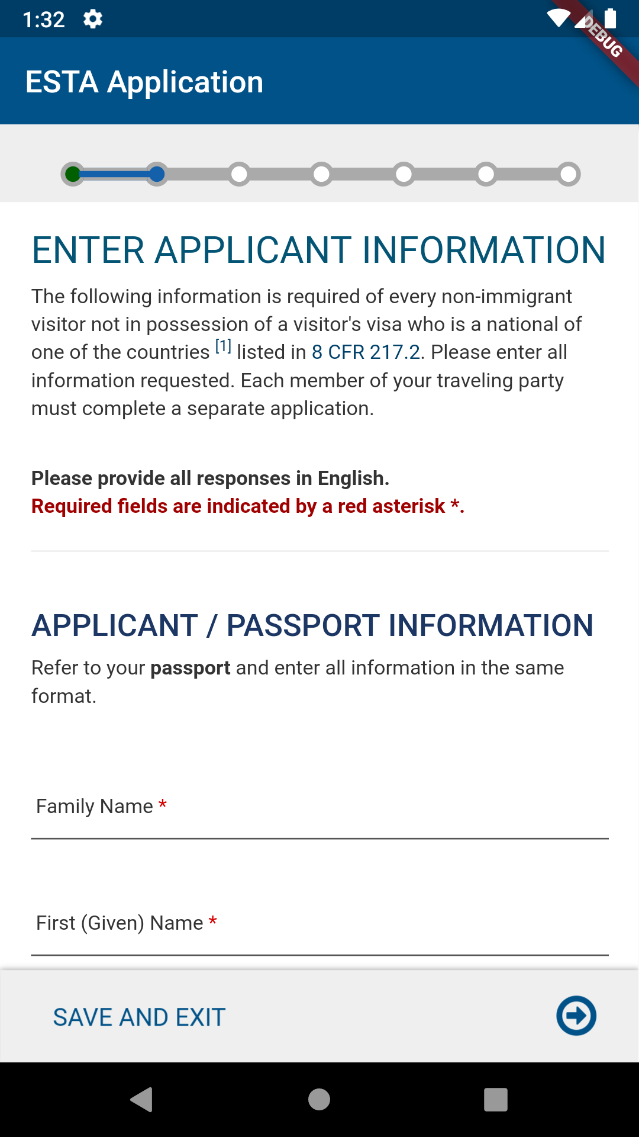
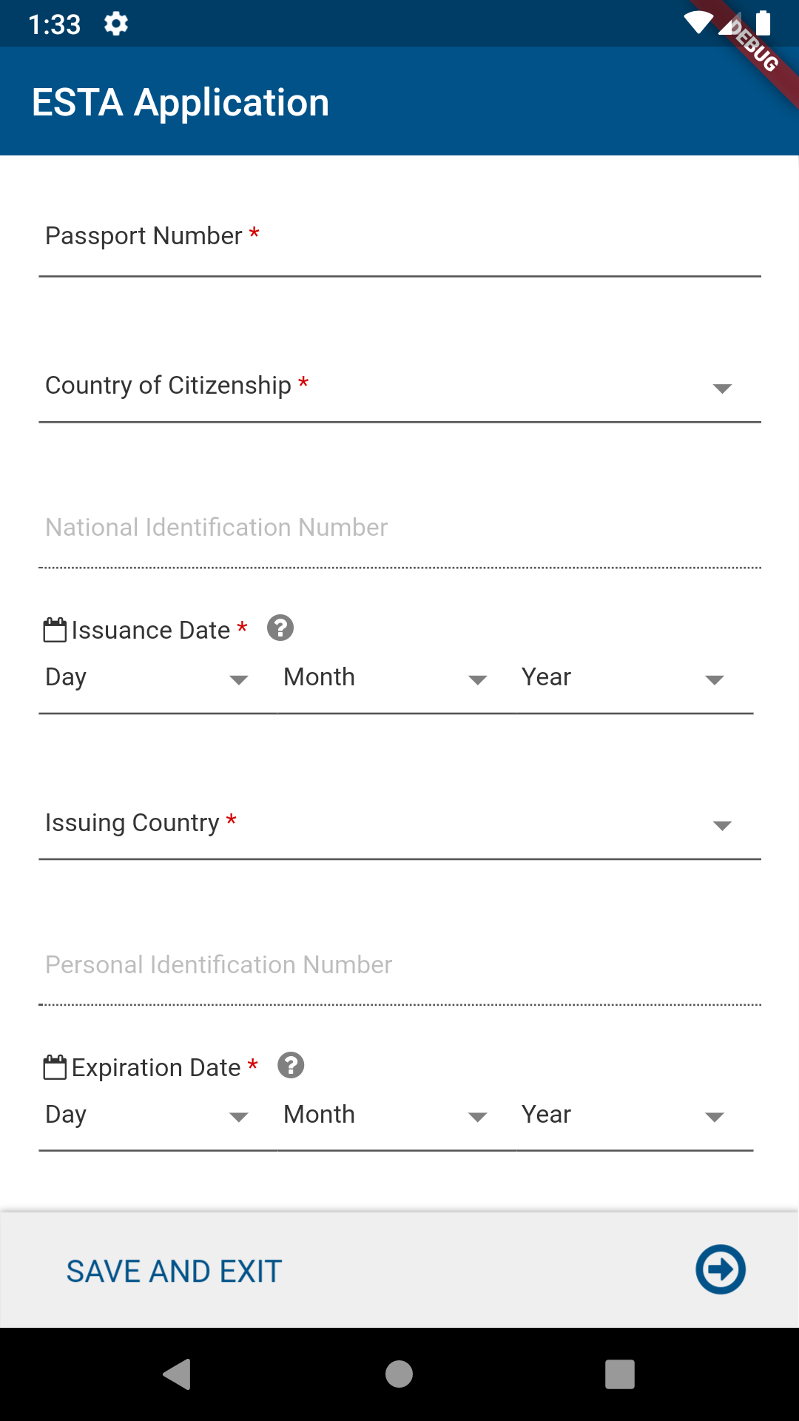
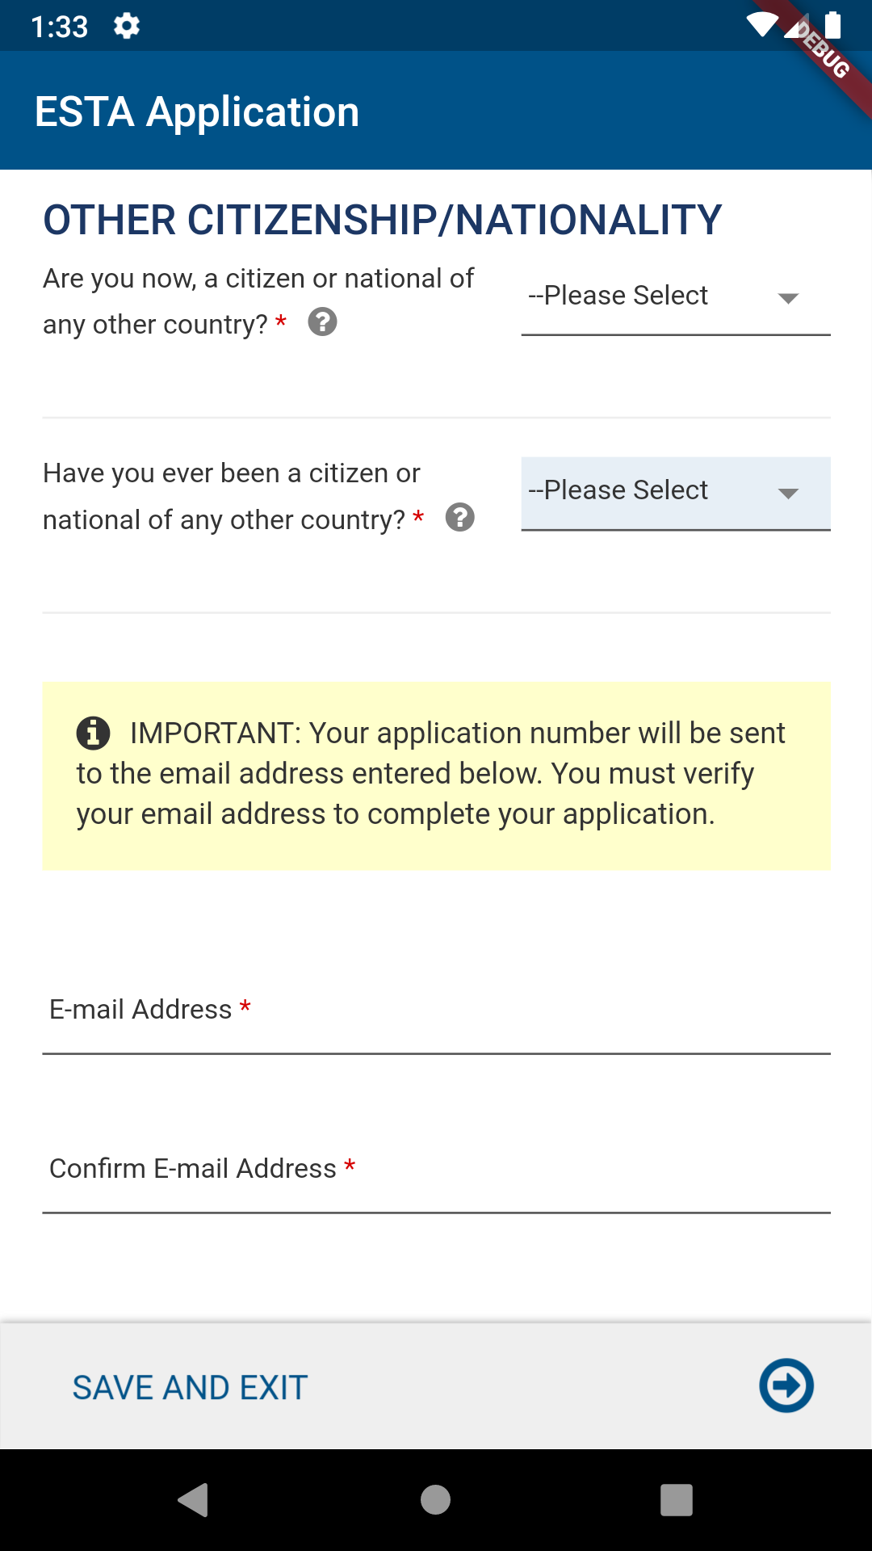
Enter Applicant Information page
Enter Applicant Information, After acknowledging the disclaimers, successful MRZ Scan, NFC Scan and Liveness Test, the applicant will be asked to enter the applicant information (or the information on the applicant’s behalf). The next few slides are the same as the ESTA web view.
CBP | OIT

Slide 12
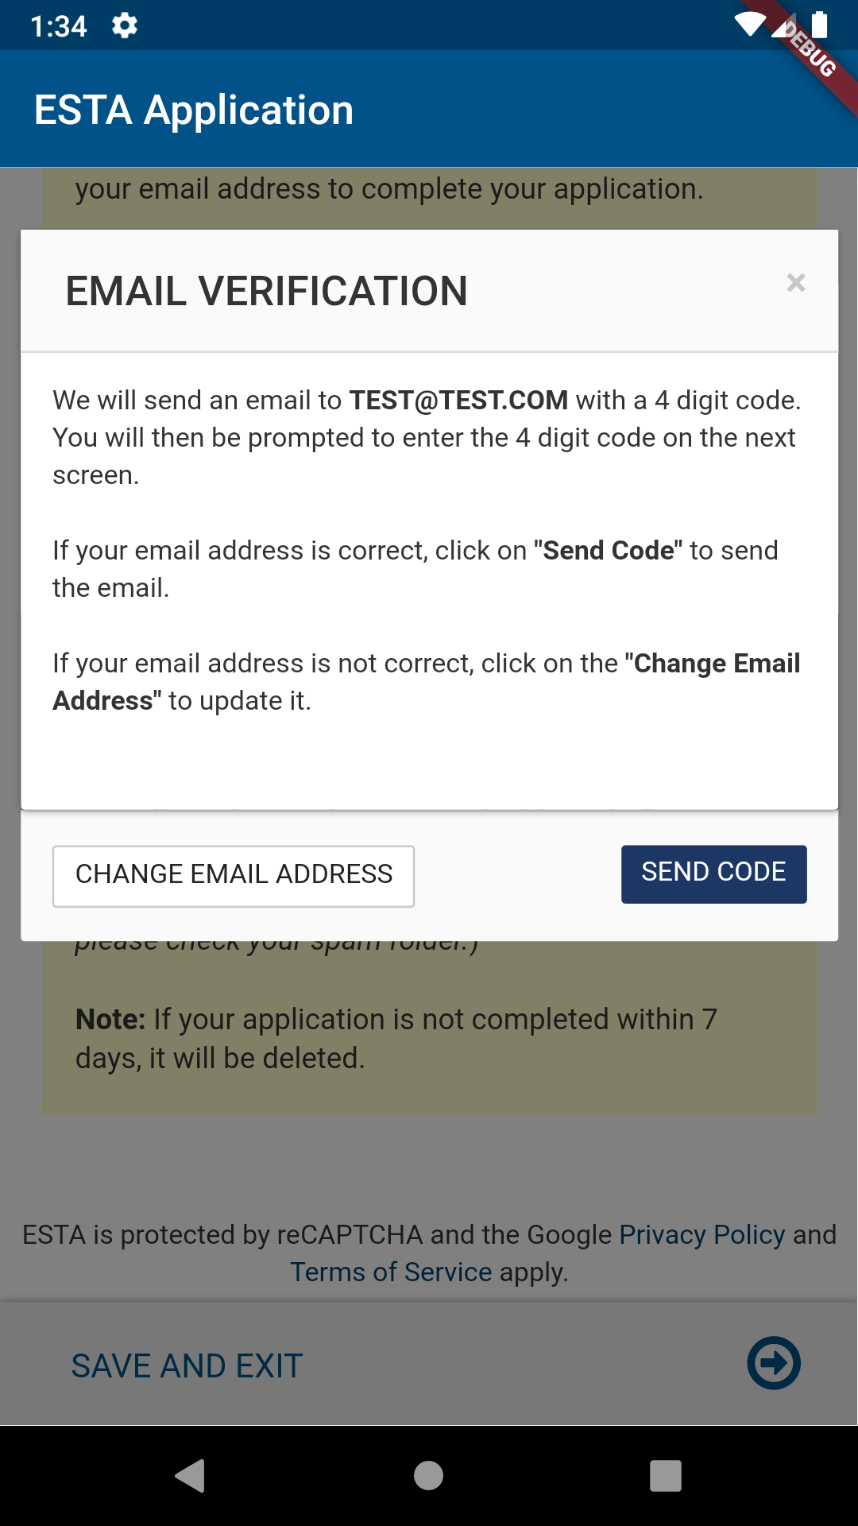
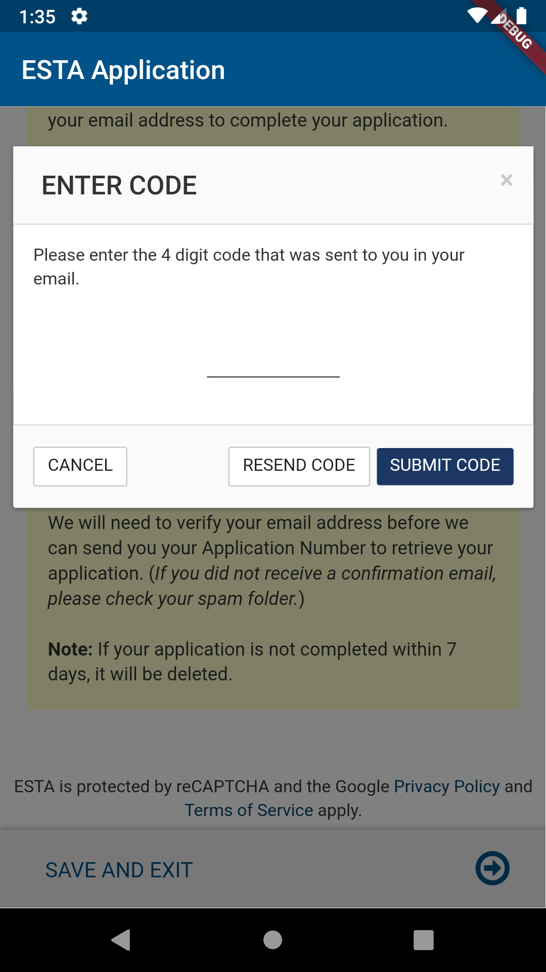
Email Verification
The “Email Verification” option prevents the user from proceeding to the application without verifying their email.
CBP | OIT

Slide 13
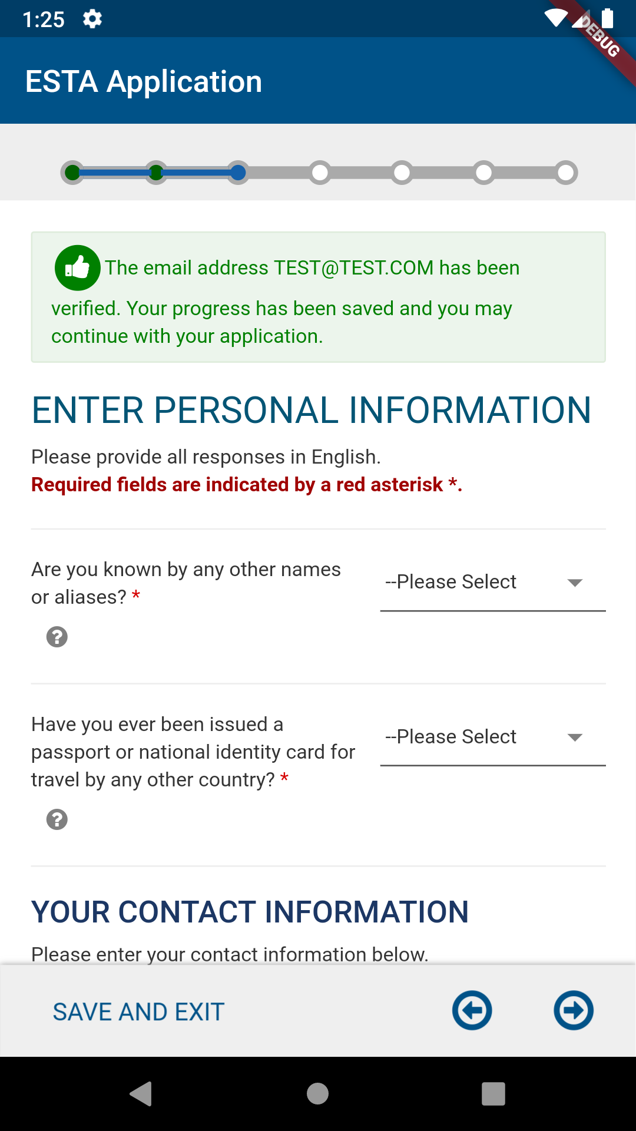
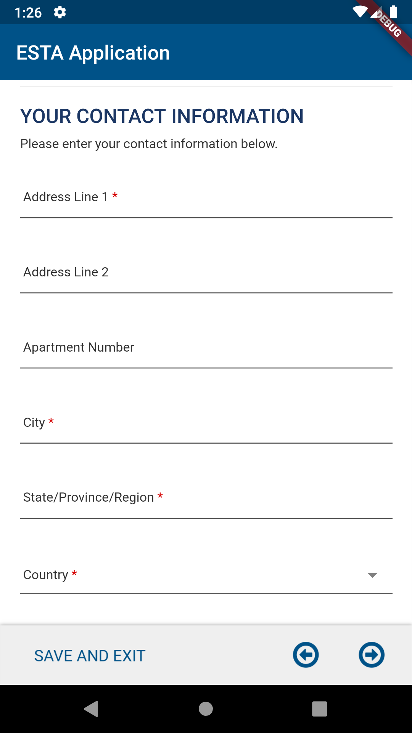
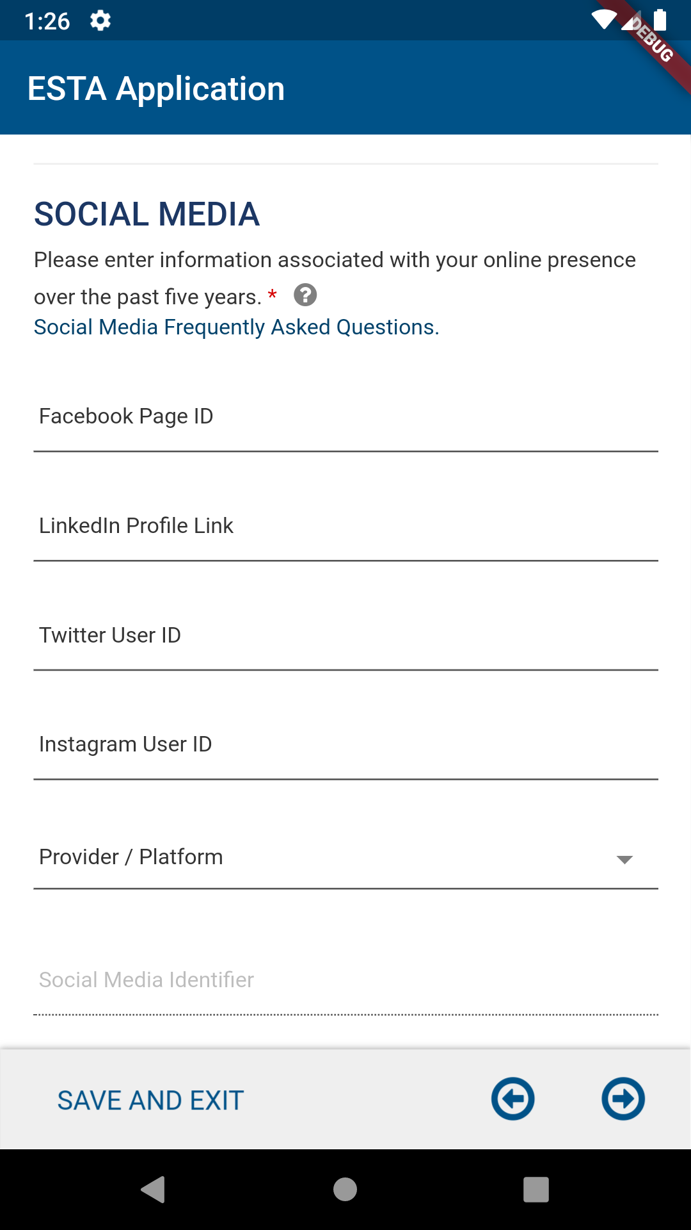
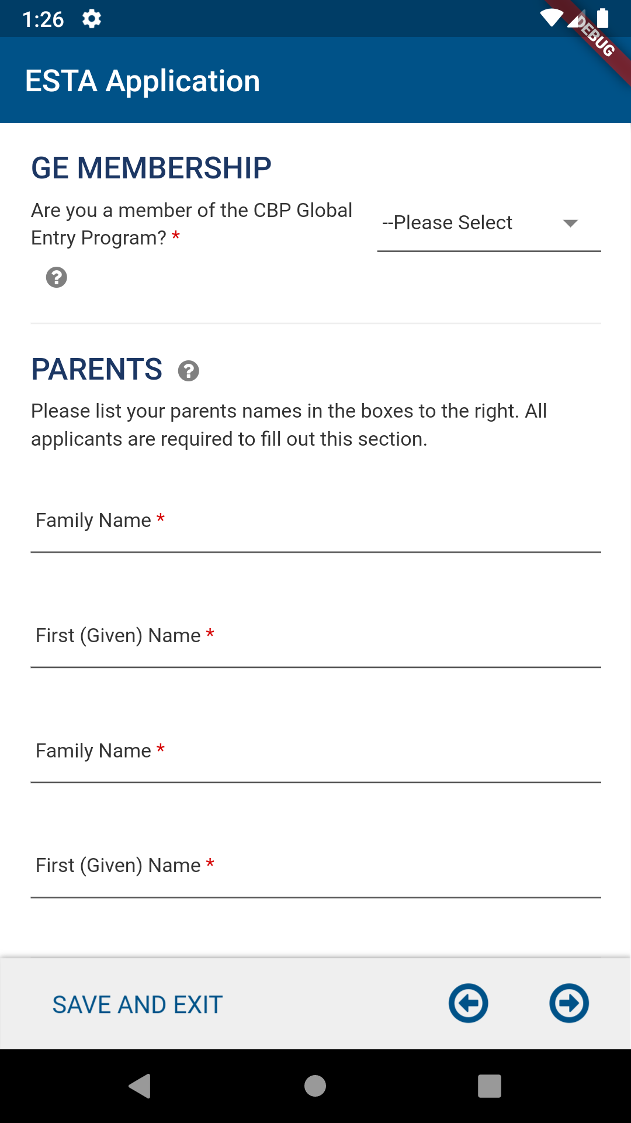
Enter Personal Information page
Enter Personal Information, After acknowledging the disclaimers the applicant will be asked to enter their personal information (or the information on applicant’s behalf).
CBP | OIT

Slide 14
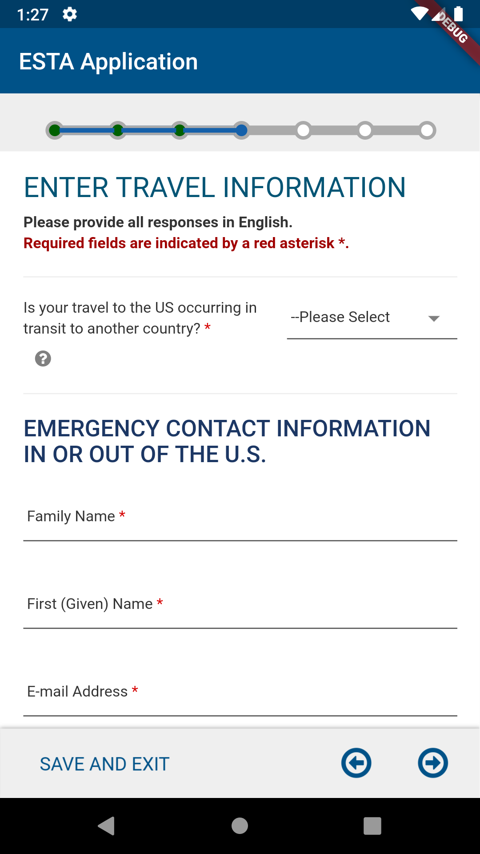
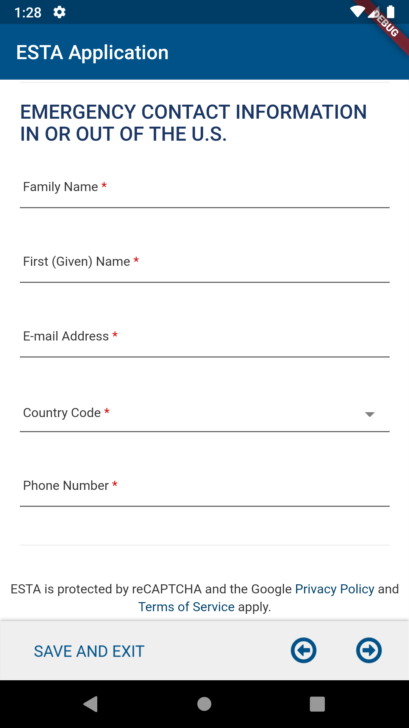
Enter Travel Information page
Enter Travel Information, After acknowledging the disclaimers the applicant will be asked to enter their travel information (or the information on applicant’s behalf).
CBP | OIT

Slide 15
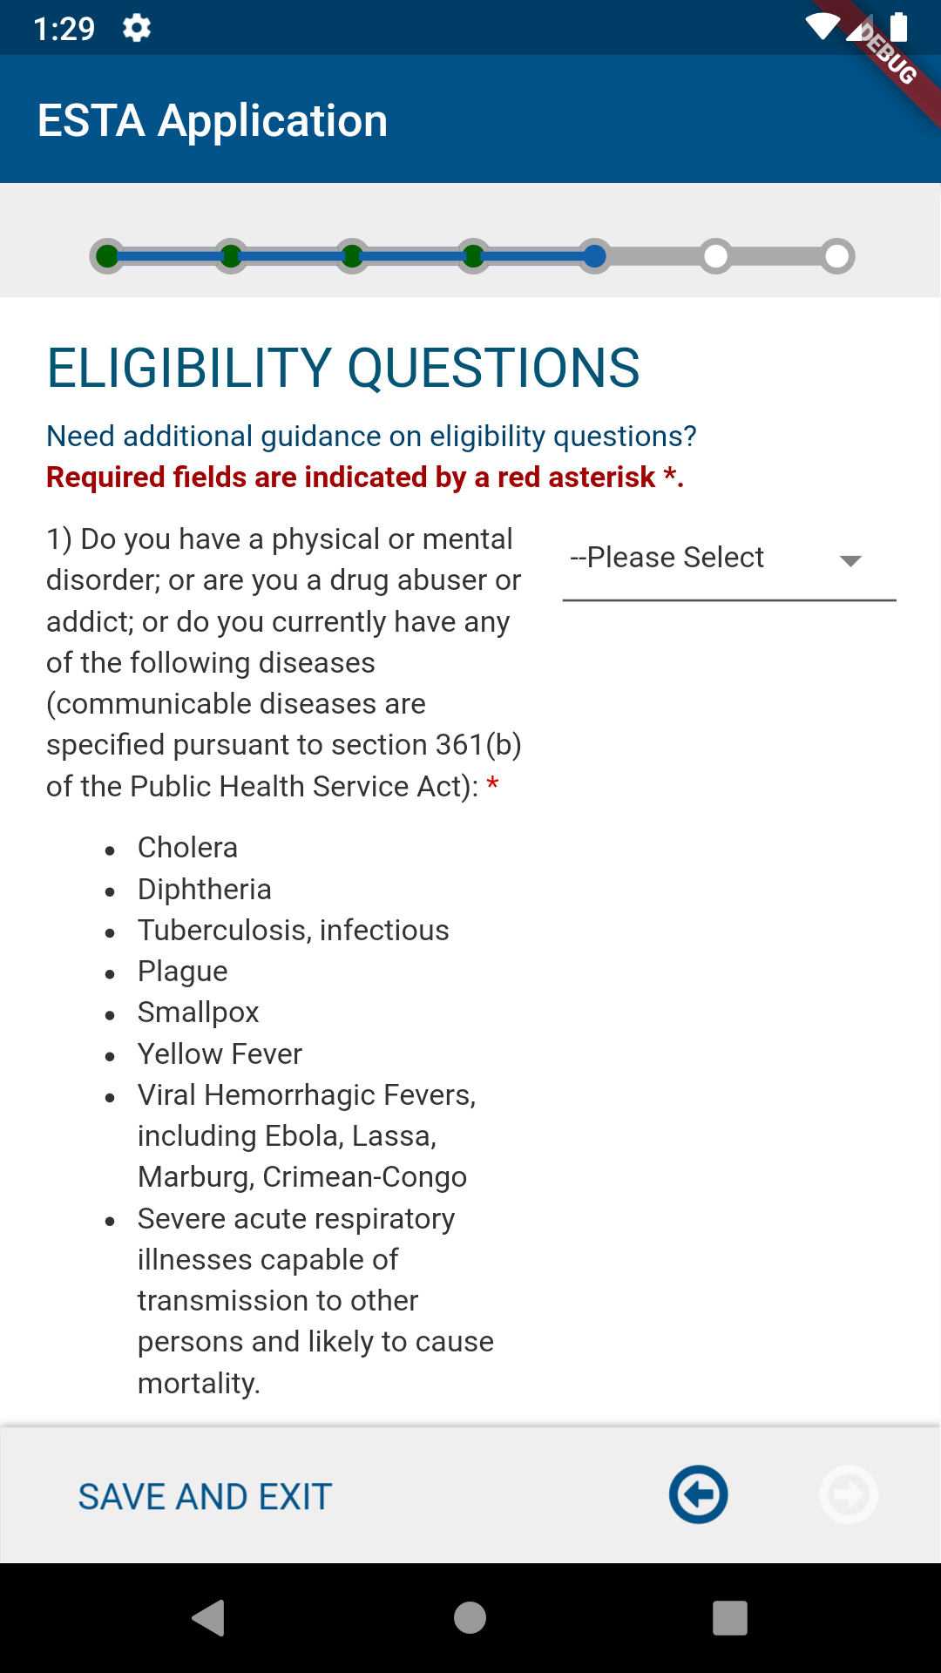
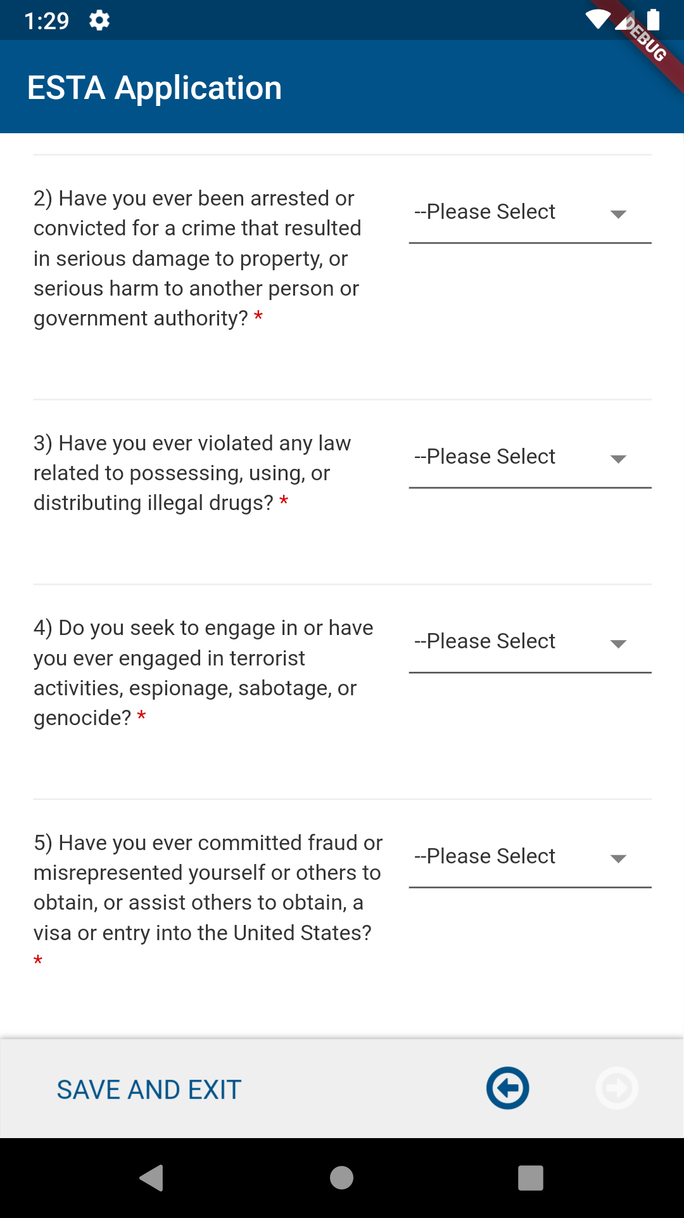
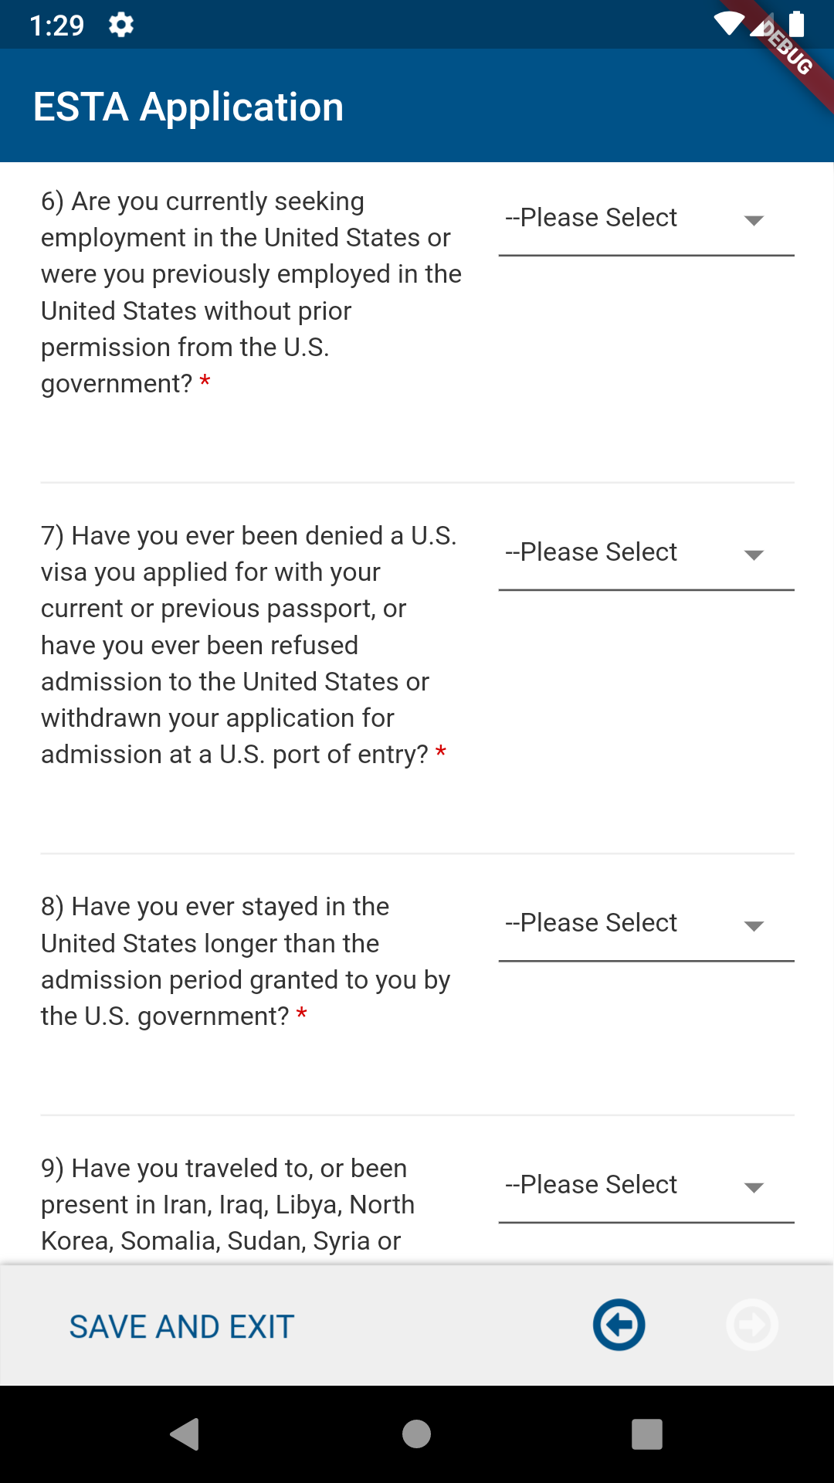
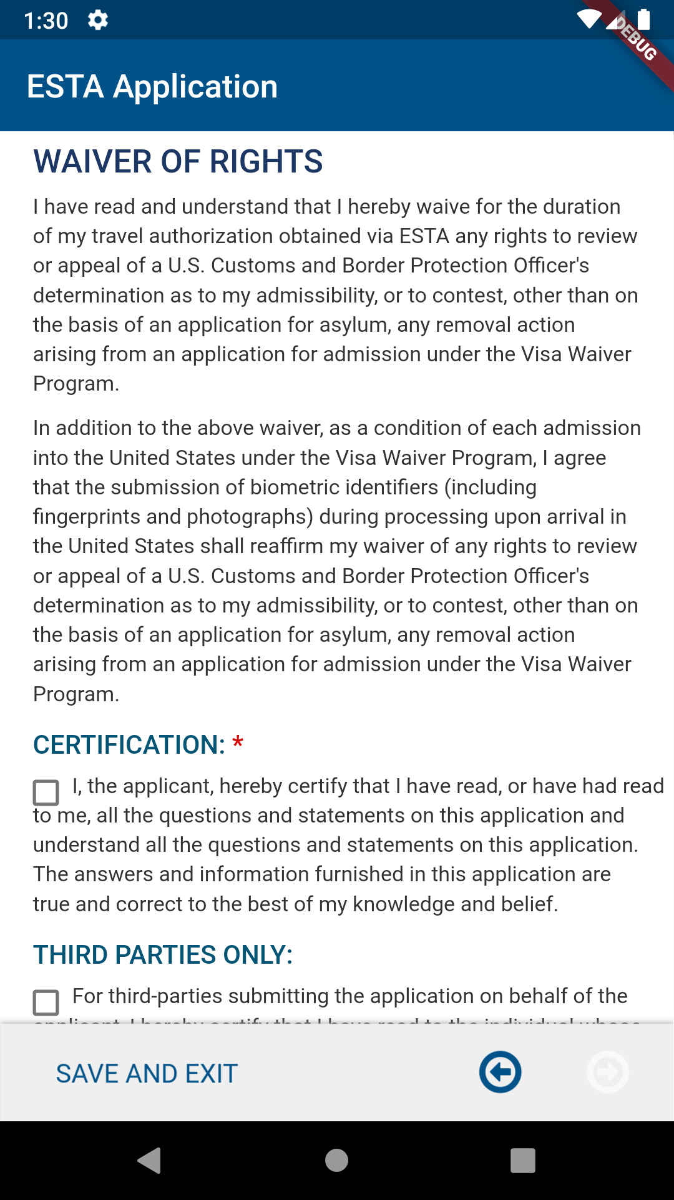
Eligibility Questions page
The Eligibility Questions determine vetting status of the applicant. Note: If a user selects “Yes” to this question 9, ESTA will prompt to select a primary reason for the trip. Certain options will prompt to fill out additional questionnaire.
CBP | OIT

Slide 16
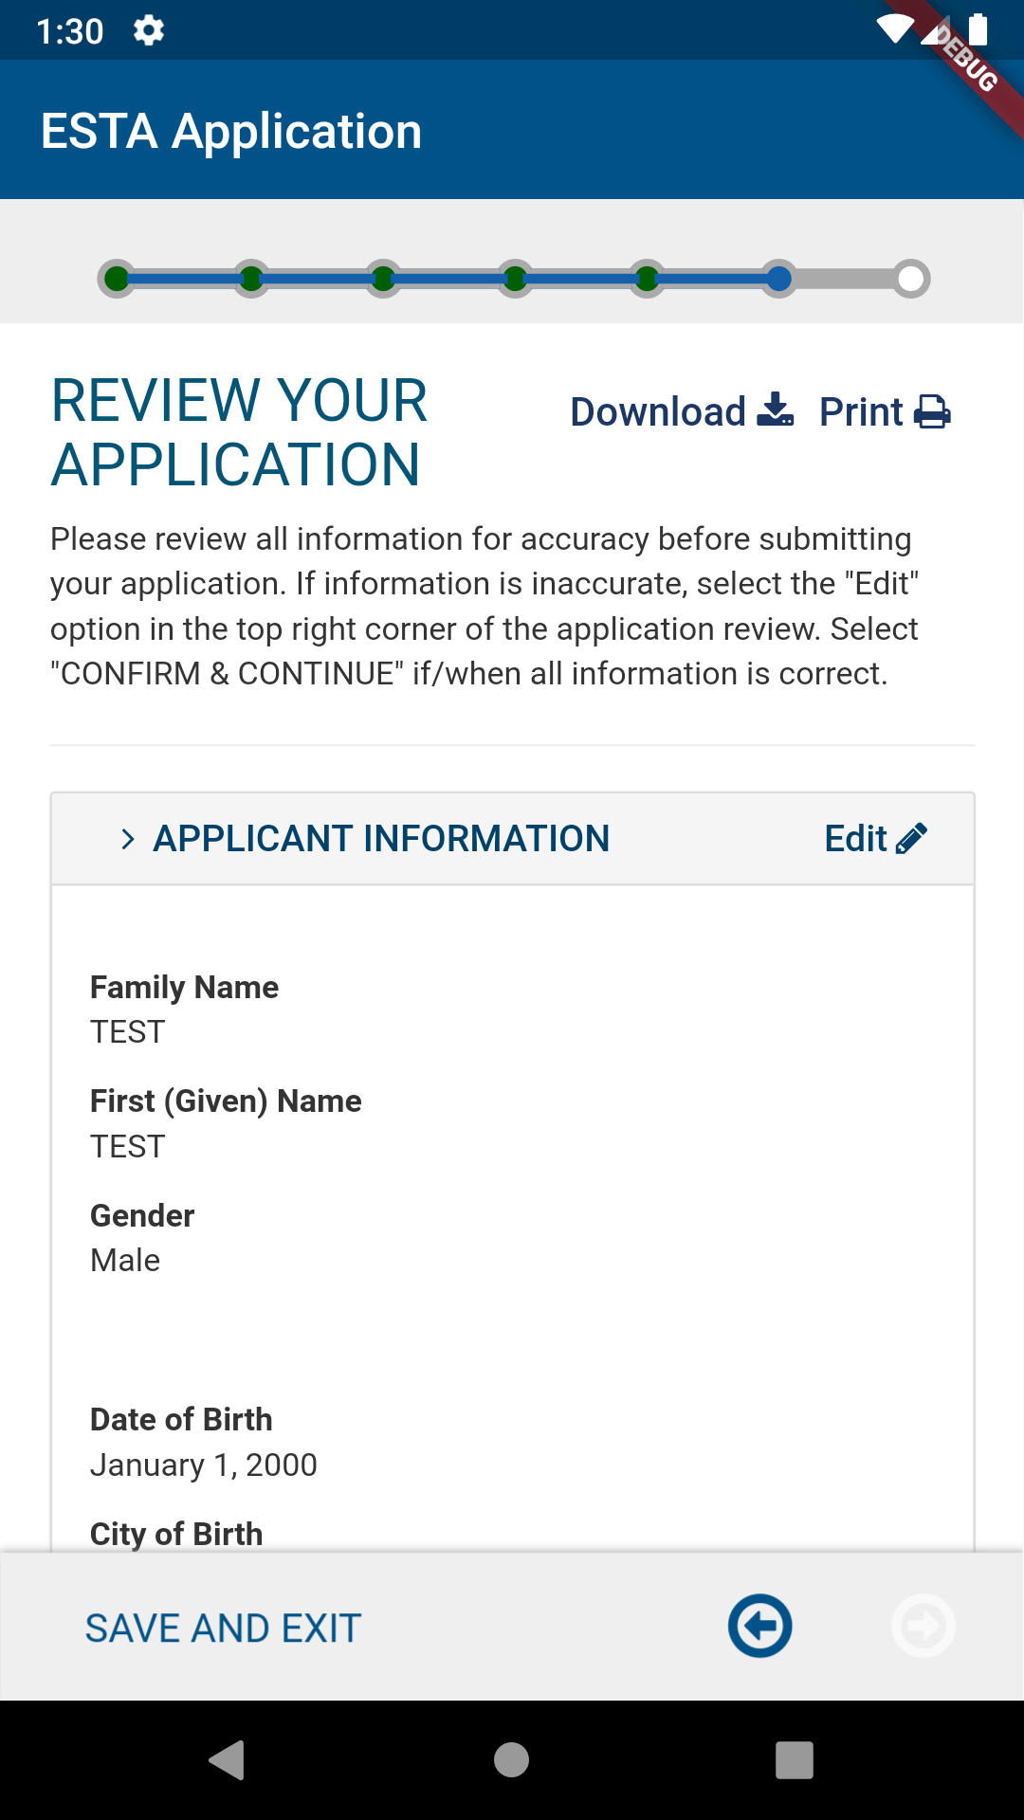
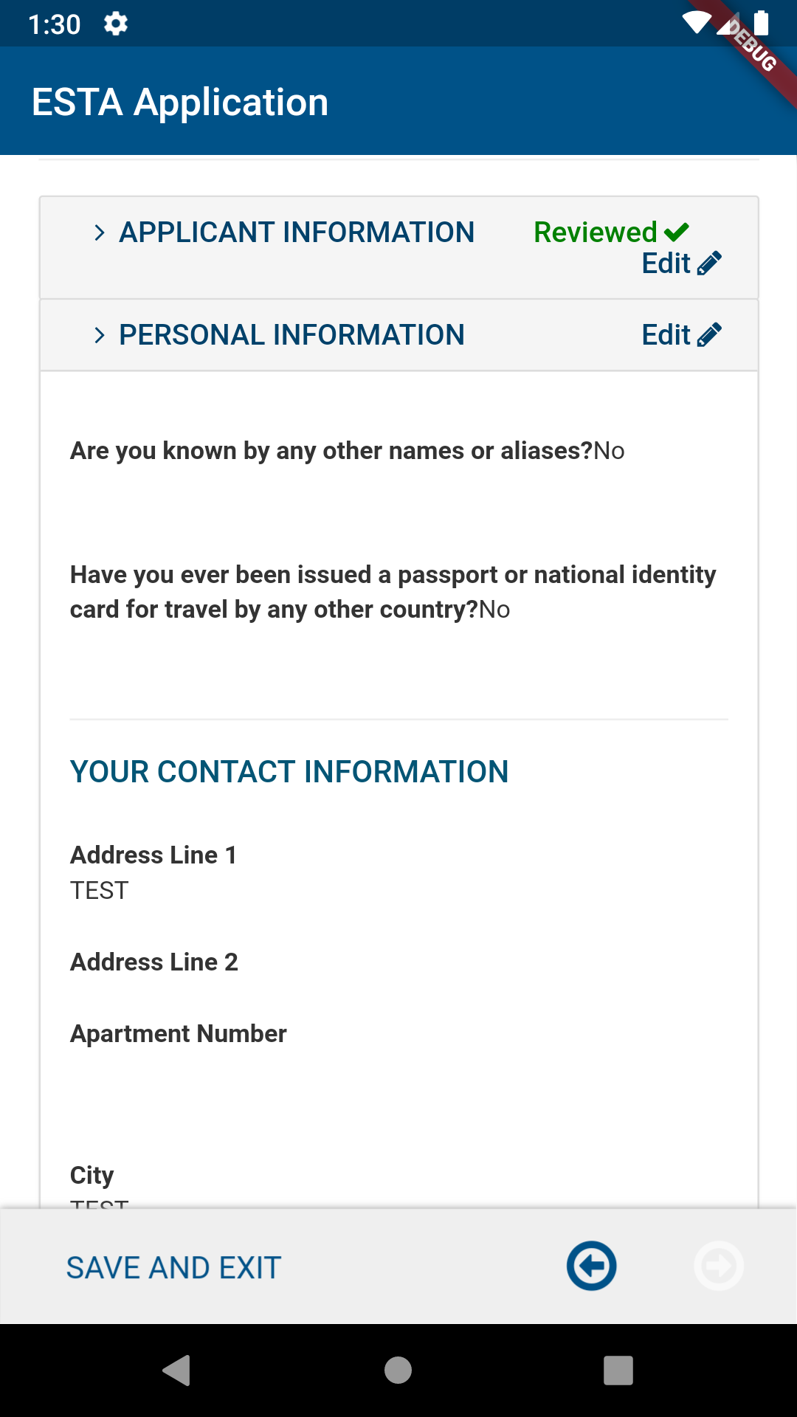
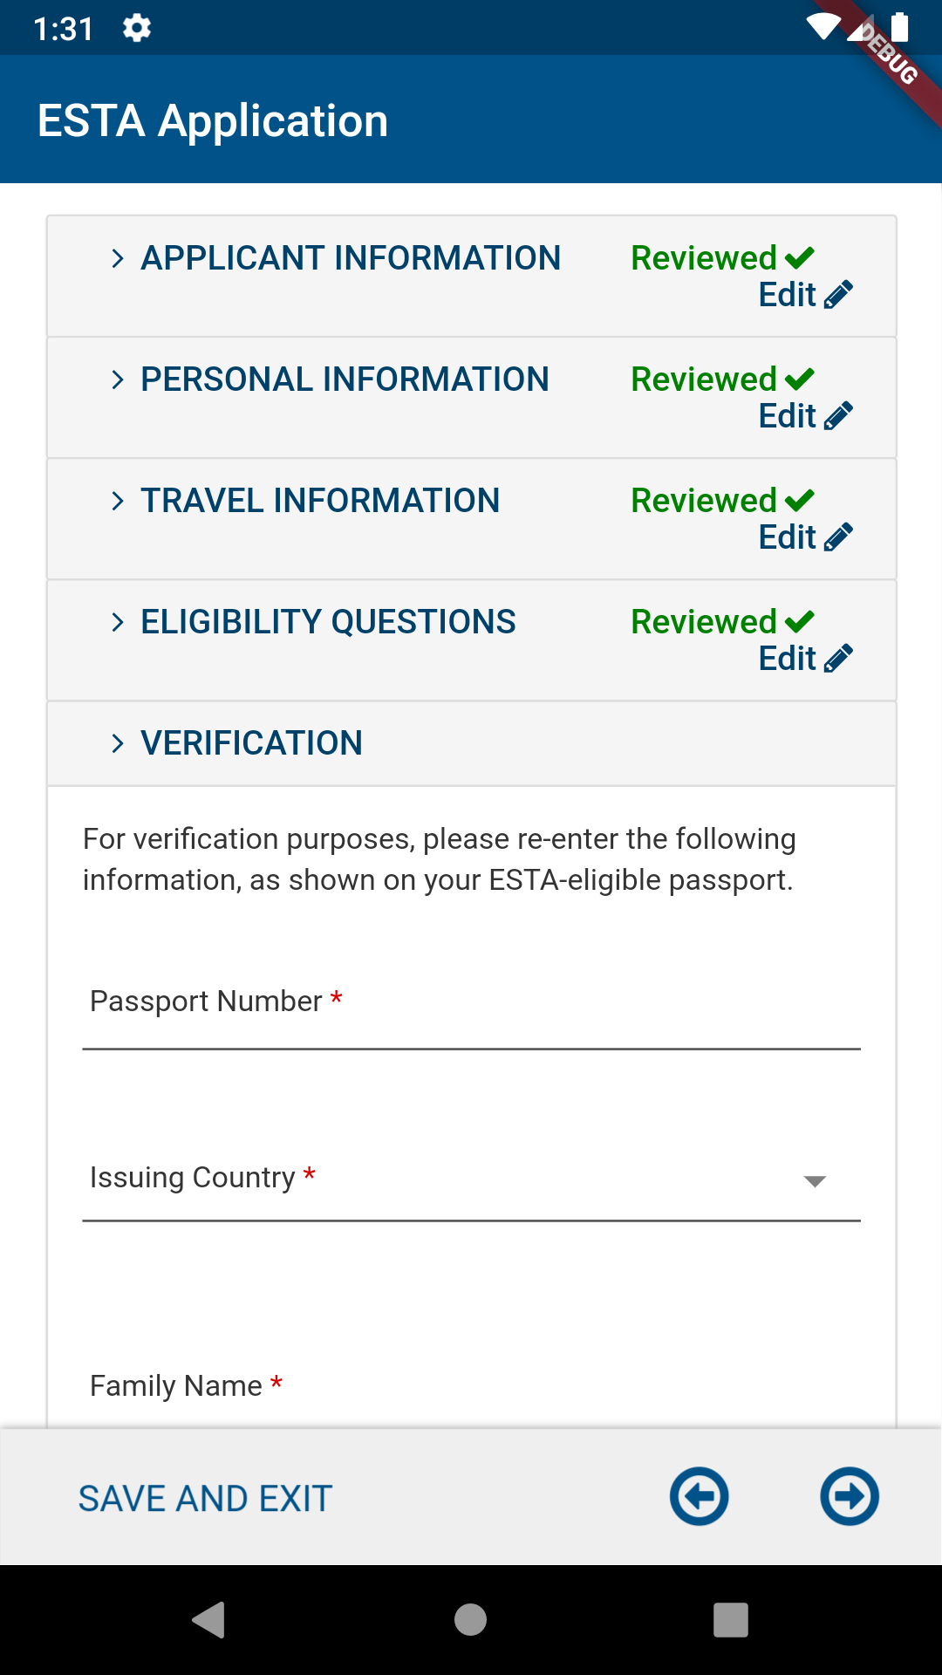
Review Your Application page
On Review Your Application, the applicant will be given the option to review and edit their application before they submit it. To complete this part of the application the applicant must select the “Confirm & Continue” icon on each section.
CBP | OIT

Slide 17
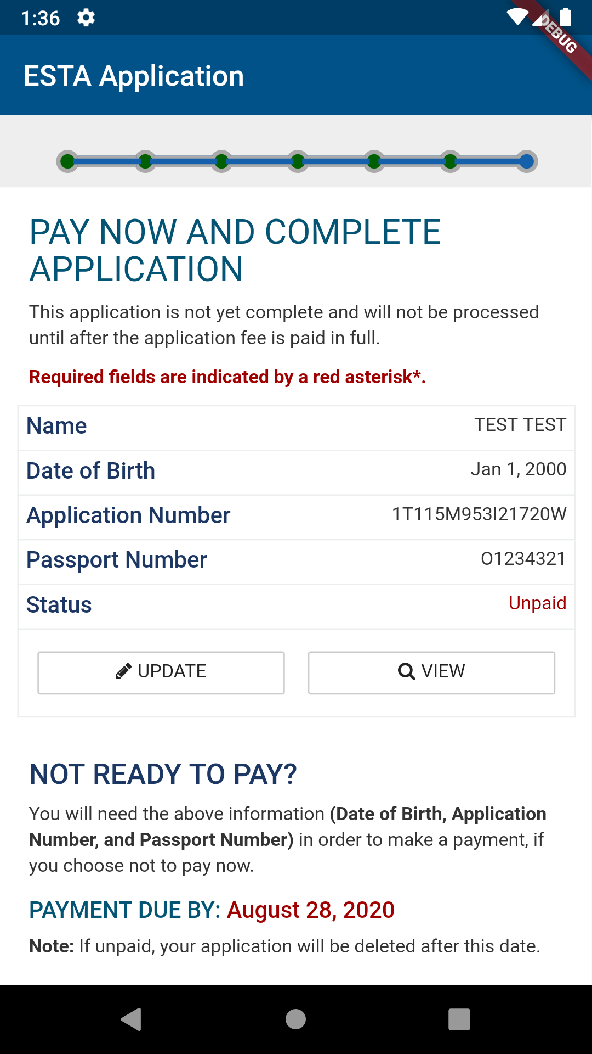
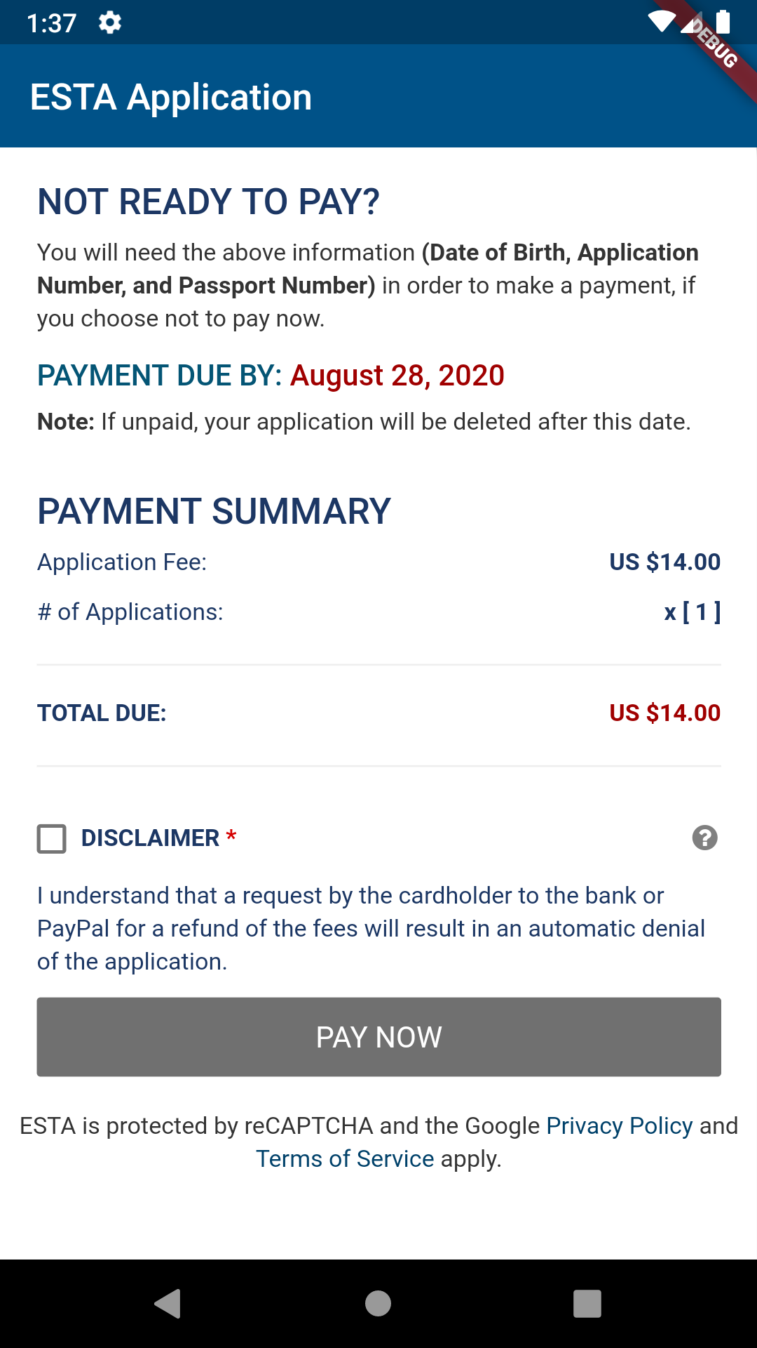
Pay Now and Complete Application page
On Pay Now and Complete Application, applicants can submit a payment by checking the Disclaimer and clicking the “Pay Now” button. After the user clicks the “Pay Now” button, the application will redirect to the Pay.gov website where the user will be given the option to pay via PayPal, credit or debit card.
CBP | OIT

Slide 18
Pay.gov pages
On Pay.gov, the user will be given the option to pay via PayPal, credit or debit card. Once the payment is complete, Pay.gov will redirect back to the ESTA app.
CBP | OIT

Slide 19
Home Page → FIND IT
The “FIND IT” option enables the user to retrieve an existing application.
CBP | OIT

Slide 20
Home Page → FIND IT → Search Results by Different Statuses
CBP | OIT

Slide 21
Home Page → FIND IT → Search Results for Payment Required Applications
After searching for an Application in Payment Required status, the user has three options:
VIEW DETAILS: Displays all information the applicant has entered for the application.
UPDATE: Navigates to the first page of application with all previously entered information filled.
PAY NOW: Navigates to the Web View of PAY NOW AND COMPLETE APPLICATION page where the applicant can view the Payment Due By date and Application Fee and Make a Payment.
CBP | OIT

Slide 22
ESTA Mobile App Icon
IOS
Android
CBP | OIT

