Slide 1

I-94 Web Application
U.S. Customs and Border Protection
Program Manager: Brian McGill
Program Manager Assistant: Soraena Giles-Outlaw
February 2021

Slide 2
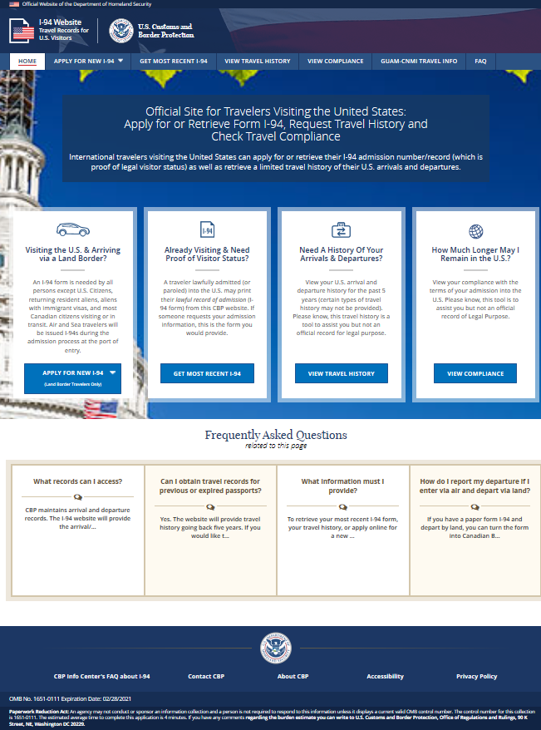
I-94 Home page

Slide 3
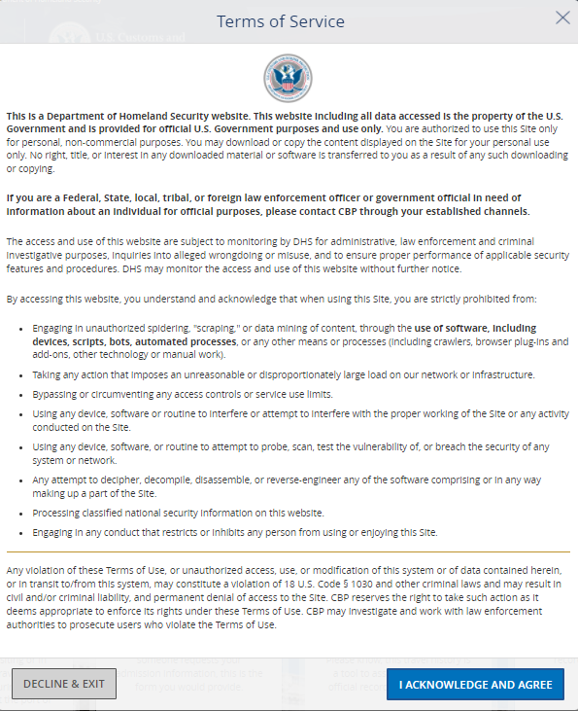
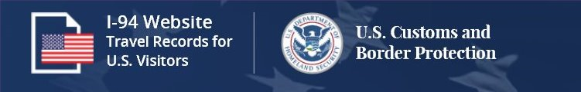
Security Notification
Users are required to confirm that they are eligible to create a provisional I-94. The Security Warning appears every time a user attempts to access the I-94 website.

Slide 4
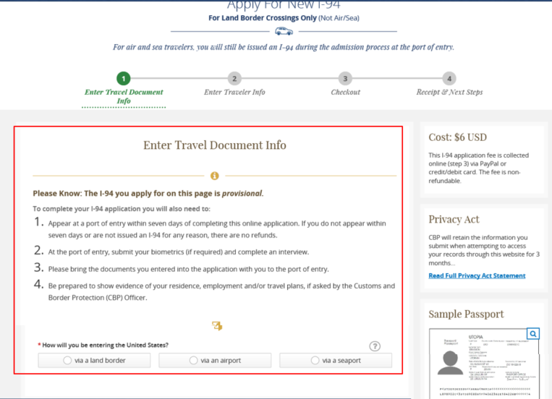
Obtain a Provisional I-94
Provisional I-94s can only be obtained for land crossings. This page warns the travel they are applying for provisional only and provides the steps for completing the I-94.

Slide 5
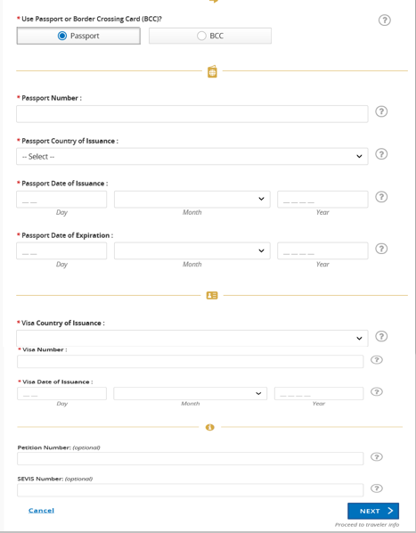
Obtain a Provisional I-94
Based upon the type of document selected, the traveler must fill in additional pieces of information. For Border Crossing Cards– this includes the Border Crossing Card number. Passports require the country of issuance, the issuance date, expiration date, visa number and visa issuance date.

Slide 6
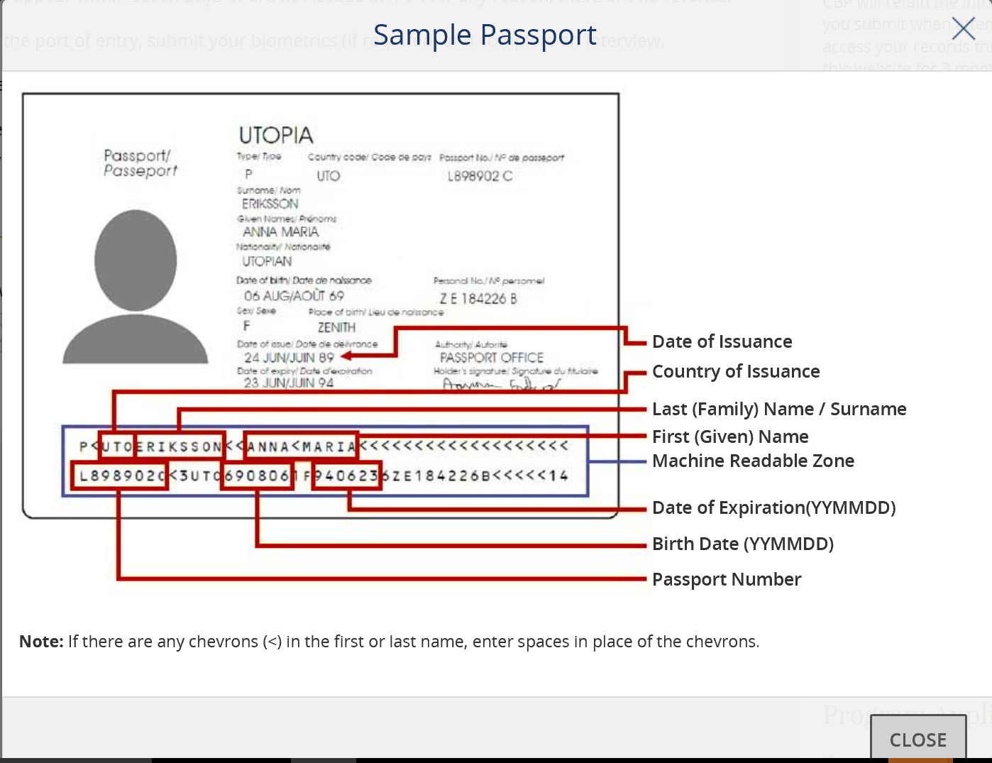
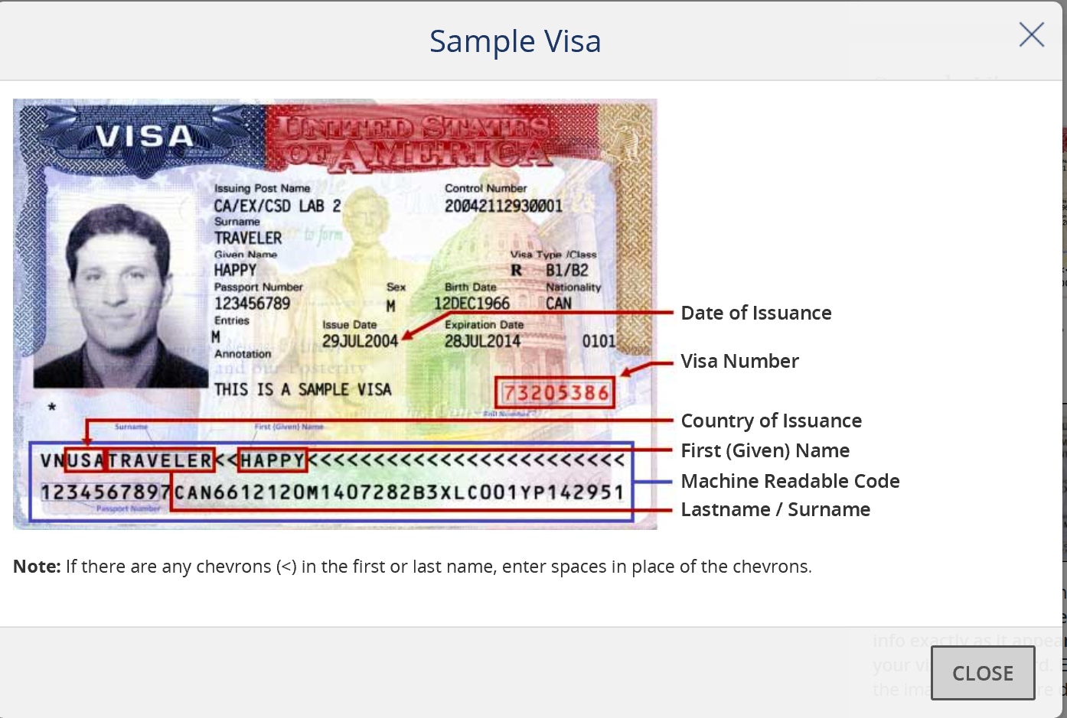
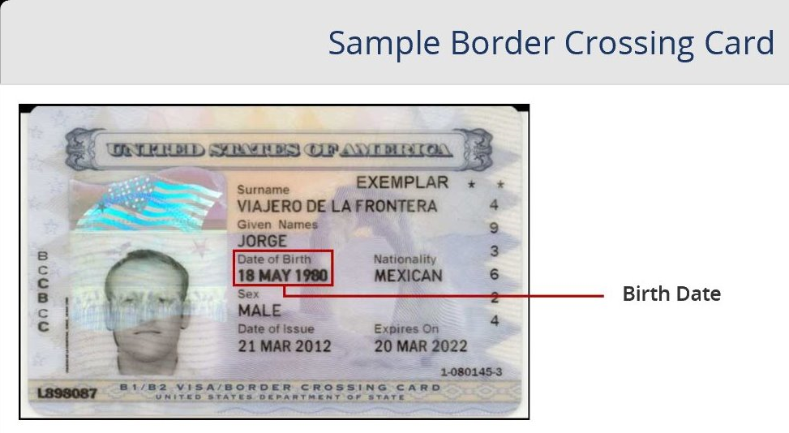
Obtain a Provisional I-94
Travelers can see sample versions of Border Crossing Cards and Passports for the information required by the form. Clickable images of each document can be displayed from every page within the I-94 website.

Slide 7
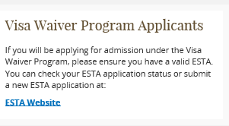
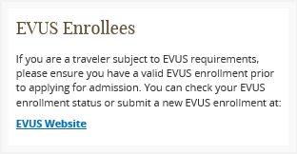
Obtain a Provisional I-94
.

Slide 8
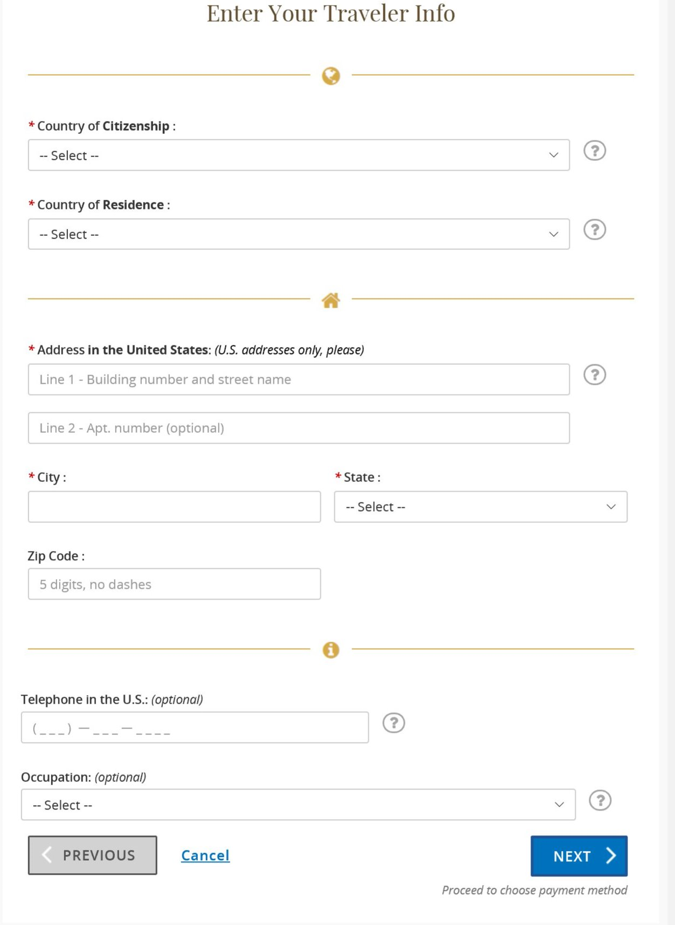
Obtain a Provisional I-94 (Continue)
After choosing the type of document, travelers must provide payment information including the city, state, zip code and address. All fields are needed to successfully process the payment.

Slide 9
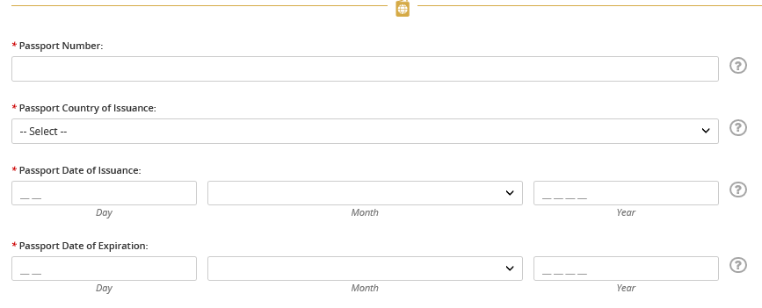
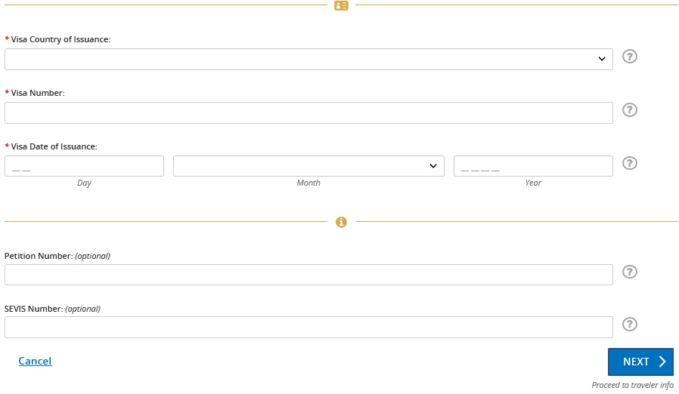
Obtain a Provisional I-94 (Continue)
After choosing the type of document, travelers must provide payment information including the city, state, zip code and address. All fields are needed to successfully process the payment.

Slide 10
Obtain a Provisional I-94 (Continue)
After choosing the type of document, travelers must provide payment information including the city, state, zip code and address. All fields are needed to successfully process the payment.

Slide 11
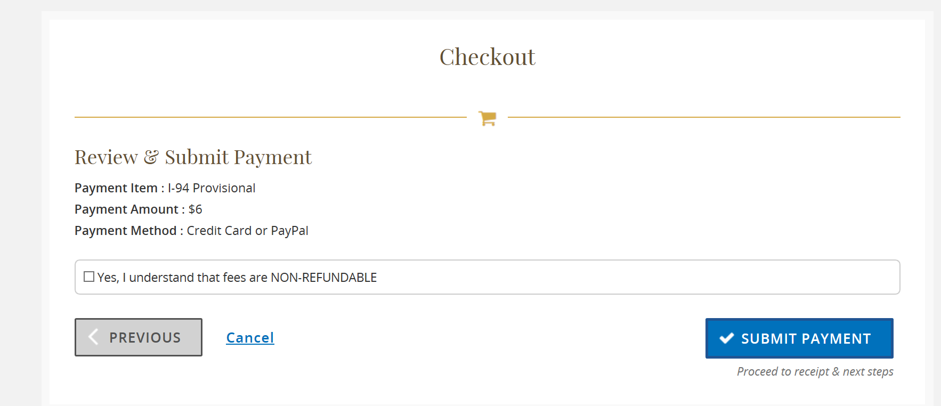
Obtain a Provisional I-94
Prior to the submission of payment to the Pay.gov portal, the user can review the receipt through our checkout page.

Slide 12
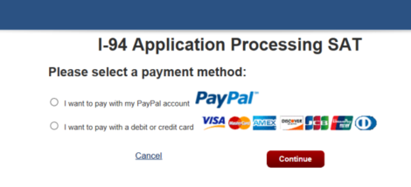
Obtain a Provisional I-94
Travelers can either pay for a Provisional I-94 using a credit card or via a PayPal account.

Slide 13
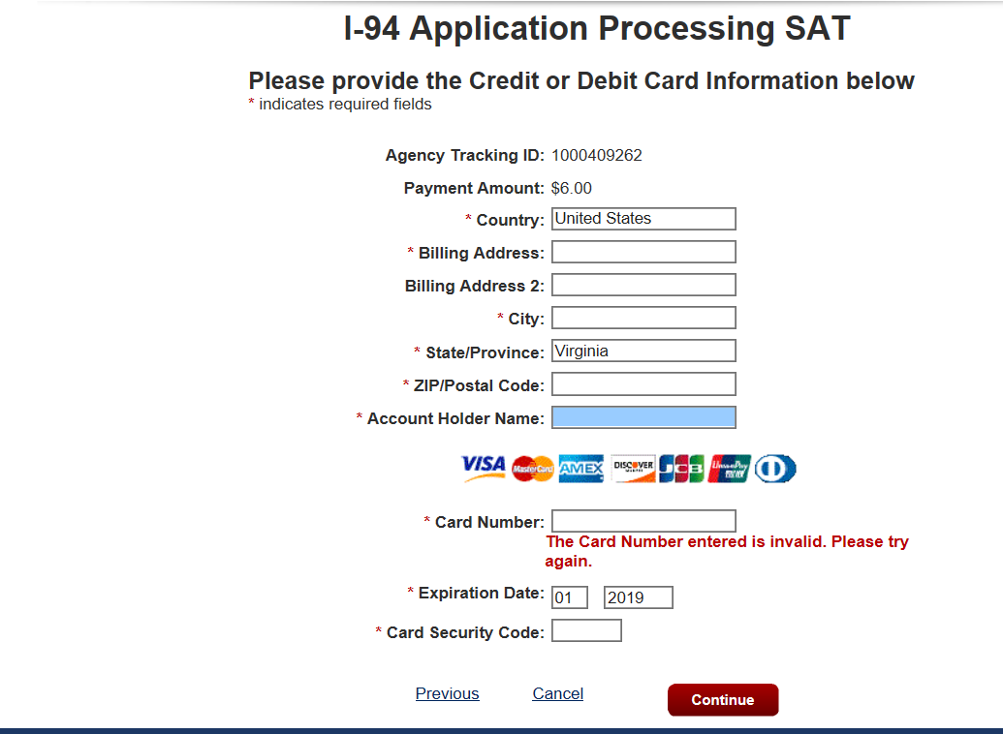
Obtain a Provisional I-94
Travelers must fill in their credit card information using the details on file with their credit card company. The I-94 website uses the Pay.gov interface to process credit cards.

Slide 14
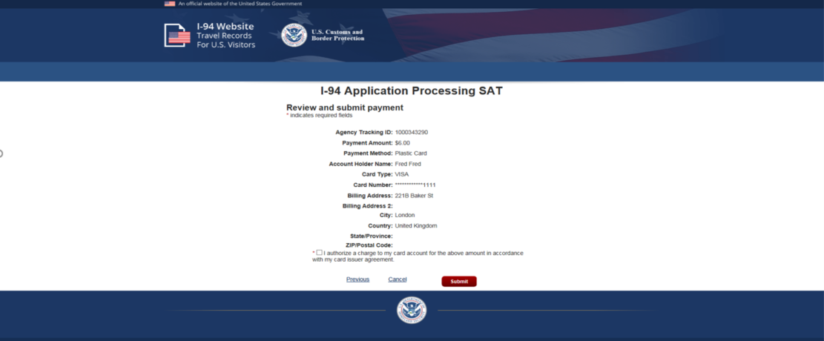
Obtain a Provisional I-94
After providing credit card information, the traveler can review their transaction prior to submission. On this page, the traveler submits their payment for processing with their credit card company.

Slide 15
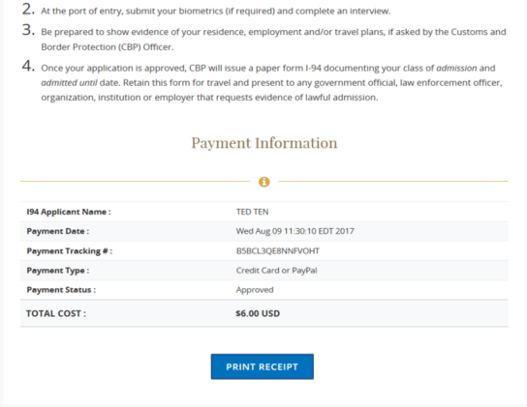
Obtain a Provisional I-94
After a successful payment, the I94 Website provides the traveler with a receipt of the transaction. The traveler can review their provisional I-94 through the “Get Most Recent I94.”

Slide 16
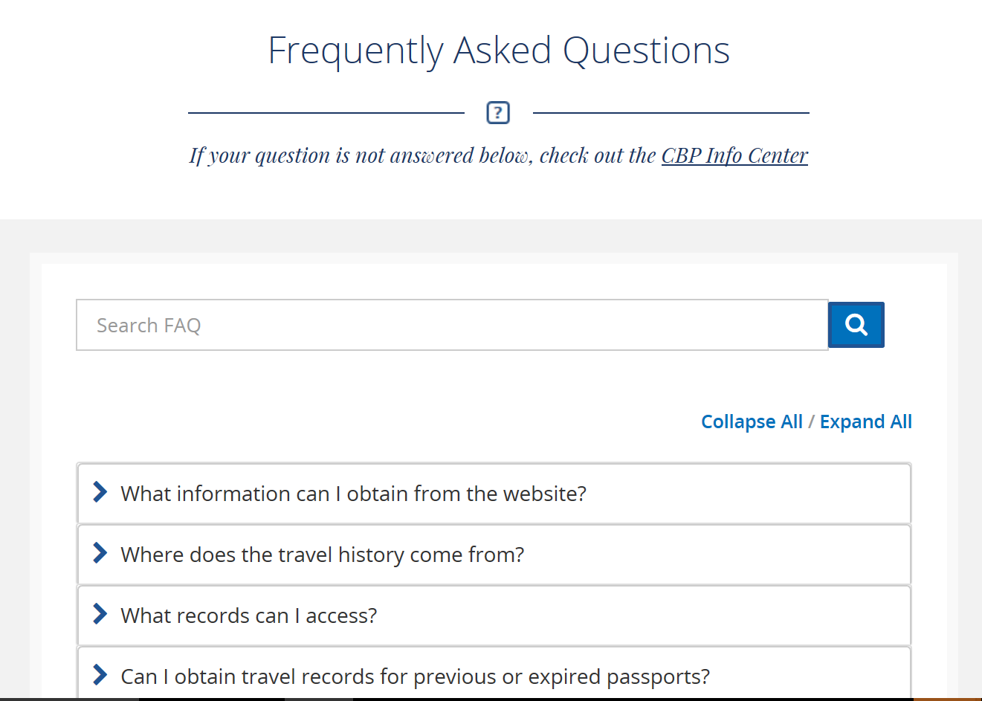
Frequently Asked Questions
Users can find details about the features of the I-94 website through the Frequently Asked Questions. These questions are designed to provide travelers with the most up to date information about the varies options available on the website.

Slide 17
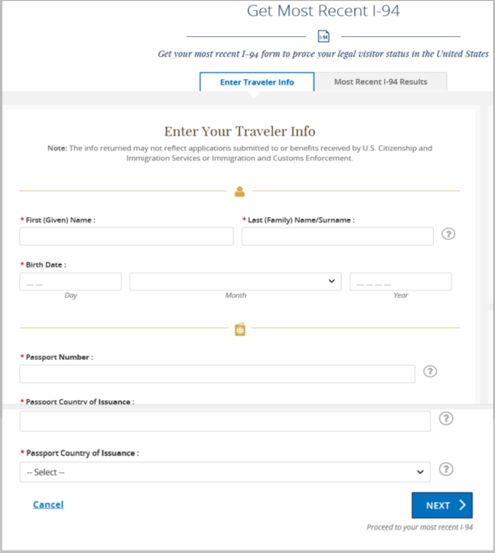
Get Most Recent I94
Travelers can search for their most recent provisional I-94 by providing their name, Date of Birth, Passport Number and county of issuance. Help and guidance is provided through interactive interface.

Slide 18
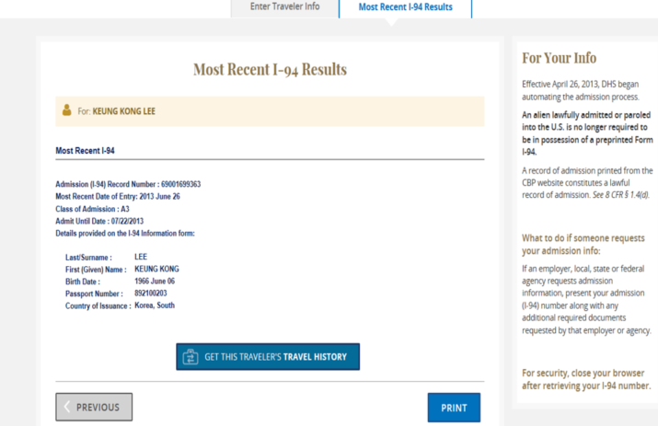
Get Most Recent I94
Travelers can review their most recent I-94 document. Details include the Admit Until date, the Class of Admission and the I94 receipt number.

Slide 19
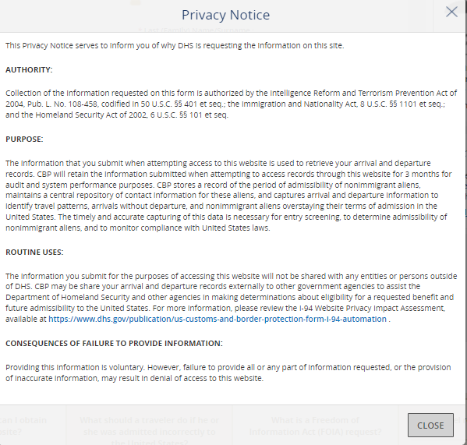
Privacy Act Statement
Every I-94 website page has the CBP Privacy Act statement showing travelers the regulations associated with the information collected.

Slide 20
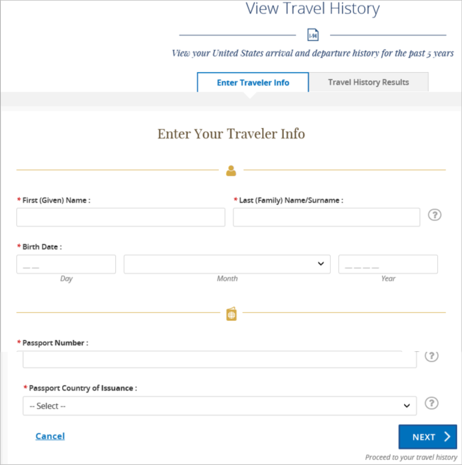
Travel History
Travelers can review their travel history through submissions of I94 documents reviewed by CBP. Users enter their name, Date of Birth, Passport Number and Country of Issuance.

Slide 21
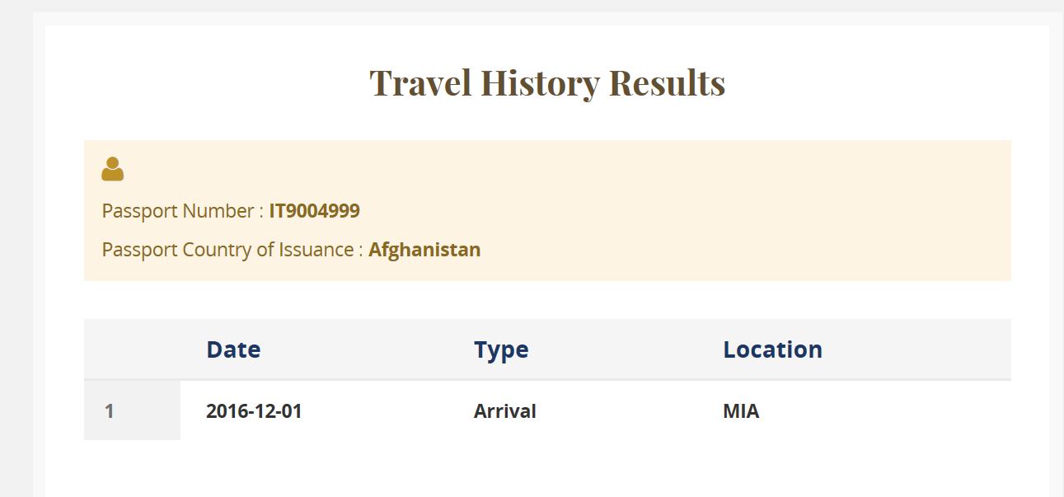
Travel History
Result from travel history provide the date of entry, the mode of travel and the arrival/departure date.

Slide 22
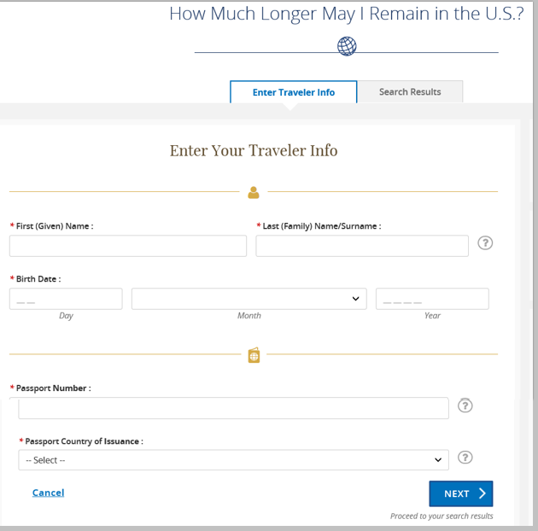
Travel Compliance
Travelers can review their travel history through submissions of I94 documents reviewed by CBP. Users enter their name, Date of Birth, Passport Number and Country of Issuance.

Slide 23
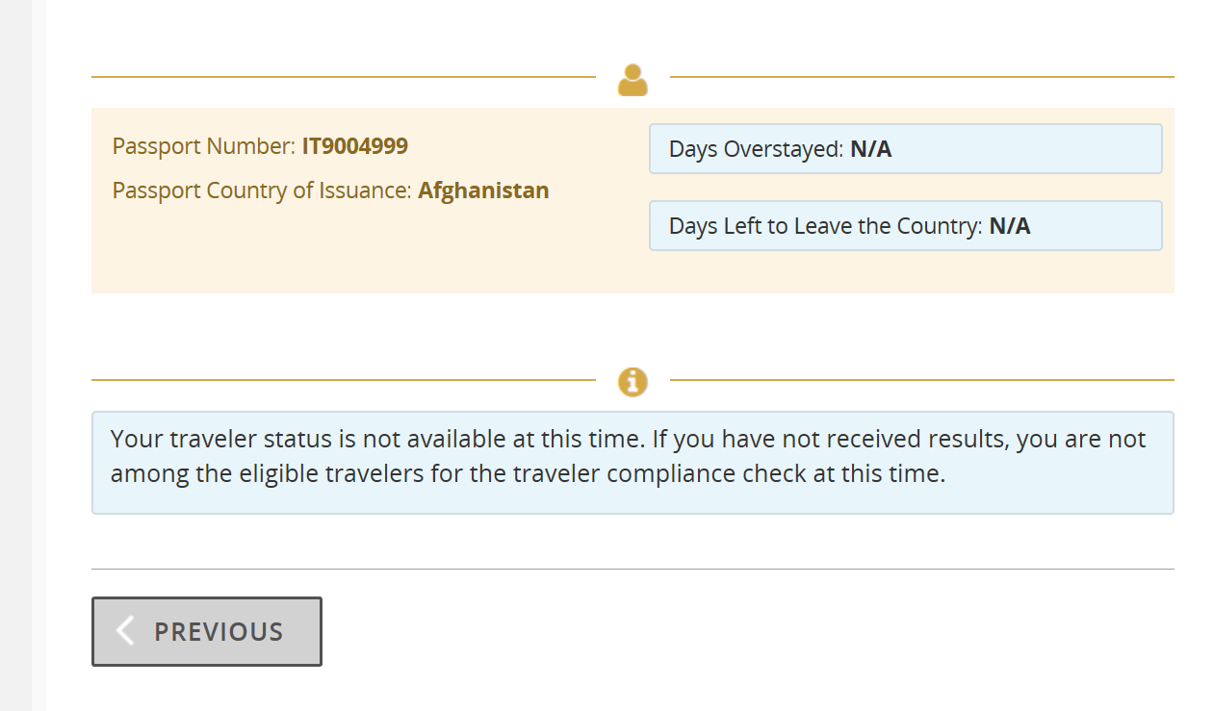
Travel Compliance
Travelers can review the number of days left on their visa, the passport number and the country of issuance. When users overstay, the system provides a detailed message of the next steps.

Slide 24
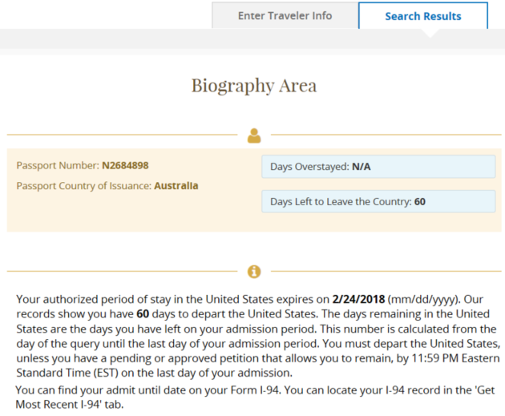
Travel Compliance
Travelers will be notified by email the days remaining in the United States. The days remaining in the United States are the days left in the travelers admission period. The number is calculated from the day of the query until the last day of the travelers admission period.

Slide 25
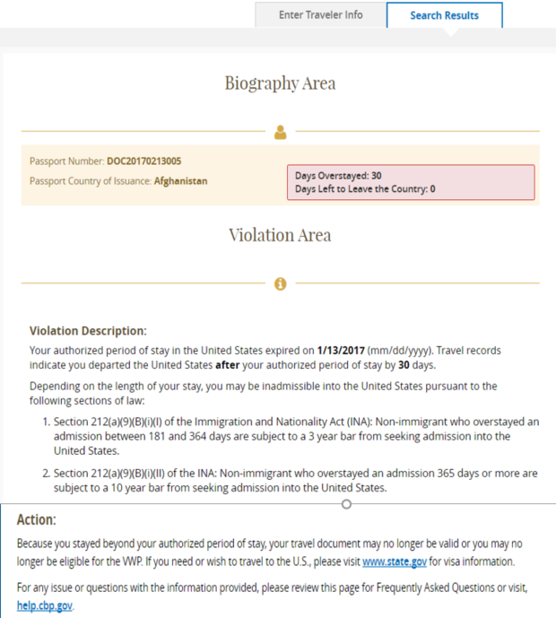
Travel Compliance
Displays the date the traveler became an overstay. Also display the number of days the traveler has overstayed. Include the violation description and action. Travelers will be notified by email.

Slide 26
Last updated by Soraena Giles-Outlaw 2/2021

