Slide 1

Provider Relief Fund (PRF)

Slide 2
PRF and ARPA–R Attestation Portal

Slide 3
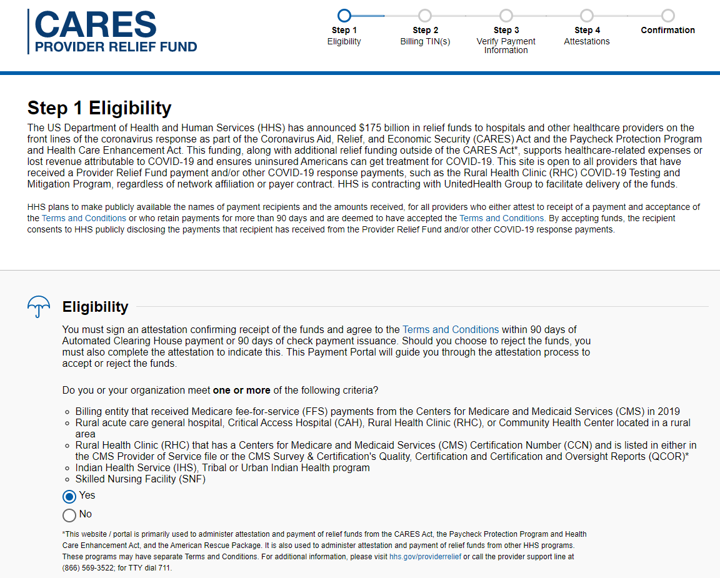
**All data displayed here is sample data for example purposes only.**
DRAFT
Notes:
To proceed further, please select Eligibility ‘Yes’.

Slide 4
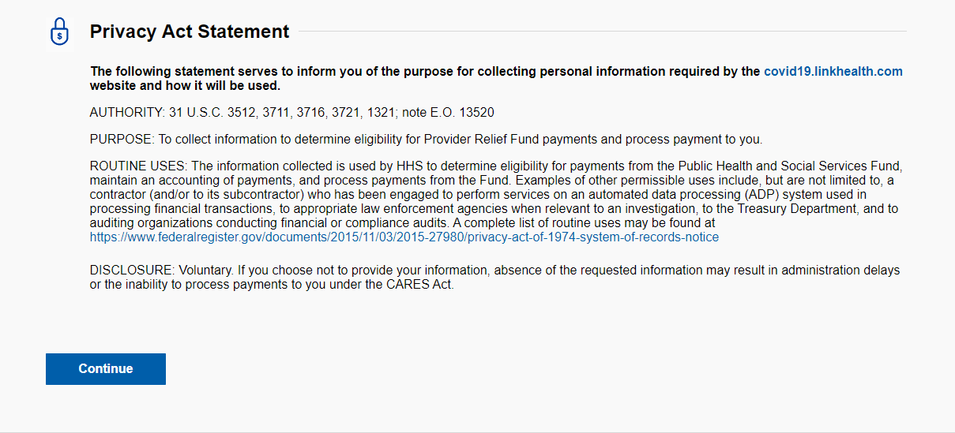
**All data displayed here is sample data for example purposes only.**
DRAFT
Notes:
Please select Eligibility ‘Yes’ and continue

Slide 5
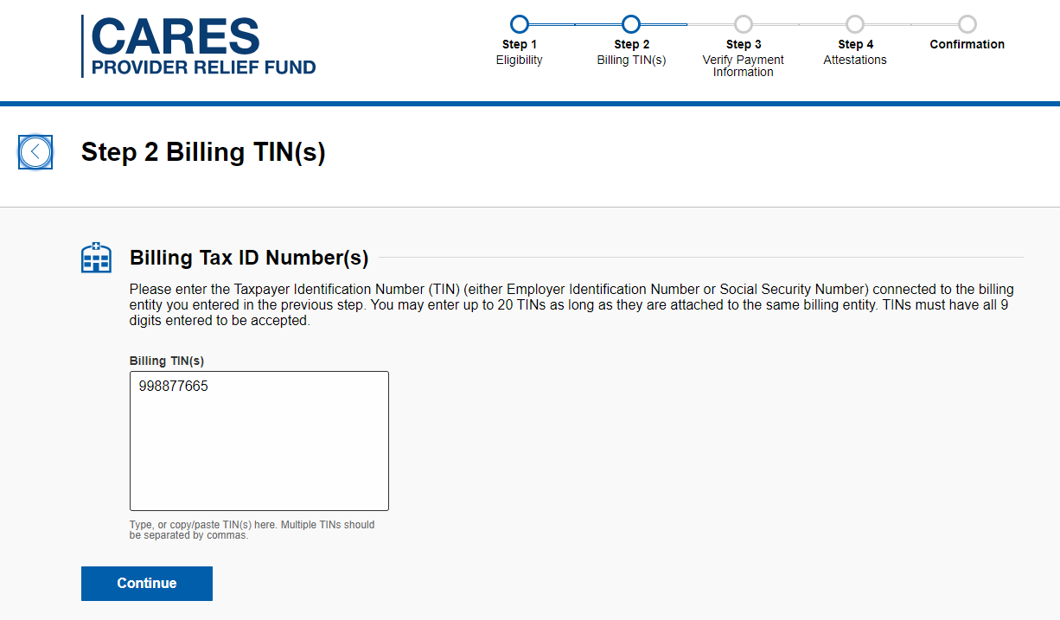
**All data displayed here is sample data for example purposes only.**
DRAFT
Notes:
Please enter Billing TIN and continue.

Slide 6
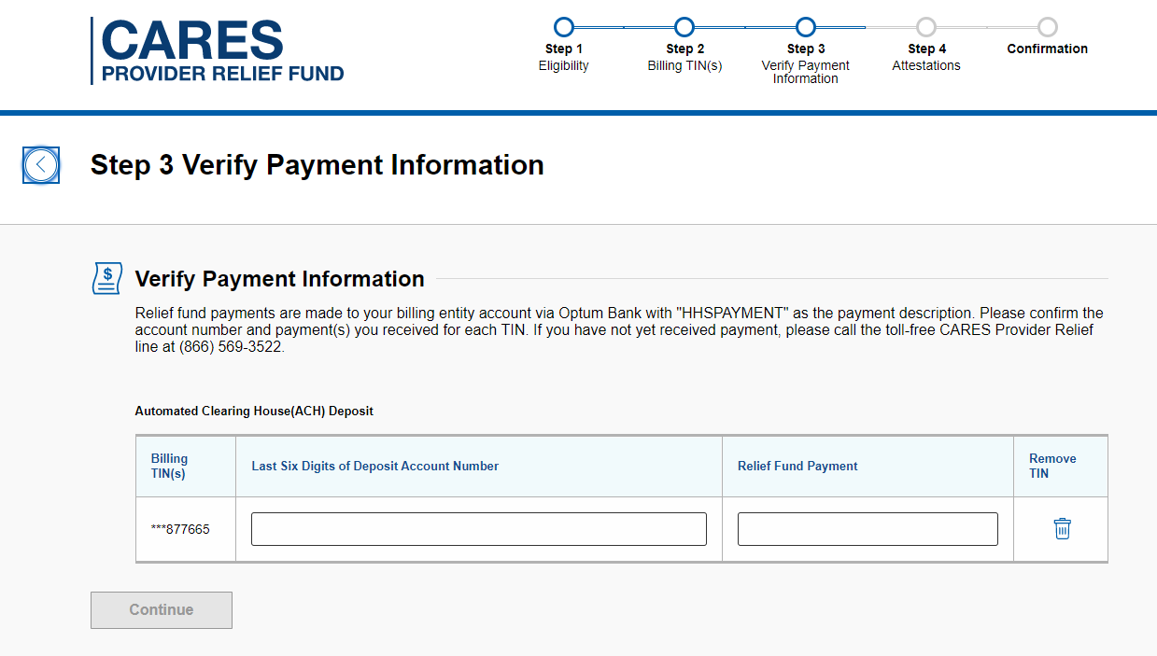
**All data displayed here is sample data for example purposes only.**
PRF and ARPA–R attestation portal: Attest ACH Payment
DRAFT
Notes:
Please enter last six digits of the account number, exact amount and continue

Slide 7
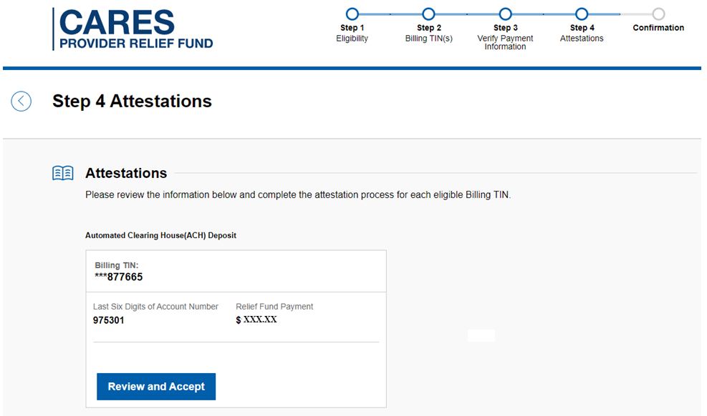
**All data displayed here is sample data for example purposes only.**
DRAFT
Notes:
Please Review the information and Accept

Slide 8
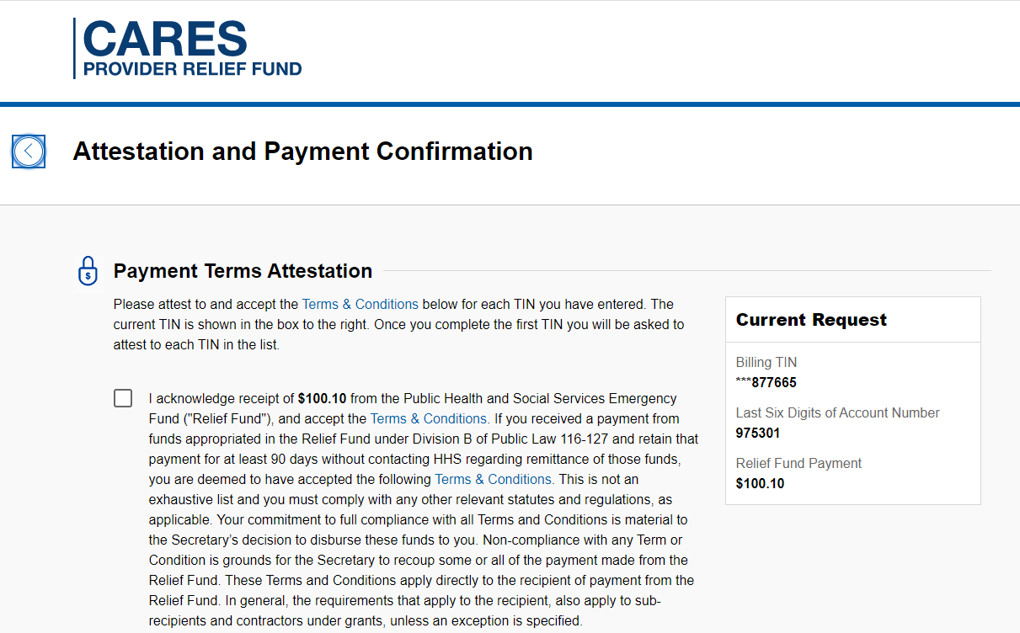
**All data displayed here is sample data for example purposes only.**
DRAFT
Notes:
Please attest to Payment Terms Attestation, enter information in all the required fields, agree to terms and conditions and select I Accept Payment

Slide 9
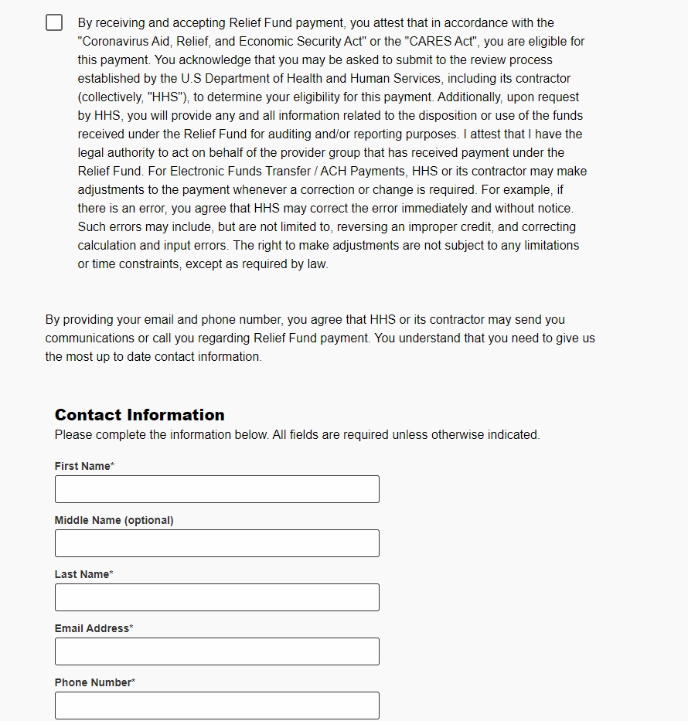
**All data displayed here is sample data for example purposes only.**
DRAFT
Notes:
Please attest to Payment Terms Attestation, enter information in all the required fields, agree to terms and conditions and select I Accept Payment

Slide 10
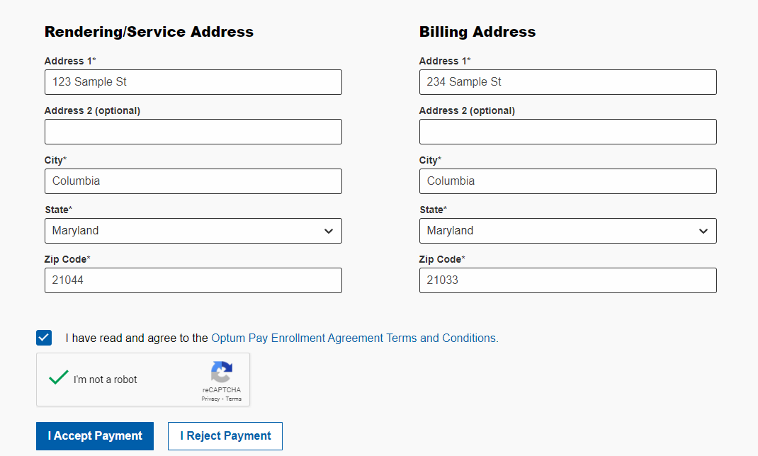
**All data displayed here is sample data for example purposes only.**
DRAFT
Notes:
Please attest to Payment Terms Attestation, enter information in all the required fields, agree to terms and conditions and select I Accept Payment

Slide 11
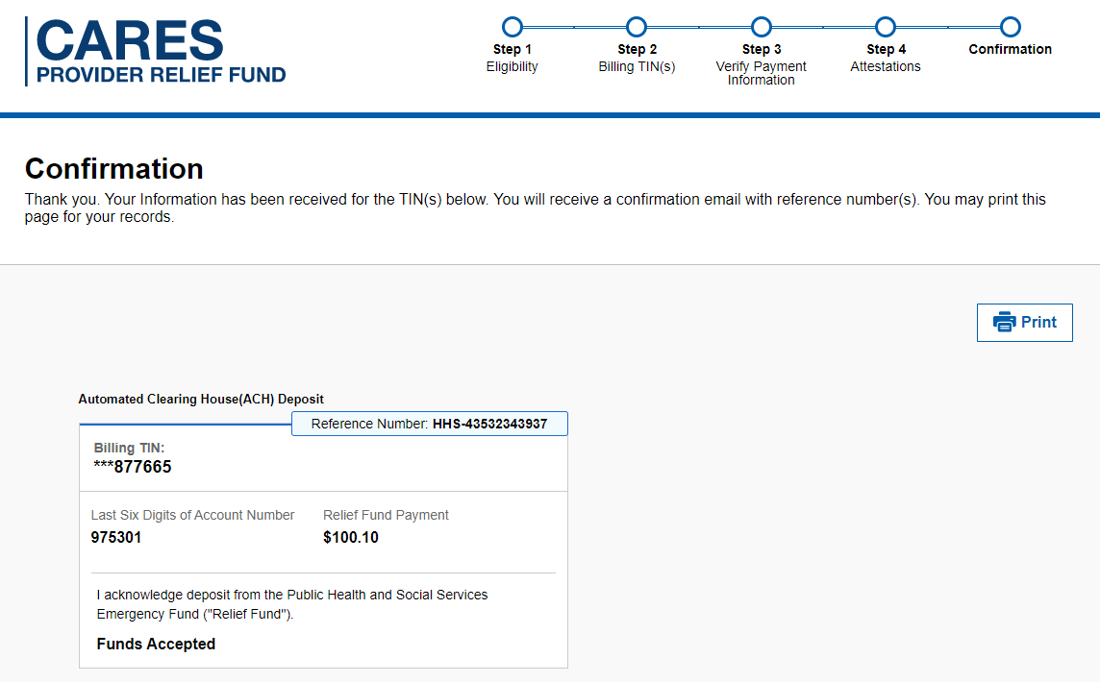
**All data displayed here is sample data for example purposes only.**
DRAFT
Notes:
Confirmation

Slide 12
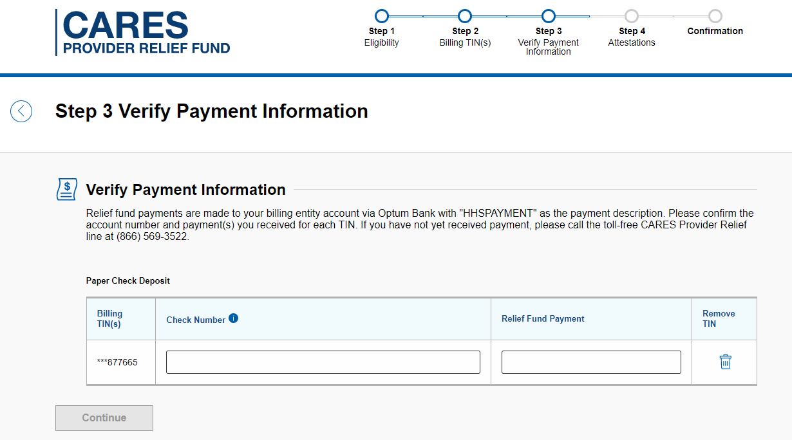
**All data displayed here is sample data for example purposes only.**
PRF and ARPA–R attestation portal: Attest CHK Payment
DRAFT
Notes:
Please enter complete check number, exact amount and continue

Slide 13
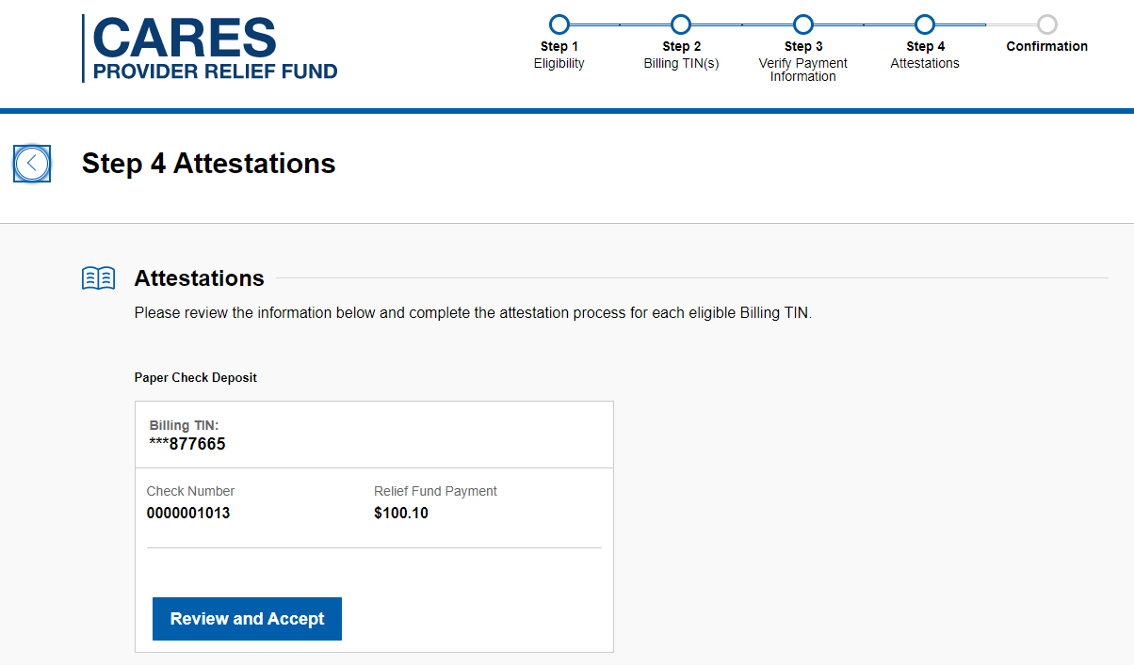
**All data displayed here is sample data for example purposes only.**
DRAFT
Notes:
Please Review and Accept

Slide 14
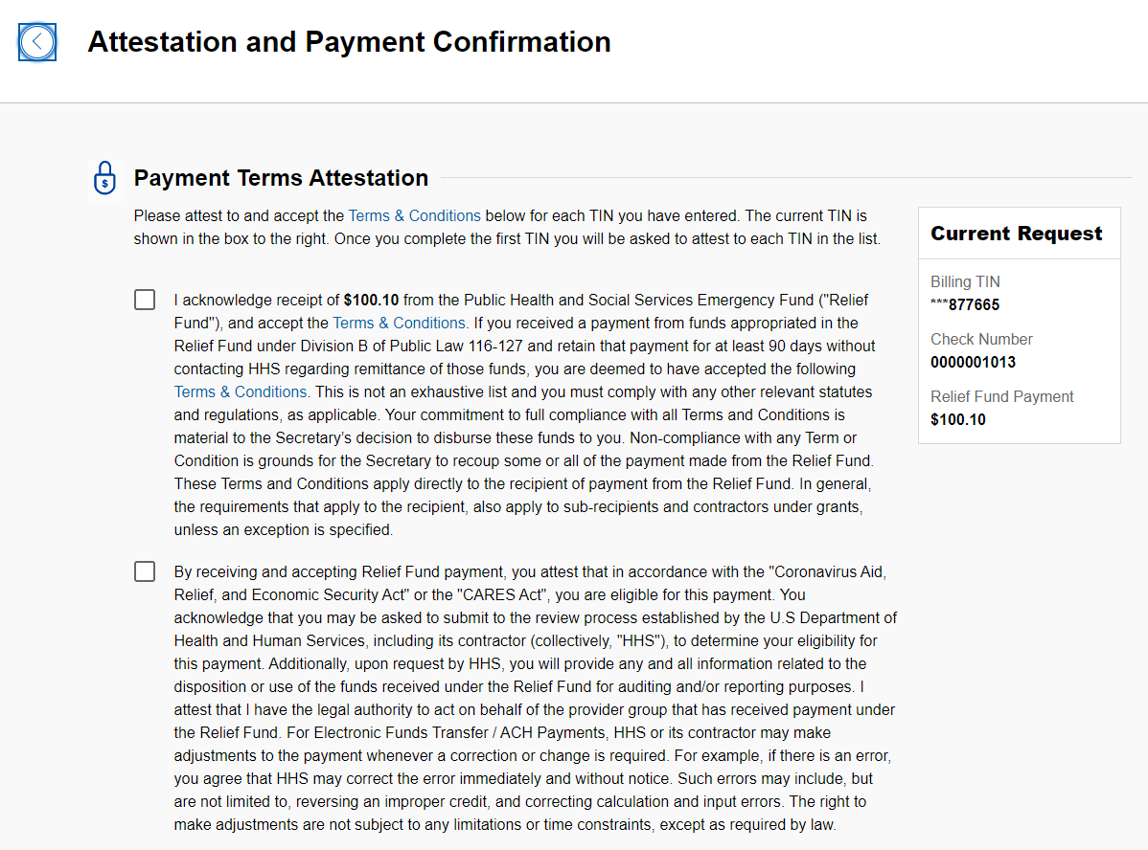
**All data displayed here is sample data for example purposes only.**
DRAFT
Notes:
Please attest to Payment Terms Attestation, enter information in all the required fields, agree to terms and conditions and accept or reject payments

Slide 15
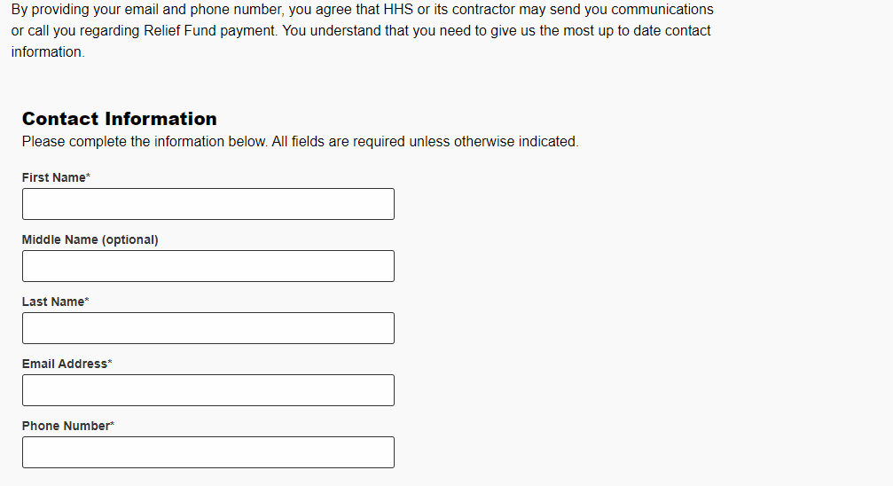
**All data displayed here is sample data for example purposes only.**
DRAFT
Notes:
Please attest to Payment Terms Attestation, enter information in all the required fields, agree to terms and conditions and accept or reject payments

Slide 16
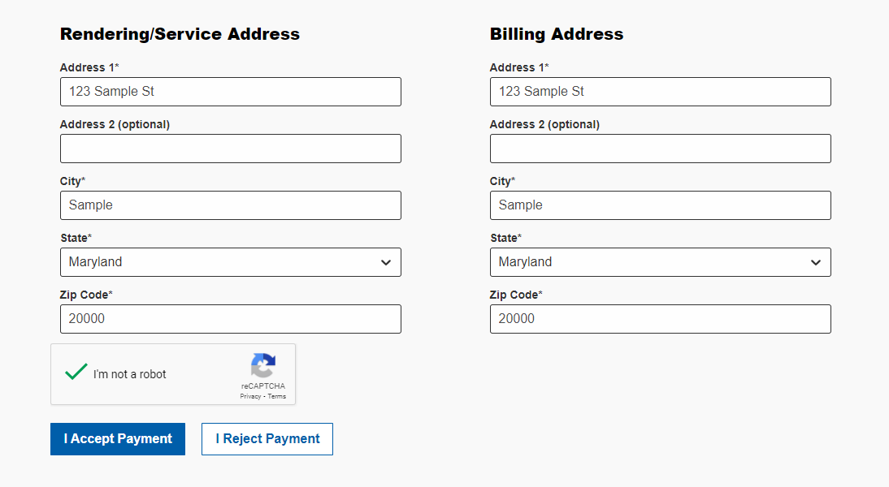
**All data displayed here is sample data for example purposes only.**
DRAFT
Notes:
Please attest to Payment Terms Attestation, enter information in all the required fields, agree to terms and conditions and accept or reject payments

Slide 17
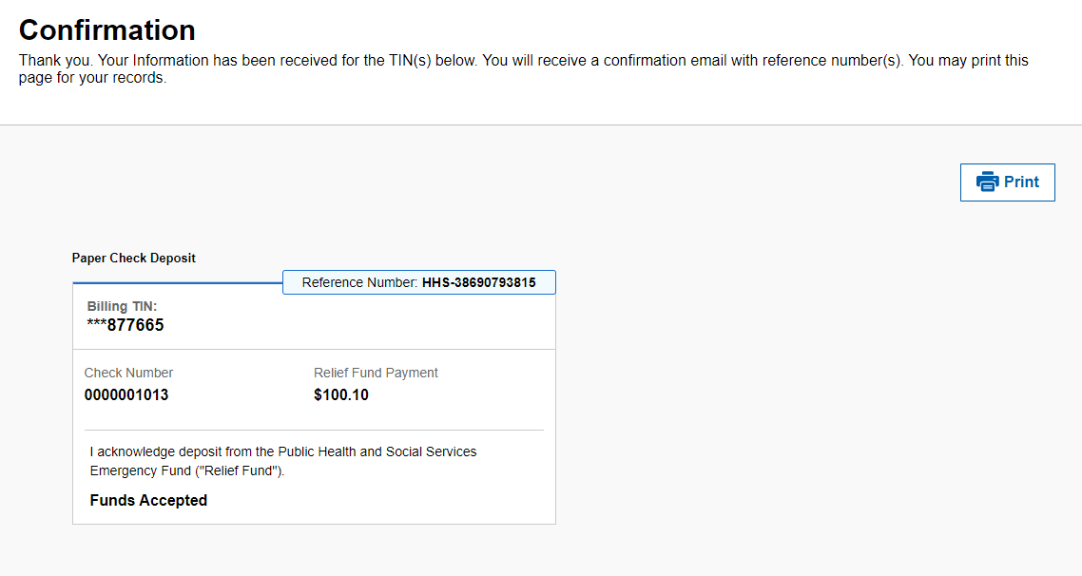
**All data displayed here is sample data for example purposes only.**
DRAFT
Notes:
Confirmation

Slide 18
PRF Phase 4/ARPA–R Application Portal

Slide 19
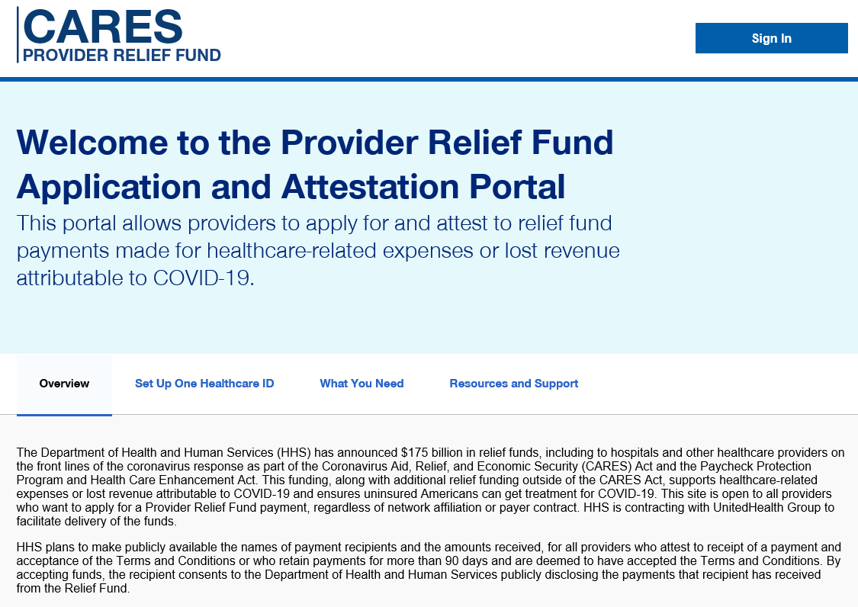
**All data displayed here is sample data for example purposes only.**
DRAFT
Notes:
Landing Page:
Contains general information about the program and how to request funds

Slide 20
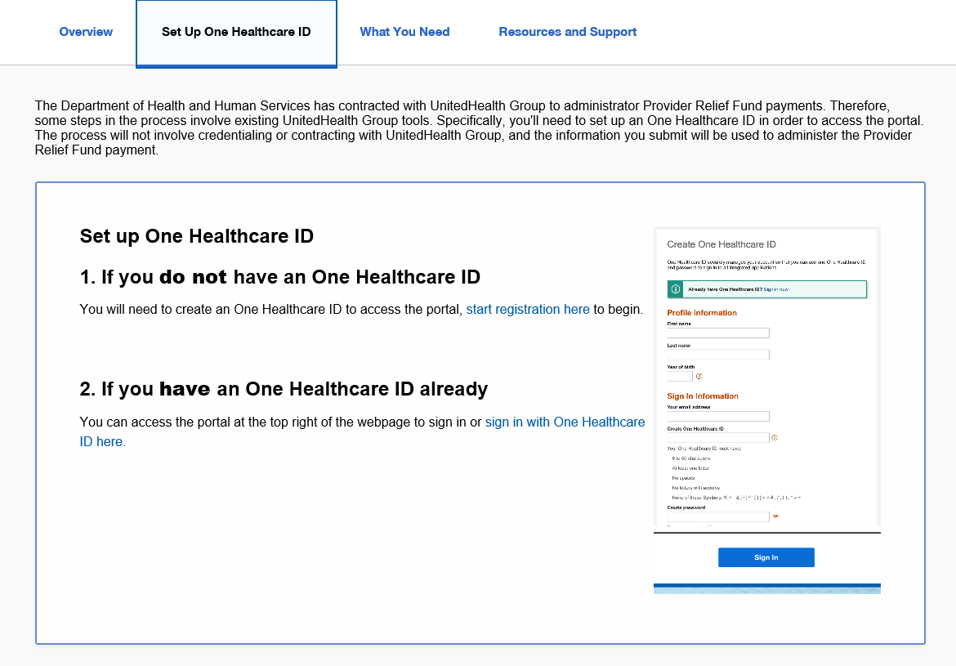
**All data displayed here is sample data for example purposes only.**
DRAFT
Notes:
Instructions to set up Optum ID

Slide 21
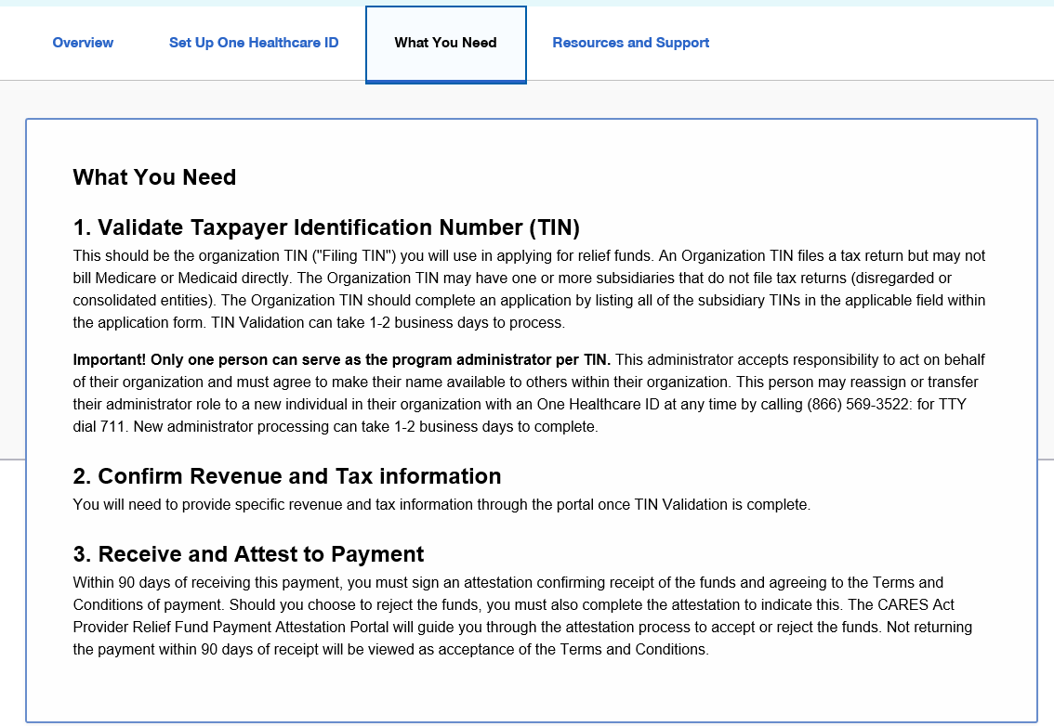
**All data displayed here is sample data for example purposes only.**
DRAFT
Notes:
What you need tab has some additional information about the three main steps for this program
Once I log into the portal, I will walk through these three steps

Slide 22
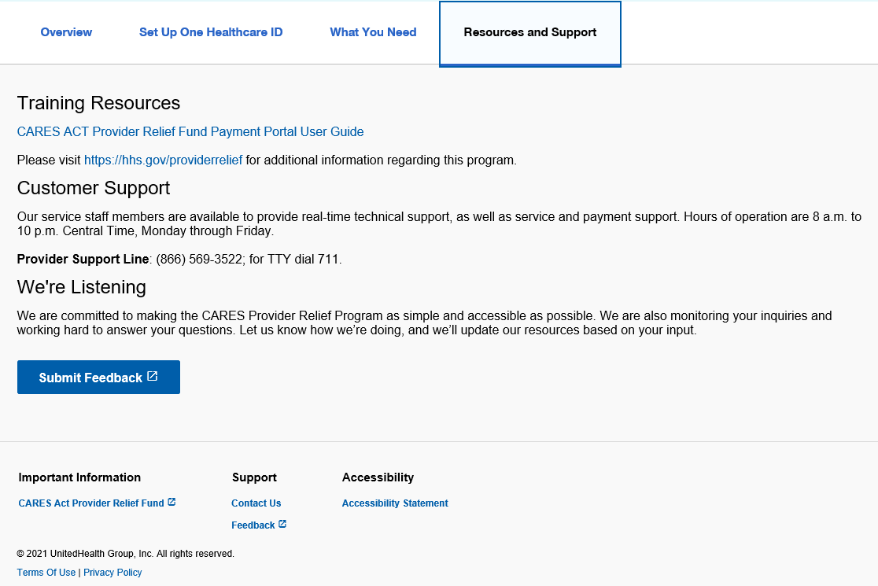
**All data displayed here is sample data for example purposes only.**
DRAFT
Notes:
The resources and support tab has some reference material. The first link is an interactive guide with some helpful tips.
Once you have reviewed the program materials and created an Optum ID (if required), please select “Sign In” in the upper righthand corner to access the portal and begin with TIN submission process.

Slide 23
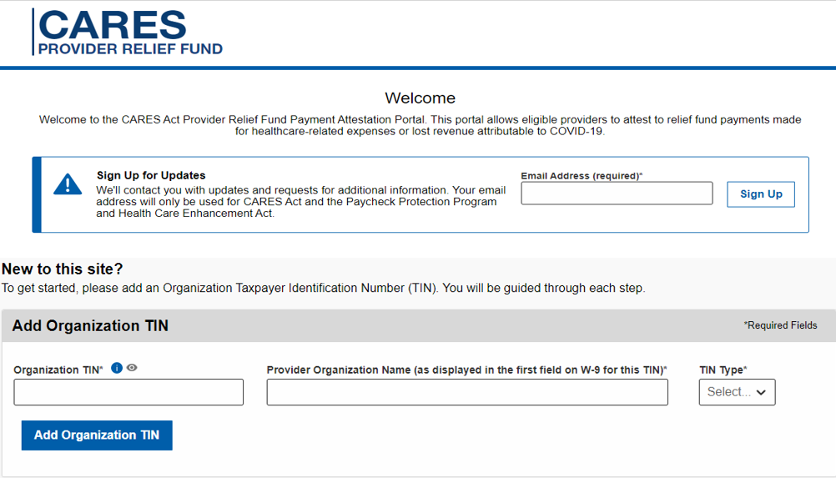
**All data displayed here is sample data for example purposes only.**
DRAFT
Notes:
Please Add your Organization TIN, Provider Name and TIN Type
Note: Please enter the Provider Organization Name exactly as it appears on your W-9

Slide 24
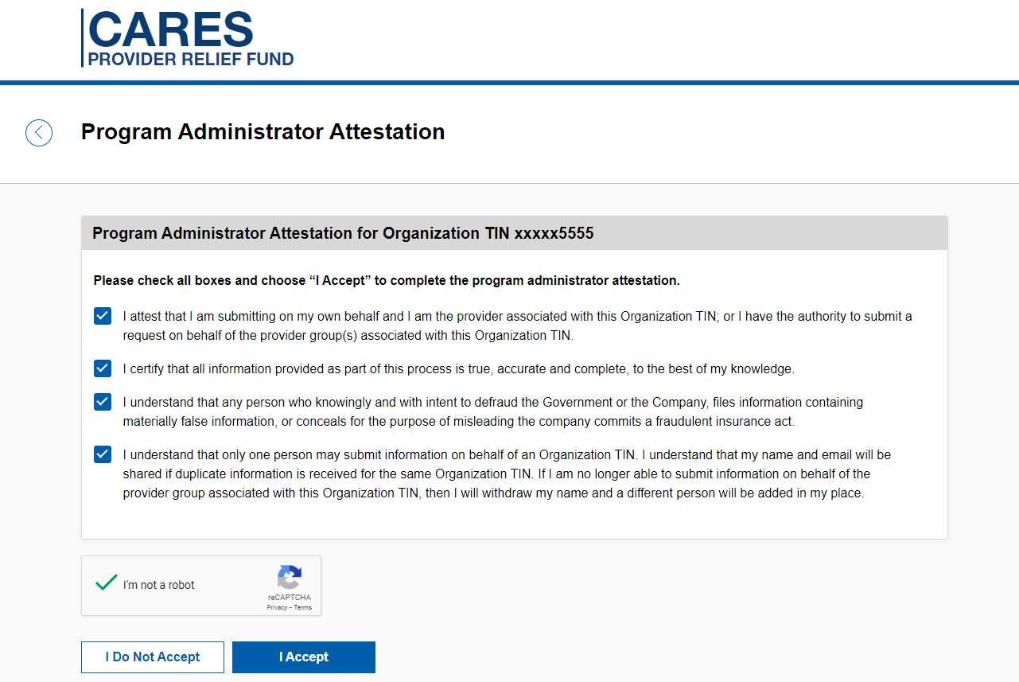
**All data displayed here is sample data for example purposes only.**
DRAFT
Notes:
Please attest to serve as the program administrator role for the tax ID.
Note: No other user will be able to access this tax ID if you attest as the program administrator.

Slide 25
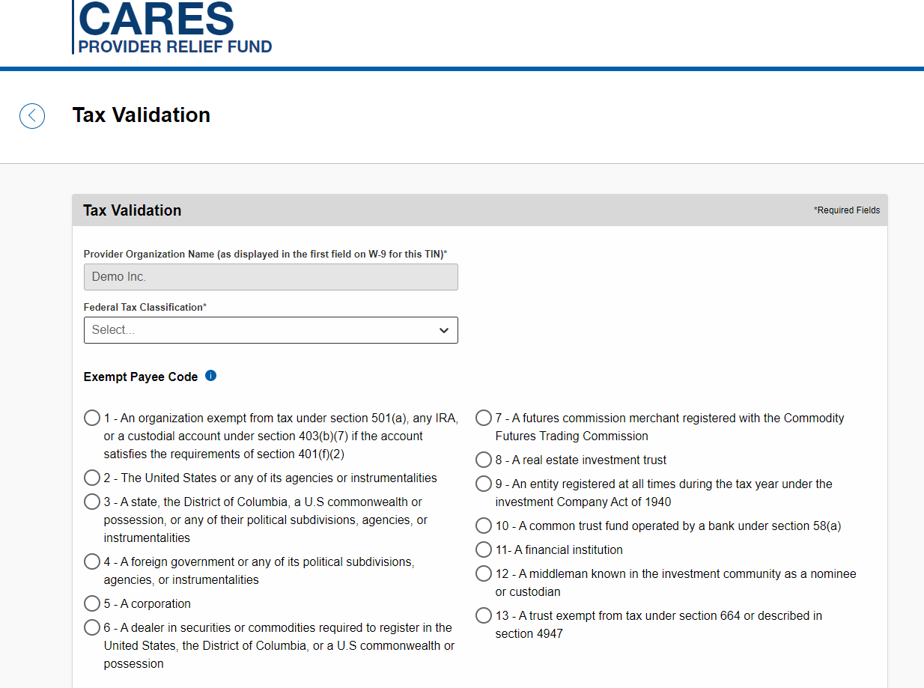
**All data displayed here is sample data for example purposes only.**
DRAFT
Notes:
Please select your Organization Federal Tax Classification, Exempt Payee Code, and Exempt from FATCA reporting code and select Continue

Slide 26
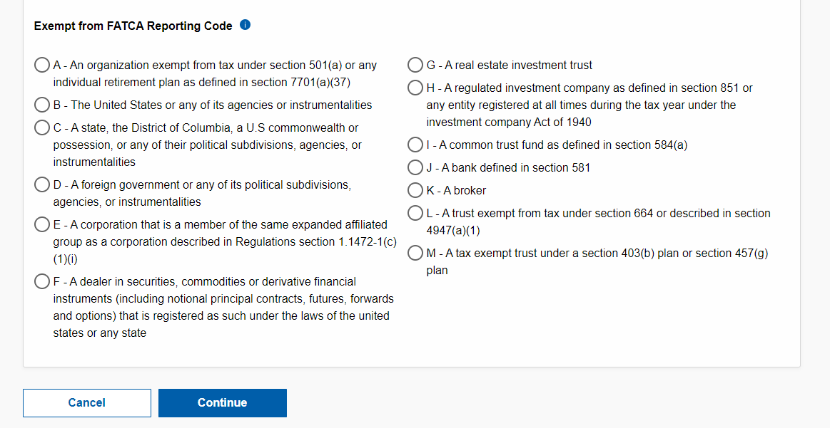
**All data displayed here is sample data for example purposes only.**
DRAFT
Notes:
Please select your Organization Federal Tax Classification, Exempt Payee Code, and Exempt from FATCA reporting code and select Continue

Slide 27
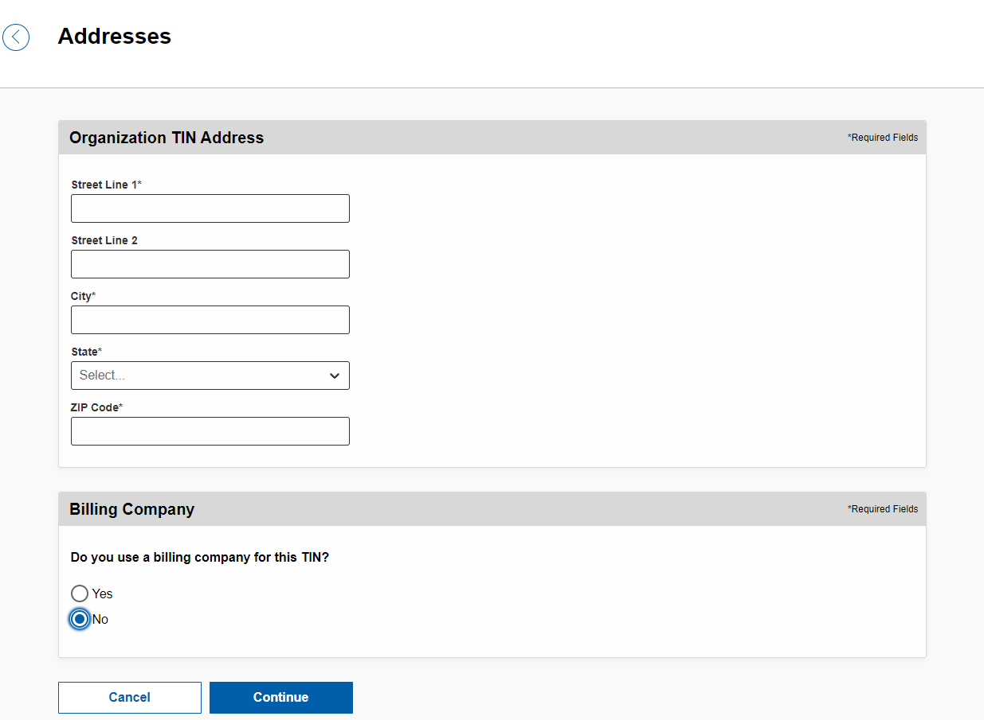
**All data displayed here is sample data for example purposes only.**
DRAFT
Notes:
Please enter Organization TIN Address and/or Billing Company information and Continue

Slide 28
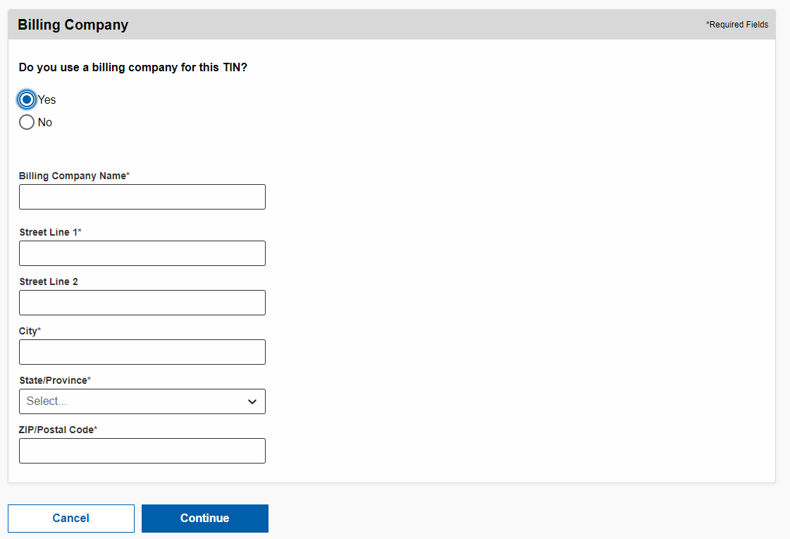
**All data displayed here is sample data for example purposes only.**
DRAFT
Notes:
Please enter Organization TIN Address and/or Billing Company information and Continue

Slide 29
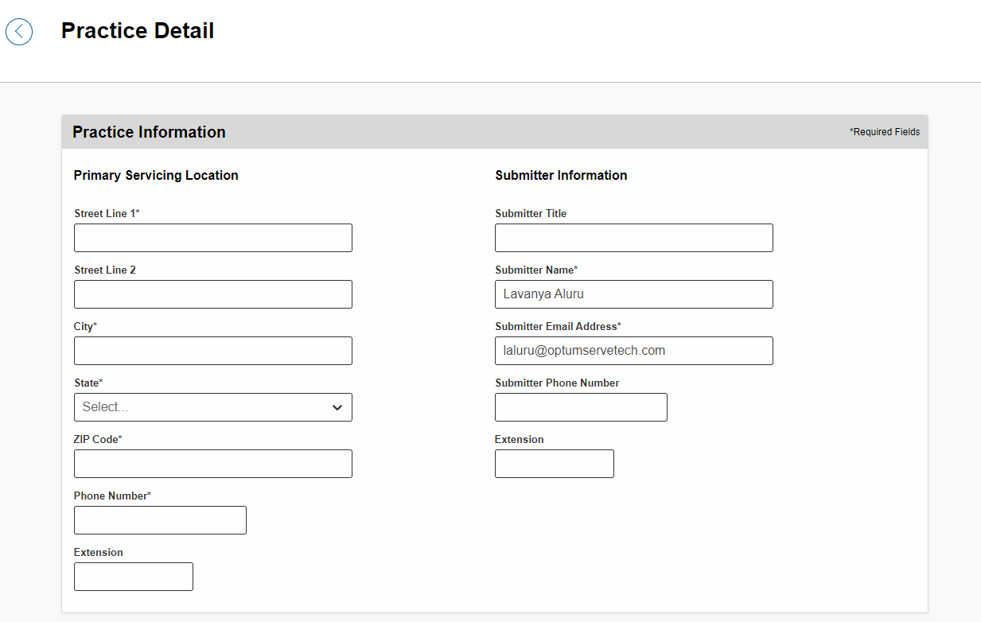
**All data displayed here is sample data for example purposes only.**
DRAFT
Notes:
Please enter primary servicing location information for your organization TIN.

Slide 30
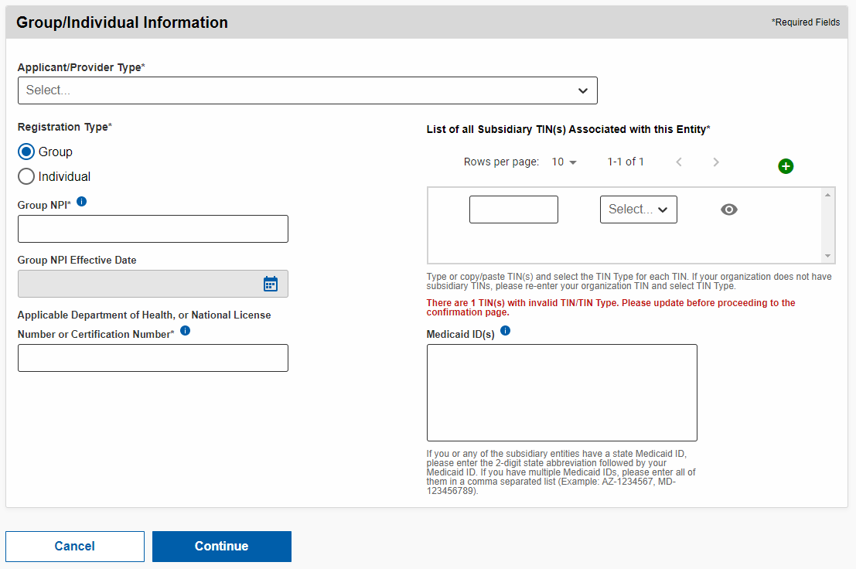
**All data displayed here is sample data for example purposes only.**
DRAFT
Notes:
Please select your registration type – either Group or Individual and provider information in all the required fields
All required fields are marked with an Asterix
Please enter subsidiary TIN and TIN Type.
If your organization doesn’t have any Subsidiary TINs, please re-enter your Organization TIN and select TIN Type.
If your organization has multiple Subsidiary TINs, please type or paste TINs, select TIN Type for each TIN.

Slide 31
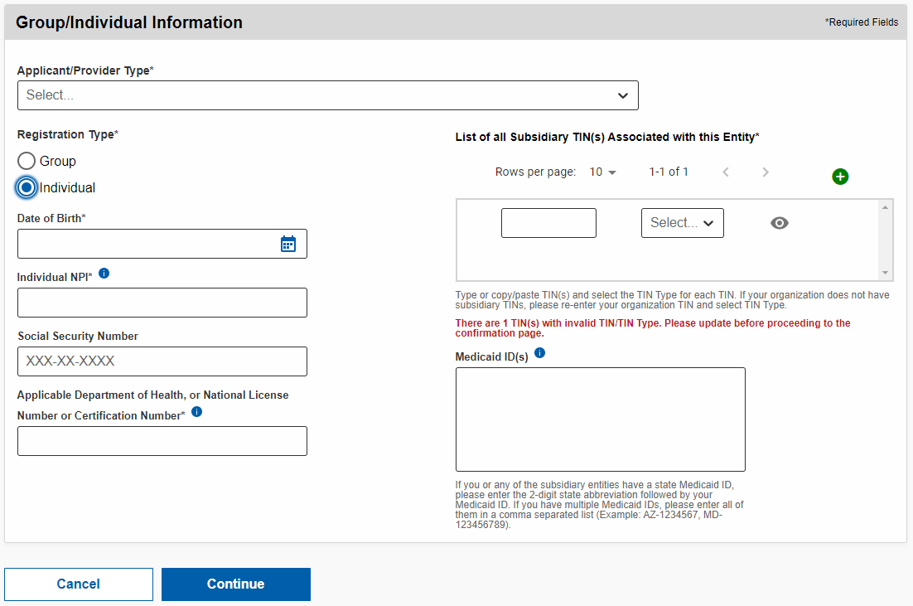
**All data displayed here is sample data for example purposes only.**
DRAFT
Notes:
Please select your registration type – either Group or Individual and provider information in all the required fields
All required fields are marked with an Asterix
Please enter subsidiary TIN and TIN Type.
If your organization doesn’t have any Subsidiary TINs, please re-enter your Organization TIN and select TIN Type.
If your organization has multiple Subsidiary TINs, please type or paste TINs, select TIN Type for each TIN.

Slide 32
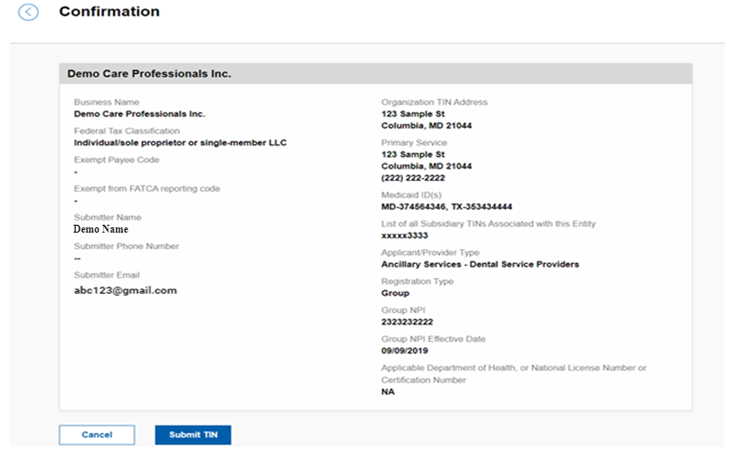
**All data displayed here is sample data for example purposes only.**
DRAFT
Notes:
Review the detail to make sure all information was inputted correctly. If there are any changes needed, select the back button in the upper left corner – otherwise select Submit TIN

Slide 33
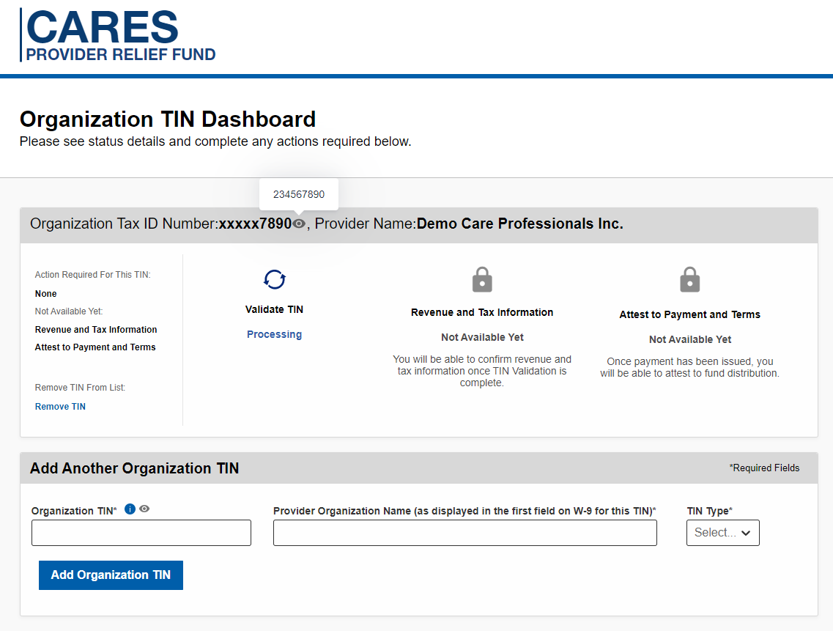
**All data displayed here is sample data for example purposes only.**
DRAFT
Notes:
You will now be brought back to the Organization TIN Dashboard.
You will receive an email once your TIN validation is complete.

Slide 34
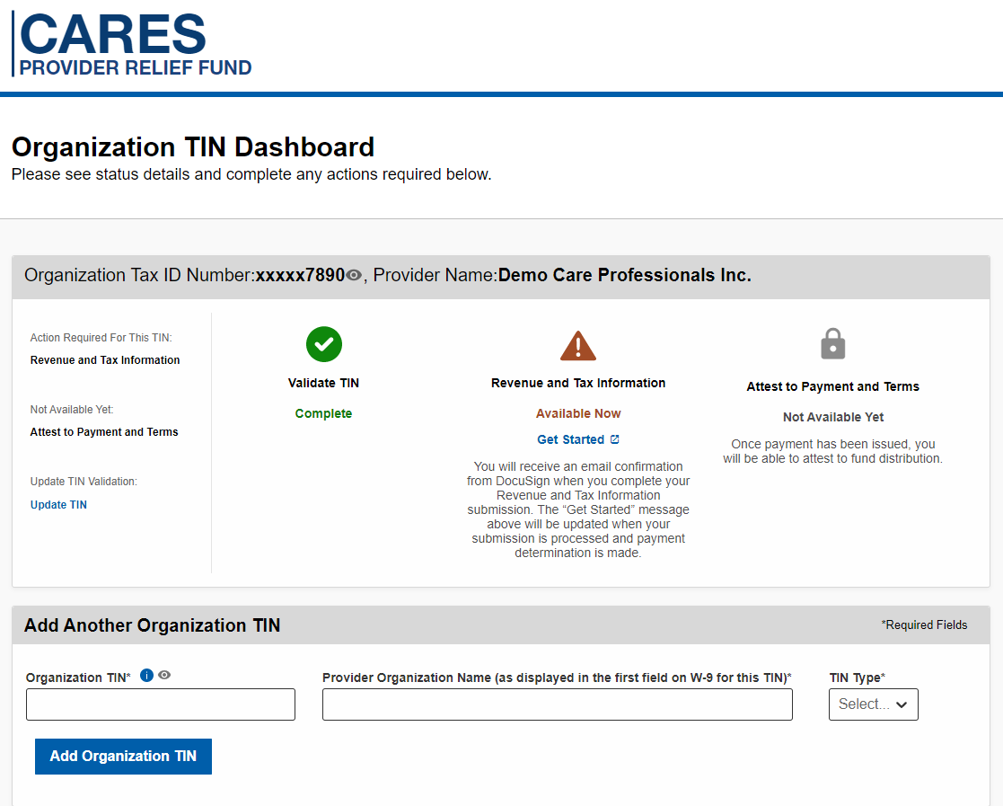
**All data displayed here is sample data for example purposes only.**
DRAFT
Notes:
Once TIN validation is complete and can proceed with Revenue and Tax Information step.
Select Get Started link under Revenue and Tax Information, proceed to the DocuSign form.

Slide 35
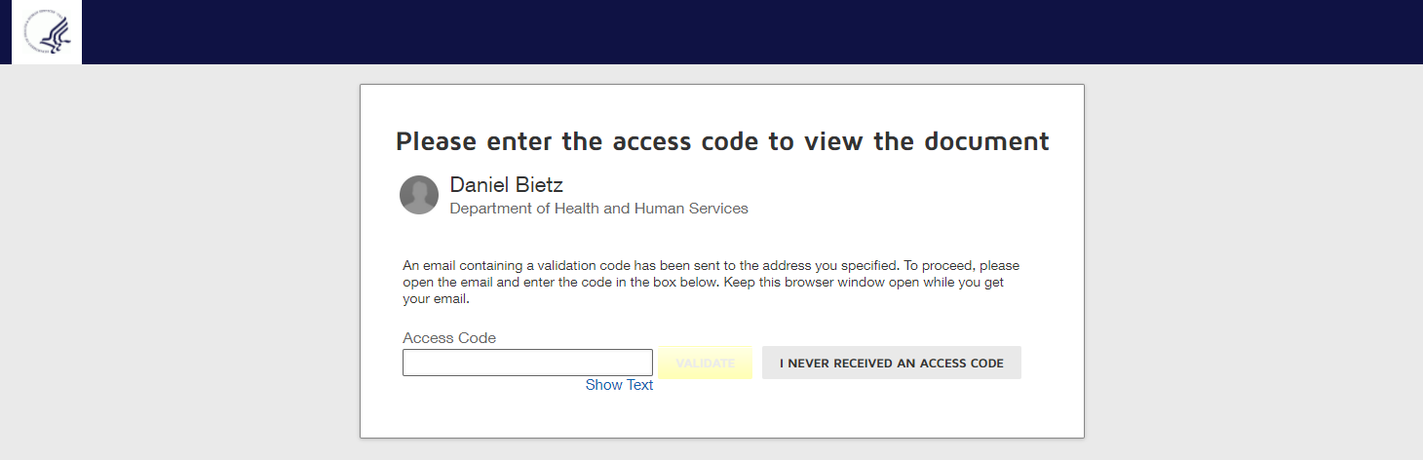
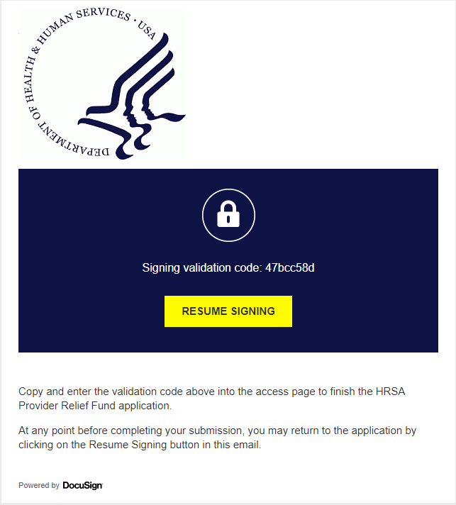
**All data displayed here is sample data for example purposes only.**
DRAFT
Subsequent Process owned by DocuSign
Notes:
You will receive an email with an Access Code to proceed to the Docusign form

Slide 36
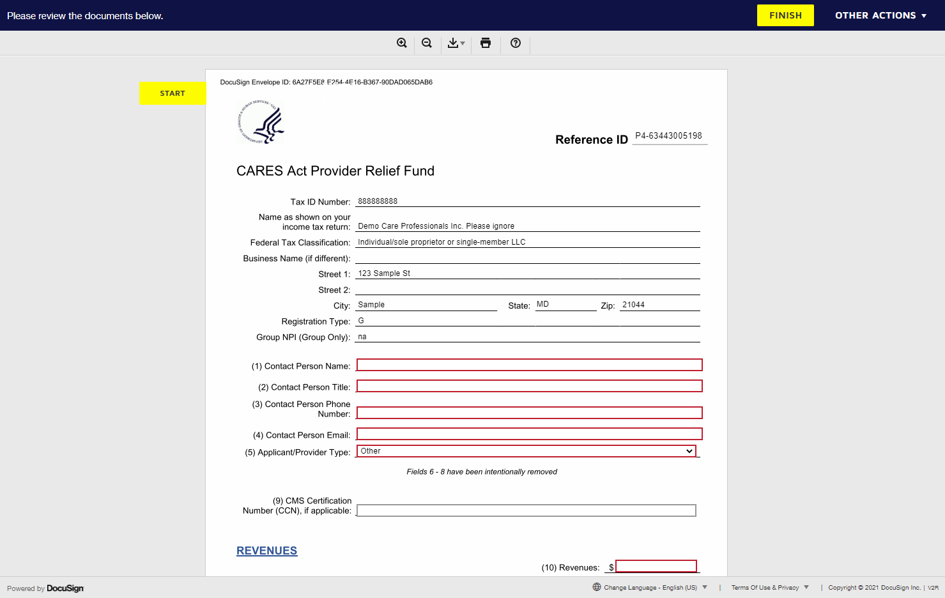
**All data displayed here is sample data for example purposes only.**
Process owned by DocuSign
DRAFT
47bcc58d
Notes:
Enter information in all the required fields within the DocuSign form
You will notice certain data from the TIN validation step is automatically populated for you
Many of the fields have tooltips to help you through the application process.

Slide 37
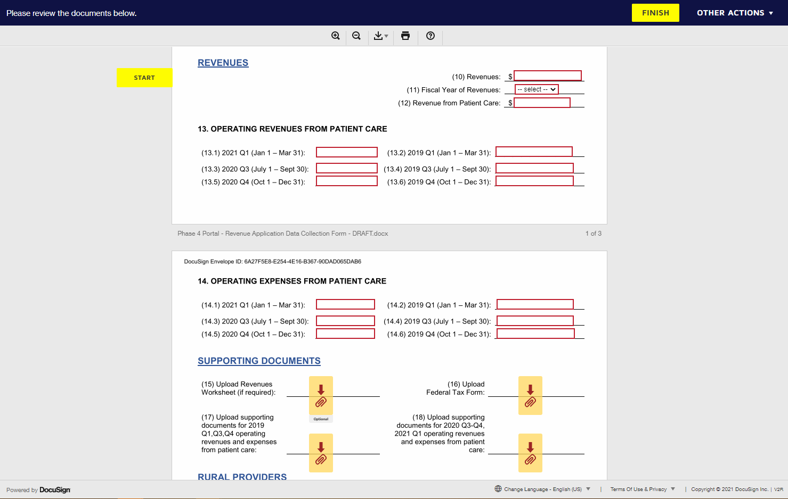
**All data displayed here is sample data for example purposes only.**
Process owned by DocuSign
DRAFT
Notes:
Enter information in all the required fields within the DocuSign form
Many of the fields have tooltips to help you through the application process.

Slide 38
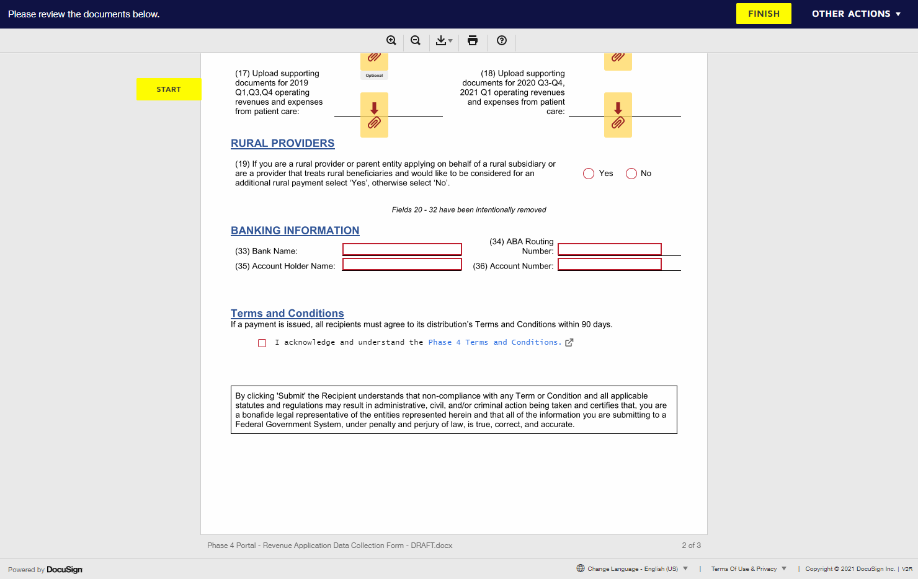
**All data displayed here is sample data for example purposes only.**
Process owned by DocuSign
DRAFT
Notes:
Once you have finished filling in all the required information, please submit

Slide 39
**All data displayed here is sample data for example purposes only.**
DRAFT
Notes:
You will be taken back to the Dashboard.

Slide 40
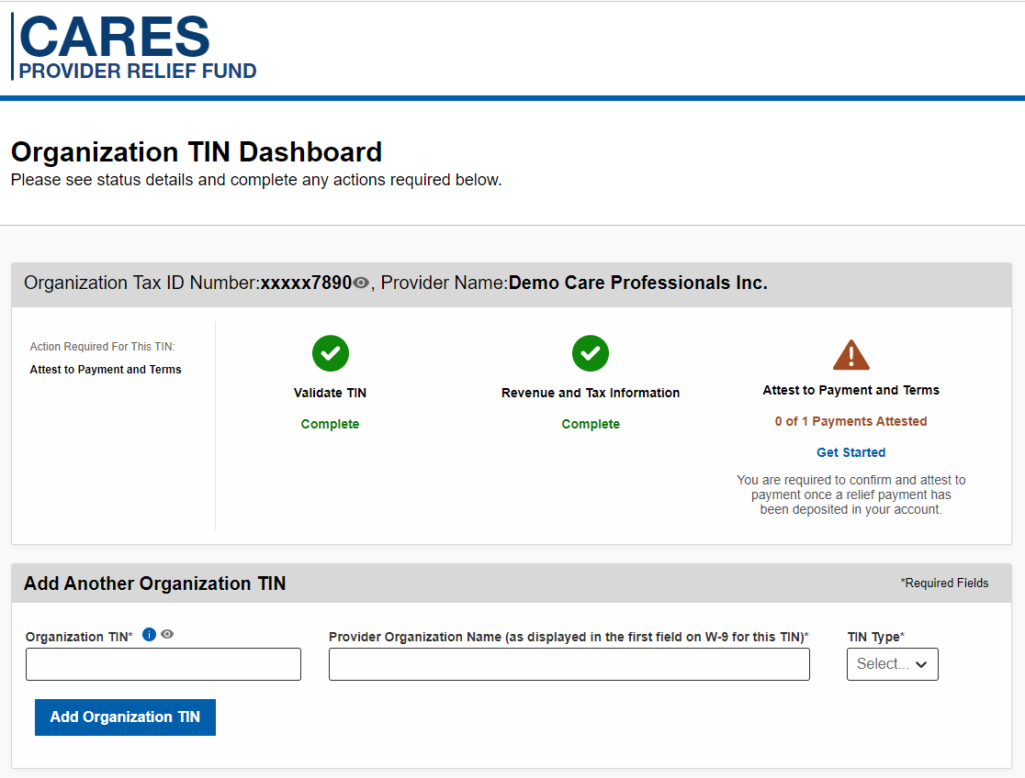
**All data displayed here is sample data for example purposes only.**
CARES PRF Portal 2.0: Attest to Payments and Terms - Accept Payments
DRAFT
Notes:
Once you have received payment, the dashboard option to Attest to Payment and Terms will be activated.
In this last step, you will attest to accepting or rejecting funds. Payments will include “HHS.gov” in the ACH descriptor. If you do receive a check, you may notice “UnitedHealth Group / OptumRx” on the check; the funds, however, are from HHS. Please have the exact amount of the payment available to complete the attestation.
As a reminder, HHS will make publicly available the names of providers and amounts received as part of the relief fund.

Slide 41
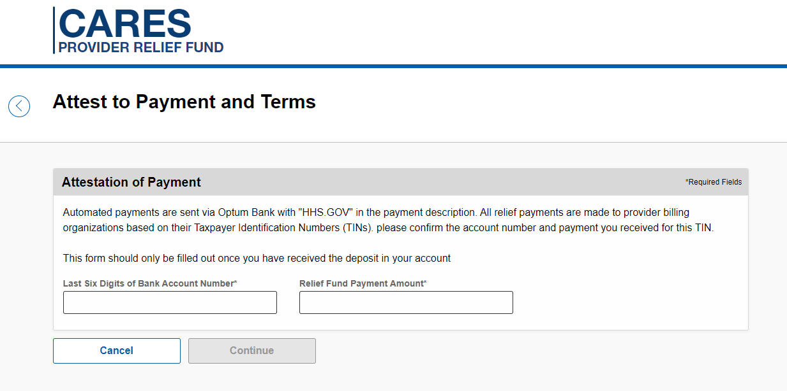
**All data displayed here is sample data for example purposes only.**
DRAFT
Notes:
Please input the check number or last 6 digits of your account number along with the relief fund payment amount you received and continue

Slide 42
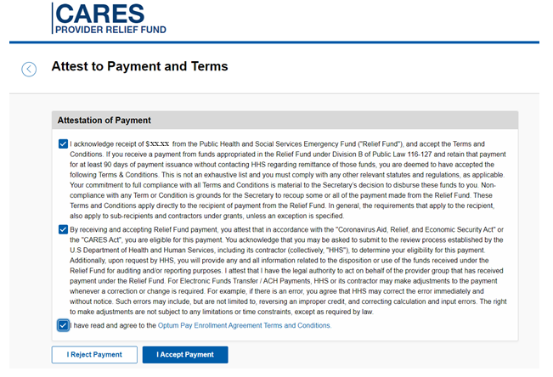
**All data displayed here is sample data for example purposes only.**
DRAFT
Notes:
Please accept to the funds and terms and conditions.
If you choose to accept and attest to the funds, no further l action is required!

Slide 43
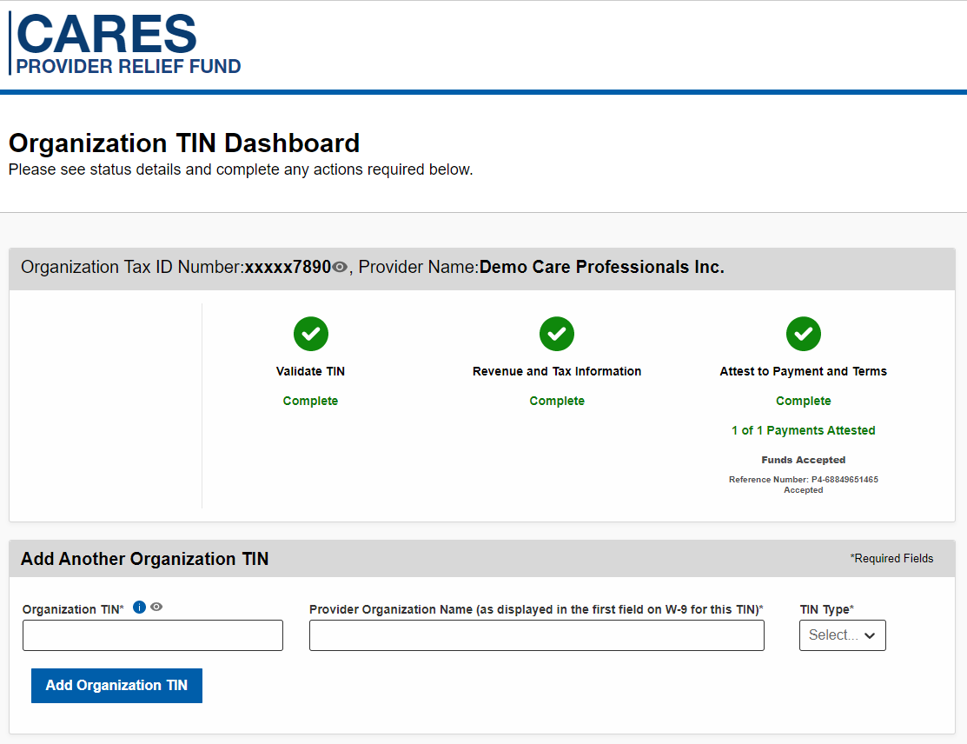
**All data displayed here is sample data for example purposes only.**
DRAFT
Notes:
You will be taken back to the Organization TIN Dashboard

Slide 44
**All data displayed here is sample data for example purposes only.**
CARES PRF Portal 2.0: Attest to Payments and Terms - Reject Payments
DRAFT
Notes:
Once you have received payment, the dashboard option to Attest to Payment and Terms will be activated.
In this last step, you will attest to accepting or rejecting funds. Payments will include “HHS.gov” in the ACH descriptor. If you do receive a check, you may notice “UnitedHealth Group / OptumRx” on the check; the funds, however, are from HHS. Please have the exact amount of the payment available to complete the attestation.
As a reminder, HHS will make publicly available the names of providers and amounts received as part of the relief fund.

Slide 45
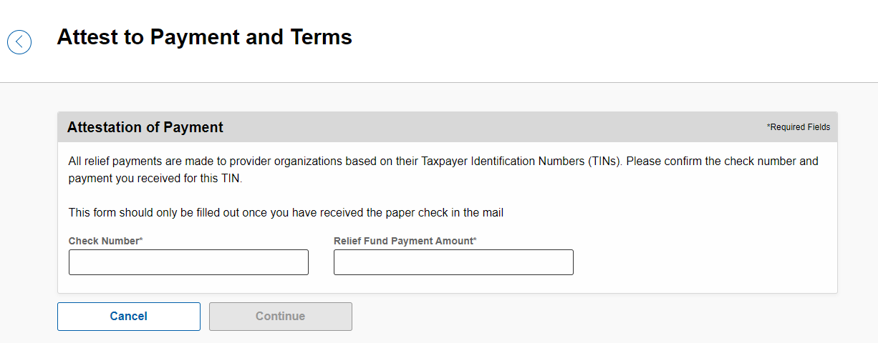
**All data displayed here is sample data for example purposes only.**
DRAFT
Notes:
Please input the check number or last 6 digits of your account number along with the relief fund payment amount you received and continue

Slide 46
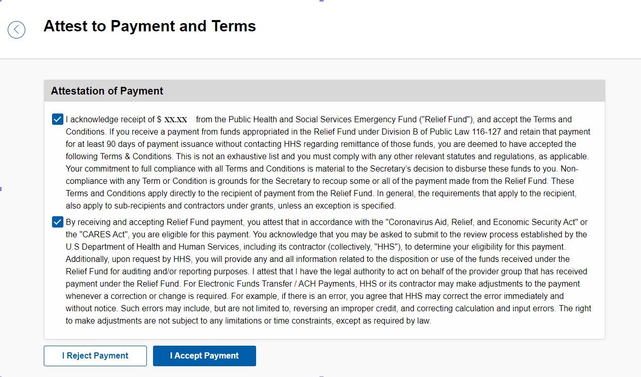
**All data displayed here is sample data for example purposes only.**
DRAFT
Notes:
Please accept to the funds and terms and conditions.
If you choose to accept and attest to the funds, no further l action is required!
If you choose to reject and return the funds, the portal will provide instructions to return your Check or Bank Deposit

Slide 47
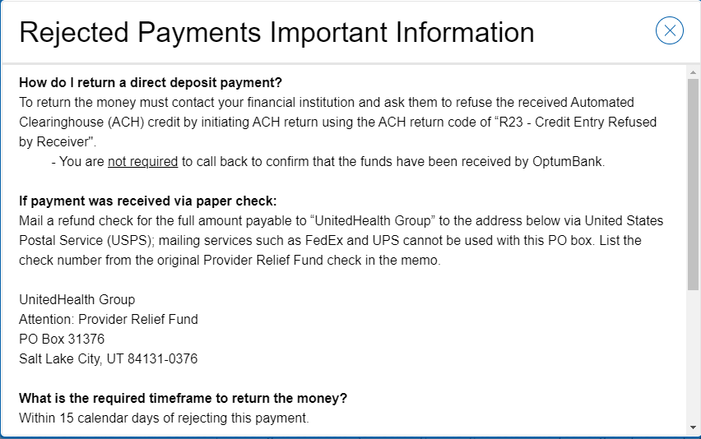
**All data displayed here is sample data for example purposes only.**
DRAFT
Notes:
Rejected Payment Information – how to return funds

Slide 48
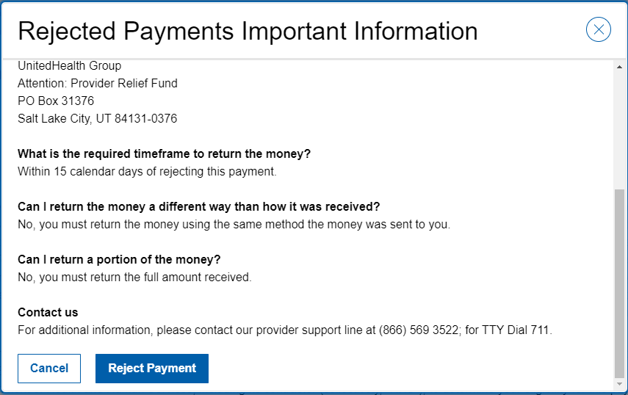
**All data displayed here is sample data for example purposes only.**
DRAFT
Notes:
Rejected Payment Information – how to return funds and Reject Payment

Slide 49
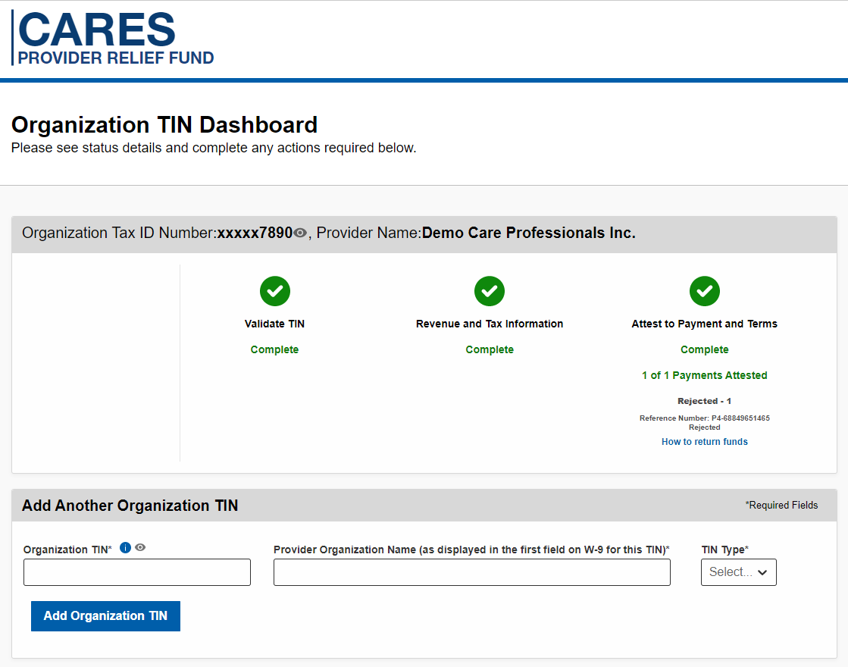
**All data displayed here is sample data for example purposes only.**
DRAFT
Notes:
You will be taken back to the Organization TIN Dashboard

Slide 50
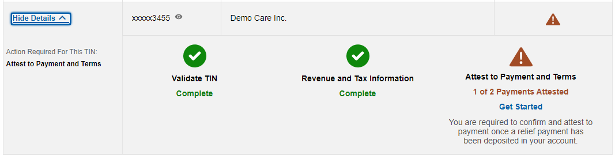
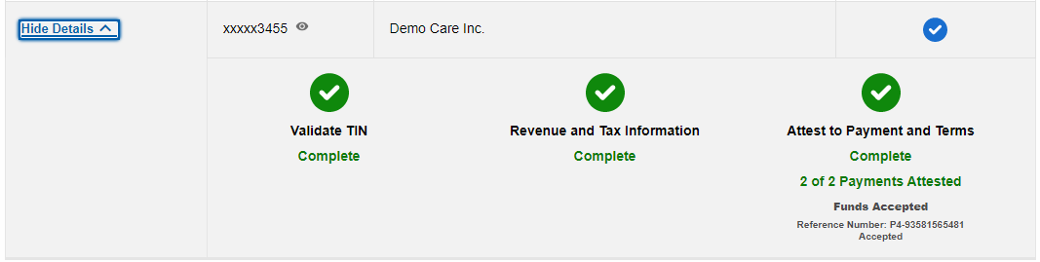
**All data displayed here is sample data for example purposes only.**
Multiple Payments
DRAFT

Slide 51

Discussion
Questions

