Slide 1
Beneficiary Web Enrollment (BWE) Screenshots
July 2022

Slide 2
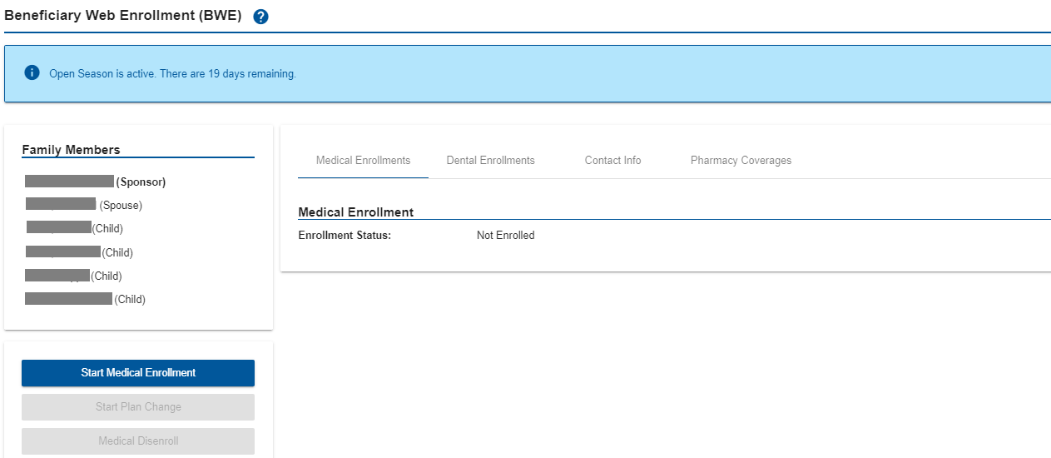
Enrollments
Click on Start Medical Enrollment to begin enrollment
Notes:
06/12/20 – updated screenshot

Slide 3
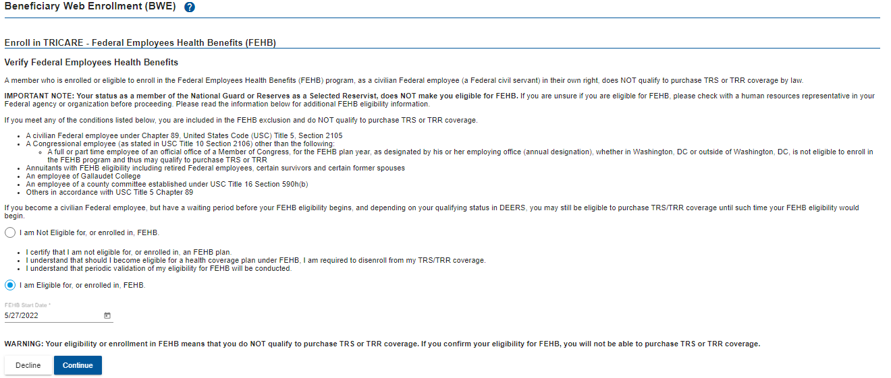
Enrollments (cont.)
For beneficiaries with TRICARE Reserve Select (TRS) and TRICARE Retired Reserve (TRR) eligibility only:
FEHBP eligibility can be added through self-attestation during enrollment.

Slide 4
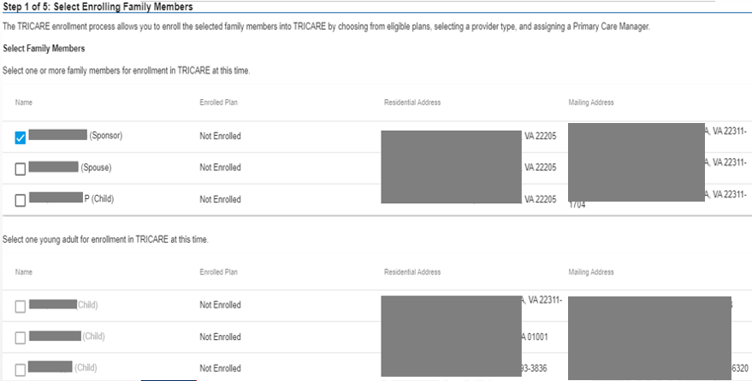
Enrollments (cont.)
Select the family member you wish to enroll and select Continue
For TYA enrollments – must enroll one family member at a time
Notes:
06/12/20 – updated screenshot

Slide 5
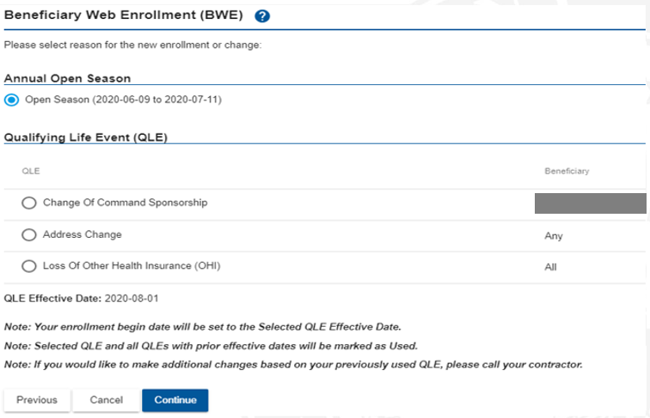
Enrollments (cont.)
Select open season or a QLE (if applicable) to begin enrollment.
Select Continue.
Notes:
06/12/20 – updated screenshot

Slide 6
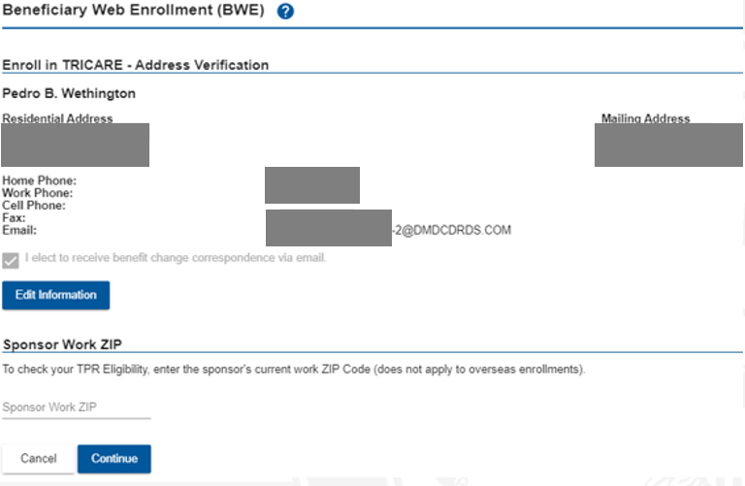
Enrollments (cont.)
Verify the address and click Continue
Notes:
06/12/20 – updated screenshot

Slide 7
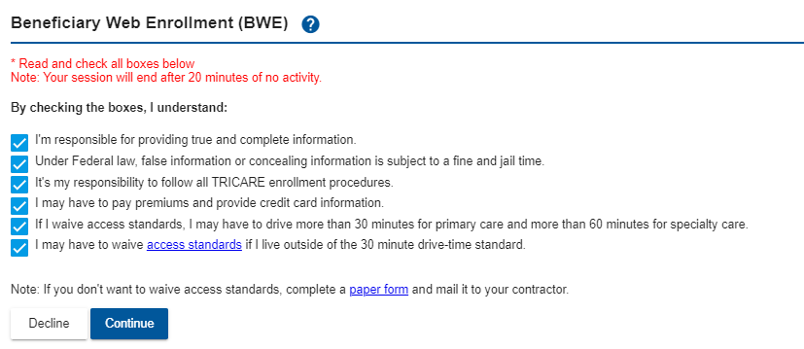
Enrollments (cont.)
Select the check boxes for Enrollment Procedure Compliance
Notes:
06/12/20 – updated screenshot

Slide 8
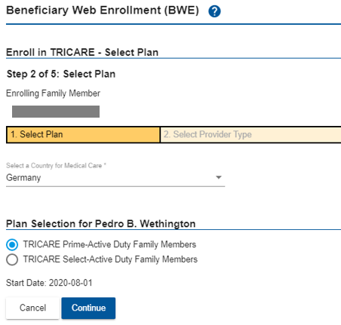
Enrollments (cont.)
Select a Country for Medical Care and plans will be displayed based on the country selected. Select plan and click Continue.
Notes:
06/12/20 – updated screenshot

Slide 9
Enrollments (cont.)
Select the checkbox to attest that the family member is command sponsored and click Continue
Notes:
06/12/20 – added slide

Slide 10
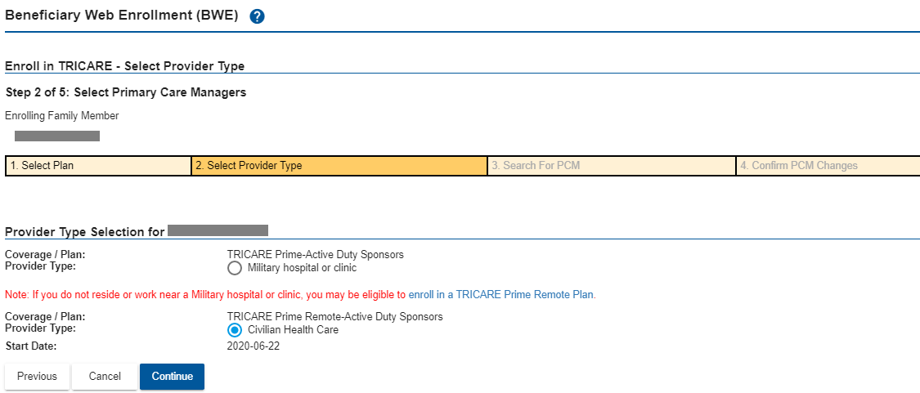
Enrollments (cont.)
Select a Provider Type and click Continue
Notes:
06/12/20 – added slide

Slide 11
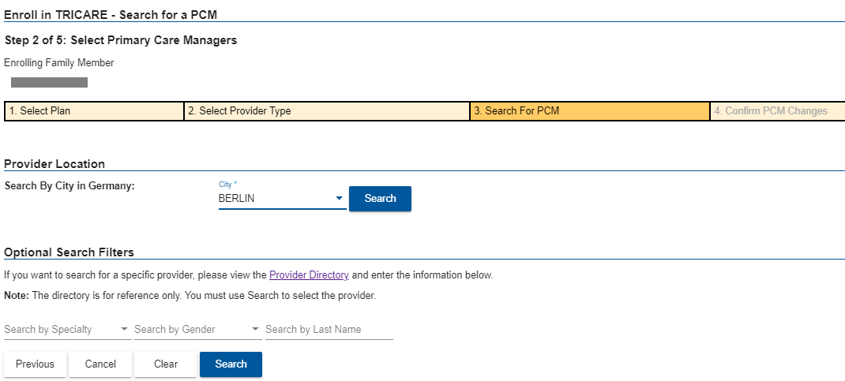
Enrollments (cont.)
Select a PCM and click Search
Notes:
06/12/20 – added slide

Slide 12
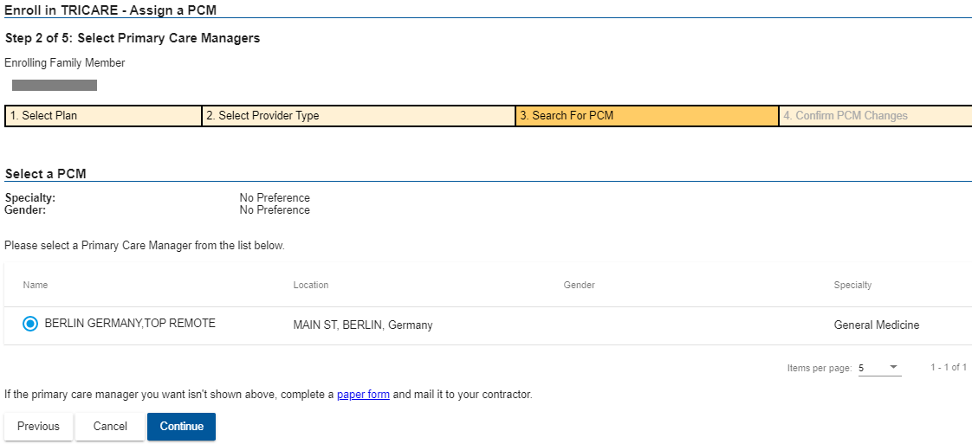
Enrollments (cont.)
Assign a PCM and click Continue
Notes:
06/12/20 – added slide

Slide 13
Enrollments (cont.)
Confirm PCM Changes and click Continue
Notes:
06/12/20 – added slide

Slide 14
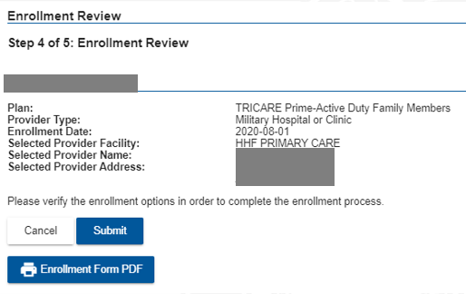
Enrollments (cont.)
Review enrollment and click Submit
Notes:
06/12/20 – updated screenshot

Slide 15
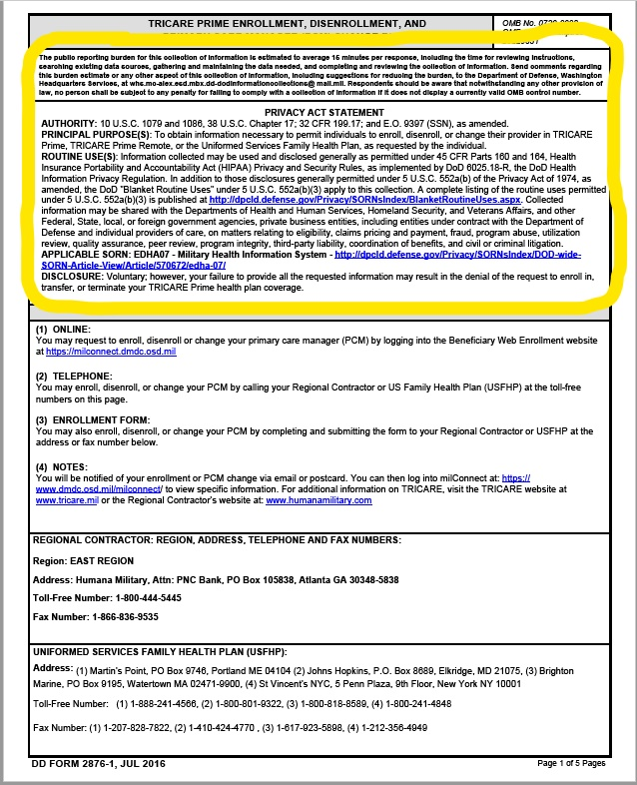
Enrollments (cont.)
After selection of “Enrollment Form PDF” button

Slide 16
Enrollments (cont.)
Enrollment Confirmation page
Notes:
updated screenshot

Slide 17
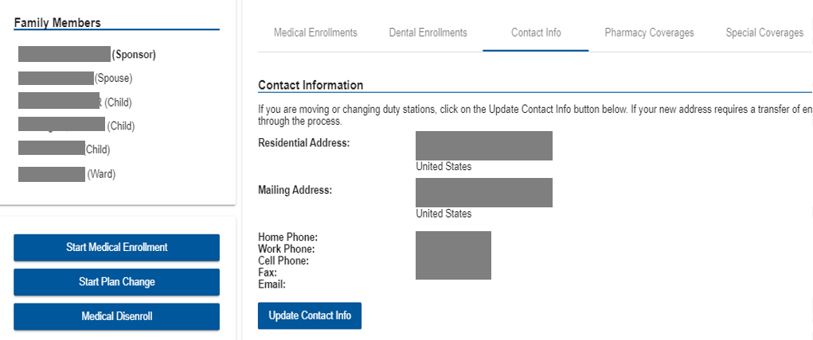
Update Address
Click Update Contact Info to update address information
Notes:
06/12/20 – updated screenshot

Slide 18
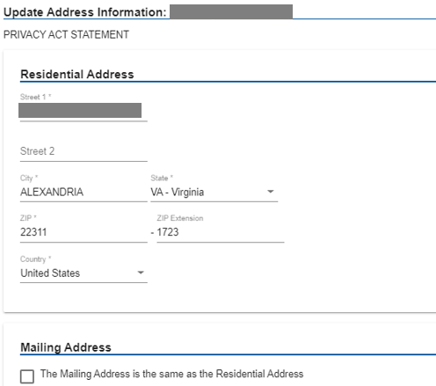
Update Address
Verify or update contact information
Add or change other family members’ email address and preference
Select beneficiaries to apply the new address information
Notes:
added slide

Slide 19
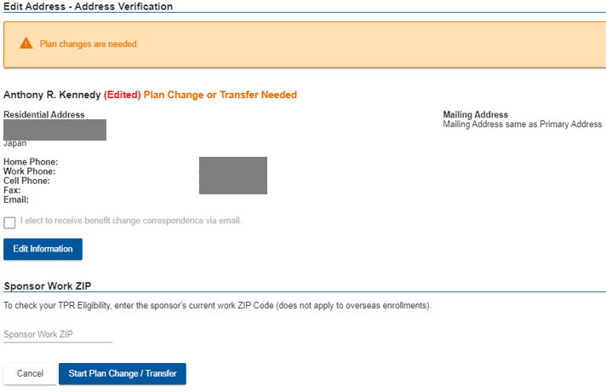
Transfer
Updating address information may prompt a plan change or transfer
If so, click Start Plan Change/Transfer to continue
Notes:
added slide

Slide 20
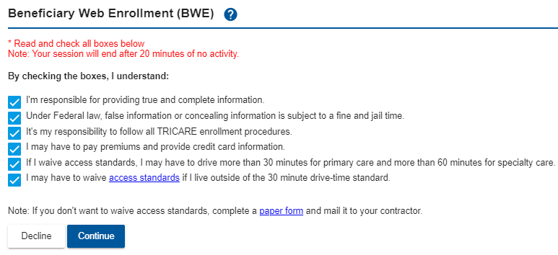
Transfer (cont.)
Select the check boxes for Enrollment Procedure Compliance
Notes:
added slide

Slide 21
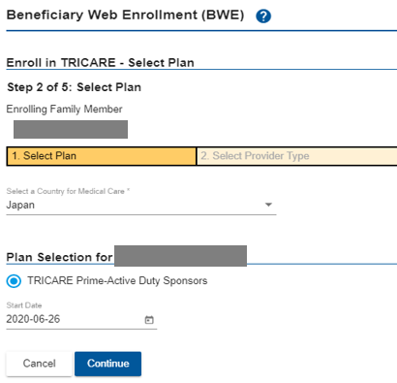
Transfer (cont.)
Select the Country for Medical Care
Select the plan and click Continue
Notes:
added slide

Slide 22
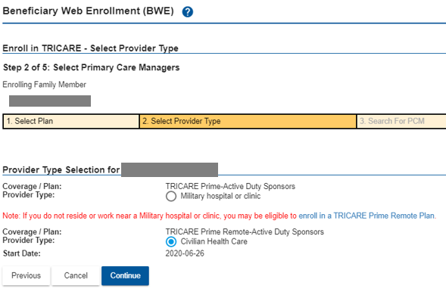
Transfer (cont.)
Select the Provider Type and click Continue
Notes:
added slide

Slide 23
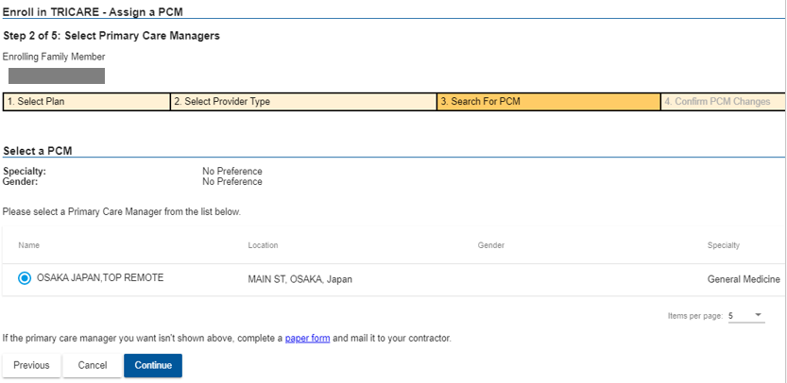
Transfer (cont.)
Select a PCM and click Continue
Notes:
added slide

Slide 24
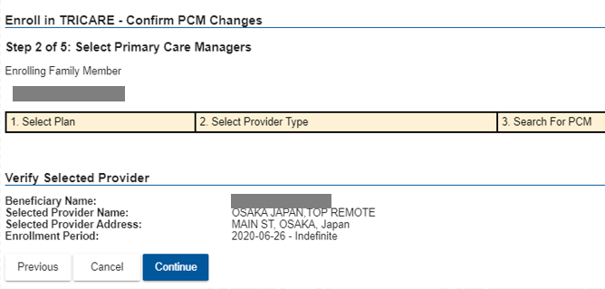
Transfer (cont.)
Verify the Selected Provider and click Continue
Notes:
added slide

Slide 25
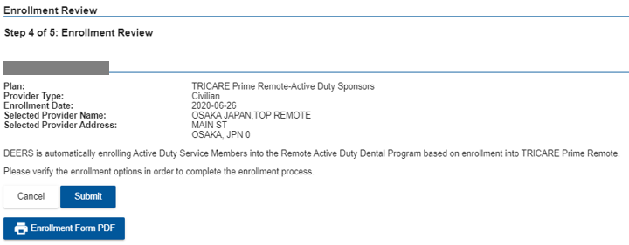
Transfer (cont.)
Click Submit to complete the enrollment process
Notes:
added slide

Slide 26
Transfer (cont.)
Enrollment Confirmation page and follow-up options
Notes:
added slide

Slide 27
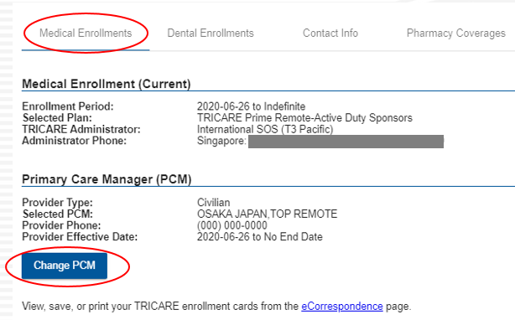
PCM Change
Navigate to the Medical Enrollments tab and click Change PCM
Notes:
added slide

Slide 28
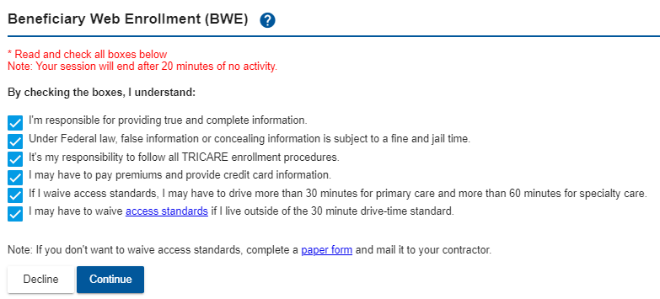
PCM Change (cont.)
Select the check boxes for Enrollment Procedure Compliance
Notes:
added slide

Slide 29
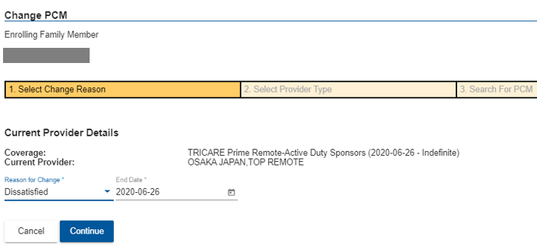
PCM Change (cont.)
Select the Reason for Change and click Continue
Notes:
added slide

Slide 30
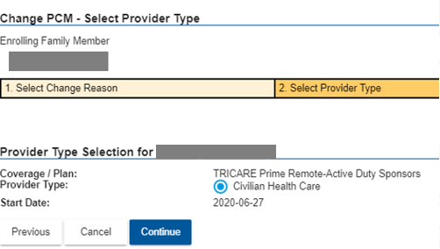
PCM Change (cont.)
Select the Provider Type and click Continue
Notes:
added slide

Slide 31
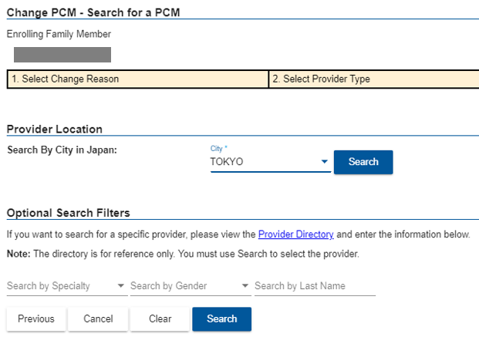
PCM Change (cont.)
Select the Provider Location and optional Search Filters, and click Search
Notes:
added slide

Slide 32
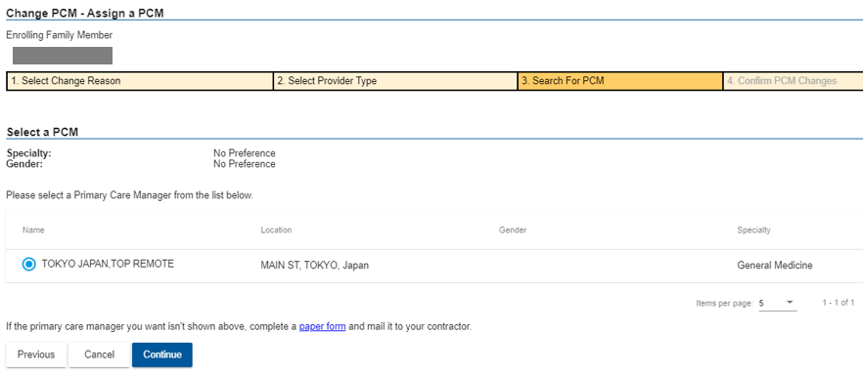
PCM Change (cont.)
Select a PCM and click Continue
Notes:
added slide

Slide 33
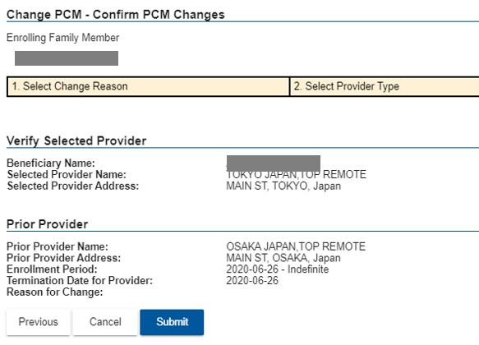
PCM Change (cont.)
Verify the select PCM and click Submit
Notes:
added slide

Slide 34
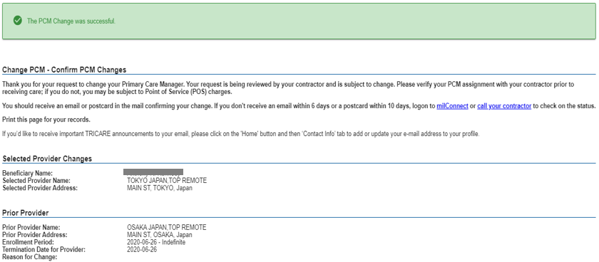
PCM Change (cont.)
PCM Change confirmation page
Notes:
added slide

Slide 35
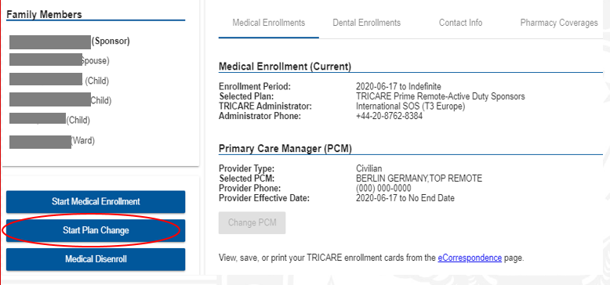
Plan Change
Select the family member and click Start Plan Change
Notes:
added slide

Slide 36
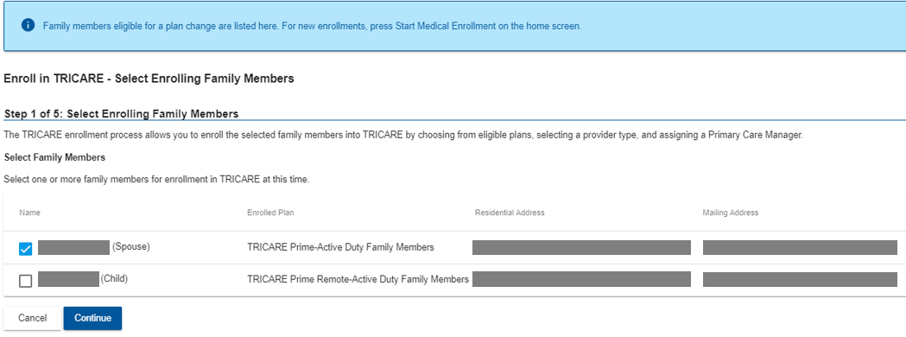
Plan Change (cont.)
Select enrolling family members and click Continue
Notes:
added slide

Slide 37
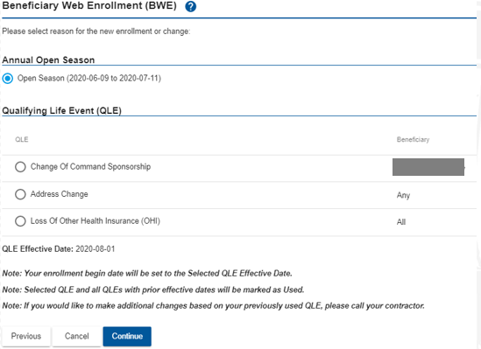
Plan Change (cont.)
Select Annual Open Season or QLE (if applicable) and click Continue
Notes:
added slide

Slide 38
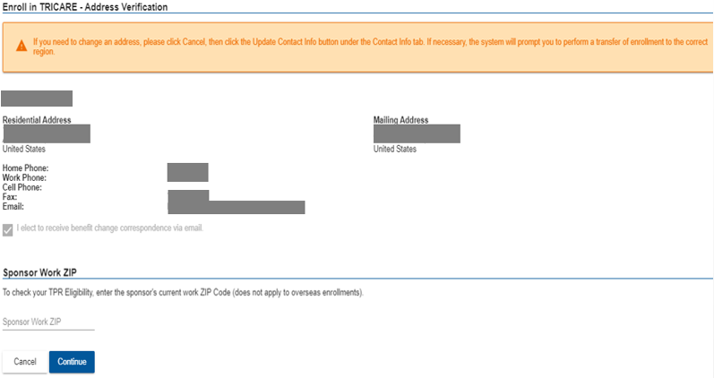
Plan Change (cont.)
Verify address information and click Continue
Notes:
added slide

Slide 39
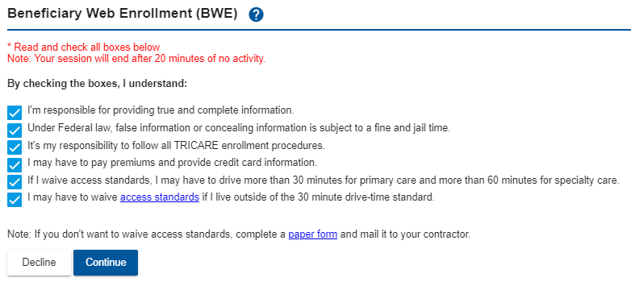
Plan Change (cont.)
Select the check boxes for Enrollment Procedure Compliance
Notes:
added slide

Slide 40
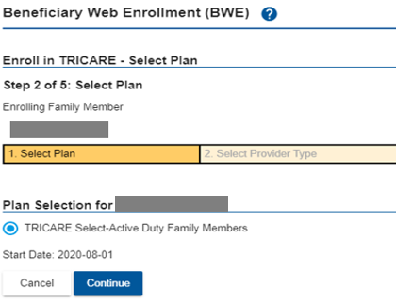
Plan Change (cont.)
Select plan and click Continue
Notes:
added slide

Slide 41
Plan Change (cont.)
Verify the selected plan and click Continue
Notes:
added slide

Slide 42
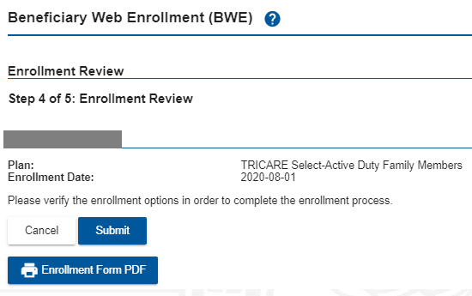
Plan Change (cont.)
Click Submit to complete the Plan Change process
Notes:
added slide

Slide 43
Plan Change (cont.)
Enrollment Confirmation screen
Notes:
added slide

Slide 44
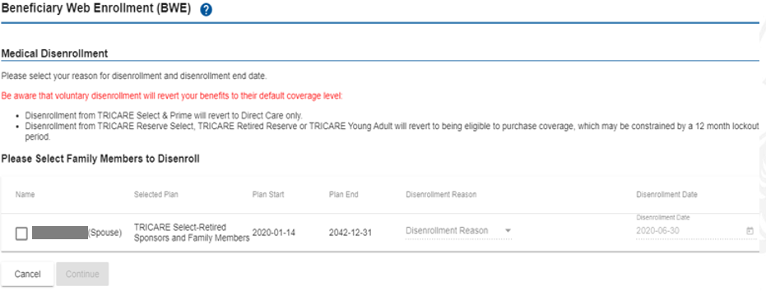
Disenrollments
Notes:
updated screenshot

