Slide 1
Drug Impaired Driving
July
2022
TV Concepts

Slide 2
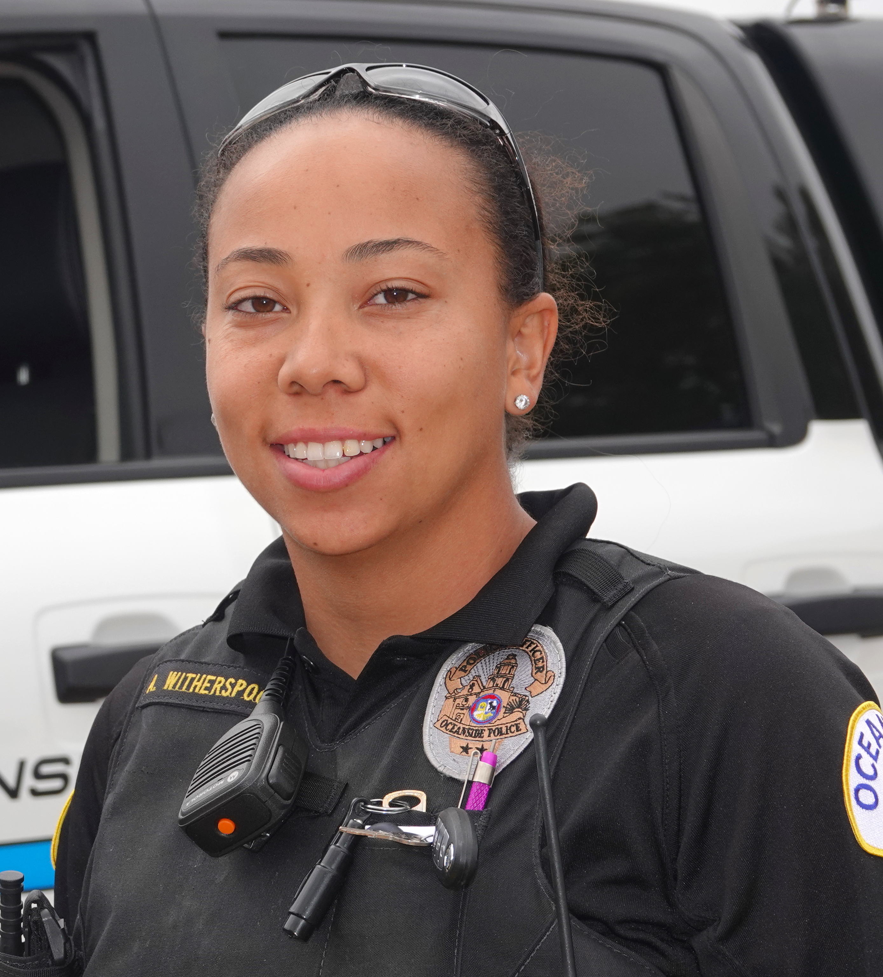
1
What’s The Difference?
How is drunk driving different from driving high? It’s not.
Open on a male driver getting pulled over by a law enforcement officer. We see the worried face of the driver in the rear view mirror glancing back at the LEO. His nervous hands gripping the wheel, adjusting his seat belt. He straightens in the seat and checks his eyes in the mirror.
VO: Let’s discuss how driving high is different from driving drunk.
The officer leaves the car and slowly walks up the road behind the car. She takes her time and the wait is unnerving.
Just as she reaches the driver's window she stops and looks straight into camera.
Law Enforcement Officer: It’s not.
VO: If you feel different you drive different. Drive high, get a DUI. LOGOS
Paid For By NHTSA

Slide 3
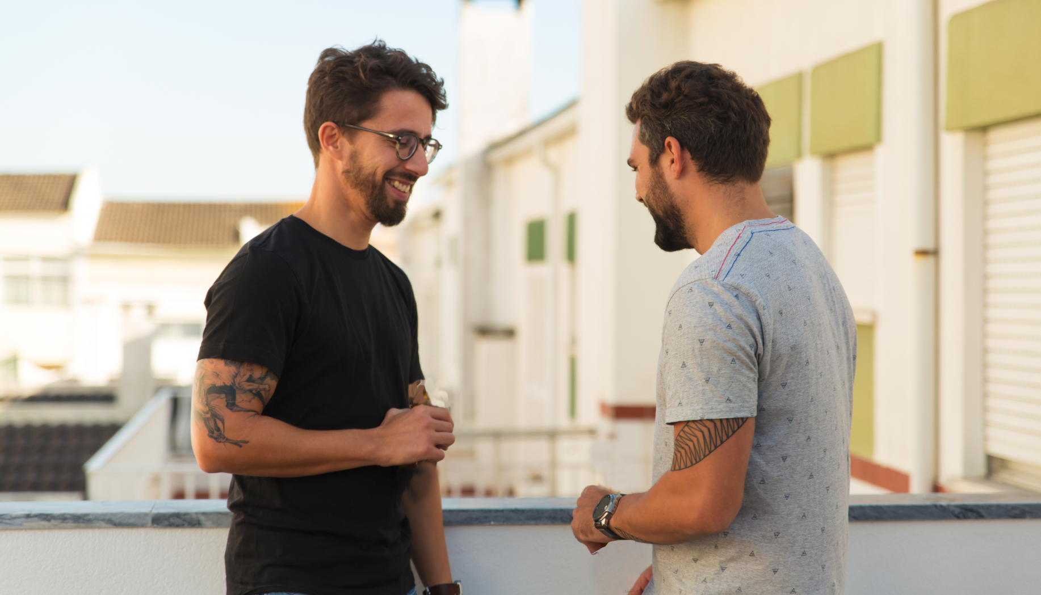
2
Play By Play
Driving high gets you the same DUI.
Open on two guys sitting on their apartment balcony. There is smoke in the air and the scene indicates they have been smoking weed. Law enforcement lights reflect off camera.
Guy 1: (Looking down on the street at a cop pulling over a car.
Dude is that your neighbor they pulled over?
Guy 2: Yeah, that’s not good. They have him out of the car. Oh boy, they’re taking him in? Looks like a DUI.
Guy 1: I thought he didn’t drink.
Guy 2: He doesn’t.
VO: If you’re driving while under the influence of marijuana, remember, driving high gets you the same DUI.
Card: If You Feel Different, You Drive Different. Drive High, Get A DUI.
LOGOS
Paid For By NHTSA

Slide 4
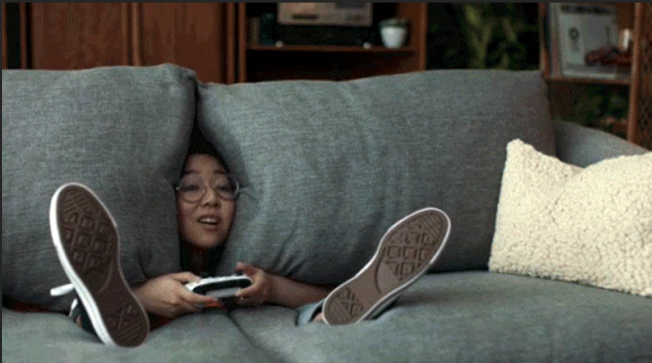
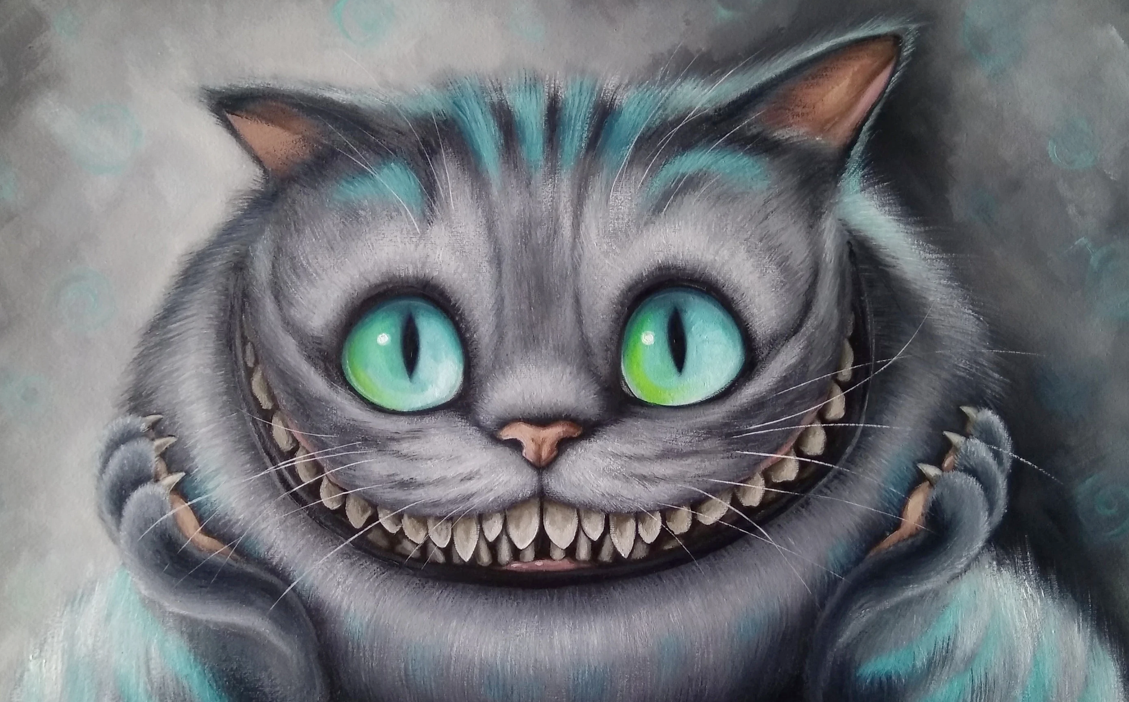
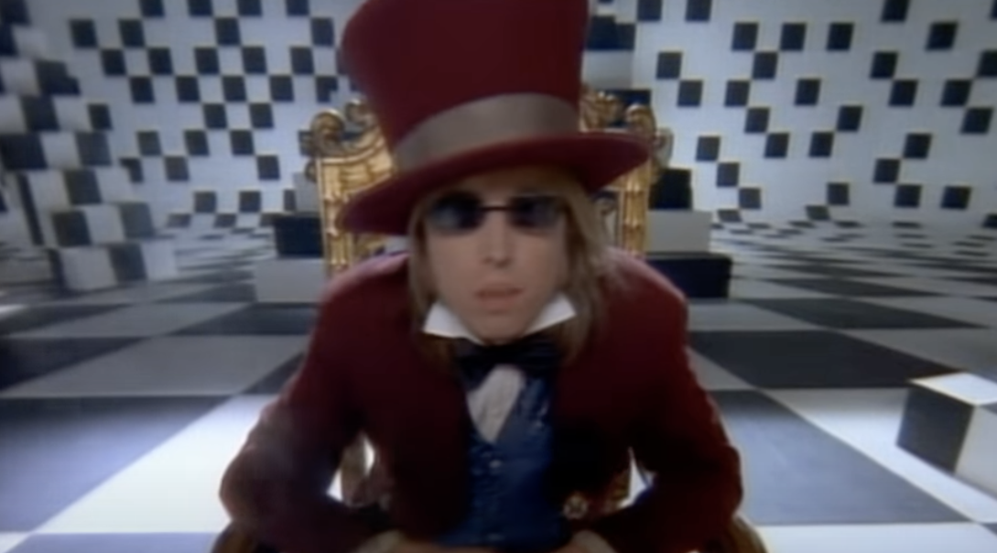
3
In Wonderland
Don’t go down the rabbit hole of driving high
Open on a man sitting in a chair staring at the TV. He appears high. There’s a remote and his keys on the coffee table. He picks up the keys.​
Man (to someone off camera): Man, I'm baked, I'm gonna run out for snacks …in a minute. ​
As he sits down and as he leans back, the sofa swallows him up and begins to tumble over backwards. The couch becomes the driver’s seat of his car.
The car begins to tumble through a void. He appears to be driving as the car is falling through the sky. He looks confused.​ ​ A Cheshire cat floats by hands him a teacup: You should not be driving!​
The car lands on the ground with a thump. ​
A rabbit pops his head it the window: Oh dear oh dear. Are you stoned? ​
Cut to the Queen: Gone with his license!​
​ A deck of cards come marching out: Up with his insurance! ​
Little law enforcement cars with lights on behind them.​ The man looks around startled. ​
The Mad Hatter steps in holding the car keys: You might want be getting back home.
The keys turn into the remote.​ The Mad Hatter hands him the TV remote.​
Cut to the man back in his living room with the remote in his hand, looking confused. There’s now a teacup on his coffee table, along with the keys ​ ​
A DUI is a DUI.
If you Feel Different, You Drive Different. Drive High, Get A DUI.​
LOGOS​ Paid For By NHTSA​

Slide 5
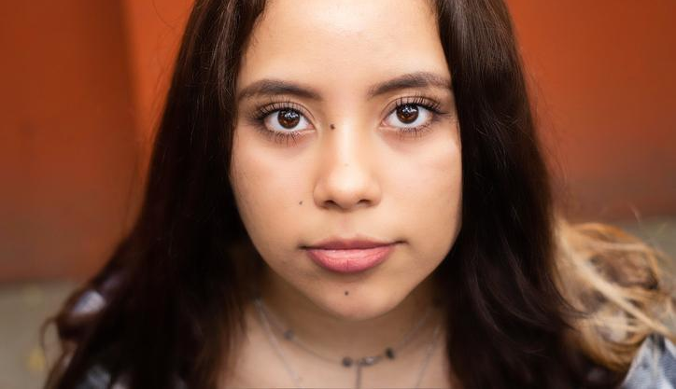
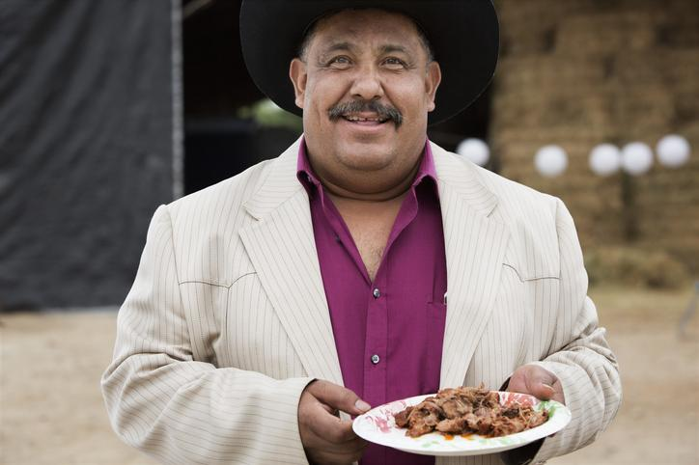
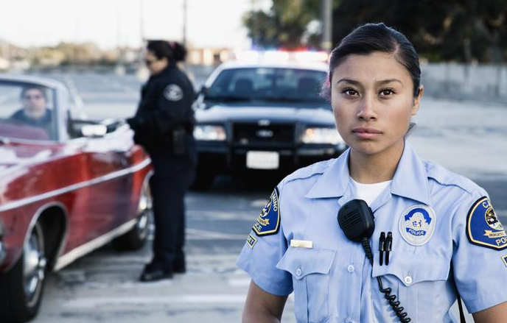
4
I Can Tell
If everyone around you can tell, officers can tell.
From the young man's POV, we see him checking his eyes in the rearview mirror of his car. His eyes are bloodshot. We then see the young man walk up to a door and see a young woman by the front door of her apartment. It's obvious they're going out. She looks at the young man, annoyed, and tells him:
Young woman: I can tell.
From the young man's POV, we see him entering a home through the back kitchen door. He says hi to his mom. She immediately notices there's something off.
Young man: Hi, mom.
Mom: I can tell.
From the young man’s POV, we see him arriving at a backyard BBQ. One of the older men approaches him and whispers.
Man: I can tell.
Finally, from the young man’s POV, we see that he has been stopped by a law enforcement officer.
We hear a VO.
VO: If you think no one can tell you’re driving high, you’re wrong.
The officer looks at the young man straight in the eye and tells him:
Officer: I can tell.
SUPER: If you feel different, you drive different. Drive High, Get a DUI.
LOGOS Paid for by NHTSA

