Slide 1
Drug Impaired Driving
July
2022
TV Concepts

Slide 2
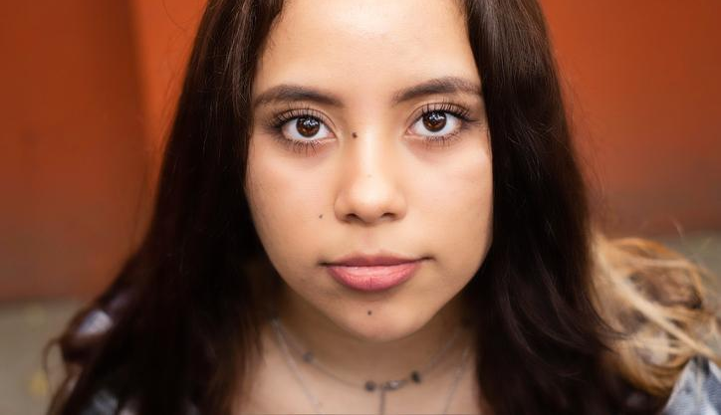
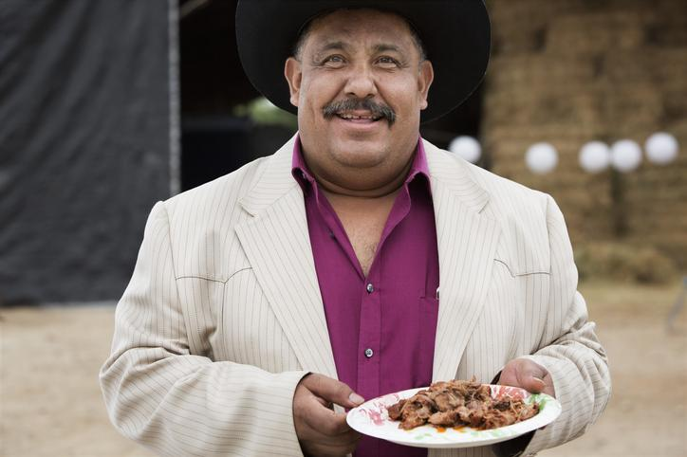
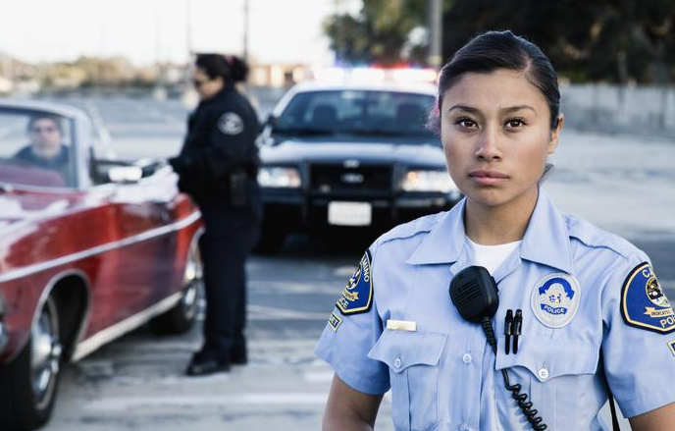
1
I Can Tell - SPANISH
If everyone around you can tell, officers can tell.
From the young man's POV, we see him checking his eyes in the rearview mirror of his car. His eyes are bloodshot. We then see the young man walk up to a door and see a young woman by the front door of her apartment. It's obvious they're going out. She looks at the young man, annoyed, and tells him:
Young woman: Me puedo dar cuenta. I can tell.
From the young man's POV, we see him entering a home through the back kitchen door. He says hi to his mom. She immediately notices there's something off.
Young man: Hola, ma. Hi, ma.
Mom: Me puedo dar cuenta. I can tell.
From the young man’s POV, we see him arriving at a backyard BBQ. One of the older men approaches him and whispers.
Man: Me puedo dar cuenta.
I can tell.
Finally, from the young man’s POV, we see that he has been stopped by a law enforcement officer.
We hear a VO.
VO: Si piensas que nadie se da cuenta que estás manejando high, estás equivocado. If you think no one can tell you are driving high, you’re wrong.
The officer looks at the young man straight in the eye and tells him:
Officer: Me puedo dar cuenta. I can tell.
SUPER: Si te sientes diferente, manejas diferente. Drive High, Get a DUI. If you feel different, you drive different. Drive High, Get a DUI.
LOGOS Pagado por NHTSA Paid for by NHTSA

Slide 3
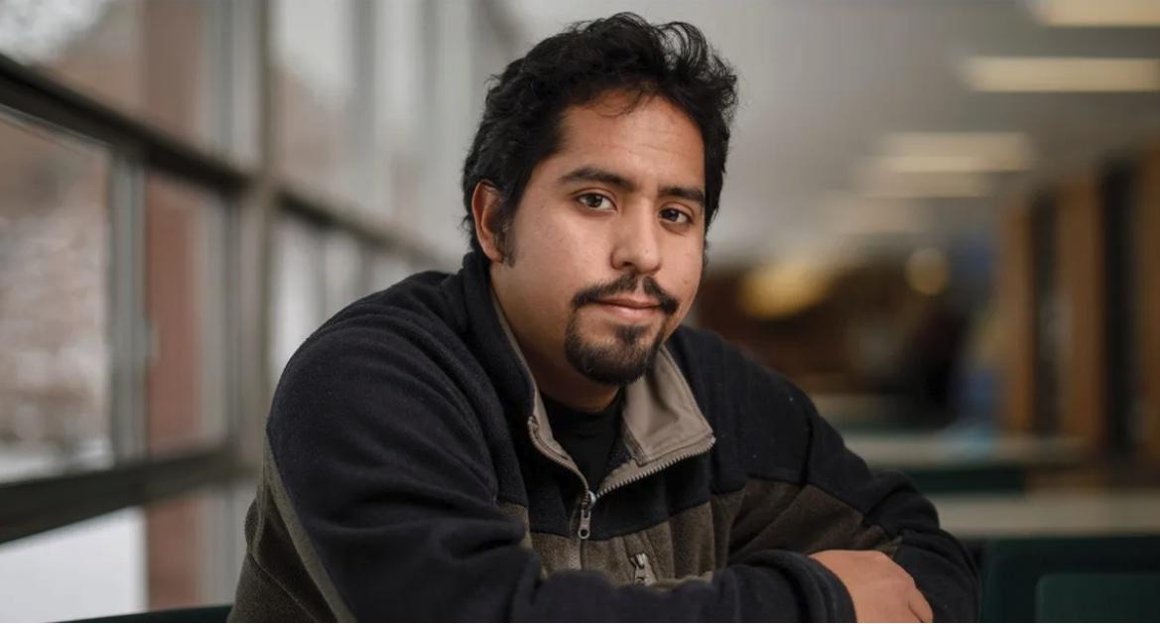
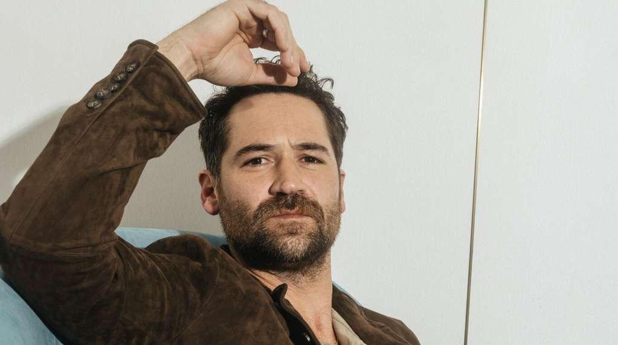
2
I’m Ok To Drive - SPANISH
Everyone has an excuse or justification for driving high.
We see a series of people in situations where they look very confident, telling us their beliefs about driving under the influence of marijuana, only to see them immediately debunked with a smash cut to them getting a ticket or in court.
We open on a man in his car speaking to the camera. We smash cut to see him driving, suddenly the law enforcement vehicle lights come on.
Man: La marihuana no afecta como manejo. ¿O sí afecta?
Marijuana doesn’t affect my driving…or does it?
We cut to a man speaking to the camera. We smash cut to see him in his car. A law enforcement officer has stopped him and is walking towards his car.
Man: No pensé que estaba bajo la influencia…No estaba pensando.
I didn’t think I was under the influence…I wasn’t thinking.
We cut to a man speaking to the camera. We smash cut to see him being tested by the officer.
Man: Cuando fumo, me relajo, me enfoco…y me multan.
When I smoke, I’m more relaxed and focused…and fined.
VO: No importa lo que pienses, manejar high es contra la ley.
Whatever you might think, driving high is against the law.
SUPER: Si te sientes diferente, manejas diferente. Drive High, Get a DUI.
If you feel different, you drive different. Drive High, Get a DUI.
LOGOS
Pagado por NHTSA
Paid for by NHTSA

Slide 4
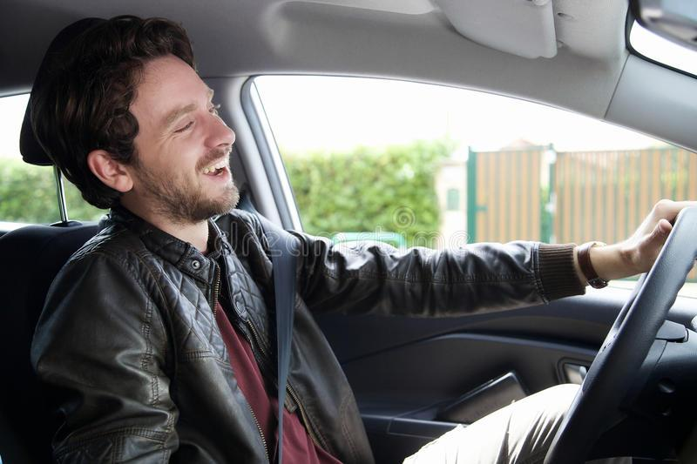
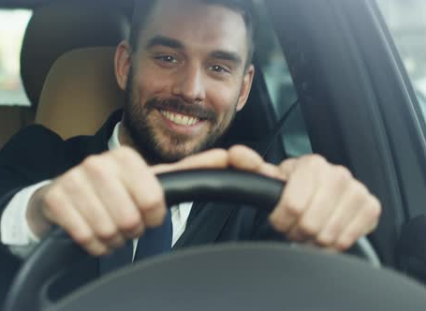
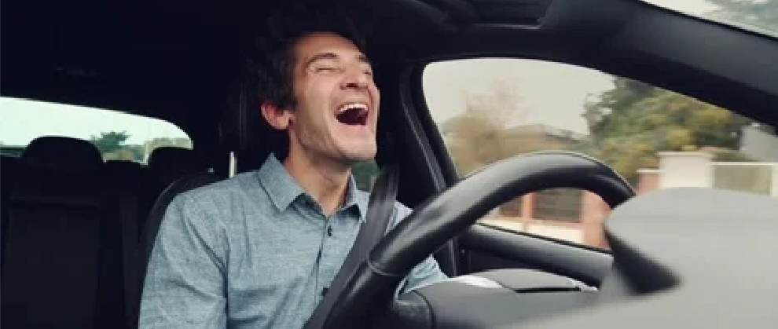
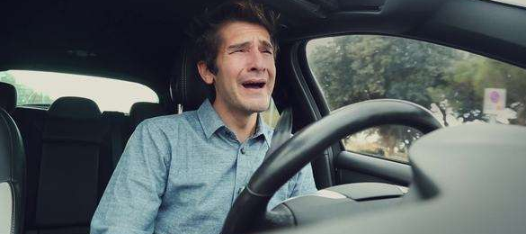
3
Mood - SPANISH
Marijuana can improve your mood, but a DUI won’t.
Cut to various people in cars driving. The drivers either have glassy eyes, or they are bloodshot. They’re all laughing, some slightly, some a bit more. They’re not worried; they’re happy.
In addition to laughing, we see some of the drivers swerving on the road and zoning out while driving.
The last guy is laughing until he sees law enforcement vehicle lights in his rearview mirror. His mood changes from laughing to crying.
We hear a VO.
VO: Recibir un DUI por manejar bajo los efectos de la marihuana definitivamente te cambiará el humor.
Getting a DUI for driving under the influence of marijuana will definitely change your mood.
SUPER: Si te sientes diferente, manejas diferente. Drive High, Get a DUI.
If you feel different, you drive different. Drive High, Get a DUI.
LOGOS
Pagado por NHTSA
Paid for by NHTSA

Slide 5
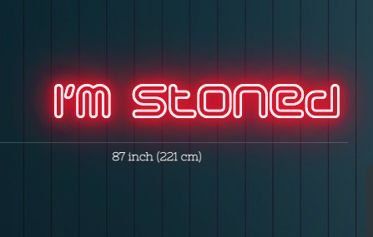
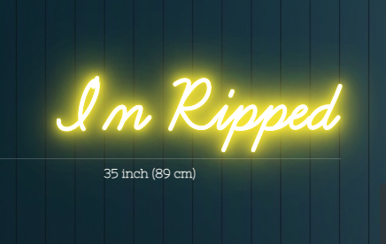
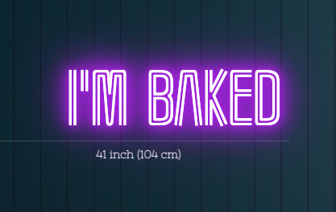
4
Can’t Hide It - SPANISH
You can’t really hide that you are high.
We see various guys that have bloodshot eyes driving around a city with different neon signs hanging in the roof of their cars. The signs advertise the state that they are in.
“Estoy alucinando”
“I’m stoned”
“Estoy fumado”
“I’m wasted”
“Fumé mota”
“I’m baked”
“Fumé un porro”
“I’m faded”
“Estoy high”
“I’m high”
A law enforcement vehicle stops the “I’m High” car. We cut to the interior and see that the driver is completely caught by surprise.
VO:
SUPER: Si te sientes diferente, manejas diferente. Drive High, Get a DUI.
If you feel different, you drive different. Drive High, Get a DUI.
LOGOS
Pagado por NHTSA
Paid for by NHTSA

