Slide 1
OPM-V Privacy Screenshots

Slide 2
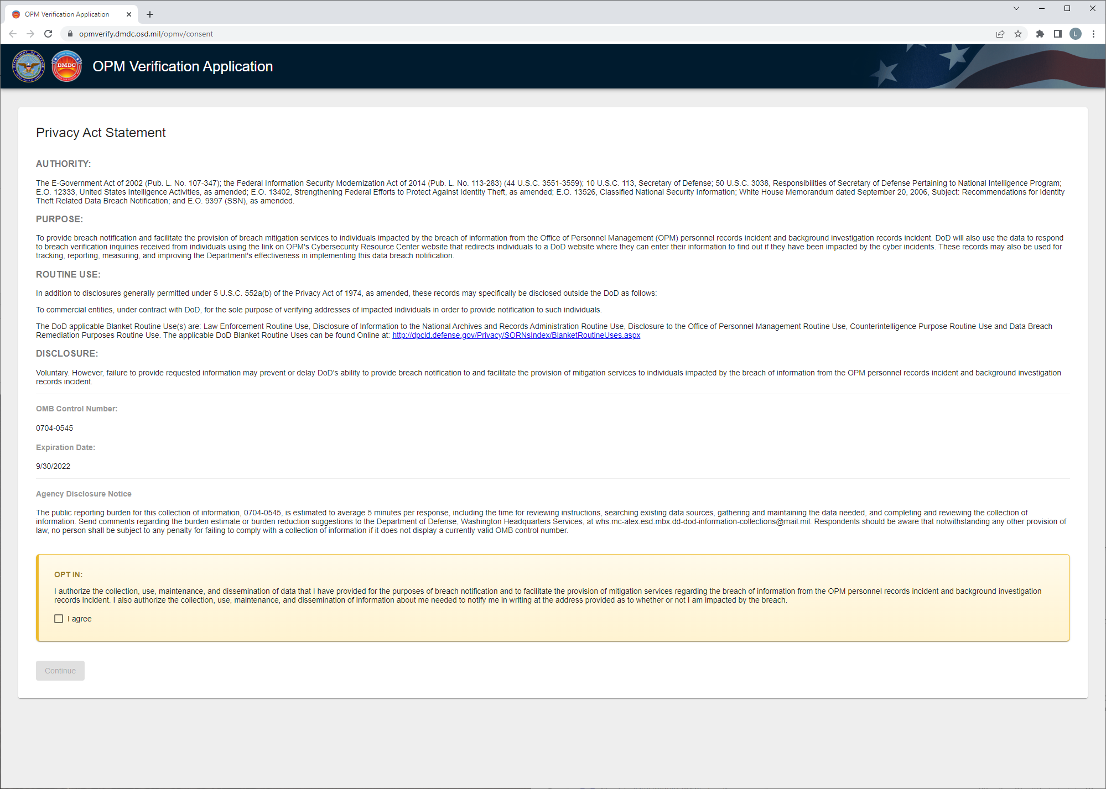
XX/XX/XXXX

Slide 3
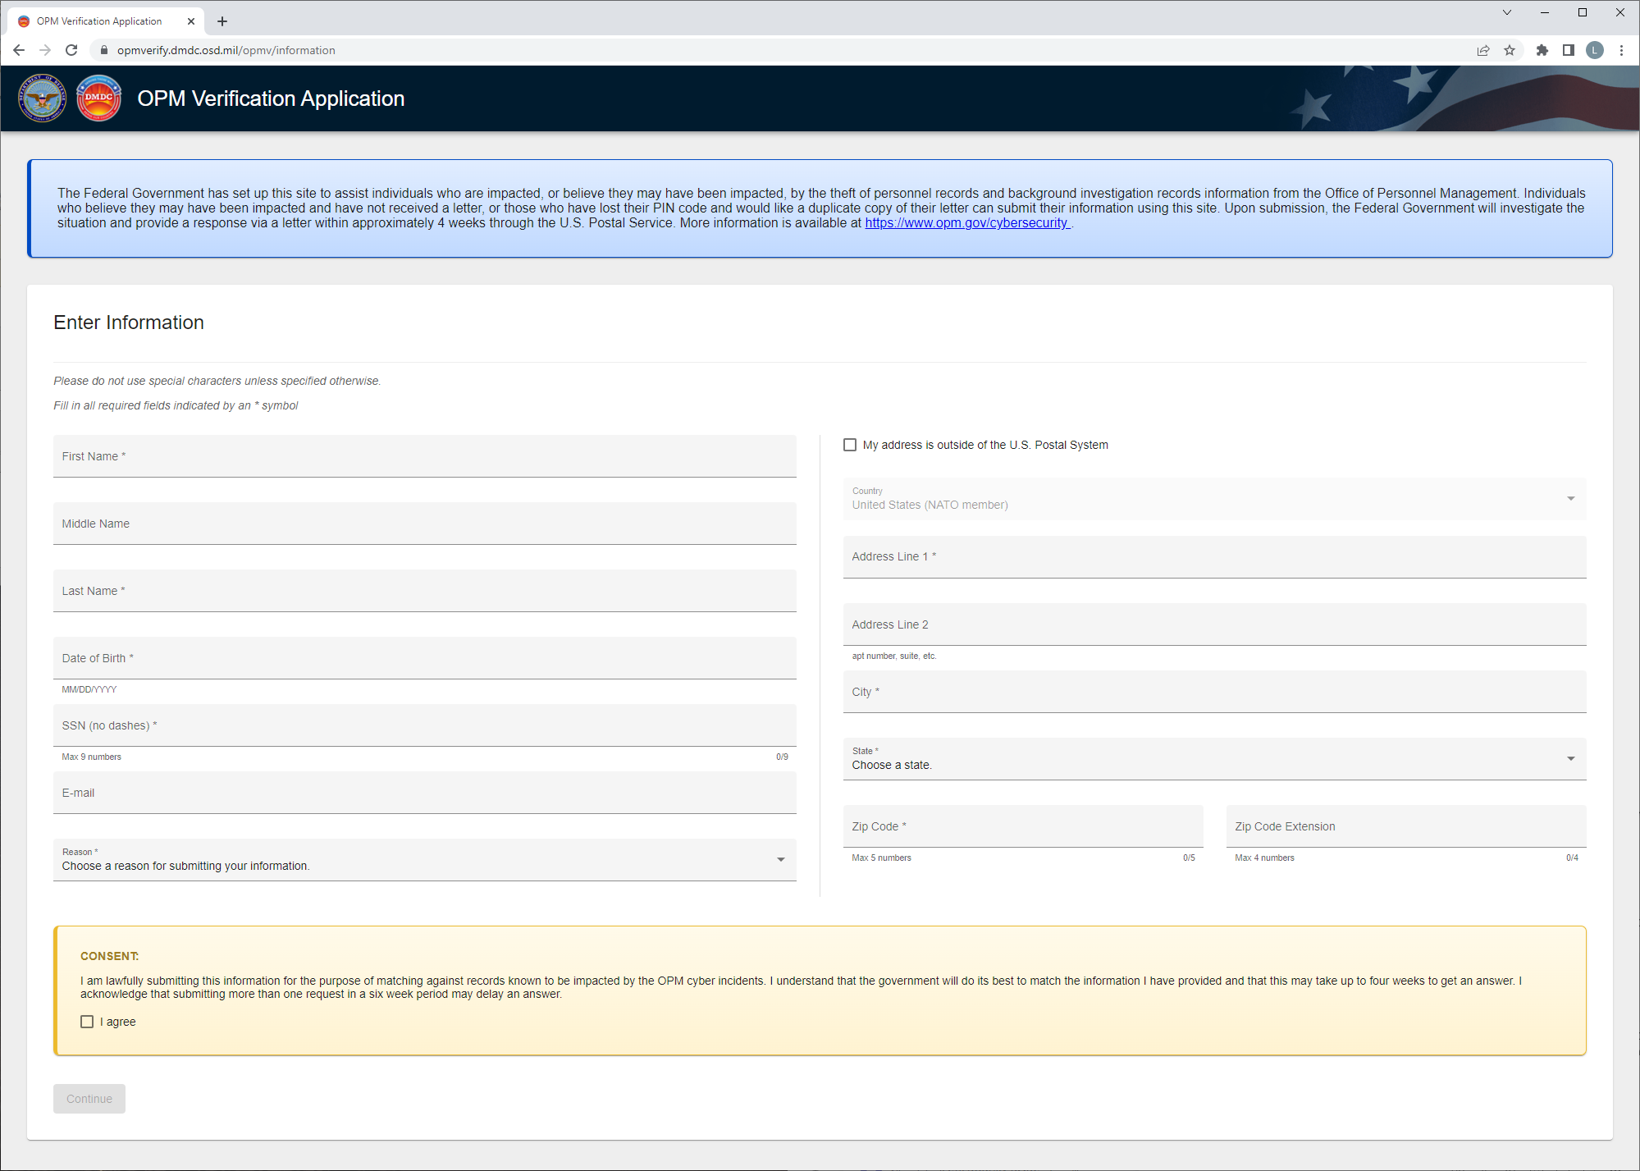

Slide 4
