Slide 1
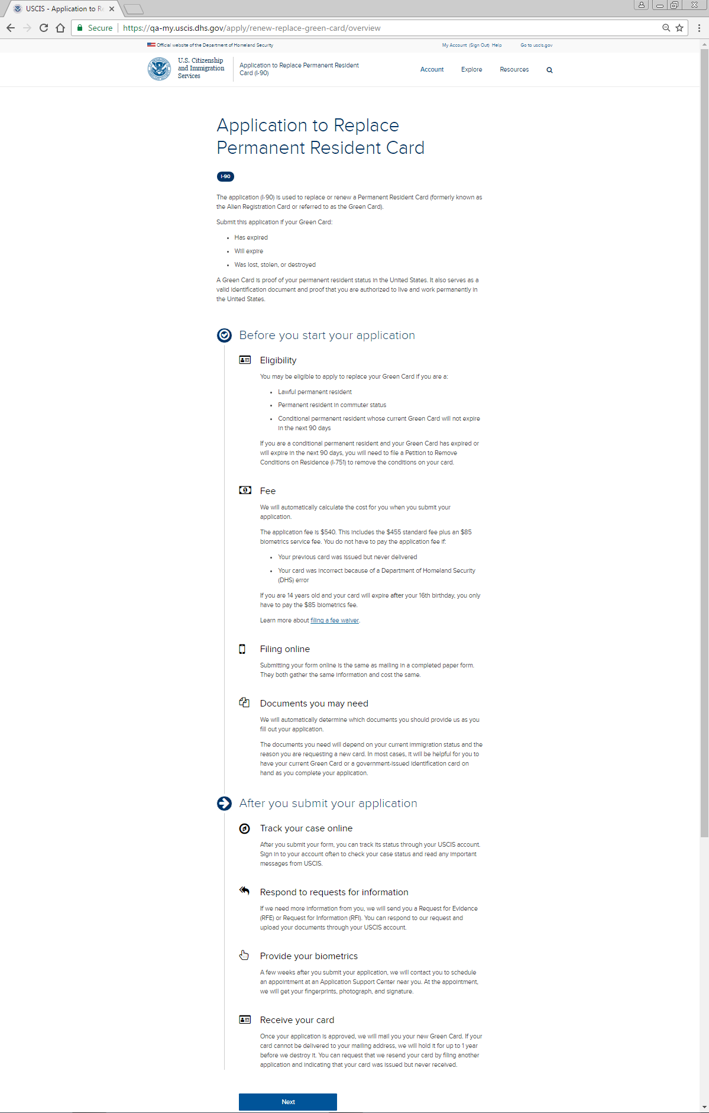
I-90 Application Overview: Page One
The application (I-90) is used to replace or renew a Permanent Resident (LPR) Card (formerly known as the Alien Registration Card or referred to as the Green Card) or an LPR in Commuter Status.
Submit this application if your Green Card:
• Has expired
• Will expire
• Was lost, stolen, or destroyed
A Green Card is proof of your permanent resident status in the United States. It also serves as a valid identification document and proof that you are authorized to live and work permanently in the United States.
If you are a conditional permanent resident with a 2-year card, you may use this application only if your card is still valid and will not expire in the next 90 days.
Eligibility
You may be eligible to apply to replace your Green Card if you are a:
• Lawful permanent resident
• Permanent resident in commuter status
• Conditional permanent resident whose current Green Card will not expire in the next 90 days
If you are a conditional permanent resident with a 2 year card and your Green Card has expired or will expire in the next 90 days, you will need to:
• File a Petition to Remove Conditions on Residence (I-751), if you obtained your conditional permanent resident status through marriage to a U.S. citizen or lawful permanent resident; or
• File a Petition by Entrepreneur to Remove Conditions on Permanent Resident Status (I-829), if you obtained your conditional permanent resident status based on the creation of a new commercial enterprise and a financial investment in the United States.
Fee
We will automatically calculate the cost for you when you submit your application.
The application fee is $540. This includes the $455 standard fee plus an $85 biometrics service fee. You do not have to pay the application fee if:
• Your previous card was issued but never delivered
• Your card was incorrect because of a Department of Homeland Security (DHS) error
If you are 14 years old and your card will expire after your 16th birthday, you only have to pay the $85 biometrics fee.
Learn more about <a href="https://www.uscis.gov/feewaiver">filing a fee waiver</a>.
Filing online
Submitting your form online is the same as mailing in a completed paper form. They both gather the same information and cost the same.
Documents you may need
We will automatically determine which documents you should provide us as you fill out your application.
The documents you need will depend on your current immigration status and the reason you are requesting a new card. In most cases, it will be helpful for you to have your current Green Card or a government-issued identification card on hand as you complete your application.
Track your case online
After you submit your form, you can track its status through your USCIS account. Sign in to your account often to check your case status and read any important messages from USCIS.
Respond to requests for information
If we need more information from you, we will send you a Request for Evidence (RFE) or Request for Information (RFI). You can respond to our request and upload your documents through your USCIS account.
Provide your biometrics
A few weeks after you submit your application, we will contact you to schedule an appointment at an Application Support Center near you. At the appointment, we will get your fingerprints, photograph, and signature.
NOTE: If you are temporarily outside of the United States due to U.S. military or government orders and you are required to include a biometrics service fee with your application, please also include a properly completed Form FD-258 (fingerprint card) and a passport-style photo with your application. (See the Part 2. Application Type, Reason for Application, Section A. or Section B. of the Form I-90 Instructions for further information of who must include a biometric services fee.)
Receive your card
Once your application is approved, we will mail you your new Green Card. If your card cannot be delivered to your mailing address, we will hold it for up to 1 year before we destroy it. You can request that we resend your card by filing another application and indicating that your card was issued but never received.

Slide 2
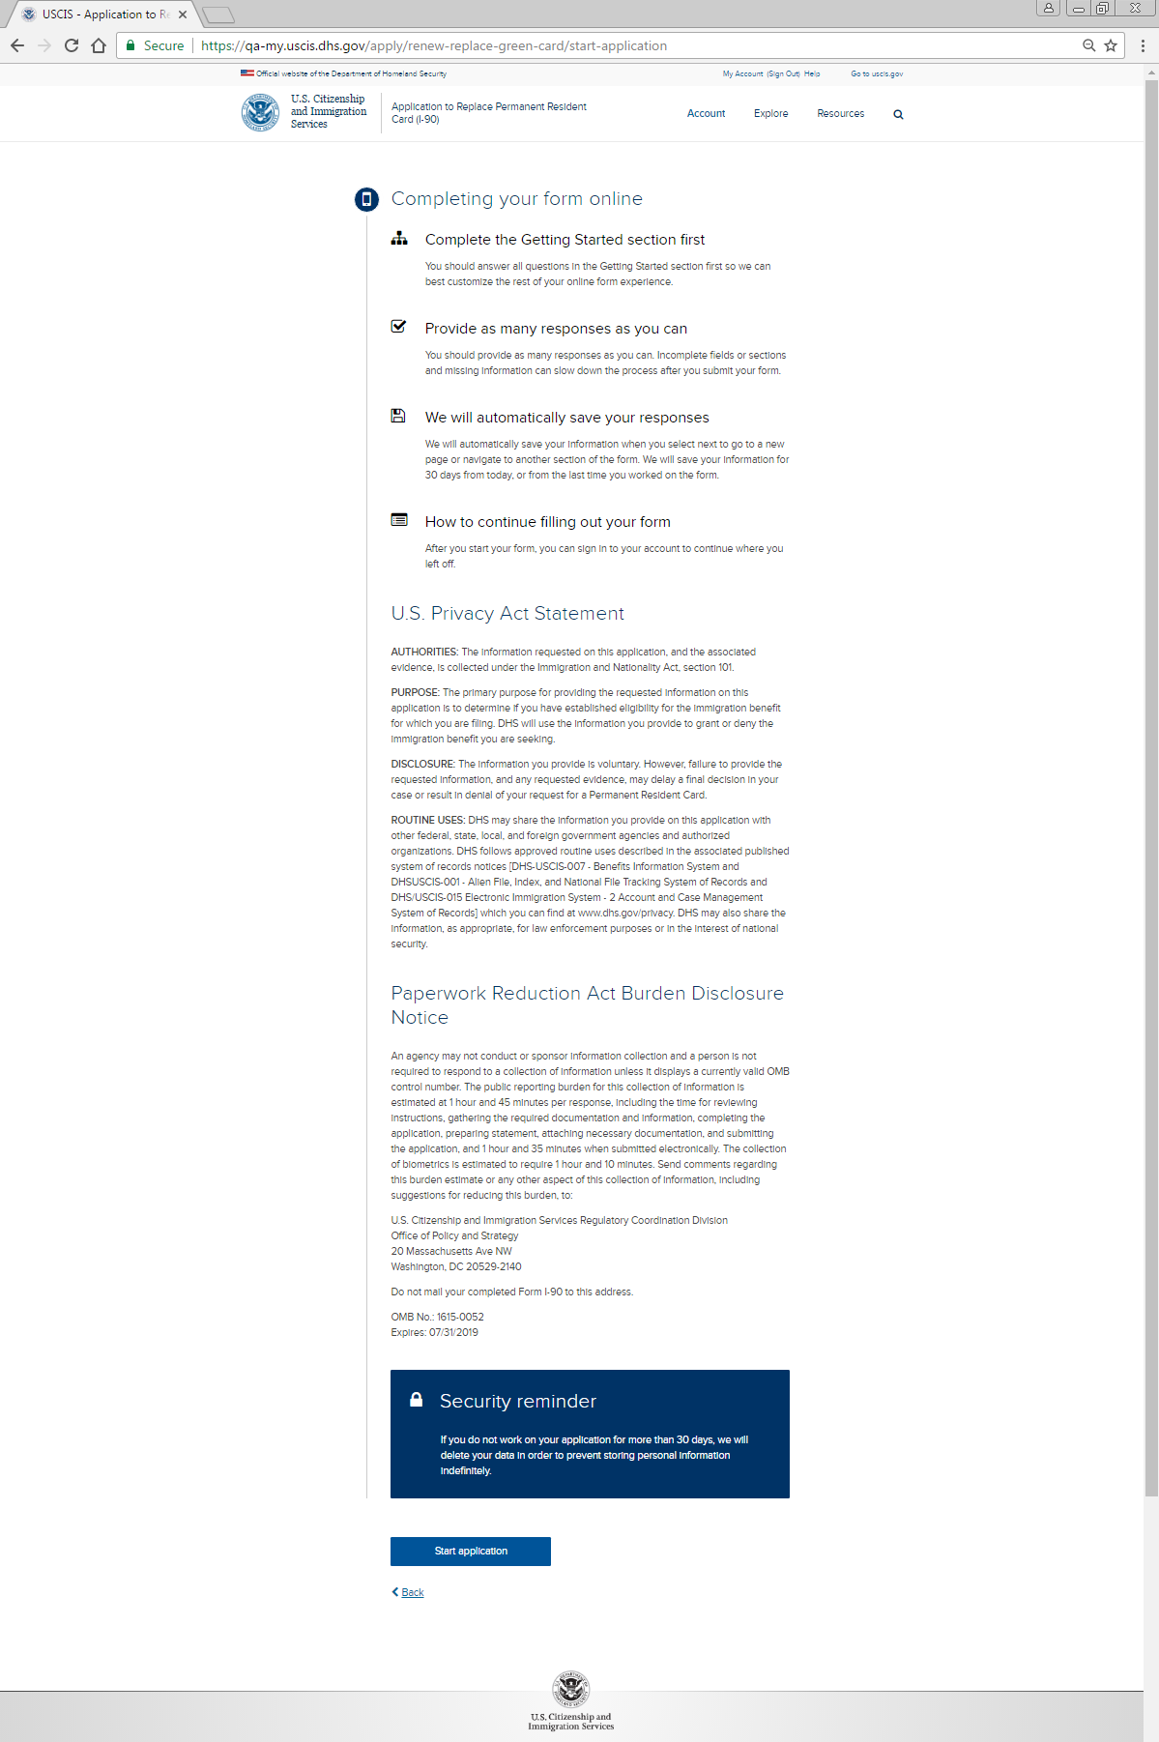
I-90 Application Overview: Page Two
DHS Privacy Notice
AUTHORITIES: The information requested on this application, and the associated evidence, is collected under the Immigration and Nationality Act Section 264, and 8 CFR Section 264.5.
PURPOSE: The primary purpose for providing the requested information on this application is to apply for a replacement or a renewal of your existing Permanent Resident Card. DHS will use the information you provide to grant or deny the immigration benefit you are seeking.
DISCLOSURE: The information you provide is voluntary. However, failure to provide the requested information, including your Social Security number (if applicable), and any requested evidence, may delay a final decision or result in denial of your application.
ROUTINE USES: DHS may, where allowable under relevant confidentiality provisions, share the information you provide on this application, and any additional requested evidence, with other Federal, state, local, and foreign government agencies and authorized organizations. DHS follows approved routine uses described in the associated published system of records notice [DHS/USCIS/ICE/CBP 001 Alien File, Index, and National File Tracking, DHS/USCIS-007 Benefits Information System, and DHS/USCIS-018 Immigration Biometric and Background Check] and the published privacy impact assessment [DHS/USCIS/PIA-056 USCIS Electronic Immigration System and DHS/USCIS/PIA-071 myUSCIS Account Experience], which you can find at www.dhs.gov/privacy. DHS may also share this information, as appropriate for law enforcement purposes or in the interest of national security.
Paperwork Reduction Act Burden Disclosure Notice
An agency may not conduct or sponsor an information collection, and a person is not required to respond to a collection of information, unless it displays a currently valid Office of Management and Budget (OMB) control number. The public reporting burden for this collection of information is estimated at 2 hours per response, including the time for reviewing instructions, gathering the required documentation and information, completing the application, preparing statements, attaching necessary documentation, and submitting the application. The collection of biometrics is estimated to require 1 hour and 10 minutes. Send comments regarding this burden estimate or any other aspect of this collection of information, including suggestions for reducing this burden to:

Slide 3
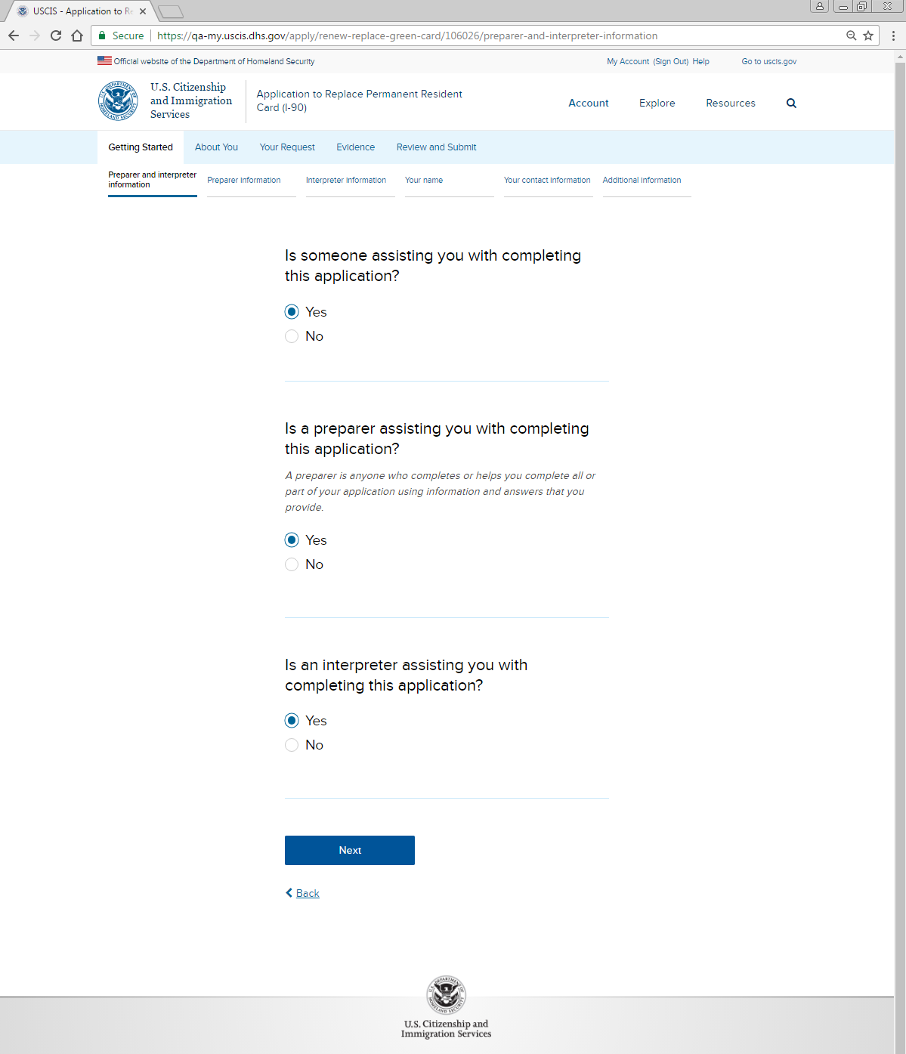
Getting Started: Preparer and interpreter information

Slide 4
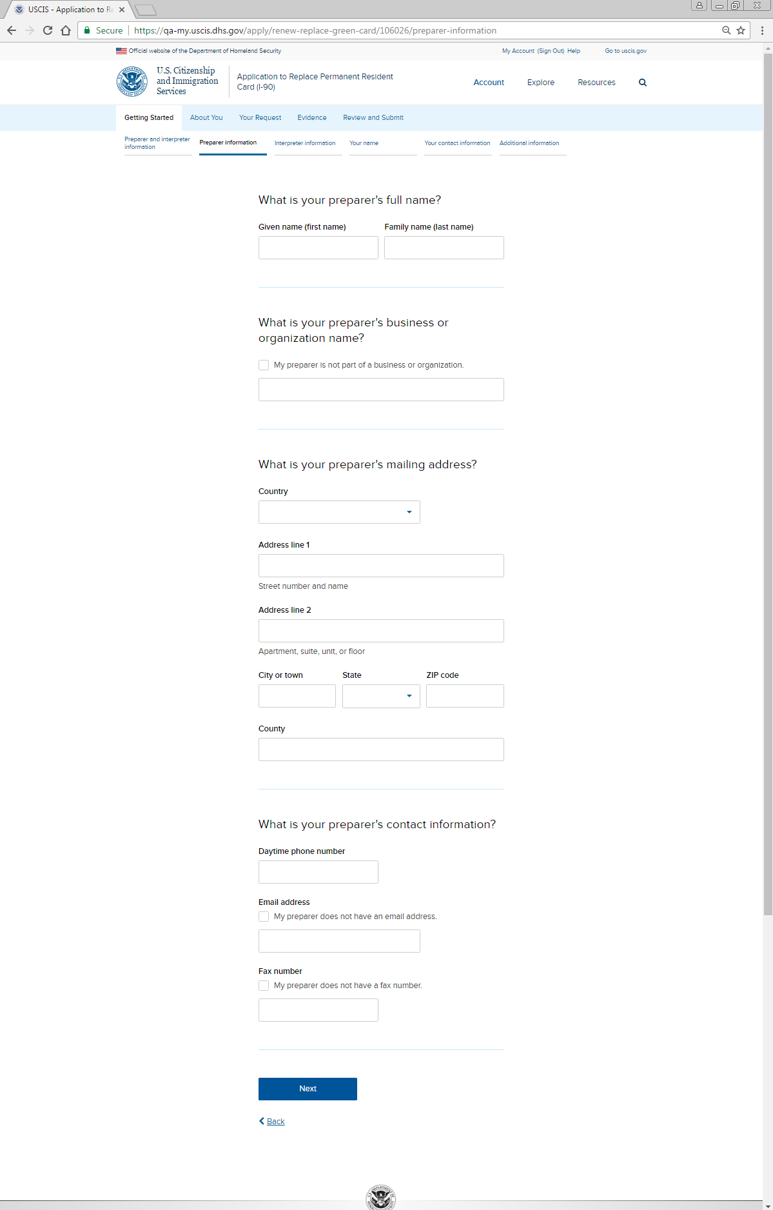
Getting Started: Preparer information
Mobile phone number
My preparer does not have a mobile phone number.

Slide 5
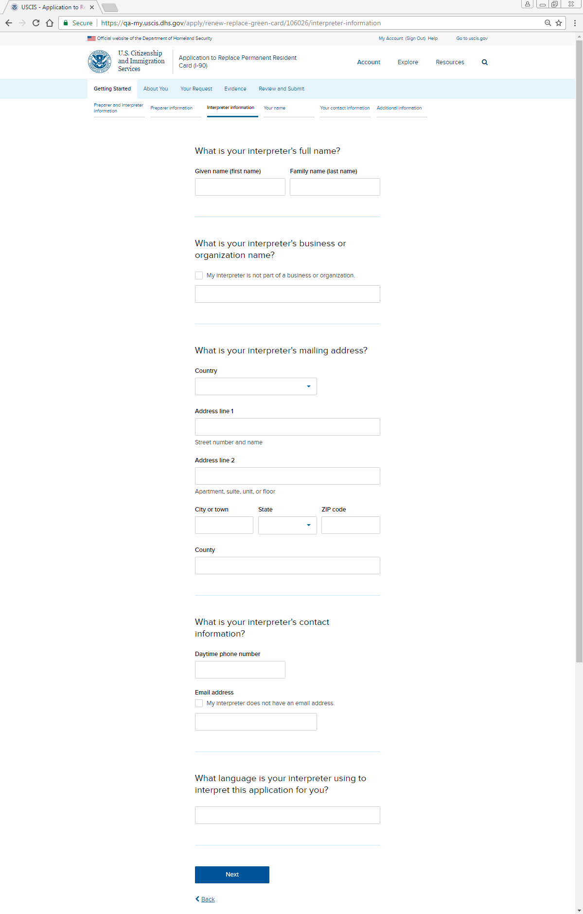
Getting Started: Interpreter information

Slide 6
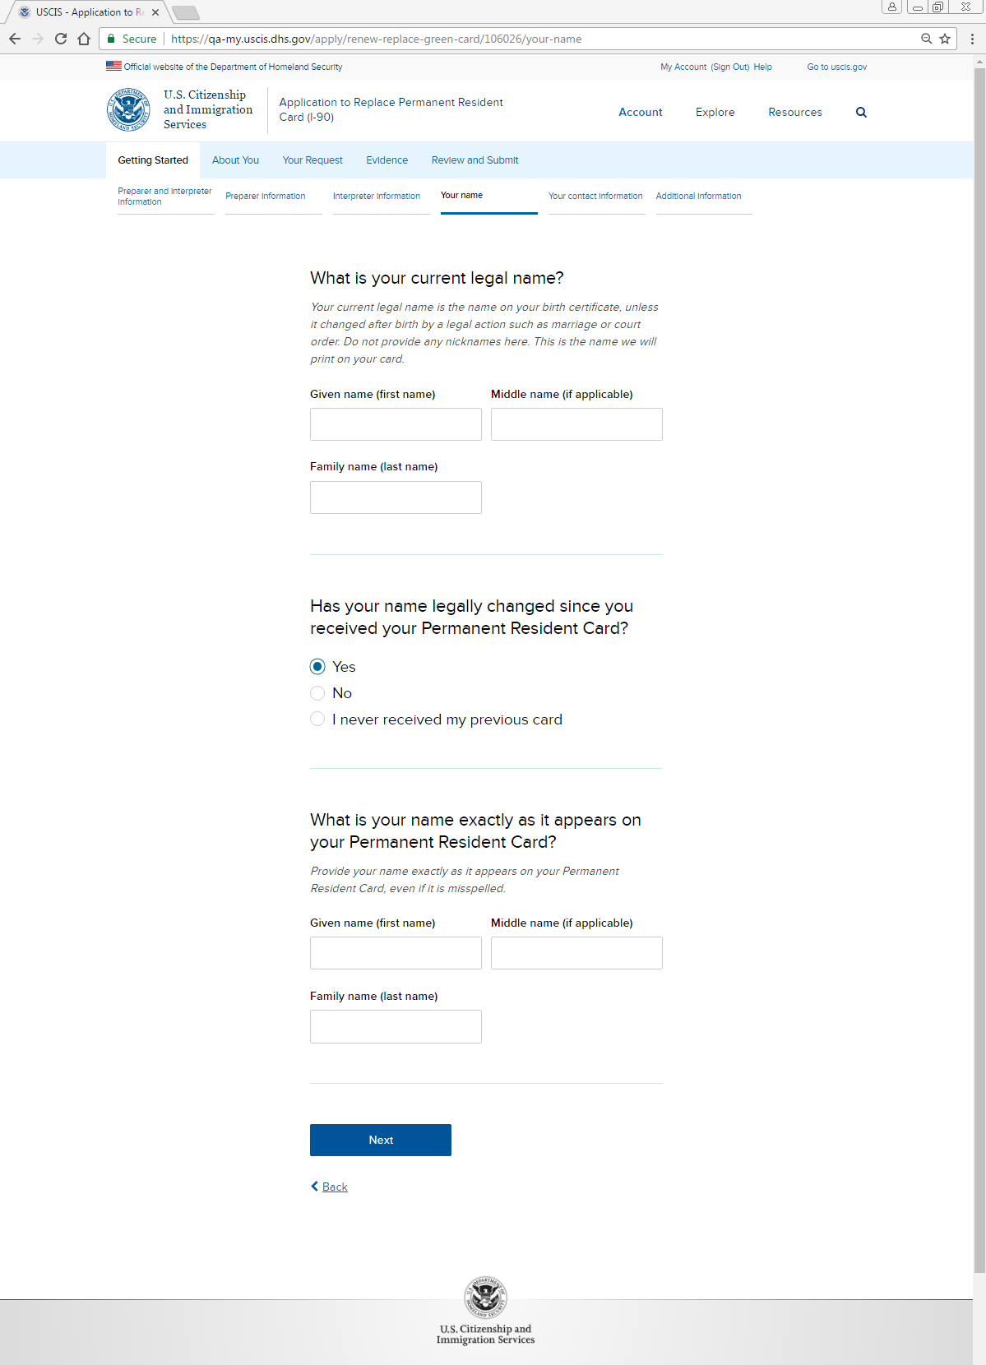
Getting Started: Your name
Provide your name exactly as it appears on your Permanent Resident Card, even if it is misspelled. If your name has legally changed since the issuance of your Permanent Resident Card, provide your name exactly as it is printed on your current Permanent Resident Card.

Slide 7
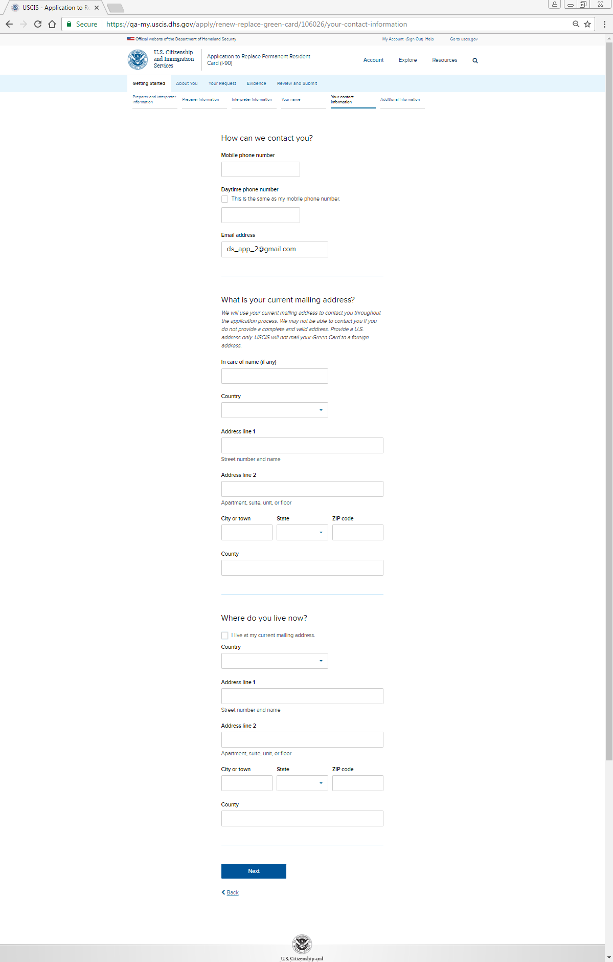
Getting Started: Your contact information
[If response here is a foreign country, port of entry fields below display]
At what U.S. port of entry do you plan to pick up your new card?
All commuters (those who currently have commuter status and those who are taking up commuter status) who provided a foreign mailing address, need to provide the U.S. port-of-entry (POE) where you will pick up your card.
NOTE: If the city or town has more than one POE, include additional information (such as an airport, bridge, or tunnel name) to assist U.S. Citizenship and Immigration Services (USCIS) in identifying which POE to mail your card.
City or town
State

Slide 8
Getting Started: Your contact information
Alternate or Safe Mailing Address
If you filed an adjustment of status application based on the Violence Against Women Act (VAWA) or as a human trafficking victim (T nonimmigrant), or victim of a qualifying crime (U nonimmigrant) and you do not want USCIS send notices about this application to your home, you may provide a safe mailing address. If you are applying as a special immigrant juvenile, you may provide an alternate mailing address.

Slide 9
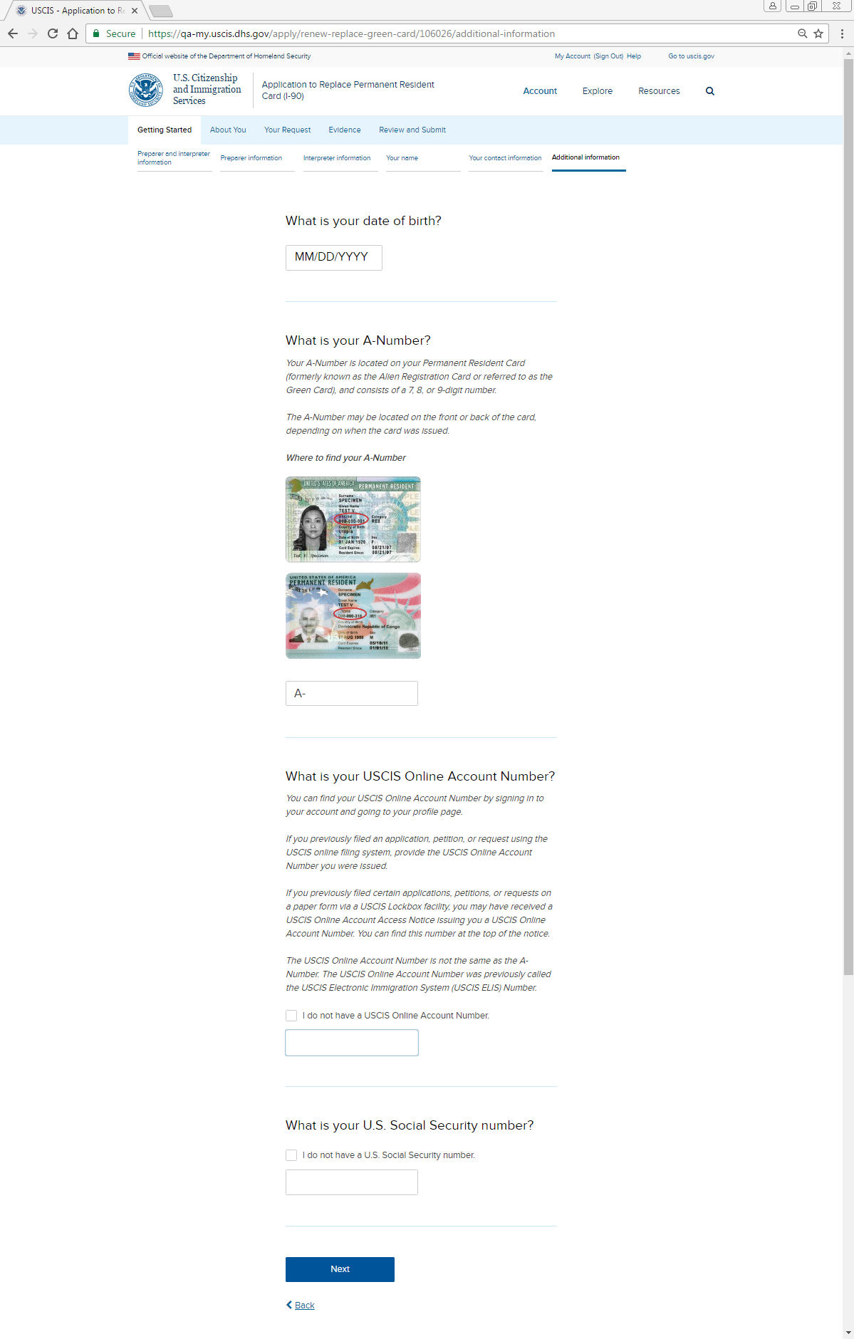
Getting Started: Additional information

Slide 10
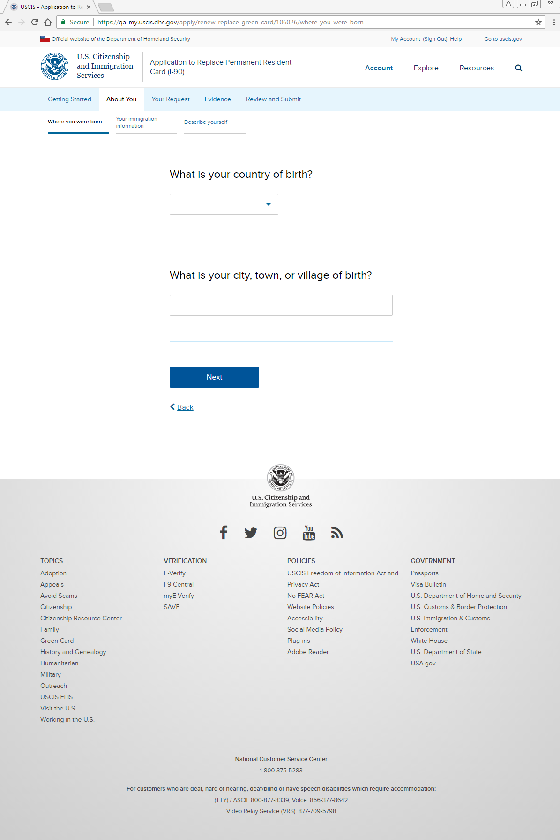
About You: Where you were born: Place of birth

Slide 11
About You: Where you were born: Mother’s and father’s names
What is your parent 1 Legal Name?
Given name (first name)
Family name (last name)
Middle name
What is your parent 2 Legal Name?
Given name (first name)
Family name (last name)
Middle name

Slide 12
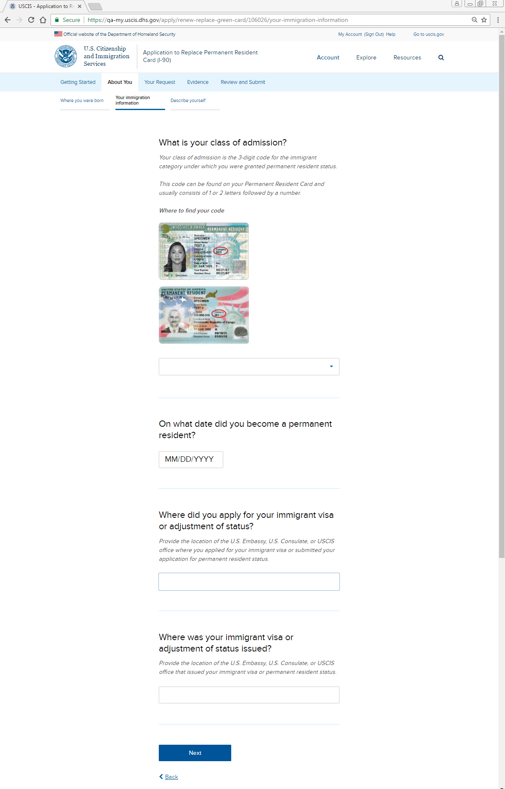
About You: Your immigration information: Class of admission
What was your date of admission?
MM/DD/YYYY

Slide 13
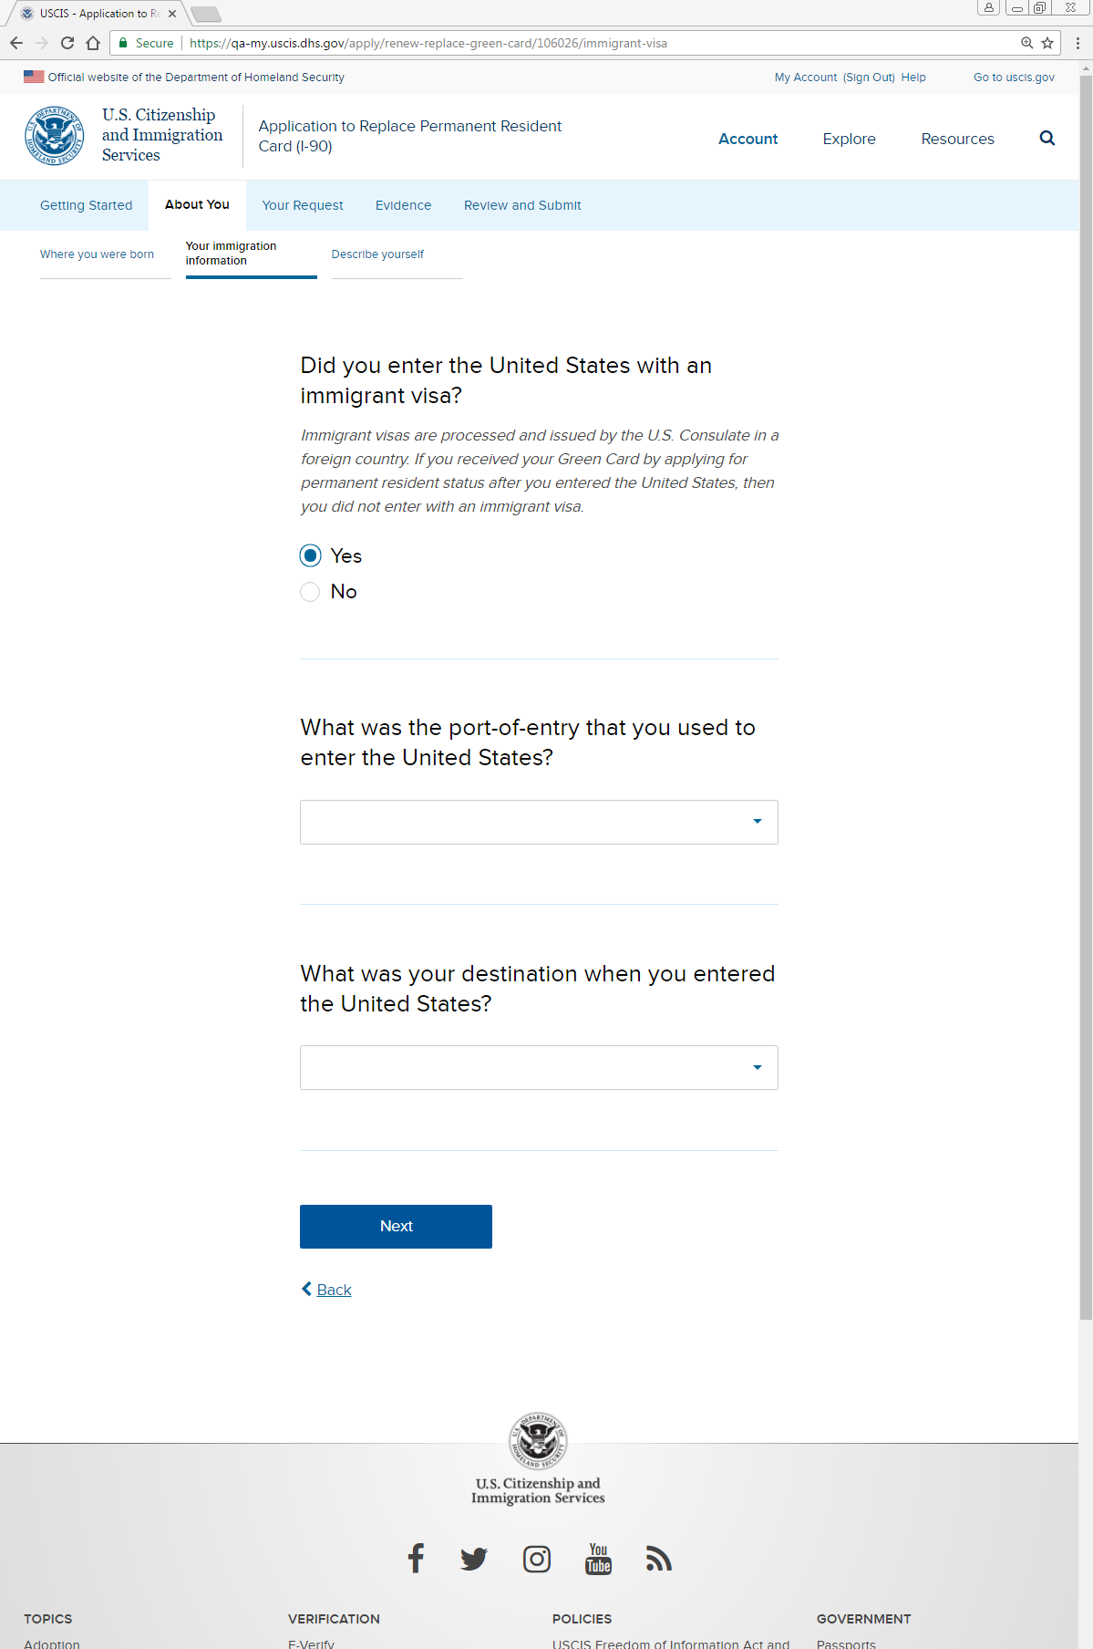
About You: Your immigration information: U.S. entry

Slide 14
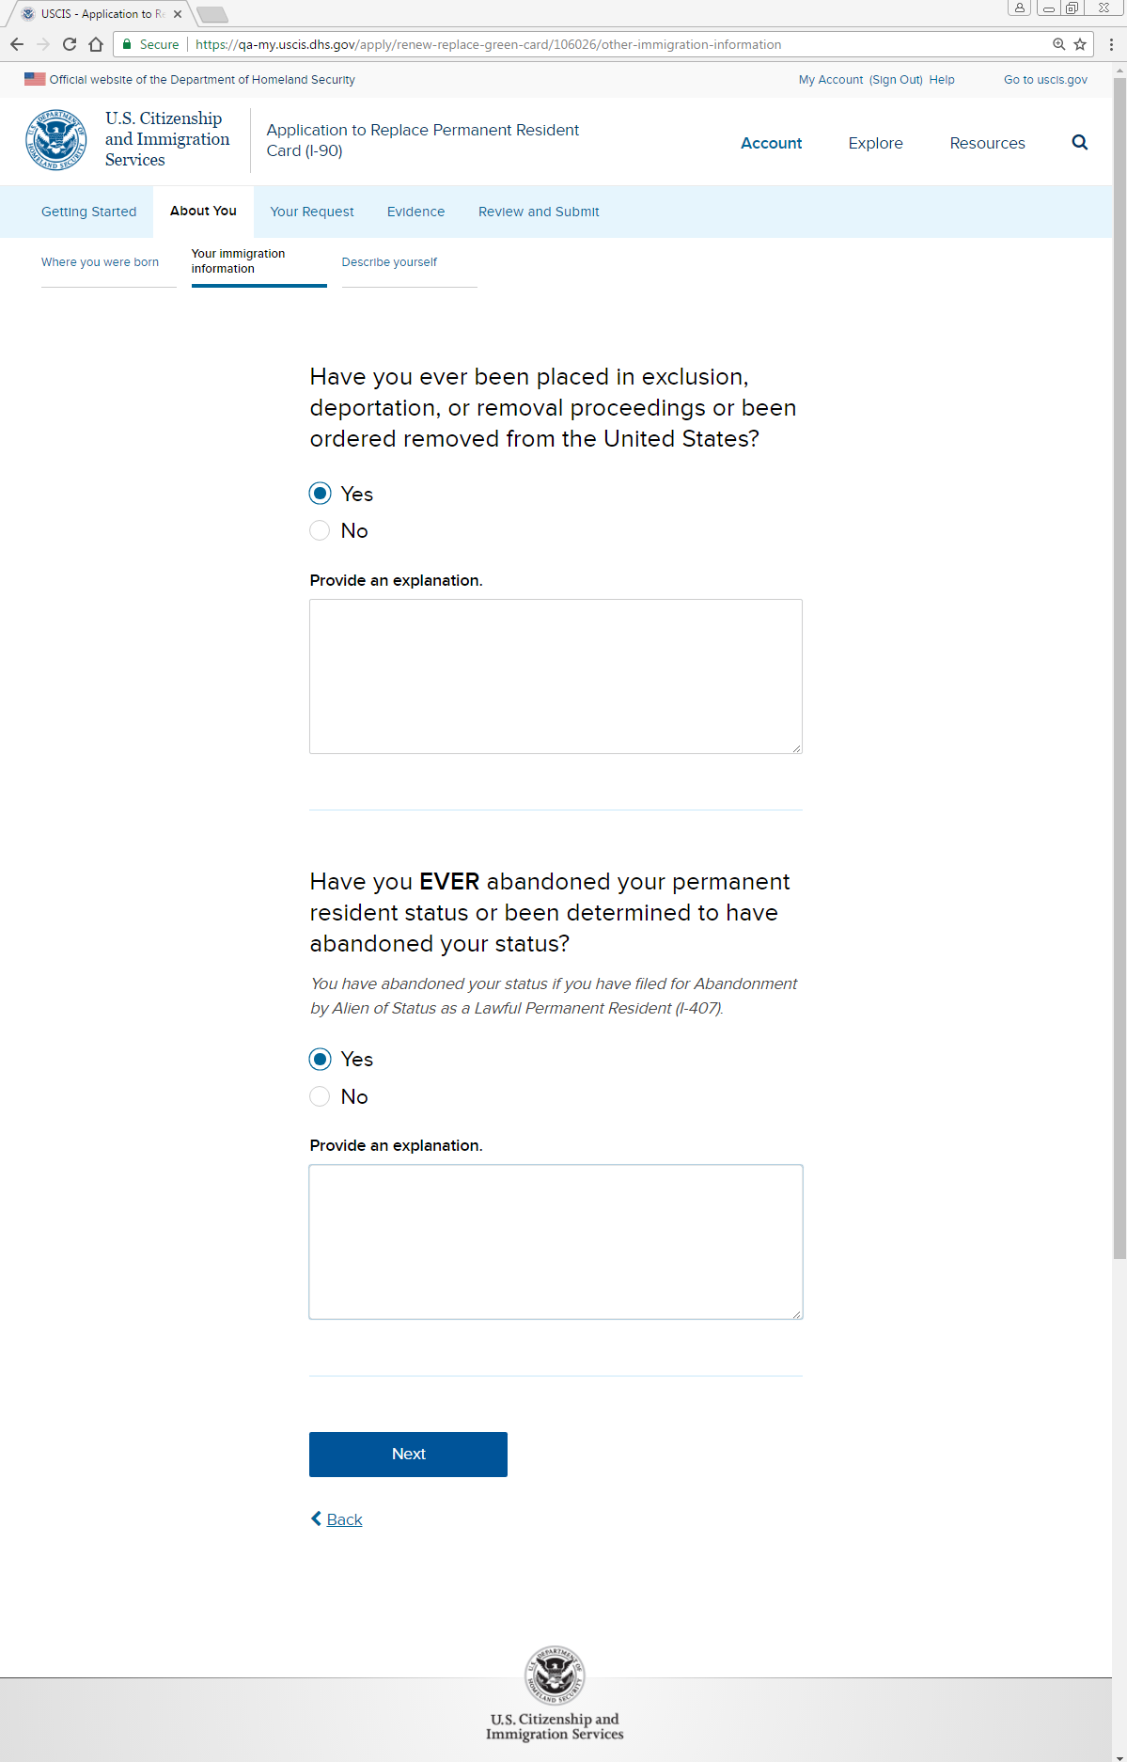
About You: Your immigration information: Removal, abandonment
You have abandoned your status if you have ever filed or signed a Form I-407, Record of Abandonment of Lawful Permanent Resident Status, or any other document indicating you have abandoned your permanent resident status.

Slide 15
About You: Your immigration information: Removal, abandonment
Have you ever been determined by a judge to have abandoned your permanent resident status?
Yes
No
Provide an explanation.
Have you ever been absent from the United States for a continuous period for more than 180 days but less than one year?
Yes
No
Provide an explanation.
Have you ever been absent from the United States for a continuous period of one year or more?
Yes
No
Provide an explanation.

Slide 16
About You: Your immigration information: Removal, abandonment
Have you ever had a residence outside the United States, other than while you held commuter status?
Yes
No
Provide an explanation.
Have you ever been employed outside the United States, other than while you held commuter status?
Yes
No
Provide an explanation.
Were you ever out of regular employment in the U.S. for a continuous period of six months or more while you held commuter status?
Only answer if you hold or have held commuter status.
Yes
No
Provide an explanation.

Slide 17
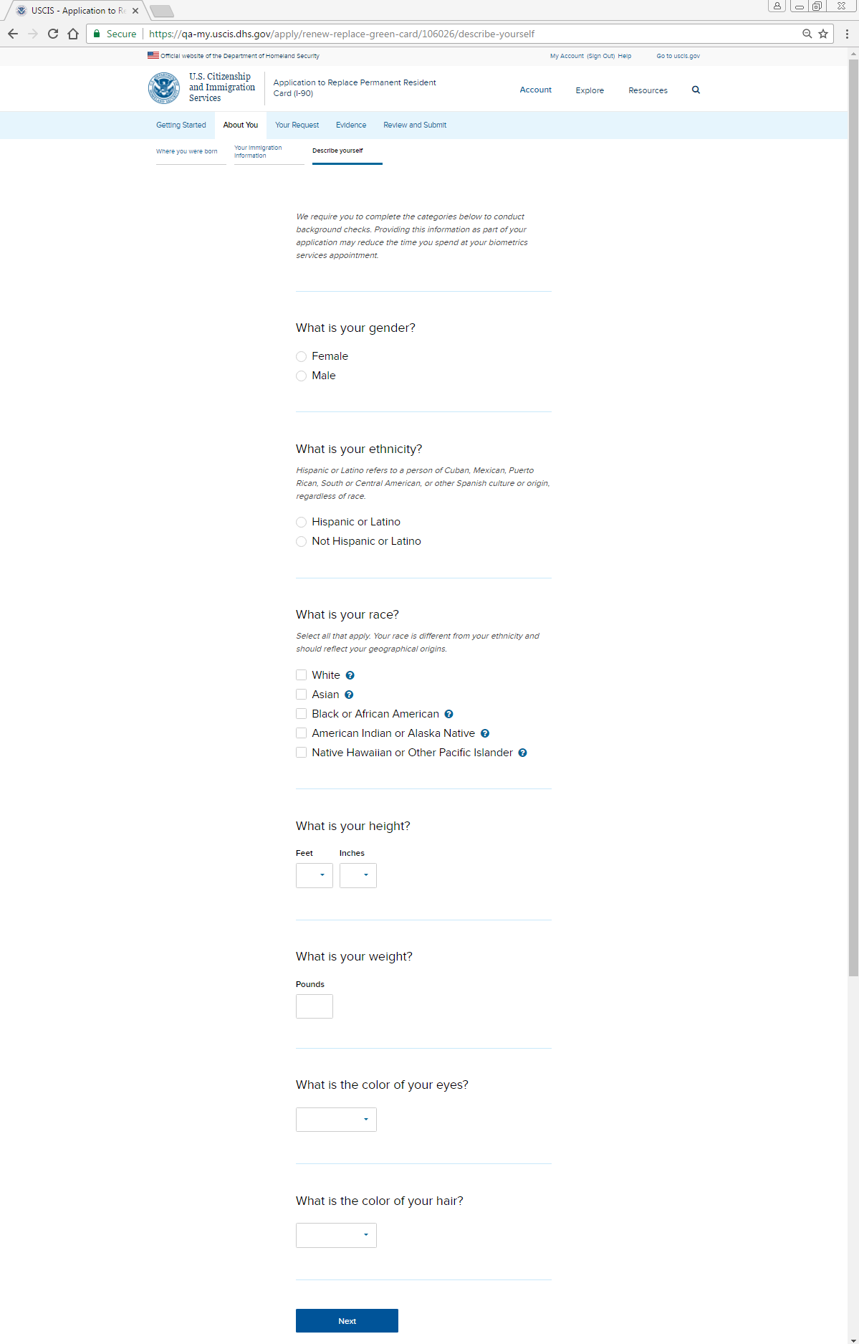
About You: Describe yourself

Slide 18
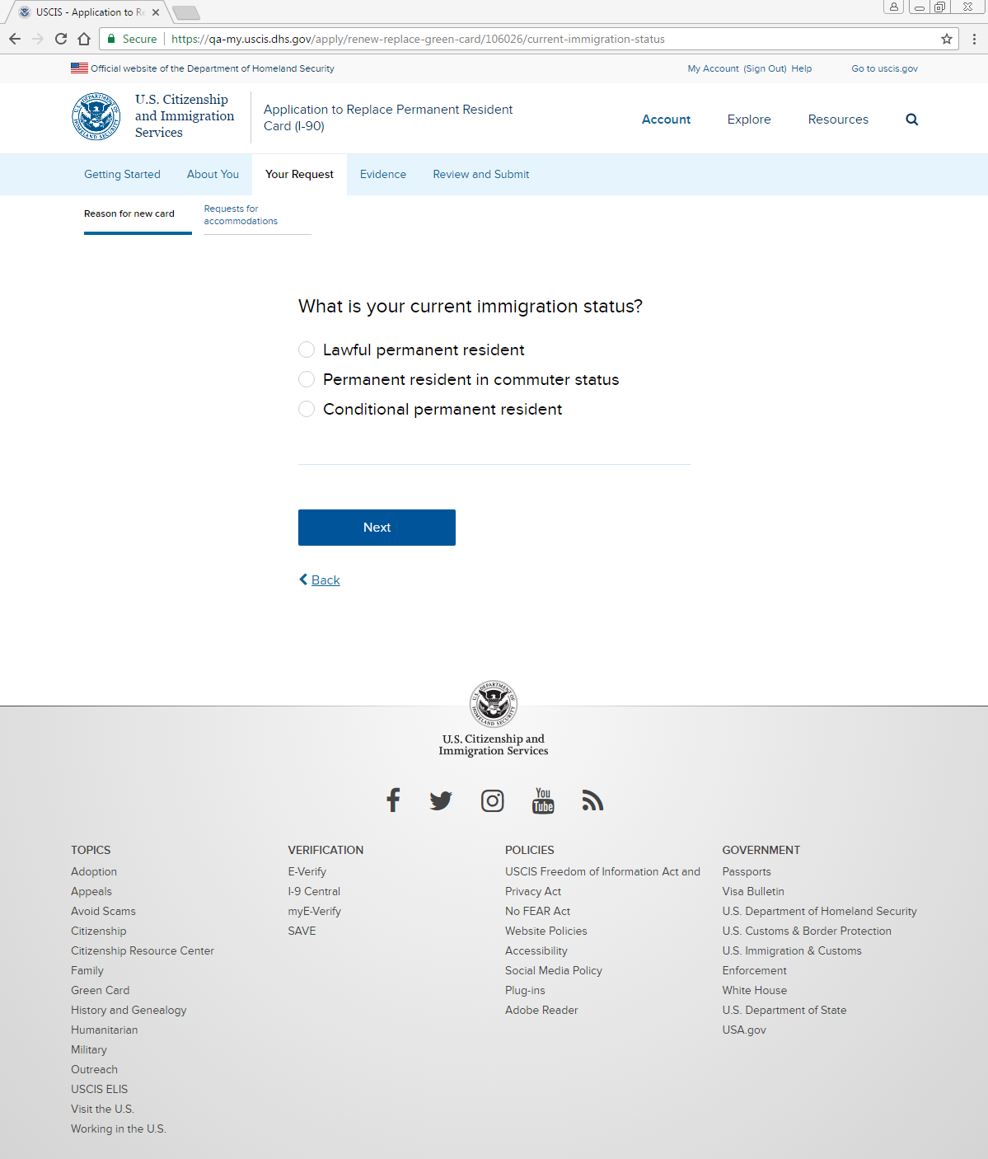
Your Request: Reason for new card: Your status

Slide 19
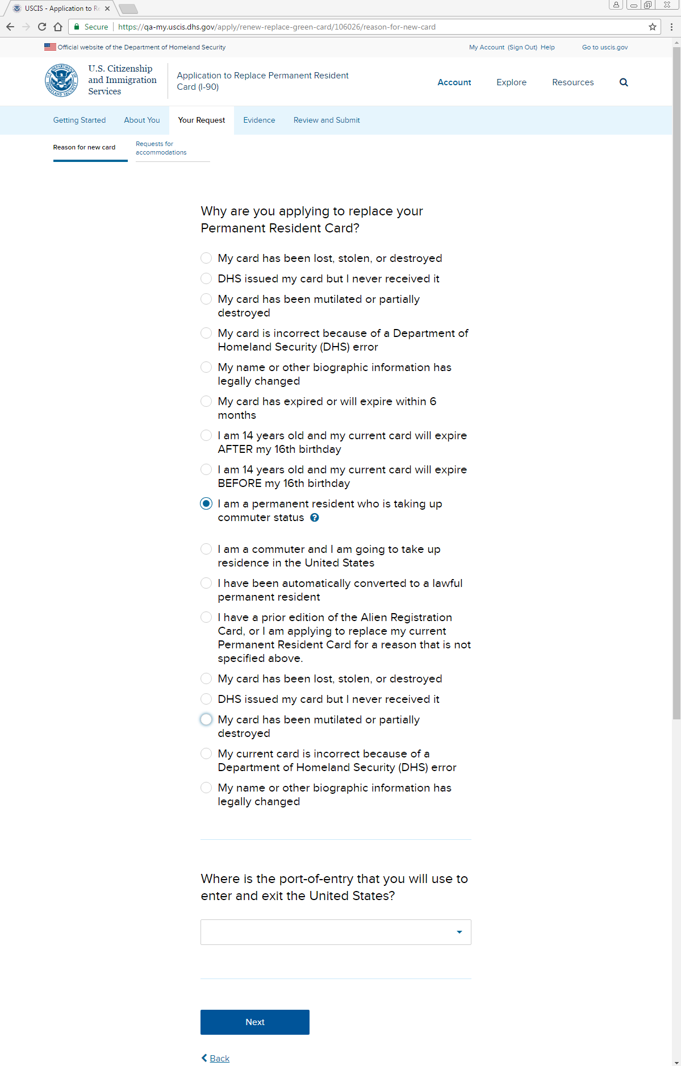
Your Request: Reason for new card: Reason for application (LPR or commuter)
My previous card has been lost, stolen, or destroyed.
My previous card was issued but never received.
My existing card has been mutilated.
My existing card has incorrect data because of Department of Homeland Security (DHS) error.
Provide a detailed explanation of the error in the space provided and return your existing card with incorrect data along with this application.
My name or other biographic information has legally changed since issuance of my existing card or my card has incorrect data and the error was not caused by DHS.
(Provide a detailed explanation of the biographic information that changed or the error in the space provided and include appropriate documentary evidence that reflects the change or new data.)
My existing card has already expired or will expire within six months.
I have reached my 14th birthday and am registering as required. My existing card will expire AFTER my 16th birthday.
If you are filing this application before your 14th birthday, or more than 30 days after your 14th birthday, you must select the option that you are applying to replace your card “for any other reason not specified.” However, if your card has expired you must select the option that your existing card has already expired or will expire within six months.
I have reached my 14th birthday and am registering as required. My existing card will expire BEFORE my 16th birthday.
If you are filing this application before your 14th birthday, or more than 30 days after your 14th birthday, you must select the option that you are applying to replace your card “for any other reason not specified.” However, if your card has expired you must select the option that your existing card has already expired or will expire within six months.
I am a permanent resident who is taking up commuter status.
I am a commuter who is taking up actual residence in the United States.
I have been automatically converted to lawful permanent resident status.
I have a prior edition of the alien registration card.
I am applying to replace my current Permanent Resident Card for any other reason that is not specified above. Provide a detailed explanation of the reason you are applying to replace your card in the space provided.

Slide 20
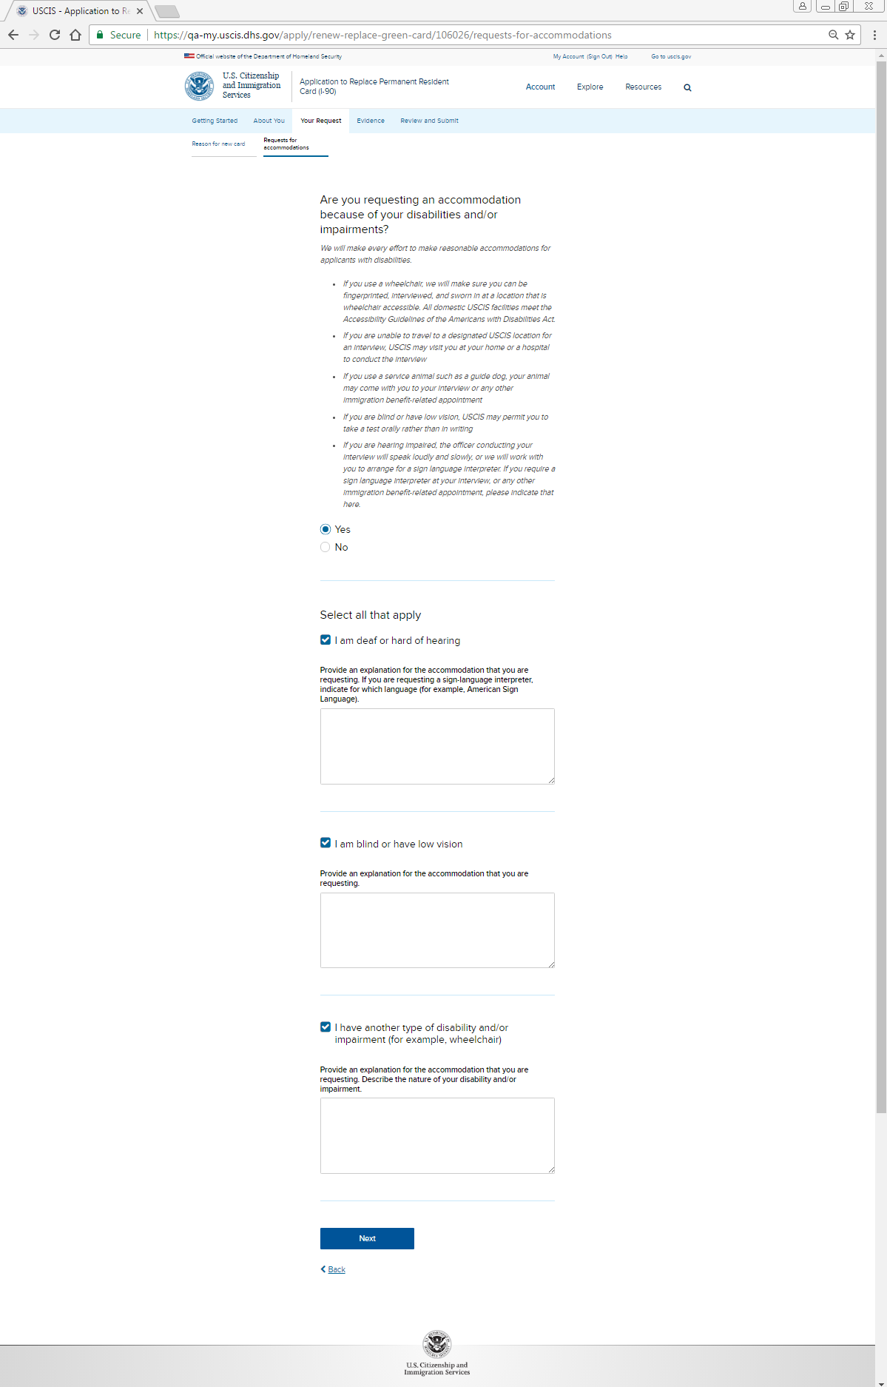
Your Request: Reason for new card: Reason for application (conditional perm. res.)
Complete this section only if you are a conditional permanent resident. If your conditional permanent resident status is expiring within the next 90 days, then do not file this application. (See the What is the Purpose of Form I-90 section of the Form I-90 Instructions for further information.)
My previous card has been lost, stolen, or destroyed.
My previous card was issued but never received.
My existing card has been mutilated.
My existing card has incorrect data because of DHS error.
Provide a detailed explanation of the error in the space provided and return your existing card with incorrect data along with this application.
My name or other biographic information has legally changed since issuance of my existing card or my card has incorrect data and the error was not caused by DHS.
(Provide a detailed explanation of the biographic information that changed or the error in the space provided and include appropriate documentary evidence that reflects the change or new data.)

Slide 21
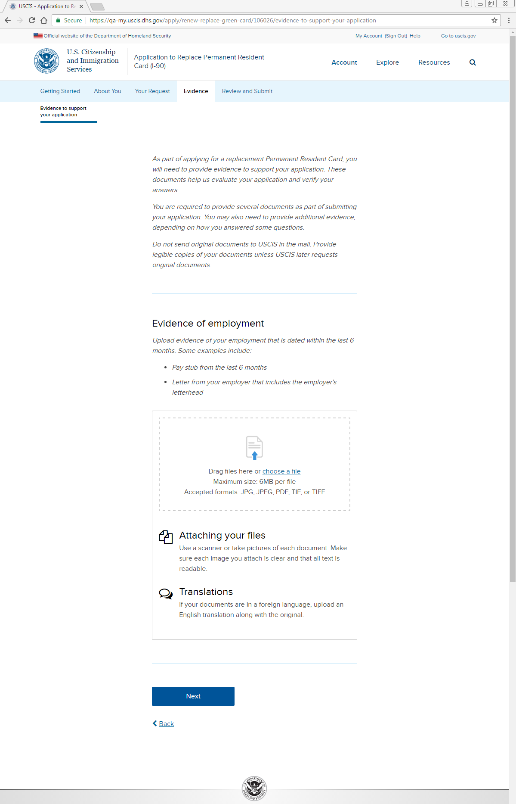
Evidence: Evidence of employment uploader

Slide 22
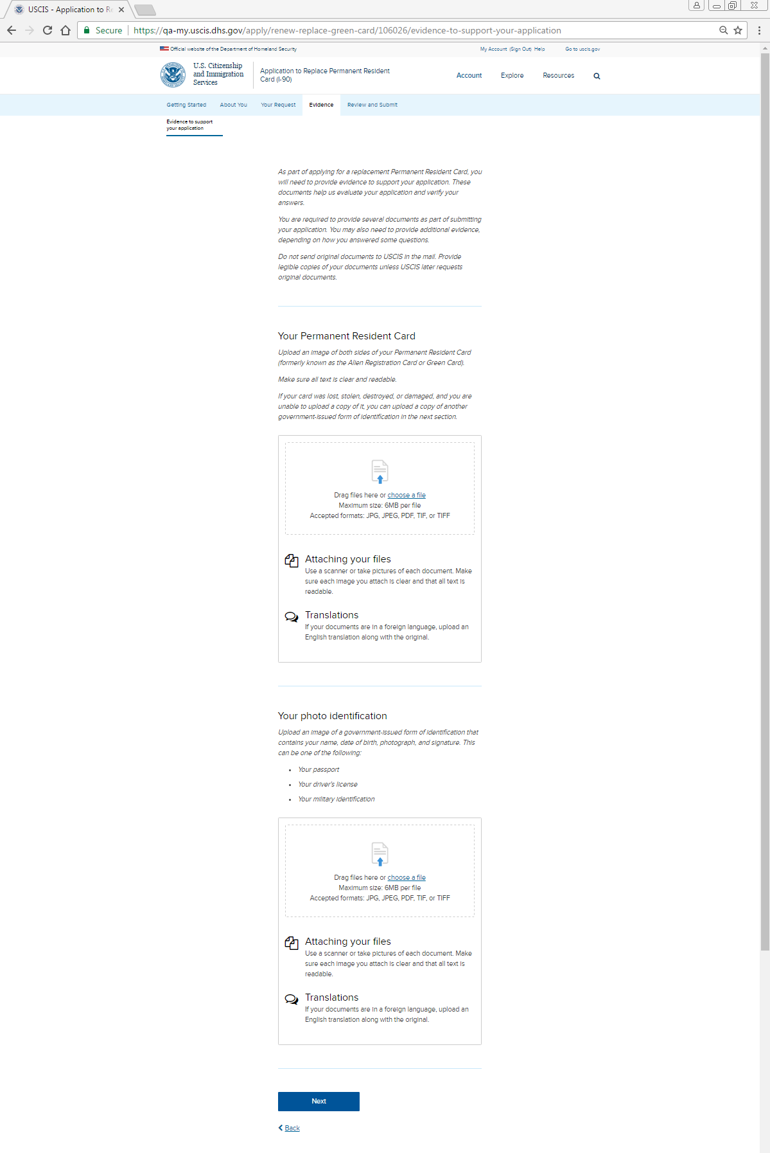
Evidence: Your permanent resident card, Your photo identification uploaders

Slide 23
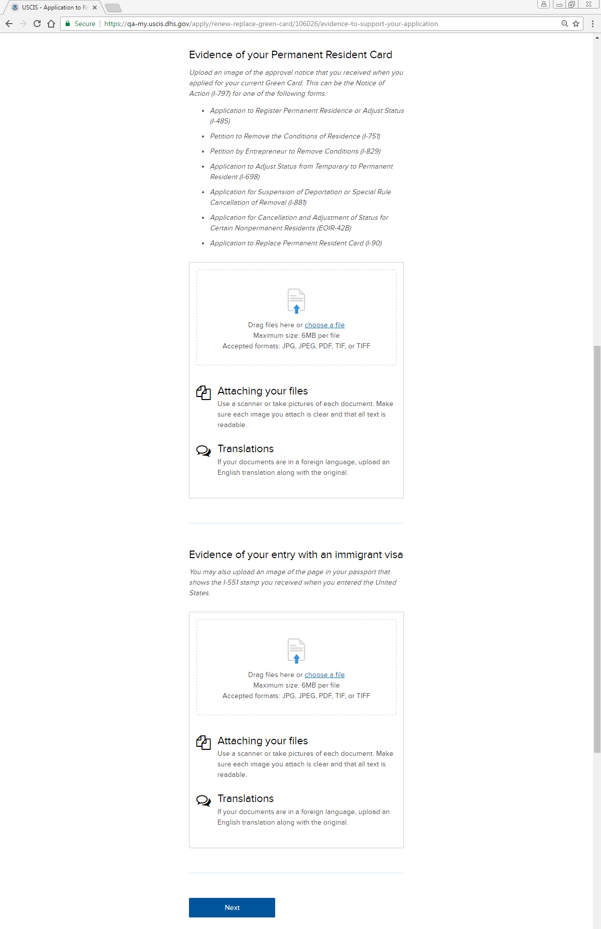
Evidence: Evidence of permanent resident card, Evidence of entry with immigrant visa

Slide 24
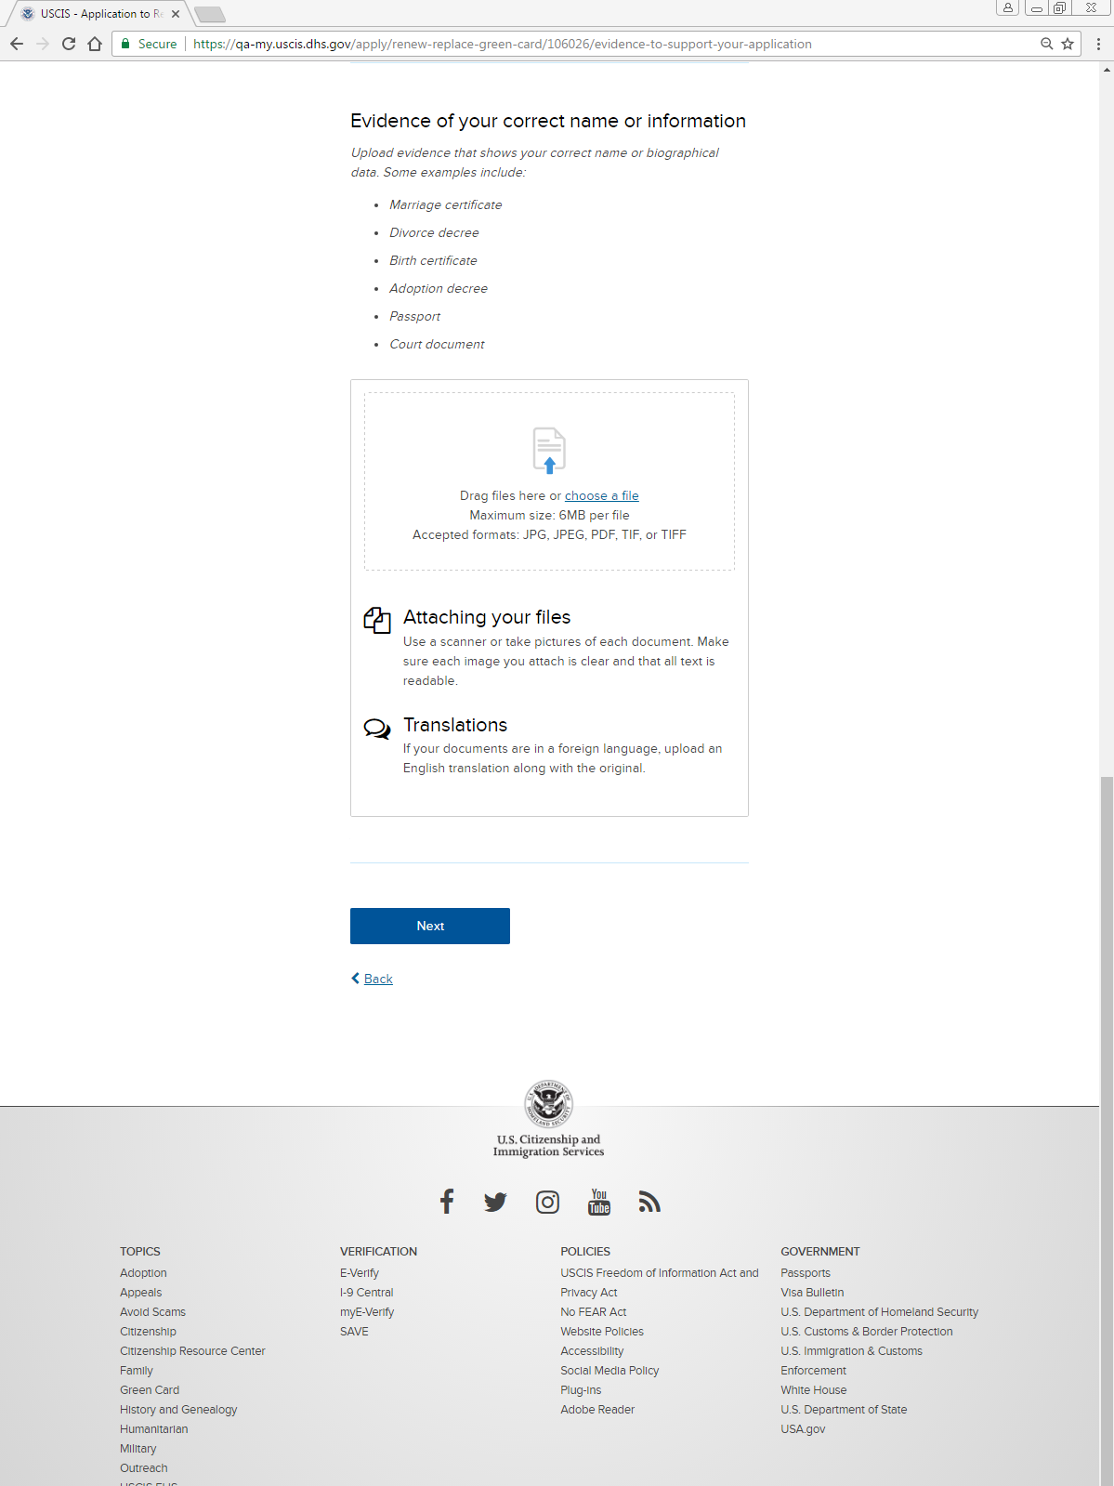
Evidence: Evidence of correct name or information uploader

Slide 25
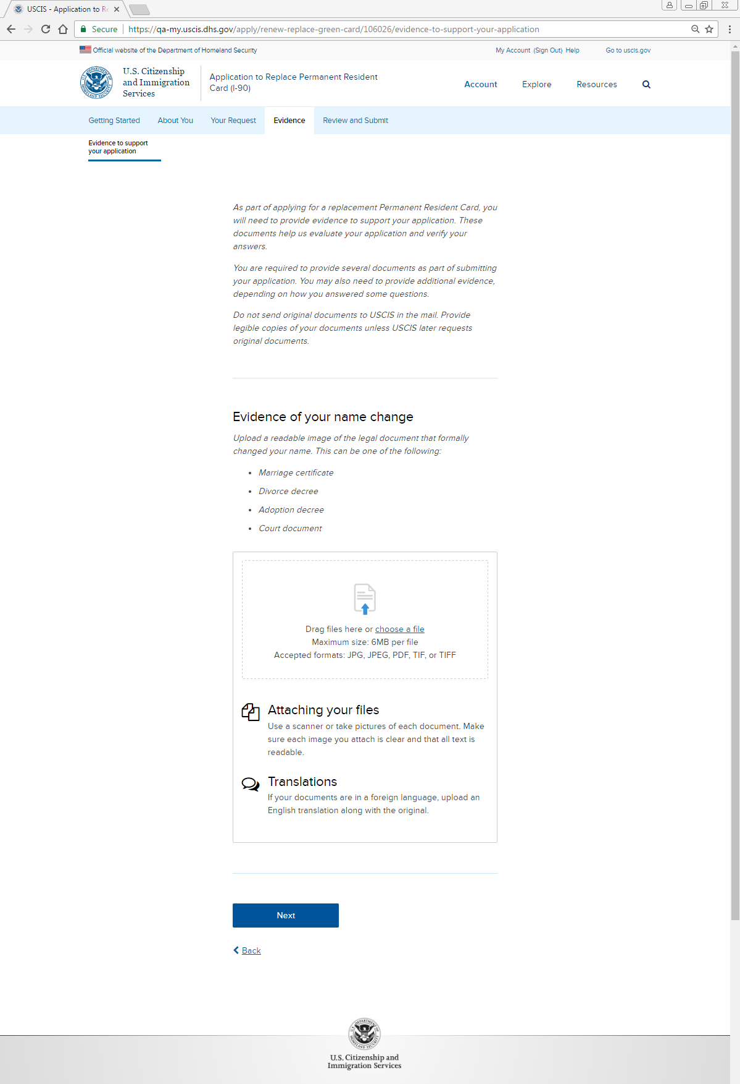
Evidence: Evidence of your name change uploader

Slide 26
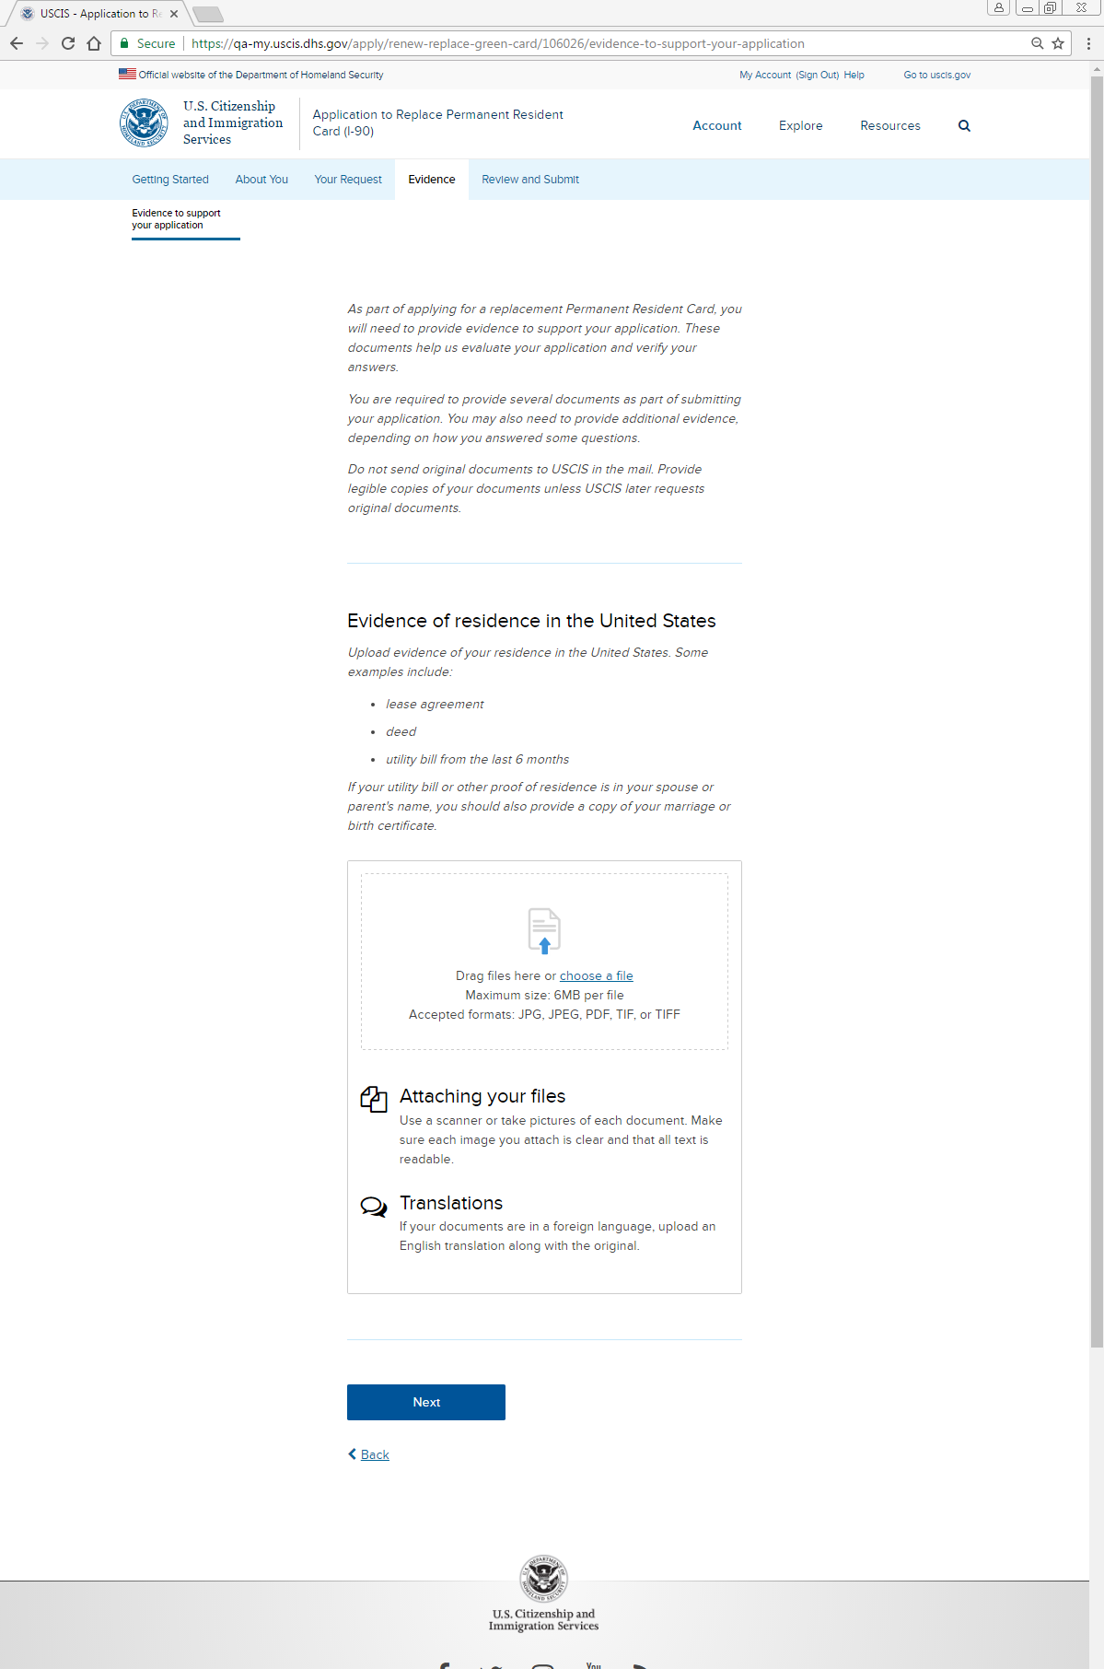
Evidence: Evidence of residence in the United States uploader

Slide 27
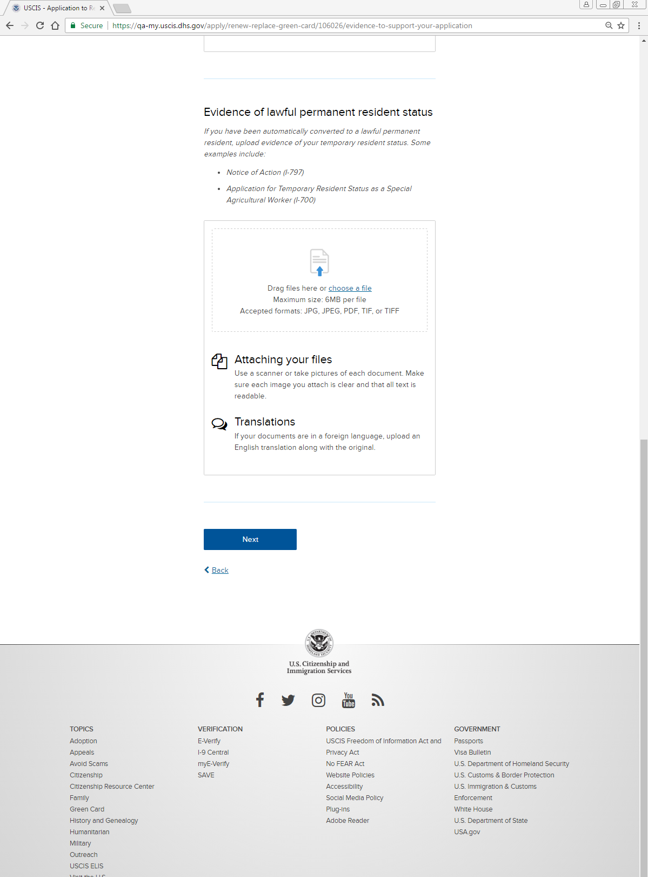
Evidence: Evidence of lawful permanent resident status uploader

Slide 28
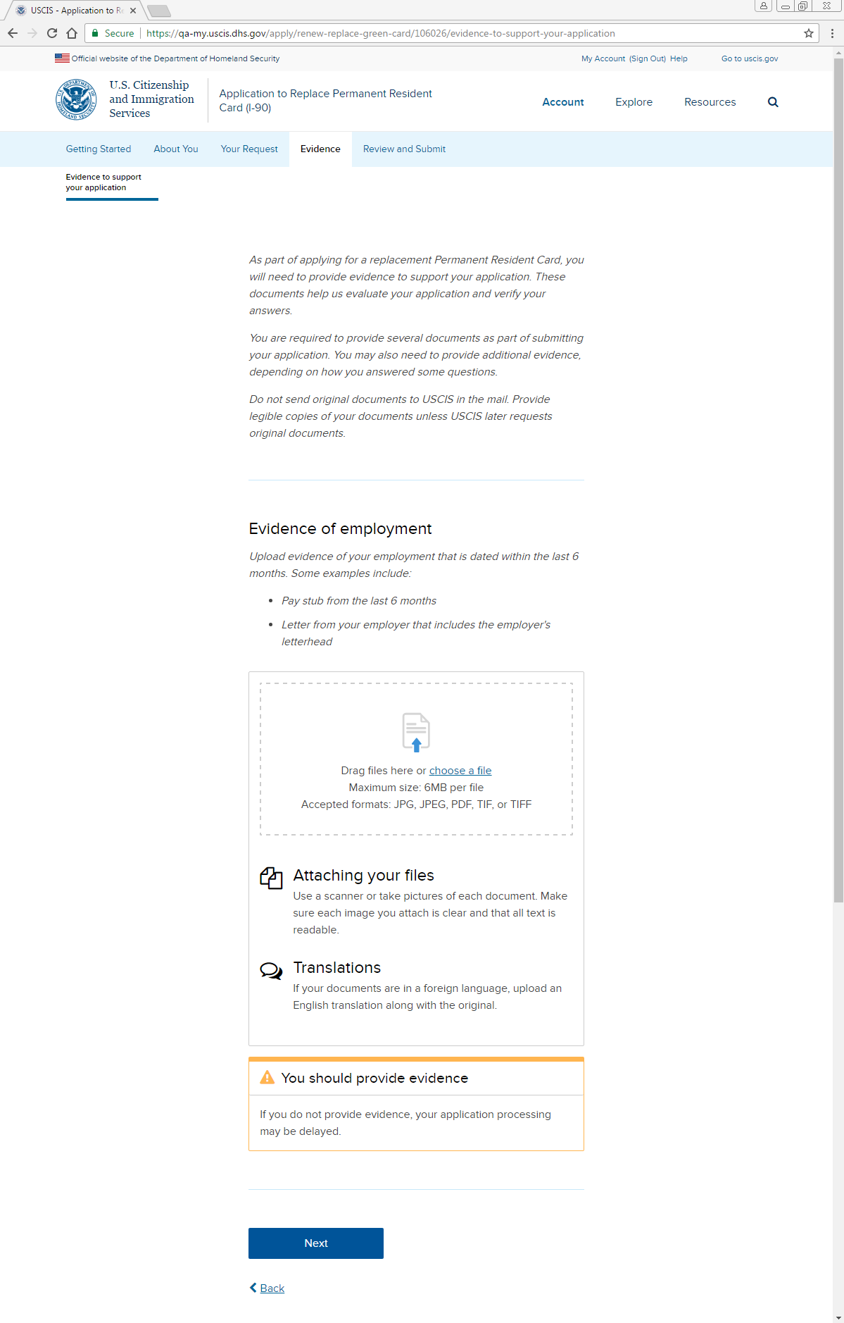
Evidence: Alert box (applies to all uploaders)

Slide 29
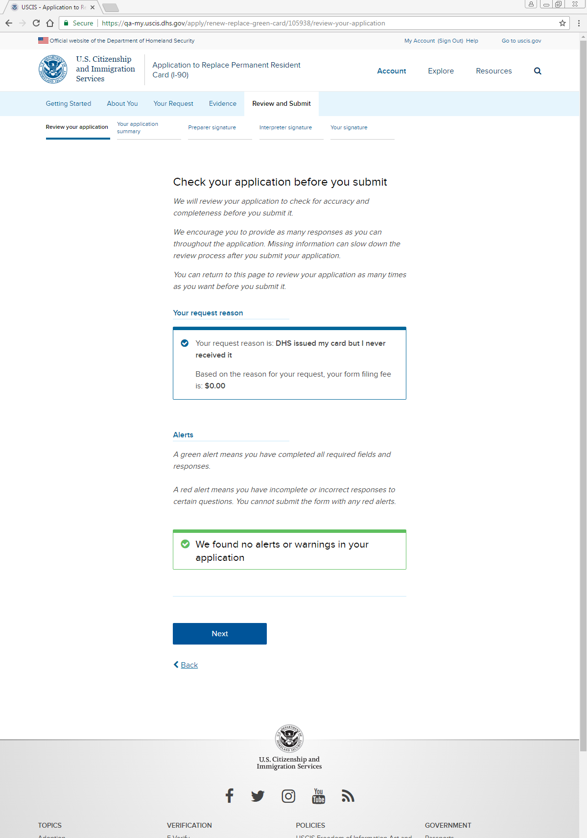
Review and Submit: Review your application

Slide 30
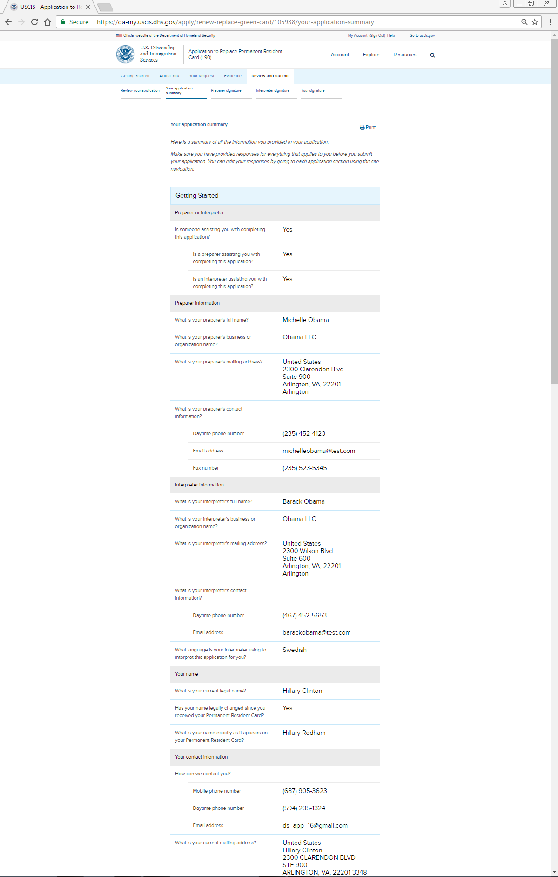
Review and Submit: Your application summary (screenshot 1)
Jane Doe
Jane Doe LLC
Jane.Doe@janedoellc.com
Jack Doe
Jane Doe LLC
Jack.Doe@janedoellc.com
First M. Last
First M. Last
First M. Last

Slide 31
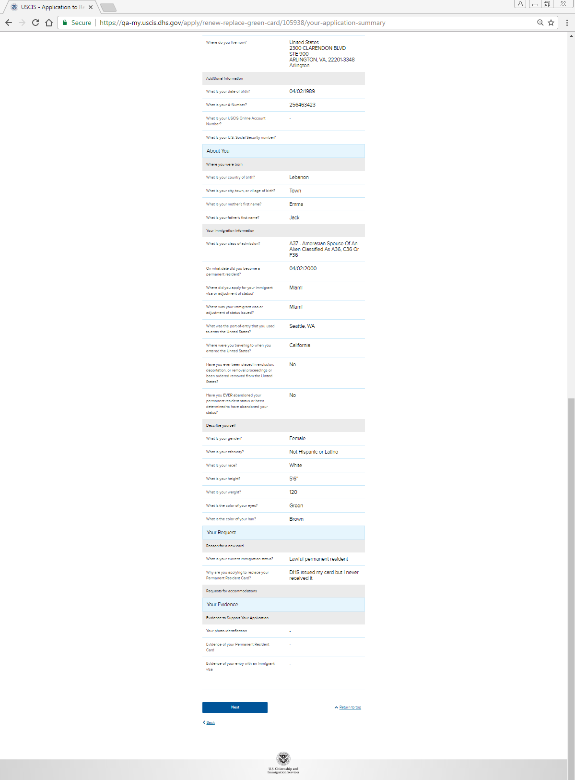
Review and Submit: Your application summary (screenshot 2)

Slide 32
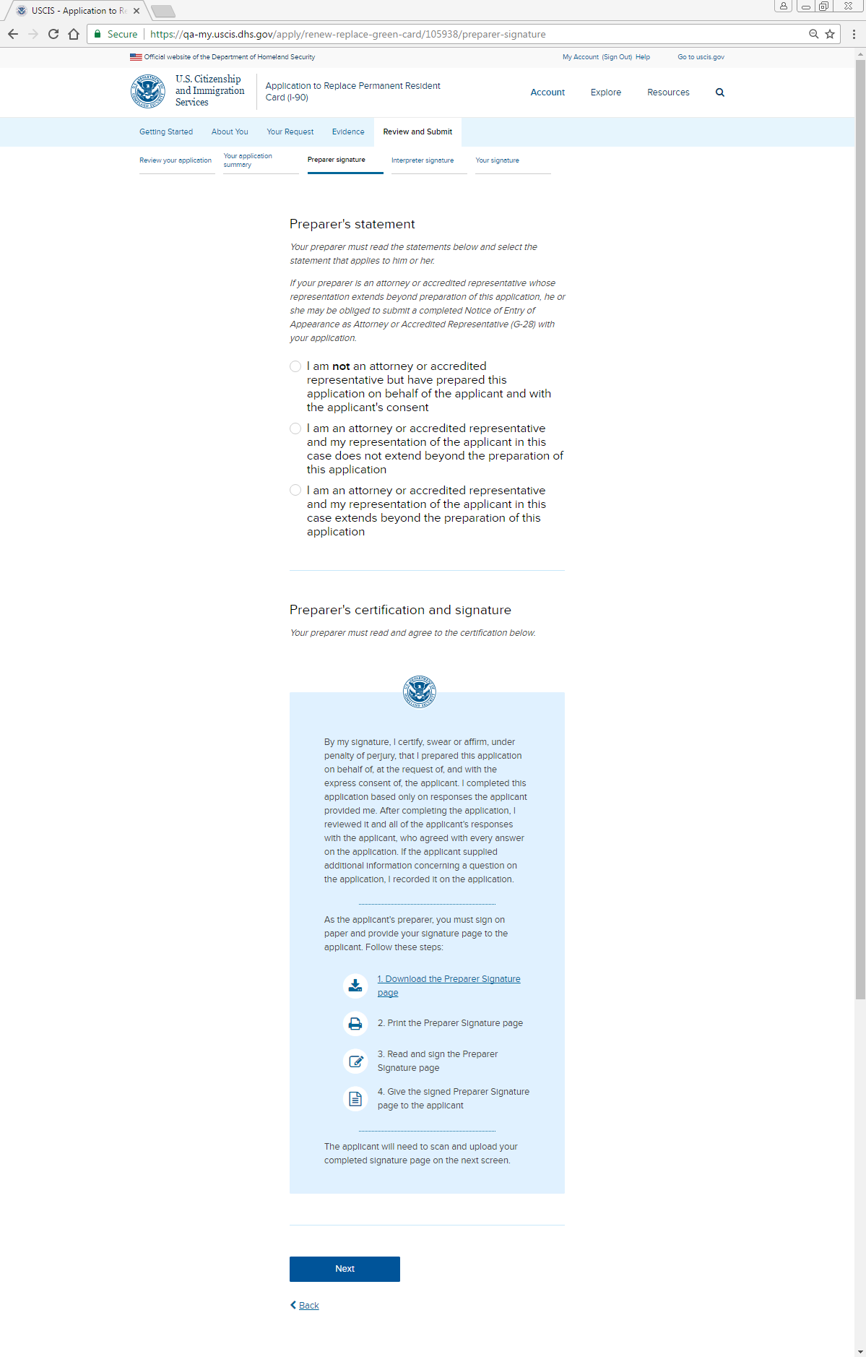
Review and Submit: Preparer signature

Slide 33
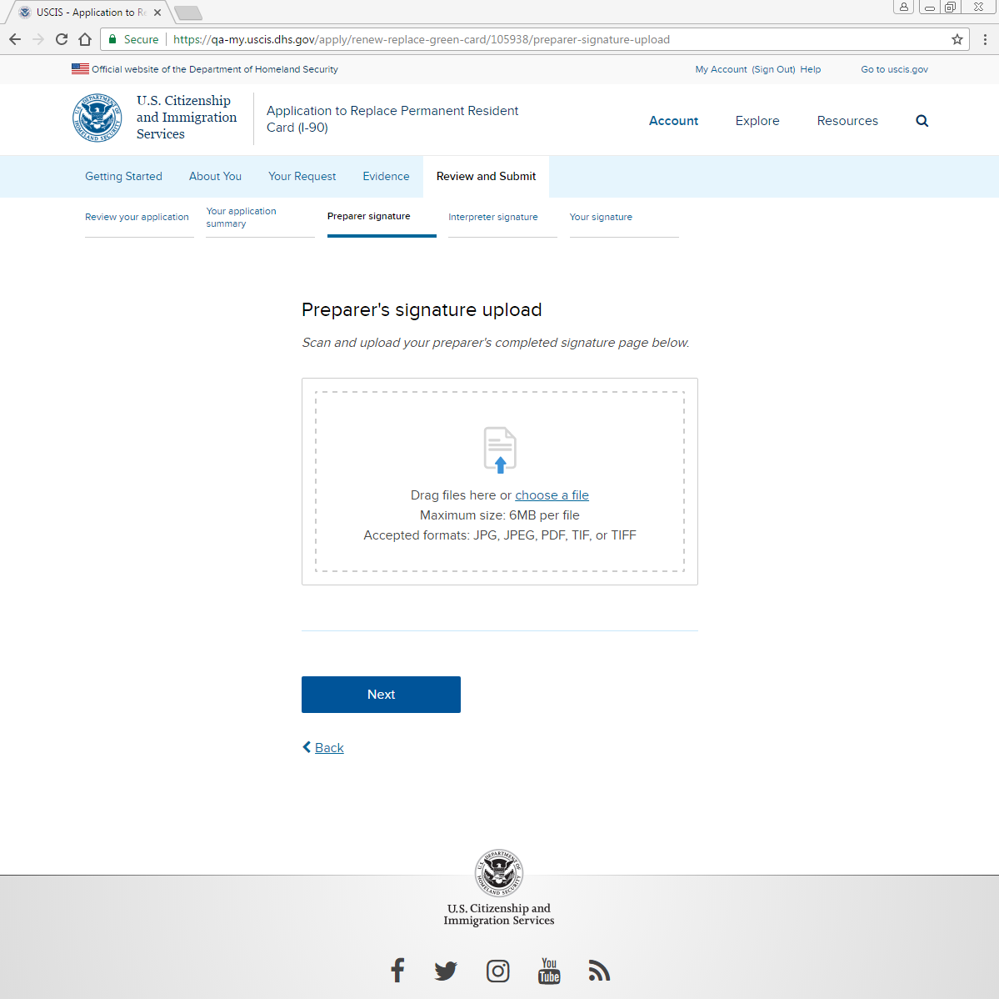
Review and Submit: Preparer signature: Upload

Slide 34
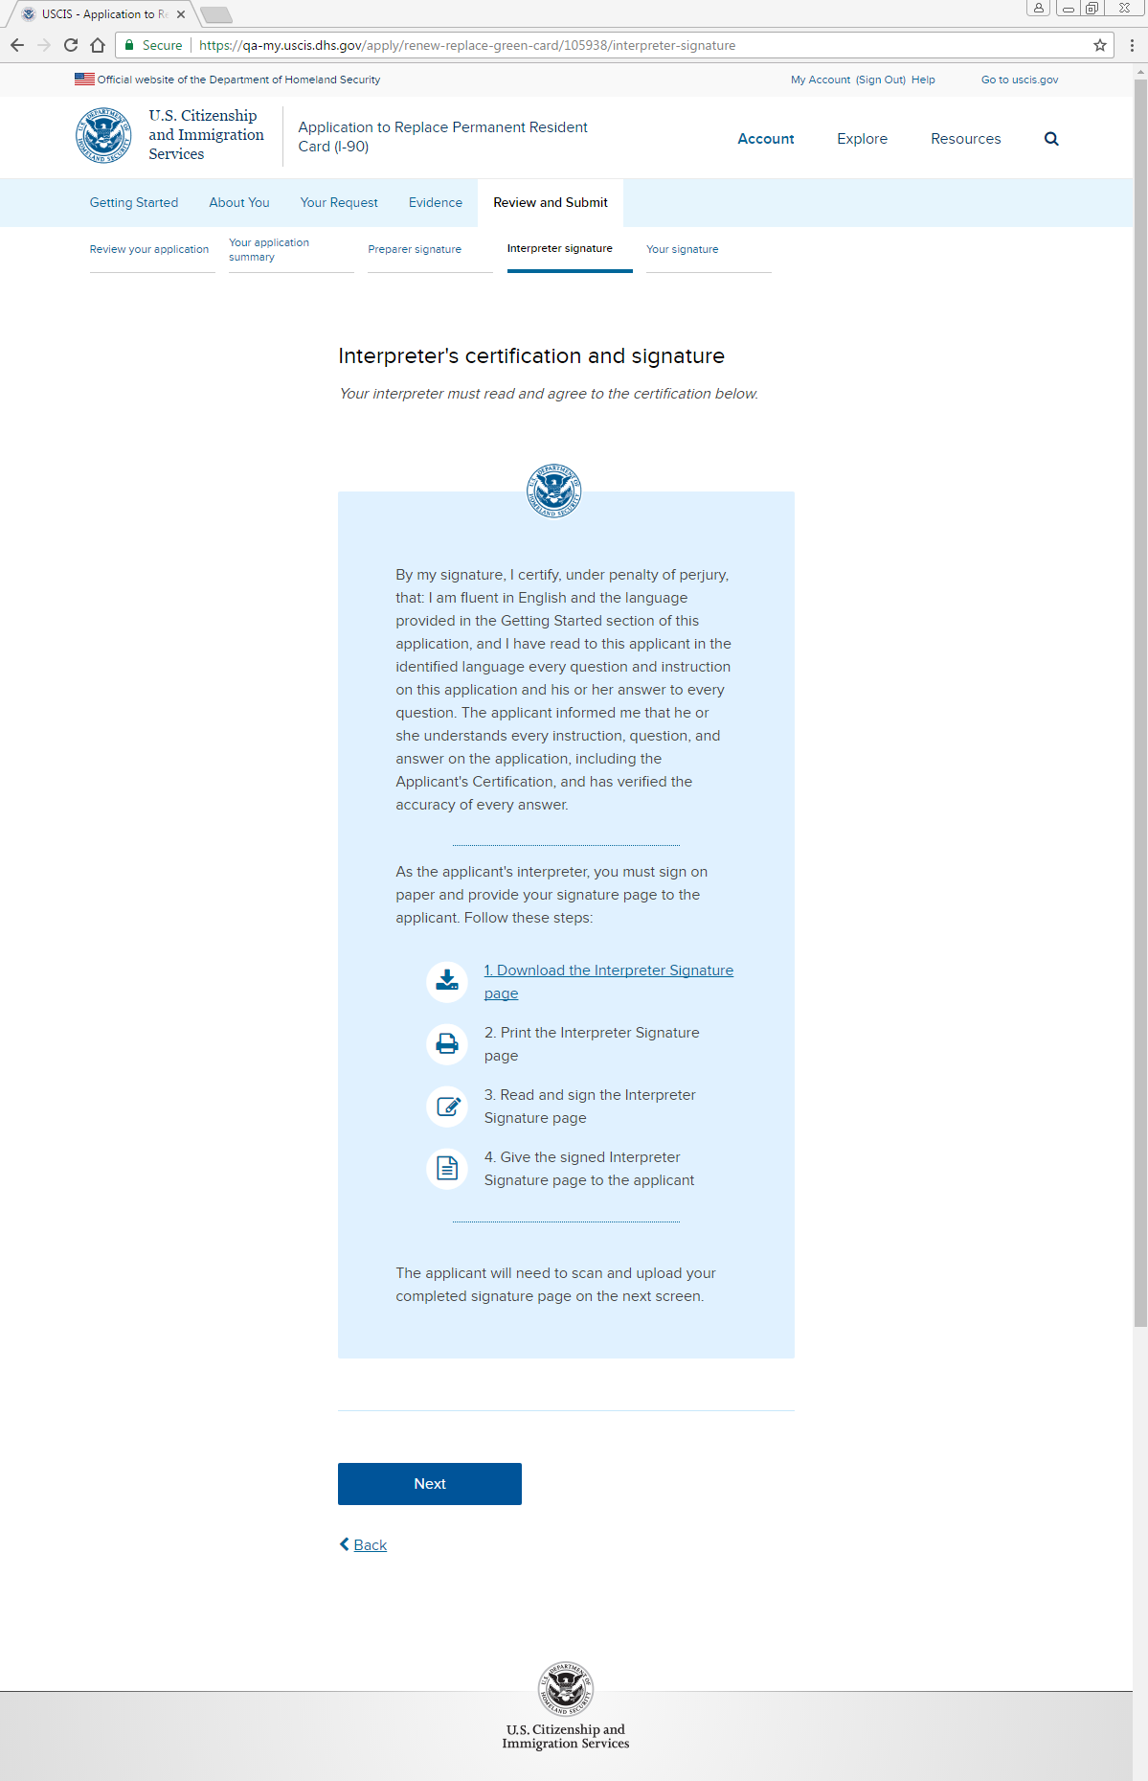
Review and Submit: Interpreter signature

Slide 35
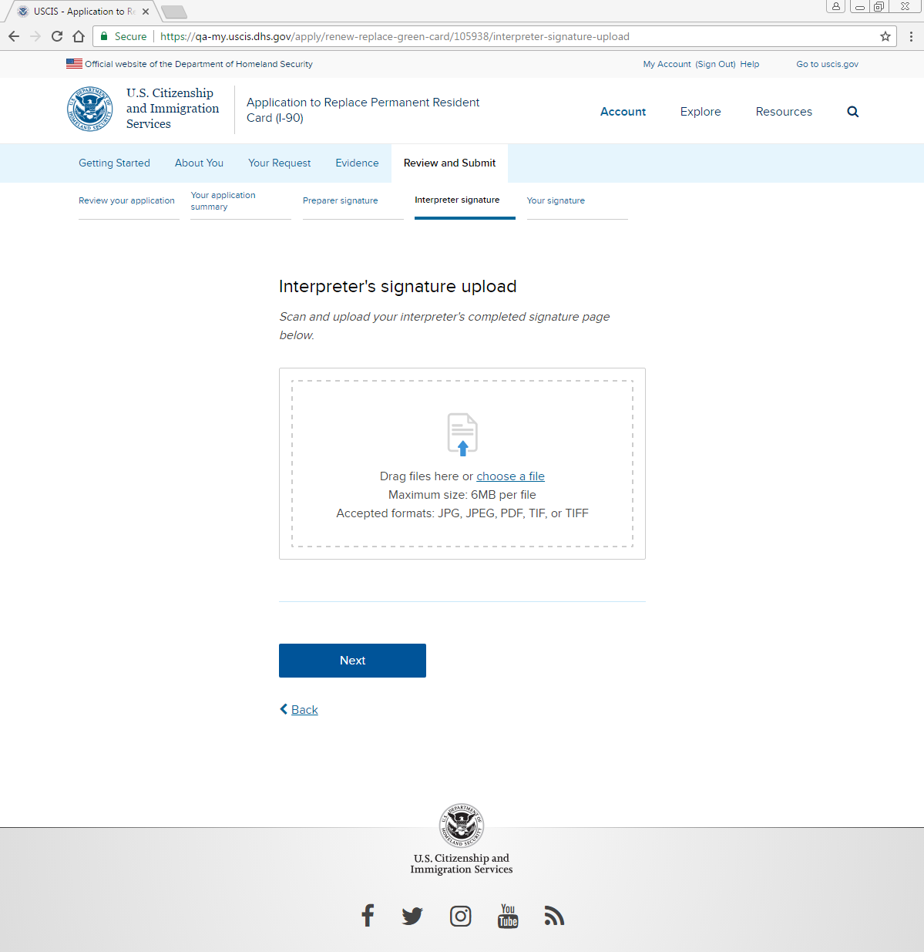
Review and Submit: Interpreter signature: Upload

Slide 36
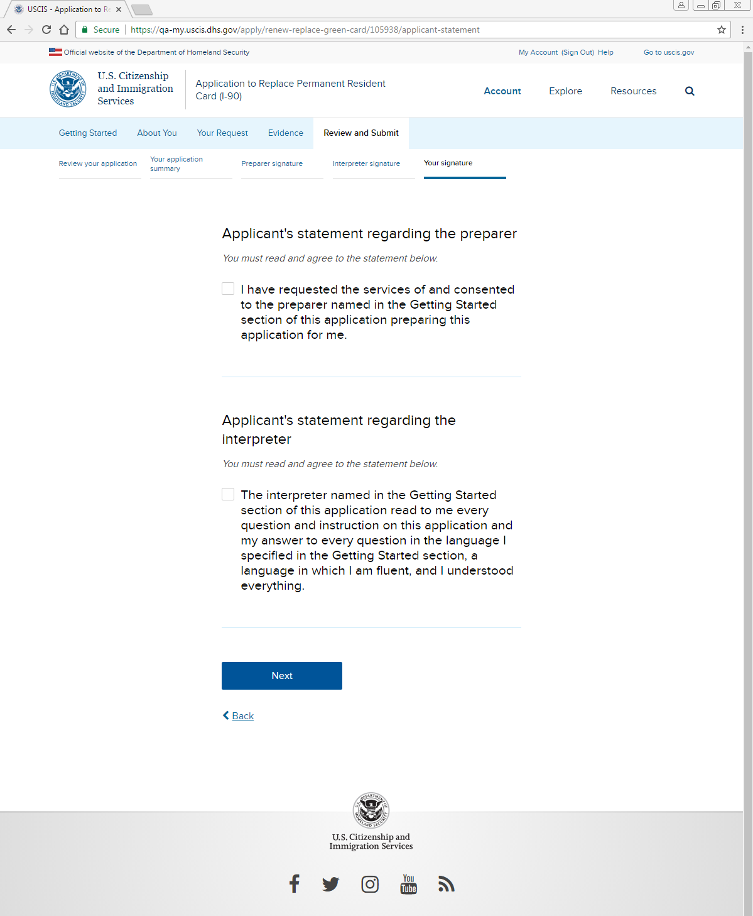
Review and Submit: Your signature: Statements regarding preparer, interpreter

Slide 37
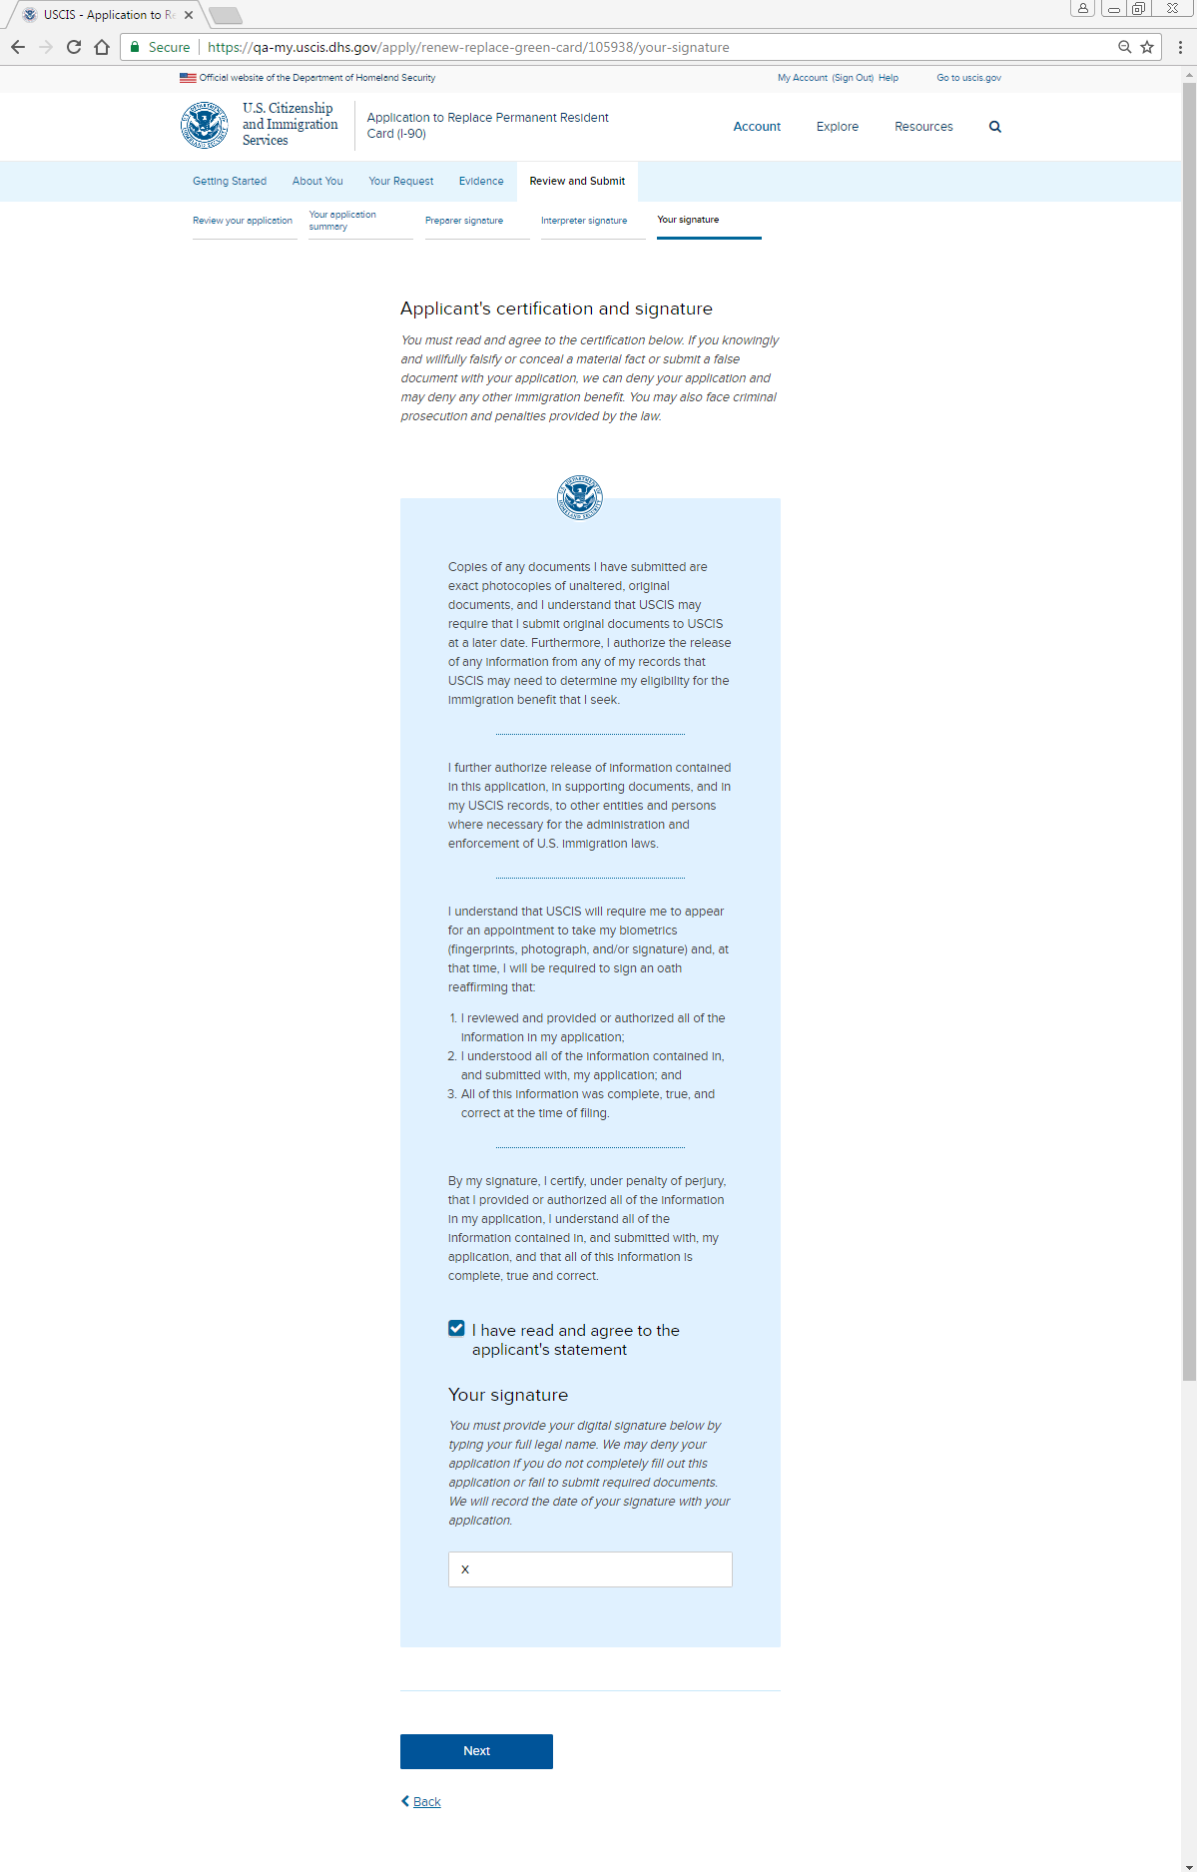
Review and Submit: Your signature: Applicant certification and signature

Slide 38
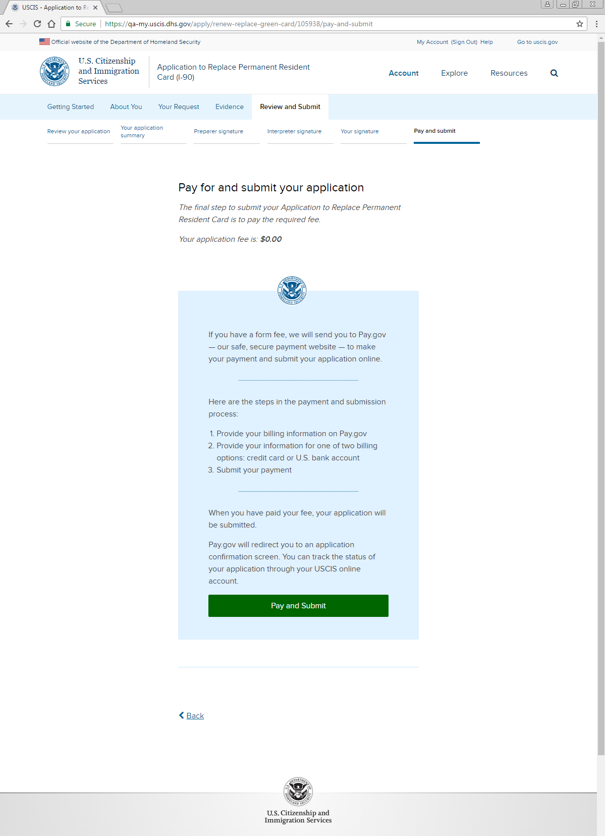
Review and Submit: Pay and Submit

