Slide 1
CARES User Guide
Register a New Non-Imported Aircraft – Individual
In this guide, you’ll learn how to:
Identify user dashboard.
Request registration for the new aircraft.
Verify/Update applicant information.
Add aircraft information.
Request N-Number.
Upload ownership documentation.
Review application.
Place requests into cart.
Pay for requests in cart.

Slide 2
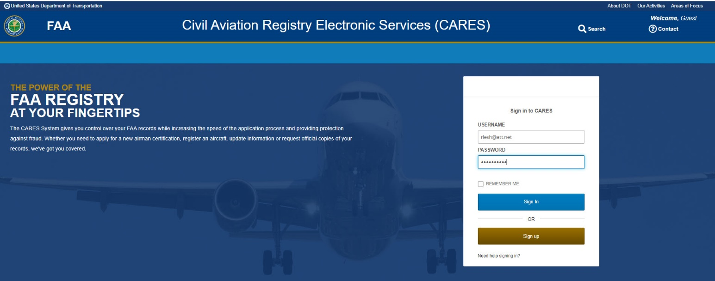
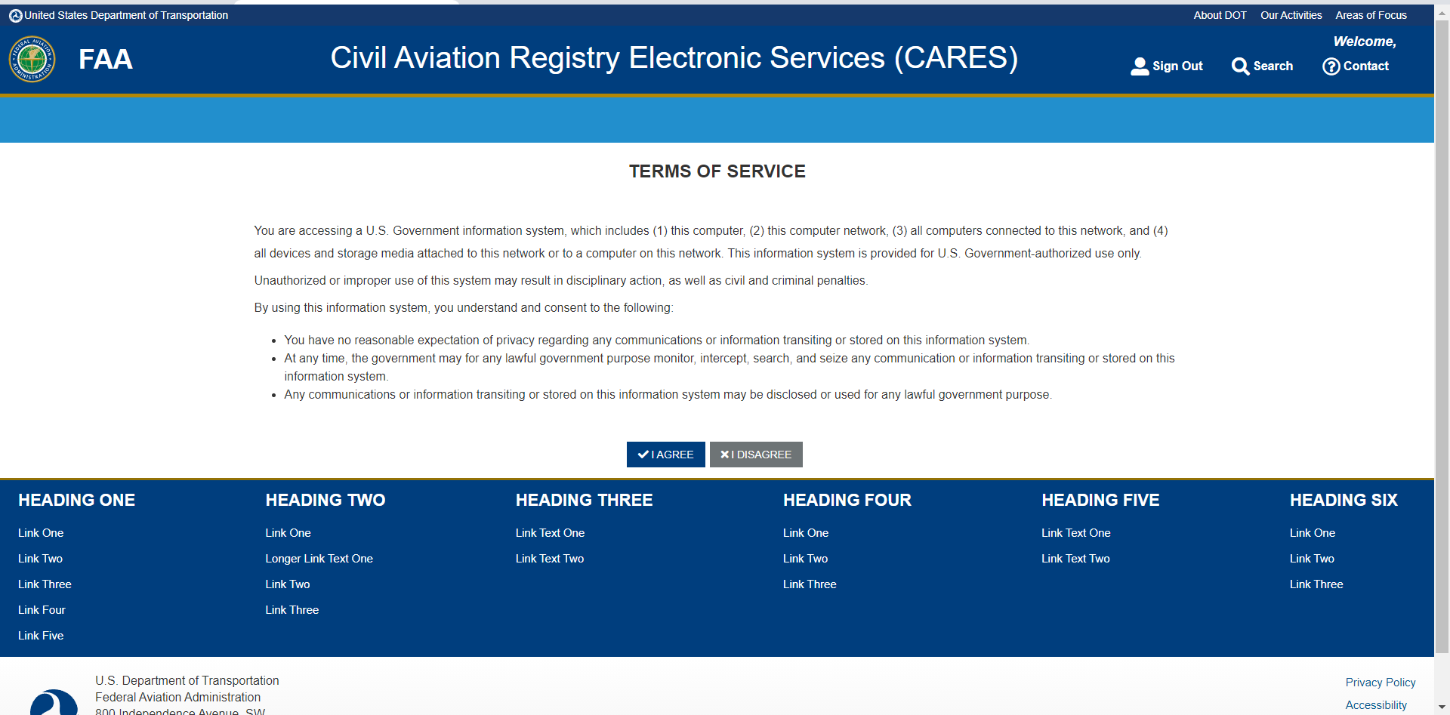
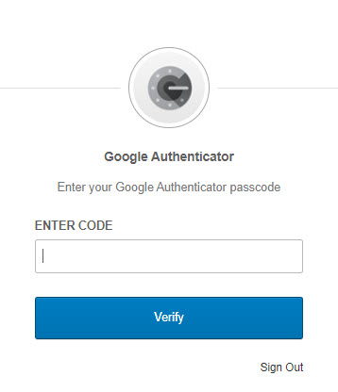
Before beginning a request for an aircraft registration, ensure you have performed the following:
Navigate to the CARES home page.
Sign up for a CARES account.
Sign into your CARES account.
Perform 2-factor authentication.
Accept Terms of Service.
Access user dashboard.
Register a New Non-Imported Aircraft – Individual

Slide 3
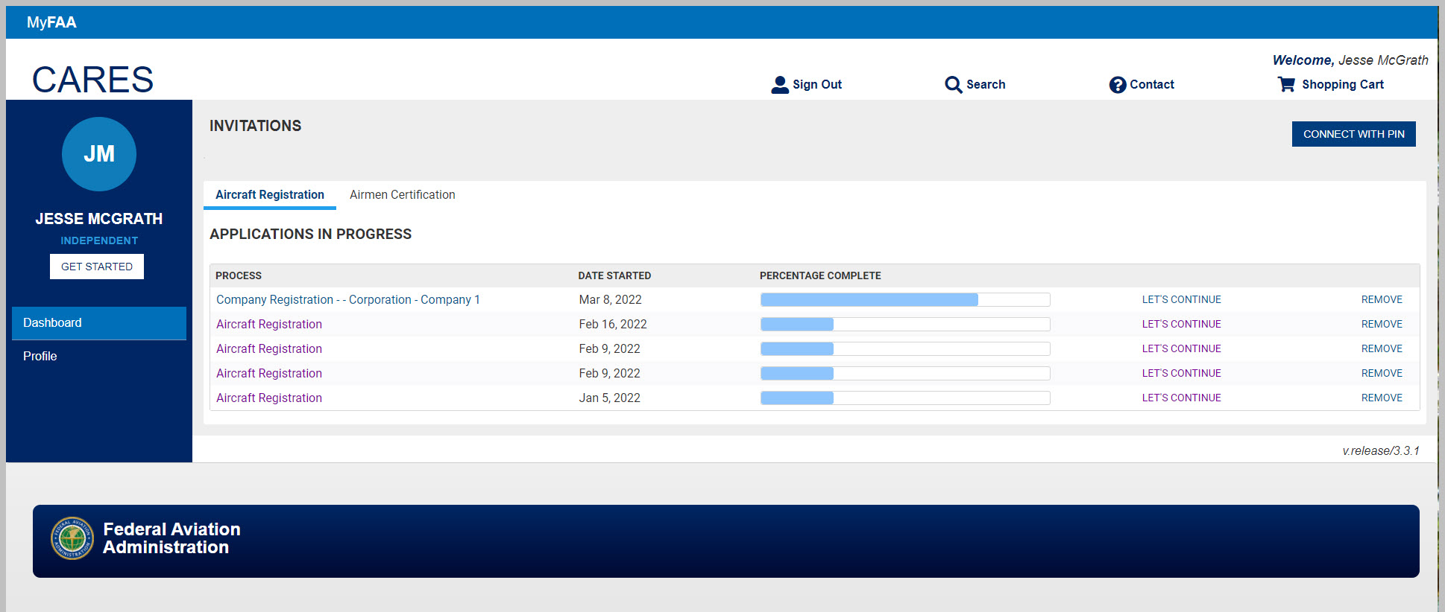
The User Dashboard contains the actions, statuses, and disposition concerning CARES related submissions, such as Aircraft Registration, Special Reserved N-Number request, and other registry related information concerning your aircraft(s).
John Smith
JS
John Smith
Register a New Non-Imported Aircraft – Individual

Slide 4
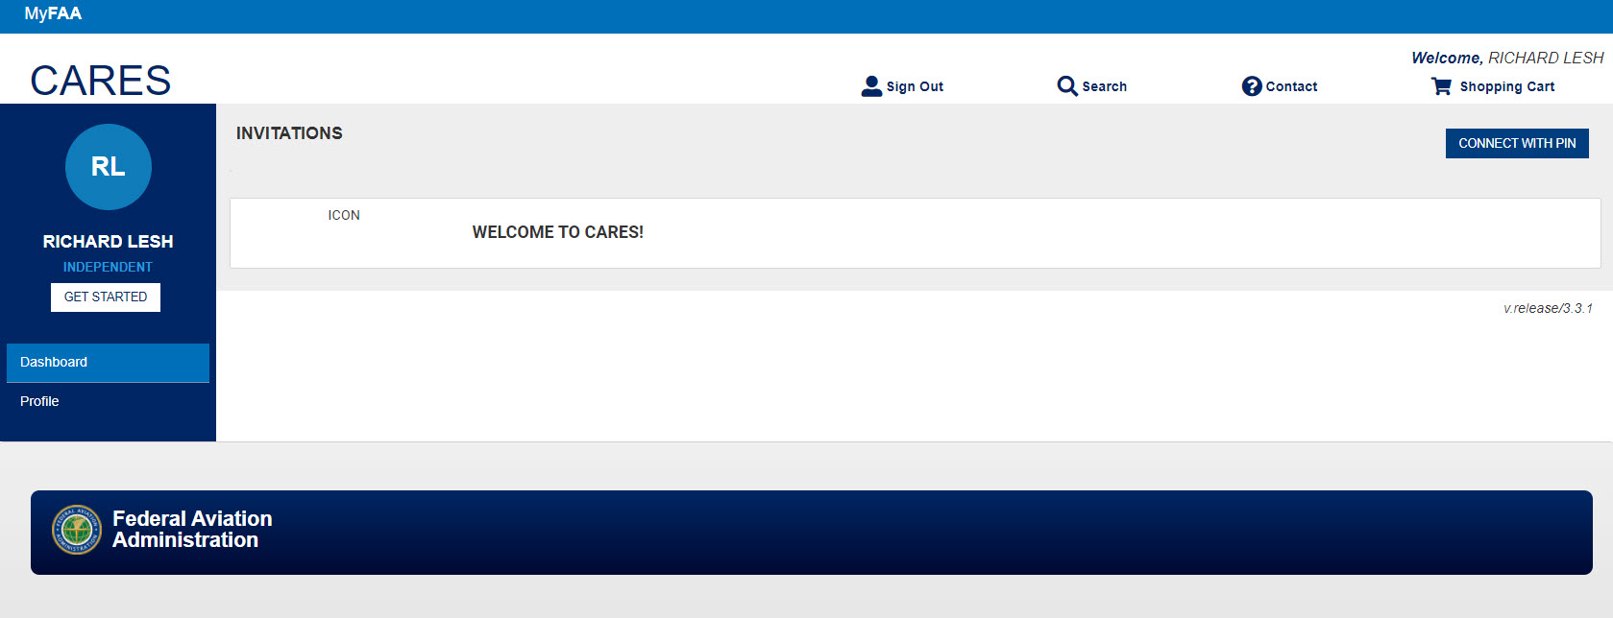
At the user dashboard, click the Get Started button:
John Smith
JS
John Smith
Register a New Non-Imported Aircraft – Individual

Slide 5
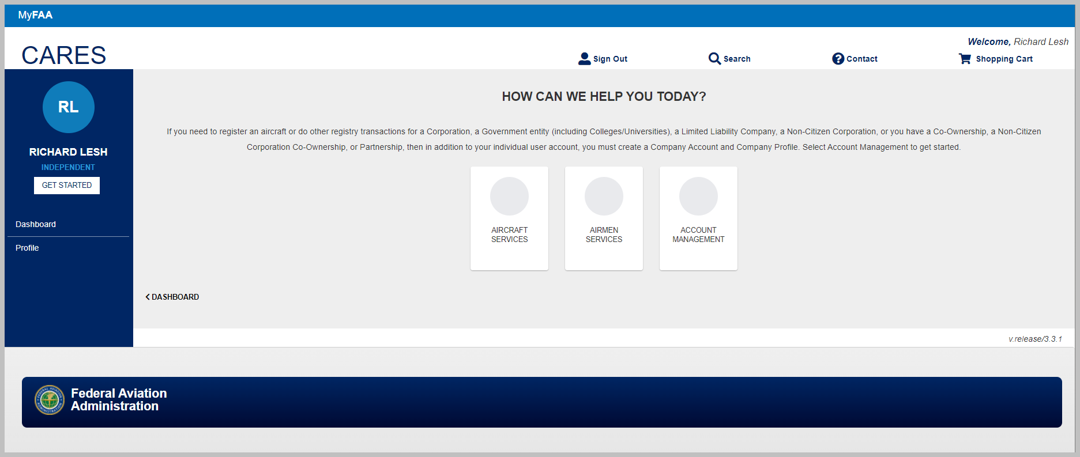
On the next screen, select Aircraft Services:
John Smith
JS
John Smith
Register a New Non-Imported Aircraft – Individual

Slide 6
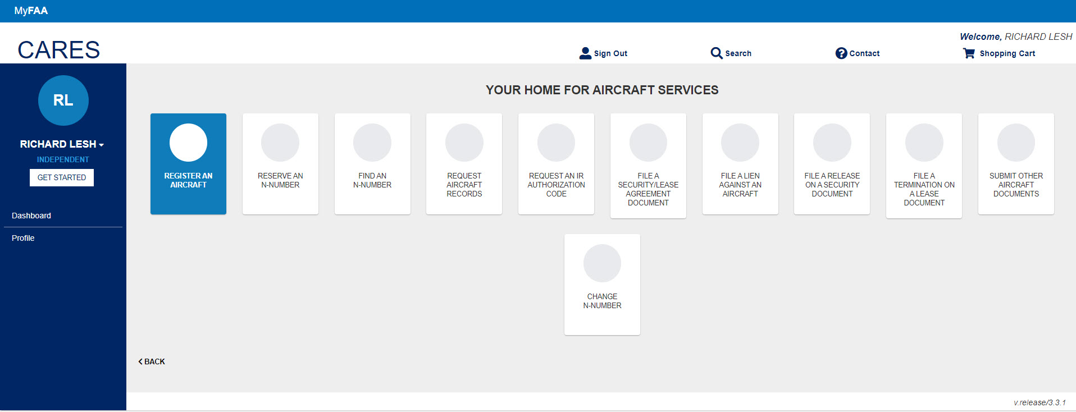
On the next screen, select Register an Aircraft:
John Smith
JS
John Smith
Register a New Non-Imported Aircraft – Individual

Slide 7
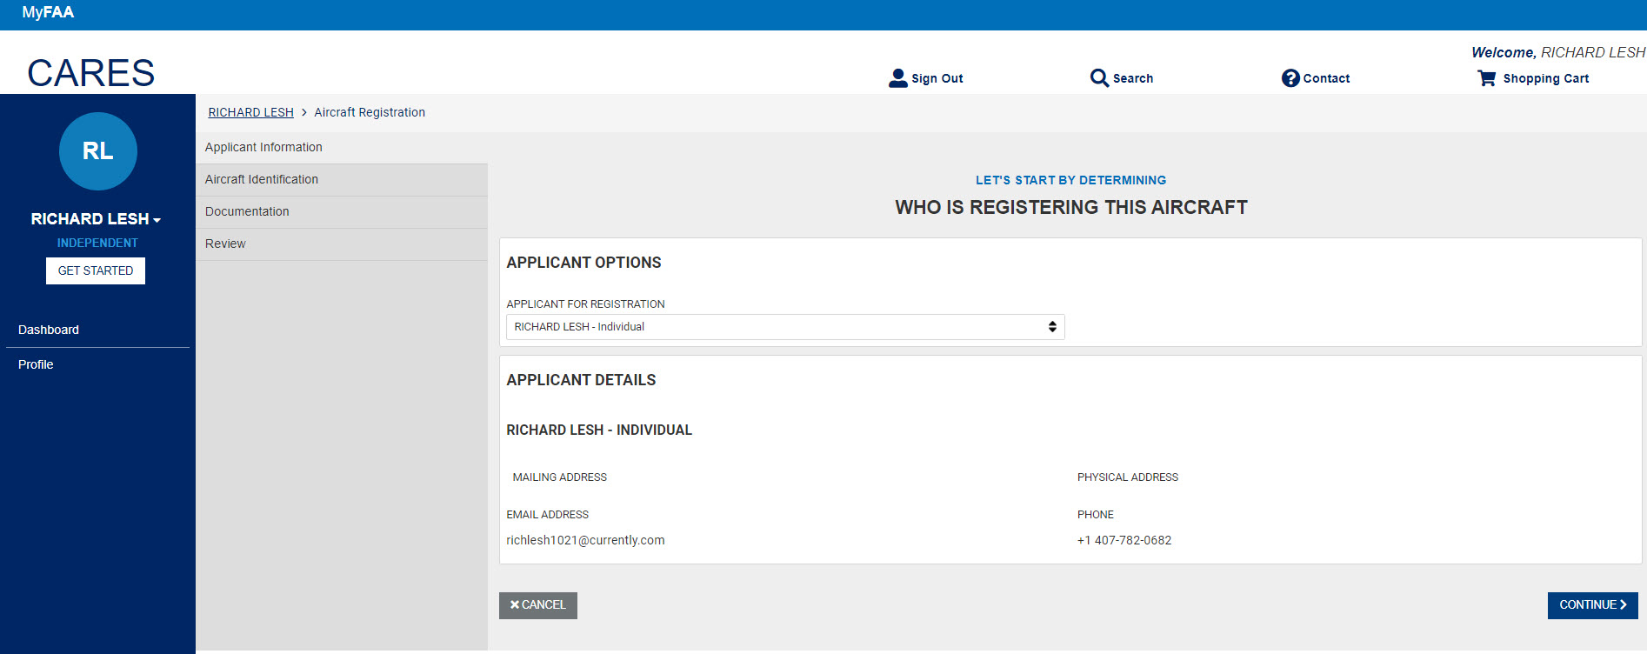
On the next screen, select the Applicant For Registration if there are more than one applicant connected to the account and verify applicant details. If any changes, go to Profile and make the changes:
Click Continue:
John Smith
JS
JOHN SMITH
John Smith
John Smith - Individual
JOHN SMITH
jsmith1021
Register a New Non-Imported Aircraft – Individual

Slide 8
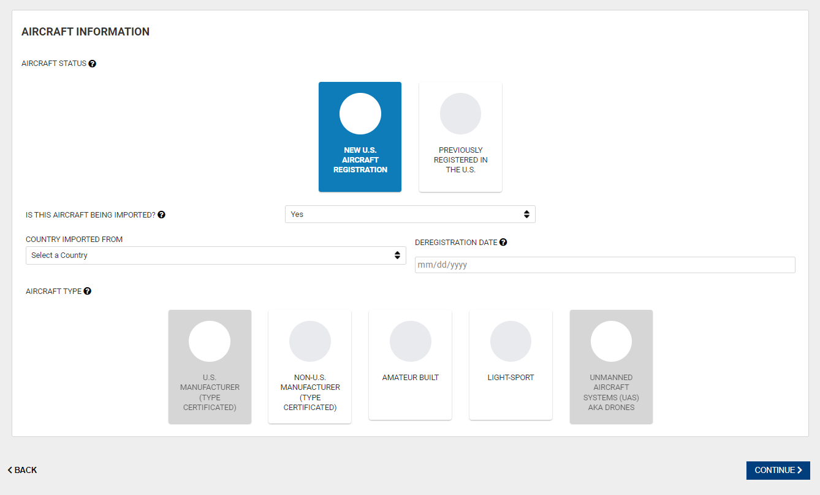
New U.S. Aircraft Registration
On the next screen, select whether the aircraft is a new U.S. registration or if the aircraft had previously been registered in the U.S. For this example, we are going to use the New U.S. Aircraft Registration option:
When you select the New U.S. Aircraft Registration option, the question asking Is This Aircraft Being Imported? appears. Select Yes or No from the drop down:
Register a New Non-Imported Aircraft – Individual

Slide 9
If Yes is selected, fields appear to select the Country Imported From and the Deregistration Date. Also, under Aircraft Type the U.S. Manufacturer is grayed out:
If No, is selected the Aircraft Types appear with the Non-U.S. Manufacturer option grayed out:
Register a New Non-Imported Aircraft – Individual

Slide 10
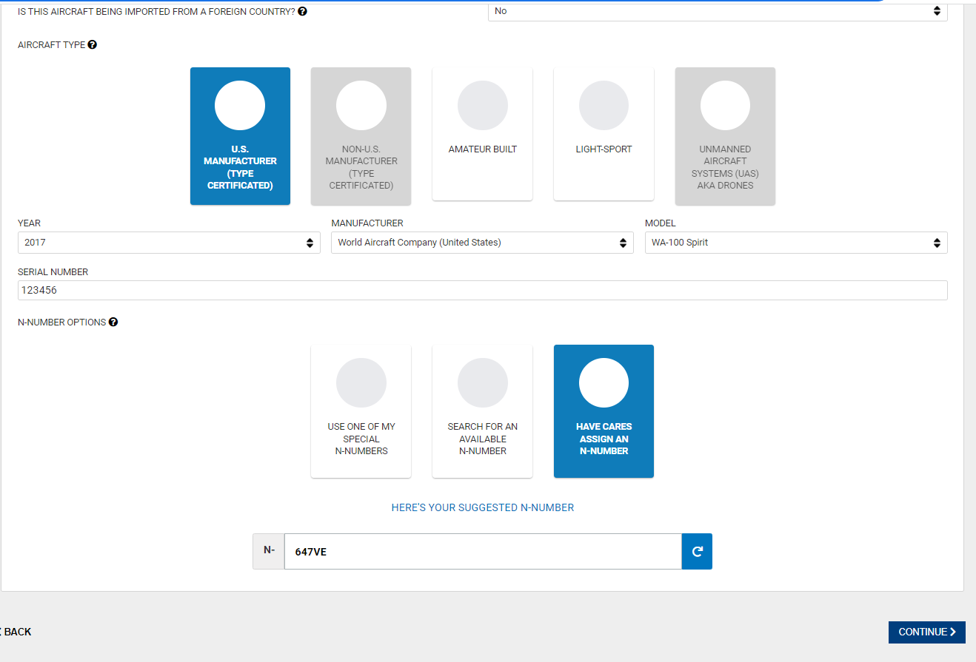
Aircraft Not Imported/U.S. Manufacturer
Select the U.S. Manufacturer (Type Certificated) option:
Select the Year, Manufacturer, Model, and Serial Number for the aircraft being registered:
Select the N-Number to assign the new aircraft. For this example, we choose to have CARES assign an N-Number:
Select CONTINUE to go to the Documents tab:
NOTE: If the suggested N-Number is not satisfactory, you can select the refresh icon to get a different number.
Register a New Non-Imported Aircraft – Individual

Slide 11
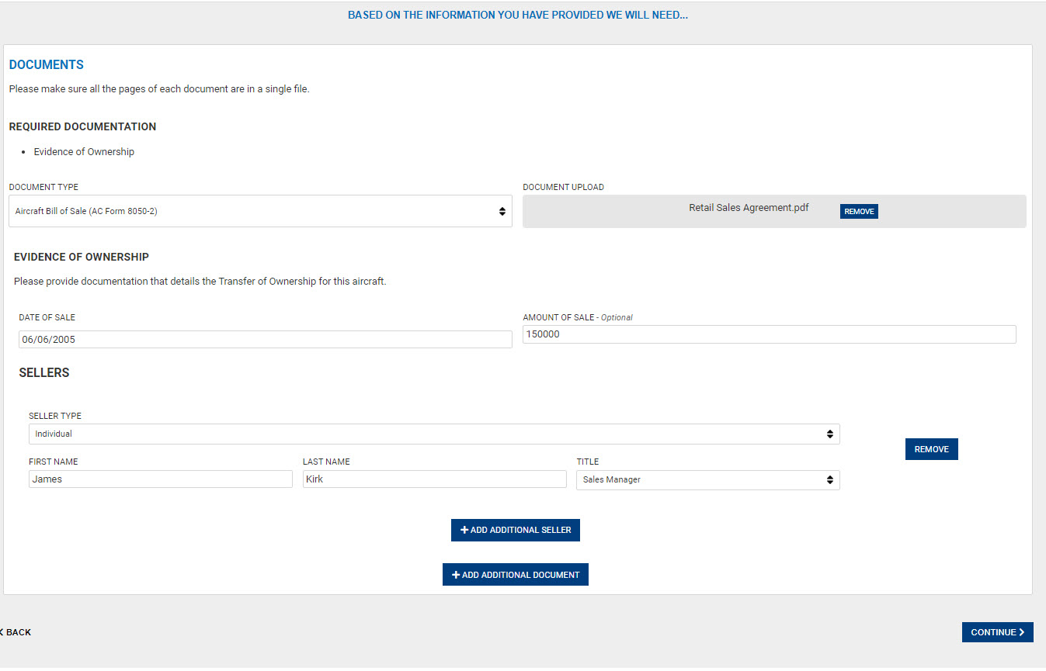
Observe the Required Documentation based on the previous information you submitted:
Select the Document Type and Upload the document from the location it is located. Add additional documents as needed:
Enter Date of Sale and Amount of Sale:
Enter seller or sellers name and title:
Select CONTINUE. The Review and Sign tab appears:
Register a New Non-Imported Aircraft – Individual

Slide 12
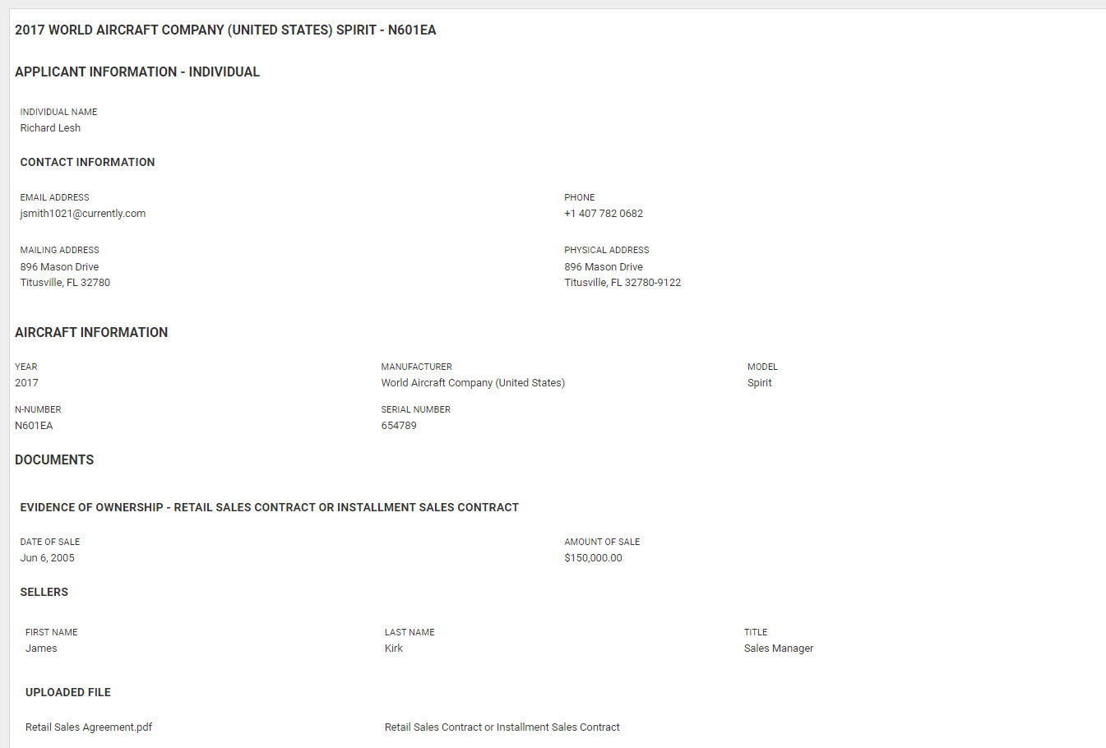
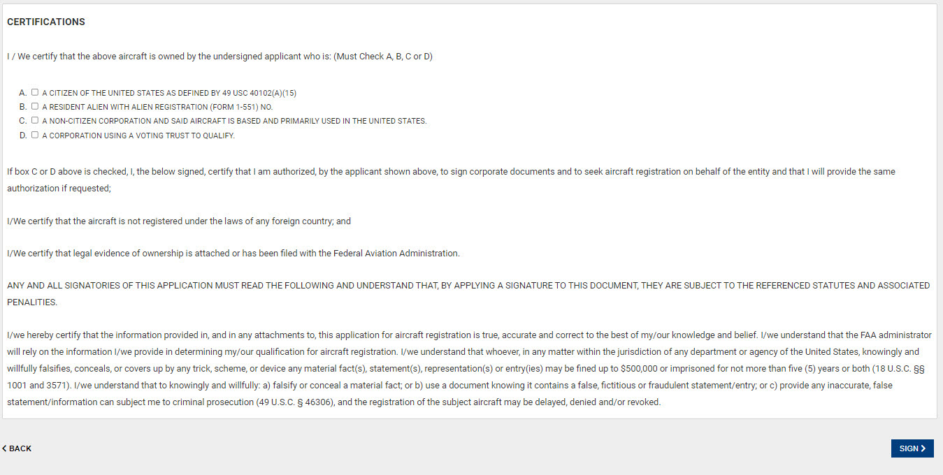
Review the information. Use the back arrow at bottom of page to make corrections as needed:
Check the appropriate citizenship boxes and click Sign to access Docusign:
John Smith
+813-221-3213
123 Main Street
Polk City, FL 32712
123 Main Street
Polk City, FL 32712
Register a New Non-Imported Aircraft – Individual

Slide 13
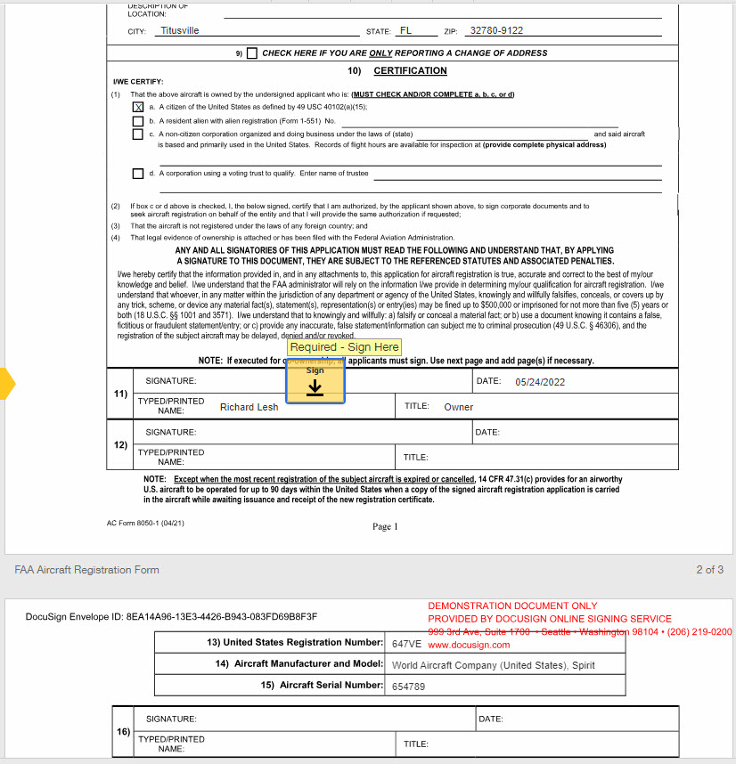
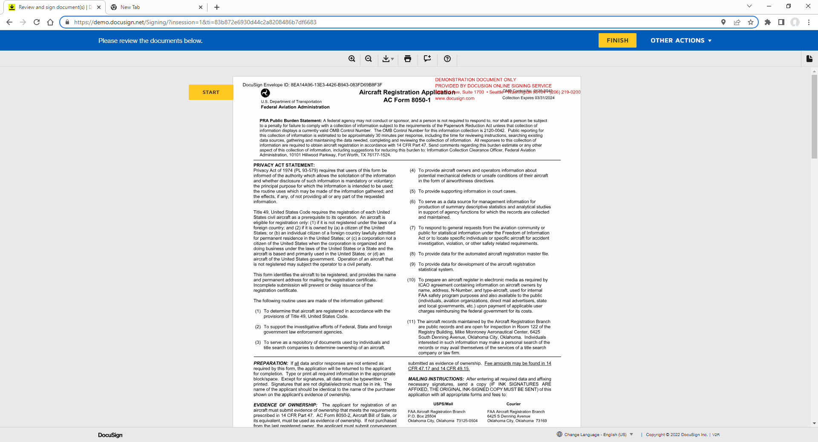
Follow the instructions for the DocuSign and click Finish when completed.
John Smith
Register a New Non-Imported Aircraft – Individual

Slide 14
Once application is signed, the aircraft appears and is placed in the shopping cart.
You can either save the application for later or pay for the registration now. If you save for later, there is no guarantee your N-Number will still be available unless you already have the number as a Reserved Special N-Number.
John Smith
JS
John Smith
John Smith
Register a New Non-Imported Aircraft – Individual

Slide 15
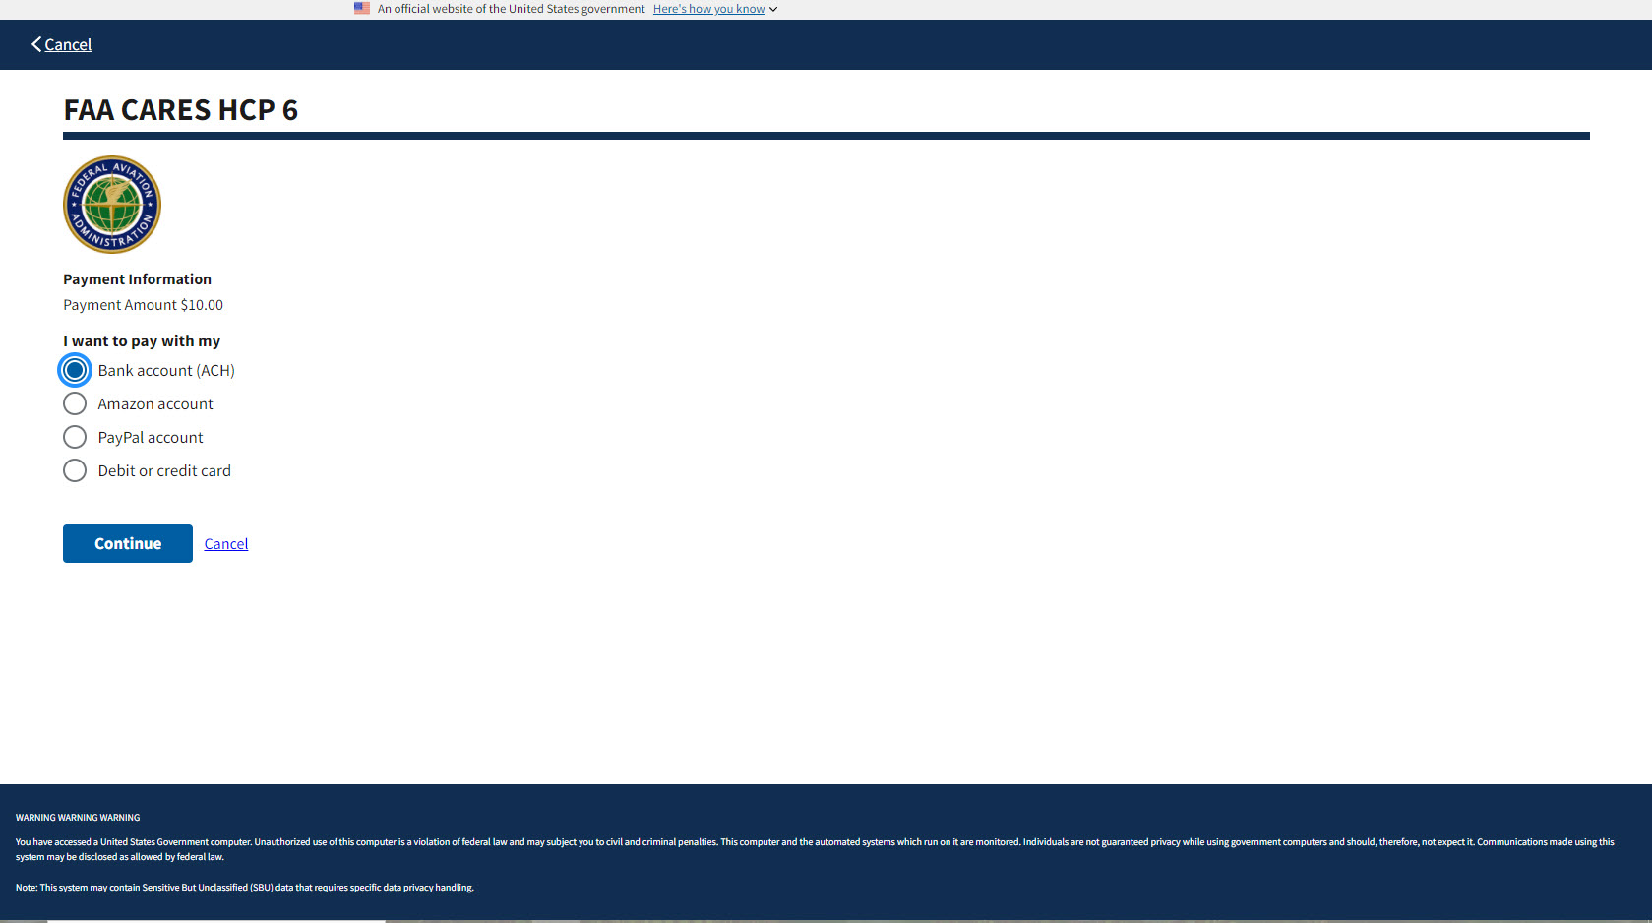
Follow the Pay.gov procedures to pay for the items in your cart. Once paid, the registration moves from your cart and is forwarded to FAA for examination. You will receive an email as a receipt for the payment.
Register a New Non-Imported Aircraft – Individual

