Slide 1

N-400 Application for Naturalization
Part 1 of 4
United States Citizenship and Immigration Services
myUSCIS Team

Slide 2
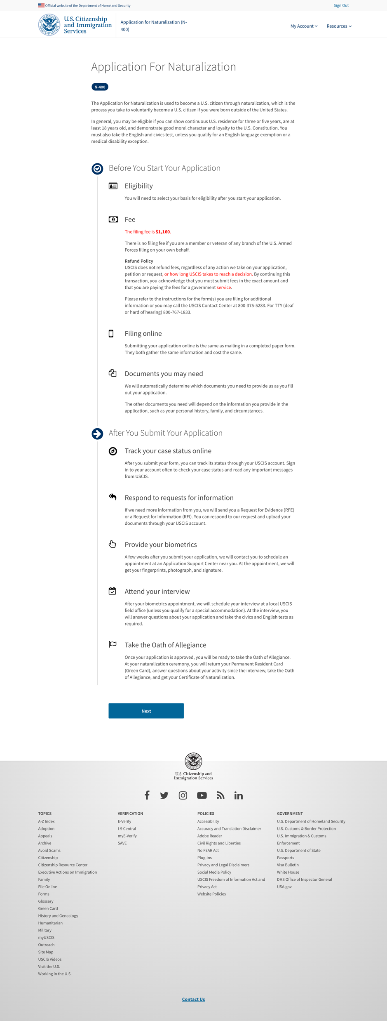
Overview

Slide 3
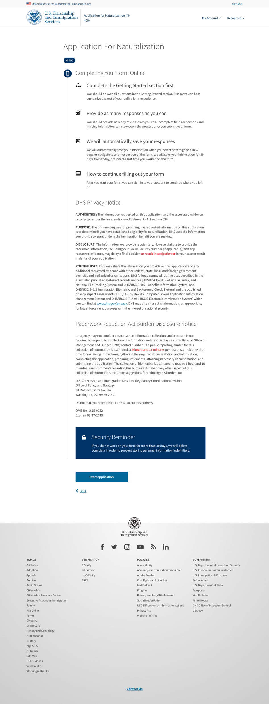
Start

Slide 4
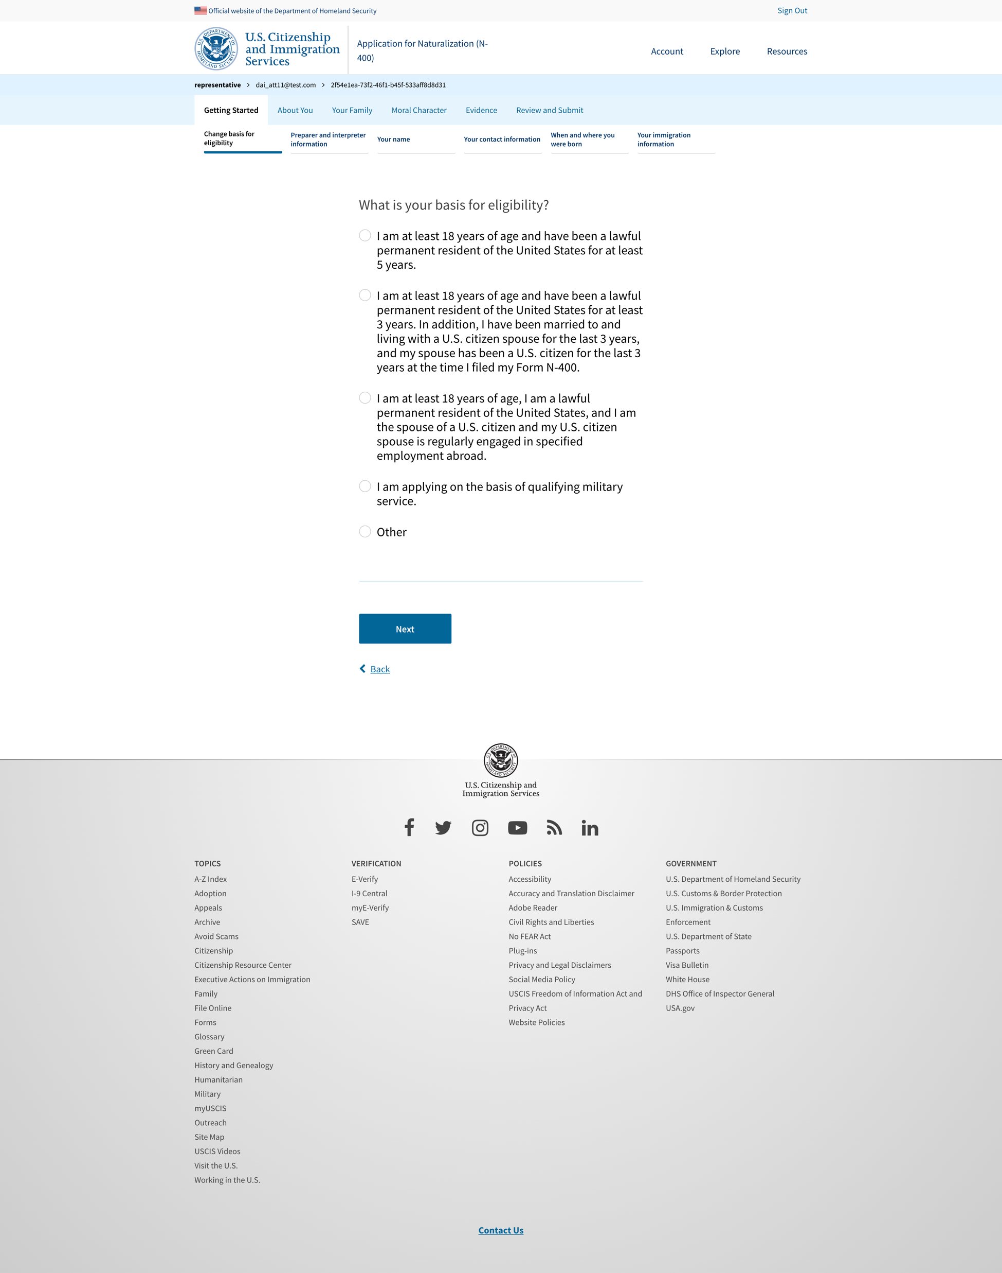
Start

Slide 5
Basis for eligibility

Slide 6
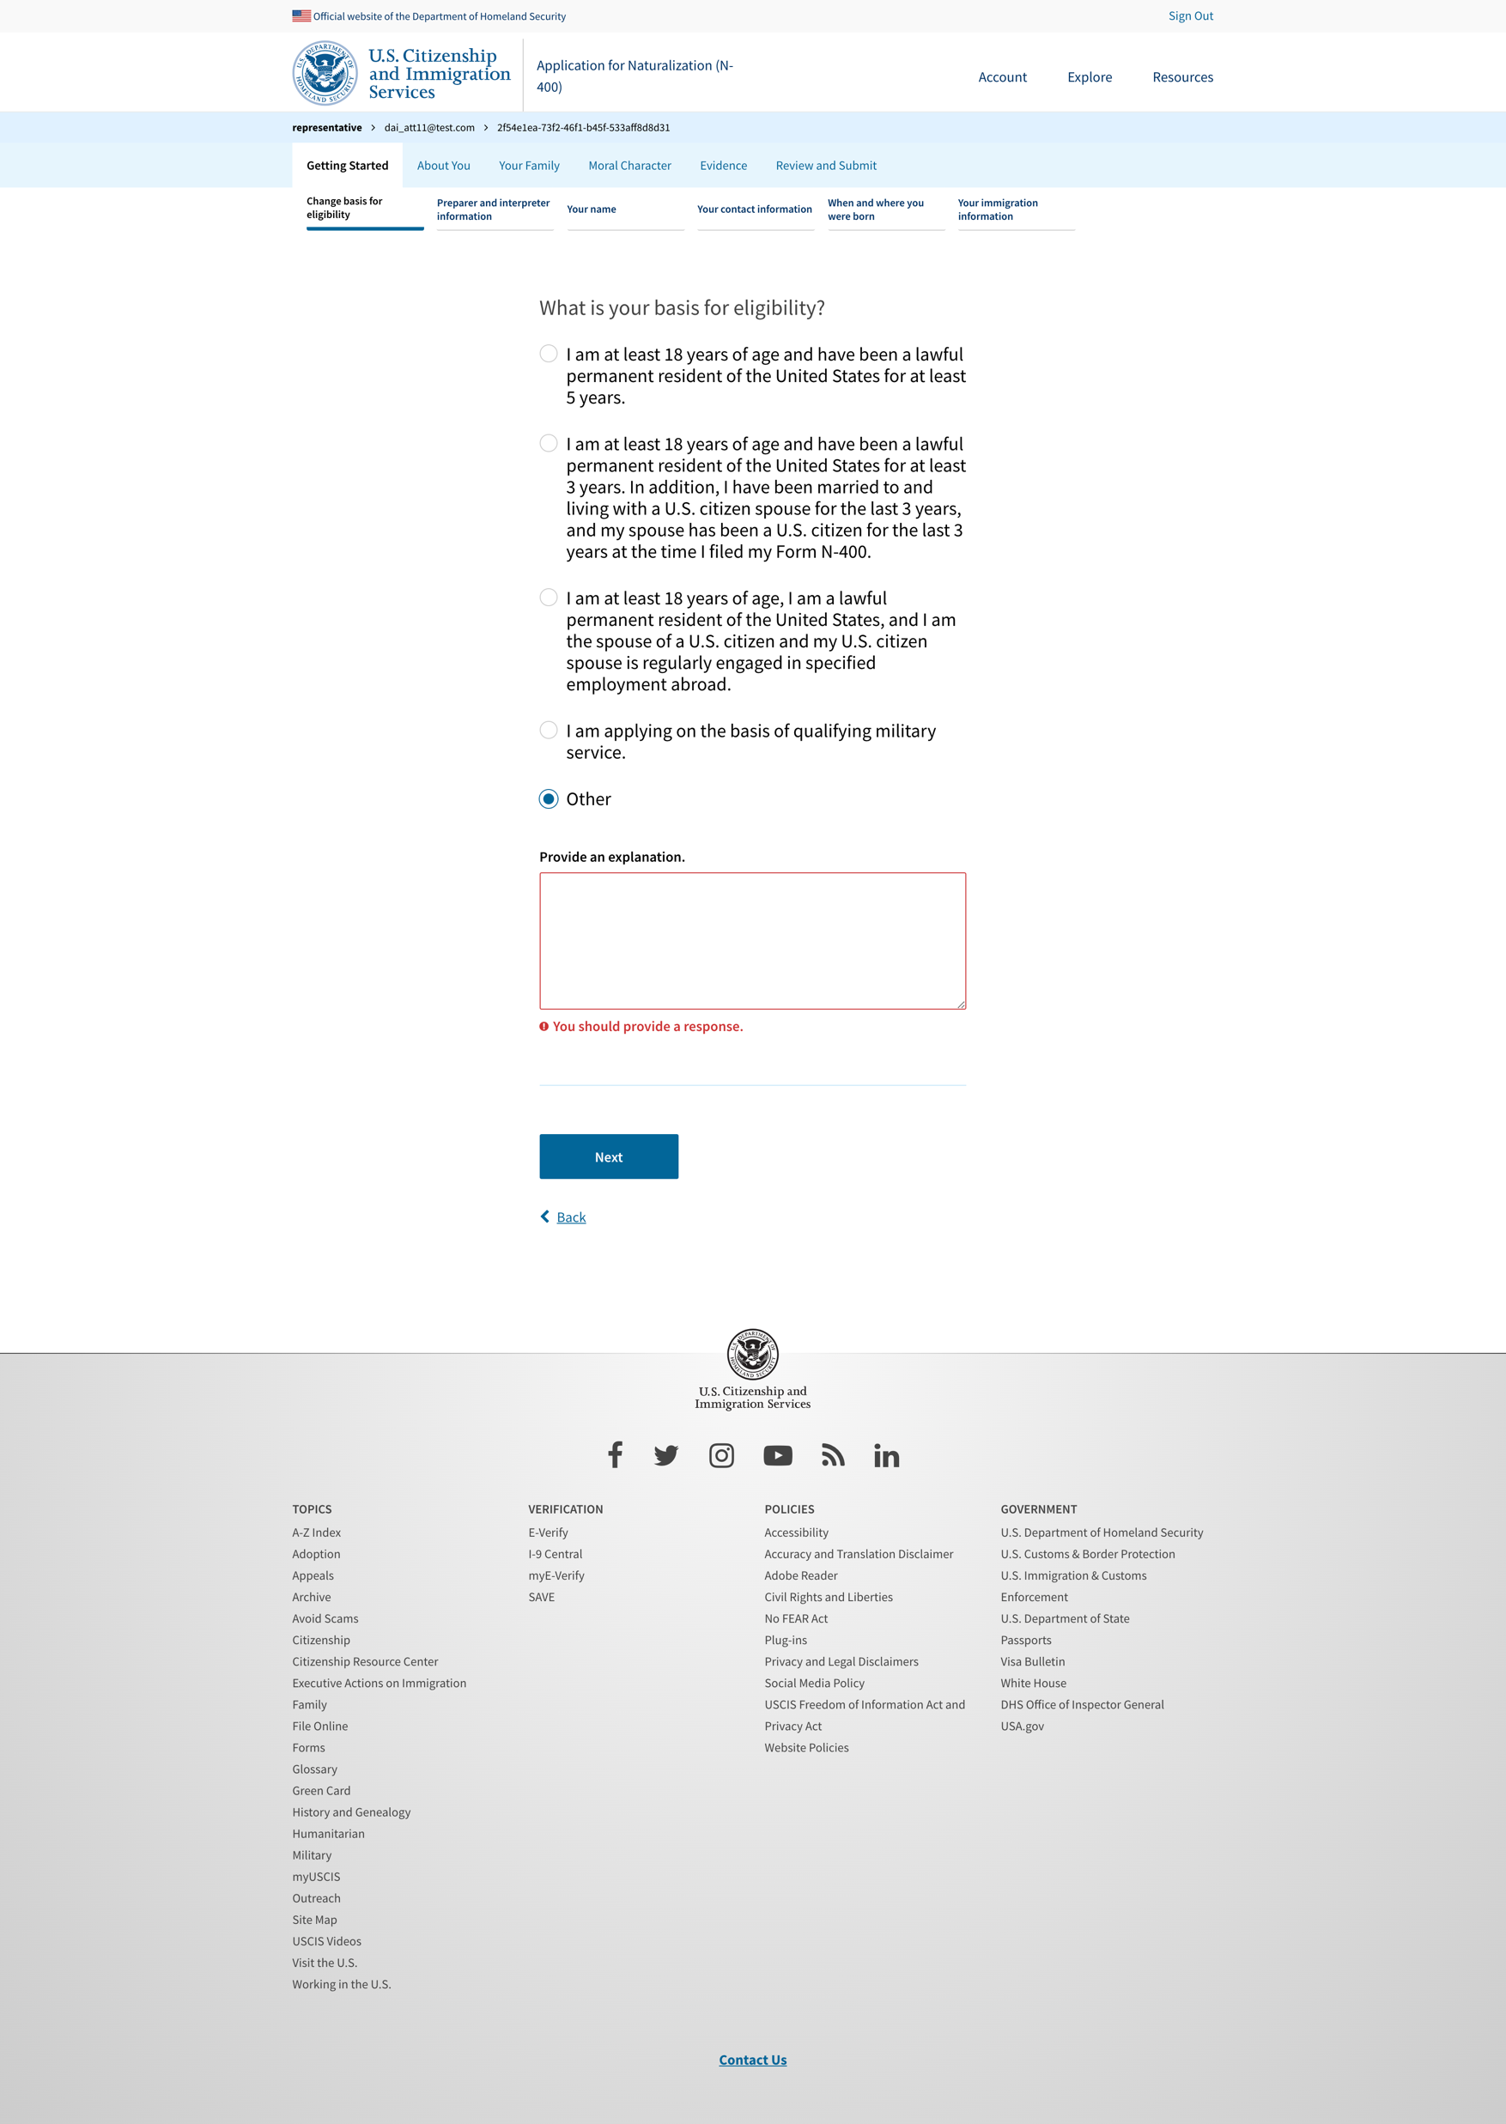
Basis for eligibility – other conditional

Slide 7
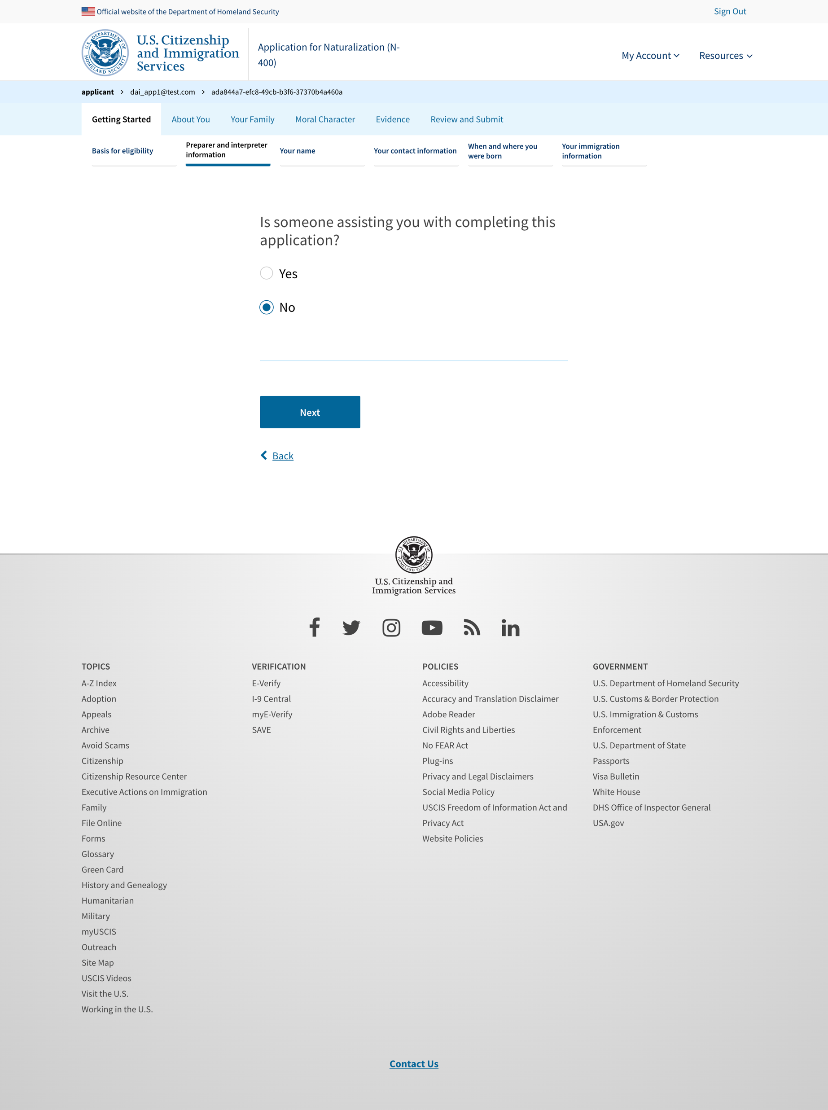
Preparer and interpreter - No

Slide 8
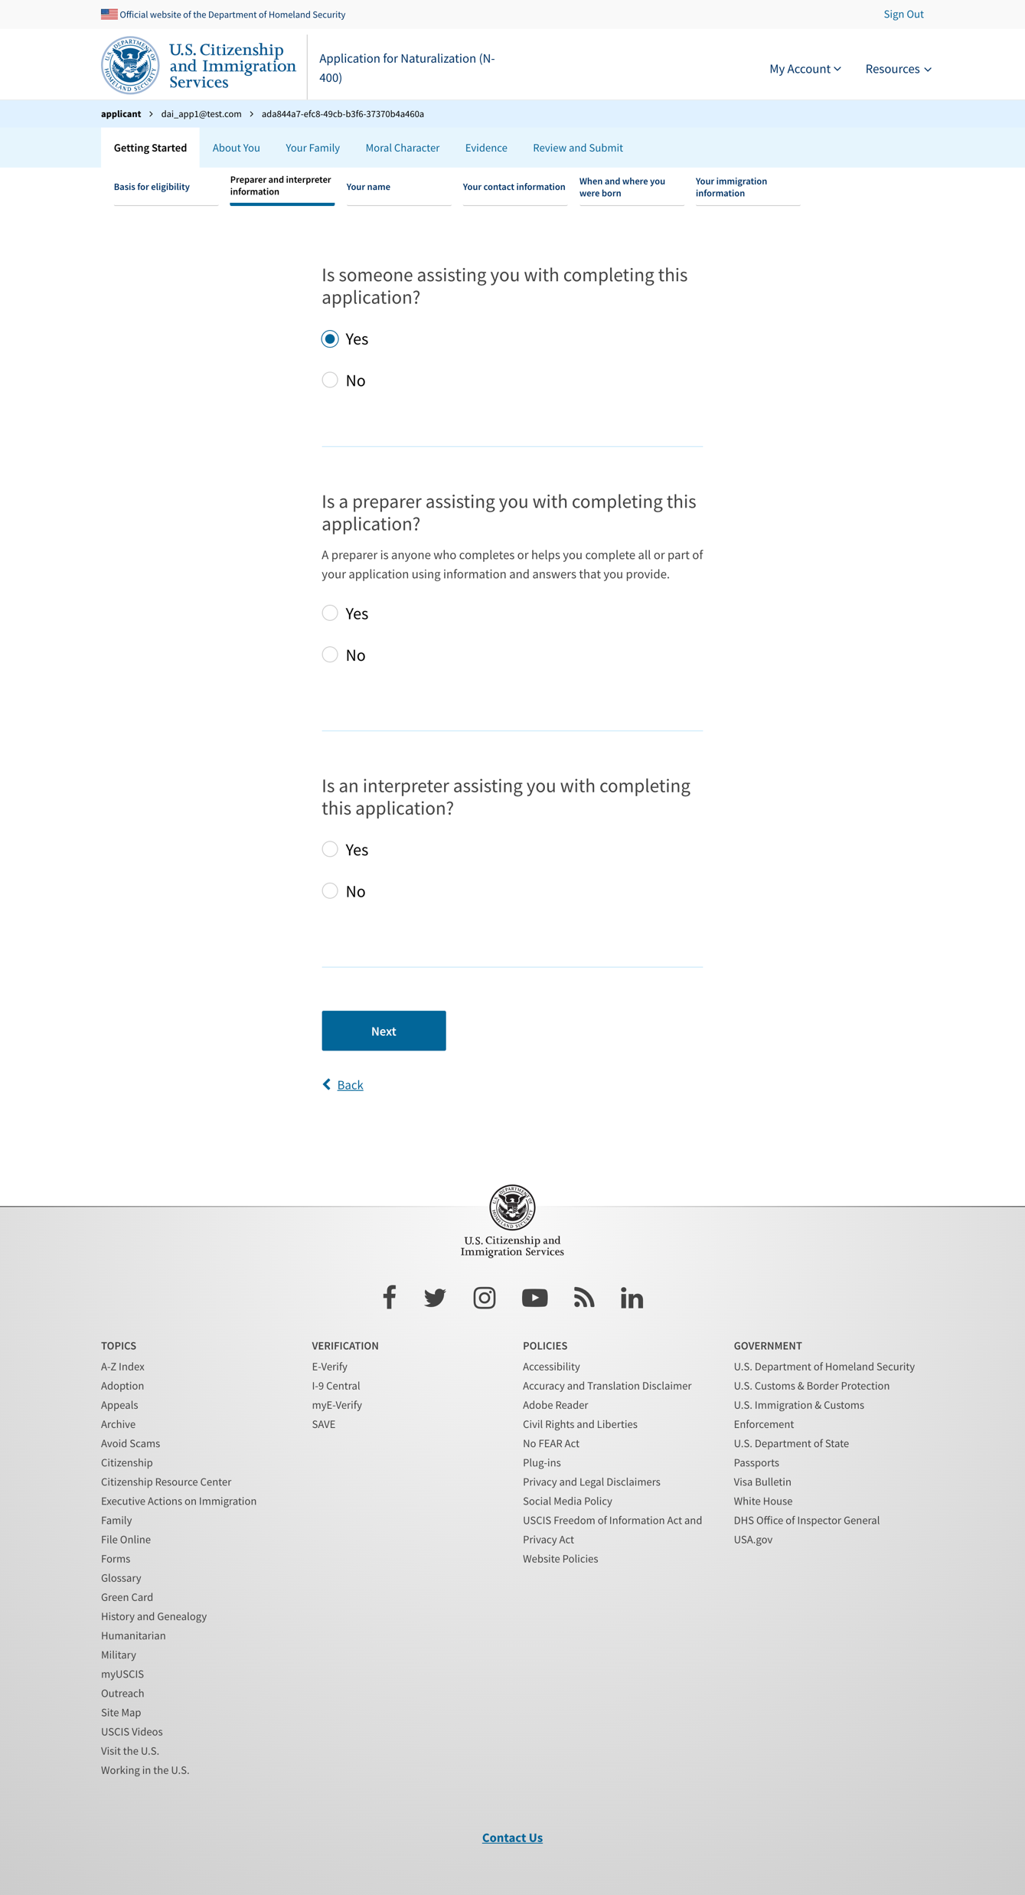
Preparer and interpreter - Yes

Slide 9
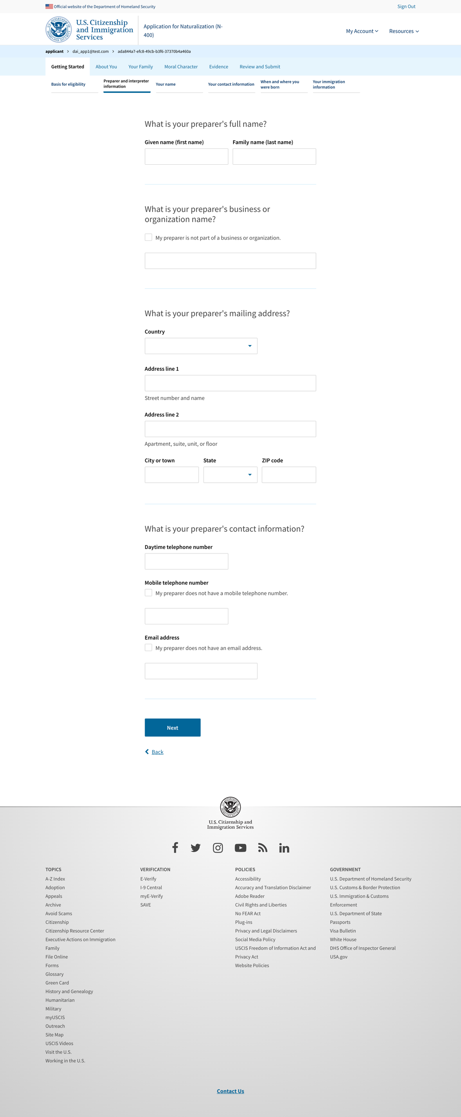
Preparer information

Slide 10
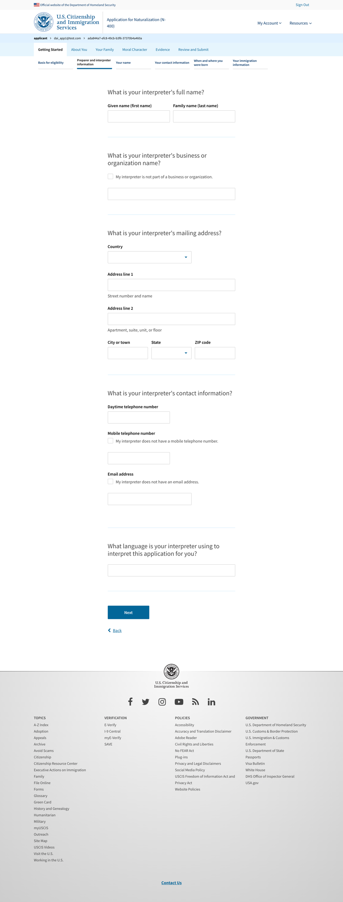
Interpreter information

Slide 11
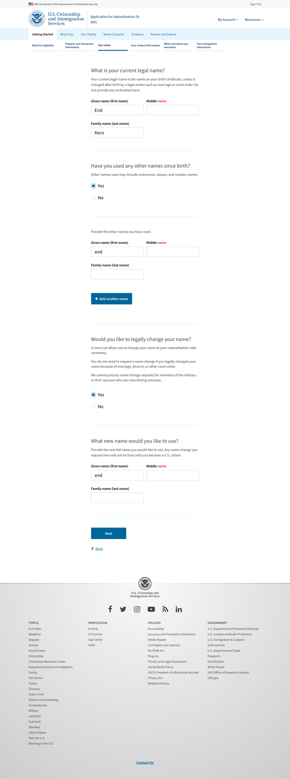
Your name

Slide 12
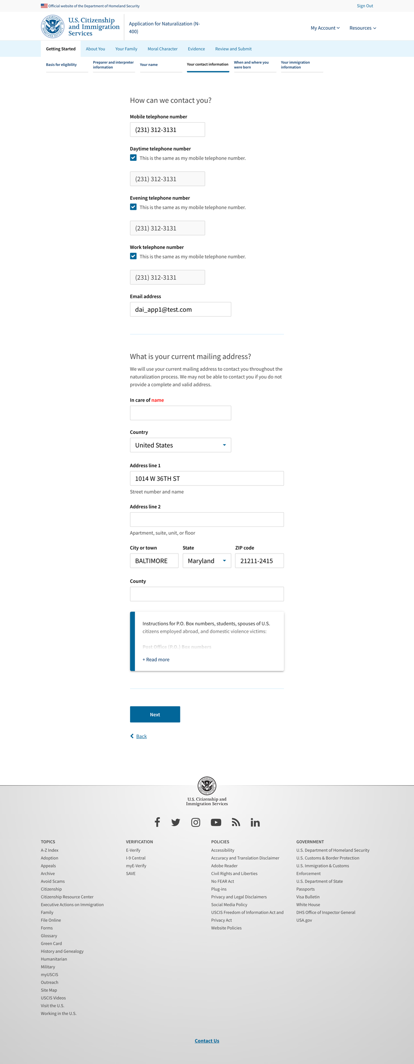
Your contact

Slide 13
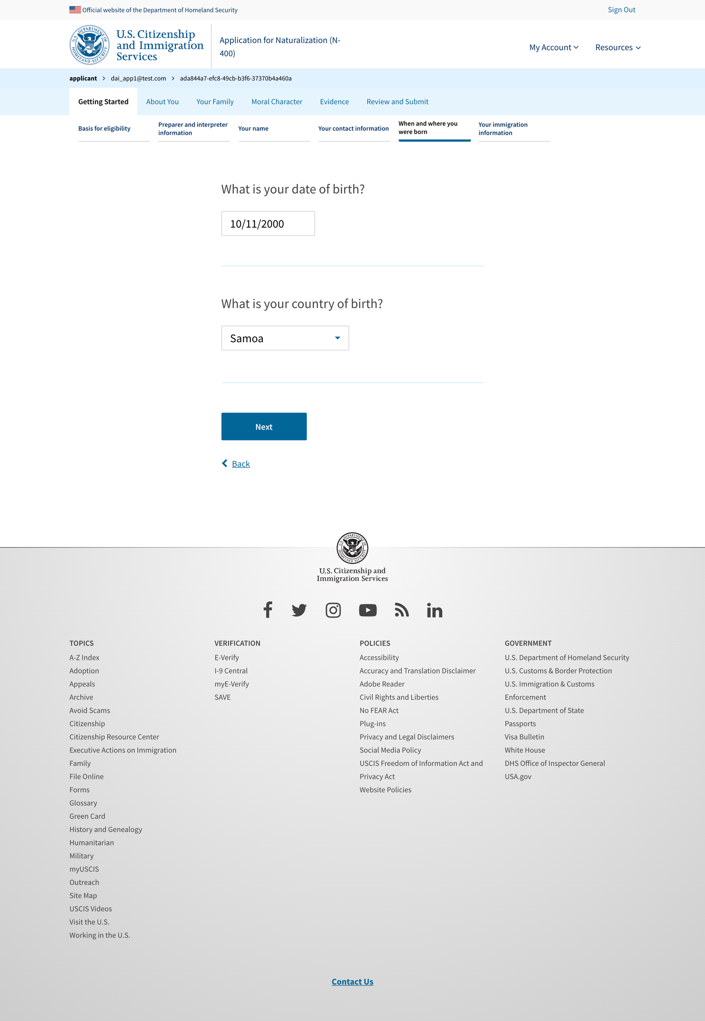
When and where you were born

Slide 14
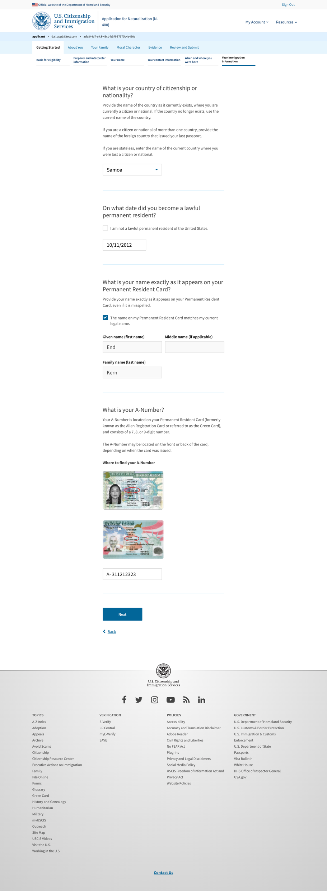
Your immigration information

Slide 15
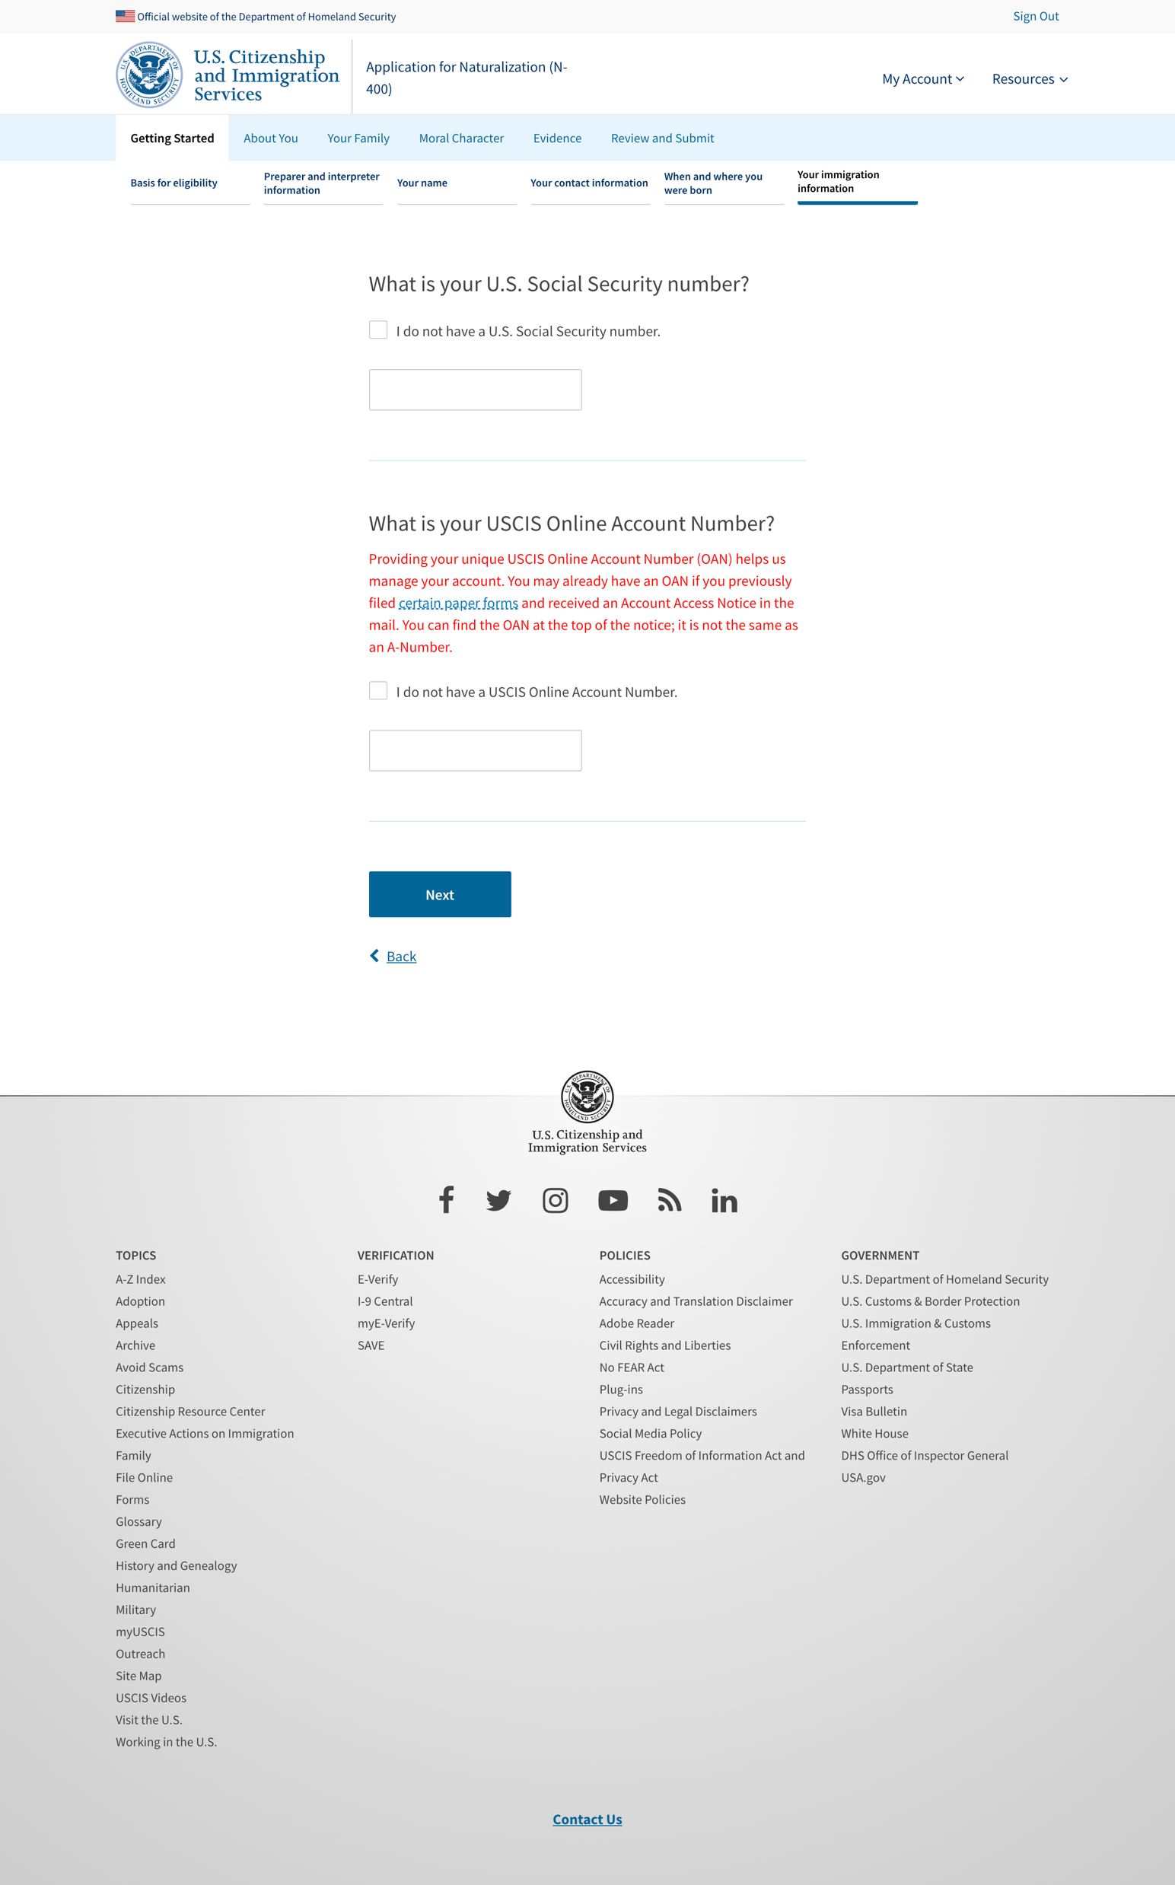
Your immigration information 2

Slide 16
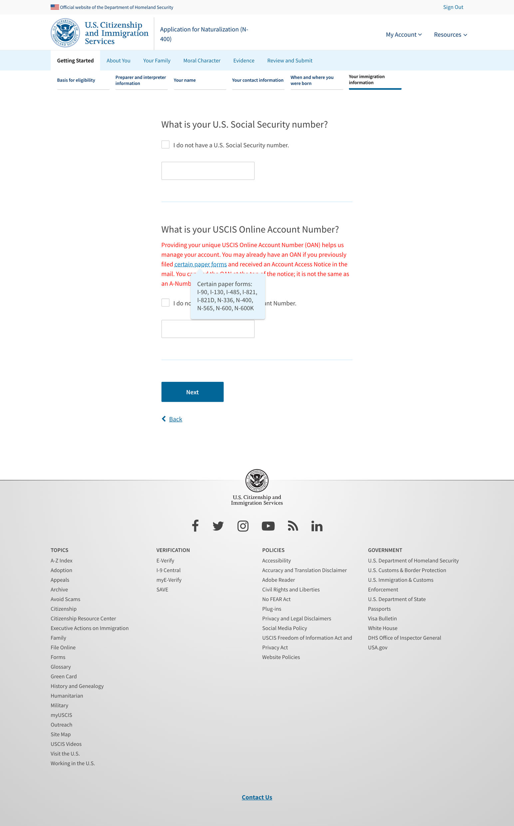
Your immigration information 2 – tooltip exposed

Slide 17
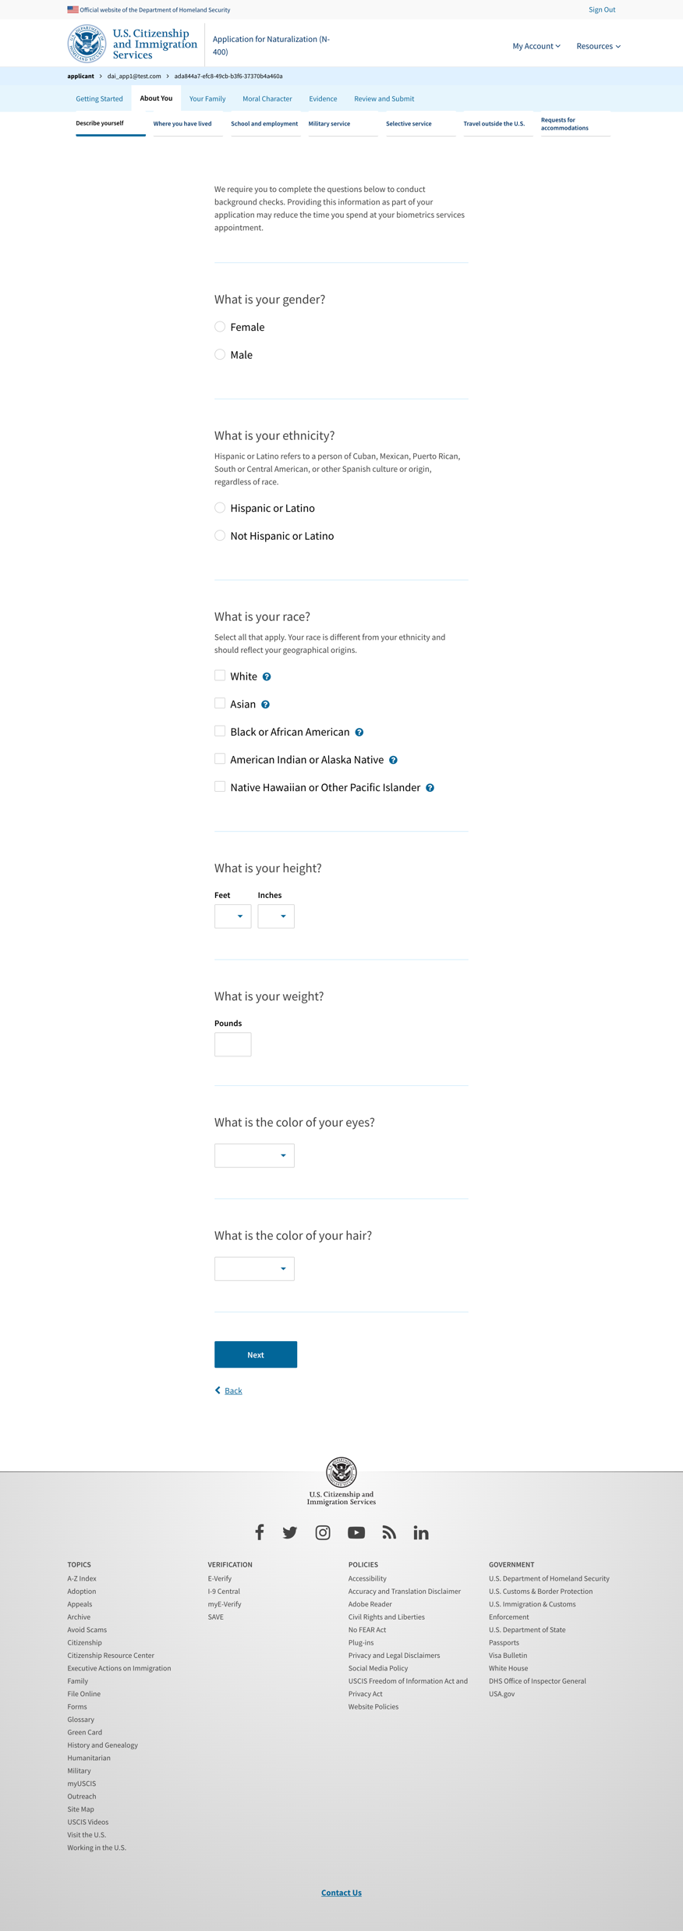
Describe yourself

Slide 18
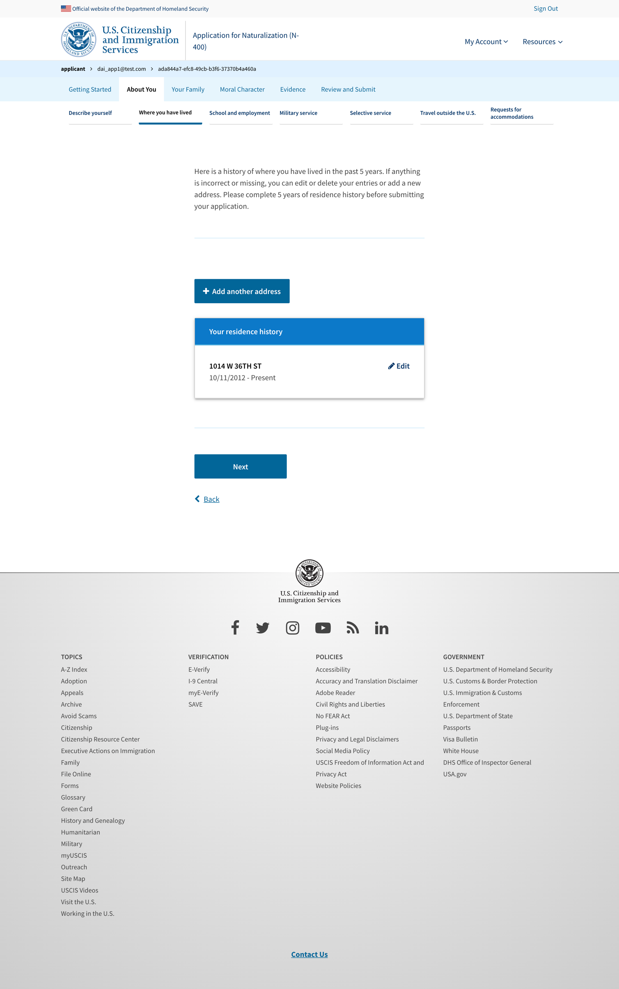
Where have you lived

Slide 19
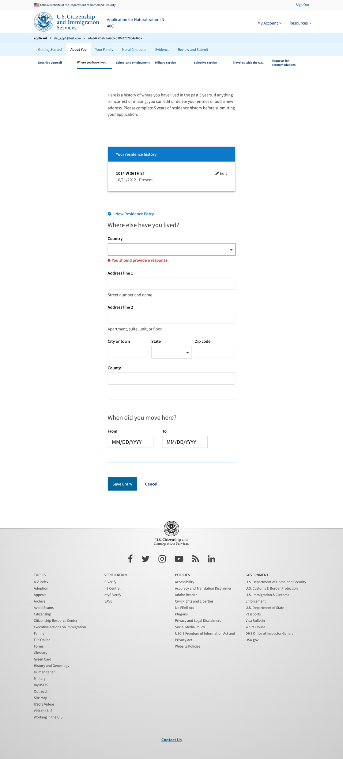
Where have you lived - add more

Slide 20
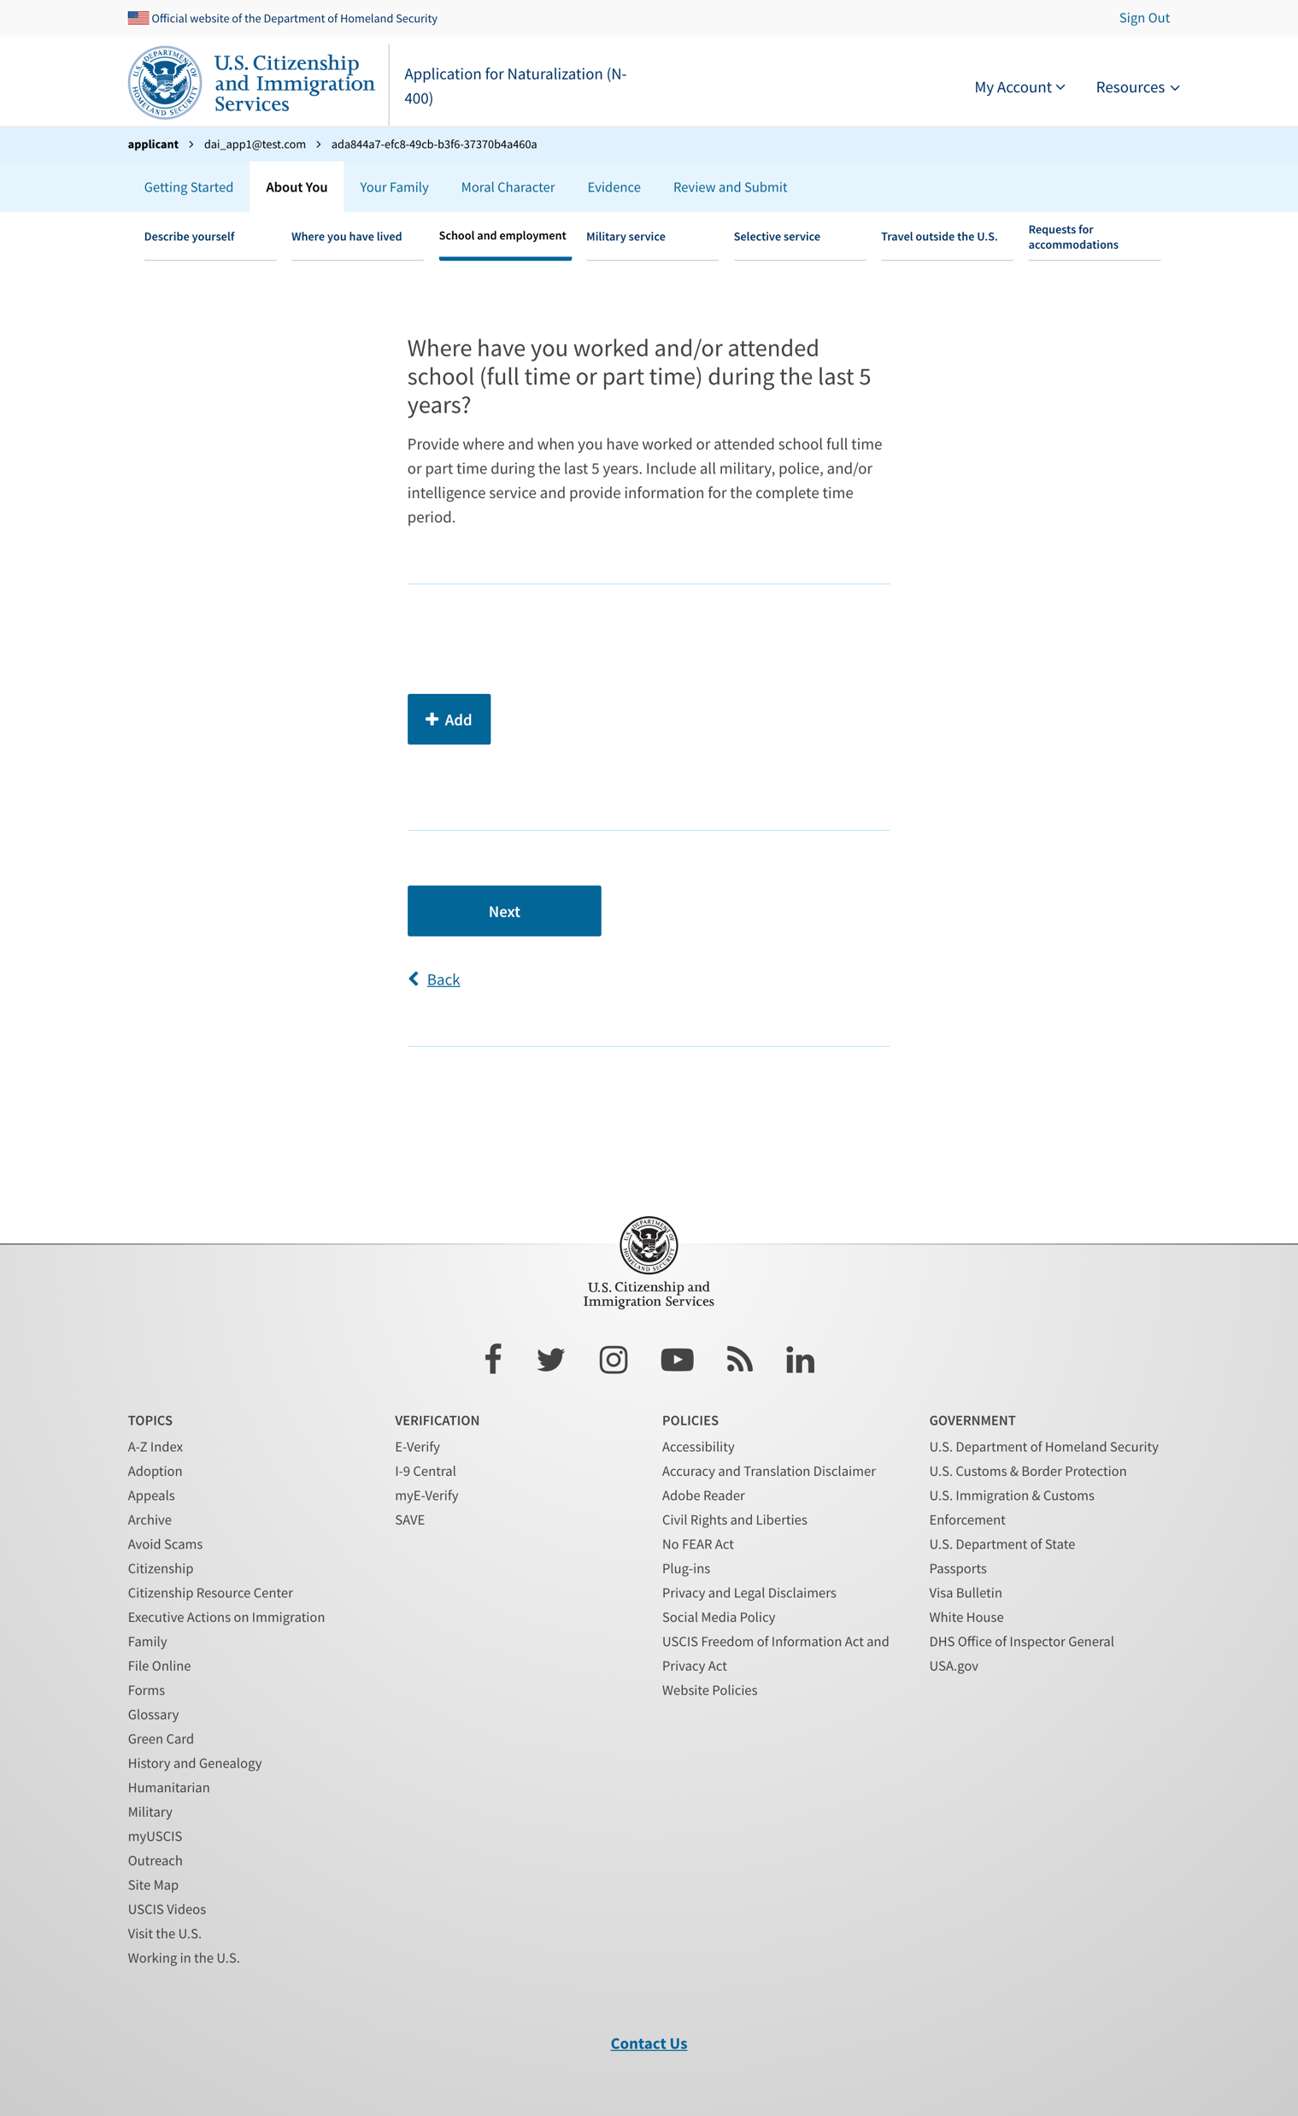
School and employment

Slide 21
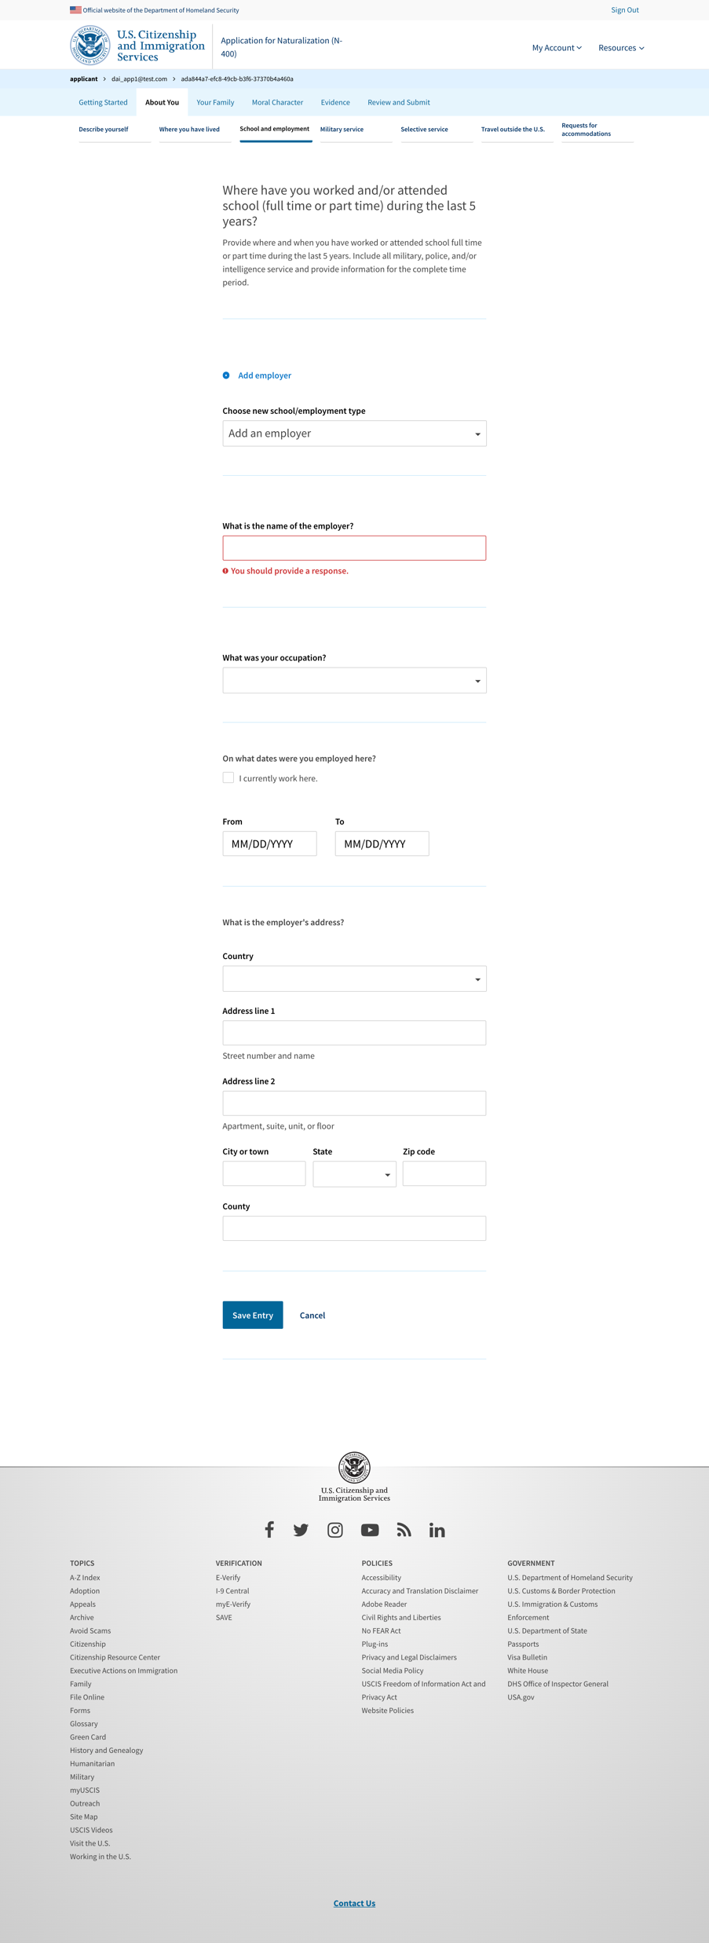
School and employment - add

Slide 22
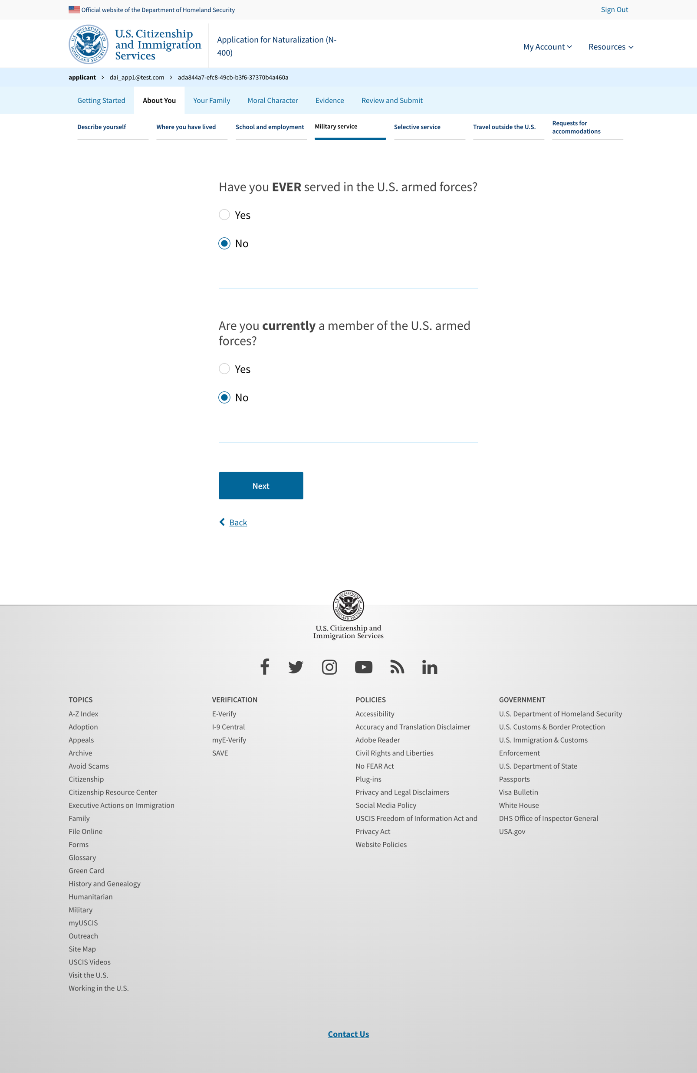
Military service

Slide 23
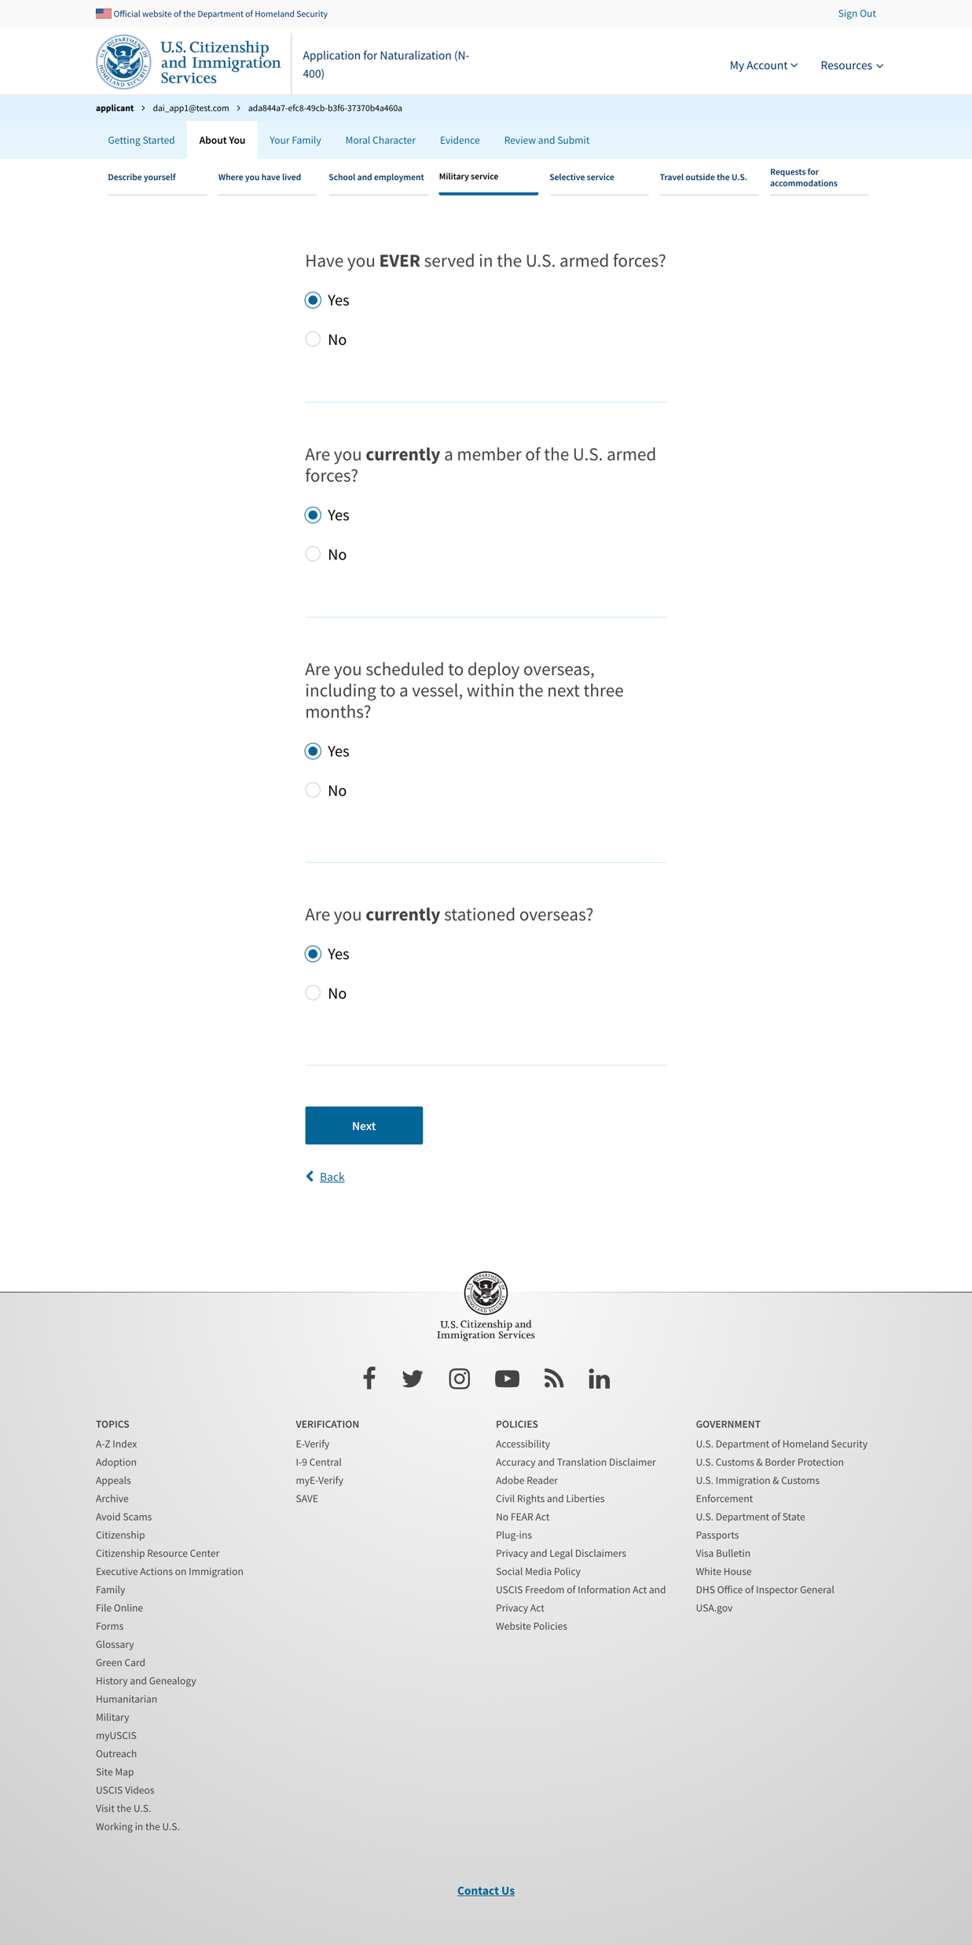
Military service - yes

Slide 24
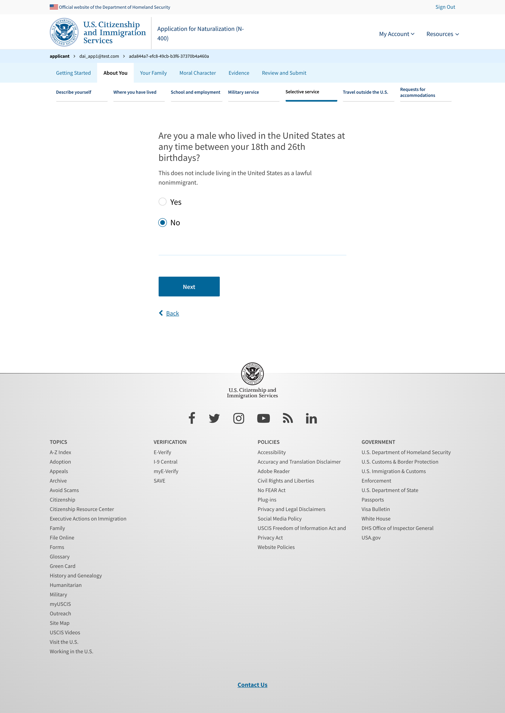
Selective service - no

Slide 25
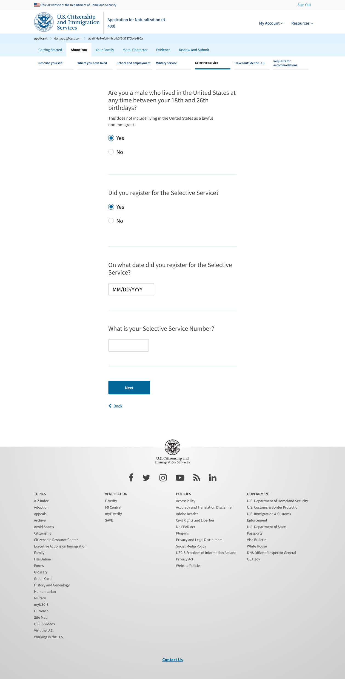
Selective service - yes

Slide 26
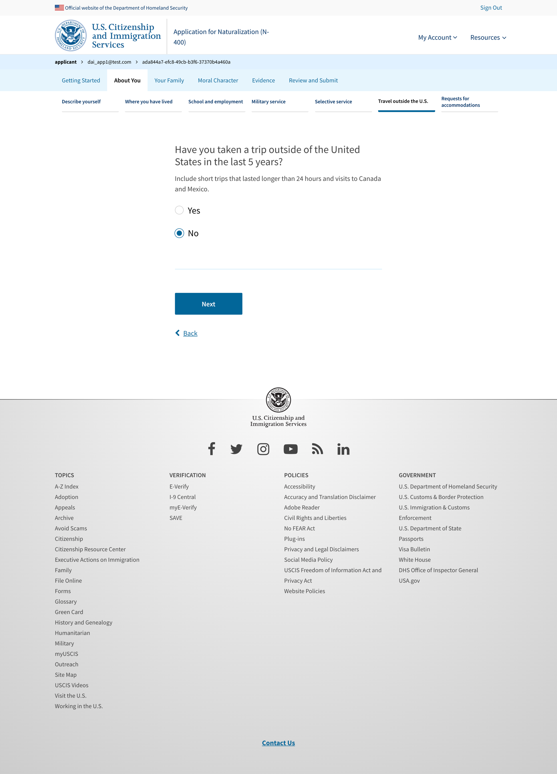
Travel outside US - no

Slide 27
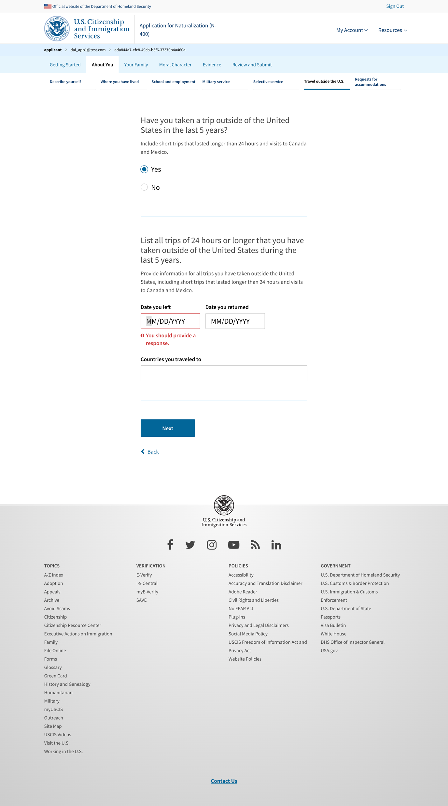
Travel outside US - yes

