Slide 1

N-400 Application for Naturalization
Part 3 of 4
United States Citizenship and Immigration Services
myUSCIS Team

Slide 2
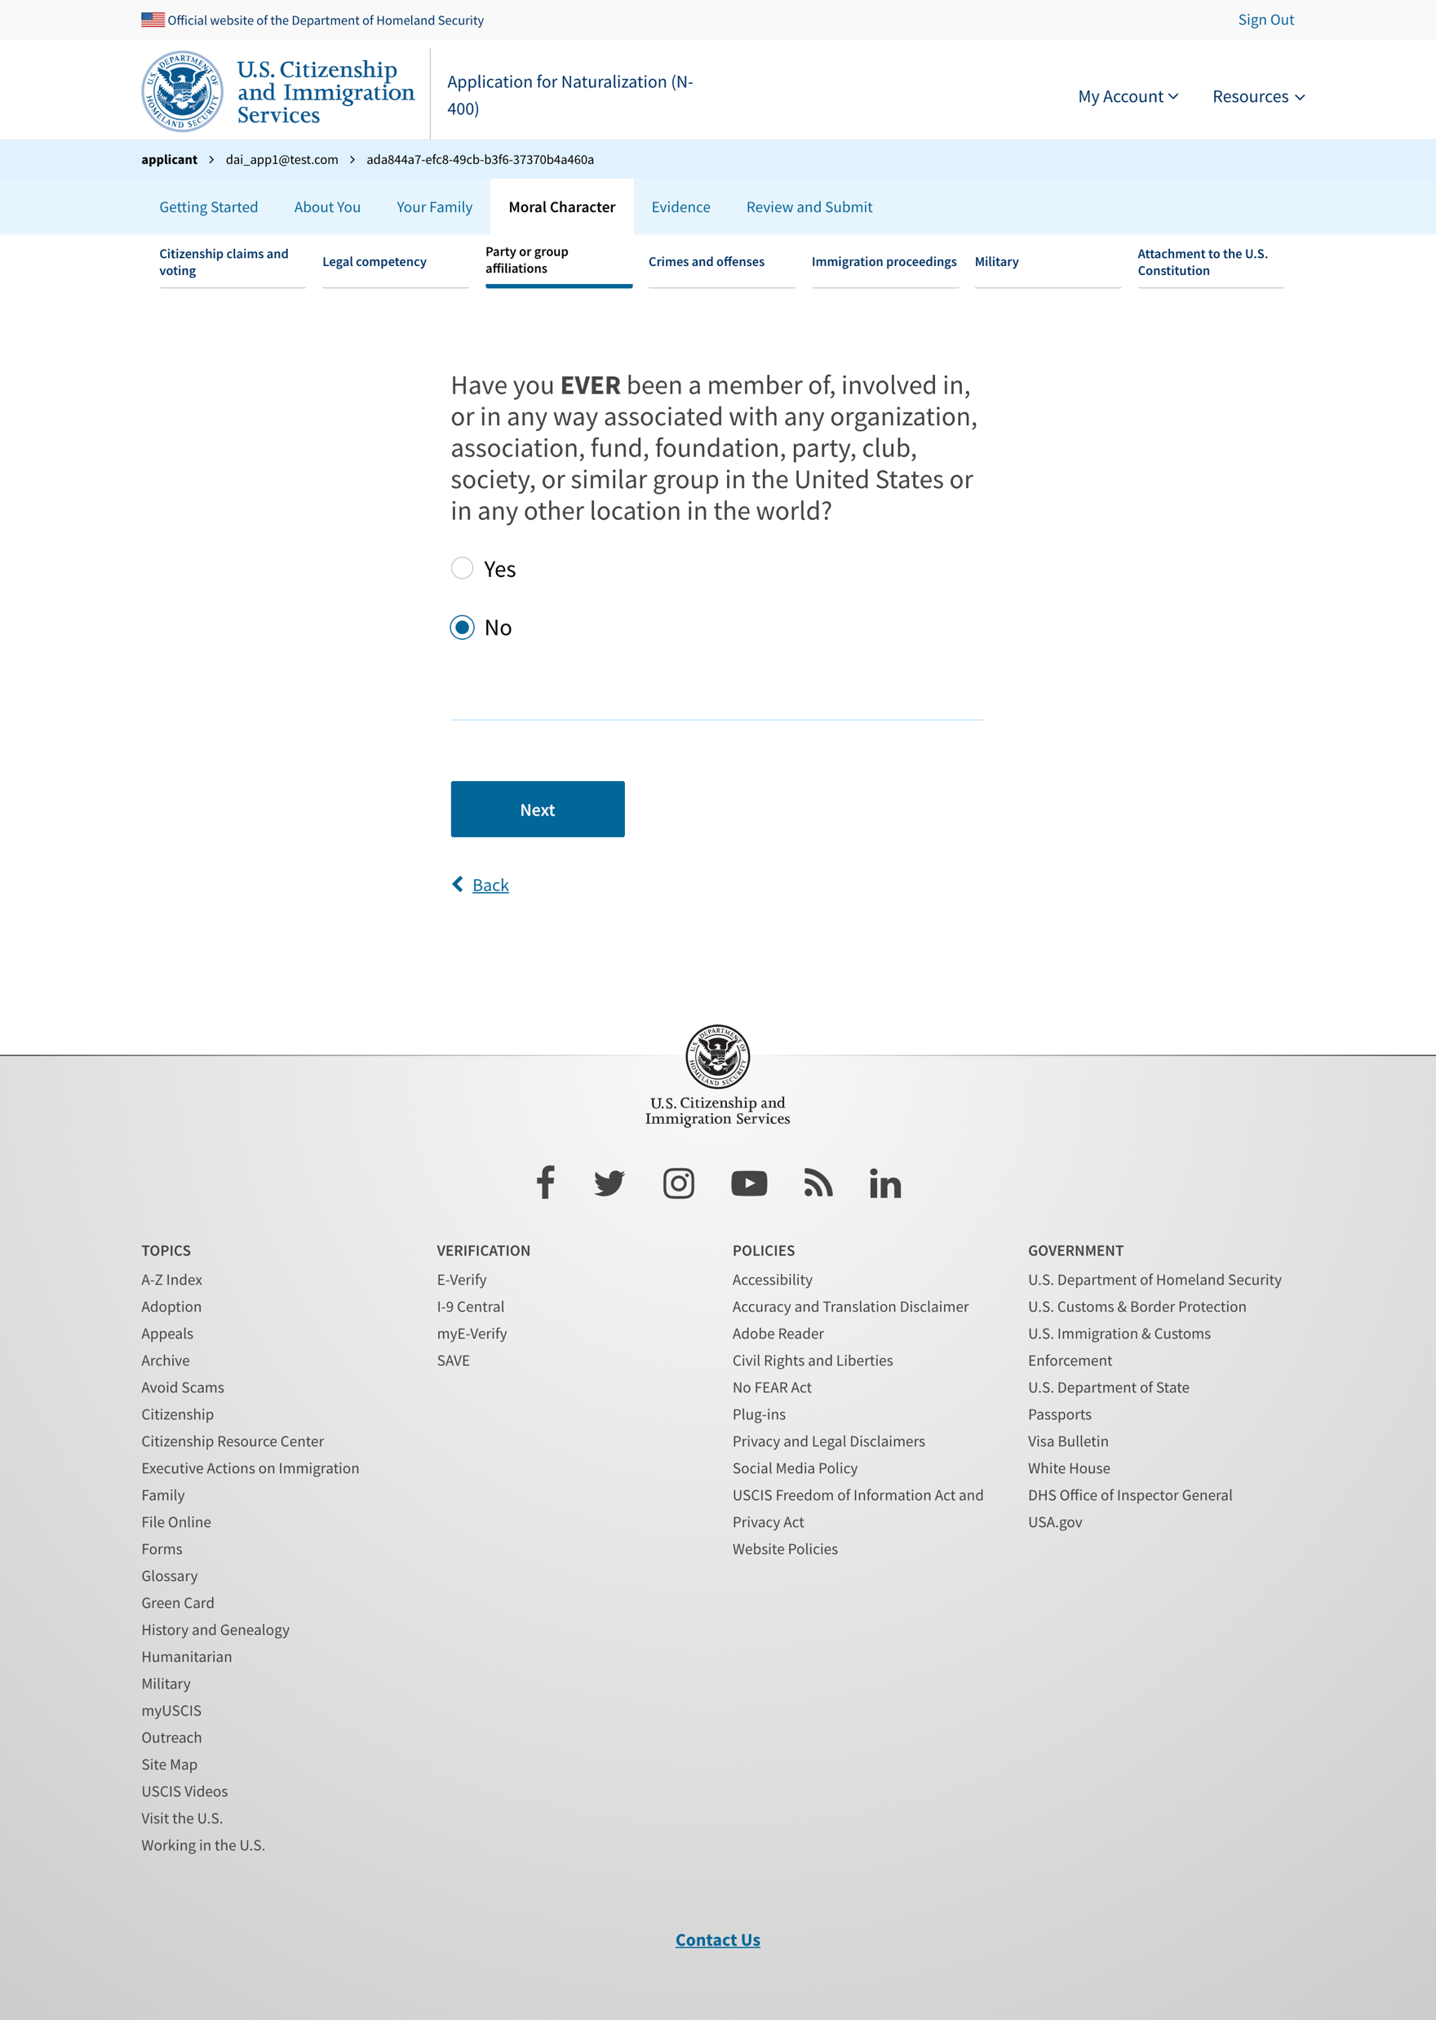
Party or group affiliations - no

Slide 3
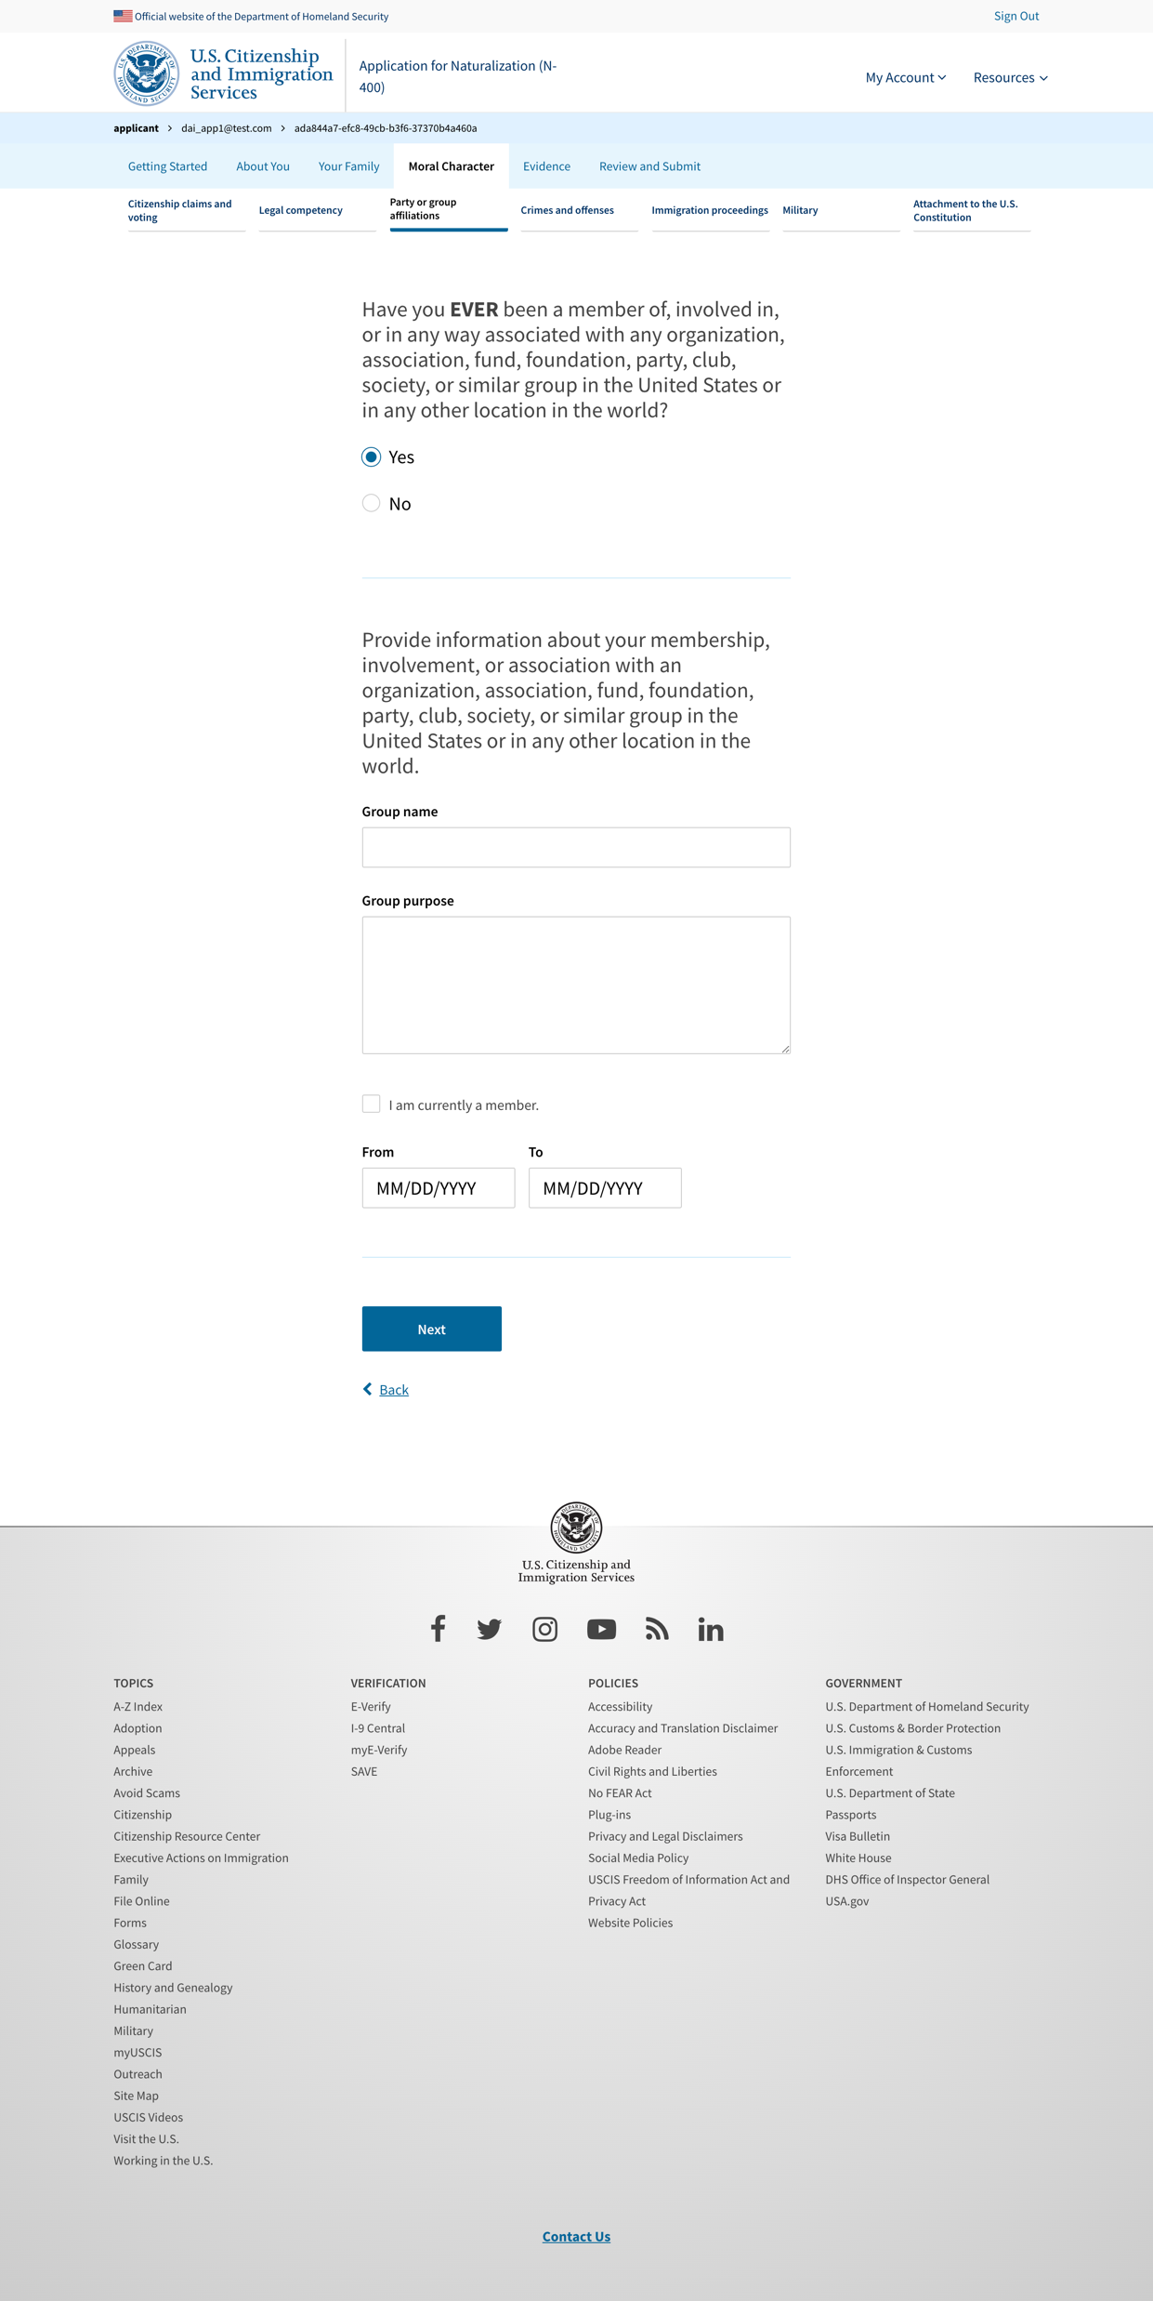
Party or group affiliations - questions

Slide 4
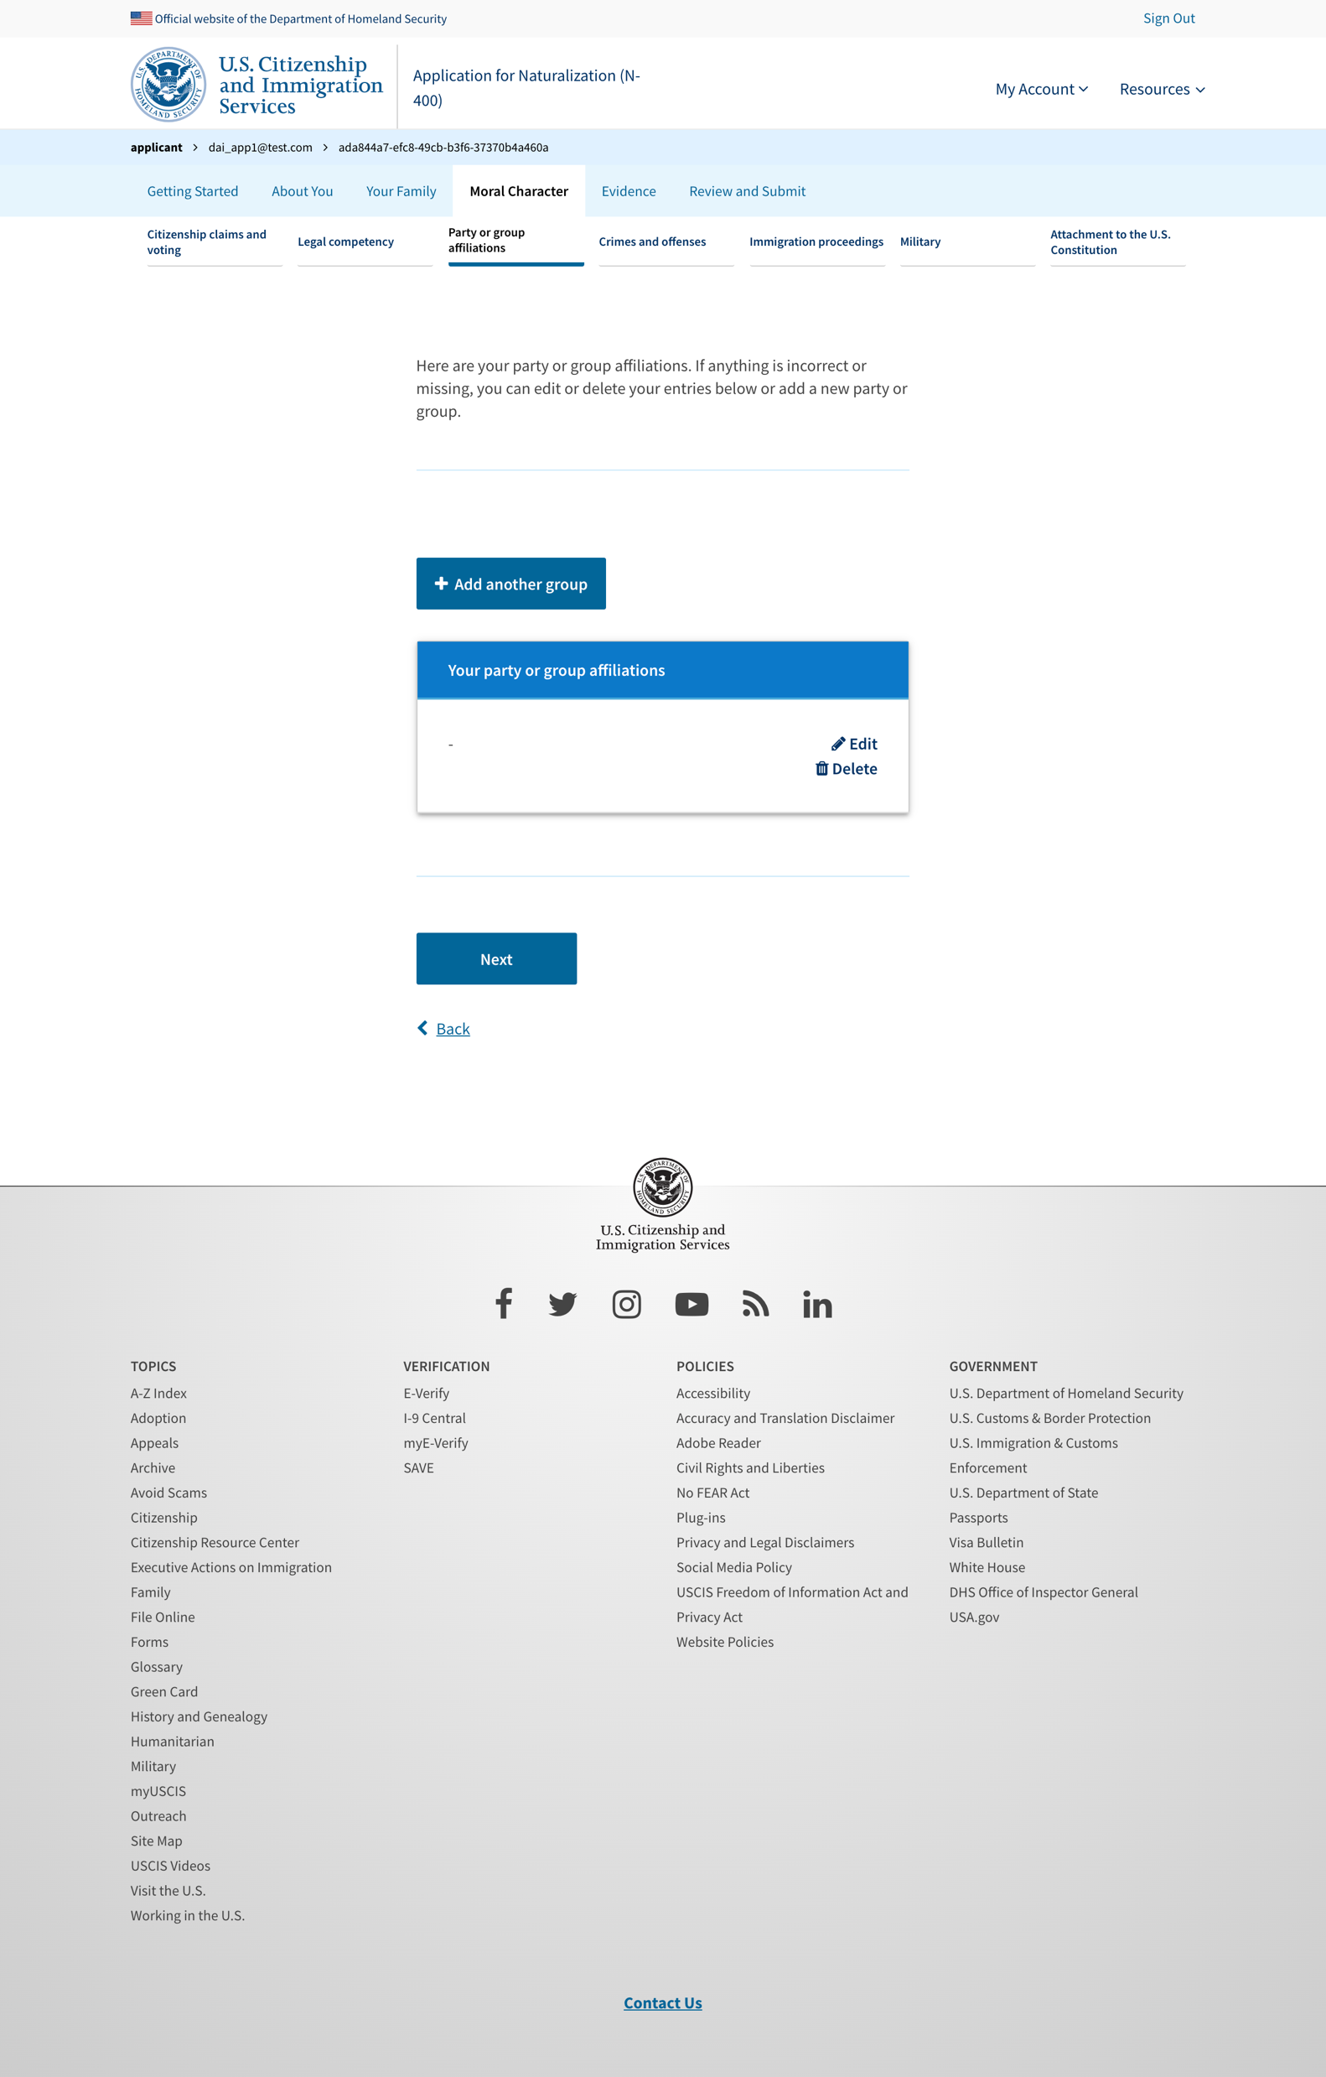
Party or group affiliations - table

Slide 5
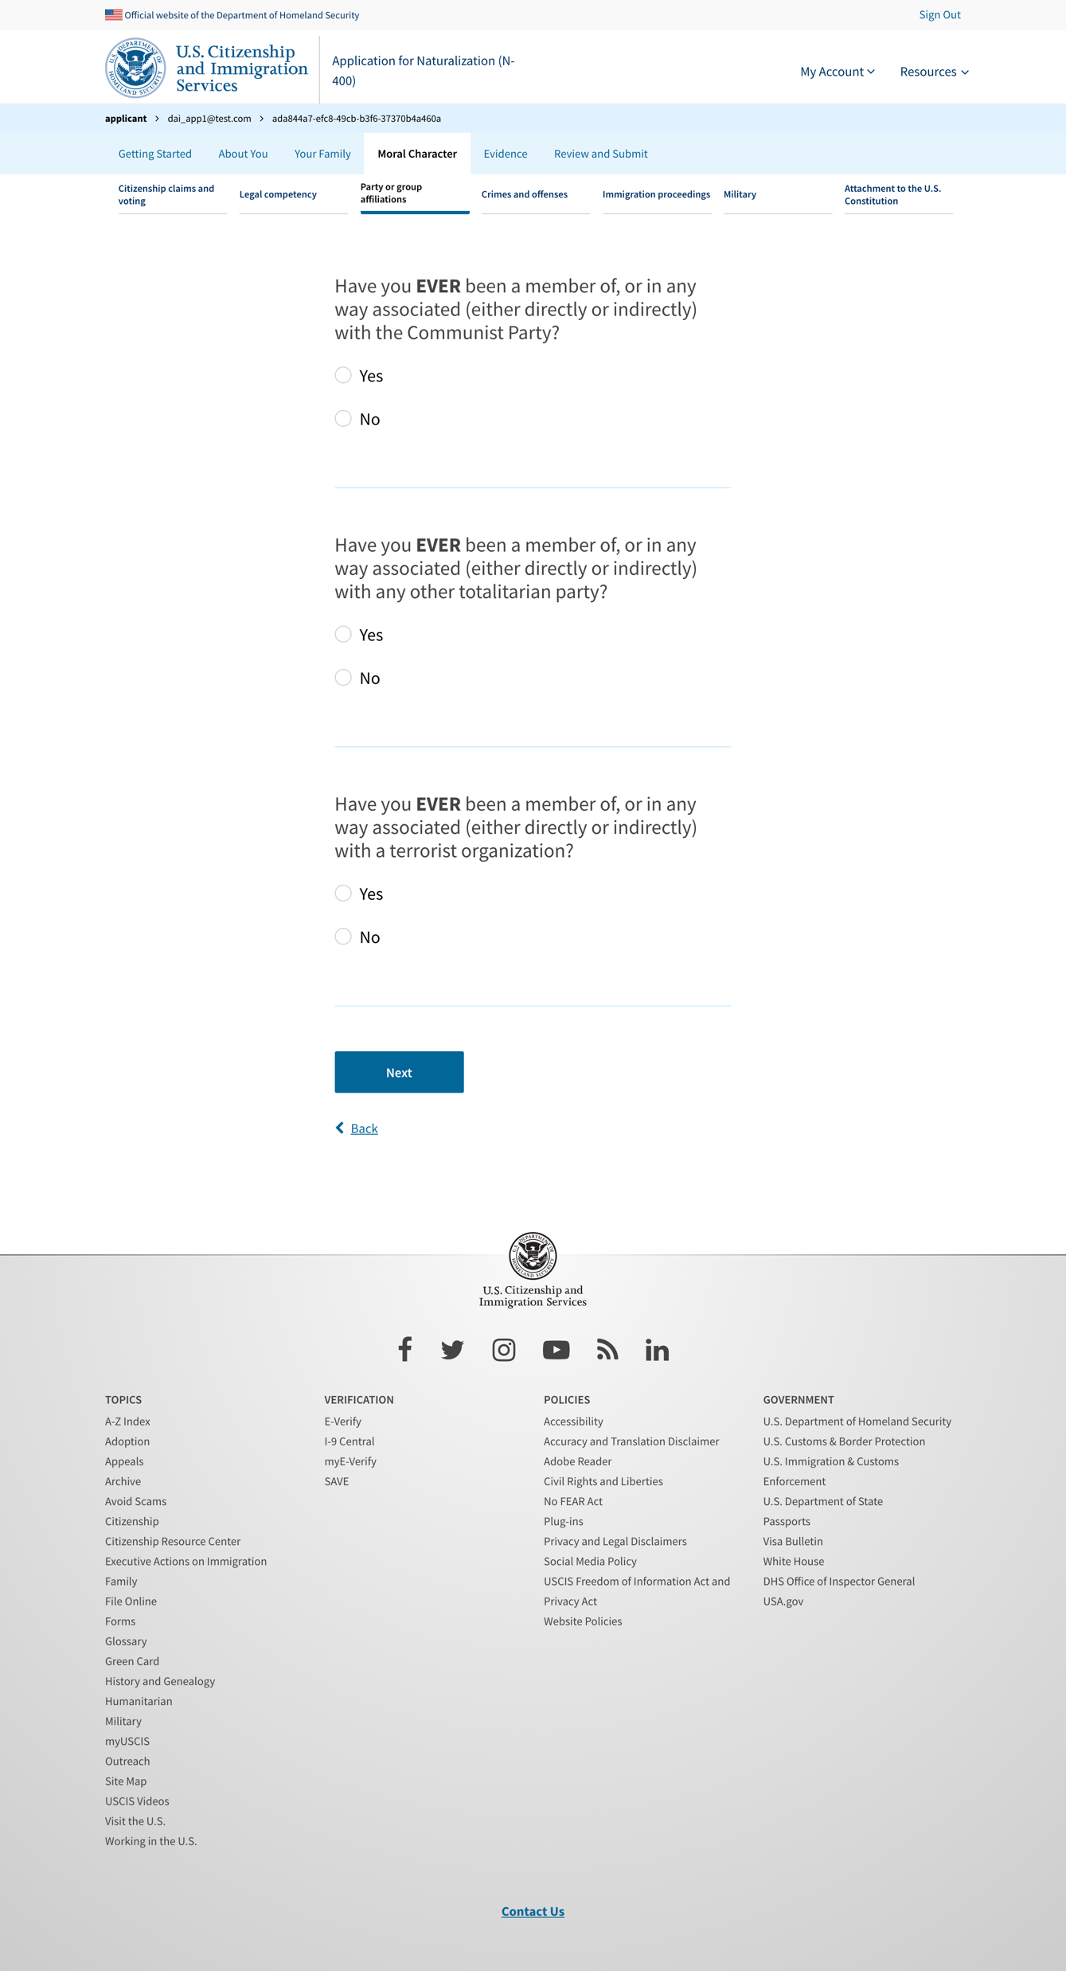
Party or group affiliations - questions

Slide 6
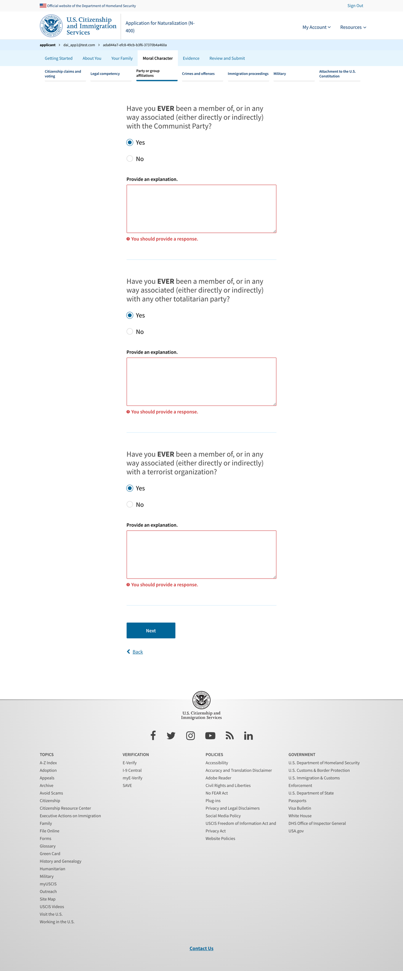
Party or group affiliations - exposed explanation

Slide 7
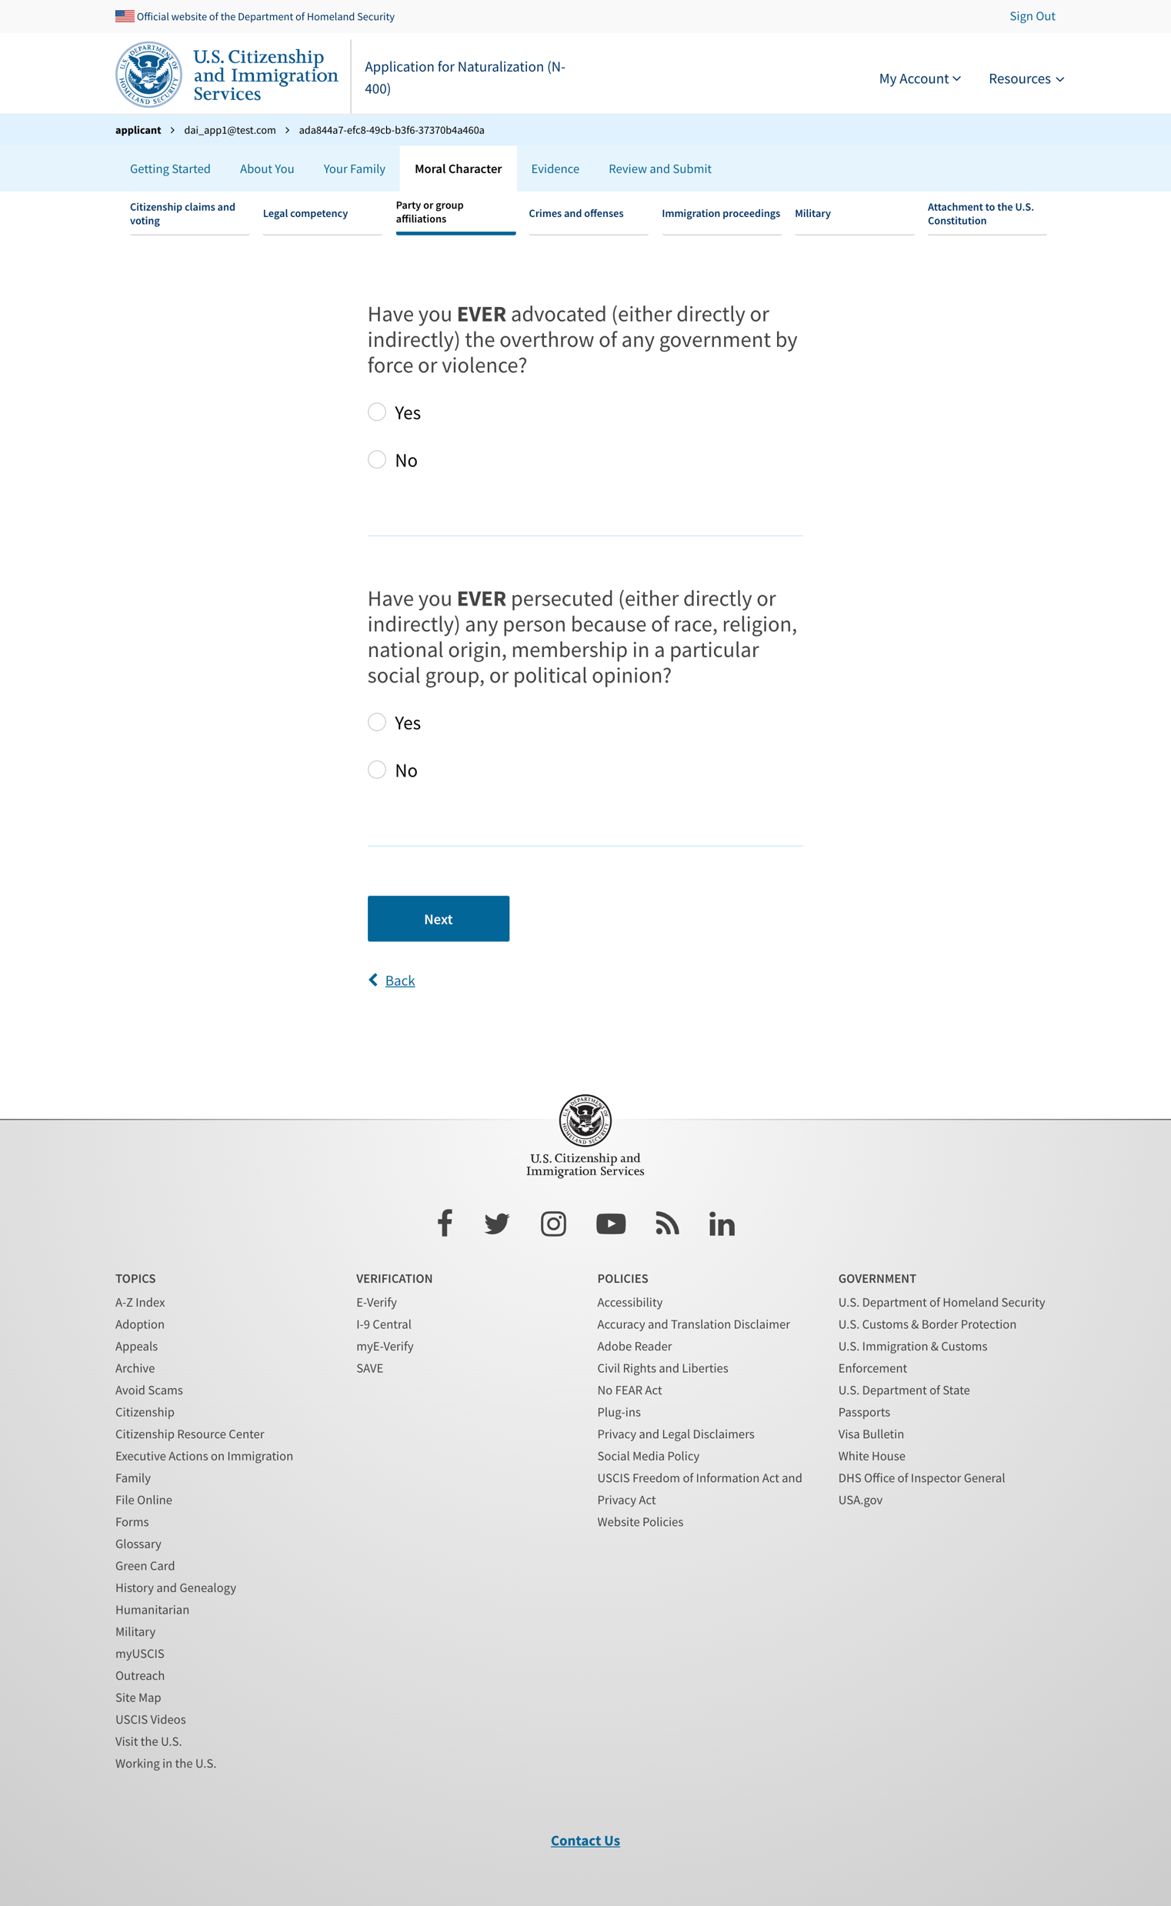
Party or group affiliations 3

Slide 8
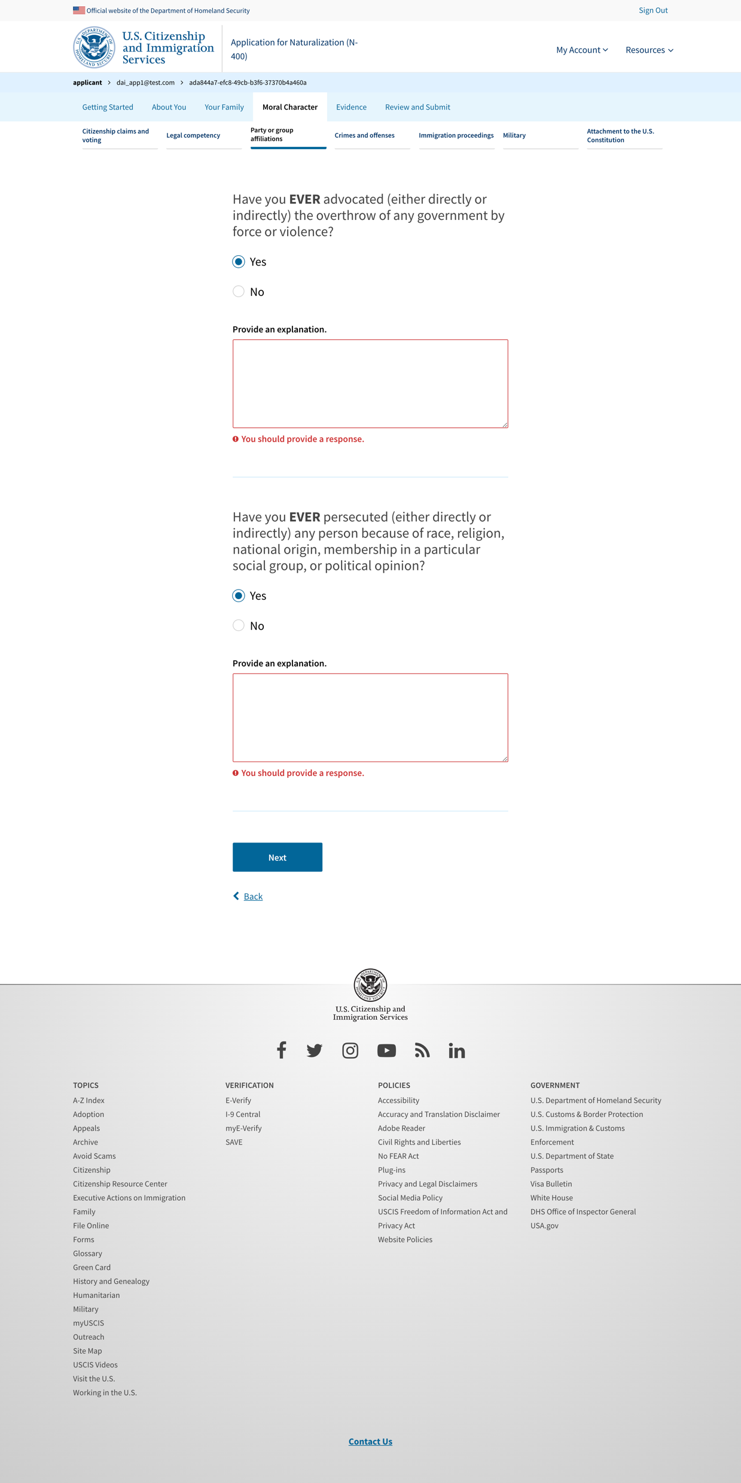
Party or group affiliations 3 - exposed explanation

Slide 9
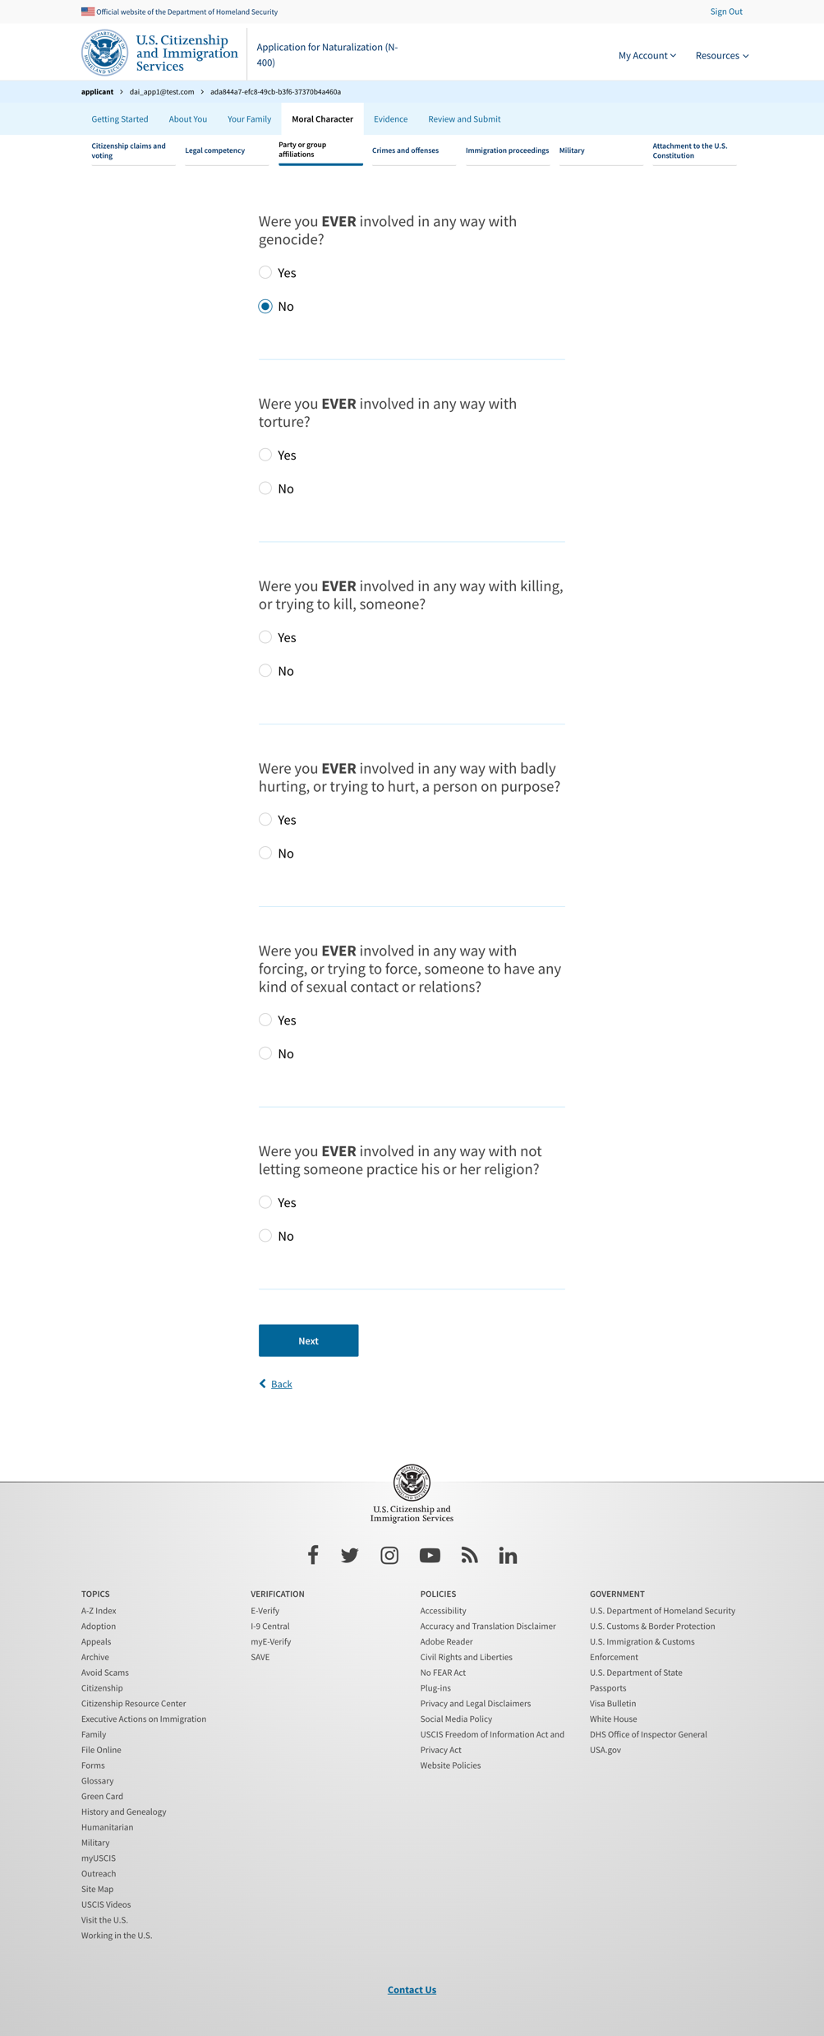
Party or group affiliations 4

Slide 10
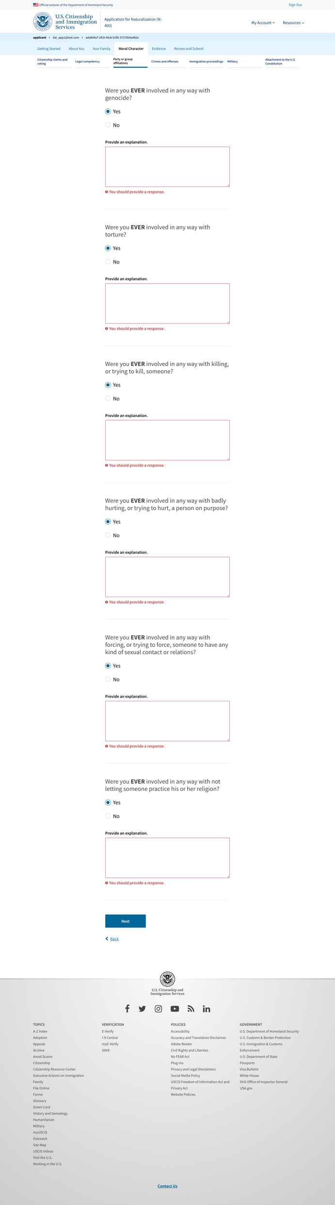
Party or group affiliations 4 - exposed explanation

Slide 11
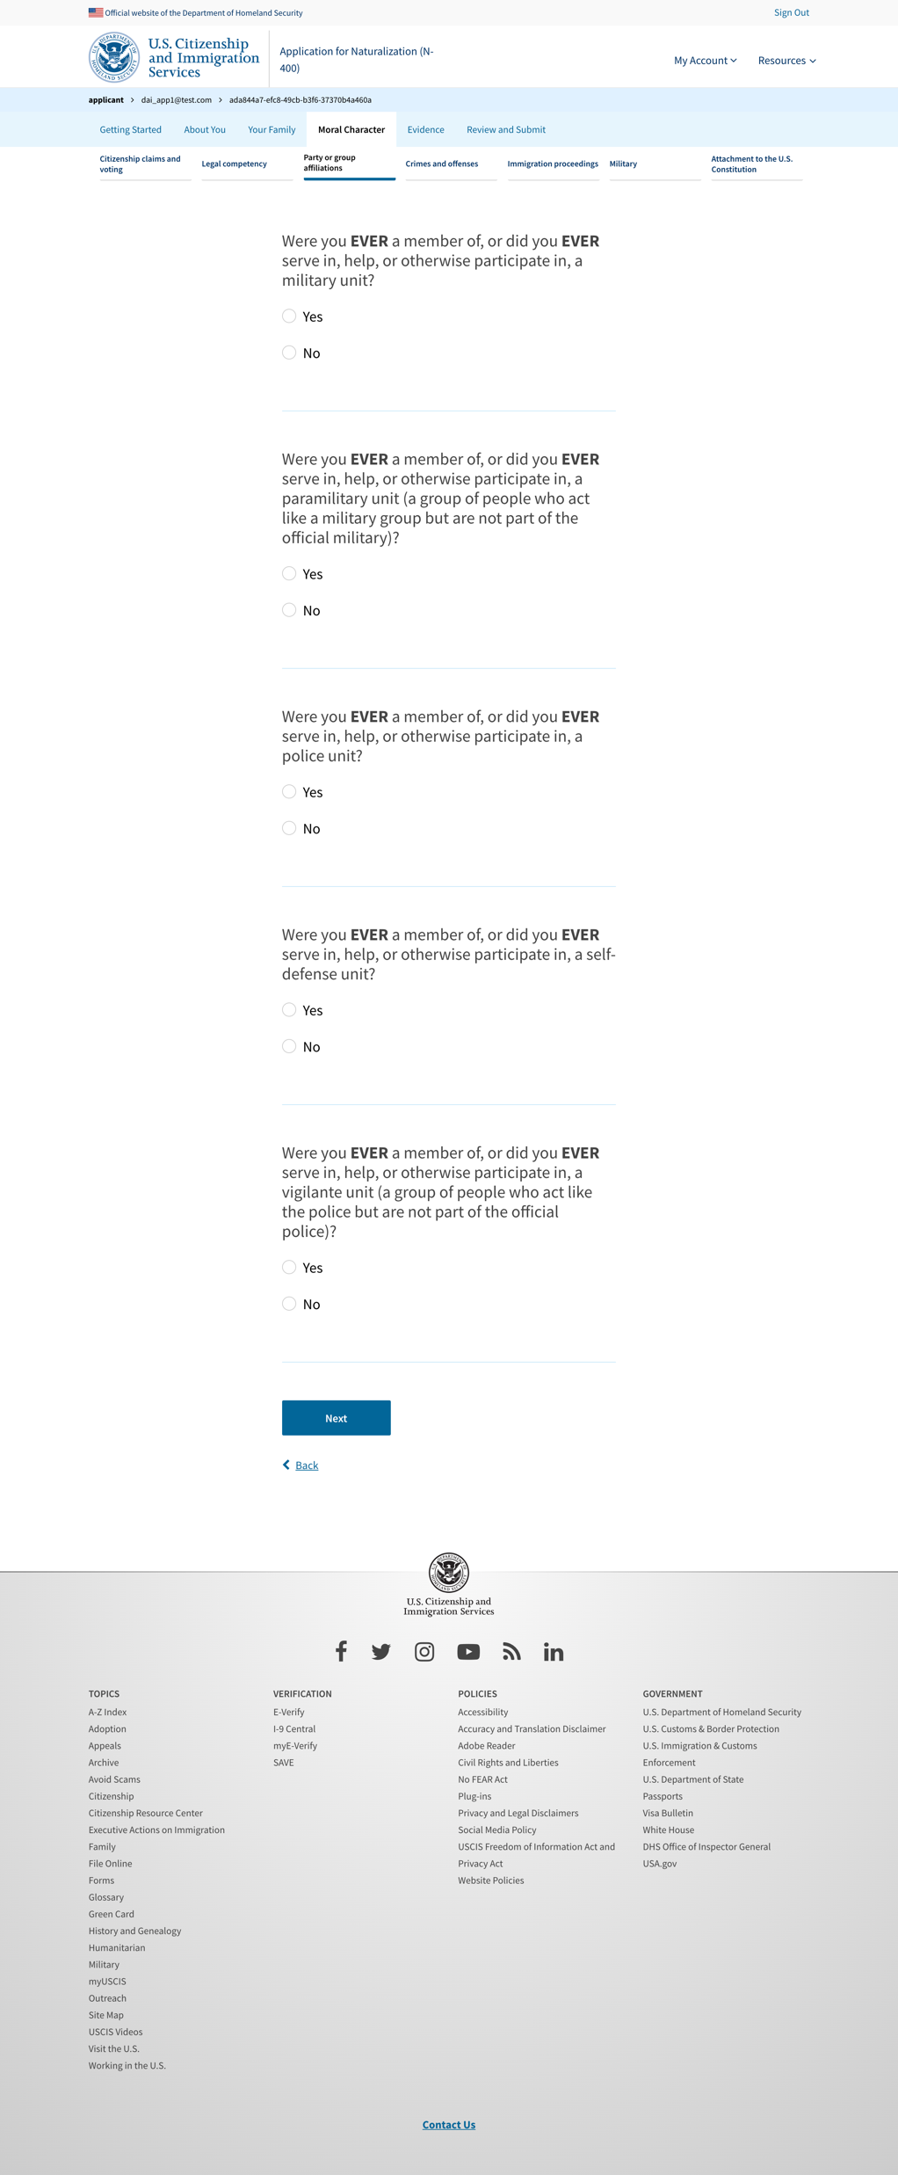
Party or group affiliations 5

Slide 12
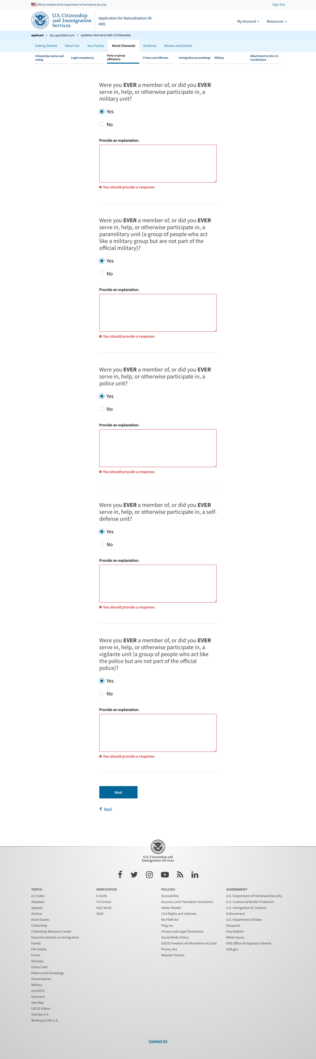
Party or group affiliations 5 - exposed explanation

Slide 13
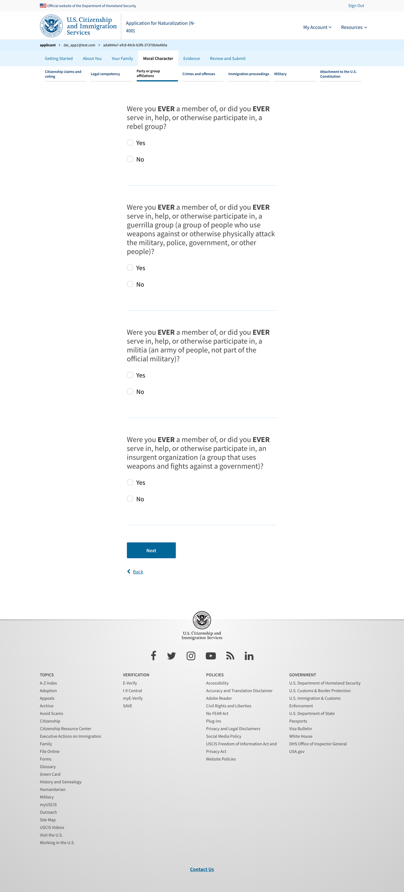
Party or group affiliations 6

Slide 14
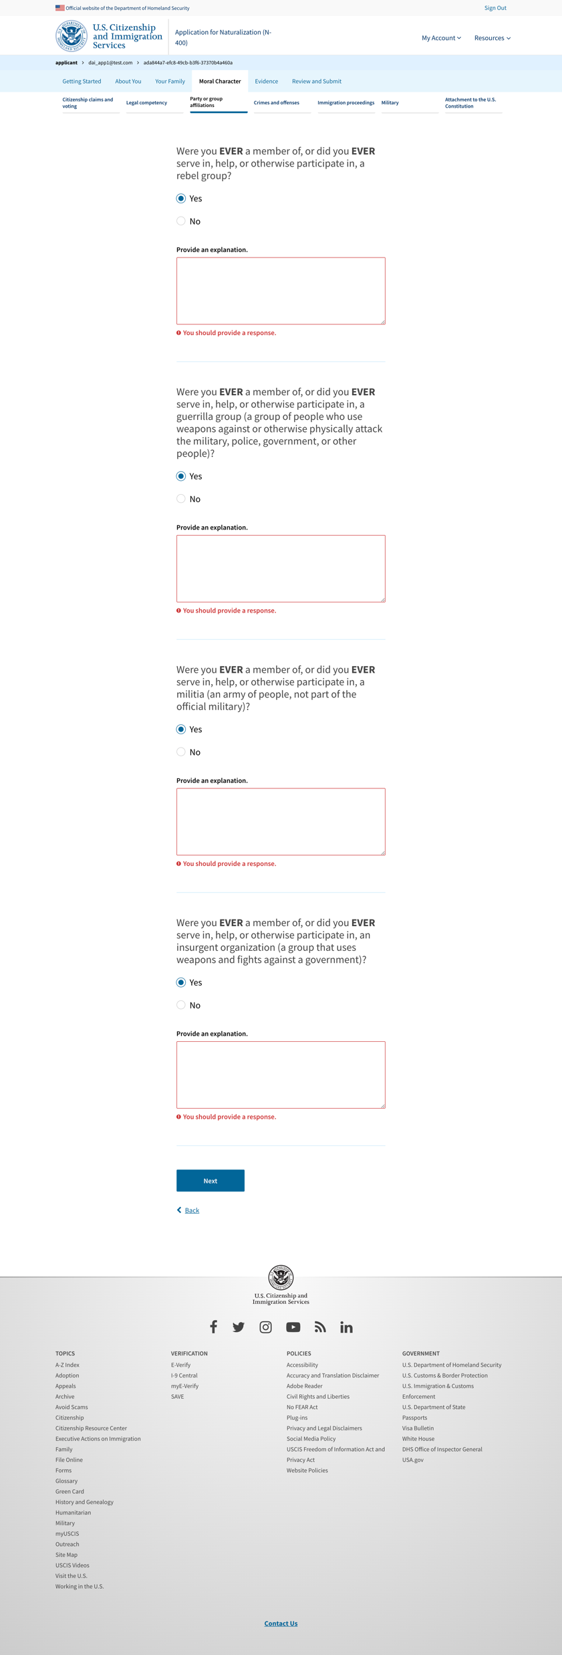
Party or group affiliations 6 - exposed explanation

Slide 15
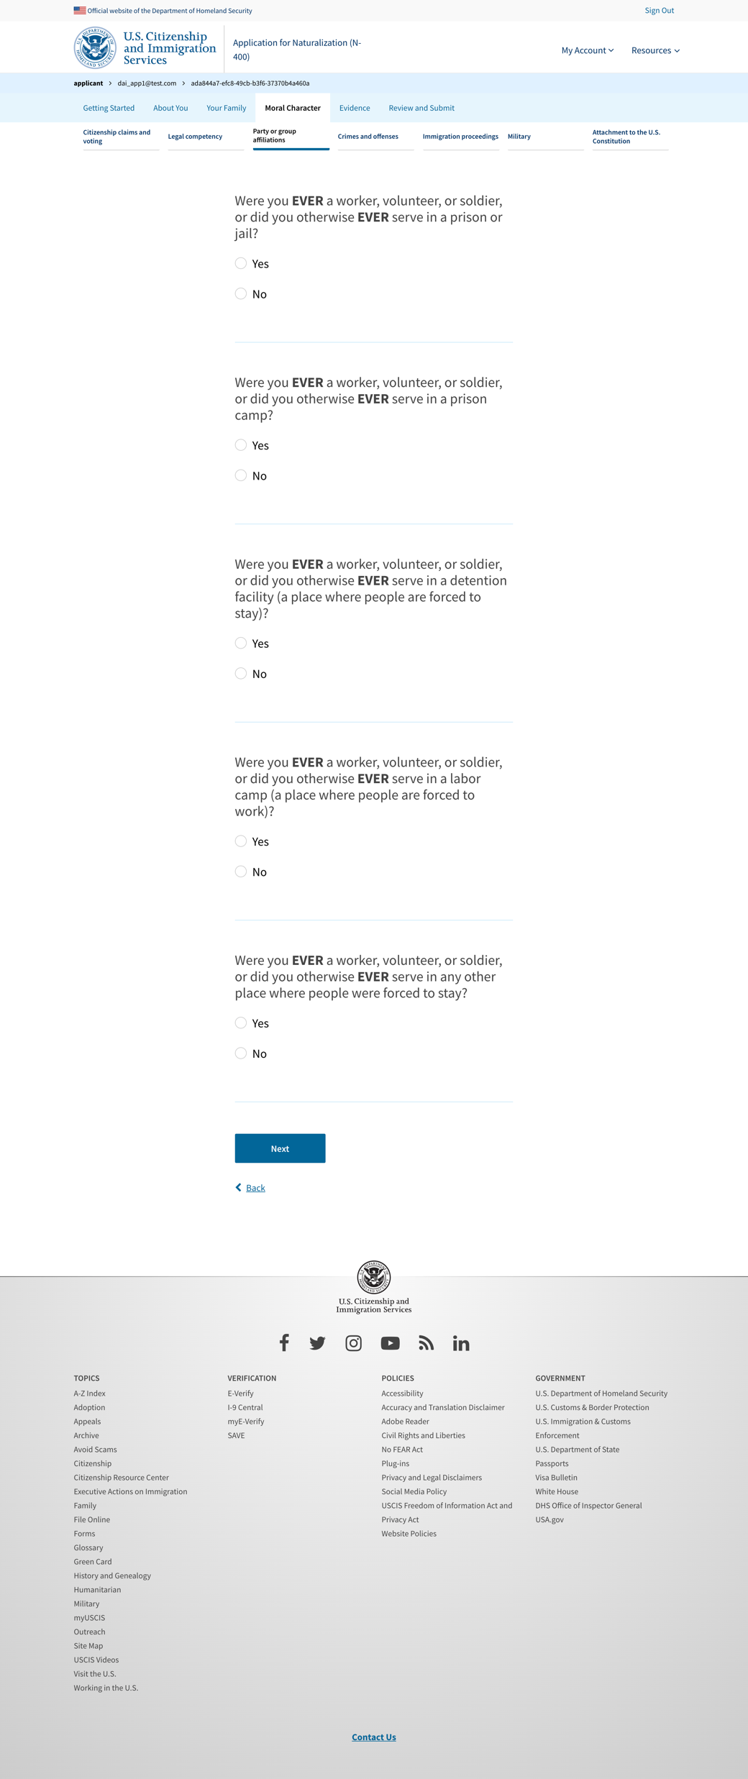
Party or group affiliations 7

Slide 16
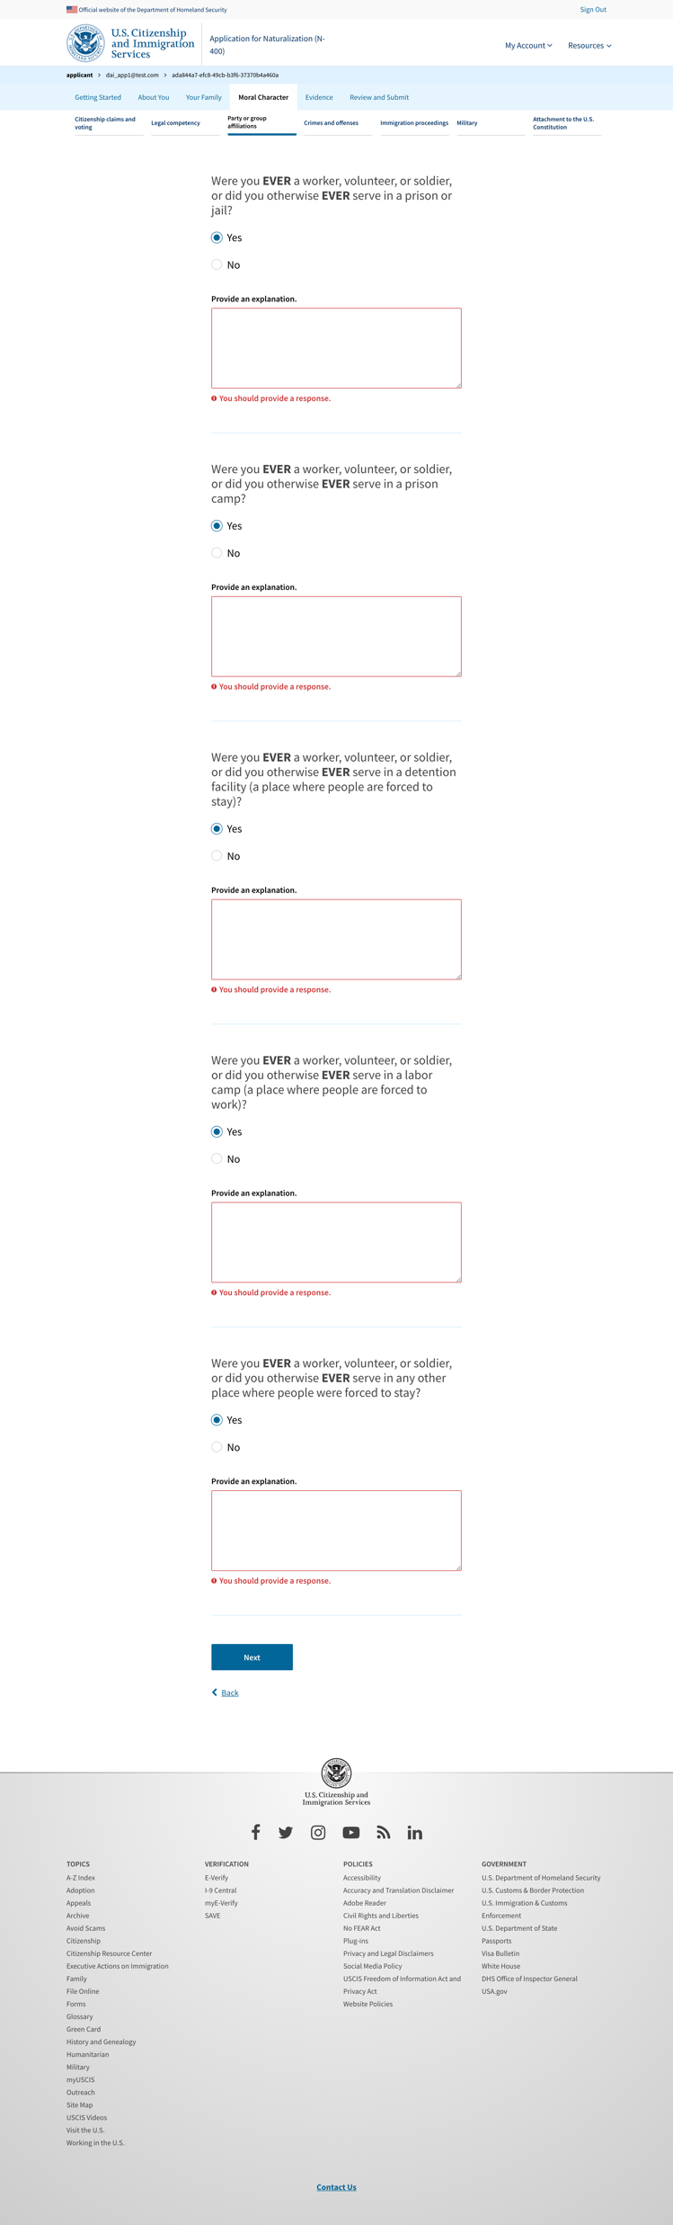
Party or group affiliations 7 - exposed explanation

Slide 17
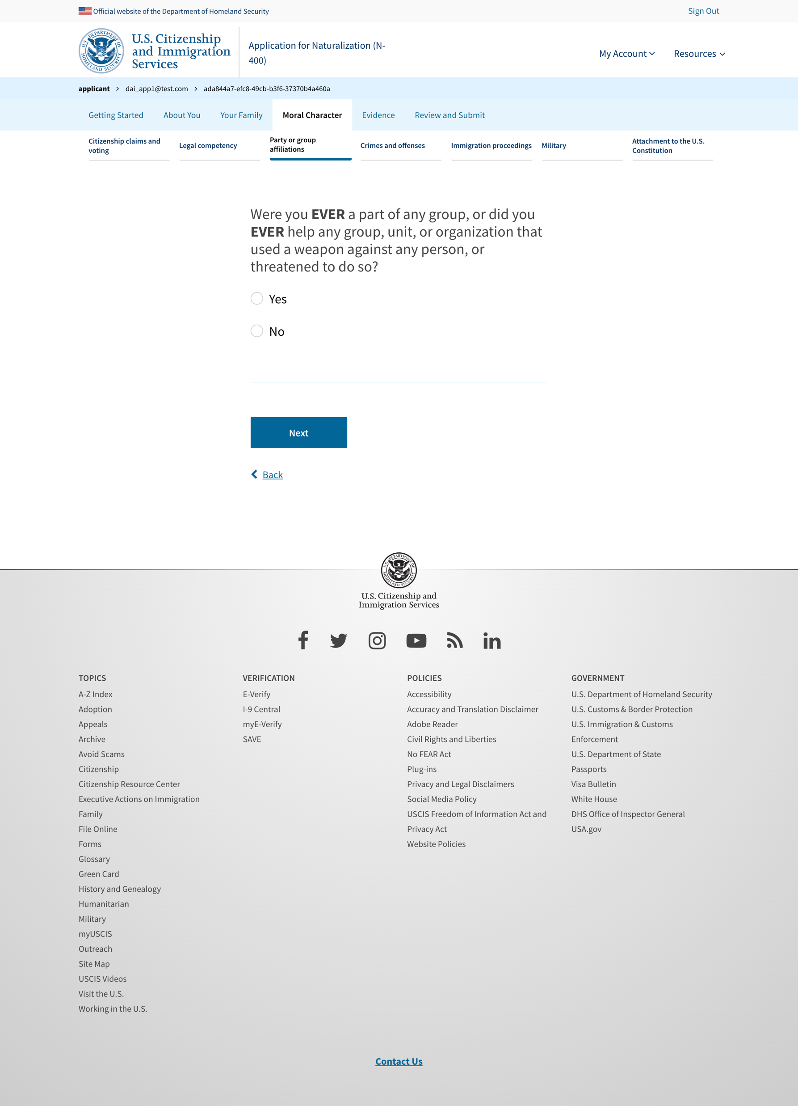
Party or group affiliations 8

Slide 18
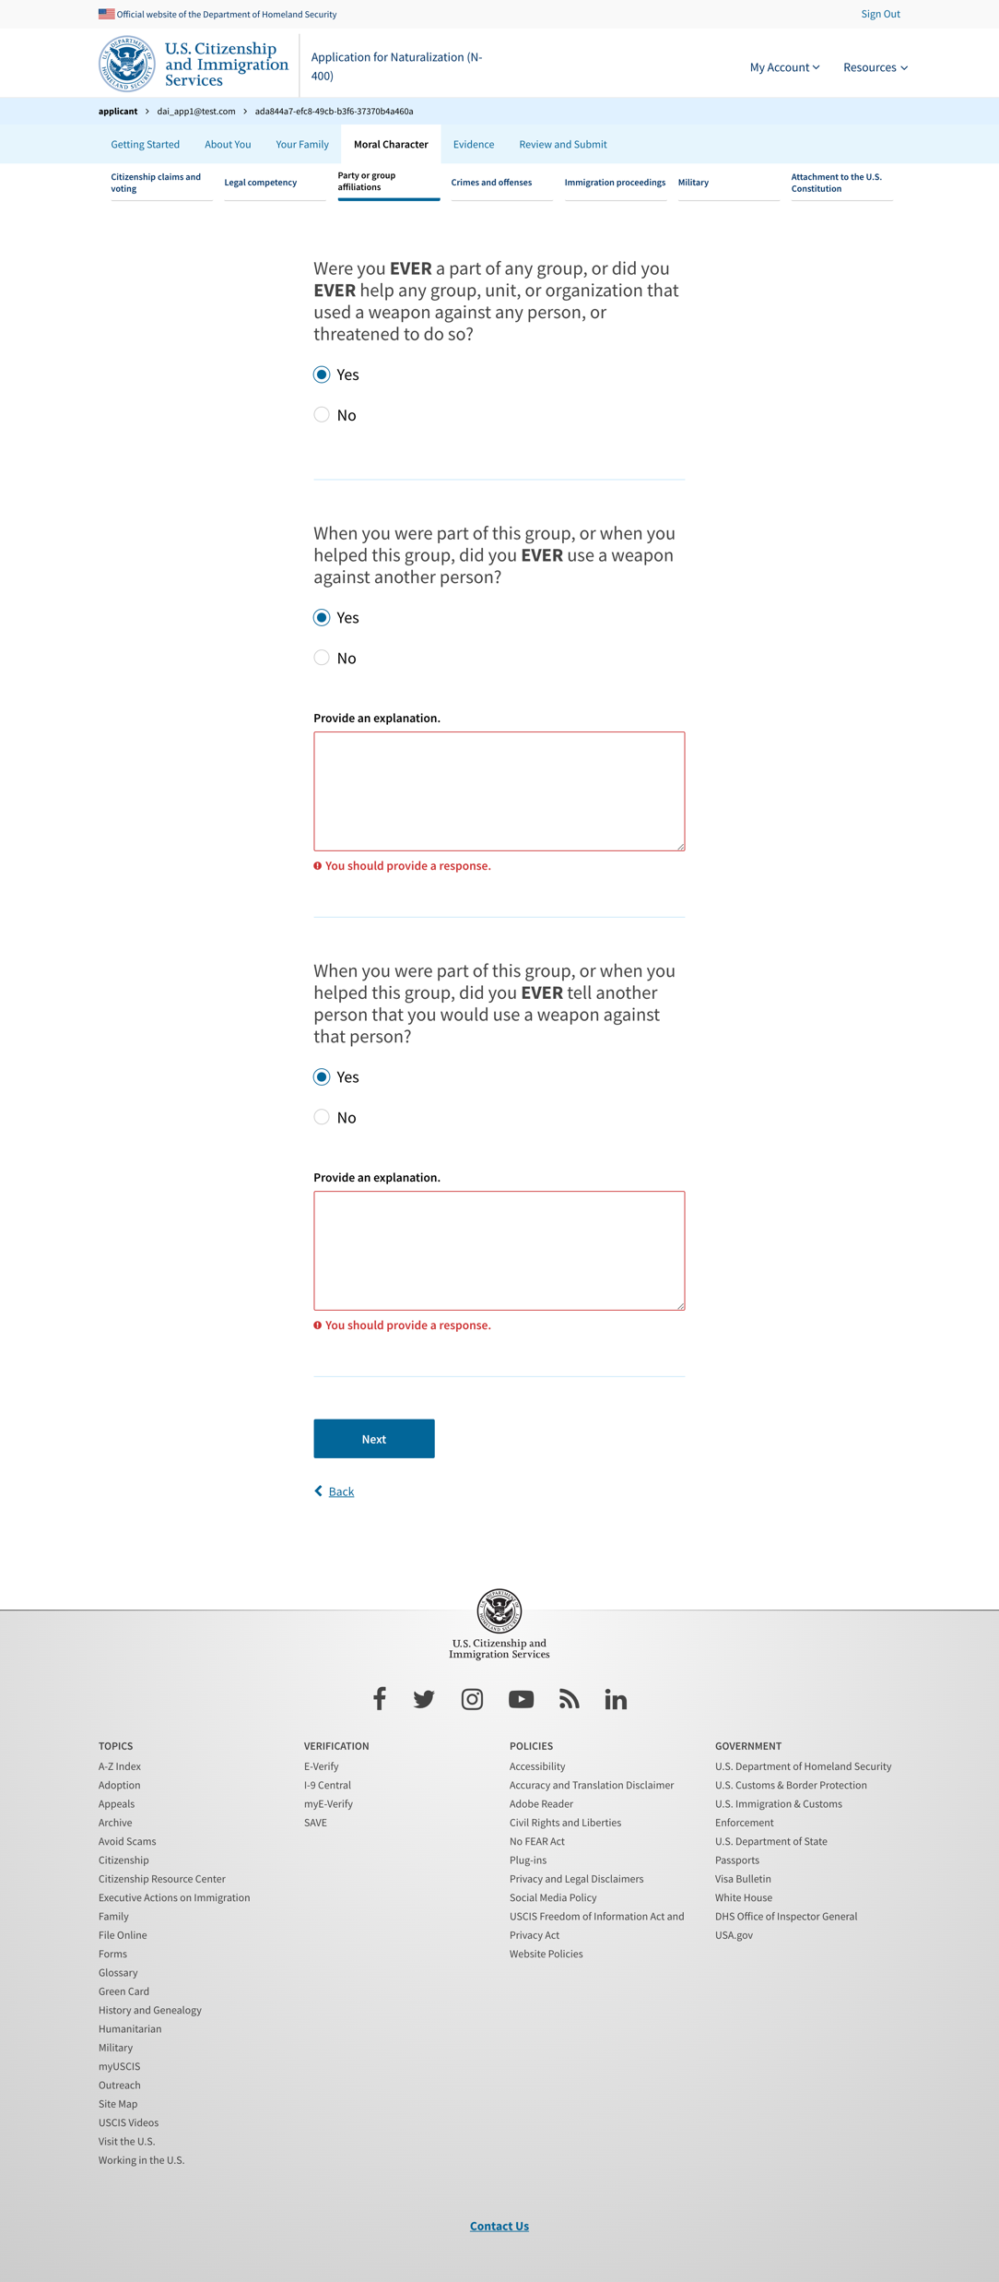
Party or group affiliations 8 - exposed explanation

Slide 19
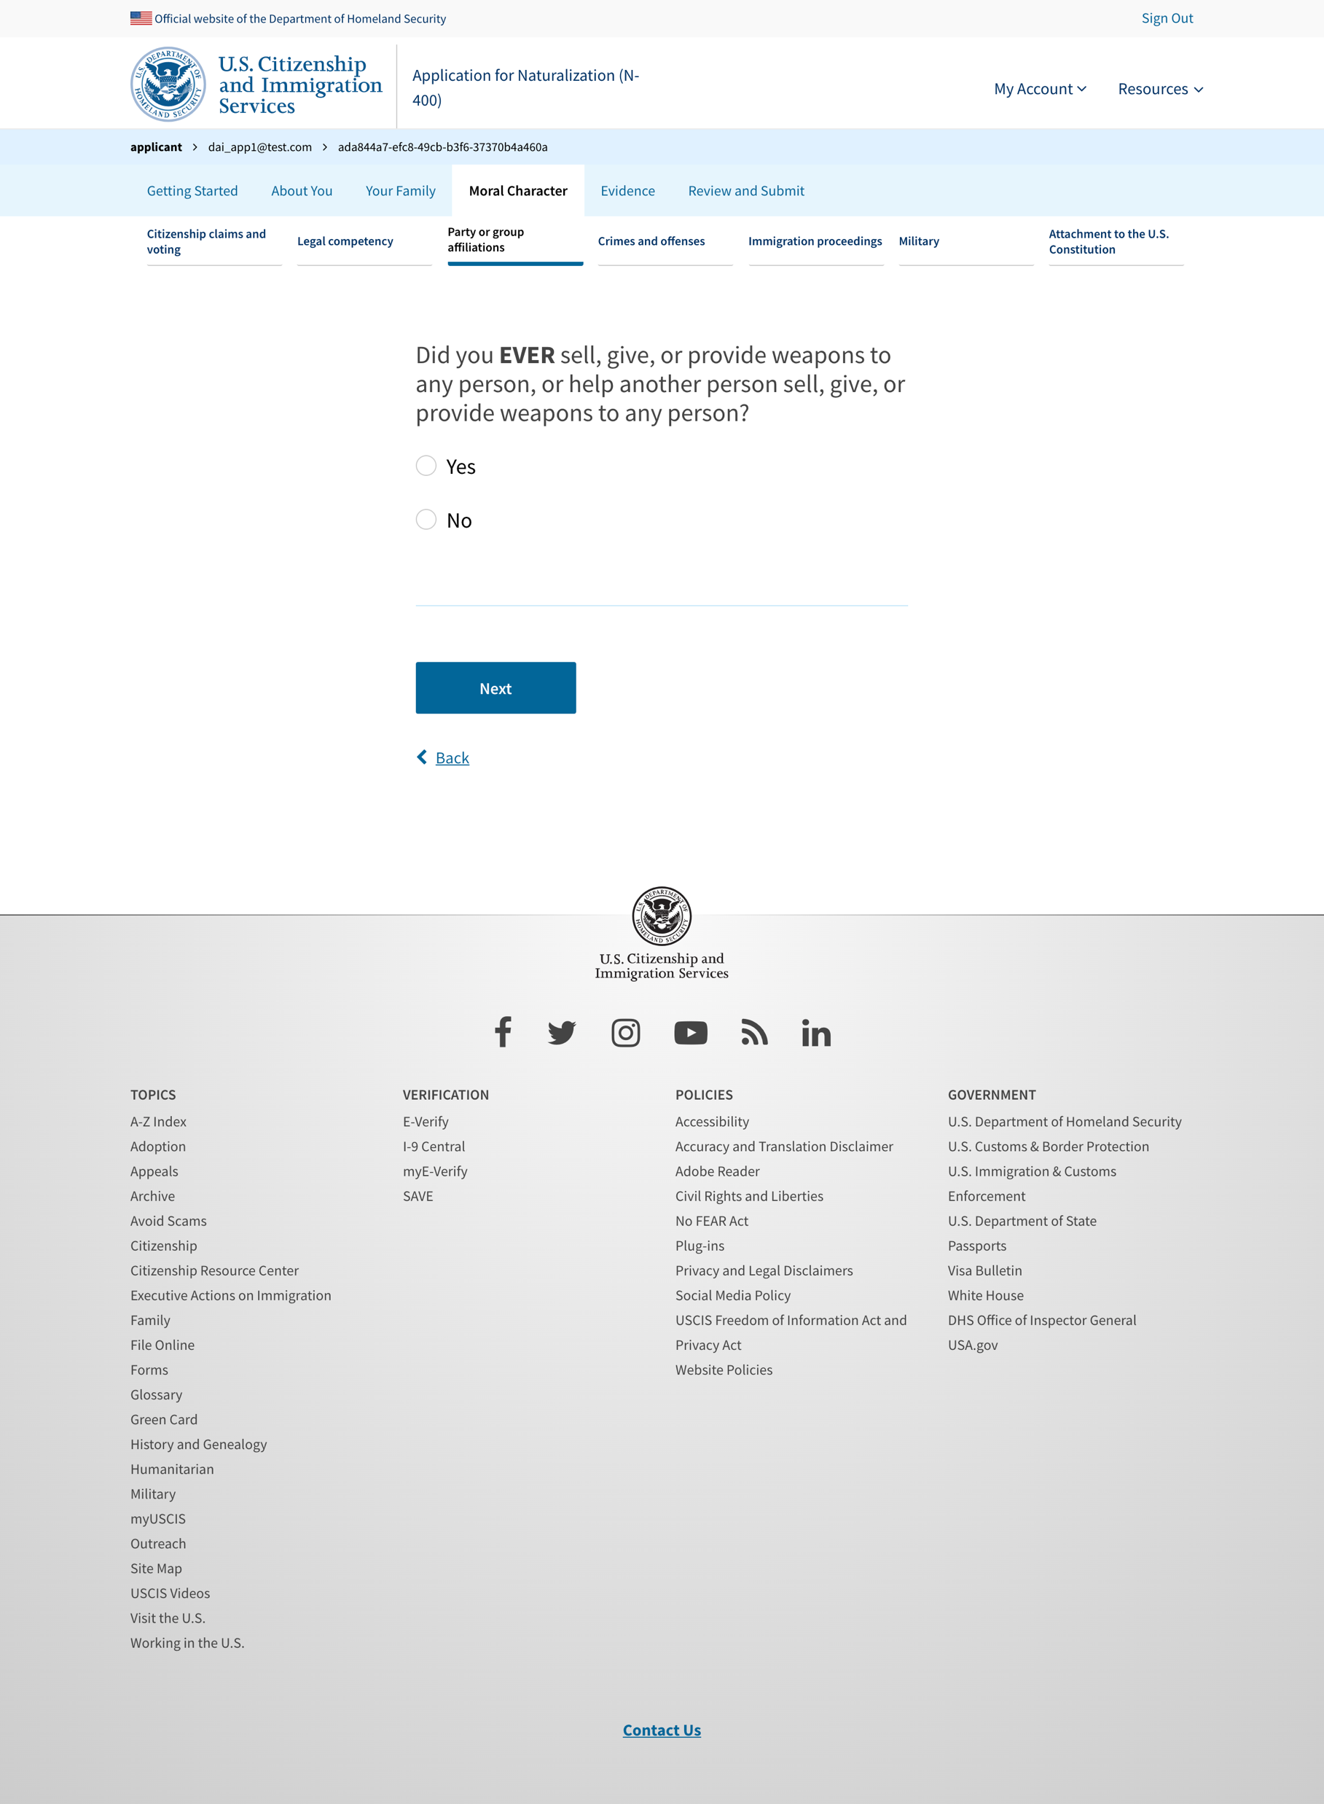
Party or group affiliations 9

Slide 20
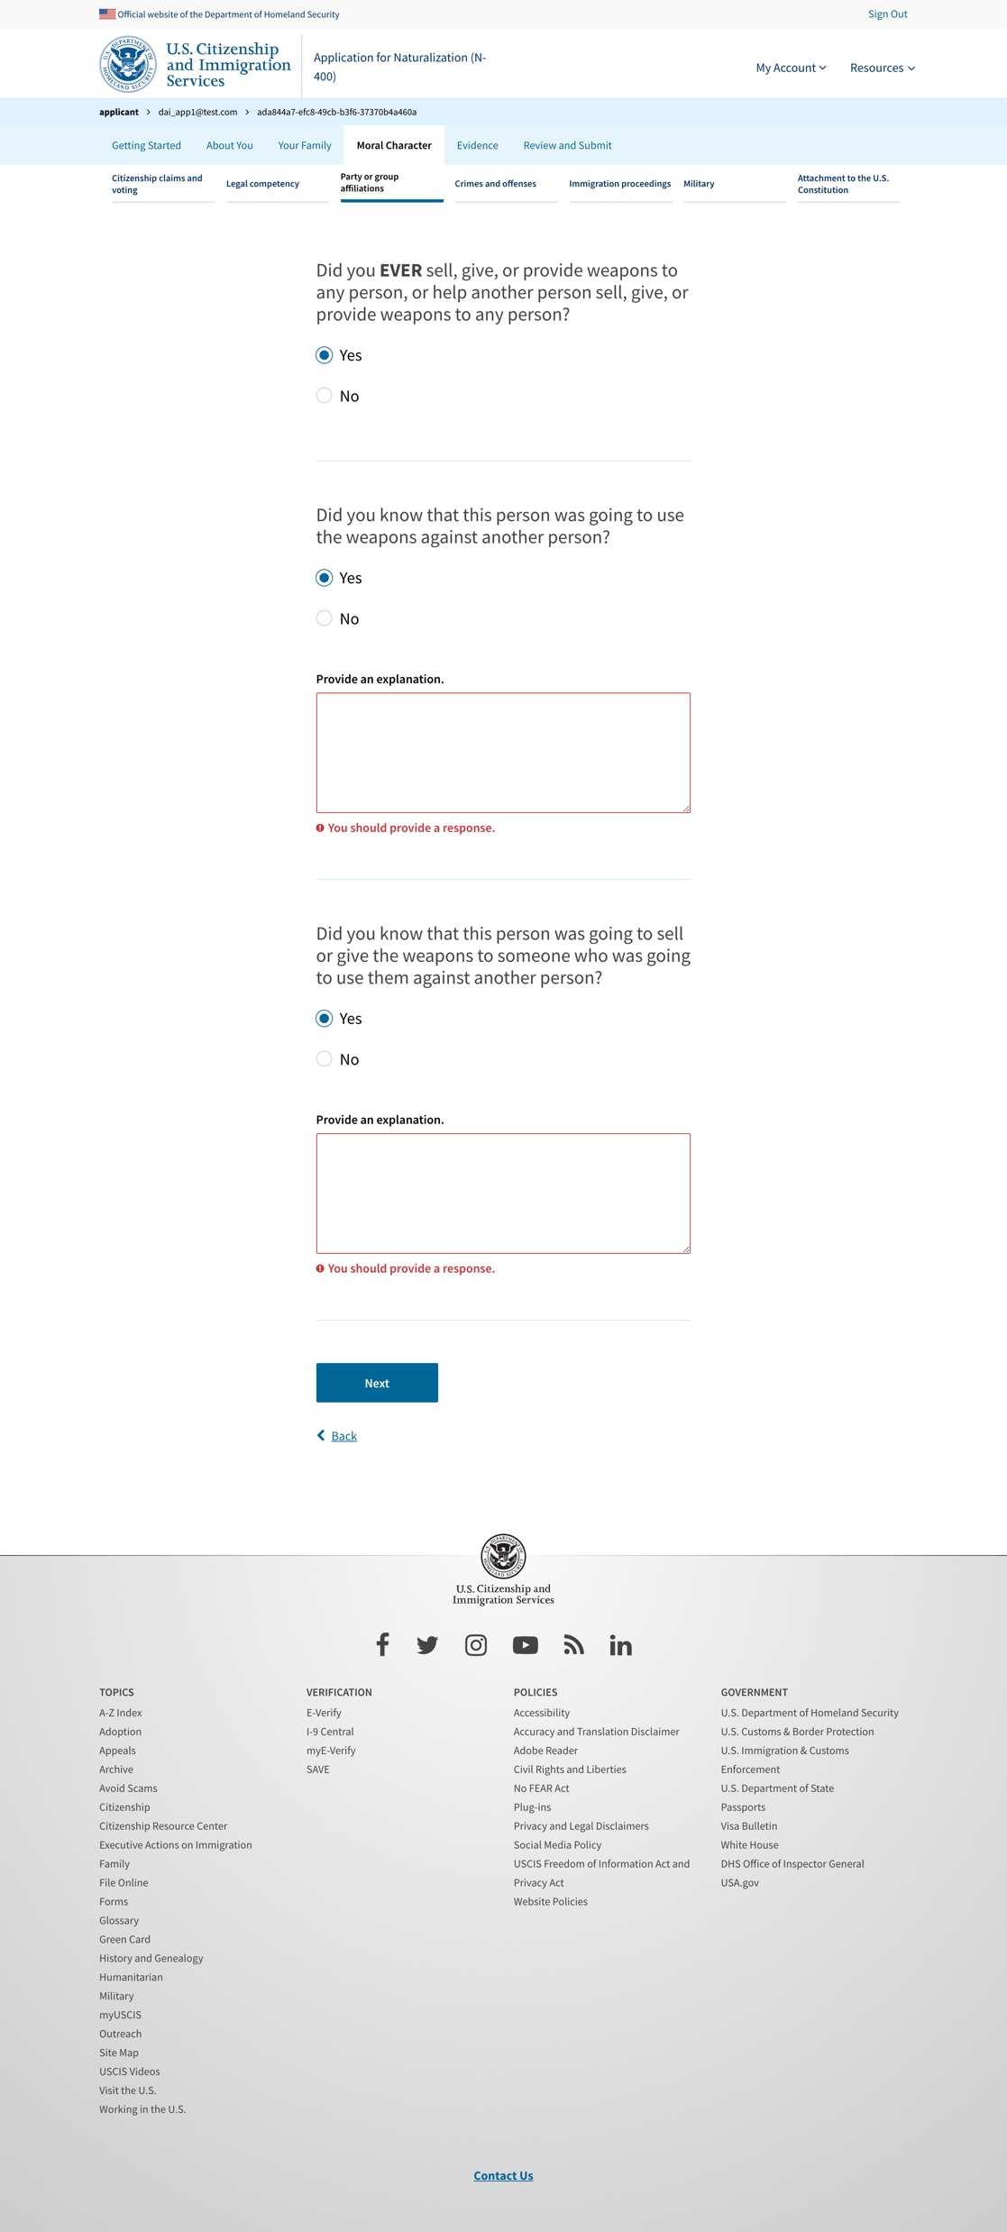
Party or group affiliations 9 - exposed explanation

Slide 21
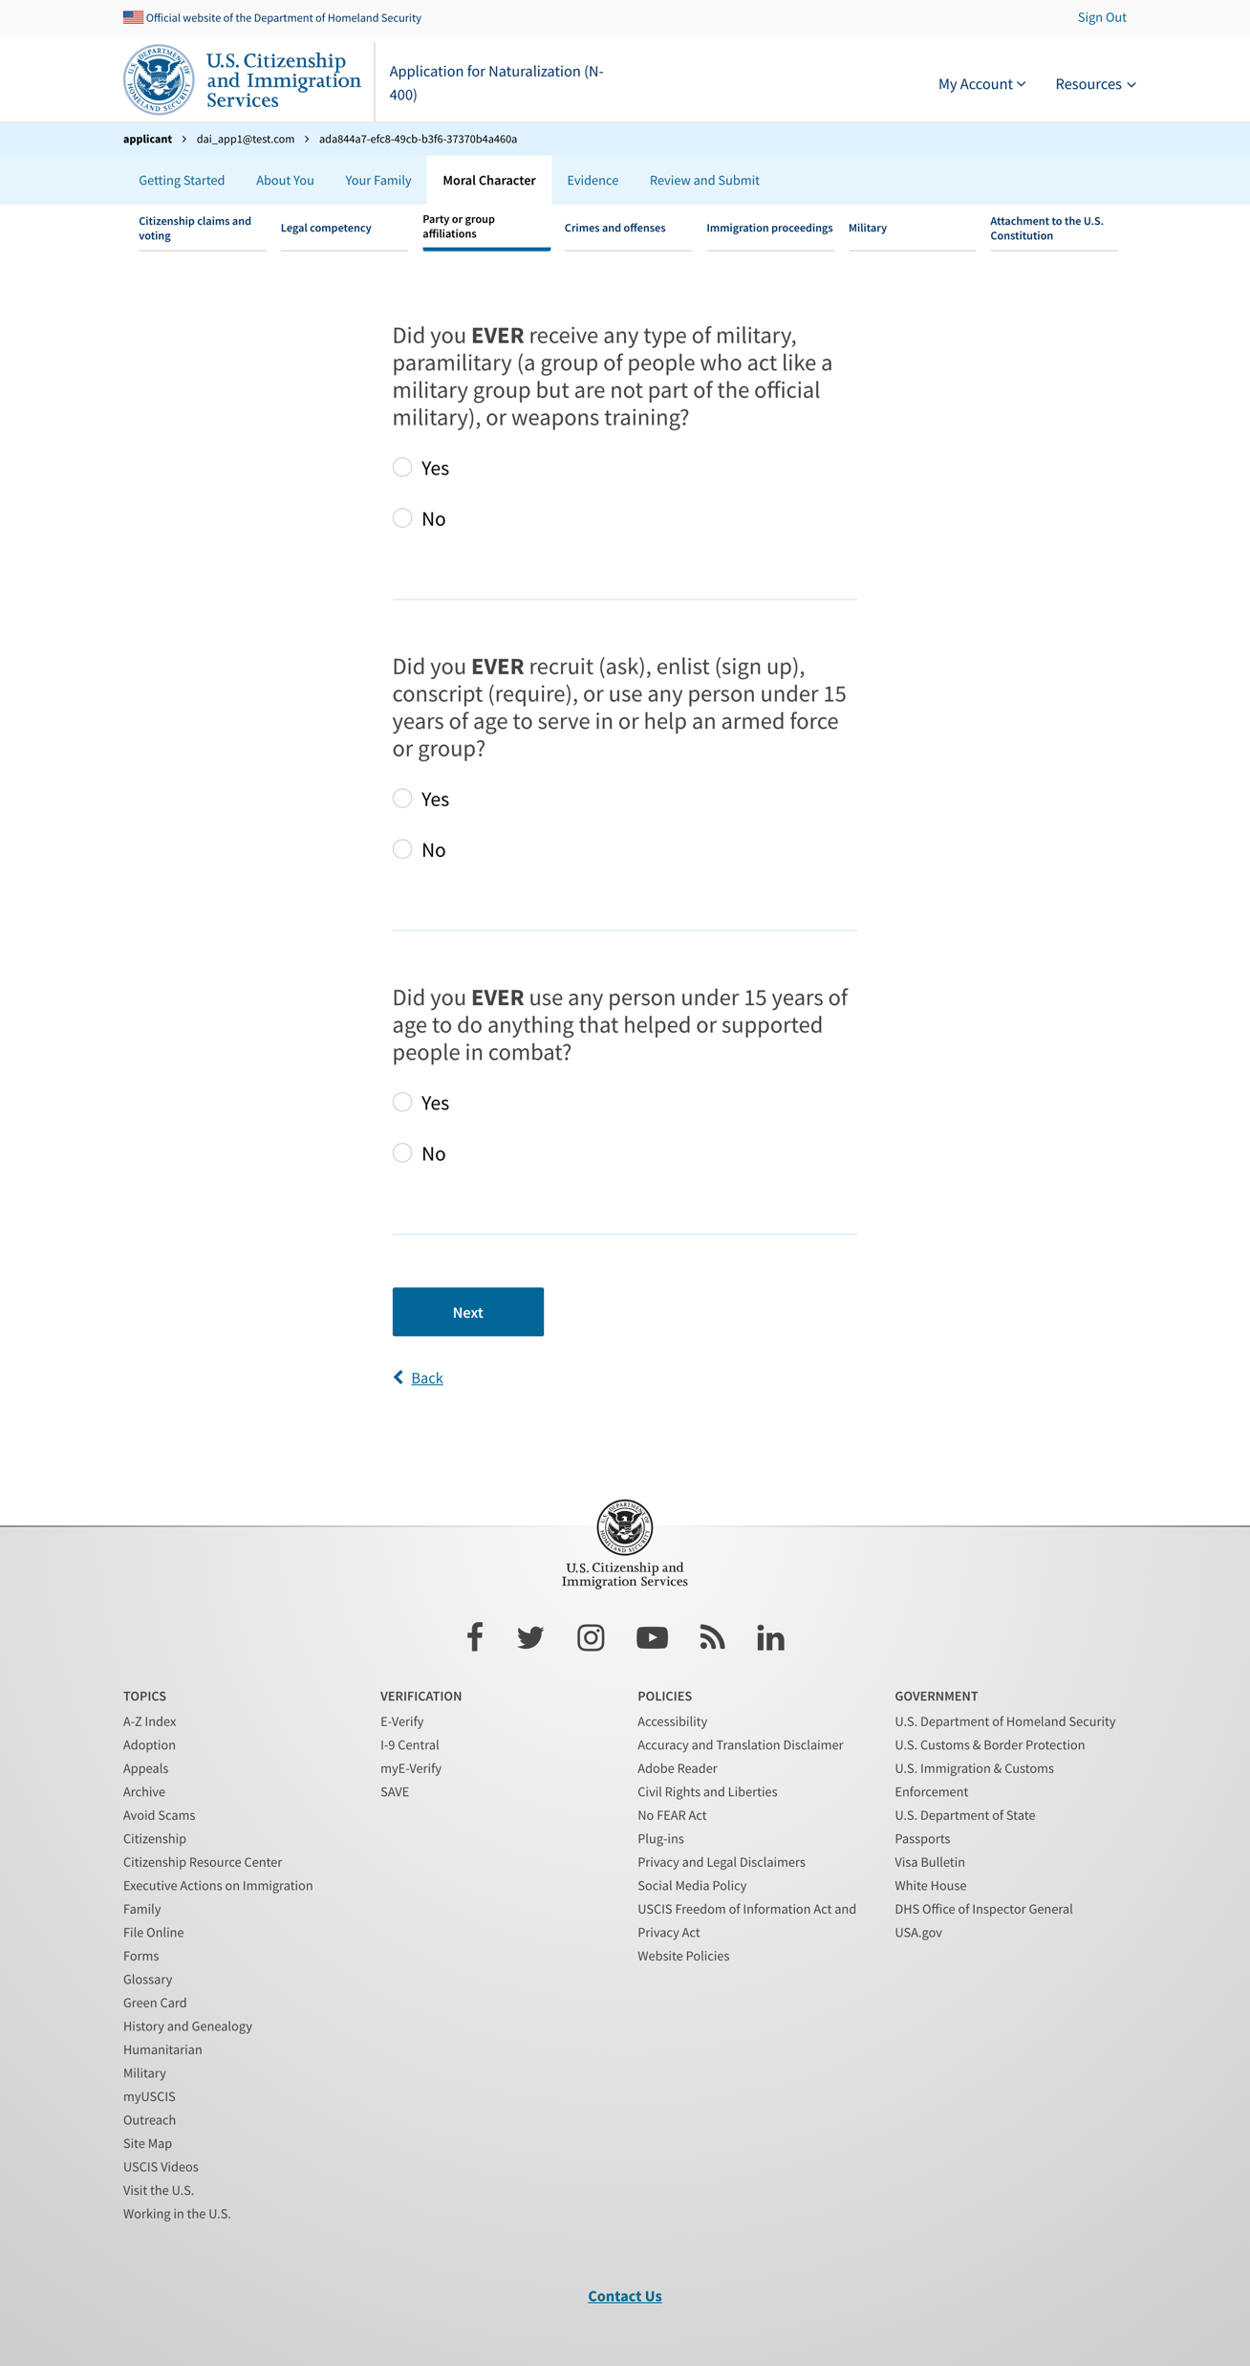
Party or group affiliations 10

Slide 22
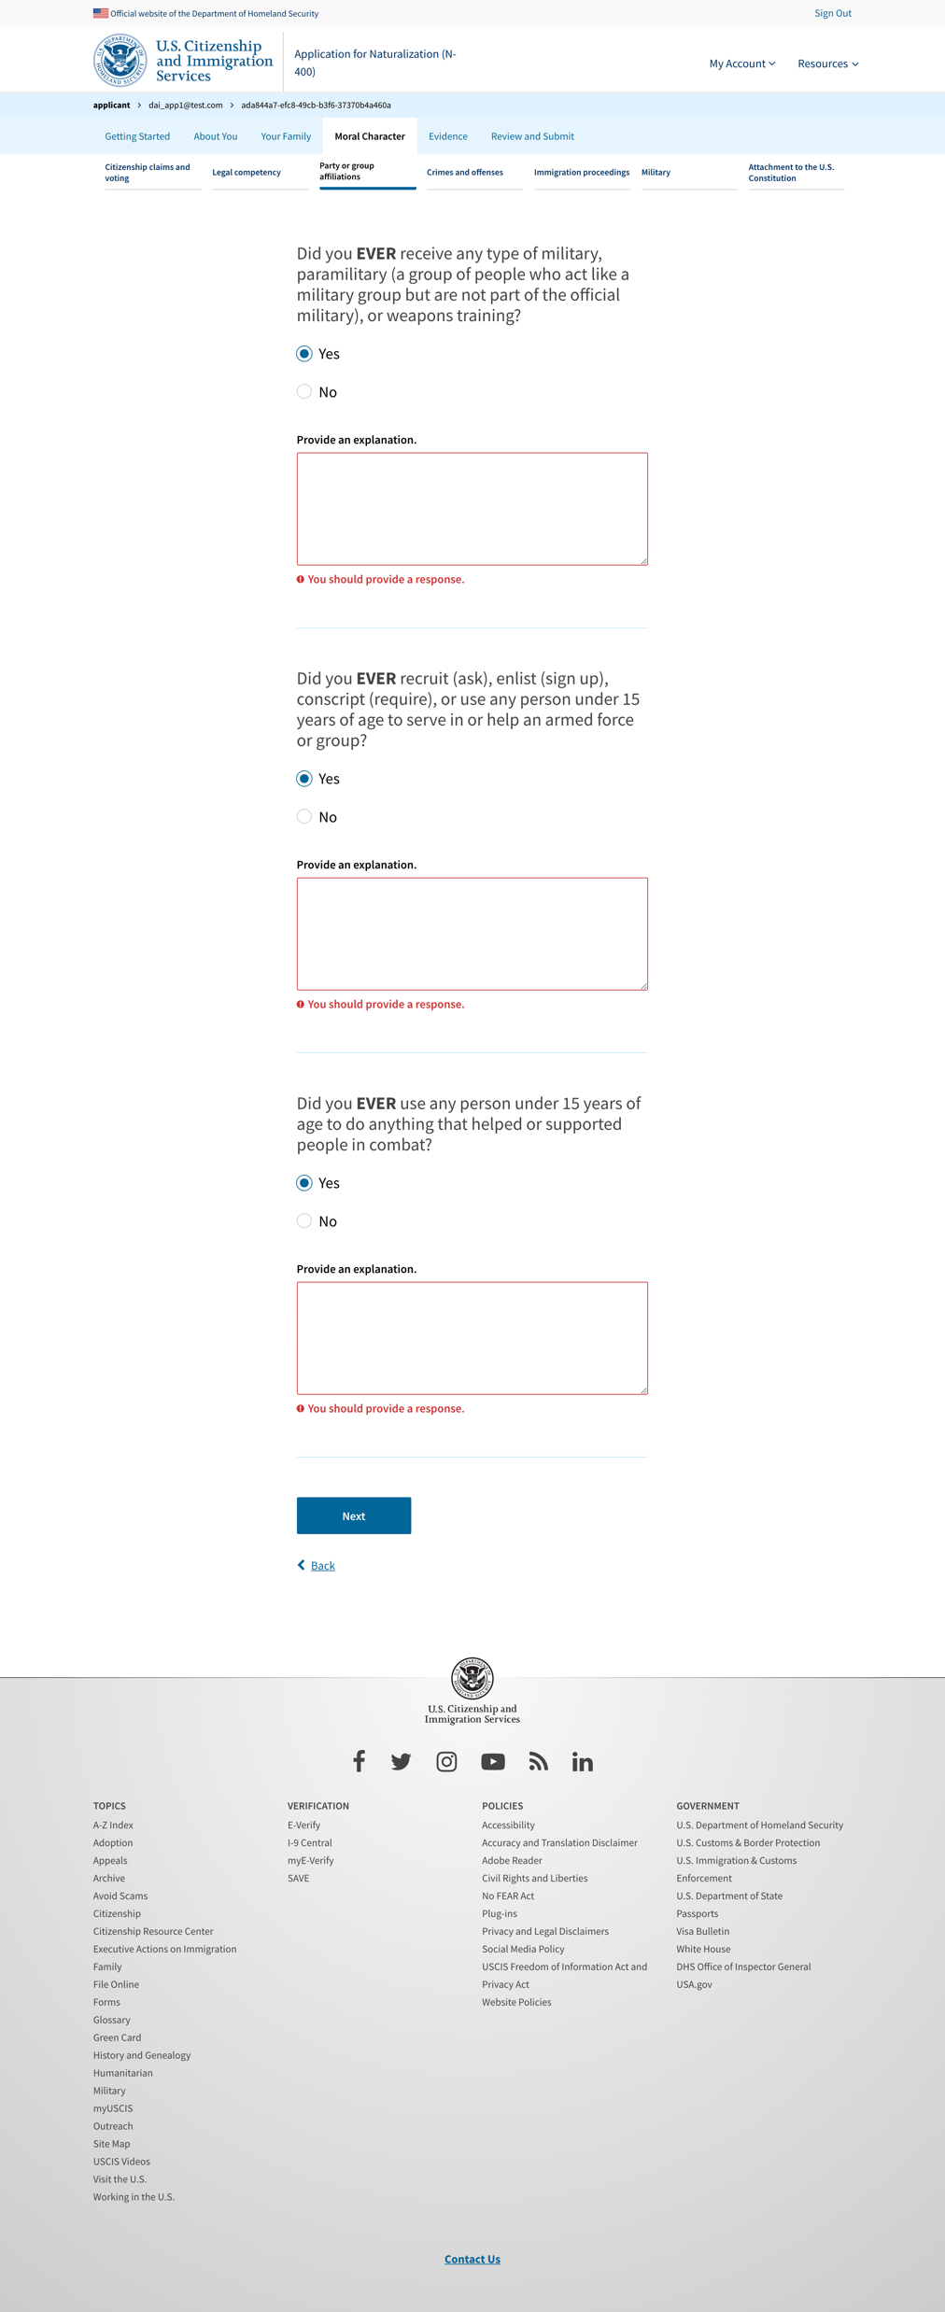
Party or group affiliations 10 – exposed explanation

Slide 23
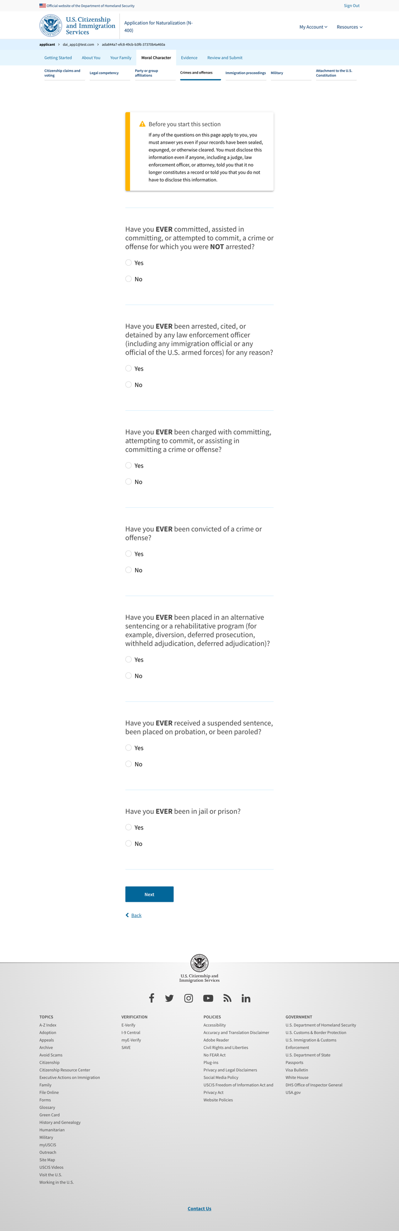
Crimes and offenses

Slide 24
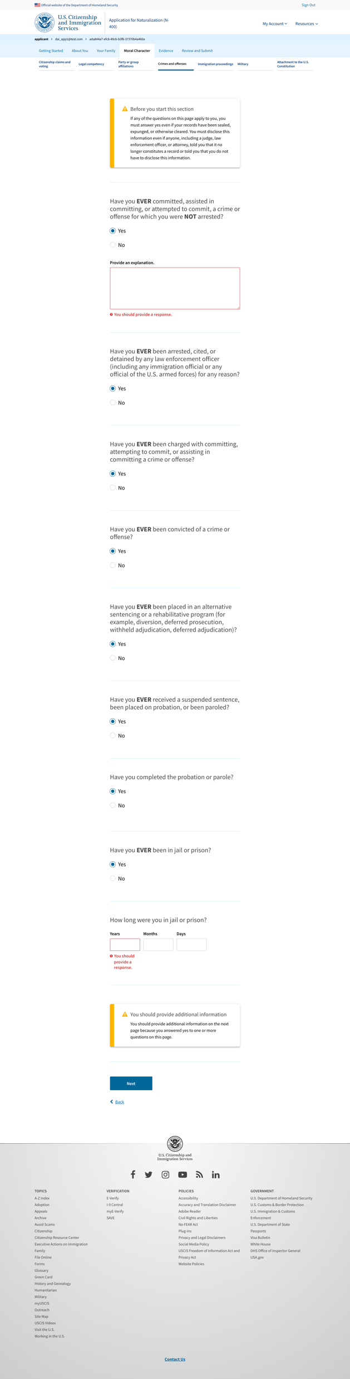
Crimes and offenses – exposed explanation

Slide 25
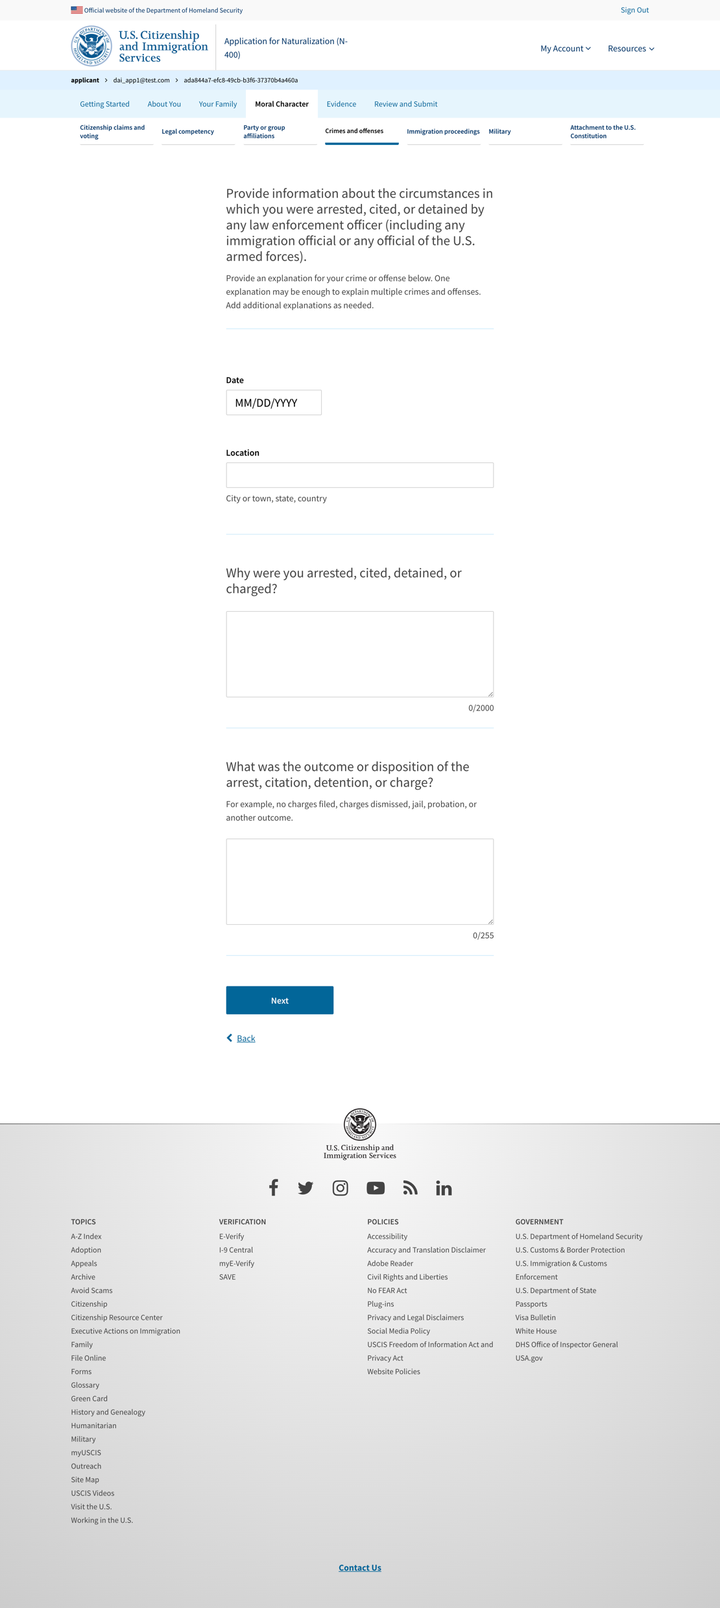
Crimes and offenses 2

Slide 26
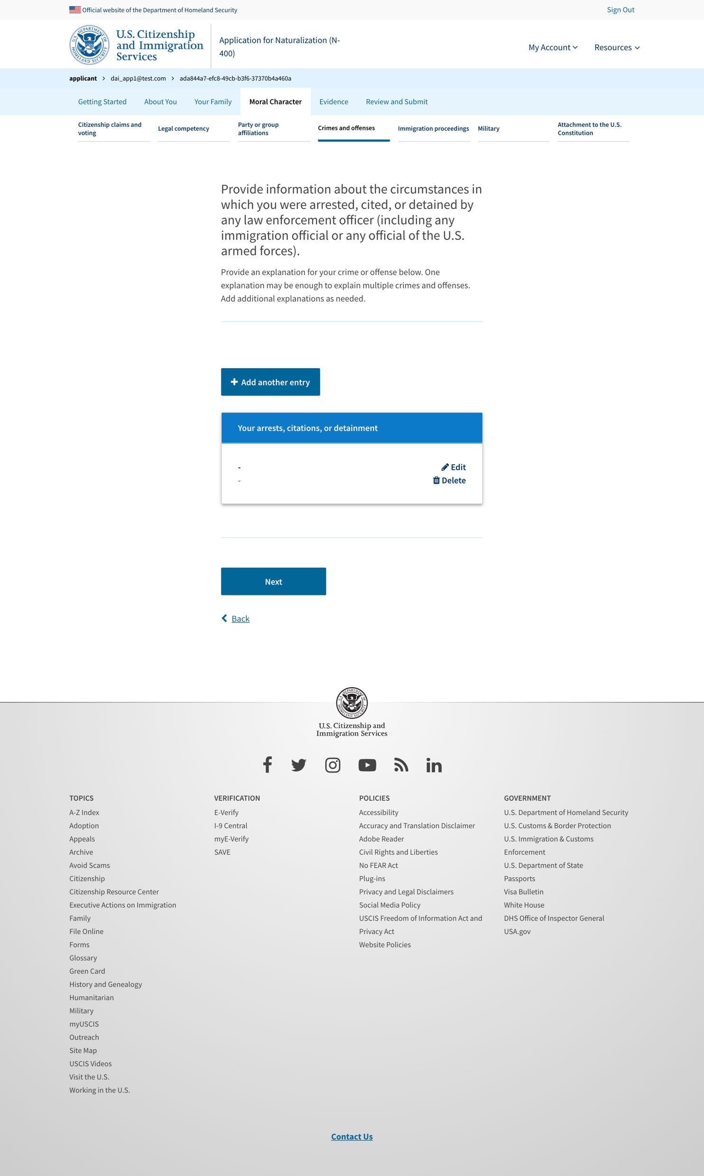
Crimes and offenses 3

Slide 27
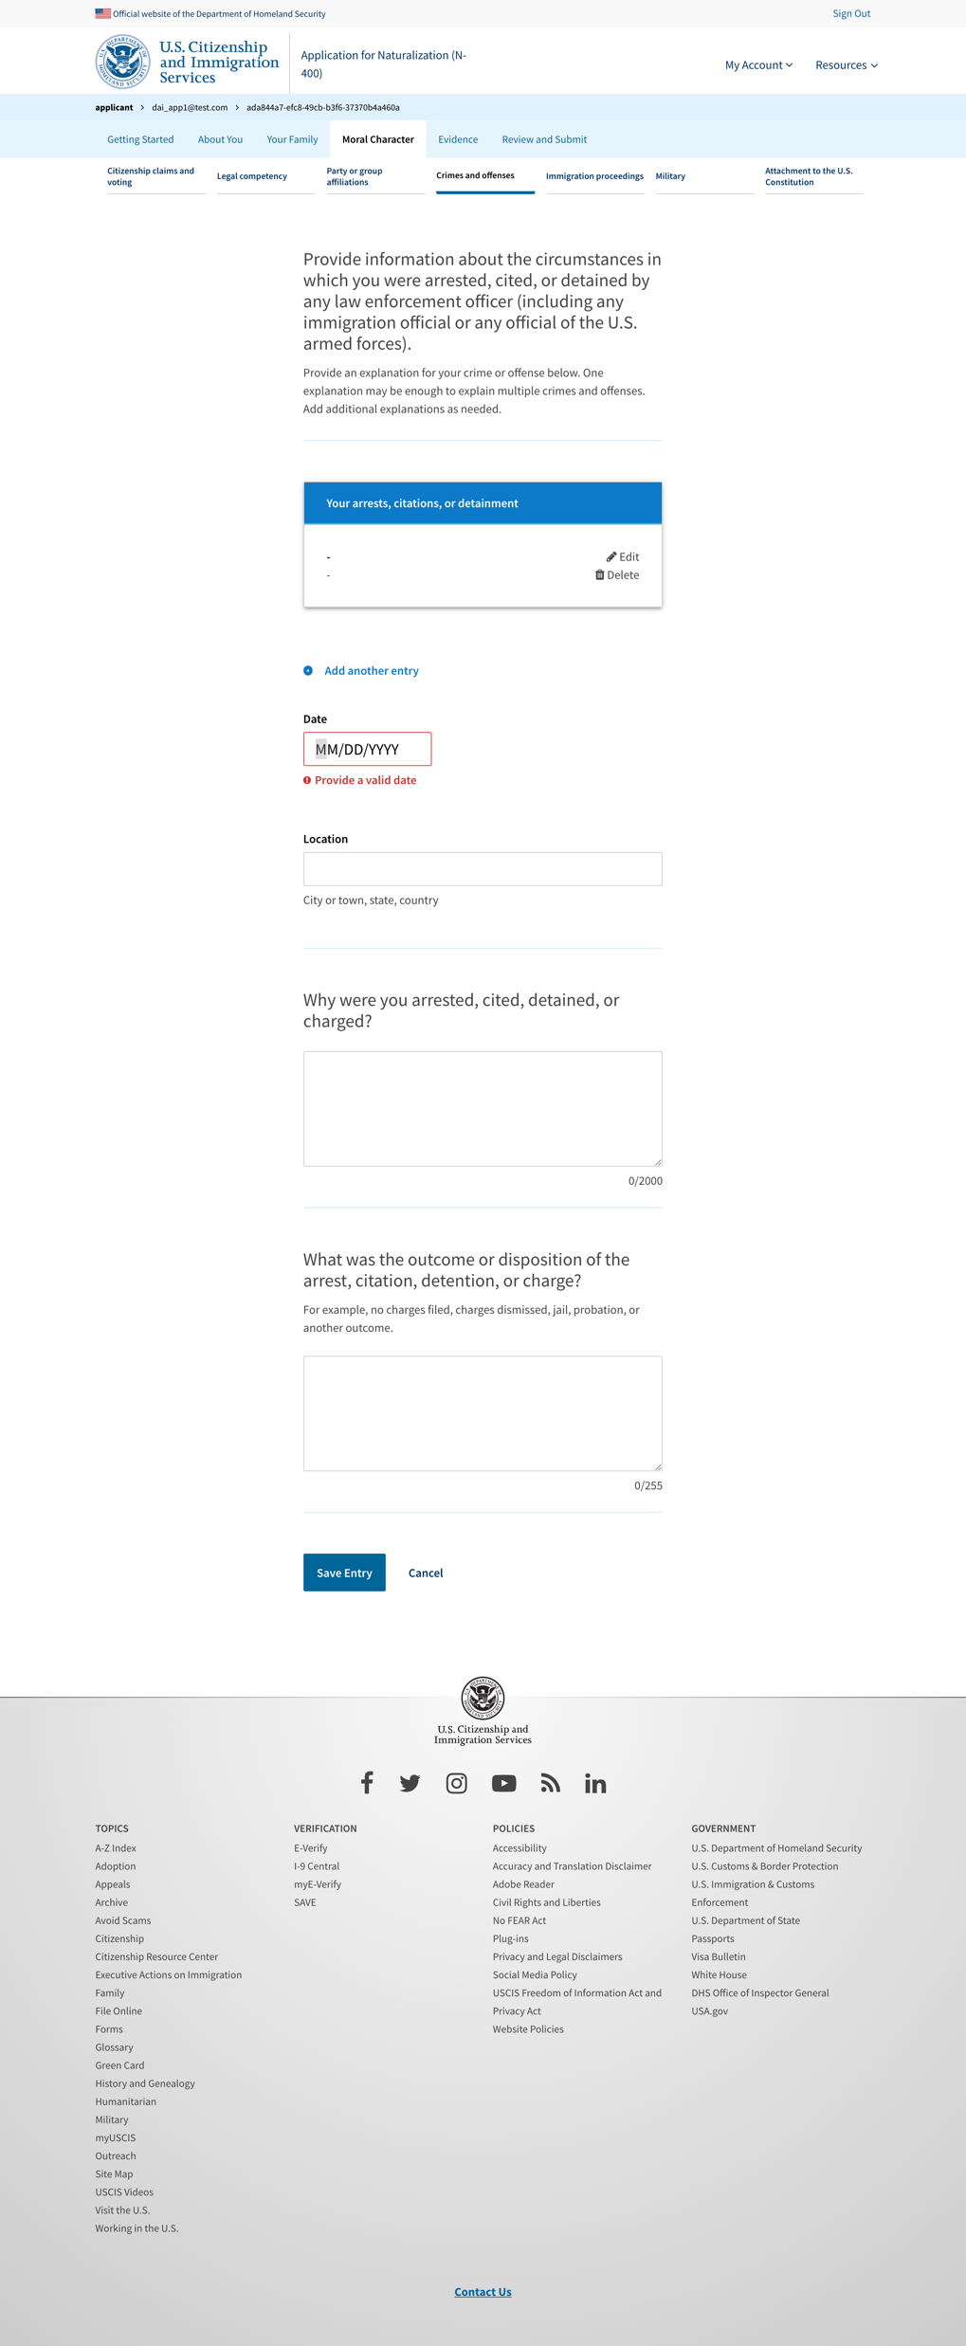
Crimes and offenses 3 add more

Slide 28
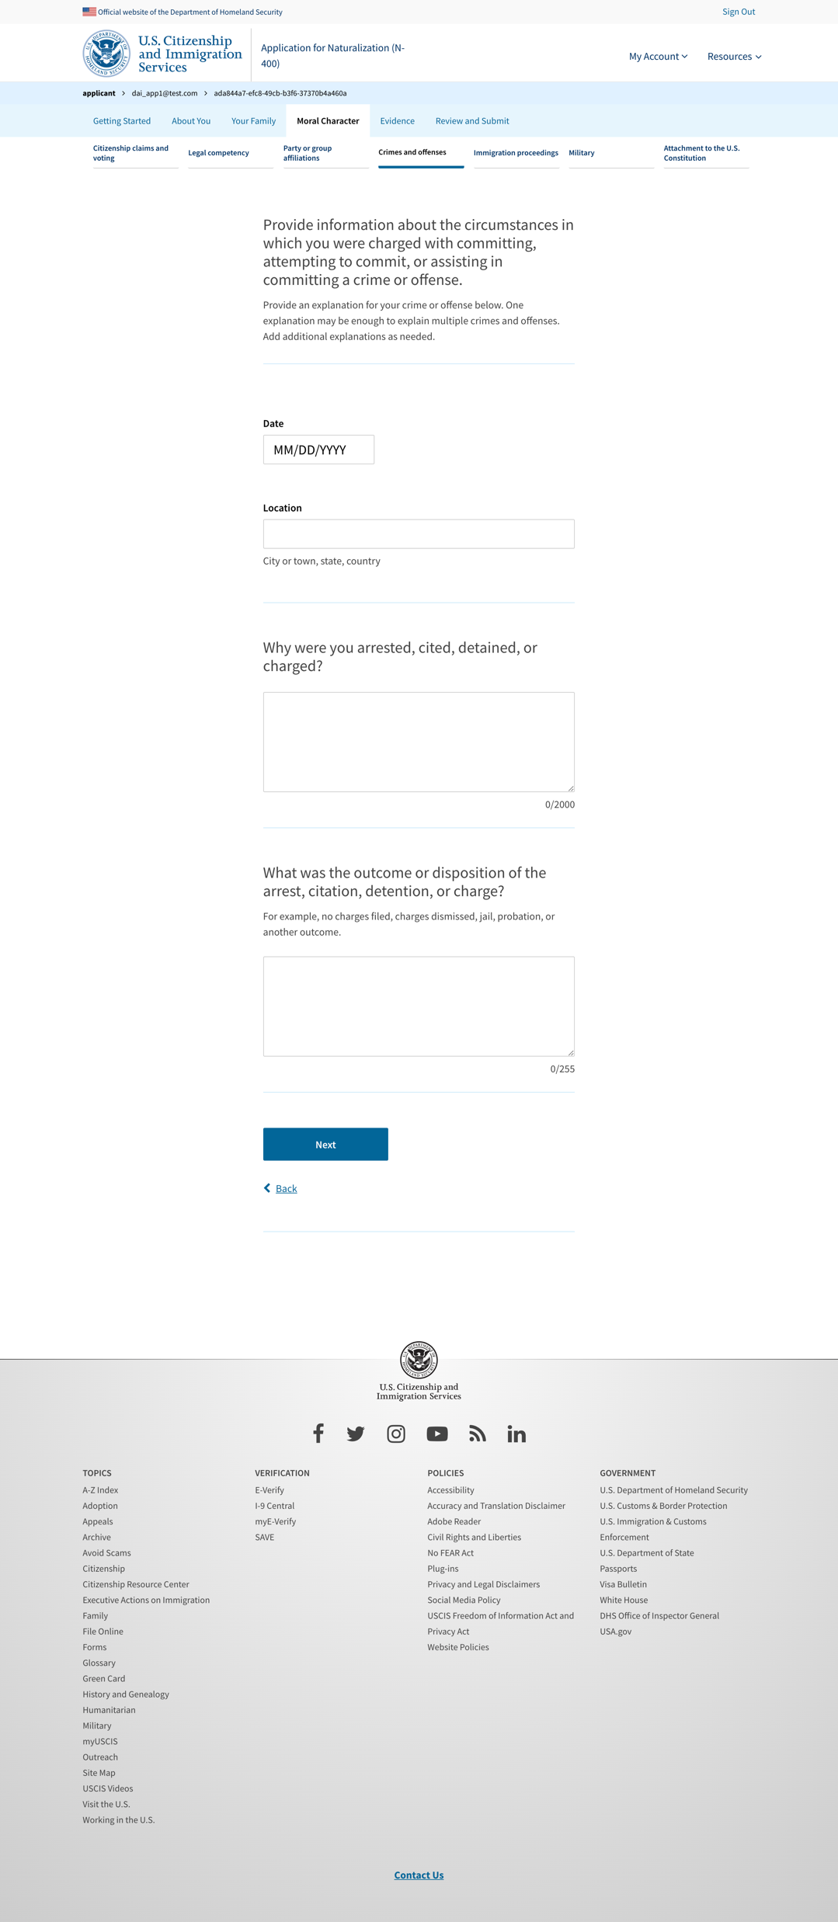
Crimes and offenses 5

Slide 29
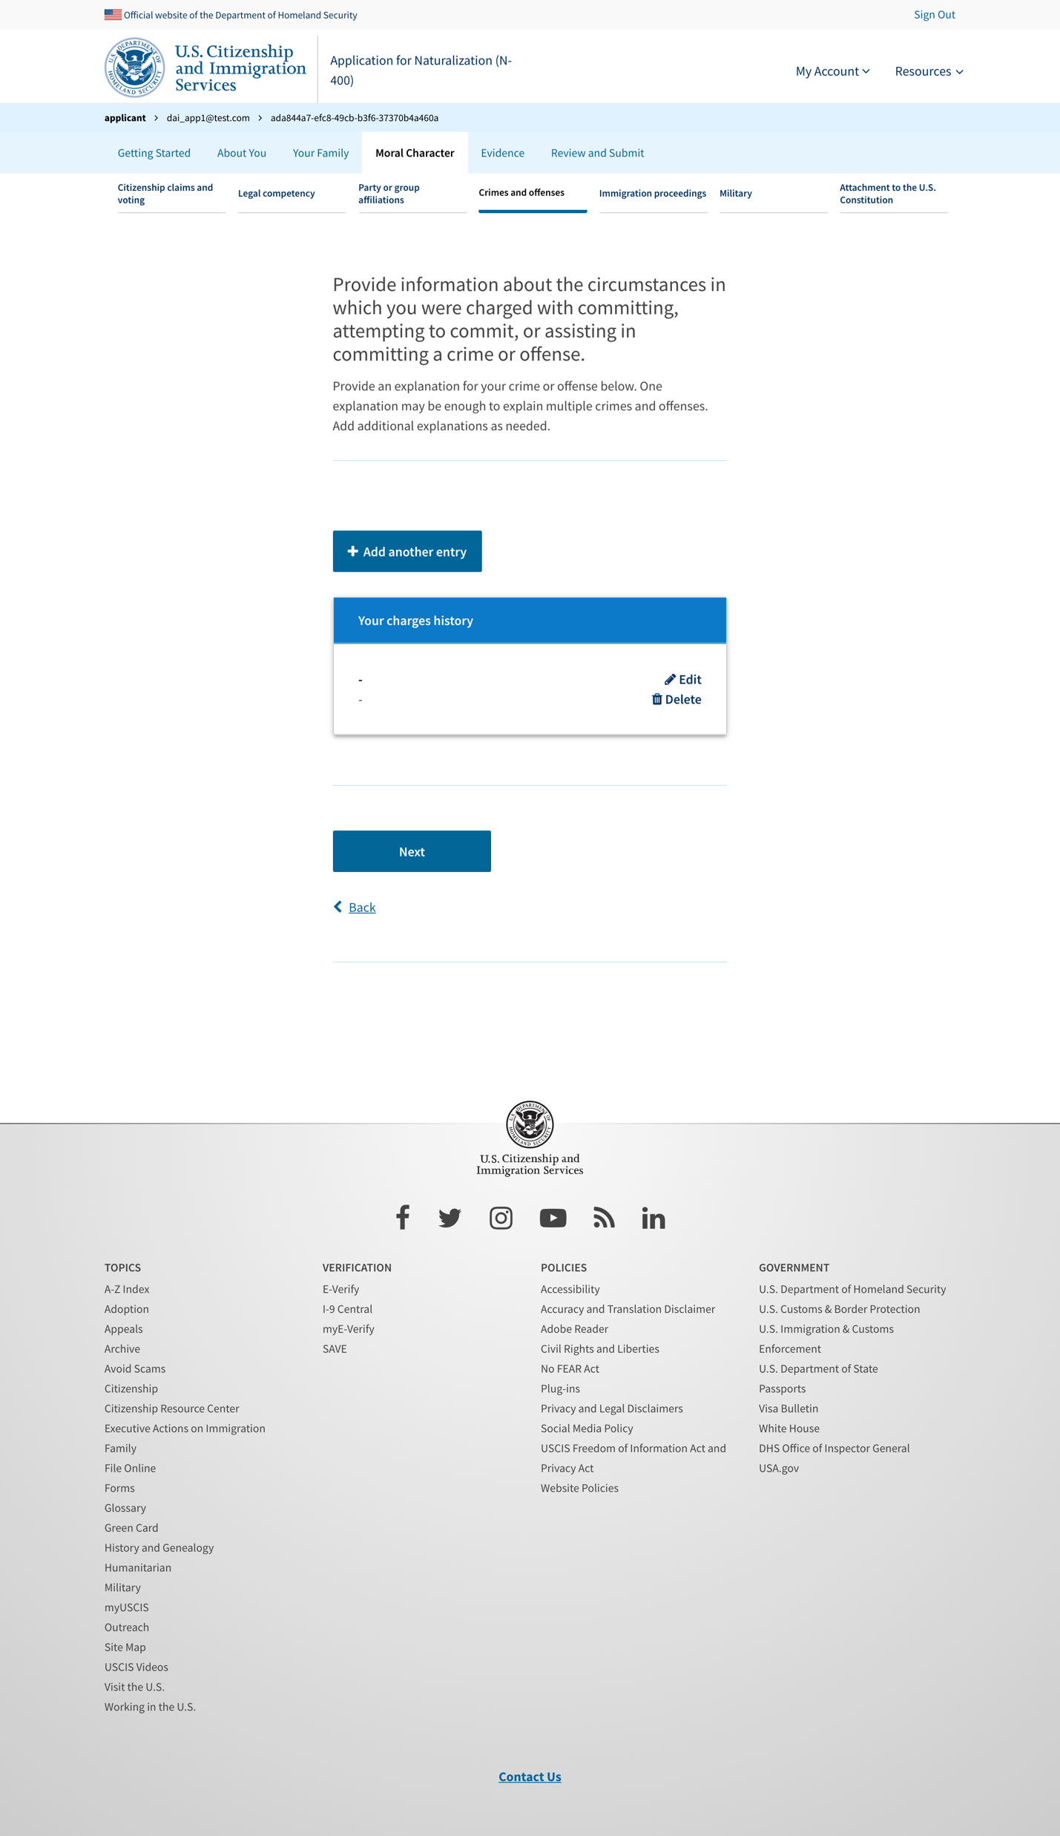
Crimes and offenses 5 - table

Slide 30
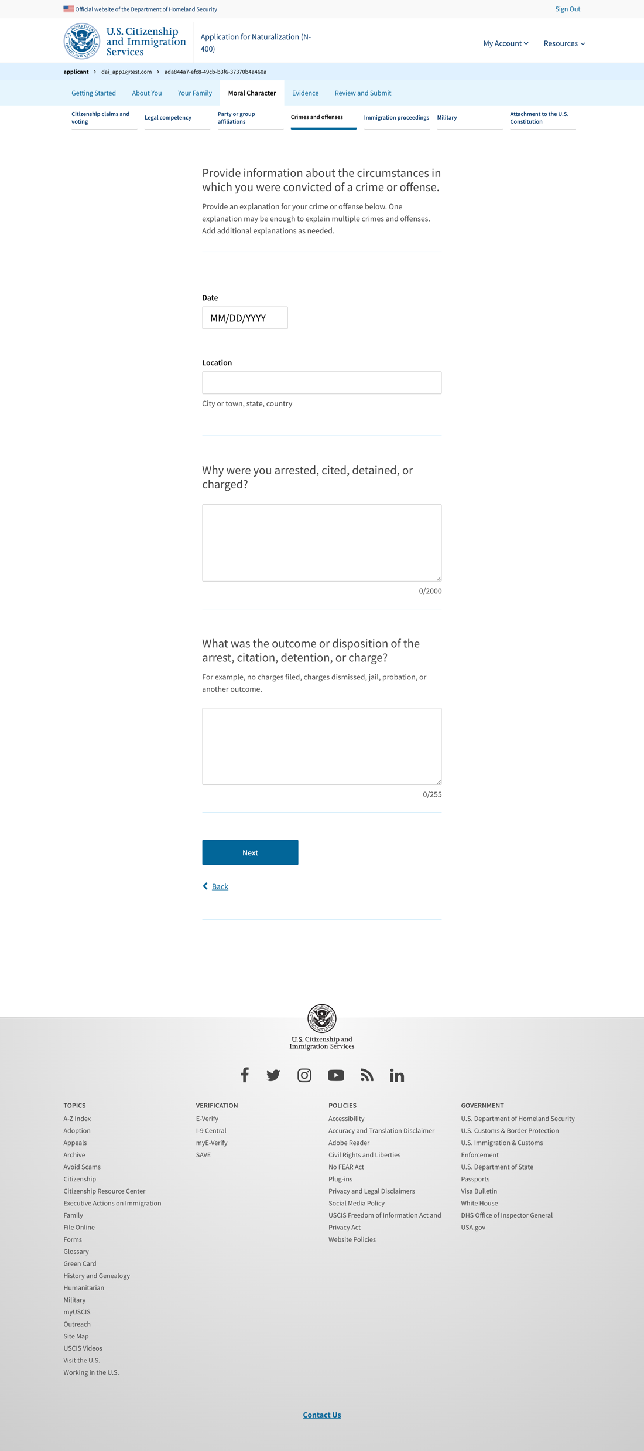
Crimes and offenses 6

Slide 31
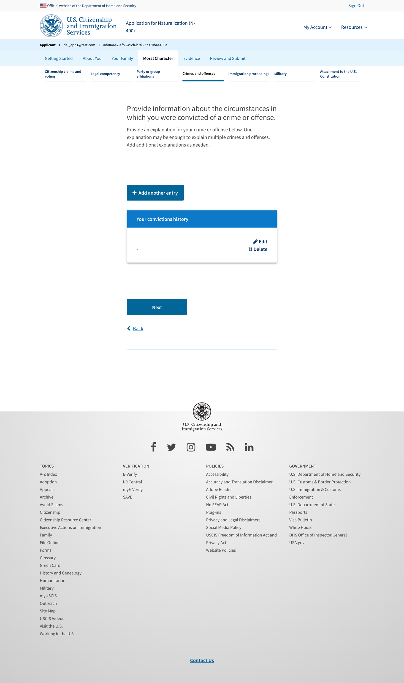
Crimes and offenses 6 - add more

Slide 32
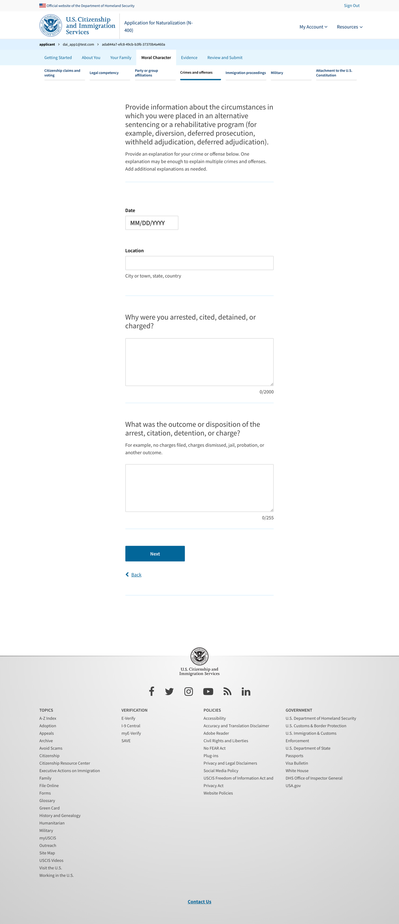
Crimes and offenses 7

Slide 33
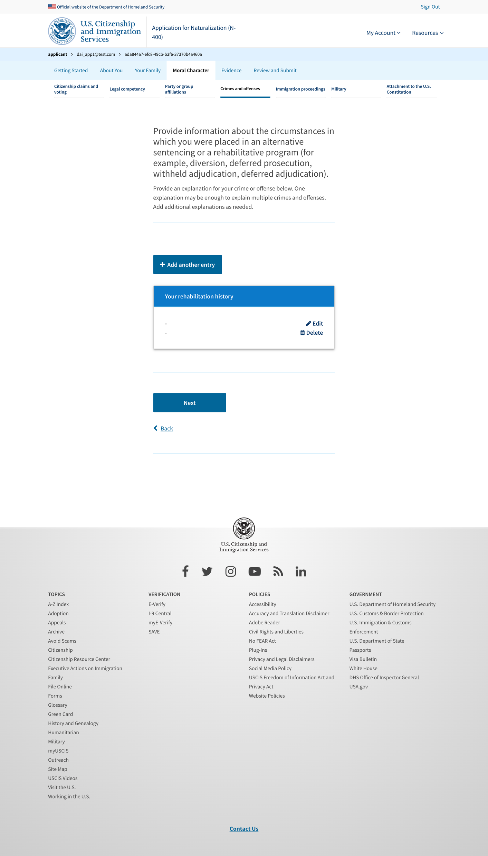
Crimes and offenses 7 - add more

