Slide 1
NASA ASRS
https://asrs.arc.nasa.gov/report/electronic.html

Slide 24
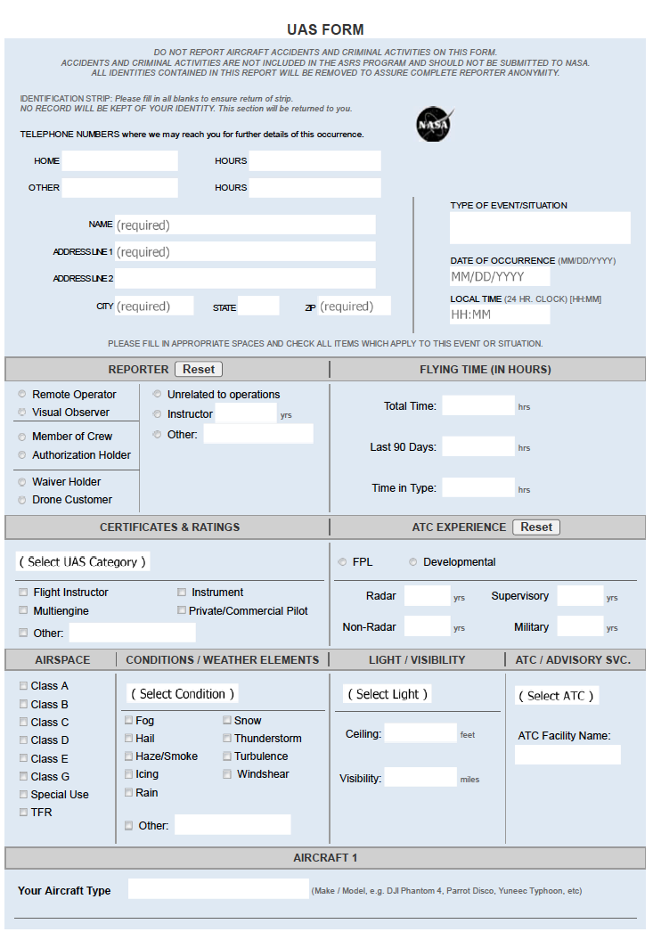

Slide 26
Rotary-Wing Form

Slide 28
RotaryWing Form

