Slide 1
BENEFEDS Enrollee Portal
Main Screen Save Point

Slide 3
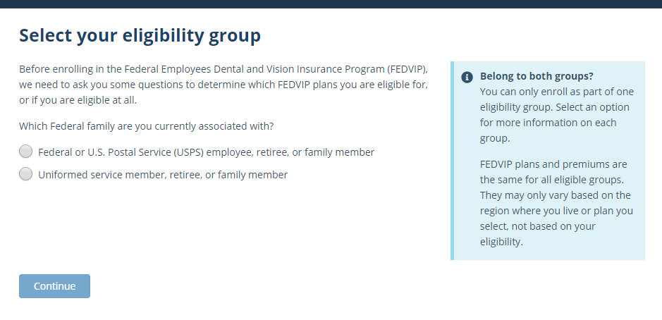
Start Eligibility Flow

Slide 4
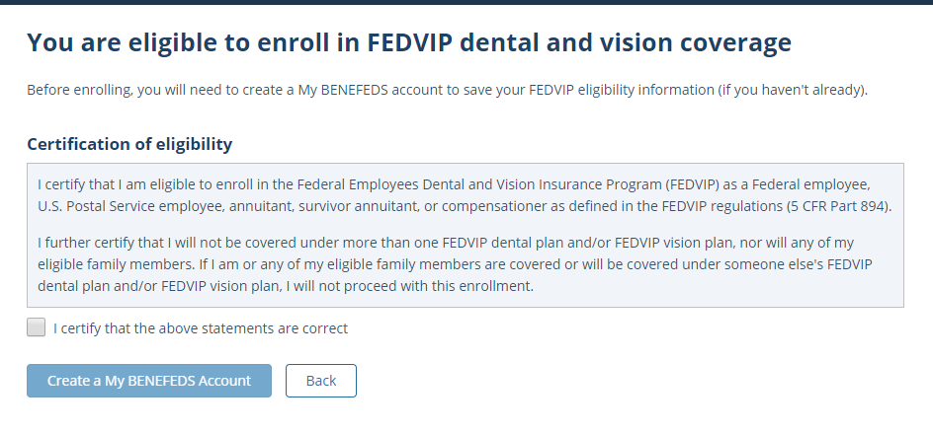
Eligibility Confirmation

Slide 5
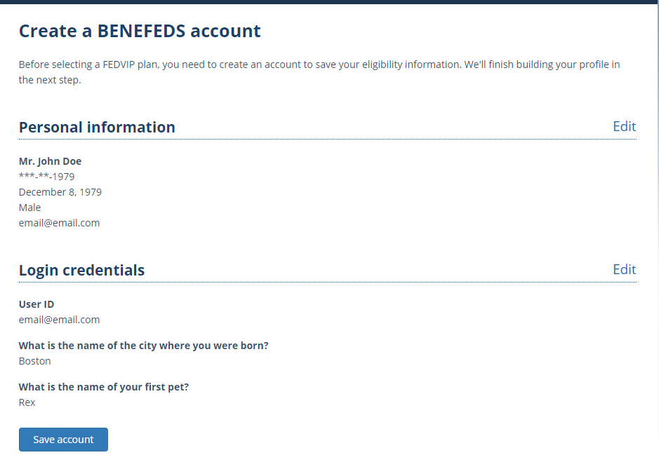
Account Creation

Slide 6
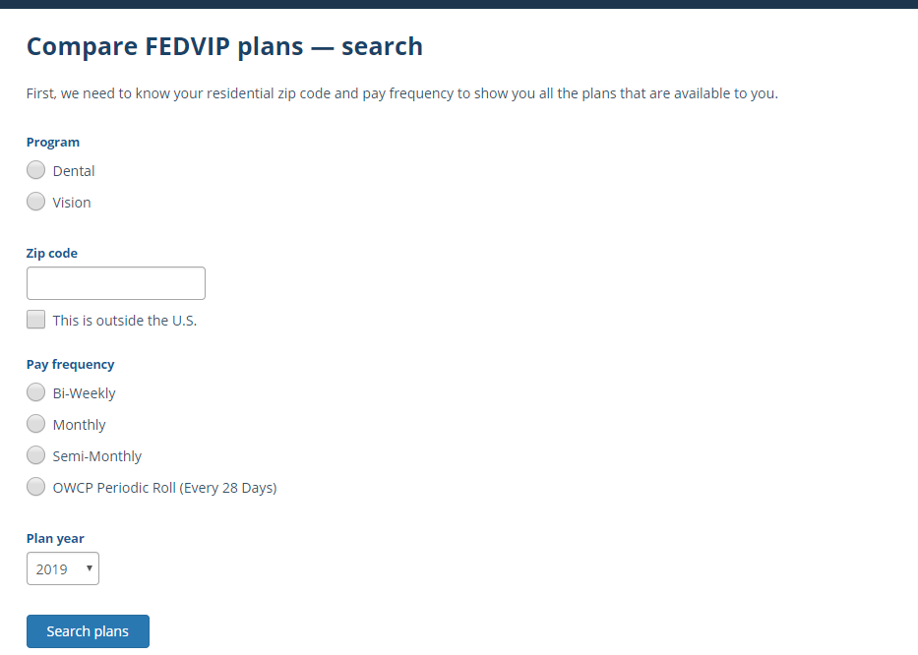
Plan Selection

Slide 7
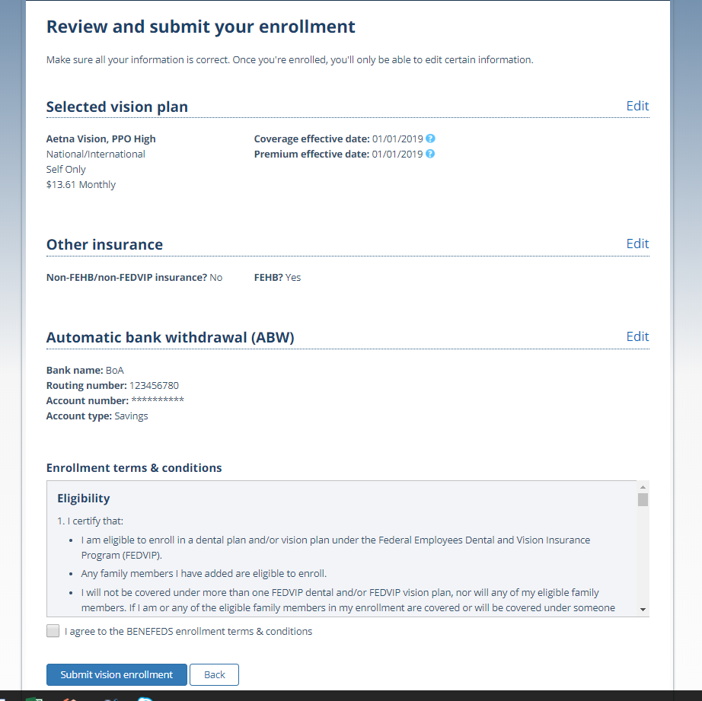
Enrollment Confirmation

