Slide 1
TRI Bus Testing
Notes:
Project Name = Use the project’s or program’s official name.
System Name = If project name is the same as the system name, then do not enter system name.
Project ID = Use same name as the project’s or program’s Confluence site.

Slide 2
Application Details
Test Link : http://ftawebtest.fta.dot.gov/BusTesting/Account/Login
Login details are pre-populated (since this is a test environment)
NOTE: Please note that this is a test environment so some of the functionalities are still in development.

Slide 3
Login

Slide 4
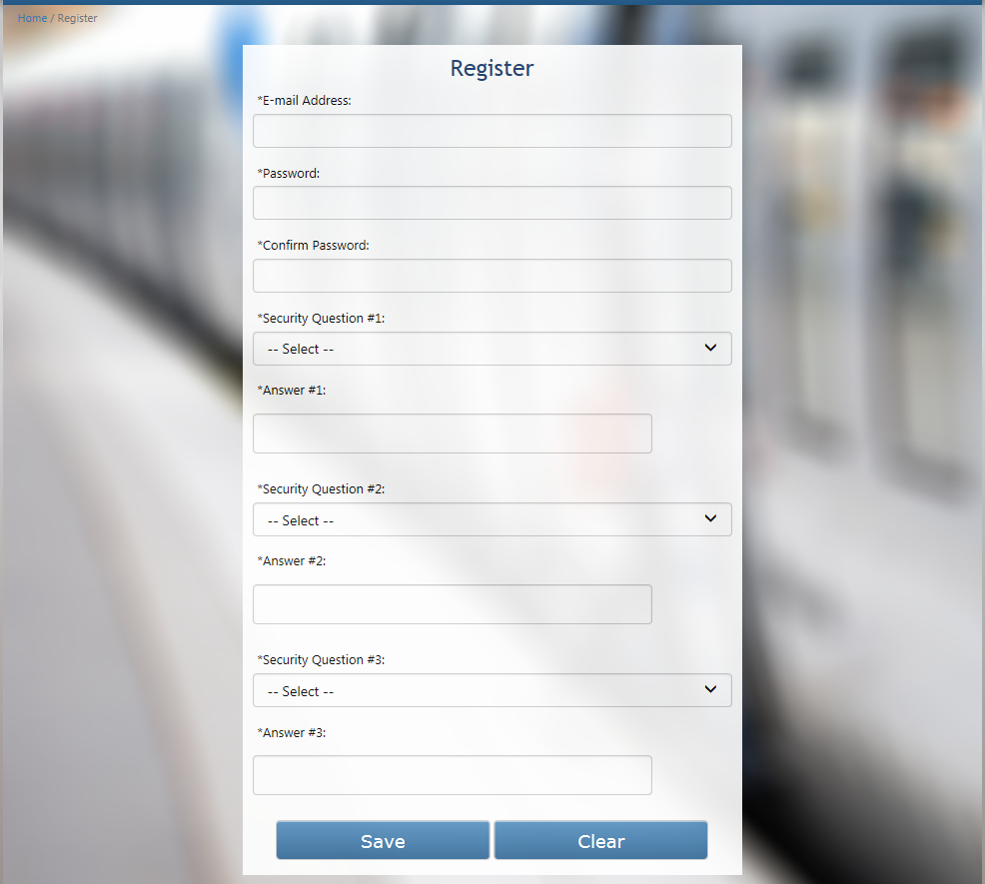
New User Registration

Slide 5
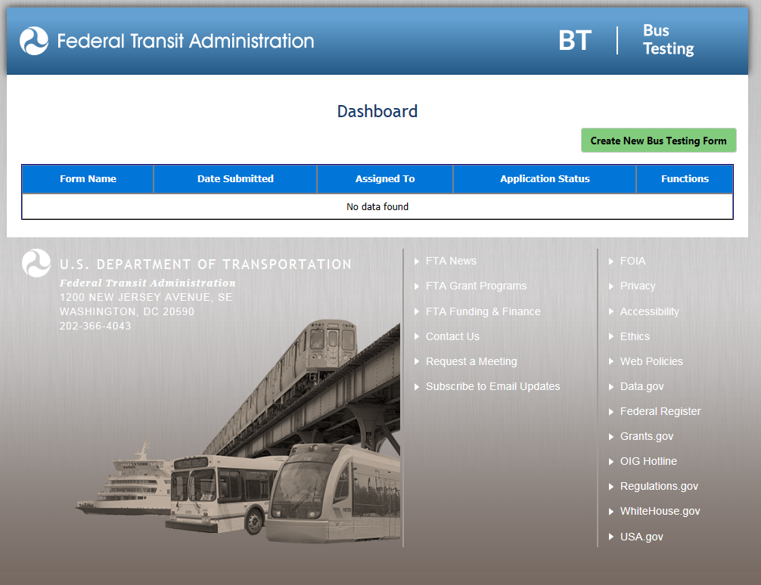
Dashboard

Slide 6
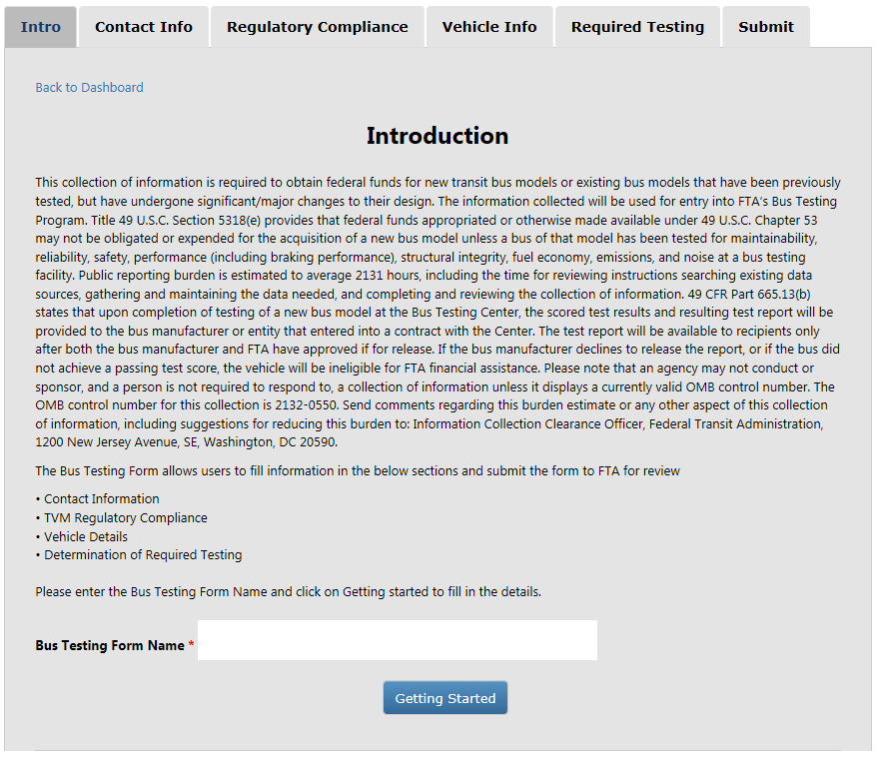
Create New Bus Testing Form – Introduction with PRA Statement

Slide 7
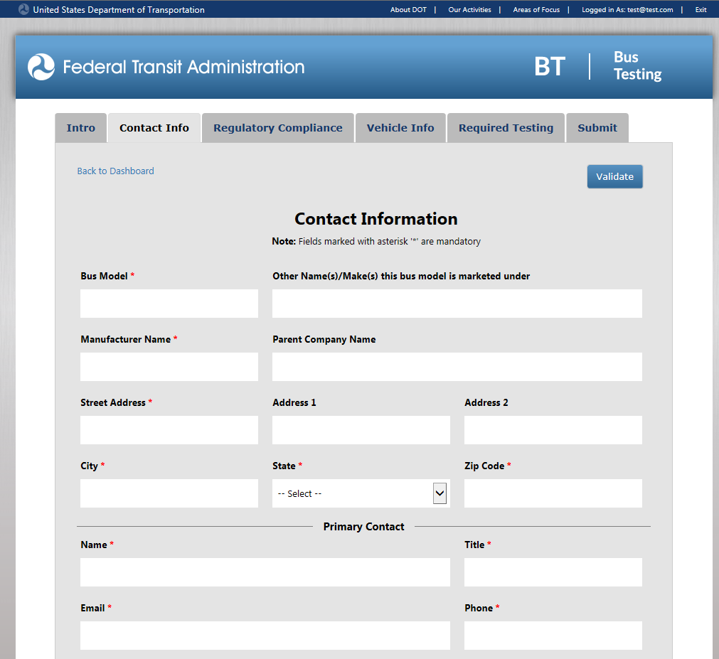
Contact Information

Slide 8
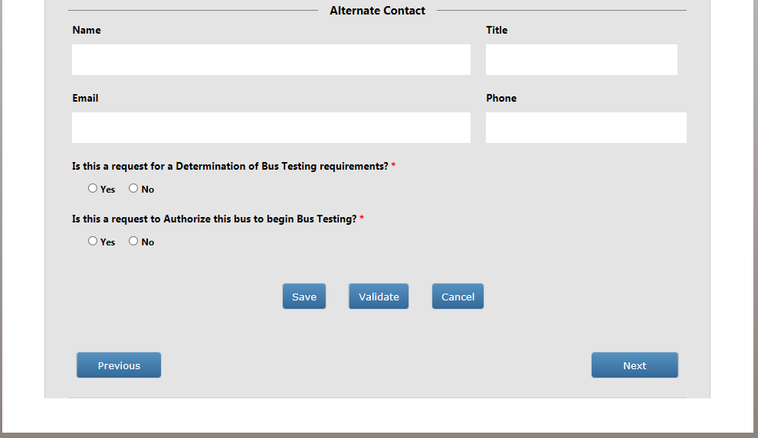
Contact Information (Contd..)

Slide 9
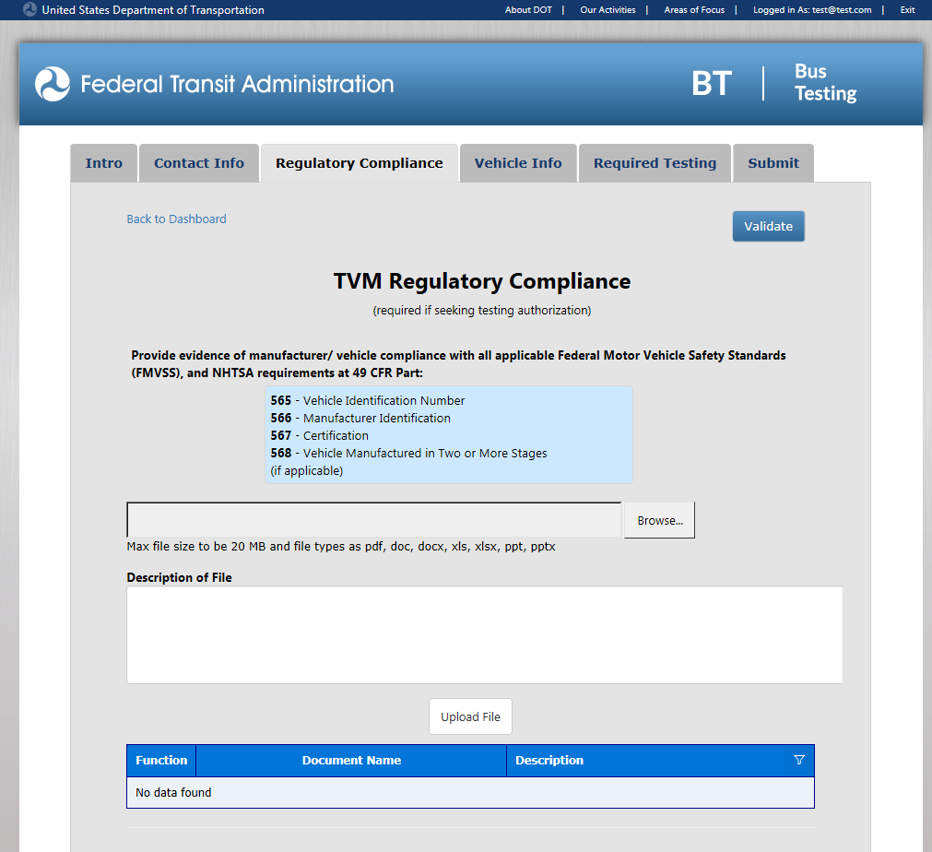
TVM Regulatory Compliance

Slide 10
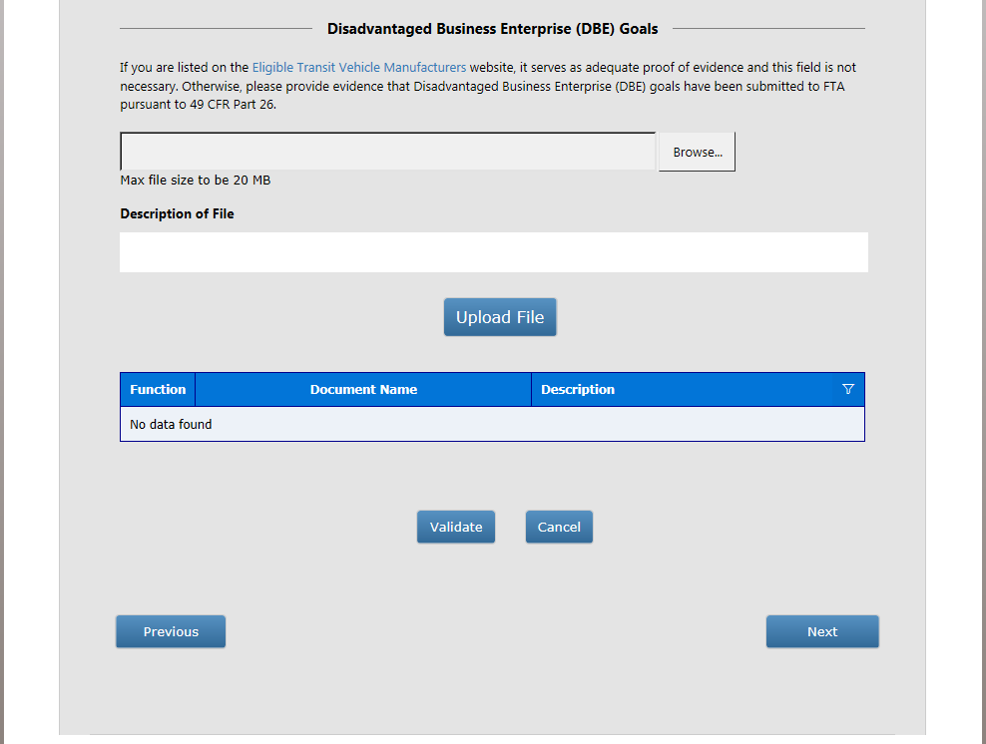
TVM Regulatory Compliance (Contd..)

Slide 11
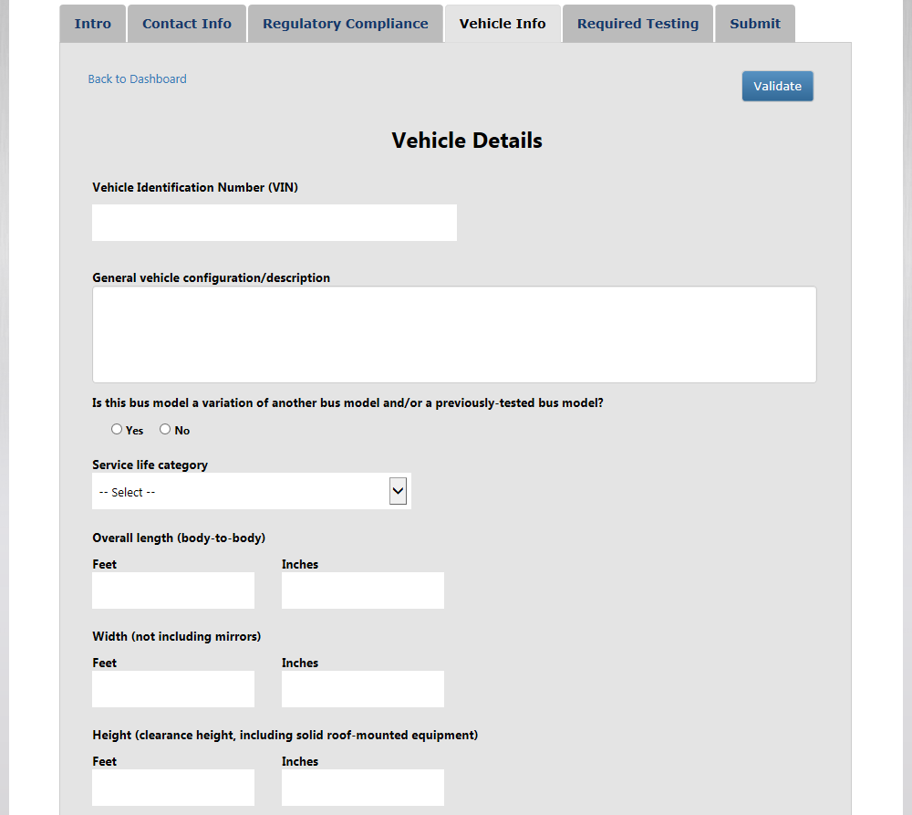
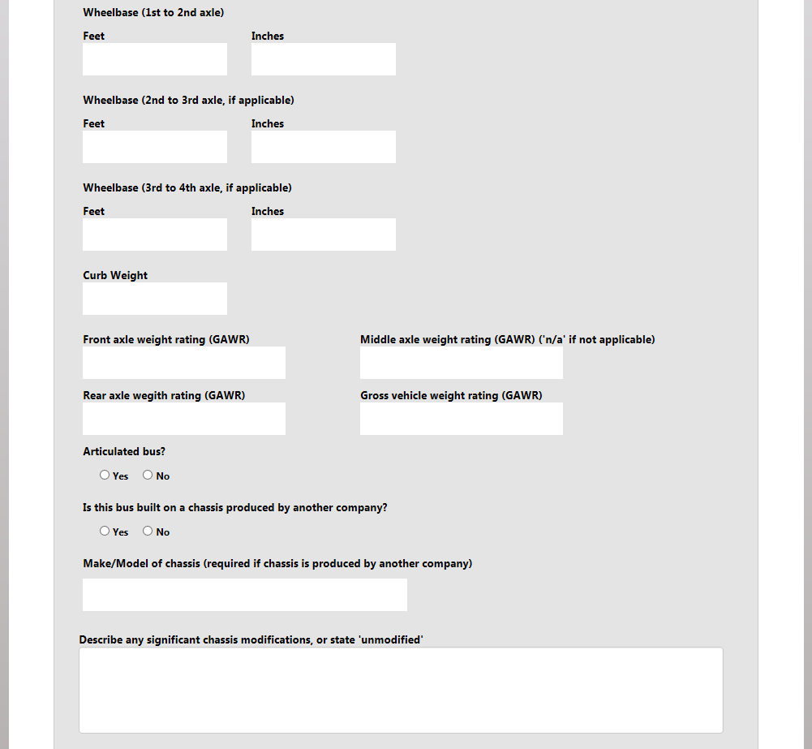
Vehicle Details

Slide 12
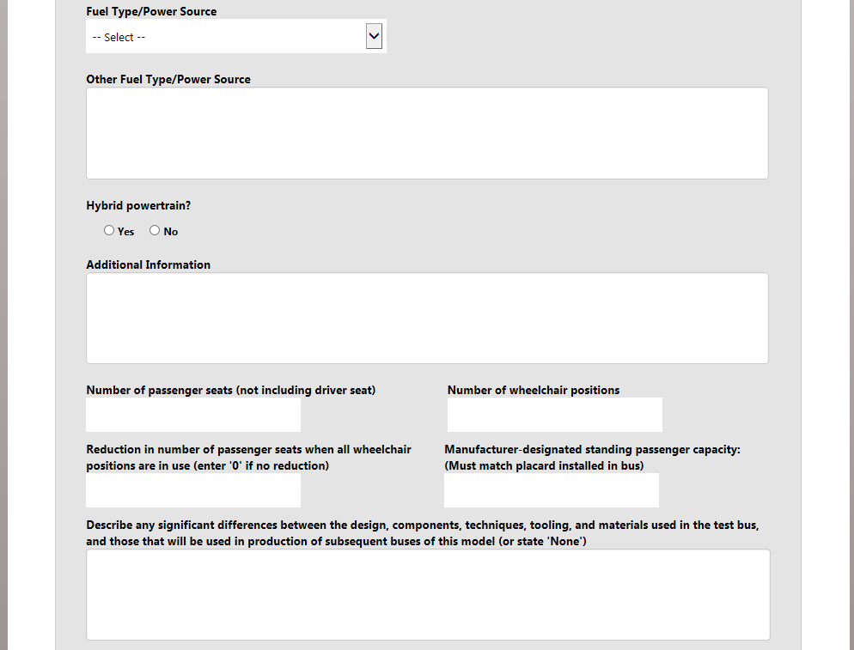
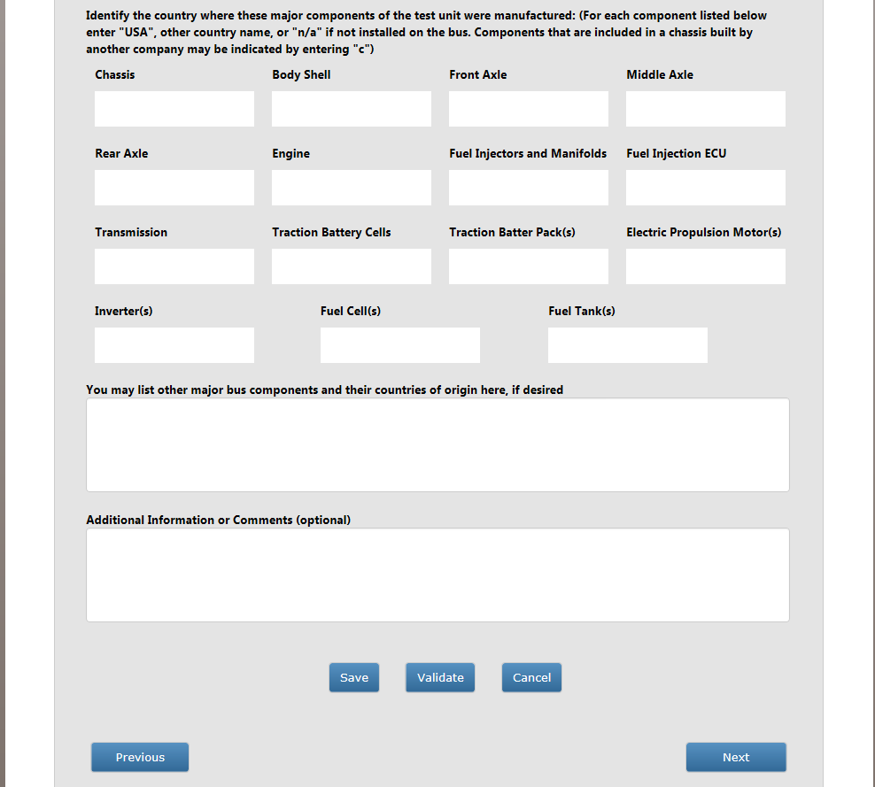
Vehicle Details (Contd..)

Slide 13
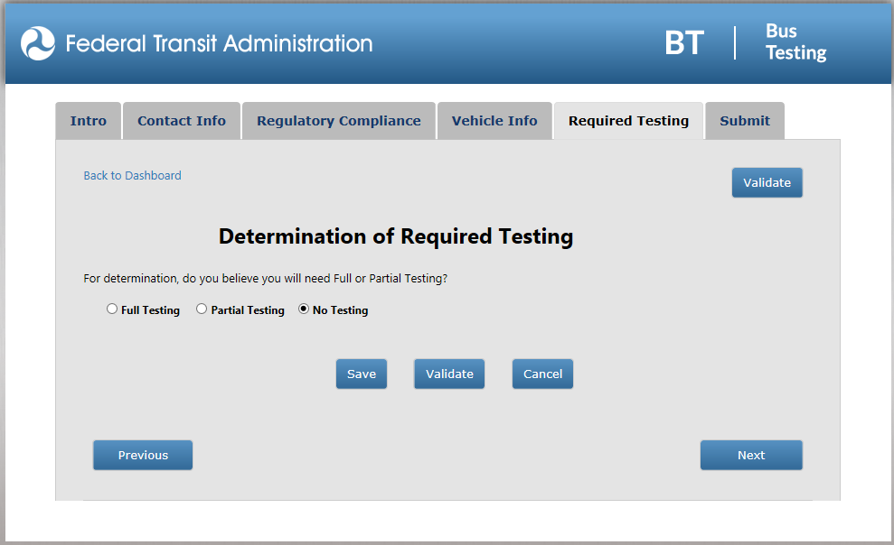
Determination of Required Testing – No Testing

Slide 14
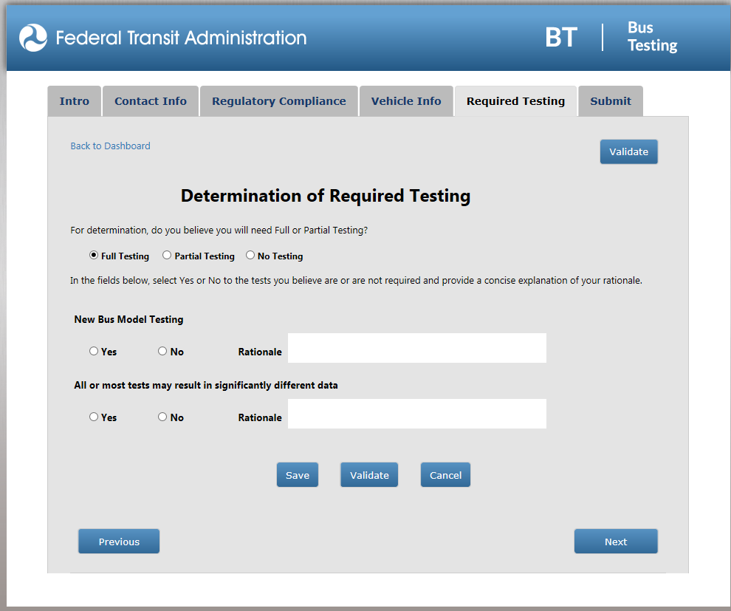
Determination of Required Testing – Full Testing

Slide 15
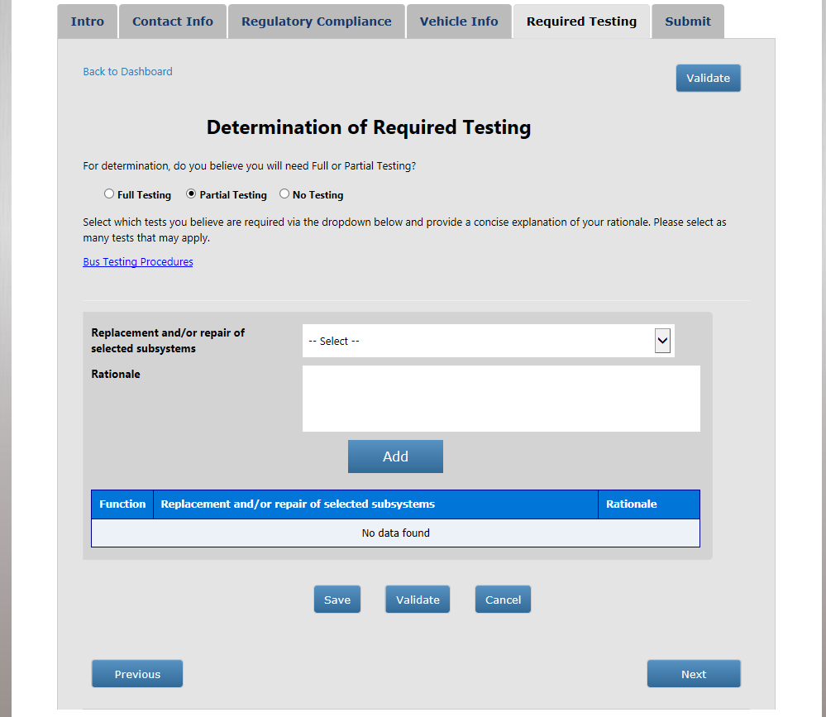
Determination of Required Testing – Full Testing

Slide 16
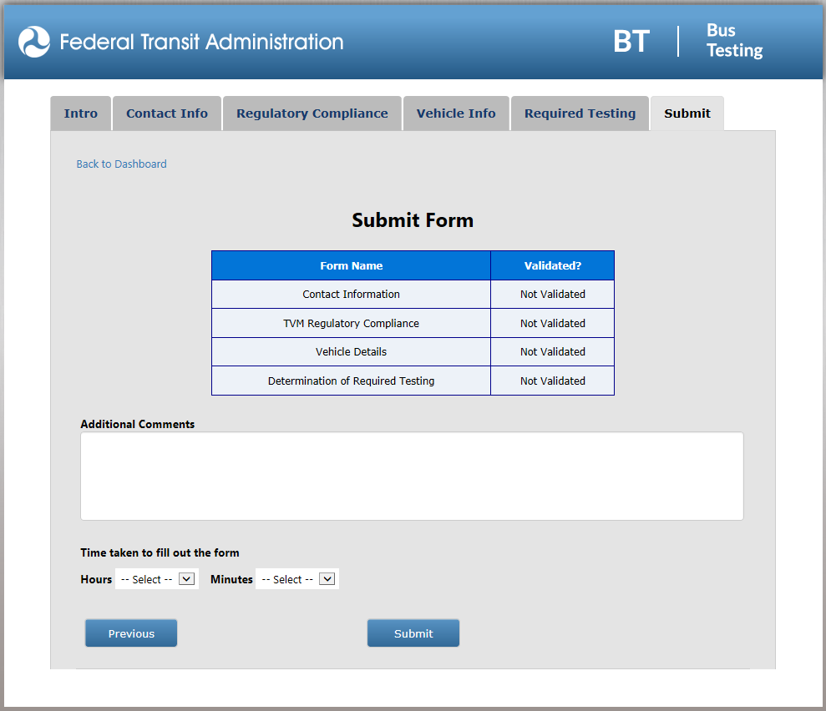
Submit Form

Slide 17
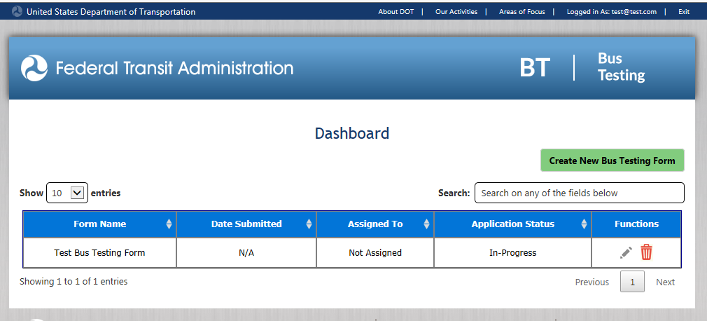
Dashboard – With Data

