Slide 1
DECCS: Commodity Jurisdiction
March 2019

Slide 2
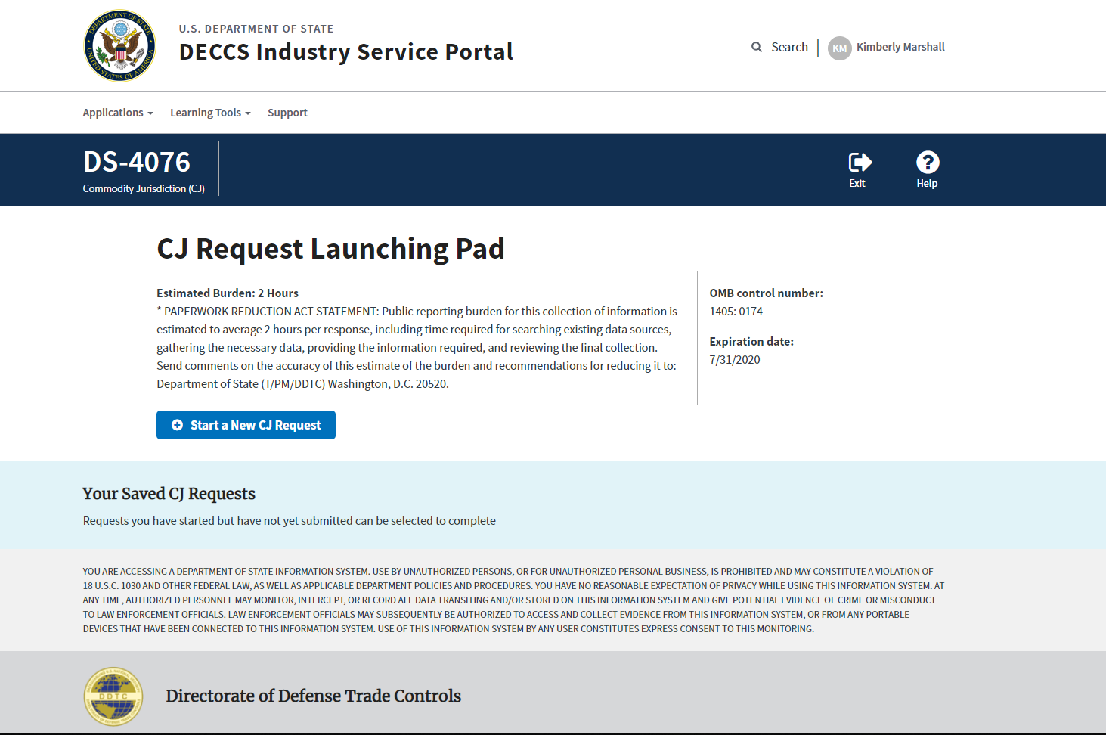
CJ Create New Page

Slide 3
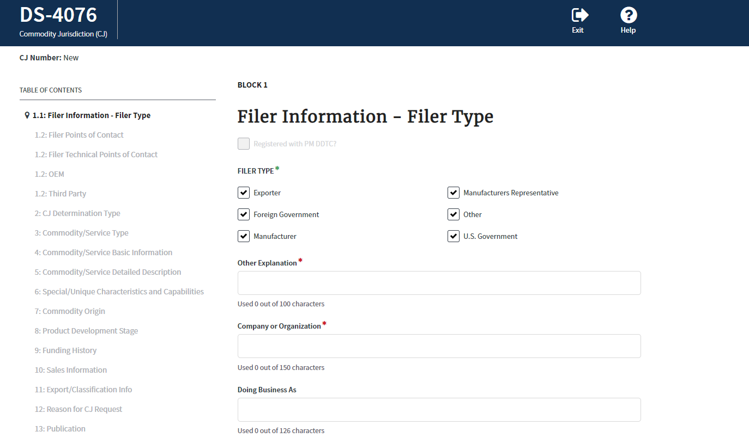
Block 1.1

Slide 4
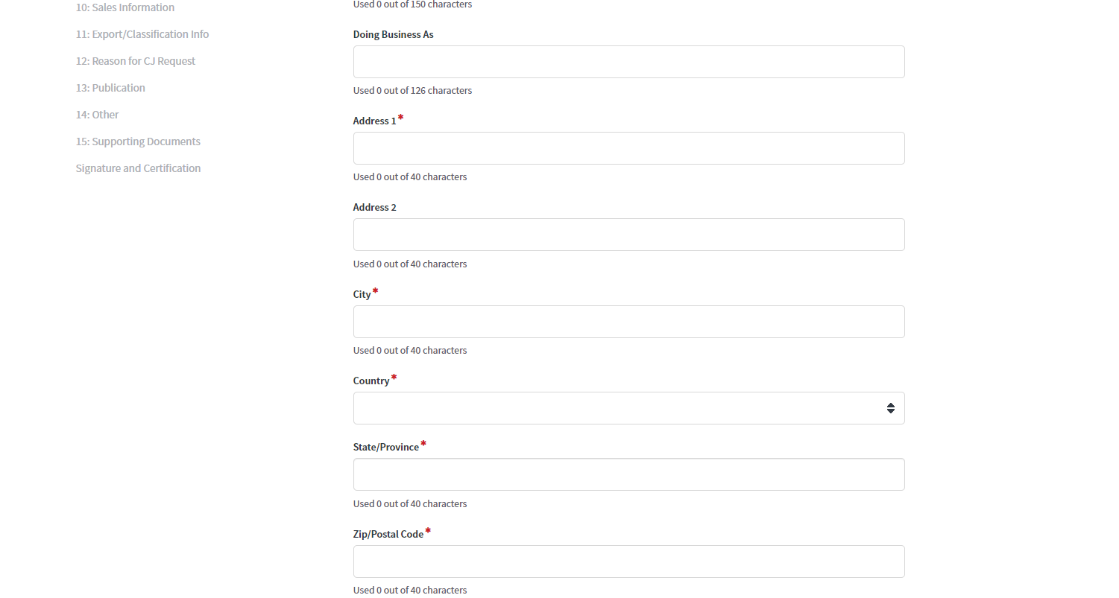
Block 1.1

Slide 5
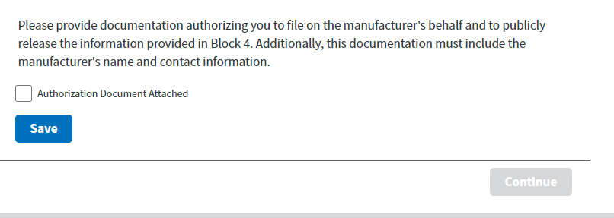
Block 1.1
Only display if Manufacturers Representative is selected

Slide 6
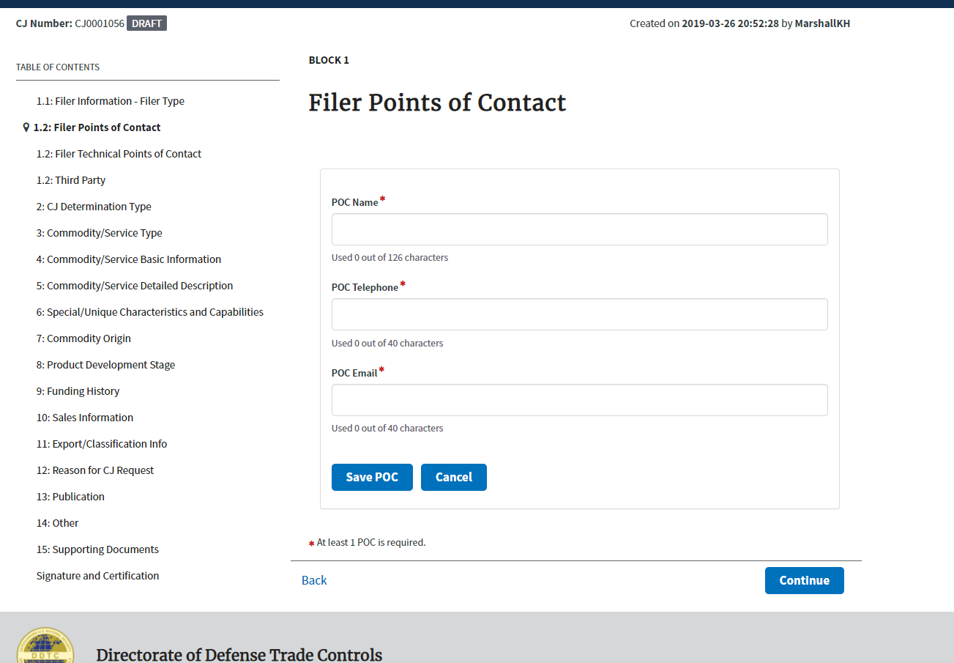
Block 1.2: Filer Point of Contact

Slide 7
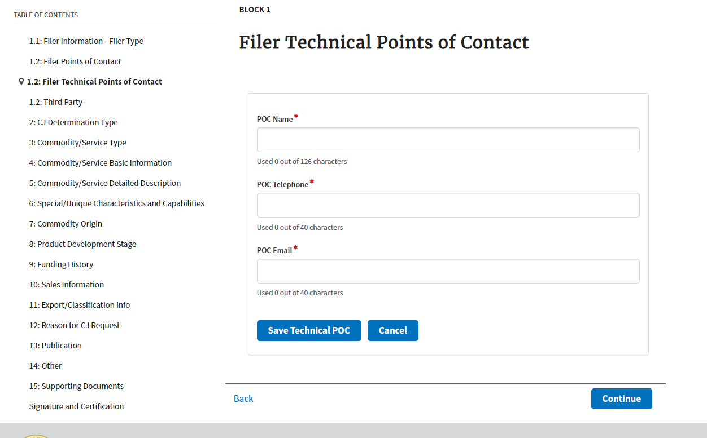
Block 1.2: Filer Technical Points of Contact

Slide 8
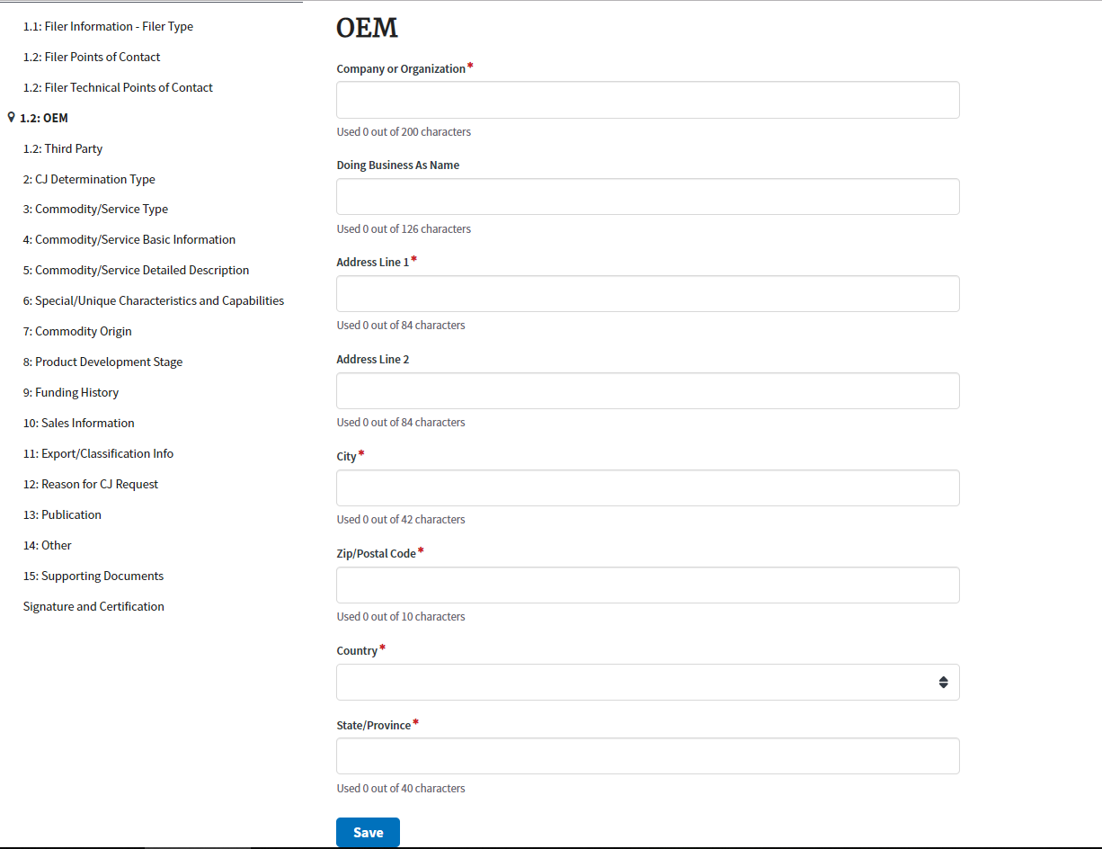
Block 1.2: OEM
- If “other” is selected for filer type.

Slide 9
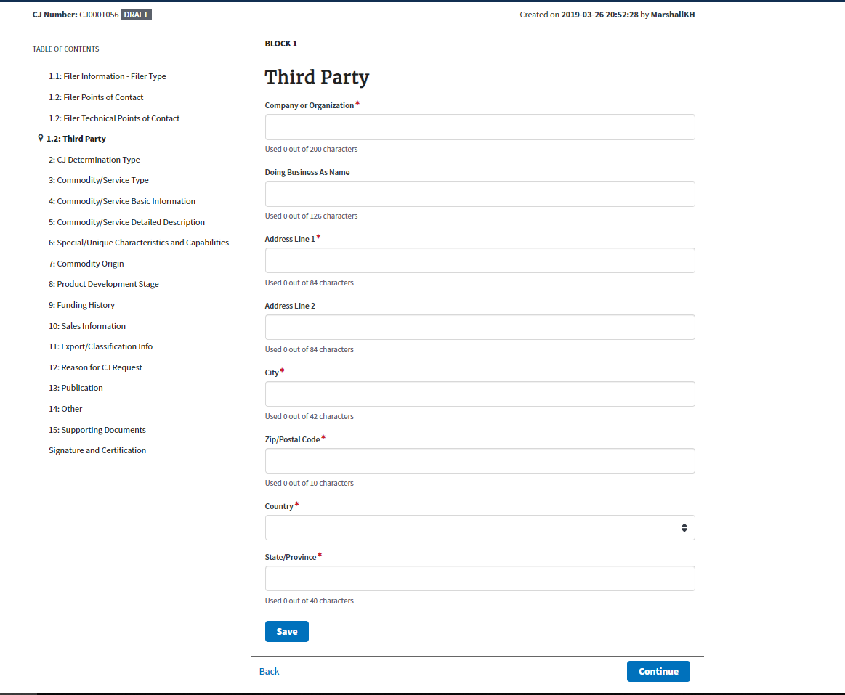
Block 1.2: Third Party Info

Slide 10
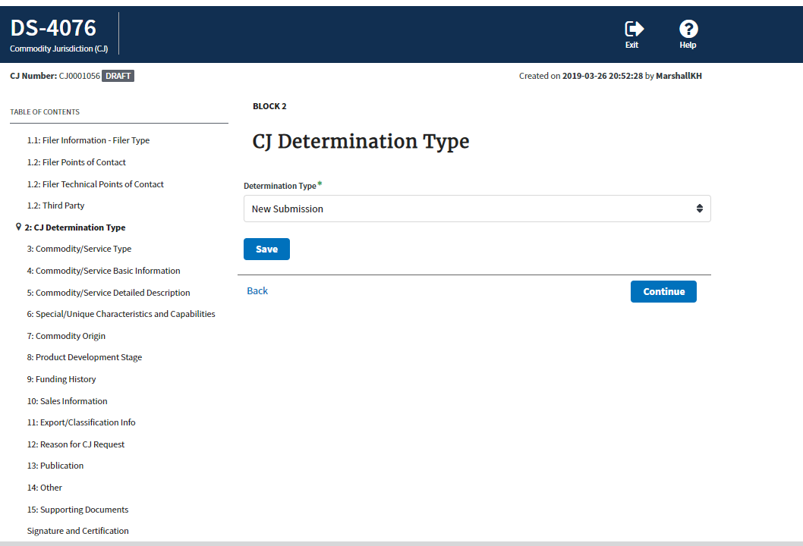
Block 2: CJ Determination TYpe

Slide 11
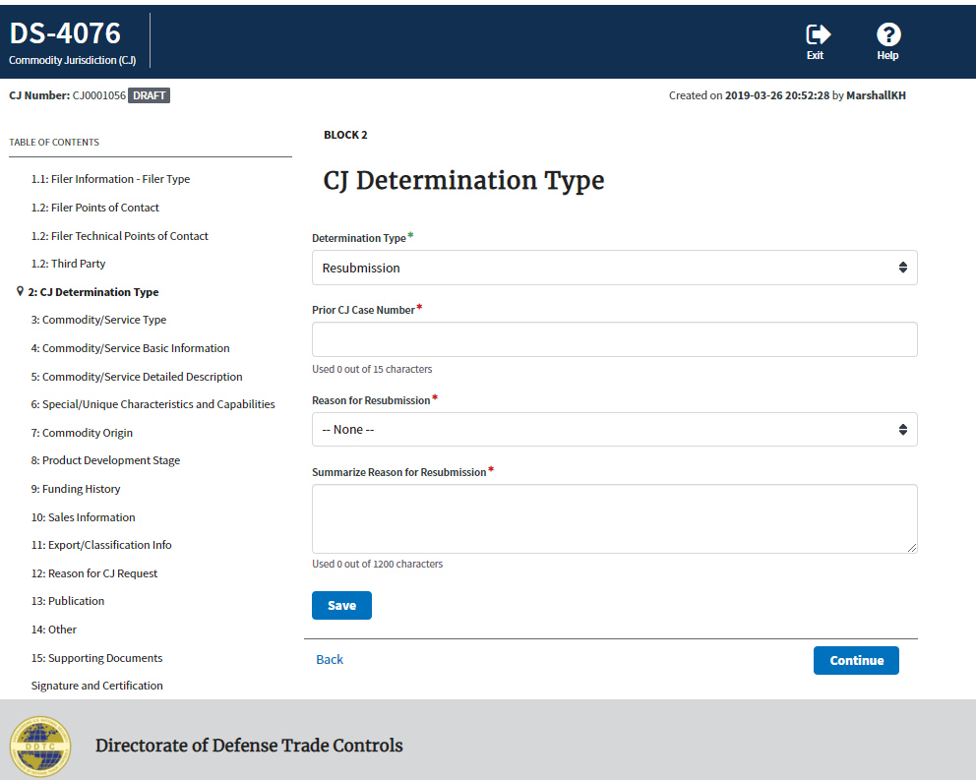
Block 2: CJ
Determination
Type

Slide 12
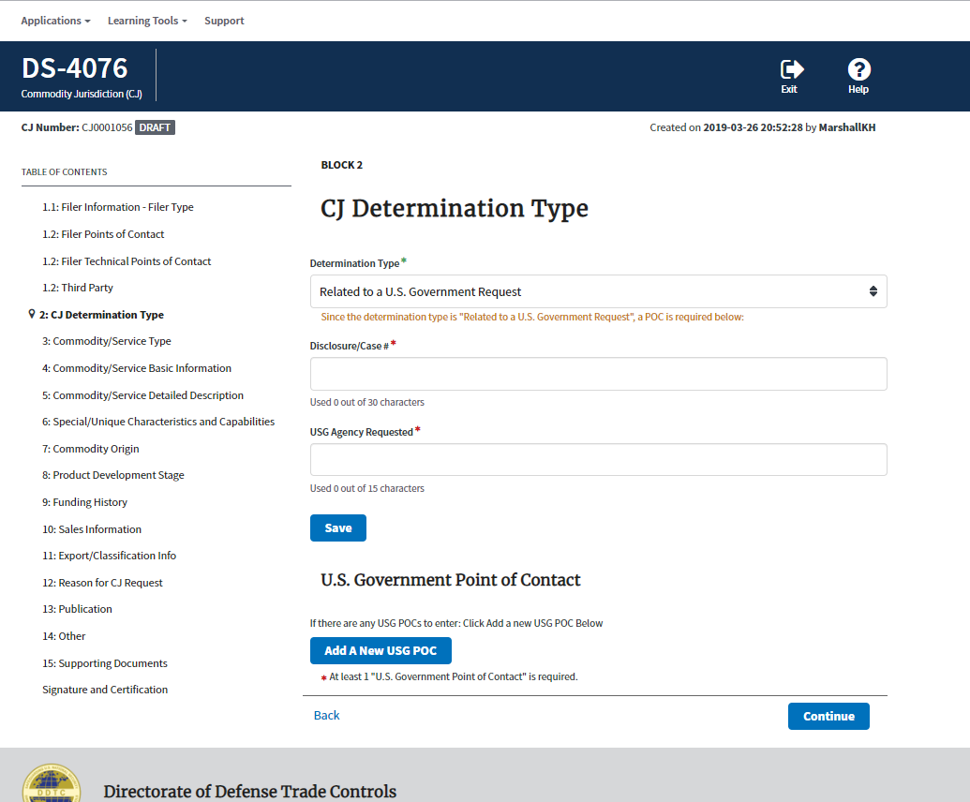
Block 2: CJ
Determination
Type

Slide 13
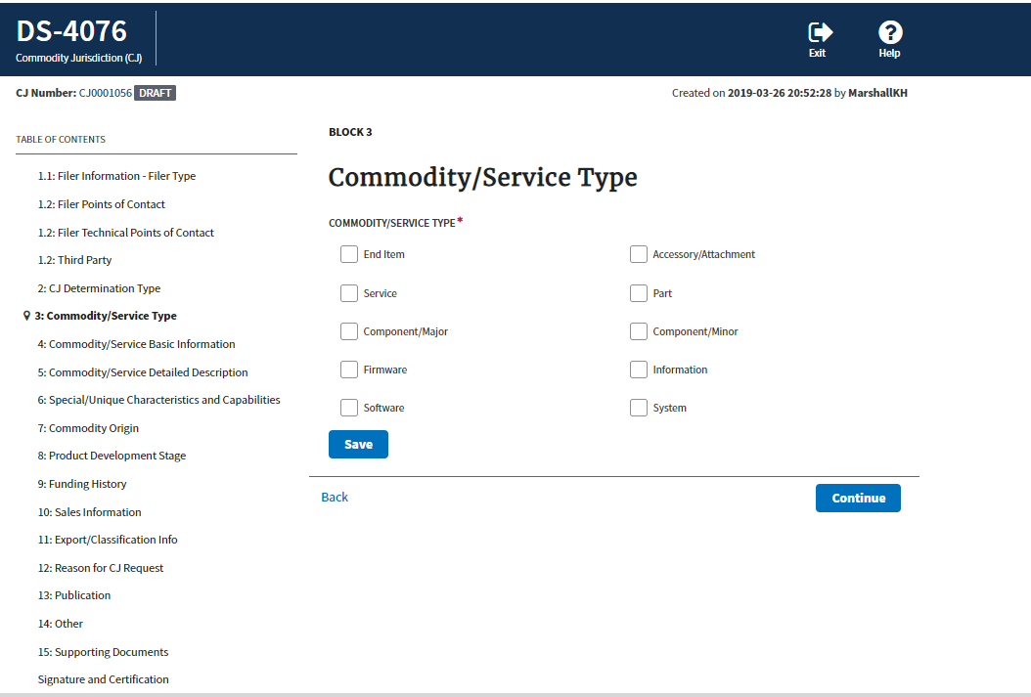
Block 3: Commodity/ Service Type

Slide 14
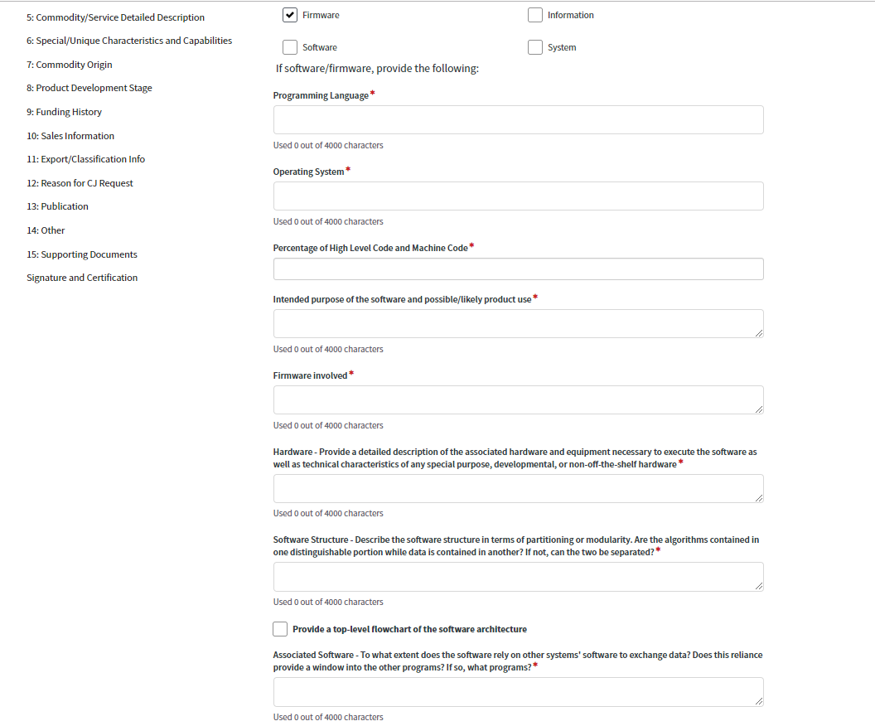
Block 3: Commodity/ Service Type Fields if Firmware/Software is selected

Slide 15
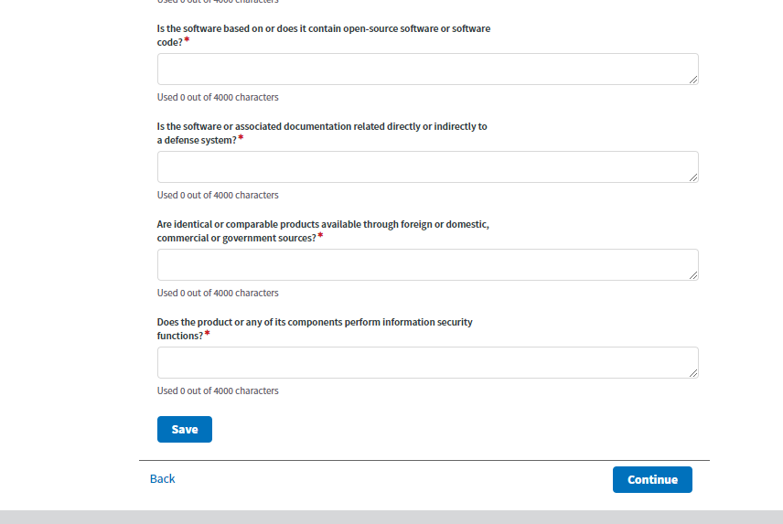
Block 3: Commodity/ Service Type Fields if Firmware/Software is selected

Slide 16
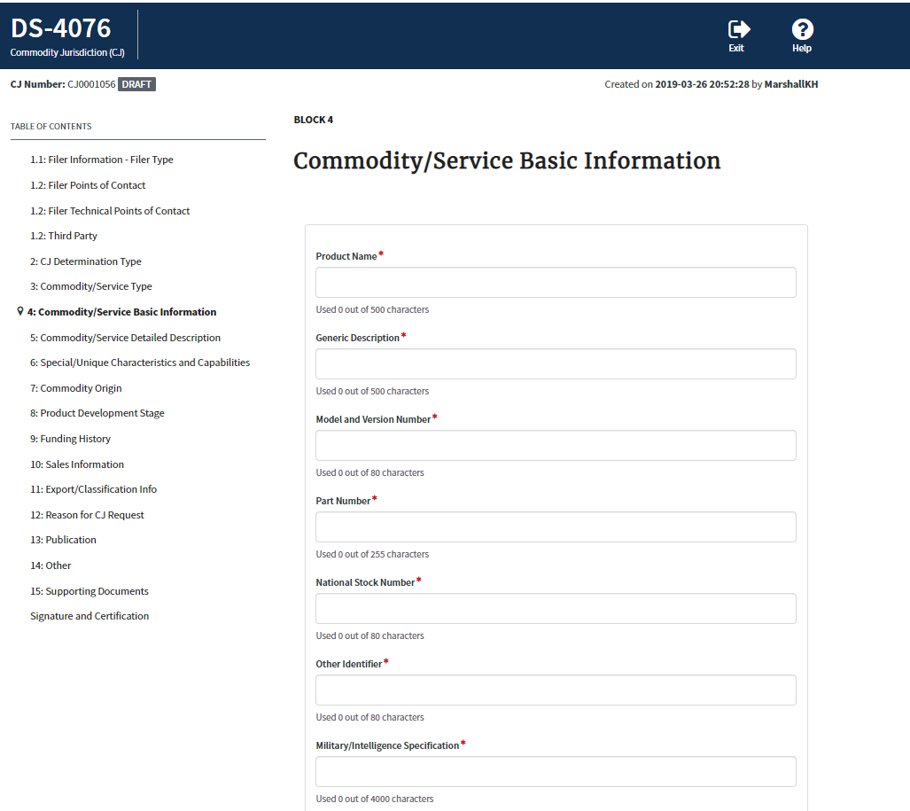
Block 4: Commodity/ Service Basic Information

Slide 17
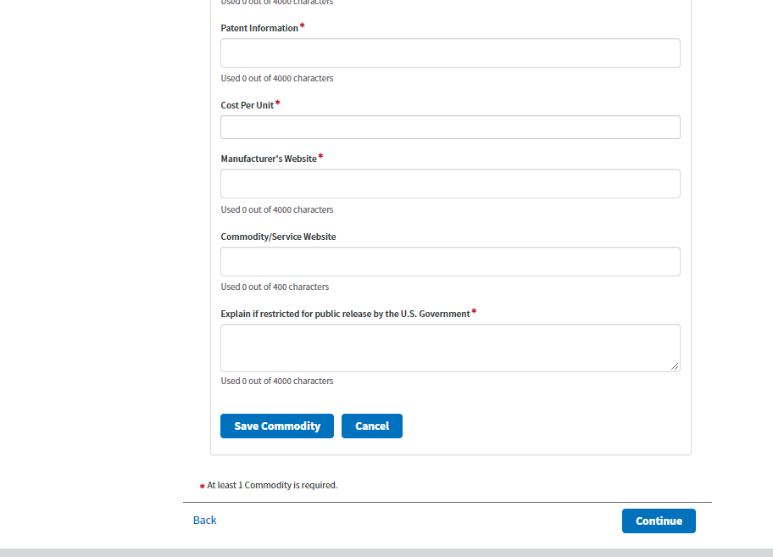
Block 4: Commodity/ Service Basic Information

Slide 18
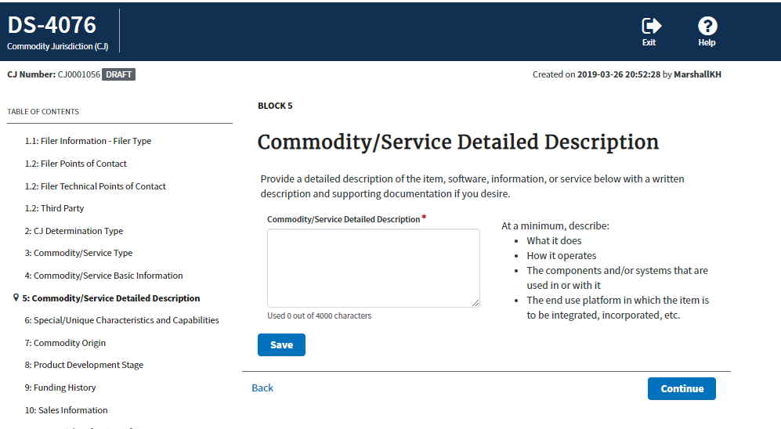
Block 5: Commodity/ Service Detailed Description

Slide 19
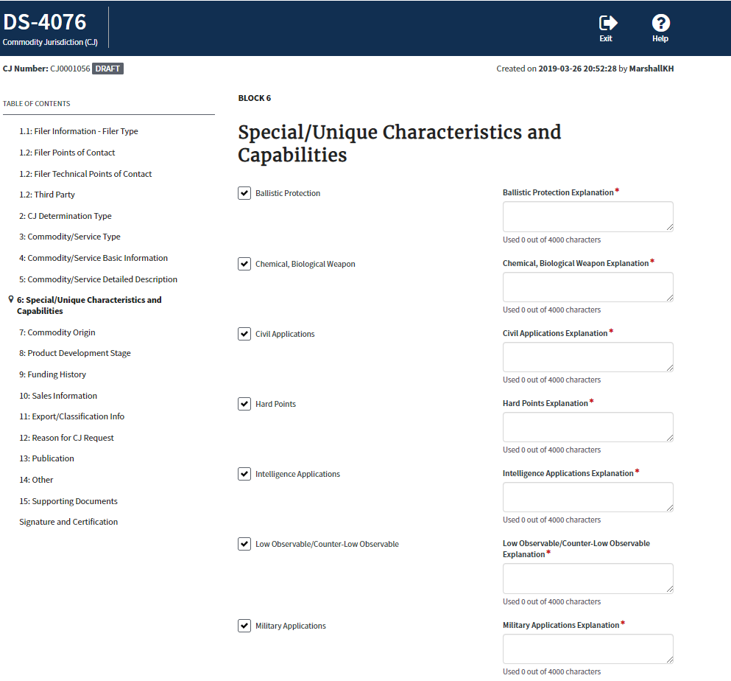
Block 6: Special/Unique Characteristics and Capabilities
- fields on right only display if box is checked on left

Slide 20
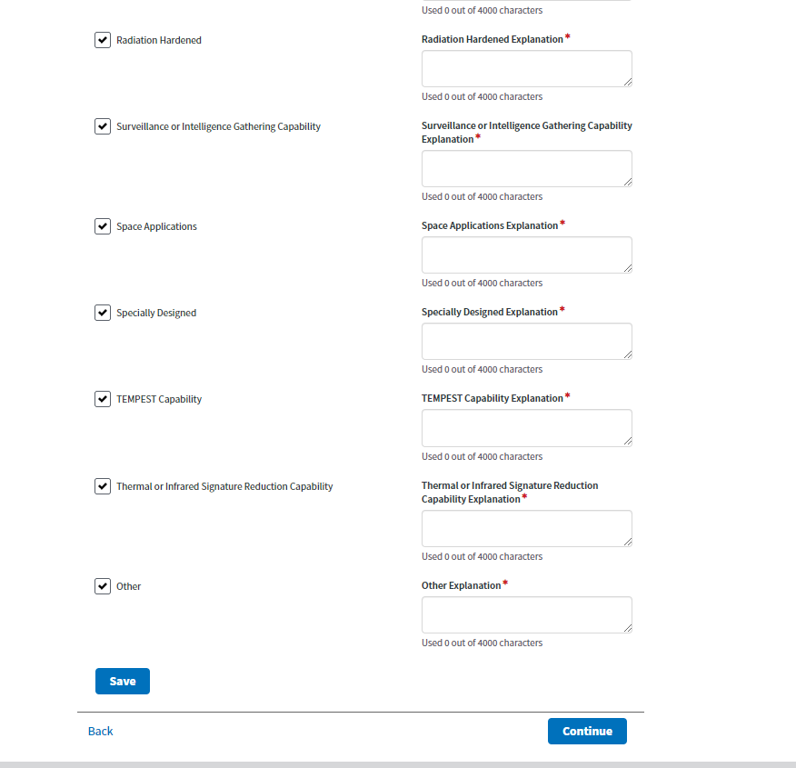
Block 6: Special/Unique Characteristics and Capabilities
- fields on right only display if box is checked on left

Slide 21
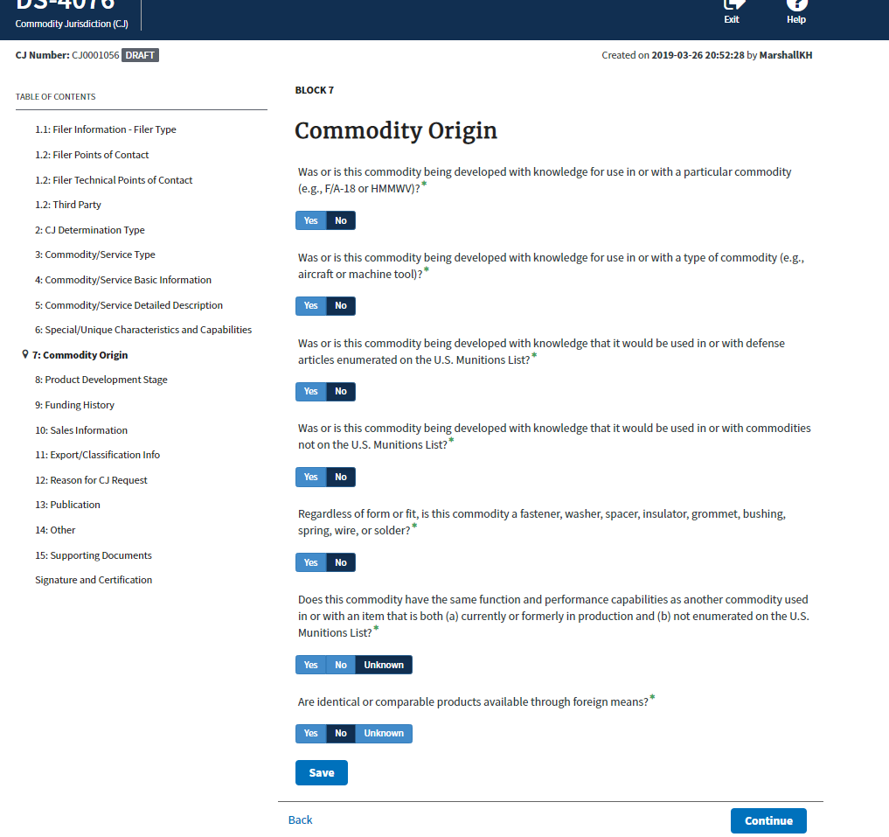
Block 7: Commodity Origin
- If yes is selected a free text box will display to enter an explanation

Slide 22
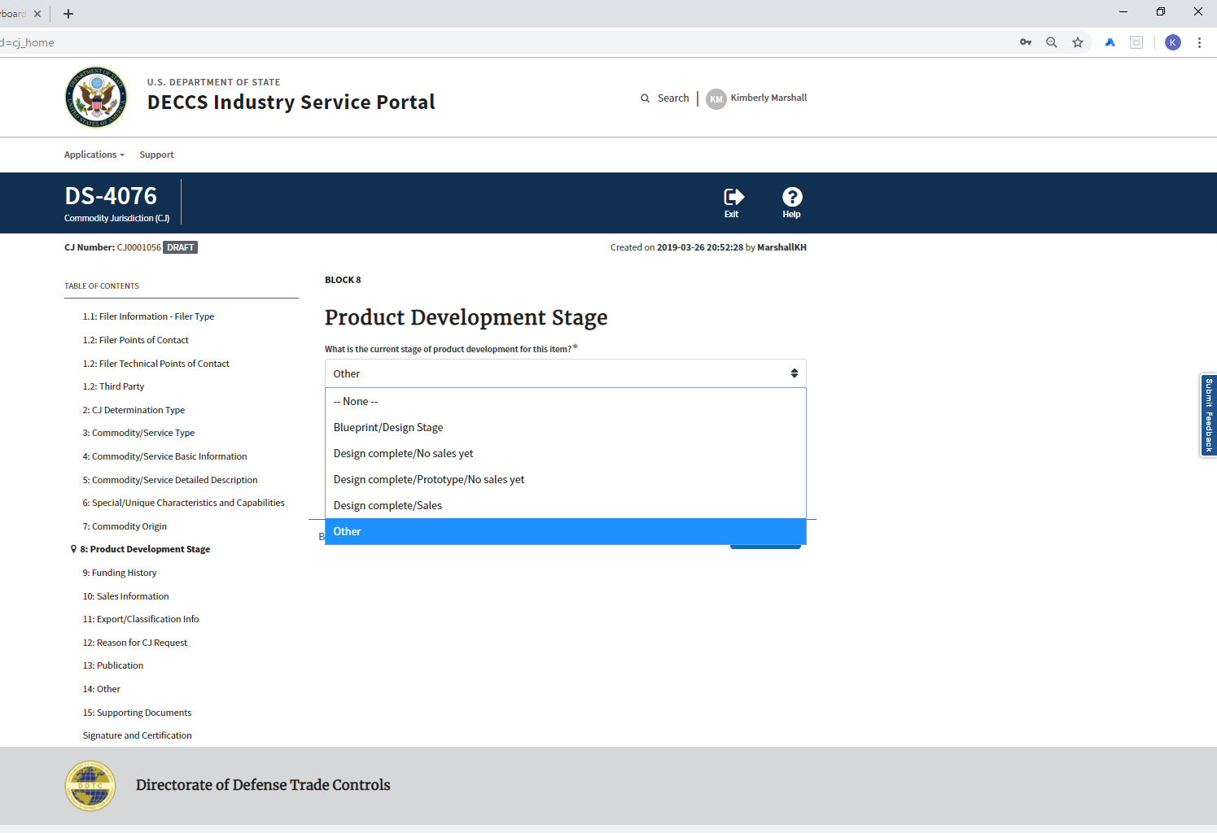
Block 8: Product Development Stage

Slide 23
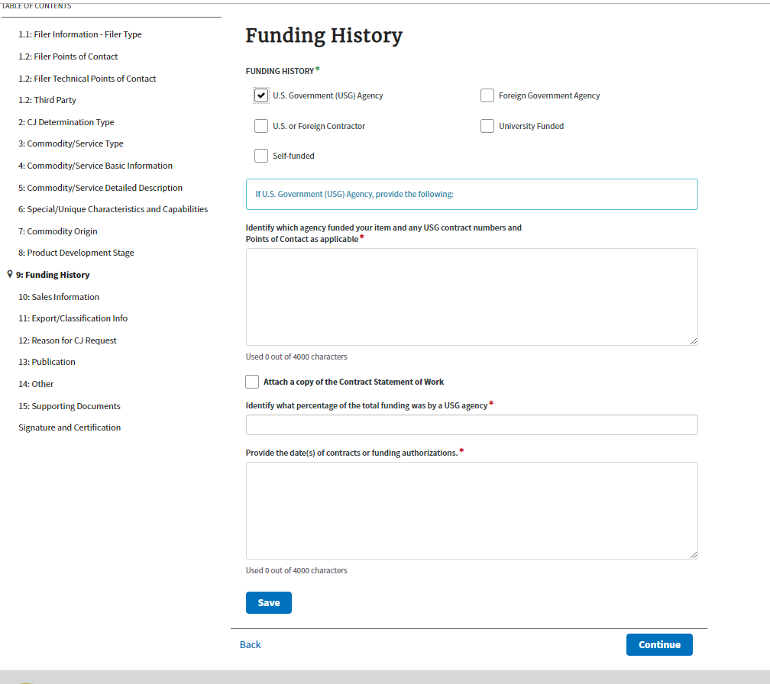
Block 9: Funding History
- If US Government Agency is selected

Slide 24
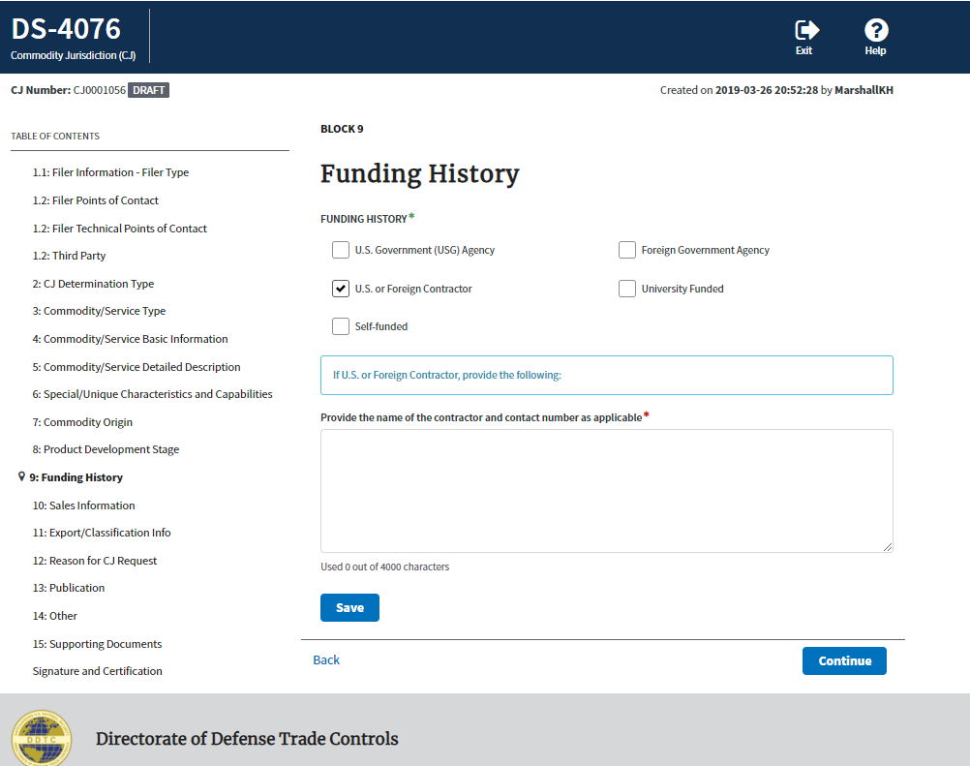
Block 9: Funding History
- If U.S. of Foreign Contractor; Foreign Government Agency; University Funded is selected

Slide 25
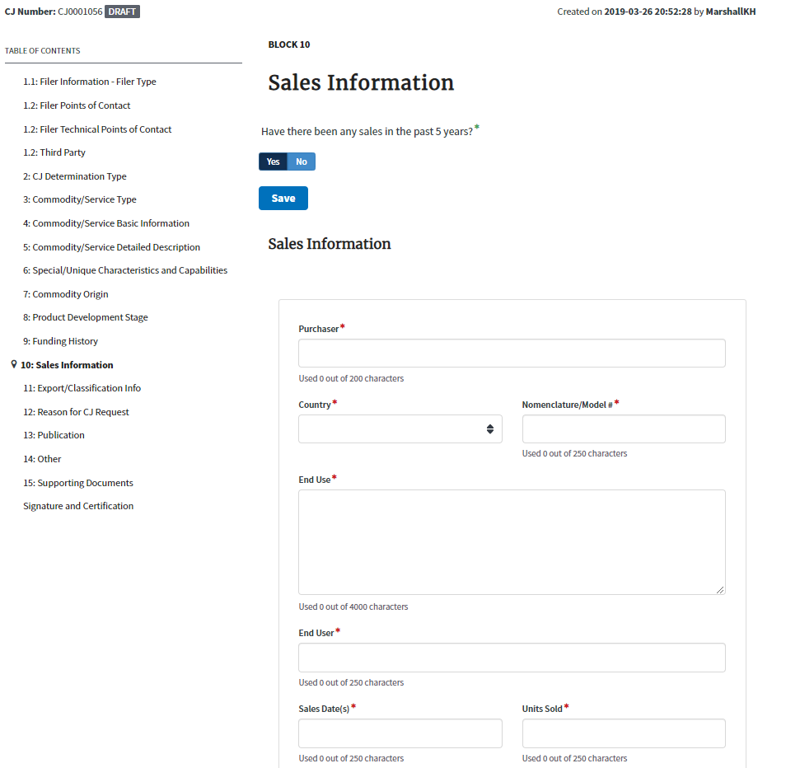
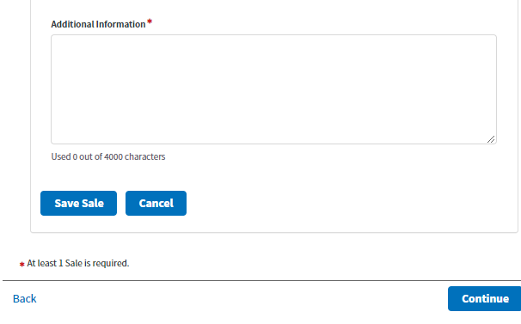
Block 10: Sales Information

Slide 26
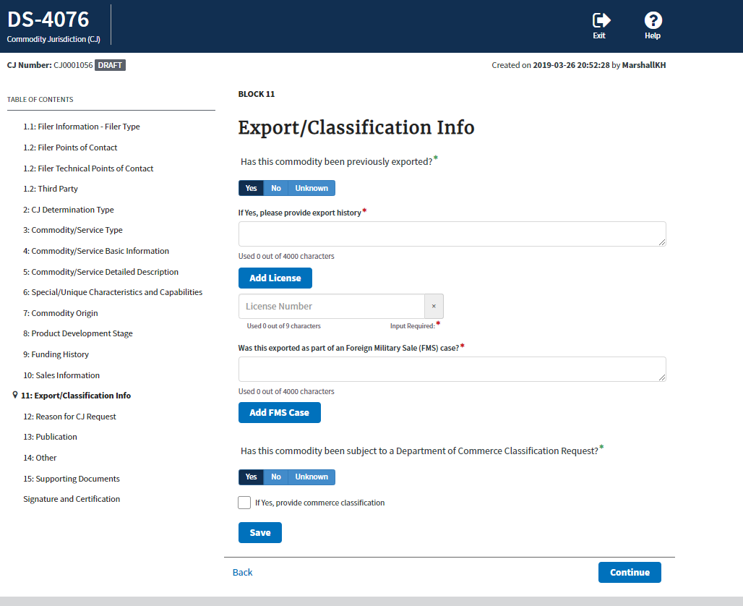
Block 11: Export/Classification Info

Slide 27
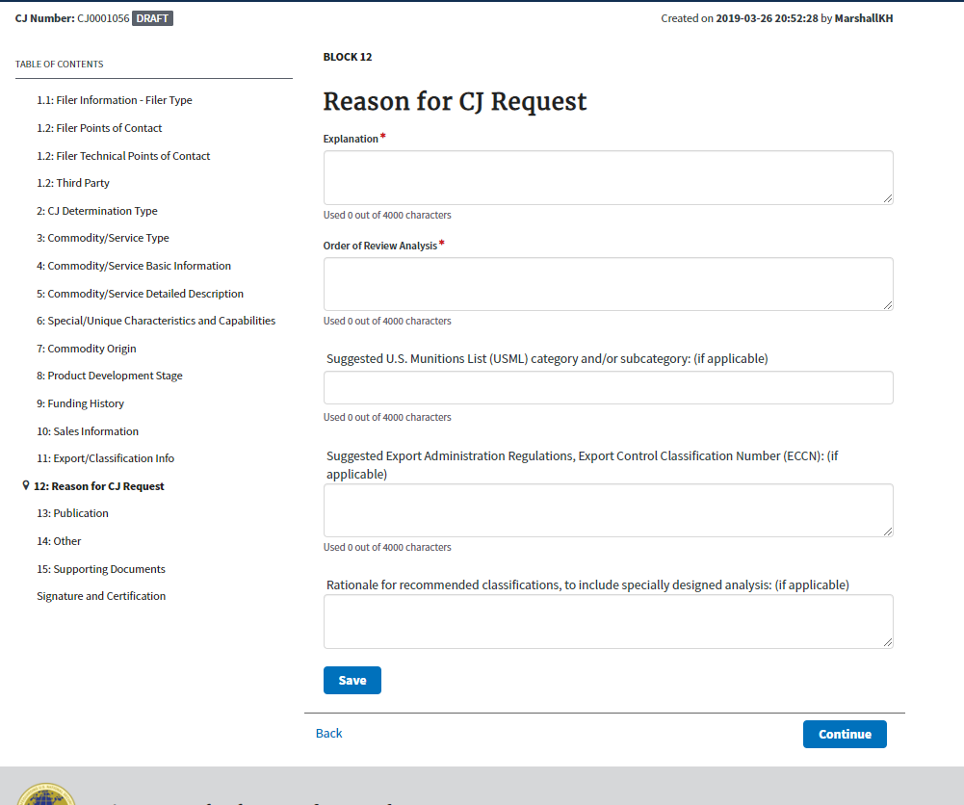
Block 12: Reason for CJ Request

Slide 28
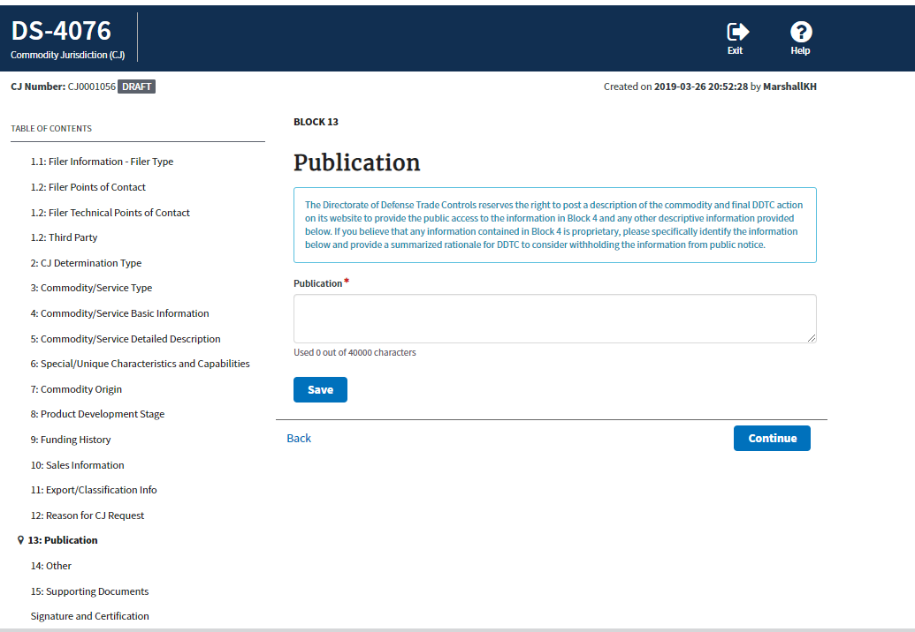
Block 13: Publication

Slide 29
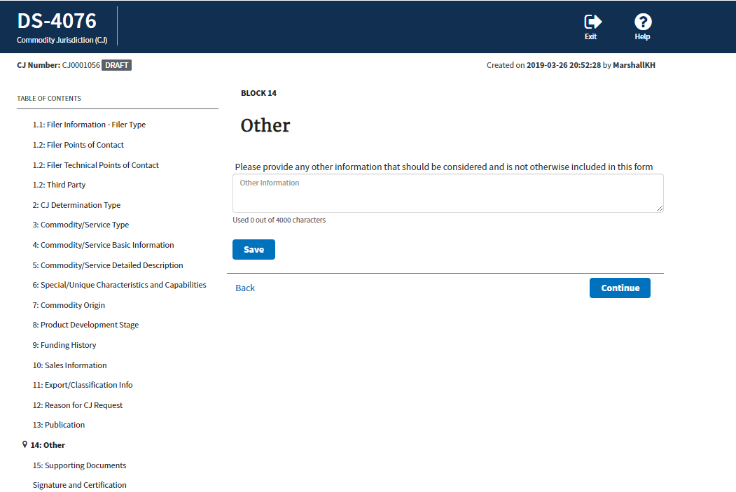
Block 14: Other

Slide 30
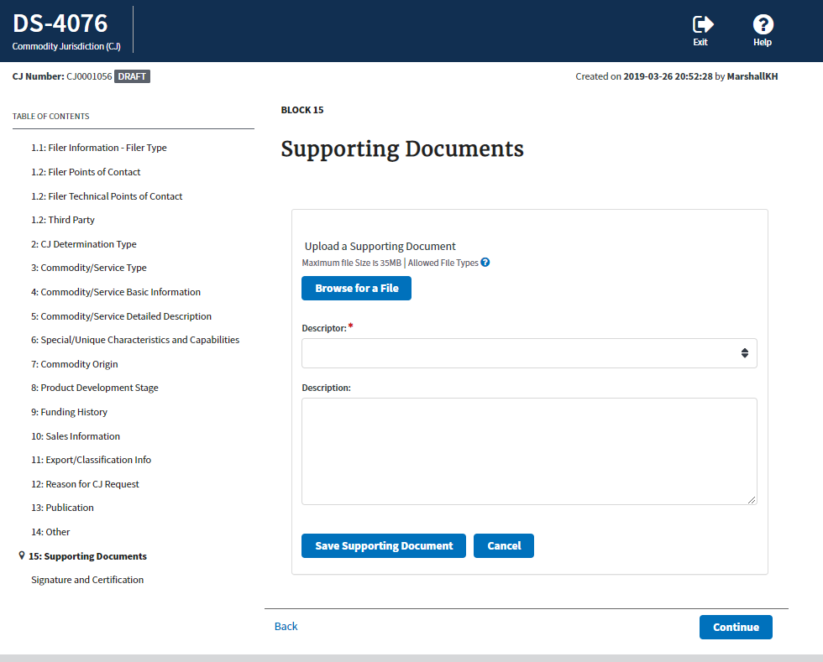
Block 15: Supporting Document

Slide 31
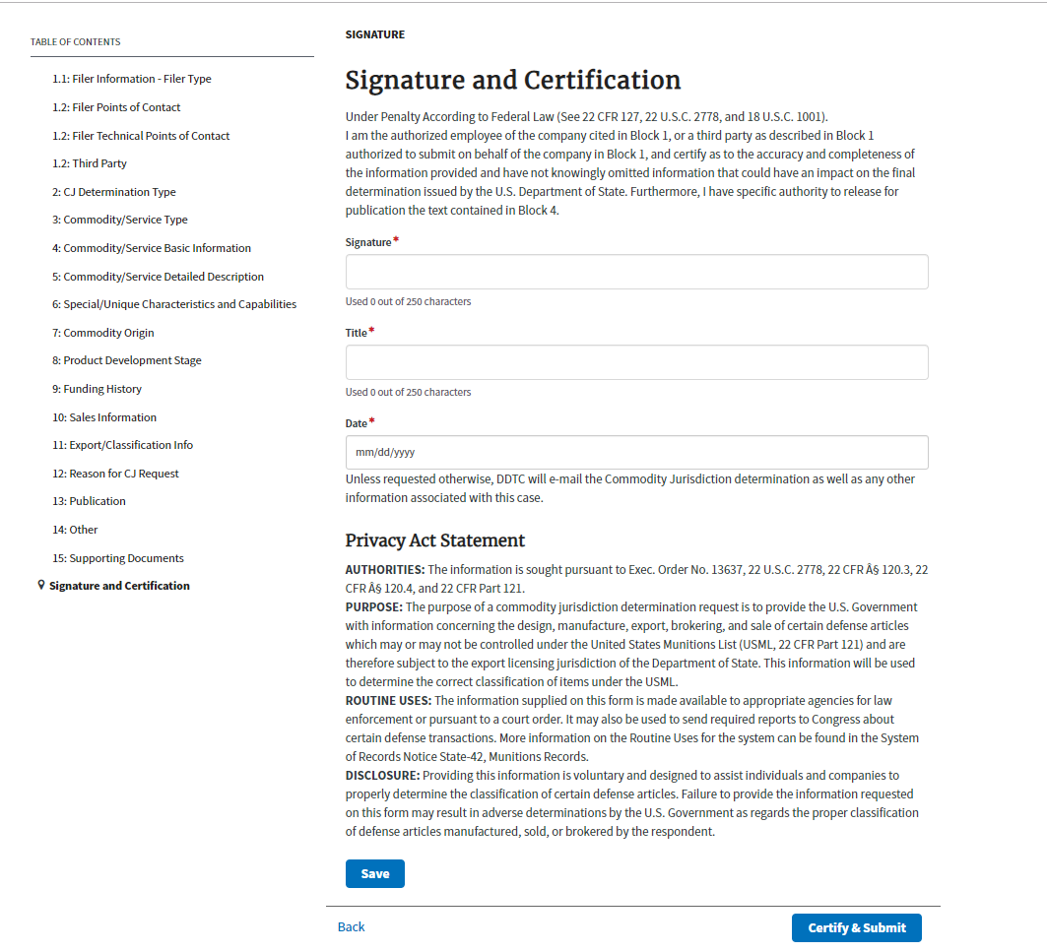
Signature and Certification

