Slide 1

Disaster Recovery Grant Reporting System Training for NSP Users
Day 2 Session
Admin
Action Plans
Drawdown
QPR
Reports
Grants
Release 7.3

Slide 2
Session Rules
Admin
Action Plans
Drawdown
QPR
Reports
Grants
Ask lots of questions
Set all cell phones to silent or vibrate.
Raise your hand if you are having computer problems or fall behind. We are here to help!

Slide 3
Today’s Agenda
Admin
Action Plans
Drawdown
QPR
Reports
Grants
Quick overview of yesterday’s material
Items to be covered:
  Drawdown Module
  Admin Module
  Reports Module
  Telling Your NSP Story via DRGR
  Common Issues & Troubleshooting
Q&A Session

Slide 4
The Basics: DRGR Modules
Admin
Action Plans
Drawdown
QPR
Reports
Grants
Action Plans
Identify activities to be funded by organization, activity type, and project.
Drawdowns
Obligate funds
for draws; create, approve, edit vouchers; receipt program income
QPRs
Summarize drawdowns, expenditures, obligations, and achievements for
the quarter
Reports
Look at financial, reporting, and user account information in an easy-to-read and exportable format
Admin
Assign and certify users; add and track TA and Monitoring Events
Notes:
DRGR is now composed of five major modules: Admin, Action Plans, Drawdowns, QPRs, and Reports. The Admin module was enhanced in late 2010 and is now a more prominent feature in DRGR. Each of these modules will be covered today. Even if you will only work within one of the modules, it is important to understand how the five modules inter-relate.
Admin: Admin module allows the grantee admin users to certify other grantee users and assign them to grants. Grantees can also record any monitoring, audit, and technical assistance (TA) events they conduct as part of grant oversight.
Action Plans: The Action Plan in DRGR mirrors the information submitted in the substantial amendment sent to HUD. If the grantee has not yet identified specific organizations and programs, the activities listed in the amendment may show as projects in DRGR. The Action Plan may be resubmitted multiple times as new activities are awarded and entered.
Drawdowns: Once the Action Plan is set up and approved, grantees will use the Drawdown Module to obligate funds, receipt program income, and create draw vouchers.
QPRs: As grantees move forward with their NSP grants, they are required to submit quarterly reports to HUD via DRGR. The information reported in the QPR module is key to demonstrating progress – both financial and performance.
Reports: The DRGR system has a comprehensive set of canned reports available to pull information out of the system, including administrative reports, financial reports, and performance reports. Reports can serve as valuable management tools for two main reasons: (1) to help grantees monitor the status and progress of their various funded projects and subrecipient, and (2) troubleshoot issues or concerns a grantee is facing within DRGR. The reports can be viewed online, printed, or downloaded as a PDF or Excel file.

Slide 5
Action Plan Review:
City of Zorro Example - Activity Structure
Admin
Action Plans
Drawdown
QPR
Reports
Grants
Financing Mechanisms (Eligible Use A)
  City LLR LH25
  City LLR LMMI
  Sub recipient LLR LH25
Acquisition/Rehab (Eligible Use B)
  Sub recipient Acquisition/Rehab LH25
  City Single Family Acquisition/Rehab LMMI
  City Multi-Family Oak Street Property LH25
  City Multi-Family Elm Street Property LH25
Notes:
The projects are straightforward. Each eligible use becomes a project, so we have Financing Mechanisms and Acquisition/Rehab. Most likely, the grantee will also be funding Admin, so that would be a third project.
Under Financing Mechanisms, we have two responsible organizations: the subrecipient and the City. This means two activities. However, the City thinks it will serve some households at or below 50% AMI and some households above 50% AMI. In order to get credit for the set-aside requirement, the households at or below 50% AMI must be associated with the set-aside national objective. To do this, the City will set up one activity with the LMMI national objective for the proposed households over 50% AMI, and one activity with the set-aside national objective for the proposed households below 50% AMI.
We see the same breakout under Acquisition/Rehab, but we see two additional activities to represent the proposed multifamily properties. Again, HUD would like these multifamily properties reported under their own DRGR activity.
Notice what is not on the slide. Please note that none of the following are “wrong,” but they tend to complicate data entry and make the whole process less efficient.
The City is not creating a separate activity for each single-family property.
The City is not breaking out separate activities for acquisition and rehab.
The City is not creating a separate activity for disposition, which can be lumped under the other activities based on its end use.
KEY POINT: The program description in the Substantial Amendment MUST be adapted for purposes of DRGR. This is not a one-for-one breakout.

Slide 6
Action Plan Review: Accomplishments
Admin
Action Plans
Drawdown
QPR
Reports
Grants
Performance Measure | NSP1 | NSP2 | NSP3
Households Benefitting | Required | Required | Required
Housing Units | Required | Required | Required
Income Levels | Required | Required | Required
Renter/Owner | Required | Required | Required
Single/Multi Family | Required | Required | Required
Race/Ethnicity | Required | Required | Required
Female-Headed | Required | Required | Required
Number of Properties | Encouraged | Encouraged | Encouraged
Green Measures | Encouraged | Required* | Required*
NSP2 & NSP3 grantees are required to identify and report on certain green features. HUD is requiring all ‘gut rehab’ and new construction must be designed to meet, at a minimum, the standard for Energy Star Qualified New Homes. Those grantees who chose to include higher green measures (like Enterprise Green Communities or LEED) in their application and/or substantial amendment should be reporting on that.
Notes:
This slide illustrates which of the accomplishment and beneficiary data is required and which is encouraged.
The majority of fields are required. Some of these fields, like Race/Ethnicity and Female-Headed Households, will only appear on the quarterly report; there is no need to break out your goals by these characteristics.
Again, many grantees have not gone back and back-filled these data elements. It is important for grantees to do so as if the information is not provided on the Action Plan (the front end), the grantee will not have an option of reporting under these categories in the QPR (the back end).
It is recommended that you verify this information is in the system before submitting your next QPR. Some of the Microstrategy Reports can quickly summarize the proposed goals entered for each activity.
You can add a wide variety of additional accomplishment data, but if you don’t have that particular item as a regular component of your program and you won’t be tracking it, don’t include it.

Slide 7
QPR Review
Admin
Action Plans
Drawdown
QPR
Reports
Grants
Purpose
  Report progress for quarter and cumulative basis by:
    Identifying accomplishments once a national objective has been met
    Pulling financial data as entered in the Drawdown Module
    Detail, in narrative format, progress of the grant as a whole and per activity
HUD FO role
  Approval or rejection of the QPR in a timely manner
  Provide and share comments with grantees (if desired)
Notes:
Given the urgency associated with NSP, HUD wanted to make sure there was good communication between the grantees and the HUD Field Office regarding performance. The QPR module in DRGR provides a tool and framework for that communication. It is the tool to identify progress towards statutory requirements, such as national objectives being met and progress toward expenditure milestones.
You, the grantee, will show progress on three levels:
Performance – by identifying actual metrics once a national objective has been met
Financial – by all the financial data entered into Drawdown Module that quarter
Narrative – by explaining how the program is progressing
After the end of each quarter, the grantee will create and submit a QPR. The HUD Field Office will review it and approve or reject the report in a timely manner.

Slide 8
DRGR Navigation Rules
Admin
Action Plans
Drawdown
QPR
Reports
Grants
Navigate using DRGR Links, rather than your browser’s.
Never use your browser’s BACK button.
Logout using the Logout link in Utilities – don’t just close the window.
Save early, save often! System times-out after 20 minutes.
If you want to copy/paste text into DRGR, do so from Notepad or a file in .txt format.
Notes:
Some basic navigation rules that are important enough to reiterate:
Just like other websites, you will navigate DRGR by clicking on linked text and buttons within the page. Any text that is underlined is typically a link.
Unlike on other websites, users should NOT use the browser’s “back” and “forward” buttons.
When copying and pasting from another document, we recommend taking an intermediate step of pasting into Notepad first. This will remove formatting from the copied text. Once the text is in Notepad, you can copy it again and paste into DRGR. If you copy and paste directly from Word or a PDF, some of the formatting, like bullet points, will be corrupted in the downloadable versions of the action plan and QPR.
When you are finished and would like to leave DRGR, instead of just closing the browser, always log out first. If you do not log out, you will be locked out of the system for at least 30 minutes.

Slide 9

Drawdown Module
Admin
Action Plans
Drawdown
QPR
Reports
Grants
Obligating Funds
Program Income
Create Vouchers
Create and Approve Draw Vouchers
Voucher Corrections
9
Notes:
This section will cover the functions that can be performed in the Drawdown Module. This include:
Obligating funds
Reporting and applying program income
Creating and approving draw vouchers
Correcting or revising vouchers

Slide 10
Drawdown Module Overview
Admin
Action Plans
Drawdown
QPR
Reports
Grants
Obligate Funds to Activity
Draw Requester
Draw Approver
Create Voucher
(with at least 1 Line Item)
Draw Requester
Review & Approve Line Items
Draw Approver
Once processed by LOCCS, payment is received in 2-3 days
Drawdown Process
  Obligate Funds
  Create Draw Voucher
  Approve Draw Voucher
  Over Threshold?
    Yes – Send additional info to HUD for approval
    No – wire transfer in 2-3 days
Additional Functions
  Draw Corrections
    Revise
    Reject
    Cancel
  Program Income
Draw sent to HUD for review if over threshold
Notes:
The Drawdown Module is where nearly all of the financial functions of DRGR are located. This includes reporting obligations and initiating the reimbursement of eligible expenditures from the grant line of credit.
The request for funds is called a “drawdown” request, thus the name of the module.
Each drawdown request becomes a “voucher,” or a record of the drawdown request against the grant line of credit.
In order to draw down grant funds and receive reimbursement from the U.S. Treasury, you must complete several tasks within DRGR. These are summarized below. Detailed instructions on completing each of these tasks will be provided later in this section. It is assumed that a grantee has already set-up their Action Plan and submitted and received approval on the original submission.
Obligate grant funds to an activity from a project.
Create the voucher.
Approve the voucher.
Note that if a voucher line item exceeds a drawdown threshold, it is forwarded to HUD for approval before being submitted to LOCCS.
DRGR will then automatically “send” the voucher to the federal Line of Credit Control System, also called “LOCCS.”
This is the system used to directly reimburse grant funds to grantees.
It is an interface with the U.S. Treasury.
LOCCS will receive and process the item overnight.
Funds will be wired to you two to three days from when the voucher is processed.
Please remember that the ability to perform these tasks is restricted by the user permissions granted to the individual DRGR user.
DRGR also allows draws to be revoked, cancelled, and revised, and for program income to be reported as received and applied.

Slide 11
Drawdown Module Overview: Field Office Actions
Admin
Action Plans
Drawdown
QPR
Reports
Grants
Give policy recommendations on when/how to obligate funds.
Get help from CFO if grantee has missing Tax ID (TIN) or Bank Routing Information in LOCCS.
Take action on draws over the threshold.
Notes:
Most drawdown actions can be completed by grantees alone. However, there are some instances where HUD staff may have to assist the grantee.
HUD field office staff can help grantees determine what is, and what is not, a valid obligation: this is specifically essential for NSP1 grantees that have a obligation milestone.
If the grantee is having issues with their Tax ID (TIN) or Bank Routing Information in LOCCS, they may not be able to draw funds from the system. The field office staff can help troubleshoot issues in these cases.
HUD can take action on draws over the threshold. Details instructions are slide 100 of this training.

Slide 12
Obligate Funds
Admin
Action Plans
Drawdown
QPR
Reports
Grants
All funds Obligated at Activity Level
  Obligated funds include both Program Funds and Program Income (as of Release 7.3)
Must meet NSP1 definition of Obligation
  If questionable, clarify with CPD Rep
Must have Request or Approve Drawdown role
Notes:
Funds must be obligated to an activity before they can be drawn. This serves both as a financial function that precedes the drawdown and reports to HUD that funds have been obligated. Note that obligations are made at the activity level, not at the project level. (Keep this in mind when setting up activities in your Action Plan.)
NSP1 grantees should keep in mind that obligations are a milestone requirement for NSP1 grantees, particular attention should be paid to the timing of making obligations in DRGR. Please consult HUD guidance regarding the NSP definition of “obligation.”
Obligating funds can be performed by users with “Request Drawdown” or “Approve Drawdown” permissions.

Slide 13
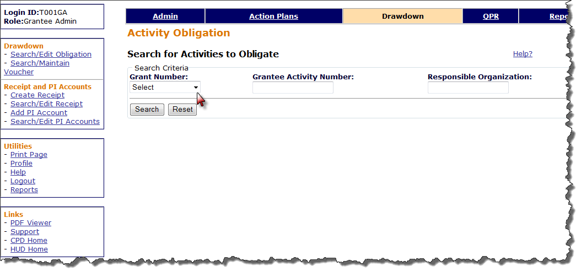
Obligate Funds
Admin
Action Plans
Drawdown
QPR
Reports
Grants
Necessary Roles: Request Drawdown or Approve Drawdown
Notes:
Selecting the “Drawdown” module in the top navigation menu will take you automatically to the Activity Obligation screen. To get there from other screens within the drawdown module, use the module navigation links in the left margin.
From the Activity Obligation screen, you will search for activities to obligate funds to them.
You may search by Grant Number, Grantee Activity Number, and/or Responsible Organization. Once you enter the search criteria, click on the “Search” button. To clear the criteria or start over, click on the “Reset” button.
Remember: You must have user permission to either create drawdowns or approve drawdowns in order to obligate funds.

Slide 14
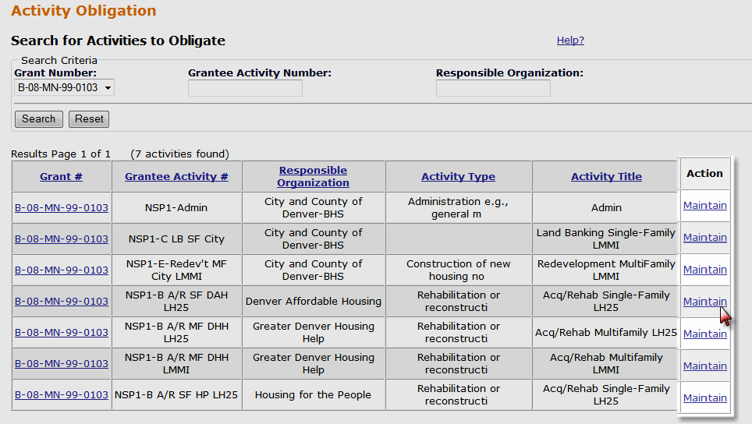
Obligate Funds
Admin
Action Plans
Drawdown
QPR
Reports
Grants
Make sure you are searching under the correct grant #
14
Notes:
After clicking “Search,” results will appear that meet the search criteria. The default sort order is Grant Number, Responsible Organization, and Grantee Activity Number.
Note that the results may be presented on more than one page. Click on the links below the results table to see more results.
Results can be narrowed by modifying or adding search criteria and clicking on the “Search” button again.
To change the obligation amount, click on the “Maintain” link in the “Action” column at the end of the row for the activity.

Slide 15
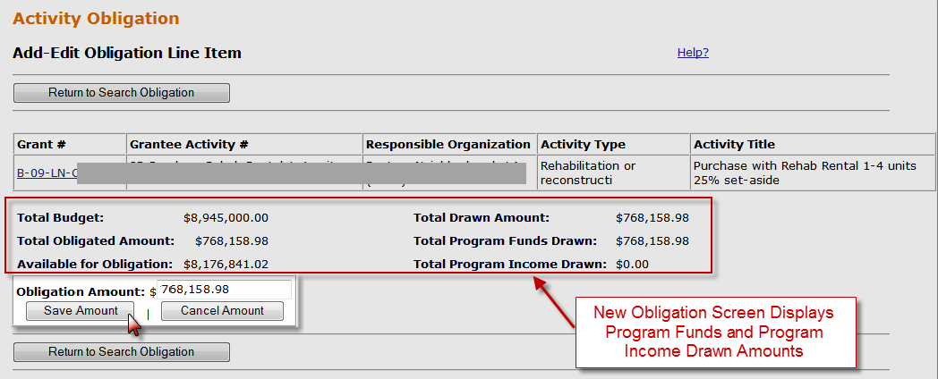
Obligate Funds
Admin
Action Plans
Drawdown
QPR
Reports
Grants
Notes:
Clicking on the link will take you to the “Add-Edit Obligation Line Item” screen. You will see Activity information, including;
Associated grant number
Grantee assigned activity number
Entity responsible for undertaking the activity
Activity type
Activity title
This screen will also show current financial information you will need to determine how much (or how little) you can obligate. Remember the math rules of DRGR (see next slide).
Total Budget (from your Action Plan)
Total Obligated Amount (currently obligated)
Available for Obligation (above and beyond the current obligation amount)
Total Drawn Amount (includes all processed vouchers)
Total PF and PI amounts drawn.
In the “Obligation Amount” field (the only field that can be edited on this screen), enter the total amount you wish to have obligated to the activity.
Click on the “Save Amount” button to change the obligation amount to the new amount entered.
You will receive the message “Obligation Amount successfully saved” if the change was accepted. If not, you will receive an error message. If you see an error message, review the math rules.
As of Release 7.3, the obligation screen provides a breakdown of the Total Amount Drawn by Program Funds and Program Income.

Slide 16

Obligate Funds: Drawdown Math Rules
Admin
Action Plans
Drawdown
QPR
Reports
Grants
Obligation amounts must be less than or equal to the Total Activity Budget and greater than or equal to the Total Drawn Amount
  (can’t decrease the obligation amount to less than the amount that has already been drawn down)
$1,000,000 ≥ $500,000 ≥ $200,000
**As of Release 7.3, grantees enter BOTH program funds and program income as part of the Total Activity Budgets and Activity Obligations.
Activity Budget ≥ Obligation ≥ Total Activity Drawn Amount (PF+PI)
Notes:
DRGR Math Rules
There are internal controls within DRGR that serve as checks and balances. These “math rules” will stop you in your tracks if you ignore them.
Grantees will not be able to change an obligation amount to an amount that is:
More than the total amount of un-obligated funds available to the grantee in DRGR; or
Less than the amount that has already been drawn down against an activity.
The amount available to obligate is the total budget (in the Action Plan) less the total currently obligated. This is not the same as the maximum obligation amount. The maximum amount that can be obligated is the amount available to obligate plus the amount currently obligated. The financial information provided on the “Add-edit obligation” screen is key to understanding the possible obligation amounts.
The Activity Budget was set in the Action Plan at $1M.
The Obligation can never exceed the Budget. The Obligation, as recorded in the Drawdown Module, thus far has been $500,000.
The Total Activity Draw Amount can never exceed the Obligation which can never exceed the Budget. Total draws to date for the activity for both Program Funds and Program Income is $200,000.

Slide 17
Obligating Funds
Case Study 8
Admin
Action Plans
Drawdown
QPR
Reports
Grants
Notes:
Let’s obligate funds!

Slide 18
Program Income (PI)
Admin
Action Plans
Drawdown
QPR
Reports
Grants
  Purpose and Functionality of Updates (Release 7.3)
    Budgeting
    PI Receipts
    PI Accounts

Slide 19
Program Income (PI): Purpose of Updates
Admin
Action Plans
Drawdown
QPR
Reports
Grants
As of Release 7.3, the changes in DRGR now:
  allows Activity budgets and obligations to include estimated program income for budgeting to be more interactive.
  complies with the requirements for spending program income first.
  creates a means (called Program Income Accounts) that identifies organizations that a grantee allows to retain PI, and not return to the grantee, for their own uses.
  identifies each PI transaction rather than recording amounts quarterly as in the past.
  creates a means (at the Project level) for users to identify Revolving Loan Funds (RLF)
Notes:
DRGR Release 7.3 made some significant changes to the way Program Income in reported and drawn in DRGR. This and the next few slides outline some of these changes.

Slide 20
PI: Functionality of Updates
Admin
Action Plans
Drawdown
QPR
Reports
Grants
  Budgets: Add estimated PI at the grant level as a distinct line item. Add estimated PI as a component of the Project/Activity Budget.
  Draws: To draw funds, DRGR requires all Program Income received in each RLF or PI account to be used before Program Funds. Similar rules apply to activities outside RLF and PI accounts (termed “General Account” for PI)
  PI Account: Add and Edit/Search Program Income Accounts to identify activities with the organization they fund that are allowed to retain PI for their own uses.
  PI Receipt: Create and Edit/Search Program Income Receipts to identify each PI transaction rather than recording amounts quarterly as in the past.

Slide 21
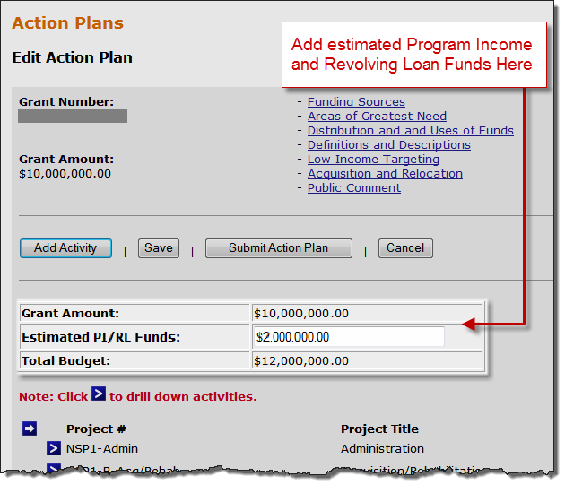
PI: Budgets at the Grant Level
Admin
Action Plans
Drawdown
QPR
Reports
Grants
  Estimate the amount of Program Income the grant will receive over the grant. Re-evaluate regularly to ensure enough funds to accommodate project and activity budgets.
Notes:
On the Action Plan page, you can now enter amount of PI or RLF the grant is estimated to generate. The estimation is done at all three phases of the budgeting in DRGR: at the Grant Level, for Projects, and Activities. These budgets should be re-evaluated periodically to ensure accuracy and to verify enough funds to accommodate Project and Activity budgets. The Grant level the only place that breaks out the PI or RLF, in the Project and Activity budgets it is entered as one sum amount (PF+PI).
At the grant level, for the Edit Action Plan screen, the Grant Amount is automatically loaded into DRGR when the grant is originally entered into the system. The Estimated PI/RL Funds is an editable line item. The Total Budget line sums the Grant Amount and Estimated PI/RL Funds; it provides the budget that the sum of the Project Budgets can not exceed.

Slide 22
PI: Budgets for Project/Activity
Admin
Action Plans
Drawdown
QPR
Reports
Grants
  Total Project and Activity budgets must include program funds and estimated program income.
  Re-evaluate regularly to ensure enough funds to accommodate project and activity budgets.
  Math Rules:
Project/Activity Budget = Program Funds + Estimated PI
  Total Budget (Grant Funds + Estimated PI/RL Funds) ≥
  Sum of Total Project Budgets ≥
  Sum of Total Activity Budgets (per Project)
Notes:
For Projects and Activities, a user includes estimated Program Income budget in the Total Budget.

Slide 23
PI Categories
Admin
Action Plans
Drawdown
QPR
Reports
Grants
PI will now be categorized as:
General Account: Pool of all PI receipted that is not in any individual RLF or PI Account(s).
PI Account(s): Separate accounts created by grantee to identify Activities under their funding agreements with their organizations that allow these organizations to RETAIN and use PI on their own Activities. In effect, PI Accounts allow users to “wall off” PI receipts for specific Activities.
Revolving Loan Fund(s): Projects to identify activities of a single Activity type where loan repayments are used to fund new loans
General Account
All PI received on any unassigned Activity must be disbursed before PF on any unassigned Activity
PI Account
All PI received in an any Activity in each PI Account must be disbursed before PF in the PI Account
RLF Project
All PI received in an any Activity in each RLF project must be disbursed before PF in the RLF Project
Notes:
PI is receipted and disbursed by Activity, and each Activity is associated with either a PI Account (as set up by the user), a General PI Account (default account if an Activity has not been associated with a PI Account), or a RLF (identified by a Project).
A Program Income Account is intended to help grantees use Program Income generated by one Activity or Responsible Organization towards the Activities managed by that same Responsible Organization, if the organization administering these activities is allowed to keep their Program Income. If this does not apply, grantees do not need to set up any program income accounts to work with program income.
Prior to the set up of these accounts, all Activities will automatically fall into a General Account. Once the grantee if finished “walling off” activities for each Responsible Organization, there may only be the grantee Administration Activity left in the General Account.

Slide 24
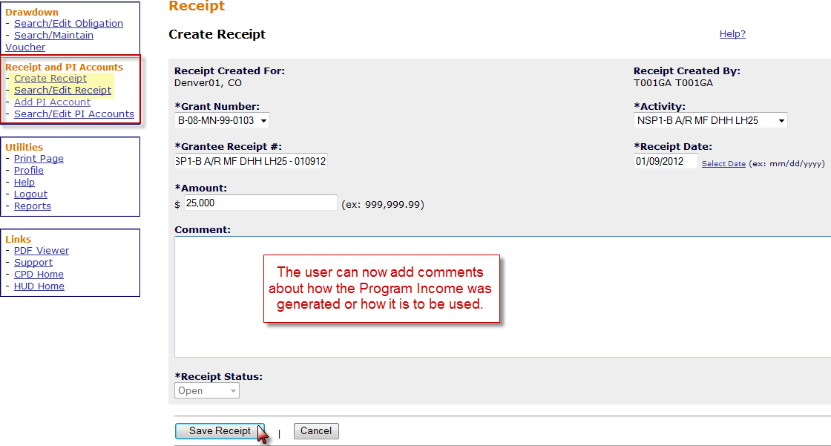
PI Receipts
Admin
Action Plans
Drawdown
QPR
Reports
Grants
PI received is recorded in the Drawdown Module as a receipts for individual PI transactions
Notes:
Prior to Release 7.3, Program Income was receipted in the QPR quarterly and drawn in the Drawdown Module. Similar to IDIS, Release 7.3 allowed Program Income receipts to be created in the Drawdown Module for individual PI transactions.
If the grantee has set up Program Income Accounts, the Program Income received will be associated with the Program Income Account the Activity belongs to. If there are no PI Accounts or RLF, it will automatically apply to the General Account
To Create a Receipt,
Select the grant
Create a Receipt Number, (there is no required naming convention)
Select the Activity that generated this PI
Enter the Amount and the Date Receipted
The Comment Field is optional, but can be helpful to keep track of PI sources.
Save

Slide 25
PI Accounts: Set-Up
Admin
Action Plans
Drawdown
QPR
Reports
Grants
Established by Responsible Organization with, typically, all of the Activities associated with that Responsible Org. in their own PI Account.
Program Income generated by an Activity in this account can only be used for itself or other Activities in that same account.
Any Activities not assigned to a PI Account will remain in a General PI Account.
Notes:
As the purpose of PI Accounts is to “wall off” PI from one organization from another, a grantee establishes PI Accounts by Responsible Organization.
NOTE: In other cases, states may require all PI to be returned from the local government to the state. It is important to remember that PI accounts do not need to be set up if local governments or subrecipients are not allowed to retain their PI.

Slide 26
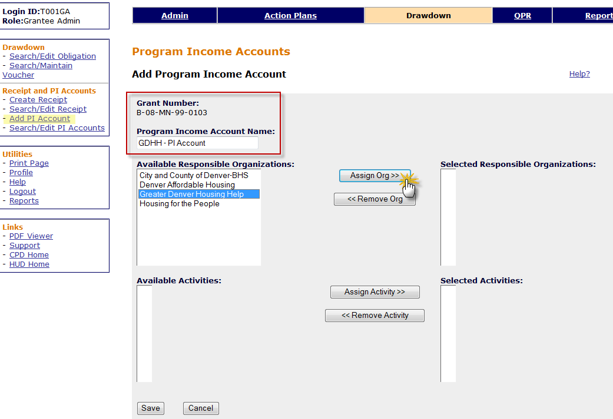
Program Income Accounts: Set-up
Admin
Action Plans
Drawdown
QPR
Reports
Grants
Notes:
To set up a Program Income Accounts, go to the Drawdown Module and along the left navigation select Add PI Account.
Select the grant and create a name for the account.
Select the Responsible Organization. Key Hint: One Responsible Organization could have been entered into the system in a number of ways such as “The City of” or “City of”. To make sure you get all activities that are associated with that Responsible Organization the system allows the user to select multiple variations. Once this is selected, click Assign Org>>.
Under Available Activities, check to make sure all of the activities for that Responsible Organization are appearing, then add the activities by clicking Assign Activities>>.

Slide 27
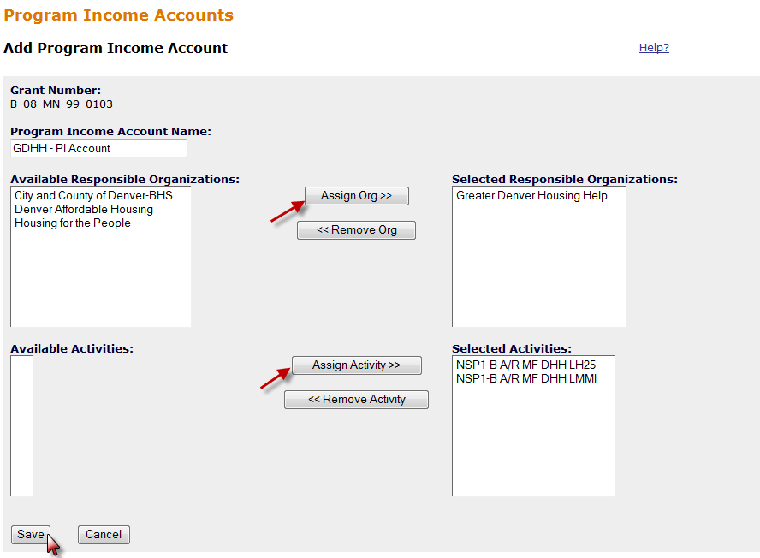
Program Income Accounts: Set UP
Admin
Action Plans
Drawdown
QPR
Reports
Grants
Notes:
This slide shows what the screen for a new PI Account would look like just before saving. The Responsible Organization and its Activities have been moved into this account. The set up of this process is very similar to assigning and certifying users.

Slide 28
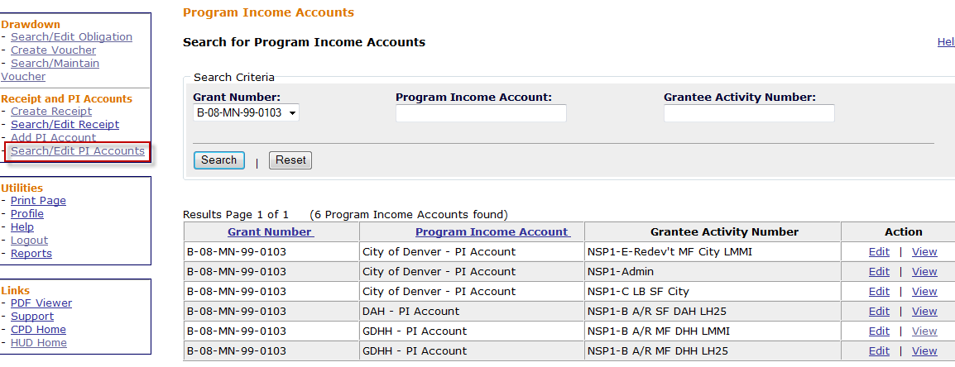
Program Income Accounts: Search/Edit
Admin
Action Plans
Drawdown
QPR
Reports
Grants
Notes:
Grantees can search and edit PI Accounts as shown in the image on this slide.

Slide 29
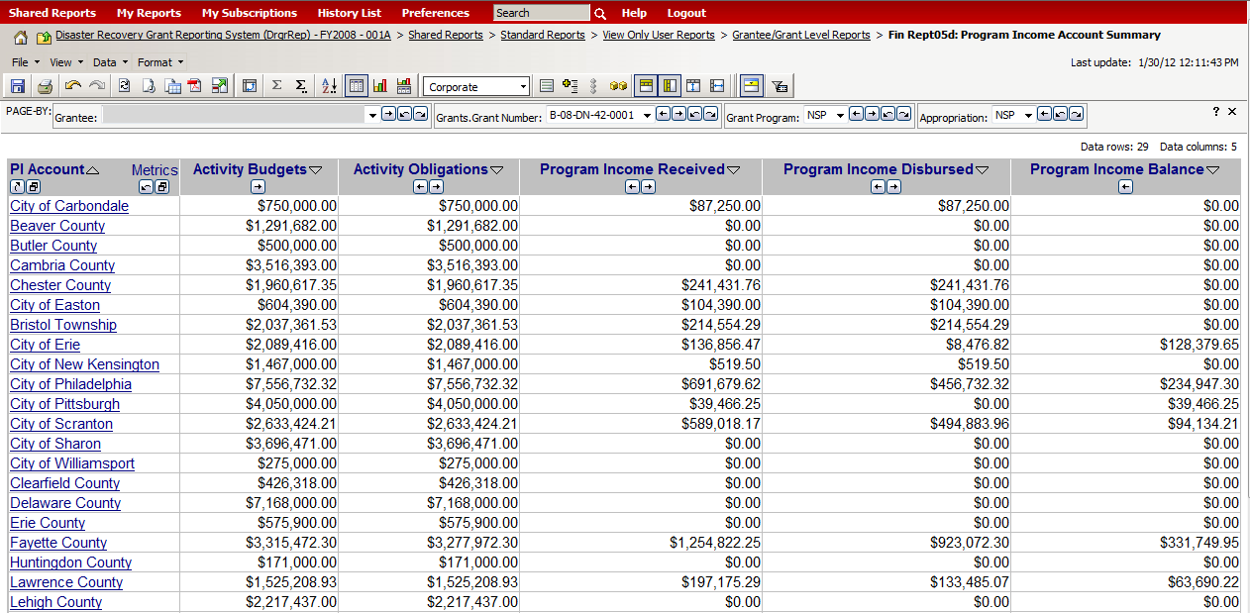
Program Income Accounts: Review
Admin
Action Plans
Drawdown
QPR
Reports
Grants
This is an example of a grantee that has set up PI Accounts according to their responsible organizations. (Fin Report 05d)
Notes:
This is a new report available in the DRGR Reports Module that will list all of the PI accounts set up by a grantee and the account’s associated budgets, PI disbursed, and PI balance.
If the grantee has not set up any PI accounts, and all PI is in the General Account, this report might not be available to them.

Slide 30
Program Income: Prior to Update
Admin
Action Plans
Drawdown
QPR
Reports
Grants
Program Income recorded prior to the update was automatically turned into receipts based on the QPR and Activity in which it was entered.
Activity Budgets and Obligations may have been automatically increased if PI was previously receipted through those activities.
By using the Search/Edit Receipt function, grantees can modify previously recorded PI to be associated with another Activity.
(That Activity’s budget might first need to be increased)

Slide 31
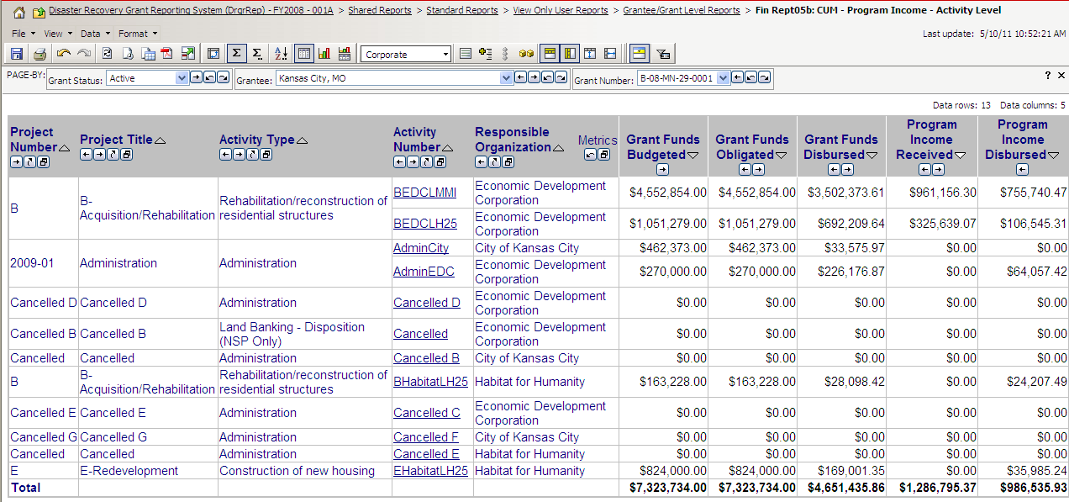
Program Income Review (FinRept05b)
Admin
Action Plans
Drawdown
QPR
Reports
Grants

Slide 32
9. Create a Program Income Account & Estimate PI Budgets
10. Create a PI Receipt
Case Study 9 & 10
Admin
Action Plans
Drawdown
QPR
Reports
Grants
Notes:
Time for more Case Studies!

Slide 33
Program Income Review
Review
  Activity budgets and obligations include estimated PI.
  Reinforces compliance with the FIFO requirements.
  Grantees can set up PI Accounts to allow their organizations to retain PI.
  PI is recorded in Drawdown module instead of QPR.
  Revolving Loan Funds (RLF) can be created at the Project Level.

Slide 34
Create/Approve Vouchers
Admin
Action Plans
Drawdown
QPR
Reports
Grants
Funds Drawn at Activity Level: Must have Request Drawdown role
Two Step Process for a Grantee
Step 1: Create the voucher
  Must have Draw Requester Role
  Determine Program Funds v Program Income Funds
  Select Activities to draw from
Step 2: Approve Voucher
  Must have Draw Approval role to approve
  Approve / Reject entire voucher
  Approve / Reject on line item basis
  Provide comments
Notes:
Drawing down funds against the line of credit requires the creation and approval of a voucher in DRGR. These are two separate steps: 1) Creating the Voucher, and 2) Approving the Voucher.
Each voucher is composed of at least one line item. A line item represents funds going to a specific activity. A voucher may include more than one line item.
It is best to think of a voucher as a single request “packet.” It “asks” LOCCS to reimburse $X against the line of credit for a grant, for costs associated with a specific activity(ies). The voucher may also communicate that certain costs are being paid for with program income received by the grantee.
Remember that the user must have the appropriate permission to either create or approve vouchers and that the same user may not have both permissions.
To create a voucher, you must know which activities you are drawing against and the funding source (program funds or program income).
Vouchers may be approved or rejected at the voucher or line item level. Approvers may also provide comments.
Remember the math rules of DRGR (see slide 104-105).

Slide 35
Create/Approve Vouchers: Roles
Admin
Action Plans
Drawdown
QPR
Reports
Grants
 | View a Voucher Line Item | Approve/Reject a Voucher Line Item | Revise a Voucher Line Item | Cancel Voucher Line Item | Revoke Approval of a Voucher Line Item
ALL | X
Draw Requester | X |  | X | X
Draw Approve | X | X |  |  | X
Notes:
This slide depicts which user roles (permissions) can perform a particular function within the drawdown module.
Any user can search for a voucher and view its status. What you can do with a voucher also depends on your role in the DRGR system.
For most functions associated with a voucher, you will have to search for the voucher first and then click “Maintain” for options on what you can do with it.

Slide 36
Create/Approve Vouchers: Daily Draw Thresholds
Admin
Action Plans
Drawdown
QPR
Reports
Grants
Draw limit for NSP1 and NSP3 = $5 million daily per draw
Draw limit for NSP2* =
  Units of general local governments and States: $1,000,000 daily per draw;
  Nonprofits: $500,000 daily per draw
If threshold exceeded, status = Approved Pending HQ
Grantee must e-mail supporting info to HUD Rep
  sufficient detail that the draw request was reviewed and approved in accordance with grantee procedures: should include support documentation with two grantee staff signatures/initials.
HUD Review (by HUD HQ users with Draw Approval rights)
  CPD Representatives must consult with HHQ prior
  to taking any action on a voucher.
  Rely on HHQ for Guidance
Notes:
HUD may place limits on the daily draw amount in DRGR. If the drawdown pushes the grantee over the daily threshold limit, the voucher will not be processed automatically and it will be given an “Approved Pending HQ” status. These draw thresholds are daily limits per draw, so once a grantee has gone over their threshold for the day, all vouchers submitted after the threshold has been exceeded will be held pending HQ approval.
In cases in which the daily limit is exceeded, the grantee must submit back up documentation to their CPD/NSP field representative. It is always best to anticipate when you may submit a draw that will be over the daily draw threshold. You can then submit documentation to the Field Office in advance of creating the voucher.
In most cases, the system will notify the CPD/NSP field representative assigned to the grant by email that there is a draw that must be reviewed. Grantees should not, however, rely on the system to notify the Field Office when such vouchers are created.
HUD’s goal is to ensure that all draw requests are turned around with 72 hours. To meet this goal, CPD representatives and grantees should be in close communication about the creation and approval of these vouchers.
The CPD/NSP field representative will be looking for the following in the voucher documentation:
Evidence of the grantee’s internal controls in approving the draw — this usually means two signatures/initials/electronic confirmations;
Basic math — the draw documentation adds up to the amount requested; and
The draw documentation is for the same activity shown on the DRGR voucher.
Once the CPD/NSP representative confirms the above information, they can send the confirmation to HQ, which should include the voucher number(s), amount of the draw, and the grant number. Once HQ receives the confirmation from the field, they will approve the draw. Jim Yerdon and Ryan Flanery are approving threshold draws for NSP, so representatives should send this information to them at James.Yerdon@hud.gov and Ryan.D.Flanery@hud.gov.

Slide 37
Create/Approve Vouchers:
Block Draws
Admin
Action Plans
Drawdown
QPR
Reports
Grants
Draws can be blocked
  at the grant and activity level by HUD (see next slide) or
  at the activity level by the Grantee Admin
Communicate with FO if draw is blocked by HUD
Check for Restricted Balance projects
Notes:
There are several ways to block draws from occurring – either by the FO or by the grantee.
For HUD staff, draws may be blocked at the grant level or per activity.
For grantees, draws may be blocked per activity by the Grantee Administrator.
A grantee should call their FO Rep to discuss if, at the grant level or per activity, draws are blocked. Additionally, if any funds are in the restricted balance project, check with the FO.

Slide 38
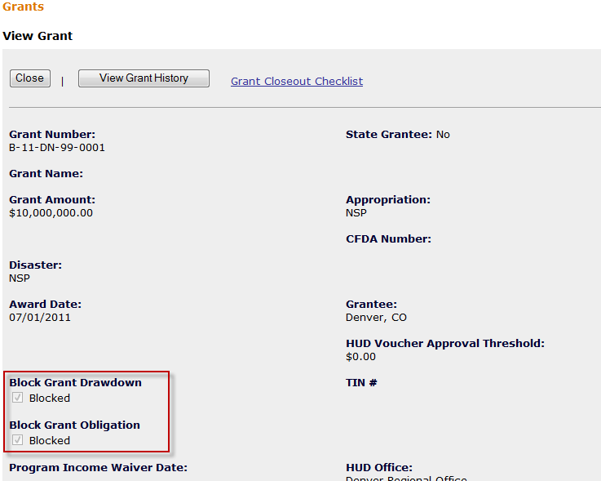
Blocked Draws – Grant Level
Admin
Action Plans
Drawdown
QPR
Reports
Grants
Notes:
Here is the screen that shows if a grant is blocked for draws. You can navigate here by clicking on your Grant Number from the Action Plan screen.

Slide 39
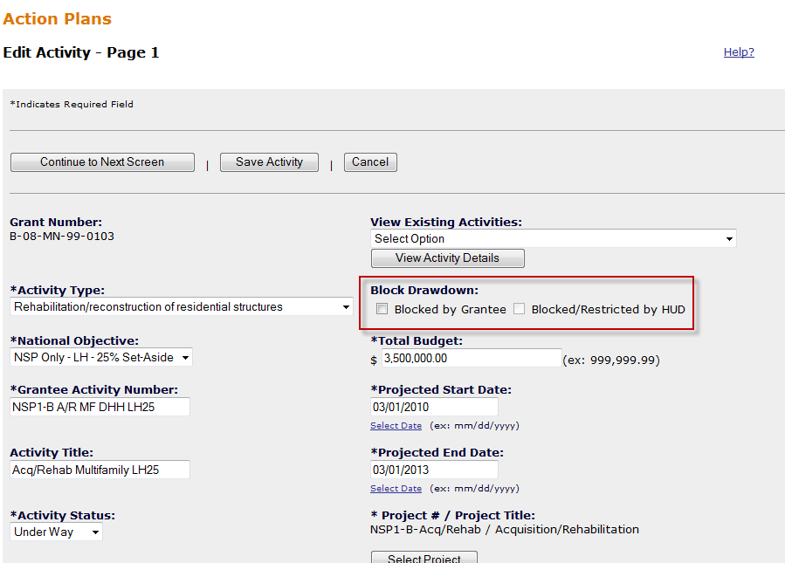
Blocked Draws – Activity Level
Admin
Action Plans
Drawdown
QPR
Reports
Grants
Notes:
Per each Activity, a grantee or HUD may block draws.

Slide 40
Create Voucher
Admin
Action Plans
Drawdown
QPR
Reports
Grants
Build the voucher in four steps:
1. Select Activities
  1a. Search for Activities
  1b. Select Fund Type
2. Enter Drawdown Amount per line items
3. Confirm Voucher
4. Verify voucher is confirmed
Notes:
There are four major steps to create a voucher in DRGR.
Remember: Only users with Draw Requester rights can create a voucher.

Slide 41
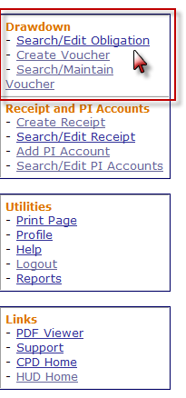
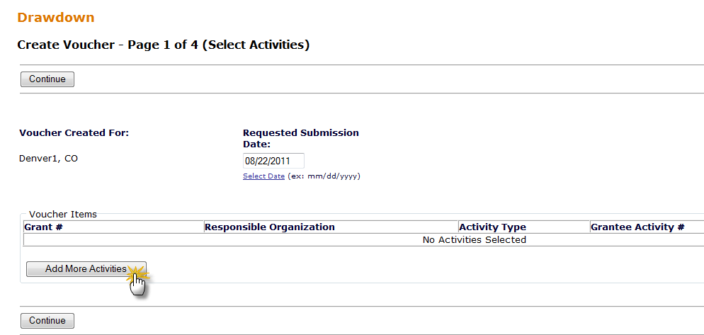
Admin
Action Plans
Drawdown
QPR
Reports
Grants
Step 1: Select Activities
Necessary Role: Request Drawdown
Notes:
To create a voucher, click “Create Voucher” from the links at the left-hand bar.
The page above, “Create Voucher – Page 1 of 4 (Select Activities),” is the first of the four voucher creation pages. In this page, you will select the voucher submission date and the activities to be included in the voucher. The submission date defaults to the current date.
Click the ‘Add More Activities’ button.

Slide 42
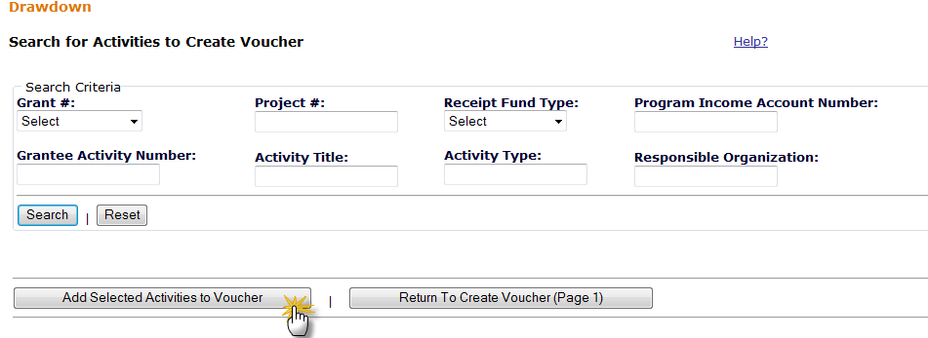
Step 1a: Search for Activities
Admin
Action Plans
Drawdown
QPR
Reports
Grants
Search by Grant number, Activity Type, or just select Search to view all possible Activities
Search criteria should include the grant number if the user has access to more than one grant.
Notes:
After selecting ‘Create Voucher’ on the links at the left-hand bar, a blank voucher appears. The Draw Requestor must add activities to this voucher (which is creating the line items).

Slide 43
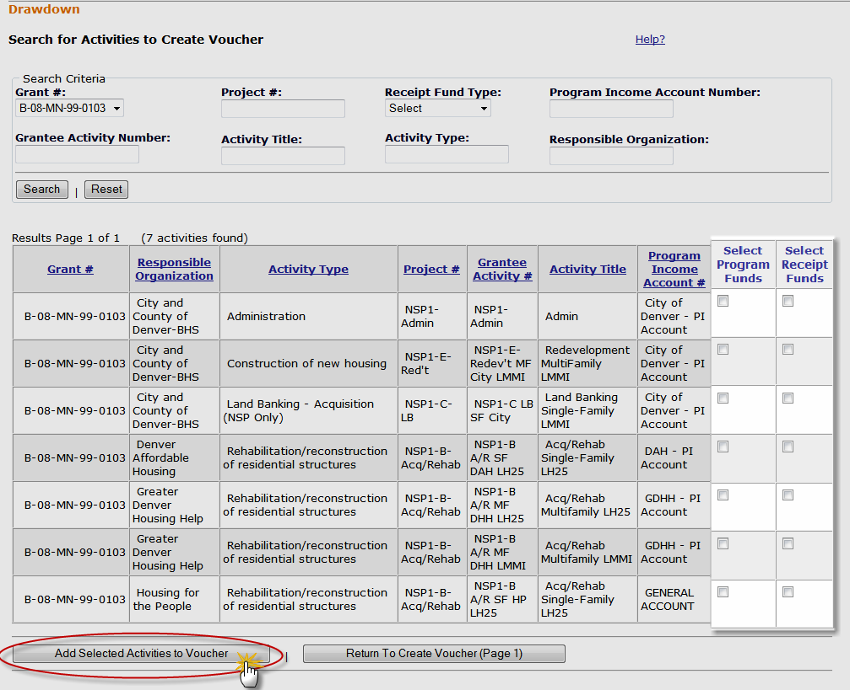
Step 1b: Select Fund Type
Admin
Action Plans
Drawdown
QPR
Reports
Grants
Select activities to include in the voucher
Notes:
The “Search for Activities to Create Voucher” page is now displayed. This page allows you to locate and add the activities to include in the voucher. You may enter one or more search criteria.
Note that entering the grantee activity number is the quickest way to search. You may, however, have several activities of a certain type or under a specific responsible organization for which you want to create a single voucher. In that case, you may want to search accordingly.
Click on the “Search” button.
The Search page will now show search results in a table below the search criteria. Each table row represents an activity. Note that the results may be presented on more than one page. Click on the links below the results table to see more results. Results can be narrowed by modifying or adding search criteria and clicking on the “Search” button again.
To change the sort order of the results, click on a column heading.
To include an item in the voucher, indicate if grant program funds and/or program income will be used and click on the “Add Selected Activities to Voucher” button to add to the voucher. This will add line items to the voucher and return to “Page 1” of the “Create voucher” pages where you can see the voucher.
From “Page 1” you can continue to search for and add more activities by clicking the “Add More Activities” button.
TIP: To remove an activity from the table, check the box in the Select column next to the activity to be removed, and then click the “Remove Voucher Item” button.
When all activities have been added to the voucher, click the “Continue” button.

Slide 44
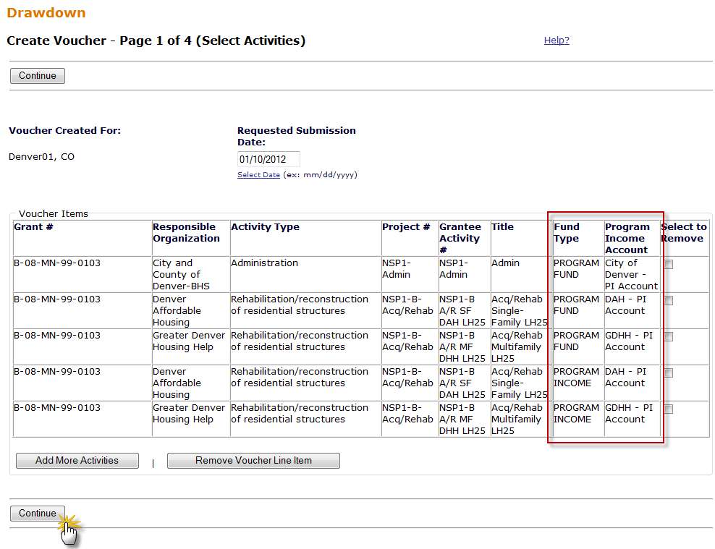
Step 2: Enter Drawdown Amount per line items
Admin
Action Plans
Drawdown
QPR
Reports
Grants
Notes:
On Page 1 and 2 of Create Vouchers, grantee enters the Draw Amount per fund type and per activity.
These screens confirm the fund type and submit the amounts entered for each Activity.

Slide 45
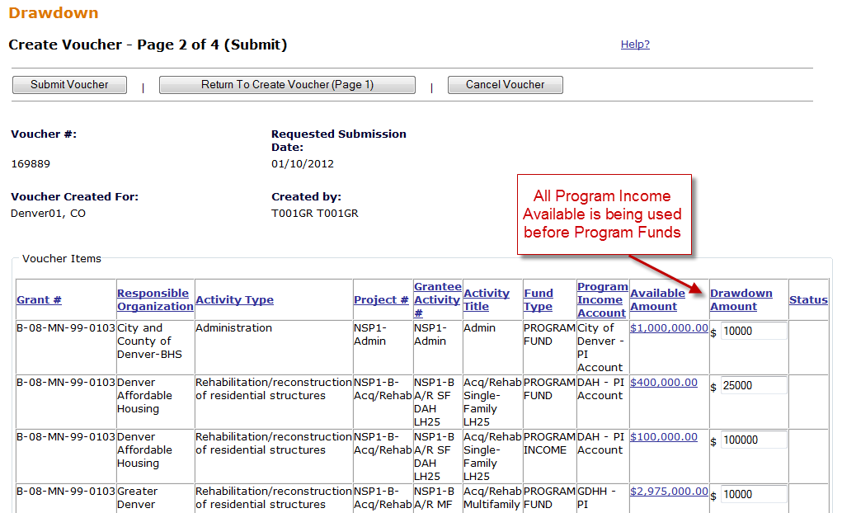
Admin
Action Plans
Drawdown
QPR
Reports
Grants
Step 2 (cont.)
Notes:
On Page 2 enter the actual drawdown amount.
If the you click on the Amount Available link, it will provide information as to how it arrived at this amount.
NOTE: DRGR may show $0 available in PF on activities within a PI account until all PI is used. The amount shown as available on PI will be the lower of the two following amounts:
The TOTAL FUNDS available for the activity (PI +PF) based on total activity obligation minus total drawn (PI+PF); or
The amount of PI available at the PI account level.
DRGR may not let grantees proceed to the next step in creating a voucher (page 3 of 4) if the grantees try to force PF draws without spending all PI within an account first.

Slide 46
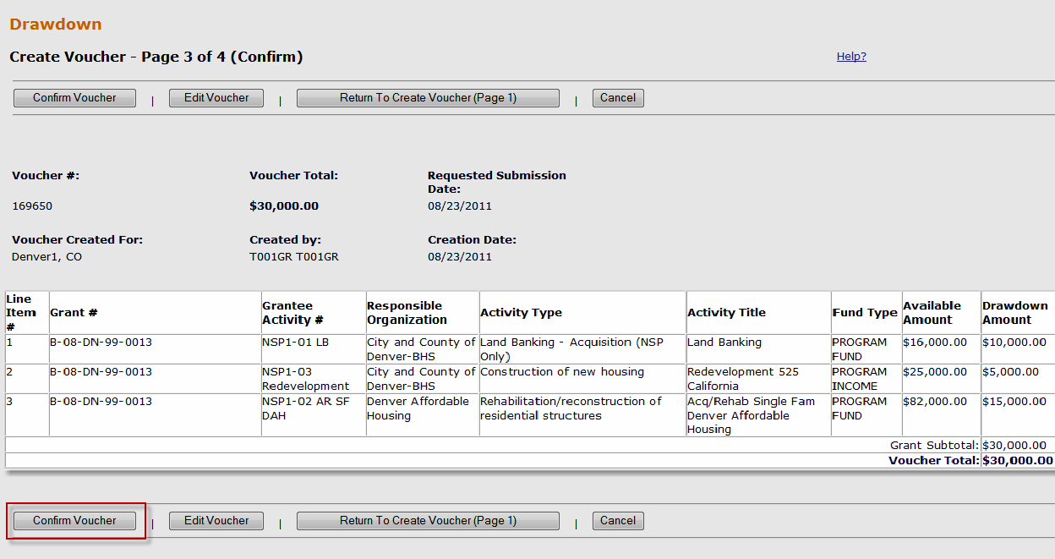
Step 3: Confirm Voucher
Admin
Action Plans
Drawdown
QPR
Reports
Grants
Notes:
On Page 3 of Create Vouchers, confirm the amount entered for each Activity.

Slide 47
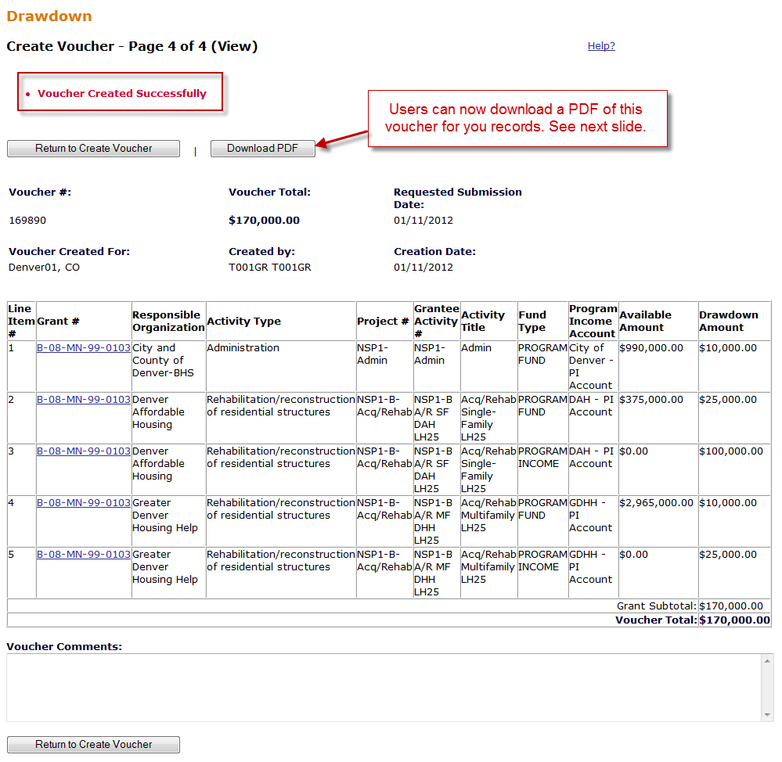
Step 4: Confirm Voucher-Printing
Admin
Action Plans
Drawdown
QPR
Reports
Grants
Voucher Comment Field
47
Notes:
On Page 4 of Create Vouchers, you should see an alert at the top of the screen letting you know that the voucher has been successfully submitted. The User does not have to actively do anything on this page, however, if this page does not appear, the user has NOT successfully submitted a voucher.
It sometimes helps to print this screen for financial records.
As of DRGR Release 7.3, users can PDF a copy of the vouchers created for their records and add comments about the vouchers.

Slide 48
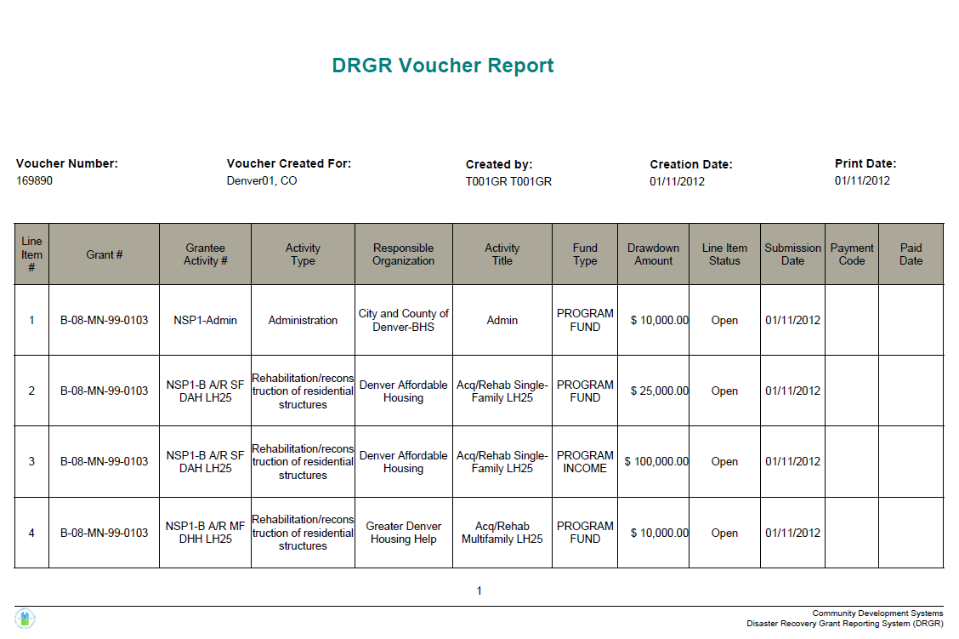
Step 4: Verify Voucher is Confirmed
Admin
Action Plans
Drawdown
QPR
Reports
Grants
Notes:
This is an example of the voucher summary PDF now available to grantees for their records.

Slide 49
Create Voucher: PF Draw Math Rules
Admin
Action Plans
Drawdown
QPR
Reports
Grants
PROGRAM FUNDS
As of 7.3, DRGR requires all PI Received in each RLF or PI account to be used before grants funds. Similar rules will apply to Activities outside RLF and PI accounts (General Account)
  Total Available Activity Amount =
  Obligated Amount
  – (Activity Total Drawn Amt. (PI+PF) +Activity Draw Pending (PI+PF)
  – Balance PI Available of Program Income (General/RLF/PI Account) + Pending PI Draws (General/RLF/PI Account).
Notes:
The Total Available Amount is calculated at the Activity level.
DRGR may show $0 available in PF on activities within a PI account on a voucher until all PI is used.

Slide 50
Create Voucher: PI Draw Math Rules
Admin
Action Plans
Drawdown
QPR
Reports
Grants
PI FUNDS
As of 7.3, PI draws is subtracted from the Total Activity Budget.
Available Activity Amount =
Sum of All PI Received for in General/RLF/PI Account
    –Drawn PI (for in General/RLF/PI Acct) + Pending PI Draws (in General/RLF/PI Acct)
Notes:
The Available Amount is calculated at the Activity level against the Total Activity Budget (which is the sum of program funds and PI).
The amount shown as available on PI on the voucher will be the lower of the two following amounts:
The TOTAL FUNDS available for the activity (PI +PF) based on total activity obligation minus total drawn (PI+PF); or
The amount of PI available at the PI account level.

Slide 51
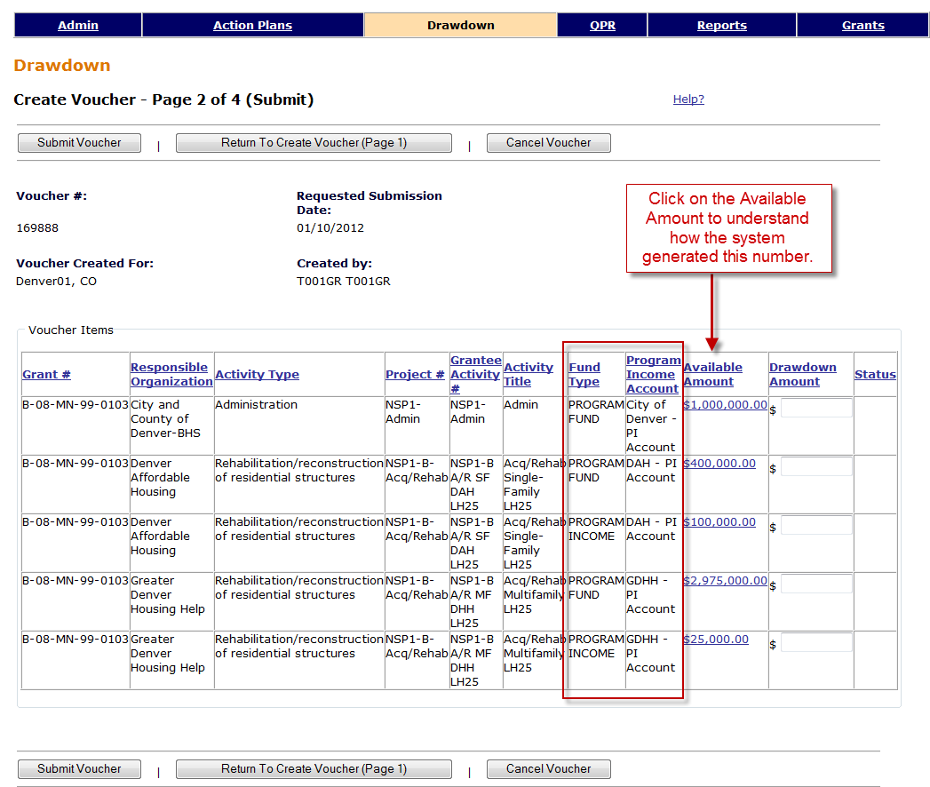
Available Amount: Draw Calculation
Admin
Action Plans
Drawdown
QPR
Reports
Grants
Notes:
In this slide, two activities have both Program Funds and Program Income selected. To see how the system calculated the Amount Available to draw, click on the linked numbers and it should take you to a screen similar to the one on the next slide. Using this function will help to understand how the system arrived at this amount available.

Slide 52
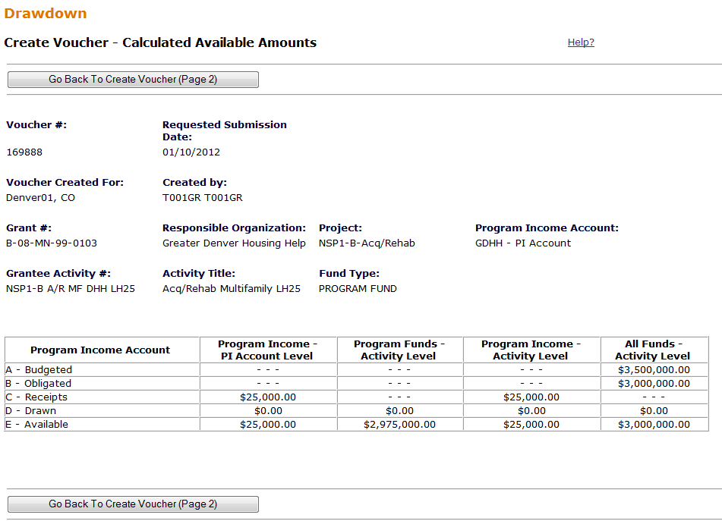
Available Amount: Draw Calculation
Admin
Action Plans
Drawdown
QPR
Reports
Grants
PI Available is calculated at the RLF and PI Account Level across activities
(Left Column)
Program Funds Available is calculated within the activity based on total budgets, draws and PI availability
Notes:
This is the screen that appears when the users selected the $2,975,000 for activity NSP1-B A/R MF DHH LH25 on the previous screen.
Calculations based on whether activity is in:
General Account
RLF Project
PI Account
Regardless of the amount available in the PI Account level, no more than $3M can be draw. A grantee may increase the obligated amount by another $500k to increase the Total Available to $3.5M. To increase more, a user would have to increase the Activity’s Total Budget.

Slide 53
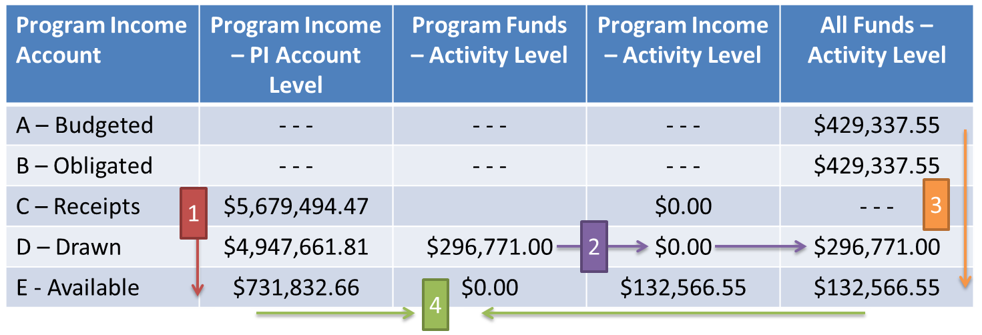
Available Amount: Example
Admin
Action Plans
Drawdown
QPR
Reports
Grants
For this Activity, only have $132,566.55 to Draw. PI MUST be drawn first and there is an available balance of PI will cover the entire balance of $132,566.55
How is this information calculated?
PI available for the PI Account : $5,679,494.47 Receipts – $4,947,661.810 PI Draws = $731,832.66
(General Account)
Total Drawn for Activity: $296,771 PF Drawn + $0 PI Drawn = $296,771.00
Total Available for Activity: $429,337.55 Obligated – $296,771 Drawn = $132,566.55
4)PF available for Activity: $132,566.55 TOTAL Available - $731,832.66 PI Available = $0.00
Notes:
This slides provides another detailed example of how to use the Calculated Amount Available screen to help a grantee understand these amounts better.
It is important to note here that although the chart shows $731,832.66 in PI available in this PI Account, only $132,566.55 is left in the Activity Budget to draw down.

Slide 54
Available Amount: Example #2
Admin
Action Plans
Drawdown
QPR
Reports
Grants
For this Activity, grantee has a total of $630,000 to Draw. PI MUST be drawn first and there is an available balance of PI of $140,000 to draw. After $140,000 has been drawn, the grantee may draw the available Program Funds available equaling $490,000.
How is this information calculated?
PI available for the PI Account : $350,000 Receipts – $210,000 PI Draws = $140,000.00
Total Drawn for Activity: $1,750,000 PF Drawn + $120,000 PI Drawn = $1,870,000.00
Total Available for Activity: $2,500,000 Obligated – $1,870,000 Drawn = $630,000.00
4)PF available for Activity: $630,000 TOTAL Available – $140,000 PI Available = $490,000
Program Income Account | Program Income – PI Account Level | Program Funds – Activity Level | Program Income – Activity Level | All Funds – Activity Level
A – Budgeted | - - - | - - - | - - - | $5,800,000
B – Obligated | - - | - - - | - - - | $2,500,000
C – Receipts | $350,000 |  | $45,000 | - - -
D – Drawn | $210,000 | $1,750,000 | $120,000 | $1,870,000
E - Available | $140,000 | $490,000 | $165,000 | $630,000
1
3
2
4

Slide 55
Available Amount: Example #3
Admin
Action Plans
Drawdown
QPR
Reports
Grants
Notes:
This is an example of the PI Account list by Responsible Organization and Activity using a modified version of a report pulled from DRGR’s Reports module. The role up at the bottom shows how much PI, if any, is available to draw for each resp. org. according to the PI account they are assigned to.
Financial Report 05d will provide a list of all established PI accounts and Financial Report 05b will show Activity budgets, obligated, disbursed, and PI received and spent.

Slide 56
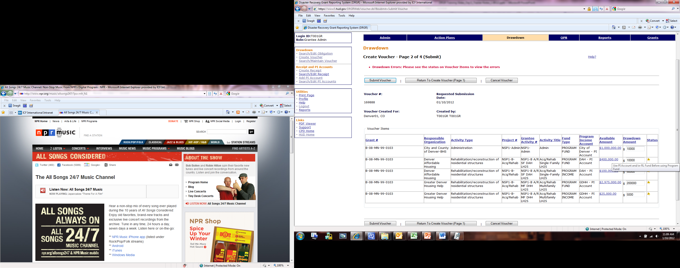
Available Amount: Error Message
Admin
Action Plans
Drawdown
QPR
Reports
Grants
Notes:
This slide displays the error messages one might receive if trying to use Program Funds before Program Income. Remember to check the available amounts to see if there is enough funding remaining in the activity’s budgets and obligated amounts to draw down.

Slide 57
Program Income: Common Issues
Admin
Action Plans
Drawdown
QPR
Reports
Grants
  Accounting for a NSP Revolving Loan Fund.
  How does the grantee identify activities with the organizations they fund that are allowed to retain their program income?
  PI previously entered under the wrong Activity.
  Error message when attempting to receipt new PI.

Slide 58
1. PI: Common Issues
Admin
Action Plans
Drawdown
QPR
Reports
Grants
  Accounting for a NSP Revolving Loan Fund.
  Solution: Grantees will be able to identify Revolving Loan Funds (RLF) using the PROJECT screen. Each RLF will allow users to identify activities where receipts will be recorded and PI will be disbursed under the RLF. RLF projects can only include activities with a single activity type.

Slide 59
2. PI: Common Issues
Admin
Action Plans
Drawdown
QPR
Reports
Grants
  A grantee has five organizations for their NSP grant. Of that, two of the organizations are allowed to retain their PI and three have to return their PI to the grantee. How does the grantee identify activities with the organizations they fund that are allowed to retain their program income?
  Solution: Grantees are able to create PI accounts that allow them to identify activities and by Responsible Organization. Through these accounts, organizations can retain and use program income on their activities if allowed. Each PI account will allow users to identify activities where receipts will be recorded and program income will be disbursed. The grantee can also receipt PI received in a General Account to be used for other purposes.

Slide 60
3. PI: Common Issues
Admin
Action Plans
Drawdown
QPR
Reports
Grants
If a grantee entered PI received in past QPRs under the wrong Activity, they may have difficulties in drawing down funds if they are identified as Scenario B or Scenario C (and D only if they should have established an RLF and hadn’t yet).
Solutions:
Edit the new RECEIPTS (created from past QPRS) in the drawdown module by an user with draw rights.
Create RLFs and/or PI Account(s)
Increase/Decrease Projects and Activity budgets as needed.

Slide 61
4. PI: Common Issues
Admin
Action Plans
Drawdown
QPR
Reports
Grants
Error message when attempting to receipt new PI.
Solution: If a grantee has already drawn all of the estimated PI/RL funding (from Edit Action Plan screen), a grantee must increase the estimated amount. Then, they must increase the Project Budget and Activity Budget associated with the PI received.
To drawdown those funds, a grantee will also need to increase the obligated amount of the Activity.

Slide 62
Creating Vouchers
Case Study 11
Admin
Action Plans
Drawdown
QPR
Reports
Grants
Notes:
Let’s create a voucher.

Slide 63
Drawdown Module Review
Review
Day 1
Obligations
Create Draw
Day 2
Approve Draw
Draw Corrections
Notes:
To briefly review some of the key points made in the section:
Work with your field office to ensure all obligations meet the NSP definition of “obligation.”
All funds are obligated and drawn at the activity level.
Be aware of the daily draw threshold and be ready to provide additional data to HUD for approval.

Slide 64
Drawdown: Additional Functions
Admin
Action Plans
Drawdown
QPR
Reports
Grants
Approve Voucher
View Voucher Line Item
Voucher Corrections
  Cancel
  Revoke
  Revise
Notes:
There are additional functions that at Drawdown Module may perform that will be outlined in the next slides.

Slide 65
Approve Voucher
Admin
Action Plans
Drawdown
QPR
Reports
Grants
After the Voucher has been created and ‘Saved’
Find the voucher
  All users can Search for Voucher
  Search by Status
2. Approve Voucher
  Must have Draw Approval role to approve
  Approve / Reject entire voucher
  Approve / Reject on line item basis
  Provide comments
Notes:
The first step to approving a voucher is finding it. Once the voucher is saved to the system, any user can search for the voucher. Only a user with Approve Drawdown privileges can mark the draw as Approved.
Use the “Search voucher” link in the drawdown module. To find vouchers that need to be approved, search for all vouchers with a status of “Open.”
Click on the “Maintain” link for a voucher to approve it.

Slide 66
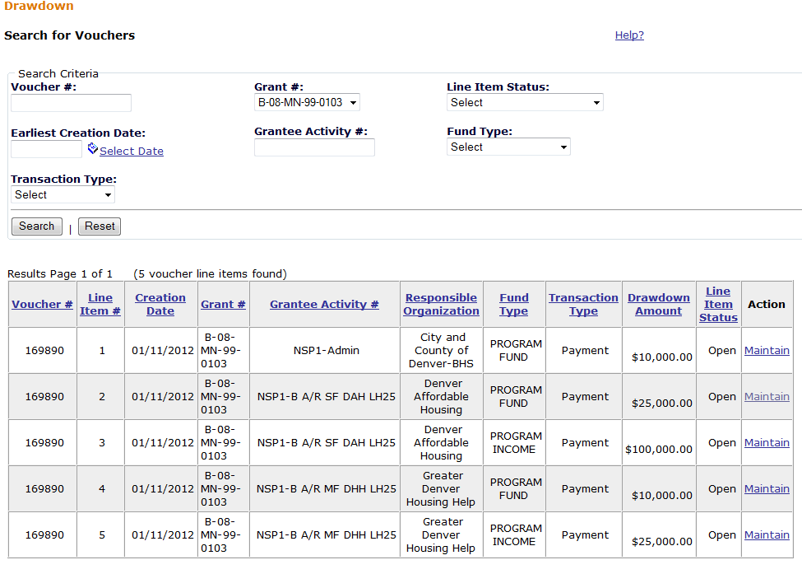
Approve Voucher
Admin
Action Plans
Drawdown
QPR
Reports
Grants
Notes:
Using the Search Vouchers function, find the activities you wish to approve and select Maintain.

Slide 67
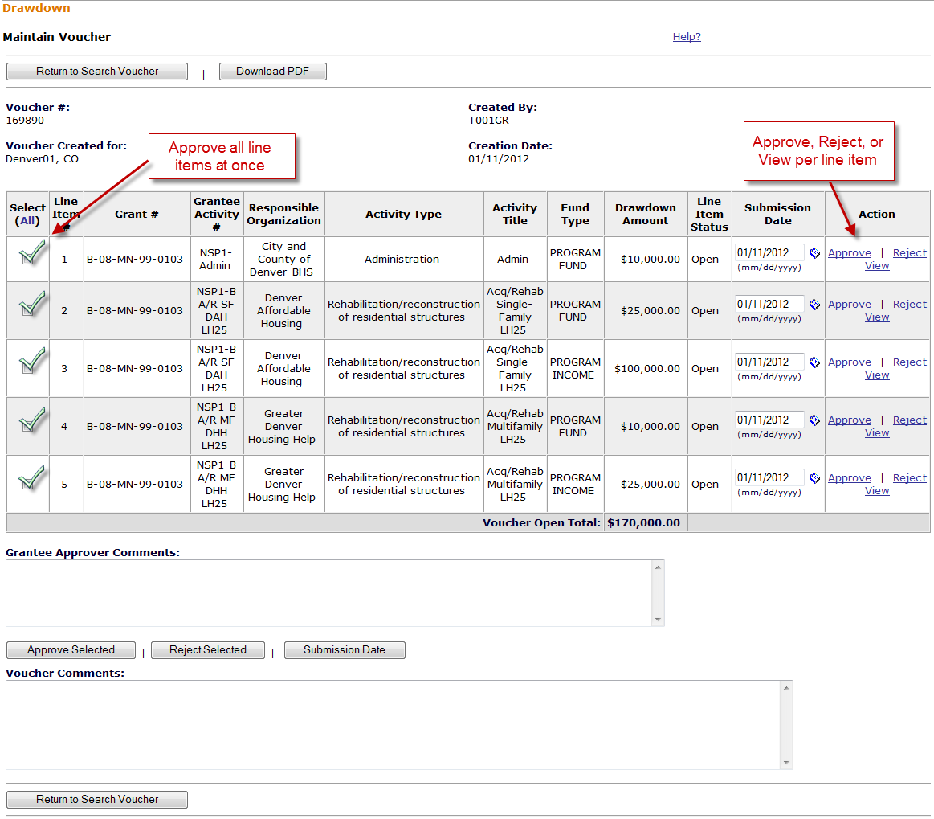
Approve Voucher Line Items
Admin
Action Plans
Drawdown
QPR
Reports
Grants
Necessary Role: Approve Drawdown
Notes:
For those with Approve Drawdown permission, the Action column on the Maintain Voucher screen will have the actions “Approve” and “Reject” to select.
Approvers have the option of approving the entire draw voucher or approving on a line item basis.
Click “(ALL)” to select all line items.
Approvers also have the option of inserting comments on the voucher. An approver can include comments regardless of approving or rejecting the voucher.
The approver can also view the voucher details by clicking on “View.”
Only Approved draws will be processed by the system and result in funds being sent to the grantee.

Slide 68
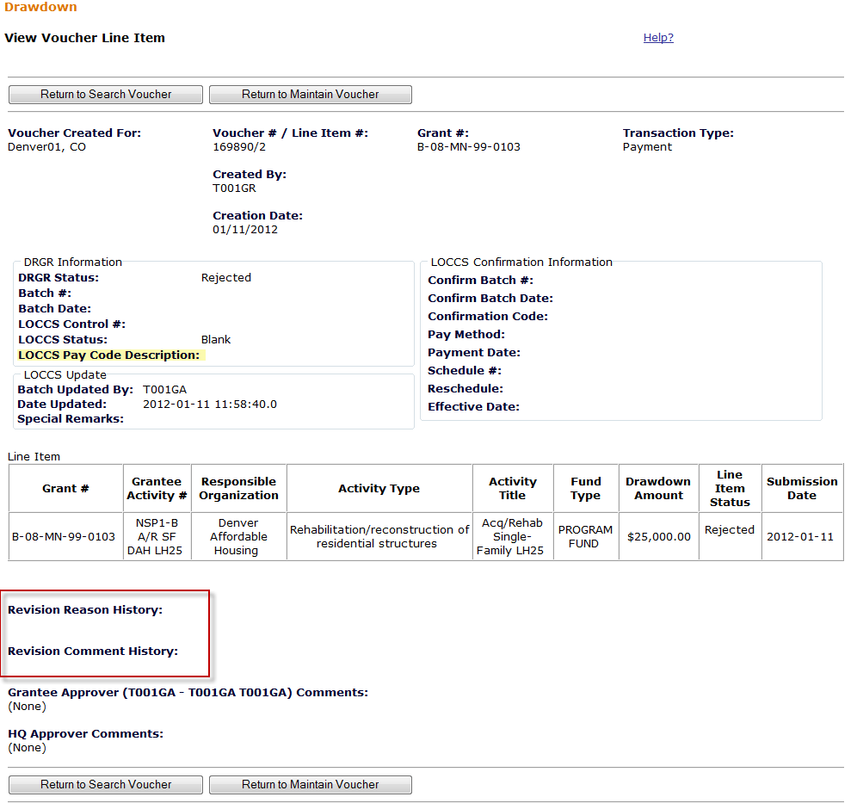
View a Voucher Line Item
Admin
Action Plans
Drawdown
QPR
Reports
Grants
New Features from 7.3 Release
68
Notes:
Here is the View Voucher page. This will provide a lot of information, including:
DRGR and LOCCS status of the voucher
The date when status was last updated
When payment was made
Who created the voucher
If funds have not been received within a week’s time, grantees should get in touch with their HUD CPD representative or the DRGR Help Desk.
All users may view a voucher line item by searching for a voucher and then choosing the line item to view.

Slide 69
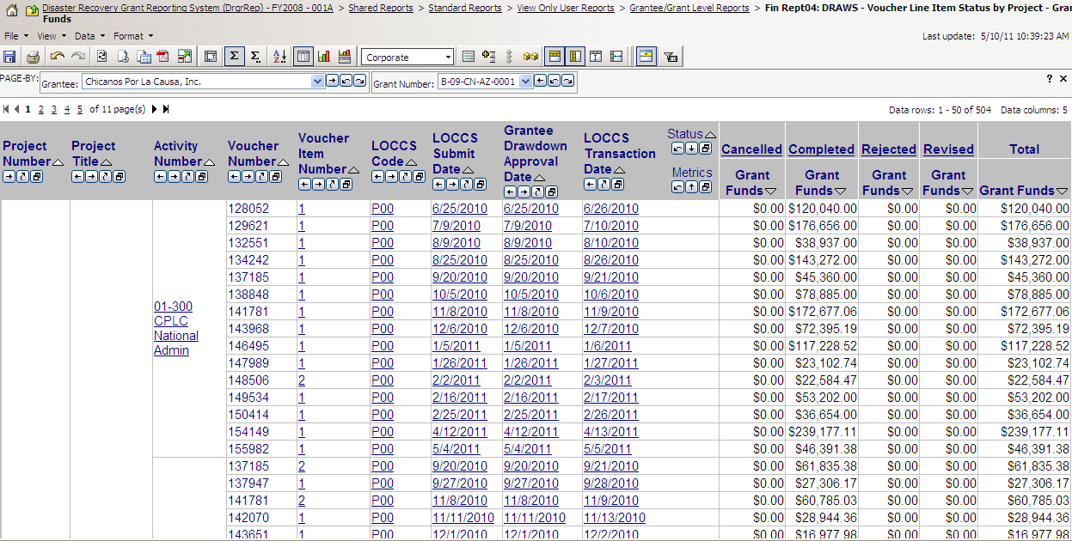
View a Voucher Line Item (FinRept04)
Admin
Action Plans
Drawdown
QPR
Reports
Grants
Notes:
Grantees may also view a voucher line item by using the Reports functionality.
This report provides details per each line item. Columns will only display if such action has been taken (e.g. ‘Cancelled – Grant Funds’).

Slide 70
Voucher Corrections
Admin
Action Plans
Drawdown
QPR
Reports
Grants
Corrected on a line item basis
Voucher Status will determine which function to use. Three options:
  Revoke Approval
  Cancelling a Voucher Line Item
  Revising A Voucher Line Item
Notes:
If a voucher is incorrect, it may be corrected in several ways. The method depends on the status of the voucher.
If the status is Approved (meaning it was marked as approved but not yet sent to LOCCS), the Draw Approver who initially approved it can revoke the approval.
You can revoke the approval as long as the line item has not yet been submitted to LOCCS (this occurs at the end of the day) and has a status of Approved.
Once revoked, the line item’s status will move back to Open and the line item will not be processed by LOCCS. This gives the grantee additional time to decide what to do.
If you want to rescind the approval of a line item after it has been submitted to LOCCS, you must contact HUD HQ for manual intervention.
If a voucher line item was created in error, a grantee can cancel it. A line item can be cancelled only if it has a status of Open (has not been approved), Approved, Approved Pending HQ, or Approved by HQ. Only a grantee with Request Drawdown role can cancel a voucher line item. The user cancelling the voucher line item does not have to be the same user as the one who created it. This line item will appear on the voucher with a status of Cancelled
If this status is Complete, this means the request has already been processed by LOCCS and the funds have been sent to the grantee. At this point, the grantee must revise the voucher or return the funds to the U.S. Treasury.

Slide 71
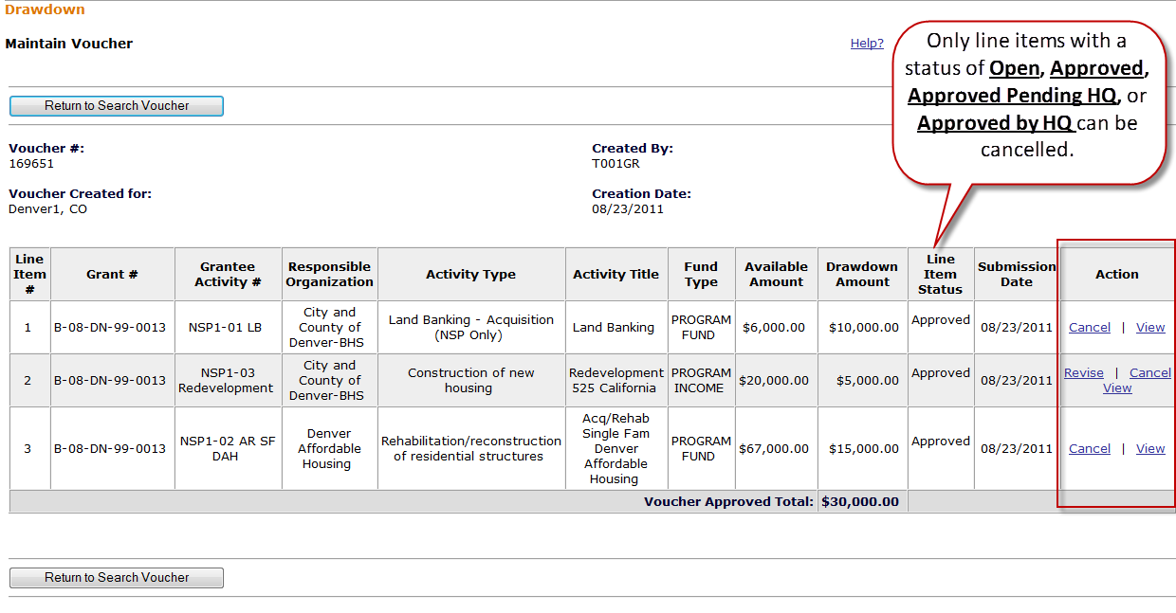
Voucher Corrections: Cancel Voucher Line Items
Admin
Action Plans
Drawdown
QPR
Reports
Grants
Necessary Role: Request Drawdown
Notes:
Only line items with a status of Open, Approved, Approved Pending HQ, or Approved by HQ can be cancelled.

Slide 72
Voucher Corrections: Revising A Voucher
Admin
Action Plans
Drawdown
QPR
Reports
Grants
Grantee may need to revise an original voucher for numerous reasons:
  Original costs incurred are not for the correct Activity
  Error in accounting and costs need to be moved to another Activity
  HUD deemed costs ineligible
Grantee has two options:
  Revise original voucher in DRGR AND off set next draw
  Wire funds back to LOCCS
    This option is used sparingly. Contact your CPD rep before wiring funds back. And, once a the wired funds is processed by HUD’s CFO staff (out of Ft. Worth), there will show a negative draw on the grant and the grantee must assign the negative draw to the desired Activity.
    When funds are returned to DRGR through wires or offsetting draws, users can now categorize these as collections and recaptures when assigning funds to new activities through the revisions.
Notes:
Revising a voucher line item is necessary when a disbursement needs to be moved from one activity to another. There are a number of reasons why you may need to revise a voucher line item:
The activity ID you selected when you created the voucher is incorrect.
Excessive Draw: You drew too many dollars for one activity when you created the voucher and now need to move a portion of the dollars to another activity within the same program and of the same fund type.
Funds for a draw were issued incorrectly and the recipient returned the funds to the U.S. Treasury. When funds are returned to the U.S. Treasury, DRGR does not process them against an activity. Instead, it credits them to a generic adjustment activity under the project.
Revising a voucher in DRGR is relatively simple. A grantee, however, must do its due diligence that the next draw is offset correctly and their internal systems and paperwork correspond to any changes in DRGR.

Slide 73
Voucher Corrections: Revising A Voucher Line Item
Admin
Action Plans
Drawdown
QPR
Reports
Grants
Roles
  To revise: Draw Requester
  To approve the revisions: Draw Approver
Conditions
  Both activities funded from same grant
  Destination activity has sufficient balance (budget and obligation)
  Destination activity cannot be cancelled
  Neither activity is blocked.
Total amount of voucher does not change: only the amount charged to each activity changes
Notes:
When revising a voucher line item, you can transfer all or a portion of the original drawdown amount to a different activity. However, a line item can be revised only in two situations:
The line item has a status of Open (not yet approved). If the line item is still open, the grantee may prefer to simply cancel and redo the draw correctly rather than revise it.
The line item has a status of Completed status (paid by Treasury).
The following conditions also apply:
Both activities must be part of the same grant.
The destination activity (the activity receiving the draw credit) must have enough money obligated to allow the drawdown.
The activity to which the drawdown is being shifted must not be a cancelled activity.
Neither activity is blocked.
All of the information will remain on the same voucher. However, the system may create new line items on the voucher to reflect the changes:
If all of the money is moved to a different activity, DRGR creates one new voucher line item. This new line item is for the activity to which the drawdown funds are being transferred.
If only part of the money is moved to a different activity, DRGR creates two new voucher line items. One of the new line items is for the activity receiving the transferred drawdown. The second line item created will have the balance of funds that stayed with the original activity.
The original line item remains on the voucher but its status is changed to Revised. It can no longer be worked with unless the new voucher line items are not approved.
Revised vouchers must be APPROVED by the grantee approver.

Slide 74
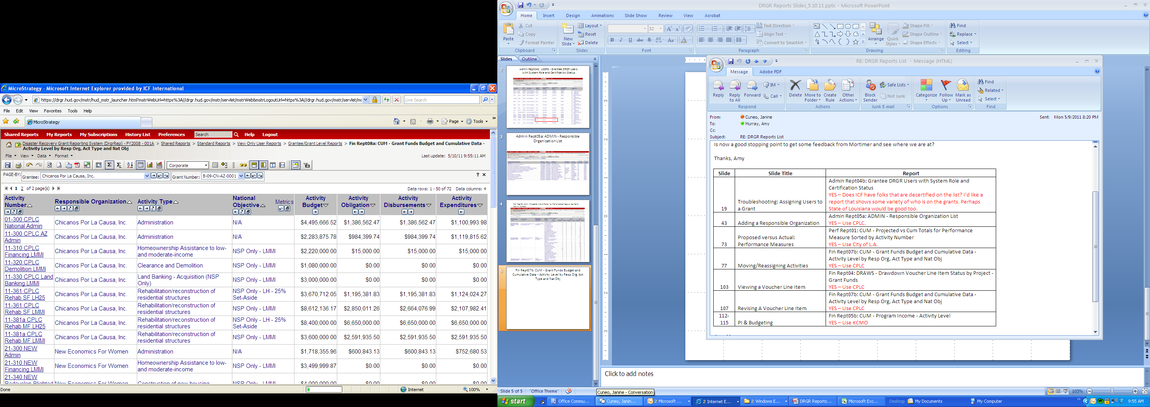
Voucher Corrections: Verifying sufficient balance (Fin Rept07b)
Admin
Action Plans
Drawdown
QPR
Reports
Grants
Notes:
When revising a voucher line item, you will need to verify there are sufficient funds to complete the revision. If the revision will increase the total disbursements above the obligation amount for the activity receiving the draw, then the revision will be blocked.
For example, you cannot move all the disbursements from 11-381a LH25 into 11-381a LMMI because 11-381 LMMI does not have sufficient budget nor obligations to accept the transfer of draws. The draw revision would be blocked.

Slide 75
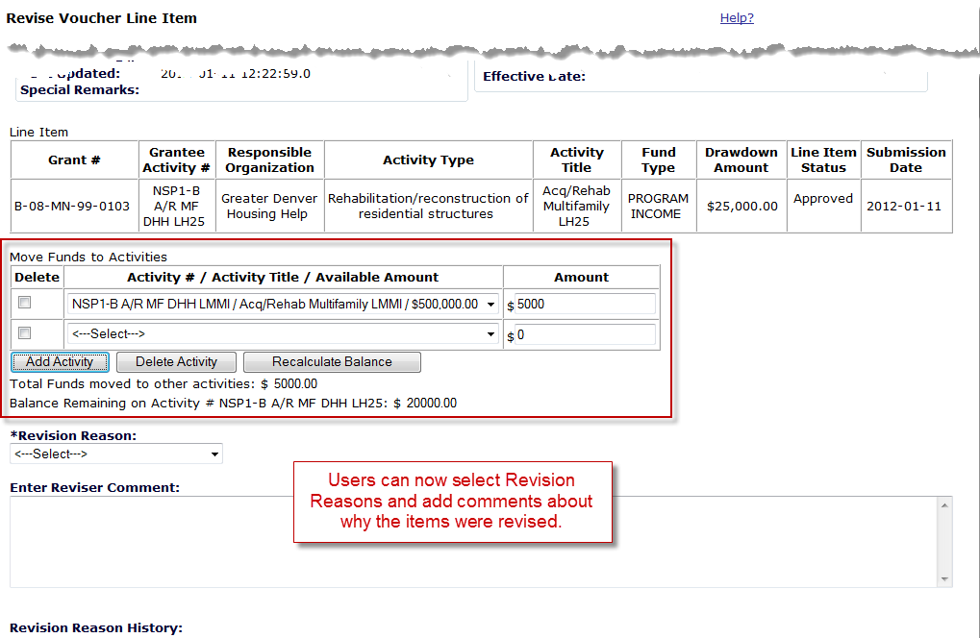
Voucher Corrections
Admin
Action Plans
Drawdown
QPR
Reports
Grants
Notes:
This slide provides an example of a grantee making multiple voucher revisions. This is a new function included in Release 7.3.
After searching for the Voucher and Line Item and selecting Revise next to the appropriate Line Item, the screen shot above appears show the voucher.
Review the DRGR and LOCCS information to confirm that it has been approved. Also review the Line Item data to verify it is the correct voucher/line item you want revised.
Then, in the “Move Funds to Another Activity” Box,
Designate the new activity; and
Enter dollar amount to revise. (you may just want a portion of the voucher)
Enter Recalculate Balance
4. If want to add additional activities, select “Add Activity” and do Step 2 and 3 again.
5. Designate the reason fro revision in the dropdown menu.
By ‘Saving’ this action, a Draw Approver can know take action.
To revise a voucher so that the amount is applied to more than one activity, you will need to revise the revised voucher.

Slide 76
Approving Vouchers
Case Study 12
Admin
Action Plans
Drawdown
QPR
Reports
Grants
Notes:
Let’s approve a voucher.

Slide 77
Voucher Process Review
Admin
Action Plans
Drawdown
QPR
Reports
Grants
DRAWDOWN REQUESTER
DRAWDOWN APPROVER
1.1) ACTIVITY OBLIGATION-
-Search Activity
1.2) Maintain
OBLIGATION
1.1) ACTIVITY OBLIGATION-
-Search Activity
1.2) Maintain
Can be updated by Creator or Approver
1) Select DRAWDOWN
- Create Voucher
A: Select/Add Activities (Pg.1)
B: Submit Voucher (Pg.2)
C: Confirm Voucher (P.3)
D: Success Message (P.4)
NEW VOUCHERS
2.1) Select DRAWDOWN
-Search Voucher
2.2) Maintain Voucher
2.3) Approve/Approve Selected
1.1) Select DRAWDOWN
-Search Voucher
1.2) Maintain Voucher
1.3) Approve/Approve Selected
EXISTING
VOUCHERS
2.1) Select DRAWDOWN
-Search Voucher
2.2) Maintain Voucher
2.3) Approve/Approve Selected
Notes:
This chart represents the voucher process from both the voucher creation and voucher approval sides. Note the tasks for each user permission type by step in the process. Only at the obligation step do the two users overlap permissions.

Slide 78
Drawdown Module Review
Review
Approve Draw
Draw Corrections
Notes:
To briefly review some of the key points made in the section:
Work with your field office to ensure all obligations meet the NSP definition of “obligation.”
All funds are obligated and drawn at the activity level.
Be aware of the daily draw threshold and be ready to provide additional data to HUD for approval.
There are multiple ways to correct drawdowns. The method to correct the data depends on the voucher’s status.

Slide 79
Drawdown Module Review
Admin
Action Plans
Drawdown
QPR
Reports
Grants
Obligate Funds to Activity
Draw Requester
Draw Approver
Create Voucher
(with at least 1 Line Item)
Draw Requester
Review & Approve Line Items
Draw Approver
Once processed by LOCCS, payment is received in 2-3 days
Drawdown Process
  Obligate Funds
  Create Draw Voucher
  Approve Draw Voucher
  Over Threshold?
    Yes – Send additional info to HUD for approval
    No – wire transfer in 2-3 days
Additional Functions
  Draw Corrections
    Revise
    Reject
    Cancel
  Program Income
Draw sent to HUD for review if over threshold
Notes:
The Drawdown Module is where nearly all of the financial functions of DRGR are located. This includes reporting obligations and initiating the reimbursement of eligible expenditures from the grant line of credit.
The request for funds is called a “drawdown” request, thus the name of the module.
Each drawdown request becomes a “voucher,” or a record of the drawdown request against the grant line of credit.
In order to draw down grant funds and receive reimbursement from the U.S. Treasury, you must complete several tasks within DRGR. These are summarized below. Detailed instructions on completing each of these tasks will be provided later in this section. It is assumed that a grantee has already set-up their Action Plan and submitted and received approval on the original submission.
Obligate grant funds to an activity from a project.
Create the voucher.
Approve the voucher.
Note that if a voucher line item exceeds a drawdown threshold, it is forwarded to HUD for approval before being submitted to LOCCS.
DRGR will then automatically “send” the voucher to the federal Line of Credit Control System, also called “LOCCS.”
This is the system used to directly reimburse grant funds to grantees.
It is an interface with the U.S. Treasury.
LOCCS will receive and process the item overnight.
Funds will be wired to you two to three days from when the voucher is processed.
Please remember that the ability to perform these tasks is restricted by the user permissions granted to the individual DRGR user.
DRGR also allows draws to be revoked, cancelled, and revised, and for program income to be reported as received and applied.

Slide 80
Admin Module
Admin
Action Plans
Drawdown
QPR
Reports
Grants
Monitoring, Audit and Technical Assistance
Demonstrate oversight efforts
Adding/Editing Events
Adding/Editing Event Topics
Public View
80
80
Notes:
Yesterday, instructions for activating a new user and (re)certifying a user were detailed.
This ‘Admin Module’ section reviews the Monitoring, Audit, and Technical Assistance functionality.

Slide 81
Admin Module Overview
Admin
Action Plans
Drawdown
QPR
Reports
Grants
Purpose
  Control user access to grants (via Grantee Admin user)
  Helps grantees keep track of their oversight activities (optional)
    Document monitoring, audit, and technical assistance activities
    Record findings, concerns
  Keeps HUD informed of grantee monitoring and TA actions (optional)
HUD FO role:
  Can review grantee’s activities
  NOT for HUD staff to report on HUD’s monitoring activities
Notes:
Note: the first bullet under PURPOSE was discussed yesterday when detailing a Grantee Admin users role and responsibility.
The purpose of the Admin Module is three-fold:
We previously discussed the Admin Module when covering activating and certifying Users in the system (for the Grantee Administrator). The focus of this section will be on Monitoring, Audit, and TA functionality.
As of version 6.5, the Admin Module provides screens for grantee users to report on oversight actions they carry out as part of meeting their responsibilities for day-to-day management of their grant programs. In DRGR, these are called monitoring, audit, and technical assistance (TA) events. These screens are not for HUD staff to report on monitoring activities – they are for grantees to report on their monitoring activities. The information entered here will be for HUD staff and grantees only. At this point, it is optional for a grantee to enter information here.
It is important to remember that this module is not a monitoring system in itself. It is only for reporting very basic summary level information about the number of visits and reports related to a grantee’s oversight of the activities funded under their grants in the DRGR system. In general, the information requested on visits is limited to the dates of visits and reports as well as very high-level categories of compliance issues reviewed such as national objective, eligible activities, financial management, environmental review, etc.
Any DRGR user can view this information, but relatively little is part of public documents.

Slide 82
Admin
Action Plans
Drawdown
QPR
Reports
Grants
Monitoring/Audit/TA Flow Chart
Two Basic Levels:
Events (4 different types of Events to chose from)
Findings, Concerns and/or Topics
Monitoring
Finding
Concern
Audit
Audit Topics
Technical Assistance
TA Topics
Monitoring & Technical Assistance
Finding
TA Topics
Concern
1.
2.
Notes:
This slide shows how the Admin Module is a two-tier hierarchy system.
Events/Reports;
Findings/Concerns/TA Topics
For the first level, grantees enter in the start and end dates of monitoring, audits and/or TA visits as well as the date of reports. Grantees can also identify which activities have been reviewed or assisted as well as the major categories of topics covered in reviews or assistance. In monitoring and audits events, findings and/or concerns may be reported as resolved during the report process or left open.
There are four different types of events to report on:
Monitoring is the formal review for compliance of subrecipients and other partner organizations.
Audits are the formal review of financial management systems for subrecipients.
Technical Assistance is training and assistance provided to subrecipients and other partner organizations to ensure compliance with all of the applicable federal regulations.
Monitoring/Technical Assistance is a combination of the two activities.
For the second level, grantees should identify any findings and concerns made, as well as their status and corrective actions. Based on the type of event chosen, a grantee may enter a Finding, Concern, and/or Topic. For technical assistance, grantees can identify the basic categories of topics covered.

Slide 83
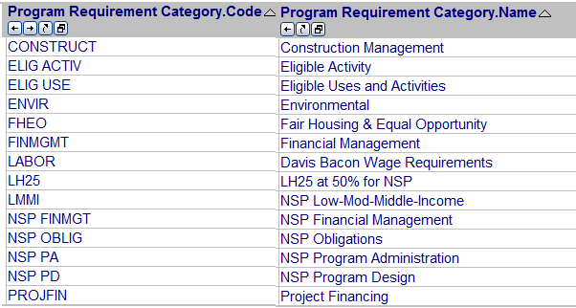
Admin
Action Plans
Drawdown
QPR
Reports
Grants
Categories: Program Requirement
Drop down menu of Program Requirement Category codes are unique to each appropriation.
Example includes NSP1 category code options:
Notes:
At the 1st Level (Event), a grantee must choose from a drop down menu of Program Requirement categories. These are categories that a grantee may choose from to demonstrate the type of work reviewed during that Event. These categories are unique to each appropriation.
At the 2nd Level (Finding, Concern and/or Topic), only categories selected at the 1st Level for review during a visit will show as options when users are selecting findings, concerns, and audit or TA topics.
These categories are based on CPD monitoring handbook exhibits.

Slide 84
1st Level: Add/Edit Event
Admin
Action Plans
Drawdown
QPR
Reports
Grants
What: Event Type
  Monitoring
  Audit
  Technical Assistance
  Monitoring/Technical Assistance
Funding Type: Grant #
Who: Responsible Org
Where: Onsite or Remote
When: Start, End, and Report Date
Result:
  Finding or Concern
  TA or Audit Topic
Notes:
Any grantee DRGR user with more than VIEW ONLY rights can add monitoring, audit, and TA events by selecting the ADMIN module from the main navigation bar and then selecting the link to ADD MONITORING/AUDIT/TA from the left navigation frame after the admin module is active.
One caveat: If an Audit does not have a start and/or end date for the engagement, then a grantee may enter the period of time covered by the audit.

Slide 85
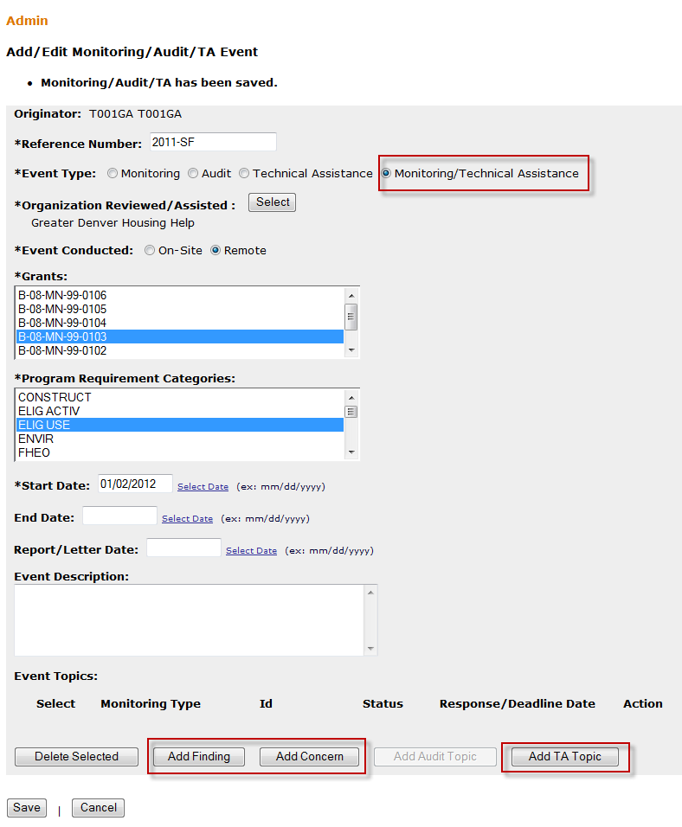
1st Level: Add/Edit Event
Admin
Action Plans
Drawdown
QPR
Reports
Grants
As of Release 7.3, grants are selected at the Event Level.
Event Type selected corresponds with the sub category options activated below (Finding, Concern, Topic)
85
Notes:
The slide above is an example of a screen that has been completed for a monitoring event. The event was Onsite and includes Program Requirement Categories such as:
Allowable Costs
CDBG Eligibility
Financial Management
The option to select a grant for the event as noted in this slide, is a new feature of the 7.3 release.
Once this has been completed, you will select either Add Finding or Add Concern.
HUD considers a Finding to be an instance of noncompliance with program requirements.
A Concern is a practice or situation that, if left unaddressed, may lead to noncompliance.

Slide 86
2nd Level: Add/Edit Finding
Admin
Action Plans
Drawdown
QPR
Reports
Grants
Finding ID & Title
Description of Finding, including regulatory citation
Activities
Program Requirement
Corrective Action
Amount Requested
Amount Recovered
Status: Open or Closed
Follow Up Action
Notes:
The list on this slide shows all the data points that need to be entered for each finding.

Slide 87
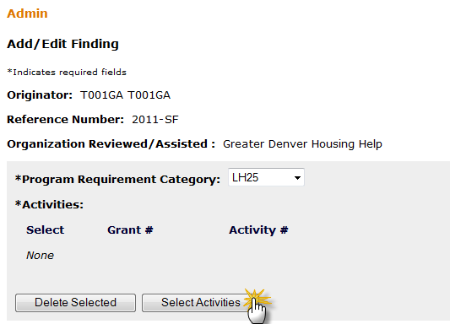
2nd Level: Add/Edit Finding
Admin
Action Plans
Drawdown
QPR
Reports
Grants
Notes:
Here is an example of where/how to define the Program Requirement Category and to add the Activities from the Action Plan with which the finding is associated.

Slide 88
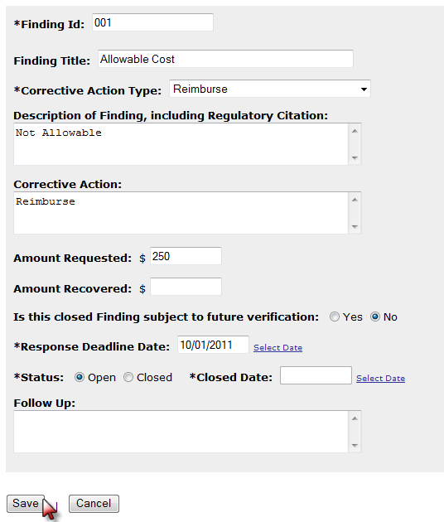
2nd Level: Add/Edit Finding
Admin
Action Plans
Drawdown
QPR
Reports
Grants
Notes:
This slide shows an example of the fields listed in a previous slide. All of the fields with an asterisk are required, but it is recommended that users complete as many fields as possible.

Slide 89
2nd Level: Findings - Corrective Action
Admin
Action Plans
Drawdown
QPR
Reports
Grants
No Action Required
Corrective Actions
  Reprogram Funds
  Reimburse
  Change Payment
  End/Alter
  Future Grant
  Other
Sanctions
  Hearing
  Reduce/Suspend/ De-obligate Funds
  Reduce future grant
  Terminate grant
  Other
Notes:
This slide shows the different options available from the Corrective Action Categories dropdown.

Slide 90
2nd Level: Add/Edit Concern
Admin
Action Plans
Drawdown
QPR
Reports
Grants
ID & Title
Activities
Program Requirement
Description
Recommended Action
Status: Open or Closed
Notes:
As there are with adding a Finding, there are DRGR pages to Add/Edit a Concern. Listed above is the specific information that should to be reported.
Each field is defined the same as the Finding fields.

Slide 91
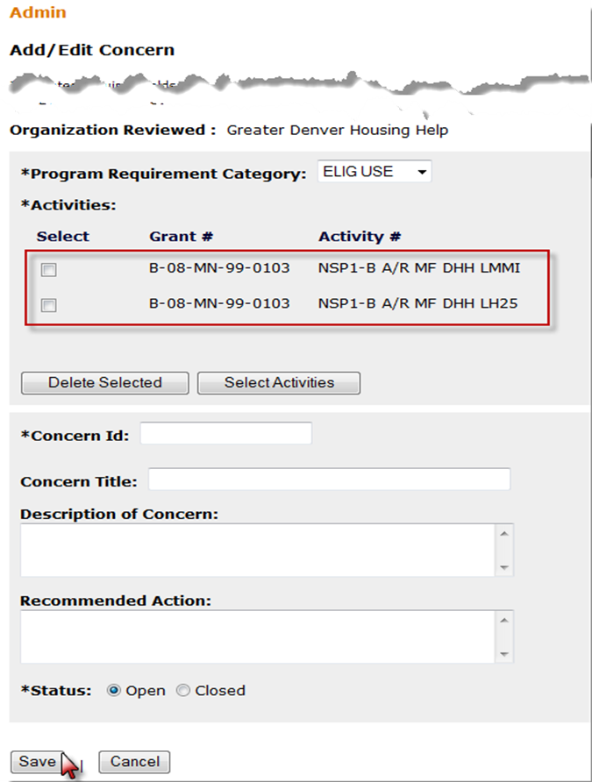
2nd Level: Add/Edit Concern
Admin
Action Plans
Drawdown
QPR
Reports
Grants
Notes:
This slide is an example of what the Add/Edit Concern screen might look like.

Slide 92
2nd Level: Add/Edit Audit Topic
Admin
Action Plans
Drawdown
QPR
Reports
Grants
Audit Topic ID & Title
Description of Audit, including regulatory citation
Activities
Program Requirement Category
Corrective Action
Amount Requested
Amount Recovered
Status: Open or Closed
Follow Up Action
Notes:
Similar to Findings, the Audit Topic may apply to all activities for an activity, or users can go through the Select Activities button to identify specific activities.

Slide 93
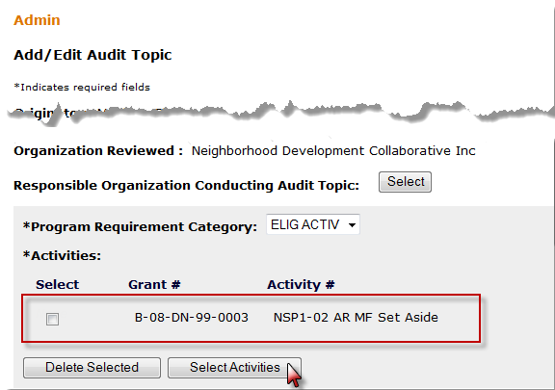
2nd Level: Add/Edit Audit Topic
Admin
Action Plans
Drawdown
QPR
Reports
Grants
Notes:
This slide is an example of an Audit Topic that has been completed.

Slide 94
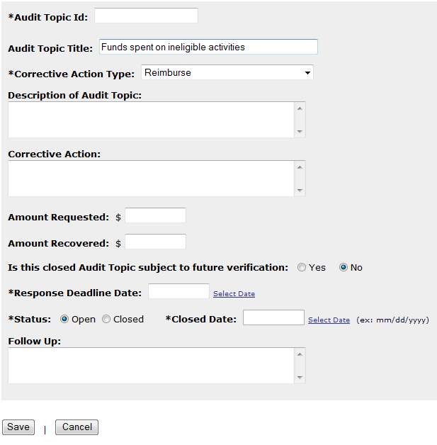
2nd Level: Add/Edit Audit Topic
Admin
Action Plans
Drawdown
QPR
Reports
Grants
Notes:
This is a continuation of the Audit Topic entry on the previous slide.

Slide 95
2nd Level: Add/Edit TA Topic
Admin
Action Plans
Drawdown
QPR
Reports
Grants
TA Topic ID & Title
Description of TA, including regulatory citation
Activities
Include additional Organizations Assisted
Program Requirement Category
Rationale
TA Topic Provider
Conclusion
Notes:
Similar to the other Events, Technical Assistance (TA) can further define the work by adding a TA Topic.

Slide 96
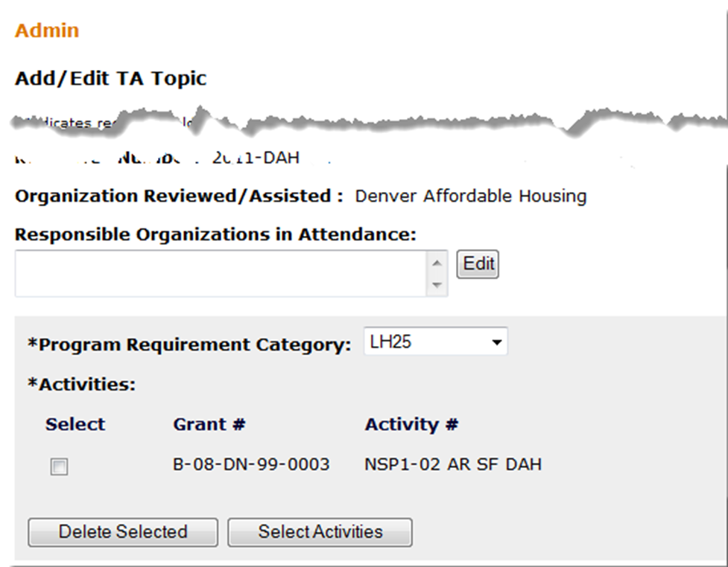
Admin
Action Plans
Drawdown
QPR
Reports
Grants
2nd Level: Add/Edit TA Topic
Notes:
Include the grantees that were in attendance and the DRGR activity (per Grant) in which the Topic took place.

Slide 97
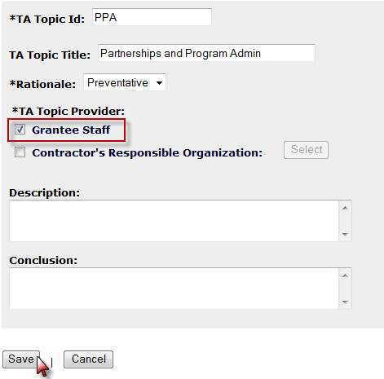
Admin
Action Plans
Drawdown
QPR
Reports
Grants
2nd Level: Add/Edit TA Topic
Notes:
Define who did the actual work for the TA Topic, the description of the work that was done, and any conclusions.

Slide 98
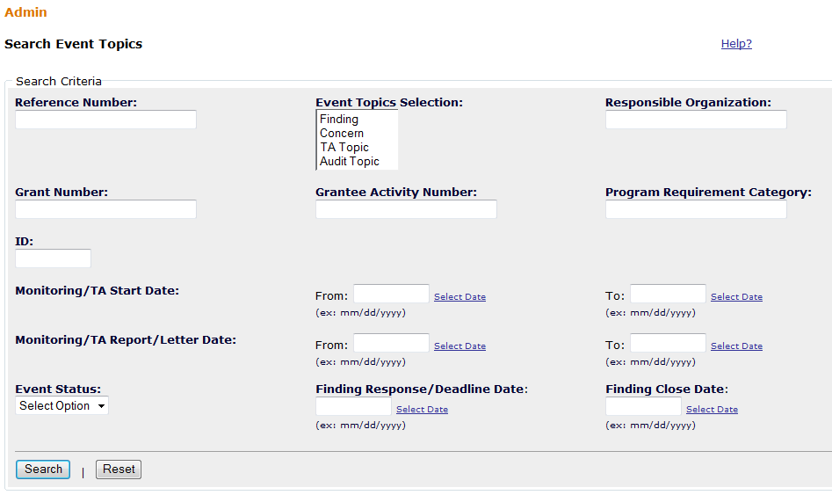
Search Events
Admin
Action Plans
Drawdown
QPR
Reports
Grants
Notes:
This screen allows grantees to search for events already entered into the system. The user can search by as many or as few fields as they choose. The Monitoring/TA Event Type will provide a dropdown list of the different event types, such as Monitoring, Audit, Technical Assistance, etc.

Slide 99
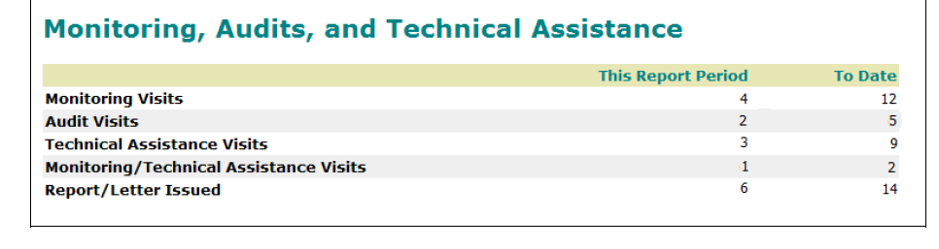
Public View: Summary (QPR)
Admin
Action Plans
Drawdown
QPR
Reports
Grants
Notes:
Most of the detailed information on monitoring, audits, and technical assistance can be viewed by grantee and HUD DRGR users, but is not viewable by the general public. Since information in the QPR may be exported and posted for viewing by the public, only summary information on the number of visits and/or reports is displayed in the View QPR screen and the results of downloading QPRs for printing. If a grantee has not entered any information in the Admin Module regarding the events, then this section will not appear in a QPR.
Microstrategy reports summarizing more detailed lists of events and findings will be available for HUD and grantee users. In general, these will be organized by event type, organization, and/or compliance categories.

Slide 100
Monitoring, Audit, and Technical Assistance
Case Study 13
Admin
Action Plans
Drawdown
QPR
Reports
Grants
Notes:
Let’s work on a case study for the Admin Module.

Slide 101
Admin Module Review
Review
Module helps grantees demonstrate and detail oversight efforts
Tracks grantees, not HUD’s, oversight efforts
Not a monitoring system – only captures summary data.
Only summary info available on QPR; more detail available in Admin module
Notes:
This module will help grantees demonstrate how they are preventing fraud, waste, and abuse.
These screens are not for HUD staff to report on monitoring activities — they are for grantees to report on their monitoring activities. The information entered here will be for HUD staff and grantees only.
It is important to remember that this module is not a monitoring system in itself. It is only for reporting very basic summary-level information about the number of visits and reports related to a grantee’s oversight of the activities funded under their grants in the DRGR system.

Slide 102
DRGR Reports
Admin
Action Plans
Drawdown
QPR
Reports
Grants
The Optional Module
Standard Reports
Modifying/Saving Reports
Public Reports
102
102
102
Notes:
This section will review the reports module by detailing the standard and public reports in addition to learning how to modifying and saving reports.

Slide 103
Reports
Admin
Action Plans
Drawdown
QPR
Reports
Grants
Purpose:
  Reports provide a relatively quick and easy way of accessing the most up-to-date information in DRGR related to user accounts, obligations and drawdowns, report status, etc.
HUD FO:
  Examine financial information and user account info
  Determine AP/QPR review status.
Grantee:
  Examine financial information and user account info
  Determine AP/QPR status.
Which reports you can access will vary based on
the type of account you have. It is a purely OPTIONAL module.
Notes:
The reports available in the Reports Module can be useful for a number of reasons.
Quickly check the status of financial information and documents (Action Plans and QPRs).
Troubleshoot common issues (e.g., user role issues) quickly and without the need to call for assistance.
Create and save reports based on the information most useful to you.
Use the Subscribe function to receive reports on a regular basis.
Note: Reports are a snapshot of that moment’s data in DRGR. If you want to see trends over time, there may be a report for that.
Unlike any other module in DRGR, a grantee may choose never to utilize this module. However, as it is extremely helpful in troubleshooting issues for a grantee, we will review the functionality and provide examples.

Slide 104

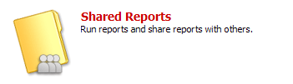
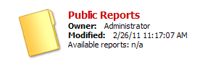

Accessing Reports
Admin
Action Plans
Drawdown
QPR
Reports
Grants
1.
2.
3.
OR
Notes:
Navigating to the folder containing the canned reports available in DRGR can be a bit tricky. The graphic above will help guide you through the process. The final folder will say “Grantee User Reports” or “Field Office User Reports” — depending on your role in the system.

Slide 105
Public vs. Standard Reports
Admin
Action Plans
Drawdown
QPR
Reports
Grants
Public Report: Interactive charts and graphs showing progress by grants, activity category or grantee projects. Contain any shared reports that can be accessed by all users
Standard Reports: Data files like spreadsheets used for tracking and quality control often containing data at the activity level. More commonly used by grantees.
Notes:
There are two main categories of reports: Public and Standard.

Slide 106

Standard Reports
Admin
Action Plans
Drawdown
QPR
Reports
Grants
Administrative Reports
  User information
  Action Plan/QPR status
Financial Reports
  Budgets
  Disbursements
  Cumulative financial data
Performance Reports
  Beneficiary measures
Notes:
There are three types of Standard Reports in DRGR: Administrative, Financial and Performance. These are canned reports HUD has created for you.
As well, there are reports that pull cumulative information and others that pull information by quarter. Cumulative total reports assist a grantee in identify macro problems . The quarter reports may assist a granted in identifying a recurring pattern for an issue.

Slide 107
Standard Reports: Admin
Admin
Action Plans
Drawdown
QPR
Reports
Grants
Admin Rept01a: GRANT - DRGR Grant Status and CPD Contact |  | Admin Rept02a: ACTPLN - Grant and DRGR Action Plan Review Status
This report shows grant status, including drawdown and obligation blocks. It also includes CPD contact for each grant. If info needs to be updated, please send to DRGR_Help mailbox. |  | This report shows whether grant is blocked from drawdowns as well as the date of the last DRGR AP approval and the current status of the DRGR AP.
Admin Rept02b: ACTPLN - Activity Status with Start and End Dates |  | Admin Rept03a: QPR - Report Status
Performance data in this report is aggregated measure types so the numbers are not meaningful in themselves. It is only include as an indicator of whether accomplishments were entered or not. |  | This report will only show the status of QPRs that have been added by grant. Grantees must add each QPR as they are due.
Admin Rept03b: QPR - Exec Summary Progress Narrative |  | Admin Rept04a Modified: USERS - Grantee DRGR Users Account Status
This report shows the overall progress narrative at the grant level by QPR |  | This is a fully prompted report that can be used as a template for building other reports.
Admin Rept04a: USERS - Grantee DRGR Users Account Status |  | Admin Rept04b Modified: USERS - Grantee Users with System Role and Certification Status
This is a master list of all grantee DRGR user accounts. |  | This is a fully prompted report that can be used as a template for building other reports.
Admin Rept04b: USERS - Grantee DRGR Users with System Role and Certification Status |  | Admin Rept04c: USERS - Grantee DRGR Users Access by Grant
This report shows system role and recertification status for grantee users. Grantee admin users must be recertified by CPD representatives and other grantee users are certified by grantee admin users. Recertifications are required every 6 months. |  | This report will only show users assigned to grants by grantee system administrators. This step must be done when new grantee user accounts or grants are added to DRGR.
Admin Rept05a: ADMIN - Responsible Organization List |  | Admin Rept05b: ADMIN- Oversight Events - Event Level
This organization is a master list of responsible organizations and associated data by grantee. |  | This is a fully prompted report that can be used as a template for building other reports.
Admin Rept05c: ADMIN- Oversight Events - Topic Level
This is a fully prompted report that can be used as a template for building other reports.
107
107
Notes:
This and the following two slides will highlight some of the most commonly used reports for each section.
The first report circled will show the grantee which individuals in their organization have access and the status of their access to each grant if there are multiple grants.
The second, Admin Report 05, will provide a list of all Responsible Organizations that have been entered into DRGR and are associated with the grantee.

Slide 108
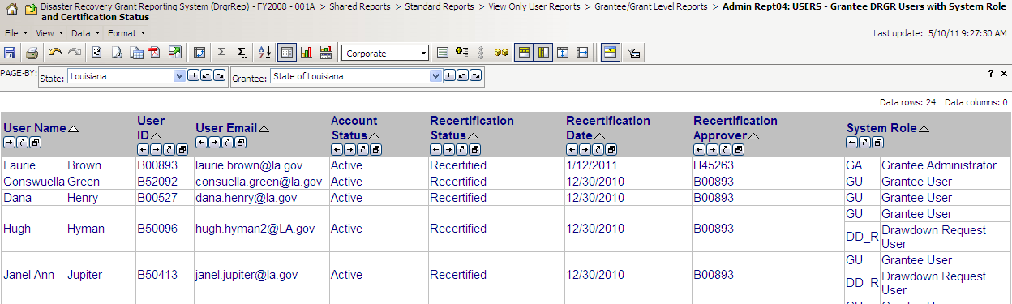
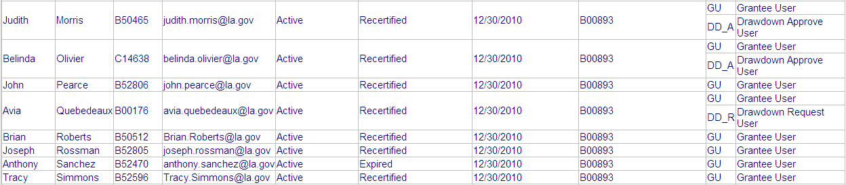
Admin
Action Plans
Drawdown
QPR
Reports
Grants
Standard Reports (Admin Rept04b)
Notes:
This slide shows the results page of Admin Report 04b. This report will tell you who needs to be certified or recertified and what their system roles are.
Mr. Sanchez has an Active account, but needs to be recertified in order to access DRGR.
Ms. Morris is the Drawdown Approver user.

Slide 109
Standard Reports: Financial (Fin)
Admin
Action Plans
Drawdown
QPR
Reports
Grants
Fin Rept01a: ACTPLN- Grant Budgets by National Objective - Activity Level |  | Fin Rept01b: ACTPLN - DRGR Grant Activity Budgets by Project
This report can be used to create a master list of activities for each grant. |  | This report shows activities and their budgets by project. NOTE: Since this is an activity level report, project budgets will repeat on each activity row within the project.
Fin Rept01c: DRAWS- Budget and Disbursements by National Objective - Grant Level |  | Fin Rept02a: DRAWS- Voucher Status by Line Item and QPR Begin Date- Grant Funds
This is a summary report at the grant level. It will only show amounts budgeted and disbursed from activities entered into DRGR. |  | This report shows the status, approval dates, and LOCCS submit date for each voucher line item using GRANT FUNDS by project, activity, and responsible organization. The report now includes a dropdown for QPR BEGIN DATE and GRANT PROGRAM.
Fin Rept02b: DRAWS- Voucher Status by Line Item - Program Income |  | Fin Rept02c: Voucher Revision Report - Grant Funds NP
This report shows the status and approval dates for each voucher line item using program income by project, activity, and responsible organization. |  | This report shows the amount of funds distributed across activities on REVISED voucher line items for activities with grant funds. It includes creation and approval users/dates.
Fin Rept03: DRAWS - Voucher Status by Line Item - Grant Funds |  | Fin Rept04: DRAWS - Voucher Line Item Status by Project - Grant Funds
This is a report showing the status and action dates of voucher line items (note: draws before Jan.1, 2009 are simulated from QPRs). SORTED BY VOUCHER AND VOUCHER ITEM # |  | This is a report showing the status and action dates of voucher line items (note: draws before Jan.1, 2009 are simulated from QPRs) SORTED BY PROJECT and ACTIVITY #
Fin Rept05a: CUM - Program Income - Grant Level |  | Fin Rept05b: CUM - Program Income - Activity Level
This is a report showing data at the grant level program income disbursements recorded in the drawdown module and program income received across all QPRs (regardless of QPR status) |  | This report shows data at the activity-level: a) grant funds budgeted, b) grant fund obligations and approved grant and program income disbursements recorded in the drawdown module and c) program income received across all QPRs
Notes:
The reports circled on this slide are some of the most useful sources of information available to a user.
The first financial report circled, Fin Report 2a, will show the status of the vouchers that have been created. If the grantee has had to revise or reject vouchers for any reason, this report is useful to ensure that the intended changes have been captured by the system.
Financial Report 5b detail the Program Income data as seen in the system, and 5d displays a list of the Program Income Accounts that have been set up.

Slide 110
Standard Reports: Financial (Fin)
Admin
Action Plans
Drawdown
QPR
Reports
Grants
Fin Rept05c: Receipts by Project and Activity |  | Fin Rept05d: Program Income Account Summary
This report shows Receipts in the Drawdown module recorded for Program Income and RLFs. (Note: Receipts before Dec.3, 2011 are simulated PI Received amounts recorded in QPRs from before that date) |  | This report shows the sum of activity budgets, obligations, program income received, and program income disbursed within each PI account. It does not include any activities not assigned to a PI account.
Fin Rept06: CUM - Fin Data - Grant Level |  | Fin Rept06b: CUM - NSP Financial Summ - Grant Level - LH25
This report shows grant-level financial data entered or calculated by quarter. It includes grant funds and program income. Grant obligations entered from Jan 09 are updated amounts rather than incremental. |  | This report shows a grant-level snapshot of financial activity for activities benefiting households below 50% AMI
Fin Rept07: CUM - Grant Funds Fin Summ - Project Level |  | Fin Rept07b: CUM - Cumulative Data - Activity Level by Resp Org, Act Type and Nat Obj
This is a report showing data at the project level from the latest DRGR Action Plan and across all QPRs (regardless of QPR status) SORTED BY STATE, GRANT # and PROJECT #. |  | This is a report showing financial data at the activity level from the latest DRGR Action Plan, from the drawdown module as of the date the report is pulled, and across all QPRs regardless of QPR status. W/ RESP ORG, ACT TYPE AND NAT OBJ.
Fin Rept07c: QPR - Fin Data by Activity and Quarter |  | Fin Rept08a: CUM - Grant Funds Budget and Cumulative Data - Activity Level by Resp Org, Act Type and Nat Obj
This report shows activity-level financial data entered or calculated by quarter. This can be used to troubleshoot data entry errors across quarters. Report updated to include project # and title. QPRs only show if financial activity during quarter. |  | This is a report showing data at the activity level from the latest DRGR Action Plan and across all QPRs (regardless of QPR status) W/ RESP ORG, ACT TYPE AND NAT OBJ
Fin Rept08b: CUM - Grant Funds Financial Summ - Activity Level by Project |  | Fin Rept09a: QPR - Fin Data by Quarter - Grant Level
This is a report showing data at the activity level from the latest DRGR Action Plan and across all QPRs (regardless of QPR status) SORTED BY PROJECT AND ACTIVITY # |  | This report shows grant-level financial data entered or calculated by quarter. Obligations entered since Jan 09 are updated amounts rather than incremental.
Fin Rept09b: QPR - Fin Data by Activity and Quarter
This report shows activity-level financial data entered or calculated by quarter. This can be used to troubleshoot data entry errors across quarters. Obligations entered from Jan 09 are updated amounts rather than incremental.
Notes:
Financial Report 5b detail the Program Income receipts by Project and Activity that have been created either by the user or automatically by the system through Release 7.3.
Financial Report 7b will provide a detailed report of the grantee’s activity budgets, obligation amounts, and expenditures by activity. This report is very helpful to both the grantee and the Field Office when determining if the grantee is meeting its obligation deadlines, (if there are any) and reporting its expenditures in the QPR correctly. It can also provide a general sense of the rate at which the funding is being spent.

Slide 111
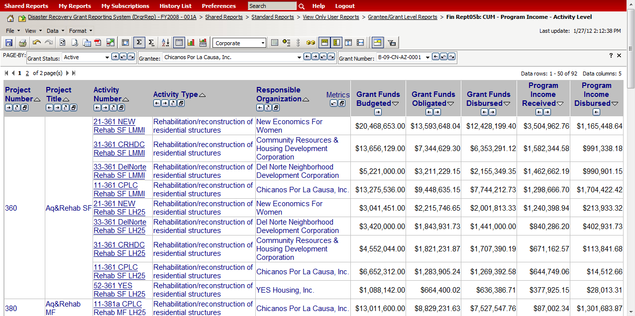
Standard Reports: Financial
(Fin Rept05b)
Admin
Action Plans
Drawdown
QPR
Reports
Grants
Notes:
This is a great report for a financial review — It covers both grant funds budgeted and disbursed and Program Income funds received and disbursed.

Slide 112
Standard Reports: Performance (Perf)
Admin
Action Plans
Drawdown
QPR
Reports
Grants
Perf Rept01: CUM - Projected vs Cum Totals for Performance Measure Sorted by Activity Number |  | Perf Rept02a: CUM - Projected vs Cum Totals for Performance Measure Sorted by Resp Org and Activity Type
This reports shows data from the latest DRGR Action Plan and all QPRs (regardless of QPR status) Note: Do not add performance measures across activity types |  | This reports shows data from the latest DRGR Action Plan and all QPRs (regardless of QPR status) Note: Do not add performance measures across activity types
Perf Rept02b: CUM - Projected vs Cum Totals for Performance Measure Sorted by Resp Org and Activity Type - NSP Only |  | Perf Rept02c: QPR - Actual Accomplishments by Quarter
This reports shows data from the latest DRGR Action Plan and all QPRs (regardless of QPR status) Note: Do not add performance measures across activity types |  | This reports shows data from each QPRs (regardless of QPR status) and can be used to troubleshoot data entry problems. Note: Do not add performance measures across activity types
Perf Rept02d: QPR - Actual Accomplishments by Quarter HH and HU Only |  | Perf Rept03: QPR - Addresses by Activity and Responsible Organization
This reports shows household and housing unit data from each QPR (regardless of QPR status) and can be used to troubleshoot data entry problems. Note: Do not add performance measures across activity types |  | This report is intended to show addresses across activities and QPRs. Each QPR normally only shows addresses entered in that report.
Perf Rept04a: ACTPLN - Beneficiary and Hsg Measure Types Selected - Activity Level |  | Perf Rept04b: ACTNPLN - Area Benefit Type Selected- Census vs Survey - Activity Level
This report shows the types of beneficiary measures selected for an activity: Direct vs. Area; Census vs. Survey; Households vs. Persons; Housing Units; SF and/or MF |  | If Area Benefit is selected as the Benefit Type, this report lists activities by whether CENSUS data has been manually selected in DRGR or summary data has been entered using the SURVEY method
Perf Rept05: ACTPLN - Area Benefit Census Method - Low Mod Calculations and CTBGs - Activity Level |  | Perf Rept06: QPR - Direct Benefit Activities - Beneficiary Statistics by Household Type
If an activity has been designated as area benefit- census method, this report shows the summary calculation and a list of the census counties, places, tracts and block groups for each activity. |  | For direct benefit activities, this report shows the distribution of households and/or persons by race/ethnicity and Hispanic status
Perf Rept09: ACTPLN - DREF Activity Budgets and Descriptions
This report shows activities under Ike only grants which have performance measures entered for DREF
Notes:
The reports circled here are some of the most useful sources of information available to a user for tracking Accomplishments.
Performance Report 01 will show a list of all the projected accomplishments entered for each activity in the Action Plan. These are generally estimates of what will be accomplished and are reported on in the QPR. The actual cumulative accomplishments from the QPR are displayed in this report as well and can then be compared against the projected figures.
Performance Report 03 provides the addresses for intended action across activities and QPRs. The QPR will show only the address for that report.
Performance Report 06 details the Fair Housing and Equal Opportunity, (FHEO) data.

Slide 113
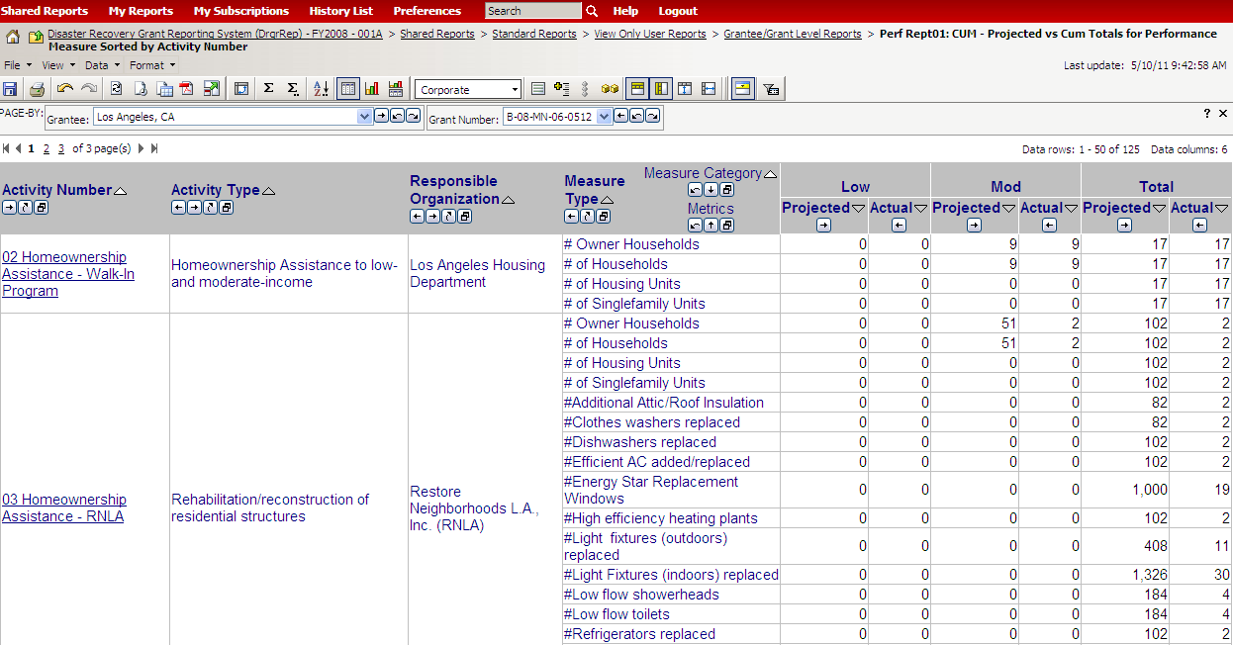
Standard Reports: Performance (Perf Rept01)
Admin
Action Plans
Drawdown
QPR
Reports
Grants
Notes:
This is a great report to review the measures that have been defined in the Action Plan (Projected) and what has currently been reported in the QPR (Actuals).

Slide 114
Modifying Reports
Admin
Action Plans
Drawdown
QPR
Reports
Grants
Common modifications users perform:
Move and Sort Columns
Grouping Columns
Adding Filters
Three ways to modify reports:
Use the ribbon (below)
Drag objects
Right click over the object for different options
Subscribe
Export to Excel or PDF
Swap Rows & Columns
Change Styles
Notes:
Grantees can modify the reports for their own uses. Common modifications a user may utilize that we’ll go over in the next slides are:
Move and Sort Columns
Grouping Columns
Adding Filters
There are three ways to modify reports in the current slide:
Use the ribbon (pictured above)
Drag objects (later slides)
Right-click the object for different options (later slides)

Slide 115
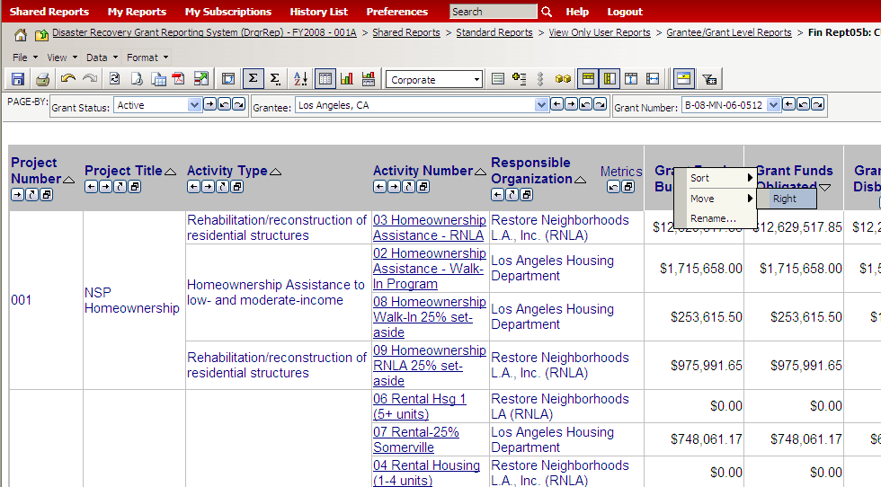
Modifying Reports: Moving Columns
Admin
Action Plans
Drawdown
QPR
Reports
Grants
Notes:
This slide demonstrates how to modify reports and move columns by right-clicking on the column you wish to move, then select the direction to move.

Slide 116


Modifying Reports: Sorting Columns
Admin
Action Plans
Drawdown
QPR
Reports
Grants
Notes:
Like the previous slide, this shows how to modify reports and sort columns by right-clicking on the column you wish to move, then selecting either Ascending or Descending order.

Slide 117

Modifying Reports: Sorting Columns
Admin
Action Plans
Drawdown
QPR
Reports
Grants
Notes:
If you would like to specify the sort order based on more than one column, there are other options using the DATA-SORT menu displayed below the report title or the A-to-Z sort icon below that.
Users have to pick each column name (up to three) and specify the order for each one selected. When the options show “(ID)” or “(DESC), “ choose “(DESC).” DESC is the order based on the text displayed. ID is an internal numeric index assigned by DRGR, and will not be useful for sorting.

Slide 118


Modifying Reports: Creating a Filter
Admin
Action Plans
Drawdown
QPR
Reports
Grants
Notes:
When you move a column to the top of the report section, the system shows only the data for the report category you want displayed. In other words, you can create a filter based on the category you’ve selected. Drag the Column title up until you see a yellow box flash at the top of the page.
In this example, the Activity Type has been selected as the filter and is showing yellow on the ribbon.

Slide 119

Modifying Reports: Creating a Filter
Admin
Action Plans
Drawdown
QPR
Reports
Grants
Notes:
After a moment, you will see the column you selected become available at the top of the page as a dropdown menu. Now you can view the information in the report above based on Activity Type.

Slide 120

Modifying Reports: Grouping Columns (Example: Activity #)
Admin
Action Plans
Drawdown
QPR
Reports
Grants
Notes:
Certain attributes, like National Objective and Voucher Number, can be moved to columns. This functionality allows you to see data broken down in a different way.
The above screenshot provides an example of what it looks like when you move attribute columns (that contain text) over metric data (in this case, funds received/disbursed, etc.) for an Activity #.

Slide 121

Modifying Reports: Grouping Columns (Example: Activity #)
Admin
Action Plans
Drawdown
QPR
Reports
Grants
Notes:
Now we see the funds grouped by Activity Numbers.

Slide 122


Modifying Reports: Grouping Columns (Example: Organization)
Admin
Action Plans
Drawdown
QPR
Reports
Grants
Notes:
Here is another example of this function, but grouped by the Responsible Organization.

Slide 123

Modifying Reports: Grouping Columns (Example: Organization)
Admin
Action Plans
Drawdown
QPR
Reports
Grants
Notes:
This is what the grouped by the Responsible Organization change looks like.

Slide 124

Modifying Reports: Grid and/or Graph
Admin
Action Plans
Drawdown
QPR
Reports
Grants
Notes:
All the reports viewed thus far are grid style. By selecting the View dropdown menu, you will see there is also a Graph style (or you can see both, as shown above).

Slide 125


Saving Reports: ‘My Reports’
Admin
Action Plans
Drawdown
QPR
Reports
Grants
Notes:
The “My Reports” tab is specific to each DRGR account. After you modify reports, you can save them in “My Reports” for future use. To save a modified report to “My Reports,” click the “Save” button (floppy disk icon) inside the report. You will then be taken to a menu were you will be able to name the report and fill in a description of the information contained inside it. Click “OK” to save.

Slide 126

Saving Reports: History List
Admin
Action Plans
Drawdown
QPR
Reports
Grants
Notes:
You can use the “Add to History List” function shown above to save the exact copy you are viewing of a particular report for future reference.

Slide 127



Subscribing to Reports
Admin
Action Plans
Drawdown
QPR
Reports
Grants
Click on link under report title
Select ADD SUBSCRIPTION
Specify frequency for the report
Notes:
Subscribing to a report will allow you to receive a copy of it at specified time intervals (e.g., every Monday, every first of the month, etc.). The report will not be emailed to you, but will instead be delivered to you within Microstrategy.
There is a three- to four-month timeline on reports saved to the DRGR server. As such, users should access and export saved reports regularly.

Slide 128


Exporting Reports
Admin
Action Plans
Drawdown
QPR
Reports
Grants
When to Export
  When selecting the report (only access to one grant)
  After modifying the report
Notes:
Look for the word “Export” or for the PDF symbol on the main report page (e.g., View Only User Reports) or inside the report (the screen you see after clicking on the report title).
You can also save the report as an Excel file with formatting (fonts, colors and groupings intact) or a TXT file, which strips all formatting and keeps all data showing in each row. Microstrategy tends to save the formatted version as an Excel Web page (HTML), so it helps to check and re-save it in the standard Excel format (*.xls or *.xlsx) when you open the file in Excel.

Slide 129

Exporting Reports to Excel
Admin
Action Plans
Drawdown
QPR
Reports
Grants
Notes:
The above screen should appear after selecting the Export to Excel function. This will allow you to determine how the export appears, (with filters, as an HTML document, etc.).

Slide 130

Accessing Public Reports
Admin
Action Plans
Drawdown
QPR
Reports
Grants
1.
2.
3.
4.
OR
Notes:
We have just finished reviewing all Standard Reports. The Public Reports folder will contain any shared reports for all users.
There are two types of Public Reports:
Financial update dashboards: Bar chart showing budgeted vs. balance by grant, project, or activity category
Quarterly Expenditure Analysis: Graph showing quarterly disbursements by grant, project, or activity category

Slide 131

Public Reports: Financial Update Dashboards
Admin
Action Plans
Drawdown
QPR
Reports
Grants
Notes:
This slide shows an example of Financial Update Dashboards. This report provides tables detailing the amount of funds by (1) grant, (2) project, or (3) activity category that have been disbursed in DRGR. The bar charts below the table illustrate these disbursements and the amount of funds remaining by each of these groupings.
In effect, the bar charts help users see the relative amount of funding across these groupings and how much progress has been made by each individual group.

Slide 132

Public Reports: Quarterly Disbursements Analysis
Admin
Action Plans
Drawdown
QPR
Reports
Grants
Notes:
While this report provides a snapshot of progress, the Quarterly Expenditure Analysis reports also break down these disbursements across quarters using data from the Quarterly Progress Reports (QPRs). This allows users to examine spending trends by grants, projects, or activity categories across the life of the grants.

Slide 133


Public Reports: How to Save
Admin
Action Plans
Drawdown
QPR
Reports
Grants
Notes:
To save a Public Report, right-click and select “Save Picture As…” from the list that appears.

Slide 134
Pull and Modifying Reports
Case Study 14
Admin
Action Plans
Drawdown
QPR
Reports
Grants
Notes:
Let’s modify a report.

Slide 135
Reports Review
Review
Do you know…
  …how to access reports?
  …how to modify reports?
  …how to export reports?
  …the difference between Shared Reports and My Reports?
Notes:
Review the questions above to make sure you understand what has been covered in the Reports Module.

Slide 136
The Basics: DRGR Modules
Admin
Action Plans
Drawdown
QPR
Reports
Grants
Action Plans
Identify activities to be funded by organization, activity type, and project.
Drawdowns
Obligate funds
for draws; create, approve, edit vouchers; receipt program income
QPRs
Summarize drawdowns, expenditures, obligations, and achievements for
the quarter
Reports
Look at financial, reporting, and user account information in an easy-to-read and exportable format
Admin
Assign and certify users; add and track TA and Monitoring Events
Notes:
You should now have a strong grasp of each of the 5 DRGR modules.

Slide 137
Telling Your NSP Story
Admin
Action Plans
Drawdown
QPR
Reports
Grants
Action Plan Checklist
QPR Checklist
137
137
Notes:
(Read through bullets)
This section will assist you in understanding:
what HUD reviews,
how HUD interacts with you as a grantee within the system, and
what story you are telling HUD through DRGR about your NSP progress.

Slide 138
Action Plan Checklist
Admin
Action Plans
Drawdown
QPR
Reports
Grants
Purpose: Provides a record of
changes/approvals of the AP
FO plays a key role: Approval process per each modification
  Ongoing updates to AP
  Summary of changes proves helpful
Usually reviewed in Print View format with additional reports pulled.
Only reviewed if the AP status is: “Submitted – Await for Review.”
Notes:
The Action Plan is the starting point of all reporting in DRGR. Proper setup of the Action Plan is key to reporting accurately in DRGR. The Action Plan Checklist is a tool HUD utilizes that assists Field Office reps in reviewing Action Plan submissions.
Field office staff play a key role in the Action Plan process, so it is important to understand the back-and-forth aspect of the Action Plan in DRGR.
Every time the grantee makes changes to the Action Plan and submits it for review, the Field Office staff person assigned to that grant must review it and either reject or approve it.
It is important for the review to occur in a timely manner because the grantee will be limited to performing certain functions, like submitting a QPR, when the Action Plan is in the review stage.
Given the fluid nature of the NSP programs and ongoing updates to DRGR, most grantees will need to make multiple changes to their Action Plan data and will submit the Action Plan for review more than once.
As a Field Office staff, you may want keep an open dialogue with your grantee(s) regarding what the changes are per submission. You will not be able to see that readily (i.e., there are no track changes). Therefore, you may request a summary of the changes when they submit an Action Plan for review.
Many FO reps will utilize the Print View format in addition to some of the standard reports. Additionally, the Print View format is posted on the NSP Resource Exchange. It is your responsibility to understand this format and how you are presented to the public. The link to download a print version will appear in the module menu when you select an action plan. When you click on the link, the system will generate a PDF of the action plan that you can save to your PC or simply print out.
A FO rep can only review and approve the AP if it is the following status: “Submitted – Await for Review.”
There is a “Action Plan Review Checklist_NSP3” that walks through several key questions a FO rep reviews. Check out the handouts that accompany these slides.

Slide 139
Action Plan Checklist
Admin
Action Plans
Drawdown
QPR
Reports
Grants
Suitable User Roles
Narratives in line with Substantial Amendment
Projects & Activity Budget Set-Up
  No ‘Bucket’ or ‘Restricted Balance’ Project/Activity
  Set-aside Requirement
  Sum of the Project budgets = Grant Amount
  Sum of the Activity budgets = Project Amount
  Budget Caps: Admin & Demo
Notes:
It is essential for a grantee to understand what details the FO is reviewing when approving an Action Plan. As this is the “record on file,” the Action Plan provides the outline of the story that a grantee is telling regarding its NSP funding.
For User Roles, HUD will verify a voucher creator (drawdown requester) and voucher approver (drawdown approver) are both on hand in the grantee’s system.
Starting at the grantee narrative level, you want to make sure that the narrative provided in DRGR is substantially equivalent to the information in the published Action Plan/Substantial Amendment. The narrative sections will be slightly tweaked based on the appropriation.
Key items to review for Activity budgets include:
A grant should not have a budget or activity associated with the Bucket Project or the Restricted Balance project.
A grant must have accurately identified enough funds for the Set-aside requirement.
The sum of the project budgets equals the grant amount. If it does not, the narratives should explain how the outstanding balance will be identified in future Action Plan Amendments.
The sum of the activity budgets equals the project amount. If it does not, the narratives should explain how the outstanding balance will be identified in future Action Plan Amendments.
A grantee must adhere to the budget caps set by the Notices – including Admin and Demo (NSP2/3).
There is a “Action Plan Review Checklist_NSP3” that walks through several key questions a FO rep reviews. Check out the handouts that accompany these slides.

Slide 140
Action Plan Checklist
Admin
Action Plans
Drawdown
QPR
Reports
Grants
Activity Programmatic Data
  Activities are broken out by national objective, responsible organization, multifamily complex *, or activity type
  Check for “too many” activities
  National objectives: Are they correct/compatible with activity types? Do the proposed accomplishments support the designated National Objective?
  Are the location descriptions in the Areas of Greatest Need as determined by the Substantial Amendment?
  Proposed beneficiary and accomplishment data entered: including correct Benefit Type
Notes:
Above all else, the grantee’s NSP story is told at the Activity level. One of the main ways to help grantees avoid problems down the road and tell their story accurately is to ensure they have their activities structured correctly. Grantees will have to draw funds and report benefits at the activity level. If the activities are set up incorrectly, the grantee may have to fix the activity setup, and they may need to make draw revisions and corrections on the QPR as well.
The correct setup will have activities broken out based on 4 characteristics.
Some grantees may have tried to parse their program into too many activities, which may cause them problems down the road. For example, they may have set up a separate activity for program delivery. Or they may have set up a separate activity for disposition. In most cases, these types of costs should be lumped into the overall activity or end use of the assisted property.
Reviewers should pay special attention to activities where the national objective selected is incompatible with the selected activity type. For example, Land Banking — as a future activity with beneficiaries that cannot be determined at this time — cannot count toward the 25% requirement; land banking should always be classified under the LMMI category. Reviewers should evaluate whether a grantee has identified accomplishments that do not support the National Objective identified in the Activity. For example, an Activity is designated for the 25% requirement but proposes to assist 10 moderate-income households.
There are two sections of the Action Plan that request narrative information at the Activity level: Location Description and Activity Description. Reviewers should verify that a grantee indicates, at a minimum, that the Activity will be located in the Areas of Greatest Need. If a grantee details more specifics on the location (e.g., gives specific census tracks or the address of the multifamily complex), then a reviewer should verify that the location is within the Area of Greatest Need as identified in the Substantial Amendment. It is not essential to have addresses in the Action Plan as many grantees will not know this exact detail until a later date.
The most current version of DRGR now has accomplishments that may not have been in the system when the grantee last submitted its Action Plan. Reviewers should check to ensure that each activity has the required accomplishments listed as goals and that the grantee has accurately determined if the Activity is a Direct Benefit or an Area Benefit and then, housing units (SF/MF) and household (owner/renter). Additionally, if a NSP2 or NSP3 grantee, there is at least one defining green characteristic required for reporting.

Slide 141


Approving/Rejecting Action Plans
Admin
Action Plans
Drawdown
QPR
Reports
Grants
Notes:
This slide demonstrates how to change the status of the Action Plan using the dropdown menu beneath the activity breakdown table at the top of the Action Plan. If a representative does not see this dropdown menu, this means the grantee has not submitted its Action Plan yet (HUD FO staff can still view grantees’ Action Plans and QPRs before they are officially submitted). Make sure to hit ‘Save Review’ (after making comments) and choose to either Approve or Reject.

Slide 142



Public Information: Action Plan
Admin
Action Plans
Drawdown
QPR
Reports
Grants
There are two options to view a grantee’s Action Plan. The first is through DRGR and requires two steps,
  Search for Action Plan then select “View Action Plan”
  For PDF select “Download Print Version”
A.
B.
Notes:
This slide shows the first of two ways to access an Action Plan. After locating the Action Plan you wish to view,
Select “View Action Plan” to see a summary
With this summary view a link should appear along the left side that says, “Download Print Version” and this link will generate a PDF version of the Action Plan.

Slide 143


Public Information: Action Plan
Admin
Action Plans
Drawdown
QPR
Reports
Grants
The second option is to search the NSP Resource Exchange, http://hudnsphelp.info.
Notes:
The second way to access an Action Plan is through the NSP Resource Exchange. It is important to understand that these documents are not only accessible by your Field Office representatives, but that they are public documents that can be viewed by anyone.
Visit the NSP RE, http://hudnsphelp.info, and search for your Action Plan

Slide 144

QPR Checklist
Admin
Action Plans
Drawdown
QPR
Reports
Grants
Purpose: Provides a record of issue areas and approvals of the QPRs
FO Role
  Approval or rejection of the QPR in a timely manner
  Share comments with grantees (if desired)
  Usually reviewed in Print View format
  Only reviewed if the QPR status is: “Submitted – Await for Review.”
Four Sections of the Review
  Overall Progress Review
  Activity Progress Review
  NSP Specific Review
  Items
  Further Guidance
Notes:
Refer the participants to the QPR Checklist in their materials. The Checklist is for NSP1. NSP3 checklist has yet to come out.
Like the Action Plan, the QPR is filled-out and submitted by the grantee and reviewed and approved (or rejected) by a CPD rep. It is the tool for identifying progress towards statutory requirements such as national objectives being met and progress toward expenditure milestones (and, important to note that the Action Plan gives the grantee the template to submit the QPR).
The main role for a CPD Rep is to approve or reject the QPR in a timely manner. They may wish to share comments as well.
And, similar to the Action Plan, it is usually reviewed in the Print View format. It should also be posted on a public website in this format for viewing as well.
A FO rep can only review and approve the AP if it is the following status: “Submitted – Await for Review.”
The checklist is divided into four sections (Give class a chance to skim the handout). We will just walk through some of the highlights.

Slide 145
QPR Checklist: Overall Progress
Admin
Action Plans
Drawdown
QPR
Reports
Grants
Is the Overall Progress Narrative sufficient to explain the progress or lack of progress of this grant?
Does it, when combined with the grant-level financial data, provide enough information to determine if sufficient progress is being made?
  Statutory Timelines
    NSP1: Expend amount equal to or greater than allocation within 4 yrs
    NSP2 and NSP3:
      Expend at least 50 percent of allocated funds within 2 years
      Expend 100 percent within 3 years of such date.
Program income funds:
  Do the narratives and/or accomplishment data imply program income has been generated by an Activity but none has been receipted?
Notes:
Key elements in reviewing the overall progress of a NSP include:
The first thing anyone reviewing a NSP grant should do is become familiar with the overall progress of the grant, it needs to be sufficient to explain the work done in the past 3 months and include any nuances a reviewer would see in the data entered. In articulating the nuances of the program, a grantee may demonstrate the unique nature of a their program and the status of its progression.
The review may be best done in concert with the grant-level financial data in order to understand progress toward statutory requirements regarding expenditures.
All NSP1 grantees must expend on eligible NSP activities an amount equal to or greater than the initial allocation of NSP1 funds within four years of receipt of those funds — or HUD will recapture and reallocate the amount of funds not expended.
NSP2 and NSP3 grantees must expend on eligible NSP activities an amount equal to or greater than the 50 percent of the initial allocation of NSP funds within two years of receipt of those funds and 100 percent of the initial allocation of NSP funds within three years of receipt of those funds — or HUD will recapture and reallocate the amount of funds not expended or provide for other corrective action(s) or sanction.
For program income, all funds must be reported in DRGR, even if the grantee has allowed the subrecipient to keep the program income and use it for additional NSP-eligible activities. As this is not a policy discussion on what is or isn’t program income nor on how to adhere to the First In, First Out program income policy, we will only discuss what to review in DRGR.
Three key questions that is asked during a review include the following:
Is there is a growing balance of program income received relative to program income drawn?
Is there a reason for this in activity descriptions and/or progress narratives?
Have funds been drawn but not reported as expenditures in the QPR?

Slide 146
QPR Checklist: Activity Progress
Admin
Action Plans
Drawdown
QPR
Reports
Grants
Accomplishments are entered after an end-use has been met.
  There may be a lag between quarters when funds are drawn for an activity to when accomplishments are entered.
  Grantees must estimate accomplishments in the Action Plan before they can report on them in the QPR.
Additional review items:
  Addresses entered have not been previously reported.
  25% Set-Aside metrics are properly identified in the LH25 activities.
  For activities that do not appear in the QPR, is their enough information over time to indicate the reason for the lack of demonstrated progress?
Notes:
An accomplishment is achieved once an end use is met. For example, for most direct beneficiary activities, such as rehabilitation/reconstruction of residential structures, grantees enter accomplishments once an income-eligible household is qualified and occupying the unit.
DRGR 7.0, released in September 2010, made significant changes to the tracking of accomplishments. Remember that grantees will only have an opportunity to report on accomplishments if they were proposed as part of the Action Plan. If the QPR does not include those measures, it may point to an issue with the Action Plan. DRGR 7.0 also gave grantees an opportunity to “back out” data incorrectly in prior QPRs by making “Prior Period Adjustments.” This includes allowing a grantee to enter negative numbers to correct prior period reporting errors. More detailed information can be found in a memo dated March 31, 2011, from Yolanda Chavez with subject line “Review of Accomplishments Entered Into DRGR.”
Some key items to verify include:
Addresses that are entered are not being double-counted. The next slide contains a report that can assist with this review.
Direct beneficiary assisted for 25% set-aside activities are identified properly in the “low” columns for race/ethnicity data and renter/owner household data field.
A grantee is not required to report on each activity for every QPR.
If there was no draw against the activity, the system does not automatically include it in the QPR.
If there are several quarters that pass without information submitted on a particular QPR regarding an activity and the activity is not referenced in the Overall Narrative Progress section, request that the grantee include this activity and provide a narrative update.
For information at the activity level, the majority of fields are pulled from the Action Plan. Changes may need a rejection of the QPR the a resubmission of the Action Plan. A rep may want to consider approving the QPR but requiring that the issue be resolved in time for the next QPR submission.

Slide 147


QPR Checklist: Activity Progress (PerfReport03: Addresses)
Admin
Action Plans
Drawdown
QPR
Reports
Grants
Notes:
This slide is an example of a report that lists addresses entered by the grantee into the QPR. It will be helpful to see if the grantee has entered an address more than once. This report is intended to show addresses across activities and QPRs. Each QPR normally only shows addresses entered in that report.

Slide 148
QPR Checklist: Activity Progress
Admin
Action Plans
Drawdown
QPR
Reports
Grants
Program funds:
  Are the draws on track to meet NSP deadline?
  Does the sum of the project budgets = grant amount?
  Are drawdowns and expenditures reasonably close?
  Are the administration budget and obligations at or under 10% of the total grant amount?
  Is the Expenditure line item ≥ Drawdown line item?
  **Remember:
  Program Fund Drawdown + PI Drawdown = Total Draws
Notes:
In addition to Program Income funds, reviews must also encompass program funds.
For program funds, a rep may consider the following questions as guidelines in their review:
Are expenditures on track to meet NSP deadline?
Does the sum of the project budgets = grant amount?
Are drawdowns and expenditures reasonably close?
Are the administration budget and obligations at or under 10% of the total grant amount? If grantees report draws in excess of expenditures on an activity, then it would be the basis for checking with the grantee and/or monitoring to see if they are drawing in advance of need.
And, remember, that your story is not just the Activity Draws, but the combination of Program Income draws and Program Fund draws.

Slide 149
QPR Checklist: Activity Progress (FinRept 7b)
Admin
Action Plans
Drawdown
QPR
Reports
Grants
Notes:
Program funds expended (or expenditures) are self-reported - how much a grantee paid out to a third party, etc. This figure has no DRGR system relationship to obligations. Expenditures are entered quarterly at the QPR - Activity Report level. Program funds drawn down (or drawdowns, or disbursements) are how much money went from treasury to grantee accounts - this is the data that relates to obligations per the drawdown module. This number is calculated automatically by the system based on grantee's vouchers. Grantees cannot draw in excess of their obligation minus their prior and pending draws.
If grantees report draws in excess of expenditures on an activity, then it would be the basis for checking with the grantee and/or monitoring to see if they are drawing in advance of need.

Slide 150

Approving/Rejecting the QPR
Admin
Action Plans
Drawdown
QPR
Reports
Grants
Notes:
This slide demonstrates how to change the status of the QPR in the dropdown menu for FO Reps. If a rep does not see this dropdown menu, this means the grantee has not submitted their QPR yet (HUD FO staff CAN still view grantees’ Action Plans and QPRs before they are officially submitted). HUD users have the option of changing the status to ‘Reviewed and Approved’ or ‘Rejected – Await for Modification.’ The first option locks down the QPR, except for draw revisions completed by grantees. The second option returns the QPR to grantees for editing.

Slide 151
QPR Checklist: Late QPRs
Admin
Action Plans
Drawdown
QPR
Reports
Grants
First late QPR:
  Send an email to the grantee noting the late submission and the next QPR date.
Second consecutive late QPR:
  Make a finding of noncompliance and send a letter.
  Corrective action should include a warning that fund access might be limited if future reports are late.
Third consecutive late QPR: Contact Headquarters CPD for guidance.
Notes:
This additional information is detailed in the Further Guidance section of the QPR Checklist.
If the grantee submitted a QPR late for the first time:
Send an email to the grantee noting the late submission and the next QPR date.
If the grantee submits a second consecutive late QPR:
Make a finding of noncompliance and send a letter.
Corrective action should include a warning that fund access might be limited if future reports are late.
For a third consecutive late QPR:
Contact CPD Headquarters for guidance.

Slide 152
Pull and Modify Reports: Round 2
Case Study 15
Admin
Action Plans
Drawdown
QPR
Reports
Grants
Notes:
Let’s pull this report from the system.

Slide 153
Admin
Action Plans
Drawdown
QPR
Reports
Grants
Common Issues & Troubleshooting
Pop Quiz
Common Problem Areas
153
153
153
153
153
Notes:
This section will provide you with the opportunity to test what you’ve learn and understand some of the common issues that NSP DRGR users have encountered in the past years.

Slide 154
Pop Quiz
Admin
Action Plans
Drawdown
QPR
Reports
Grants
Don’t Worry…No Grading!
Please organize into teams of three or four.
I will present you with a potential issue a grantee confronts. Please brainstorm and let the class know what measures you would take to solve it.
Notes:
There may be multiple correct answers for any particular question – you must give me at least one correct response. You will receive multiple points if you provide more than one correct answer.
Question 1: You have not received a large draw payment yet.
Question 2: In the above scenario, where in the system could you go to troubleshoot that will help you determine the nature of the problem?
Question3: You cannot submit a QPR.
Question 4: Follow up to number 3, where in the system could you go to troubleshoot that will help you determine the nature of the problem?
Question 5: You continually receive error messages when trying to save a Direct Benefit activity in the QPR.
Question 6: Where does the City account for costs relating to failed acquisitions?
Question 7: How many activities will you need to set up in the following scenario:
3 subrecipients for Acquisition/Rehab, and 1 subrecipient for Land Banking
The first sub is doing two Multi-Family acquisition-rehabilitation programs (building 1: 25 units, building 2: 10 units). Building #1 will have 10 units with an income target at 50% of AMI and 15 units with an income target at 51% to 80% AMI. Building 2 will have 10 units with an income target at 120% AMI or less.
The second sub is doing a single-family with an income target will be 50% of AMI or less. (8 units)
The third sub will have one MF and one SF Acq/Rehab program for 51% to 120% AMI.
The fourth sub will first acquire approximately 20 single-family homes for land banking, demolition these buildings, and then hold them for no more than 10 years with an undetermined end-use at this time.

Slide 155
Common Issues
Admin
Action Plans
Drawdown
QPR
Reports
Grants
Administrative Issues
Moving Budgets and Draws
Accomplishments
Notes:
Across the different modules, these seem to be the most common issues that grantees will experience with DRGR.

Slide 156
1. Administrative
Admin
Action Plans
Drawdown
QPR
Reports
Grants
Problems:
  Access to the system:
    Getting locked out of the system
    Access to Reports
    User Roles and Certification Status
How to know if you have this problem:
  Error message when attempting to log on to DRGR or, in particular, activating the Reports Module.
How to solve it:
  If timed-out message or cannot access the Reports module, wait for at least 30 minutes. If still locked-out, call the DRGR Help Desk at 1-800-998-9999, and coordination with your field office.
  If locked-out of the system, check with the Grantee Administrator to verify you are Active and Certified on each grant you need access to (if you are a Grant Administrator, check with your CPD Rep).
    A quick way to check the status is to pull AdminReport 04b. If you need to change your user role, then submit to your CPD Rep the change along with your B#.
Notes:
Administrative issues can range from getting timed out of the system and locked out to failing to recertify users that need access. Most of these issues can be resolved with support from the DRGR help desk and/or paying attention to this training.

Slide 157

1. Administrative
Admin
Action Plans
Drawdown
QPR
Reports
Grants
Notes:
This slide represents Admin Report 4b: a key report in troubleshooting most administrative issues a grantee encounters.

Slide 158
2. Moving Budgets and Draws
Admin
Action Plans
Drawdown
QPR
Reports
Grants
  Common Problems
  Q1. How does a user revise a voucher line item?
  Q2. How does a grantee get credit for funds spent on LH25 that were originally budgeted for LMMI?

Slide 159
2. Moving Budgets and Draws
Admin
Action Plans
Drawdown
QPR
Reports
Grants
  How to solve it:
  Q1: In order to revise a voucher it must first be in a status of Open (not approved) or Completed (paid by Treasury).
    If the voucher line item is Open, the user with the Draw Approver role will reject the amount allowing the Draw Requester to resubmit with correct funding.
    If the voucher has been completed, the Voucher Creator will modify the voucher per line item and move the funding to another Activity under the same grant (assuming budget and obligation amounts are enough for the modification). The modifications need to be approved by the user with the Approver Role.
Notes:
Please note that grantees can now revise multiple line items at one time if needed.

Slide 160
2. Moving Budgets and Draws (Q2)
Admin
Action Plans
Drawdown
QPR
Reports
Grants
  How to solve it:
  Q2: If an activity was originally projected for LMMI, but ended up going towards LH25 and you would like to receive credit for this there are two options;
    If the entire amount that has been invoiced and budgeted for the activity can be changed to LH25, simply change the status on the first page of Add Activity (changes to Action Plan will trigger a resubmission of Action Plan for approval).
    The second option may require moving the invoiced and funding amounts to an existing or completely new activity. For this, follow the directions outlined for question 1 and utilize the Reports module to build out what you would like to move before changing information in DRGR. Keep in mind that all Accomplishments will need to be moved as well.

Slide 161
3. Accomplishments
Admin
Action Plans
Drawdown
QPR
Reports
Grants
Common Potential Problems:
  Q1: A Grantee does not see owner v renter or SF v MF (when reporting the actual measures in the QPR or when pulling reports)
  Q2: Cumulative households, or housing units, appears to be over projected (as seen in the QPR or per reports pulled)
  Q3: I continue to receive error messages when entering data in the QPR for a Direct Benefit Activity.

Slide 162
3. Accomplishments
Admin
Action Plans
Drawdown
QPR
Reports
Grants
  How to solve it:
  Q1: A Grantee does not see owner v renter or SF v MF (when reporting the actual measures in the QPR or when pulling reports)
  Grantee did not complete required elements in the Action Plan and must enter all beneficiary data in the Action Plan for every applicable Activity (make a note in QPR)
  Q2: Cumulative households, or housing units, appears to be over projected (as seen in the QPR or per reports pulled)
  Grantee may have entered total units completed to date in each quarter, rather than entering only the additional/incremental units completed that quarter. Grantee may need to manually correct data by entering negative numbers in certain data fields in the next QPR.
Notes:
The answers to the problems outlined in the slide include:
Q1. Keep in mind that only the projected accomplishments entered into the activity will appear in the QPR to be reported on.
All data entered should be for the quarter in which you are reporting, not the cumulative total.
Negative amounts can be entered to correct any data errors.
Q2. A grantee only enters accomplishment data that has met a National Objective (i.e., end use) DURING that quarter. If entered total units completed to date each quarter, the grantee will be demonstrating over projected accomplishments in DRGR. Since the release of version 7.0, DRGR will accommodate negative numbers in the accomplishment fields. This allows grantees to bring cumulative totals in each subcategory (e.g., households or housing units) to their correct amount. Utilize the “DRGR Accomplishments Correction Tool” provided for you in this training to assist with calculating the exact numbers to enter.

Slide 163
4. Accomplishments
Admin
Action Plans
Drawdown
QPR
Reports
Grants
  How to solve it:
  Q3: I continue to receive error messages when entering data in the QPR for a Direct Benefit Activity.
  When a grantee modifies certain accomplishment data fields in the Action Plan (for example, modifying the household field so that the Activity is serving owners where it was previously reported as serving renters), there may be an error in reporting in that quarter’s QPR if there is already data entered in prior quarters.
  DRGR automatically checks totals across categories and subcategories and will identify discrepancies. To rectify the error messages and complete prior-period corrections, a grantee must first identify the cumulative totals entered in prior QPRs and then determine the category(ies) and subcategory(ies) to be updated.
Notes:
The answers to the problems outlined in the slide include (the following case study walks you through this common issue):
Q3. When a grantee modifies certain accomplishment data fields in the Action Plan (for example, modifying the household field so that the Activity is serving owners where it was previously reported as serving renters), there may be a ripple effect in that quarter’s QPR if there is already data entered in prior quarters. DRGR automatically checks totals across categories and subcategories and will identify discrepancies. These discrepancies will result in error messages.
Since the release of version 7.0, DRGR will accommodate negative numbers in the accomplishment fields. This allows grantees to bring cumulative totals in each subcategory (e.g., households or housing units) to their correct amount. A user must make prior-period corrections to save and submit the QPR.
First, DRGR checks the cumulative totals for total households from the race/ethnicity data fields and compares it to the cumulative totals by tenure and income level. If these do not match, DRGR will display error messages similar to the example below identifying the subcategory’s totals (i.e., owner households) that do not equal the category’s totals (i.e., households).
Cumulative sum of income levels for ‘Households - Total’ must be equal to cumulative sum of ‘Owner – Total’ <Number>
Second, DRGR checks cumulative totals, including data from all past QPRs, for total housing units. It compares that data to cumulative totals for the selected subcategory — either single-family or multifamily. It is important to note that users should select only one of these two categories for each activity. If the subcategory total and housing unit total do not match, DRGR will display error messages similar to the example below. These error messages will identify the subcategory’s totals (i.e., Single Family) that do not equal the category’s totals (i.e., Housing Units).
Cumulative sum for ‘Housing Units – Total’ must be equal to cumulative sum of ‘Single Family – Total <Number>
To rectify the error messages and complete prior-period corrections, a grantee must first identify the cumulative totals entered in prior QPRs and then determine the category(ies) and subcategory(ies) to be updated. There are two ways in DRGR to extract the actual accomplishments entered from all prior QPRs: a. Use the VIEW QPR screen to see current quarter vs. cumulative totals. b. Pull PerfReport 1 {Actuals v Projected} and PerfReport 6 {FHEO data}. For analysis of the data, utilize the “DRGR Accomplishments Correction Tool” provided for you in this training to assist with calculating the exact numbers to enter.

Slide 164
Prior Period Corrections
Case Study 16:
Admin
Action Plans
Drawdown
QPR
Reports
Grants
Notes:
Let’s make some changes! Be careful, this is an advanced case study.

Slide 165
Who do I to talk to if…
Admin
Action Plans
Drawdown
QPR
Reports
Grants
…I need a password reset or the DRGR system is down?
  HITS Help Desk @ 1-888-297-8689.
  TIP: Be ready to provide your user ID and PIN to the Help Desk staff. Please keep track of the service desk ticket # they provide you.
…I need a session reset and/or other technical assistance?
  DRGR Help Desk @ 1-800-998-9999, Option 3.
  E-mail: DRGR_Help@hud.gov
  DRGR question lookup system posted online at: https://lmco.custhelp.com
Notes:
The HITS help desk should be contacted for any technical issues and password problems. Session resets should come through the HUD Help Desk (DRGR_Help@hud.gov or the 800 number). If you need a password reset, you’ll get a message that says you have exceeded the number of login attempts. If you have been idle for 30 minutes within the system and you are automatically logged out, you will likely be unable to log in again and will need to reset your password.

Slide 166
Q&A: Who do I to talk to if…
Admin
Action Plans
Drawdown
QPR
Reports
Grants
…I am a grantee and am missing information in LOCCS (TIN or Bank Routing Information).
  Your HUD CPD Representatives!
…I have more than a quick question or our NSP team needs some one-on-one, intensive Technical Assistance?
  NSP Resource Exchange www.hud.gov/nspta
  ‘Request Assistance’ section
Notes:
A grantee should contact their CPD rep if there is missing information in LOCCS immediately.
If a grantee is seeking an answer, in writing, to a specific issue, they may enter it at the NSP Resource Exchange. A grantee may also request one-on-one technical assistance at this website.

Slide 167


Additional Resources
Admin
Action Plans
Drawdown
QPR
Reports
Grants
NSP Resource Exchange Official NSP Help Site (features FAQs, videos, manuals, intensive Technical Assistance) : http://hudnsphelp.info
DRGR Help e-mail
(DRGR_Help@hud.gov)
1-800-998-9999
Community Connections (step-by-step manuals, trainings): http://www.comcon.org/programs/drgr.html
DRGR question lookup system posted online at: https://lmco.custhelp.com/
DRGR home page (page that pops up once you sign in)
Official DRGR Help Site (features videos, module guides, etc.): http://www.hud.gov/offices/cpd/communitydevelopment/programs/drsi/drgrs.cfm
Notes:
You can find information about any updates or major changes to the DRGR system on the DRGR website. For DRGR resources, the resource site listed above is best; NSP policy documents are all posted on the NSP Resource Exchange. For help with the system outside of password reset issues, please contact the Help Desk using the email above or by calling the 800 number listed on the previous slide.

Slide 168
Admin
Action Plans
Drawdown
QPR
Reports
Grants
Question & Answers
Thanks for attending – please feel
free to share any feedback you have with us!

