Slide 1
What Stable Isotopes Tell Us About Elwha Ecosystem Restoration
Stable isotopes are……..different forms of the same element but with different numbers of protons?
For instance C can have 15 or 14
Nitrogen can have 13 or …..
Different sources of C and N have different ratios of protons
A higher ratio of heavier to lighter sources is considered “enriched”
Marine sources of C and N are isotopically heavier than freshwater or terrestrial sources
Ratios of heavier to lighter isotopes are often used as natural tracers to determine
Because most salmon are anadromous (are born in freshwater, spend most of their life in the ocean, but return to spawn in their birth waters) Carbon (C) and Nitrogen (N) isotope ratios of their flesh changes over time
Young salmon out-migrating to the sea have relatively low ratios of C and N when they leave the Elwha. At sea, they put on (95%?) of their body mass. By consuming food sources of heavier C and N, their flesh also becomes enriched. You are what you eat.
When they return to their natal (birth) waters on the Elwha to spawn, their flesh contains higher C and N ratios than ……what, anything else around?
These changes in C and N ratios can be used to trace the transfer of salmon nutrients throughout the Elwha food web
When their flesh, gametes (eggs and milt), or even just the dissolved nutrients released from their bodies is taken up or consumed by freshwater and terrestrial organisms, their isotopic ratio also goes up…….You Are What You Eat
By measuring changes in C and N isotopes in different organisms in the Elwha relative to the presence and absence of spawning adult salmon, we can trace where salmon nutrients go when they return to their natal waters to spawn.
Migratory salmon are a central part of the Elwha food web, sustaining human life
also consumed by dozens of mammals and bird species, hundreds of invertebrate and plant species, and unknown numbers of microbes (bacteria, fungi, ??)
This nutrient transfer occurs from the headwaters to the ocean
From the river to the riparian zone to the uplands
And even beneath the river in the secret hyporheic zone
When adult salmon return from the ocean to spawn in their natal Elwha waters, they carry more of the heavier isotopes back into the freshwater
These heavier isotopes are released into the Elwha by gametes, decaying bodies, etc.
By measuring the ratios of heavy to light isotopes in different organisms, we can trace how salmon nutrients are being used across the entire Elwha food web
To help track changes in energy (food) across the entire Elwha food web
From the headwaters to the ocean
From the river to the riparian zone to the uplands
In the benthic portion of the food web, scientists have been examining changes in C15 and N13 values in macroalgae, periphyton, and benthic macroinvertebrates
Macroalgae is…..enriched in C15 and N13 through dissolved nutrients in water
Periphyton is…..matrix of ….autotrophic and heterotrophic
Benthic macroinvertebrates take up in a variety of ways
By eating enriched periphyton (scrapers)
By filtering food particles
By feeding directly on salmon eggs and carcasses
By eating other invertebrates
For over a decade, researchers on the Elwha have been tracking stable isotopes levels in four different taxa (aka type) of benthic macroinvertebrates.
These four taxa were chosen because they are typically the easiest to find across the entire watershed. They also represent different feeding strategies

Slide 2
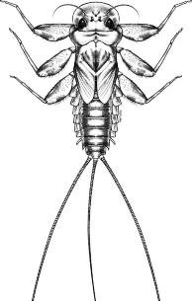
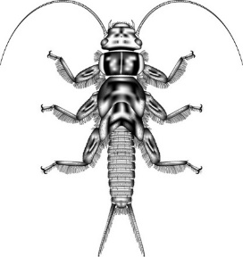
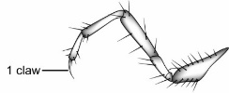
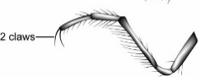
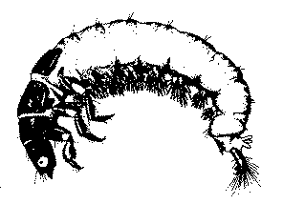
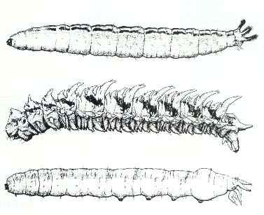
Benthic Macroinvertebrates (BMI) – The Basics Benthic = bottom-dwelling, Macro = large (visible to the naked eye), Invertebrate = no backbone
There are hundreds of different species of BMI in the Elwha Watershed alone.
BMI are important food source for fish and other animals, and play a big role in nutrient cycling.
The most common and diverse types of BMI in streams and rivers are insects.
Most aquatic insects spend their larval (immature) stage in water and their adult stage on land.
The most common types of insects in streams and rivers are:
Mayflies (Order Ephemeroptera)
Stoneflies (Order Plecoptera)
Caddisflies (Order Trichoptera)
True Flies (Order Diptera)
Mayflies and stoneflies can be hard to tell apart sometimes:
both have sclerotized bodies (hardened and shiny like a beetle)
both have three sets of segmented legs on their thorax (chest) and long tails (called cerci), but
mayflies always have one claw at the end of each leg, while stoneflies have two
mayflies can have two or three cerci, while stoneflies always have two
mayflies have leaf-like gills along their abdomens (belly); while stoneflies have finger-like gills on their thorax (chest) or none at all
Caddisflies
also have three sets of segmented legs (not always as obvious as on mayflies and stoneflies)
head and part of thorax are sclerotized; abdomen is fleshy and more worm-like
instead of cerci, caddisfly have “anal prolegs” (hooks at the end of their abdomen)
often (but not always) live inside cases built of rock or plant material
True flies are soft-bodied
never have three sets segmented legs
may have one set of small prolegs or multiple fleshy suckers along body
usually have a distinct head capsule (but sometimes difficult to make out)
this order is very diverse in appearance but usually look worm-like
BMI’s have varied body types and also different life-history strategies (ways of making a living)
They are often classified into different “Functional Feeding Groups” such as:
Grazers – use their specialized mouth parts to scrape off algae from rocks
Shredders – tear apart leaves and other organic material into smaller particles
Collectors – dart along the river bottom collecting small particles of food
Filterers – similar to collectors but use a web or mouth parts to filters particles from water
Predators – eat all or some of the above – rawrrrr!
Other important differences between types of BMI’s:
Life-spans – some BMI’s complete multiple life cycles in a year while others live for multiple years
Sensitivity – BMI’s vary widely in how much they can tolerate different types of disturbance
Researchers on the Elwha have been studying how the total numbers and types of BMI have changed before, during, and after dam removal. This information helps us better understand the ways dams impact rivers and how these ecosystems recover when dams are removed
Mayfly
Stonefly

Slide 3
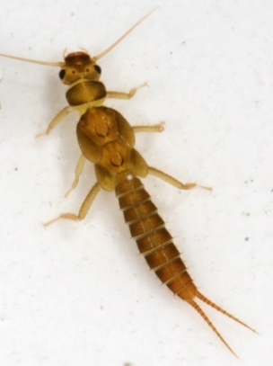
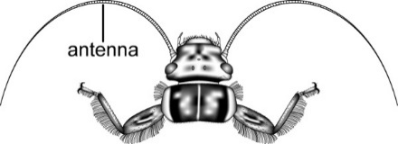
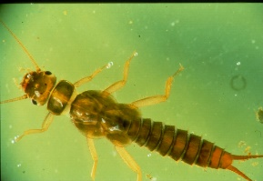
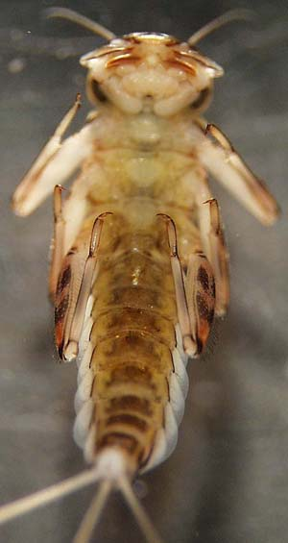
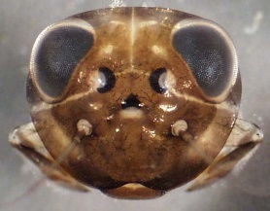
Common name: “Little Green Stoneflies”
Scientific Name: Order = Plecoptera, Family = Chloroperlidae
How to tell it’s a stonefly (Order Plecoptera)
Sclerotized body (hardened and shiny like a beetle)
Two long thick antennae
Three sets of segmented legs
Two claws at end of each leg
Two segmented tails (NEVER three)
No leaf-like gills along the abdomen (may have finger-like gills on thorax)
How to tell it’s a Green Stonefly (Family: Chloroperlidae)
Slender yellow/tan body, not patterned
Younger instars may be very pale
Fairly small (typical range is 7-12 mm long)
No gills anywhere on the body
Body may be covered with fine hairs
Tails are shorter than the abdomen
Relatively short legs
Fun facts
Sensitive to human disturbance
Predators
Where to find them
Live under and between rocks, unlikely to find just by picking up a rock
Pick these out of kick or Surber net sample collected in a riffle
Common name: “Flat-headed Mayflies”
Scientific Name: Order = Ephemeroptera, Family = Heptageniidae
How to tell it’s a mayfly (Order Ephemeroptera)
Sclerotized body (hardened and shiny like a beetle)
Three sets of jointed legs
One claw at end of each leg
Two or three segmented tails
Abdominal segments with gills
Family: Heptageniidae
Head is the widest part of the body
Head and body flattened like a pancake
Eyes pointed upward (dorsally)
Outspread legs
Plate-lake gills along abdomen
Range in size from small to medium
notch
Where to find them
Clinging to the surfaces of rocks
Sucked onto the sides of your collection buckets]
Swim poorly in collection tray in odd flopping motion
Fun facts
palpi
palpi
These mayflies use their gills like a suction cup to attach to the surface of rocks
They use their specialized mouthparts to scrape algae off rocks, like little cows!

Slide 4
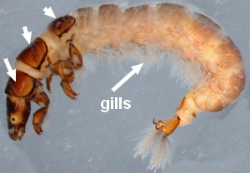
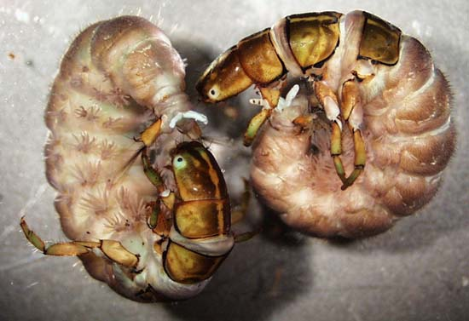
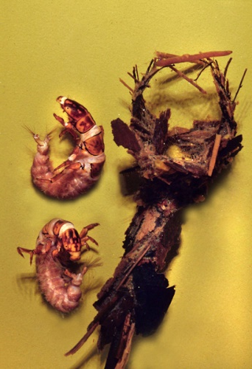
Common name: “Green Rock Worm”
Order: Trichoptera
Sclerotized (shiny) head, legs, some thorax
Abdomen unsclerotized
Three sets of thoracic legs (on chest)
Anal prolegs that end in a single hook
Family: Rhyacophilidae
Thick body with small head
Second and third thoracic plate completely fleshy or only with small sclerotized plates
Abdomen with deep constrictions between segments
Anal prolegs long, largely free of abdomen (belly)
Abdominal segment 9 with shiny dorsal plate
Greenish, pink, or purplish – never bright white
Where to Find Them
On top of rocks, clinging to the sides of your net
Free-living (don’t build cases)
Fun facts
Very diverse-looking: bodies can be green, pink, or purple but never white
Fierce predators!
Common name: “Net spinner Caddisfly”
Order: Trichoptera
Sclerotized (shiny) head, legs, and some thorax
Abdomen unsclerotized (fleshy)
Three sets of thoracic legs
Anal prolegs that end in a single hook
Family: Hydropsychidae
Three thoracic segments covered dorsally with well-developed sclerotized plates
Abdomen with branched gills and scattered hairs
Tuft of long setae at tip of each anal proleg
Body generally curved
Setae
Where to Find Them
On top of rocks
Free-living (don’t build cases) but make “retreats” (sloppy-looking tents)
Fun facts
At one end of retreat they spin a web like a spider to collect food in the current
Males are territorial and emit high-pitched “screeches” at each other underwater

Slide 5
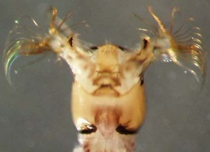
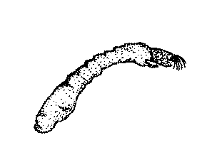
Common name: “Black Fly”
Order: Diptera
Thorax lacks three sets of jointed legs
Family: Simulidae
Very small bodies shaped like bowling pins
Sclerotized head external and clearly visible
Head with fan shaped mouthparts
Single proleg just below head
Ring of tiny hooks on posterior end
Typically 3-8 mm
Hooks
Fans
Where to Find Them
In colonies on the leading edges of rocks in fast-flowing water
Fun facts
Use their mustache fans to filter food out of the water column
Use their anal hooks to attach to rocks
Move like an inch-worm in the sampling tray
Excrete sticky silk similar to spiders that makes them hard to remove from your forceps/paint brushes

Slide 6
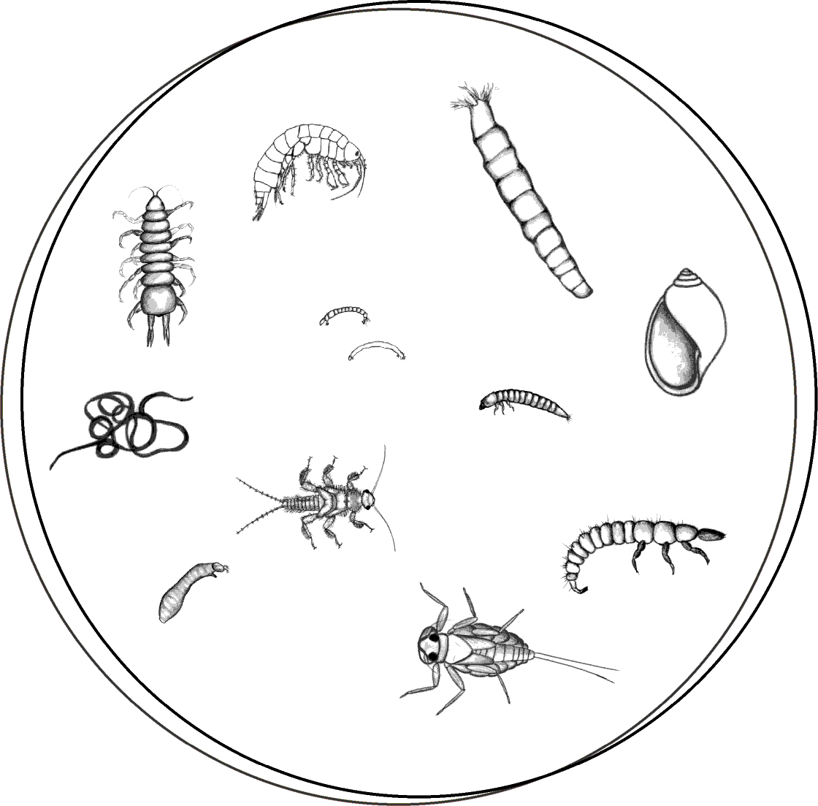
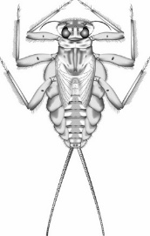
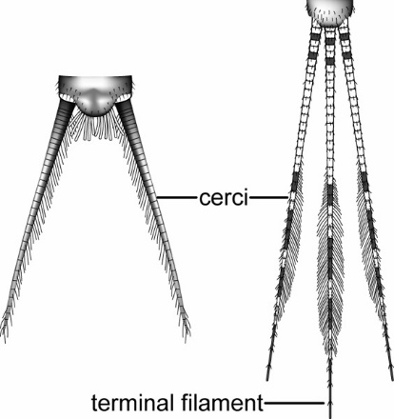
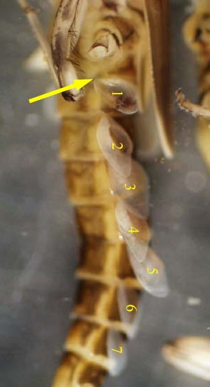
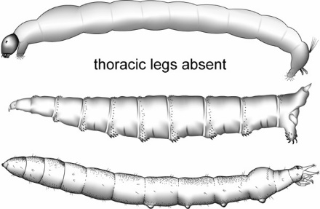
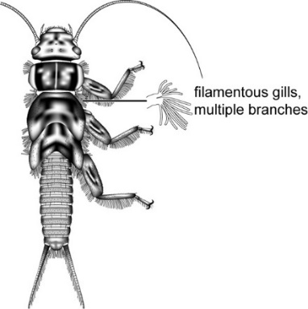
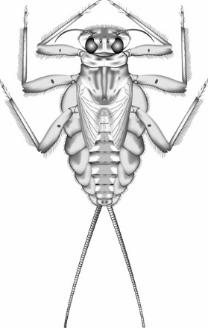
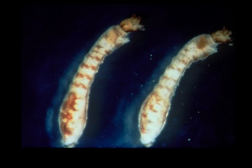
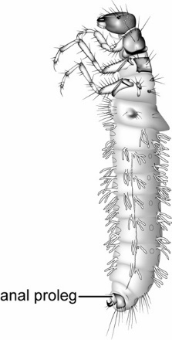
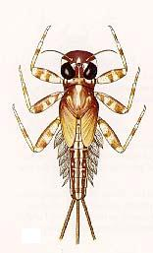
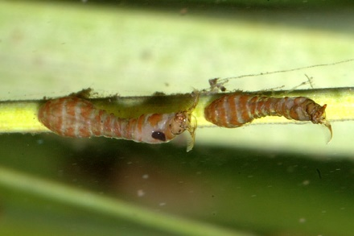
Aquatic insects take many different shapes and sizes, but all have ……….
Describe basic morphology (head, thorax, abdomen) – include schematic
Some spend their entire life in water (e.g., water striders, water beetles)
Others have a pupal stage (chrysalis) like a caterpillar/butterfly.
Gills similar in size, do not meet beneath abdomen
Gills do not have fibrilliform (frilly) portion
Maxillary palpi protrude at sides of head
Small notch in front margin of head

Slide 7
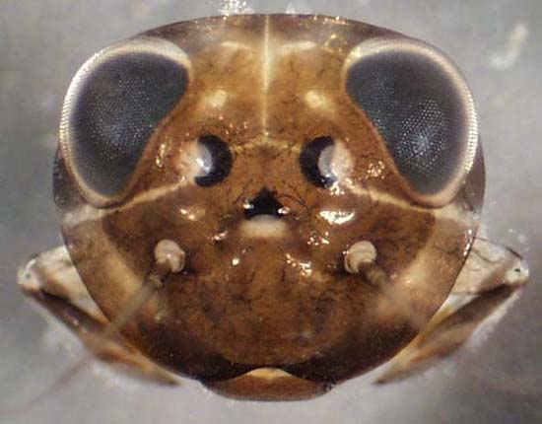
Order: Trichoptera
Sclerotized head, legs, some thorax
Abdomen unsclerotized
Three sets of thoracic legs
Anal prolegs that end in a single hook
Family: Rhyacophilidae
Second and third thoracic plate completely fleshy or only with small sclerotized plates
Abdomen with deep constrictions between segments
Anal prolegs long, largely free of last abdominal segment
Abdominal segment 9 with dorsal plate
Greenish, pink, or purplish – never bright white
Genus: Rhyacophila
Without dense tufts of stout gills on each side of thorax and abdominal segments 1-8.
Very diverse genus
Order: Ephemeroptera
Sclerotized body
Three sets of jointed legs
Two or three segmented tails
Abdominal segments with gills
One claw at end of each leg
Family: Heptangeniidae
Body flattened, outspread legs
Eyes pointed upward (dorsally)
Gills on abdominal segments 1-7 platelike
Genus: Cinygmula
notch
Gills similar in size, do not meet beneath abdomen
Gills do not have fibrilliform (frilly) portion
Maxillary palpi protrude at sides of head
Small notch in front margin of head
palpi
palpi

Slide 8
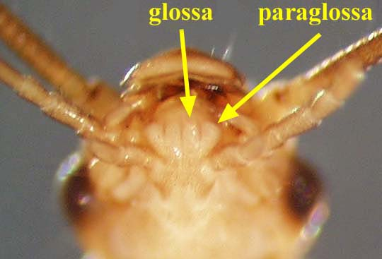
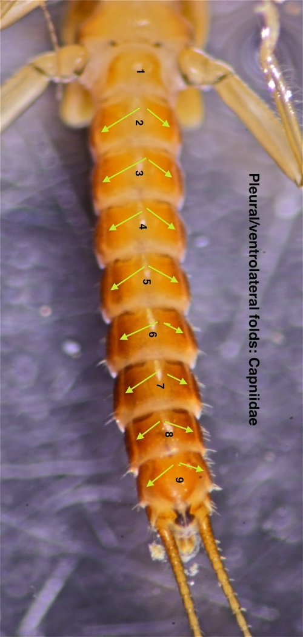
Order: Diptera
Thorax lacks three sets of jointed legs
Family: Simulidae
Body shaped like a bowling pin
Sclerotized head external and clearly visible
Single proleg just below head
Ring of tiny hooks on posterior end
Typically 3-8 mm
Hooks
Fans
Genus: Simulium
Head with fan shaped mouthparts
Body pigmented
Antenna never transparent with dark brown tip
Hypostoma with paralateral teeth
Hypostoma with median tooth taller than lateral teeth; sublateral teeth shorter than median and lateral teeth
paralateral
lateral
Hypostoma
median
sublateral
Hypostomal Teeth
Order: Plecoptera
Sclerotized body
Three sets of jointed legs
Two segmented tails
Two claws at end of each leg
Family: Capniidae
Slender light-colored body
Long tails and antennae
No visible gills
Glossa and paraglossa ~ same length
Wing pads long and narrow, essentially parallel to body
Extended hindlegs reach far short of end of abdomen
Membranous pleural folds on abdominal sternum 1-9
Metathoracic wingpads about as wide as long, reduced, or absent
Abdominal usually widest posteriorly

Slide 9
Order: Diptera
Thorax lacks three sets of jointed legs
Family: Simulidae
Body shaped like a bowling pin
Sclerotized head external and clearly visible
Single proleg just below head
Ring of tiny hooks on posterior end
Typically 3-8 mm
Hooks
Fans
Genus: Simulium
Head with fan shaped mouthparts
Body pigmented
Antenna never transparent with dark brown tip
Hypostoma with paralateral teeth
Hypostoma with median tooth taller than lateral teeth; sublateral teeth shorter than median and lateral teeth
paralateral
lateral
Hypostoma
median
sublateral
Hypostomal Teeth
Order: Plecoptera
Sclerotized body
Three sets of jointed legs
Two segmented tails
Two claws at end of each leg
Family: Capniidae
Slender light-colored body
Long tails and antennae
No visible gills
Glossa and paraglossa ~ same length
Wing pads long and narrow, essentially parallel to body
Extended hindlegs reach far short of end of abdomen
Membranous pleural folds on abdominal sternum 1-9
Metathoracic wingpads about as wide as long, reduced, or absent
Abdominal usually widest posteriorly

