Slide 1
I-589 Location Validation Copy Deck

Slide 2
Location Verification
This flow shows when a user starts the I-589 and is requested to allow location services to verify that they are in the United States.

Slide 3
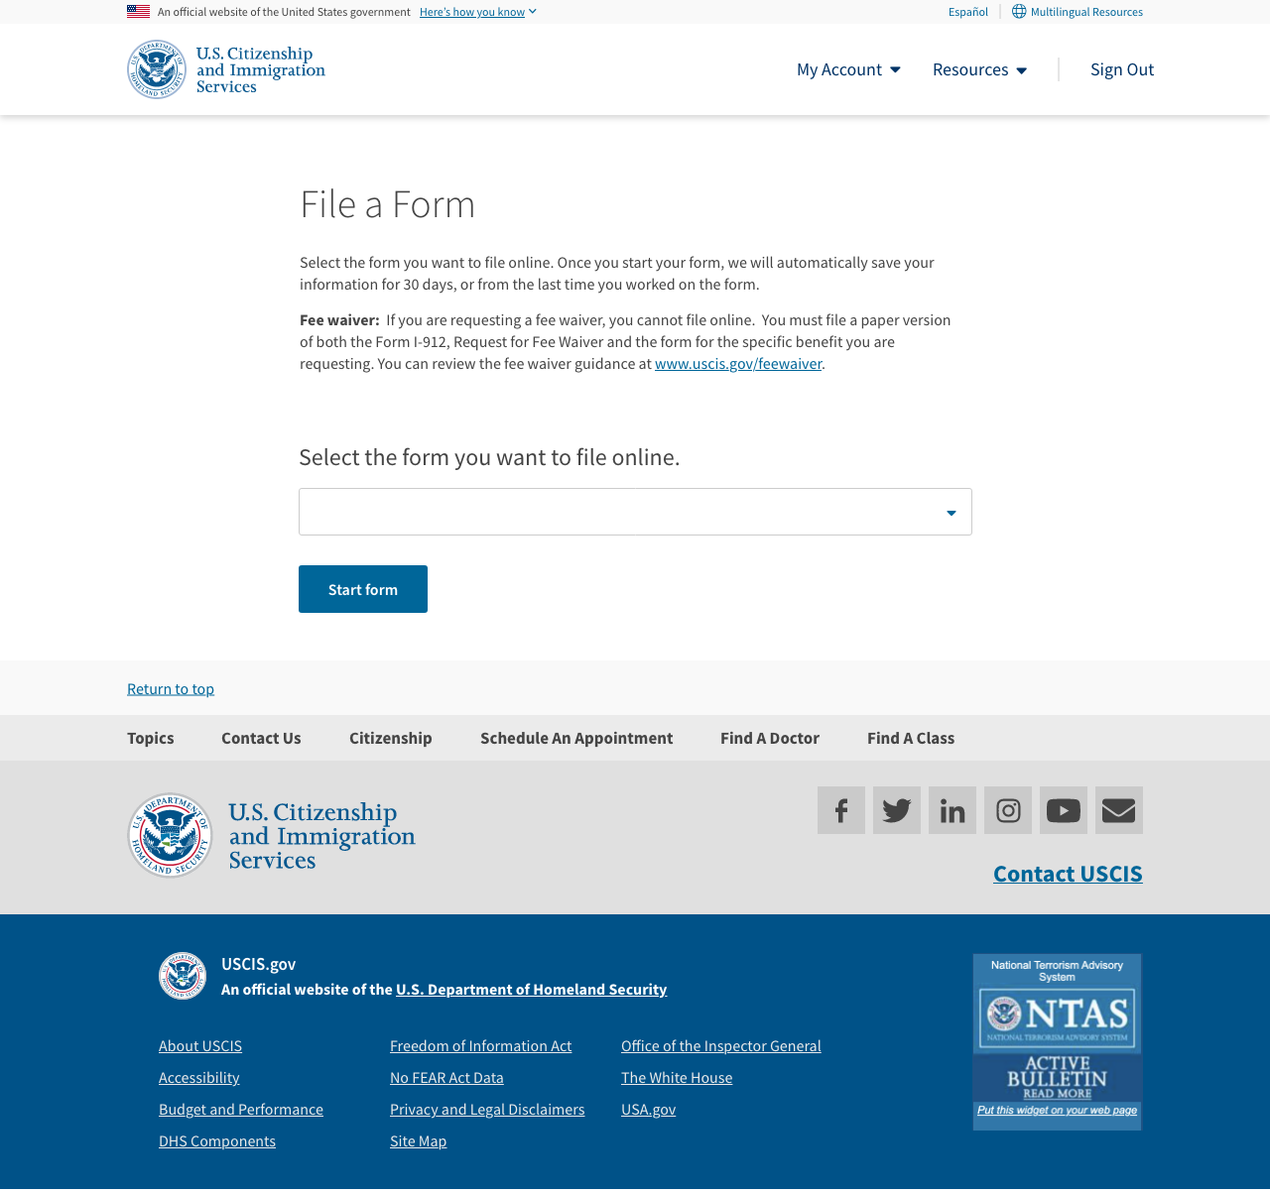
File a Form Page
Copy:
No updates
Notes:

Slide 4
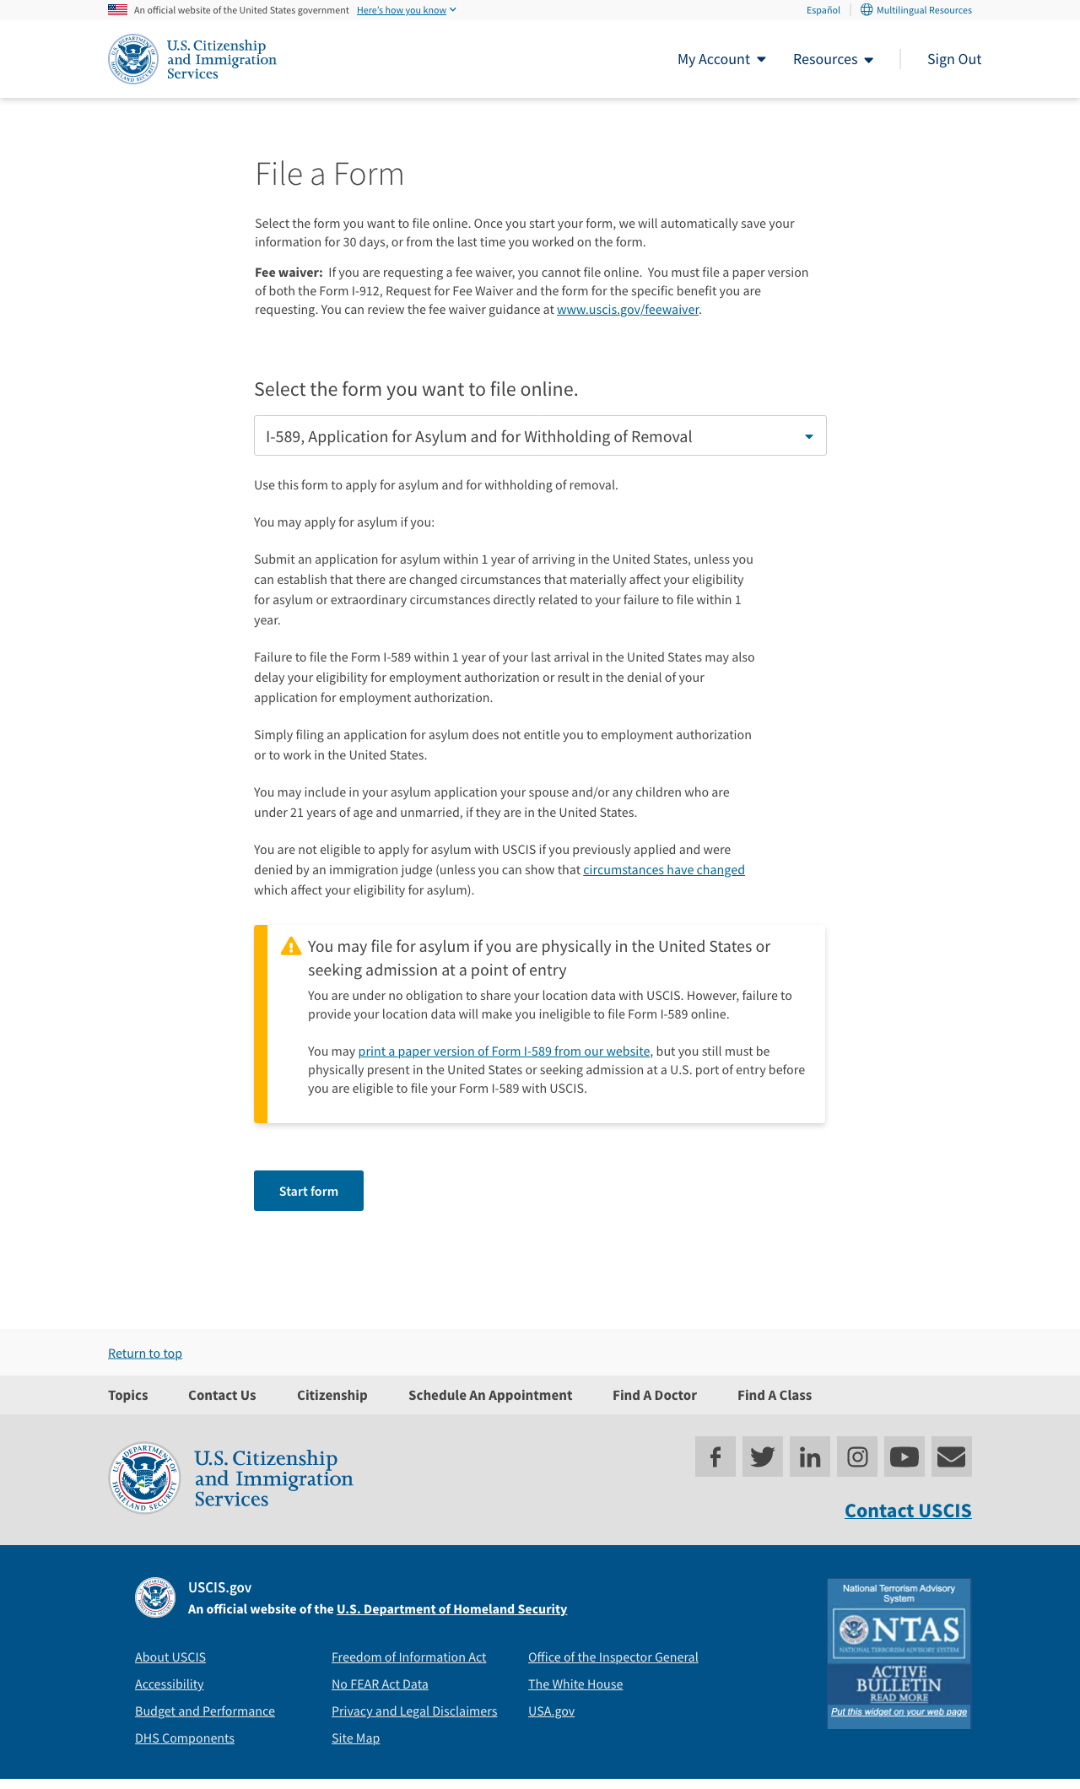
File a Form – User Sects I589
Copy:
[Alert – Warning]
[H4] You may file for asylum if you are physically in the United States or seeking admission at a point of entry
[Body]
You are under no obligation to share your location data with USCIS. However, failure to provide your location data will make you ineligible to file Form I-589 online.
You may print a paper version of Form I-589 from our website [insert weblink], but you still must be physically present in the United States or seeking admission at a U.S. port of entry before you are eligible to file your Form I-589 with USCIS.

Slide 5
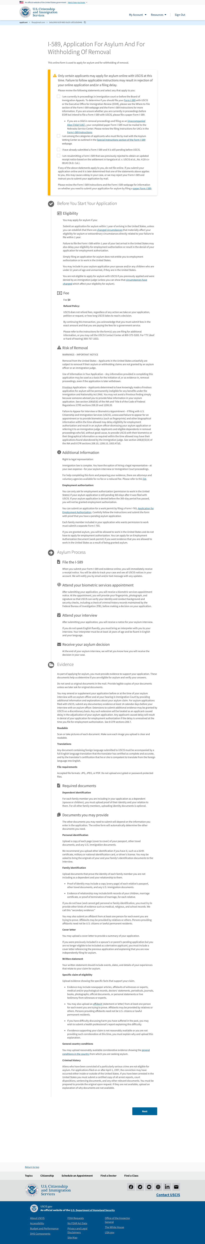
Overview Page
Copy:
No updates made

Slide 6
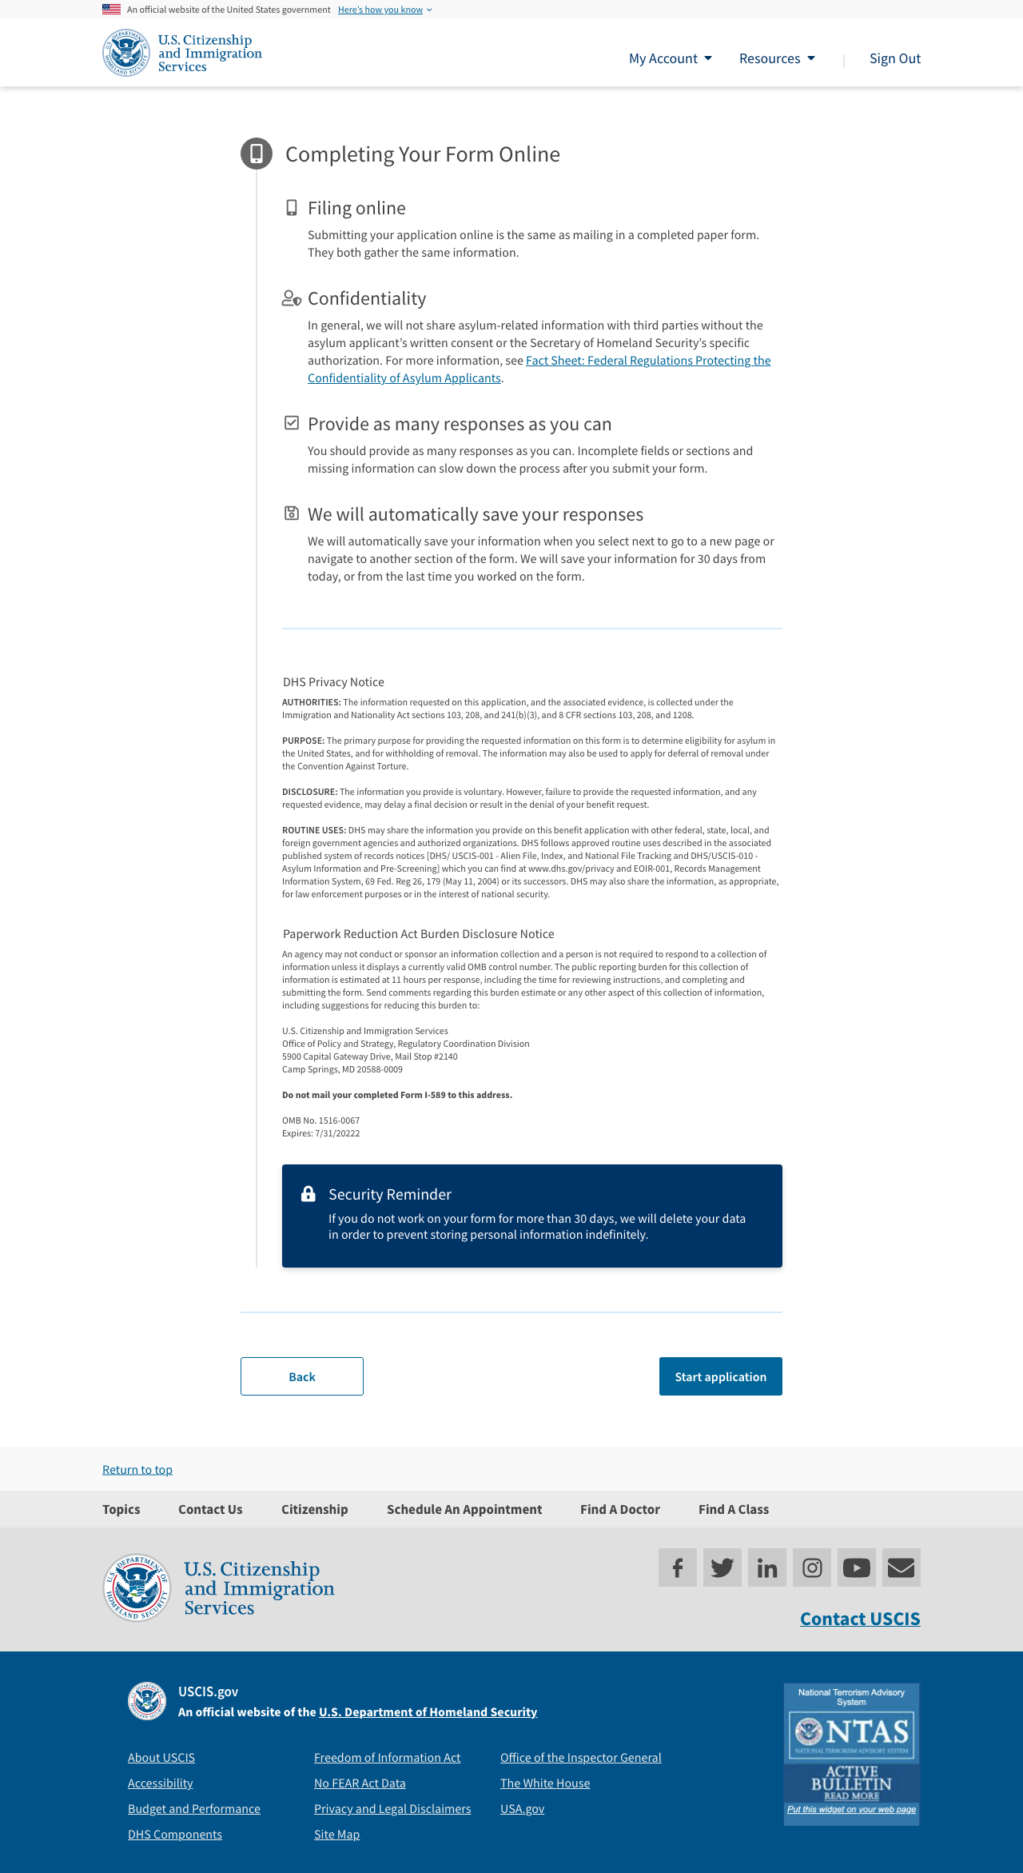
Overview Page 2
Copy:
No updates made

Slide 7
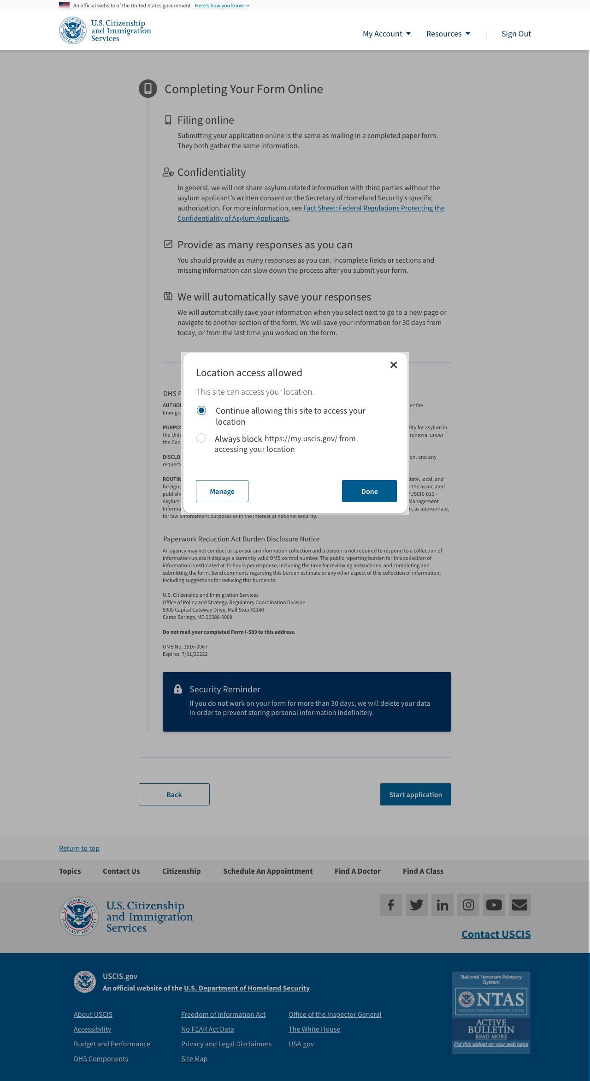
Overview Page 2 – User Clicks Start
Copy:
No updates made
When user selects "start" browser's geo-locate permissions appear

Slide 8
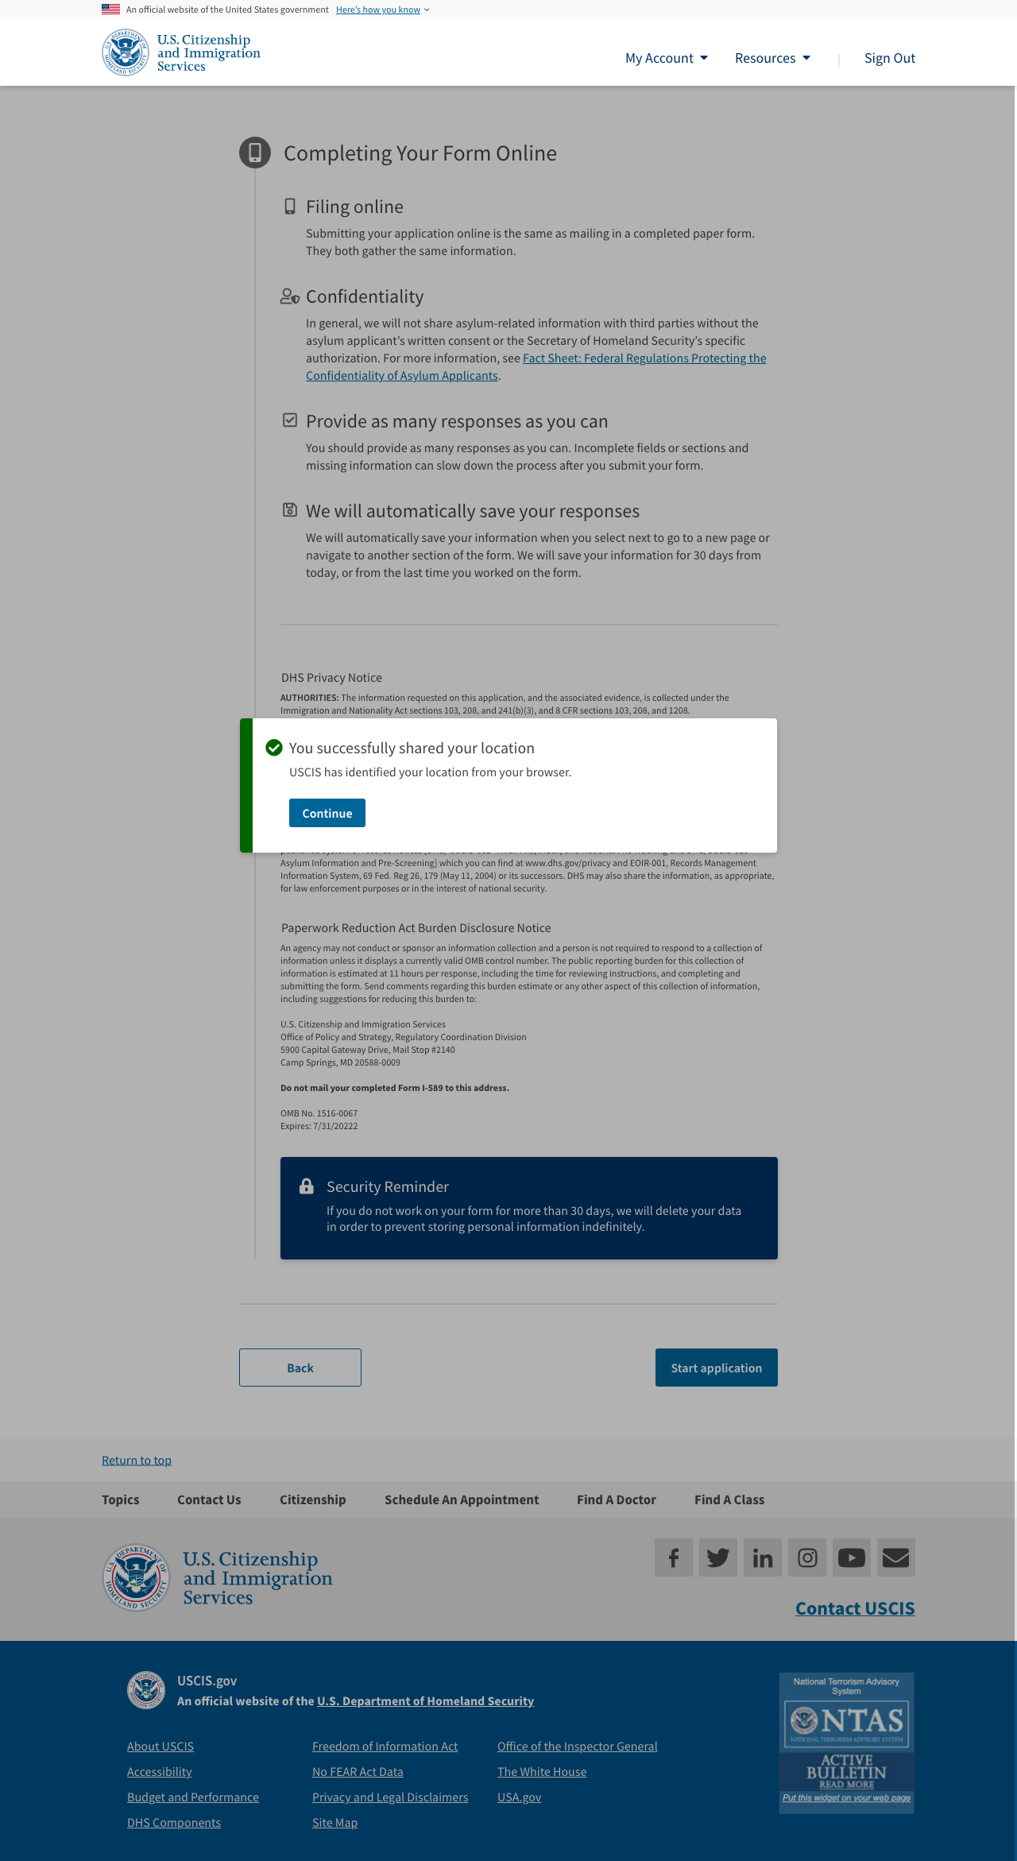
Scenario – Location ID’d
Copy:
[Header]
You successfully shared your location.
[Body]
USCIS has identified your location from your browser.
[CTA]
Continue

Slide 9
Scenario: Successfully ID’d as in the US
Copy:
Users location is in U.S. no alert appears and user is able to go to start the form

Slide 10
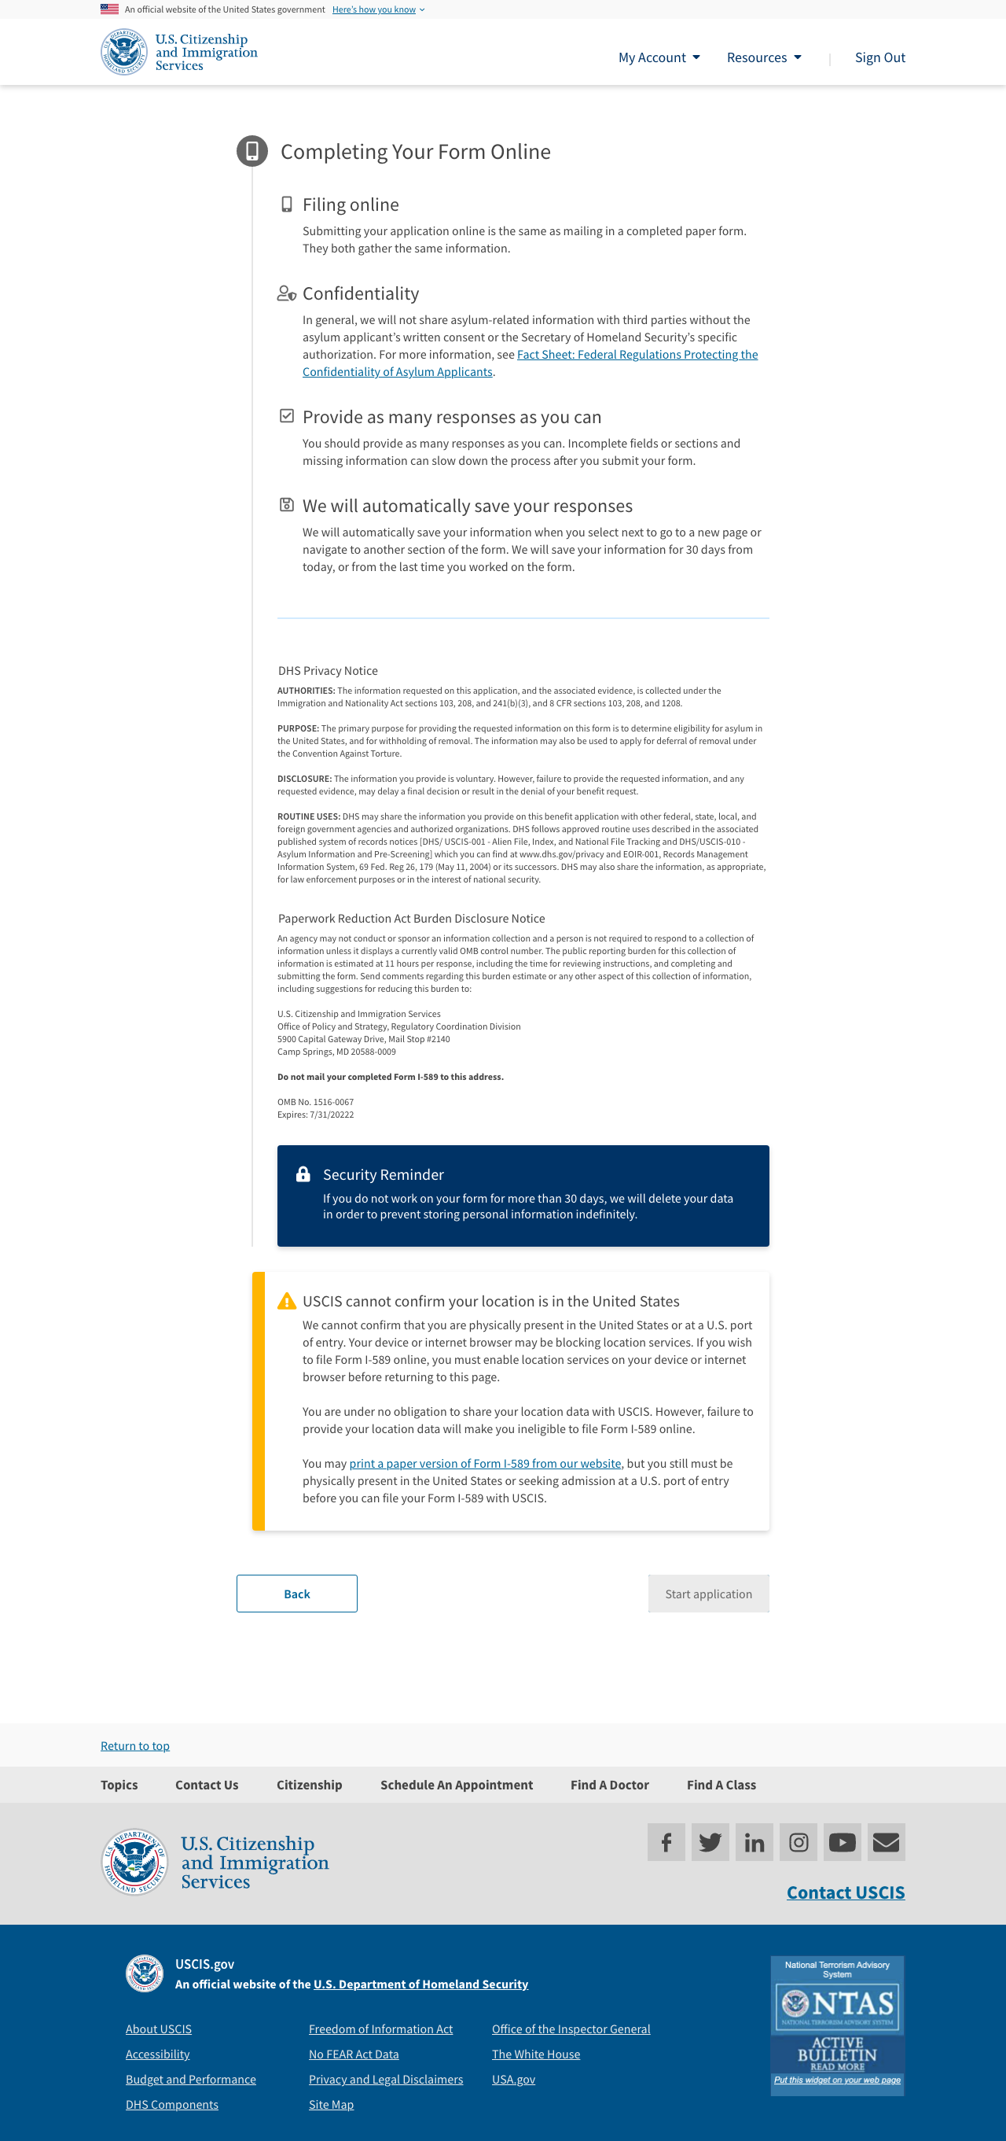
Scenario: Identified as outside the US
Copy:
[Alert – Warning]
[H4] USCIS cannot confirm your location is in the United States.
[body]
We cannot confirm that you are physically present in the United States or at a U.S. port of entry. Your device or internet browser may be blocking location services. If you wish to file Form I-589 online, you must enable location services on your device or internet browser before returning to this page.
You are under no obligation to share your location data with USCIS. However, failure to provide your location data will make you ineligible to file Form I-589 online.
You may print a paper version of Form I-589 from our website [insert link], but you still must be physically present in the United States or seeking admission at a U.S. port of entry before you can file your Form I-589 with USCIS.

Slide 11
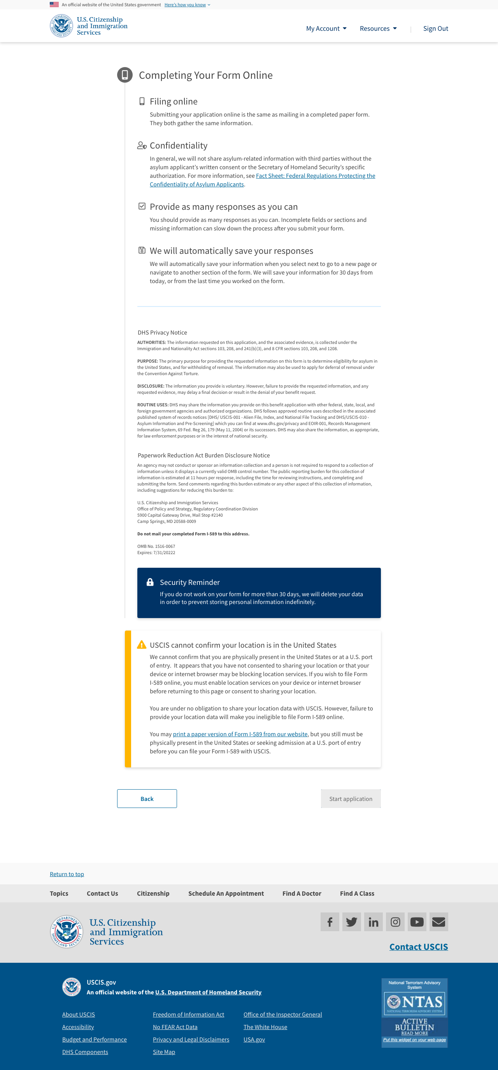
Scenario: Doesn’t consent to location sharing
Copy:
[Alert – Warning]
[H4] USCIS cannot confirm your location is in the United States.
[body]
We cannot confirm that you are physically present in the United States or at a U.S. port of entry. It appears that you have not consented to sharing your location or that your device or internet browser may be blocking location services. If you wish to file Form I-589 online, you must enable location services on your device or internet browser before returning to this page or consent to sharing your location.
You are under no obligation to share your location data with USCIS. However, failure to provide your location data will make you ineligible to file Form I-589 online.
You may print a paper version of Form I-589 from our website [insert link], but you still must be physically present in the United States or seeking admission at a U.S. port of entry before you can file your Form I-589 with USCIS.

