Slide 1
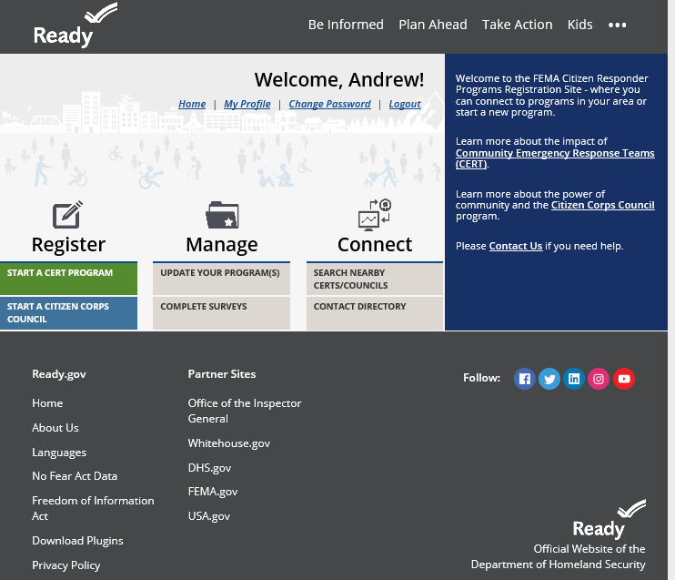

Slide 2
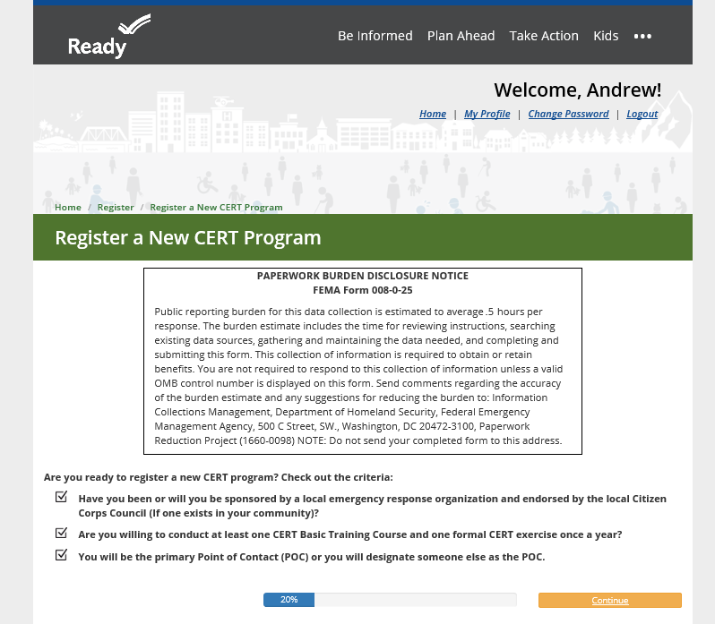

Slide 3
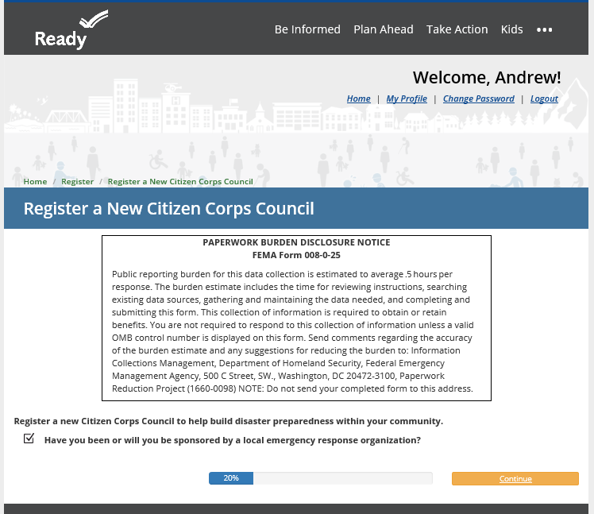

Slide 4
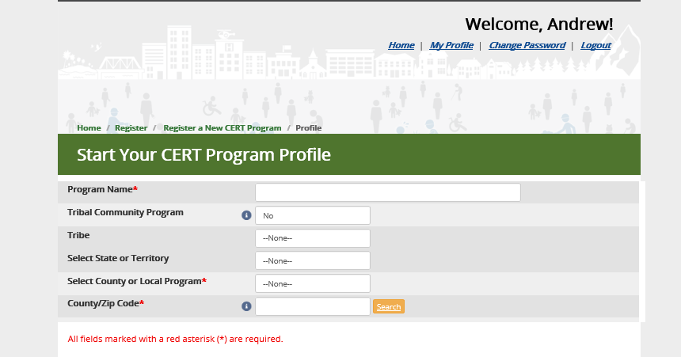

Slide 5
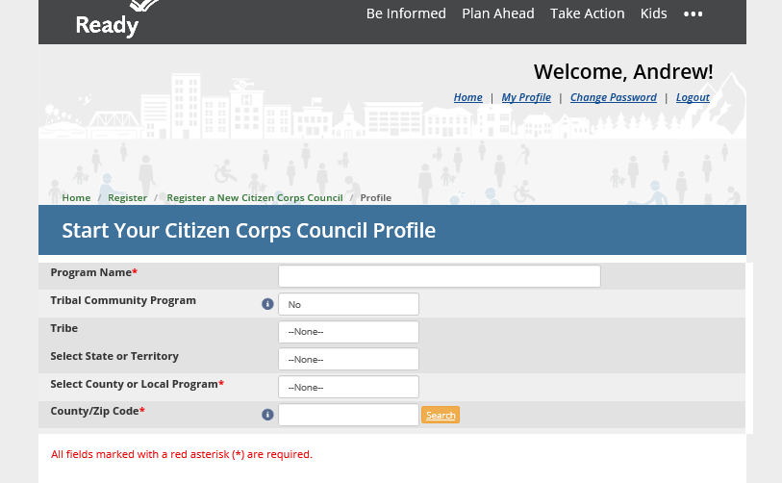

Slide 6
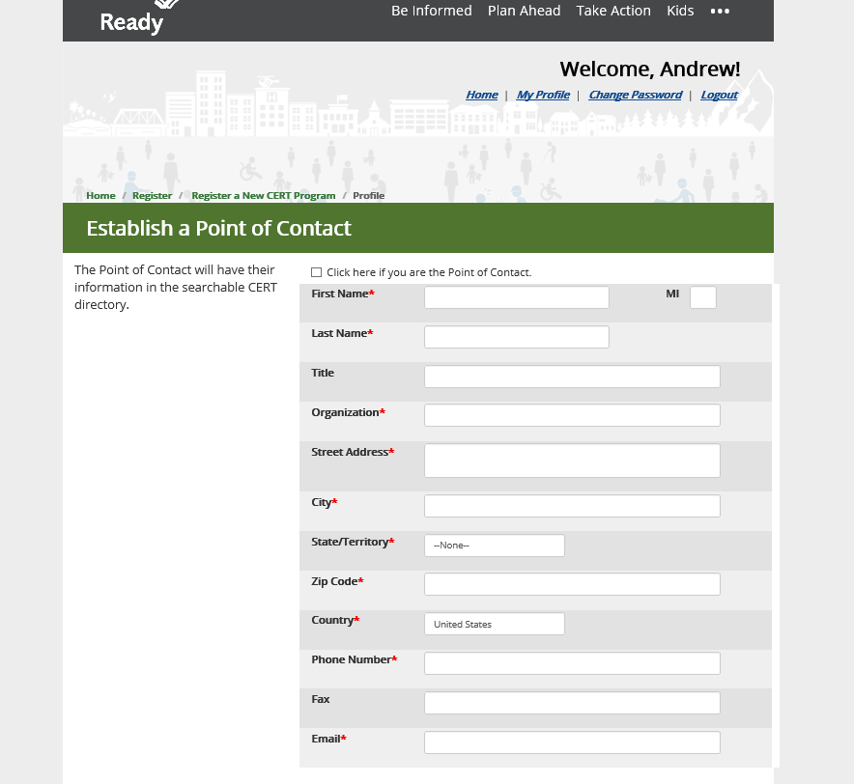

Slide 7
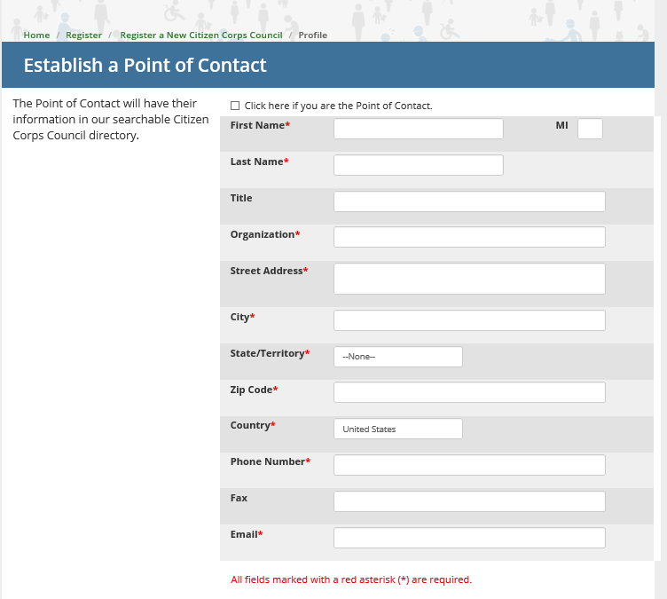

Slide 8
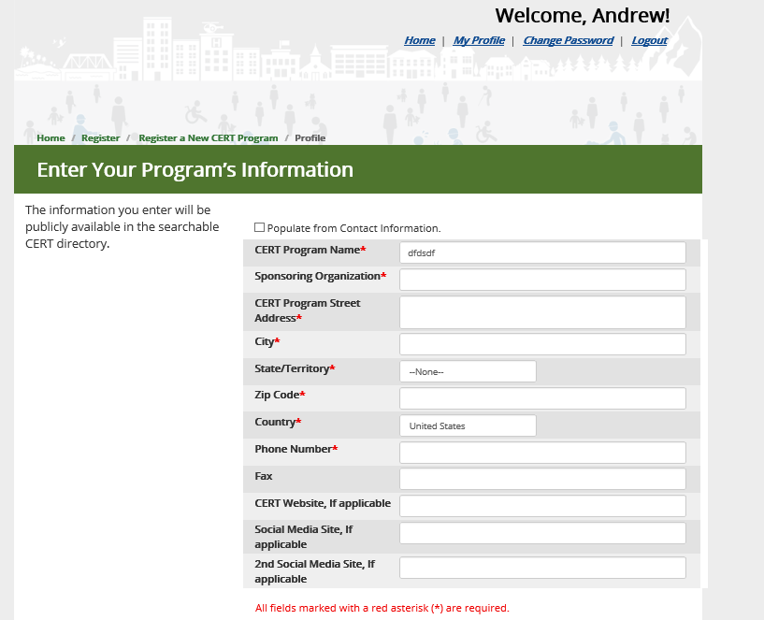

Slide 9
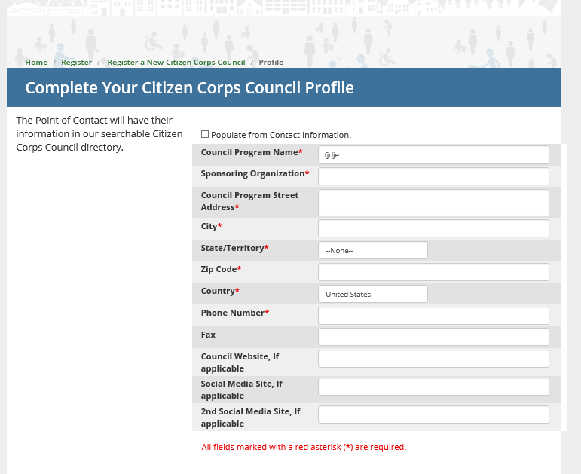

Slide 10
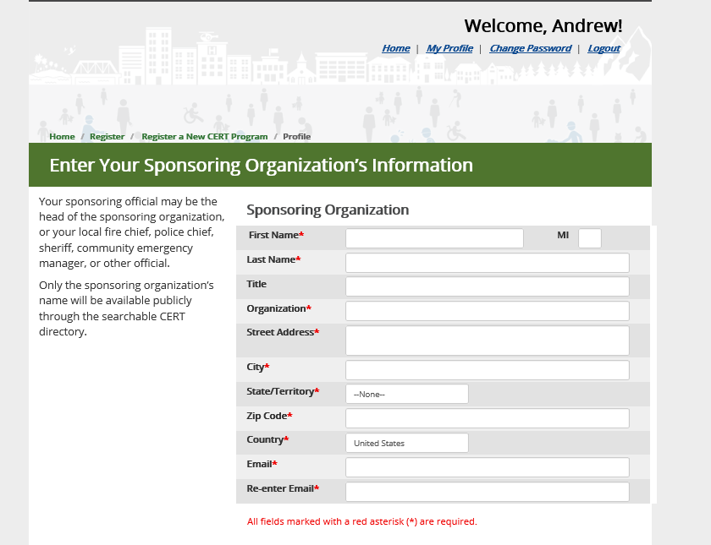

Slide 11
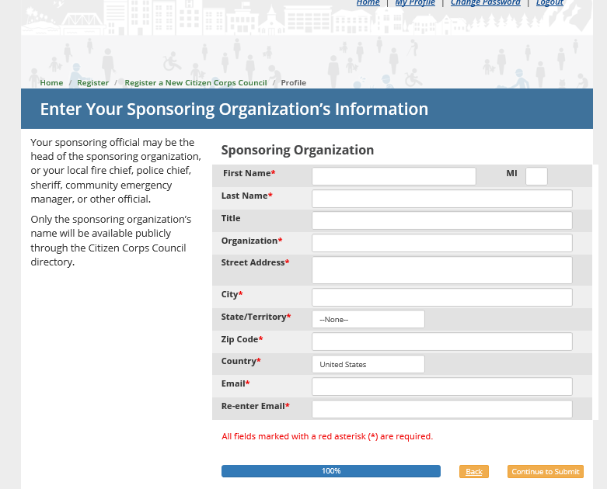

Slide 12
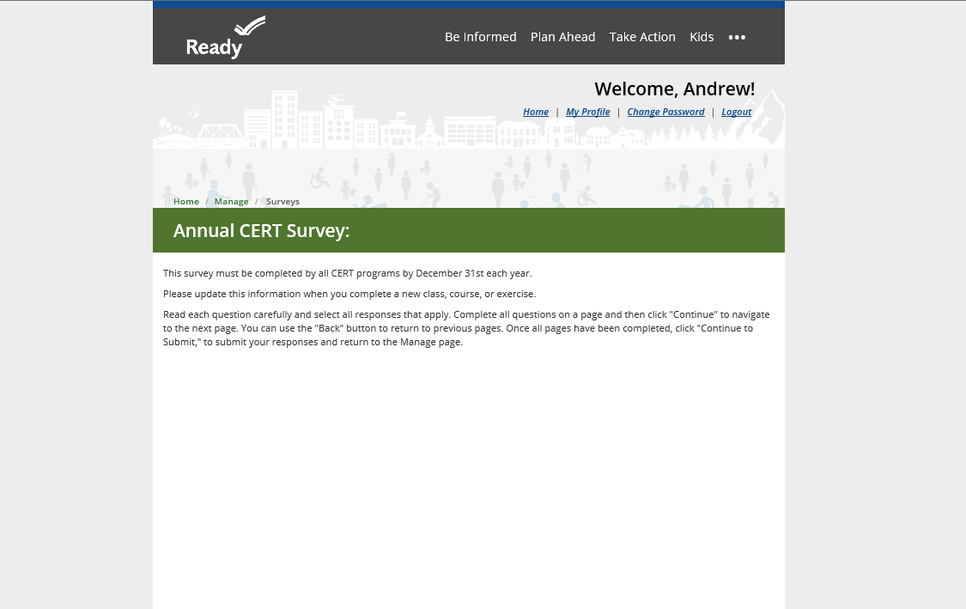
Program Information
Survey respondent (your name): 2. Program state:
3. Sponsoring organization: 4. Program zip code
5. Name of sponsor Point of Contact:
6. Type of sponsoring organization:
Fire Department
Law Enforcement
EMS
State
Tribal
Territorial
County
City
Other

Slide 13
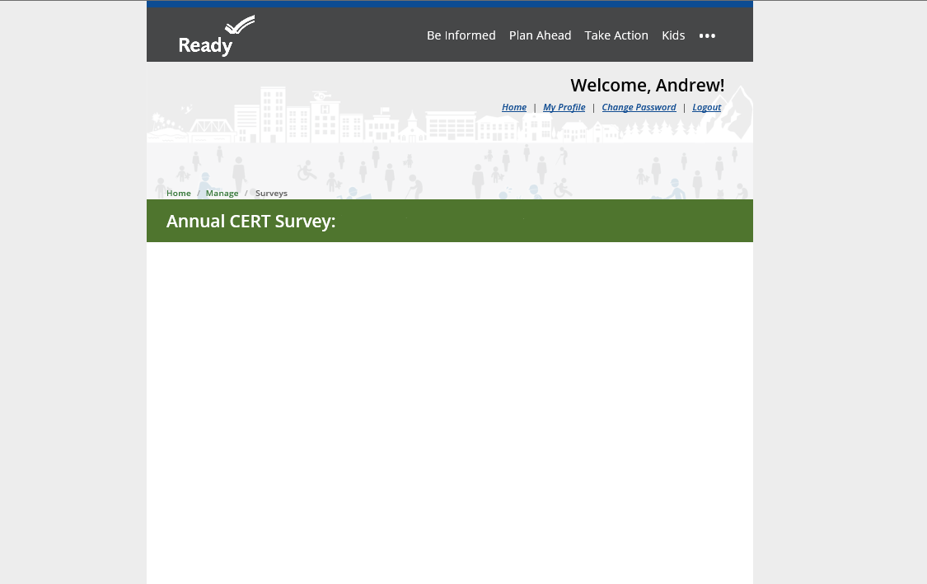
7. Name of sponsoring organization POC: ________________________
8. Name of sponsoring organization: _________________________
9. Does your program support more than one team? (a CERT program may cover a jurisdiction or geographic area that can support separate teams in different communities, for example a county level program could have teams for different cities or neighborhoods as well as Teen CERT teams in schools)
Yes___ No___ If yes, How many?______

Slide 14
10. Program emphasis
General/Community
Teen
Campus
Workplace
Other
11. Community served
State
City
County
Tribal
Territorial
Neighborhood
High school
University
Faith-based organization
Workplace
Military
Other

Slide 15
12. Approximate Number of Active Volunteers (Participation, outreach, response, etc. in the last year)
13. Estimated service population (population living within program service area)
14. How many CERT instructors do you have available?
15. Describe the professional experience of CERT instructors (Fire/EMS, Law Enforcement, Volunteer, etc.)

Slide 16
Training
During the last calendar year, how many times did your program conduct the CERT Basic Training course?
During the last calendar year, approximately how many volunteers graduated from the CERT Basic Training course?
Does your program offer training to the community? Select all that apply.
General public
Neighborhood groups
Businesses
Government groups (e.g., local or state)
Faith-based organizations
Teens/youth
Colleges and universities
People with disabilities
Military groups
Other ­­­­­­­­

Slide 17
4. Does your program offer CERT members training in addition to the CERT Basic course?
Select all that apply.
CERT Animal Response I
CERT Animal Response II
Amateur Radio Operation
Other animals in emergencies training
Community coalition building
Volunteer management
Cardio-pulmonary resuscitation (CPR)
Automatic external defibrillator (AED)
Additional damage assessment
Decontamination
First aid
Additional incident command system
Additional national incident management system
Shelter operations/management
Additional search and rescue
Other ________________

Slide 18
Exercises
During the past year, in how many exercises did your program participate?
2. During the past year, how many volunteers participated in program exercises?

Slide 19
CERT in Action
How many times has your program deployed in the last year?
What was the nature of the event to which your program responded? (Select all that apply)
Hurricane
Earthquake
Avalanche
Flood
Landslide
Fire
Wildfire
Tornado
Volcano
Tsunami
Winter storm
Other
Did your program deploy outside of its jurisdictional boundaries? (Yes No )
Where did you go?
How long was the deployment?

Slide 20
4. Approximately how many volunteers deployed in the last year?
Approximately how many hours were volunteered in deployment in the last year?
What activities has your program conducted in emergencies?
Sheltering operations
Search and rescue
Sandbagging
Command post support
Disaster medical operations
Animal rescue
Communications support
Other
7. Approximately how many hours were volunteered in preparedness activities in the last year?
8. What activities has your program conducted in non-emergencies? (Select all that apply)
drills
exercises
training
community outreach
other

Slide 21
9. What activities has your program conducted in non-emergencies? (Select all that apply)
exercises with emergency services
risk mitigation assessments or activities (fire prevention, erosion control, etc)
flood insurance awareness and outreach
financial preparedness outreach
You Are the Help Until Help Arrives
AED training
CPR training
Stop the Bleed
Other __________________
10. What sort of community outreach activities has your program conducted
distributing preparedness information
speaking with others about preparation (canvassing)
speaking with others about preparation (booth/table events)
hosting preparedness meetings or training
facilitate developing household emergency plans
stocking supplies individually or at a community level
encouraging non-members to take part in a drill or exercise to practice response
financial preparedness activities or outreach

Slide 22
Funding
Please estimate the percent of funding your CERT receives from the following sources
State _____%
Tribal _____%
Territorial _____%
Local _____%
Private _____%
Fundraising _____%
Other _____%
2. Please check the box corresponding to your CERT Program approximate annual budget
$2,499 and below
$2,000-$4,999
$5,000-$9,999
$10,000-$19,999
$20,000-$29,999
$30,000-$49,999
$50,000-$99,999
$100,000+
3. Is your program registered as a 501(c)3 non-profit organization? Yes ____ No ____

