Slide 1
MISSION ASSIGNMENT
PROCESS
OVERVIEW

Slide 2
Overview
Authorities
Types of Mission Assignments
Mission Assignment Process

Slide 3
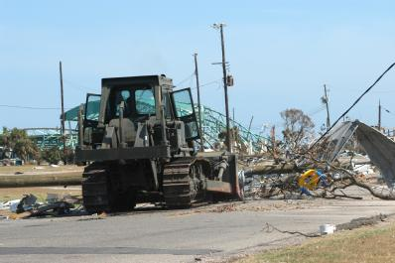
Authorities
Homeland Security Act 6 U.S.C. 741
Homeland Security Act 6 U.S.C. 753
Stafford Act Section 402 (42 U.S.C. 5170a)
Stafford Act Section 403 (42 U.S.C. 5170b)
  Stafford Act Section 502 (42 U.S.C. 5192)
  44 CFR 206.5
  44 CFR 206.7
  44 CFR 206.8
  44 CFR 206.208

Slide 4
What Is a Mission Assignment (MA)?
A Mission Assignment is a work order issued to a Federal agency by FEMA, directing completion by that agency of a specified task and setting forth funding, other managerial controls, and guidance
A Mission Assignment is a work order issued by FEMA to another Federal agency, with or without reimbursement, directing completion of a specific task, and citing funding, other managerial controls, and guidance
References: 6 U.S.C. 741
42 U.S.C. 5170a
Stafford Act Section 402

Slide 5
Ways to Mission Assign
Operational
Verbal
PSMA
Operational mission assignments are created during an event between FEMA and a supporting agency
Verbal mission assignments are initiated anytime and anywhere by those with FEMA Delegated signatory authority
PSMA are pre-planned statements of work that have been discussed and agreed upon prior to an event.

Slide 6

2 Types of Mission Assignments
Federal Operations Support (FOS)
Direct Federal Assistance (DFA)

Slide 7
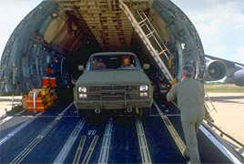
Types of Mission Assignments
Federal Operations Support (FOS):
  For any type of support to Federal responders
  Requested by the Federal government
  100% federally funded
  Eligible before or after declaration
  Term FOS only found in FEMA policies
EXAMPLE: Mission Assignment to transport DHS/FEMA assets to X Location
References: 42 U.S.C. 5170a
Stafford Act Section 402
42 U.S.C. 5192
Stafford Act Section 502

Slide 8

Types of Mission Assignments
Direct Federal Assistance (DFA)
  For goods and services beyond the
  State’s capability to provide
  Requested by the State
  Subject to State cost share
  Eligible after declaration
  EXAMPLE: Mission Assignment to U.S. Army Corp of Engineers to perform debris removal
References: 42 U.S.C. 5170a
Stafford Act Section 402
42 U.S.C. 5170b
Stafford Act Section 403
42 U.S.C. 5192
Stafford Act Section 502

Slide 9

Criteria for MA Issuance
  DFA must be completed within 60 days of the declaration in absence of extenuating circumstances
  There is no specified time limitation to complete work for FOS mission assignments
  Involves ONLY non-permanent work
  Cannot be work that falls under the mission assigned agency’s inherent authorities

Slide 10

Who Can Request Assistance?
Disaster Assistance Needs Identified
Tribal
Government
State Government
Local & County Government
A variety of sources may identify disaster assistance needs.
Voluntary Organizations
Private Sector (businesses
& citizens)
The State . . .
  Validates needs.
  Provides assistance.
  Requests Federal assistance, as needed.
State Assistance
Federal Assistance

Slide 11
Mission Assignment Process Flowchart
Internal
Need
Identified
Requestor submits Resource Request Form (RRF) to FEMA
FEMA Evaluates
Request (RRF)
External
(Via MA)
MA issued to OFA
OFA
Performs/
Completes
Work
OFA
Bills
FEMA
FEMA Reimburses OFA as Approved
FEMA Region/HQ Closes MA
10

Slide 12

Can the Request Be Met by FEMA?
Yes
No
“Internal to FEMA”
“External to FEMA”
FEMA
Logistics
Operations
FEMA Assets
Procurement
Public Assistance (PA)
Long-Term Work
OFA Statutory Authority
MA

Slide 13

Where Mission Assignments Can Be Issued?
National Response
Coordination Center (NRCC)
Regional Response
Coordination Center (RRCC)
IMAT Teams
Joint Field Office (JFO)

Slide 14
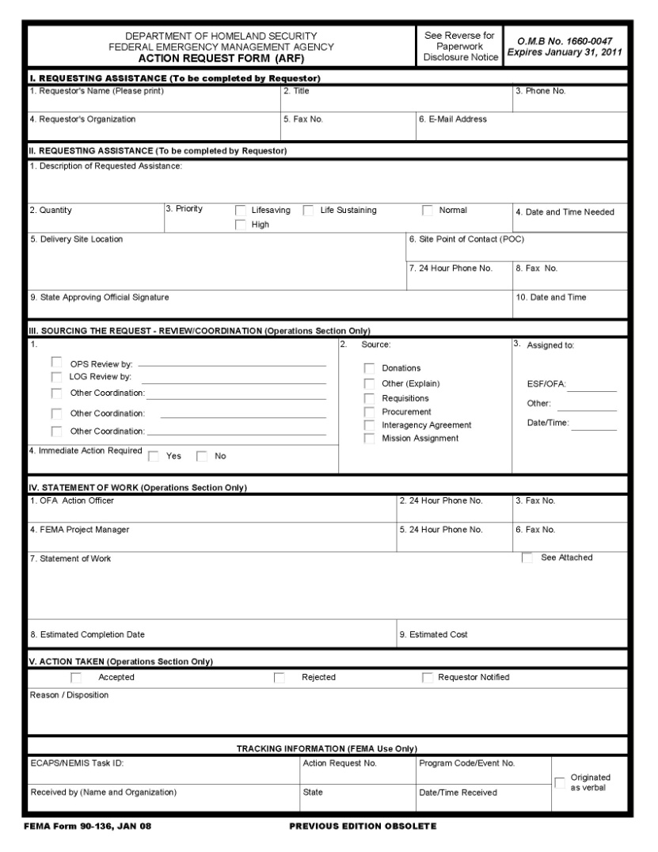
Resource Request Form (RRF)
  All official requests should be made to FEMA via the Resource Request Form (RRF)
  FEMA Form 010-0-7

Slide 15
WebEOC – Resource Request Board
Within WebEOC there are two methods by which a request can be submitted.
Create Request – which is a request that does not have a pre-scripted mission assignment.
Create Request from PSMA – which is a request that has a pre-scripted mission assignment already defined.
FINAL

Slide 16
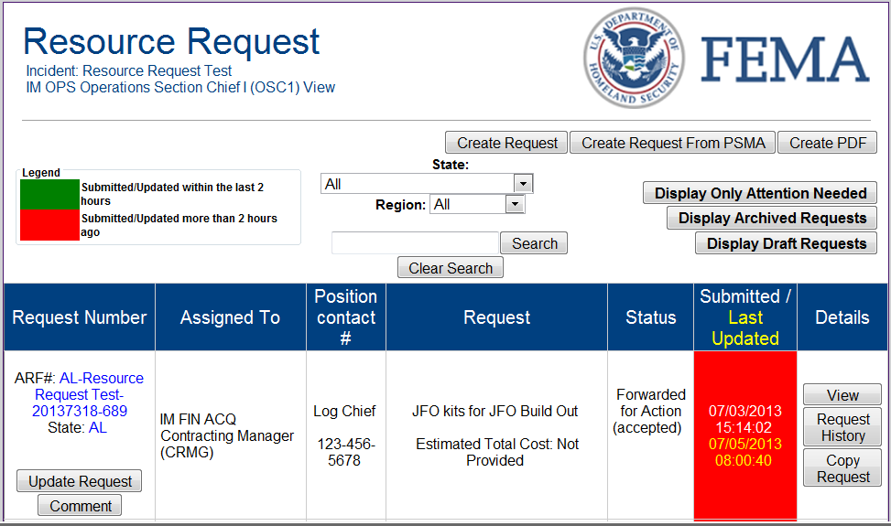
Create Request
From the Resource Request page, you can create a request from Pre-Scripted Mission Assignments (PSMA) or create a request that is not covered under PSMA.
FINAL

Slide 17
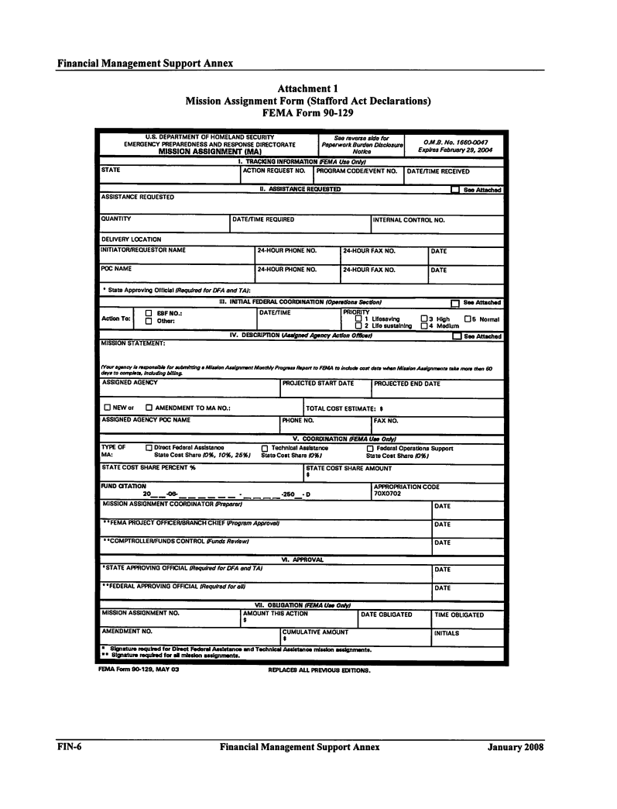
Mission Assignment Form (MA)
  Signature block for State for MAs that include a State cost share such as DFA
  Scope of Work broadly lays out work order to the mission assigned agency
  Task Orders, issued under the MA, are generally used to provide specific taskings
  FEMA Form 010-0-8

Slide 18
Pre-Scripted Mission Assignments (PSMAs)
  “To expedite the provision of assistance under the National Response Plan … the Administrator, in coordination with Federal agencies with responsibilities under the National Response Plan, develops prescripted mission assignments, including logistics, communications, mass care, health services, and public safety”
  Developed to:
    Facilitate rapid response.
    Standardize Mission Assignments.
  Statement of Work, dollar amount, and timeline serve as a general guideline or template
Reference: 6 U.S.C. 753(c)

Slide 19
Eligible Expenditures for Mission Assignments
  Overtime, travel, and per diem of PFTs
  Wages, travel, and per diem of temporary workers
  Travel and per diem of military personnel
  Cost of work, services, and materials procured
  Cost of materials, equipment, and supplies from regular stock
  Costs from trust or revolving funds
  Other costs with justification or by agreement
Reference: 44 CFR 206.8

Slide 20
Questions

