Slide 1
Module 8
ARF/Resource Request Process

Slide 2
Contents
Resource Support Section
Outline of Roles
Initiating an ARF/Request in WebEOC
Process Flows and How Requests Get Into WebEOC
WebEOC Processes
Part 1: Create ARF/Resource Request
Part 2: Create ARF/Resource Request From Pre-Scripted Mission Assignment (PSMA)
Request Follow Up
How to View ARF/Request History and Track the Request

Slide 3
Resource Support Section
Outline of Roles

Slide 4
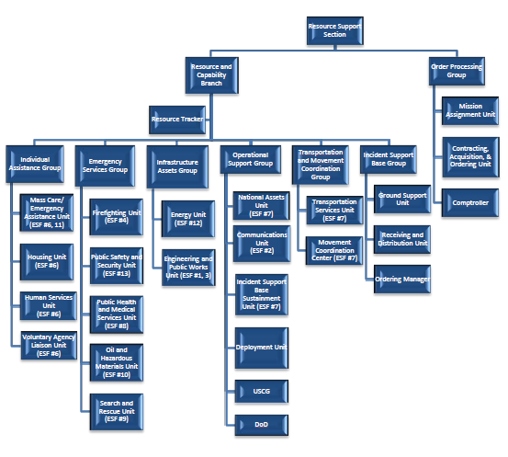
Resource Support Section

Slide 5
Resource Support Section
Resource and Capability Branch
Interagency group of response partners focused on developing sourcing recommendations to fulfill disaster requests in support of RRCC and/or JFO operations.
Divided into 5 supporting groups and coordinated by the Resource and Capability Branch Director.
Order Processing Group
Finalizes documentation, coordinates funding, mission assignments and contracts
Processes orders based on the sourcing method identified by the RCB. This group completes financial and acquisition documentation necessary for the sourcing method determined and acquiring the necessary approvals to execute the order.
40-1s, statements of work, MOUs, MOAs.
Individual Assistance Group
National coordination of resources and develops sourcing plans to meet mass care needs identified by the region.
These requests include sheltering, feeding, first aid, etc.
Incident Support Base Group
Responsible for maintaining the status of resources in the ISB and providing materiel, services, and personnel support necessary to initiate and establish ISB operations.
Maintains the status of resources in ISBs and Federal Staging Areas (FSAs) and reports the status of resources to the RCB for inclusion in NRCC situation reports and briefings.
Coordinates ISB/FSA support through the deployment of teams, services and equipment necessary to establish ISB or FSA operations during surge FEMA National Incident Support Manual and response.

Slide 6
Resource Support Section Cont.
Infrastructure Assets Group
National coordination of resources and develops sourcing plans to meet infrastructure needs.
This groups addresses national-level support for removal of debris to facilitate both the entry of emergency workers and the evacuation and return of the public and restoration of public and private nonprofit facilities.
Operational Support Group
National coordination of resources and develops sourcing plans to meet operational response needs such as identified by the region.
These requests include internal FEMA, air, communications, or military assets.
Personnel Deployment Unit.
Transportation and Movement Coordination Group
Coordinates and tracks movement of commodities, equipment, teams, and personnel supporting incident management operations.
Synchronizes the utilization and scheduling of all transportation resources.
Emergency Services Group
National coordination of resources and develops sourcing plans to meet emergency services needs and Federal lifesaving and life-sustaining activities identified by the region.

Slide 7
Initiating an ARF/Resource Request in WebEOC
Process Flows and How Requests Get Into WebEOC

Slide 8
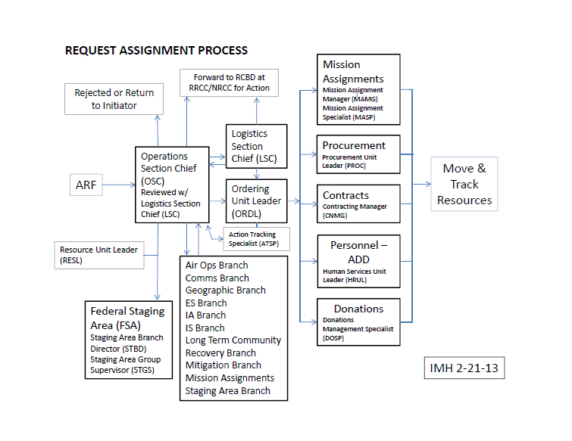
Requests initiated at the JFO/IMAT Positions will be automatically routed to the OSC

Slide 9
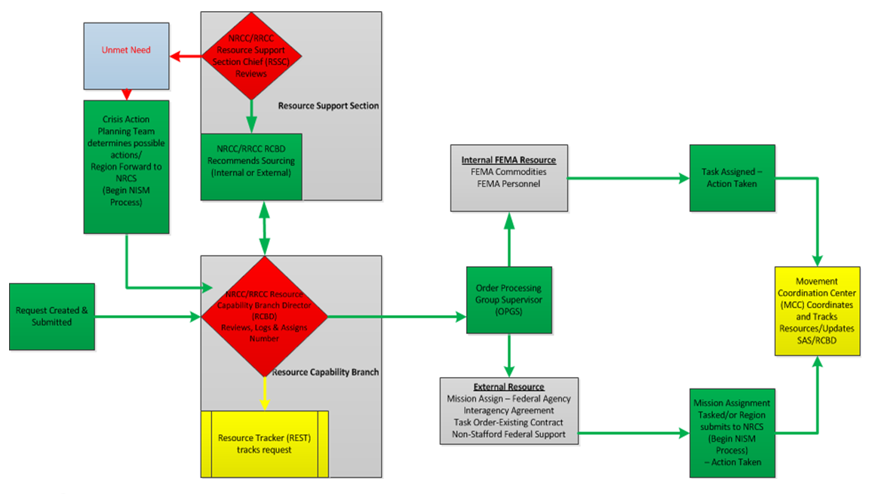
NISM/RISM ARF/Resource Request Flow

Slide 10
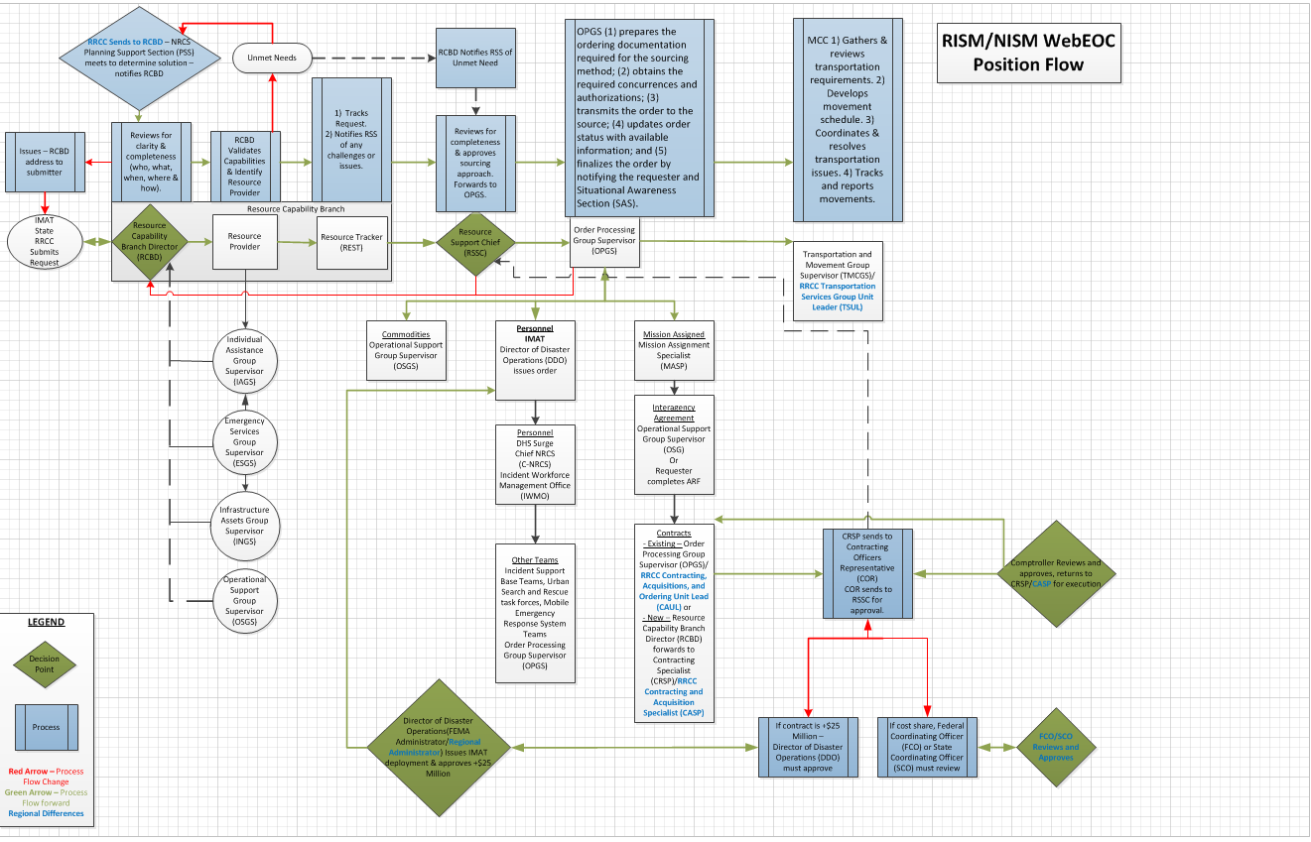
WebEOC ARF/Resource Request Task Flow
Future Phase – As of August 2013 WebEOC does not have the capability to track requests past Mission Assignment however, this will be incorporated in future phases of WebEOC development to allow for full lifecycle tracking of requests.

Slide 11
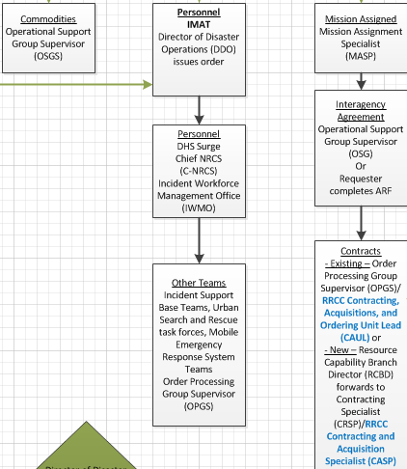
Available Resources and Means of Fulfilling Resource Requests
Commodities are items that FEMA either has available to them in storage or has access to delivering to incidents. Deployment of commodities is managed by the Operations Support Group.
Certain requests can be fulfilled through pre-defined Interagency Agreements (IAG) or new IAGs.
Requests can be fulfilled through existing contracts or new contracts can be developed to meet the needs. Contracts in excess of $25 million must be approved by the Director of Disaster Operations
Personnel are a critical asset to FEMA response capabilities. Personnel can be deployed via several means including:
IMAT – deployed under the orders of the Director of Disaster Operations or the Regional Administrator or their designee.
DHS Surge Force – Coordination details for the DHS Surge Force are handled by the Incident Workforce Management Office.
Other specialty teams might include Incident Support Base Teams, Search and Rescue (SAR) Task Forces, Mobile Emergency Response System Teams (MERS).

Slide 12
Unmet Needs
When it is determined that a request cannot be met at a regional level, the request is sent to the NRCC Resource Capability Branch Director. If the request is not something that the NRCC can fulfill through available means then a Crisis Action Planning Team is convened.
Crisis Action Planning Team
In the course of supporting incidents, FEMA HQ elements and NRCS sections and units routinely address problems and develop ad hoc crisis action plans to deal with these problems. Personnel with functional expertise make up the crisis action planning team and provide input to help develop the crisis action plan.

Slide 13
Initiating an ARF - Resource Request
ARF - Resource requests can be initiated in several ways.
Request initiated by state/tribe.
Request initiated by IMAT.
Request initiated by JFO.
Request initiated from the field.
Request initiated by RRCC.
Request initiated by ESF.
ARF - Resource requests can also be received in several ways.
Verbal request.
Request submitted via Form (Fax or Email).
Request submitted via hardcopy.
Request submitted in WebEOC.
Regardless of who initiates the request or how it was initiated, the request must be entered into WebEOC in order to be tracked.

Slide 14
ARF/Request Methods in WebEOC
Within WebEOC there are two methods by which a request can be submitted.
Create Request – which is a request that does not have a pre-scripted mission assignment.
Create Request from PSMA – which is a request that has a pre-scripted mission assignment already defined.
The following sections will breakdown those requests as independent processes.

Slide 15
Questions

Slide 16
WebEOC Processes
Part 1: Create ARF/Resource Request

Slide 17
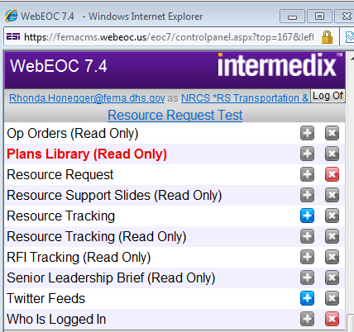
Create ARF/Request - Initiate a Resource Request
When request is received outside of WebEOC, the request must be logged into the system so that it can be processed. The Resource Tracker is responsible for logging requests into the system.
Click on Resource Request in the Control Panel.

Slide 18
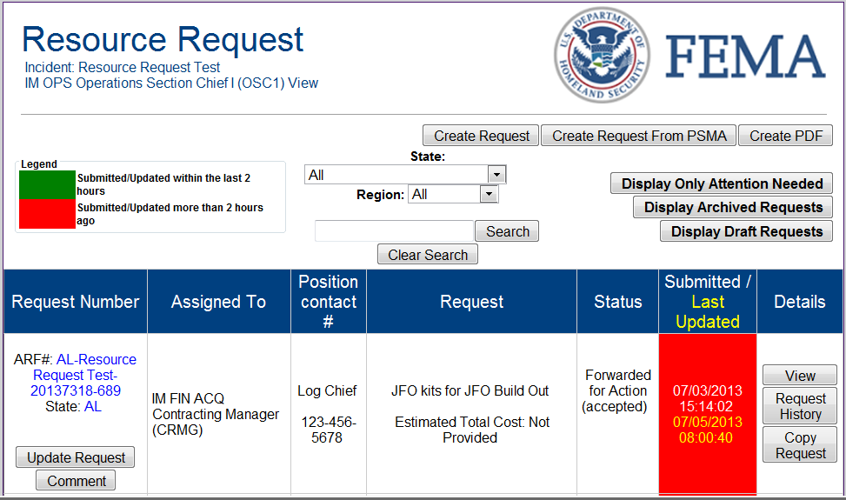
Create ARF/Request
From the Resource Request page, you can create a request from Pre-Scripted Mission Assignments (PSMA) or create a request that is not covered under PSMA.

Slide 19
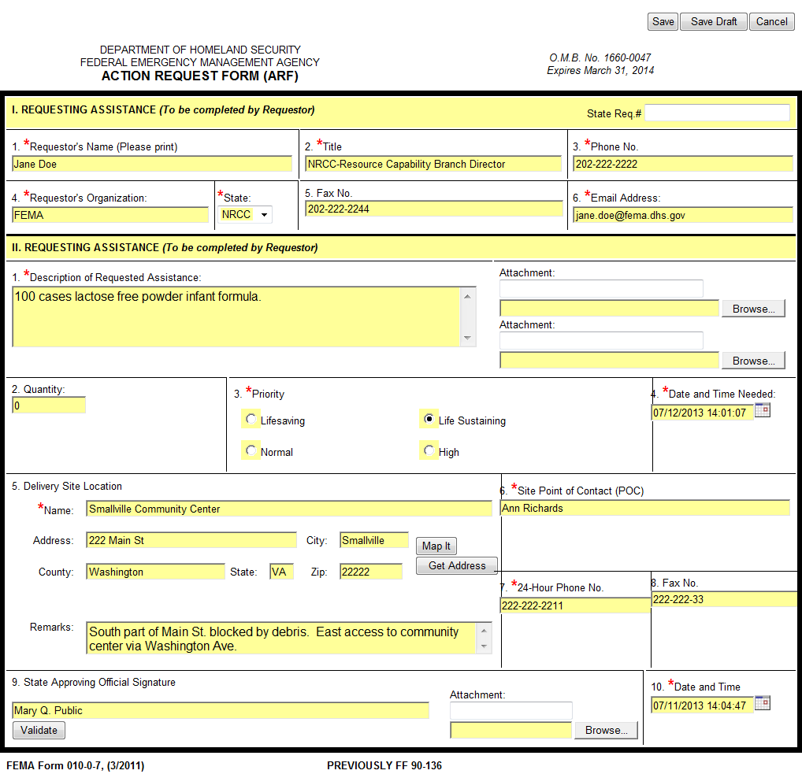
Create ARF/Request - Completing the Request Form
Fill in the request form.
Items with red * must be filled in.
Ensure that specific details are included such as size of item, type of item, item capabilities, any unique requirements, etc.
If there are delivery limitations, include that information in the remarks.
If the request is coming from the state or has a dollar value exceeding $25 M, State Approving Official must Validate.
When all of the information is complete, click the Save button. The Save Draft button will keep the request in the que but will not forward it on.

Slide 20
Create ARF/Request - Resource Request Board
Once a request has been entered and saved, it can be viewed on the Resource Request Board.
Authorized users can Update Request and make Comments.
All users can View, Request History, and Copy Request.
Sample of Request History

Slide 21
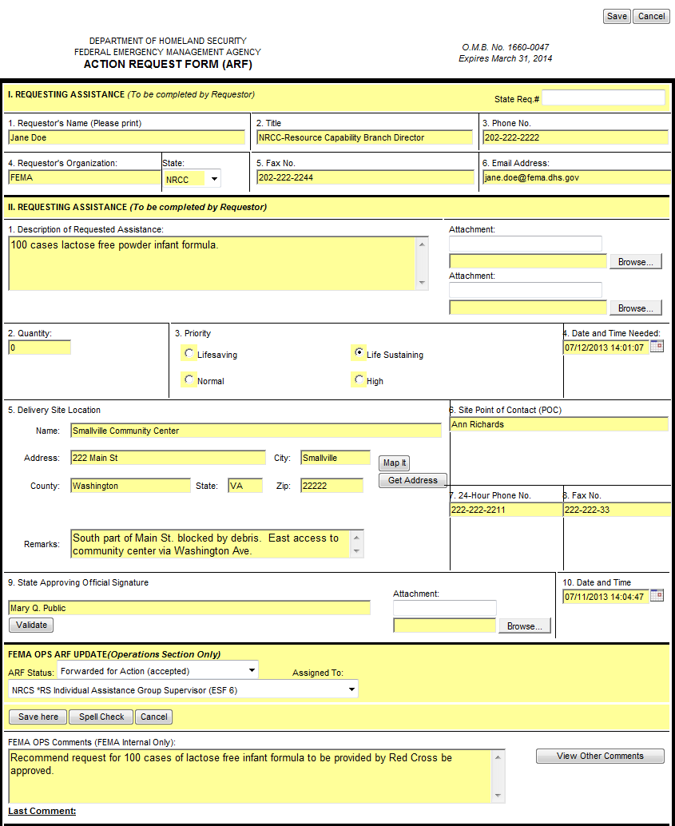
Create ARF/Request – Initial Review Resource Capability Branch Director (RCBD)
The Resource Capability Branch Director (RCBD) reviews the initial request.
If there are any questions for the requestor, RCBD contacts them to resolve.
RCBD works with the resource providers to determine the best means of fulfilling the request.
This request would be fulfilled under the Individual Assistance Group. RCBD would forward the request to the Individual Assistance Group Supervisor (IAGS) for review.
Click the Save here button.

Slide 22
Create ARF/Request – Branch Directors Review
The Branch Director reviews the request and enters any relevant comments for the record and returns the request to the Operations Section Chief (OSC).
Users making updates can View Other Comments by clicking the button.
The ARF Status options are:
Approved
Approved in ADD
Contract Awarded
Contract Pending
Delayed
Delivered
Enroute
Entered into eCAPS
Forwarded for Action (accepted)
Funded in IFMIS
MA Issued (Funded)
Rejected (invalid)
Request Submitted in ADD
Resource Request Process Completed
Returned (need more info)
Returned for Final Approval
Reviewed by Resource Tracker

Slide 23
ARF/Request Status - Definitions
Approved - After the OSC or RSSC agrees with the final solution and ready to forward to the Ordering Unit Leader or Order Processing Group Supervisor
Approved in ADD – The request for personnel is entered and completed in ADD
Contract Awarded - CAUL has awarded a contract to meet a request
Contract Pending – CAUL is waiting for a contract to be awarded
Delayed – Resource was in enroute and is now delayed not reaching its destination
Delivered – Resource has reached its destination
Enroute – Resource is moving or traveling to its destination
Entered in eCAPS – The Mission Assignment positions have entered the approved request into eCAPS
Forwarded for Action (accepted) – The request has been accepted and forwarded to the next position for action
Funded in IFMIS – Funding has been committed to the request (40-1, Mission Assignment)
MA Issued (Funded) – The MA has been funded and issued to the supporting Agency
Rejected (invalid) – Request is not acceptable or is not longer needed
Request Submitted to ADD – The request is routed to the ADD position for action
Resource Request Process Completed – The request has been validated, routed and finalized
Returned (need more info) – The request is lacking information or needs clarification
Returned for Approval – After the request has been worked it’s returned to the OSC or RSSC for final approval
Reviewed by Resource Tracker – The Resource Tracker has completed their review for outstanding requests with no action taken

Slide 24
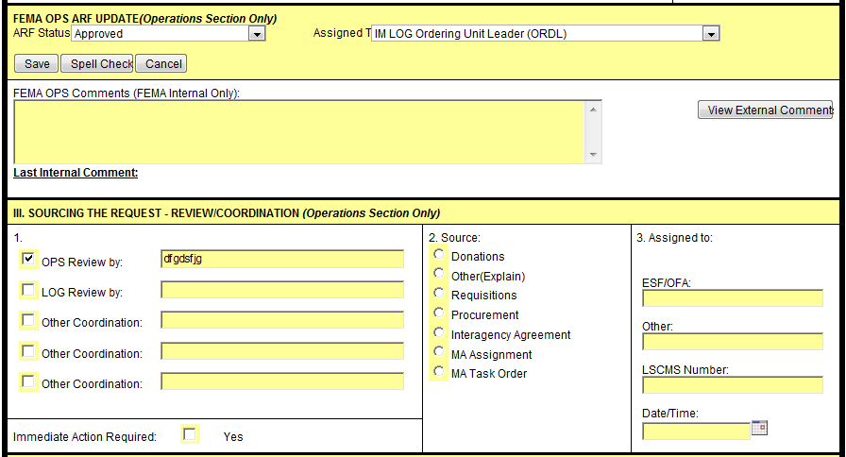
Create ARF/Request – Final Approval Operations Section Chief (OSC)
OSC receives the request back from the Branch Directors and has ensured all of the necessary details are on track, OSC sends the request for the final approval to the Ordering Unit Leader (ORDL).
If the request requires immediate action, the box is checked to indicate the urgency.
OSC indicates approval in Section III and identifies who the request is assigned to and how the source will be fulfilled.

Slide 25
Create ARF/Request – RRCC/NRCC - Initial Review Resource Capability Branch Director (RCBD)
The Resource Capability Branch Director (RCBD) or OSC reviews the initial request.
If there are any questions for the requestor, RCBD contacts them to resolve.
RCBD works with the resource providers to determine the best means of fulfilling the request.
This request would be fulfilled under the Individual Assistance Group. RCBD would forward the request to the Individual Assistance Group Supervisor (IAGS) for review.
Click the Save here button.

Slide 26
Create ARF/Request – Resource Provider Review
The resource provider reviews the request and enters any relevant comments for the record and returns the request to the Resource Capability Branch Director (RCBD).
Users making updates can View Other Comments by clicking the button.
The ARF Status options are:
Forward for Action (Accepted)
Rejected (invalid)
Returned (need more info)
Returned for Approval
Entered into ECAPS
Funded in IFMIS
Contract Pending
Contract Awarded
MA Issued (Funded)
Request Submitted in ADD
Approved in ADD
Approved
Resource Request Process Completed

Slide 27
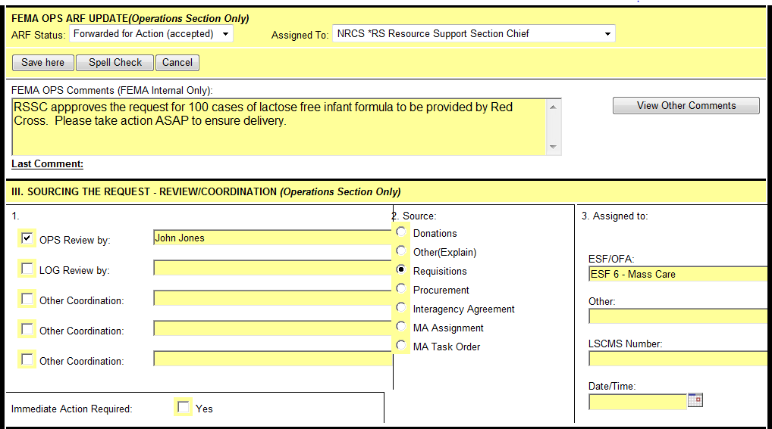
Create ARF/Request – Final Approval Resource Support Section Chief (RSSC)
RCBD receives the request back from the resource provider and has ensured all of the necessary details are on track, RCBD sends the request for the final approval to the Resource Support Section Chief (RSSC).
If the request requires immediate action, the box is checked to indicate the urgency.
RSSC indicates approval in Section III and identifies who the request is assigned to and how the source will be fulfilled.

Slide 28
Create ARF/Request – Order Processing Group Supervisor (OPGS)
The Order Processing Group Supervisor (OPGS) is responsible for ensuring that the request is fulfilled. In this case, the request for 100 cases of lactose free infant formula will be met through a contract with Red Cross (ESF-6 Mass Care) OPGS forwards the request to the Contracting and Acquisitions Unit Leader (CAUL) to be fulfilled.

Slide 29
Create ARF/Request – Contracting and Acquisitions Unit Leader
The Contracting and Acquisitions Unit Leader (CAUL) takes action to place and fulfill the order.
Once the contract is awarded, Contracting and Acquisitions will update the status in WebEOC.
From this point forward the Resource Provider (in this case ESF-6) is responsible updating details on whether the request has been fulfilled, when it has been delivered and to whom, and updating the request in WebEOC.

Slide 30
Questions?

Slide 31
WebEOC Processes
Part 2: Create ARF/Resource Request From Pre-Scripted Mission Assignment (PSMA)

Slide 32
Pre-Scripted Mission Assignment (PSMA) – Initiate a ARF/Resource Request
When request is received outside of WebEOC, the request must be logged into the system so that it can be processed. The Resource Tracker is responsible for logging requests into the system.
Click on Resource Request in the Control Panel.

Slide 33
Pre-Scripted Mission Assignment (PSMA) - Creating a ARF/Request
From the Resource Request page, select the Create Request from PSMA button.

Slide 34
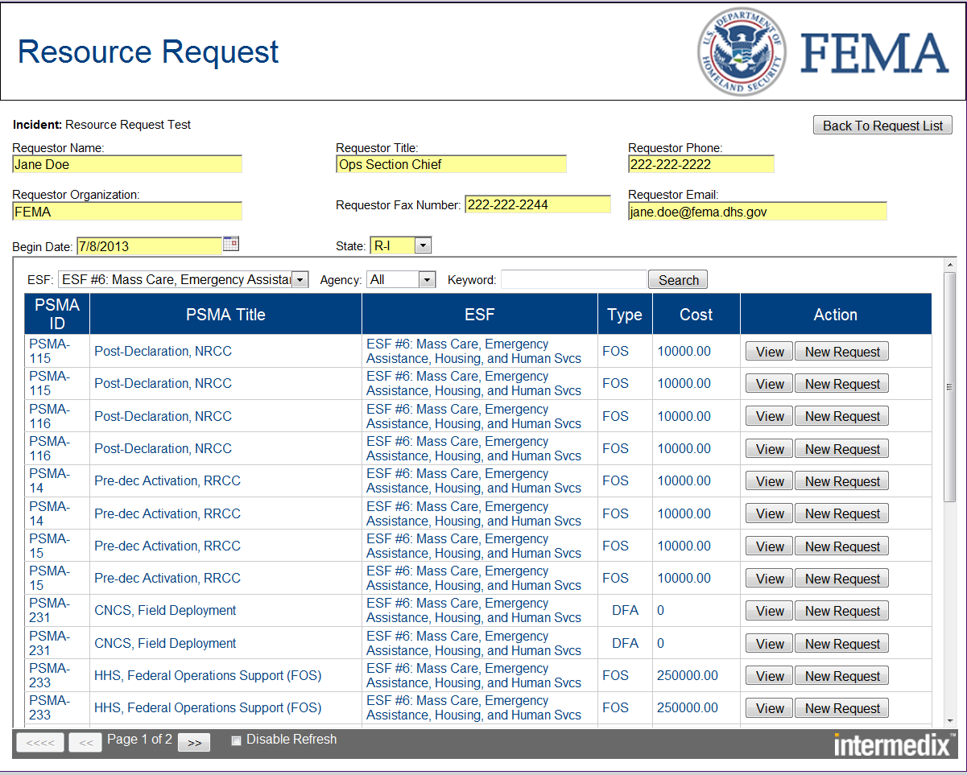
Pre-Scripted Mission Assignment (PSMA) – Creating a ARF/Request Cont.
Complete the fields at the top of the request and then select the PSMA.
When selecting from Pre-scripted mission assignments, users have the option of searching by ESF’s, by Agency, or by Keyword.
Click on View to see details of the PSMA.
Click on New Request to select that PSMA.

Slide 35
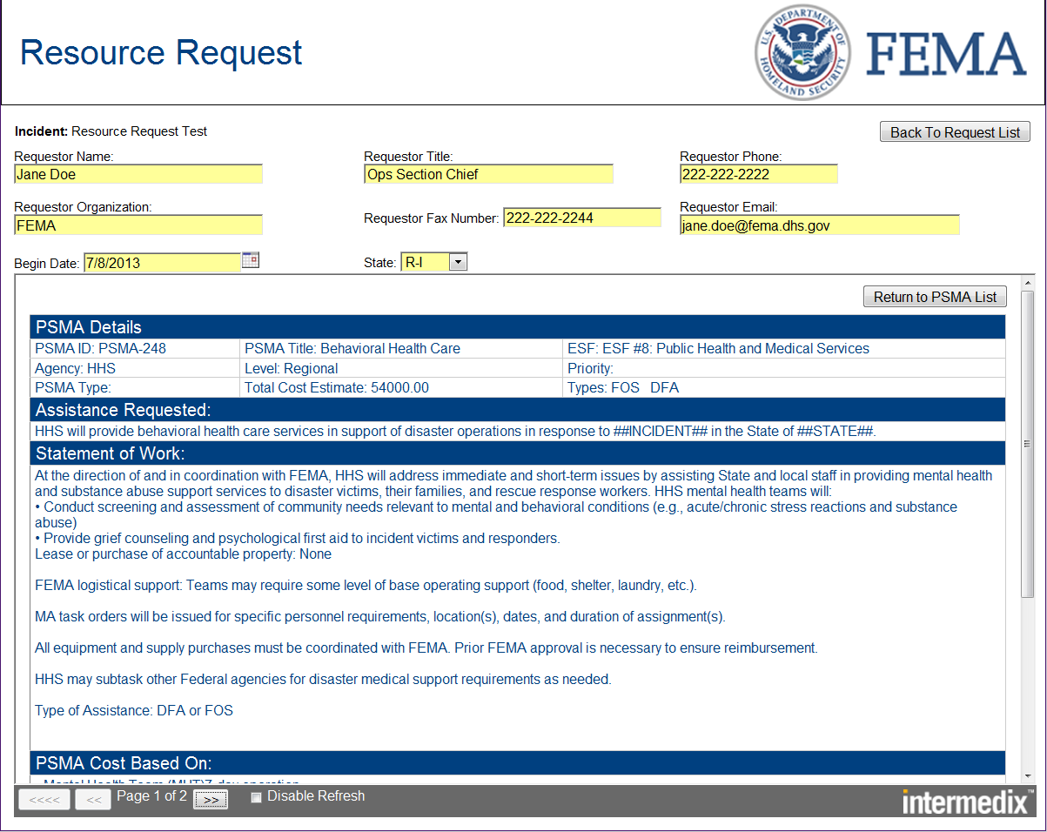
Pre-Scripted Mission Assignment (PSMA) - View Details
When you click on the View button, it will display the details of the PSMA.
There may be multiple pages which can be viewed by clicking on the arrows.

Slide 36
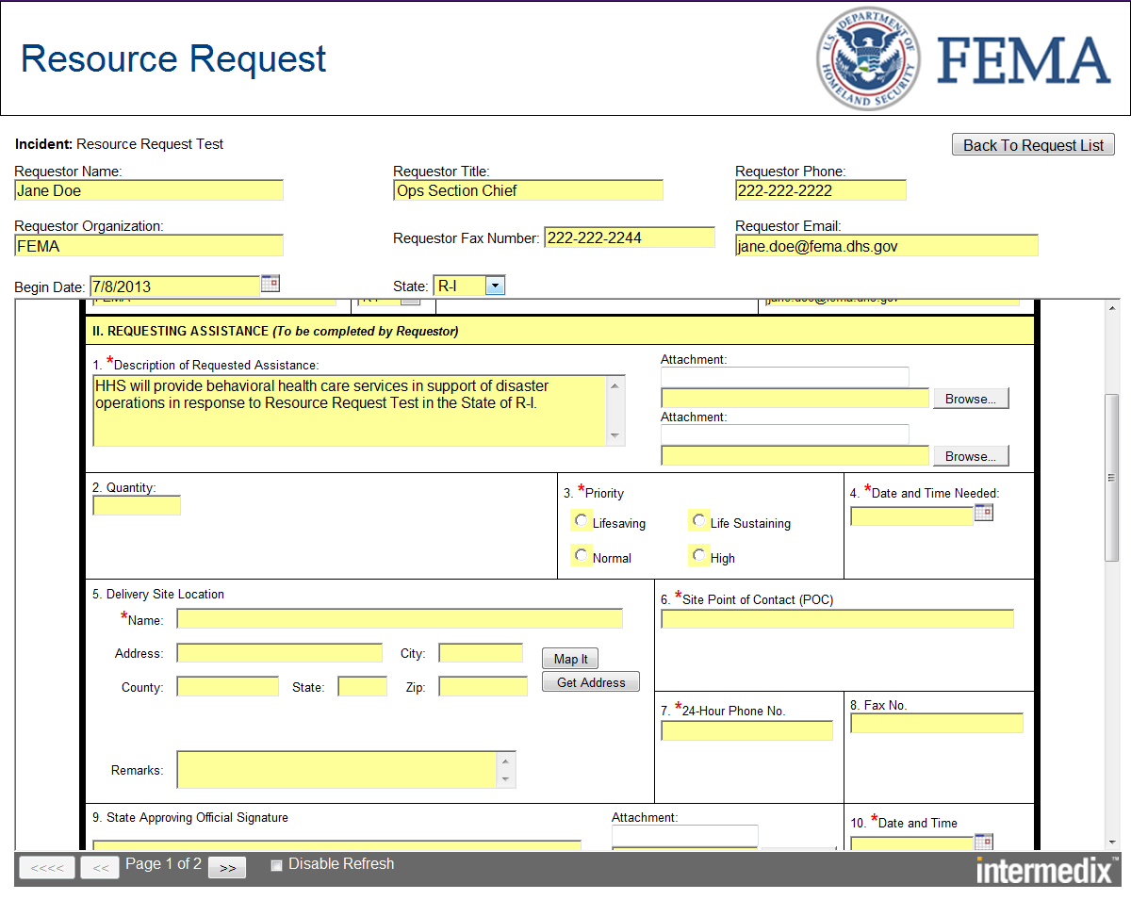
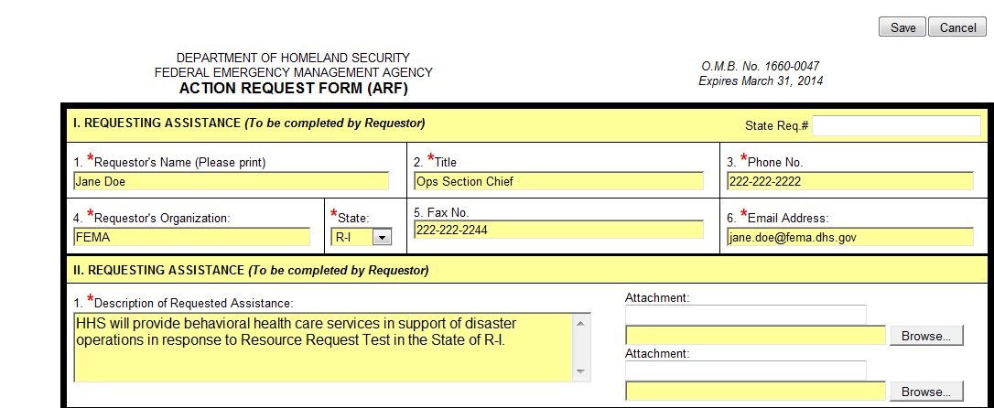
Pre-Scripted Mission Assignment (PSMA) - New ARF/Request
Some information is pre-populated from the PSMA however the remainder of the information must be completed before submission. Ensure all items with a red * are complete.
Once all information has been entered, click the Save button.

Slide 37
Pre-Scripted Mission Assignment (PSMA) - Updating ARF/Request
The Resource Request is automatically routed to the Ops Section Chief in the field or the Resource Capability Branch Director at the NRCC/RRCC.
The highlighted bar across the Update Request Button shows that this is a new item for OSC/RCBD. Click on the Update Request button.
The field under the submitted column will be green if the request was submitted or last updated within 2 hours. If the field is red, it has been more than 2 hours since the submission or last update.

Slide 38
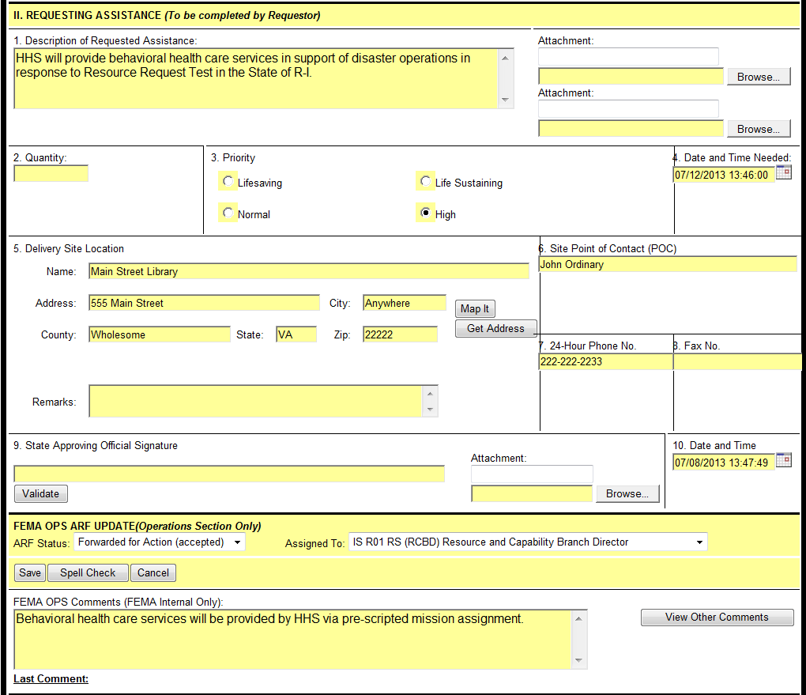
Pre-Scripted Mission Assignment (PSMA) - ARF Status
The ARF Status options are:
Forward for Action (Accepted)
Rejected (invalid)
Returned (need more info)
Returned for Approval
Entered into ECAPS
Funded in IFMIS
Contract Pending
Contract Awarded
MA Issued (Funded)
Request Submitted in ADD
Approved in ADD
Approved
OSC will update the status and assign the Resource Request to the RCBD.

Slide 39
Pre-Scripted Mission Assignment (PSMA) - Resource Capability Branch Director (RCBD) Approval
Once the request has been submitted, it is routed to the Resource Capability Branch Director (RCBD). RCBD reviews and determines if a mission assignment is the correct means of fulfilling the request.
If there is already a mission assignment in place or another similar request, RCBD may decide to combine requests or add on to an existing request.
If the mission assignment is approved to proceed, RCBD would select the Update Request button to process the next step.

Slide 40
Pre-Scripted Mission Assignment (PSMA) - Review by Resource Provider
The next step in the process is to have the request reviewed by the resource provider. Since this particular request is for ESF-8 Public Health and Medical Services, that falls under the Emergency Services Group. RCBD would route the request to the Emergency Services Group Supervisor for review. Once the ESGS reviews the request and concurs that it should be fulfilled through a PSMA, ESGS routes the approval to RCBD. ESGS can enter any relevant comments in the comments section, select the Resource Capability Branch Director (RCBD) in the Assigned To dropdown menu and then click the Save Here button.
If the cost for supplying or supporting the resource is shared between FEMA and the affected State, the FCO and State Coordinating Officer (SCO) must also review and approve the documentation.

Slide 41
Pre-Scripted Mission Assignment (PSMA) - Approval by Resource Support Section Chief
The final approval is by the Resource Support Section Chief (RSSC).
Once the RSSC approves the request and returns it to RCBD, the Resource Capability Branch Director (RCBD) forwards the request to the Order Processing Group Supervisor (OPGS) for execution.

Slide 42
Pre-Scripted Mission Assignment (PSMA) - RCBD Final Review
Once the request has been approved as a pre-scripted mission assignment in coordination with the resource provider, the Resource Capability Branch Director (RCBD) forwards the request to the Order Processing Group Supervisor (OPGS) for action. To execute this action hit Save Here button.
The OPGS reviews the request, inserts any necessary comments and forwards it to the Mission Assignment Unit Lead (MAUL). To execute this action hit Save button.

Slide 43
Pre-Scripted Mission Assignment (PSMA) - Order Processing Group Supervisor
Once approval has been obtained by RSSC, the RCBD forwards the request to the Order Processing Group Supervisor (OPGS).
The OPGS processes orders based on the sourcing method identified by the RCBD and orders the required resources or services according to established procedure and processes.
For this scenario, the request is being mission assigned so OPGS would forward the request to the Mission Assignment Unit Lead (MAUL).

Slide 44
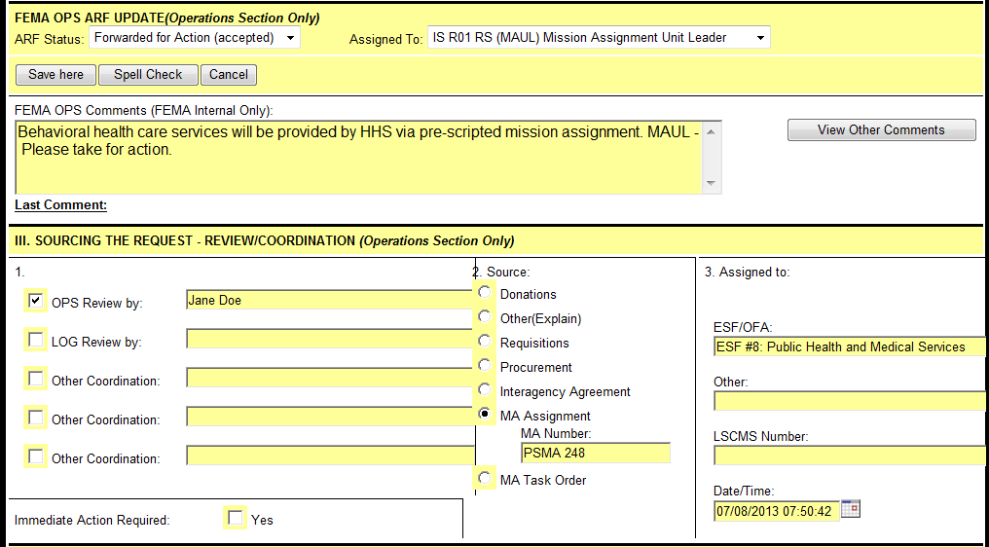
Pre-Scripted Mission Assignment (PSMA) - Mission Assignment Unit Lead
The Mission Assignment Unit Lead (MAUL) reviews the & processes the request and records the Mission Assignment number. If transportation is necessary, then they work with Transportation Services Unit to coordinate transportation.
The Mission Assignment Unit Lead also assigns the ECAPS ID which is recorded at the bottom of the form.

Slide 45
Questions?

Slide 46
Request Follow Up
How to View ARF/Request History and Track the Request

Slide 47
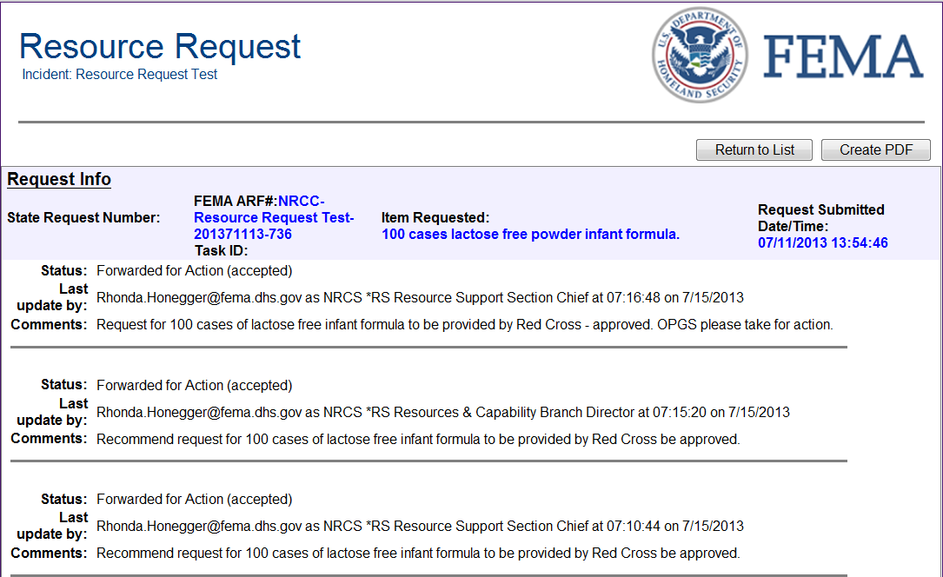
Request History
The history of a request can be viewed by clicking on the Request History button.
The history can be saved as a PDF for emails by clicking on the Create PDF button.
Once a user is done viewing the history, click on the Return to List button.

Slide 48
Role of Resource Tracker
The Resource Tracker:
Maintains visibility and provides the status of all resources ordered from source through delivery by coordinating with Resources staff at all levels and managing a database with all resource requests and orders.
Tracks requests and status of resource requests as instructed by the RSS Chief.
Updates on resource status are input by the resource provider.

Slide 49
Future WebEOC Phases
Currently WebEOC only supports routing requests as far as Mission Assignment. Plans are in place to build on routing capabilities to other positions to include:
Contracting Acquisitions and Ordering Unit Lead
Operational Support Group Specialist
DHS Surge Chief
Transportation and Movement Group Supervisor
Once this occurs, requests will be able to tracked from initialization through delivery all on WebEOC.

Slide 50
Questions?

