Slide 1
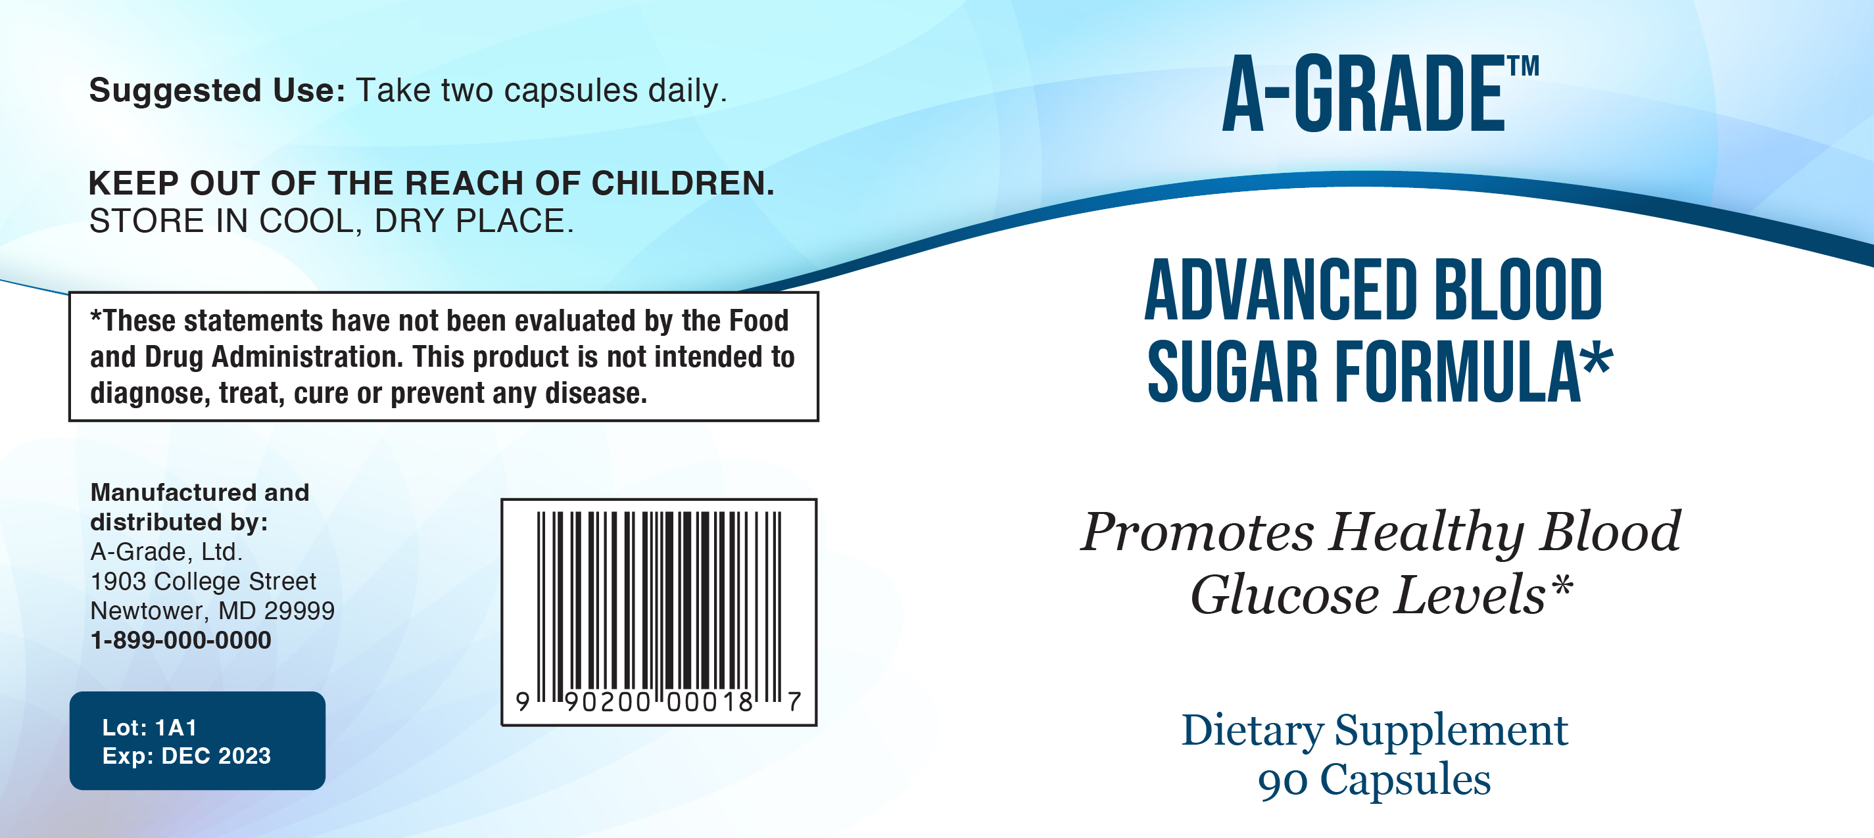
Dietary Supplement Claims One-on-one In-depth Interview Study
Attachment 7. Examples of mock-up labels and claims

Slide 2
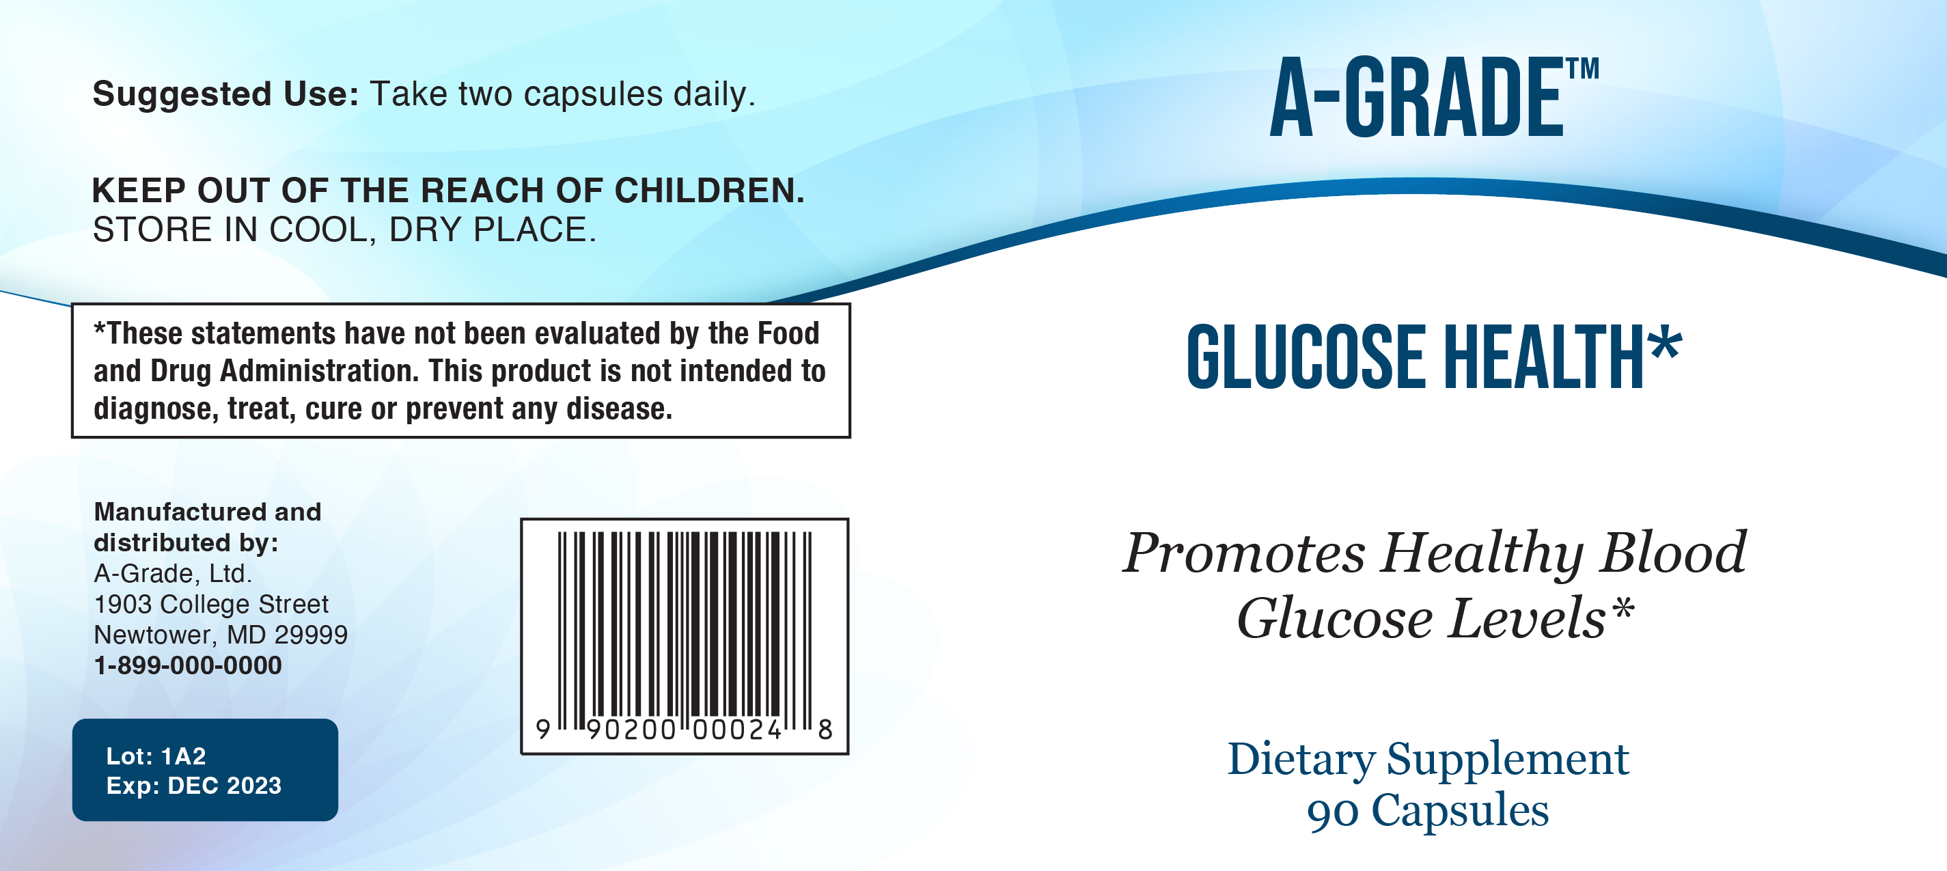

Slide 3
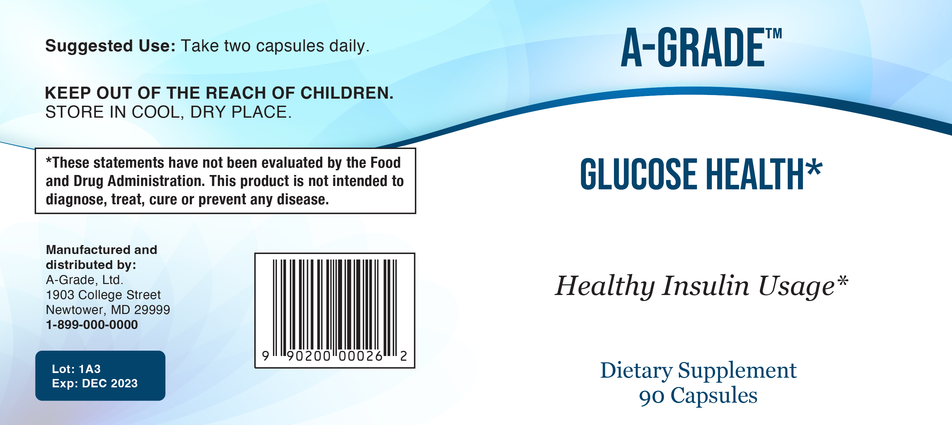

Slide 4
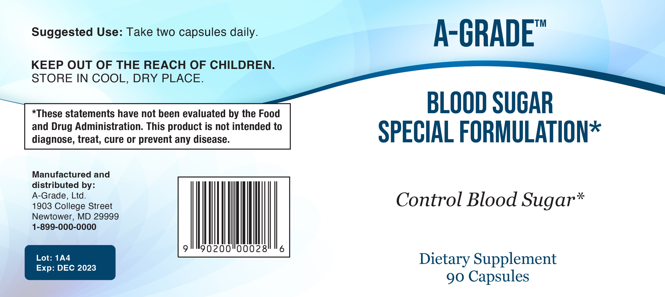
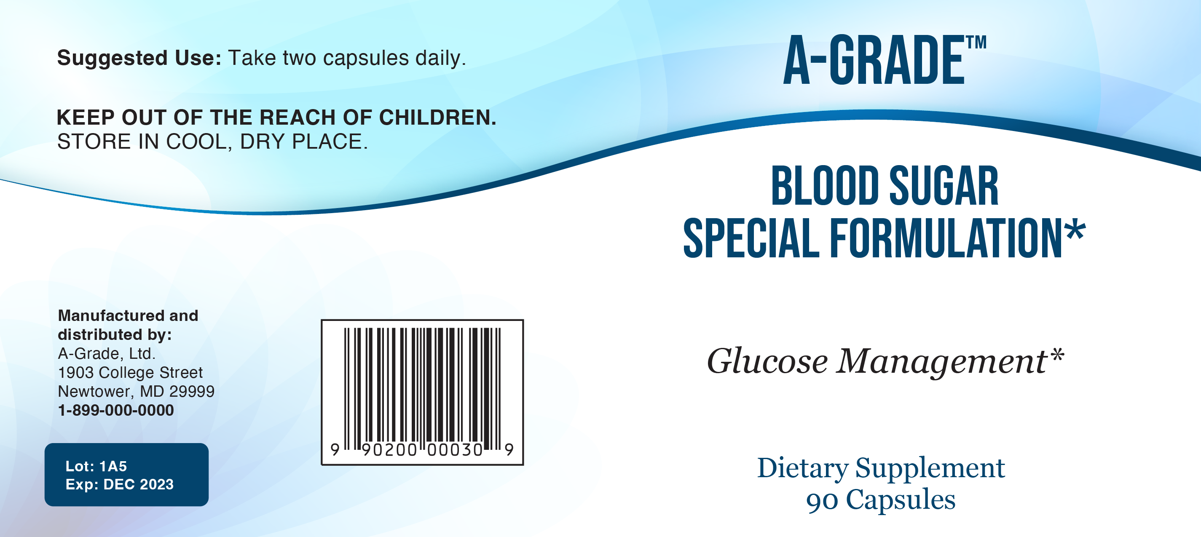

Slide 5
Card sorting claims – sugar/glucose
Helps regulate blood sugar levels
Promotes insulin production by supporting pancreatic cells
Supports glucose metabolism
Improves glucose intolerance
Promotes healthy blood glucose levels already within normal range
Support for healthy glucose metabolism
Helps maintain healthy glucose levels
Regulates healthy blood sugar levels
Controls blood sugar
Supports sugar metabolism
Decreasing the amount of glucose that enters your bloodstream
Healthy insulin usage

Slide 6
Card sorting claims – hypertension
Maintains healthy blood pressure and healthy blood flow
Supports blood vessel dilation which in turn supports healthy blood pressure levels and healthy blood flow
Plays a role in controlling blood pressure
Supports blood pressure
Promotes healthy blood pressure already within normal range
Preventing high blood pressure
Improves blood pressure
Maintains normal blood pressure levels
Supports blood pressure regulation
Regulates and maintains healthy blood pressure

Slide 7
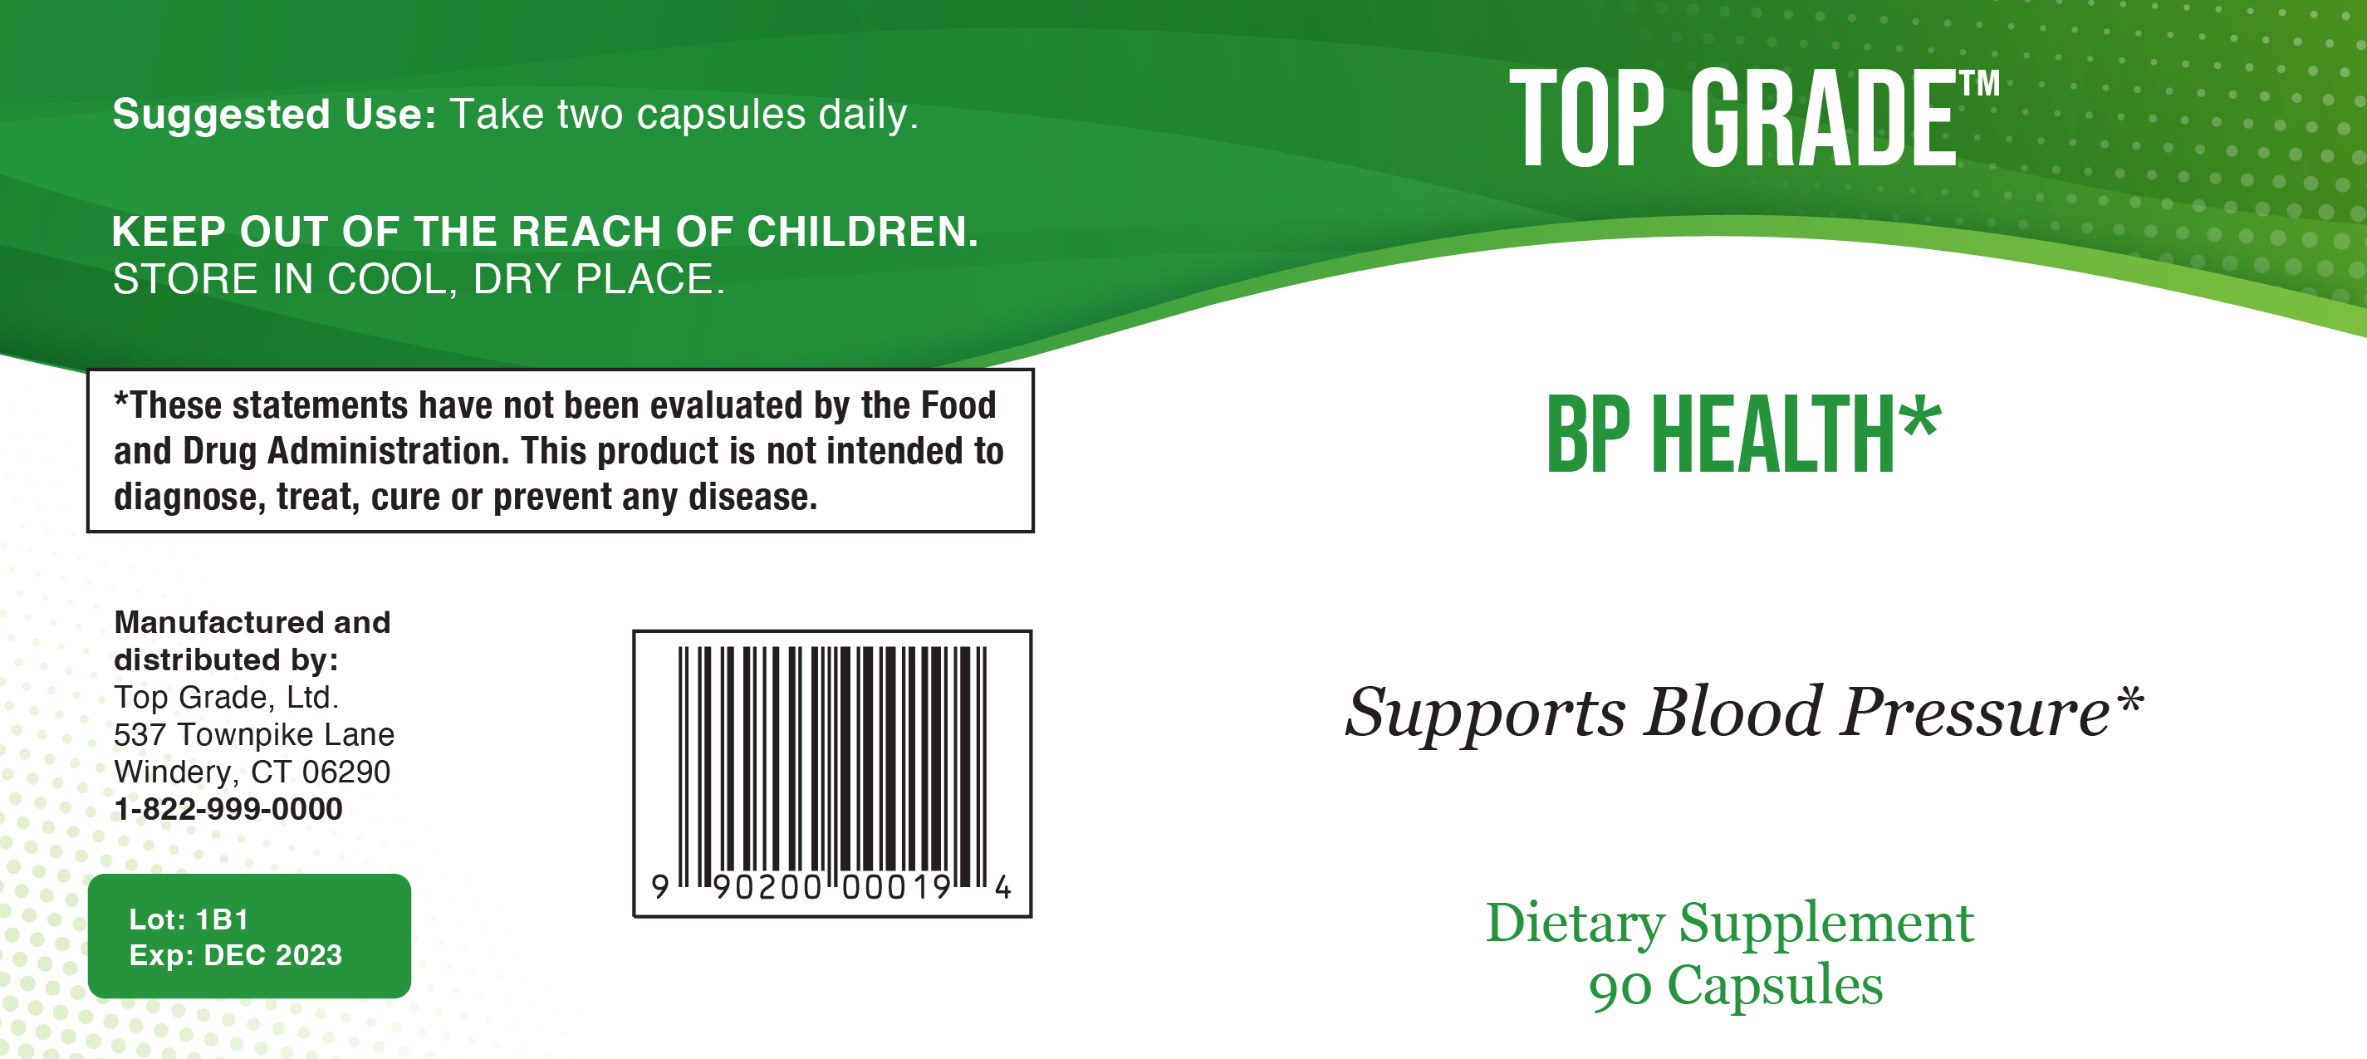

Slide 8
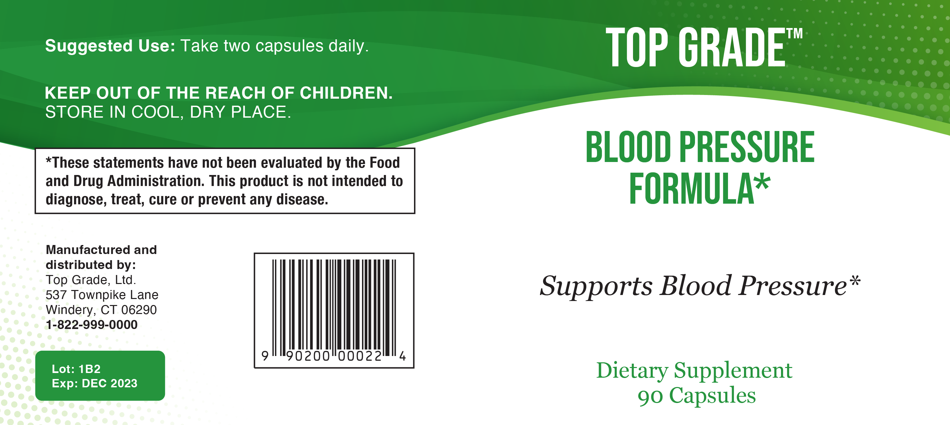

Slide 9


Slide 10
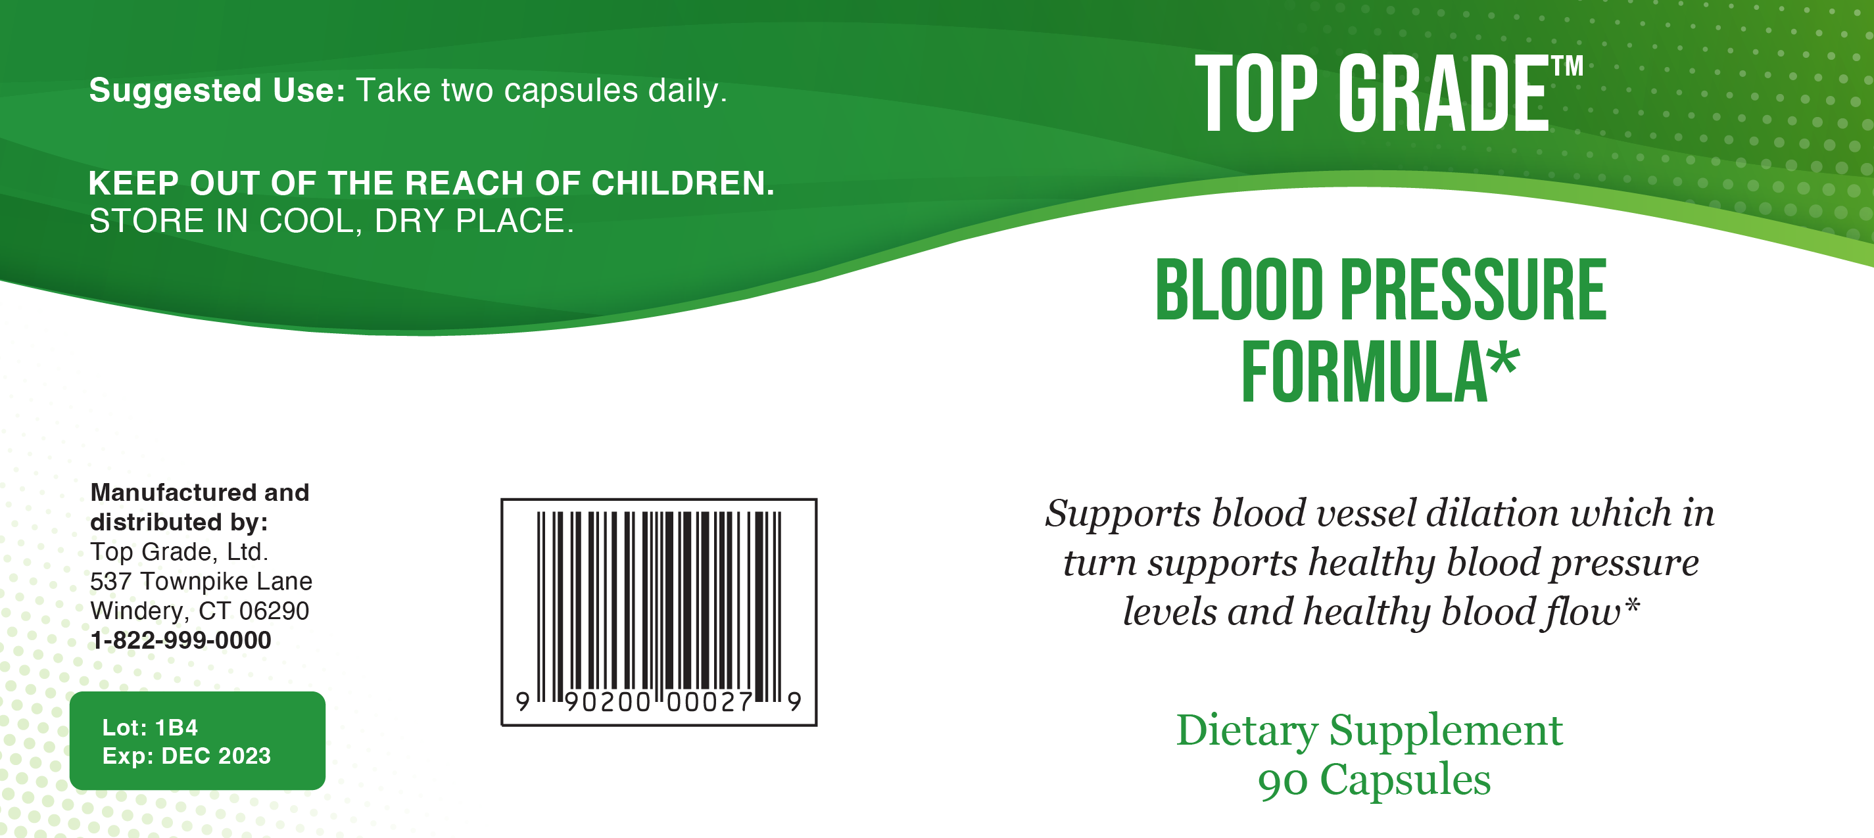

Slide 11
Maintains blood pressure levels
Maintains normal blood pressure levels

