Slide 1
Matching of Screenshots of Online Form to Paper Form Content
I-131, Application for Travel Document
OMB Control Number 1615-0013
Edition: 10/31/22
Expiration Date: 10/31/2024
This deck includes screenshots of the I-131 online form and the I-131 paper form (linked below)
Form I-131
Instructions for Form I-131
United States Citizenship and Immigration Services
myUSCIS Team
March 2023

Slide 2
How to use this document
Left side: Screenshot of the online form
Right side: Paper form showing the text that is reflected in the online form
Note: Some slides may not have any text on the right side as these pages are shown only in the online form experience.

Slide 3
I-131 Content

Slide 4
This page is only applicable for the online experience.

Slide 5
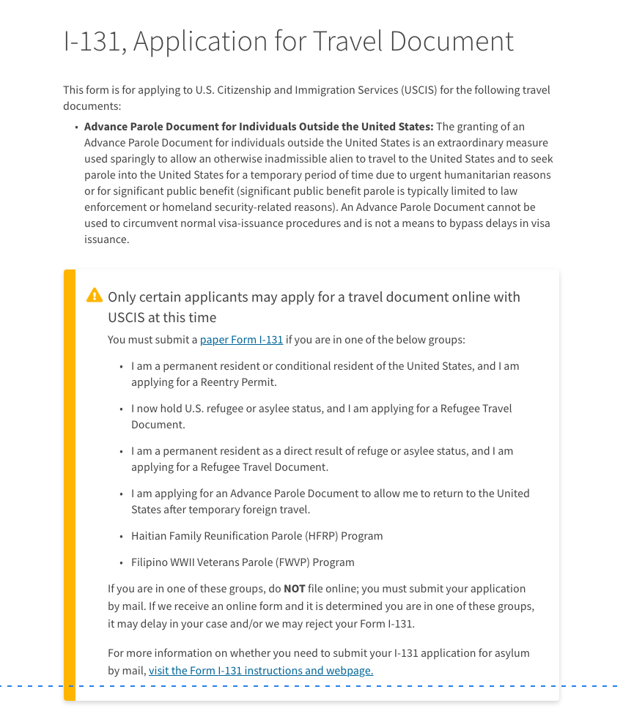

Slide 6
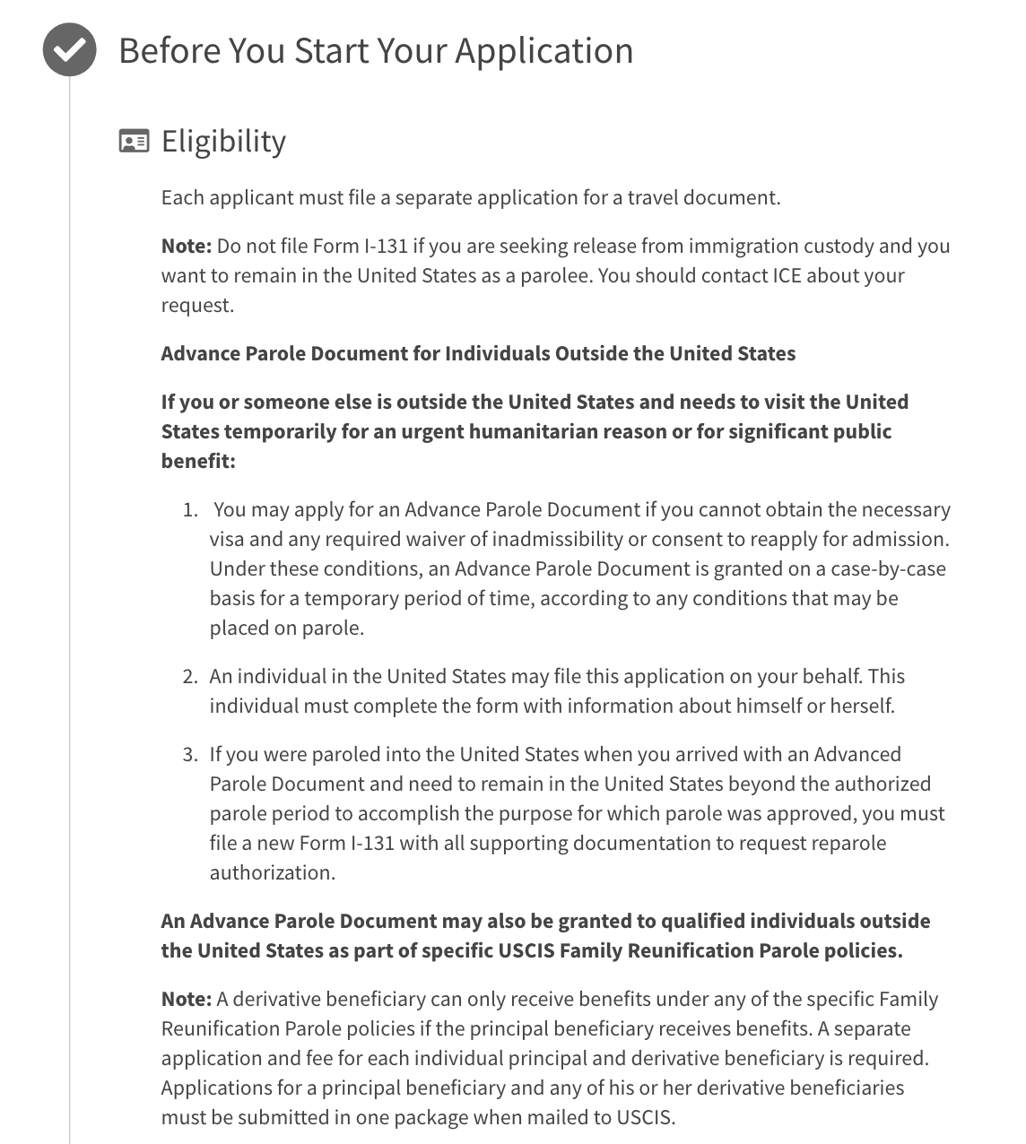
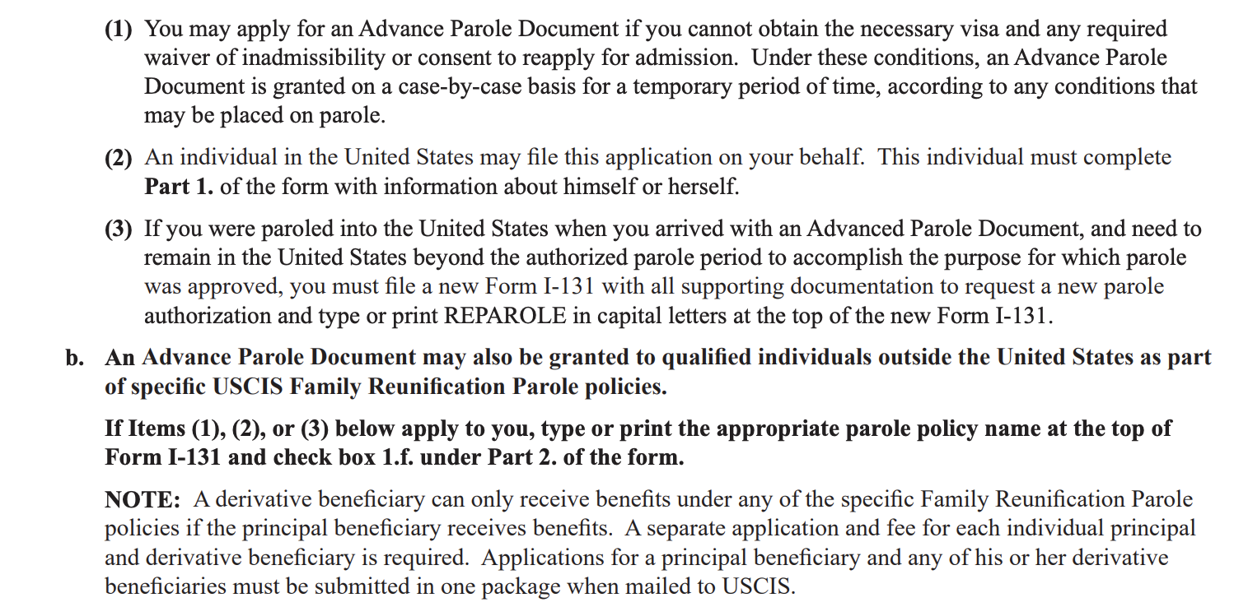

Slide 8
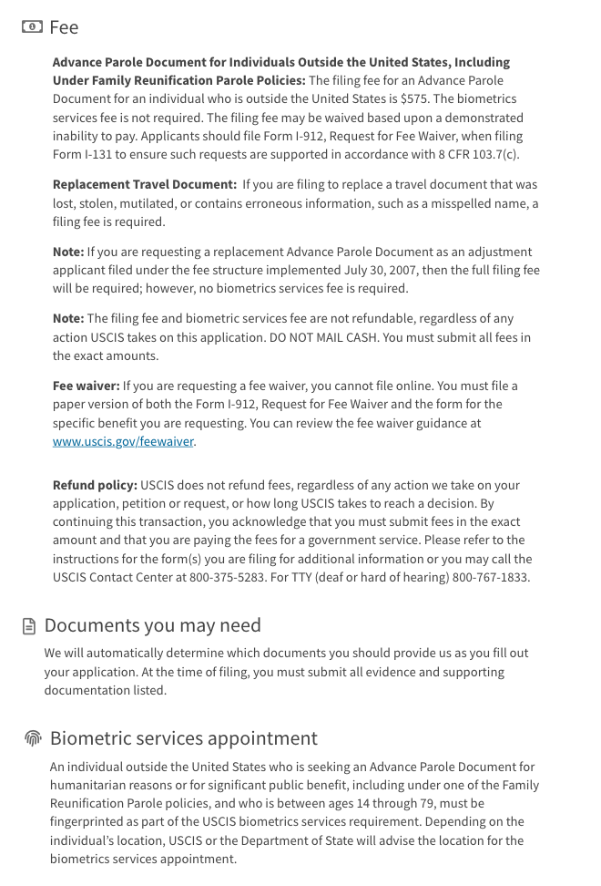

Slide 9
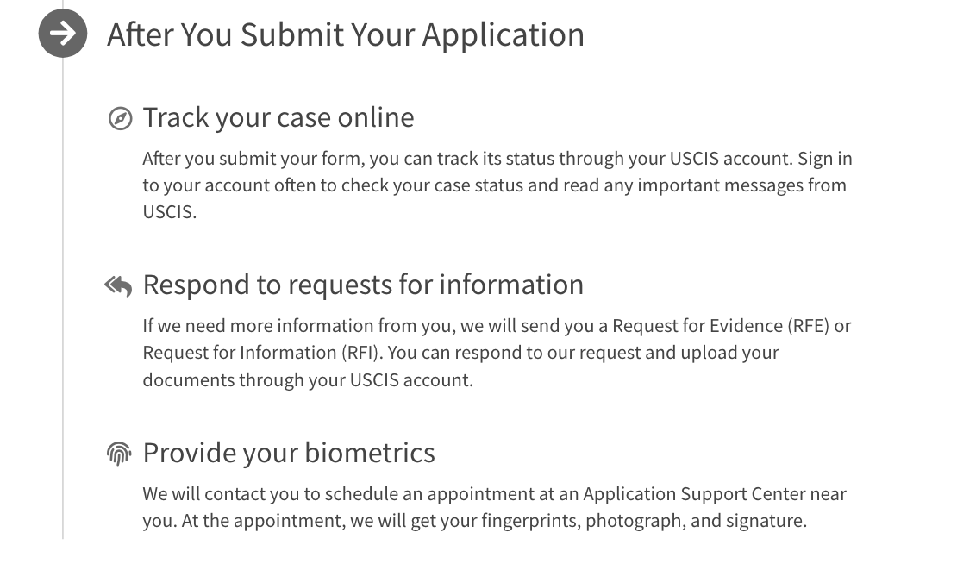

Slide 10
This page is only applicable for the online experience.

Slide 11
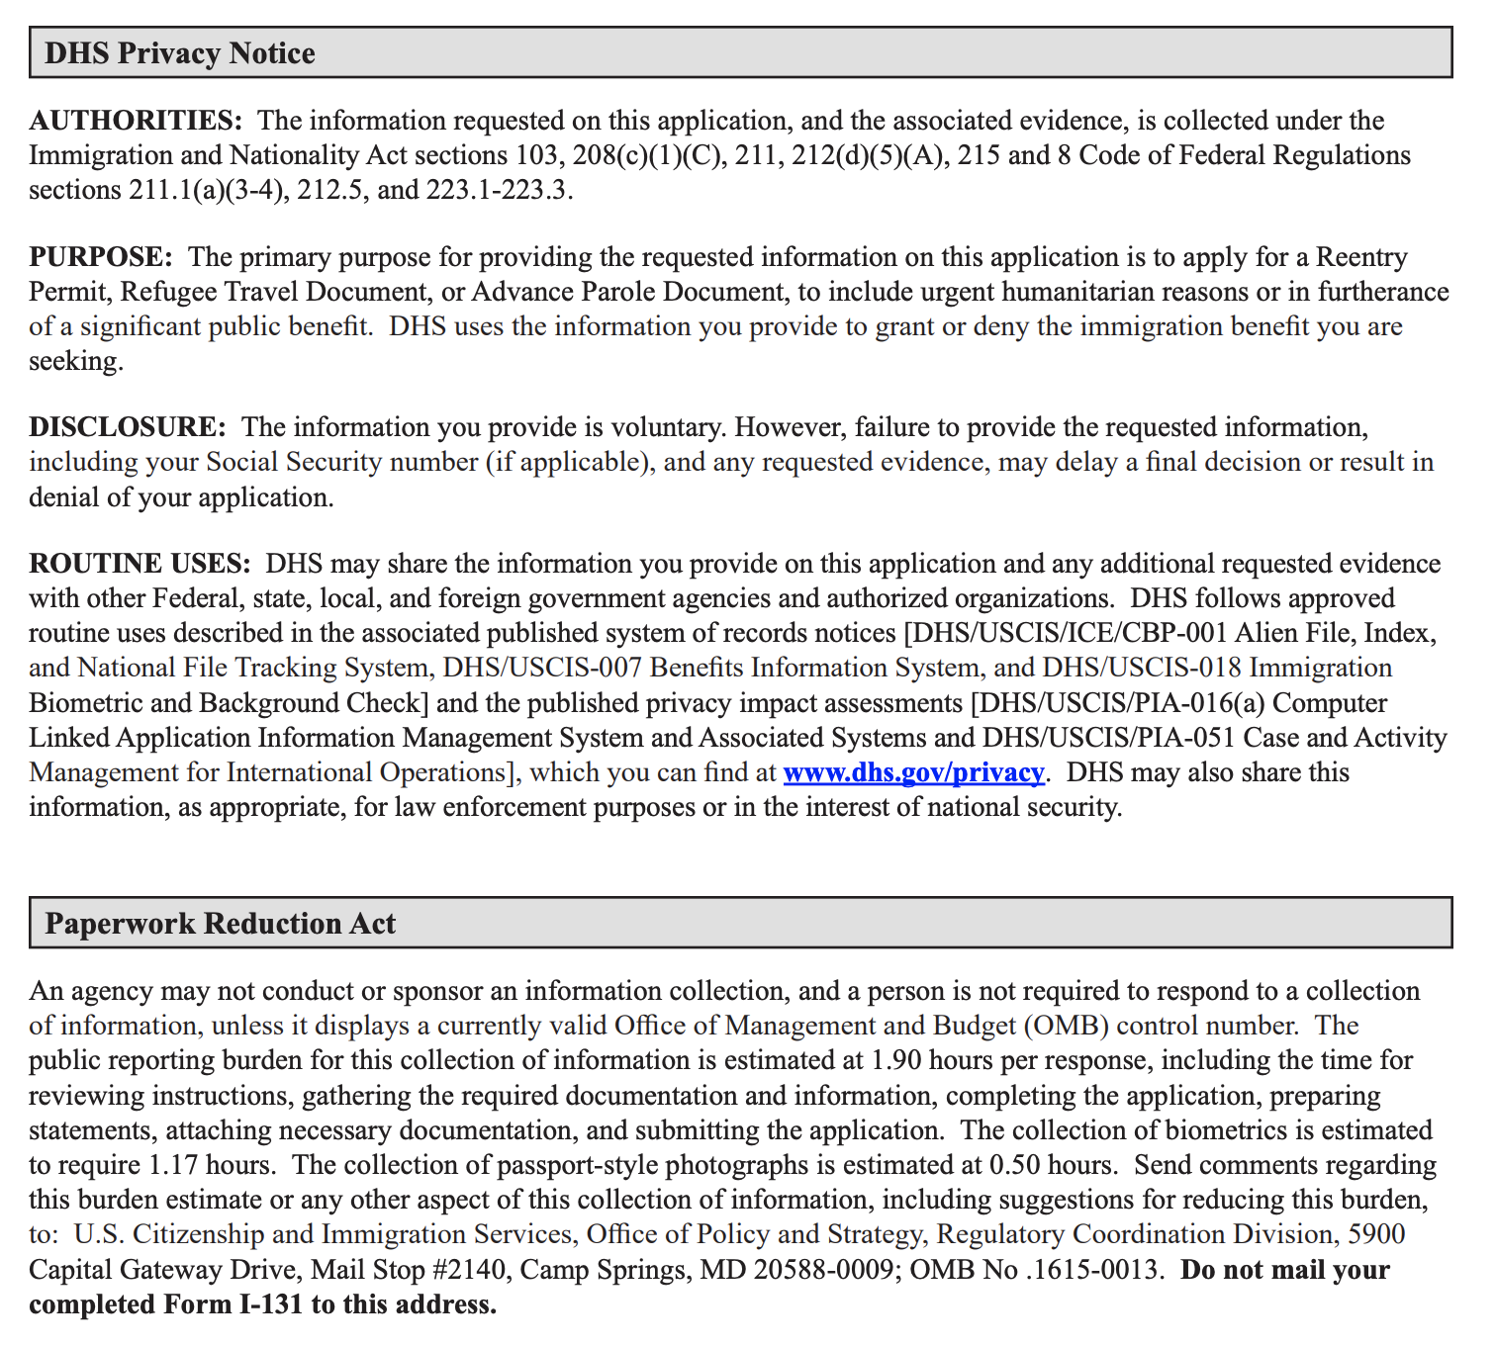

Slide 12
Getting Started

Slide 13
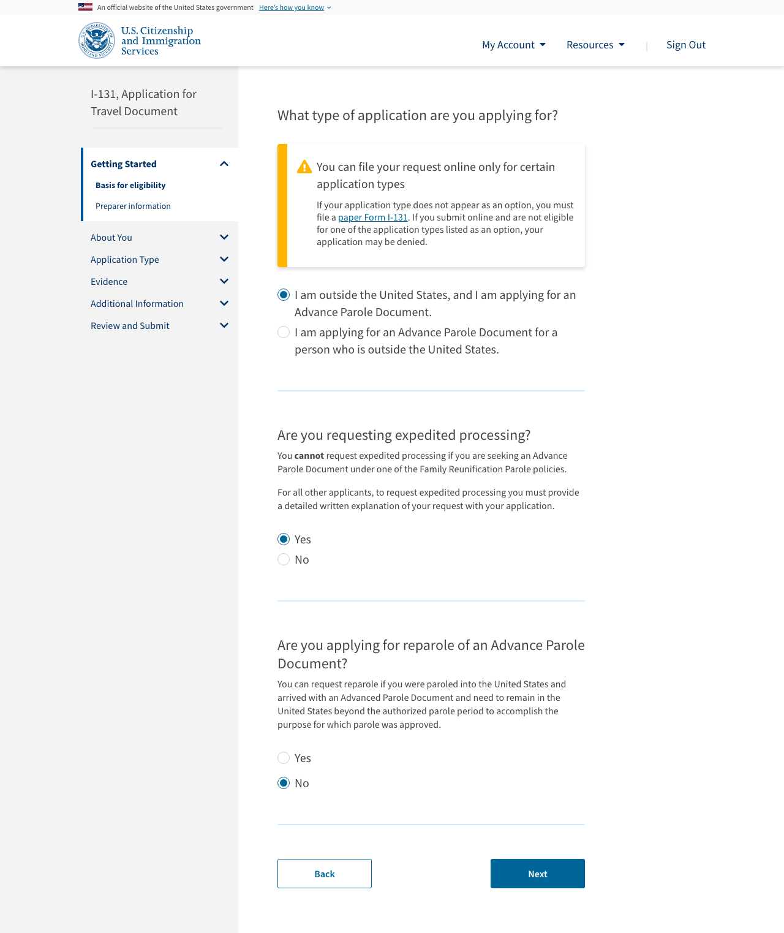

Slide 14
Questions catered for the online experience.

Slide 15
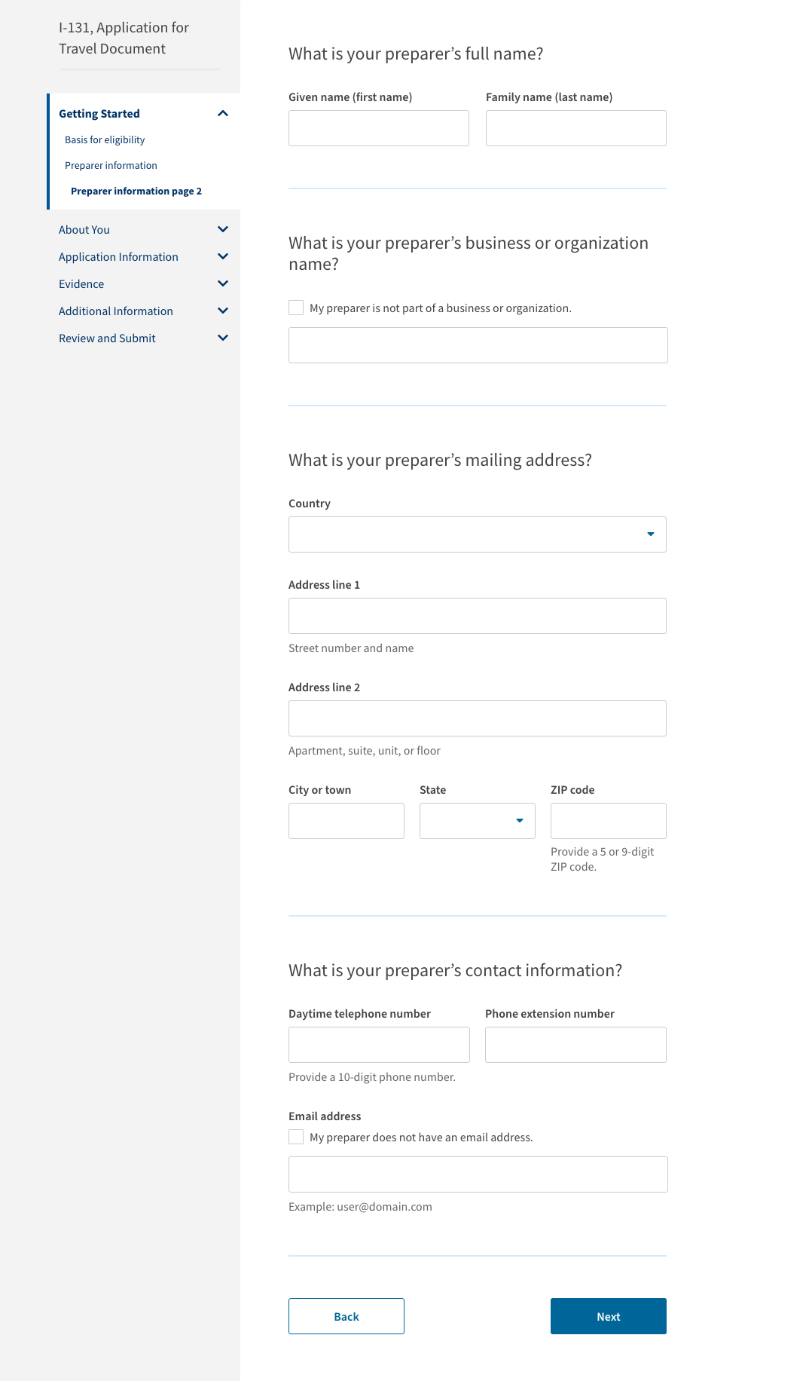
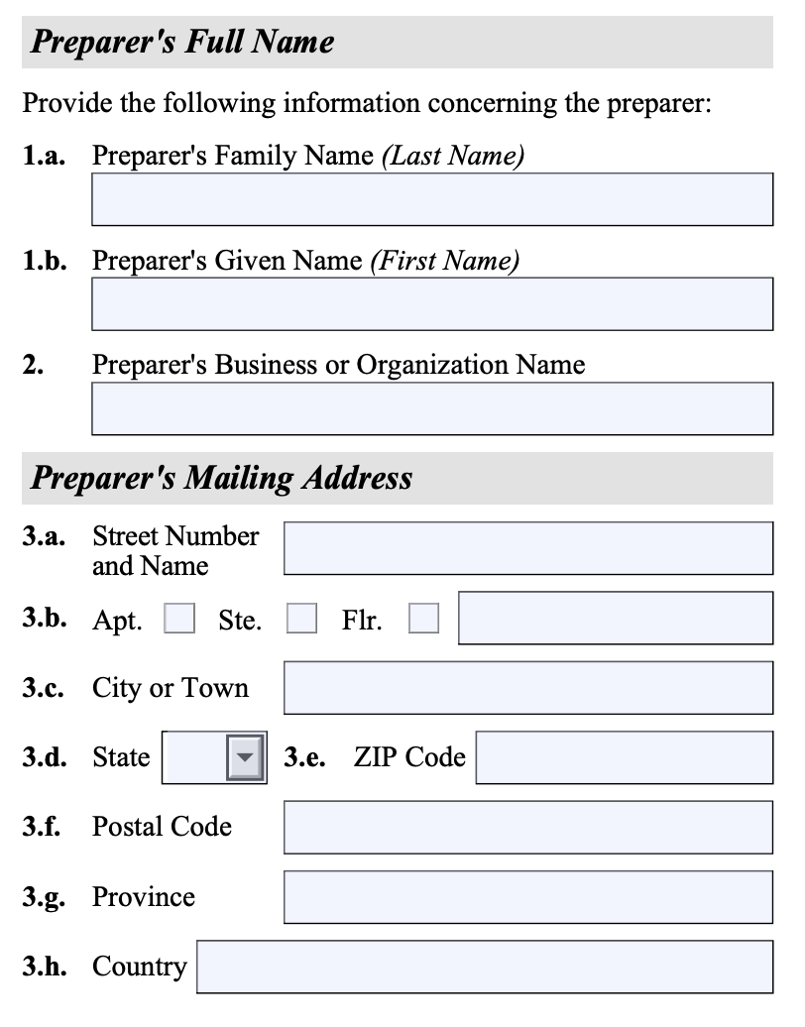
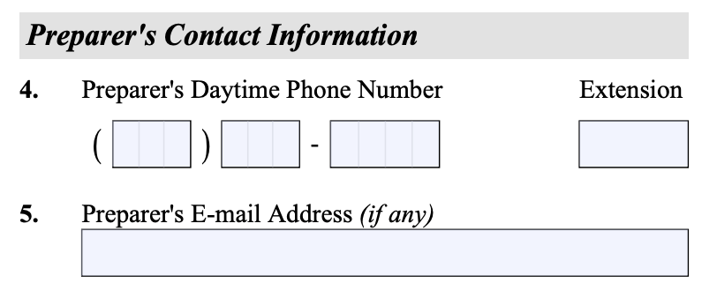

Slide 16
About You

Slide 17
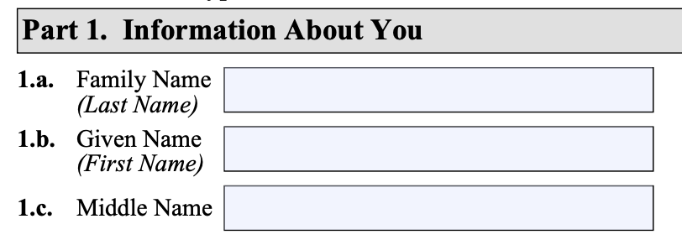

Slide 18
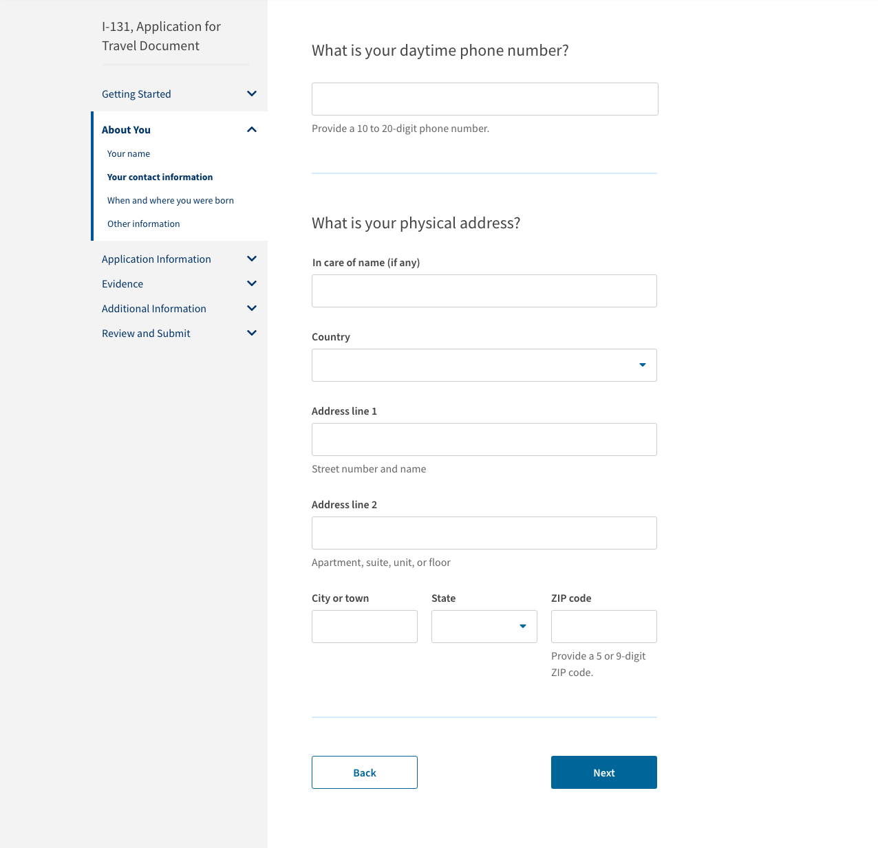
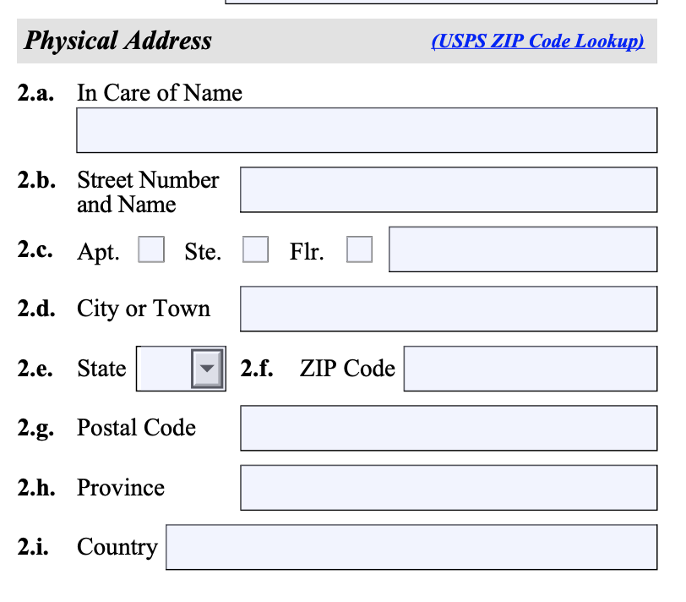

Slide 19
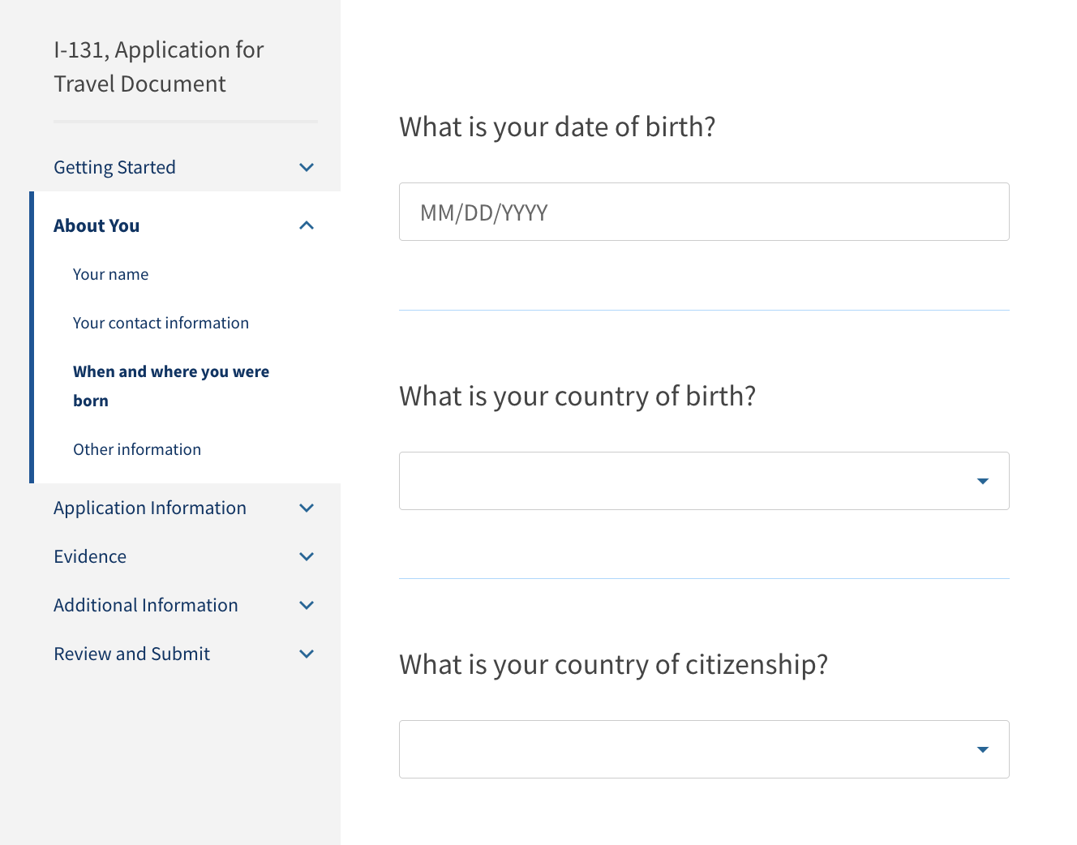

Slide 20
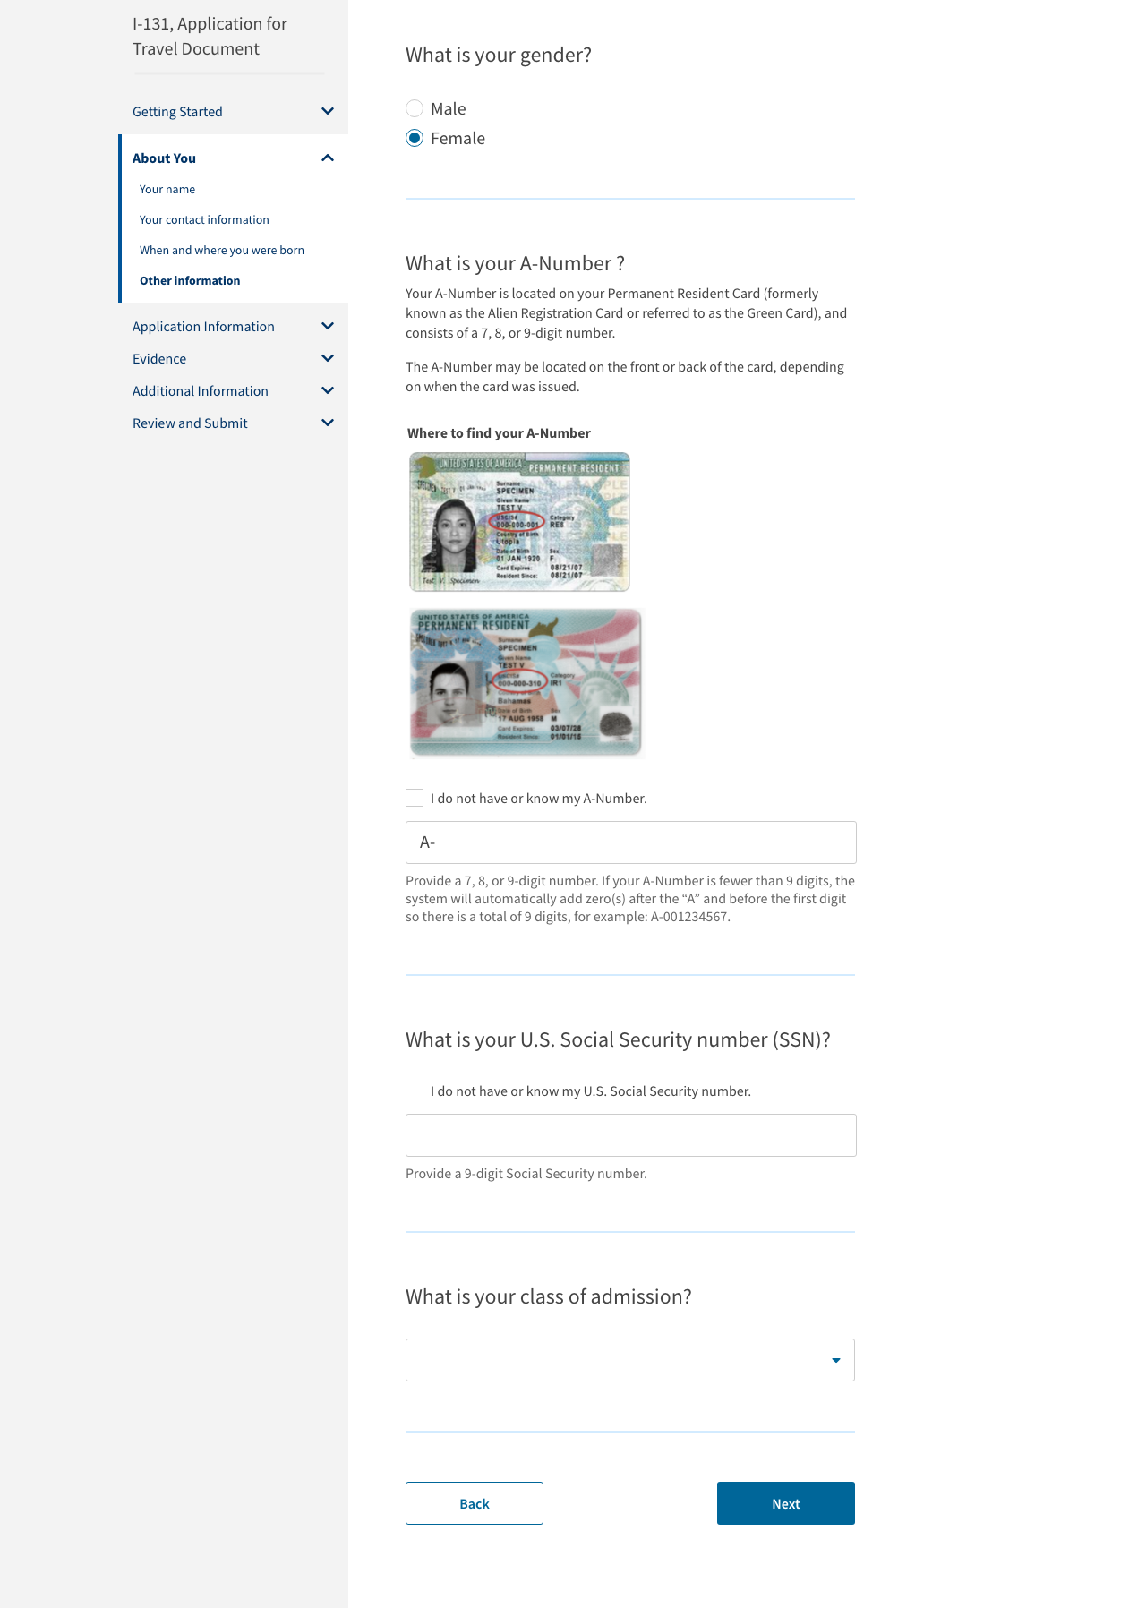

Slide 21
Application Information

Slide 22
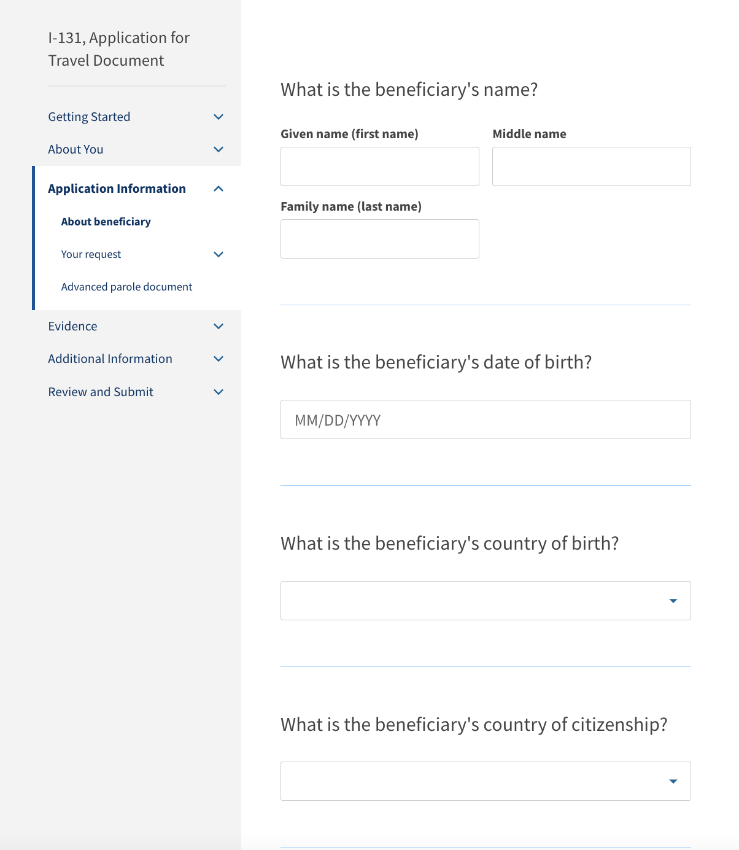
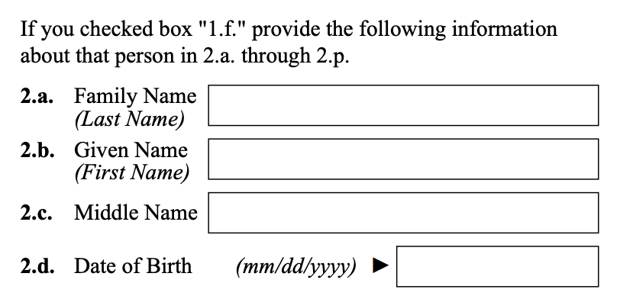

Slide 23
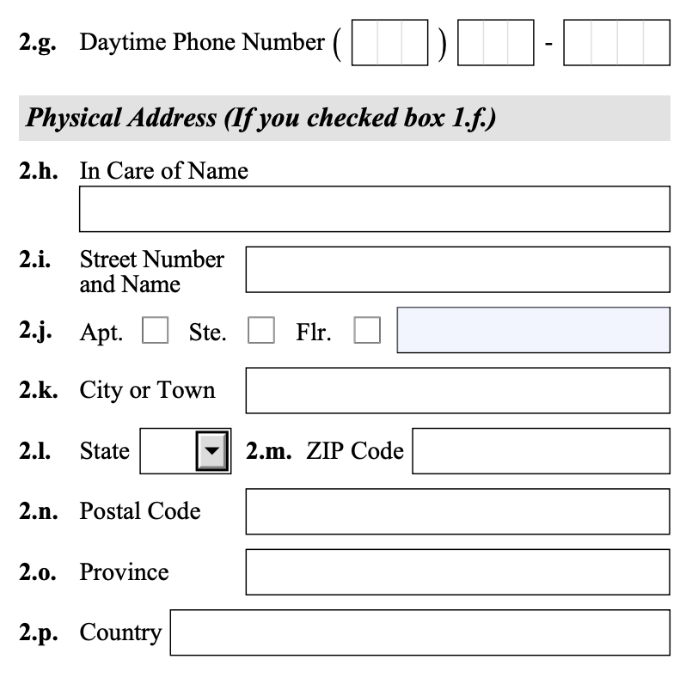

Slide 24
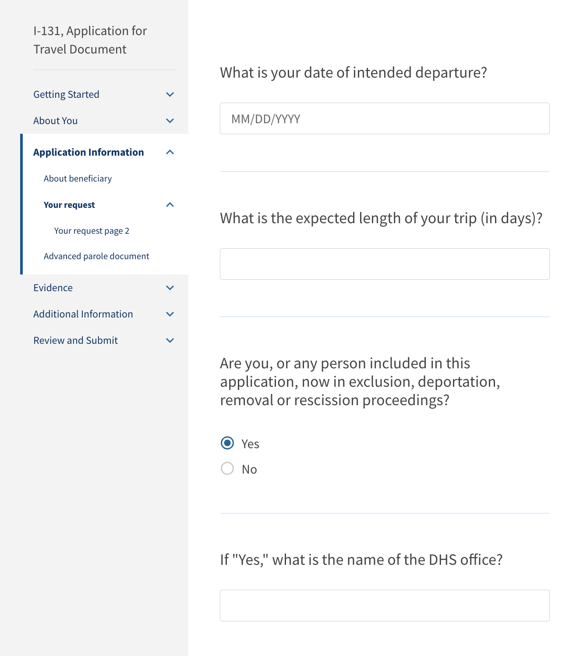
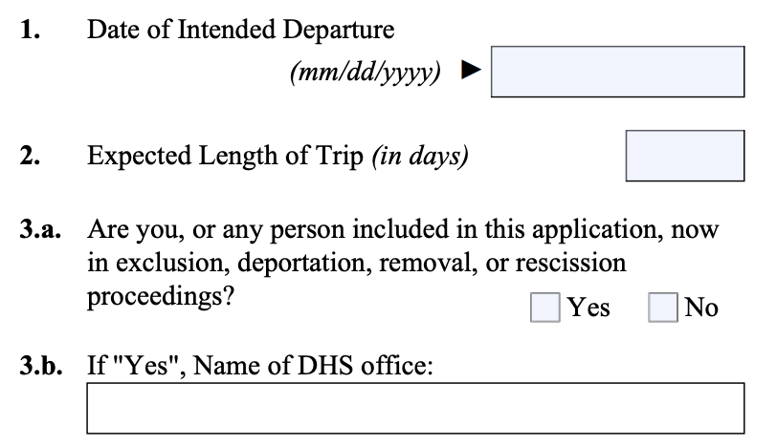

Slide 25
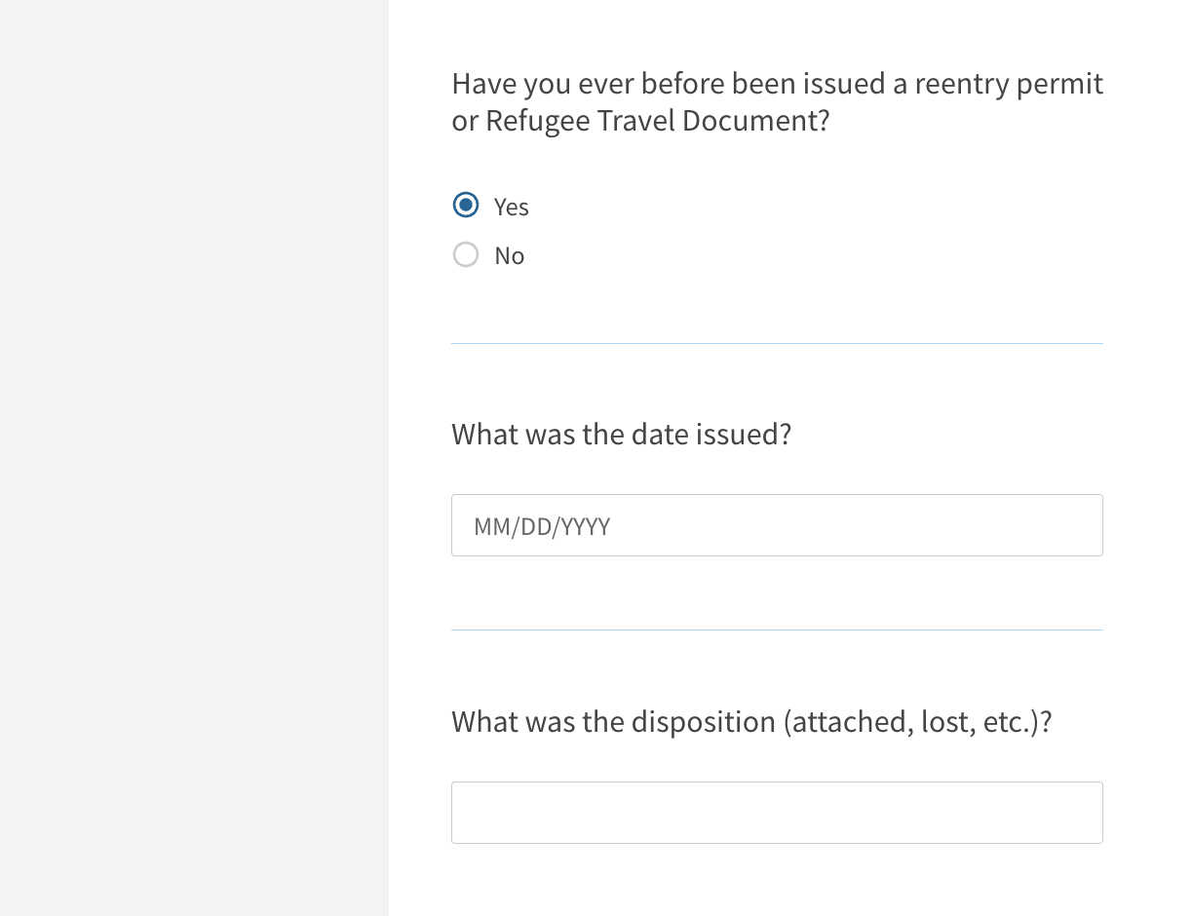
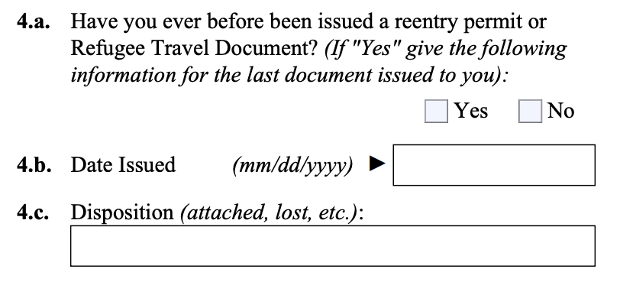

Slide 26
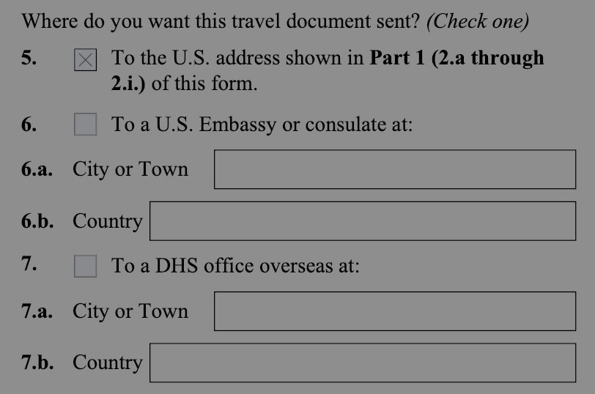

Slide 27
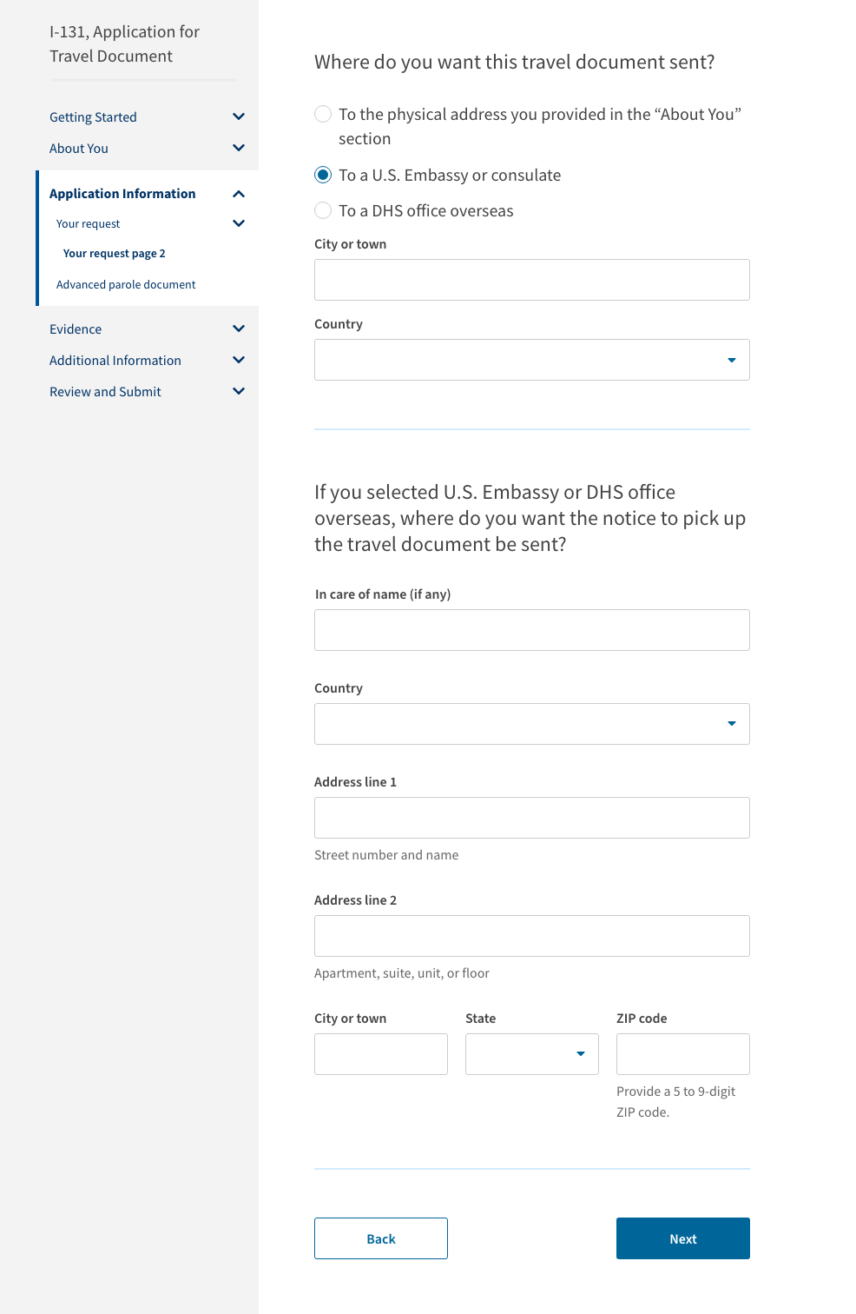
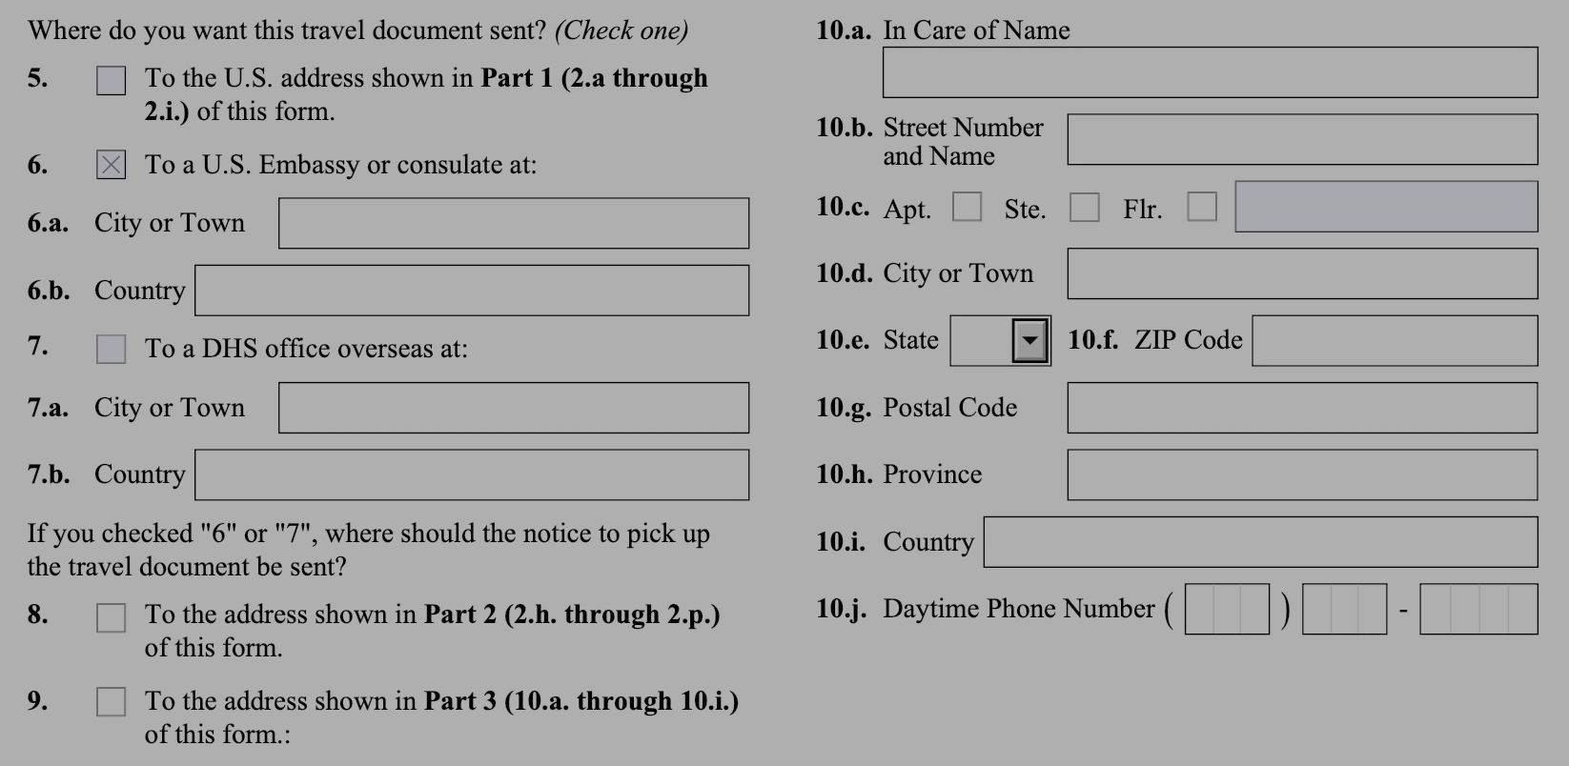
Conditional logic for: I am outside the United States, and I am applying for an Advance Parole Document.
Option to select Beneficiary's address DOES NOT show up.

Slide 28
Conditional logic for: I am outside the United States, and I am applying for an Advance Parole Document.
Option to select Beneficiary's address DOES NOT show up.

Slide 29
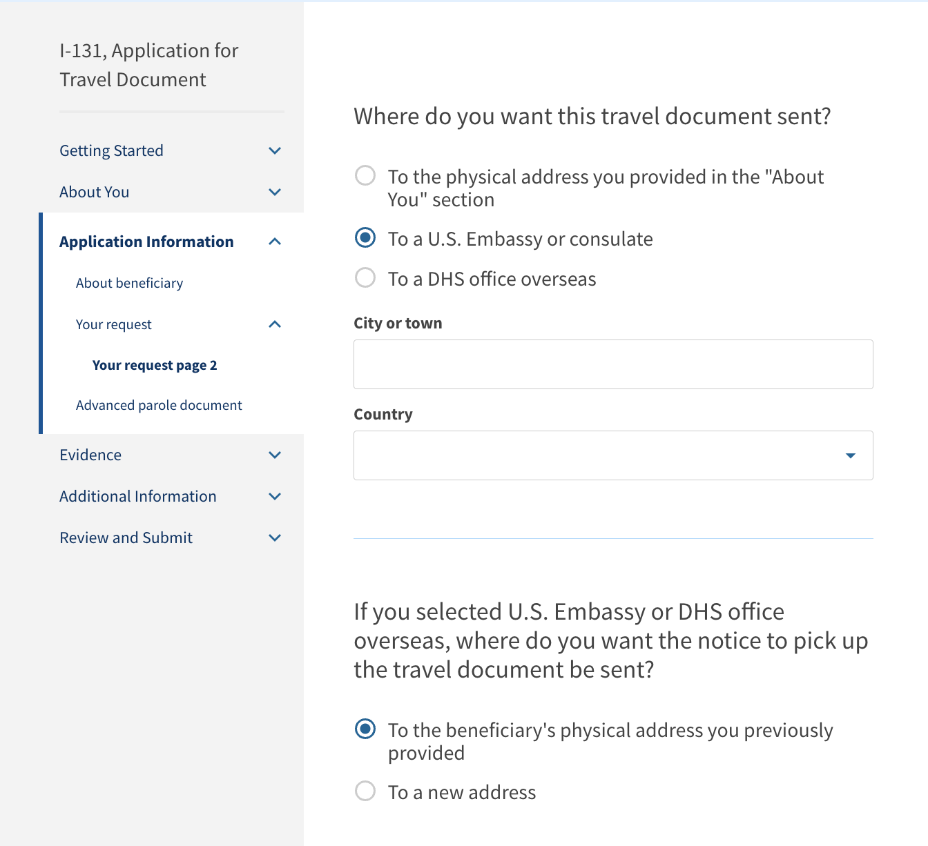
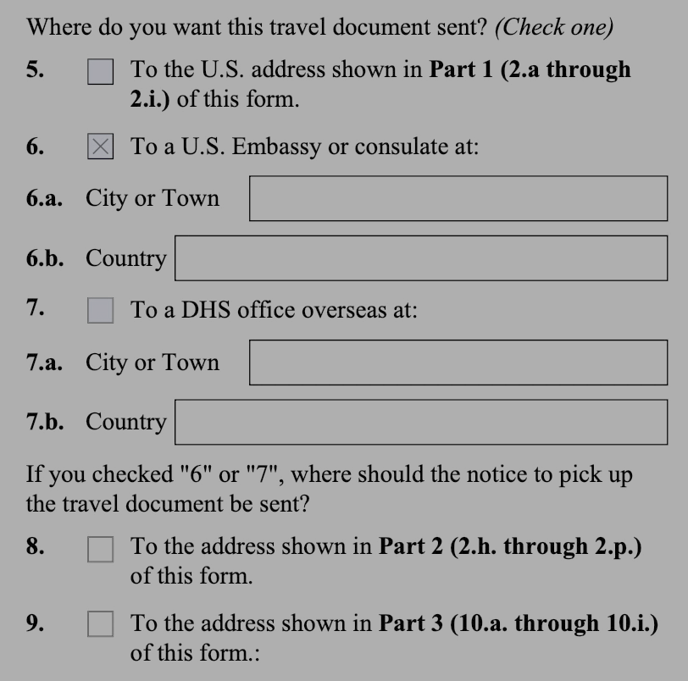
Conditional logic for: I am applying for an Advance Parole Document for a person who is outside the United States.
Option to select Beneficiary's address WILL show up.

Slide 30
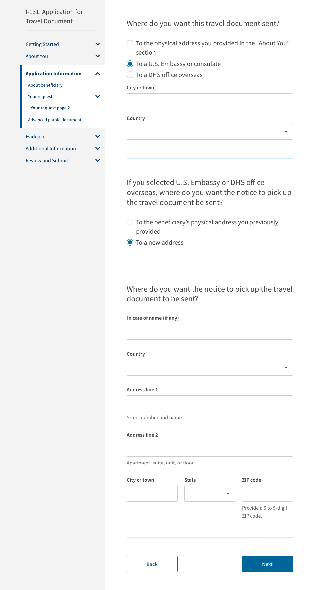
Conditional logic for: I am applying for an Advance Parole Document for a person who is outside the United States.
Option to select Beneficiary's address WILL show up.

Slide 31
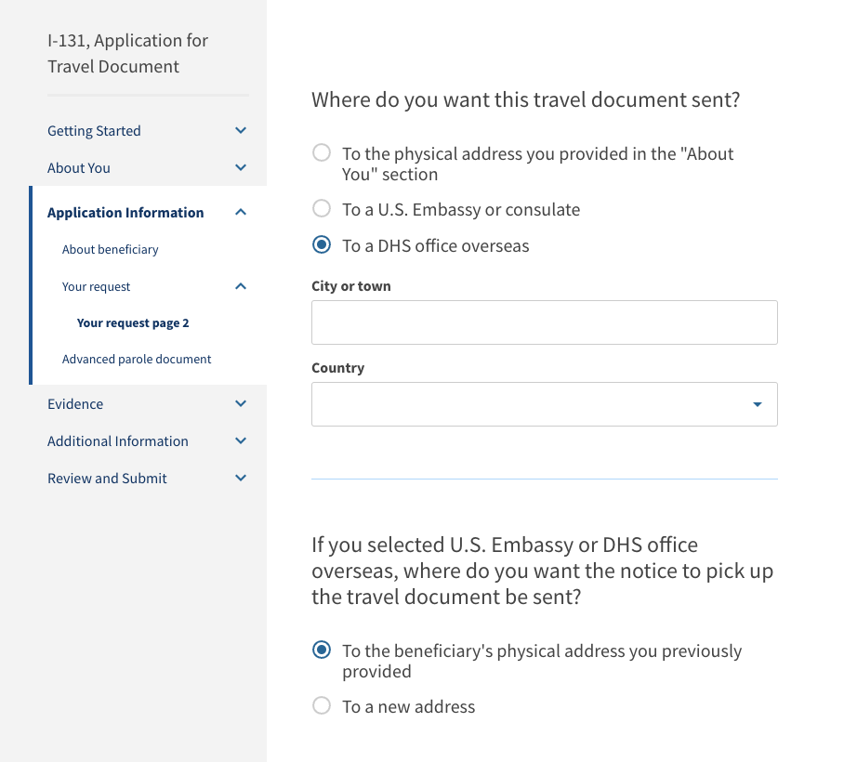
Conditional logic for: I am applying for an Advance Parole Document for a person who is outside the United States.
Option to select Beneficiary's address WILL show up.

Slide 32
Conditional logic for: I am applying for an Advance Parole Document for a person who is outside the United States.
Option to select Beneficiary's address WILL show up.

Slide 33
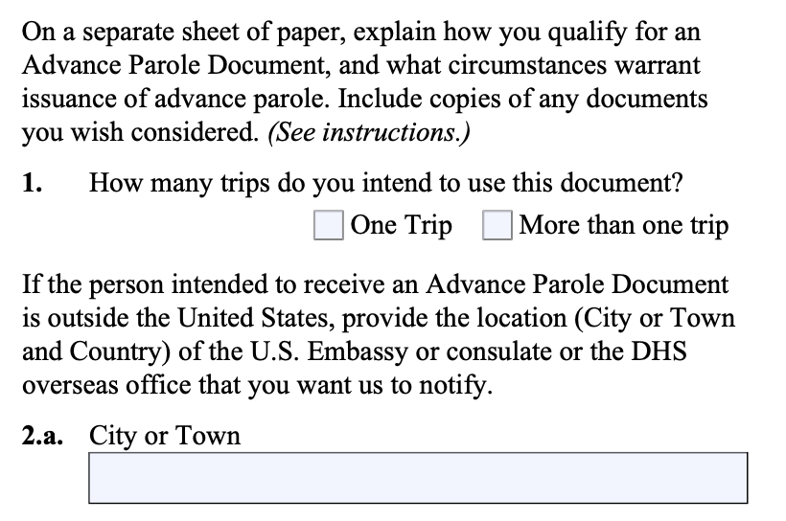

Slide 34
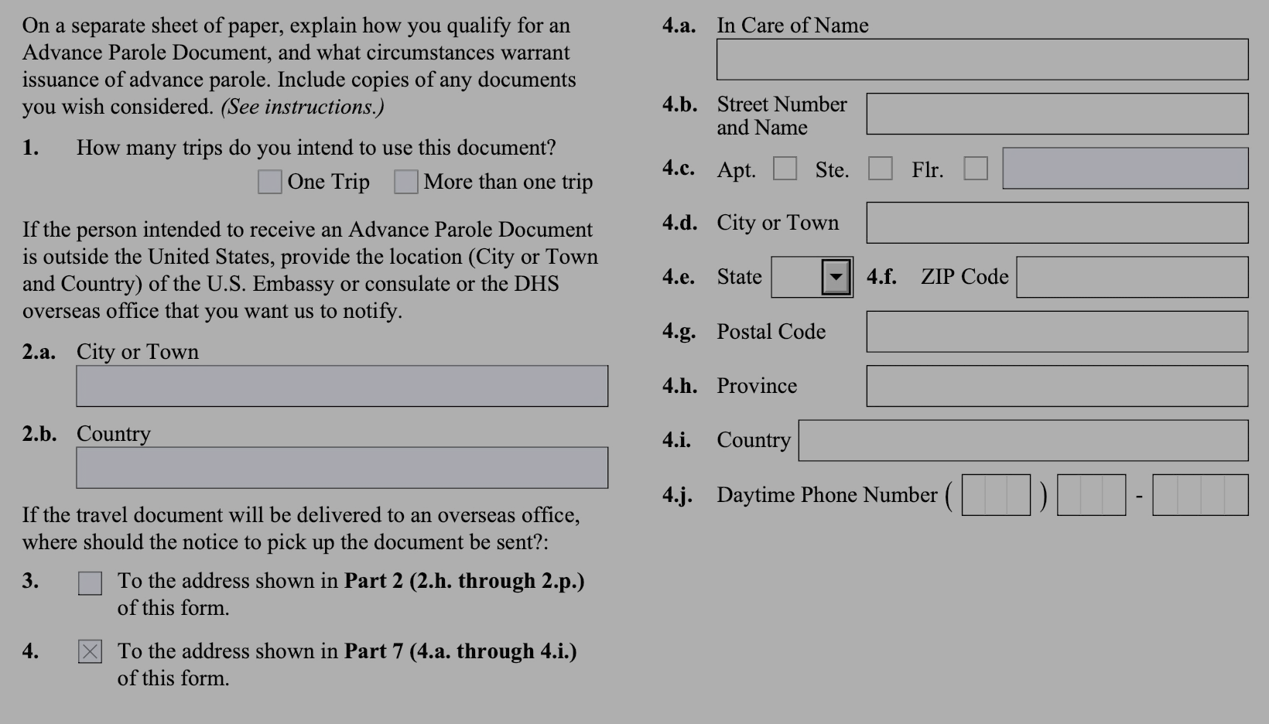
Conditional logic for: I am outside the United States, and I am applying for an Advance Parole Document.
Option to select Beneficiary's address DOES NOT show up.

Slide 35
Conditional logic for: I am applying for an Advance Parole Document for a person who is outside the United States.
Option to select Beneficiary's address WILL show up.

Slide 36
Conditional logic for: I am applying for an Advance Parole Document for a person who is outside the United States.
Option to select Beneficiary's address WILL show up.

Slide 37
Evidence

Slide 38
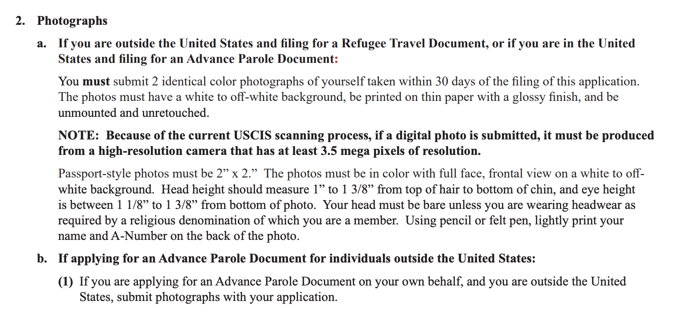

Slide 39
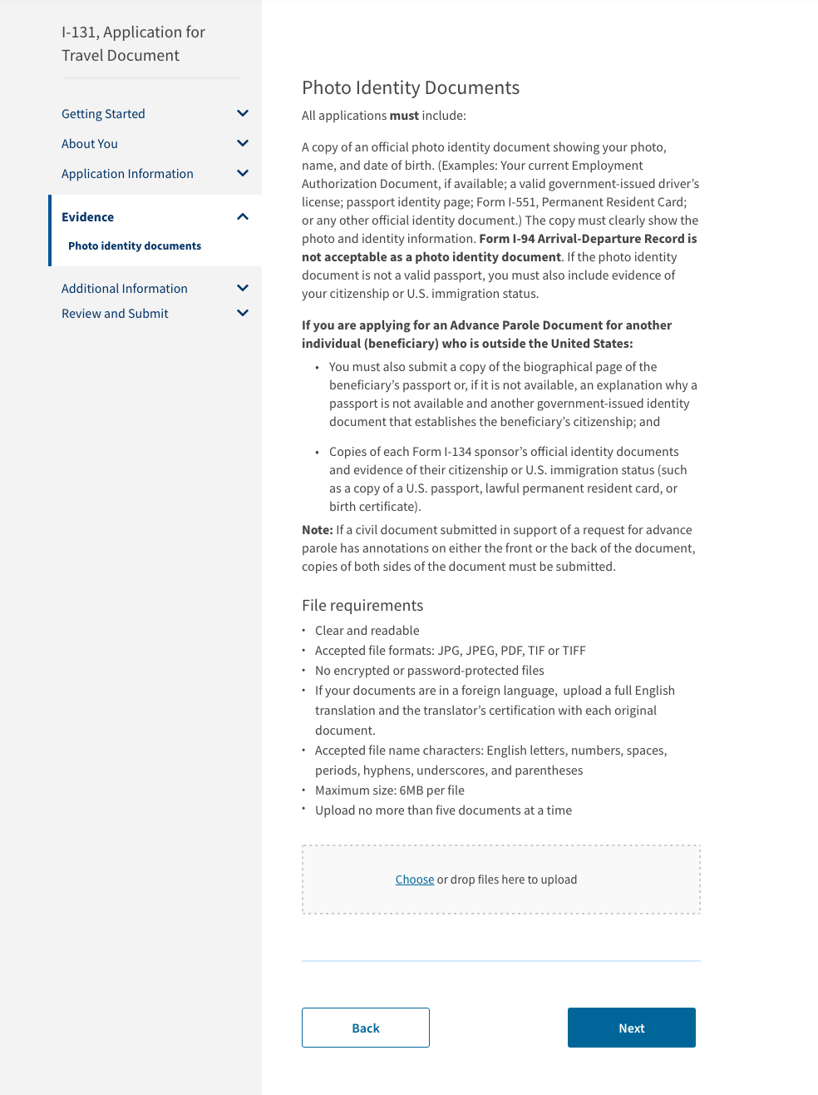

Slide 40
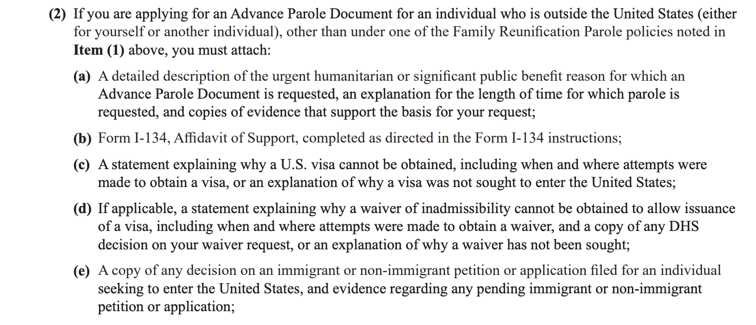

Slide 41
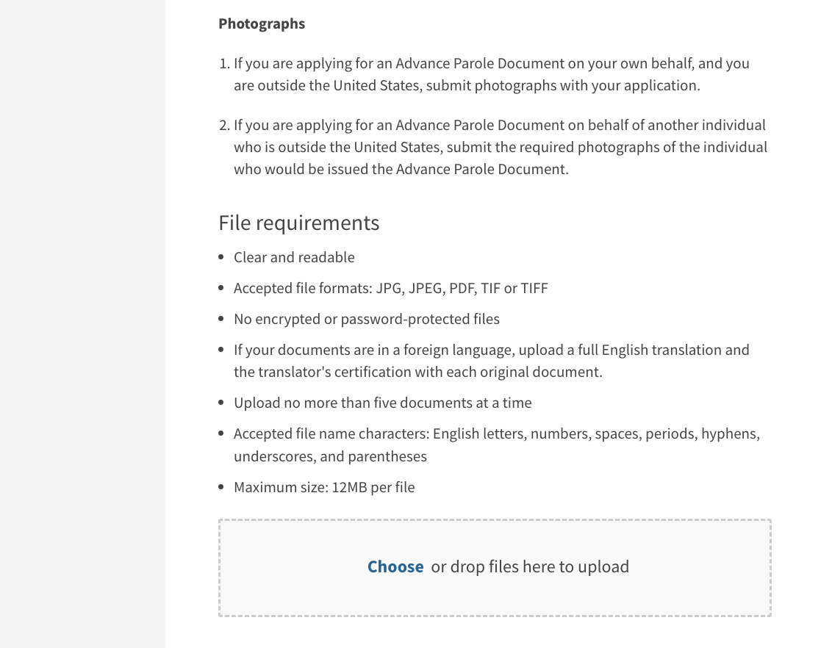

Slide 43
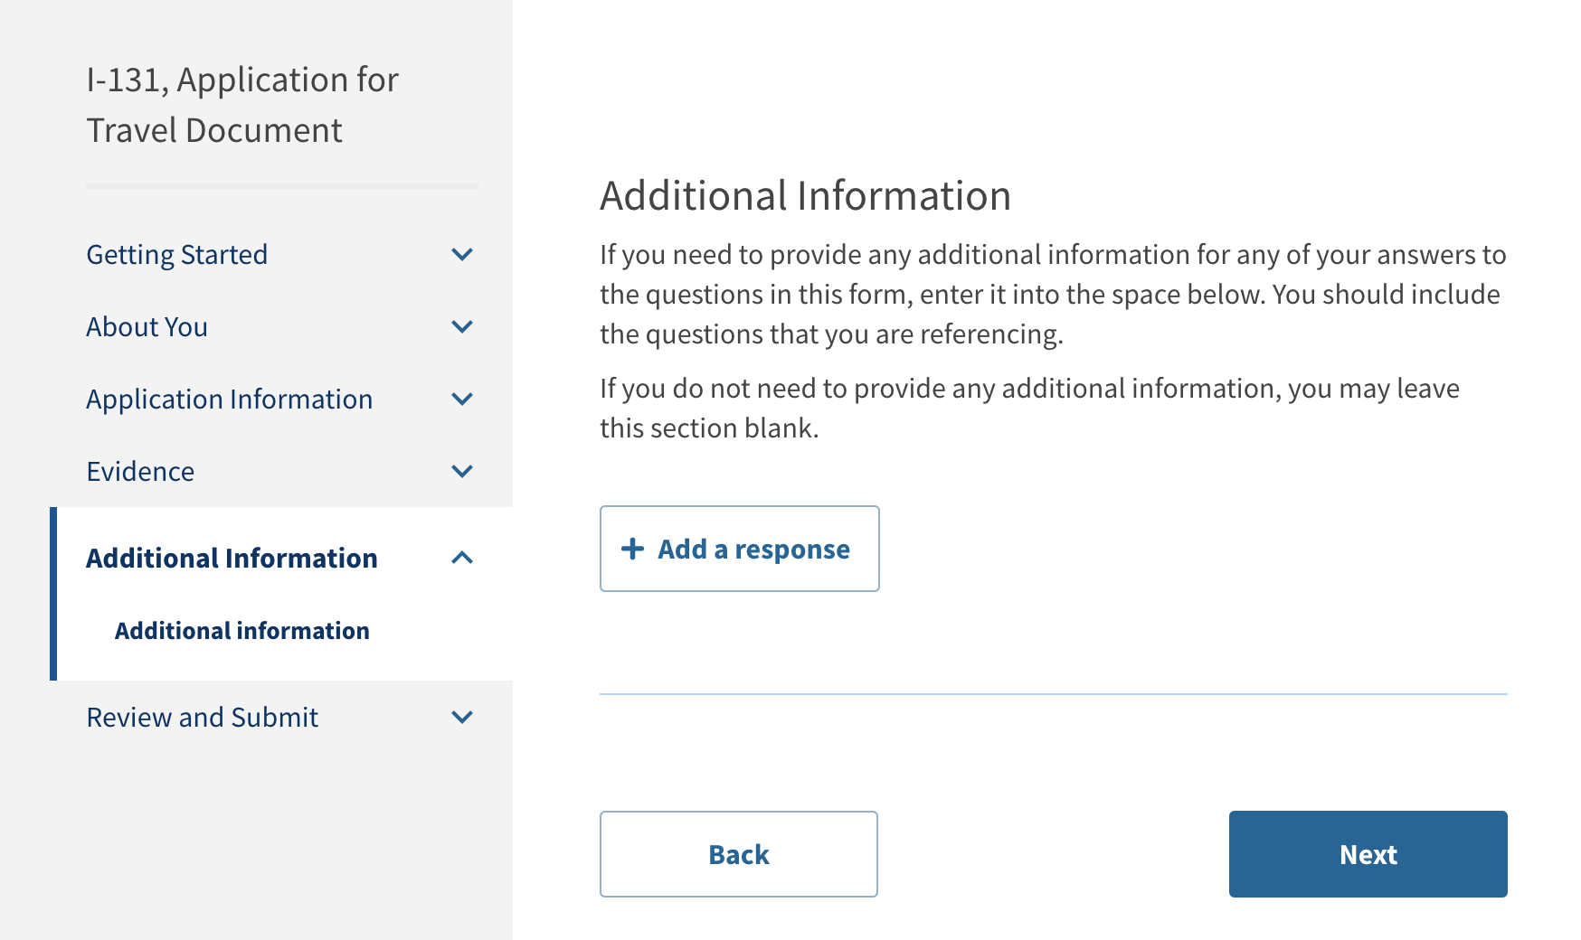

Slide 44
Review and Submit

Slide 45
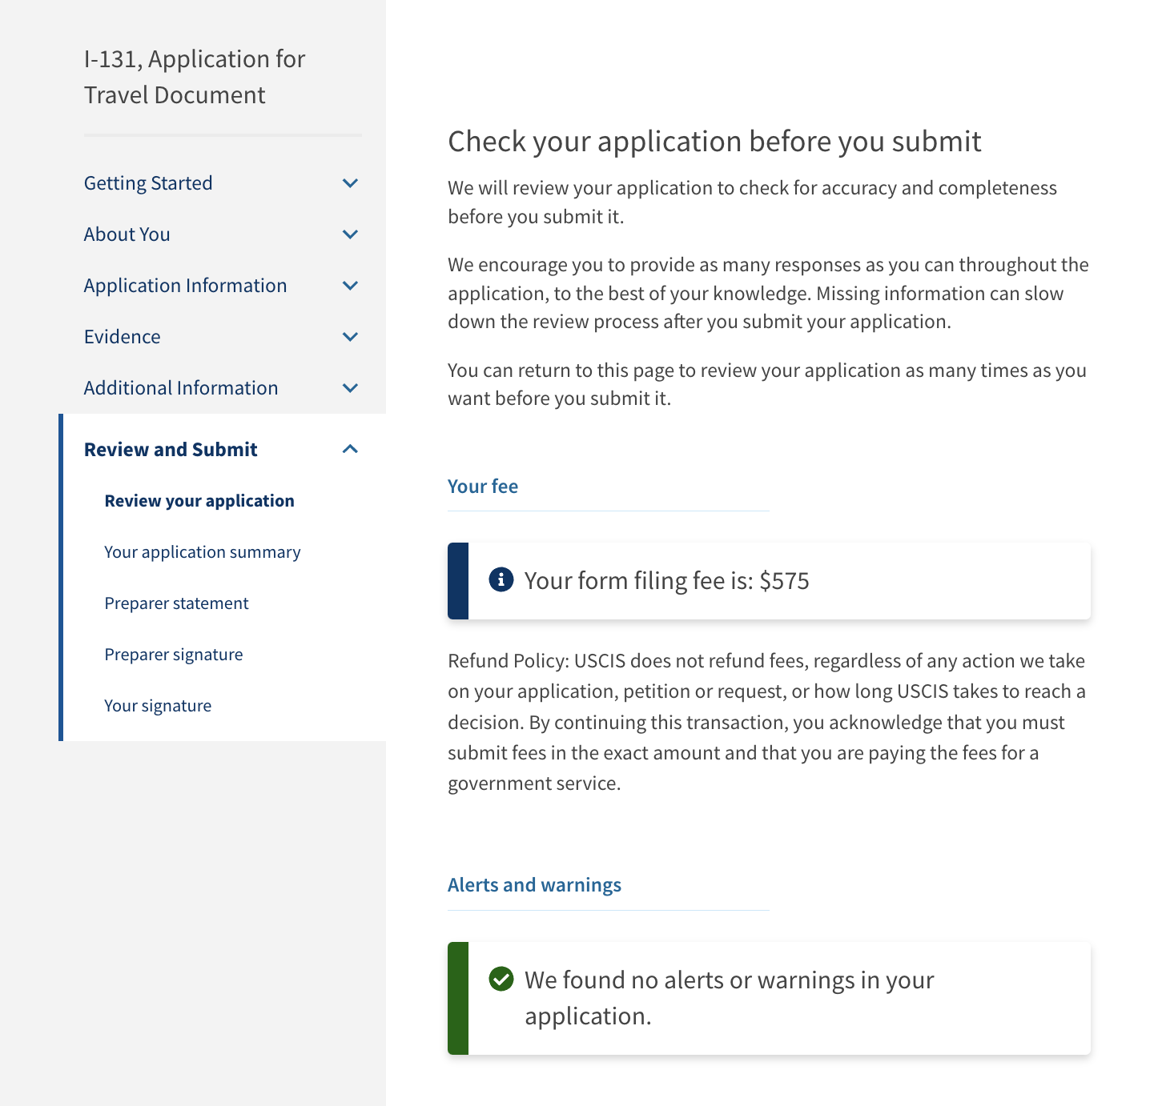

Slide 46
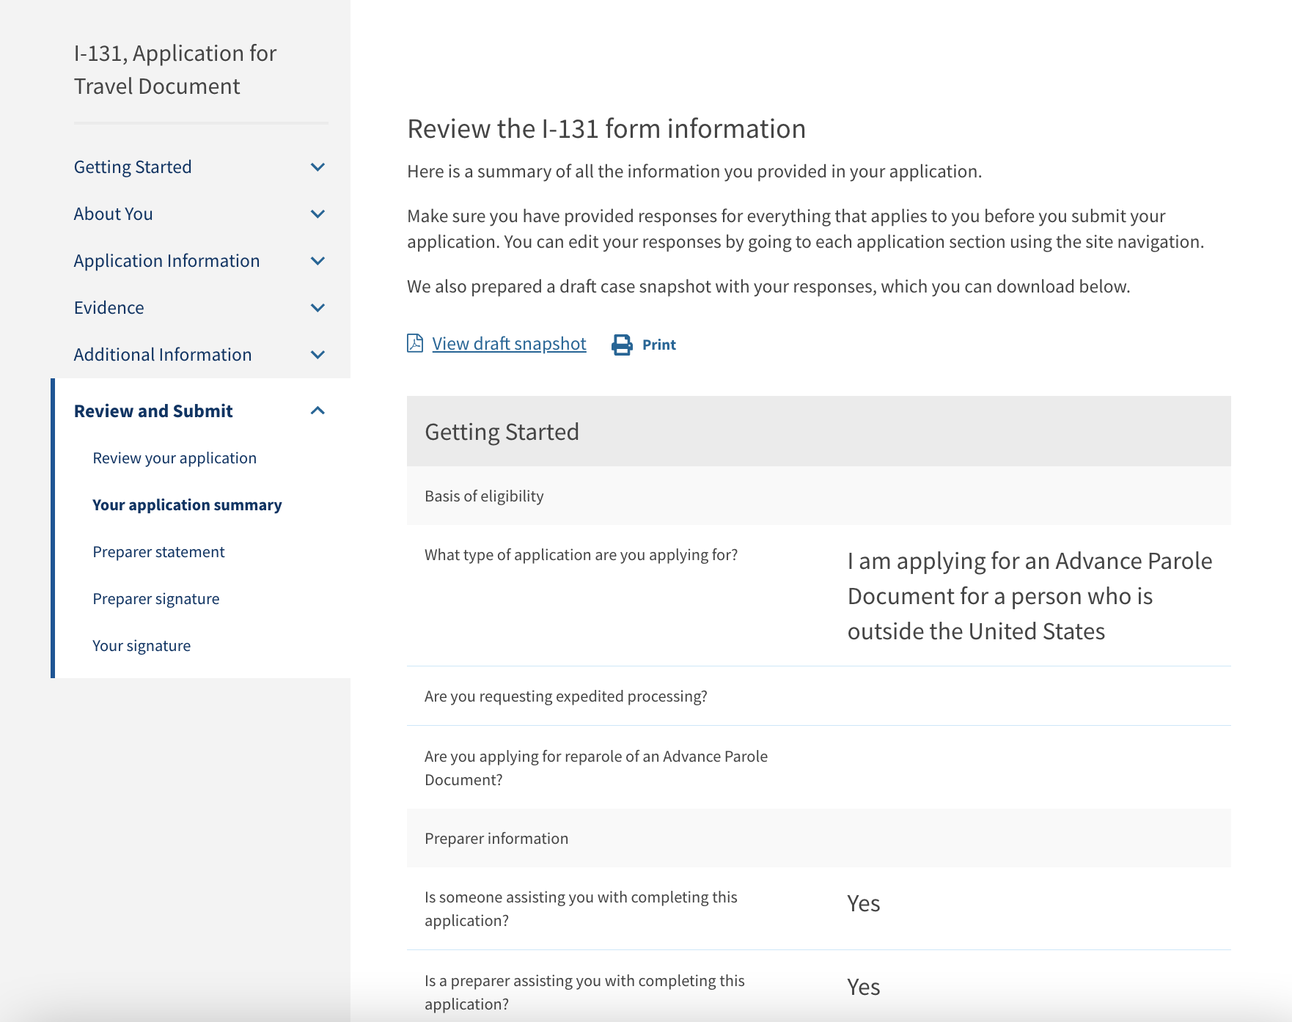
This page is only applicable for the online experience.

Slide 47
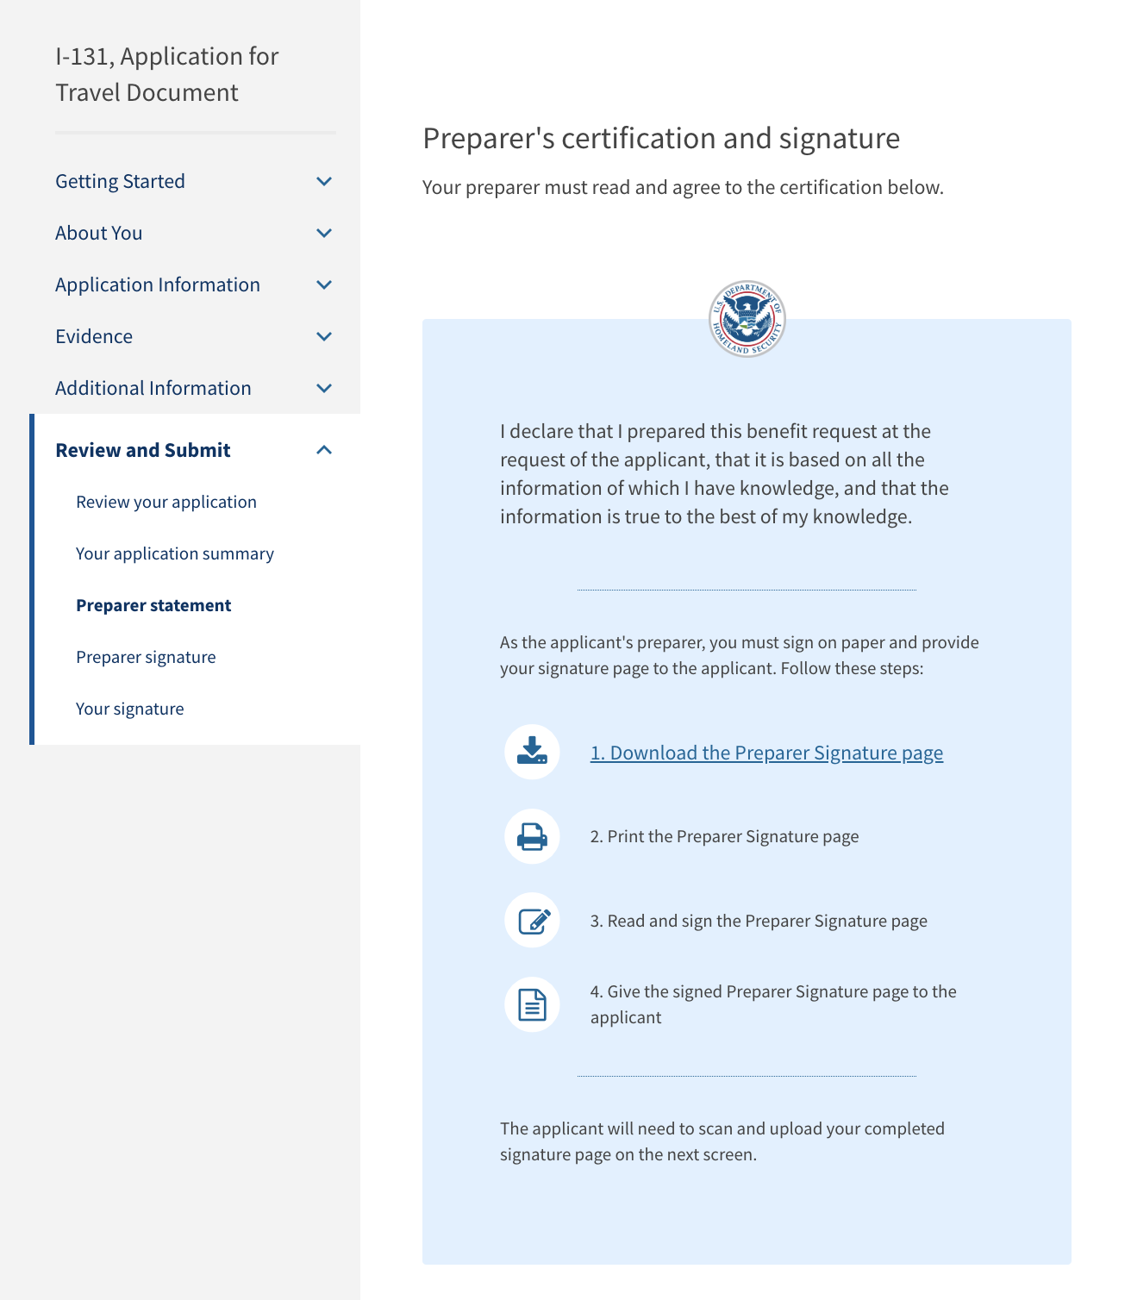
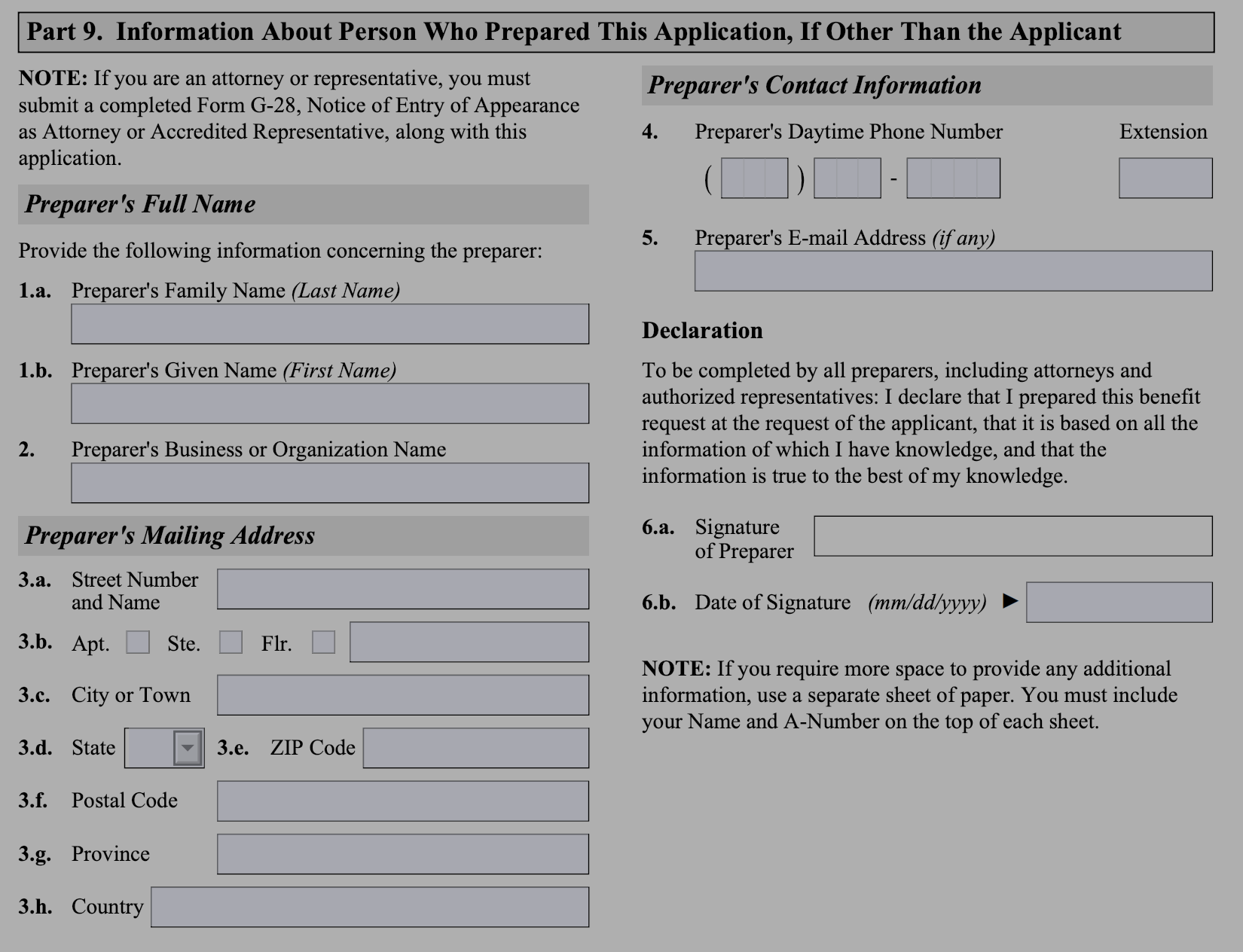

Slide 48
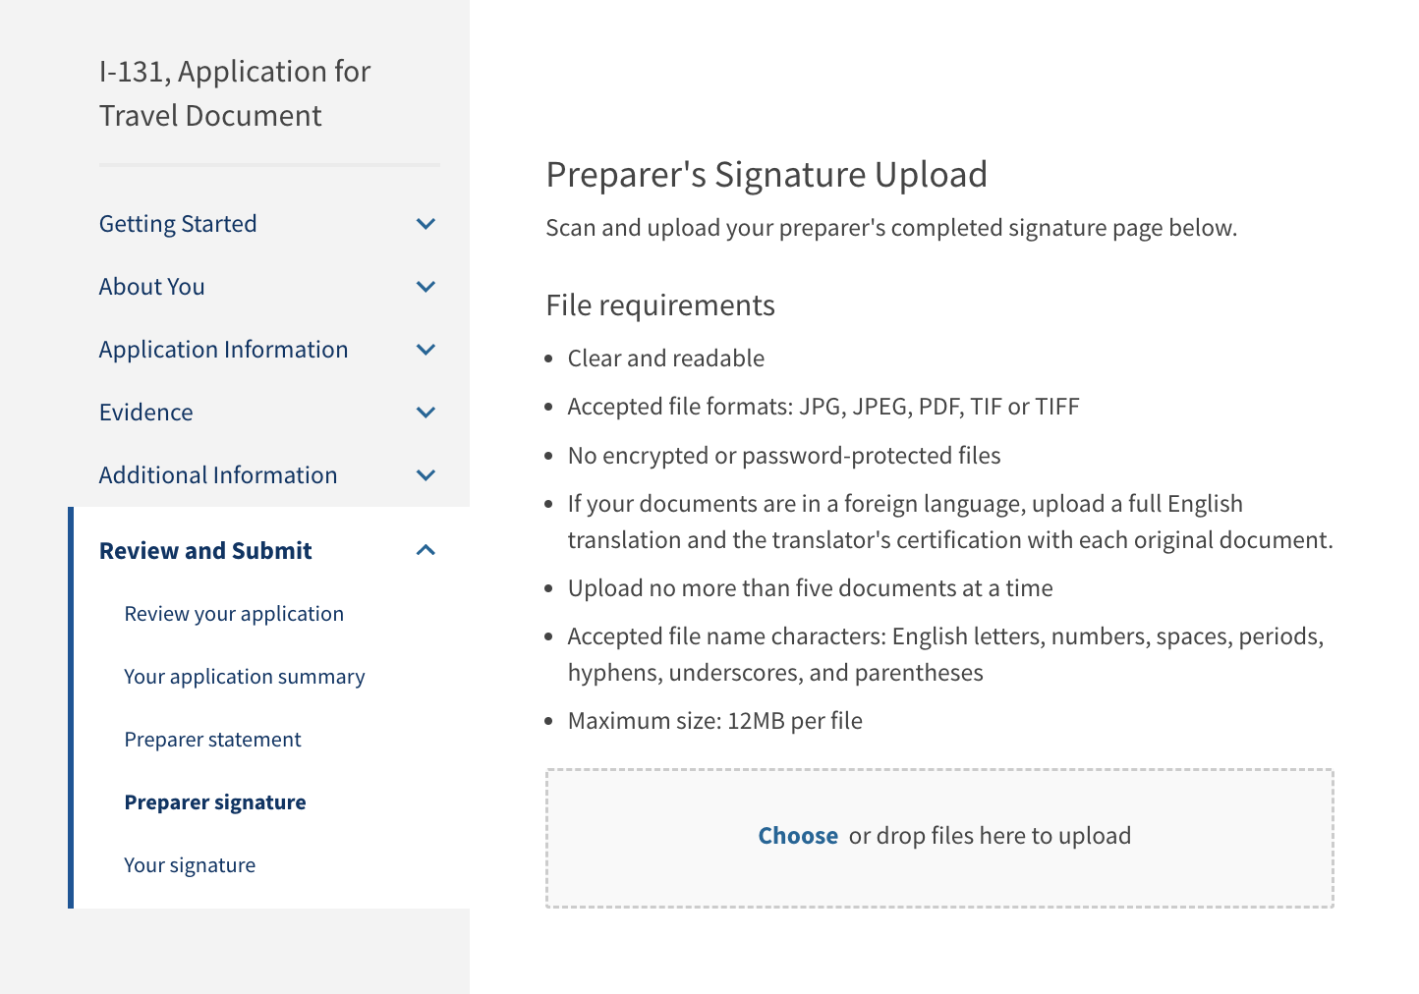
This page is only applicable for the online experience.

Slide 49
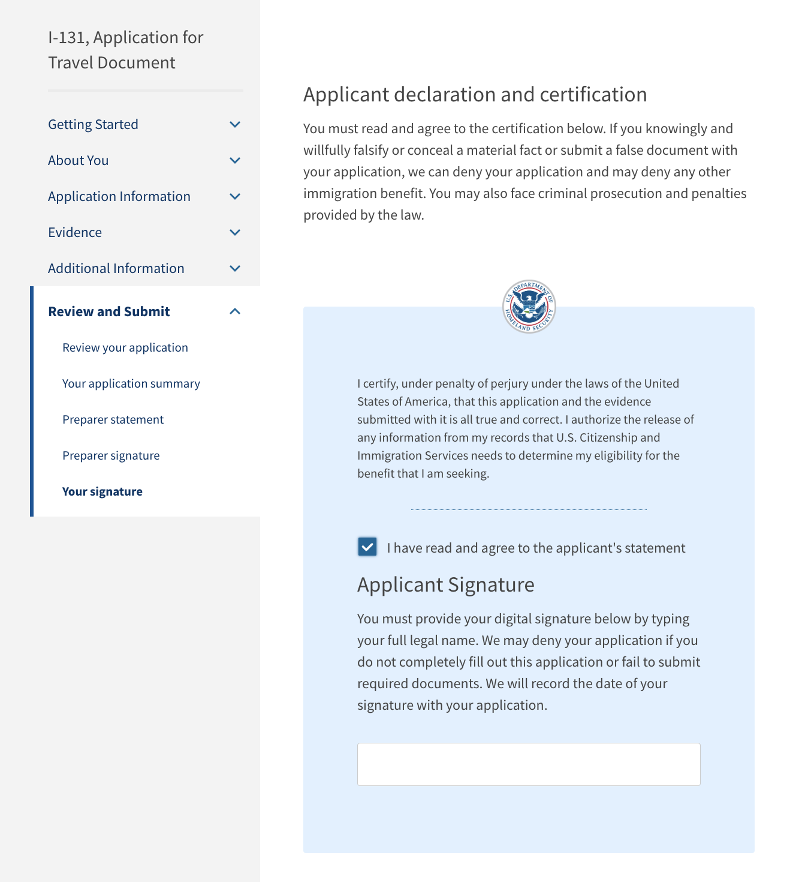

Slide 50
This page is only applicable for the online experience.

