Slide 1
Lead User Guide:
Abatement Notifications
Updated 01/05/2018
Notes:
Welcome to the online tutorial for the Lead program’s Abatement Notifications application. This tutorial will walk you through the process of completing and submitting an Abatement Notification to EPA through the Central Data Exchange (CDX).

Slide 2
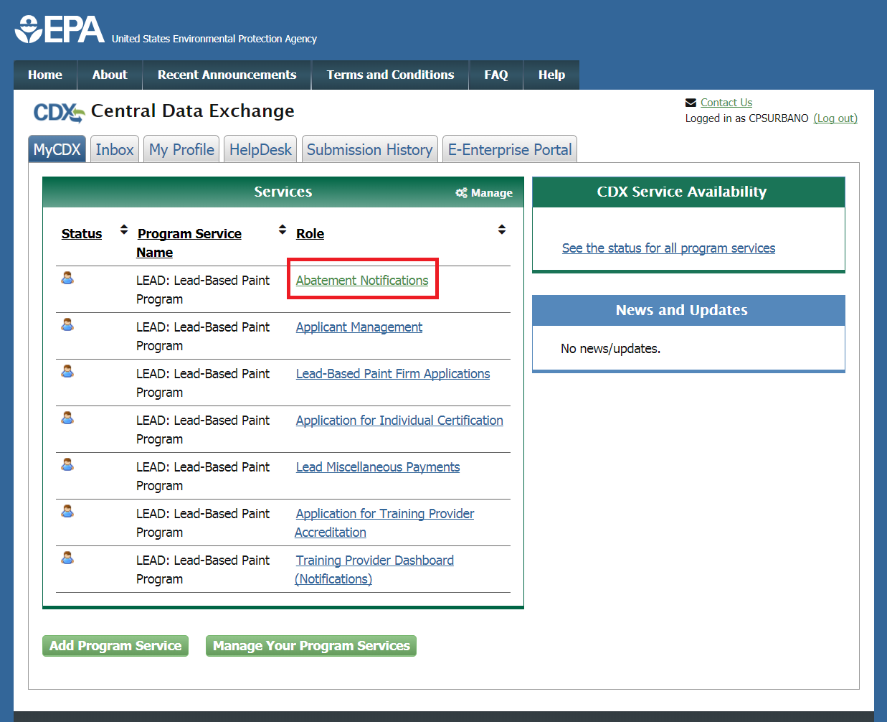
Abatement Notifications Role
Notes:
To access the Abatement Notifications application, click on the “Abatement Notifications” link on the MyCDX page after logging in with your CDX user name and password.

Slide 3
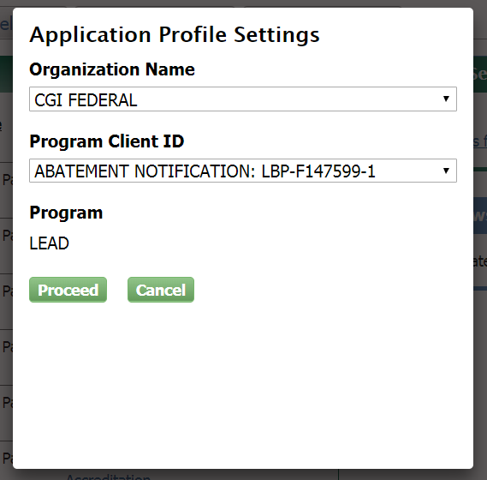
Abatement Notifications Role
Notes:
If you have multiple abatement certifications linked to your account, you will be prompted to select which certification you would like to submit notifications for. Otherwise, you will be directly navigated to the Abatement Notifications home page.

Slide 4
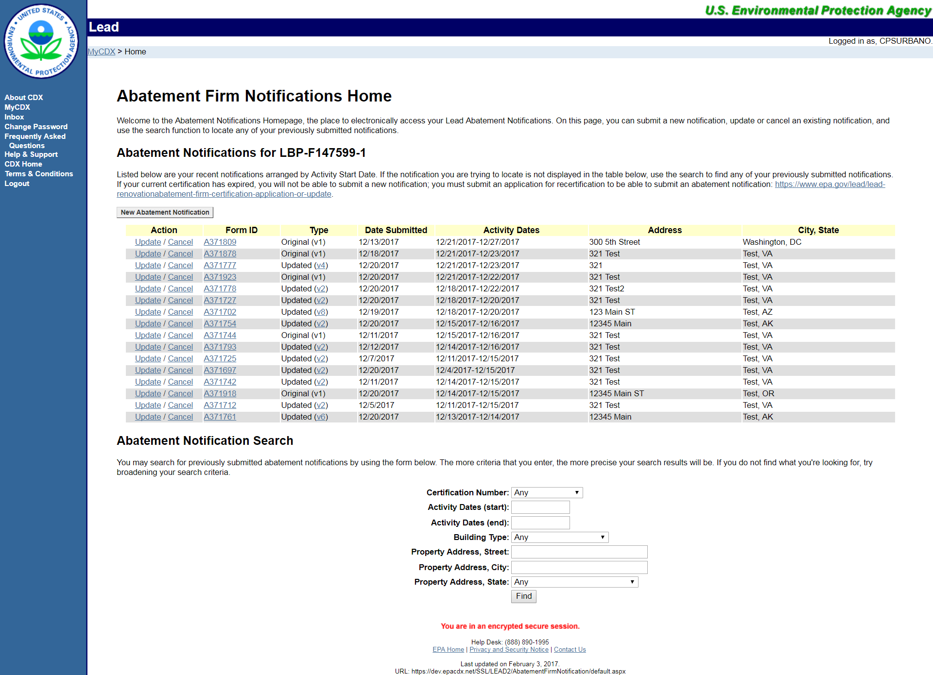
Abatement Notifications Home Page
Notes:
This is the Abatement Notifications home page. On this page, you can view your recent notifications, arranged by activity start date, and update or cancel any of these listed notifications. You can also submit a new abatement notification by clicking “New Abatement Notification.” Toward the bottom of the home page, there is an Abatement Notification search that you can use to locate any of your previously submitted notifications.

Slide 5
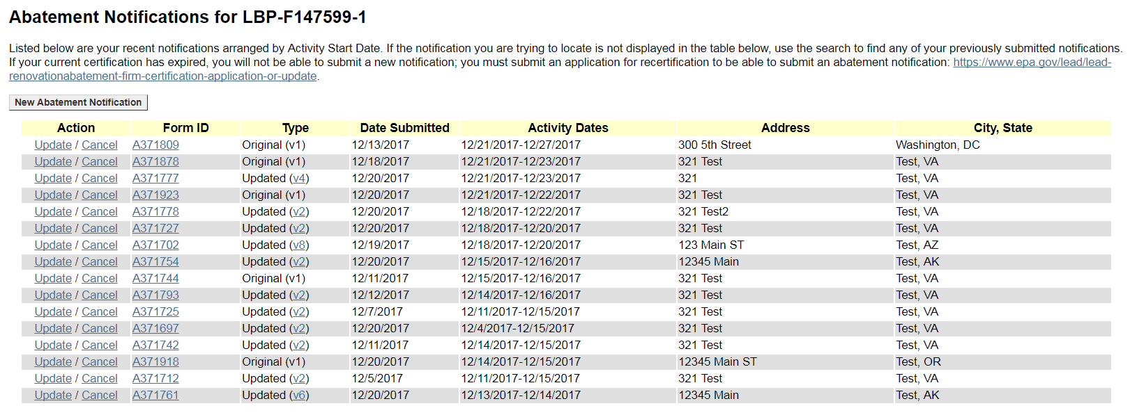
Abatement Notifications Table
Notes:
The Abatement Notifications table displays your recent notifications, arranged by activity start date. You can update or cancel any notification listed on this table. Cancelled notifications will not appear on this table, and will have to be accessed through the abatement notification search. Any other submitted notifications that do not appear on this table can also be accessed through the abatement notification search.

Slide 6
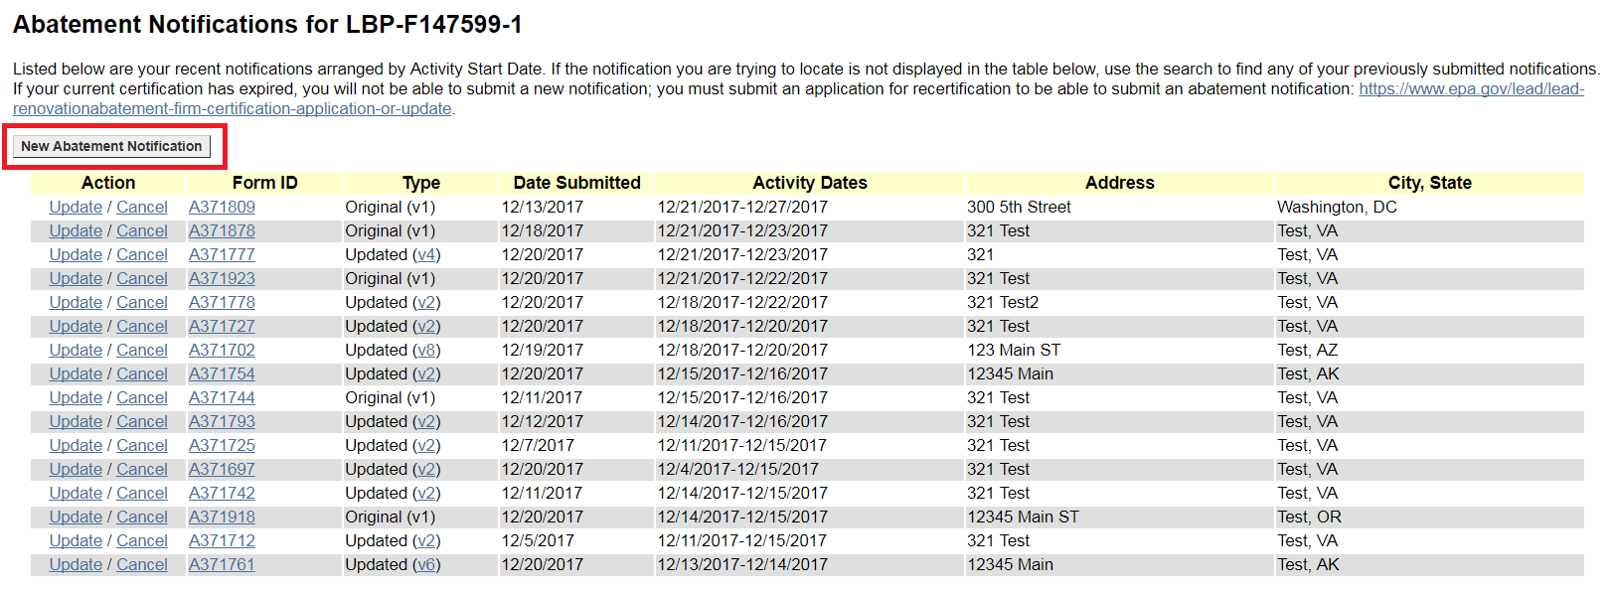
New Abatement Notification Button
Notes:
To submit a new notification, click “New Abatement Notification.”

Slide 7
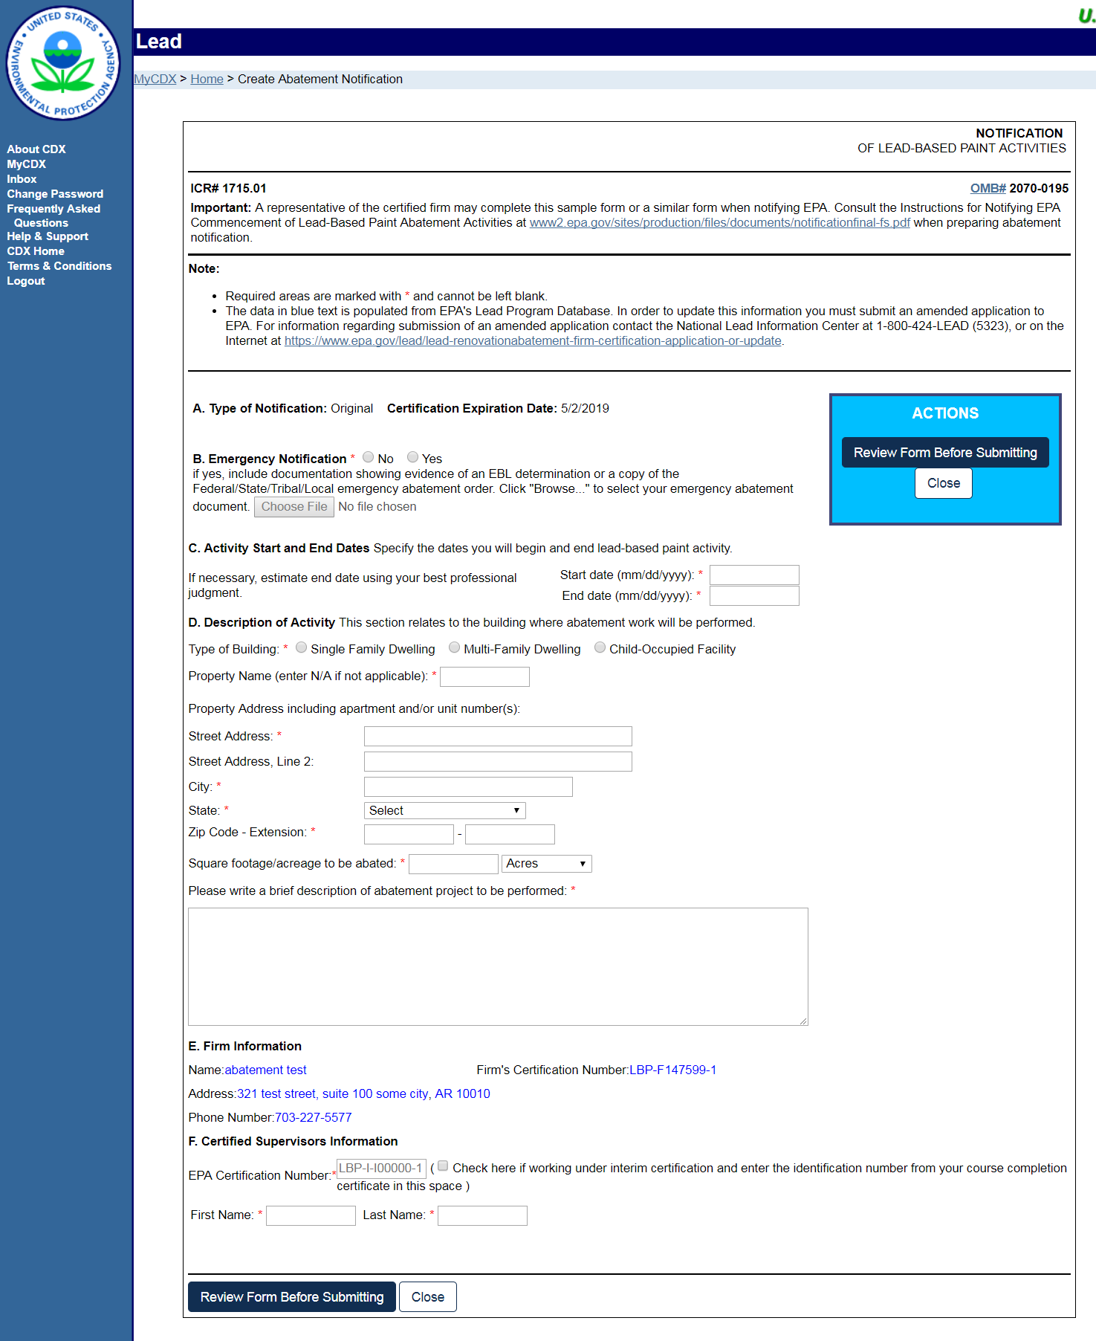
New Abatement Notification – Edit Page
Notes:
This is the full view of the edit page. Continue to the next slide for a breakdown of sections on this page.

Slide 8
New Abatement Notification – Edit Page
Notes:
Section A displays the type of notification being created and the certification expiration date, which cannot be edited. In Section B, use the radio buttons to select whether the notification is an Emergency Notification. If so, you must upload documentation to demonstrate this by clicking the ‘Choose File’ button and selecting the appropriate file. In Section C, enter the dates that lead‐based paint activity will begin and end. The end date must fall before the Certification Expiration Date as shown in Section A.

Slide 9
New Abatement Notification – Edit Page
Notes:
In Section D, answer the questions and enter the required information describing the building where the work is to be performed.

Slide 10
New Abatement Notification – Edit Page
Notes:
The data in section E, Firm Information, is prepopulated from EPA’s Lead Program database and cannot be edited on this form. Finally, in Section F, you must enter the EPA Certification Number and First and Last name of the Certified Supervisor. When all sections have been completed, click ‘Review Form Before Submitting’ to continue.

Slide 11
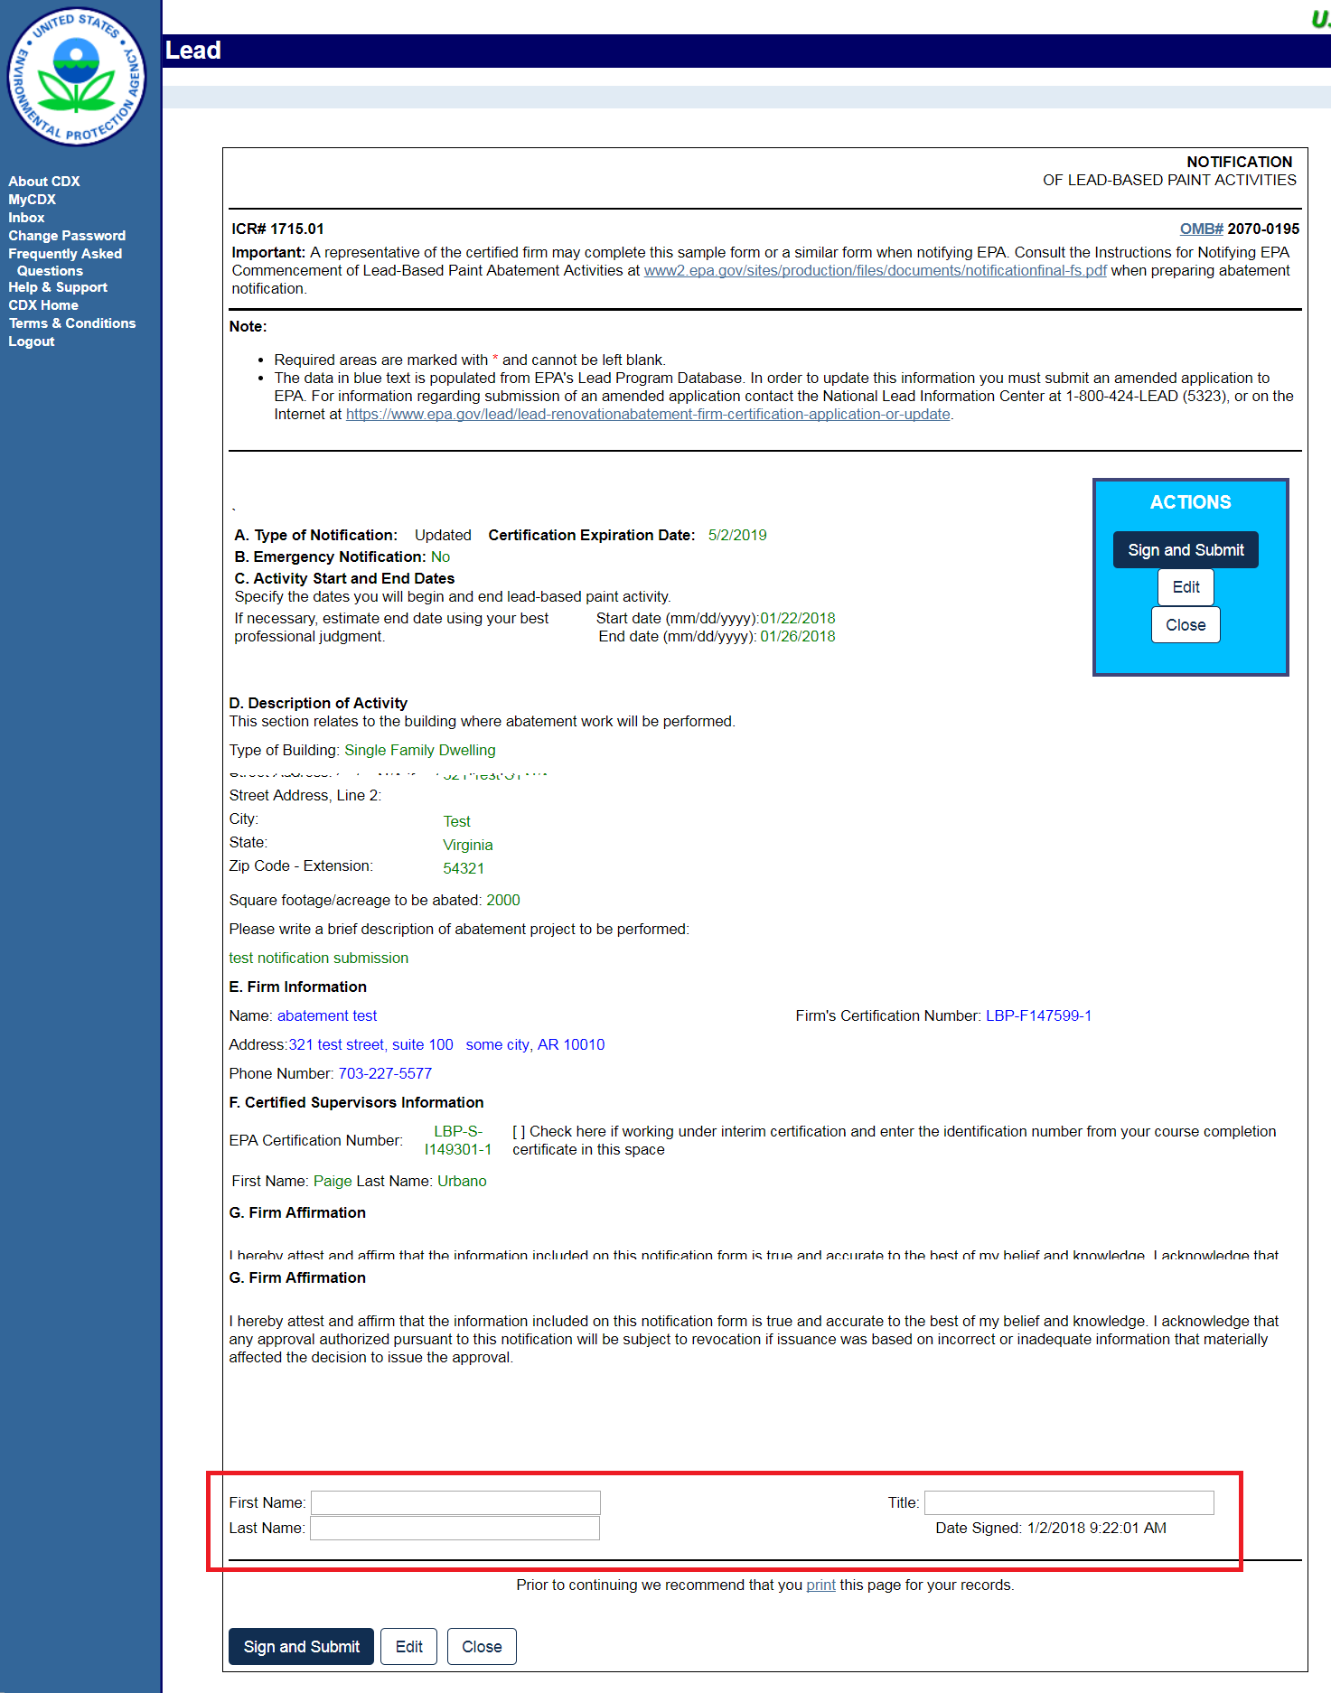
New Abatement Notification – Review Page
Notes:
The Application Review page displays the data that was entered on the previous page in a read‐only format. Review the information on this page to ensure its accuracy and completeness before submitting the notification. If you would like to make any changes, click the “Edit” button to return to the edit page. Don’t forget to sign enter your first name, last name, and title in section G, Firm Affirmation. Click ‘Sign and Submit’ to submit the application.

Slide 12
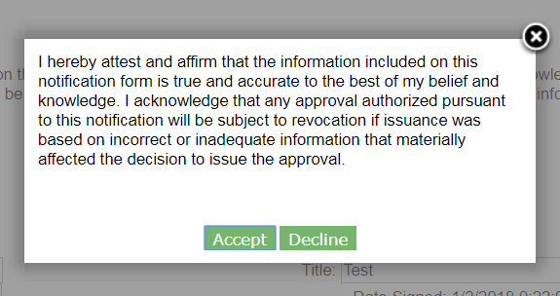
New Abatement Notification – Acceptance Statement
Notes:
Read the acceptance statement and click “Accept” to continue.

Slide 13
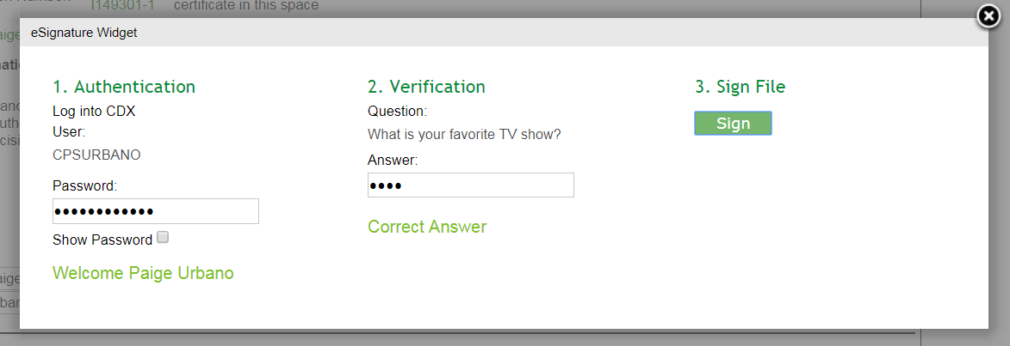
New Abatement Notification – eSignature Widget
Notes:
The eSignature widget will appear. To finalize your submission, you will have to enter your CDX account password, answer one security question, and click “Sign.”

Slide 14
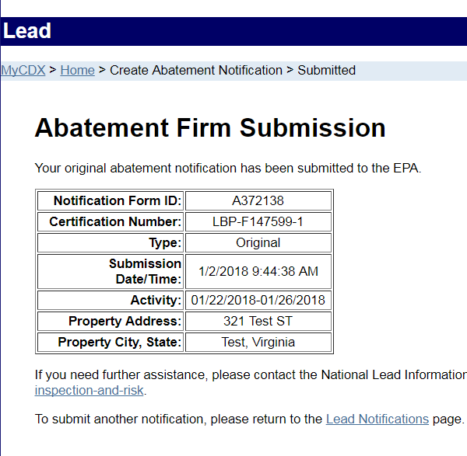
New Abatement Notification – Submission Confirmation
Notes:
Once the notification has been submitted, the Abatement Firm Submission Confirmation page will be displayed. A Notification Form ID will be generated for your submission.

Slide 15
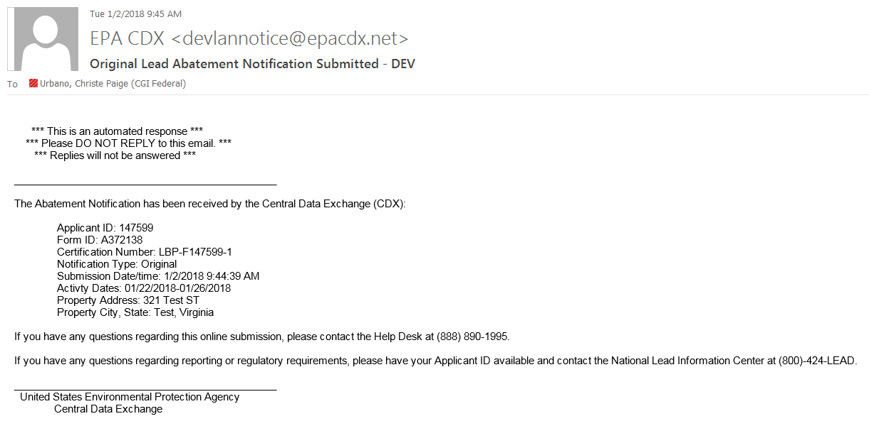
New Abatement Notification – Email Confirmation
Notes:
You will also be sent an email confirmation containing the same information regarding your submission.

Slide 16
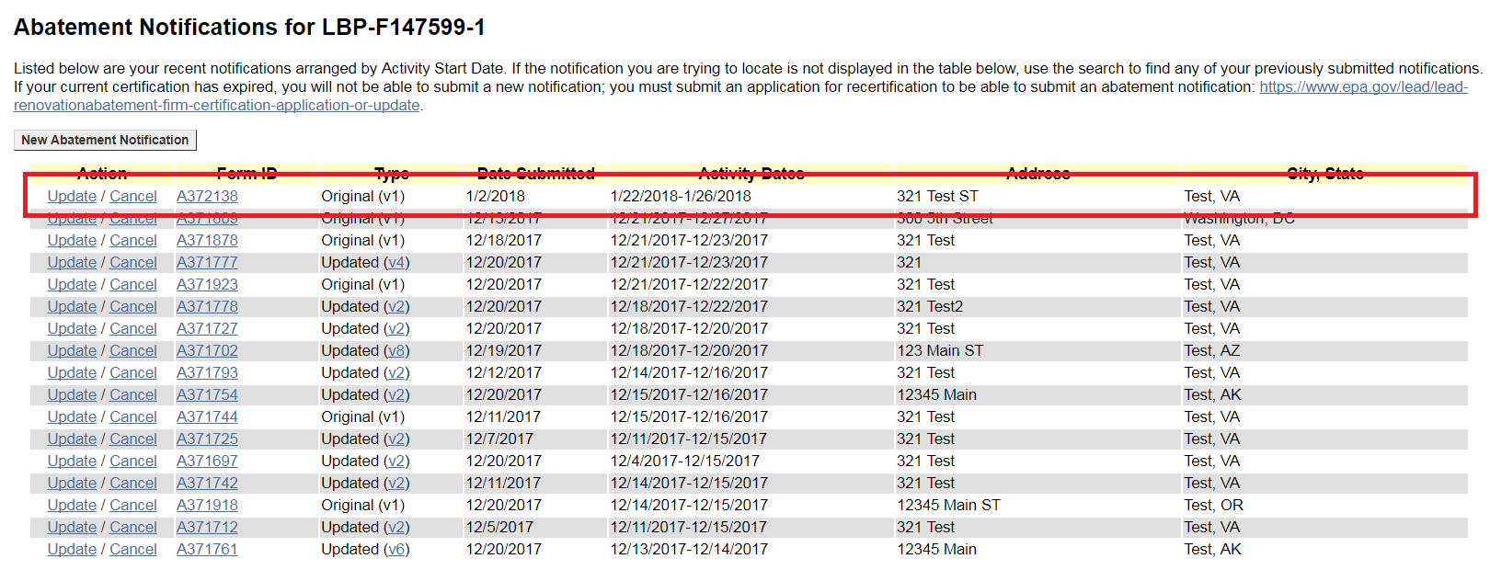
Notification Added to Table
Notes:
Depending on the activity start dates listed on your notification, the table will update with your successfully submitted notification. This table only displays recent notifications, so if the notification you submitted is happening too far into the future, it will not be displayed in the table – in this case, please use the abatement notification search to access your notification.

Slide 17
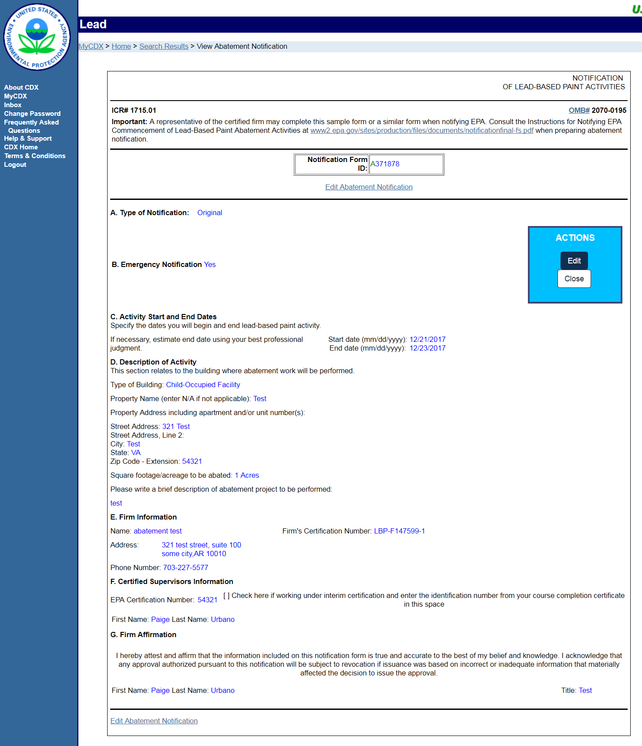
View Submitted Notification
Notes:
To view a submitted notification from the table, click the notification’s Form ID. On this view page, you will also have the option to update the notification by clicking “Edit.”

Slide 18
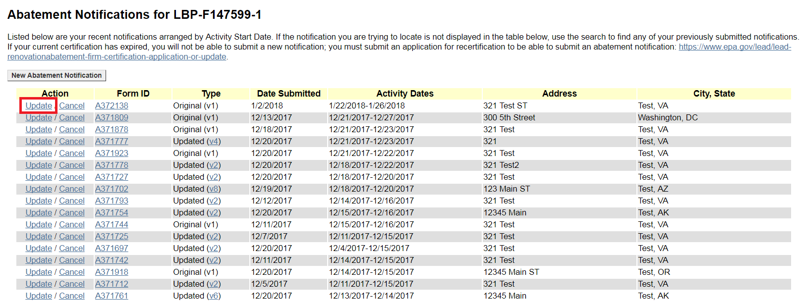
Update Abatement Notification
Notes:
To update a notification, click on the “Update” action option next to the notification you want to update.

Slide 19
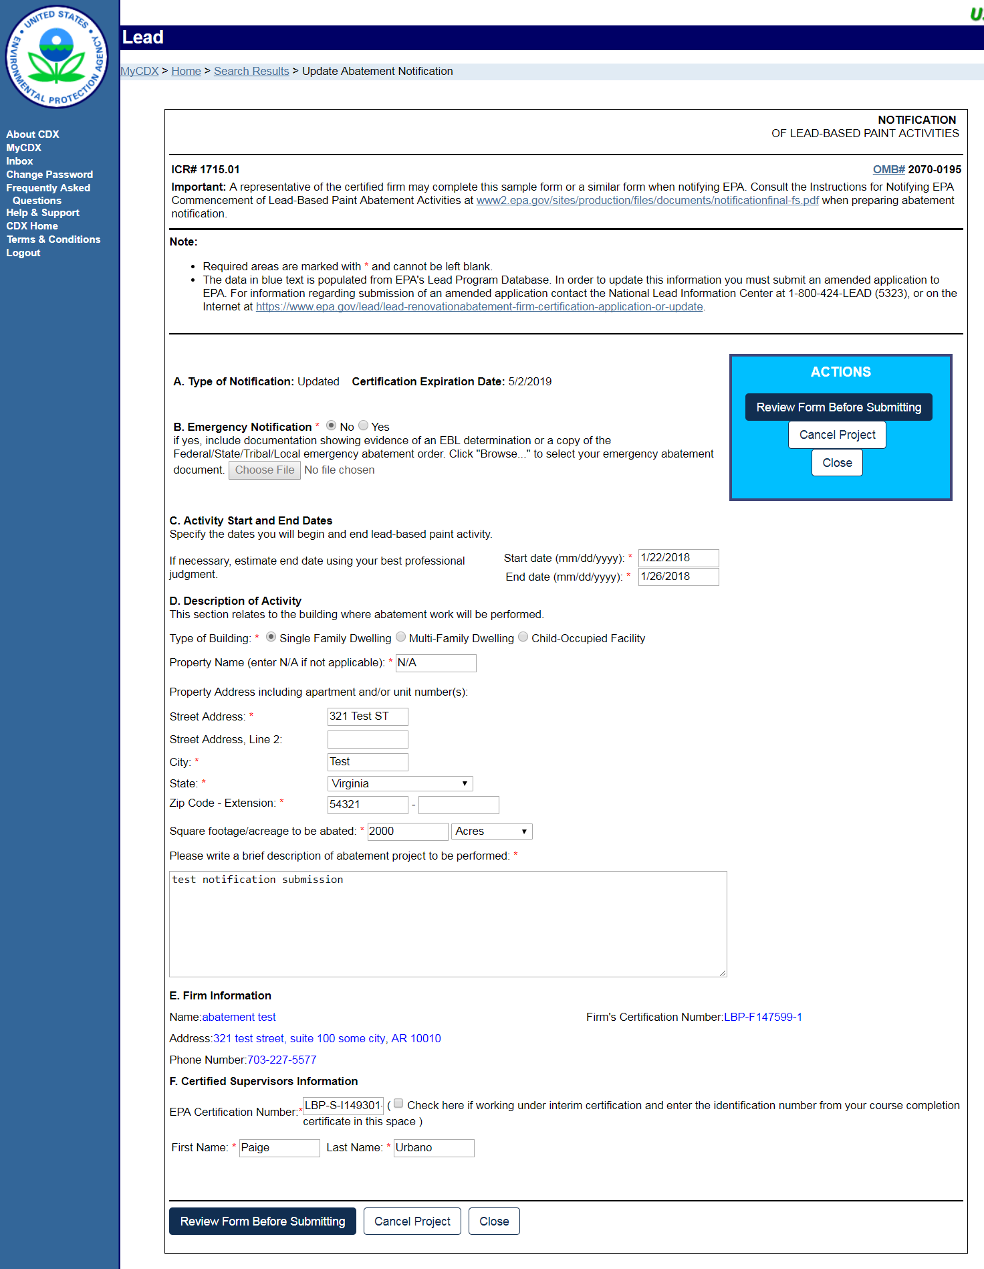
Update Abatement Notification – Edit Page
Notes:
On the edit page, make any edits to your previously submitted notification. When you are done updating the information, click “Review Form before Submitting.”

Slide 20

Update Abatement Notification – Review Page
Notes:
The review page displays the data that was entered on the previous page in a read‐only format. Review the information on this page to ensure its accuracy and completeness before submitting the update. If you would like to make any changes, click the “Edit” button to return to the edit page. Don’t forget to enter your first name, last name, and title in section G, Firm Affirmation. Click ‘Sign and Submit’ to submit the update.

Slide 21
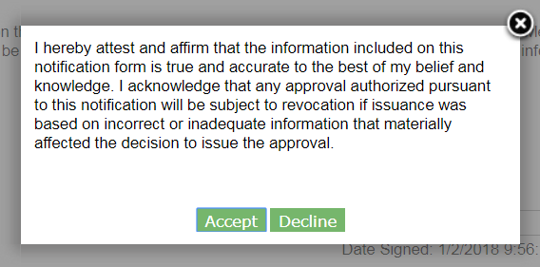
Update Abatement Notification – Acceptance Statement
Notes:
Read the acceptance statement, and click “Accept” to continue.

Slide 22
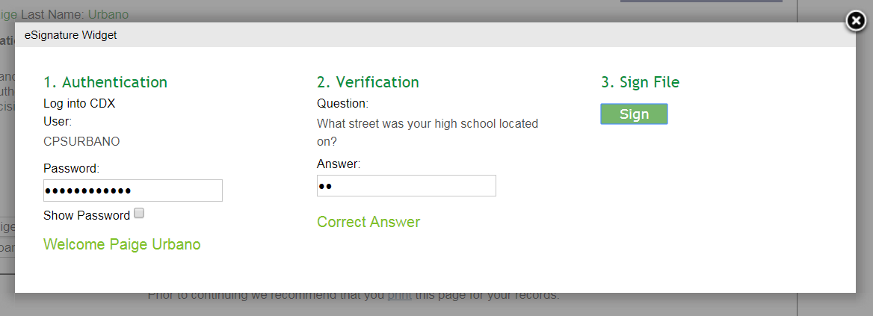
Update Abatement Notification – eSignature Agreement
Notes:
The eSignature widget will appear. To finalize your update, you will have to enter your CDX account password, answer one security question, and click “Sign.”

Slide 23
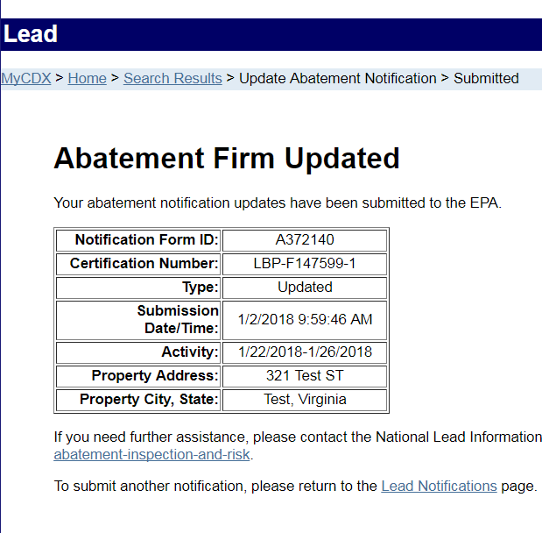
Update Abatement Notification – Submission Confirmation
Notes:
Once the update has been submitted, the Abatement Firm Updated Confirmation page will be displayed.

Slide 24
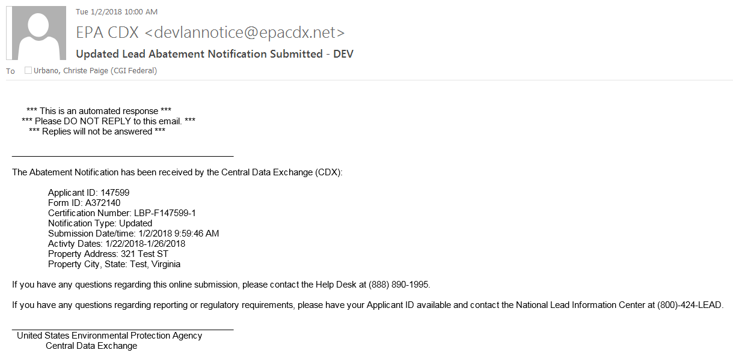
Update Abatement Notification – Email Confirmation
Notes:
You will also be sent an email confirmation containing the same information regarding your update.

Slide 25
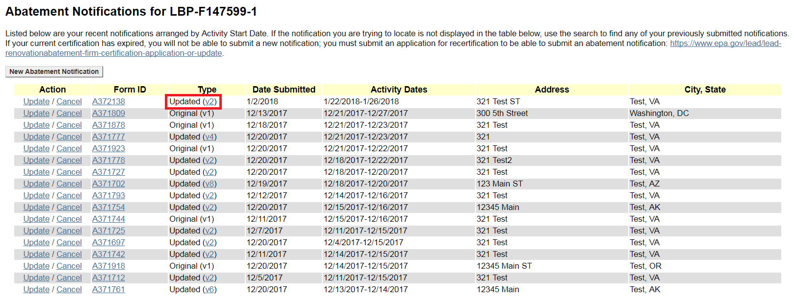
View Version History
Notes:
When a notification is updated, its “Type” is changed to “Updated (v2)” on the table. Click “v2” to view your notification’s version history.

Slide 26
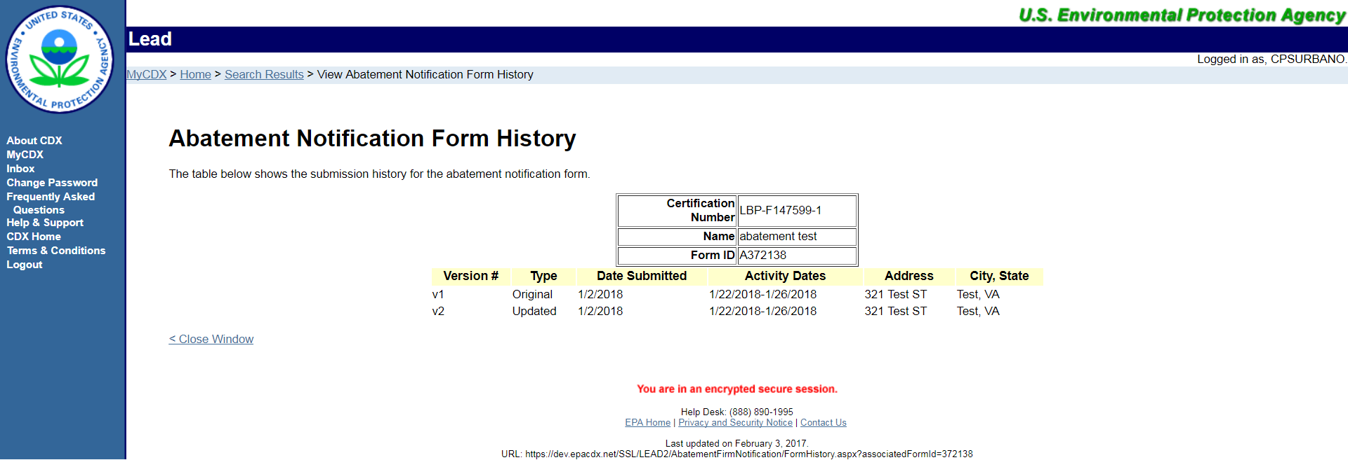
Version History Page
Notes:
This is the Version History page. Here you will see when you originally submitted your abatement notification, as well as the dates of any updates you sent in.

Slide 27
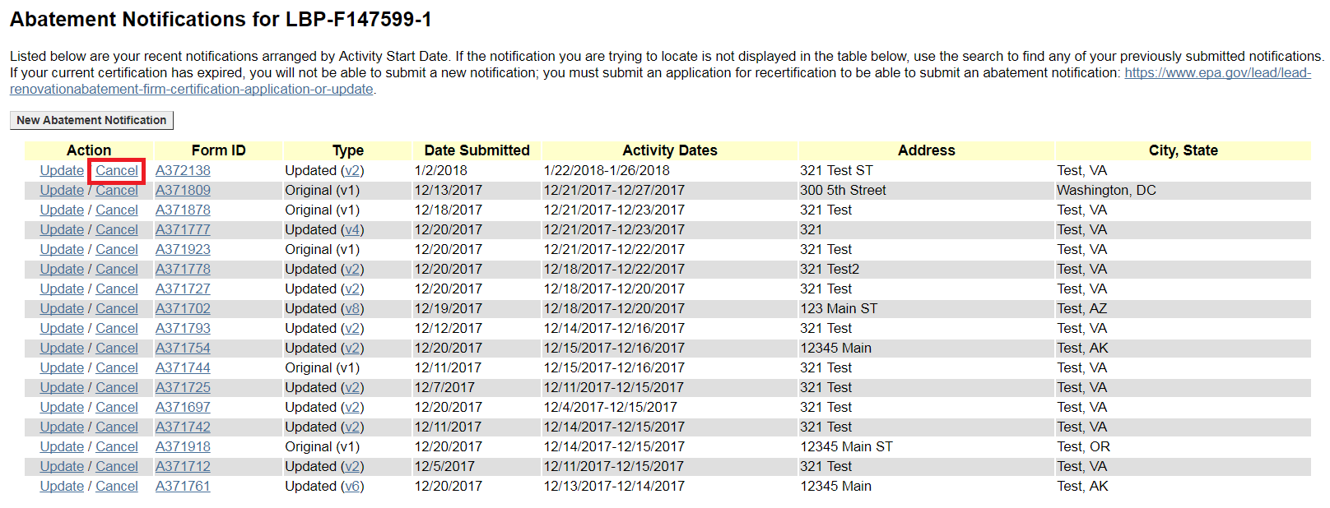
Cancel Abatement Notification
Notes:
To cancel a notification, click on the “Cancel” action option next to the notification you want to cancel.

Slide 28
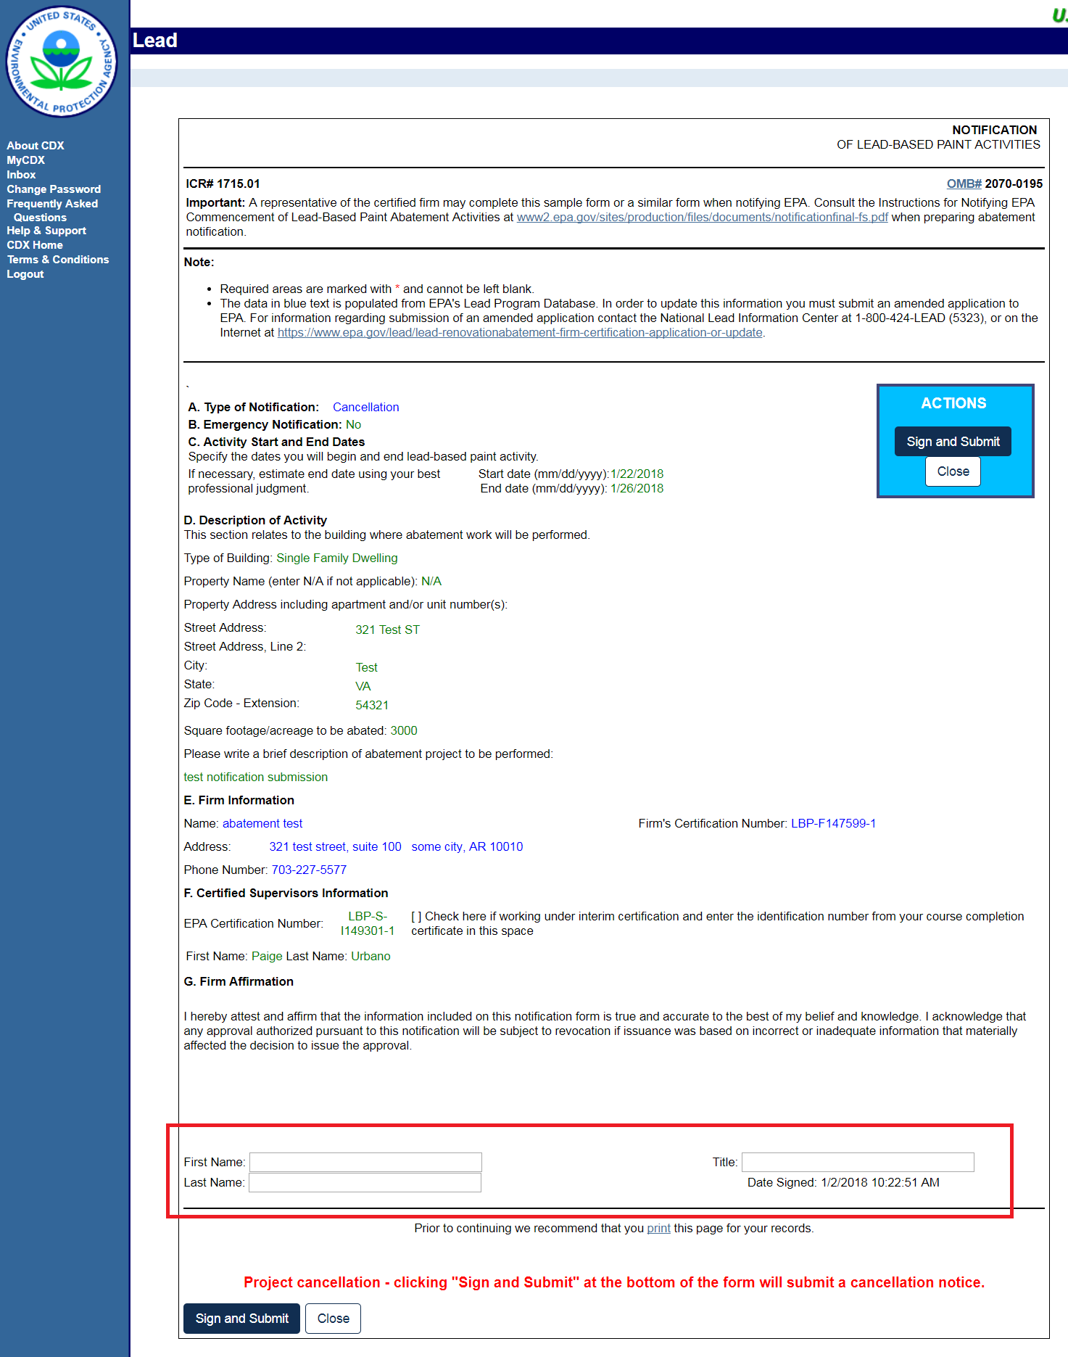
Cancel Abatement Notification – Review Page
Notes:
Review the information on the notification you want to cancel and enter your first name, last name, and title in section G, Firm Affirmation, then click ‘Sign and Submit.’

Slide 29
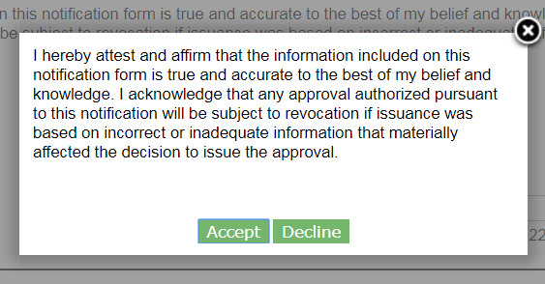
Cancel Abatement Notification – Acceptance Statement
Notes:
Read the acceptance statement and click “Accept” to continue.

Slide 30
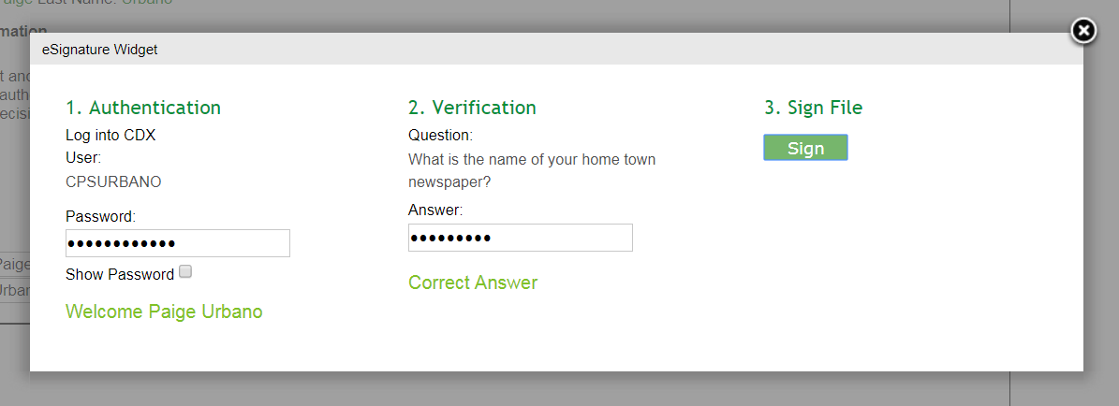
Cancel Abatement Notification – eSignature Widget
Notes:
The eSignature widget will appear. To finalize your cancellation, you will have to enter your CDX account password, answer one security question, and click “Sign.”

Slide 31
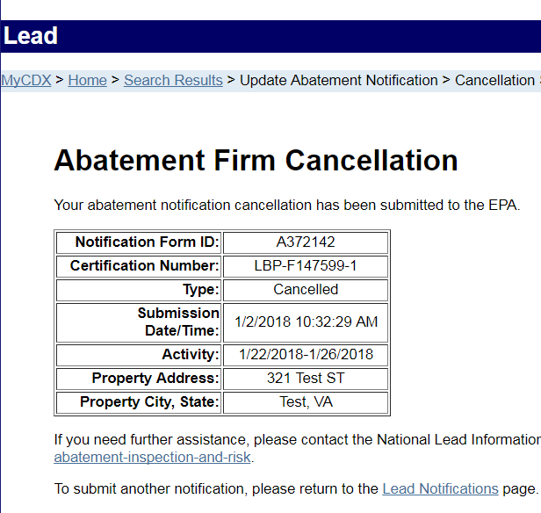
Cancel Abatement Notification – Submission Confirmation
Notes:
Once the cancellation has been submitted, the Abatement Firm Cancellation Confirmation page will be displayed.

Slide 32
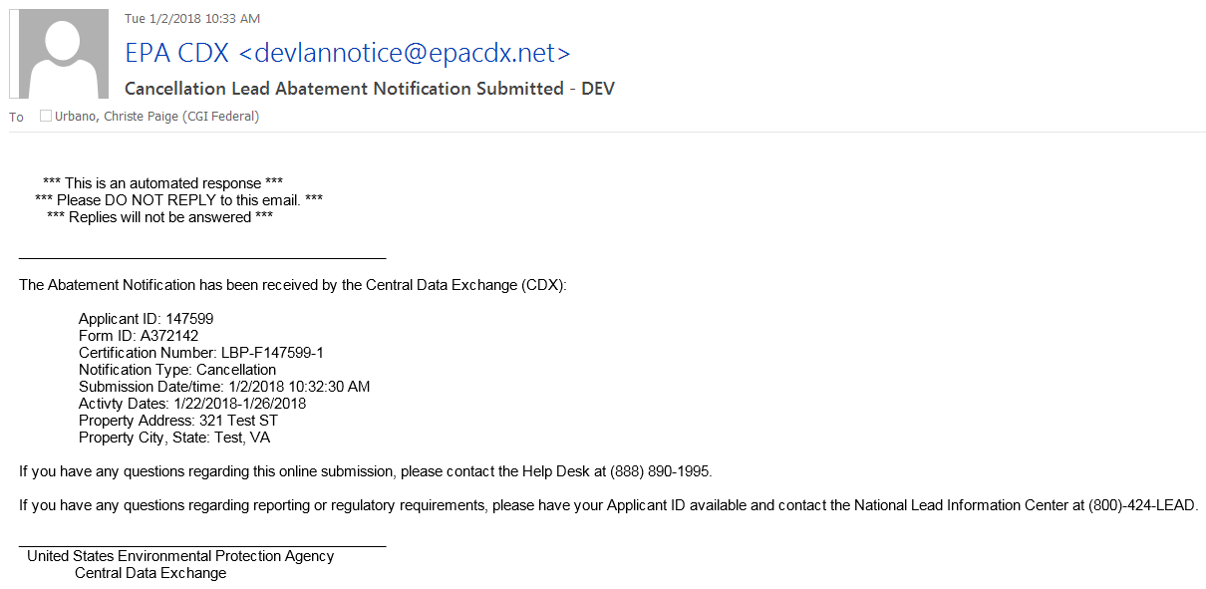
Cancel Abatement Notification – Email Confirmation
Notes:
You will also be sent an email confirmation containing the same information regarding your cancellation.

Slide 33
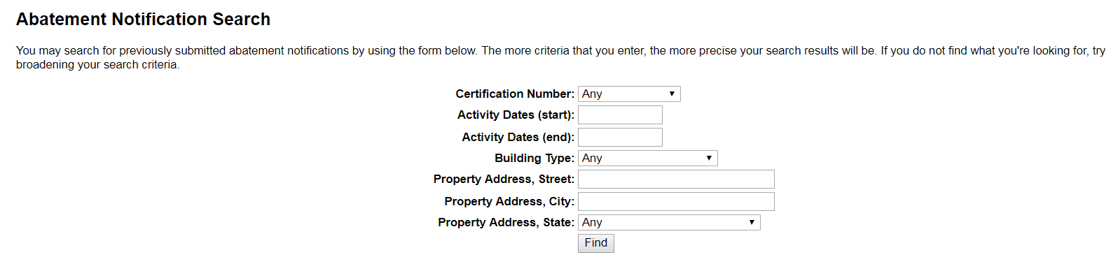
Abatement Notification Search
Notes:
From the Abatement Notification home page, you can search for any existing abatement notifications using the Search form. Enter as many search criteria as desired, then click the ‘Find’ button.

Slide 34
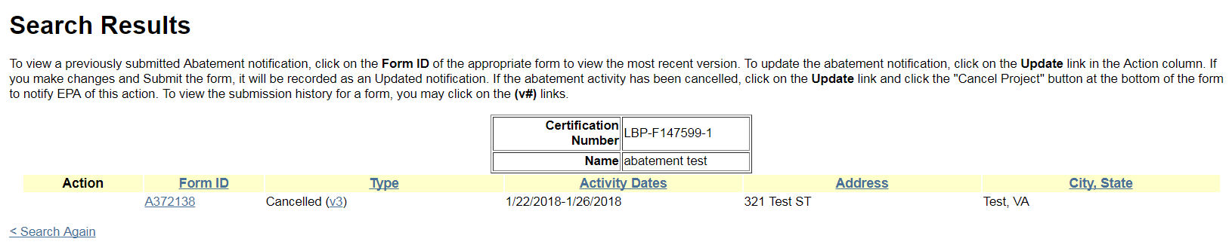
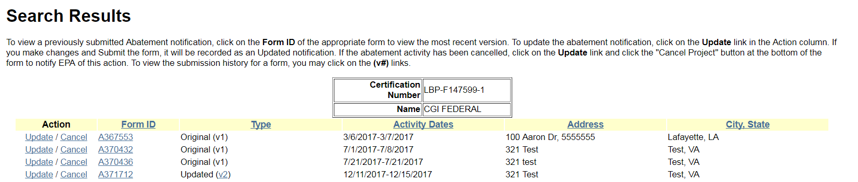
Abatement Notification Search Results
Notes:
You will then be navigated to the Search Results page, where any notifications matching your search will be displayed. The results table works similarly to the notifications table on the home page. You have the choice to update or cancel any of your prior submissions, view a notification, and view a notification’s version history. Cancelled notifications will appear on the table, but no action options will be available for notifications that have been cancelled. You can, however, still view a cancelled notification’s version history.

