Slide 1
Lead User Guide: Training Provider Notifications
Updated 01/05/2018
Notes:
These instructions are intended as guidance for the CDX HelpDesk. This user guide will cover the process for submitting training provider notifications.

Slide 2
Training Notifications Role
Notes:
Training Provider Notifications are now housed within the greater Training Provider Dashboard (Notifications) role on MyCDX.

Slide 3
Training Notifications Tile
Notes:
Click the “Training Notifications” tile on the Training Provider Dashboard to access the Training Notifications home page.

Slide 4
Training Notifications Home
Notes:
This is the Training Notifications home page. Here the user can view submitted notifications, submit a new pre-training notification, submit a new e-learning post training notification, and use the search to find older notifications. If a user would like to find a notification not listed in the table, they will have to search for their notification. The “New e-learning Post-Training Notification” only applies to notifications for renovator, refresher, and e-learning courses with no hands on requirement; all other post-training notifications must be preceded by a pre-training notification. The button only appears if the training program is accredited for a renovator, refresher, or e-learning course. The users can submit post-training notifications, update notifications, and cancel notifications from the buttons displayed in the data table.

Slide 5
Create Pre-Training Notification
Notes:
If the user clicks the “New Pre-Training Notification” button they will be taken to the new pre-training notification edit page. Here they can enter all their information to submit with their pre-training notification. Their Training Facilities and Training Instructors are pre-filled with data associated with their accreditation number. A user can select “Other” for training facility only if they are accredited to have non permanent training facilities. There is no longer an option for “Other” under Training Instructors. To add training facilities or instructions, the training providers must submit an amendment from the “Manage People and Facilities” tile on the Dashboard.

Slide 6
Create Pre-Training Notification – Review Page
Notes:
When the user clicks the “Submit New Pre-Training Notification” button they will be taken to the Review Page. Here they will be able to review their information before submitting. The user can select “Sign Notification” to bring up the eSignature Widget to sign and submit their notification, “Edit” to return to the previous page and edit their notification information, or “Cancel Submission” to return to the home page and erase their data without submitting.

Slide 7
Notification Successfully Submitted
Notes:
The user will see this confirmation message when their notification is submitted.

Slide 8
Training Notifications Home
Notes:
An entry will be added to the table on the user’s Training Notifications home page when it is submitted.

Slide 9
Email Confirmation
Notes:
The user will also receive a confirmation email when their notification is submitted.

Slide 10
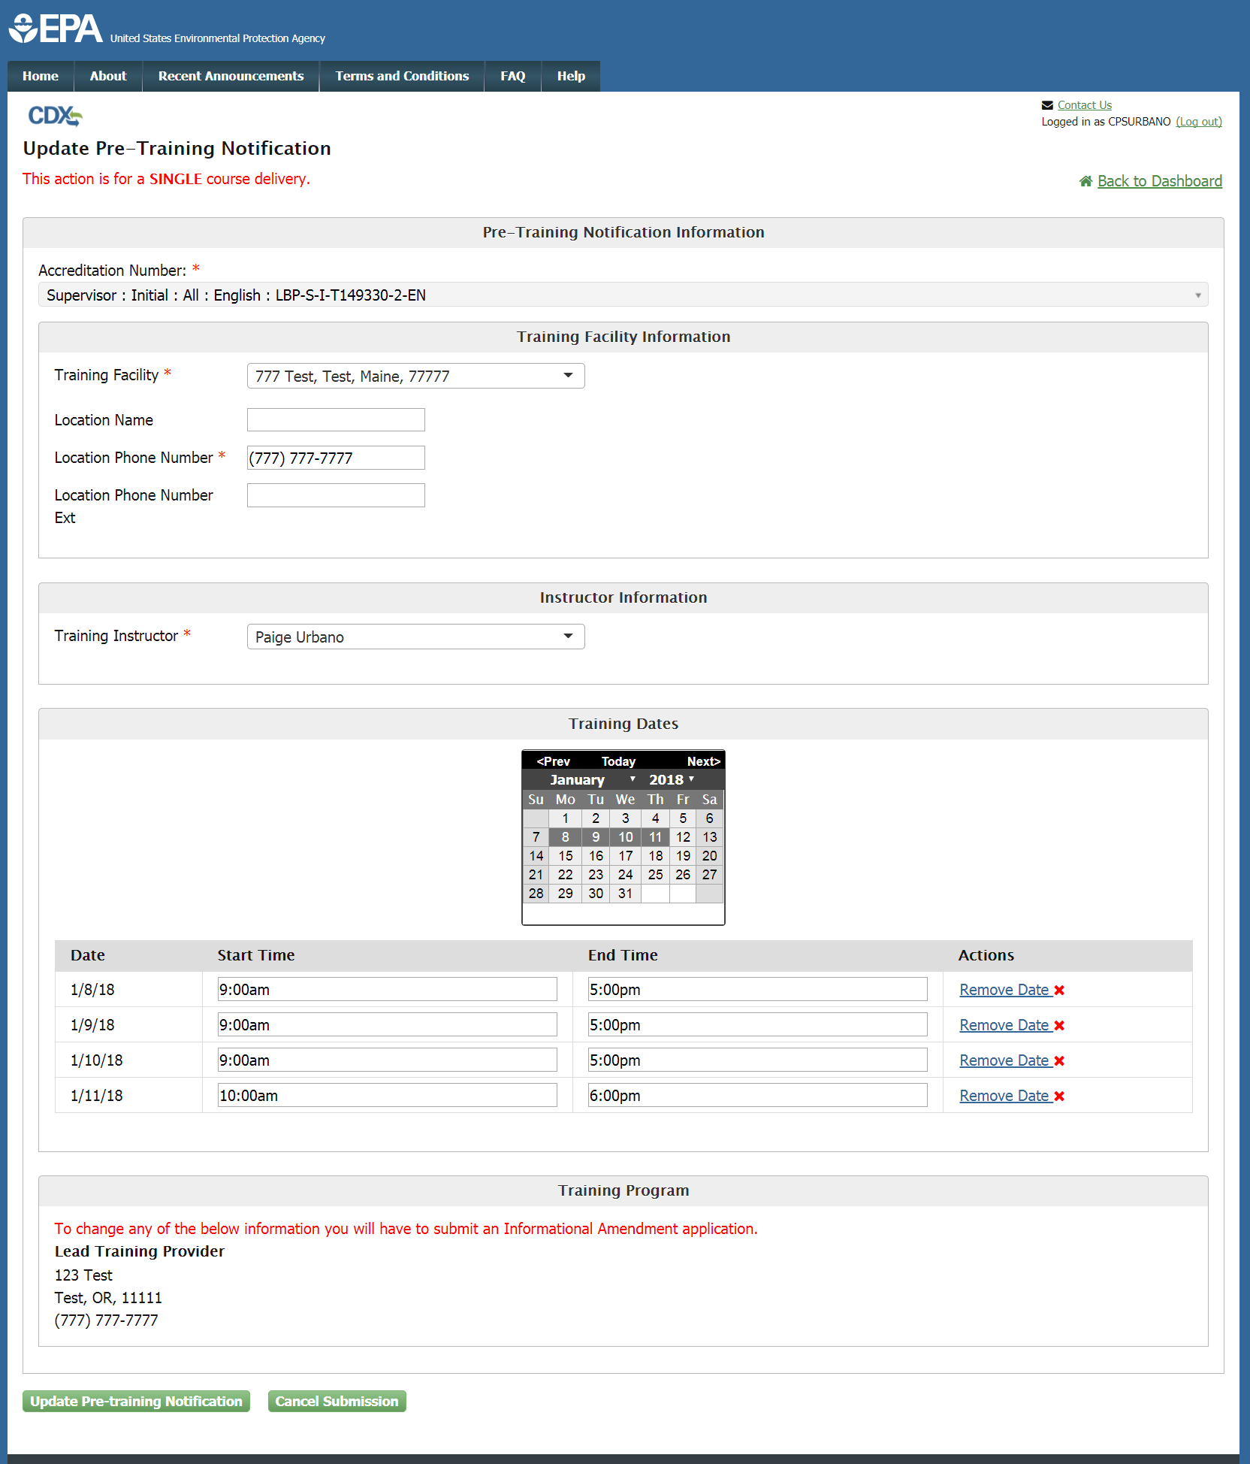
Update Pre-Training Notification
Notes:
If the user clicks the “Update Pre-Notification” button, they will be taken to the update pre-training notification edit page. Here they can make any edits to a previously submitted pre-training notification.

Slide 11
Update Pre-Training Notification – Review Page
Notes:
When the user clicks the “Update Pre-training Notification” button, they will be taken to the Review Page. Here they will be able to review their information before submitting. The user can select “Sign Notification” to bring up the eSignature Widget to sign and submit their notification, “Edit” to return to the previous page and edit their notification information, or “Cancel Submission” to return to the home page and erase their data without submitting. Once the notification has been successfully signed and submitted the user will receive an email confirmation.

Slide 12
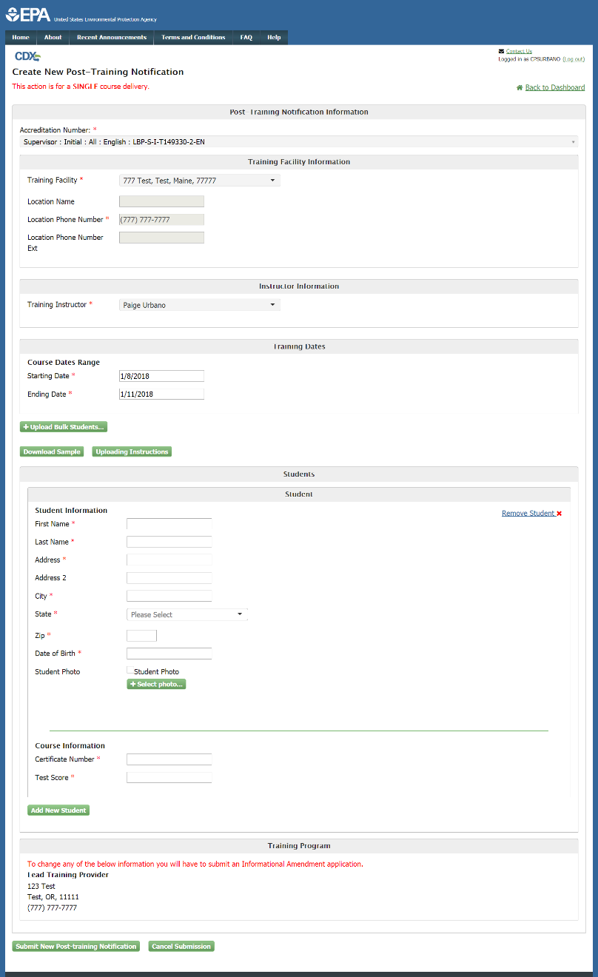
Create Post-Training Notification
Notes:
If the user clicks the “Create Post-Training Notification” button, they will be taken to the post-training notification edit page. Here they can enter all their information to submit with their post-training notification with pre-filled accreditation number and training dates. The user has the option to upload student information in bulk or to enter them individually.

Slide 13
Create Post-Training Notification – Review Page
Notes:
When the user clicks the “Submit New Post-Training Notification” button, they will be taken to the Review Page. Here they will be able to review their information before submitting. The user can select “Sign Notification” to bring up the eSignature Widget to sign and submit their notification, “Edit” to return to the previous page and edit their notification information, or “Cancel Submission” to return to the home page and erase their data without submitting. Once the notification has been successfully signed and submitted the user will receive an email.

Slide 14
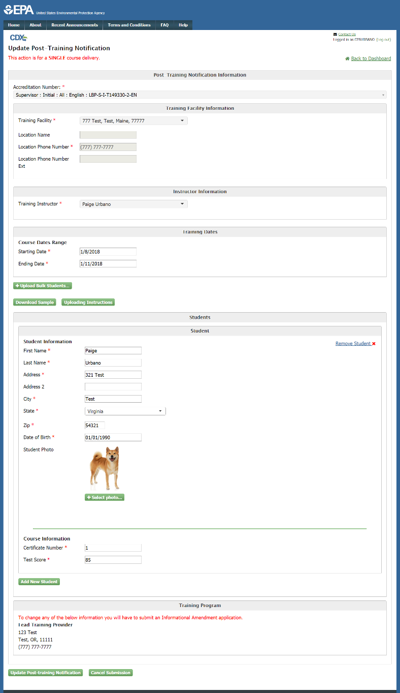
Update Post-Training Notification
Notes:
If the user clicks the “Update Post-Training Notification” button, they will be taken to the post-training notification edit page. Here they can update the information they had previously submitted.

Slide 15
Update Post-Training Notification – Review Page
Notes:
When the user clicks the “Update Post-Training Notification” button, they will be taken to the Review Page. Here they will be able to review their information before submitting. The user can select “Sign Notification” to bring up the eSignature Widget to sign and submit their notification, “Edit” to return to the previous page and edit their notification information, or “Cancel Submission” to return to the home page and erase their data without submitting. Once the notification has been successfully signed and submitted the user will receive an email.

Slide 16
Create E-Learning Post-Training Notification
Notes:
If the user clicks the “New e-learning Post-Training Notification” button, they will be taken to the new e-learning post-training notification edit page. Here they can enter all their information to submit with their post-training notification. The user will only be allowed to select renovator, refresher, or e-learning courses. Their Training Facilities and Training Instructors are pre-filled with data associated with their accreditation number. A user can select “Other” for Training facility only if they are accredited to have non permanent training facilities. There is no longer an option for “Other” under Training Instructors. To add training facilities or instructions, the training providers must submit amendments from the training provider application role. If the user selects the “Yes” answer to the “Does this course require hands-on learning?” question, the user is not allowed to submit the notification. The user will have to submit a pre-training notification first. The user is also required to submit the e-learning completion date.

Slide 17
Create E-Learning Post-Training Notification – Review Page
Notes:
When the user clicks the “Submit New Post-Training Notification” button, they will be taken to the Review Page. Here they will be able to review their information before submitting it. The user can select “Sign Notification” to bring up the eSignature Widget to sign and submit their notification, “Edit” to return to the previous page and edit their notification information, or “Cancel Submission” to return to the home and erase their data without submitting. Once the notification has been successfully signed and submitted the user will receive an email and they will be taken back to the home page where the notification will appear in the data table.

Slide 18
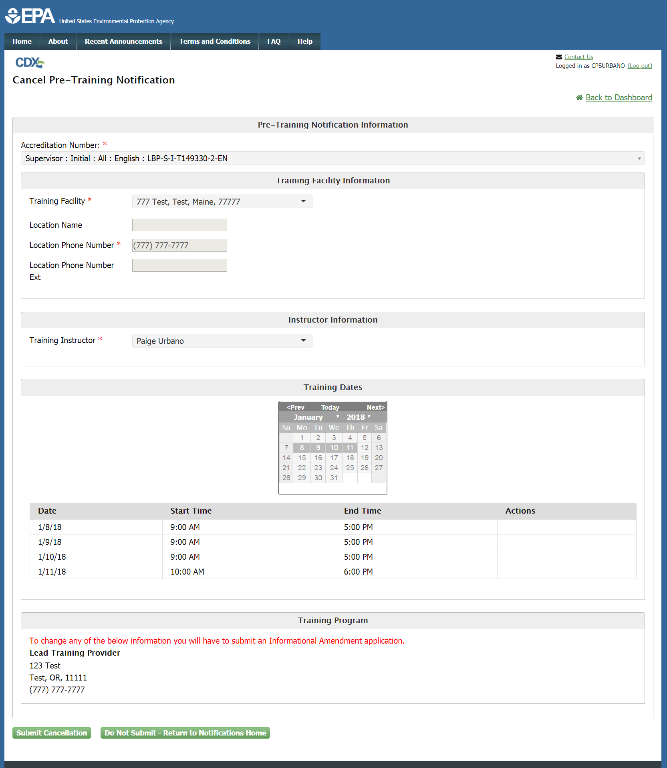
Cancel Notification
Notes:
If the user clicks the “Cancel Notification” button, they will be taken to the Cancel notification page. Here their notification information is displayed in read-only format.

Slide 19
Cancel Notification – Review Page
Notes:
When the user selects “Submit Cancellation” button they, are taken to the Review Page. Here they will be able to review their information before submitting. The user can select “Sign Notification” to bring up the eSignature Widget to sign and submit their notification, “Edit” to return to the previous page and edit their notification information, or “Cancel Submission” to return to the home page and erase their data without submitting. Once the notification has been successfully signed and submitted the user will receive an email.

Slide 20
Training Notification Search
Notes:
Clicking ‘Search’ on the Training Notifications home page will bring the user to the Search page. Using the search, the user can locate any notifications that are not displayed on the data table (which only displays recently submitted notifications). Please note: the search may take longer for users with a high volume of notifications.

Slide 21
Training Notification Search Results
Notes:
Once the user searches, the results are displayed on the result page. Here the user can create post-training notifications, update notifications, and cancel notifications just like in the data table on the home page.

