Slide 1
Appendix V. FPRS Screenshots
FNS- 152, FNS-153, and FNS- 668
FNS- 44, FNS-10, FNS-191 and FNS-292

Slide 2
Attachment 20- FNS-152 FPRS Screen Shot

Slide 3
Attachment 20- FNS-152 FPRS Screen Shot

Slide 4
Attachment 20- FNS-152 FPRS Screen Shot

Slide 5
Attachment 20- FNS-152 FPRS Screen Shot

Slide 6
Attachment 20- FNS-152 FPRS Screen Shot

Slide 7
Attachment 20- FNS-152 FPRS Screen Shot

Slide 8
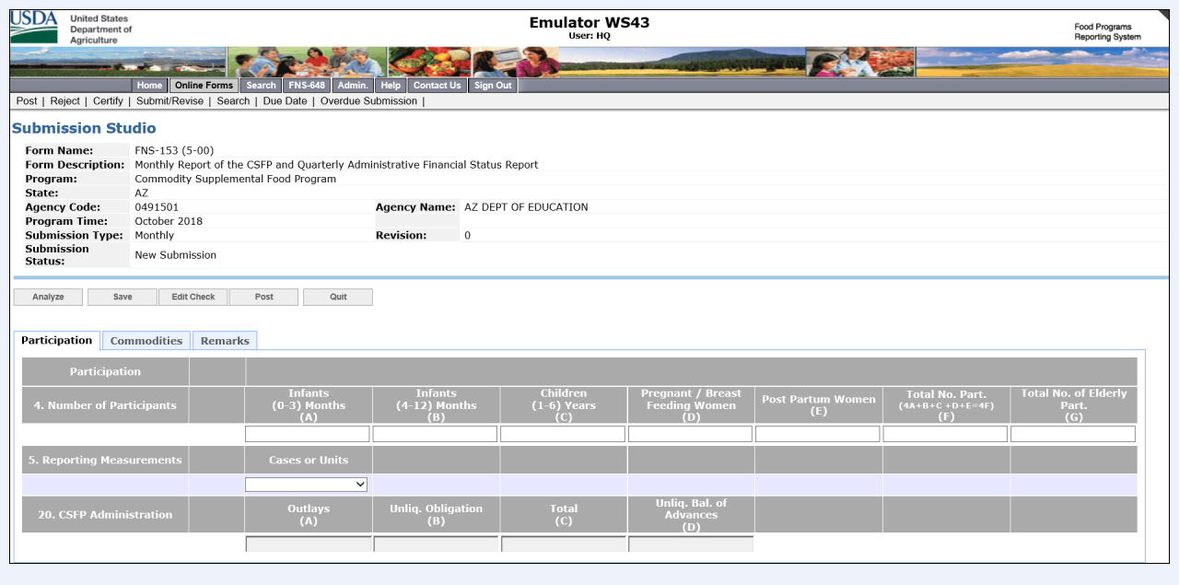
Attachment 20- FNS-153 FPRS Screen Shots

Slide 9
Attachment 20- FNS-153 FPRS Screen Shots

Slide 10
Attachment 20- FNS-668 FPRS Screen Shot

Slide 11
Attachment 20- FNS-668 FPRS Screen Shot

Slide 12
Attachment 20- FNS-44 FPRS Screen Shot

Slide 13
Attachment 20- FNS-44 FPRS Screen Shot

Slide 14
Attachment 20- FNS-44 FPRS Screen Shot

Slide 15
Attachment 20- FNS-44 FPRS Screen Shot

Slide 16
Attachment 20- FNS-44 FPRS Screen Shot

Slide 17
Attachment 20- FNS-44 FPRS Screen Shot

Slide 18
Attachment 20- FNS-44 FPRS Screen Shot

Slide 19
Attachment 20 FNS-10

Slide 20
Attachment 20 FNS-10

Slide 21
Attachment 20 FNS-10

Slide 22
Attachment 20 FNS-10

Slide 23
Attachment 20- FNS- 191

Slide 24
Attachment 20 FNS-292A

Slide 25
Attachment 20 FNS-292A

Slide 26
Attachment 20 FNS-292A

Slide 27
Attachment 20 FNS-292A

Slide 28
Attachment 20 FNS-292A

