Slide 1
DOCP Survey Requirements
Web Screen Mockups
Last update: 03/30/2023

Slide 2
Confidential Version

Slide 3
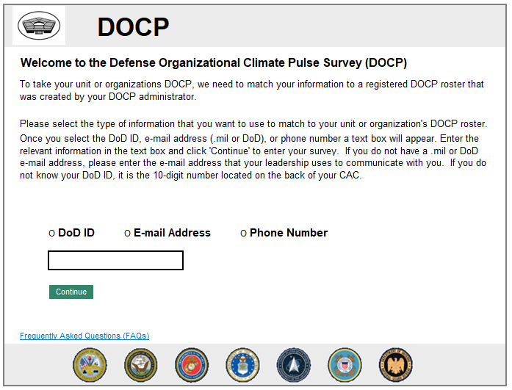
DOCP Login/Landing Page

Slide 4
Error messages for login
DOCP Login/Landing Page cont.
ERROR MESSAGE(S):
Non-matched DoD ID:
“The DoD ID that you entered does not match to a registered DOCP roster. It could be the case that you are entering your correct DoD ID but are not matching to a roster because your DOCP administrator did not list that information on the roster.
Try entering an e-mail address or phone number that your leadership uses to communicate with you. If you are still unable to log into the system, please contact the individual who invited you to this survey.”
Non-matched E-mail:
“The e-mail address you entered did not match to a registered DOCP roster. Please try another e-mail address, your DoD ID, or a phone number. If you are still unable to log into the system, please contact the individual who invited you to this survey.”
Non-matched Phone Number:
“The phone number you entered did not match to a registered DOCP roster. Please try another phone number, an e-mail address, or your DoD ID. If you are still unable to log into the system, please contact the individual who invited you to this survey.”
If the participant is enrolled in more than one open DEOCS registrations
“We have found multiple registrations matching your information. Please select the DOCP you wish to take now.”

Slide 5
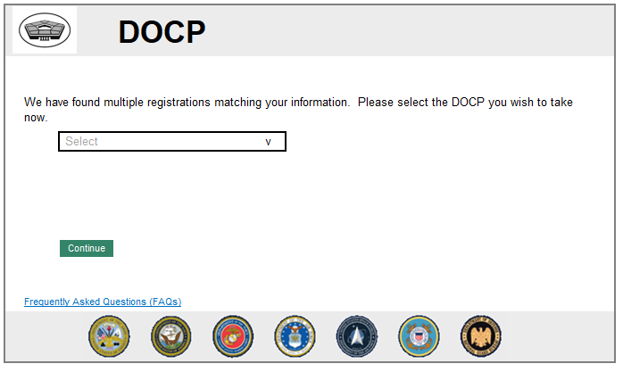
Multiple Registrations

Slide 6
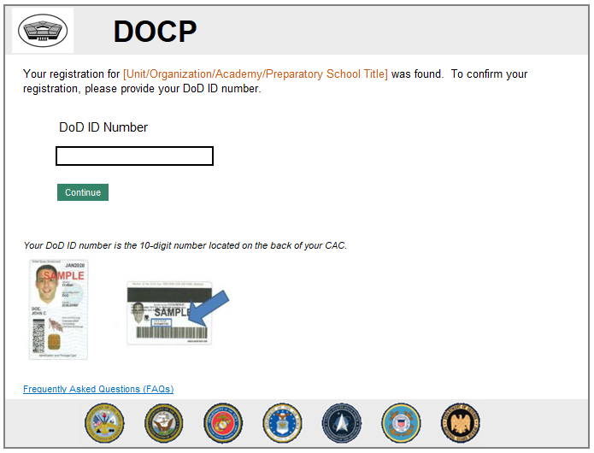
DoD ID Prompt

Slide 7
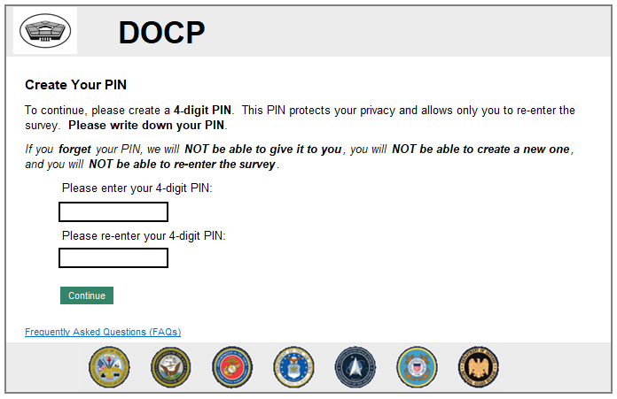
PIN Creation
ERROR MESSAGE(S):
If the participant does not enter any PIN
“You are required to create a PIN to continue. Your PIN must be 4 digits.”
If the participant enters only one PIN
“The PINs entered do not match.”

Slide 8
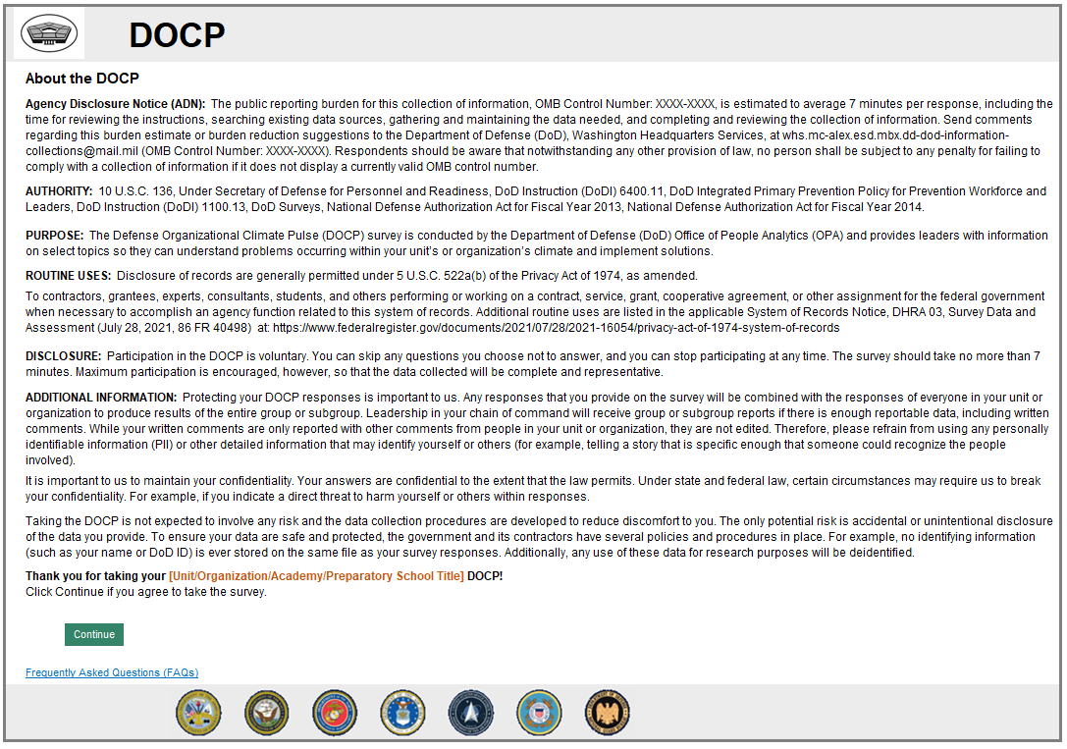
About the DOCP (Informed Consent)
INTERNAL NOTE:
Clicking “Continue” will take the participant to the next web screen (Web Screen 4: Pre-Survey Instructions)

Slide 9
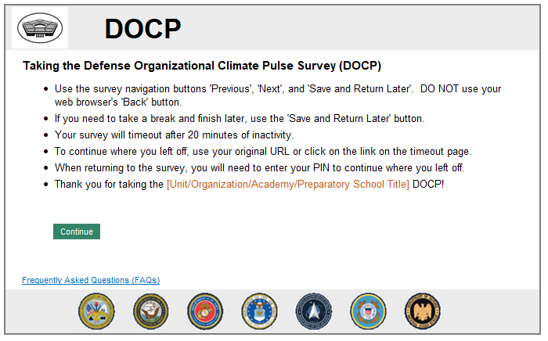
Pre-Survey Instructions

Slide 10
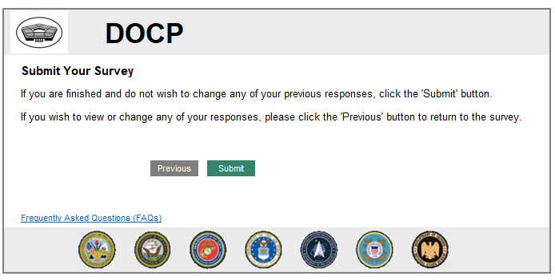
Submit Survey

Slide 11
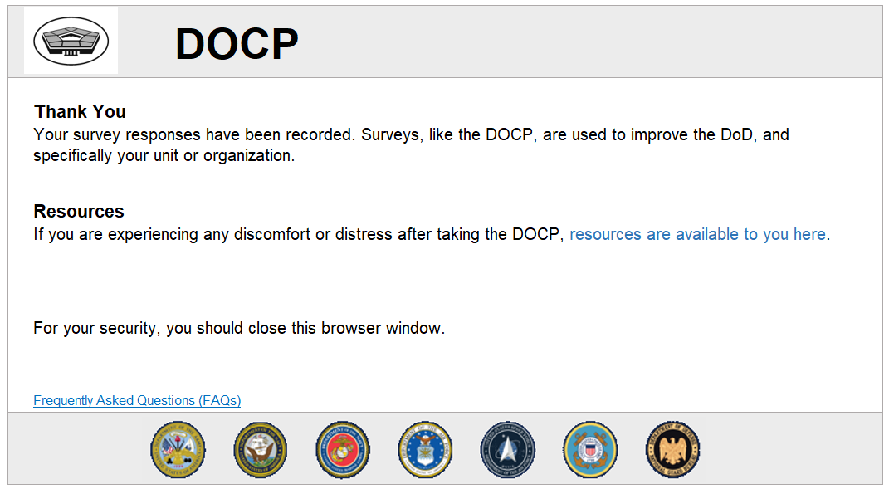
Thank You

Slide 12
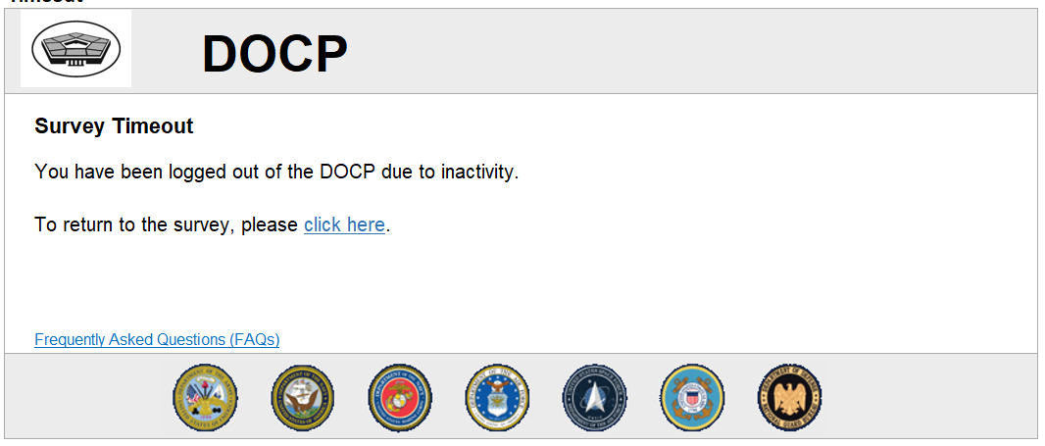
Timeout

Slide 13
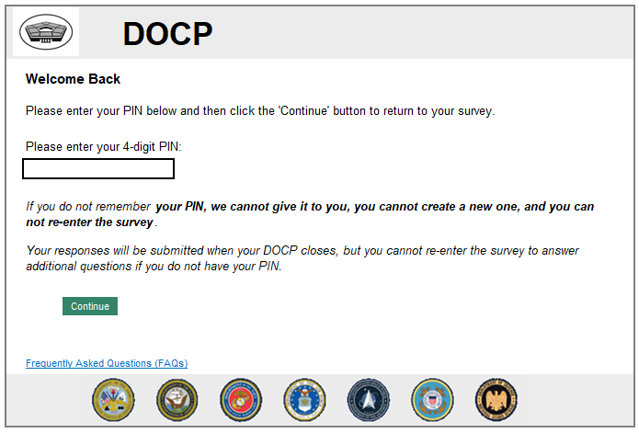
Welcome Back

Slide 14
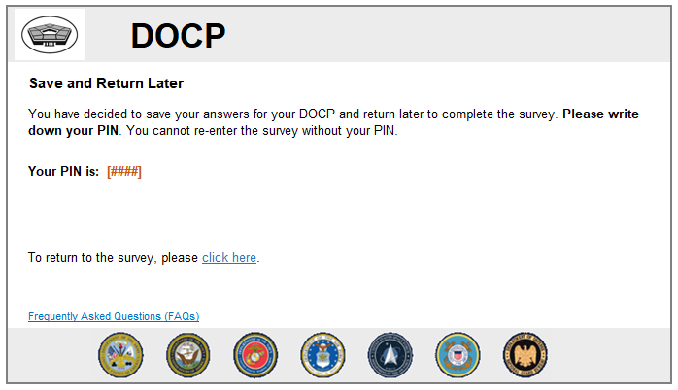
Save and Return Later

Slide 15
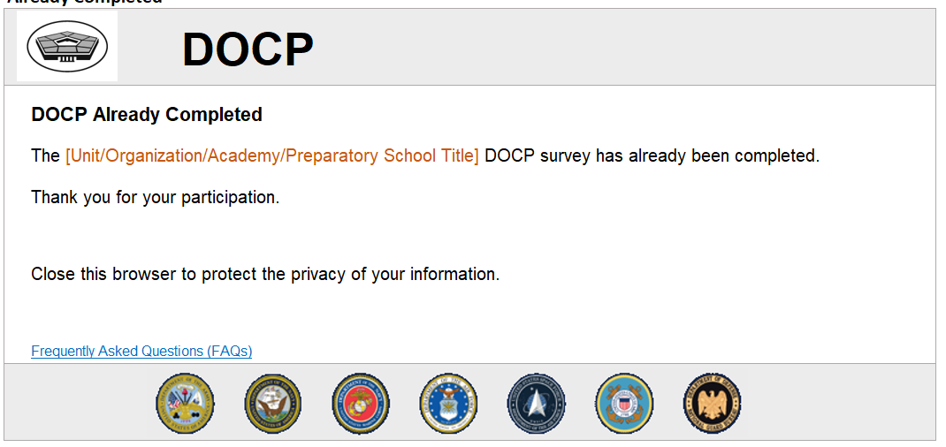
Already Complete

Slide 16
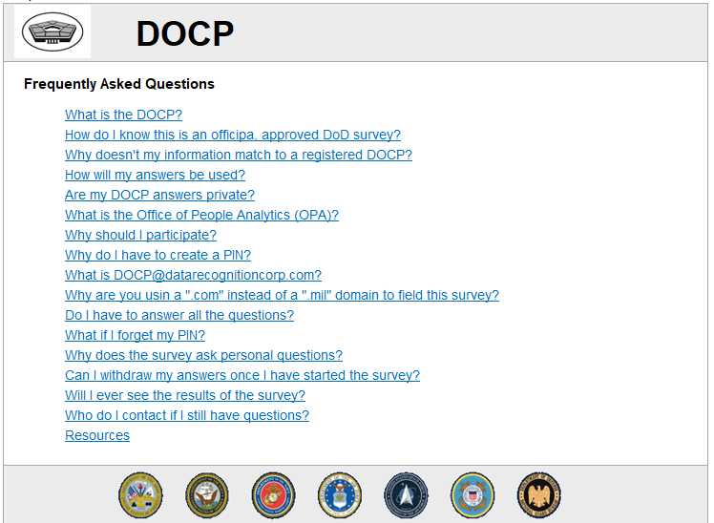
FAQ

Slide 17
Forced Anonymous Version
NOTE: the standard DOCP version is Confidential, and not Forced Anonymous. Forced Anonymous DOCP’s retain the same survey structure but are an option for classified units/organizations (e.g., SOCOM). In the registration of a DOCP, survey administrators can identify the unit/organization as classified and opt into an anonymous condition. This option is reserved for classified or otherwise protected populations and should be rarely selected. The most notable difference is in the information provided on unit/organization personnel and changes the way that participants access the survey.

Slide 18
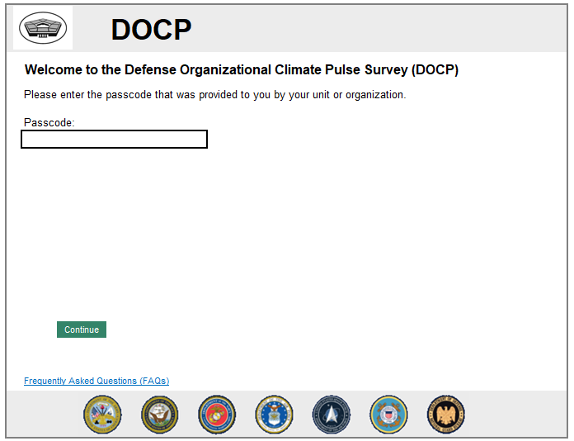
Landing Page

Slide 19
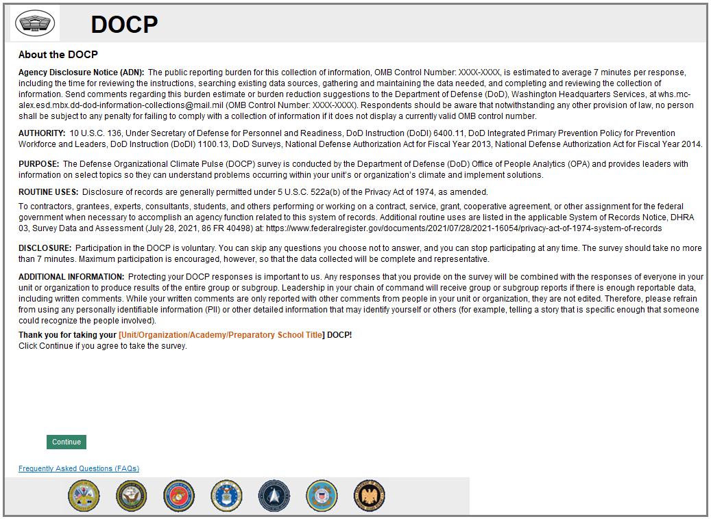
About the DOCP (Informed Consent)
INTERNAL NOTE:
Clicking “Continue” will take the participant to the next web screen (Web Screen: Pre-Survey Instructions)

Slide 20
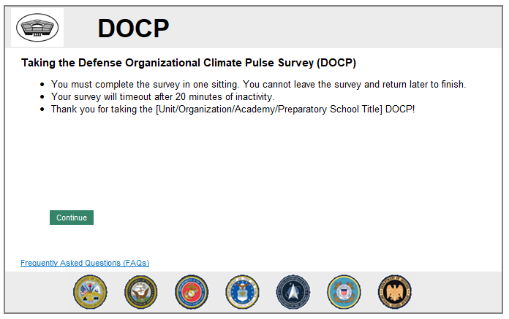
Pre-Survey Instruction

Slide 21
Submit Survey

Slide 22
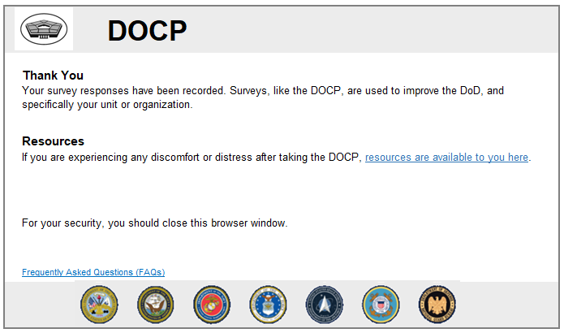
Thank You

Slide 23
FAQ

