Slide 1
Enroll Company
Steps:
Access E-Verify Enrollment Website
Read and Agree to Terms to Access the E-Verify Website
Review Enrollment Checklist and Collect Needed Information (offline)
Determine Access Method (choose company type)
Select Organization Designation and Applicable Federal Contractor Category
Sign Memorandum of Understanding (MOU)
Enter Company Information
Register Users
Review and Certify Information
Print MOU

Slide 2
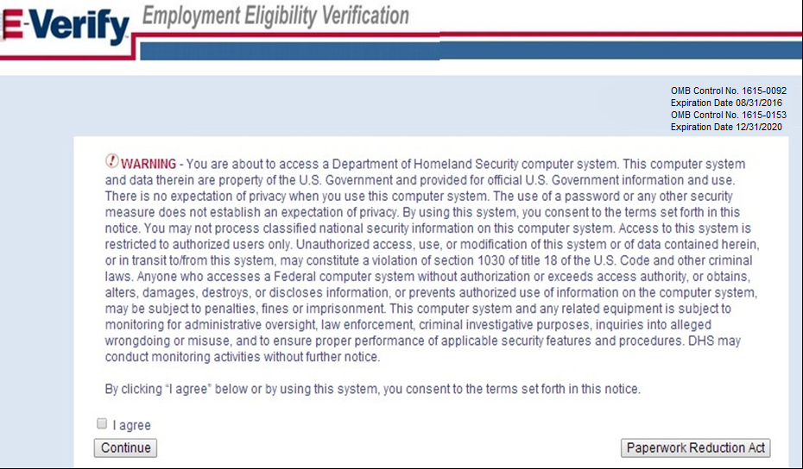
Privacy Statement

Slide 3
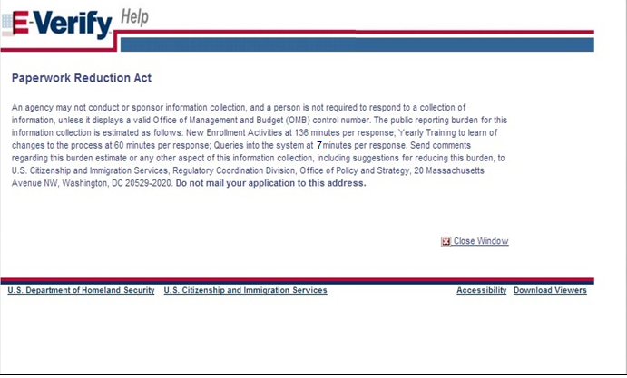
Paperwork Reduction Act Help

Slide 4
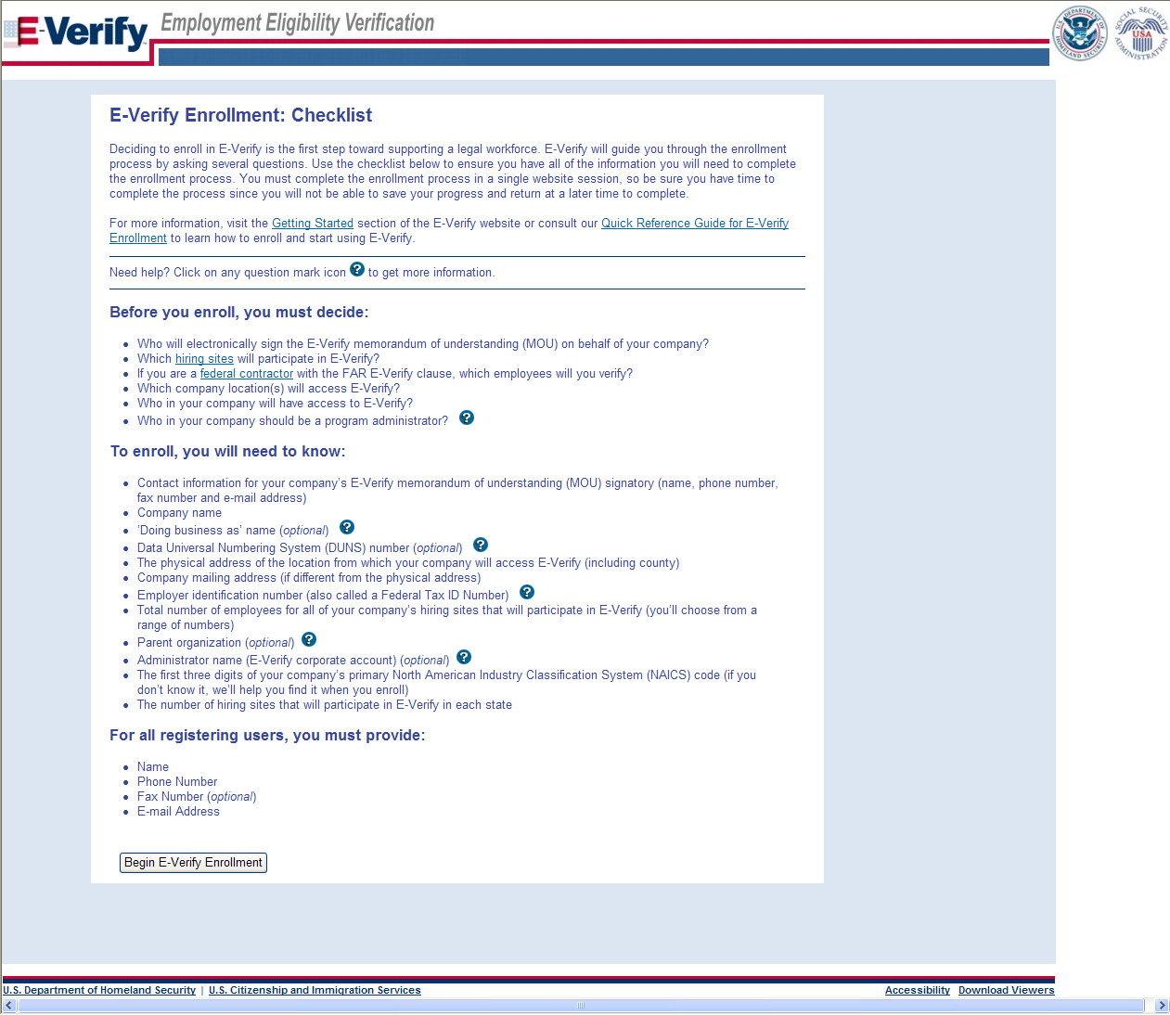
Review Enrollment Checklist

Slide 5
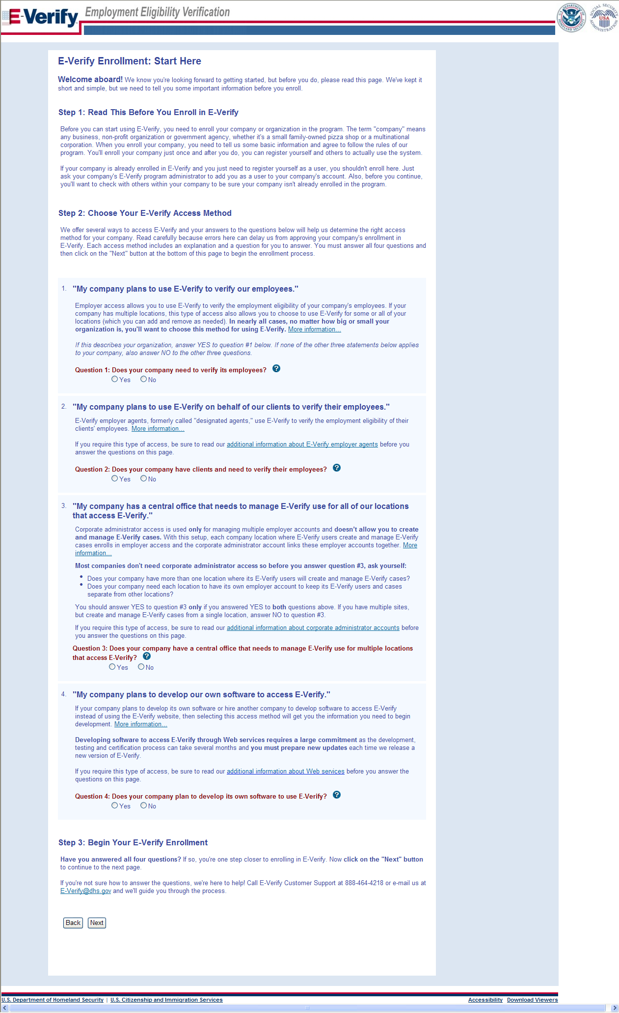
Determine Access Method

Slide 6
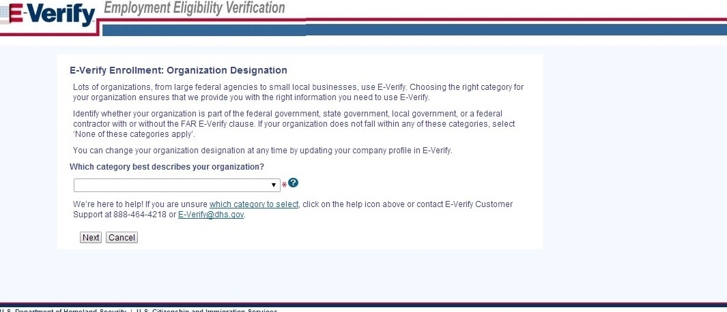
Select Organization Designation

Slide 7
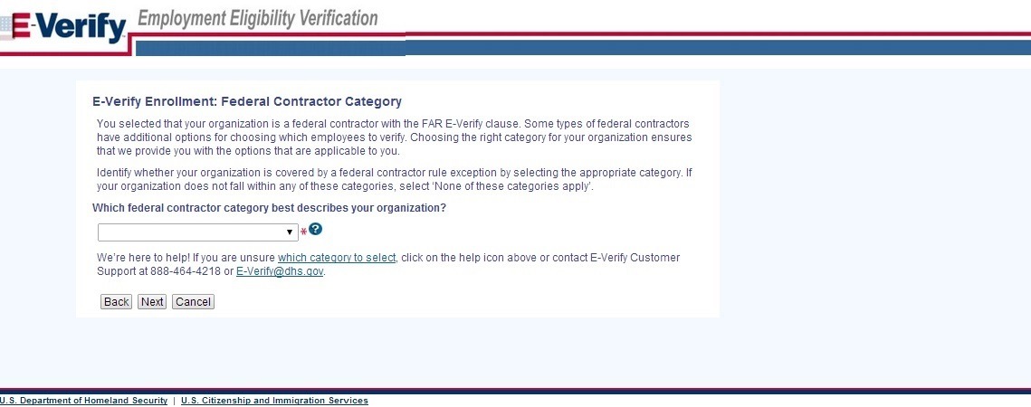
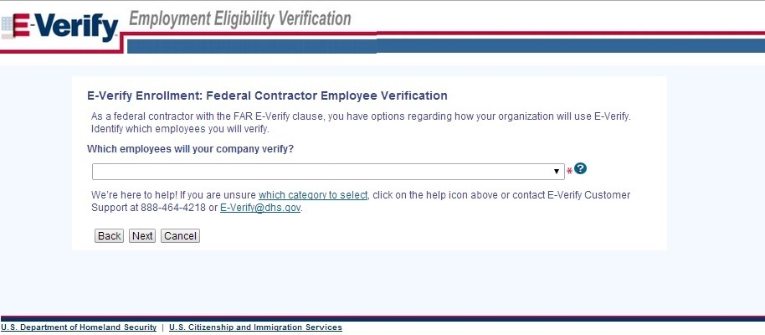
Select Federal Contractor Category

Slide 8
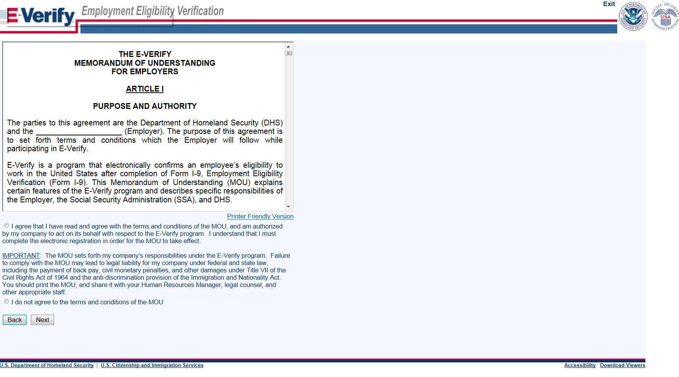
Sign Memorandum of Understanding (MOU)

Slide 9
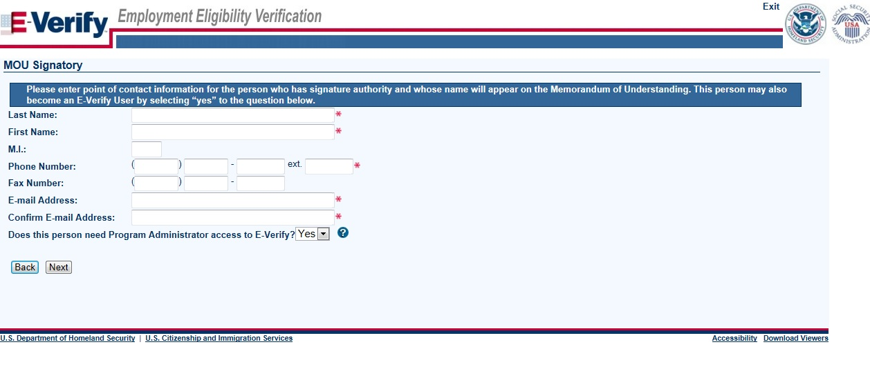
Enter Company Information – MOU Signatory

Slide 10
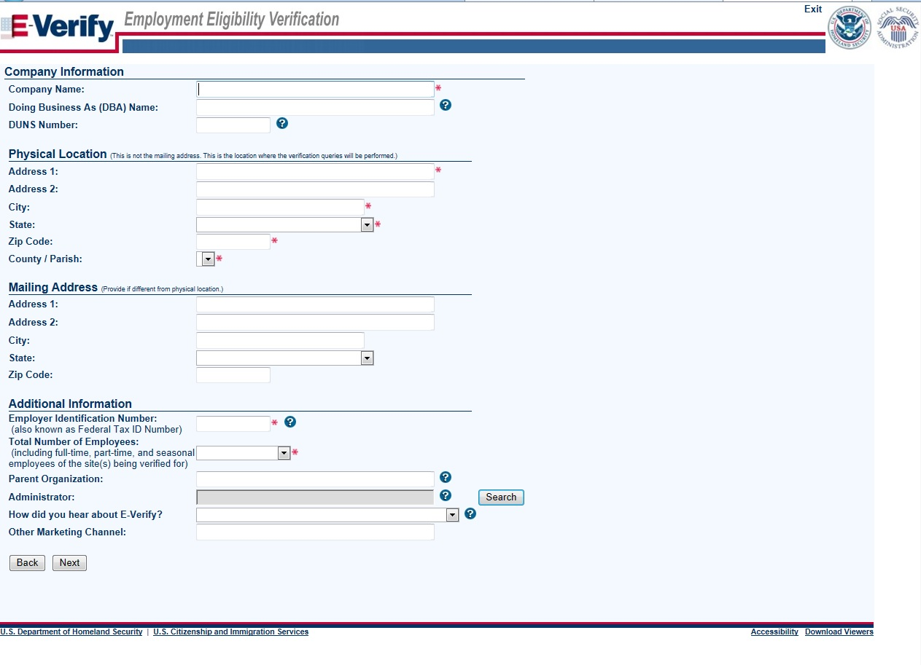
Enter Company Information

Slide 11
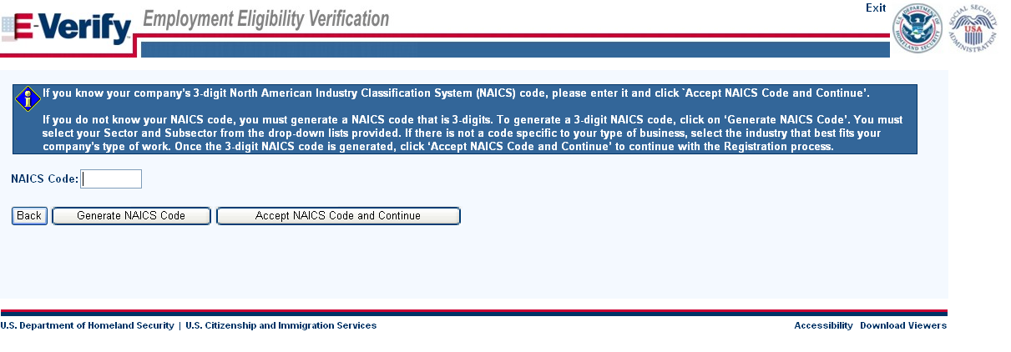
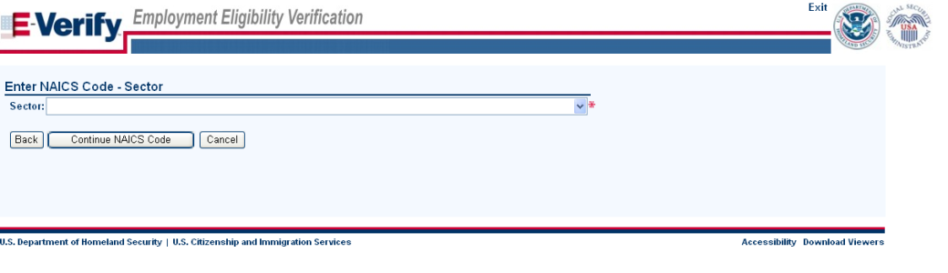
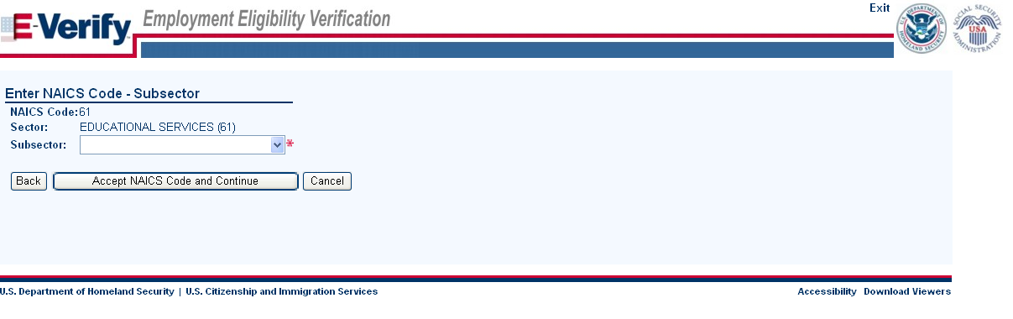
Enter NAICS Code

Slide 12
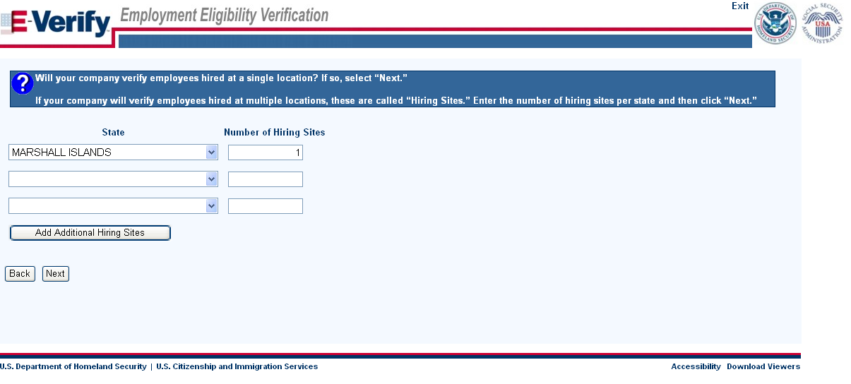
Enter Hiring Site Information
VIRGINIA

Slide 13
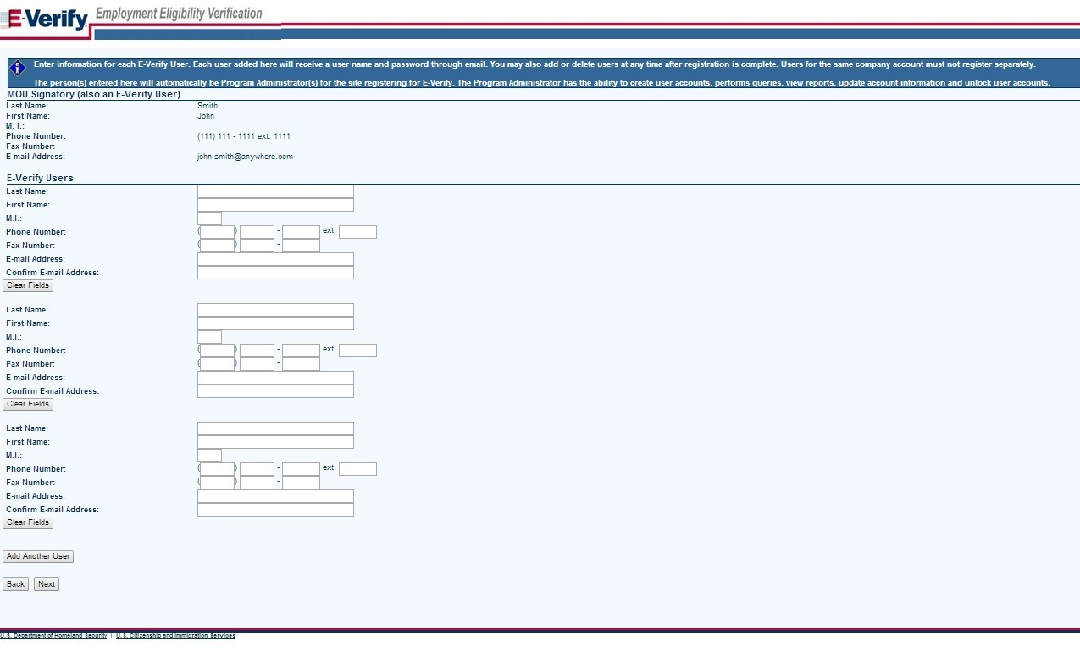
Register E-Verify Users

Slide 14
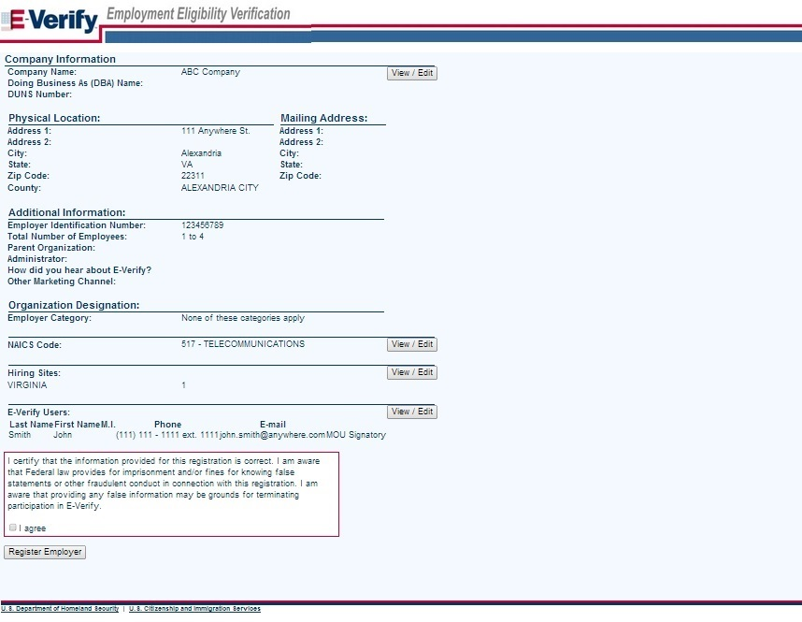
Review and Certify Information

Slide 15
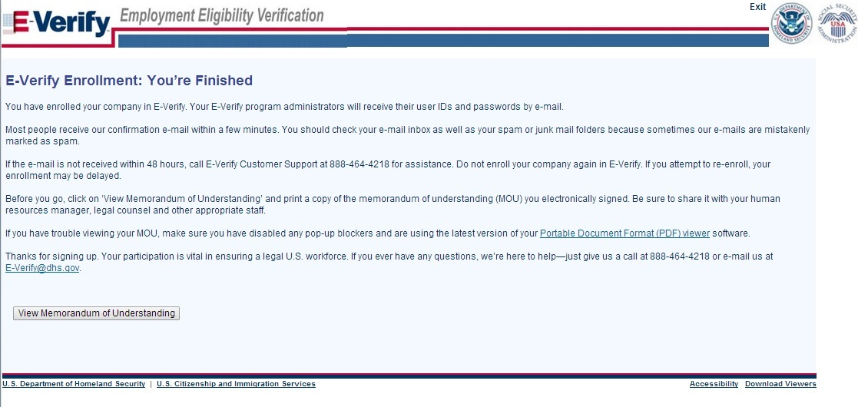
Print MOU

Slide 16
Complete Tutorial
Steps:
Log into E-Verify
Receive Required Tutorial Notification
Complete Tutorial
Pass Knowledge Test

Slide 17
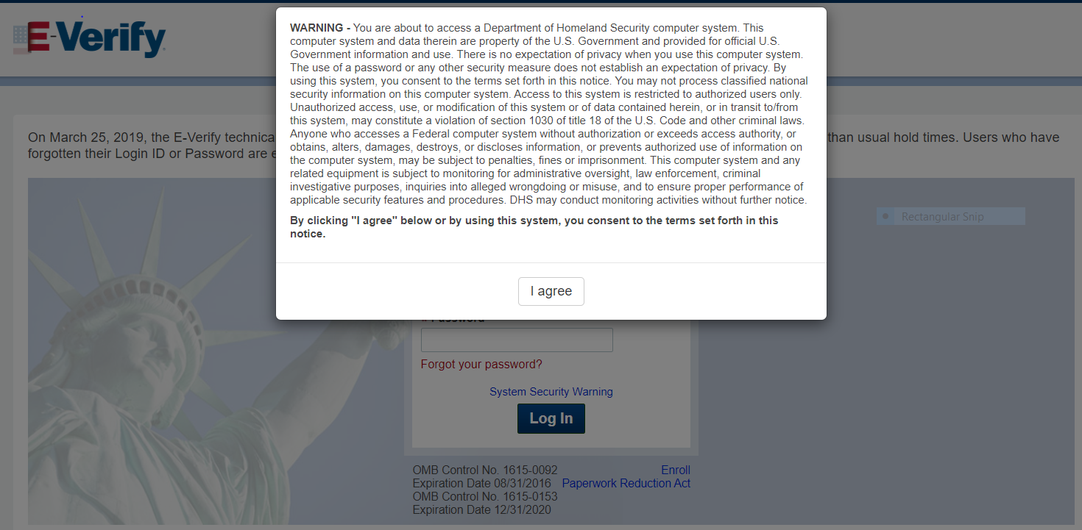
Access E-Verify Website

Slide 18
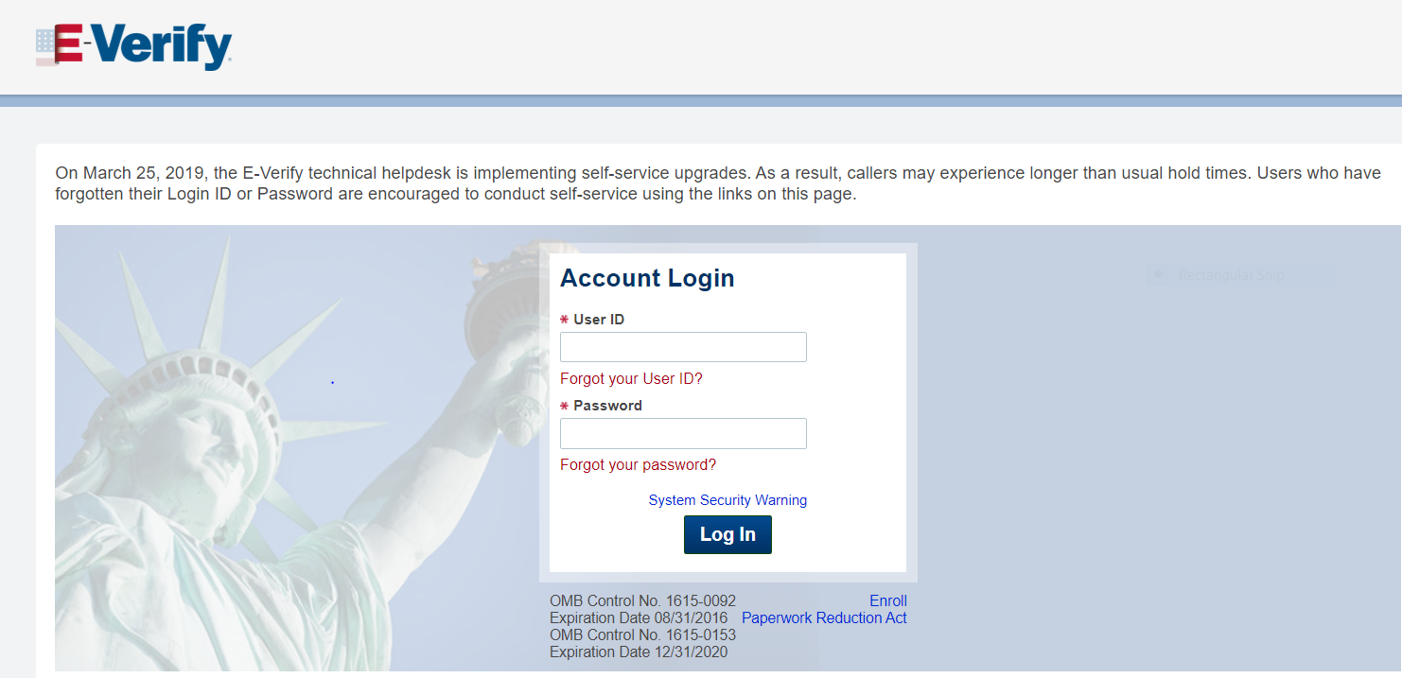
E-Verify Log-in Screen

Slide 19
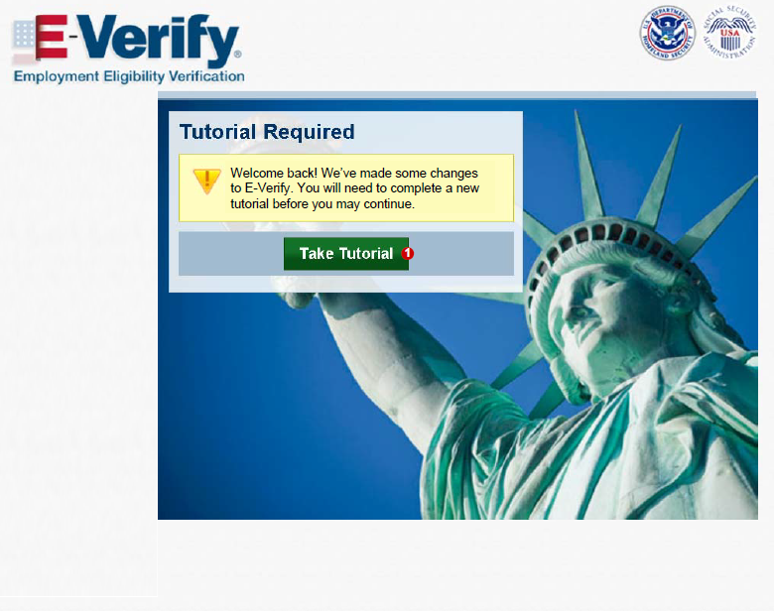
Tutorial Required

Slide 20
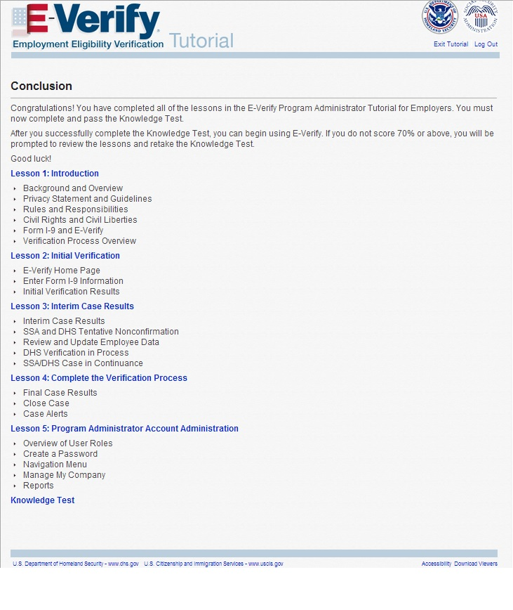
Tutorial Completion Screen

Slide 21
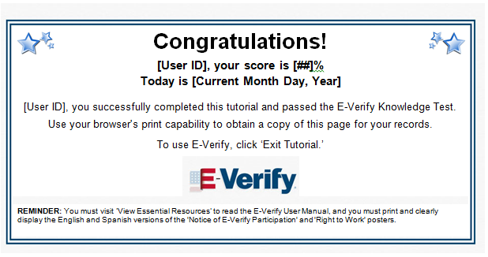
Knowledge Test Completed

Slide 22
Create Case
Steps:
Log into E-Verify
Select Create New Case
Select and Enter Form I-9 Information
Submit Case to E-Verify
Review Case Results

Slide 23
Access E-Verify Website

Slide 24
E-Verify Log-in Screen

Slide 25
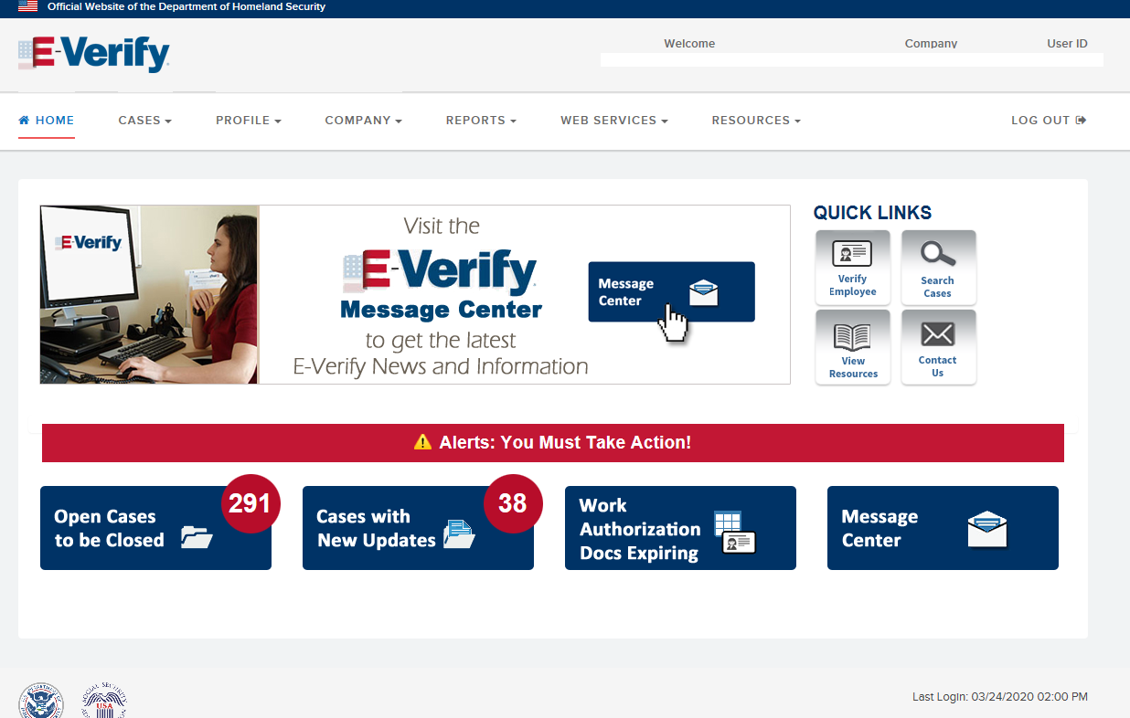
E-Verify Home Page

Slide 26
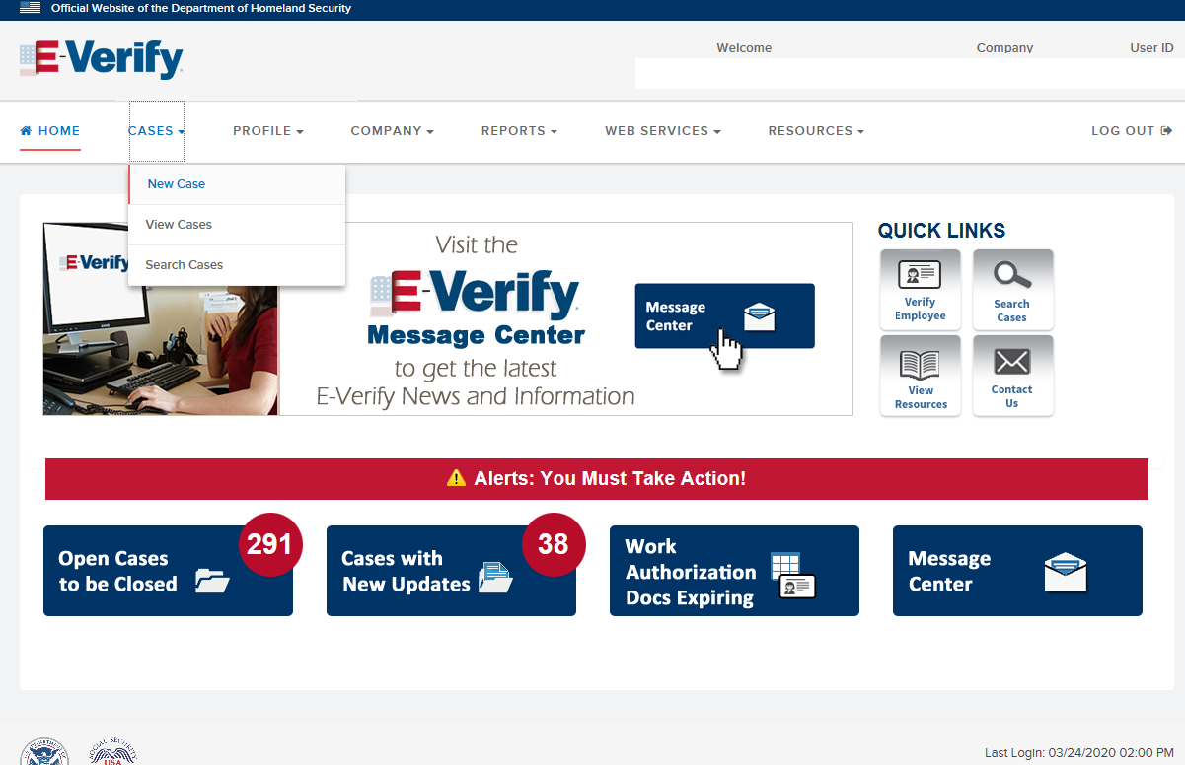
Create New Case

Slide 27
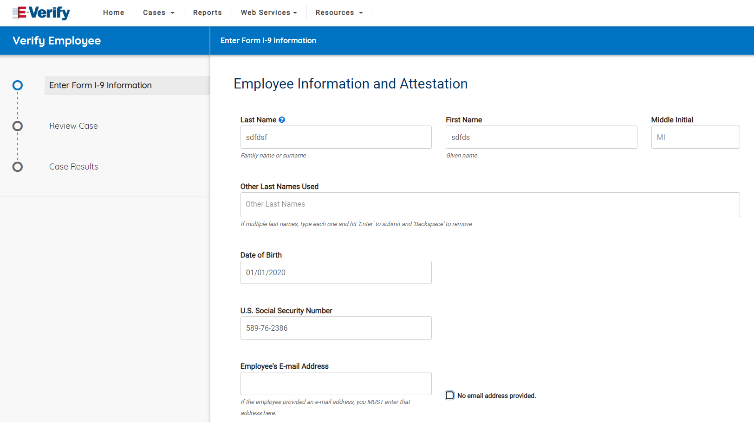
Form I-9 Section 1 Entry Page

Slide 28
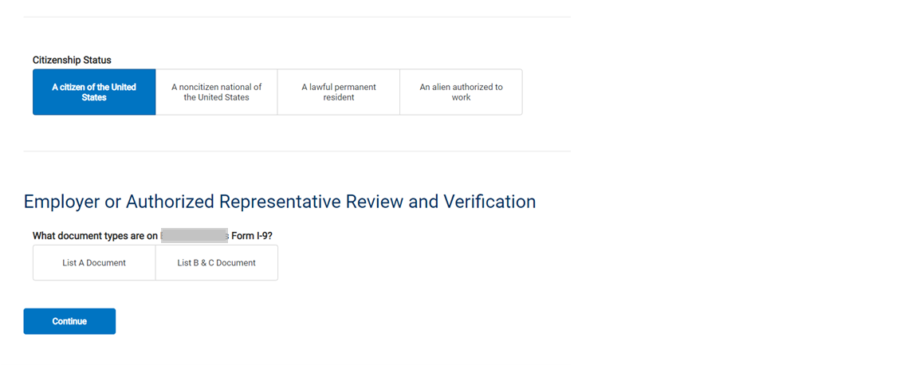
Attestation Page*
*Attestation Page is the Same for All Citizenship Statuses

Slide 29
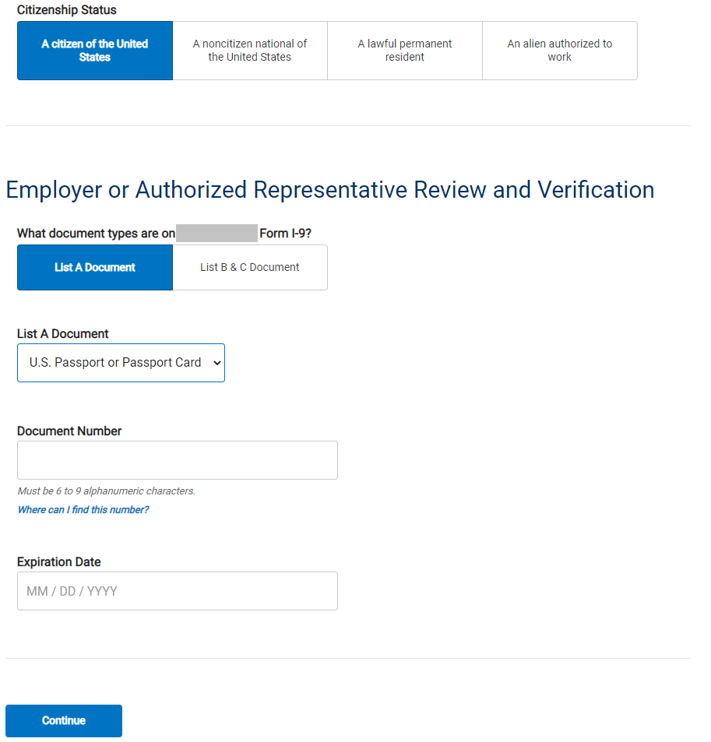
Form I-9 Section 2 Entry Page, U.S. Citizen, List A Document, U.S. Passport or Passport Card

Slide 30
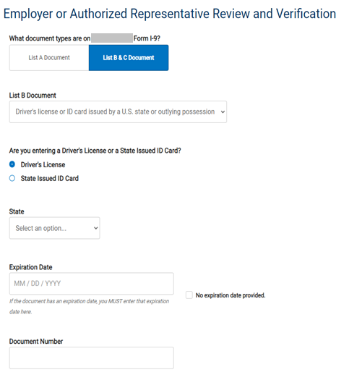
Form I-9 Section 2 Entry Page, U.S. Citizen, List B Document, Driver’s License or State ID

Slide 31
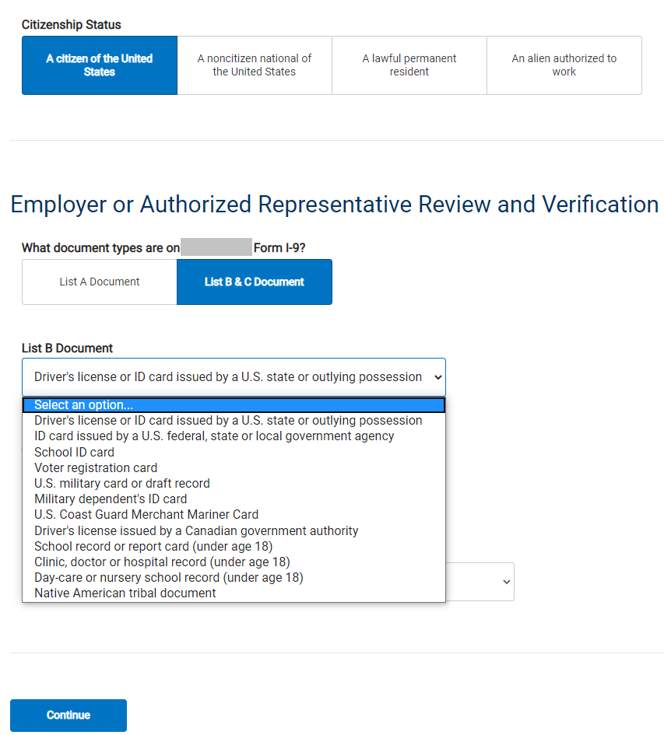
Form I-9 Section 2 Entry Page, U.S. Citizen, List B Document*
*All List B Documents (except for the Driver’s License and State ID Card) Only Require Selecting the Document Name

Slide 32
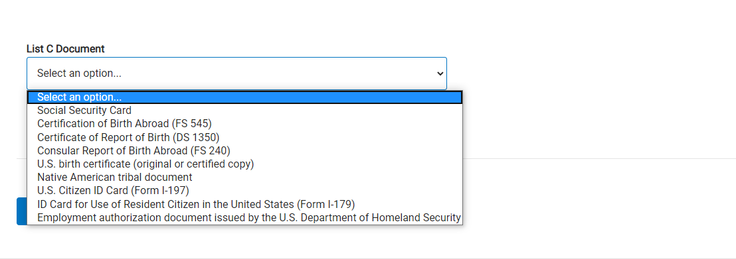
Form I-9 Section 2 Entry Page U.S. Citizen, List C Documents*
*All List C Documents Only Require Selecting the Document Name

Slide 33
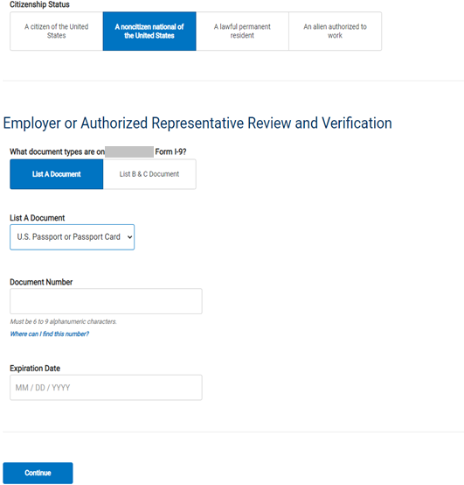
Form I-9 Section 2 Entry Page, Noncitizen National, List A Document, U.S. Passport or Passport Card

Slide 34
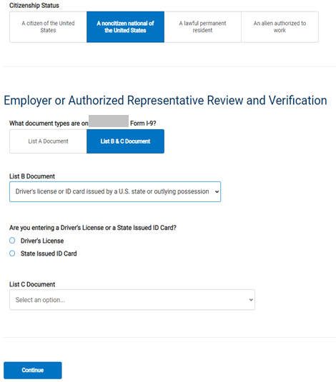
Form I-9 Section 2 Entry Page, Noncitizen National List B, Document Driver’s License or State ID

Slide 35
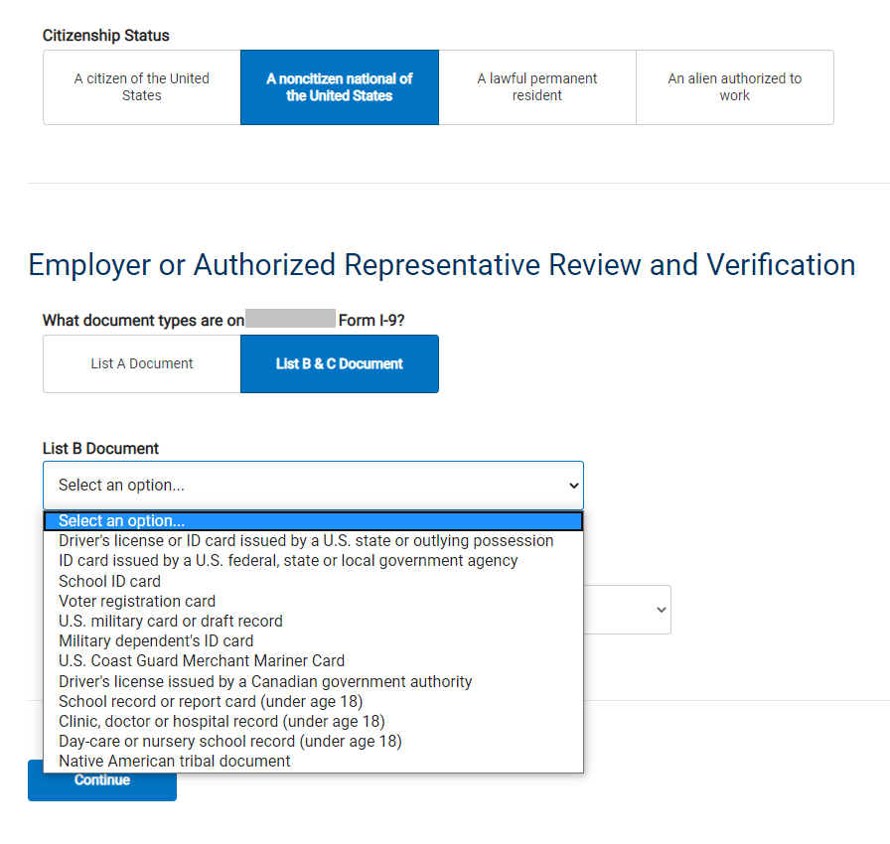
Form I-9 Section 2 Entry Page, Noncitizen National, List B Document*
*All List B Documents (except for the Driver’s License and State ID Card) Only Require Selecting the Document Name

Slide 36
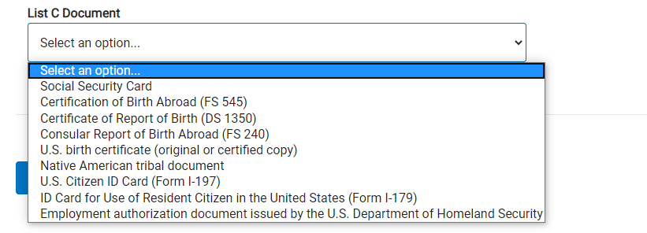
Form I-9 Section 2 Entry Page, Noncitizen National, List C Documents*
*All List C Documents Only Require Selecting the Document Name

Slide 37
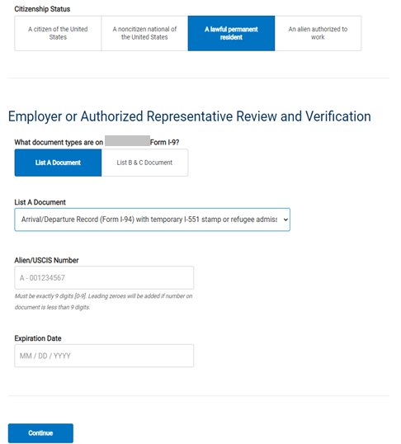
Form I-9 Section 2 Entry Page, Permanent Resident, List A Document, Form I-94 with Temporary I-551 or Refugee Admission Stamp

Slide 38
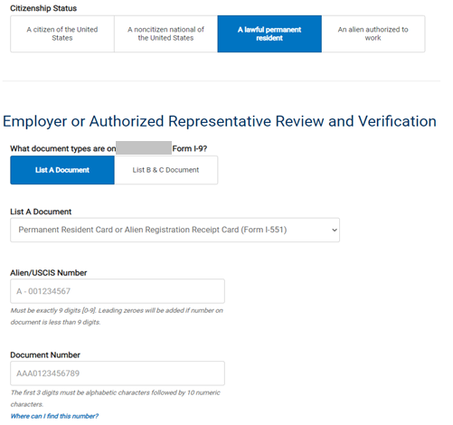

Form I-9 Section 2 Entry Page, Permanent Resident, List A Document, Permanent Resident Card or Alien Registration Receipt Card

Slide 39
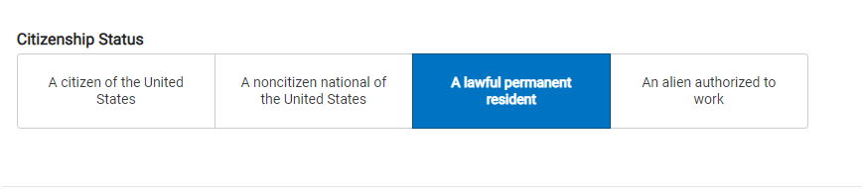
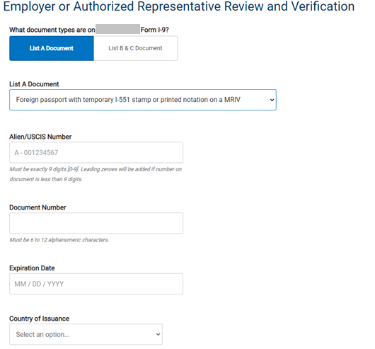
Form I-9 Section 2 Entry Page, Permanent Resident, List A Document, Foreign Passport with I-551 or MRIV

Slide 40
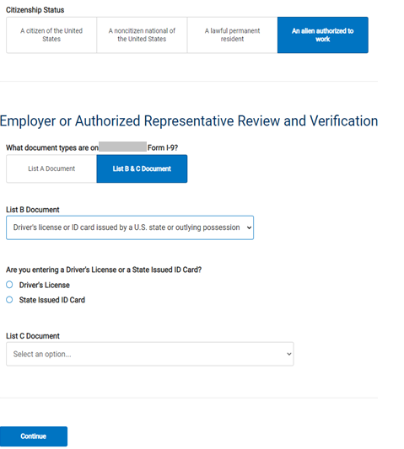
Form I-9 Section 2 Entry Page, Permanent Resident, List B Document Driver’s License or State ID

Slide 41
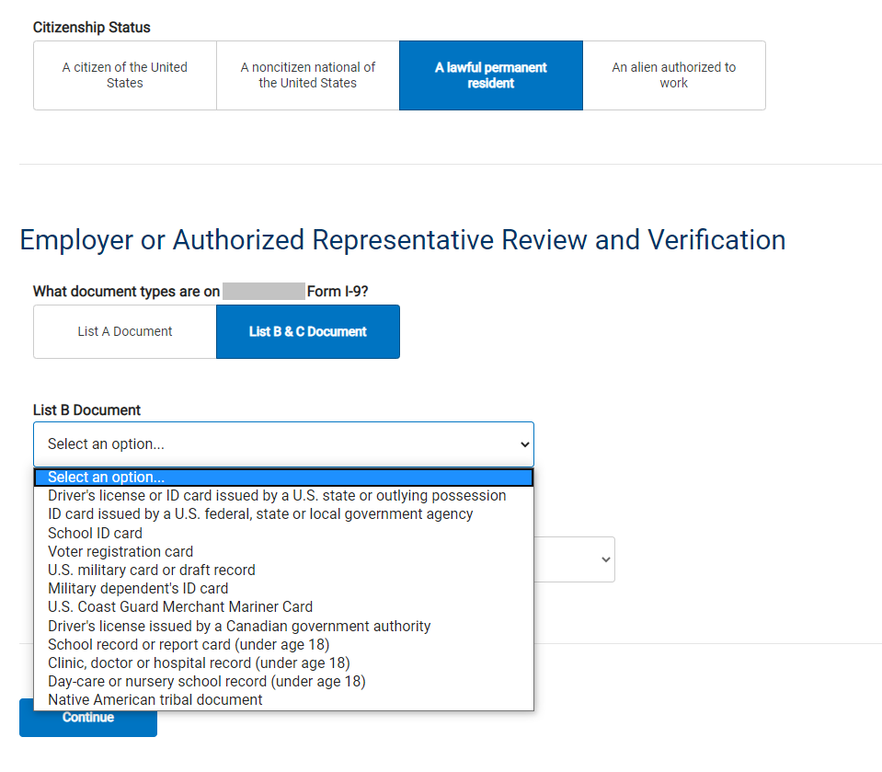
Form I-9 Section 2 Entry Page, Permanent Resident, List B Document*
*All List B Documents (except for the Driver’s License and State ID Card) Only Require Selecting the Document Name

Slide 42
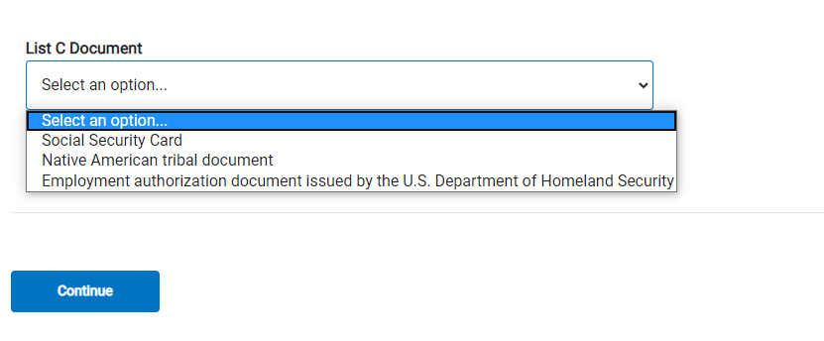
Form I-9 Section 2 Entry Page, Permanent Resident, List C Documents*
*All List C Documents Only Require Selecting the Document Name

Slide 43
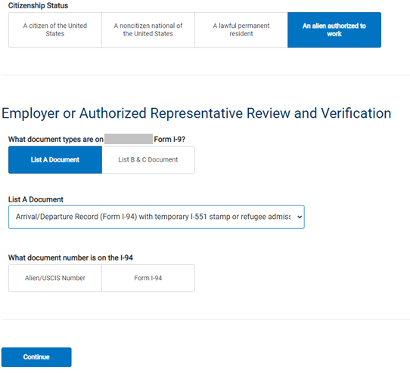
Form I-9 Section 2 Entry Page, Alien Authorized to Work, List A Document, Form I-94 with Temporary I-551 or Refugee Admission Stamp

Slide 44
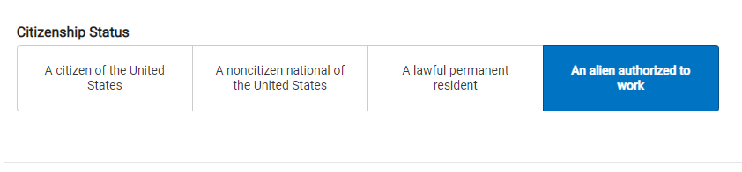
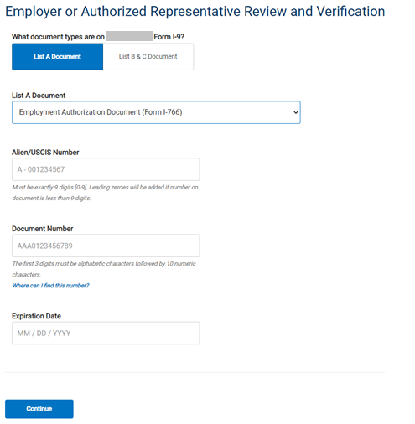
Form I-9 Section 2 Entry Page, Alien Authorized to Work, List A Document, Employment Authorization Document

Slide 45
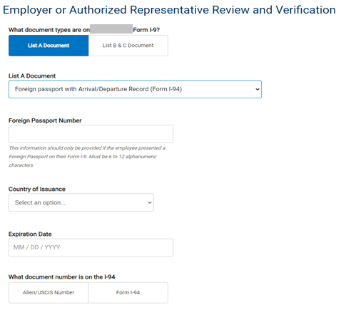
Form I-9 Section 2 Entry Page, Alien Authorized to Work, List A Document, Foreign Passport with I-94

Slide 46
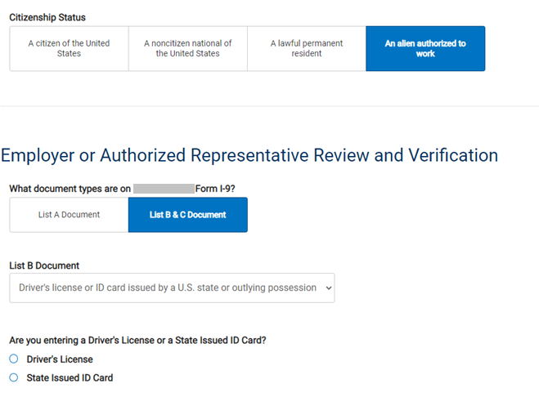
Form I-9 Section 2 Entry Page, Alien Authorized to Work, List B Document, Driver’s License or State ID

Slide 47
Form I-9 Section 2 Entry Page, Alien Authorized to Work, List C Documents*
*All List C Documents Only Require Selecting the Document Name

Slide 48
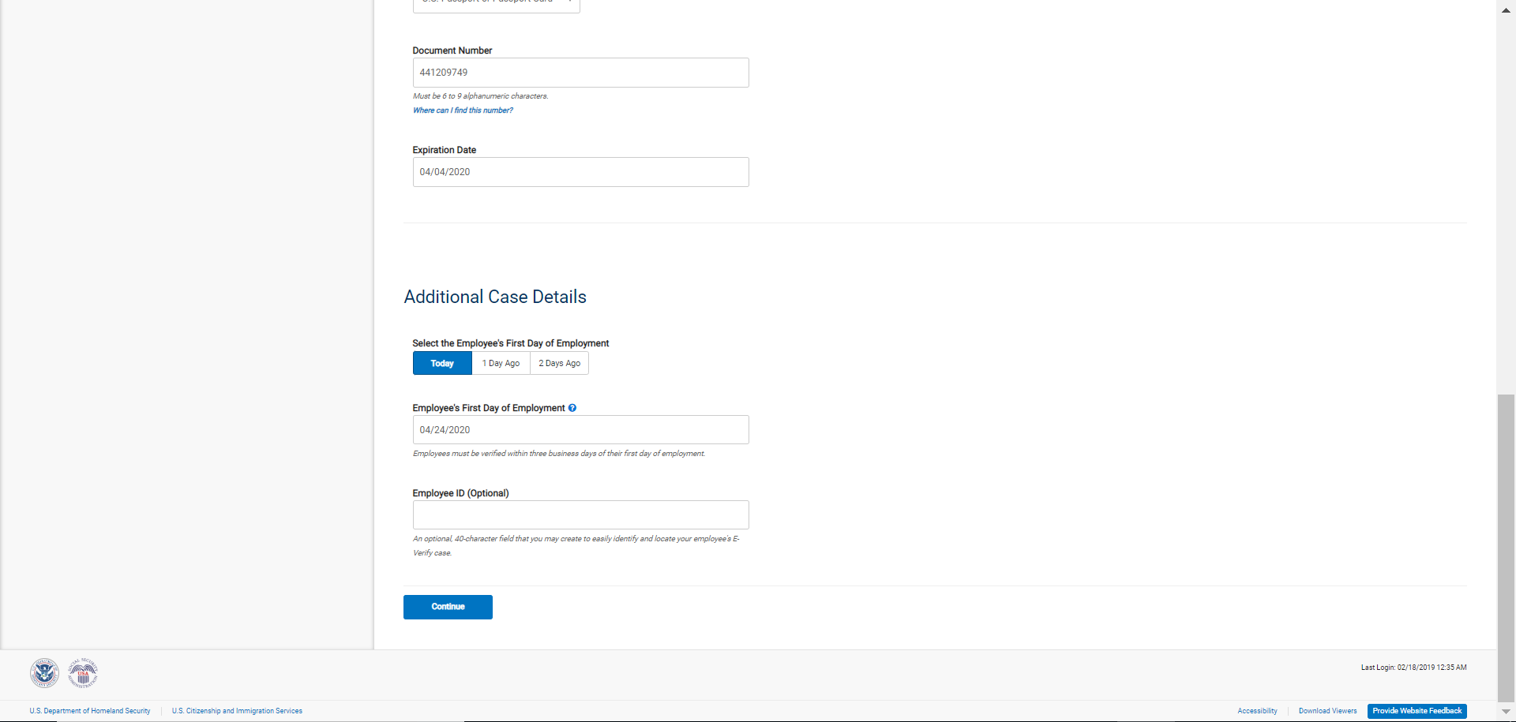
Additional Case Details Entry Page

Slide 49
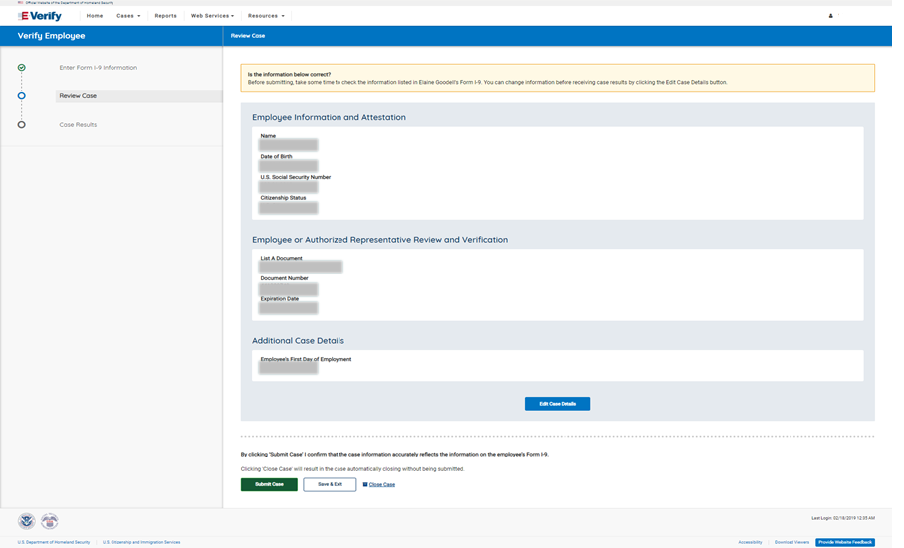
Verify Data

Slide 50
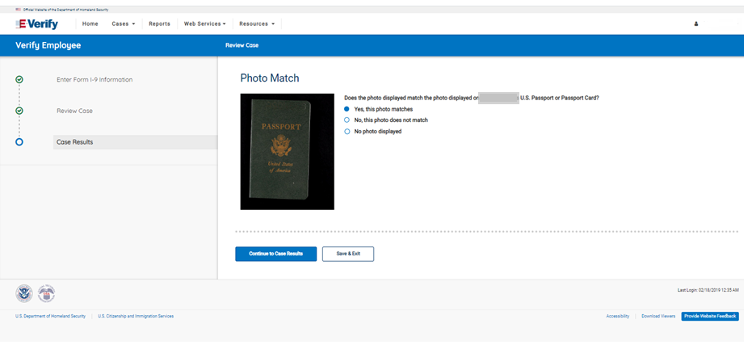
Photo Matching

Slide 51
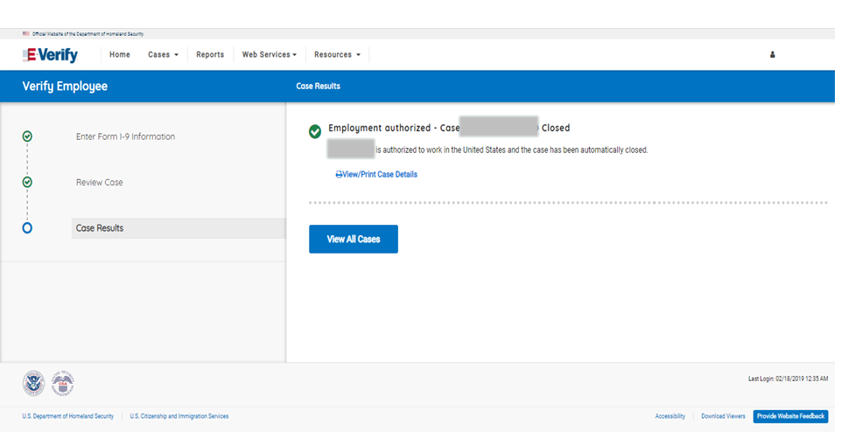
Case Results

Slide 52

Final Nonconfirmation Result

Slide 53
Tentative Nonconfirmation Process
Steps
  Review Case
  Tentative Nonconfirmation (Social Security Administration and Department of Homeland Security)
  Further Action Notice
  Referral Date Confirmation Notice
  Review Case Results

Slide 54

Review Case

Slide 55

Tentative Nonconfirmation

Slide 56


Social Security Administration Further Action Notice

Slide 57

Referral Date Confirmation

Slide 58

Social Security Administration Referral Date Confirmation Notice

Slide 59


Department of Homeland Security Further Action Notice

Slide 60
Referral Date Confirmation

Slide 61

Department of Homeland Security Referral Date Confirmation Notice

Slide 62
Case Results

Slide 63
Final Nonconfirmation Result

