Slide 1
GDA
Appendix F – FOP Schemes and Mock Product Labels for FDA FOP Experiment​
Middle
Least Healthy
Healthiest

Slide 2
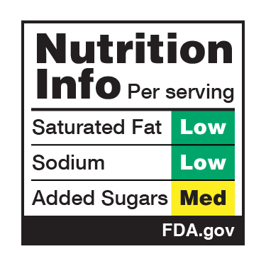
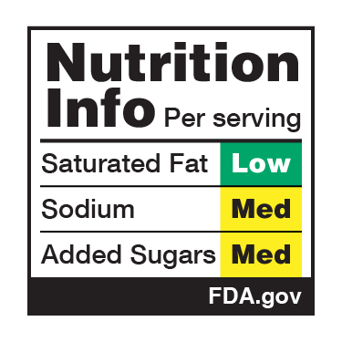
Nutrition Info
Healthiest
Middle
Least Healthy

Slide 3
Nutrition Info w/Magnifying Glass
Healthiest
Middle
Least Healthy

Slide 4
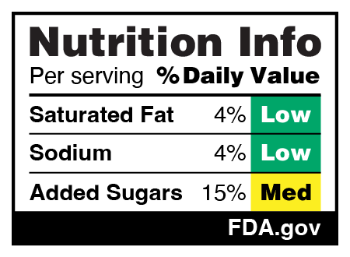
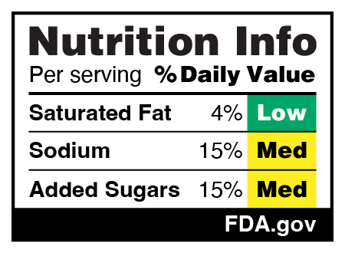
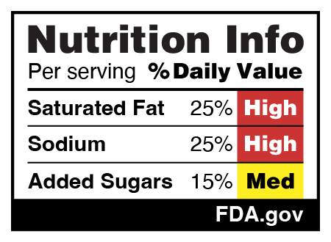
Nutrition Info w/DV
Healthiest
Middle
Least Healthy

Slide 5
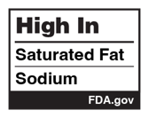
High In
Healthiest
Middle
Least Healthy

Slide 6
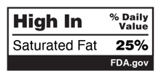
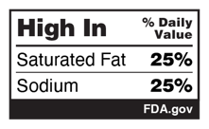
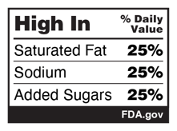
High In w/DV
Healthiest
Middle
Least Healthy

Slide 7
Breakfast cereal

Slide 8
Frozen meal

Slide 9
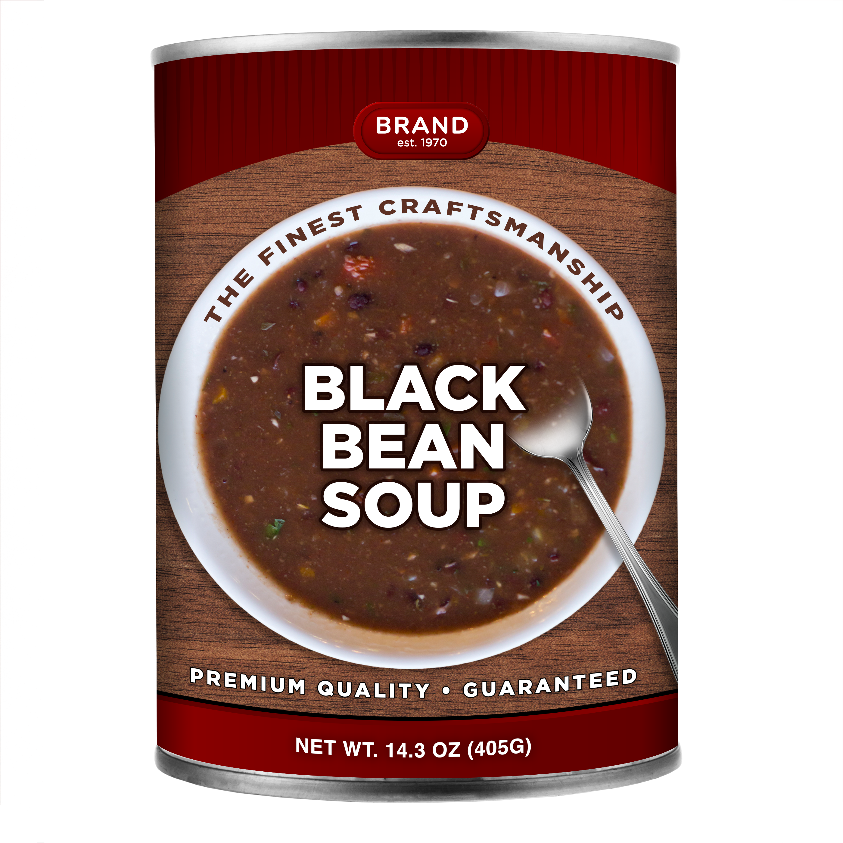
Canned Soup

