Slide 1
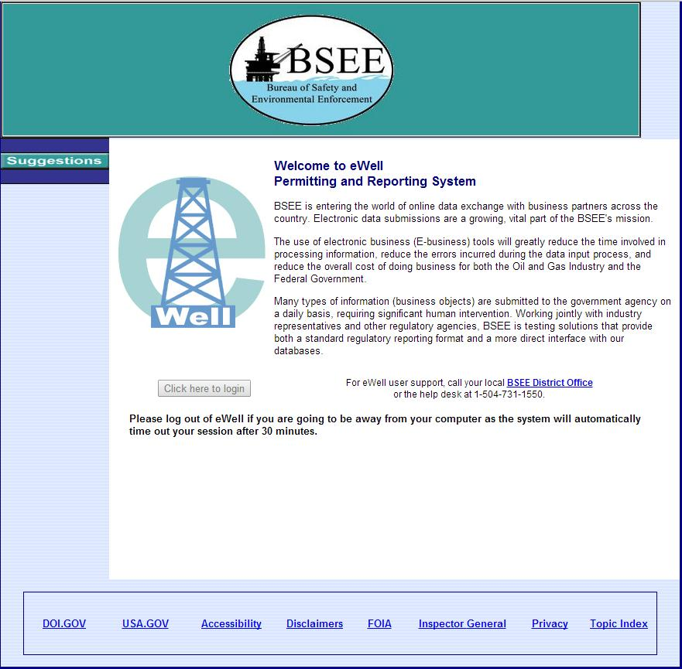
Click to get started

Slide 2
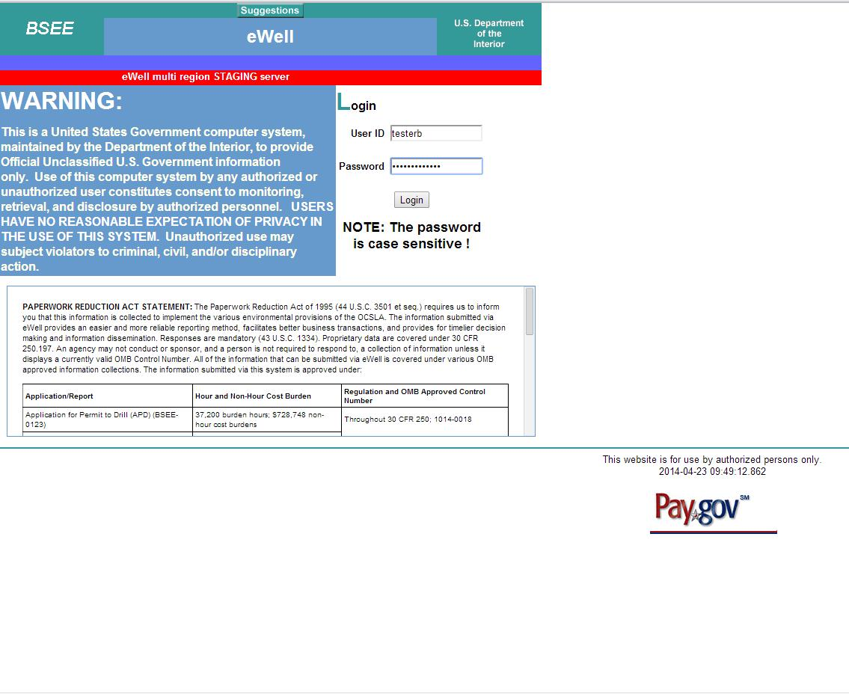
Login

Slide 3
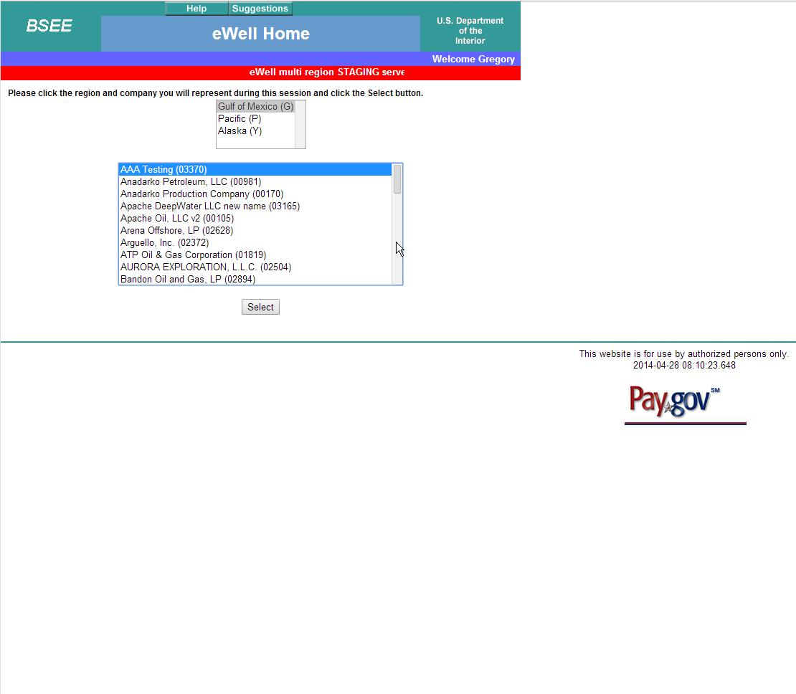
Select Region
Select Operator

Slide 4
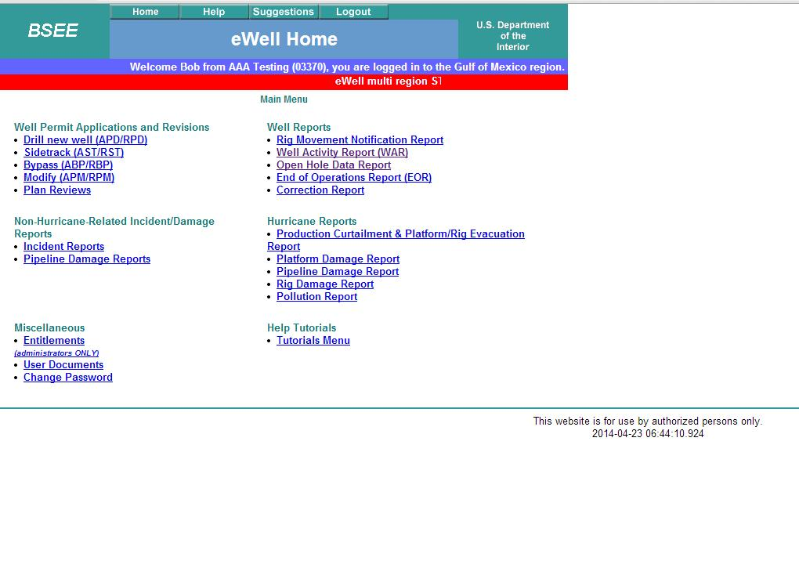
To create an Open Hole Report, you have to start in the WAR.

Slide 5
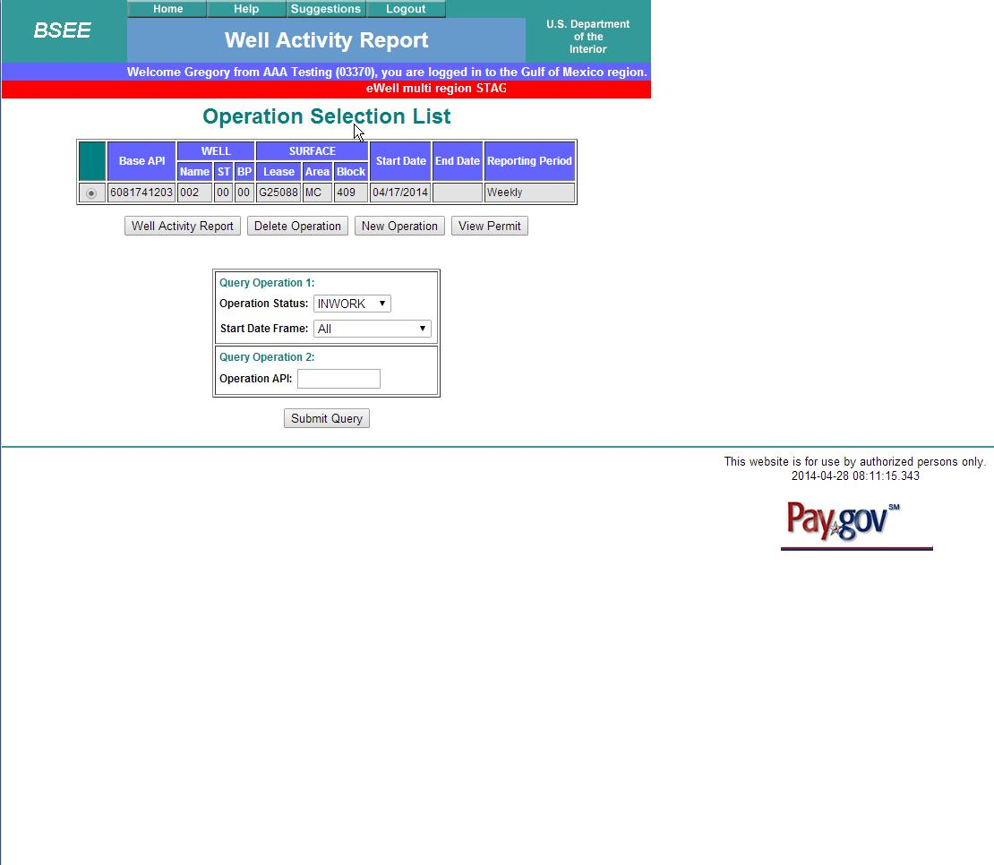
Select 10 digit API number
Then select Well Activity Report

Slide 6
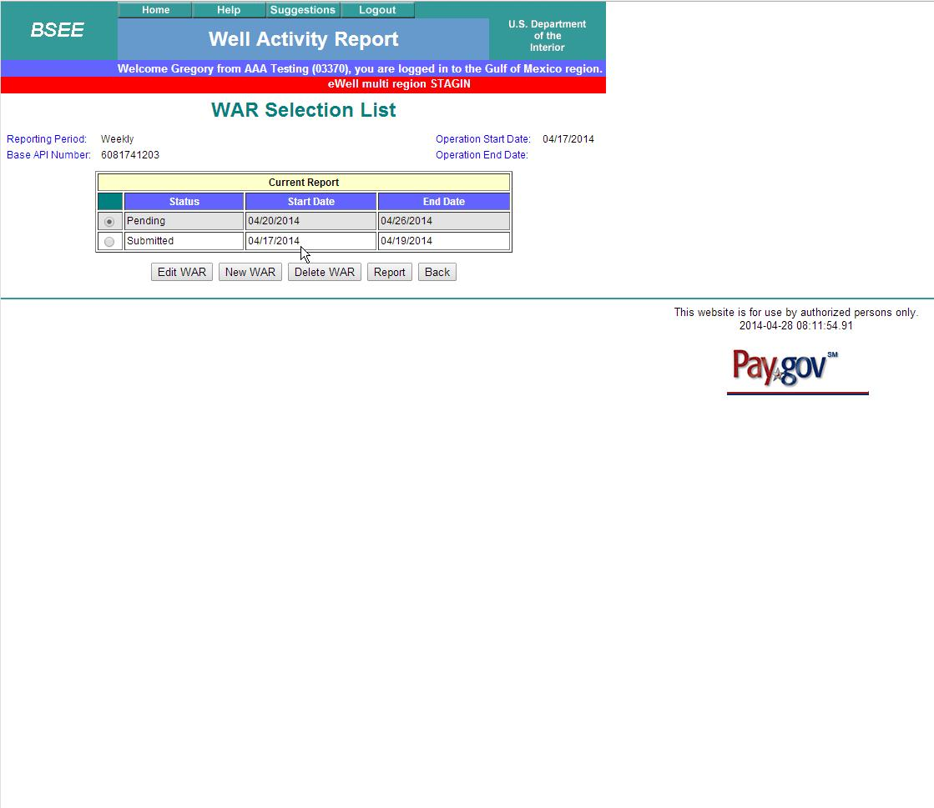
Select Pending.
Select Edit WAR

Slide 7
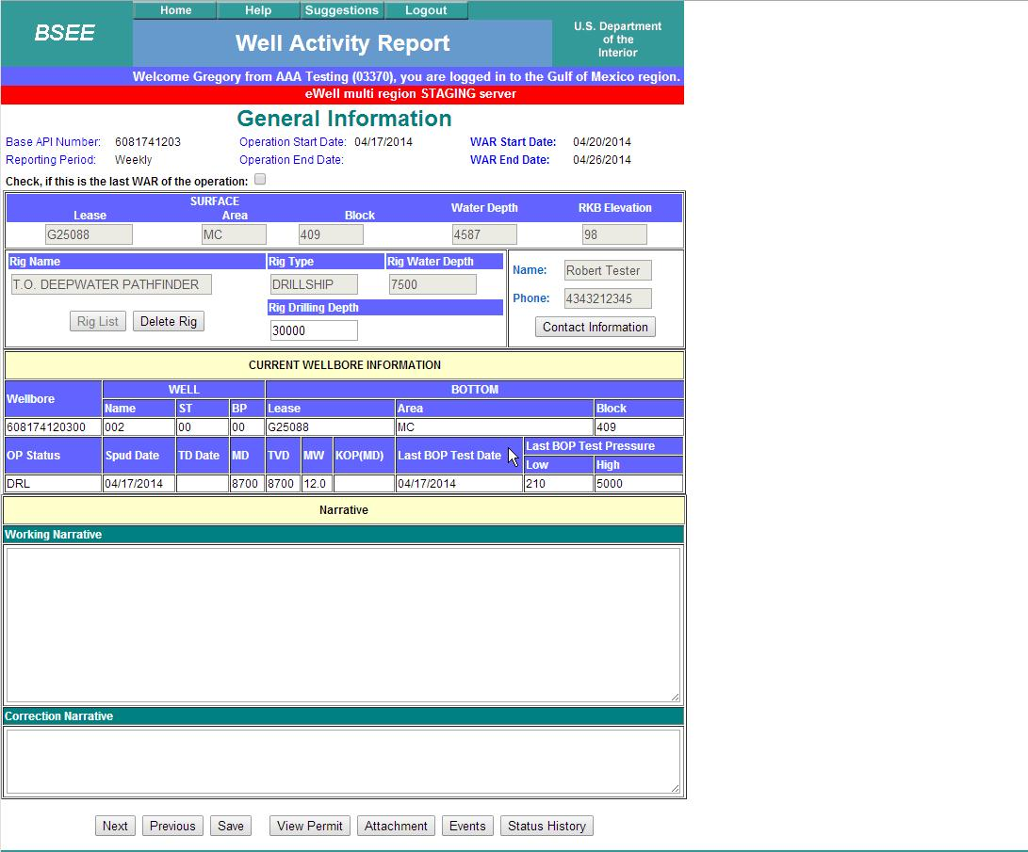
This will bring you to the General Information screen.
Select Next

Slide 8
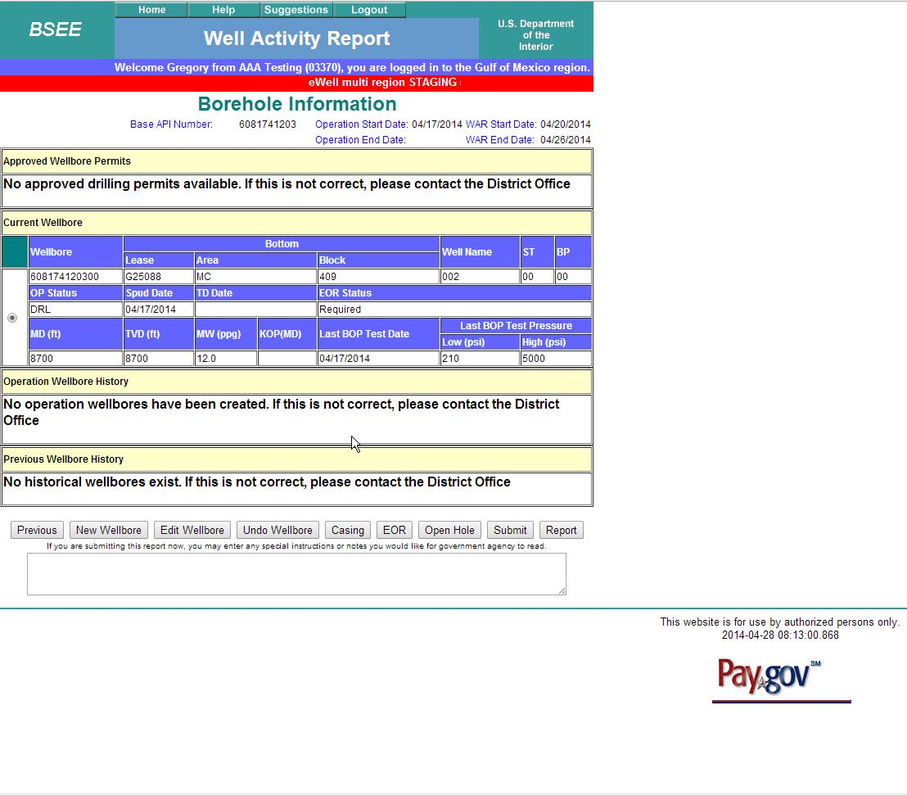
Select
Select Edit Wellbore

Slide 9
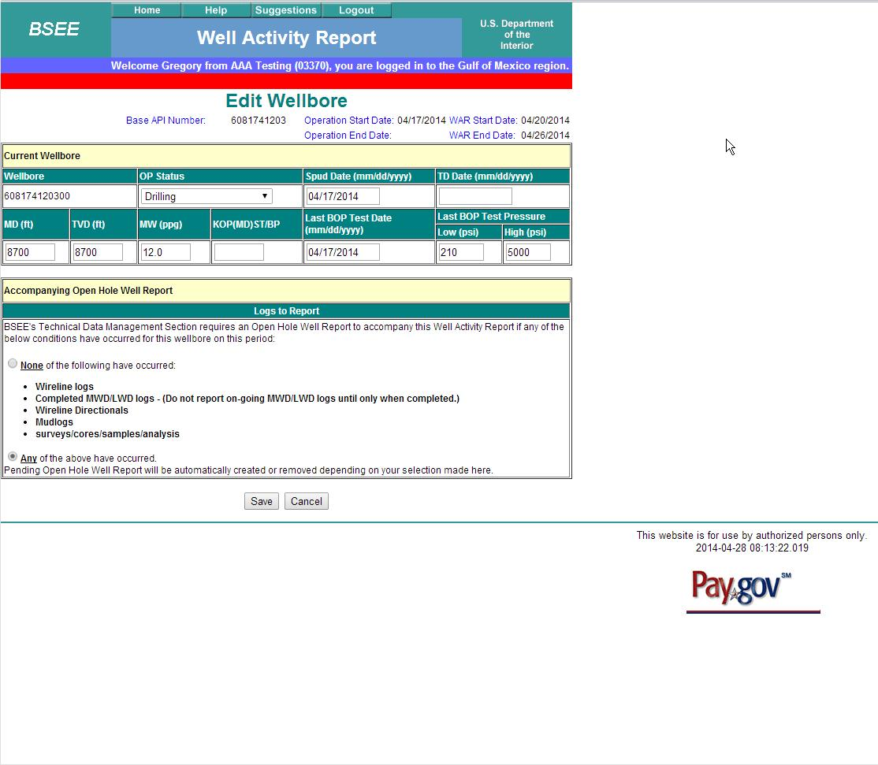
Selecting the Any button and then selecting Save will create the Open Hole Report.

Slide 10
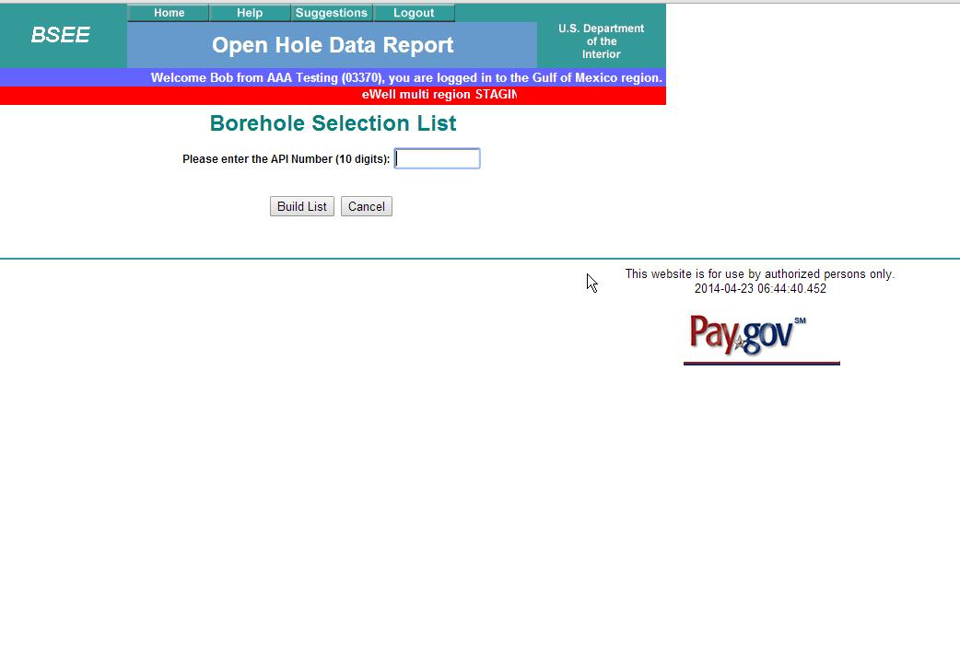
Enter API number

Slide 11
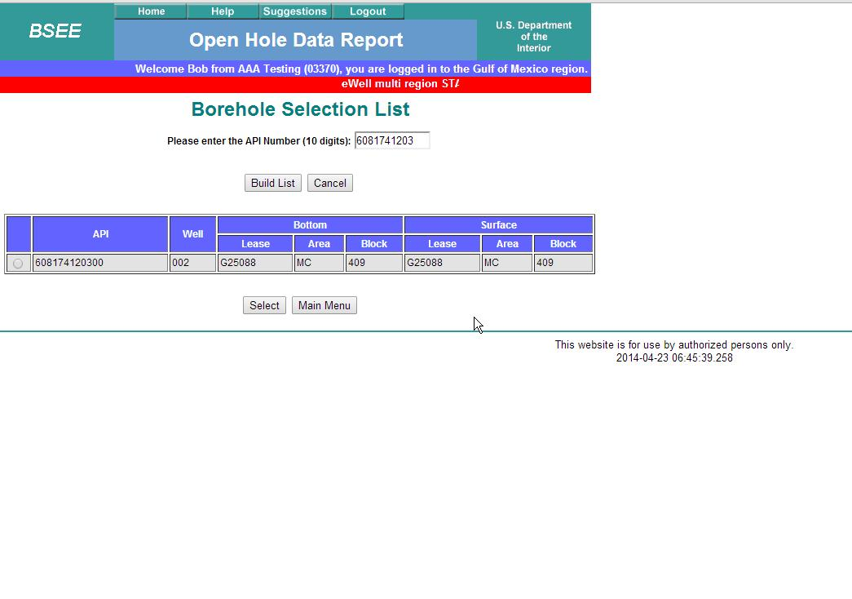
.
Select

Slide 12
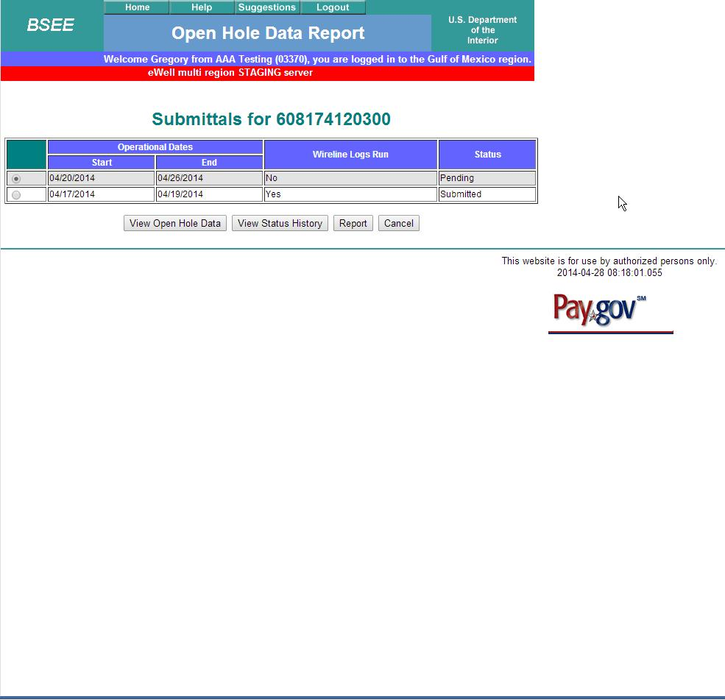
This is the Open Hole Report just created.
Select View Open Hole Data

Slide 13
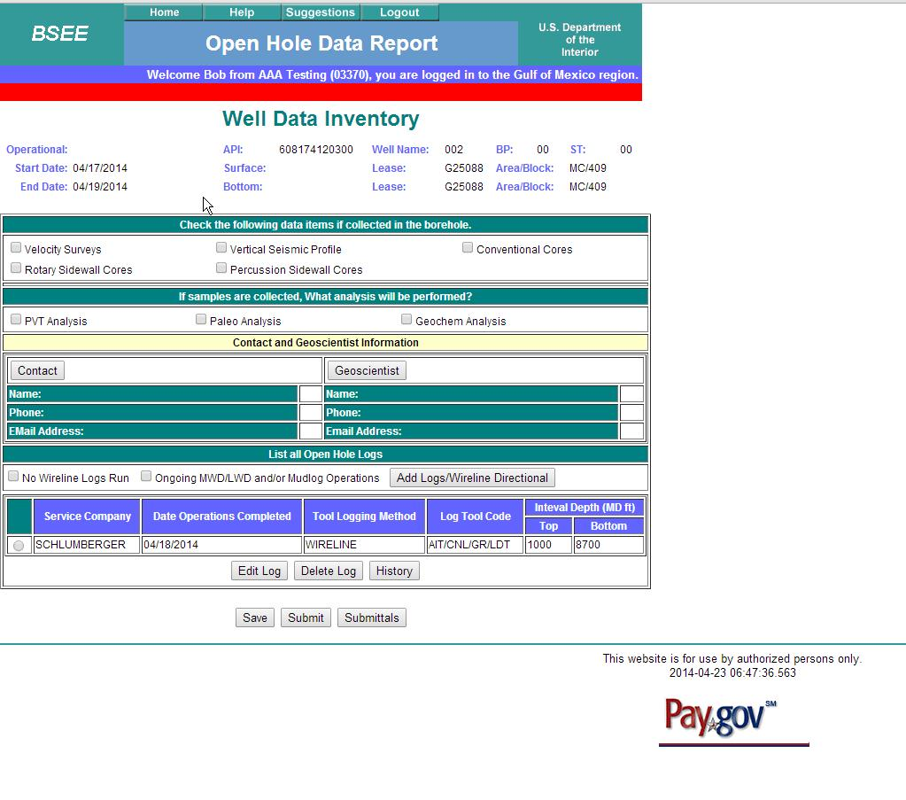
Add Logs

Slide 14
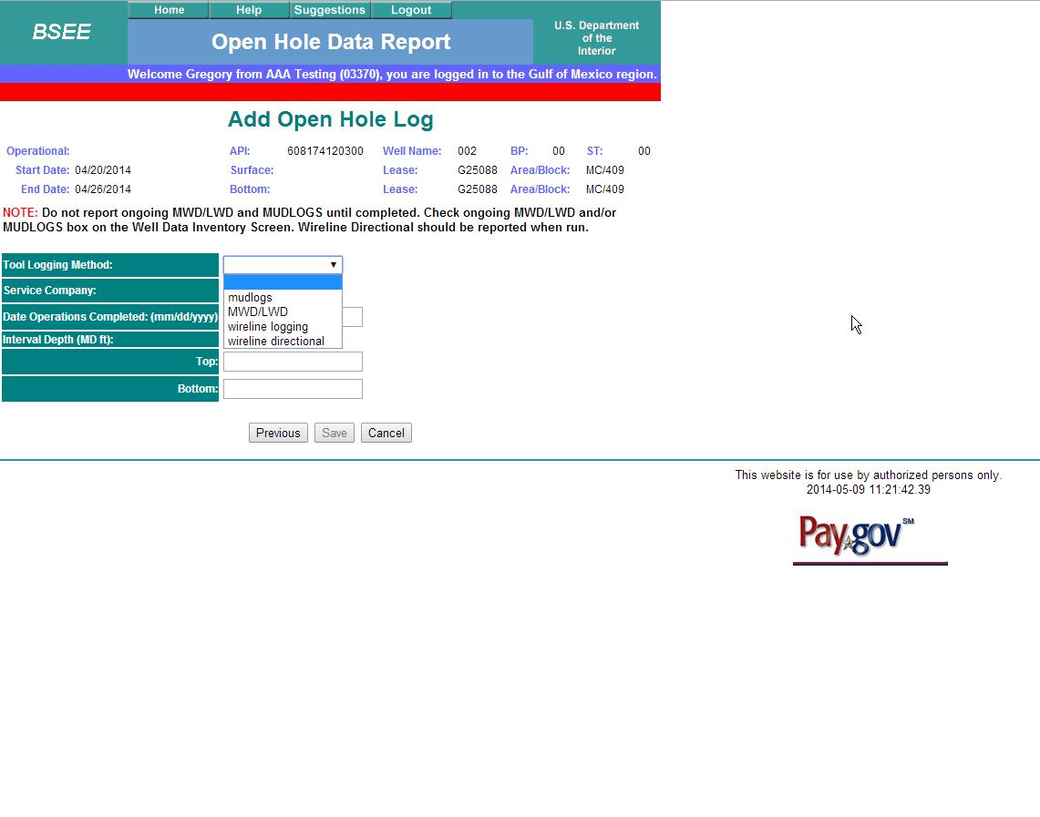
Choose Logging Method

Slide 15
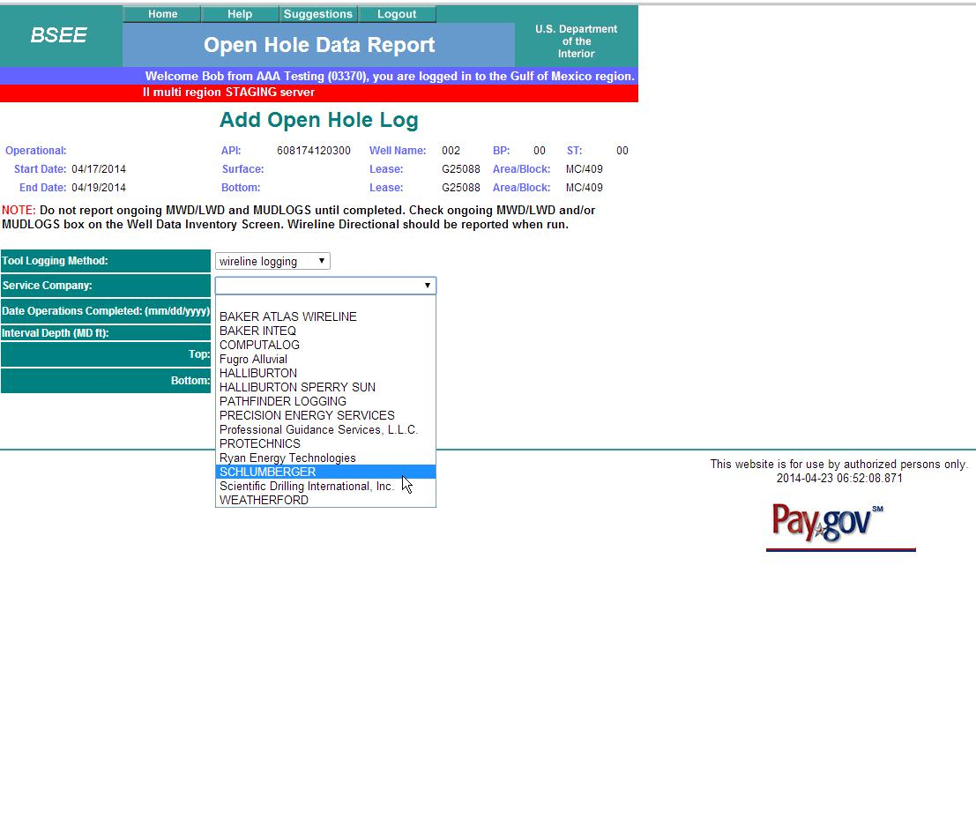
Choose Logging Company

Slide 16
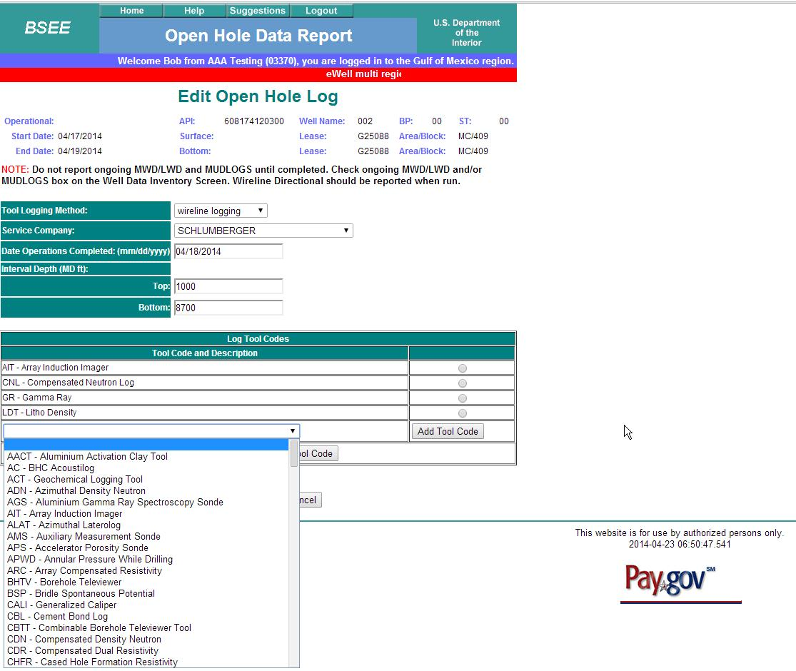
Record Date
Record Top and Bottom Depths
Add all Tool Codes for that Logging Run from Drop Down Menu

Slide 17
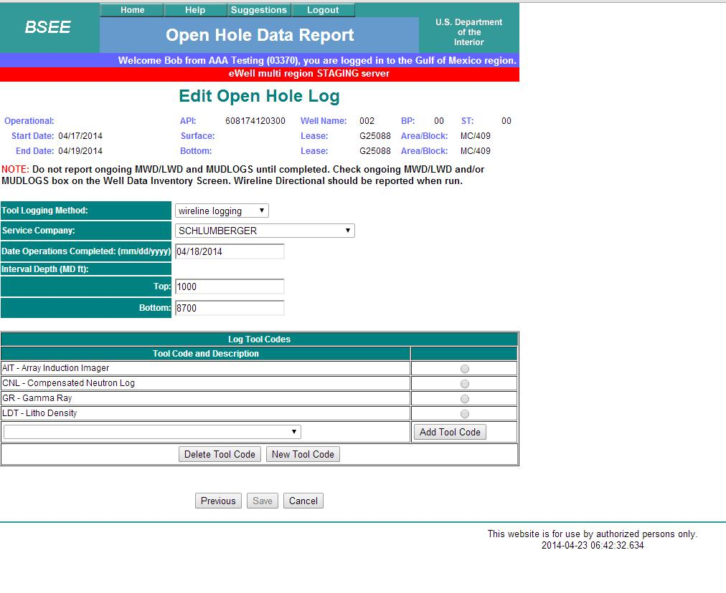
ALWAYS remember to Select the Save button.

Slide 18
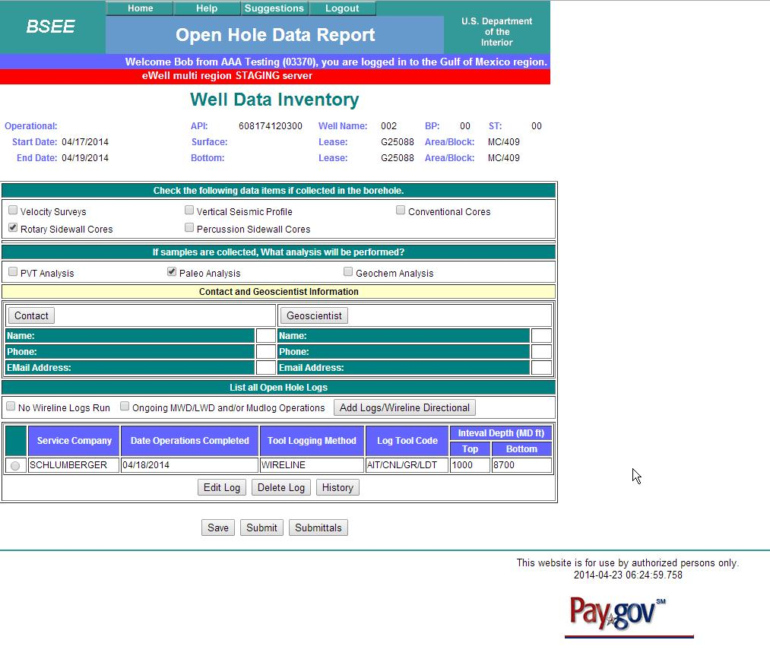

Slide 19
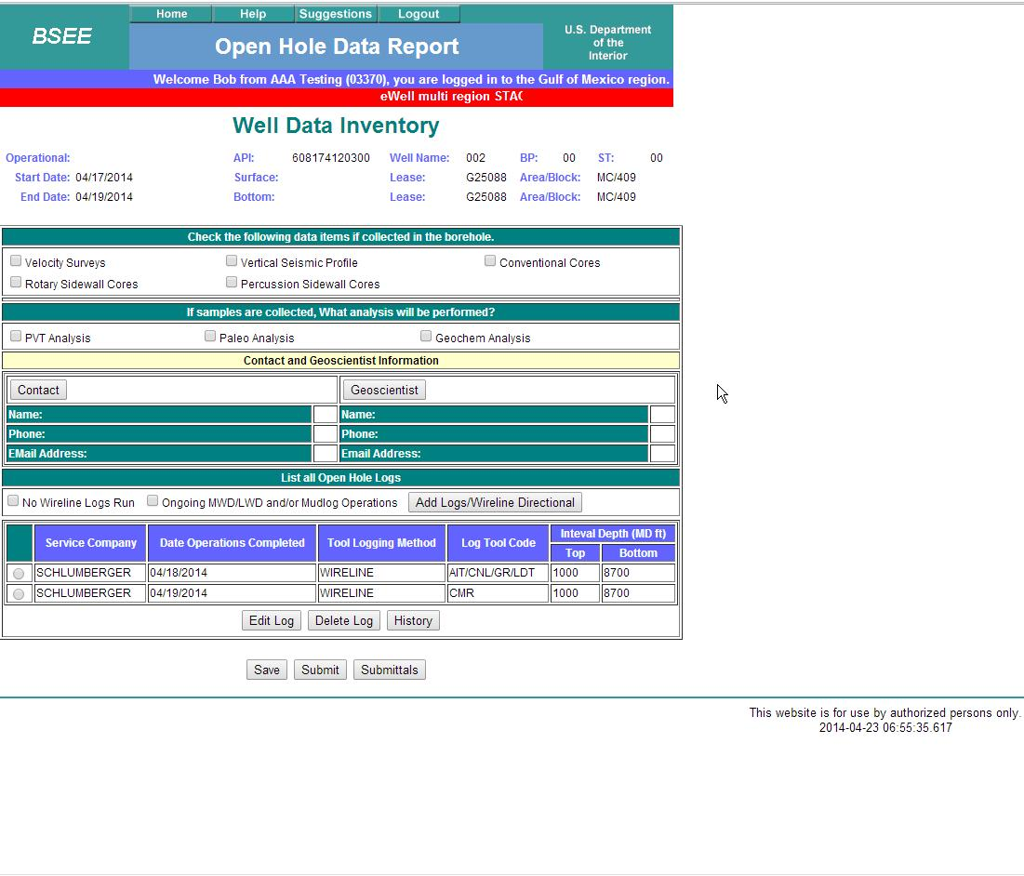

Slide 20
Select to add New Tool Code

Slide 21
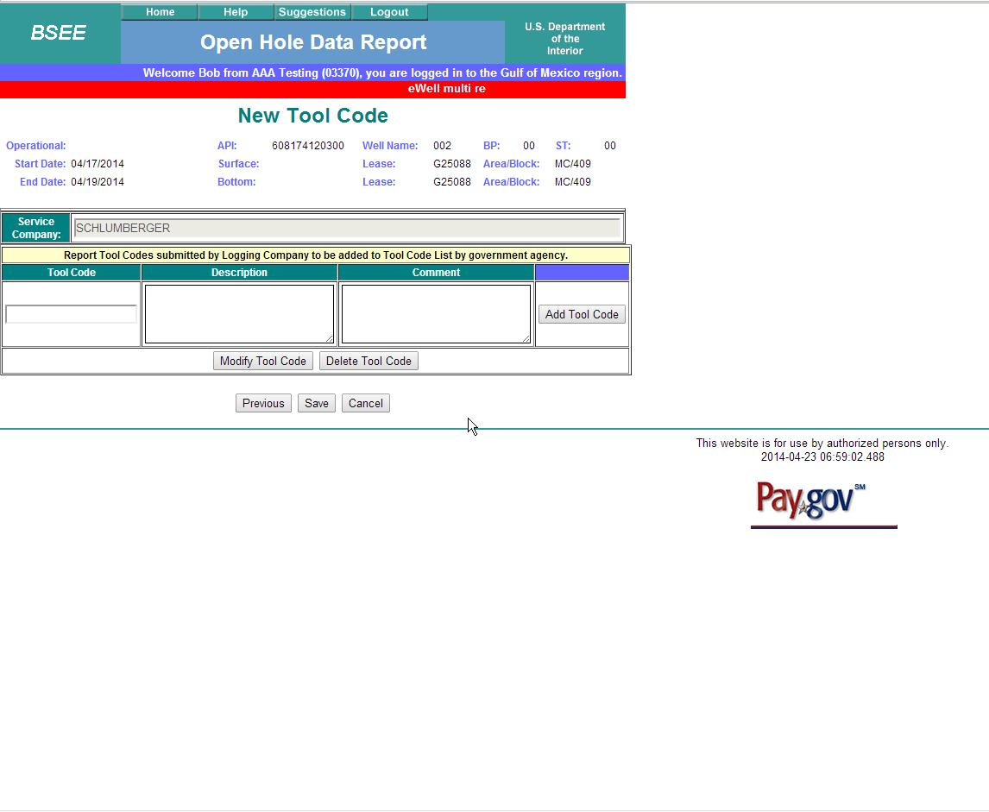

Slide 22
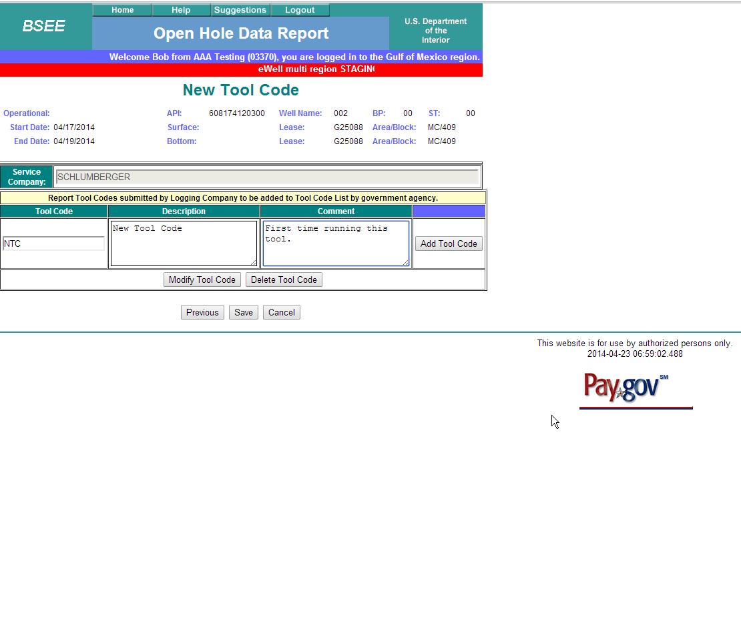
Fill in information as best as you can from service company.
ALWAYS remember to Select the Save button.

Slide 23
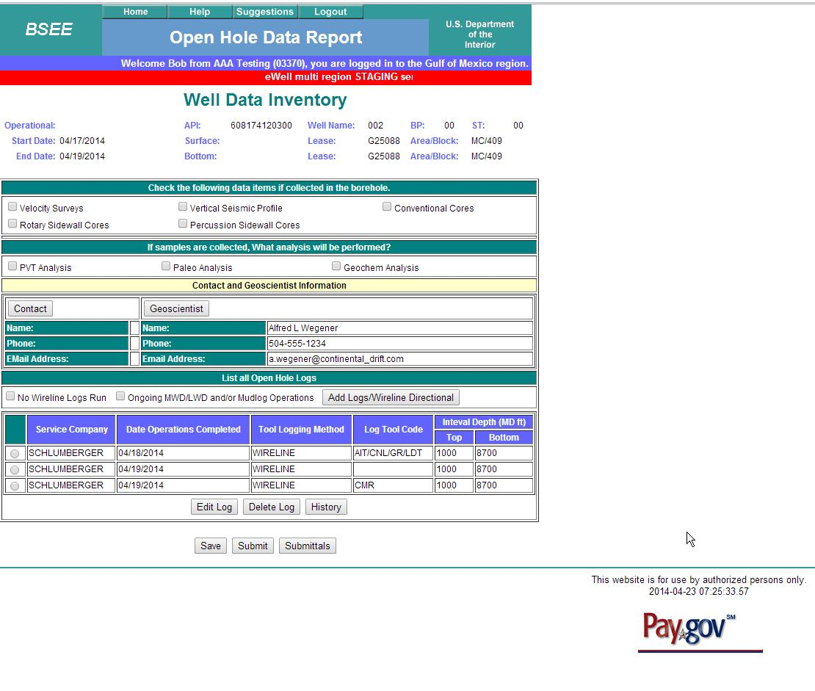
View History

Slide 24
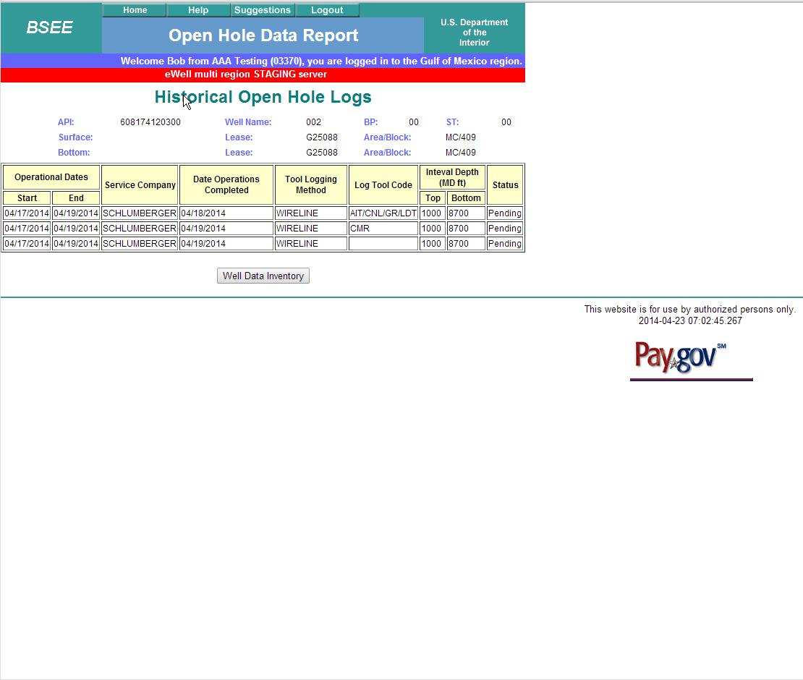

Slide 25
Adding Contacts

Slide 26
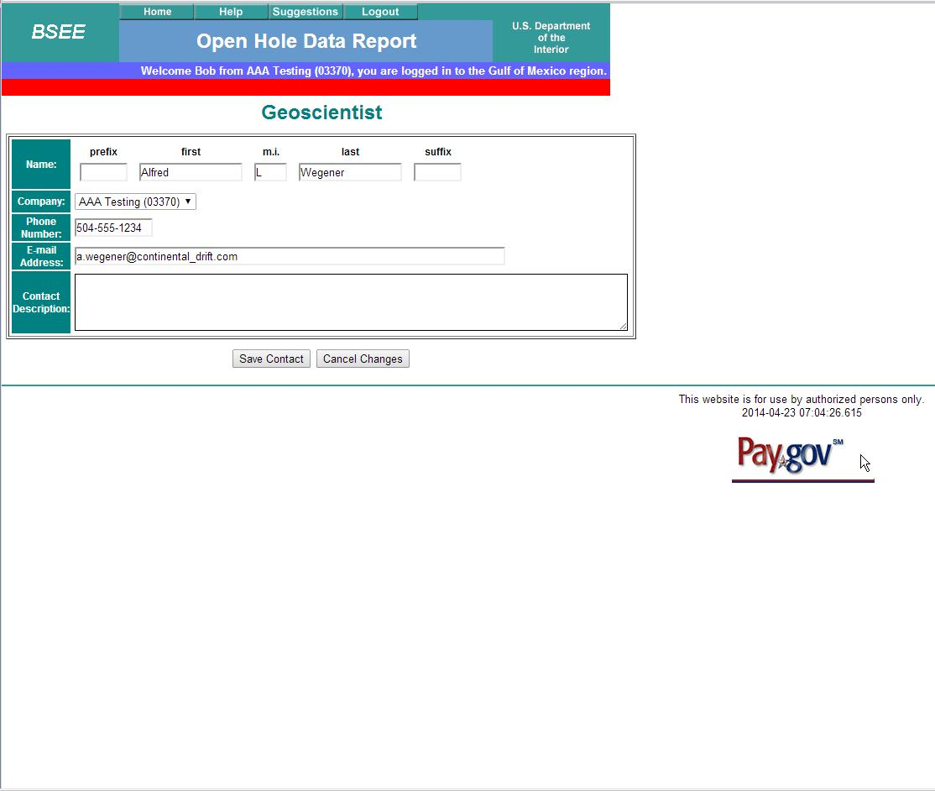
Select

Slide 27
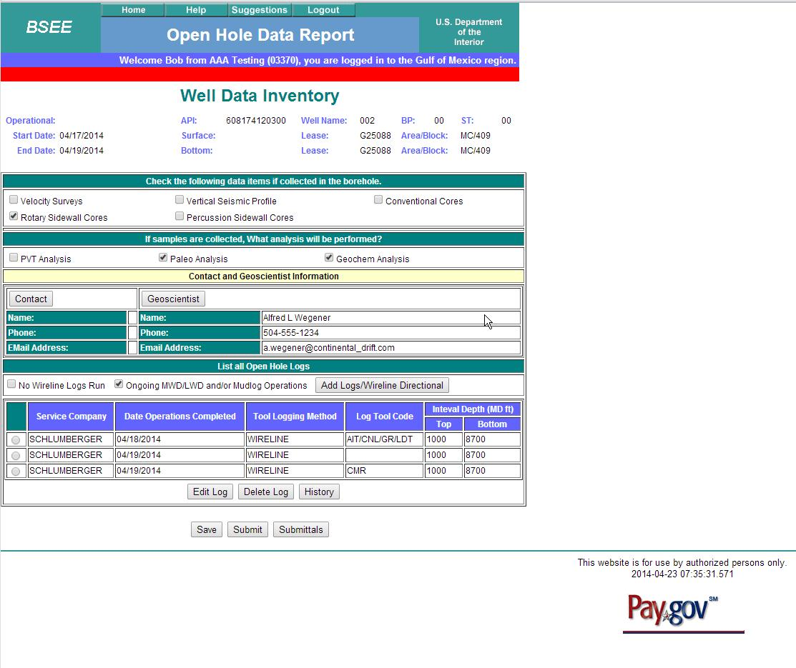

Slide 28
Check all analysis performed
ALWAYS remember to Select the Save button.

Slide 29
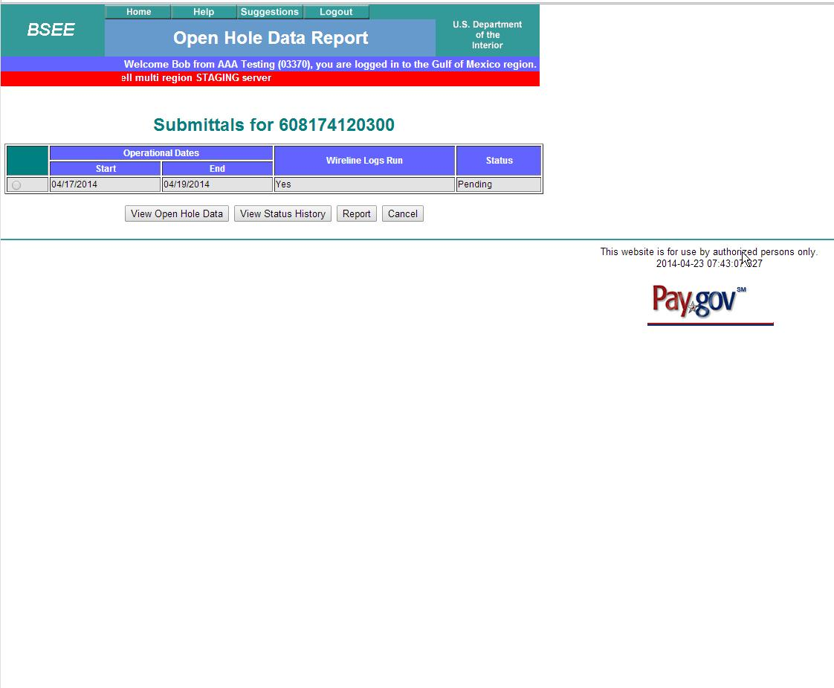
.
Select to see Report

Slide 30
