Slide 1

AIRSIDE
© Airside Mobile, Inc.. -- 2017

Slide 2
CBP “Box” Screen Progression

Slide 3
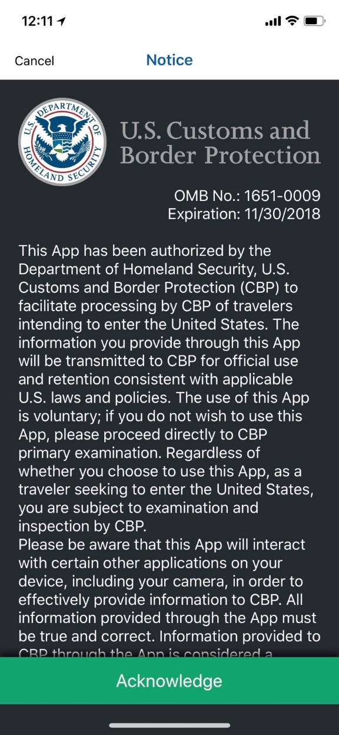
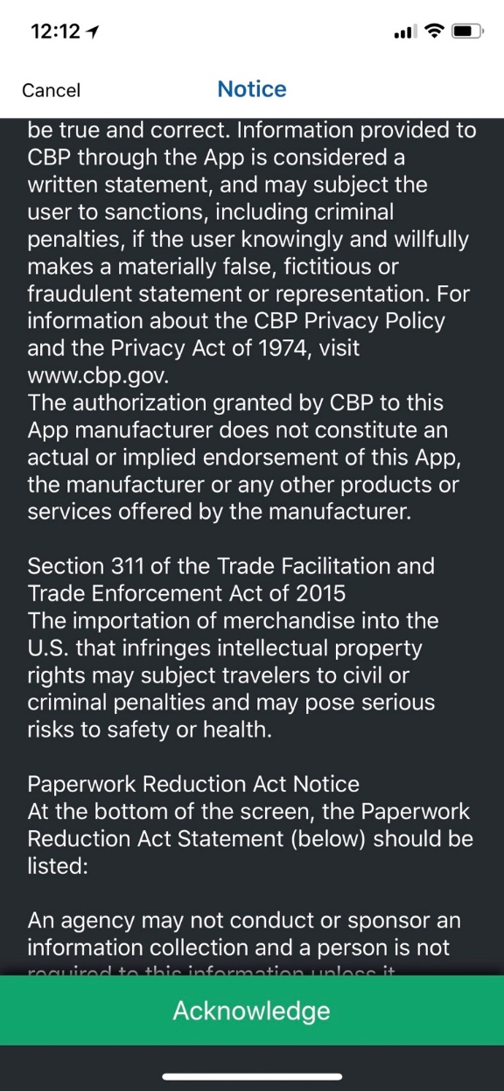
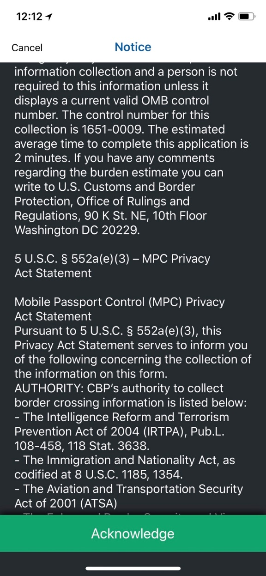
CBP “Box” Screen Progression (1 of 7)
i51a
i51b
i51c
3

Slide 4
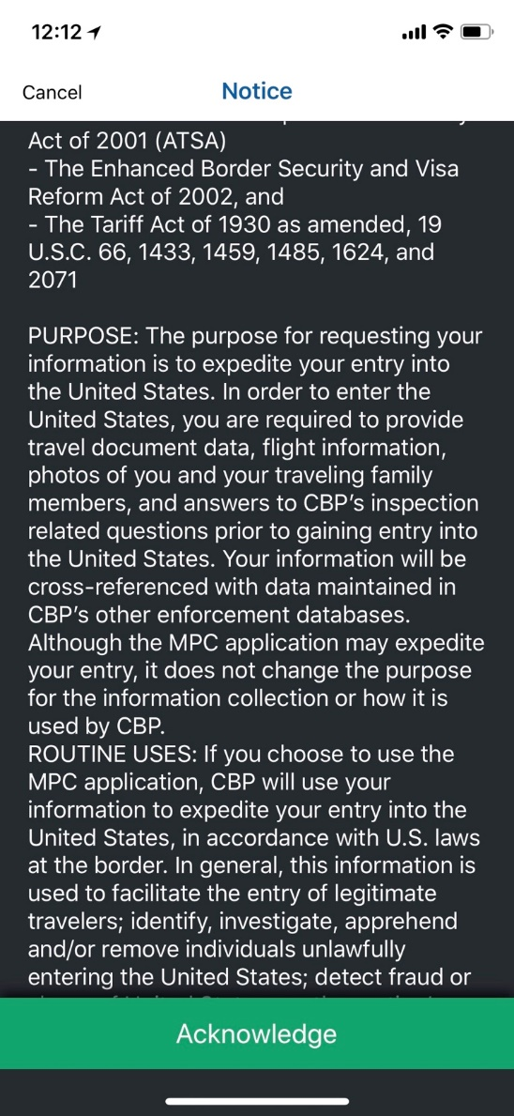
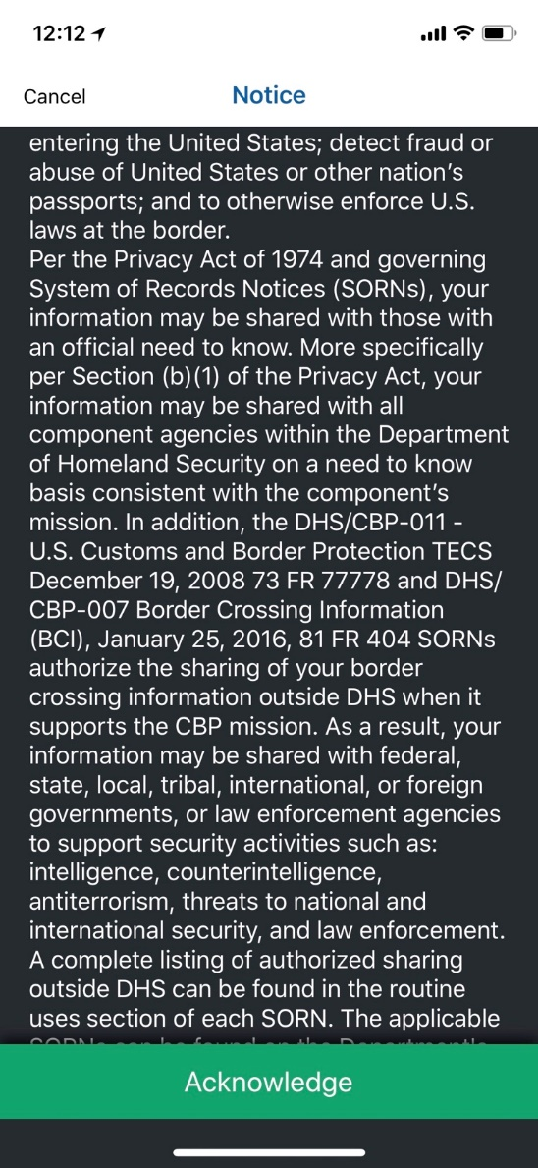
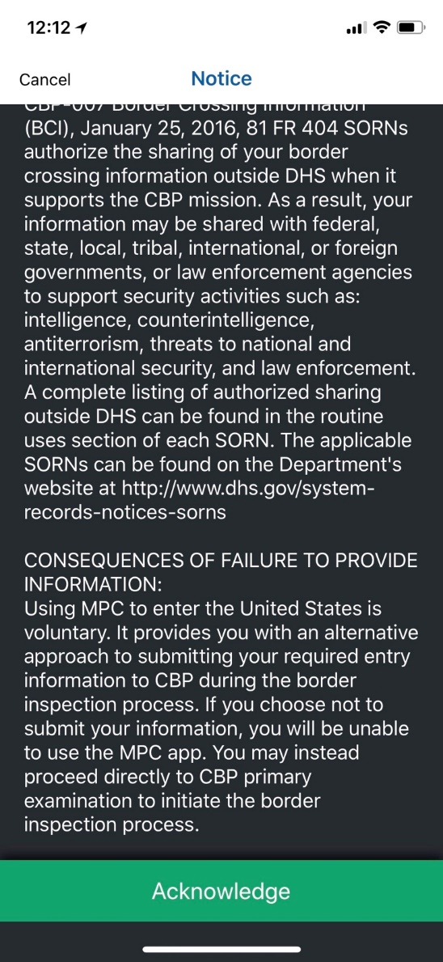
CBP “Box” Screen Progression (2 of 7)
I51d
i51e
i51f
4

Slide 5
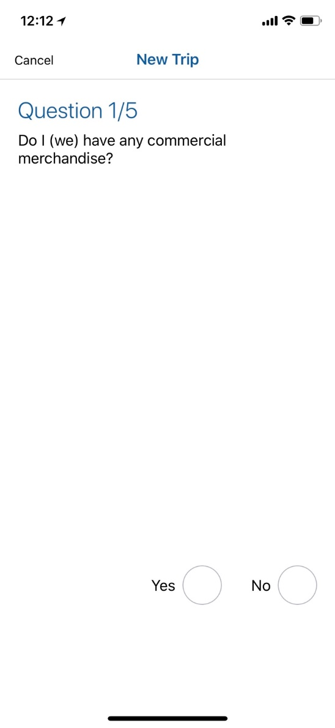
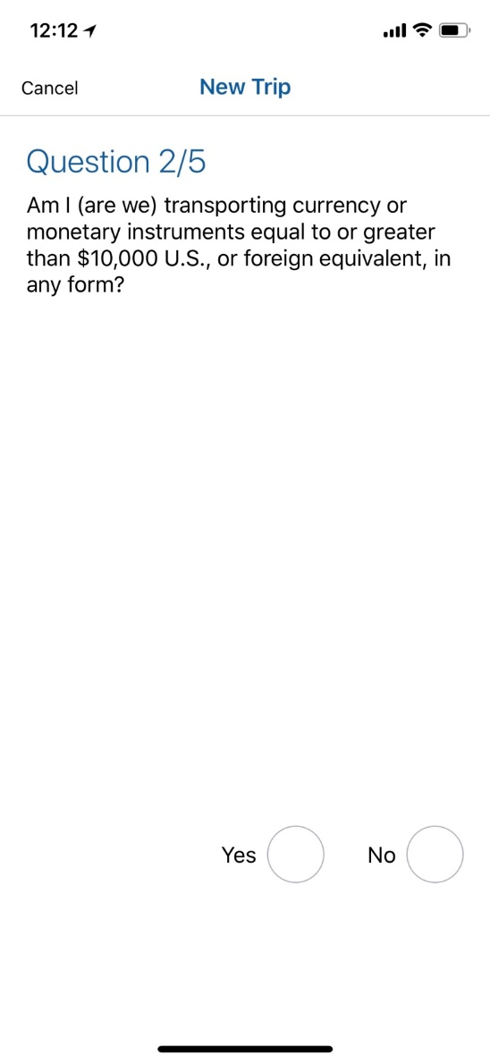
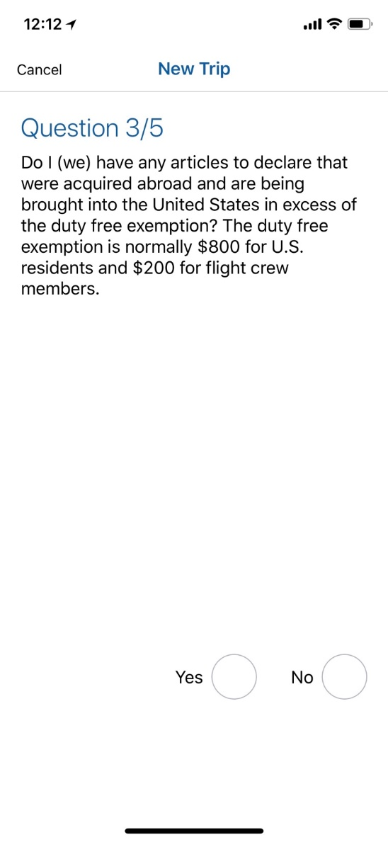
CBP “Box” Screen Progression (3 of 7)
i52
i53
i54
5

Slide 6
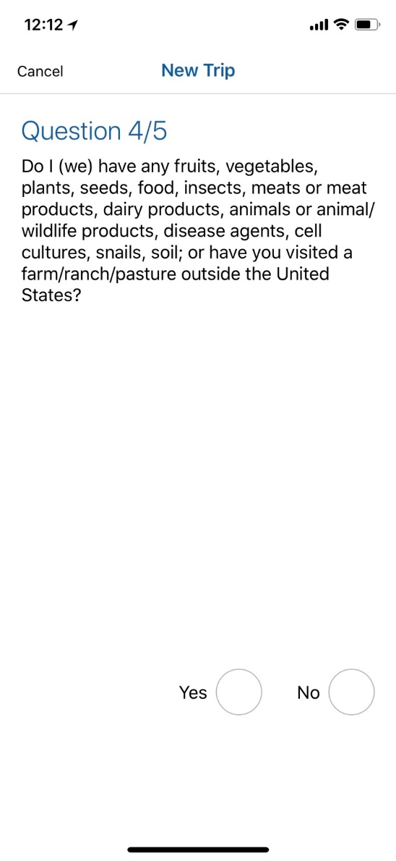
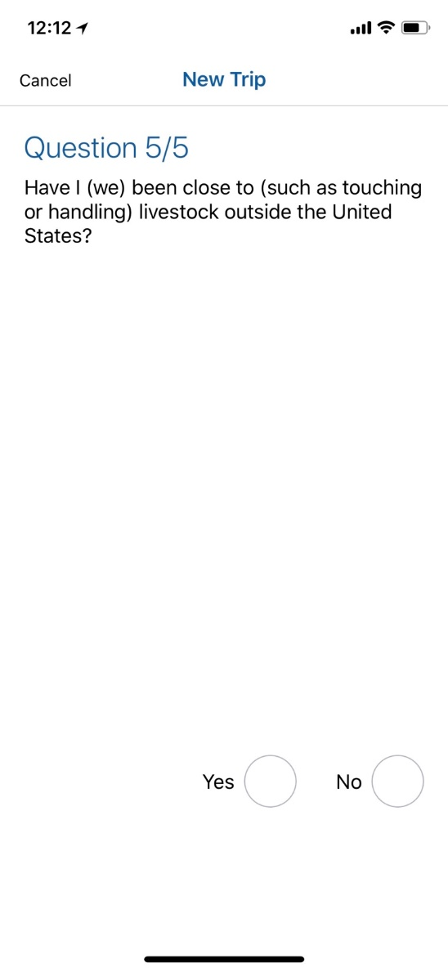
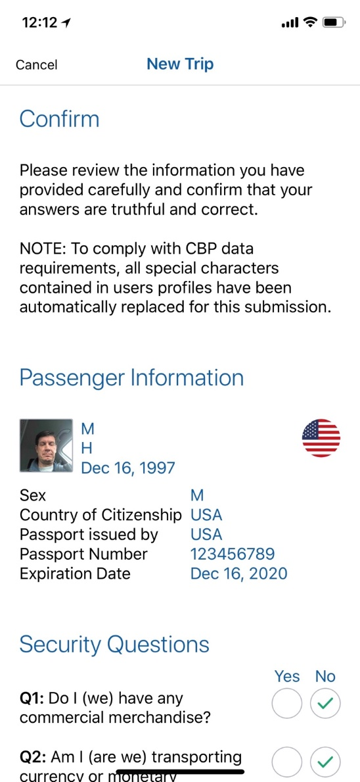
CBP “Box” Screen Progression (4 of 7)
i55
i56
i57
6

Slide 7
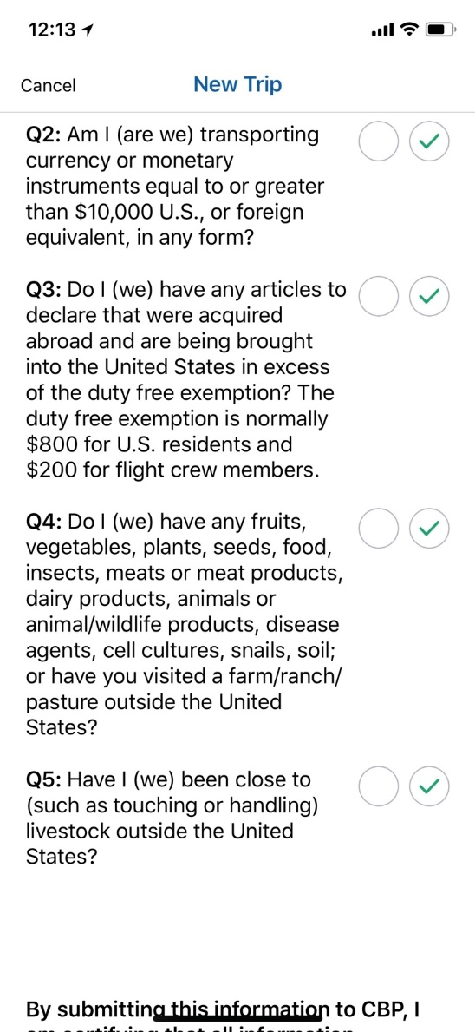
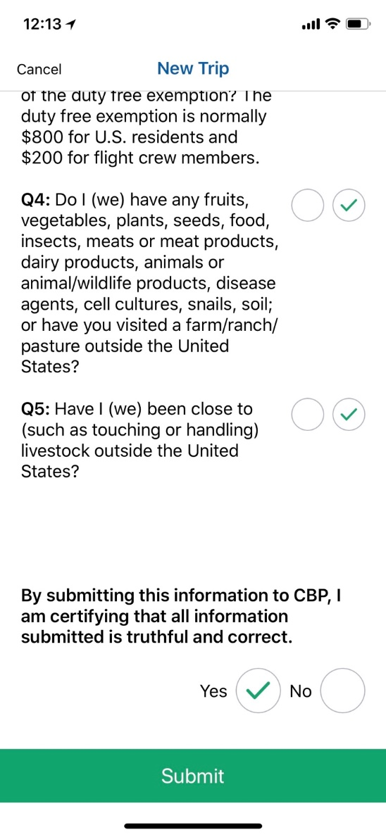
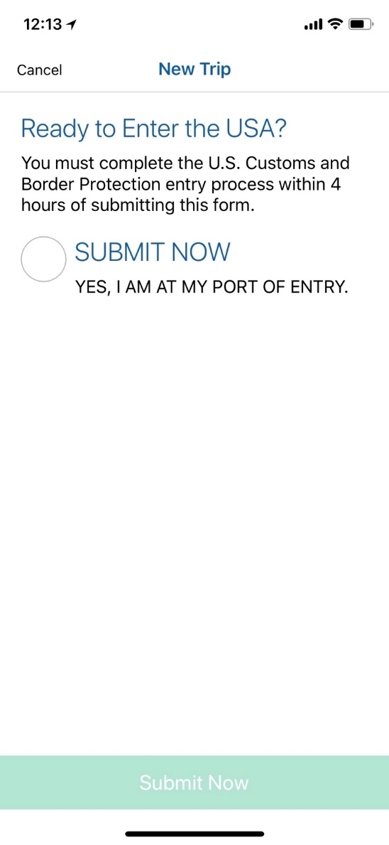
CBP “Box” Screen Progression (5 of 7)
i58a
i58b
i59
7

Slide 8
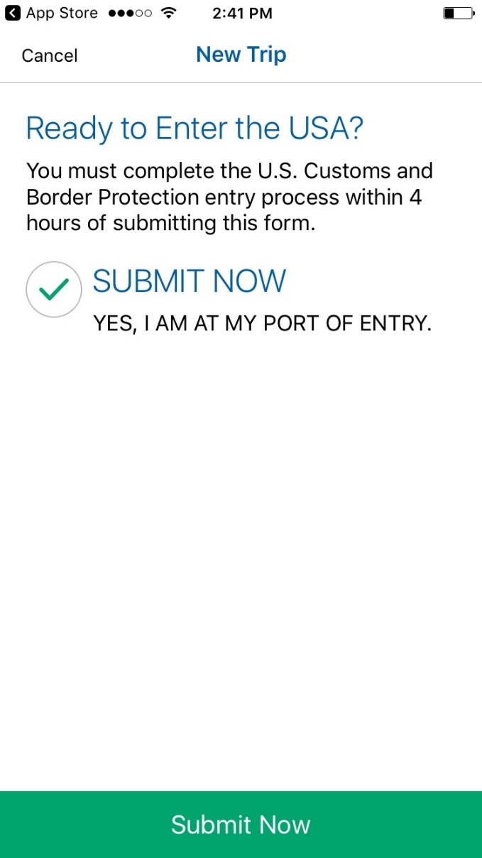
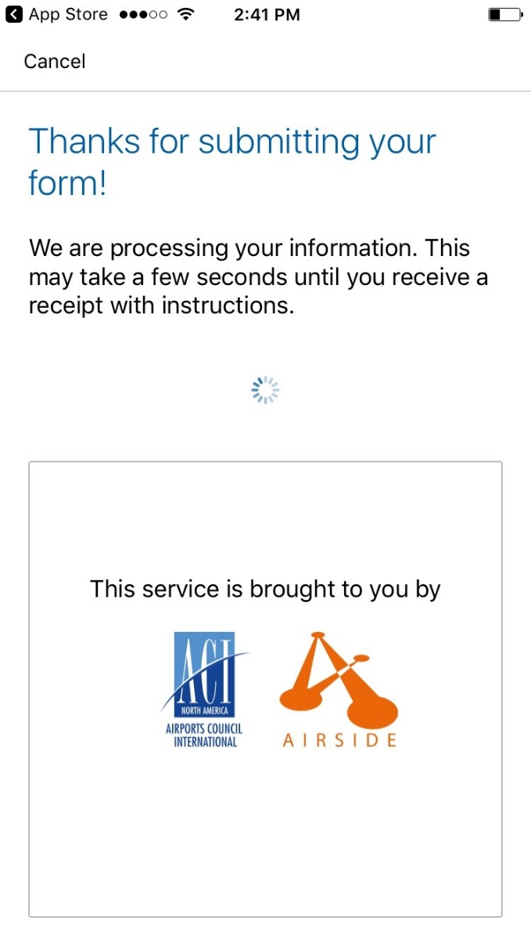
CBP “Box” Screen Progression (6 of 7)
i60
i61
A) Successful transaction
B) Check document
8

Slide 9
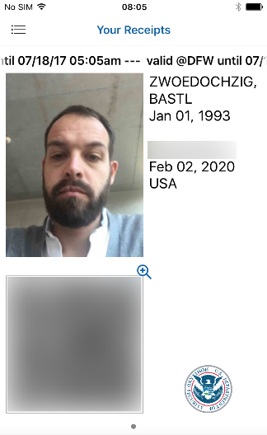
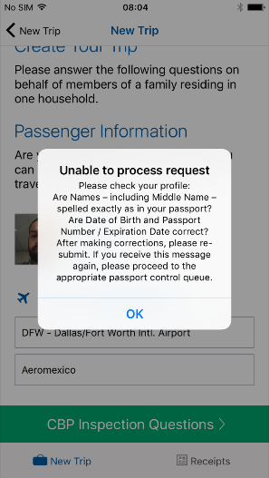
CBP “Box” Screen Progression (7 of 7)
A) Successful transaction
B) Check document
i62
i63
9

