Slide 1
Online Unified Reporting Tool (URT)
THIRA/SPR Screenshots
December 15, 2020

Slide 2
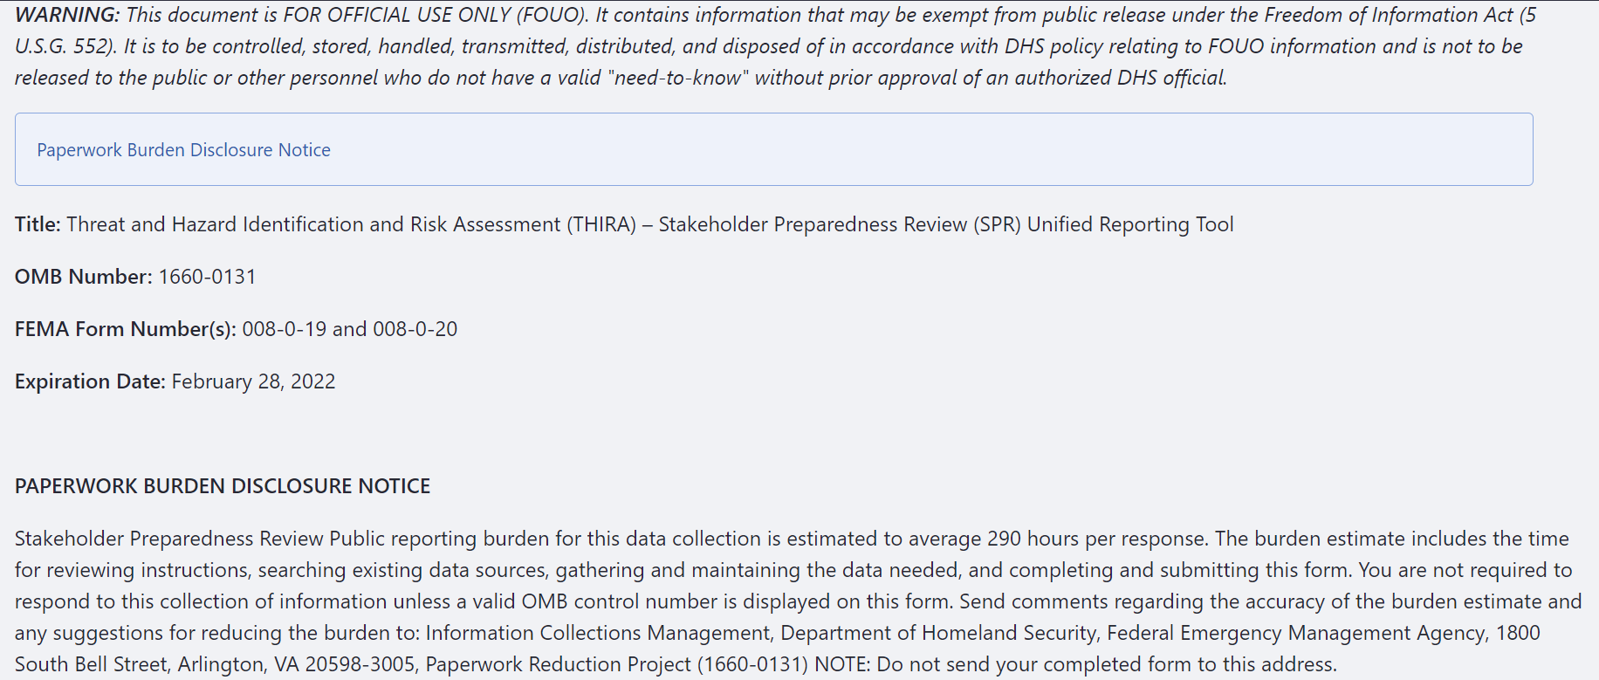
Paperwork Burden Disclosure Notice

Slide 3
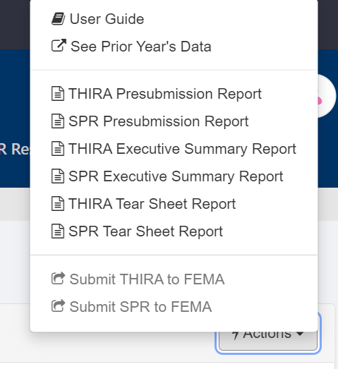
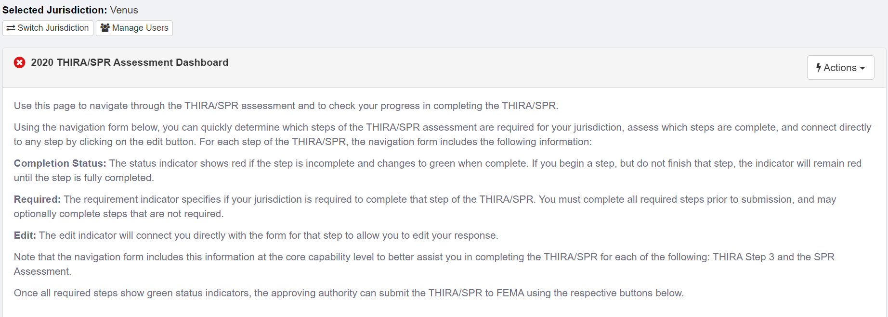
THIRA/SPR Assessment Dashboard (1 of 3)

Slide 4
THIRA/SPR Assessment Dashboard (2 of 3)

Slide 5
THIRA/SPR Assessment Dashboard (3 of 3)

Slide 6
THIRA Step 1 FEMA Form 008-0-19

Slide 7
THIRA Step 2 (1of 3) FEMA Form 008-0-19

Slide 8
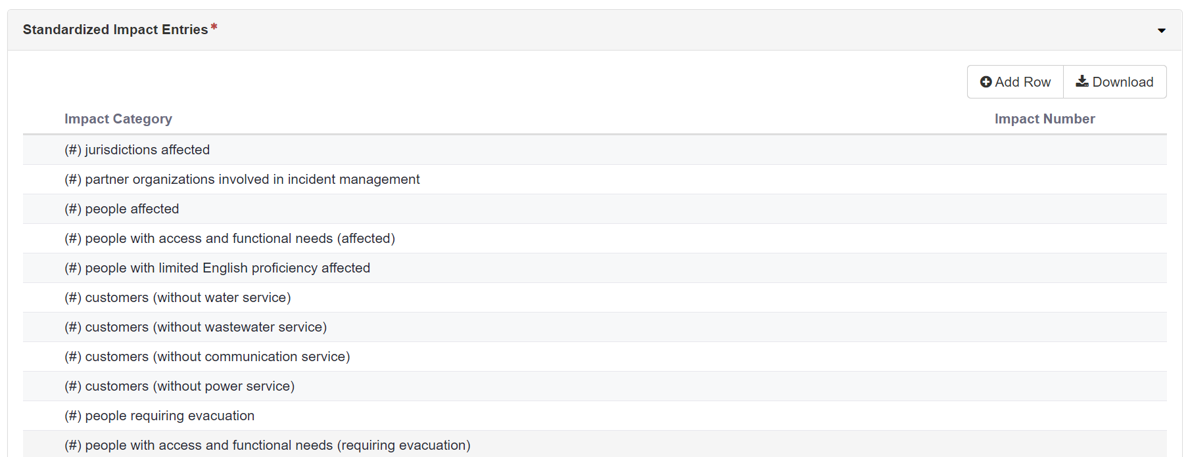
THIRA Step 2 (2 of 3) FEMA Form 008-0-19

Slide 9
THIRA Step 2 (3 of 3) FEMA Form 008-0-19

Slide 10
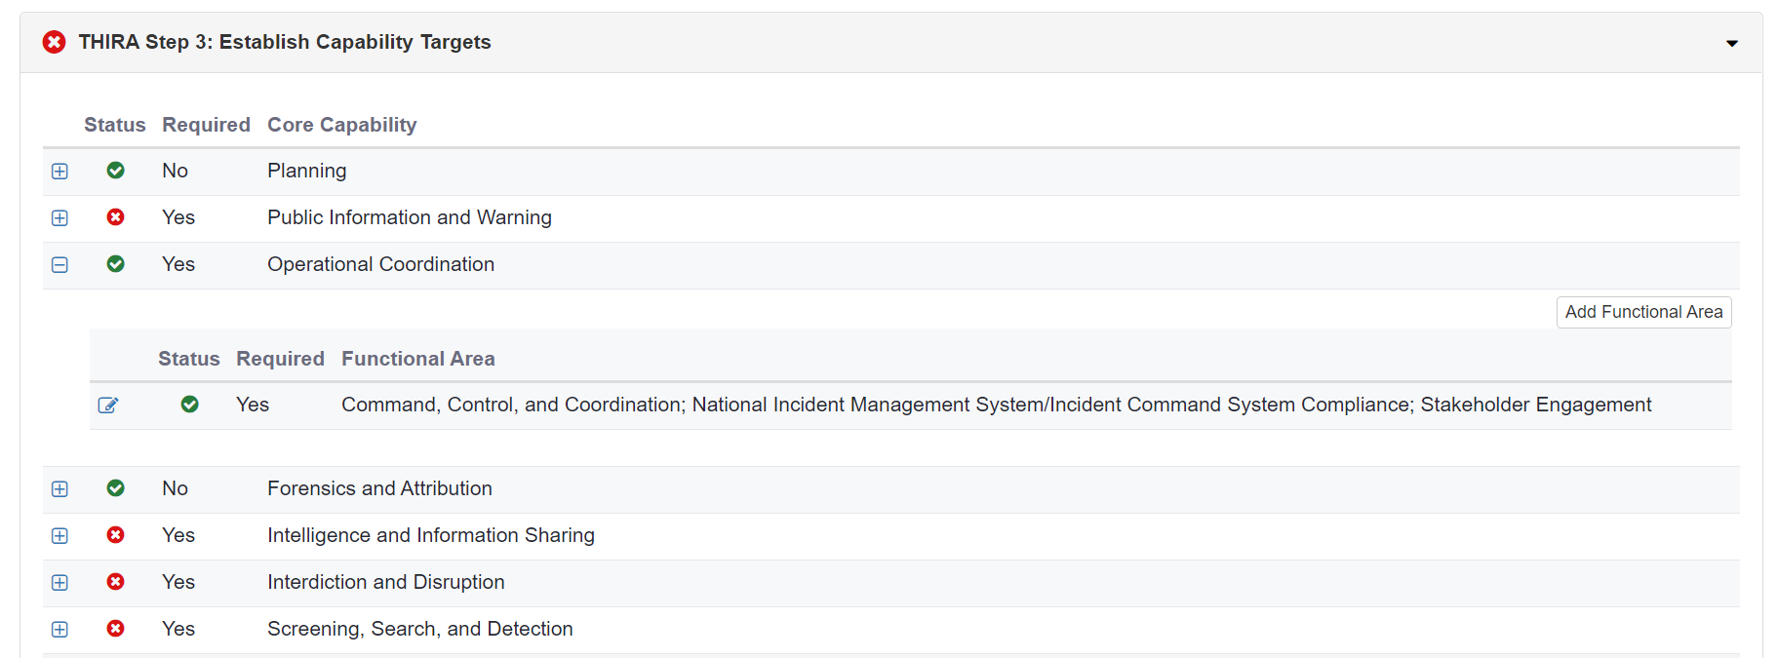
THIRA Step 3 (1of 3) FEMA Form 008-0-19

Slide 11
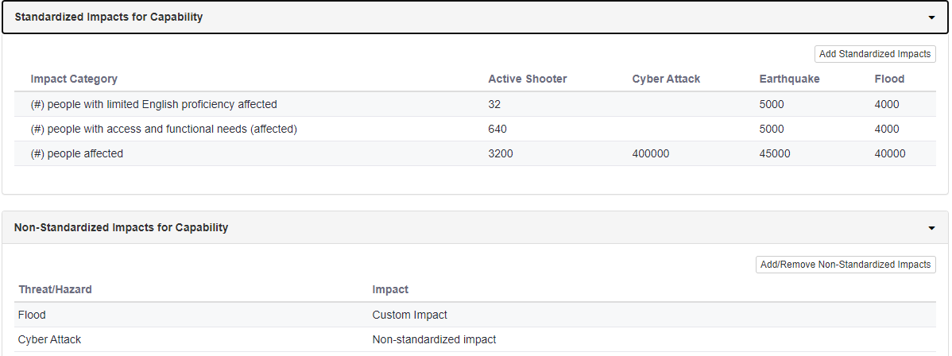
THIRA Step 3 (2 of 3) FEMA Form 008-0-19

Slide 12
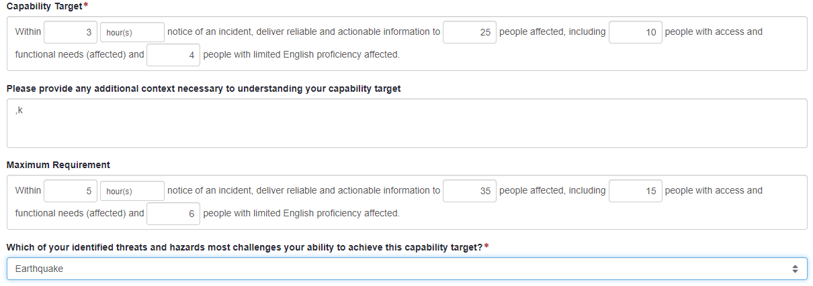
THIRA Step 3 (3 of 3) FEMA Form 008-0-19

Slide 13
SPR: Assessment Dashboard FEMA Form 008-0-20

Slide 14
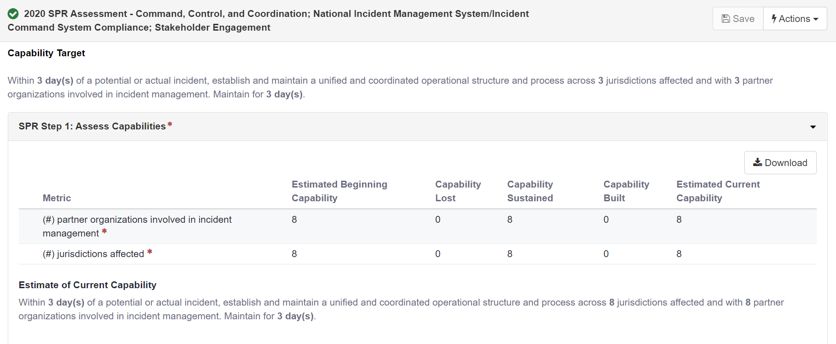
SPR Step 1 (1of 2) FEMA Form 008-0-20

Slide 15
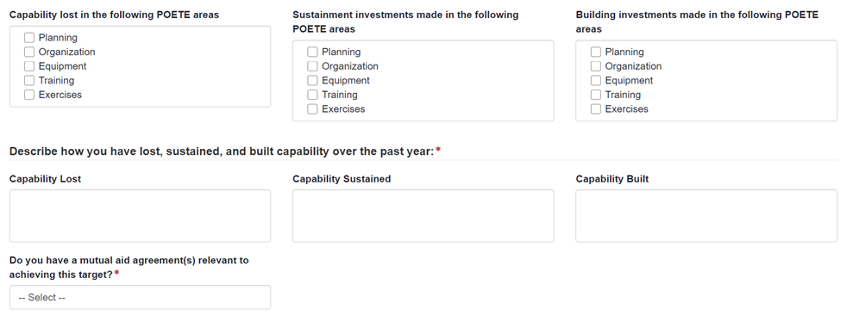
SPR Step 1 (2 of 3) FEMA Form 008-0-20

Slide 16
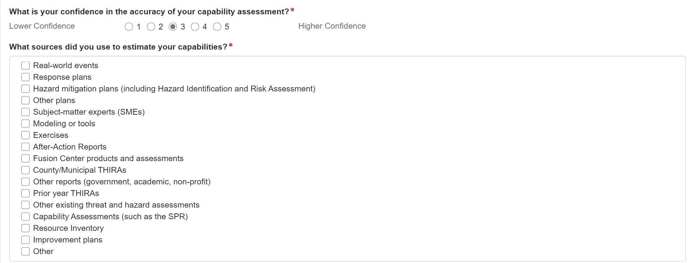
SPR Step 1 (3 of 3) FEMA Form 008-0-20

Slide 17
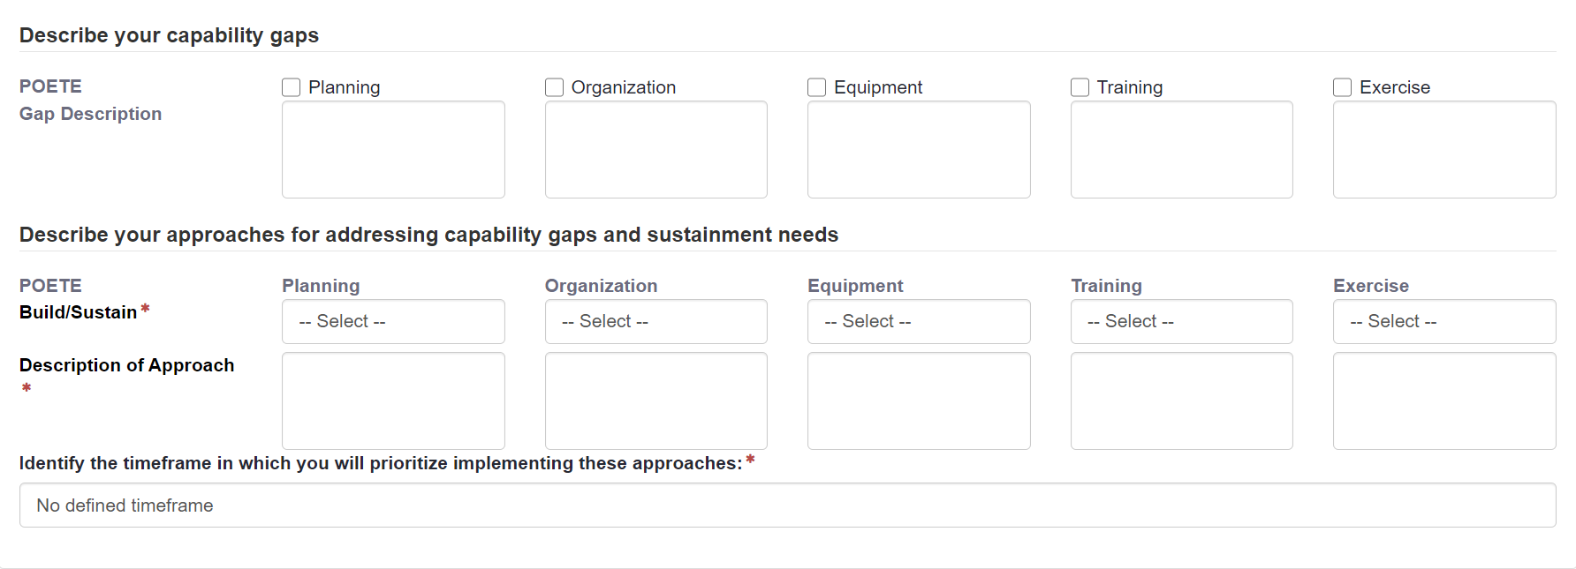
SPR Step 2 FEMA Form 008-0-20

Slide 18
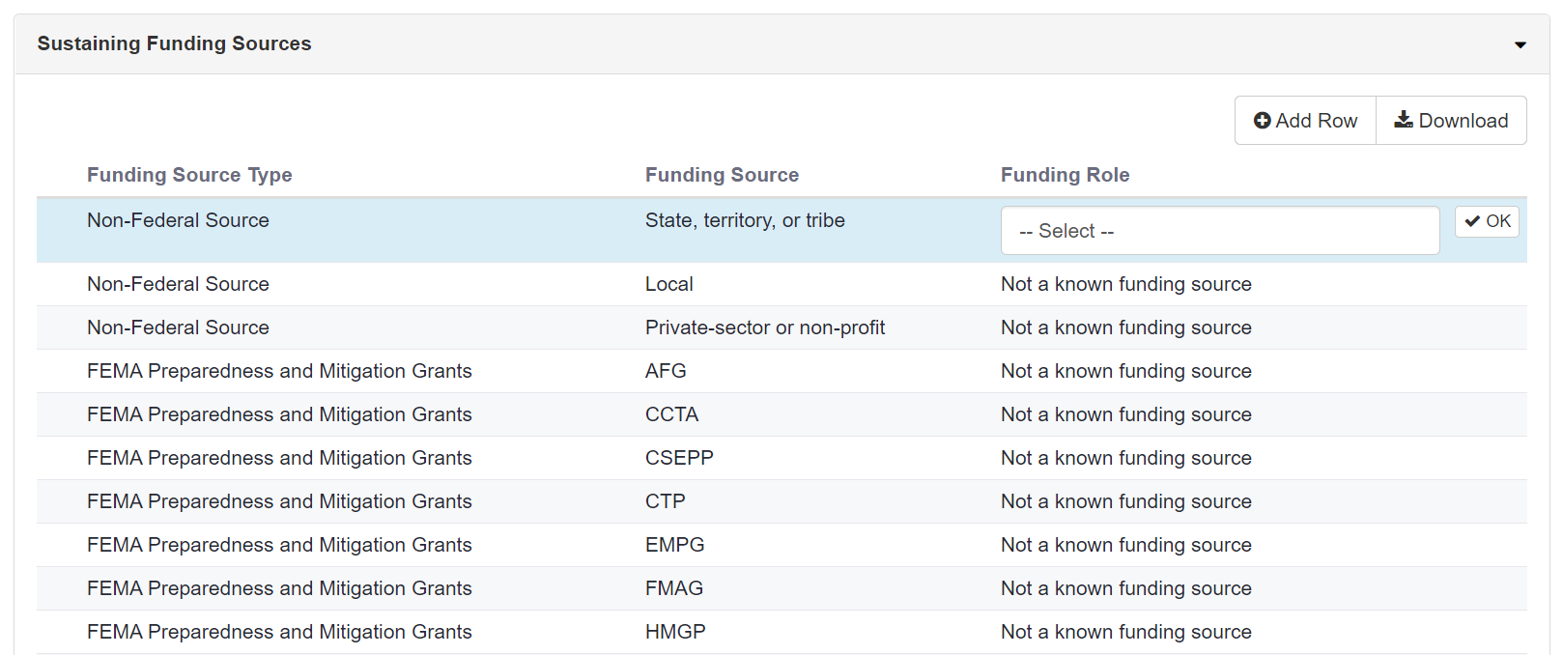
SPR Step 3 (1 of 3) FEMA Form 008-0-20

Slide 19
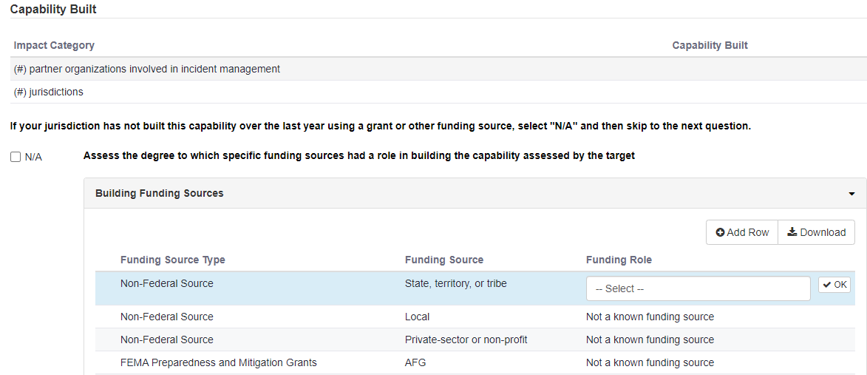
SPR Step 3 (2 of 3) FEMA Form 008-0-20

Slide 20
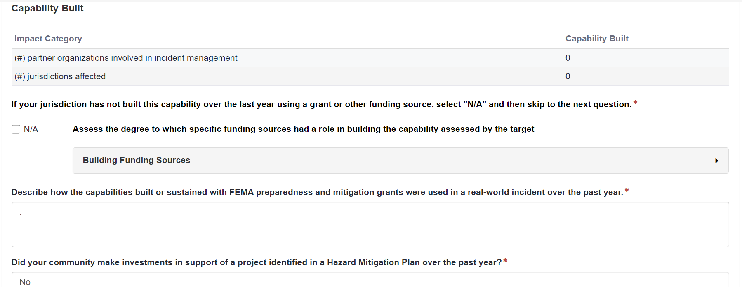
SPR Step 3 (3 of 3) FEMA Form 008-0-20

Slide 21
SPR: Assessment Dashboard FEMA Form 008-0-20

Slide 22
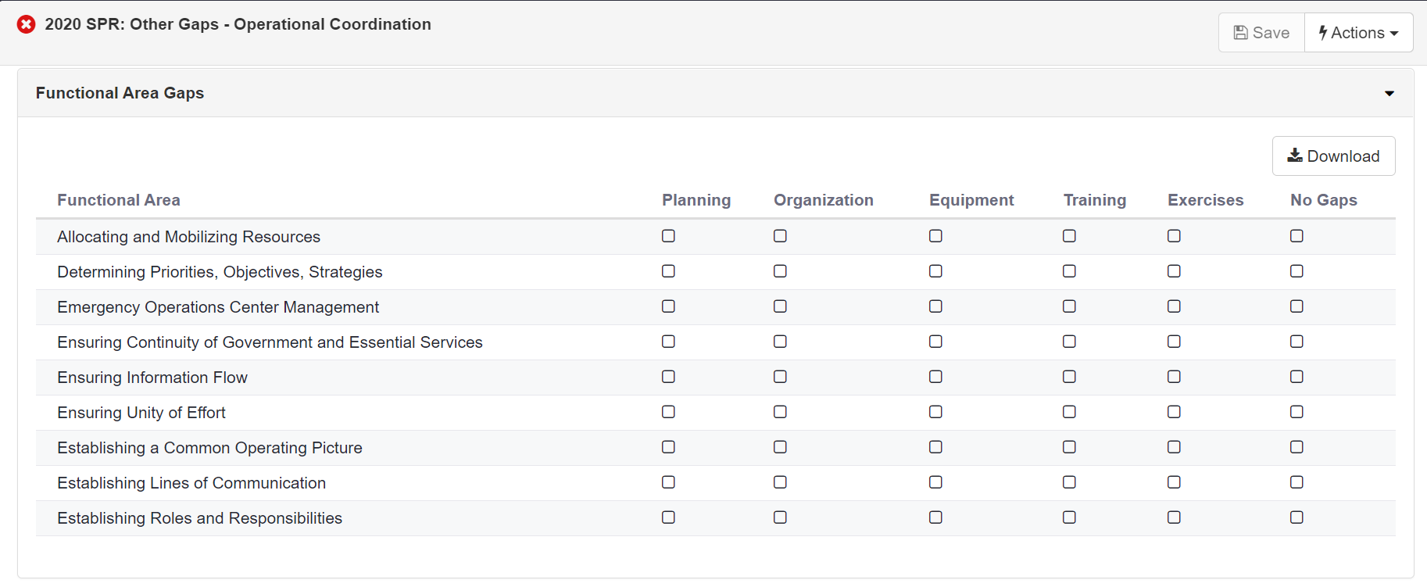
SPR Additional Functional Area Gaps FEMA Form 008-0-20

Slide 23
THIRA/SPR: Assessment Dashboard FEMA Form 008-0-20

Slide 24
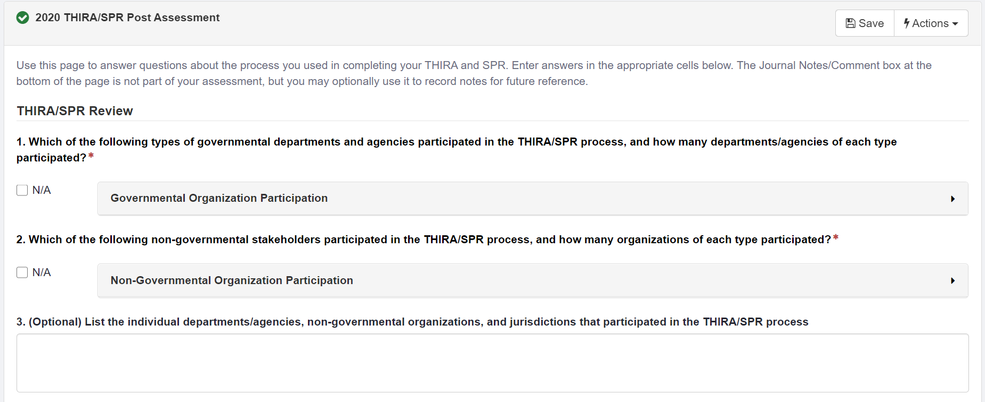
THIRA/SPR Post Assessment (1 of 7) FEMA Form 008-0-20

Slide 25
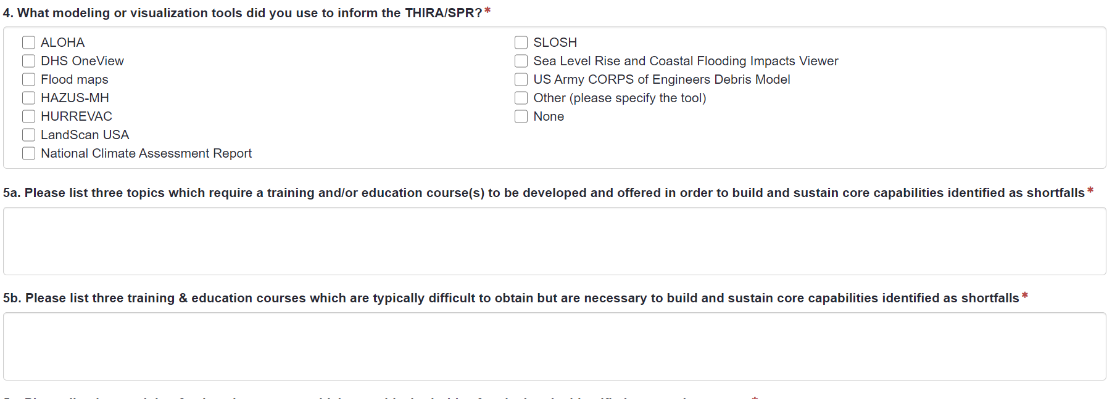
THIRA/SPR Post Assessment (2 of 7) FEMA Form 008-0-20

Slide 26
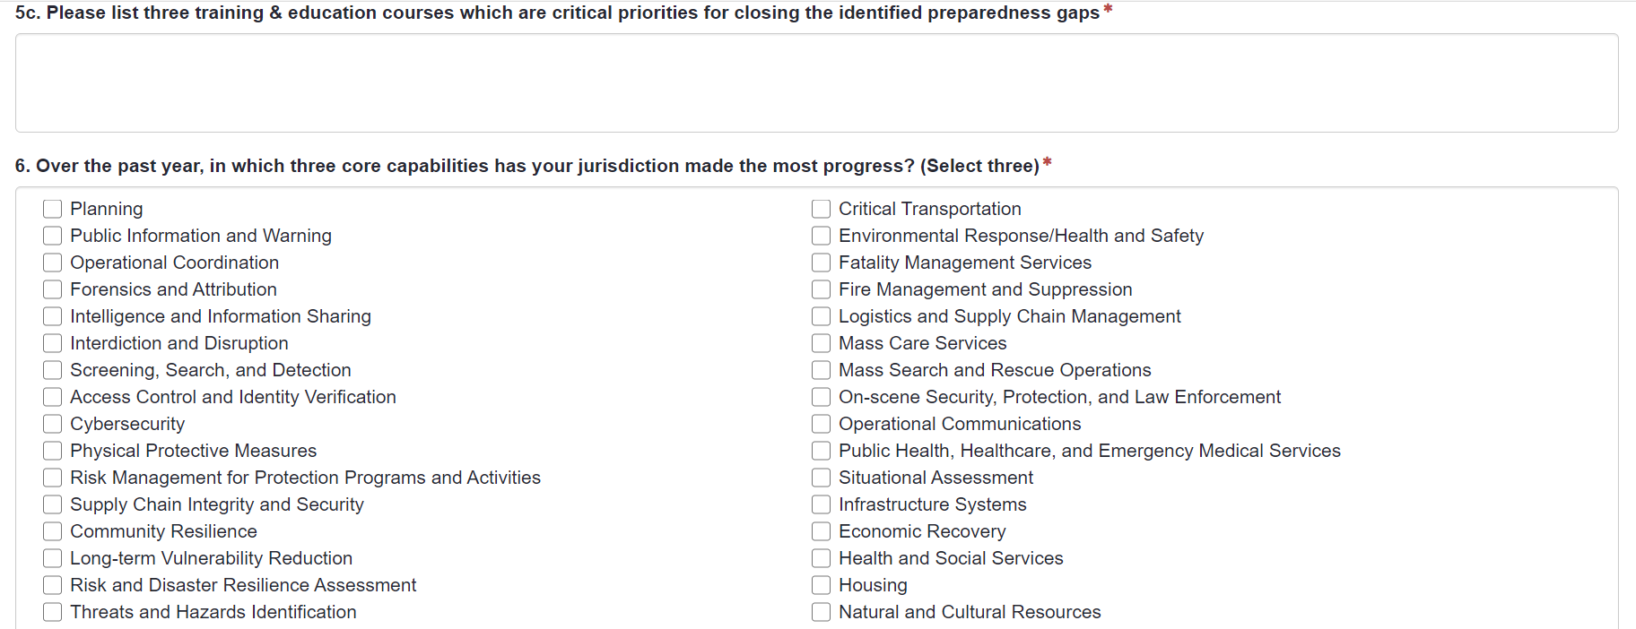
THIRA/SPR Post Assessment (3 of 7) FEMA Form 008-0-20

Slide 27
THIRA/SPR Post Assessment (4 of 7) FEMA Form 008-0-20

Slide 28
THIRA/SPR Post Assessment (5 of 7) FEMA Form 008-0-20

Slide 29
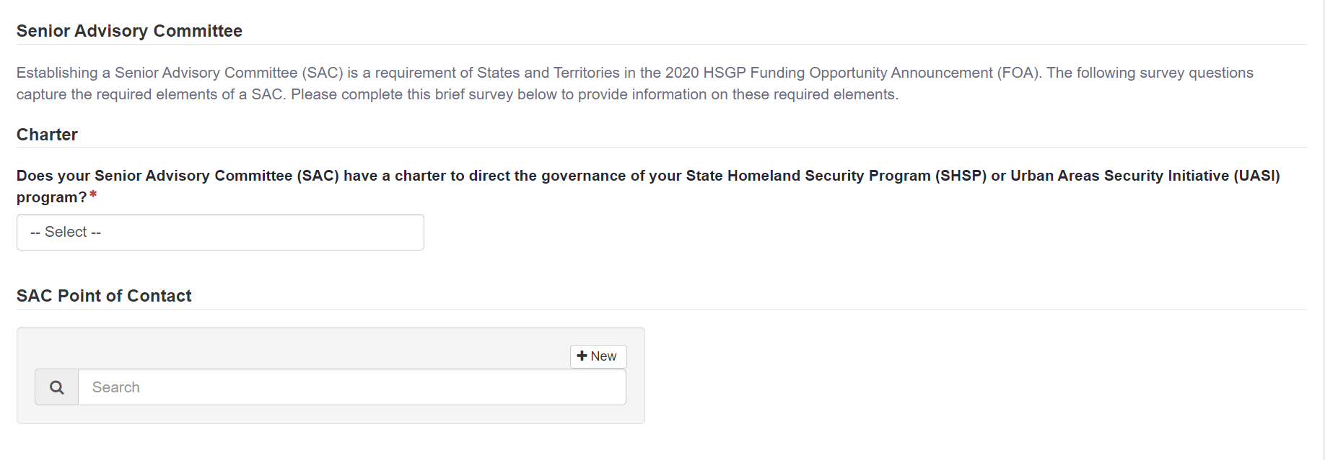
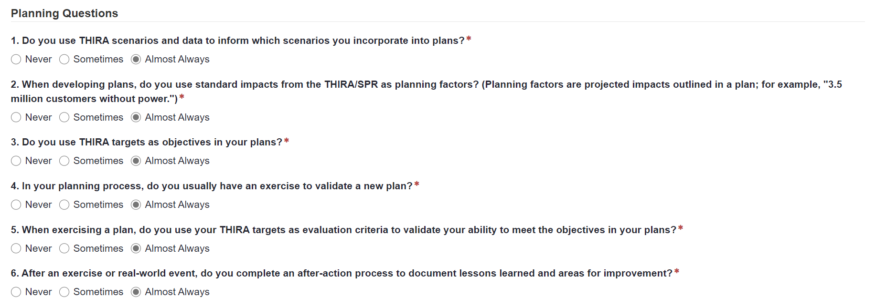
THIRA/SPR Post Assessment (6 of 7) FEMA Form 008-0-20

Slide 30
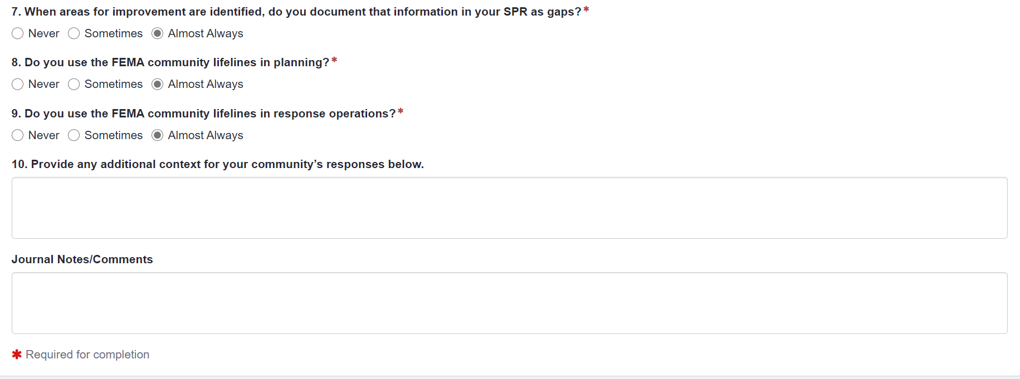
THIRA/SPR Post Assessment (7 of 7) FEMA Form 008-0-20

Slide 31
CPG 101 (1/6)

Slide 32
CPG 101 (2/6)

Slide 33
CPG 101 (3/6)

Slide 34
CPG 101 (4/6)

Slide 35
CPG 101 (5/6)

Slide 36
CPG 101 (6/6)

Slide 37
NIMS (1/9)

Slide 38
NIMS (2/9)

Slide 39
NIMS (3/9)

Slide 40
NIMS (4/9)

Slide 41
NIMS (5/9)

Slide 42
NIMS (6/9)

Slide 43
NIMS (7/9)

Slide 44
NIMS (8/9)

Slide 45
NIMS (9/9)

