Slide 1
Pesticide Submission Portal (PSP) Electronic Confidential Statement of Formula (eCSF) Screen Captures
May 14, 2020

Slide 2
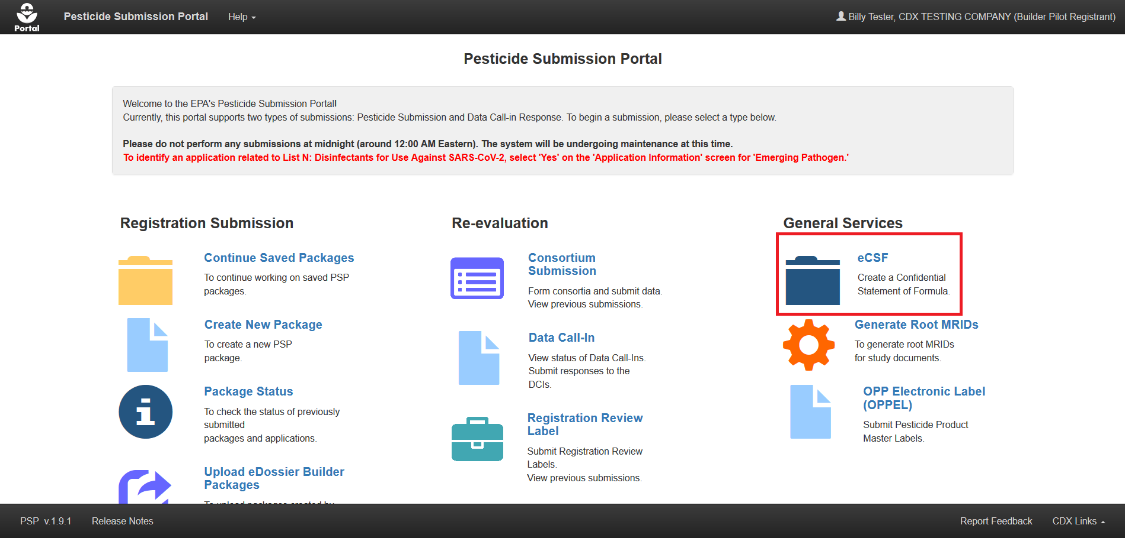
PSP Portal Screen

Slide 3
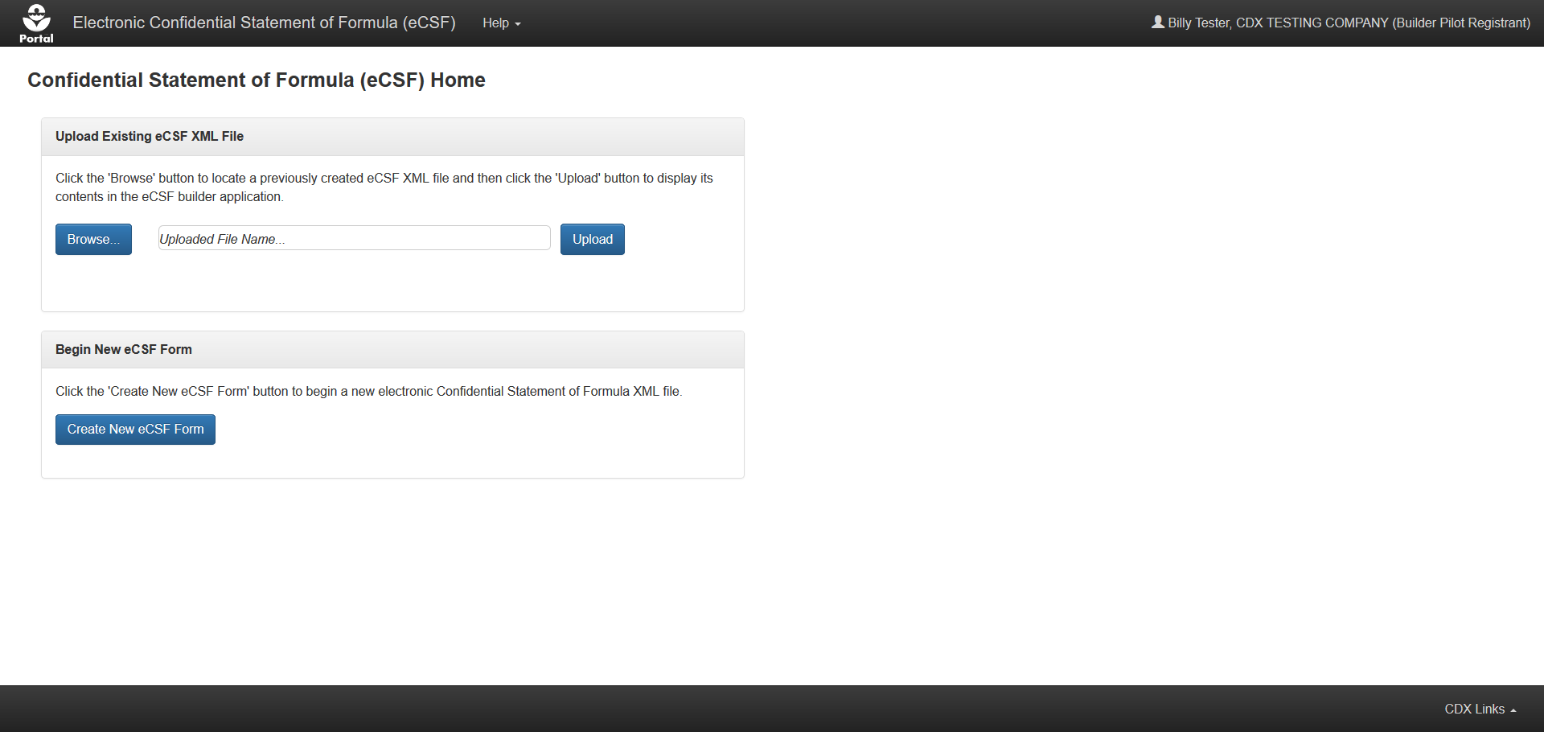
eCSF Home Screen
This collection of information is approved by OMB under the Paperwork Reduction Act, 44 U.S.C. 3501 et seq. (OMB Control No. 2070-[NEW]). Responses to this collection of information are mandatory (40 CFR 158). An agency may not conduct or sponsor, and a person is not required to respond to, a collection of information unless it displays a currently valid OMB control number. The public reporting and recordkeeping burden for this collection of information is estimated to range from 0.32 – 2,006 hours per response. Send comments on the Agency’s need this formation, the accuracy of the provided burden estimates and any suggested methods for minimizing respondent burden including through the use of automated collection techniques to the Director, Regulatory Support Division, U.S. Environmental Protection Agency (2821T), 1200 Pennsylvania Ave., NW, Washington, D.C. 20460. Include the OMB control number in any correspondence. Do not send the completed form to this address.
Anticipated Placement of
the PRA language

Slide 4
Preliminary Questions Screen

Slide 5
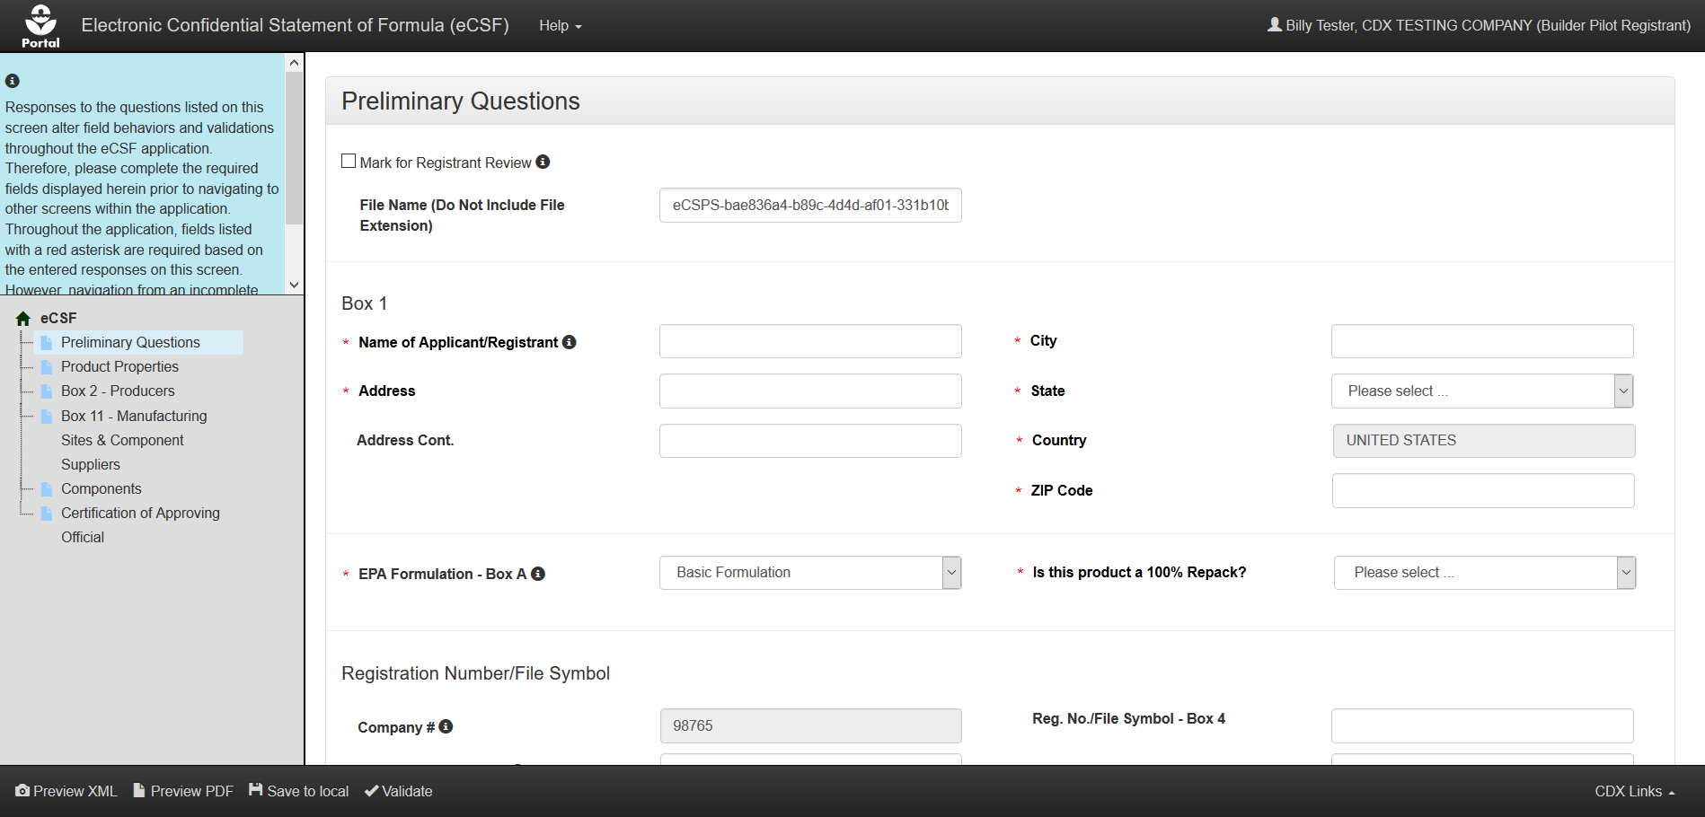
Preliminary Questions – Basic Formulation

Slide 6
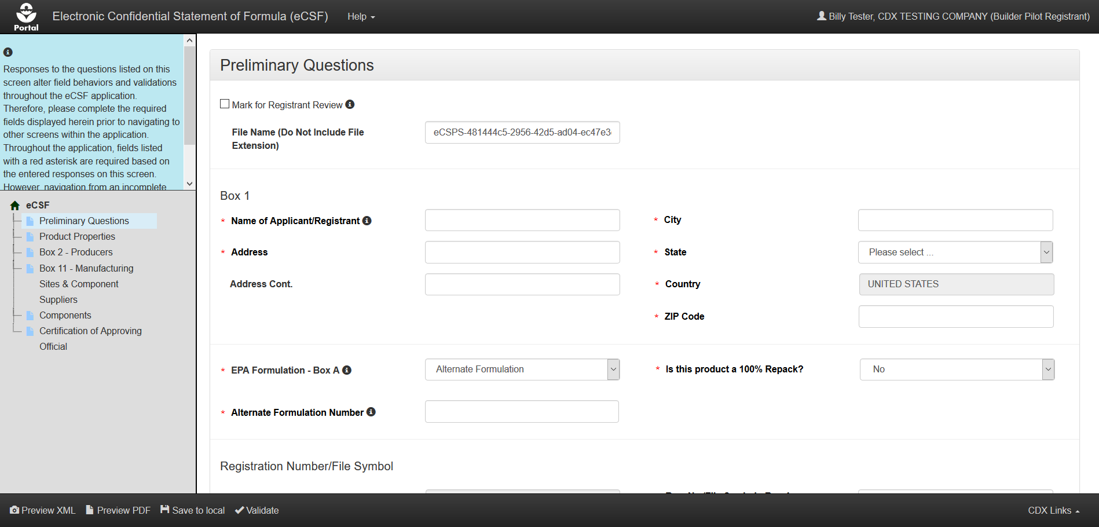
Preliminary Questions – Alternate Formulation

Slide 7
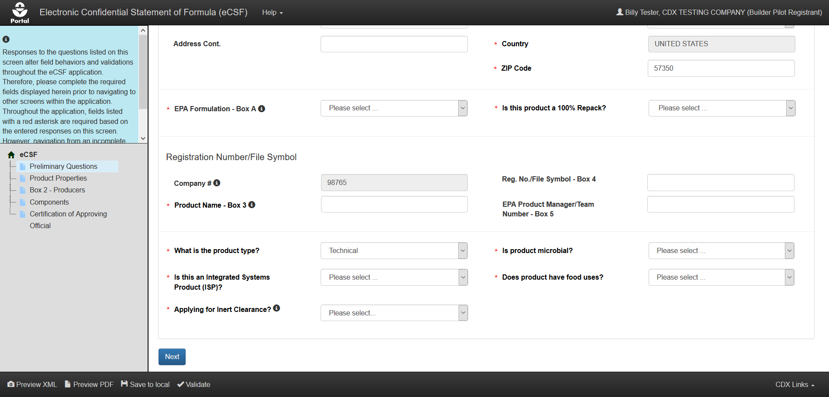
Preliminary Questions – Technical & EUP

Slide 8
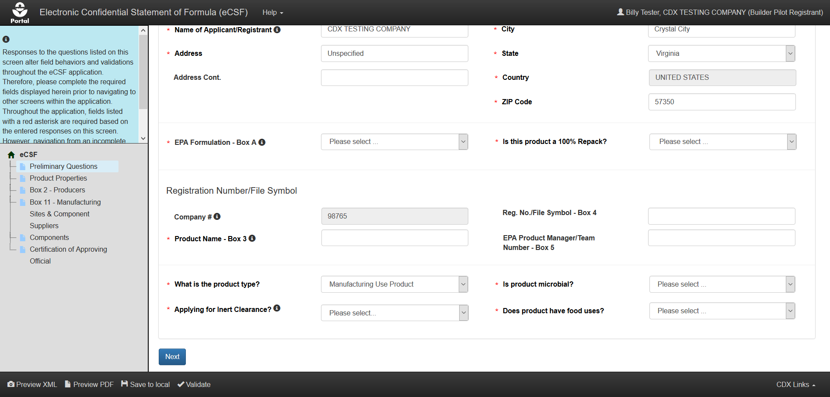
Preliminary Questions – MUP

Slide 9
Product Properties Screen

Slide 10
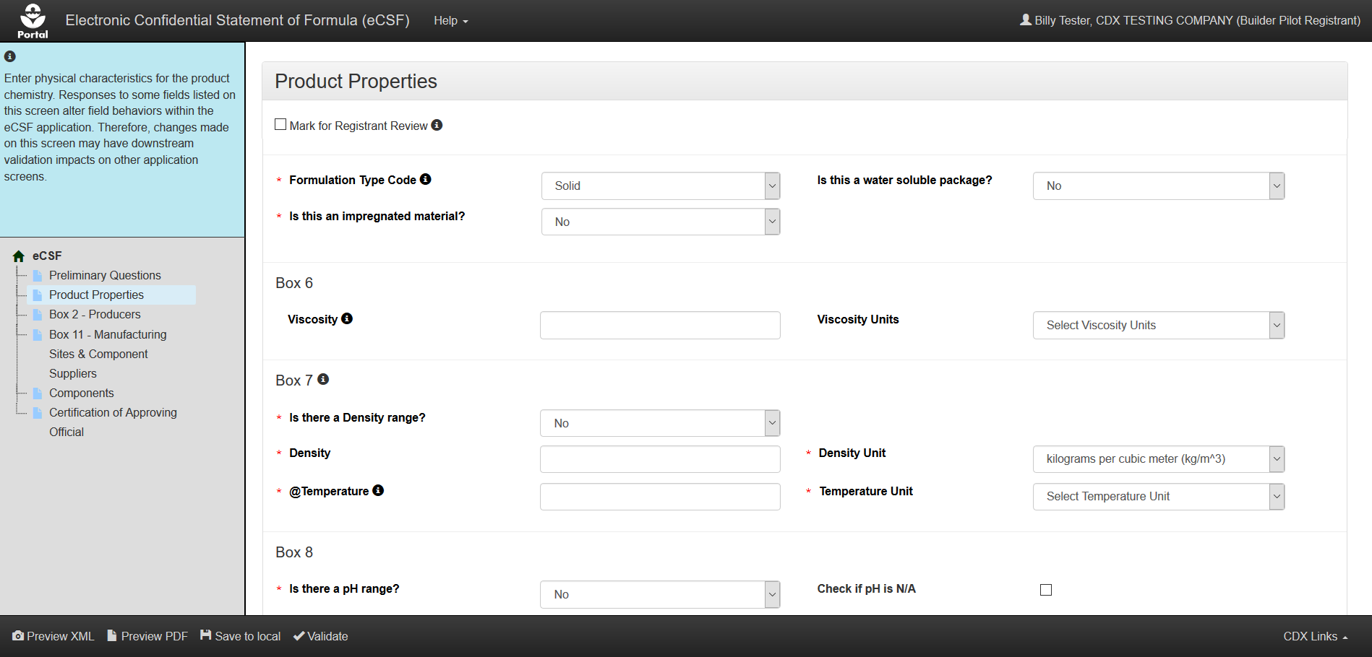
Product Properties – Solid

Slide 11
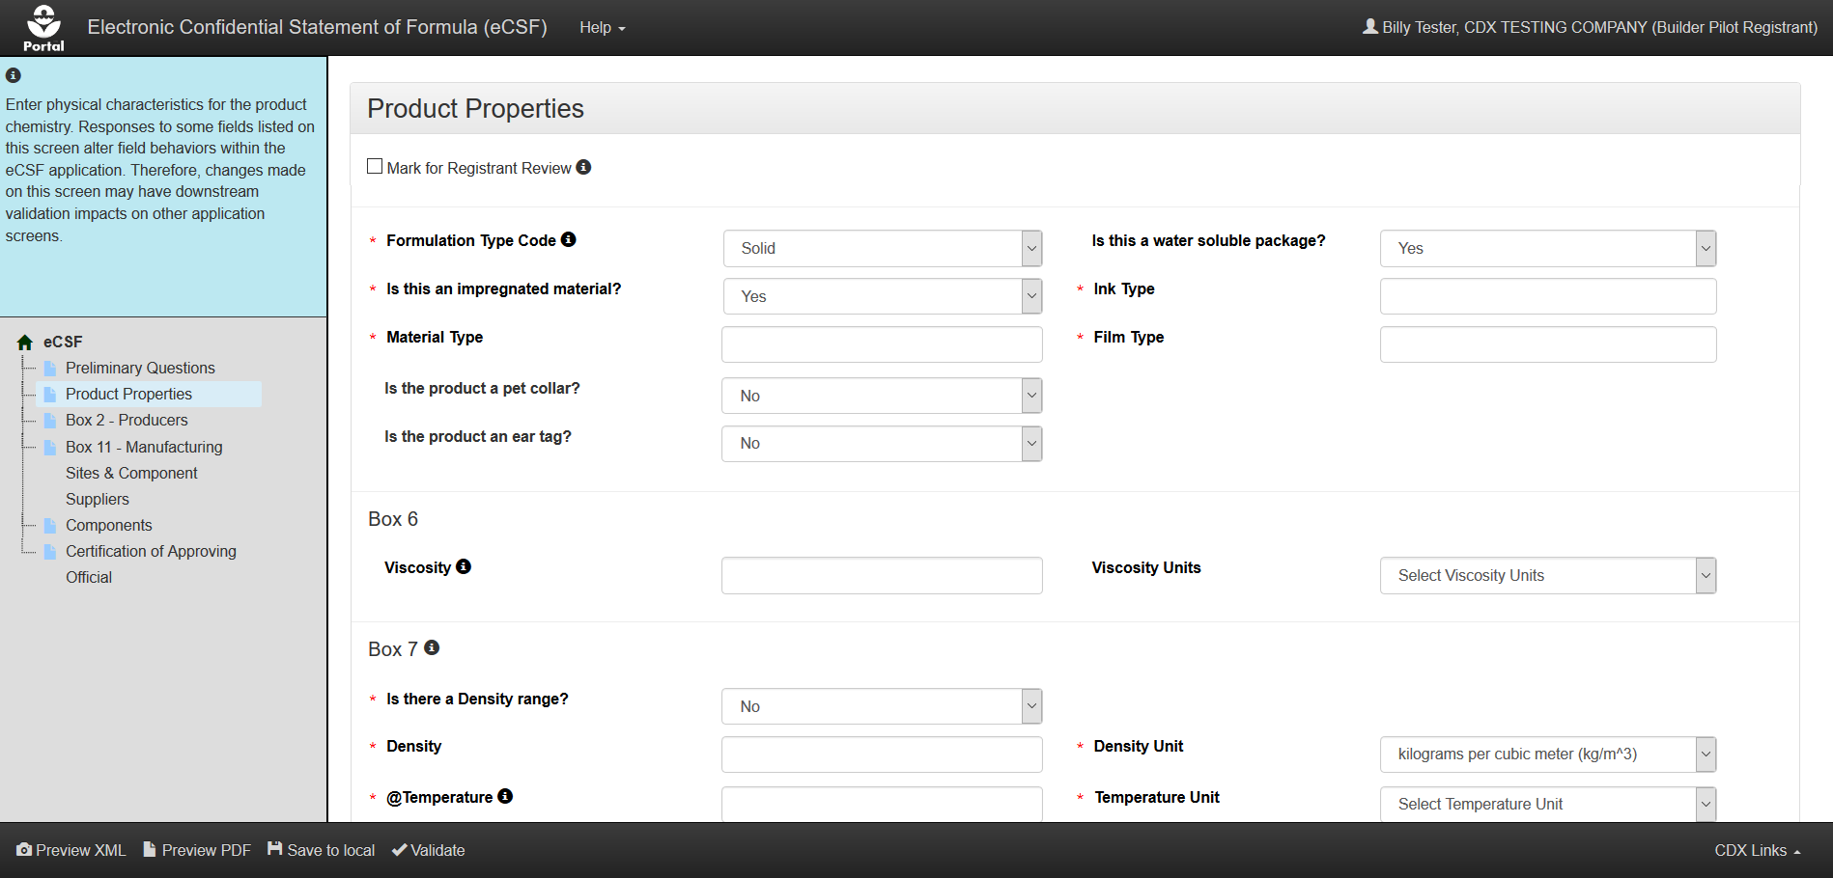
Product Properties – Solid, Impregnated Material, and Water Soluble Packaging

Slide 12
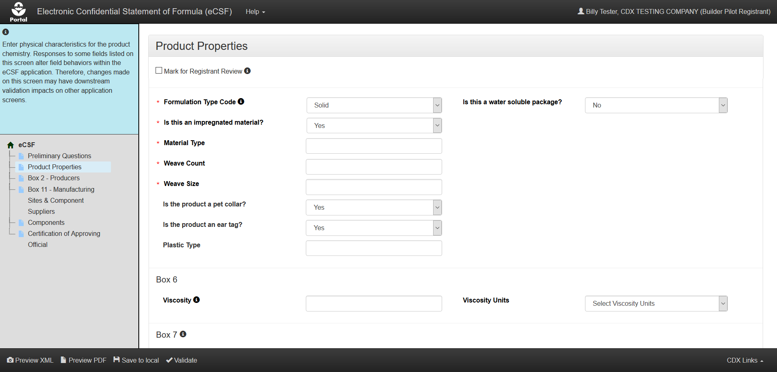
Product Properties – Solid, Impregnated Material, Collar/Ear Tag

Slide 13
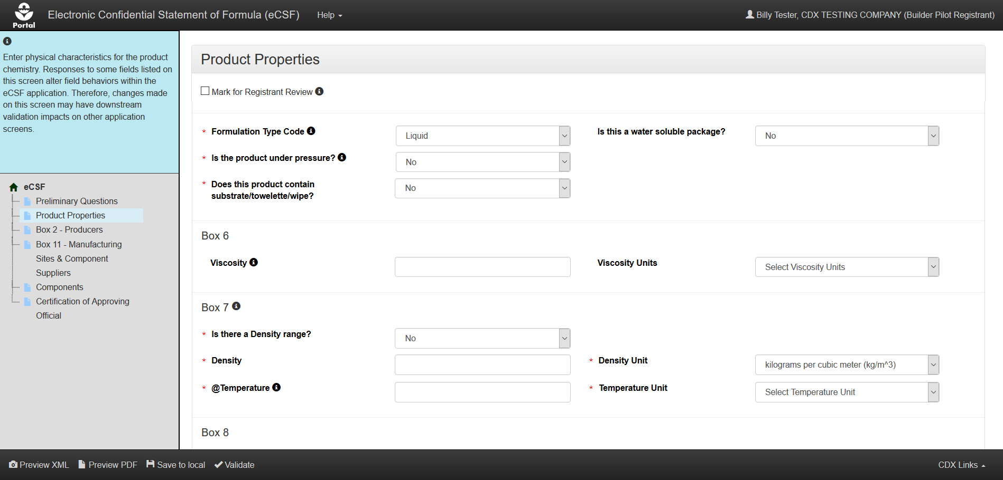
Product Properties – Liquid

Slide 14
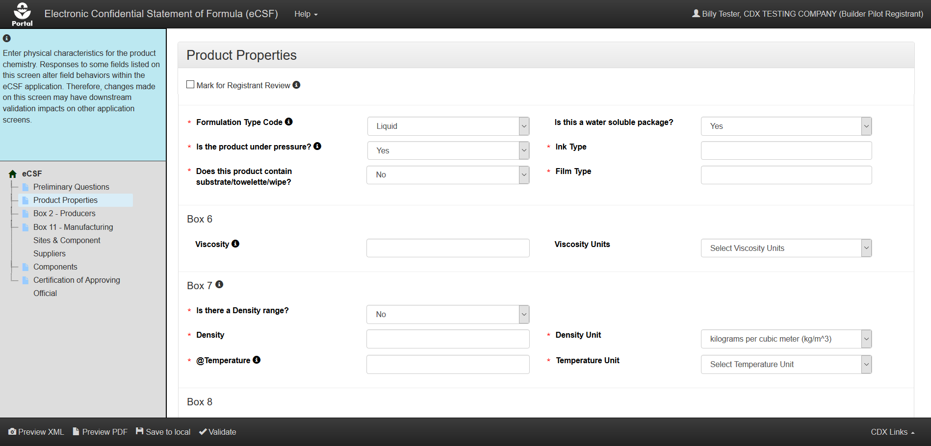
Product Properties – Liquid and Water Soluble Packaging

Slide 15
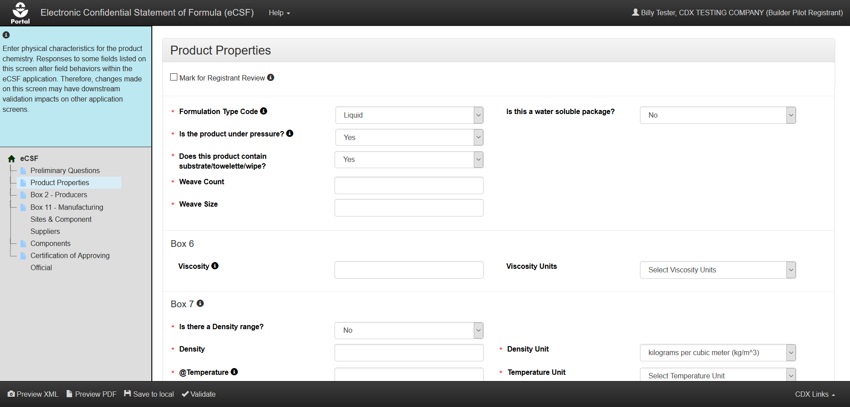
Product Properties – Liquid and Towelette

Slide 16
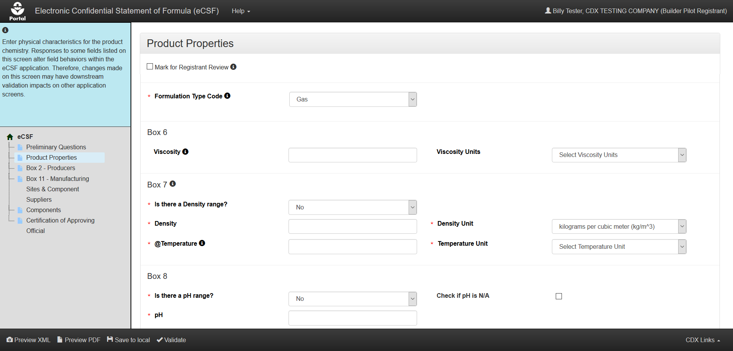
Product Properties – Gas

Slide 17
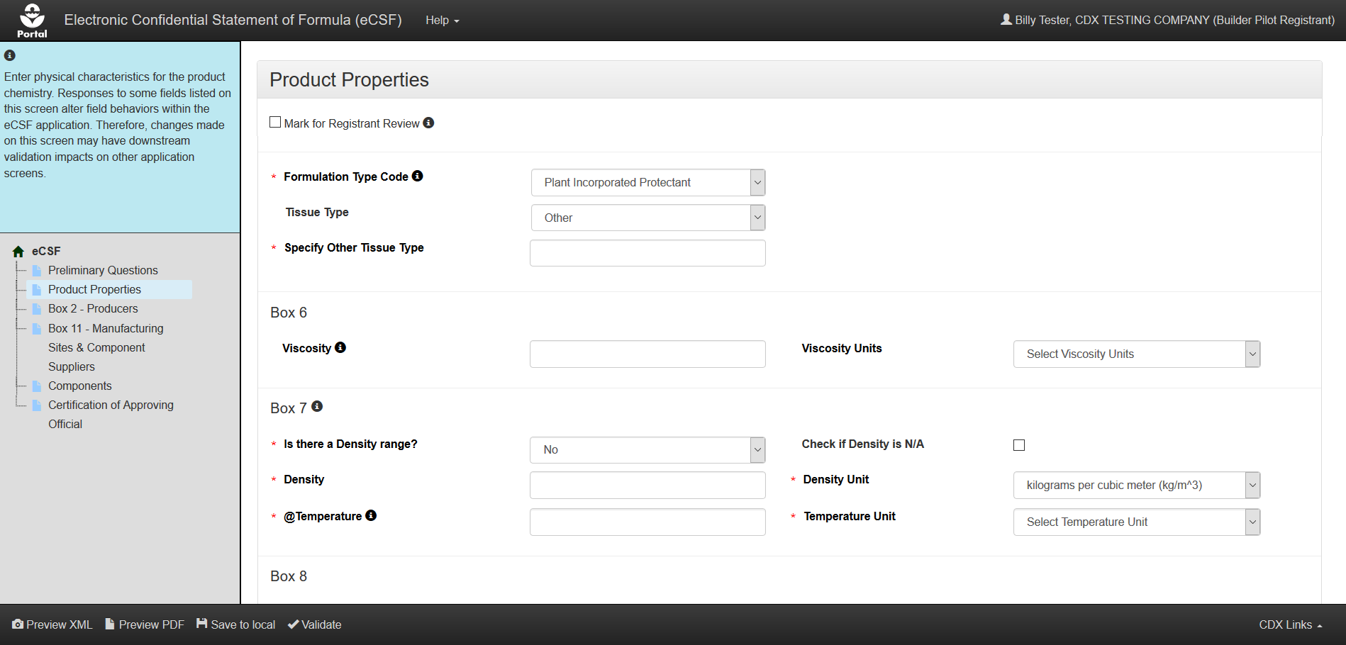
Product Properties – Plant Incorporated Protectant w/Other Type

Slide 18
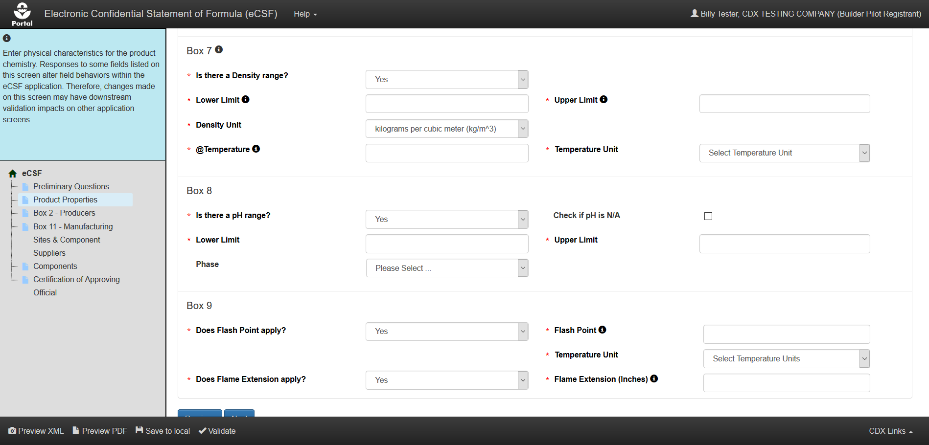
Product Properties – Density Range, pH Range, Flash Point, and Flame Extension

Slide 19
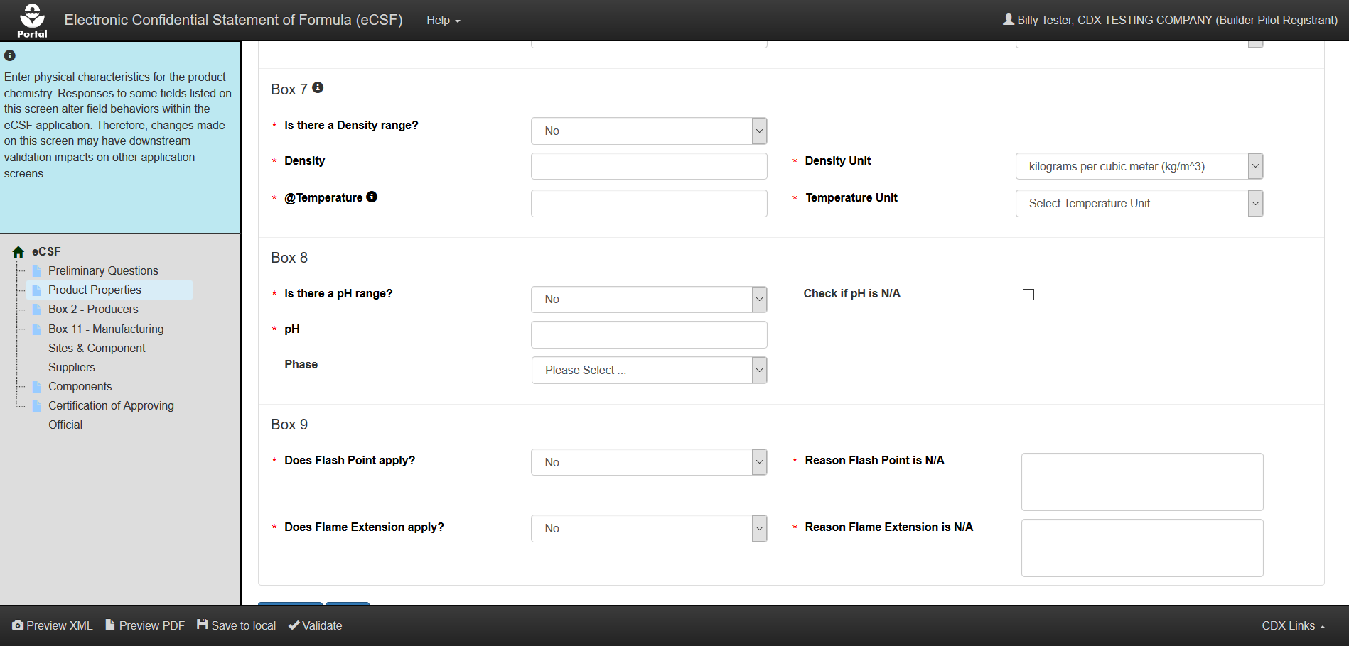
Product Properties – No Density Range, pH Range, Flash Point, or Flame Extension

Slide 20
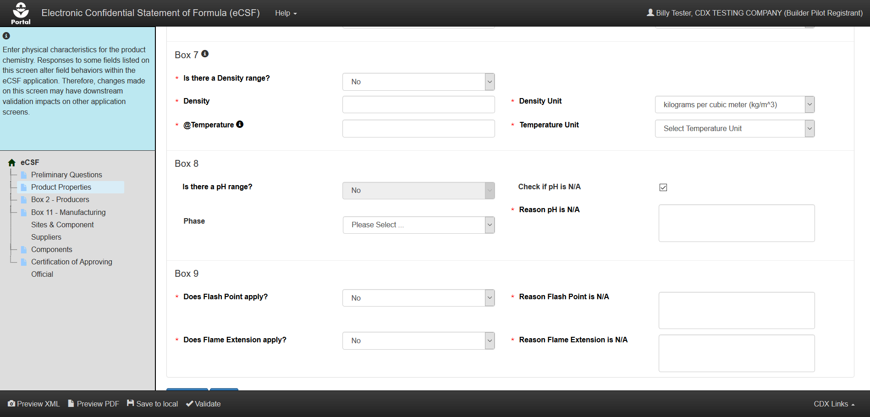
Product Properties – No Density Range, Flash Point, or Flame Extension and pH N/A,

Slide 21
Box 2 – Producers or
Box 2 – Product Repackaging Site Screen
Notes:
The screen displays as ‘Box 2 – Producers’ for non-100% repackaged products and as ‘Box 2 – Product Repackaging Site’. Otherwise, the screens are identical.

Slide 22
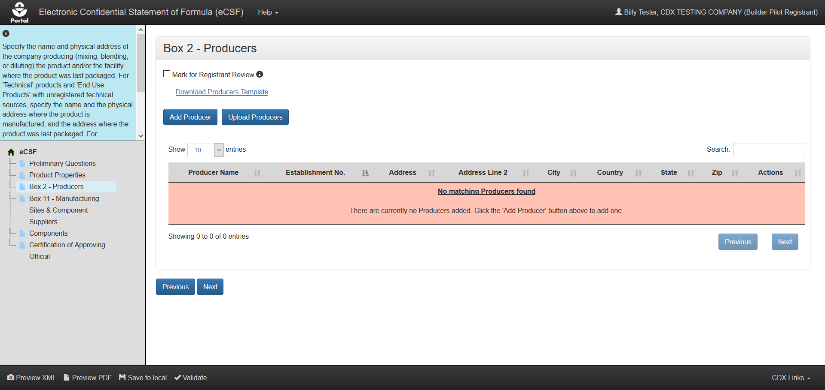
Box 2 – Producers - Unpopulated

Slide 23
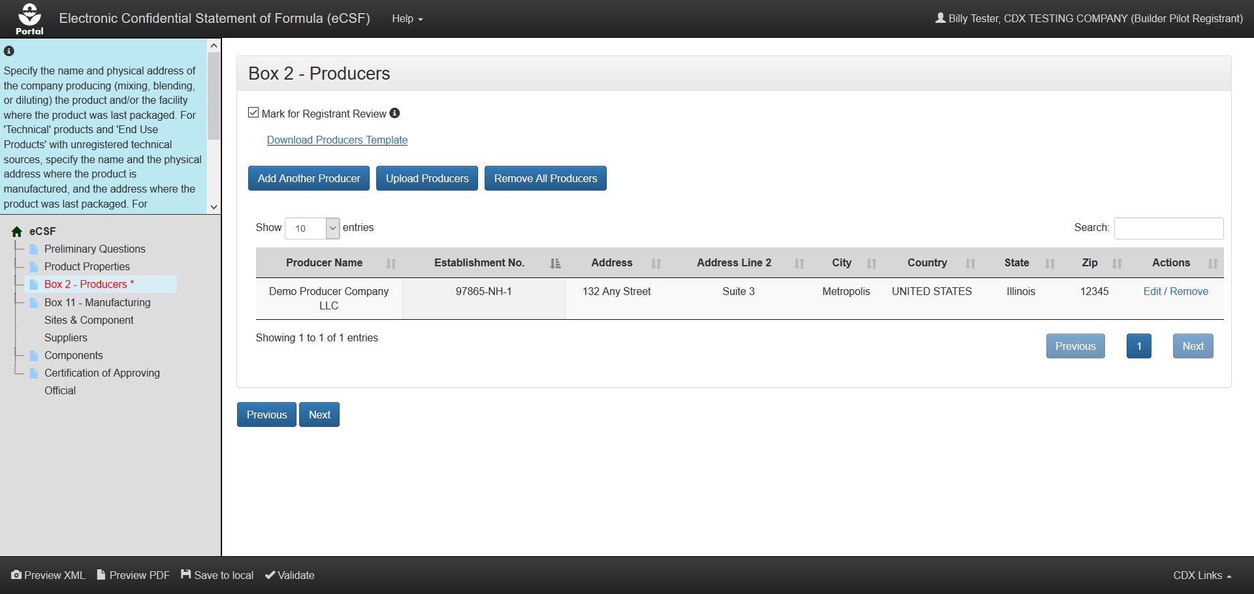
Box 2 – Producers - Populated

Slide 24
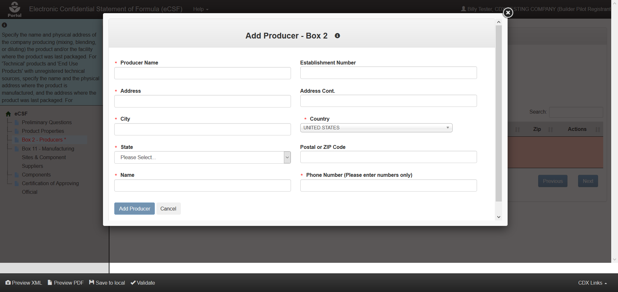
Add Producer Modal – Domestic Producer

Slide 25
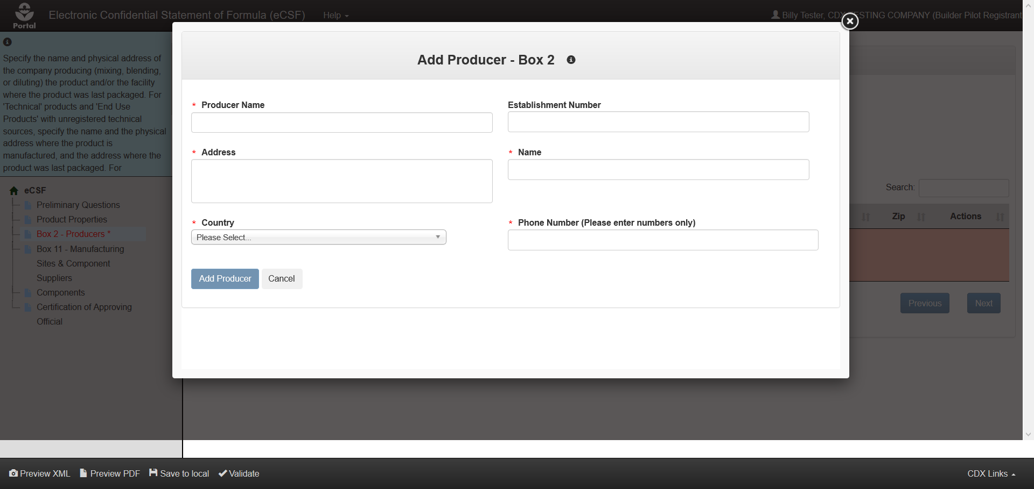
Add Producer Modal – International Producer

Slide 26
Box 11 – Manufacturing Sites & Component Suppliers Screen

Slide 27
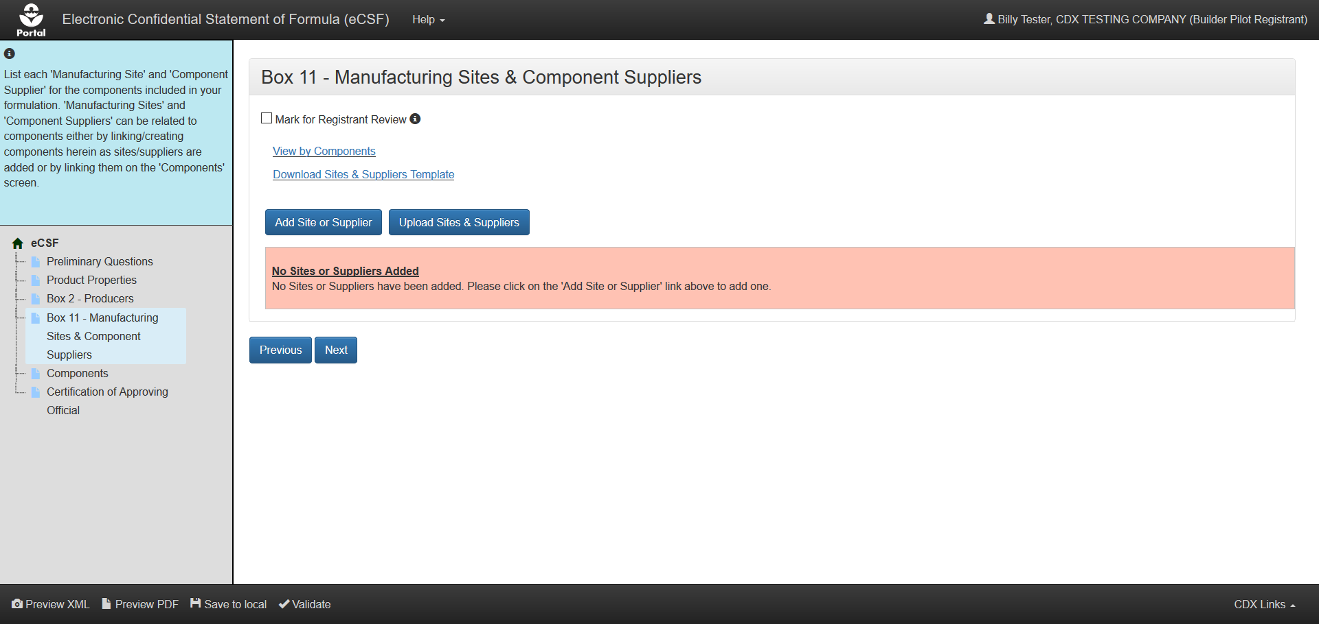
Box 11 – Manufacturing Sites & Component Suppliers - Unpopulated

Slide 28
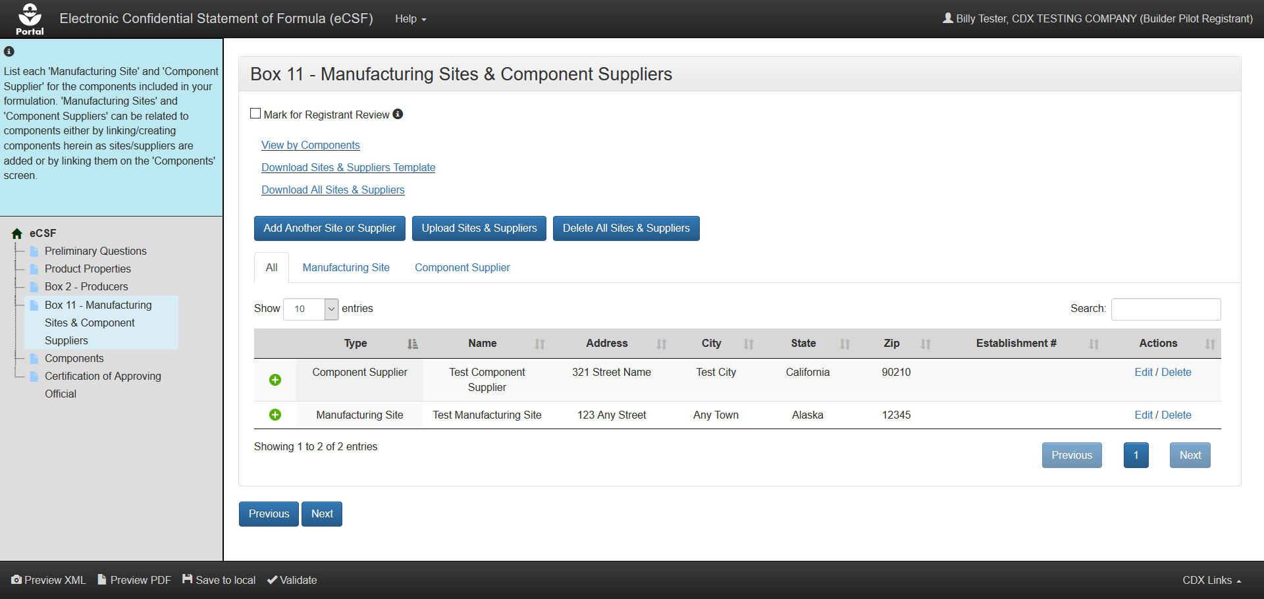
Box 11 – Manufacturing Sites & Component Suppliers - Populated

Slide 29
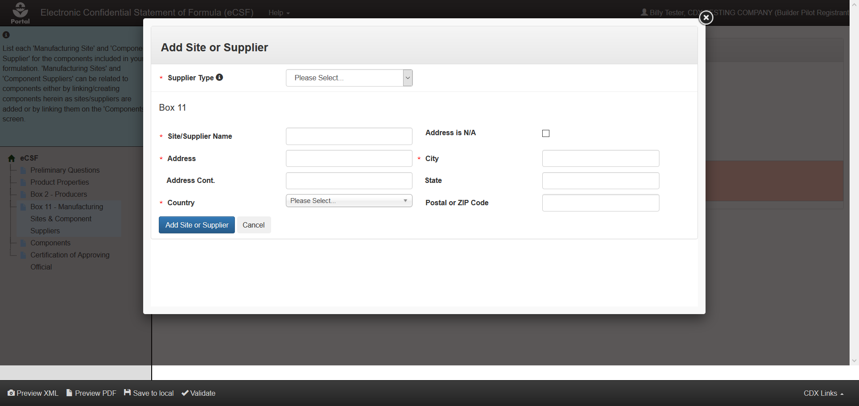
Add Site or Supplier Modal

Slide 30
Components Screen

Slide 31
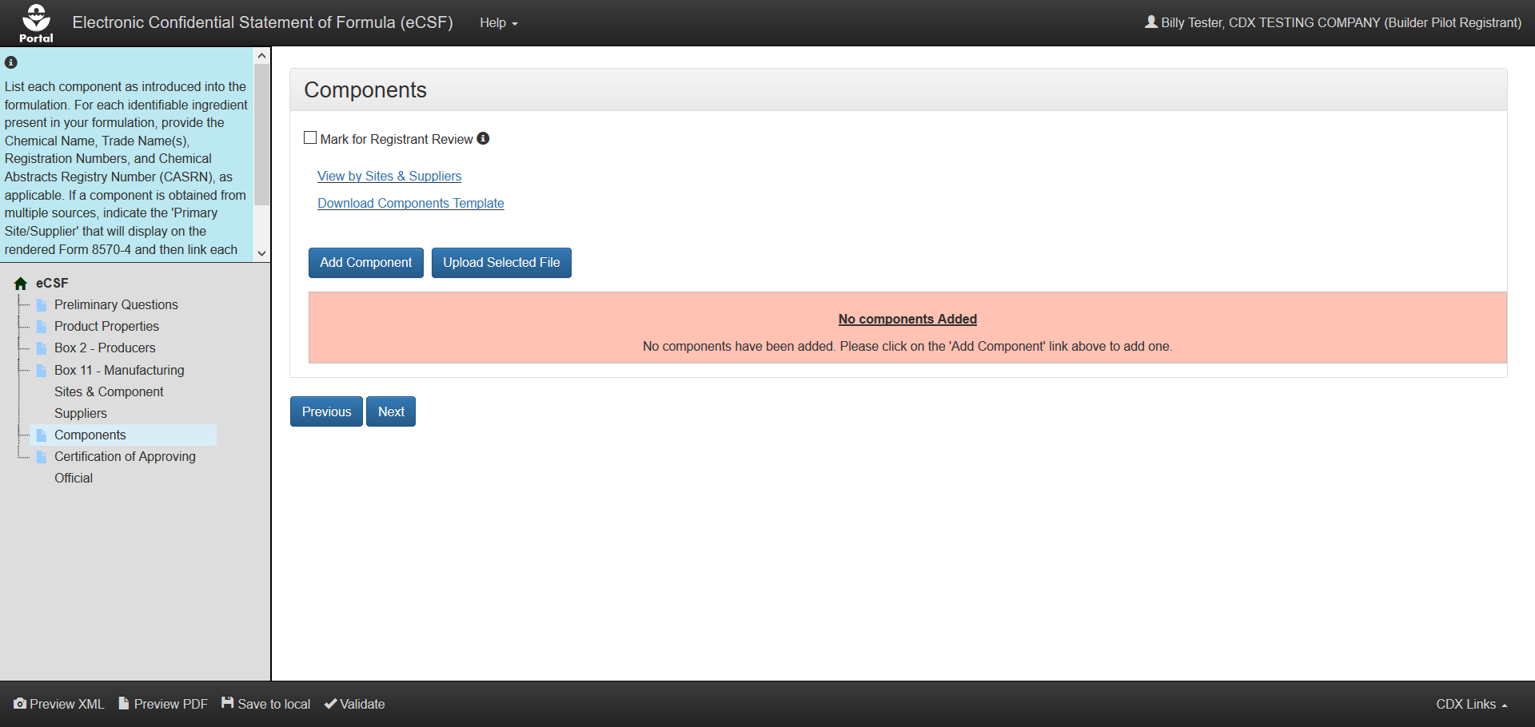
Components - Unpopulated

Slide 32
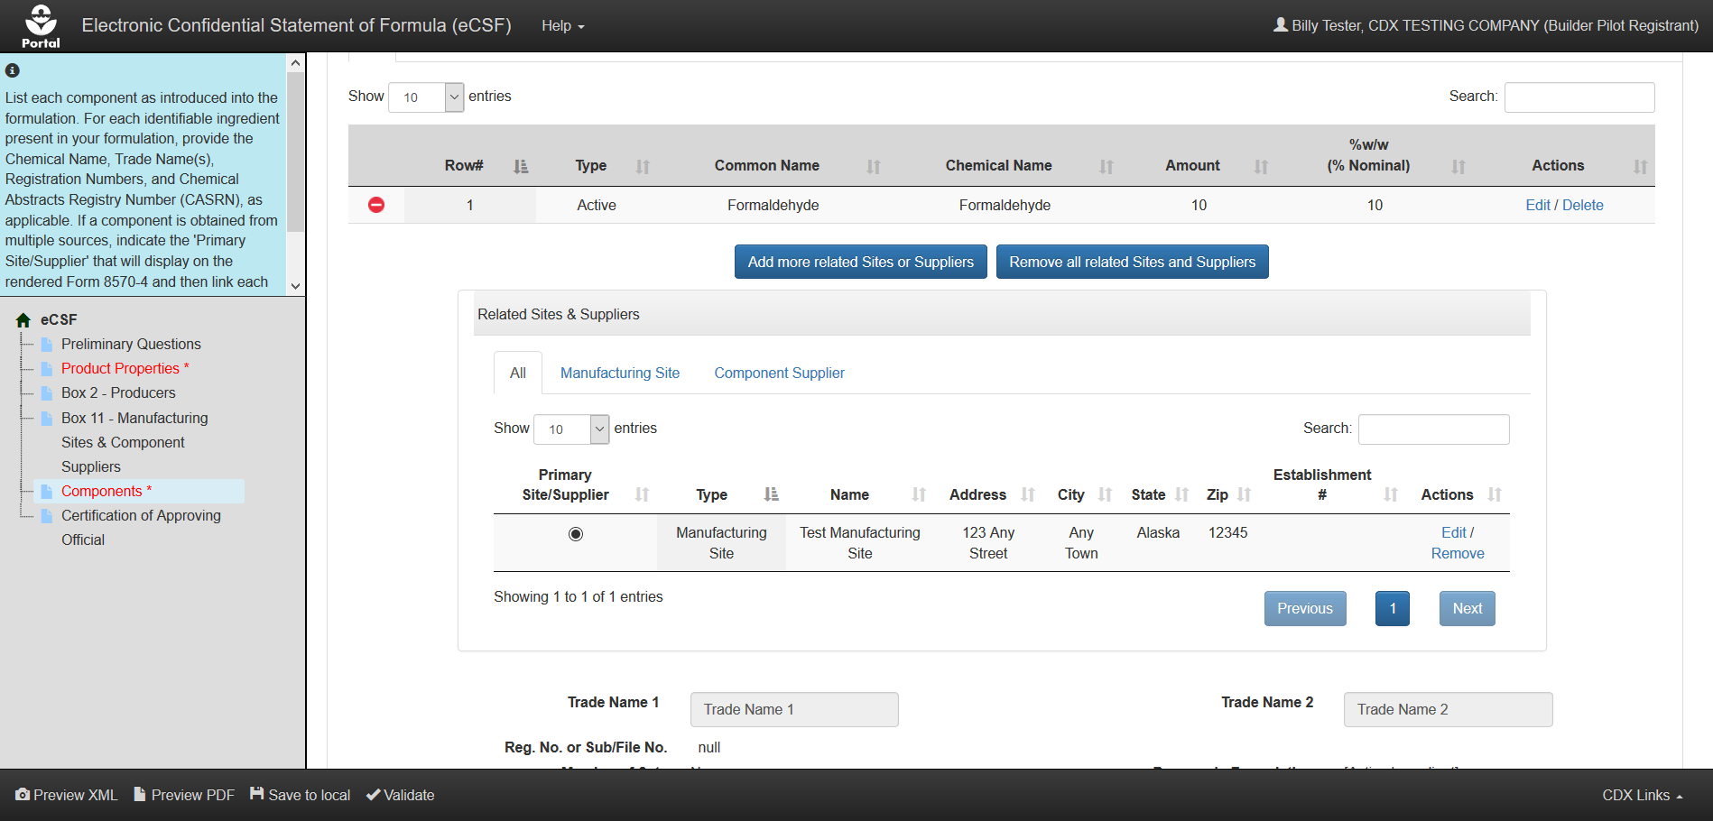
Components – Populated / Select Primary Site/Supplier

Slide 33
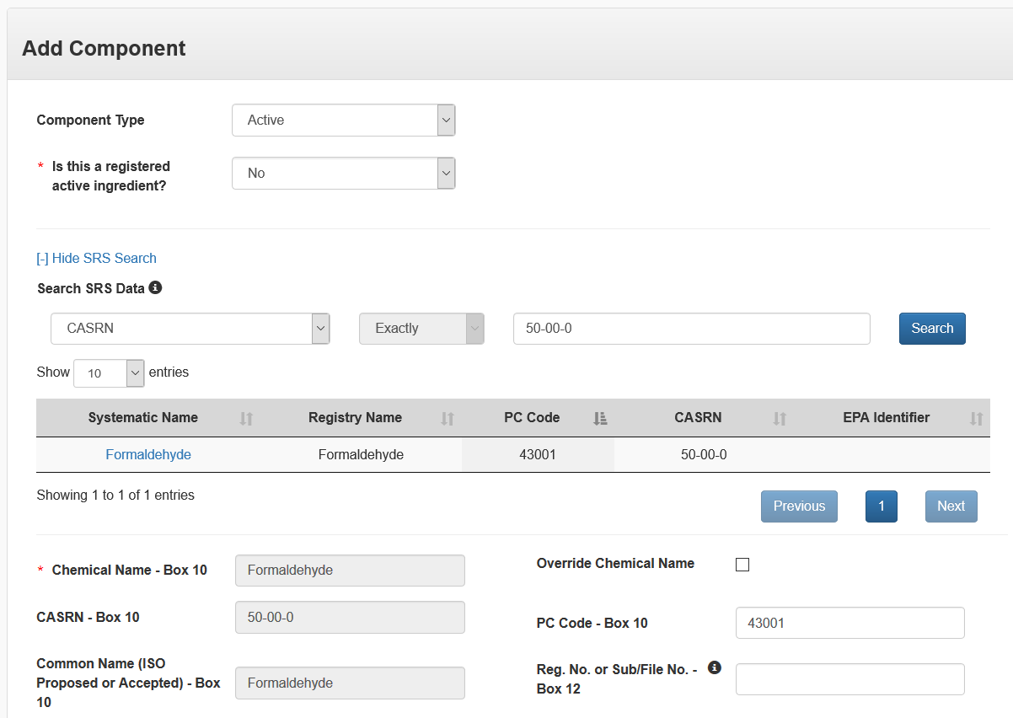
Add Component Modal – Unregistered Active Component – Scroll 1

Slide 34
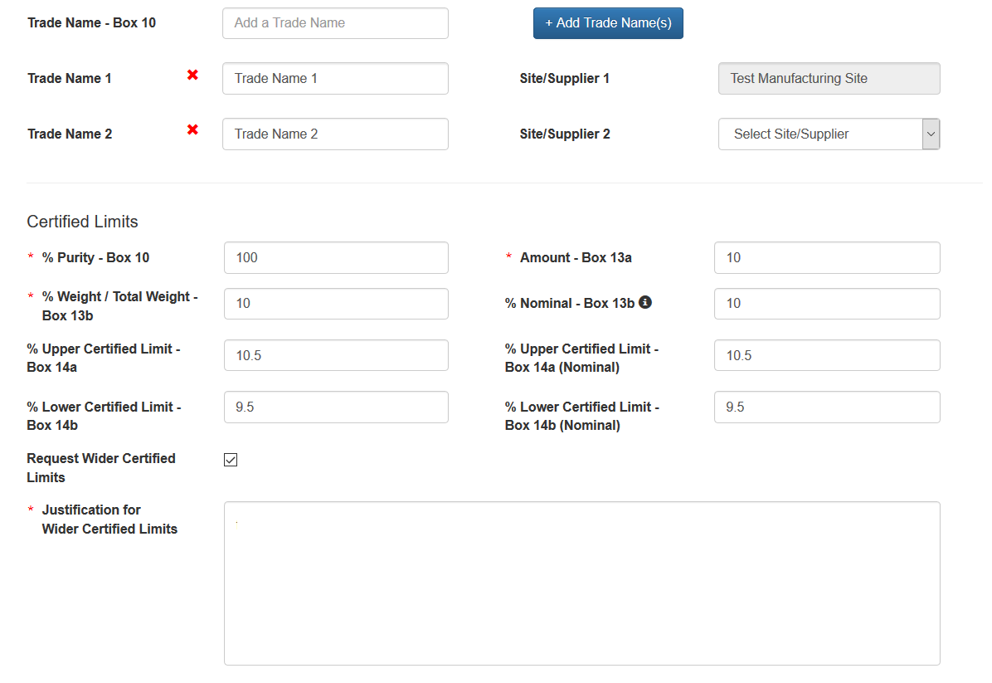
Add Component Modal – Unregistered Active Component – Scroll 2

Slide 35
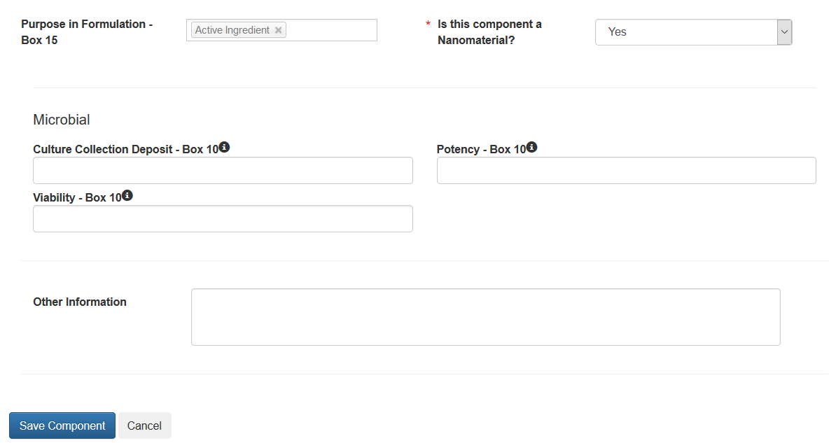
Add Component Modal – Unregistered Active Component – Scroll 3

Slide 36
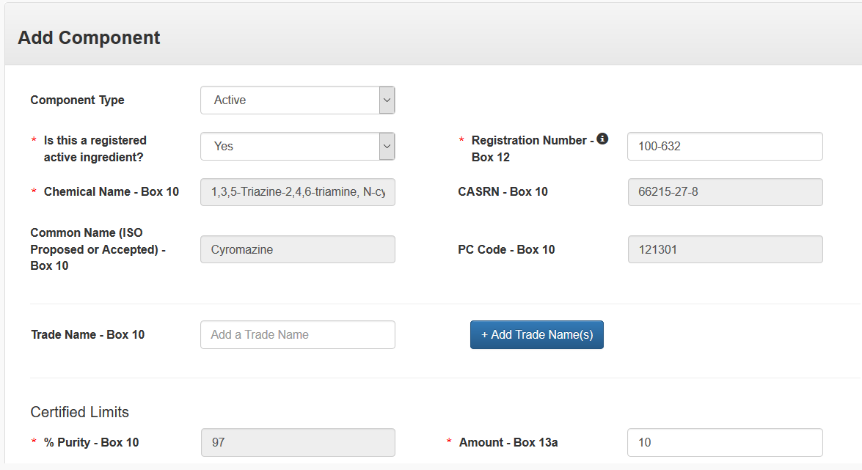
Add Component Modal – Registered Active Component – Scroll 1

Slide 37
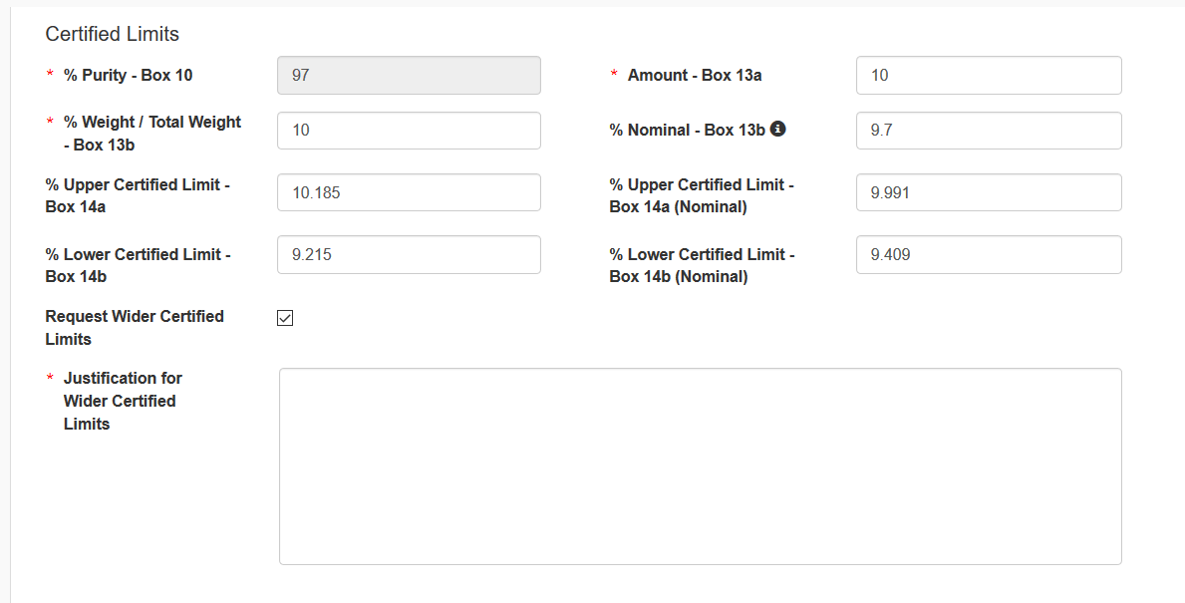
Add Component Modal – Registered Active Component – Scroll 2

Slide 38
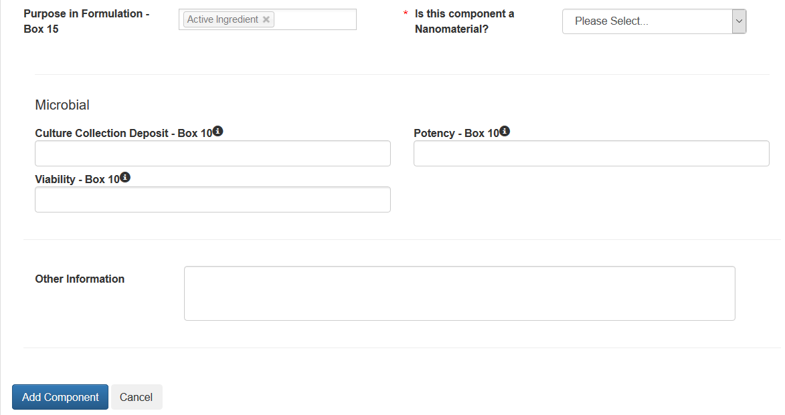
Add Component Modal – Registered Active Component – Scroll 3

Slide 39
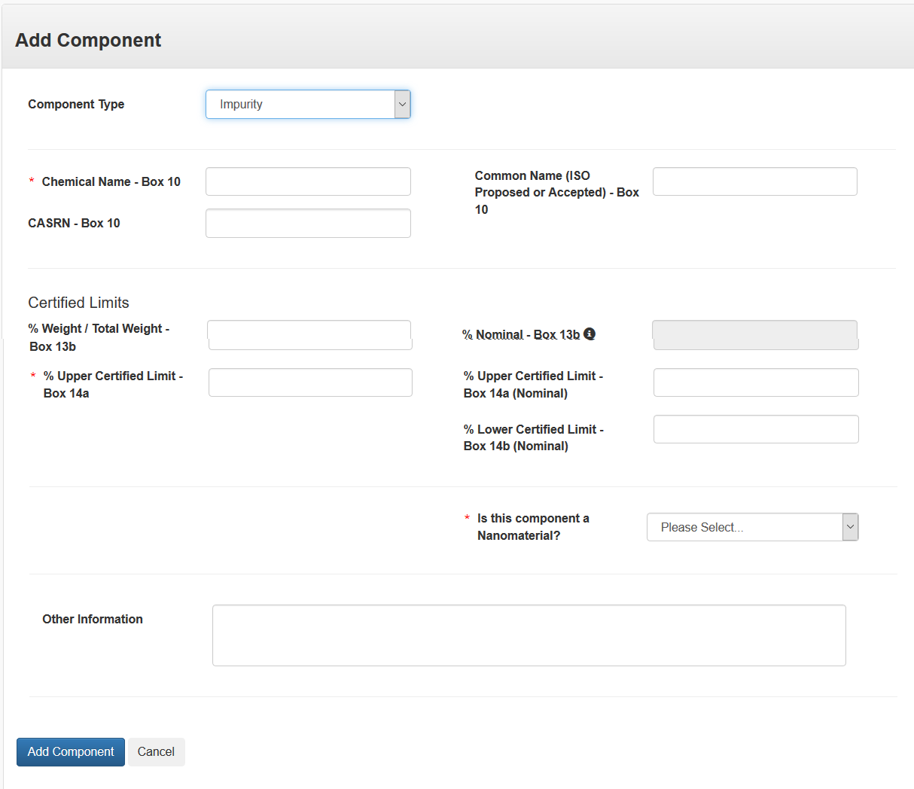
Add Component Modal – Impurity Component

Slide 40
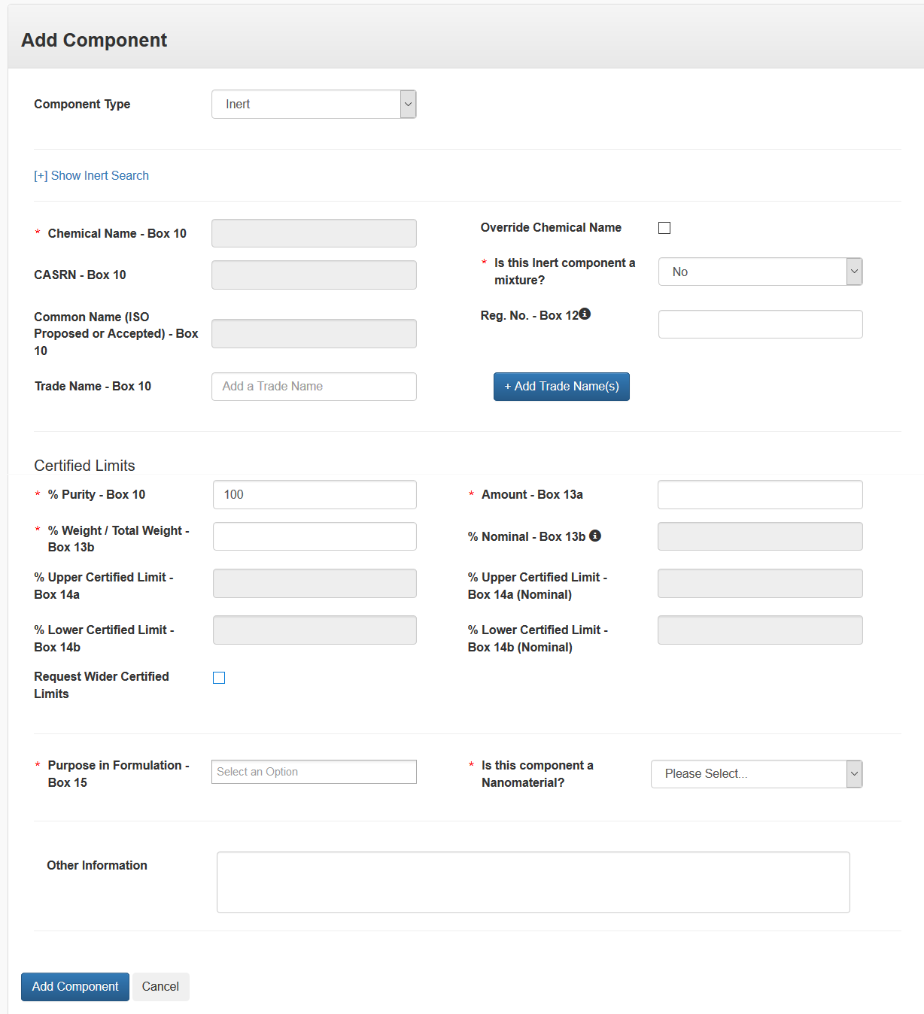
Add Component Modal – Inert Component

Slide 41
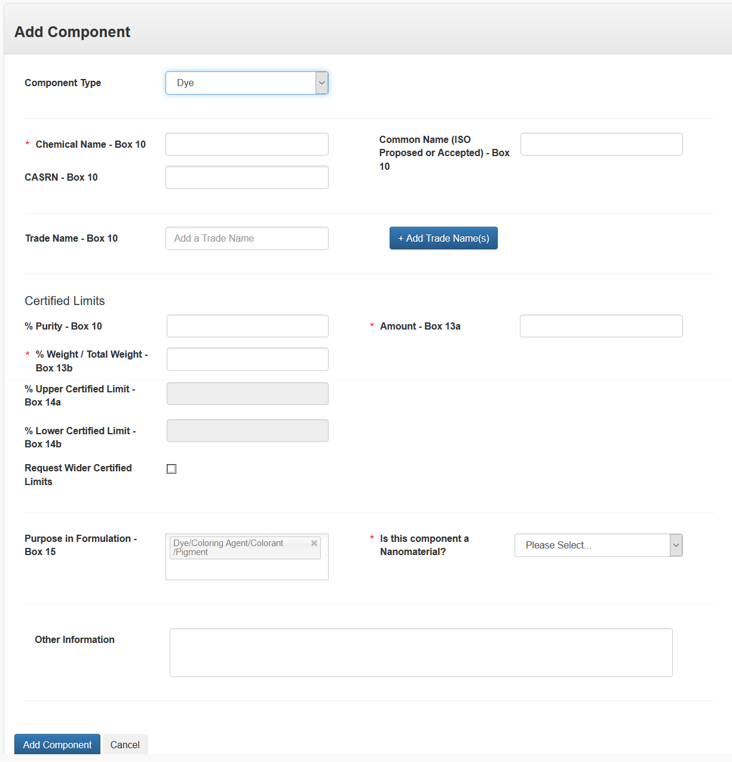
Add Component Modal – Dye Component

Slide 42
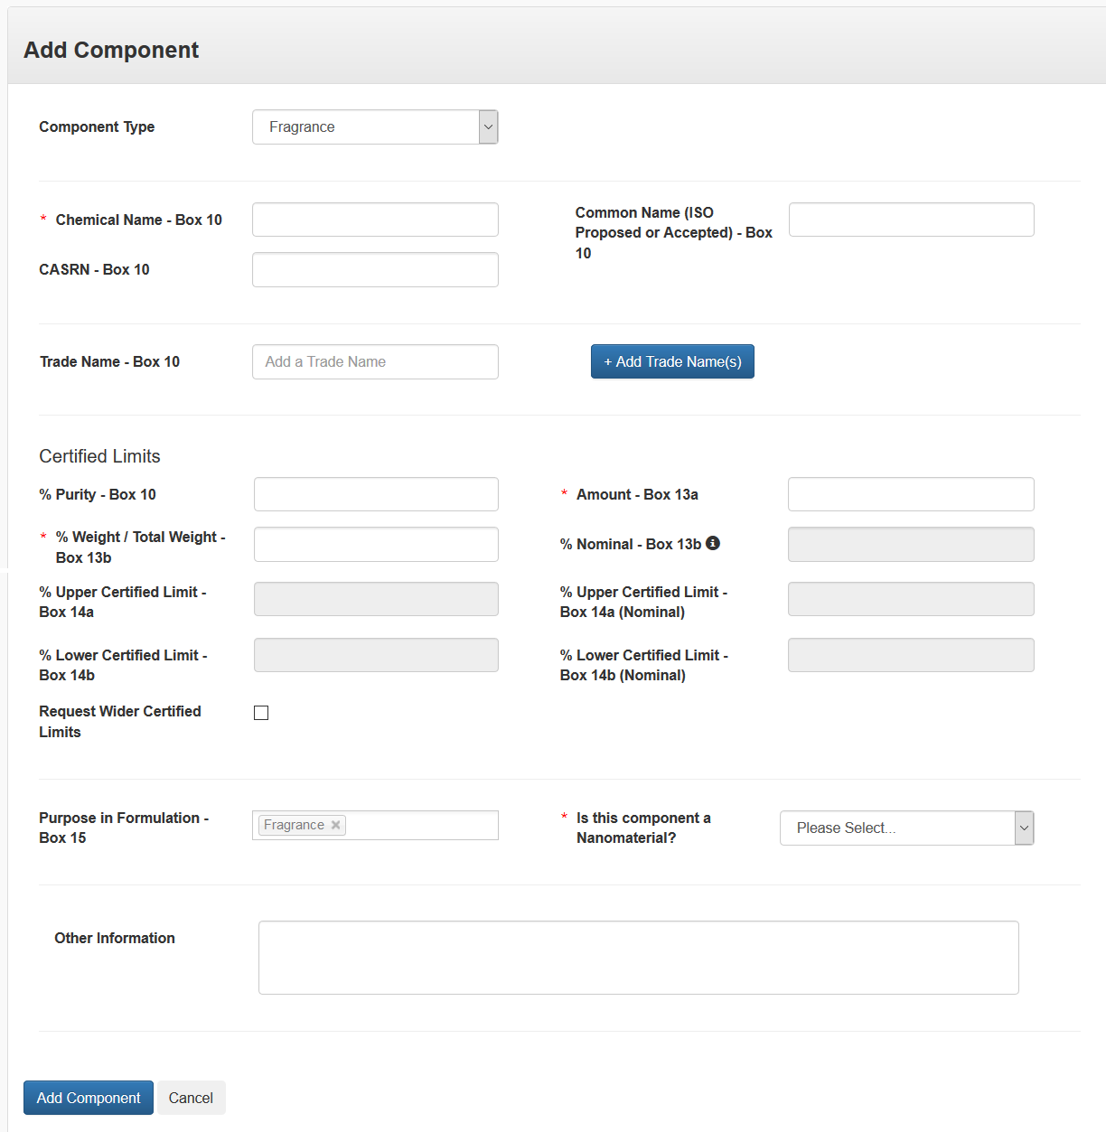
Add Component Modal – Fragrance Component

Slide 43
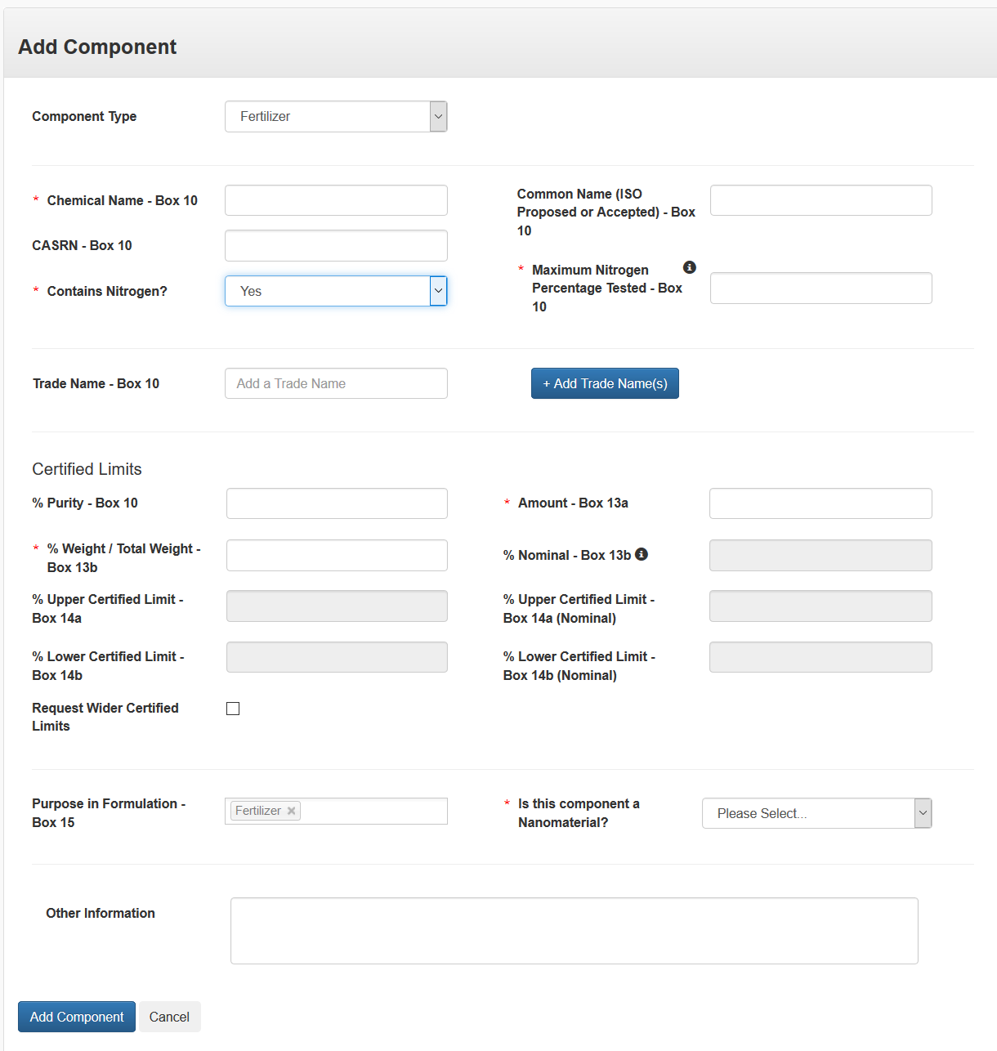
Add Component Modal – Fertilizer Component

Slide 44
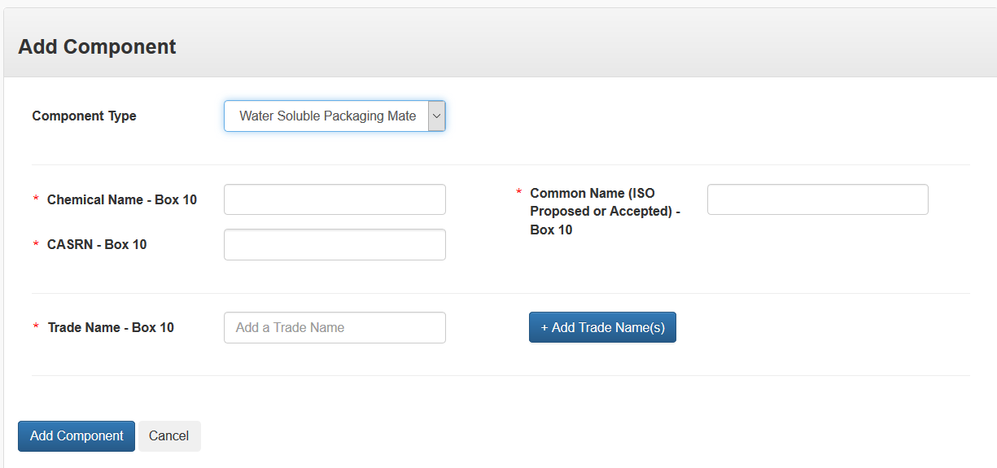
Add Component Modal – Water Soluble Packaging Material Component

Slide 45
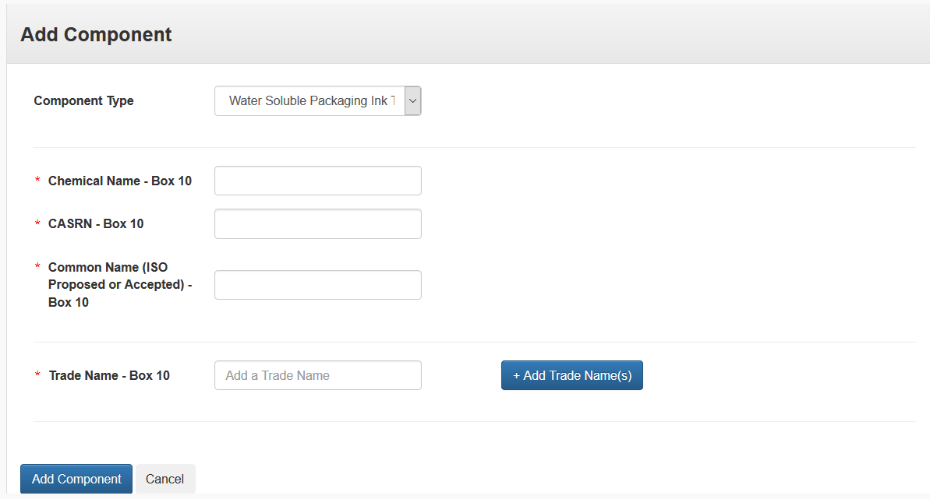
Add Component Modal – Water Soluble Ink Type Component

Slide 46
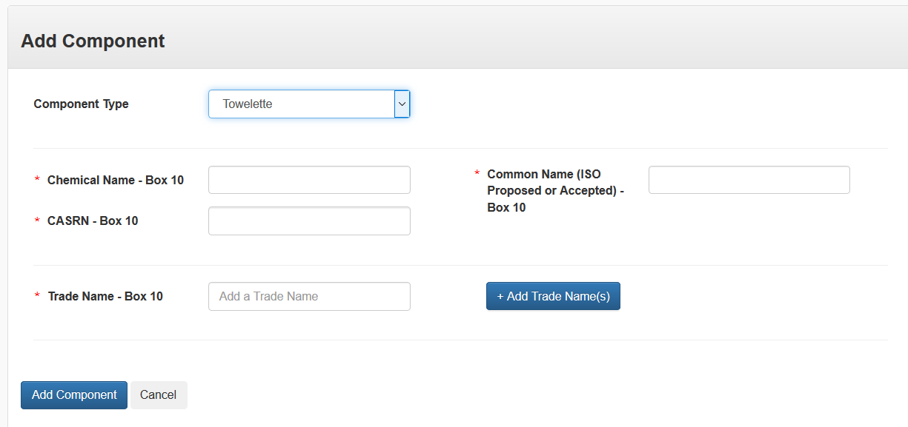
Add Component Modal – Towelette Component

Slide 47
Certification of Approving Official
Screen

Slide 48
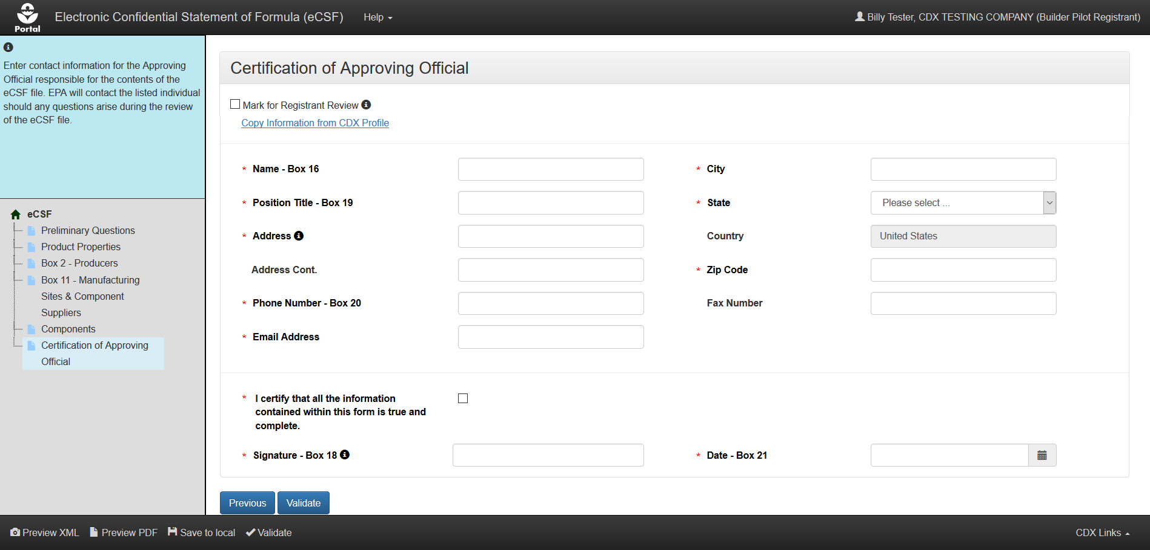
Certification of Approving Official

